Slide 1

Safe Zones
Guidelines for miniplates use in orthodontics
Giovanni Bruno
University of Padua, Department of Neuroscience
7th Global Dentists and Pediatric Dentistry Annual meeting
March 31- April 1, 2016 Valencia, Spain

Slide 2

Third law of motion
“Actioni contrariam semper & aequalem esse reactionem: sive corporum duorum actiones in se mutuo semper esse aequales & in partes contrarias dirigi”
To every action there is always opposed an equal reaction : or the mutual actions of two bodies upon each other are always equal, and directed to contrary parts

Slide 3
Anchorage
Anchorage is resistance against undesired tooth movement
Anchorage loss can be a significant complication during treatment
Anchorage control is an important issue that needs to be addressed right from the leveling stage
Nanda, Biomechanics in Orthodontics: Principles and Practise

Slide 4
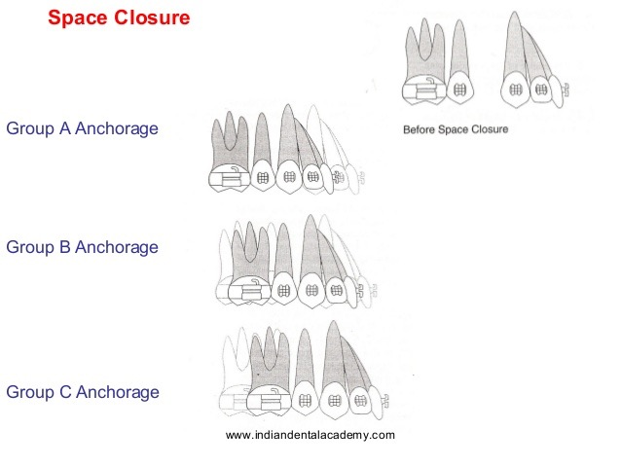
Anchorage
Maximum Anchorage
Medium Anchorage
Minimum Anchorage
Nanda, Biomechanics in Orthodontics: Principles and Practise

Slide 5
How to control anchorage
Intraoral
Increasing/reducing the number of teeth
Cortical bone anchorage
Transpalatal arch
The Nance appliance
Uprighting springs
Lip bumper
Extraoral
Cervical headgear
High Pull headgear
Reverse headgear

Slide 6
How to control anchorage
Extraoral appliances are the most reliable and powerful source of anchorage
BUT
efficiency depends on patient compliance

Slide 7
Skeletal Anchorage
Advantages
Avoid patient compliance
Provide a reliable intraoral anchorage
Avoid undesirable dental movements
Help in hard clinical challenges

Slide 8
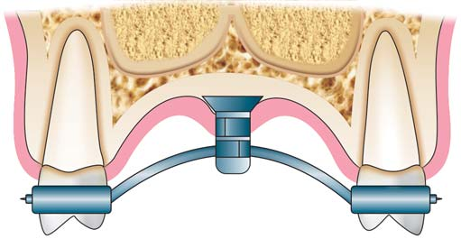
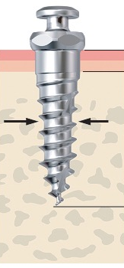
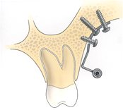
Skeletal Anchorage
Devices
Onplants / Palatal implants
Miniscrews
Miniplates

Slide 9
Skeletal Anchorage
Indications
Nonsurgical camouflage of skeletal malocclusions
Nonextraction treatment in severe malocclusions
Traction of deeply impacted teeth
Need of molar movement
Nanda, Biomechanics in Orthodontics: Principles and Practise
Notes:
Cercare immagini

Slide 10
Skeletal Anchorage
Indications
Presurgical and post surgical treatment in orthognatic patients
Re-treatment of failed previous complex treatments
Interdisciplinary treatments with severe dental problem
Nanda, Biomechanics in Orthodontics: Principles and Practise
Notes:
Cercare immagini

Slide 11
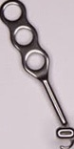
Skeletal Anchorage
Miniplates
Body with two or three holes for mono-cortical screws
Transmucosal arm portion
Intraoral head portion provided with a hook or a tube
Notes:
Cercare immagini

Slide 12
Skeletal Anchorage
Knowledge from literature
No need of osteointegration
Minimally invasive surgery
Good oral hygiene
Primary stability
Angle Orthodontist, 2011

Slide 13
Skeletal Anchorage
Primary stability
Plate design (T, Y, I)
Surgical technique
Cortical bone thickness (at least 1mm)
Cortical bone density
AJODO, 2009

Slide 14
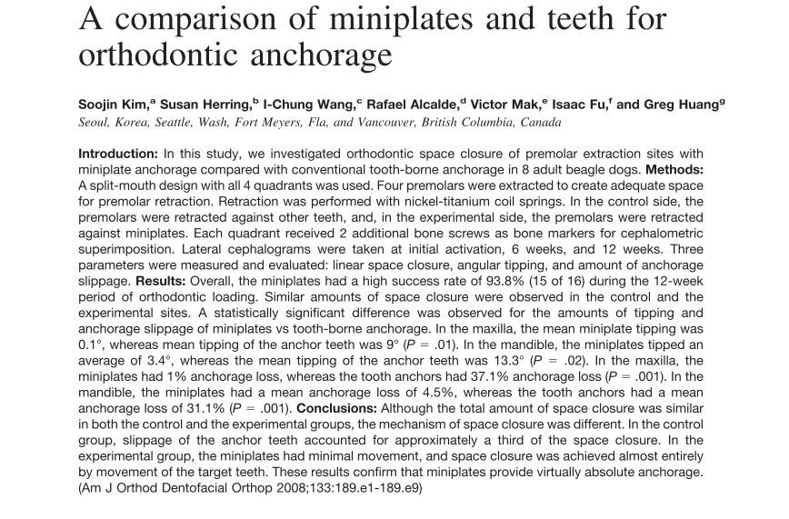
Skeletal Anchorage
Tooth VS plates anchorage
AJODO, 2008

Slide 15
Skeletal Anchorage
Plates or screws?
Higher and longer stability
Less bone thickness necessary
Orthopedic force
Surgery to place and to remove
Flap elevation
Higher complication rate
Clinical oral implants research, 2007
AJODO, 2011

Slide 16
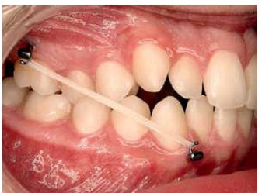
Skeletal Anchorage
Orthopedic treatment
Lighter and continuos force (200g) than Face Mask
No dento-alveolar compensation
Reduce post-treatment period
Higher compliance
H. De Clerck, AJODO, Angle, JOMS

Slide 17
Skeletal Anchorage
Plates or screws?
Cortical bone thickness insufficiency for single screw
Previous miniscrew failure
Orthopedic forces
En-mass distalization

Slide 18
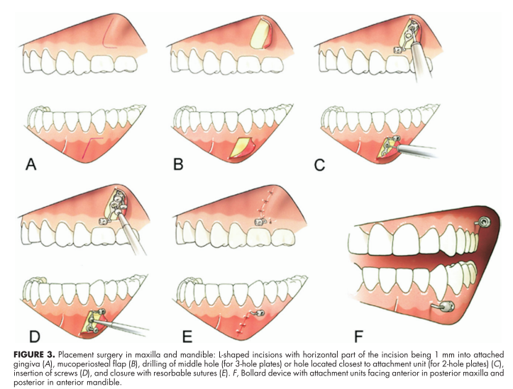
How to place a plate?
A- L-shape incision 1mm in attached gingiva
B- mucoperiostal flap
C- drilling the middle hole
D- insertion of screws
E- closure with resorbable sutures
F- Bollard device with attachment units
JOMS, 2008

Slide 19
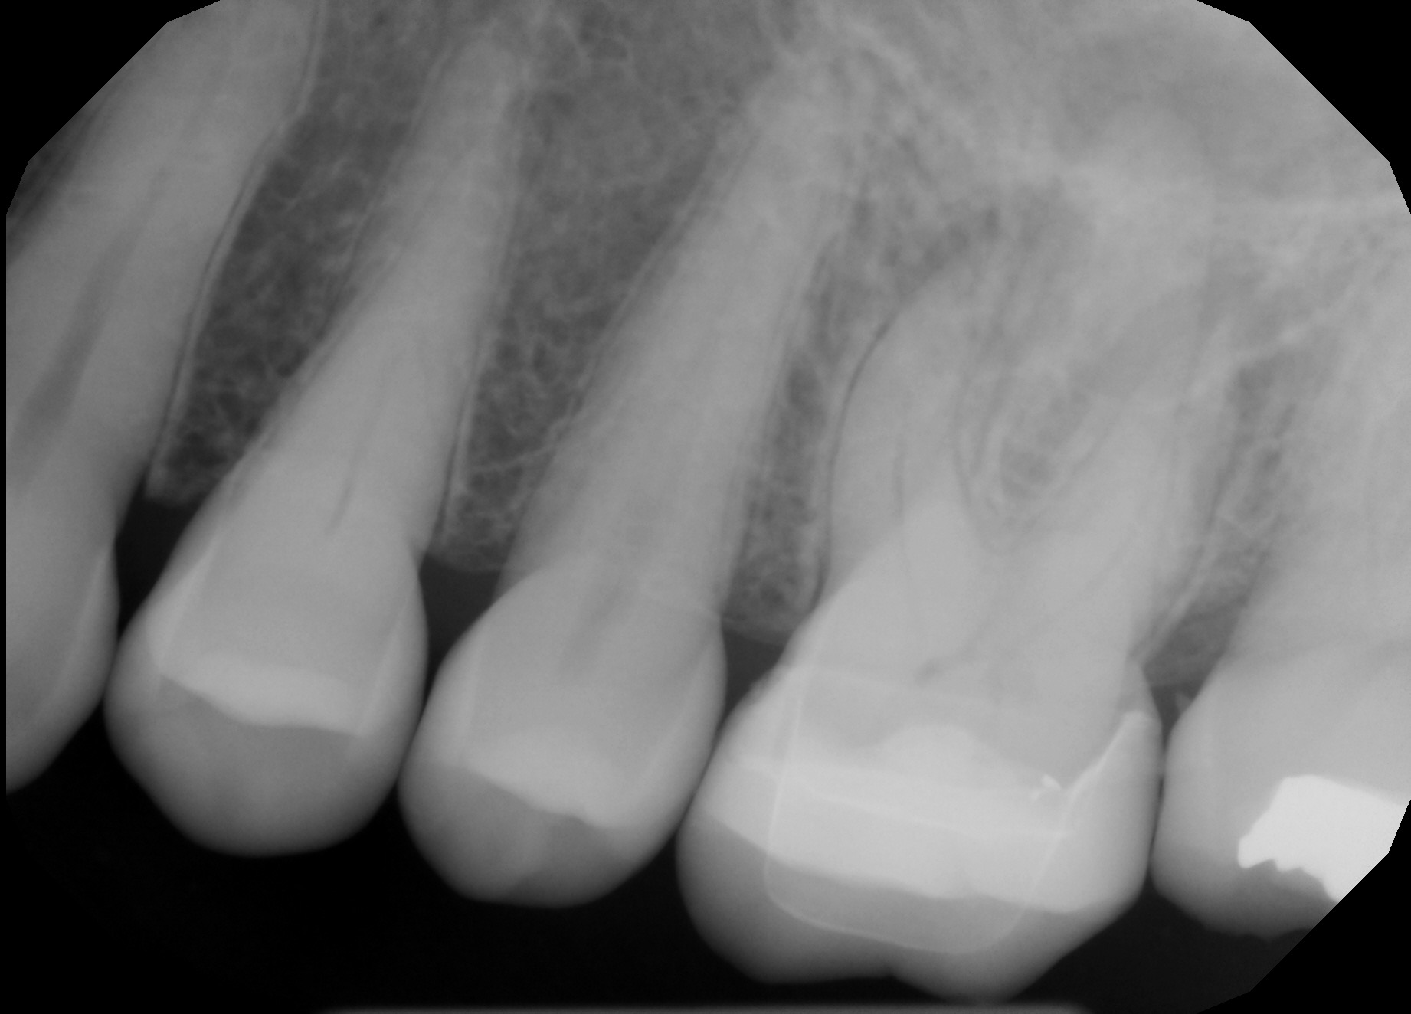
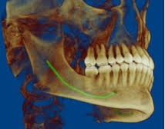
Safe Zones
Anatomical structures
Dental roots
Inferior Alveolar Nerve
Mental Foramen
Notes:
immagine NAI CBCT + layout

Slide 20
What about cortical bone thickness and density?

Slide 21
Safe Zones
Literature
Three studies investigated over the cortical bone thickness at the most frequent sites for miniplates placement: the zygomatic buttress, nasal buttress and mandibular symphysis
Two studies investigated over the cortical bone thickness and density changes in relation to age, gender and skeletal pattern.
Notes:
immagine NAI CBCT + layout

Slide 22
Safe Zones
Materials and methods
Retrospective study on CBCT
Evaluation of cortical bone thickness (mm) and density (HU)
92 patients
Maxilla and Mandible
26640 measurements

Slide 23
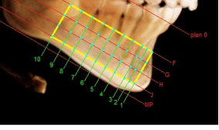

Slide 24
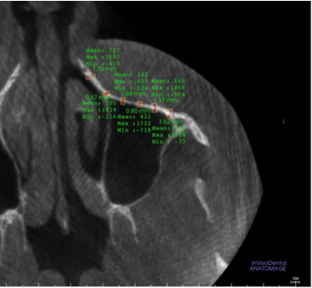
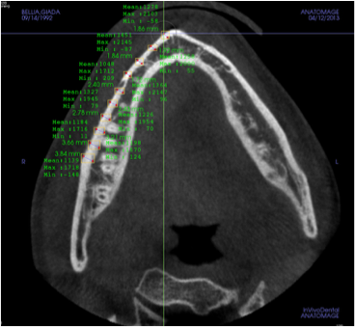

Slide 25
Safe Zones
Inclusion criteria
No previous orthodontics treatment
No impacted teeth
No tooth agenesis/oligodontia/iperdontia
No maxillo-facial deformities
No age limit

Slide 26
Safe Zones
Statistical analysis
Non-parametric Wilcoxon-Mann-Withney
Male VS Female
Young VS Adults
Skeletal Class I VS II VS III

Slide 27
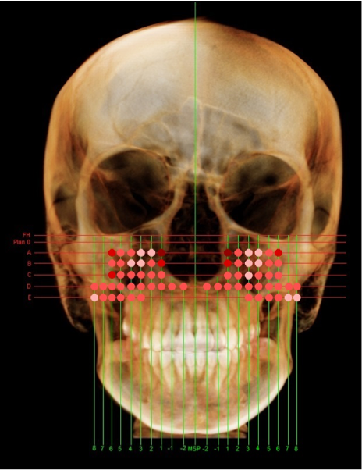
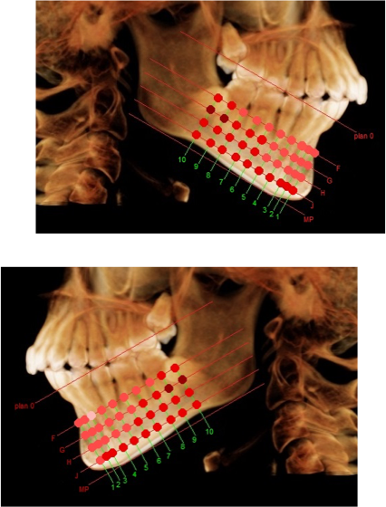
Safe Zones
Results
No difference in bone thickness related to gender, age
and skeletal class (p-value < 0.05)
Bone thickness increases in basal and distal direction

Slide 28
Safe Zones
Results
Older patients showed higher density than younger
Female showed higher density in a small area in maxilla
No skeletal class differences were found
Notes:
Densità

Slide 29
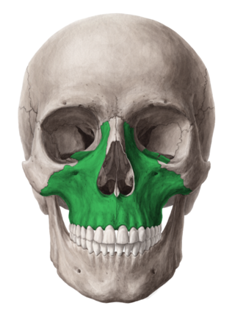
Safe Zones
Conclusion
Suitable areas:
Zygomatic buttress
Nasal buttress
Basal bone between canine and first molar

Slide 30
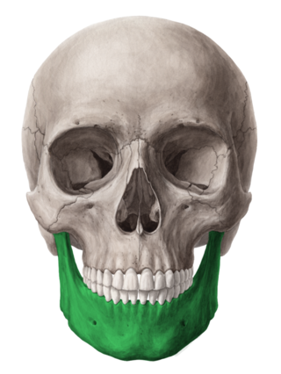
Safe Zones
Conclusion
Suitable areas:
Symphisis and basal bone of the mandible corpus
Attention to NAI and mental foramen

Slide 31

Take home messages
Choose properly the patient
CBCT always necessary
Respect anatomy
Surgery as minimal as possible

Slide 32

Thank you for your kind attention

