Slide 1

Pneumococcal conjugate vaccine – Use of pneumococcal surface protein A (PspA) as carrier
Dr Giovana Cappio Barazzone
Centro de Biotecnologia
giovana.barazzone@butantan.gov.br

Slide 2
Streptococcus pneumoniae
Streptococcus pneumoniae is the most common cause of bacterial pneumonia, sinusitis and acute otitis media in childhood.
Polysaccharide (PS) capsules are the main virulence factor of the pneumococci.
There are more than 90 polysaccharide serotypes.
Anti-pneumococcal vaccines are based on capsular polysaccharide (PS), plain or conjugated to a carrier protein.
serotype-dependent protection against the disease.

Slide 3
Conjugate Vaccine
Polysaccharide antigens induce T cell-independent immunity ➔ weakly immunogenic in children under 2 years old.
The covalent linkage of the PS to a protein converts the PS to a T cell-dependent antigen. This can raise a response with isotype switching, generation of memory cells and boosting effect.
Using pneumococcal conjugate vaccine (PVC) has decreased the incidence of invasive pneumococcal disease caused by serotypes included in formulation.
serotype prevalence varies among regions.

Slide 4
Pneumococcal surface protein A (PspA)
Several groups have been investigating the use of pneumococcal proteins as alternative antigens candidates for a pneumococcal vaccine.
Pneumococcal surface protein A (PspA) is described to be an important virulence factor for inhibiting complement deposition. It is immunogenic and protective and is present in all pneumococcal strains.
PspA molecules are classified into families and clades: family 1 (clades 1 and 2), family 2 (clades 3, 4, and 5) and family 3 (clade 6) .
More than 90% of clinical isolates are from family 1 and family 2.

Slide 5
Our Proposal
Using PspA as a carrier protein in conjugate vaccine. Is it an alternative to broaden the vaccine coverage?
Conjugates synthesized :
PS23-rPspA1
PS14-rPspA3
PS6B-rPsPA1
PS1-rPsPA1
PS14-rPspA4Pro

Slide 6
Conjugation Chemistry
DMT-MM = 4-(4,6-dimethoxy-1,3,5-triazin-2-yl)-4-methylmorpholinium chloride

Slide 7
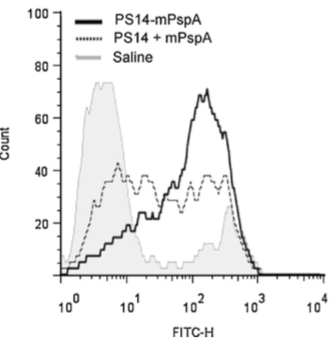
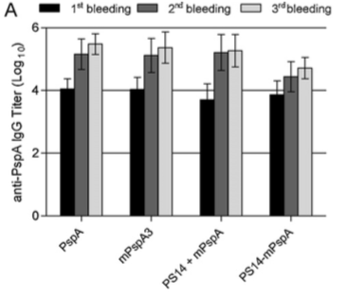
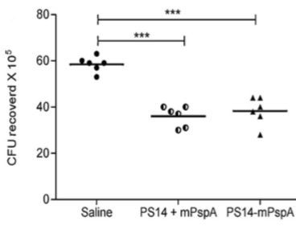
PS14-rPspA3 conjugate
Anti-PspA IgG titer
FACS analysis of complement deposition profile on the surface of S. Pneumoniae strain P275/97 (PspA clade 3, serotype 3)
conjugate
Conjugate dose: 2.5μg of PS14 and 5.5 μg of PsPA3
Opsonophagocytic assay
S. Pneumoniae strain P679/99 (PspA clade 3, serotype 6B).
Sera dilution 1:8.
Santamaria R., et al, Vaccine 29, 8689-8695, 2011

Slide 8
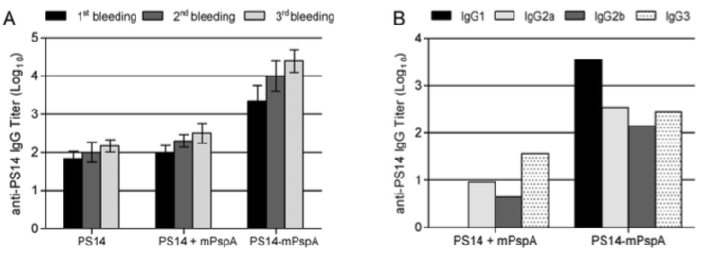
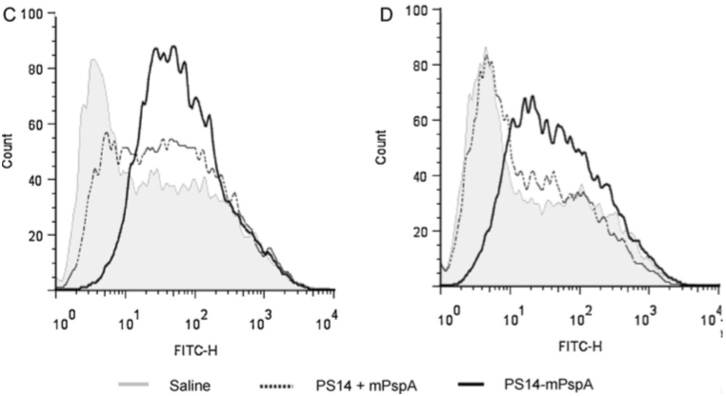
PS14-rPspA3 conjugate
Anti-PS14 IgG Titer
IgG isotype profile
FACS analysis of the complement deposition profile
S. Pneumoniae strain P630 (PspA clade 1, serotype 14).
S. Pneumoniae strain 245/00
(PspA clade 1, serotype 14).
calculated avidity index (AI):
Co-administered (PS14 + mPspA) = 0.5
Conjugate (PS14-mPspA) = 0.8
Santamaria R., et al, Vaccine 29, 8689-8695, 2011

Slide 9
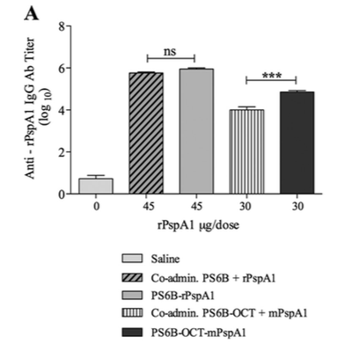
PS6B-rPspA1 conjugates
- Reductive Amination:PS6B-rPspA1 (15µg PS : 45µg rPspA1)
- DMT-MM conjugation: PS6B-OCT-mPspA1 (15µg PS : 30µg )
24% of PS6B in the conjugate fraction
55% of PS6B in the conjugate fraction
Conjugates doses:
PS6B-rPspA1 (15µg PS : 45µg rPspA1)
PS6B-OCT-mPspA1 (15µg PS : 30µg rPspA1 )
Perciani CT, et al, Clin Vaccine Immunol 20, 858-866, 2013
Notes:
The acid hydrolysis of native PS6B reduced its size from 1,000 kDa to approximately 20 kDa.
DMT-MM-mediated conjugation was shown to be more efficient in coupling PS6B to rPspA clade 1. 55.0% of PS6B was in the conjugate fraction, whereas 24% was observed in the conjugate fraction with reductive amination.
The conjugate obtained by reductive amination (PS6B-rPspA1) induced the same anti-rPspA1 IgG titer as rPspA1 coadministered with PS6B. On the other hand, the conjugate synthesized by carboxamide formation (PS6B-OCT-mPspA1) displayed an anti-rP-spA1 antibody titer higher than that induced with the coadministered antigens.
Both conjugates induced functional anti-rPspA1 and anti-PS6B antibodies. The functionality of these antibodies was evaluated by their ability to mediate complement deposition on the pneumococcal surface and their opsonophagocytic activity.
Fluorescein isothiocyanate (FITC)-conju-gated goat antiserum to mouse complement C3 (MP Biomedicals)

Slide 10
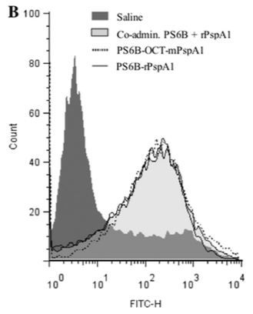
PS6B-rPspA1 conjugates
Complement deposition on S. pneumoniae bacteria strain 245/00
(serotype 14 and PspA clade 1)
conjugates
Perciani CT, et al, Clin Vaccine Immunol 20, 858-866, 2013 ​
Notes:
Complement deposition on S. pneumoniae bacteria. An example of a flow cytometry histogram for C3 deposition is shown. S. pneumoniae strain 245/00 (serotype 14 and PspA clade 1) was incubated with sera from mice immunized with PspA clade 1 conjugated to PS6B or to PS6B-OCT. Sera from mice immunized with the respective coadministered components or with saline plus Al(OH)3 were used as controls.
The ability to induce opsonizing antibodies that mediate C3 comple- ment deposition on the pneumococcus was preserved after conjugation

Slide 11
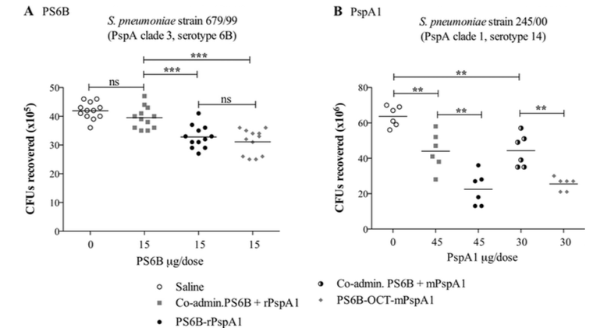
PS6B-rPspA1 conjugate
Opsonophagocytic assay
conjugates
** P<0.001; *** P<0.0001
Sera dilution 1:16
Perciani CT, et al, Clin Vaccine Immunol 20, 858-866, 2013 ​

Slide 12
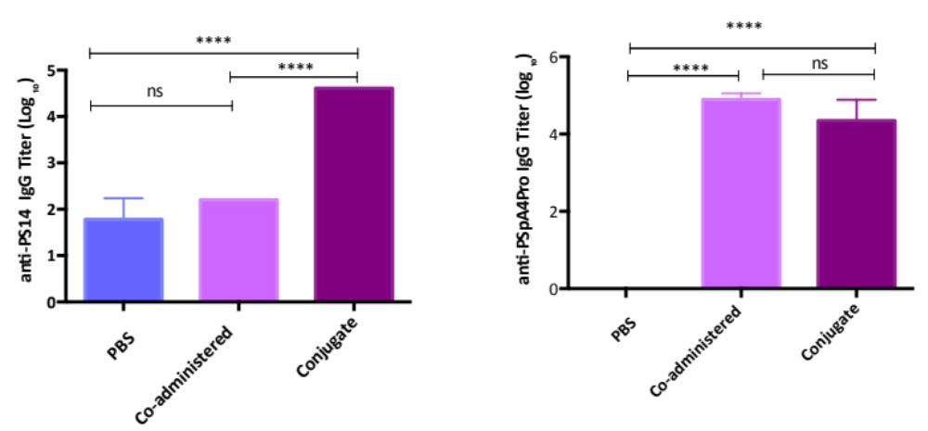
PS14-rPspA4Pro conjugate
Anti-PS14 IgG titer
Anti-PspA4Pro IgG titer
(Manuscript under preparation)

Slide 13
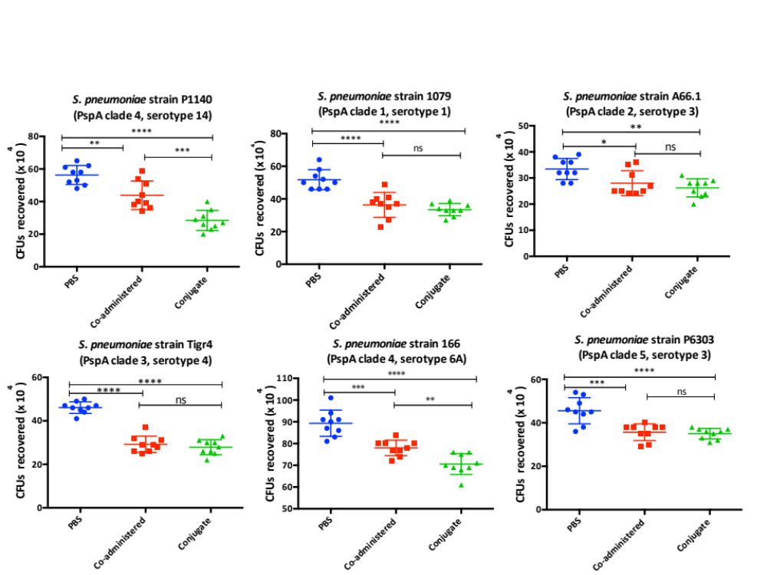
PS14-rPspA4Pro conjugate
Opsonophagocytic assay
(Manuscript under preparation)

Slide 14
Conclusions
Our results support the use of rPspA as an antigenic carrier protein.
So far, the conjugates studied were able to induce functional antibodies against PS and proteins.
The conjugates of PS to rPspA could be a promising alternative vaccine.

Slide 15



Participant Researchers
Martha M Tanizaki
Giovana C Barazzone
Luciana C C Leite
Viviane M Gonçalves
Joaquin Cabrera-Crespo
Cátia T Perciani
Raquel Santamaria
Míriam A Silva
Cibelly Goulart
Thiago R Converso

