Slide 1
About OMICS Group
OMICS Group International is an amalgamation of Open Access publications and worldwide international science conferences and events. Established in the year 2007 with the sole aim of making the information on Sciences and technology ‘Open Access’, OMICS Group publishes 400 online open access scholarly journals in all aspects of Science, Engineering, Management and Technology journals. OMICS Group has been instrumental in taking the knowledge on Science & technology to the doorsteps of ordinary men and women. Research Scholars, Students, Libraries, Educational Institutions, Research centers and the industry are main stakeholders that benefitted greatly from this knowledge dissemination. OMICS Group also organizes 300 International conferences annually across the globe, where knowledge transfer takes place through debates, round table discussions, poster presentations, workshops, symposia and exhibitions.

Slide 2
About OMICS Group Conferences
OMICS Group International is a pioneer and leading science event organizer, which publishes around 400 open access journals and conducts over 300 Medical, Clinical, Engineering, Life Sciences, Phrama scientific conferences all over the globe annually with the support of more than 1000 scientific associations and 30,000 editorial board members and 3.5 million followers to its credit.
OMICS Group has organized 500 conferences, workshops and national symposiums across the major cities including San Francisco, Las Vegas, San Antonio, Omaha, Orlando, Raleigh, Santa Clara, Chicago, Philadelphia, Baltimore, United Kingdom, Valencia, Dubai, Beijing, Hyderabad, Bengaluru and Mumbai.

Slide 3


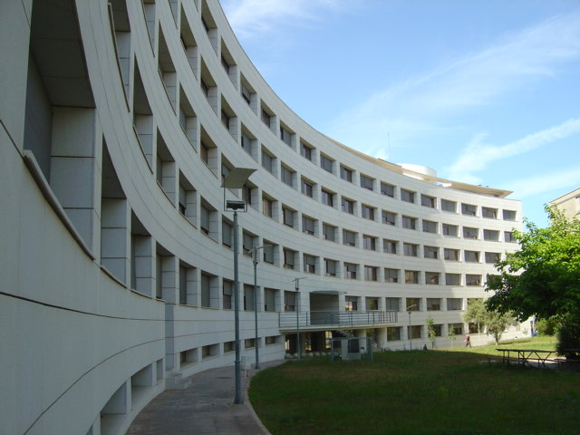
3th International Conference on
Forensic Research and Technology
Octuber 6-8, 2014
San Antonio
USA
Chemical Element Levels as a Methodological Tool in Forensic Science
GIANNI GALLELLO
(co-authors: Julia Kuligowski, Agustín Pastor, Agustín Diez, Joan Bernabeu)

Slide 4
INDEX
INTRODUCTION
I.MATERIAL AND METHOD
II.METHODOLOGICAL QUALITY
III.BONES AND DIAGENESIS
IV.BURNED BONES METHOD
V. FORENSIC ARCHAEOLOGY CASES
VI.CONCLUSIONS AND FUTURE DEVELOPMENTS

Slide 5
INTRODUCTION
Alterations on the structure and chemical composition of human bones and tissues can be generated by:
Human activities
Accidents
Cremations
Funerary rituals
General aim
We are looking for trace elements and rare earth elements (REE) potential characteristics to propose novel methodological approach applicable to forensic science scenarios.
Specific aims
Define a strategy to select bone samples correctly .
Heavy metal results ( e.g. arsenic -As-, mercury- Hg- and lead-Pb-) correct interpretation for forensic science approaches.

Slide 6
I.MATERIAL AND METHOD
I.1 ANALYTICAL TECHNIQUES
To determine trace elements and rare earth elements (REEs), techniques based on atomic spectrometry are employed.
Inductively Coupled Plasma Optical Emission Spectrometry (ICP-OES)
Inductively Coupled Plasma Mass Spectrometry (ICP-MS)
Cold-Vapor Atomic Absorption Spectrometry “mercury direct measurement” (CV-AAS)
Hydride Generation Atomic Fluorescence Spectrometry (HG-AFS)

Slide 7
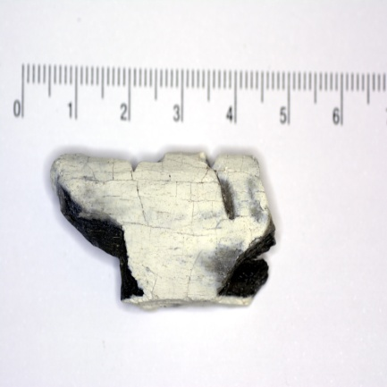
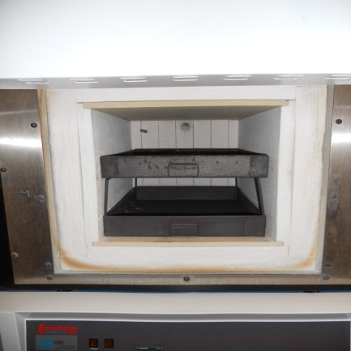
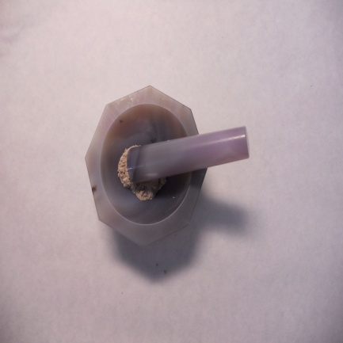
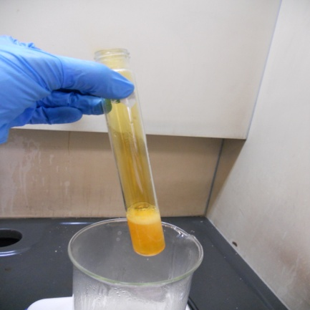
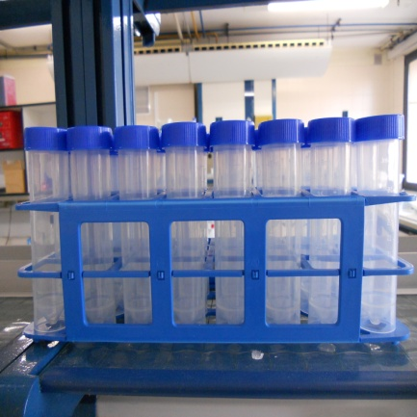
I.2 Analytical Methodology
Sample Preparation
Analyzed samples during the last two years
TYPES | NUM.
BONES | 226
BONE SURFACE | 141
SOILS | 136
WOODS | 10
HUMAN TISSUES | 7
TEXTILES | 2
TOTAL | 522

Slide 8
I.3 Statistics
Multivariate Statistics
Cluster Analysis (CA)
Principal Component Analysis (PCA)
Partial Least Squares Discriminant Analysis (PLS-DA)
Hypothesis Testing
Standard Deviations
Dixon Test
Average Comparison
Propagation of Error

Slide 9
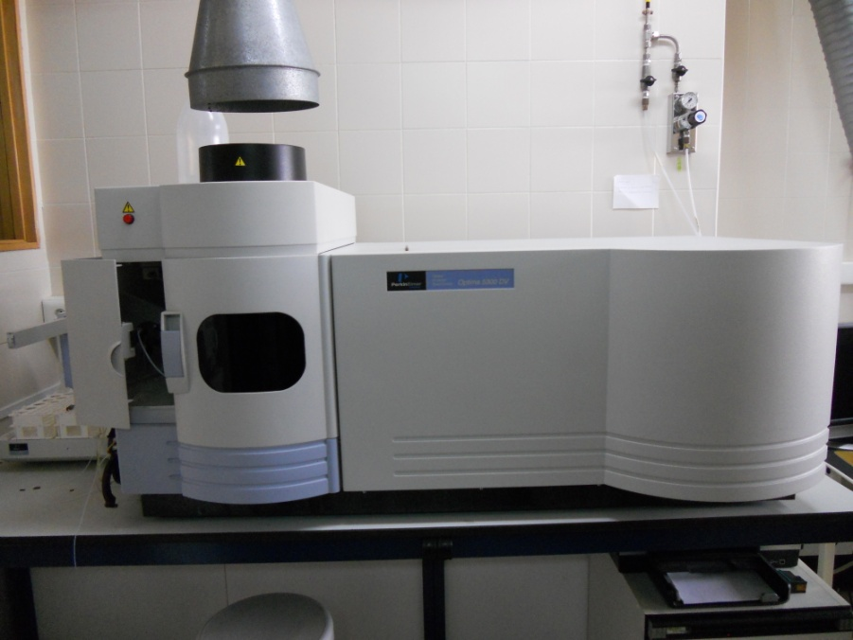
II. METHODOLOGY and QUALITY
II.1Measurement and Elemental Parameters (ICP-OES)
Argon Flows | Plasma 15 L/min Auxiliar 0.2 L/min Nebulizador 0.80 L/min
Power | 1300 Vatios
Plasma position | Radial (Ca, Sr, Mg) Axial (Elementos traza y REEs)
ELEMENTS | W.L. [nm] | LOD (μg/g) | LOQ (μg/g) | R²
Ca | 317.933 | 1600 | 5400 | 0.9996
Sr | 421.552 | 4 | 13 | 0.9995
Mg | 285.213 | 0.4 | 1.3 | 0.9999
Zn | 206.2 | 0.4 | 1.2 | 0.9998
Cu | 327.393 | 0.11 | 0.4 | 0.9999
Ba | 233.527 | 0.08 | 0.3 | 0.9999
V | 290.88 | 0.07 | 0.2 | 0.9999
Mn | 257.61 | 0.14 | 0.5 | 0.9997
Cd | 228.802 | 0.05 | 0.17 | 0.9998
Pb | 220.353 | 0.6 | 1.8 | 0.9996
Cr | 267.716 | 0.06 | 0.2 | 0,9999
Co | 238.892 | 0.01 | 0.3 | 0,9999
Ni | 231.604 | 0.17 | 0.6 | 0,9998
La | 408.672 | 0.04 | 0.13 | 0.9999
Ce | 413.764 | 0.03 | 0.11 | 0.9995
Pr | 390.844 | 0.4 | 1.2 | 0.9995
Nd | 406.109 | 0.2 | 0.8 | 0.9998
Sm | 359.26 | 0.2 | 0.7 | 0.9994
Eu | 382.967 | 0.003 | 0.01 | 0.9996
Gd | 342.247 | 0.004 | 0.014 | 0.9995
Tb | 350.917 | 0.03 | 0.08 | 0.9997
Dy | 353.17 | 0.02 | 0.07 | 0.9995
Ho | 345.6 | 0.008 | 0.03 | 0.9997
Er | 337.271 | 0.11 | 0.4 | 0.9995
Tm | 346.22 | 0.04 | 0.12 | 0.9997
Yb | 328.937 | 0.003 | 0.009 | 0.9999
Lu | 261.542 | 0.003 | 0.009 | 0.9996
Sc | 361.383 | 0.002 | 0.006 | 0.9999
Y | 371.029 | 0.006 | 0.02 | 0.9999
Ru* | 240.272 | - | - | -
Be* | 313.107 | - | - | -
Re* | 197.248 | - | - | -

Slide 10
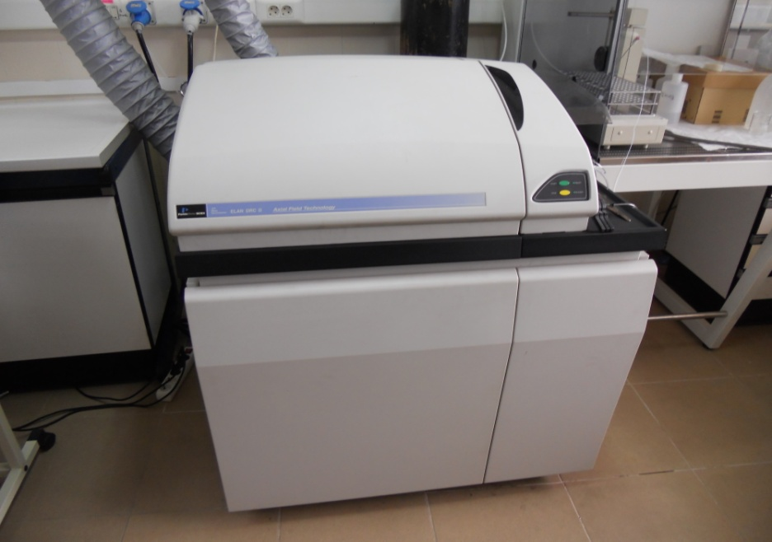
II.2Measurement and Elemental Parameters (ICP-MS)
ELEMENTO | SIMBOLO | ms [Da] | LOD (μg/g) | LOQ (μg/g) | R²
Lantano | La | 139 | 0.0004 | 0.0014 | 0.9997
Cerio | Ce | 140 | 0.0005 | 0.0018 | 0.9997
Praseodimio | Pr | 141 | 0.00010 | 0.00032 | 0.9997
Neodimio | Nd | 142 | 0.0003 | 0.001 | 0.9985
Samario | Sm | 152 | 0.00035 | 0.0011 | 0.9999
Europio | Eu | 151 | 0.00005 | 0.00018 | 0.9998
Gadolinio | Gd | 158 | 0.00015 | 0.0005 | 0.9998
Terbio | Tb | 159 | 0.00005 | 0.00017 | 0.9977
Disprosio | Dy | 162 | 0.00001 | 0.00004 | 0.9998
Holmio | Ho | 165 | 0.00003 | 0.00011 | 0.9983
Erbio | Er | 166 | 0.00013 | 0.0005 | 0.9999
Tulio | Tm | 169 | 0.000016 | 0.00005 | 0.9985
Iterbio | Yb | 172 | 0.00007 | 0.0002 | 0.9999
Lutecio | Lu | 175 | 0.000017 | 0.00006 | 0.9991
Escandio | Sc | 45 | 0.013 | 0.04 | 0.9998
Itrio | Y | 89 | 0.0005 | 0.0016 | 0.9996
Bario | Ba | 138 | 0.00019 | 0.0006 | 0.9992
Bismuto | Bi | 209 | 0.0006 | 0.002 | 0.9999
Cadmio | Cd | 111 | 0.00017 | 0.0006 | 0.9995
Cromo | Cr | 52 | 0.01 | 0.3 | 0.9986
Cobalto | Co | 59 | 0.0004 | 0.0014 | 0.9986
Cobre | Cu | 63 | 0.009 | 0.03 | 0.9991
Plomo | Pb | 207 | 0.0007 | 0.002 | 0.9996
Litio | Li | 7 | 0.0002 | 0.0008 | 0.9994
Manganeso | Mn | 55 | 0.004 | 0.015 | 0.9983
Molibdeno | Mo | 95 | 0.0011 | 0.004 | 0.9998
Niquel | Ni | 60 | 0.007 | 0.02 | 0.9996
Estroncio | Sr | 88 | 0.0005 | 0.0015 | 0.9999
Talio | Tl | 205 | 0.00008 | 0.0003 | 0.9999
Titanio | Ti | 47 | 0.09 | 0.3 | 0.9999
Vanadio | V | 51 | 0.7 | 2 | 0.9985
Zinc | Zn | 64 | 0.015 | 0.05 | 0.9998
Rodio | Rh* | 103 | - | - | -
Presión de vacio | 5x 10⁻⁵ torr
Argon Flow | 0.92 L/min
Power | 1100 Watts
Plasma setting | 15 sec

Slide 11
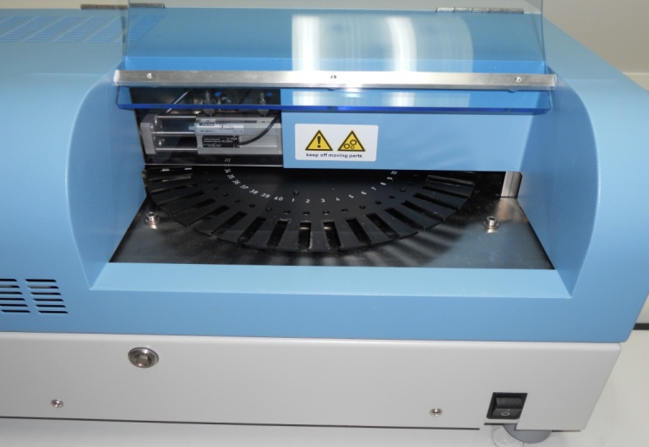
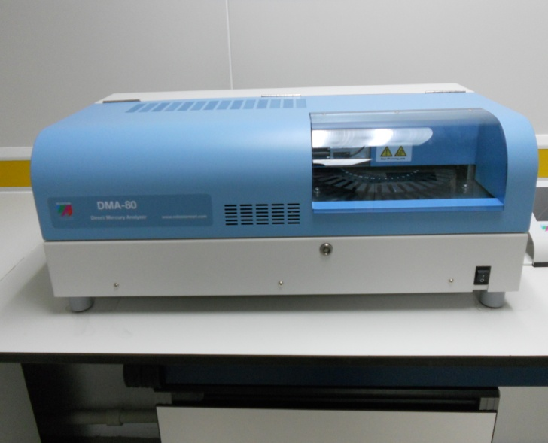
II.3Measurement and Elemental Parameters (AAS-CV)
N. | Time | Temperature
1 | 00:01:00 | 200°C
2 | 00:02:00 | 650°C
3 | 00:01:00 | 650°C
Starting Maximum Temperature 200°C
Purge 50 seconds
(μg/g)
(μg/g)

Slide 12
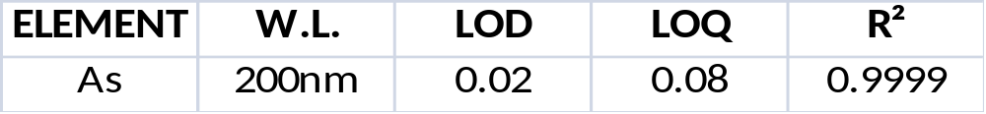
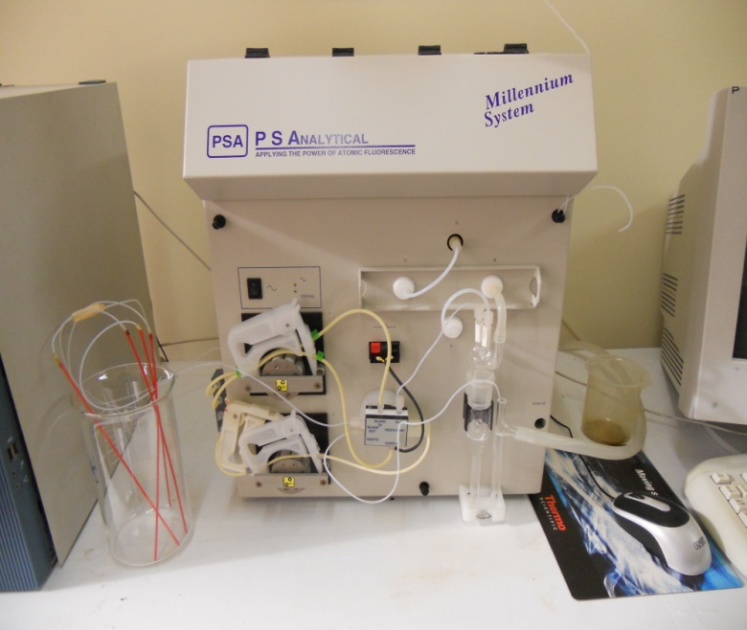
II.4 Measurement and Elemental Parameters (HG-AFS)
Argon Flow | 250 mL/min
NaBH₄ Flow | 4.5 mL/min
Fist Discharge mA | 27.5
Second Discharge mA | 30
Element | As
(μg/g)
(μg/g)

Slide 13
II.5 Certificate and Control Samples
To carry out a proper control on the quality, reliability and validation of the results, we have continuously employed CRMs and control samples.
NIST - 1400 Bone Ash (ICP-OES, ICP-MS and HG-AFS)
NIM- GBW07408 Soil (ICP-OES and ICP-MS)
NIST -1633C Coal Fly Ash (Mercury AAS-CV )
Control Samples “MF” (ICP-OES y ICP-MS)

Slide 14
II.6 Reliability and precision of the analytical methodology employed
BONE ASH NIST 1400 values expressed in µg/g. Obtained Values (OBT. V.). Certificate Values(CERT.V.). Standard Deviation (s). * mg/g values.
El. | OBT. V. | s | V. CERT. | s
Ca* | 380 | 30 | 381.8 | 1.3
Mg | 7190 | 320 | 6840 | 130
Sr | 280 | 30 | 249 | 7
Zn | 178 | 21 | 181 | 3
BONE ASH NIST 1400 obtained values during each analysis

Slide 15
III.BONES AND DIAGENESIS
Post-mortem alterations (weathering, dissolution, precipitation, microbial attack, mineral replacement, ionic substitution, recrystallization and isotopic exchange) in bones are commonly referred to as diagenesis.
In many cases a previous impact on the structure and chemical composition of the bones is induced by cremation during funerary rituals, cooking habits or other human activities.
As a development of those prior methodological works, more recently, rare earth elements (REEs) analyses have been in general performed to monitoring the impact of diagenetic processes in bones.
The limits of chemical analysis methodological approaches are linked to the control of the variables intervening during the post-depositional processes that can mislead data interpretations.

Slide 16
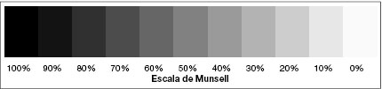
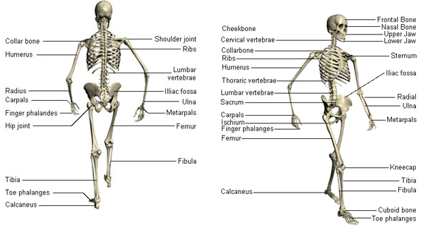
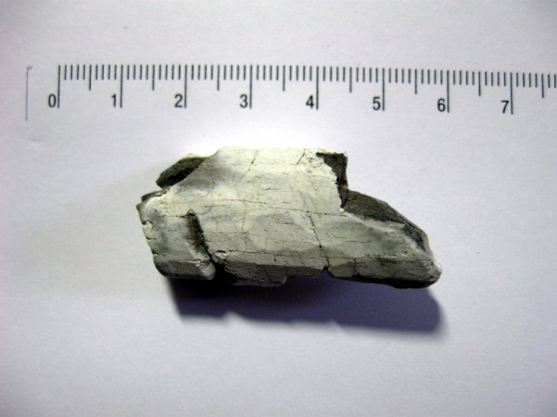
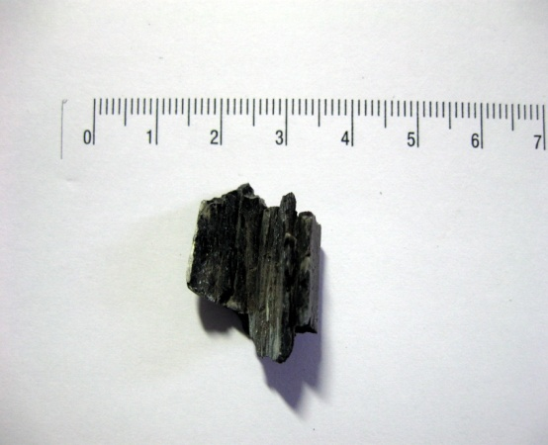
IV.BURNED BONES METHOD
A sampling strategy to control archaeological bone contamination due to diagenetic and taphonomic processes has been designed.
Cremated bones that were suffered different thermal impact were sampled. They belong to different part of a “thermal” gradient.
Different skeletal sectors for each individual have been sampled.
Iron age Necrópolis of Corral de Saus. Cremated bones.

Slide 17
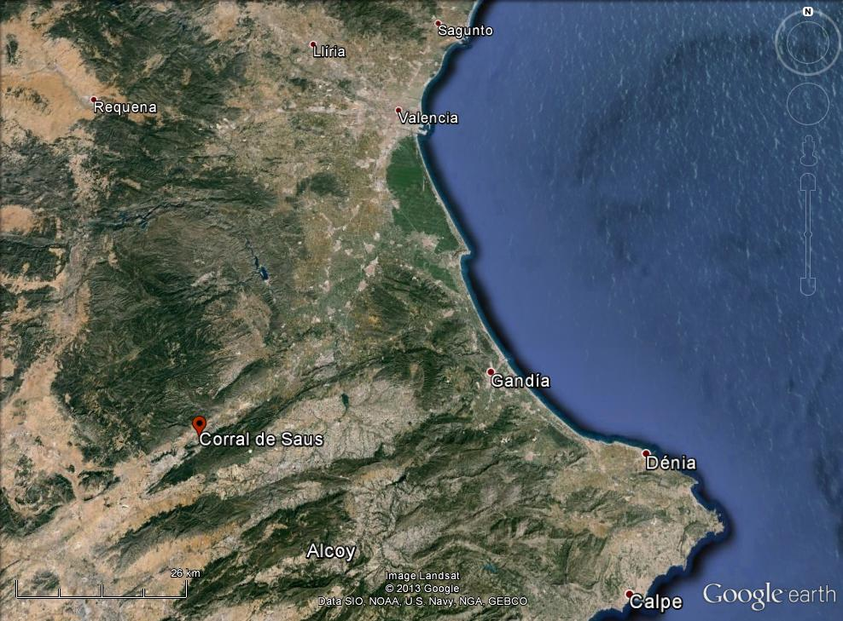
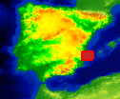
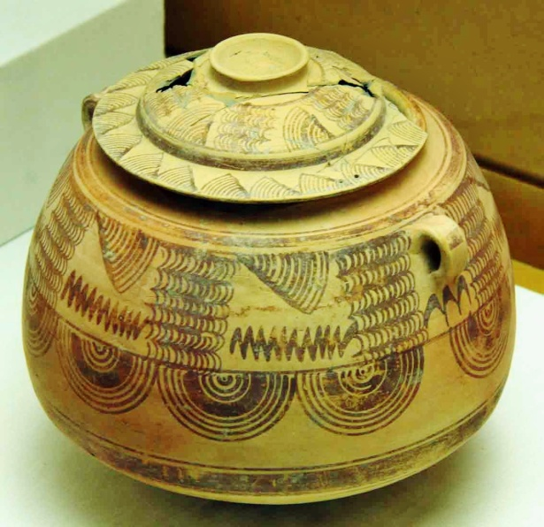
Corral de Saus
IV.1 Results

Slide 18
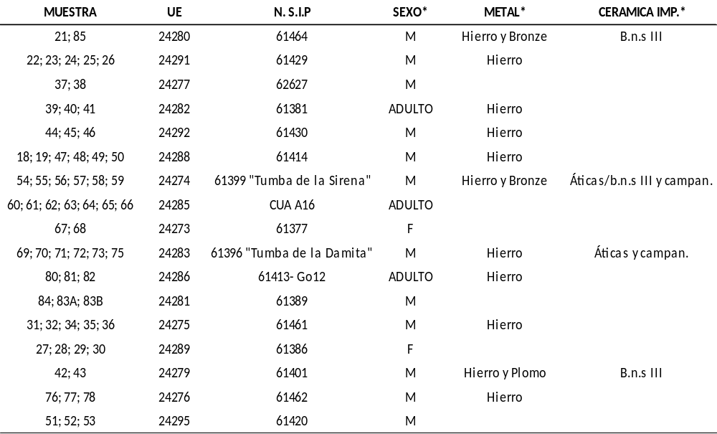
17 individuals dated III-II centuries BC have been analyzed.
The obtained dataset contained 65 samples and 22 variables (elements).

Slide 19
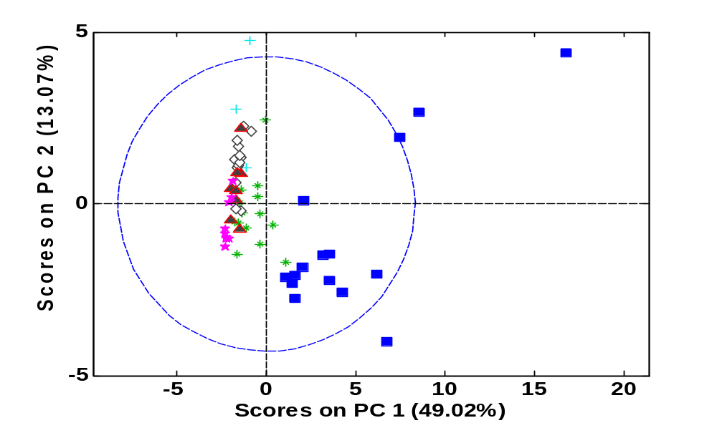
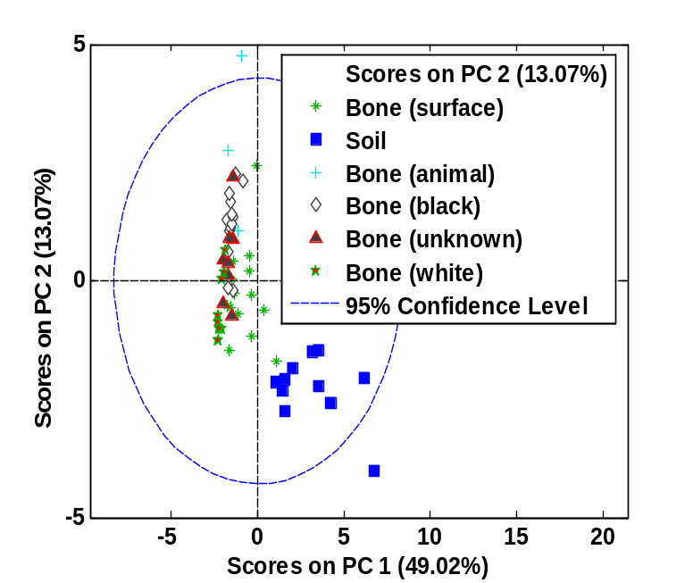
  Revealing the impact of diagenetic factors applying PCA
Bone samples from the outer bone layer are located between soil samples and bone samples in the direction of PC1.
PC2 captures variance explaining differences between white and black bone samples (all from the inner bone part).

Slide 20
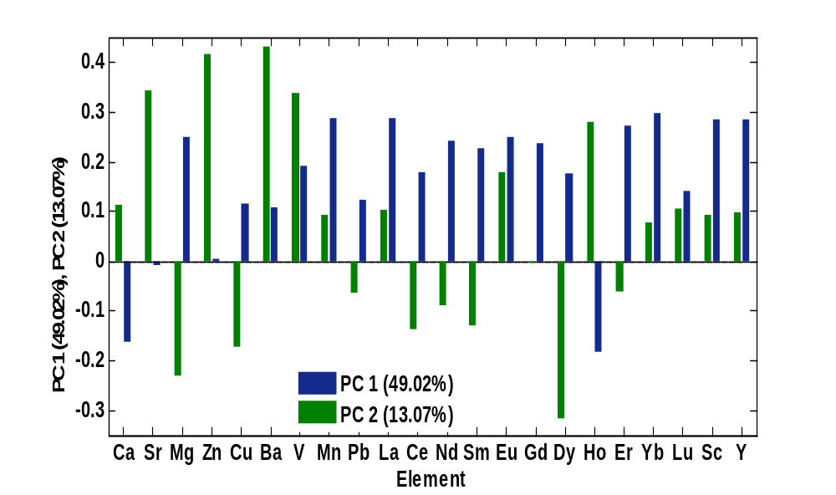
Loadings. Contribution of each variable (i.e. elements) to the calculation of PC1 and PC2 are represented.
Ca show higher concentrations in bone samples than soil samples.
Concentrations of Mn, La, Er, Yb, Sc and Y are lower in bone samples and higher in soil samples.

Slide 21
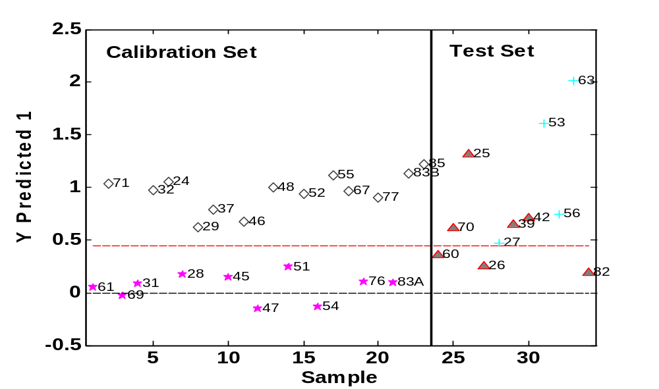
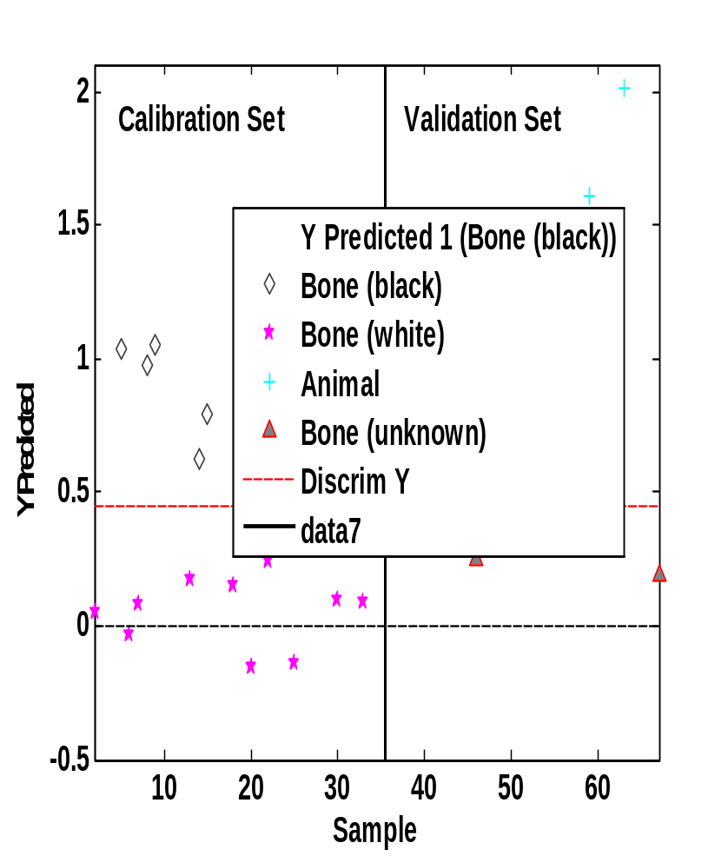
Corral de Saus Cremated bones classification (PLS-DA).
Good class separation between black and white bones was obtained using a PLS-DA model .
The model was applied to a set of bone of unidentifiable burning and some animal bone in dependence on their chemical characteristics.

Slide 22
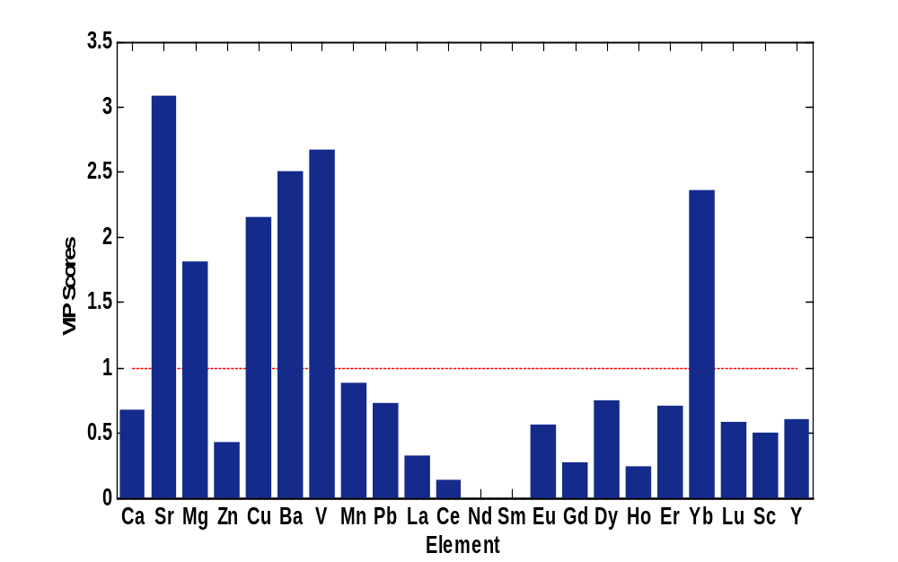
Variable Importance in Projection (VIP) scores for the calculated model .
Sr, Mg, Cu, Ba, V and Yb were the elements with the highest impact on the PLS-DA model.
Concentrations are higher in carbonized than incinerated bones.

Slide 23
IV.2 Population Lifestyle (diet) reconstruction, differences depending on the bone class: an example
El/Ca Corral de Saus samples. Zn/Ca (rich and poor protein intake), Sr/Ca (vegetable and animal protein based diet). Incinerated bones (I.), carbonized bones (CB.), bone surface (S.H.).

Slide 24
V. FORENSIC ARCHAEOLOGY CASES
Some forensic archaeological studies have focused their efforts on the determination of heavy metals in human remains in order to establish intentional or unintentional poisoning as the cause of death of some individuals.
Arsenic (As), Mercury (Hg) and Lead (Pb) have been the more attractive elements from scholars investigating the cases of poisoning in ancient populations or in famous people of antiquity.

Slide 25
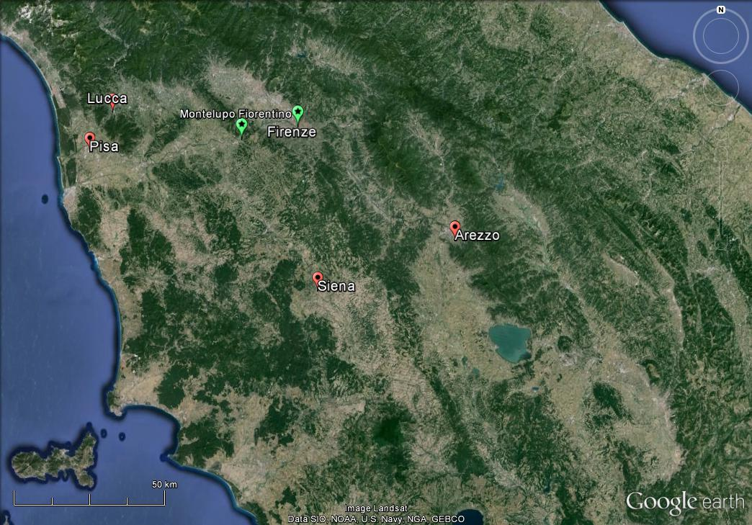
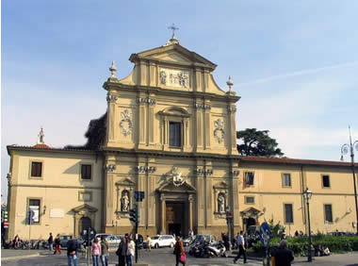
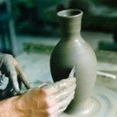
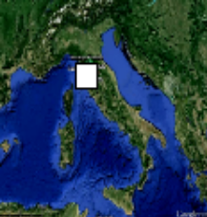
Renaissance Humanists and Medieval Ceramist
We have selected two cases:
The first case about the Italian Renaissance Florentine humanists, Giovanni Pico della Mirandola, Angelo Poliziano and Girolamo Benivieni.
The second case from the medieval excavation of Montelupo Fiorentino town (Florence, Italy), famous for its ceramic production (an individual that archaeologist believe to be a ceramist).
Las muestras

Slide 26


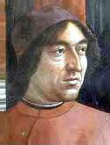
Humanist Florentine individuals chemical analysis of toxic metals (As, Hg) have been carried out to clarify if their death was due to poisoning, and to find out the biological relevance of elemental concentrations not conditioned by post-mortem processes .
Pico della Mirandola
(1463-1494)
Benivieni
(1453-1542)
Poliziano
(1454-1494)
About ceramist the aim have been understand, through metal analyses (As, Hg, Pb), if its high concentrations levels are due to the long exposure to toxic agents (colors) or if the results are conditioned by post-mortem processes.

Slide 27
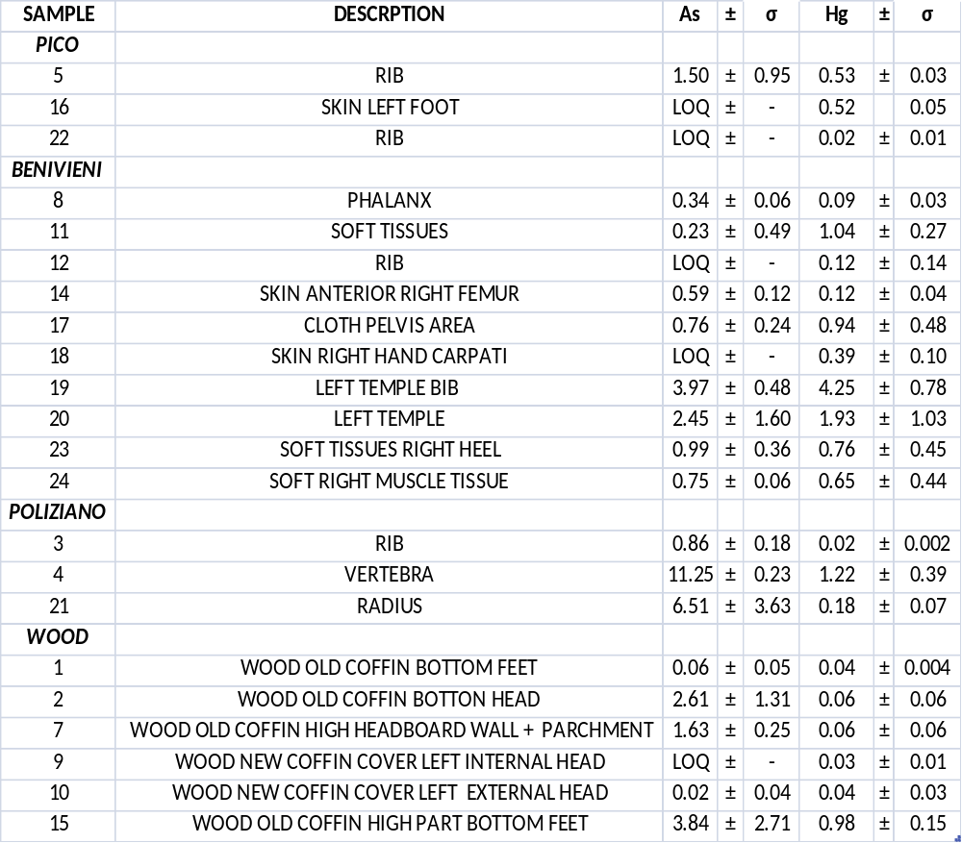
As y Hg (µg/g) values in Giovanni Pico Della Mirandola, Girolamo Benivieni y Angelo Poliziano.

Slide 28
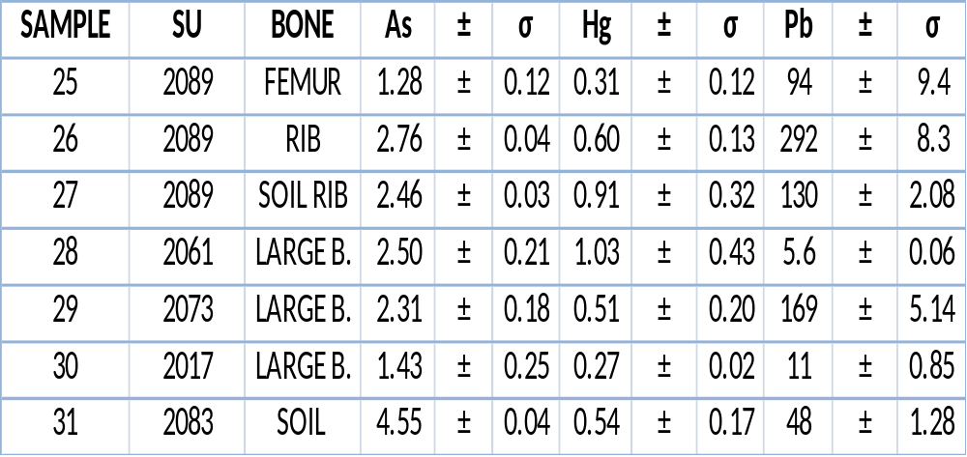
As, Hg y Pb (µg/g) values in Montelupo Fiorentino samples
Soil sample “31” Pb value minor than soil sample “27”.
Soil sample“27” Pb higher value related to rib values.
Femur “25” contains high Pb values .
High Pb values also found in large bone child“29” SU 2073.

Slide 29
VI. CONCLUSIONS
AND FUTURE DEVELOPMENTS
During the development of our project many factors have contributed to obtain innovative results:
1) the proposed analytical methodology has produced a meaningful and reliable statistical analysis of our database.
2) The combination involving major elements, trace elements and REEs analysis, the strategy of sample selections and the multivariate statistic treatment of data applied to very heterogeneous and diachronic archaeological materials have provided support to develop some original methodological proposals adding new ways to overcome problems in some forensic science and forensic archaeology.

Slide 30
The most interesting conclusions need to be stressed:
1.Carbonized bones have been statistically differentiated from incinerated bones and class assignment of bone samples with uncertain thermal impact in dependence on their trace elements composition has shown to be feasible.
2. Chemical analysis and statistical classification of burned bones exposed to different thermal impact, are a good tool, together with analysis of bones belonging to different skeletal sectors to control diagenetic factors in order to decide whether a sample is suitable or not for forensic, biological or paleonutritional studies.
3.The use of elemental profiles found in outer bone layers (buried and cremated) for biochemical-archaeological studies is not recommended.
4. Diet profile of a population could change depending on the class of bones analyzed between the same population and individuals.
5.The analysis of heavy metals in forensic archaeological studies have been an effective tool in certain situations to rebuilt interpretations about human toxic element exposure, although an accurate strategy of sampling need to be applied.
6.Pico Della Mirandola bone samples have not presented toxic levels of As and Hg.

Slide 31
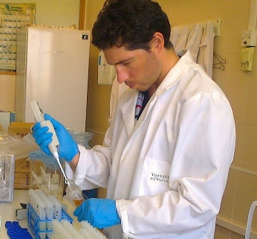
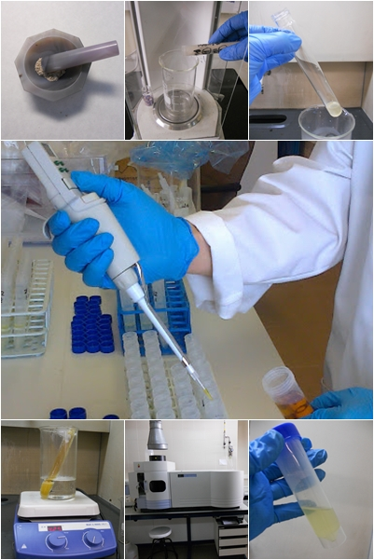
7.In Girolamo Benivieni corpse, some substance containing As and Hg has probably been employed post-mortem as preservative.
8.Poliziano has got a chronic exposure to arsenic caused by environmental factors or medical cures, but Poliziano´s death by arsenic poisoning has not been confirmed.
9.In the case of Montelupo Fiorentino individual has not been possible to determine whether the individual was a ceramist.
I consider the results of this thesis an interesting contribution to the progress of forensic methodologies. This work was born as a multidisciplinary research approach.

Slide 32
VI.2 Future Developments
Due to the encouraging results achieved by bone analysis, the same methodological proposals are being tested in other ancient forensic cases as studying the people died during the Spanish civil war (1936-1939) to indentify individuals. Analysis have shown to be an effective tool to know living habits of individuals excluding post-mortem contaminations.
Also comparative studies between organic and inorganic bone matter have to be developed to better understand if there are, and which are, the relationships between diagenetic processes involving both tissues employing our proposed methodology.
Eventually, non-destructive techniques like Spectral diffuse reflectance VIS-SWIR, XR Fluorescence and Laser Ablation ICP-MS, could allow to determine the mineral content of samples without any complex sample pre-treatment and facilitate the advance of future studies in some of the mentioned materials.

Slide 33

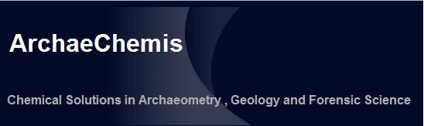
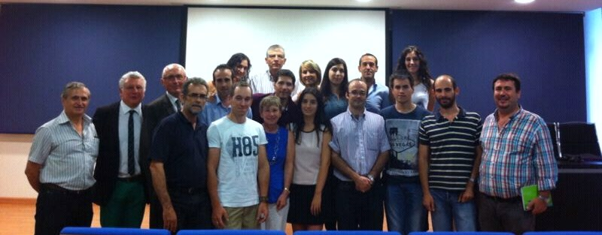



ACKNOWLEDGMENT
Analytical Chemistry Department
www.uv.es/archaechemis/

Slide 34
Let Us Meet Again
We welcome you all to our future conferences of OMICS Group International
Please Visit:
www.omicsgroup.com
www.conferenceseries.com

