Slide 1
Influence of Glycans on Biological Activities of Pituitary Gonadotropins: Follicle-Stimulating and Luteinizing Hormone
George R. Bousfield
Dr. L.M. Jones Distinquished Professor, Department of Biological Sciences
August 10, 2015

Slide 2
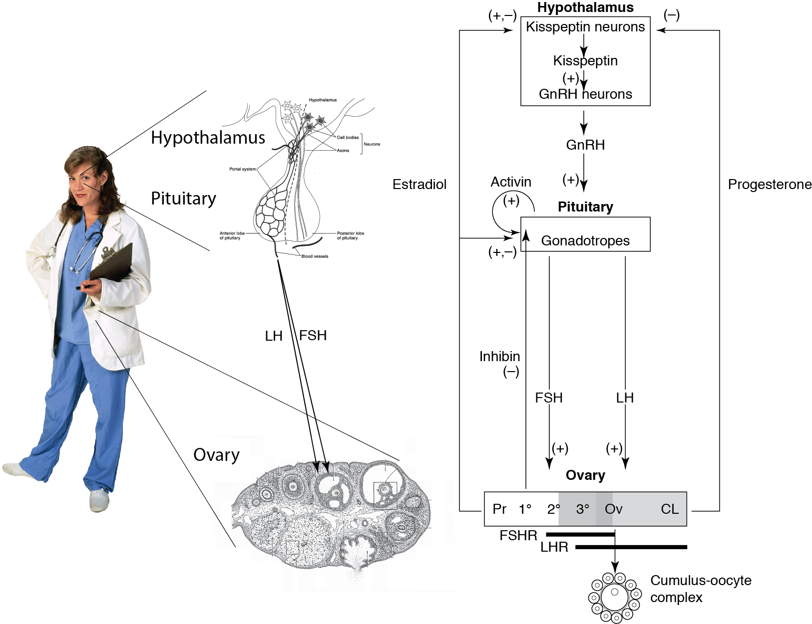
Hypothalamo-Pituitary-Gonadal Axis

Slide 3
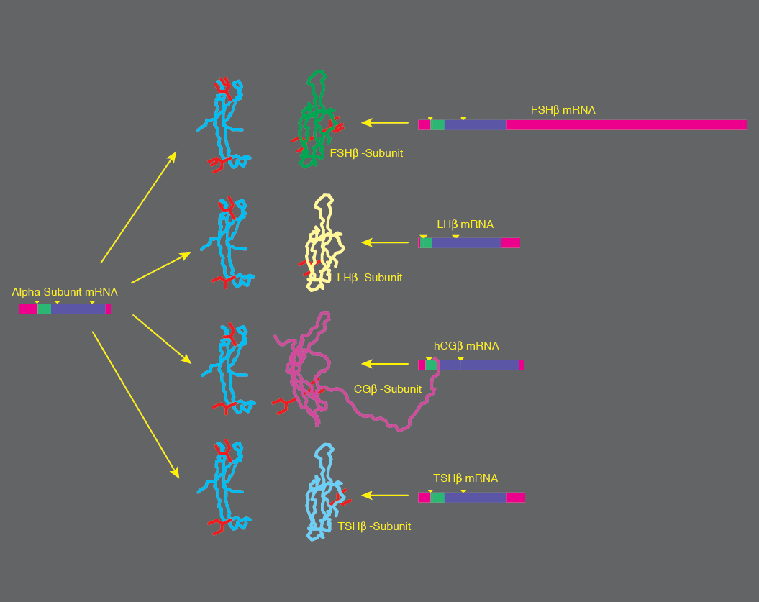
LH, FSH & Glycoprotein Hormone Family

Slide 4
α-Subunit Embraced by β Seatbelt Loop
A.J. Lapthorn, et al., Nature, 369 (1994) 455-461.
H. Wu, et al., Structure, 2 (1994) 545-558.

Slide 5
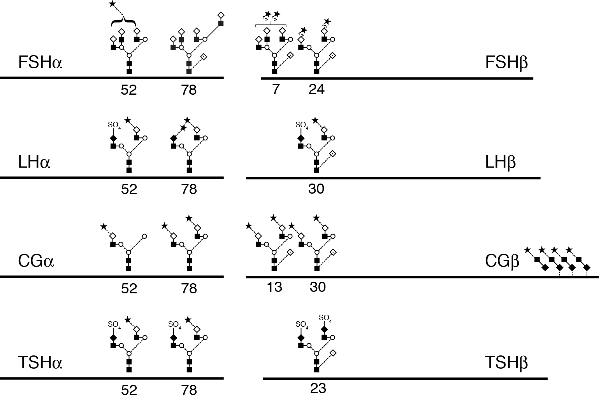
Hormone-specific glycosylation

Slide 6
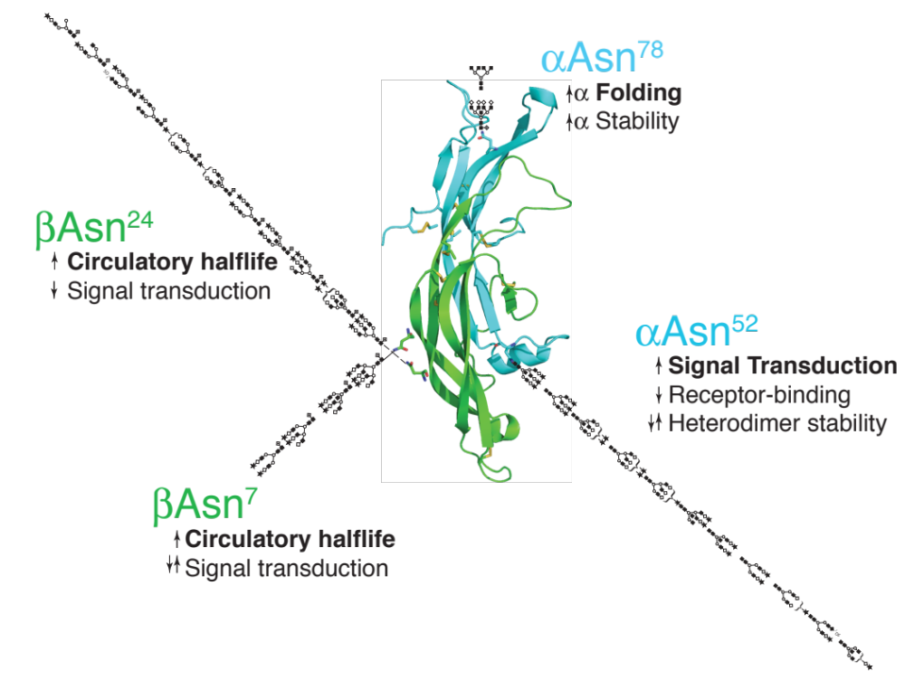
LH/FSH Glycan Functions
Notes:
Figure. FSH glycosylation microheterogeneity and function. The glycans localized at each N-glycosylation site by glycopeptide mass spectrometry are shown. The functions for each glycan are indicated.

Slide 7
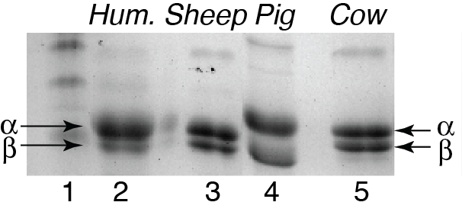
LH Preparations

Slide 8
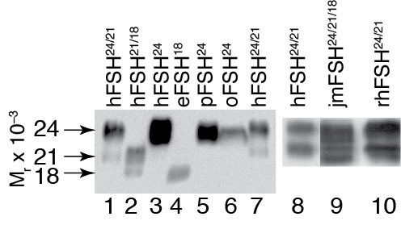
Mammalian FSHβ Western Blots
Notes:
Point out that human FSH exists as differentially glycosylated FSHbeta glycoforms, while eFSH has essentially one (1 glycan) while pig and sheep FSH appear to have one glycoform (2 glycan).
Complete separation of pFSH 21 to the pLH fraction. However, accompanied by some pFSH24 as well.

Slide 9
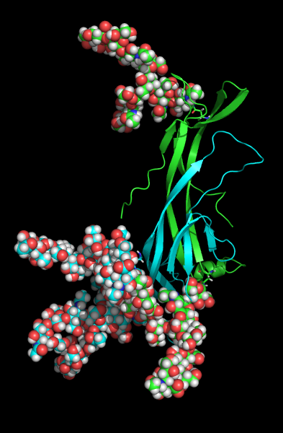
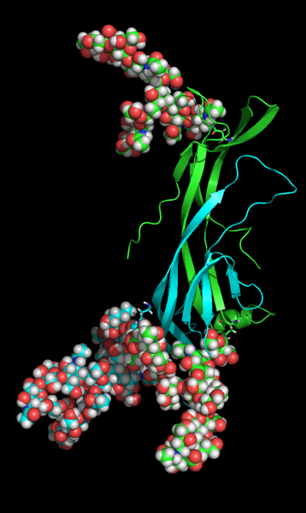
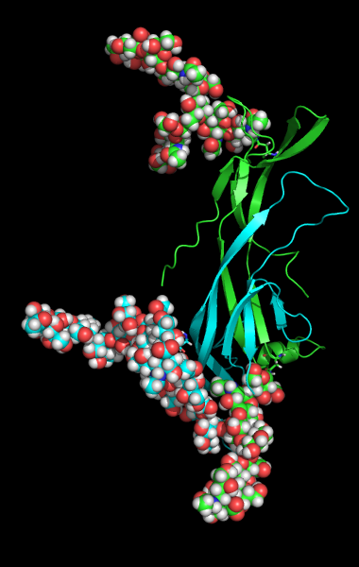
Human FSH Glycoforms
αN⁷⁸
αN⁷⁸
αN⁷⁸
βN²⁴
βN²⁴
αN⁵²
αN⁵²
αN⁵²
βN⁷
βN⁷
FSH²⁴
FSH²¹
FSH¹⁸

Slide 10
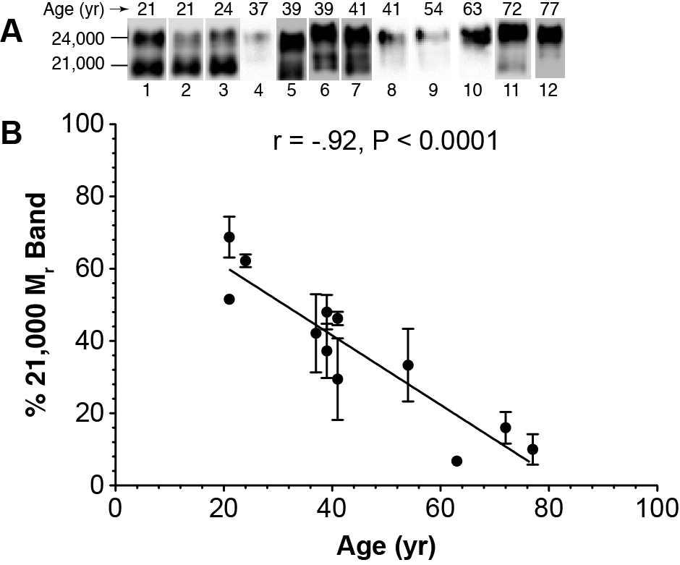
Age-related decline in pituitary hFSH²¹
Notes:
Analysis of hFSH from pituitaries of 12 women, shows a significant correlation between increasing age and reduced di-glycosylated hFSH abundance.

Slide 11
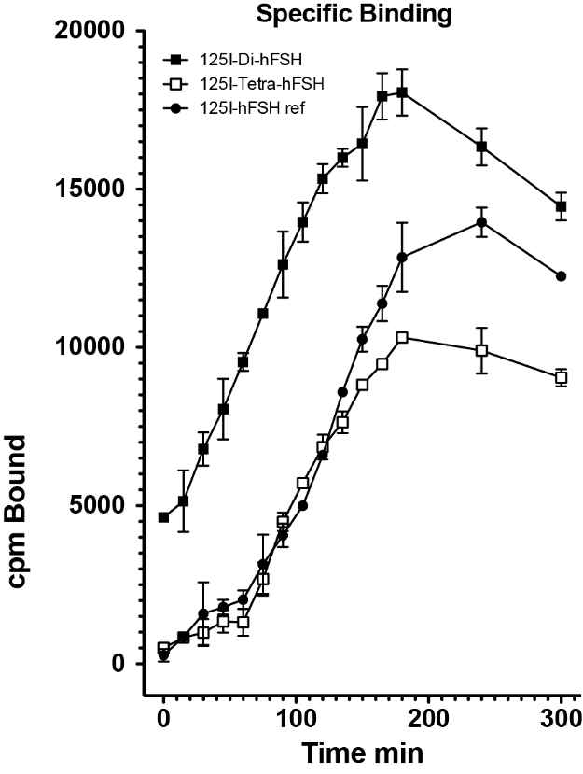
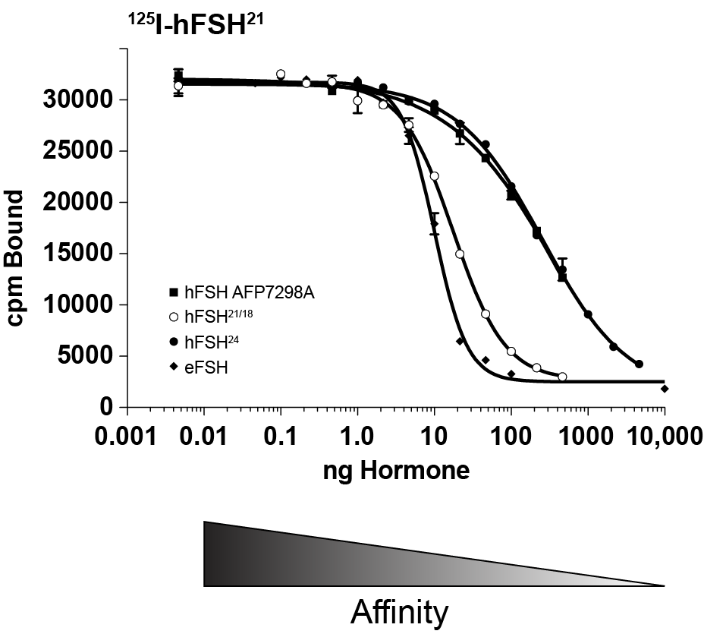
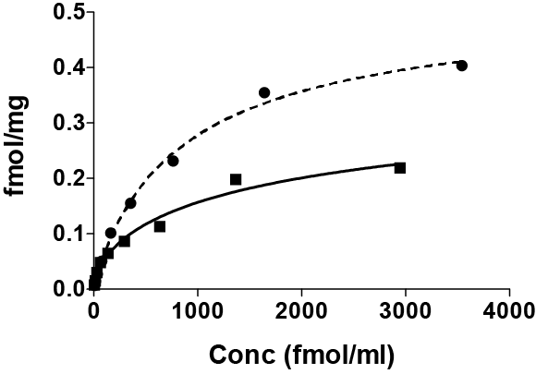
FSH²¹ More Active Than FSH²⁴
FSH²¹
FSH²¹
FSH²¹
FSH²⁴
FSH²⁴
FSH²⁴
eFSH
Faster
Association
Higher
Affinity
Greater
Occupancy
Bousfield, G. R., et al., Mol. Cell. Endocrinol. 382: 989-997, 2014
Notes:
Note that eFSH is the most active

Slide 12
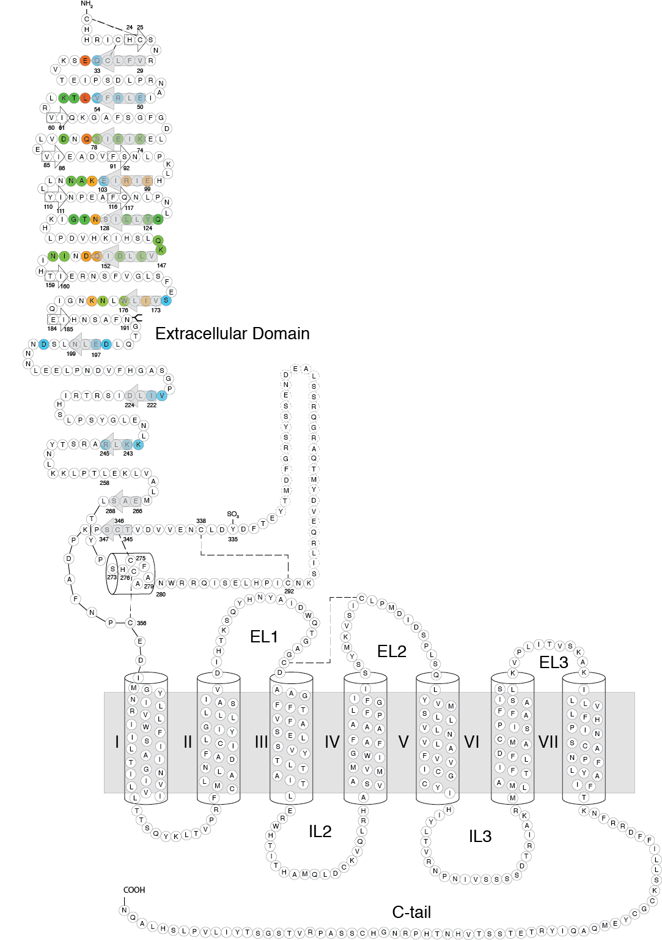
FSH receptor

Slide 13
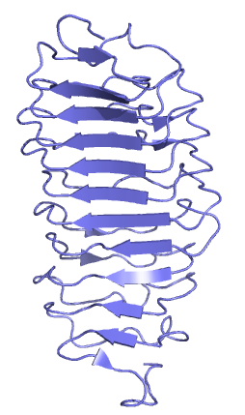
FSH receptor hormone-binding domain
1wxd
Q.R. Fan, et al., Nature, 433 (2005) 269-277.

Slide 14
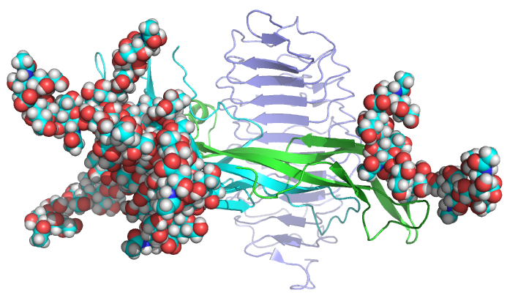
FSHR–FSH²⁴ Complex
FSH²⁴
1wxd
1wxd
Glycam model of FSH²⁴

Slide 15
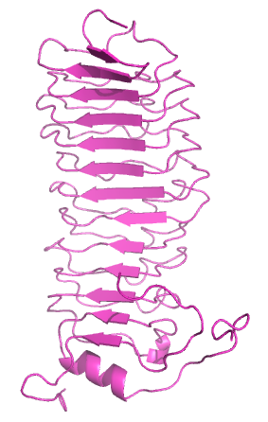
FSH receptor hormone-binding domain
1wxd
4ay9
X. Jiang, et al., Proc. Natl. Acad. Sci. USA, 109 (2012) 12491-12496.

Slide 16
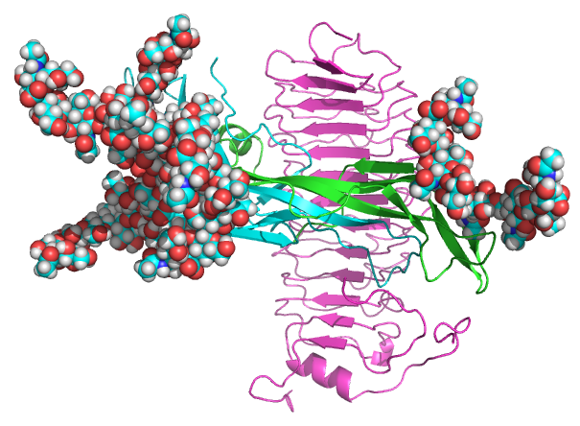
FSH receptor hormone-binding domain
FSH²⁴
1wxd
4ay9
Glycam model of FSH²⁴

Slide 17
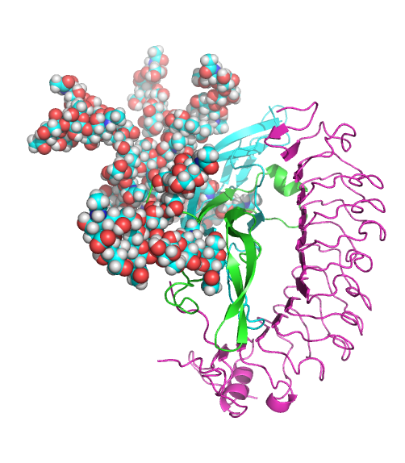
FSH glycans and FSHR_{ecd}
FSH²⁴
FSH²⁴
FSHR_{ecd}
FSHR_{ecd}
Glycam models of FSH²⁴

Slide 18
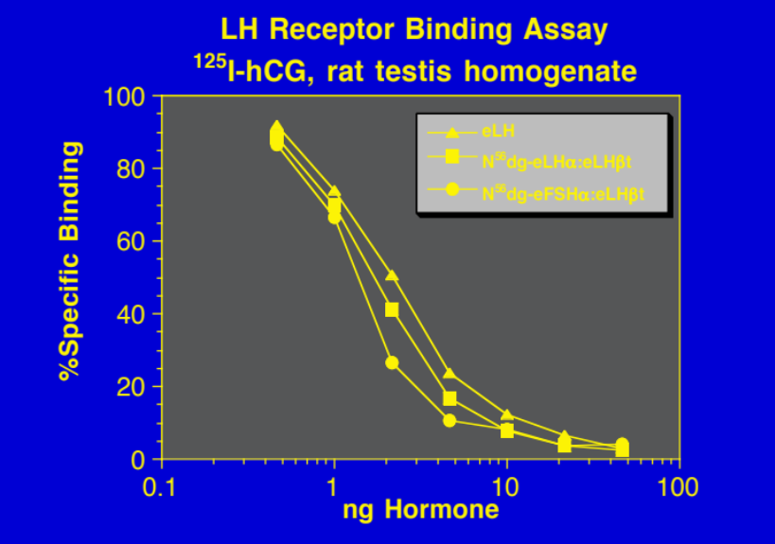
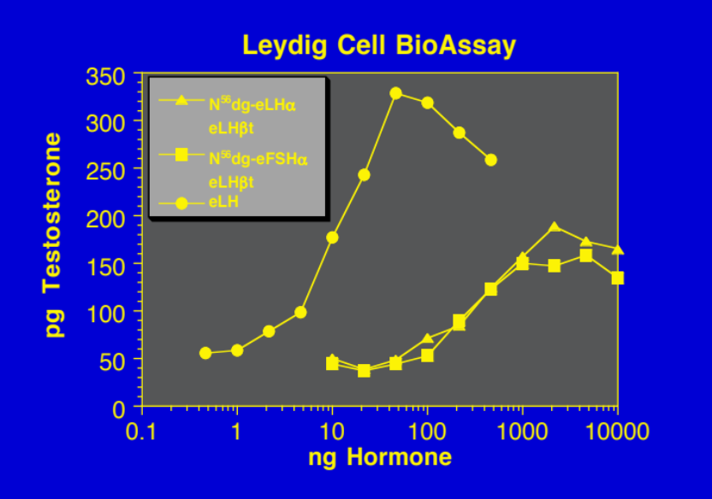
αAsn⁵² Glycan Necessary for Biological Activity

Slide 19
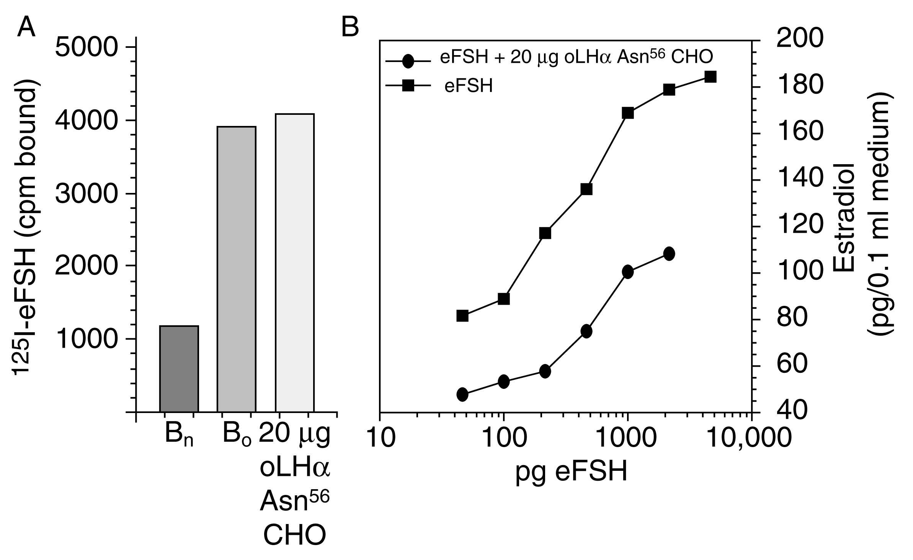
Oligosaccharide Inhibition of FSH-stimulated steroidogenesis

Slide 20
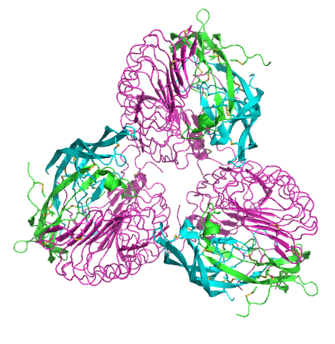
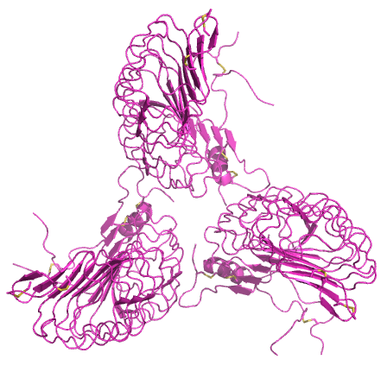
FSH Receptors as Oligomers
Jiang, X., et al., (2012) Proc. Natl. Acad. Sci. USA 109(31): 12491-12496.

Slide 21
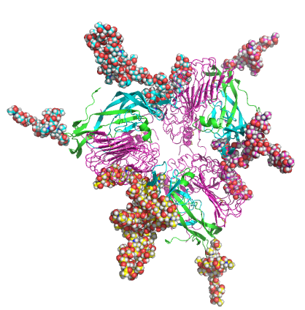
FSH Receptors as Oligomers
Glycam models of FSH
Jiang, X., et al., (2012) Proc. Natl. Acad. Sci. USA 109(31): 12491-12496.

Slide 22
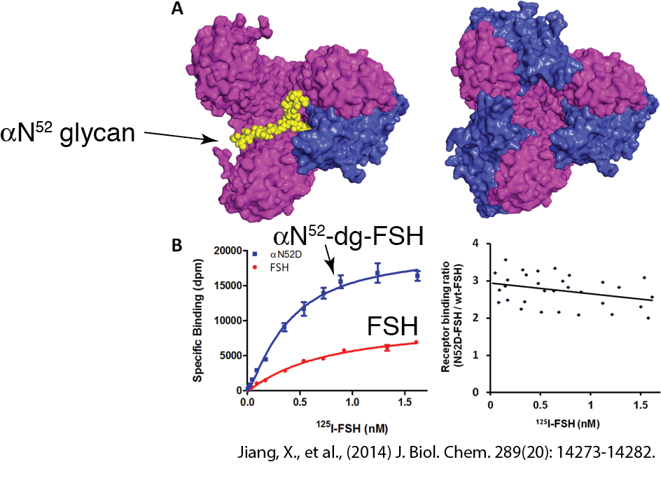
αN⁵² glycan potentially reduces binding

Slide 23
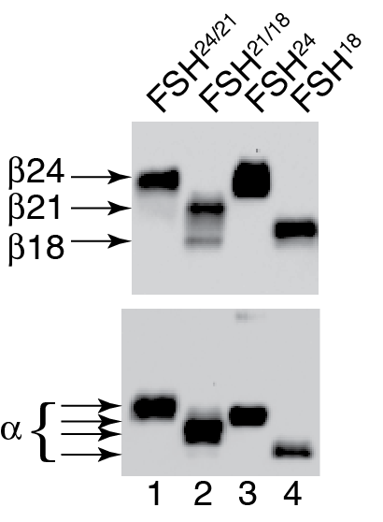
αN⁵² glycan potentially reduces binding

Slide 24
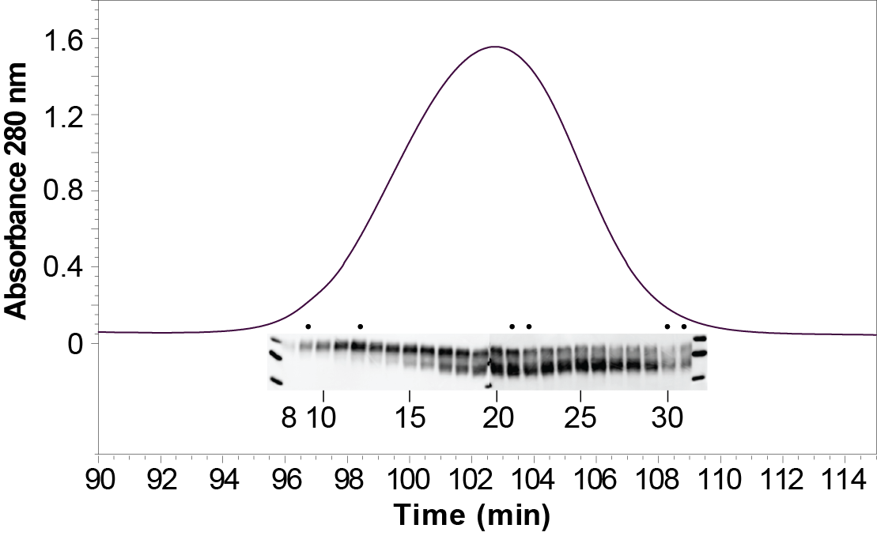
FSH Glycoform Isolation

Slide 25
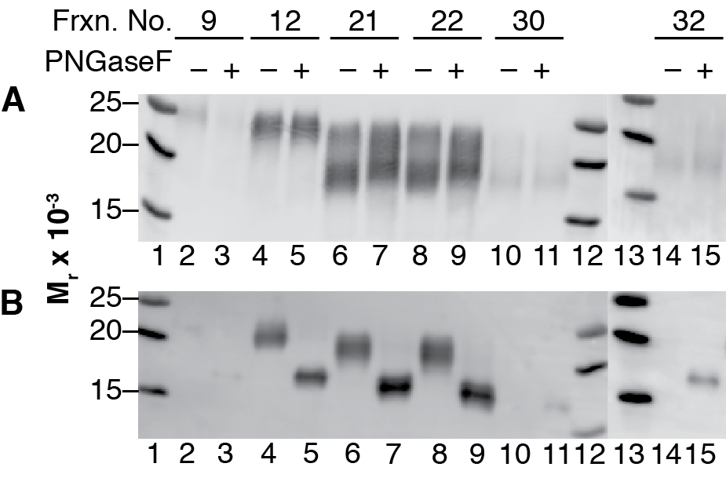
Selective αAsn⁵² Glycan Removal

Slide 26
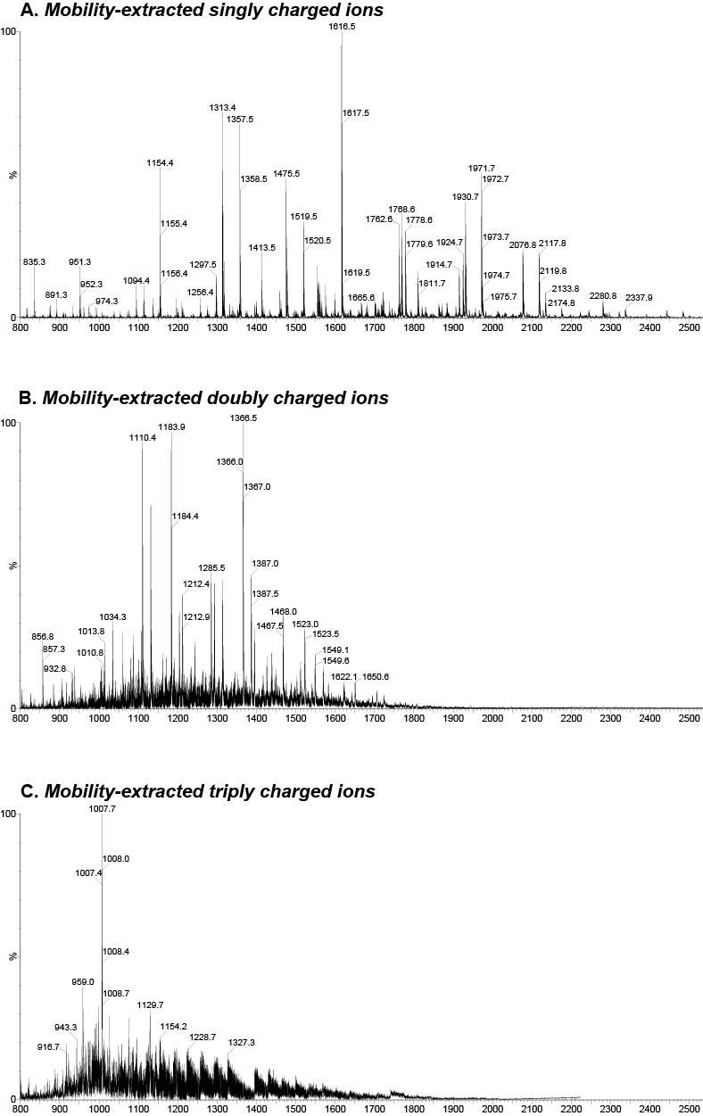
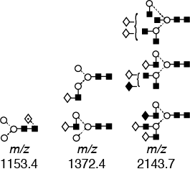
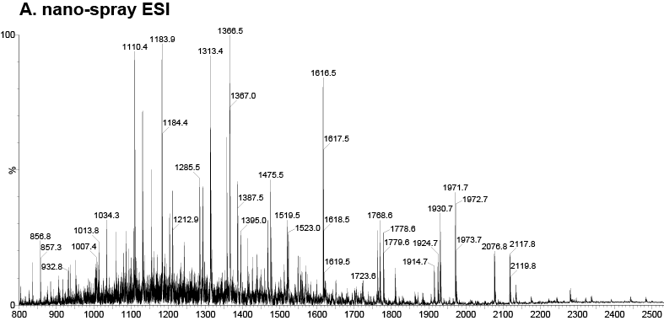
ESI-MS vs Ion Mobility + MS
-1
-2
-3

Slide 27
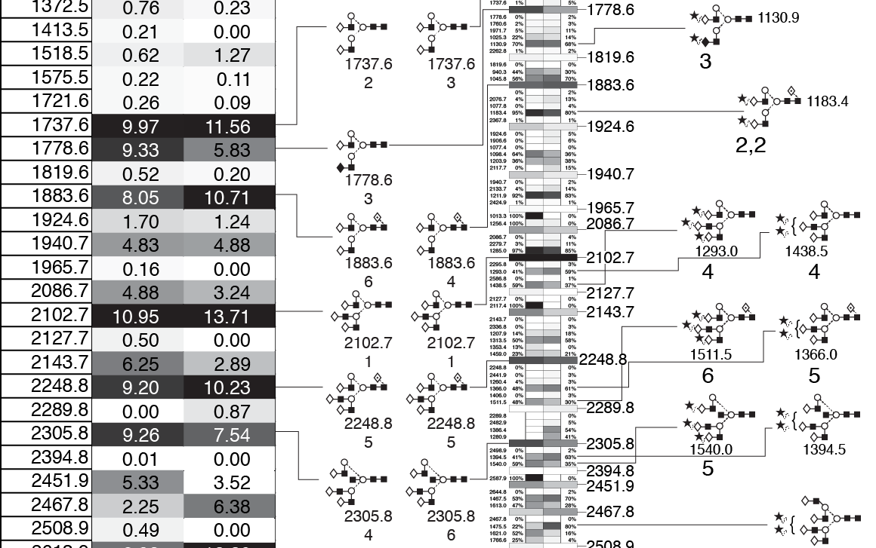
Compare FSH preparation glycans

Slide 28
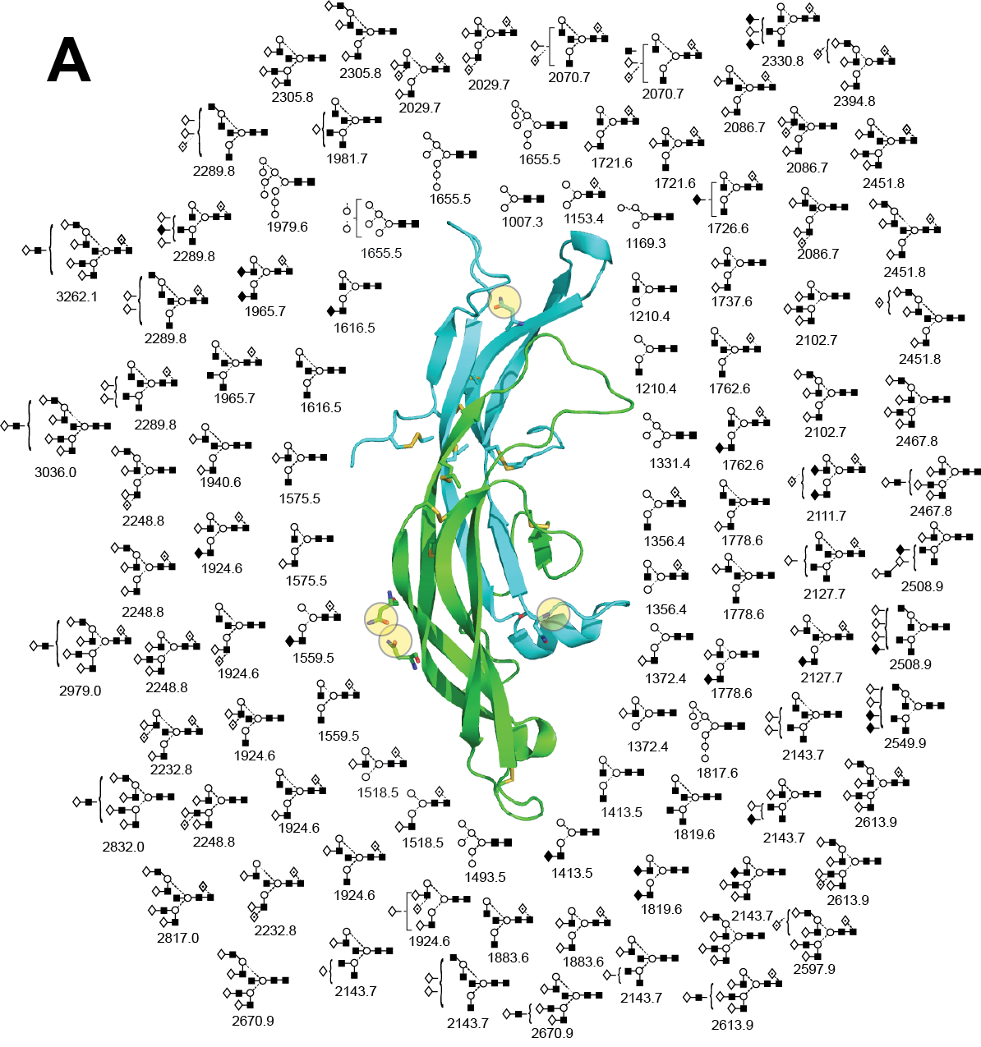
FSH Total Glycan Microheterogenity

Slide 29
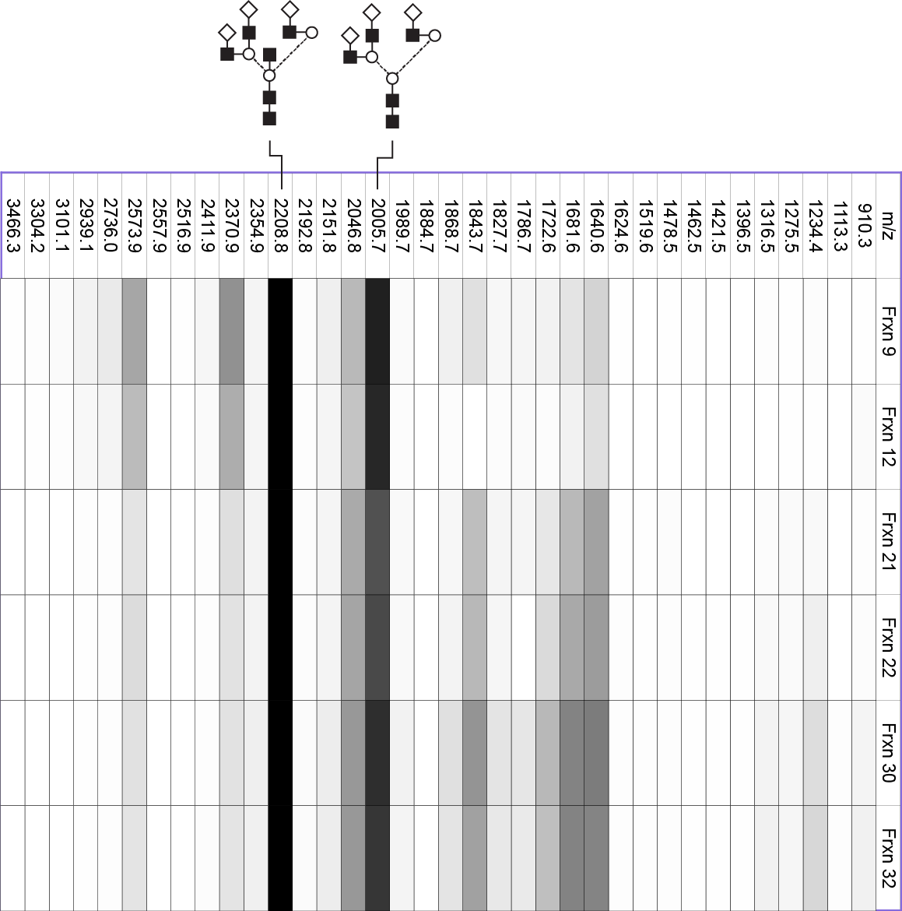
FSHα N⁵² Glycans
Notes:
m/z 2208.8 = 100%
m/z 2005.7 = 68-87%

Slide 30
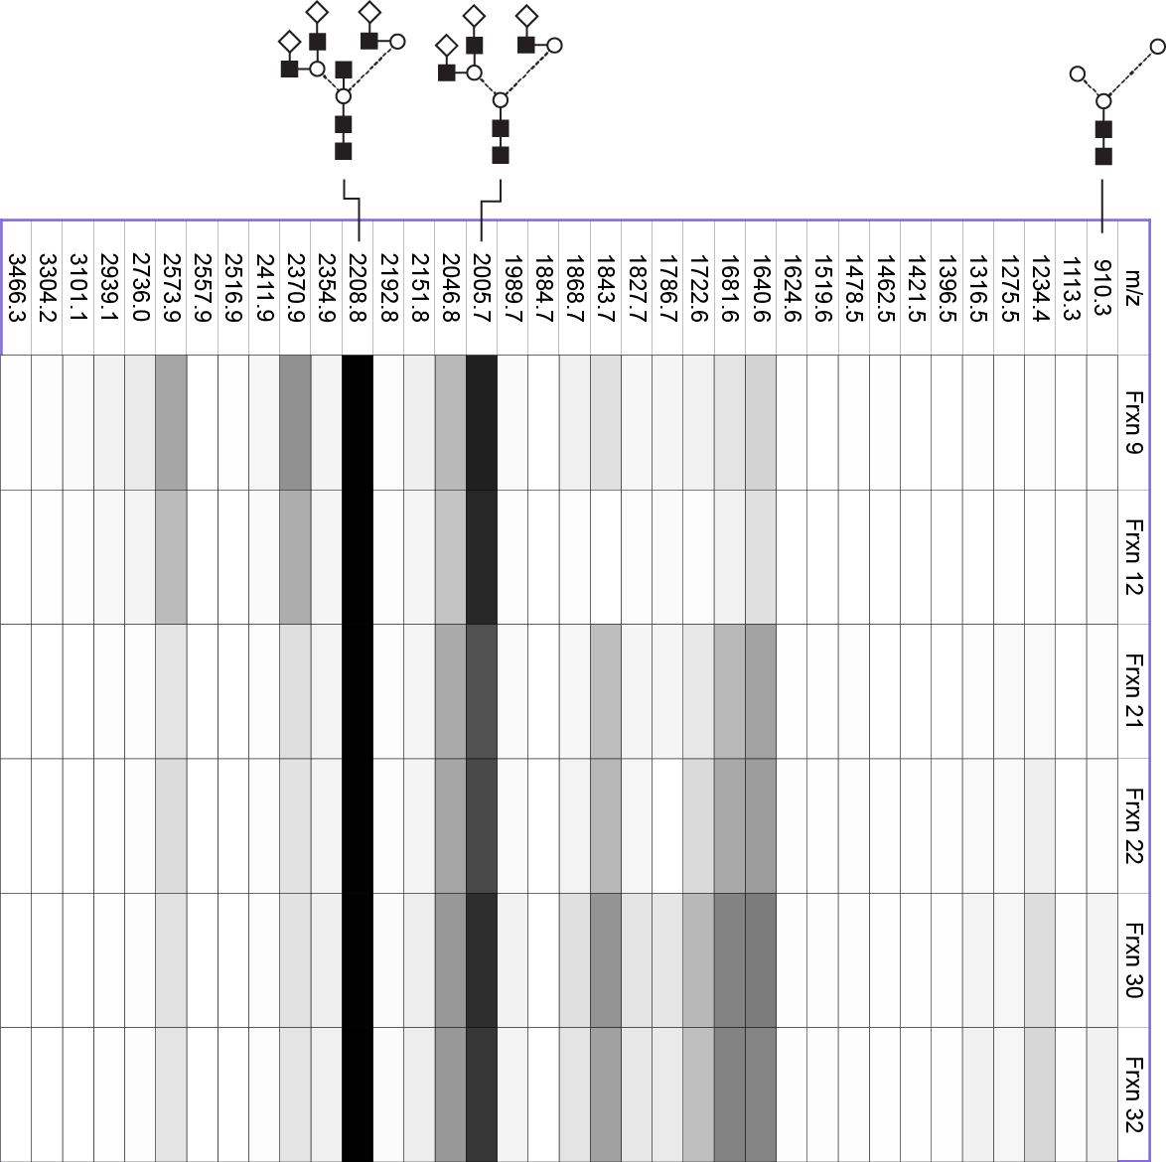
FSHα N⁵² Glycans
Notes:
Pentasaccharide core m/z 910.3 = 0.2-5.4%

Slide 31
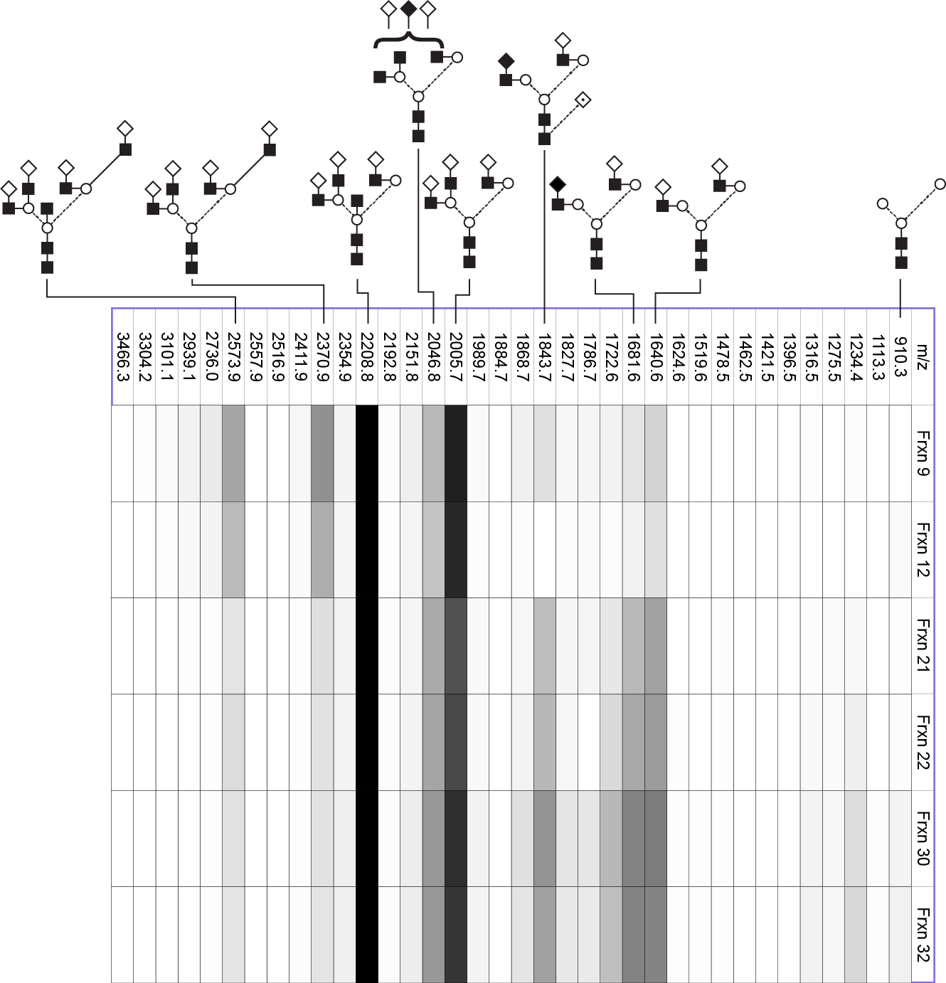
FSHα N⁵² Glycans
Notes:
Decrease as go larger to smaller = 2370.9 or 2573.9 from 43% or 34% to 11%
Increase as go larger to smaller = 1640.6 or 1981.6 from 11% or 18% to 48%

Slide 32
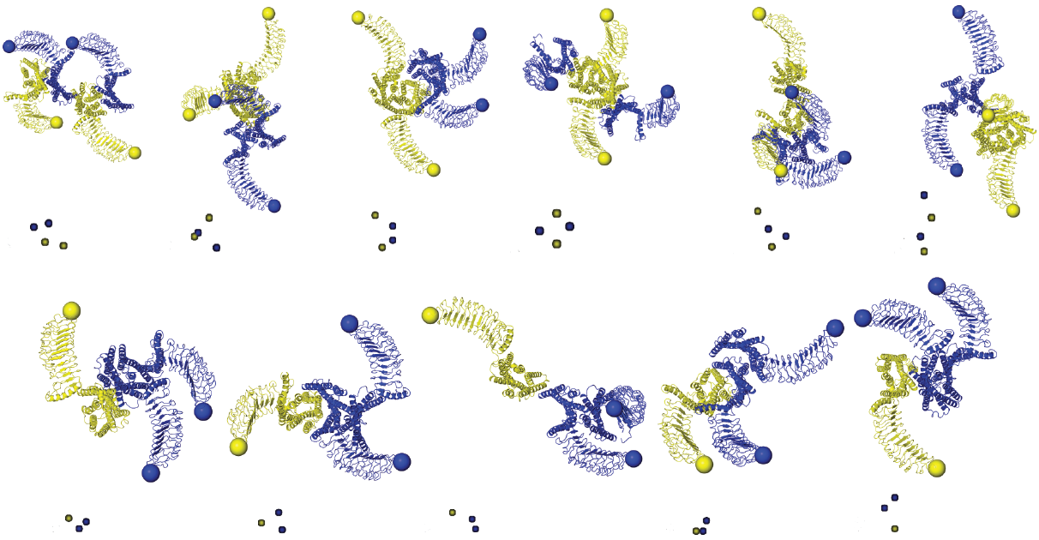
LH receptors as variety of oligomers
Jonas, K. C., et al. (2015). J. Biol. Chem. 290: 3875-3892.
Notes:
Dimer/oligomer = 43%
Presumably monomeric receptor = 57%

Slide 33
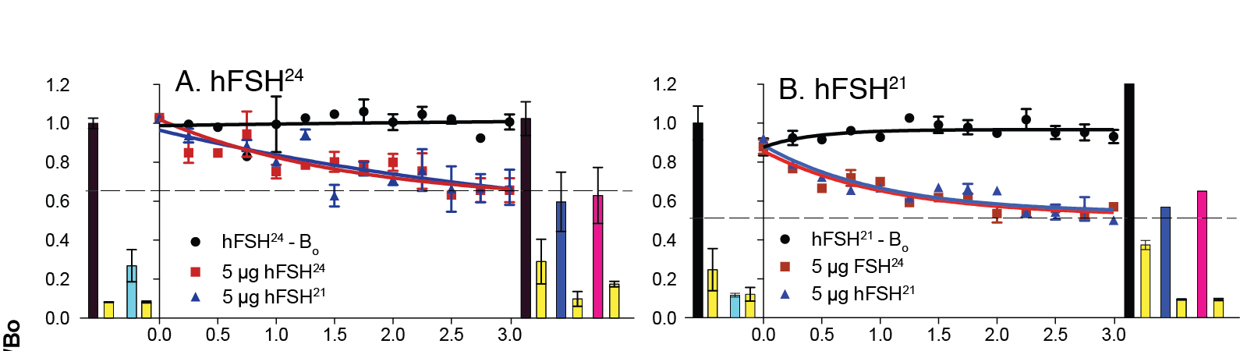
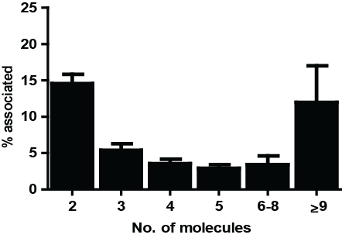
FSHR Dissociation Reveals Negative Cooperativity for Both FSH²¹ and FSH²⁴
Calf testis membranes
B_{t}/B_{o}
Jonas, K. C., et al. (2015). J. Biol. Chem. 290: 3875-3892.
Notes:
57% monomer
43% oligomers of various types

Slide 34
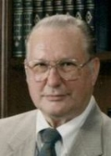
Acknowledgements
WSU
Wendy Walton
Vinod Singh
Van Nguyen
Jennifer Huneidi
Mary Allen
Quang Pham
Hy-Vong Ha
Katie Norton
Monica Rueda-Santos
Bill White
Alice Hwang
Ramy El-Said
P01
Jeff May (WSU)
John Davis (UNMC)
Raj Kumar (KUMC)
Gerry Lushington (KU)
Aaron Smalter Hall (KU)
Vladimir Butnev (WSU)
Viktor Butnev (WSU)
Bin Shuai (WSU)
Darrell N. Ward
Jan. 22, 1924 - June 2, 2013
Oxford University
David Harvey
Univ. Pennsylvania
William Moore
Univ. of Arizona
Naomi Rance
Univ. of Kansas
Heather Desaire
Janet Irungu
Dilusha Dalpathado
Todd Williams
Funding
P01 AG029531
P20 RR016475
P20 RR-17708
Wadsworth Institute
James Dias
Inst. Gustave-Roussy
Jean-Michel Bidart

Slide 35
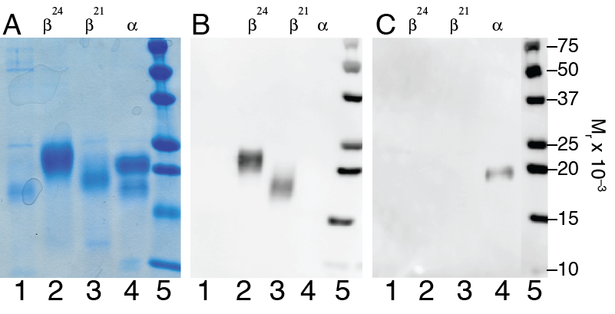
Isolation of FSHβ subunit glycoforms
Coomassie Blue
anti-FSHβ
anti-FSHα

Slide 36
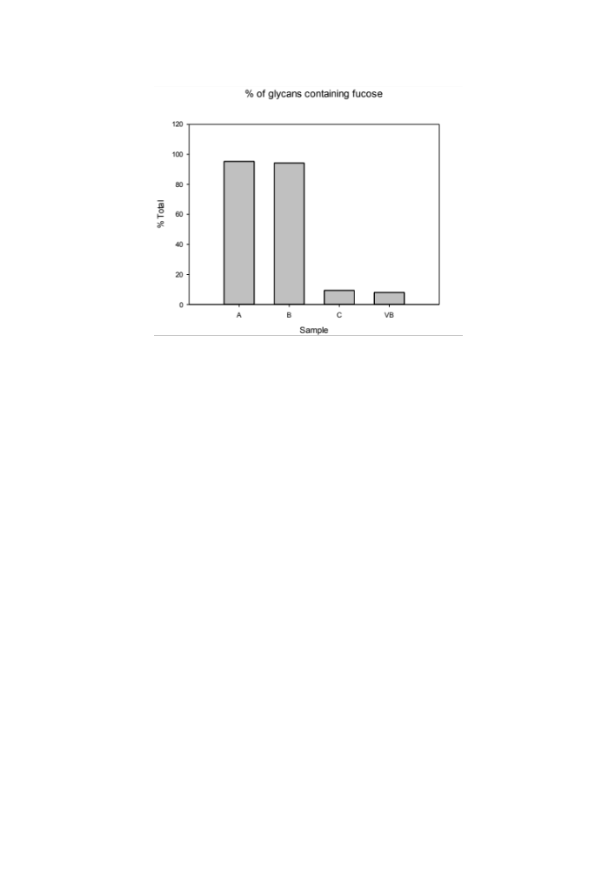
FSH Total Glycan Microheterogenity
β²⁴
β²¹
αΝ⁵²
αΝ⁷⁸

Slide 37
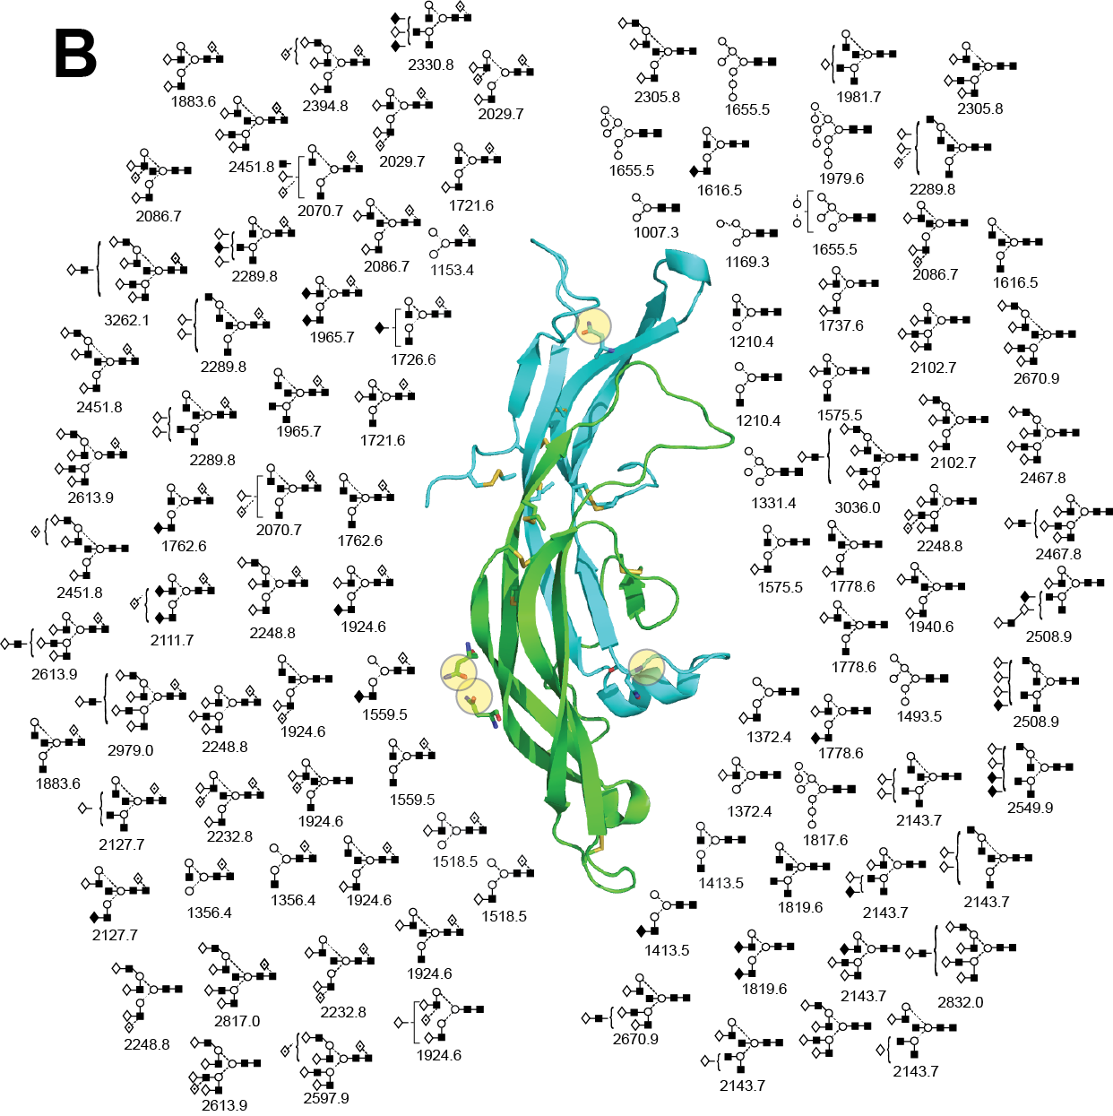
FSH Total Glycan Microheterogenity

Slide 38
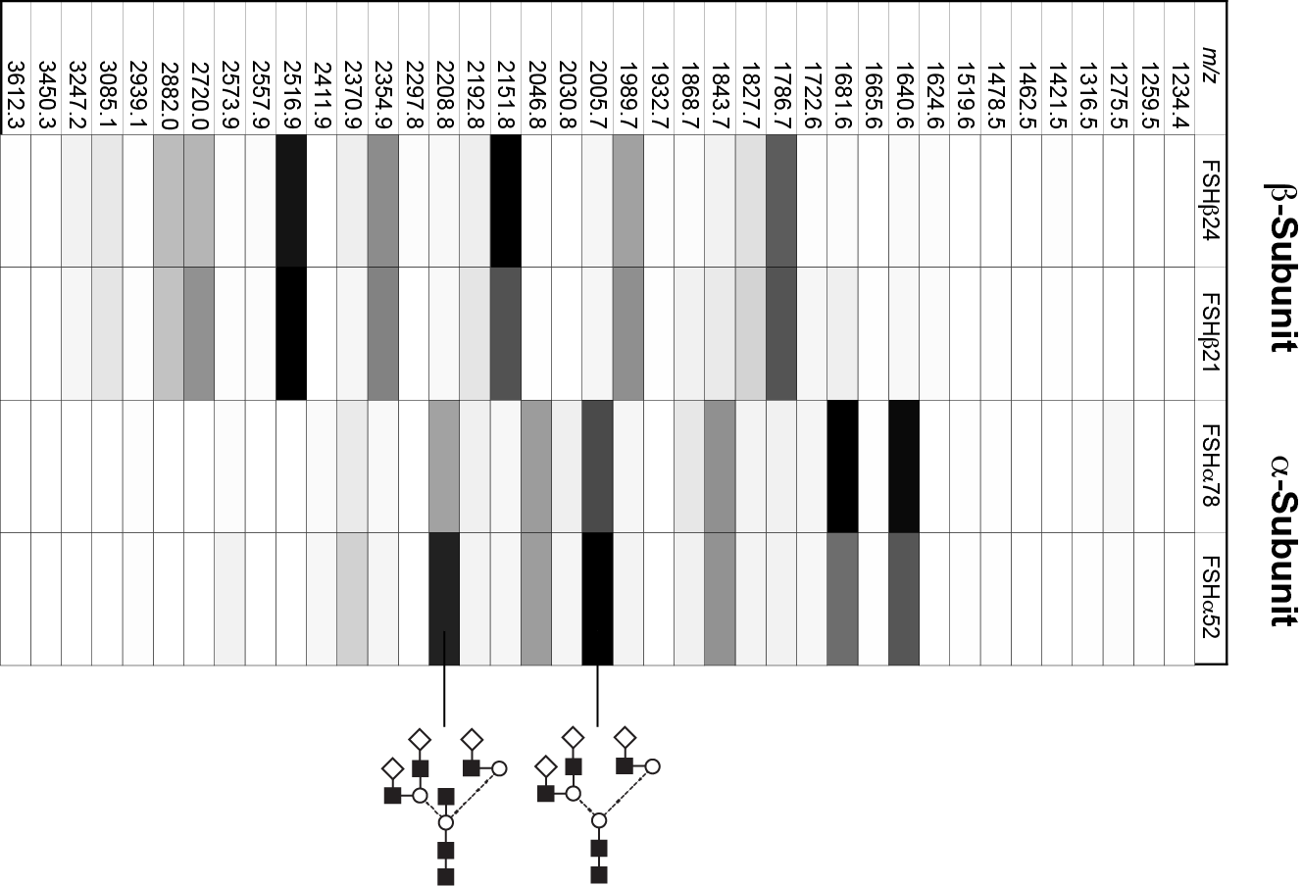
Site-Specific FSH Glycosylation αAsn⁵²
Notes:
m/z 2005.7 = 100%
m/z 2208.8 = 87%

Slide 39
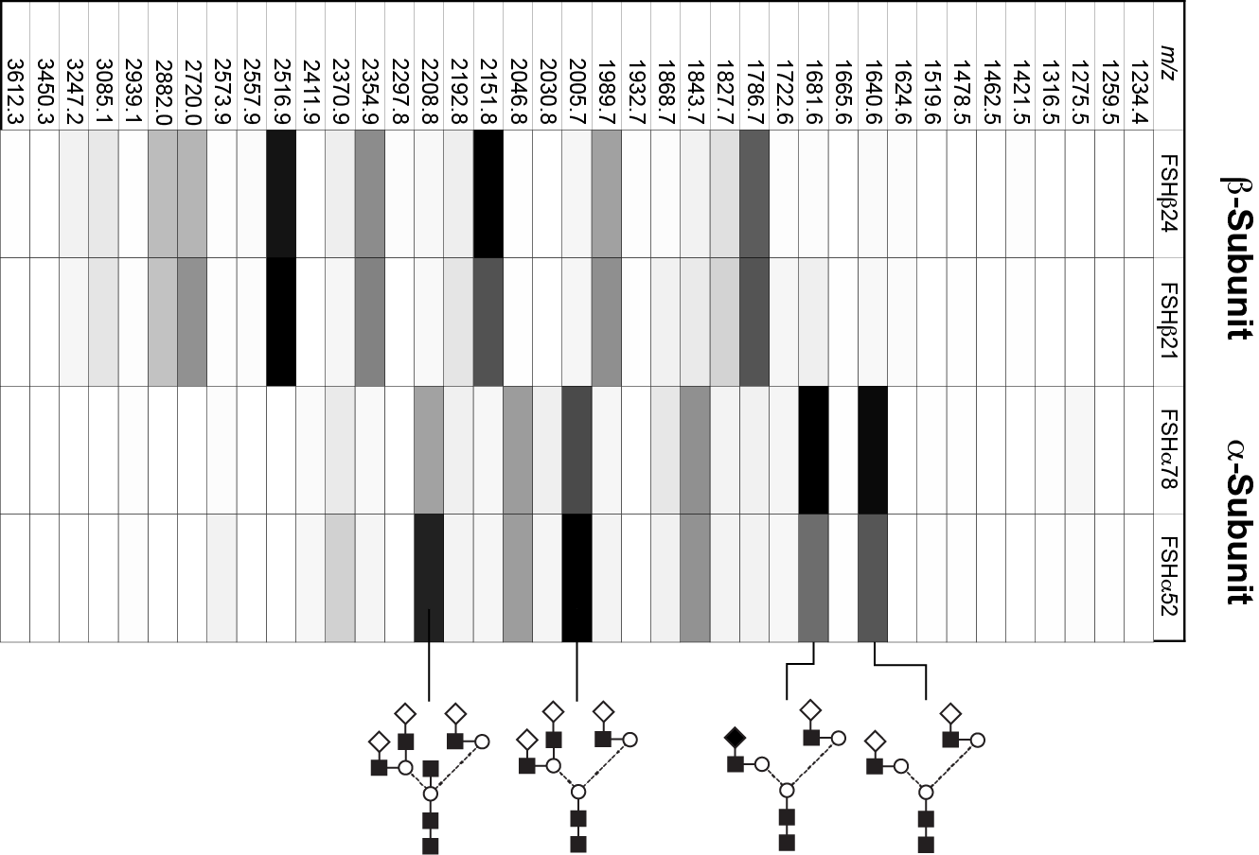
Site-Specific FSH Glycosylation αAsn⁷⁸
Notes:
m/z 1681.6 = 100%
m/z 1640.6 = 96%

Slide 40
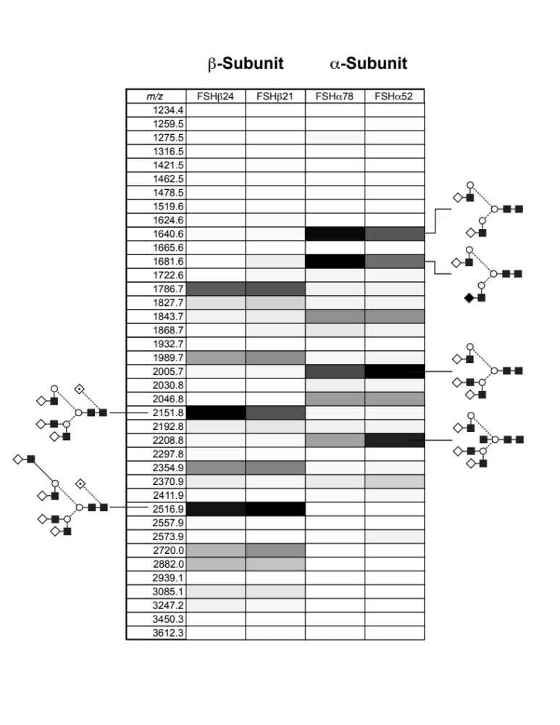
Site-Specific FSH²⁴ Glycosylation βAsn^{7/24}
Notes:
m/z 2151.8 = 100%
m/z 2516.9 = 92%

Slide 41
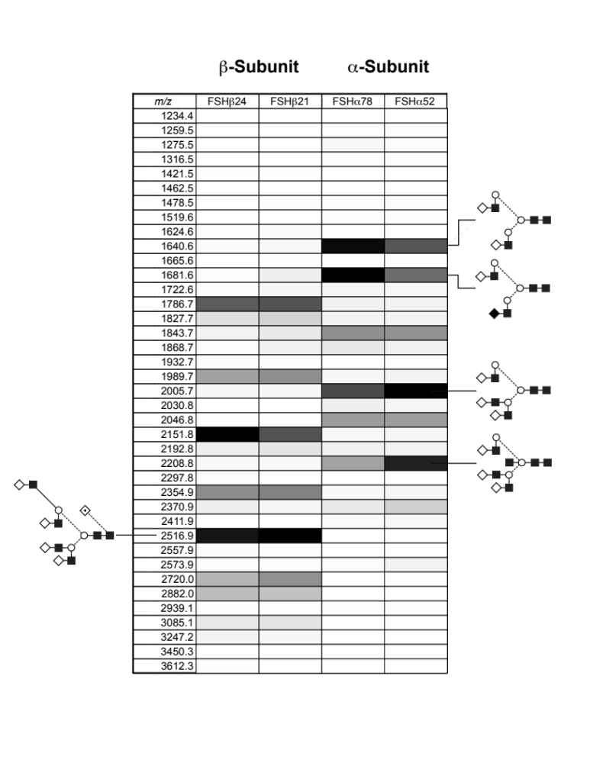
Site-Specific FSH²¹ Glycosylation βAsn⁷
Notes:
m/z 2516.9 = 100%

Slide 42
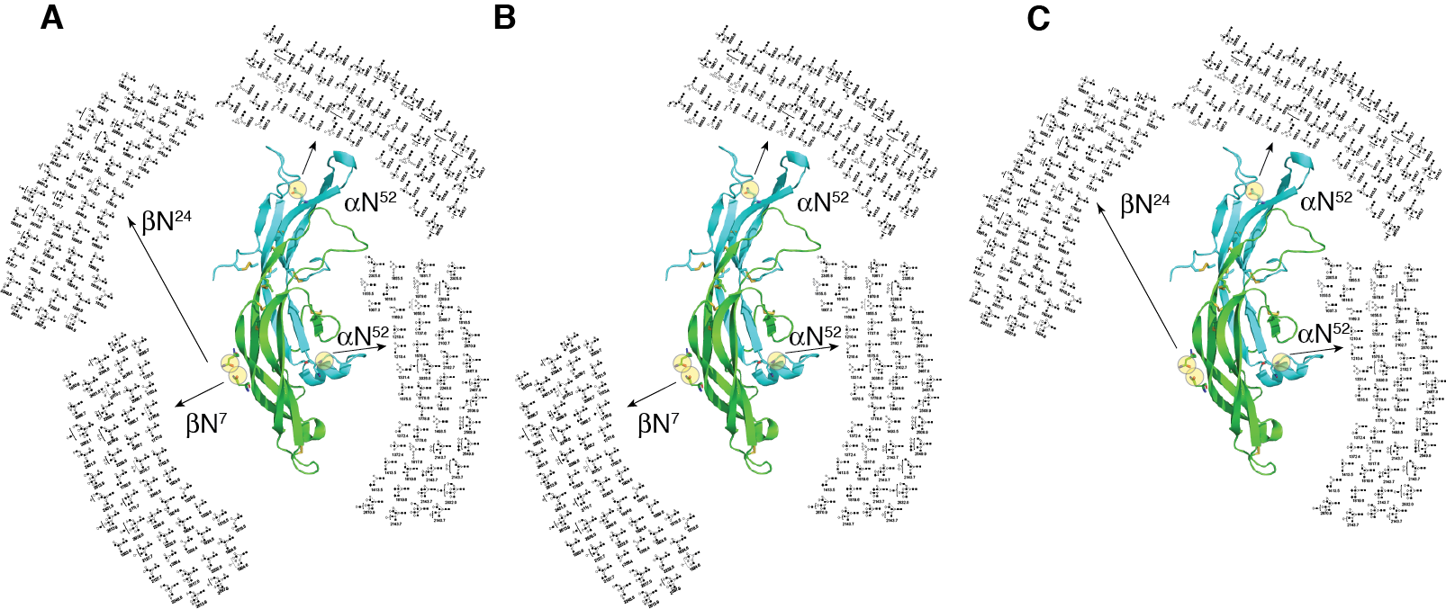
Macro + Micro Heterogeneity in FSH
FSH²⁴
FSH²¹
FSH¹⁸

Slide 43
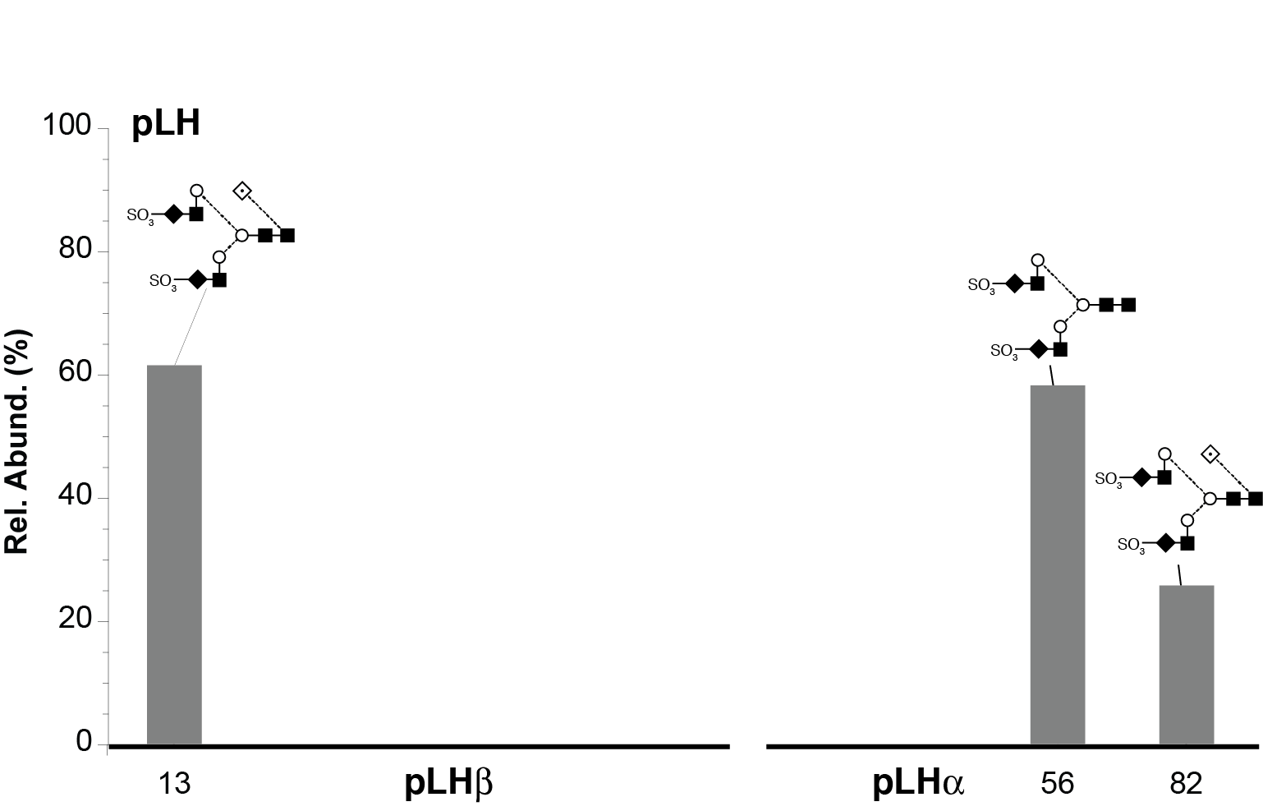


LH Major N-glycans

