Slide 1
4.5 to 7.8ºC
Global Surface Warming
from Today’s
CO2 and CH4 Levels
Gene R. H. Fry

Slide 2
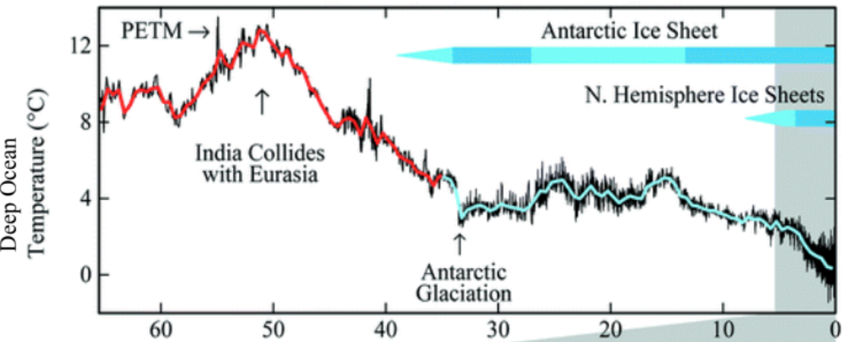
We can learn lessons from the distant past.
million years ago
Earth’s surface can grow far warmer than now.
With more ice, temperature
swings are wider, since
albedo changes - from
icy to less icy - are larger.

Slide 3
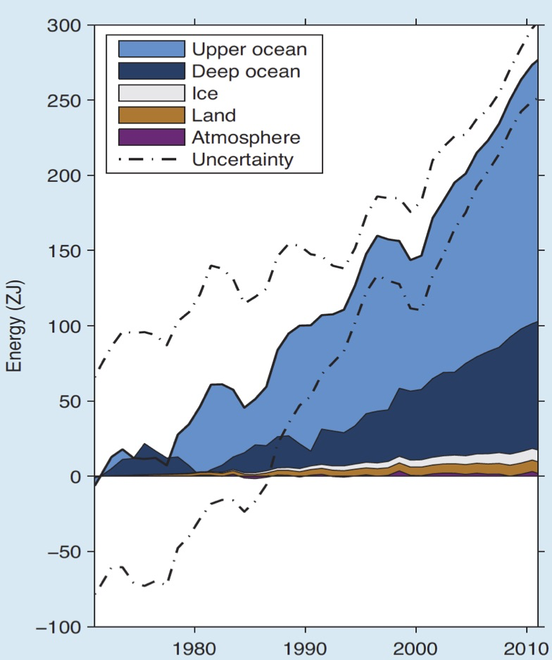
Only a tiny fraction of warming goes into the atmosphere.

Slide 4
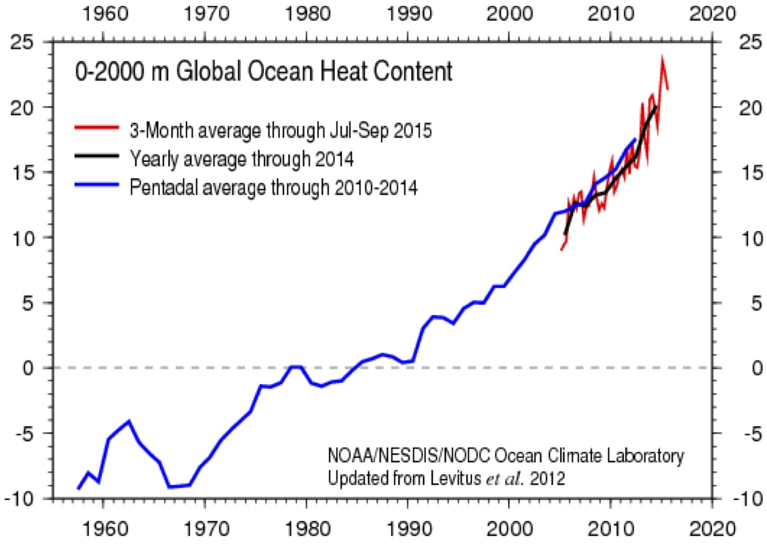
Ocean Heat Content
1967-1990 +0.4 x 10²² Joules / year
1991-2005 +0.7 /
Heat Content (10²² Joules)
2006-2016 +1.0 /
acceleration
The oceans now gain
more heat every 2 years than
ALL the energy we’ve ever used.
10²² Joules = 100 years of US energy use

Slide 5
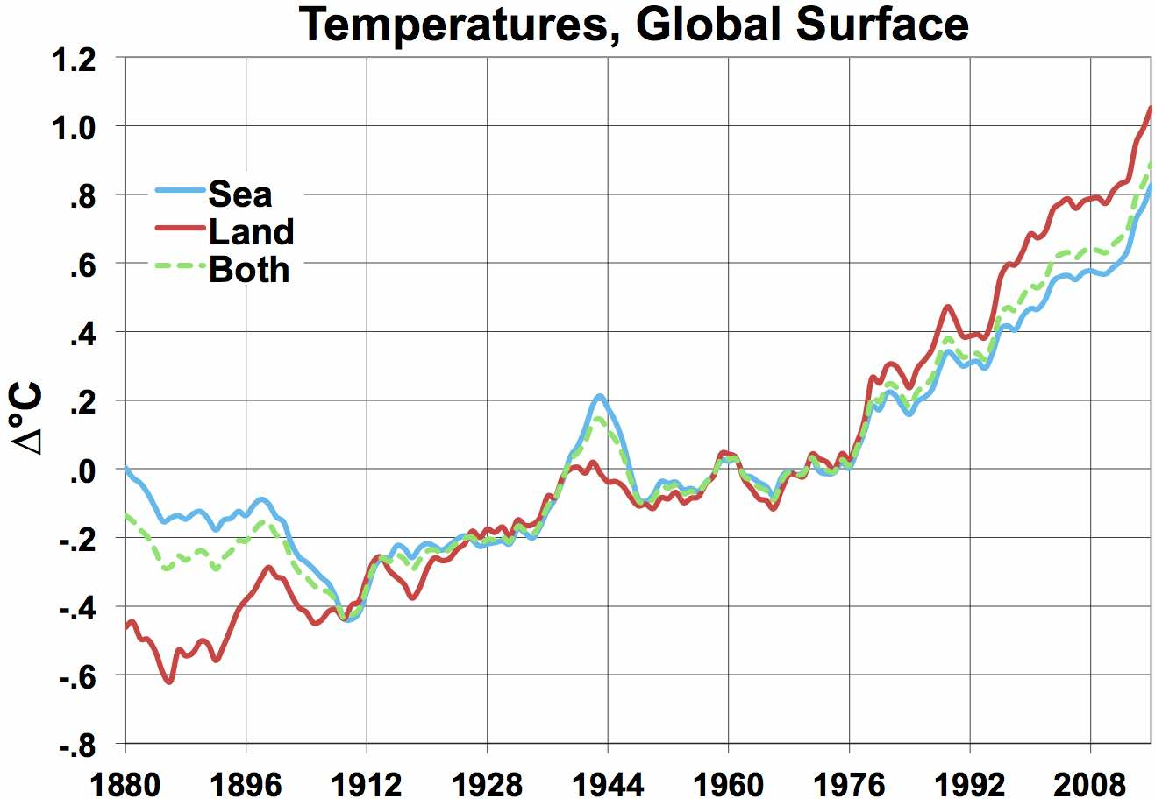
+1.13ºC in 100 years
NASA, 5-year moving average
The 1996-2016 rate of change was
At that rate, “Both”
will pass 2ºC above 1880 levels in 2068.
2.4ºC / 100 years for Land,
2.1 for Sea,
2.2 for Both.
“Land” in 2056.

Slide 6
Earth Is Heating Up.
• Earth now absorbs 0.25% more energy than it emits:
a 300 (±75) million MW heat gain
= 50 x global electric supply.
  This absorption has been accelerating, from near zero in 1960.
Earth’s surface must warm another 0.6ºC .
so it emits enough heat to balance absorption.
The oceans have gained ~ 10 x more heat in 40 years
  than all the energy humans have EVER used.
(Hansen ’11)
Notes:
6
6

Slide 7
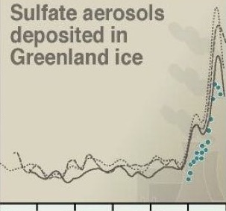
Sulfate Cooling Un-Smooths GHG Warming
sulfates still
3x 1880 levels
NASA GISS – Earth’s
7,000 weather stations
- adjusted for urban
heat island effects
warming unmasked
Brown .
cloud .
grows
over ..
China,
India. .
Sulfates fall 27%.
Sulfates
up 52%
(61/40).
Sulfates
up 46%.
Sulfates
fall 13%.
Coal-Fired Power Plants
Pinatubo
erupts
cool
Sulfates up 110%.
El Chichón
erupts
cool
+1.7ºC
cool
warming
unmasked
major cooling
cool
Santa Maria,
Soufriere,
Pelee erupt
Katmai,
Colima
erupt
Agung erupts
200
150
100
50
0
Krakatoa
erupts
cool
US SO2
cuts start.
mg SO₄⁼ /
tonne of ice
in dark gray
cool
Great
Depression
warming
unmasked
cool
less SO2
up the stacks
US, EU MT S / yr
cool
1400 1600 1800 2000
Sulfate
Cooling
offsets
GHG
warming.
Sulfate
Cooling
offsets
GHG
warming.
40
61
89
77
116
162
118
1880
2000
Sulfate Levels in Greenland Ice
milligrams of Sulfate per Ton of Ice
(Intergovernmental Panel
on Climate Change, 2002)

Slide 8
CO2 Levels in the Air ,
highest level since 14-15 million years ago (430-465 ppm)
Up
43% since 1750
Annual
Averages
The deep ocean then was ~ 5.6ºC warmer.
Tripati ‘09
Seas then were 25-40 meters higher.
CO2 levels were almost as high (357-405 ppm) 4.0 to 4.2 million years ago.
Sea surfaces then were ~ 4ºC warmer.
Csank ‘11, Dwyer ‘08
(36%
Since 1880)
Seas then were 20-35 meters higher.
This means ice then was gone from almost all of Greenland,
most of West Antarctica, and
some of East Antarctica.
2/3 of West Antarctic ice is grounded below sea level;
so is 1/3 in the East.
Sediments show East Antarctic ice then retreated 100s of km inland.
van de Fliert‘13
Vostok ice cores suggest a 4.5ºC or more warmer world at 400 ppm.
That is similar to 4 million years ago.
(CH4
up
110%
since 1880)
300 ppm
(maximum between
ice ages)
What happened before will happen again with 400+ ppm. .
CO2 levels now will warm Earth’s surface 4+ºC,
not just the 1.2ºC seen to date.
Notes:
8
8

Slide 9
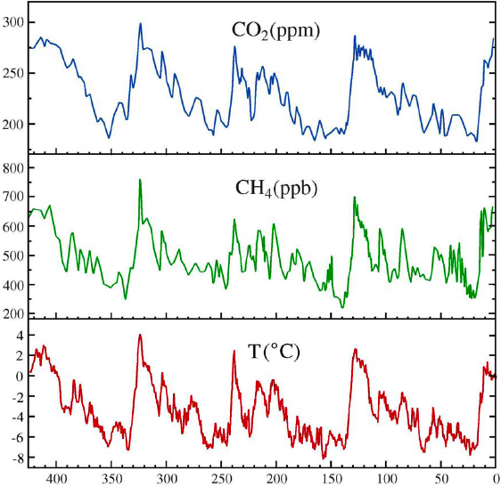
Vostok Ice Core Data .
Vostok Ice Core Data
+ 2015 CH4 level ~ 1836 ppb
+ 2015 CO2 level ~ 400 ppm
∆
₊ 2015
Vimeux, Cuffey & Jouzel,
Earth and Planetary Science
Letters 203: 829-843 (2002)
Thousand Years before Present
ppm = parts per million ppb = parts per billion
Notes:
9

Slide 10
Lessons for Our Future from Ages Ago
For the ratio of the global average ∆ºC to Vostok ∆ºC,
I use 0.6, the ratio of polar change to global, over the last 2 million years,
from Snyder (2016).
With current CO2 & CH4 levels, the equations yield global surface warming of 7.8ºC,
but only 4.5ºC if CH4 is neglected.
Warming
how fast?
20-40% in decades,
the rest over centuries.
9.0
7.2
5.4
3.6
1.8
0
-1.8
-3.6
-5.4
(10 K year resolution)
14.1 -
14.5
Mya
R² for Vostok
4.0 - 4.2 Mya
.846
.733
Est. Global ∆ºC from 1951-80
400 ppm in 2015
0 - .420 Million years ago
Estimating ∆ºC at Vostok
-107 + 19.1 * LN (CO2)
-110.7 + 11.23 * LN (CO2) + 7.504 * LN (CH4)
CH4 today ~1840 ppb
384 461 554
Vostok typical ppb CH4 for ppm CO2: 2.13 x

Slide 11
Global Surface ∆°C = 0.6 *
(-110.7 + 11.23 * LN (CO2) + 7.504 * LN (CH4))
+2ºC globally requires (e.g.)
323 ppm CO2 and
700 ppb CH4.
This means removing 65% of the CO2
that humans have emitted
and all of the CH4.
Humanity’s remaining carbon budget
for burning fossil fuels is
NEGATIVE 250 GT of carbon.

Slide 12
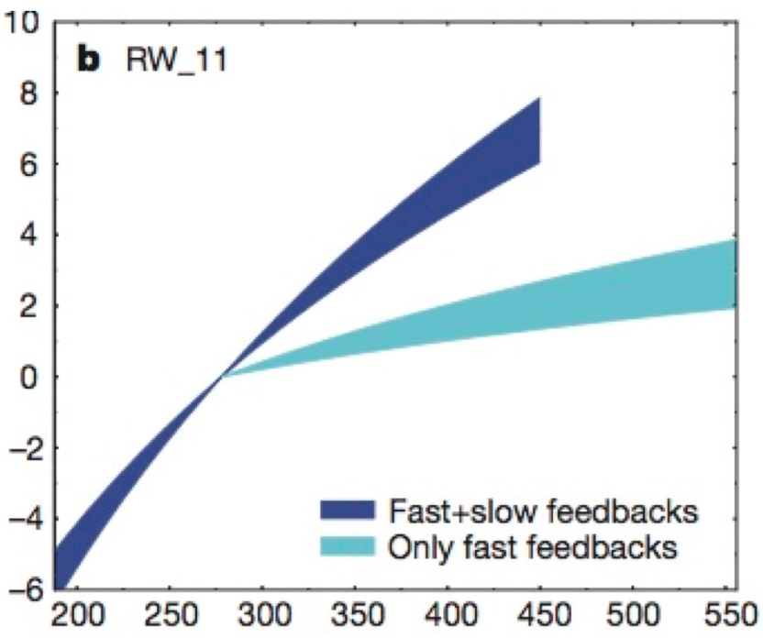
Climate Sensitivity
from the last 20 million years, by van der Wal, 2011
9°
also Snyder, 2016
data from last 2 million years,
based on CO2
5°
3°
∆°C
1.5°
ppm CO2

Slide 13
Warming to 2100 and beyond
will be dominated by
albedo changes
and
permafrost emissions.
How do albedo effects produce
that much warming?

Slide 14
Earth will warm 3 x more,
phasing out coal’s sulfur emissions (about 0.5ºC),
vanishing Arctic sea ice (~0.3ºC),
receding northern snow cover (~0.3ºC),
receding Greenland & Antarctic ice (~0.3ºC),
warming oceans enough so energy out = in (~0.6ºC),
more H2O vapor & less cloud cover (1-1.5ºC), and
carbon emissions from permafrost, etc. (~0.6ºC).
More carbon emissions can add up to 2.2ºC each
from H2O vapor, clouds & permafrost.
even if we stop emitting now.
Blame

Slide 15
When? (How fast?)
Sulfur and sea ice loss (Mar-Nov) will be complete before 2100.
Snow cover and cloud cover losses will continue.
Permafrost + emissions ramp up in an S-curve thru 2300.
Polar land ice loss and warming deep oceans span centuries.

Slide 16
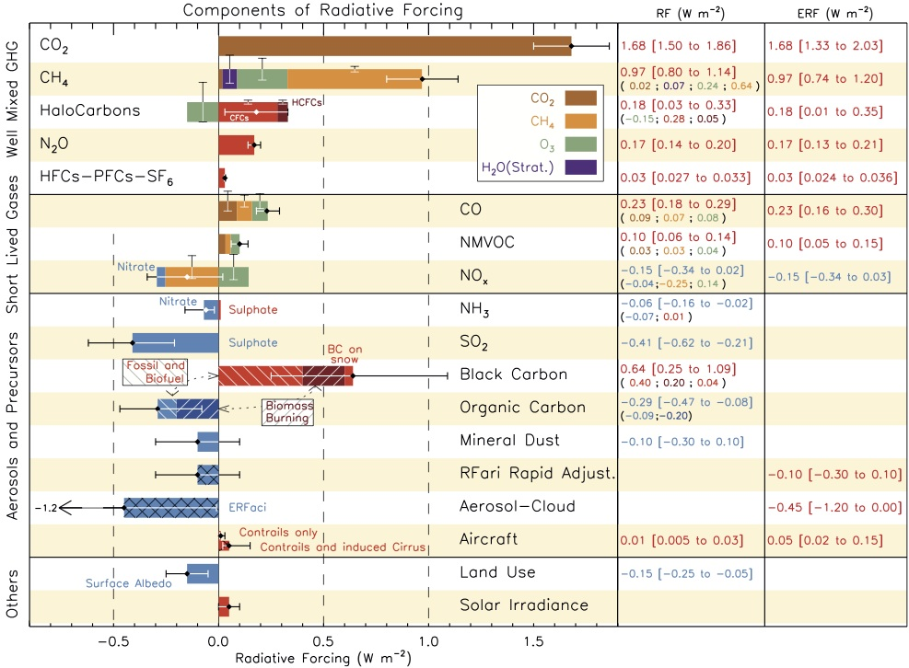
Radiation Forcings IPCC AR5 .
Sulfate Cooling
Figure TS.7: IPCC, AR5 (2013)
Sulfates offset (0.41 + 0.10 + 0.45 - .01 = 0.95) / (sum of above = 2.30 + 0.95) = 29% of GHG warming.
Notes:
16

Slide 17
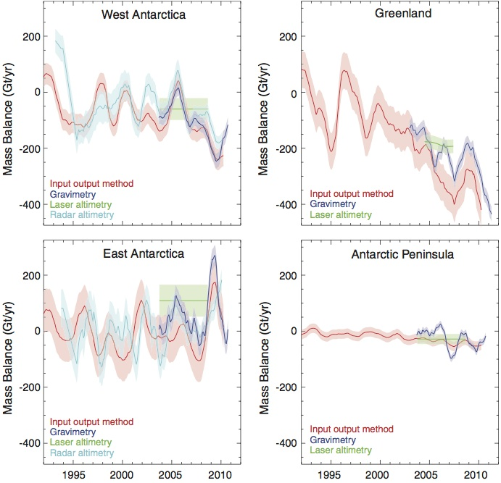
Greenland & Antarctic Ice .
Andrew Shepherd et al.,
“A Reconciled Estimate of Ice-Sheet Mass Balance”,
Science 38(6111):1183-1189. Nov. 30, 2012
Notes:
17

Slide 18
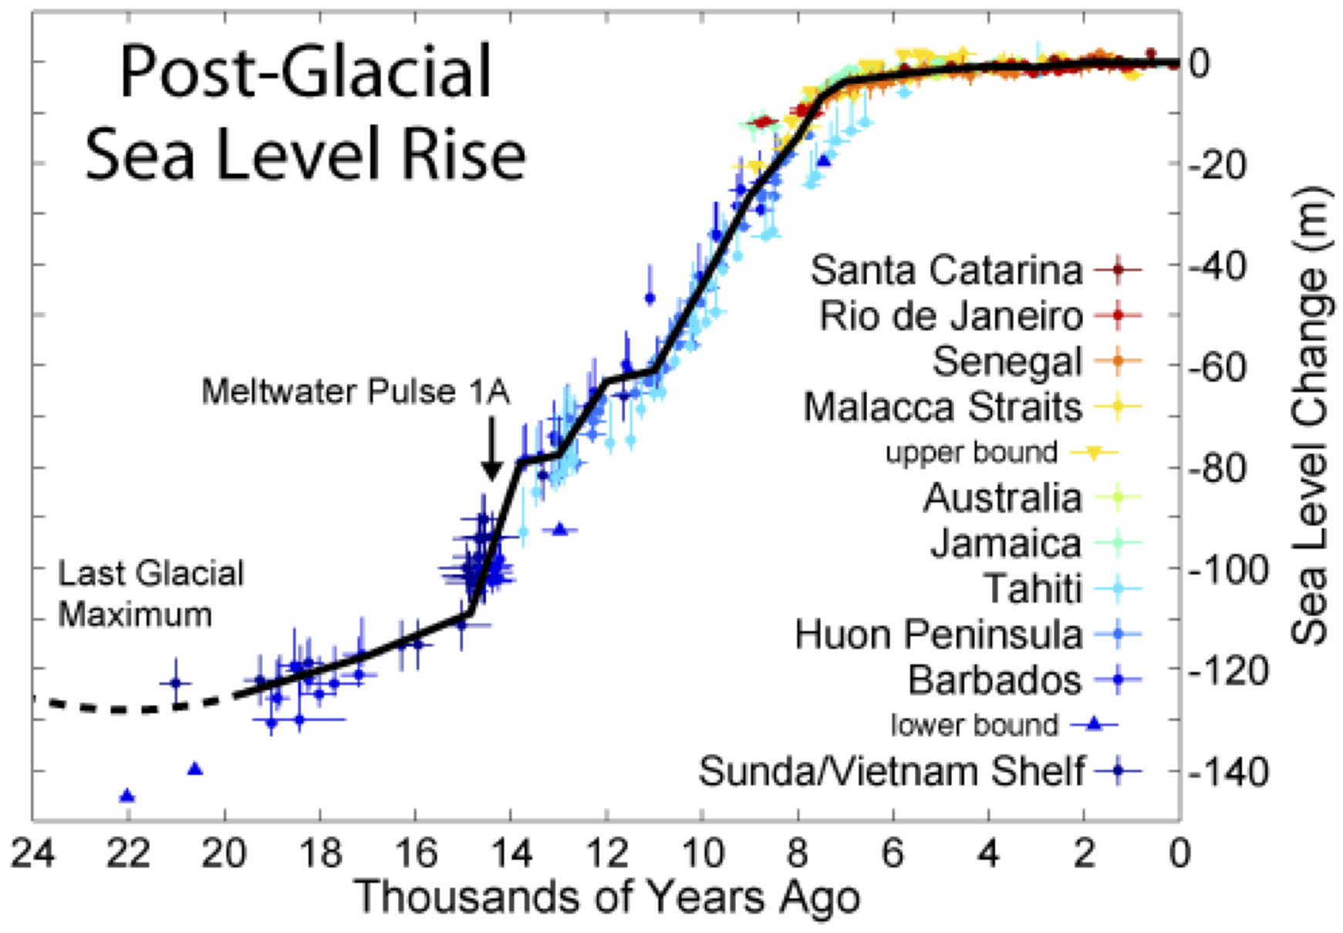
Sea Levels over Last 24,000 Years
3 meters per century during Meltwater Pulse 1A (1 millennium)
1.5 meters per century from 15 to 8 millennia ago
Warming is 40-50 times as fast as then, but only 1/3 as much ice is left.
Notes:
18

Slide 19
Earth’s Thermostat .
Arctic Ocean ice is shrinking fast..
Minimum ice area fell 49% in 37 years,
The ice could melt away by fall in 4-9 years
The dark water absorbs far more heat than ice: .
Greenland’s net ice-melt rate rose 7 x in the past 17 years.
So, the ice cap’s life expectancy fell from 60,000 years to 8,000.
Antarctica’s yearly net ice-melt was ~ 1/3 of Greenland’s.
Its melt rate doubled over 2007-11. .
Seas may rise .3 to 2 meters by 2100
U of Washington
PIOMAS
U of Bremen
Wipneus
The ice got thinner too.
while volume fell 73%
, 50% in the last 10.
& be gone all summer in 9-30.
so far, like 20 extra years of CO2.
It has 9 x the ice.
It will last longer.
& 30 meters over centuries.
Notes:
19
19

Slide 20
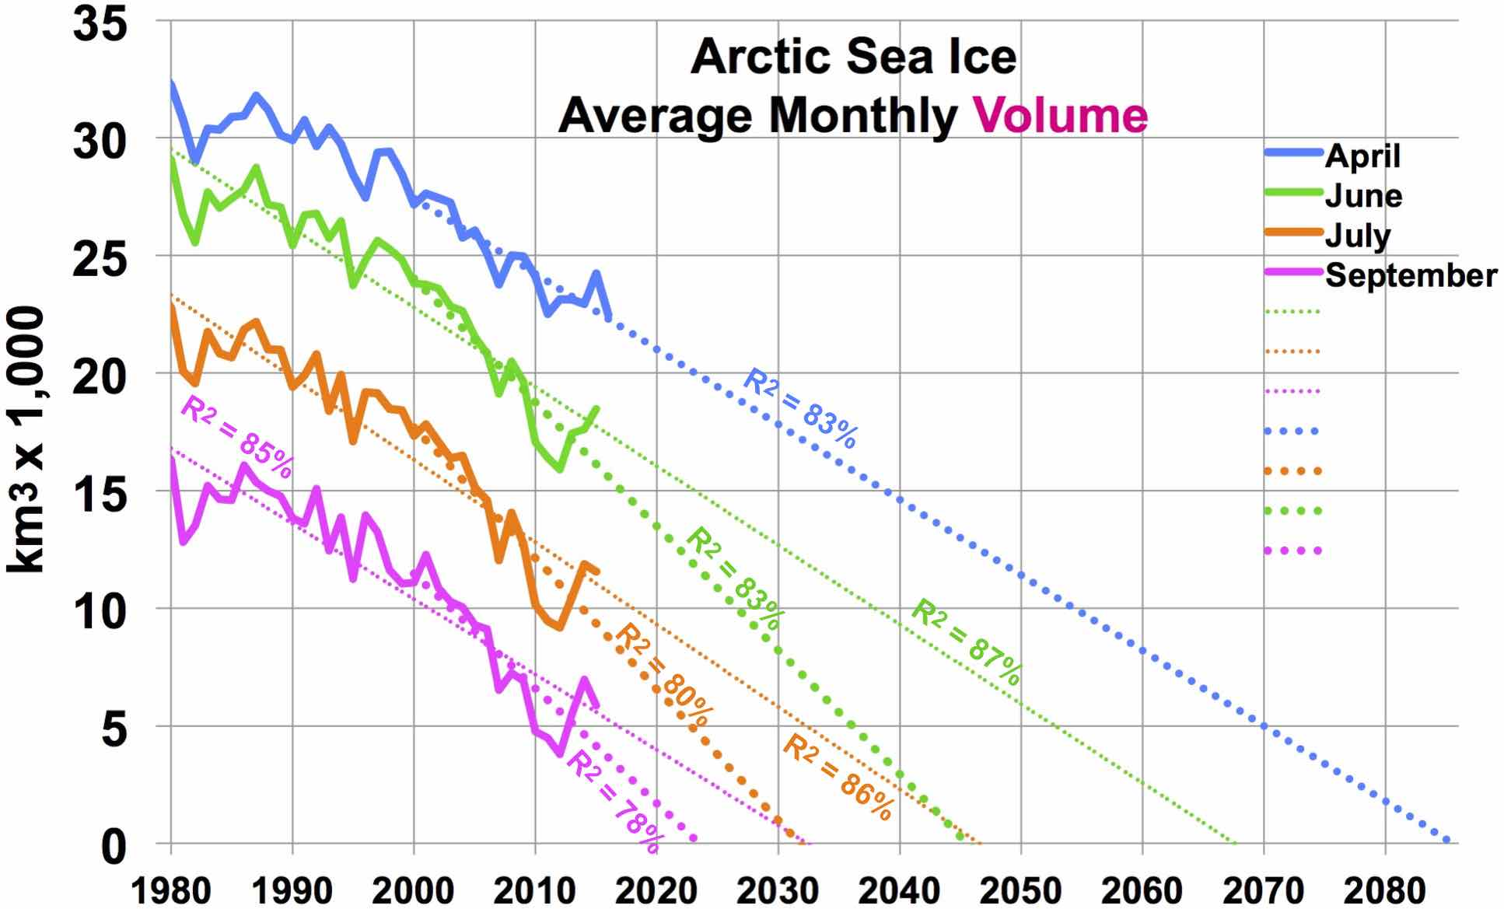
U of Washington, PIOMAS model, by Wipneus

Slide 21
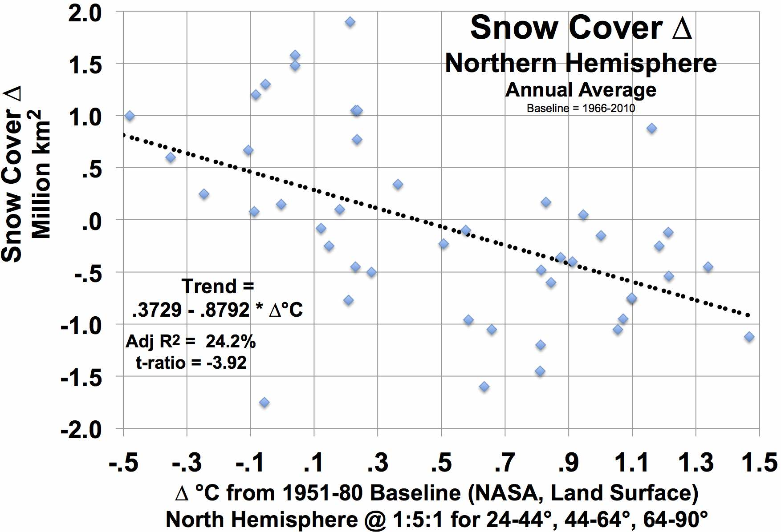
Snow Observations, 1965-2012
State of the Climate in 2012, American Meteorological Organization

Slide 22
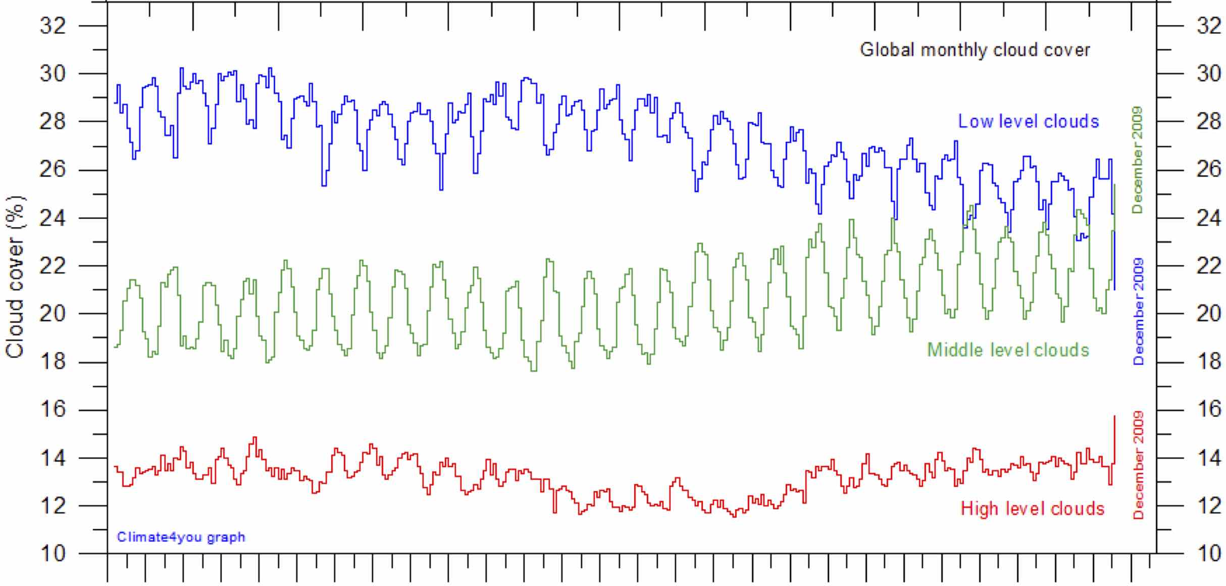
Clouds by Altitude
Low
Global Monthly Cloud Cover
less cooling clouds
Middle
Cloud Cover (%)
High
less warming clouds
more warming clouds
International Satellite Cloud Climatology Project
1984 1988 1992 1996 2000 2004 2008
dashed lines by Gene Fry
net warming effect. Magnitude?

Slide 23
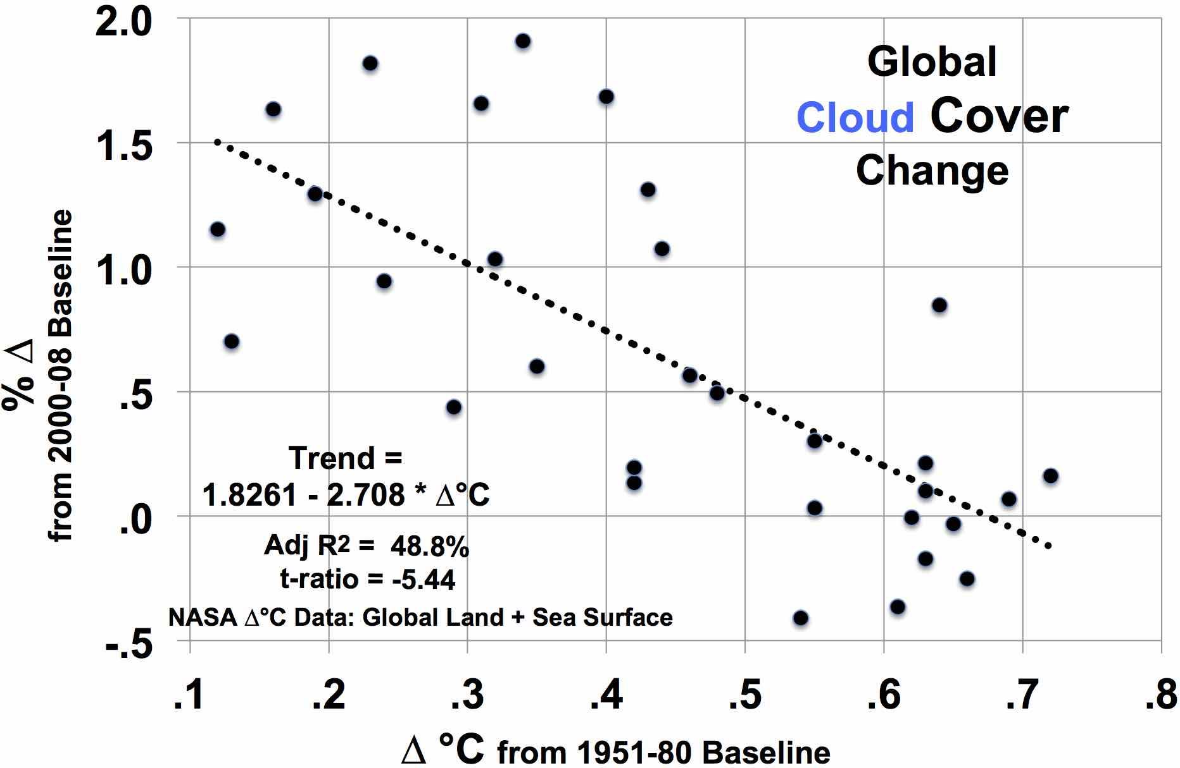
Clouds reflect ~17.5% of incoming sunlight (~ 59 W/m²) = 10 W/m².
Annual Average Cloud Observations, 1982-2012
State of the Climate in 2012, American Meteorological Organization
mean of 5 data sets,
including ISCCP

Slide 24
Water Vapor’s GHG Effect
1°C warmer air contains 7% more H2O vapor, on average.
That increases radiative forcing by 1.45 W/m².
That is 86% as much as from CO2 emitted since 1750.

Slide 25
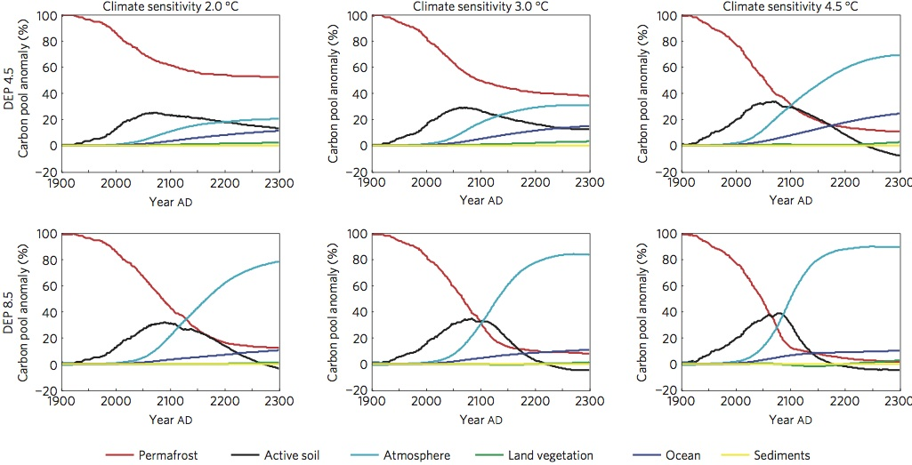
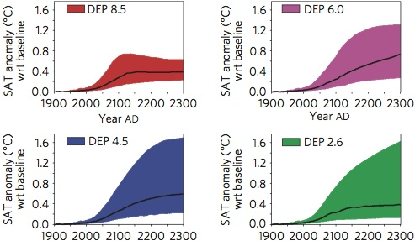
MacDougall 2012
Permafrost
contains ≥ 2 x the carbon
in the atmosphere.

Slide 26
Scenarios on the next slide spread ocean warming over 1,000 years.
They use the previous 10 slides for permafrost emissions, sea level, water vapor & albedo effects of reduced sulfates, snow, ice, and clouds.
For clouds, 60% of the amount from AMO 2013 is used.
Cloud changes are complex and explain part of warming to date.
The effect of Arctic sea ice loss from Hudson (2011) is used:
globally, 0.7 W / sq meter for total loss, during the daylight season,
of which 0.1 had already occurred.
Permafrost carbon emission trajectories in the scenarios
are based on work by MacDougall et al. (2012).
But permafrost has twice the carbon he modeled.
Albedo changes will warm permafrost faster than he modeled.
So, in the case of fossil fuel phase-out by 2050, and especially
the base case (peak ~ 2015, but zero only after 2100),
permafrost emissions exceed those shown by MacDougall.
In the carbon sequester case, they are lower.

Slide 27
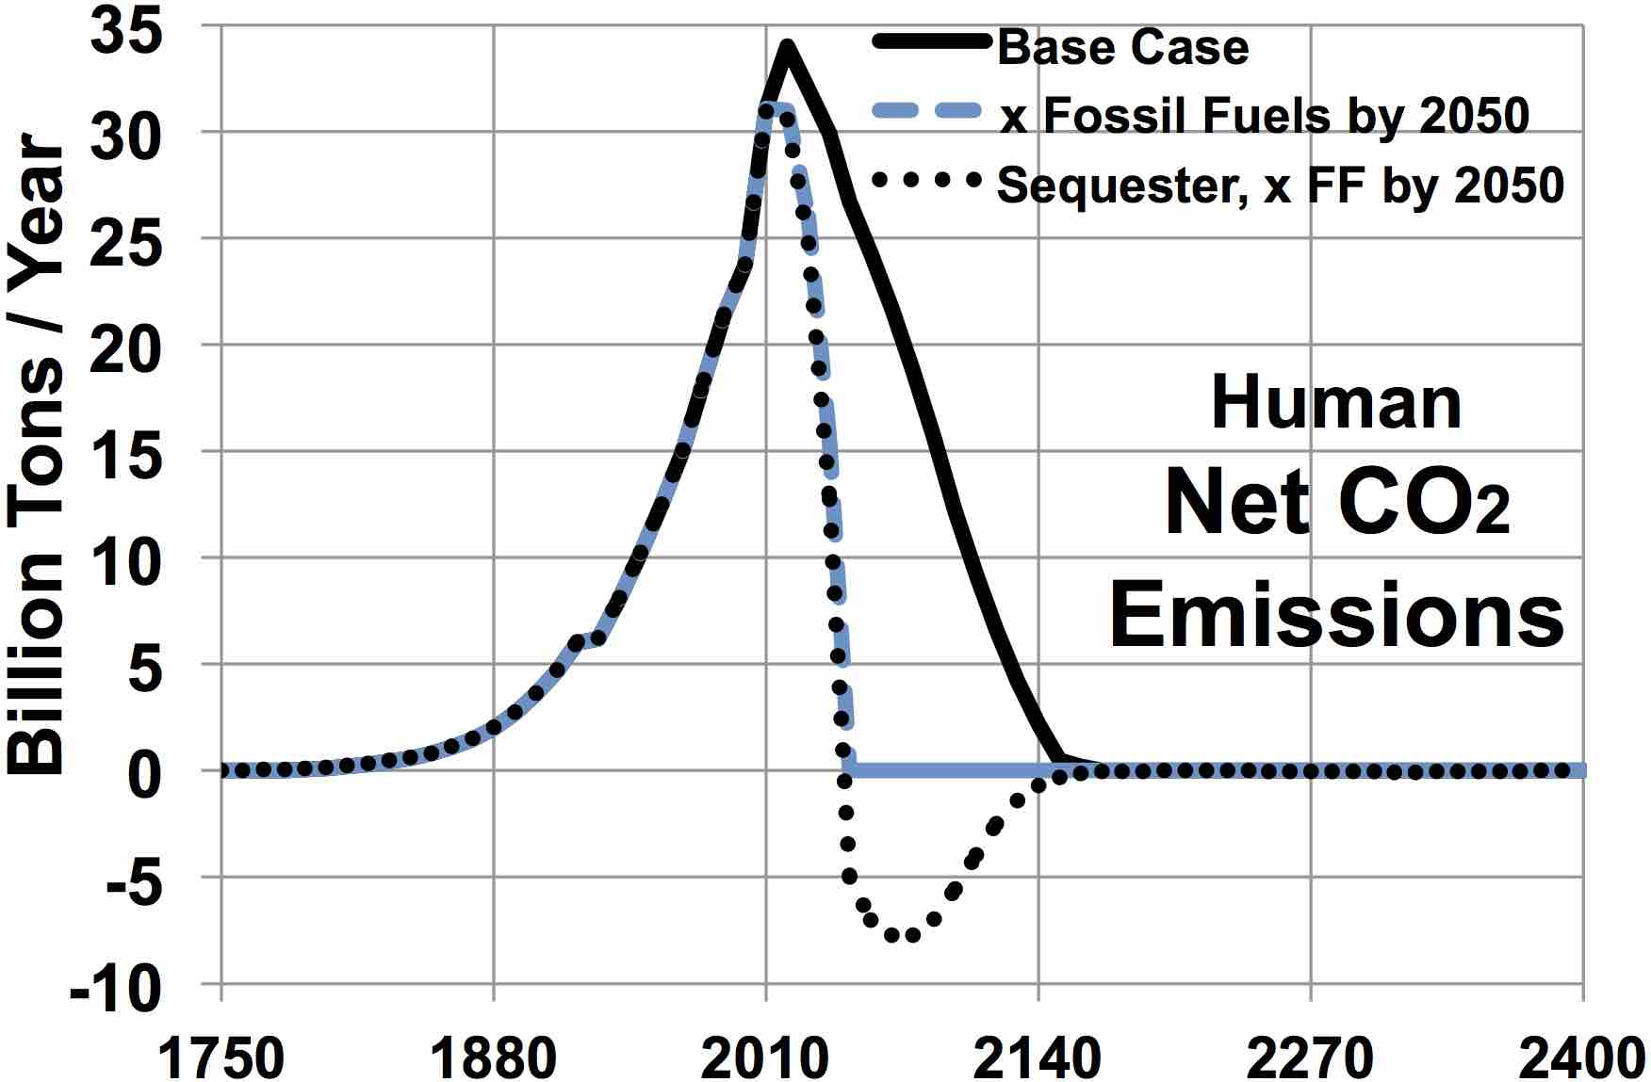
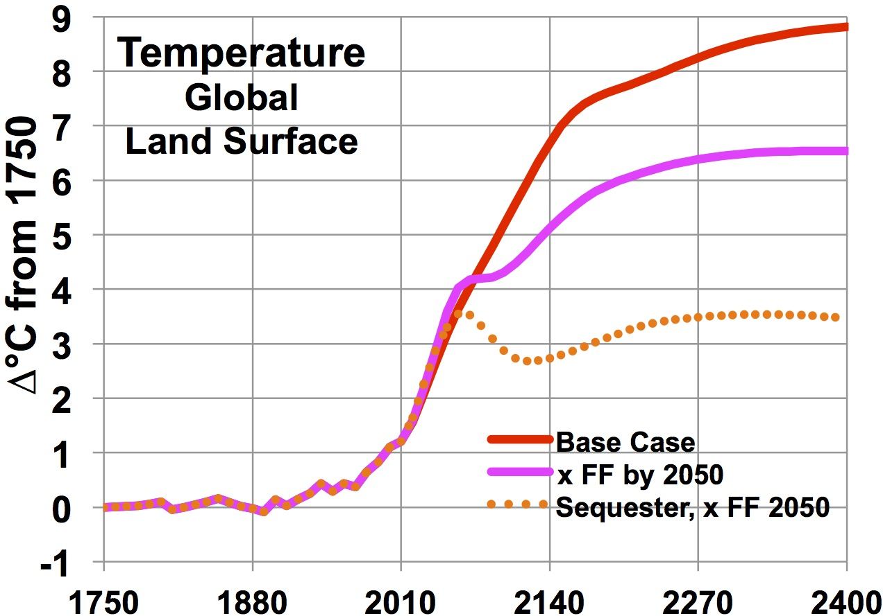
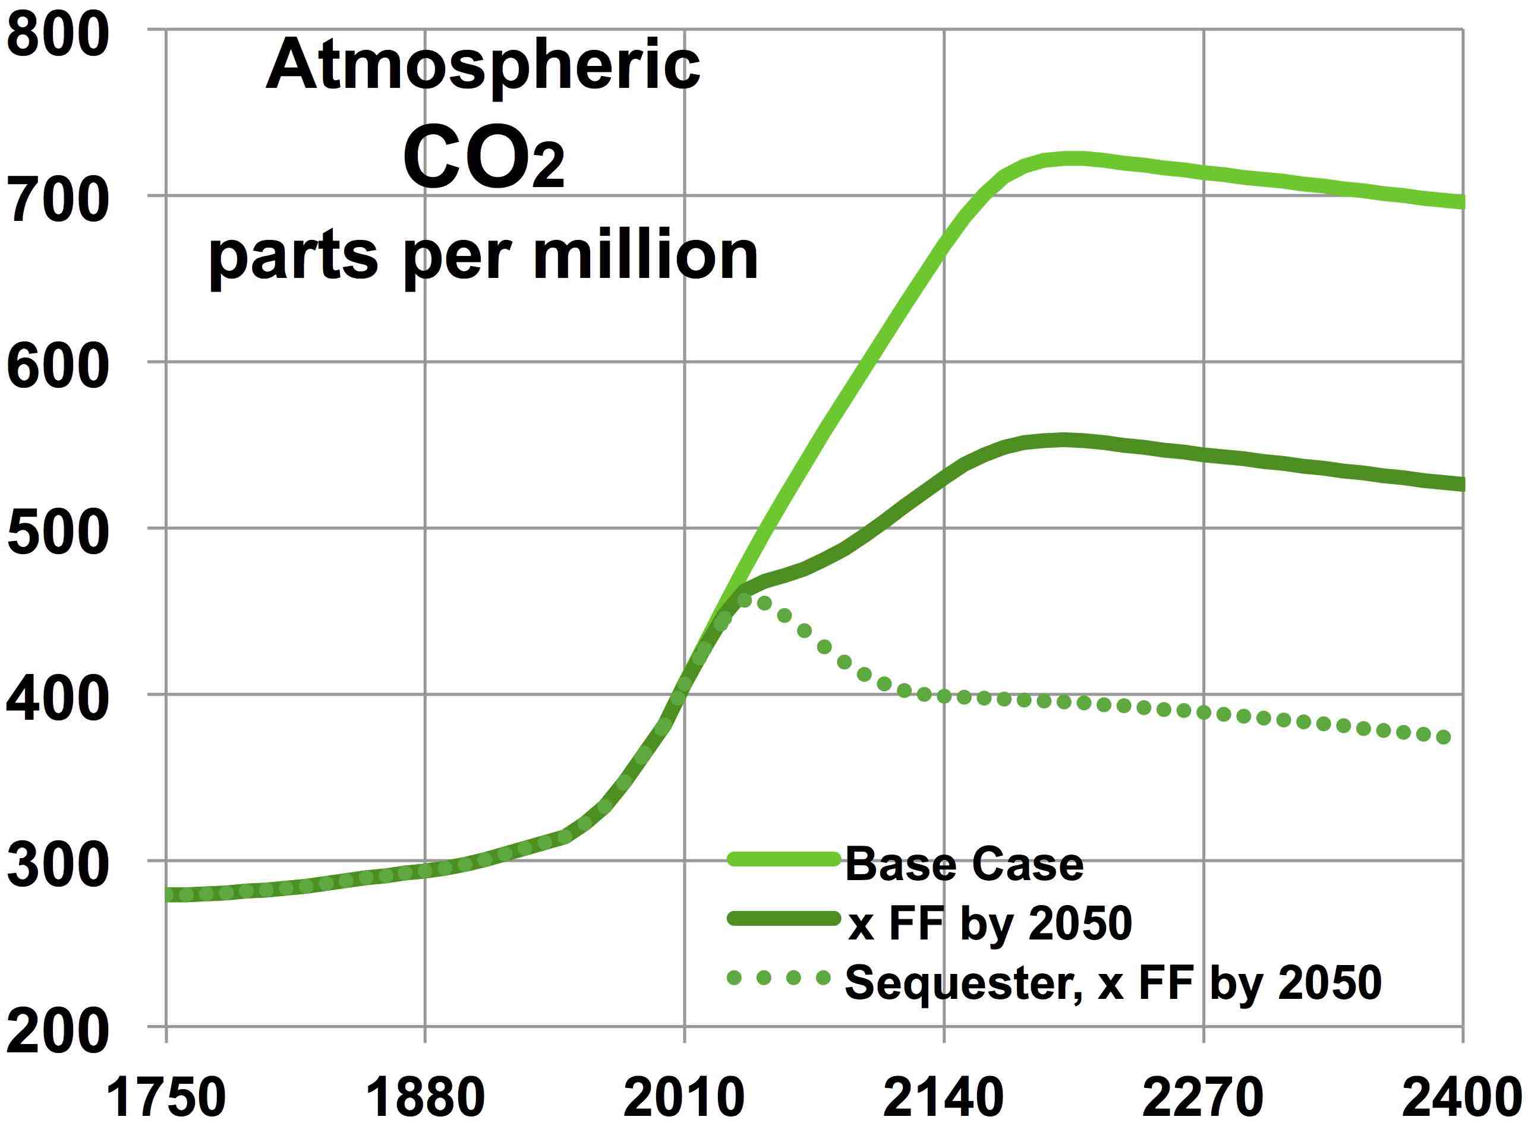
Climate Future Scenarios
2100
2100
peak ~2015
Soil carbon loss
since 10,000 BC
= 60% of fossil
fuel emissions.
Lal ‘01
includes big albedo effects:
loss of sulfates; sea ice;
some cloud cover,
snow & land ice.
Kansas gets as hot
as Las Vegas now.
sulfates loss
fossil fuels
international
target
Sequestration =
22% of fossil
fuel emissions.
Permafrost carbon
emissions included:
+ppm CO2 2100 2300
Base 57 + 185
x FF 2050 54 + 113
& Sequester 30 + 29
Norfolk, S Florida, Sacramento
Baton Rouge, Trenton under water
includes thermal expansion &
near total ice loss (x Sequester)
from most glaciers except
Greenland (x2050) & E. Antarctica,
where % loss is modest.

Slide 28
Consider Salina, Kansas,
in the heart of wheat country,
breadbasket of the world.
+ 5.8ºC /
100 years
+3.2ºC /
100 years
Over 1995-2015, Salina actually warmed 44% faster than the US average.
+0.2ºC
/ 100 years
3-Year
Moving Average
Hot as Las Vegas now in 2088.
At +3.2ºC / 100 years, by 2100 summer in Salina would be hotter than Dallas now.
At 5.8ºC / 100 years, in 2120 it would be as hot as Las Vegas now.
We should PREVENT this.

Slide 29
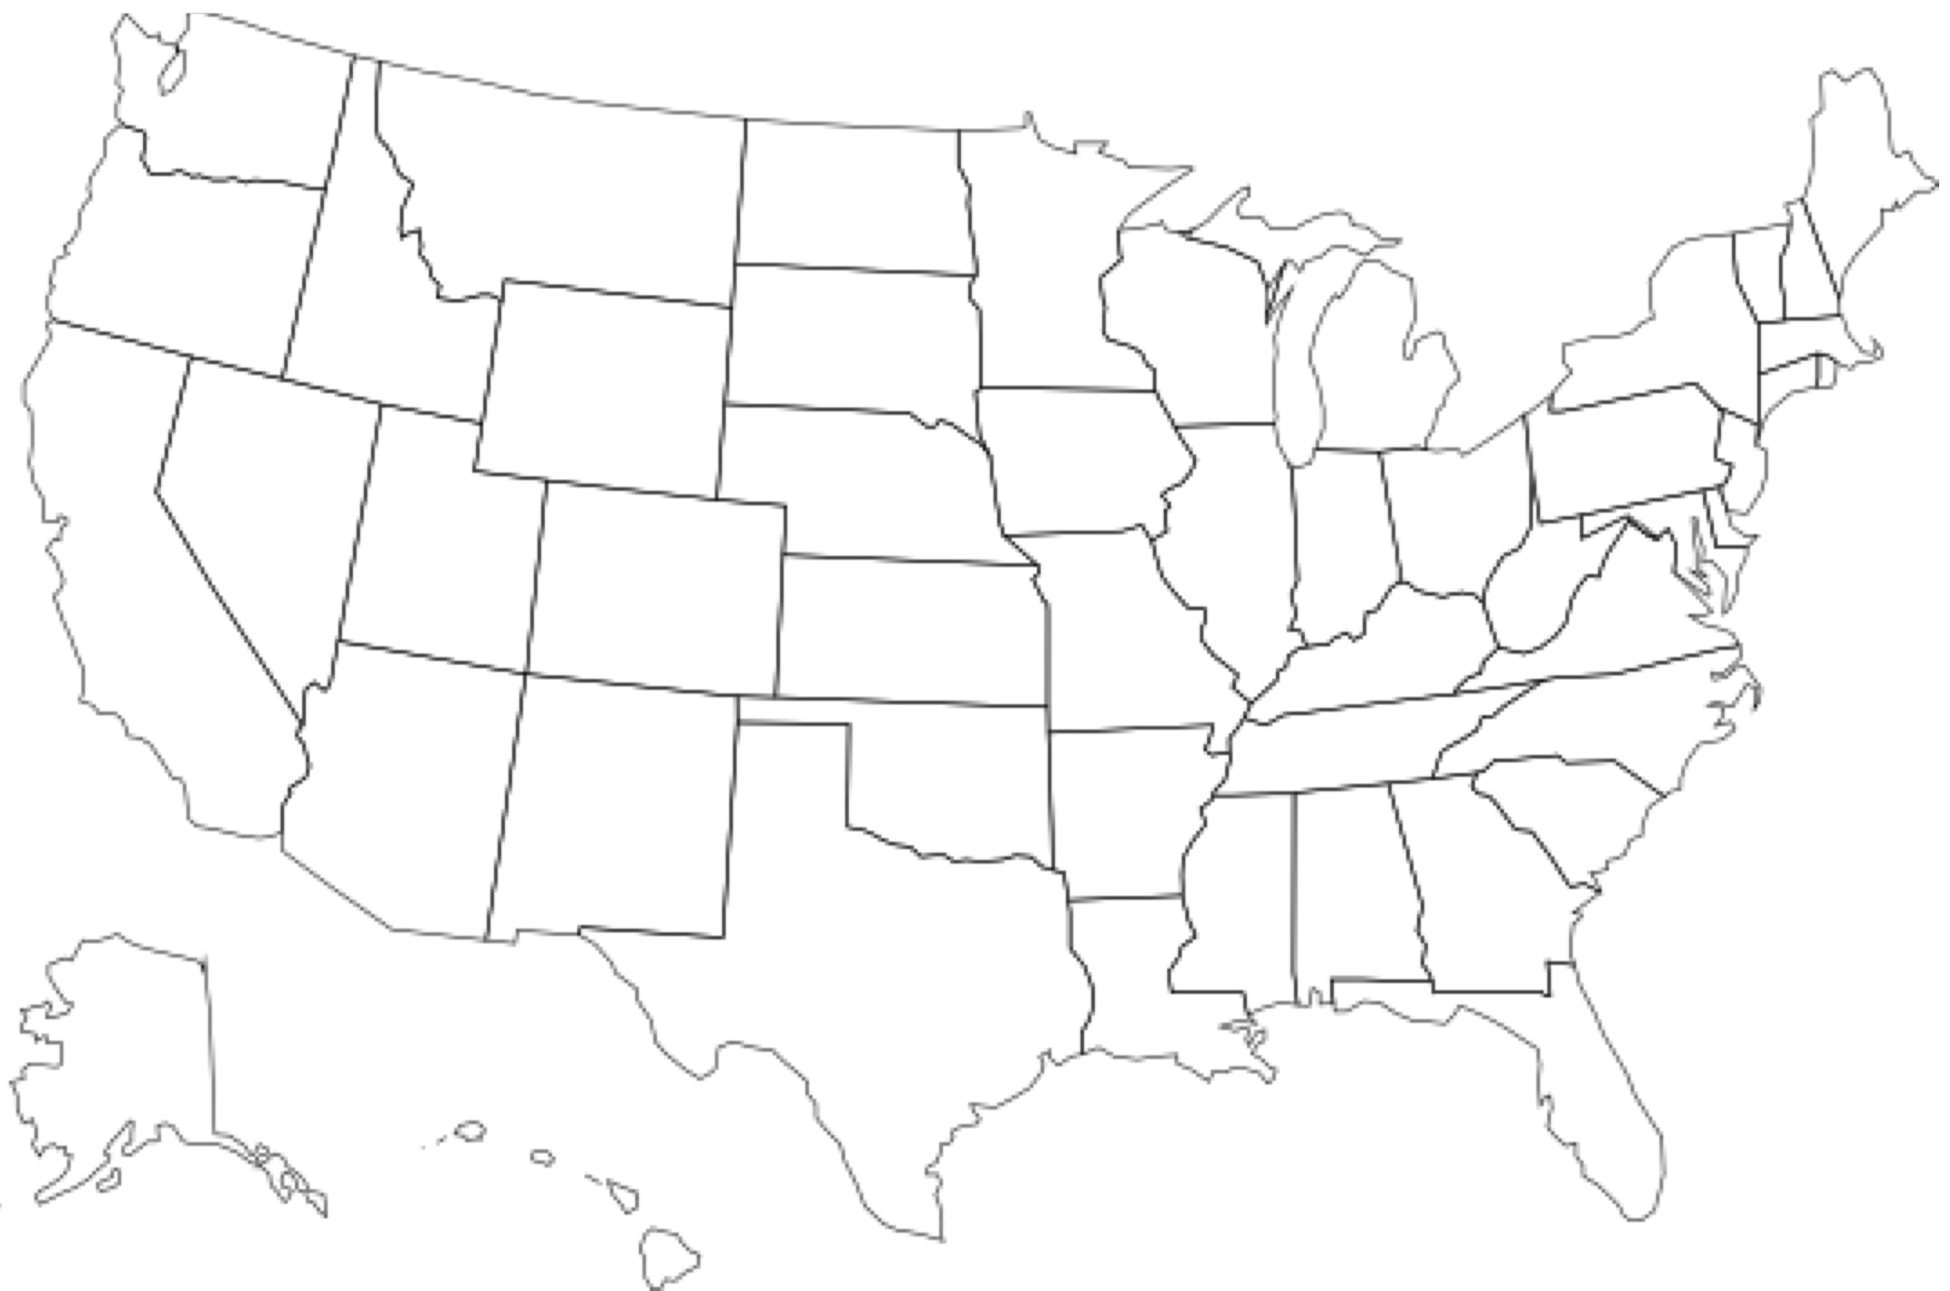
When Do State Summers Become as Hot as Las Vegas Now?
The average of daily highs in Las Vegas, June 1 thru September 30, 1995-2015, was 37.8ºC.
Dates shown assume LOCAL daily high trends for those 21 years CONTINUE.
Trends use 21 years x 122 days, for 348 places.
2371
New
England
2322
2145
2362
Dakotas
2245
2191
2287
2128
2567
2086
2483
2348
2253
2164
2266
2315
2052
2108
2149
2181
2194
2104
2252
MD-NJ-DE
2096
2137
2169
2162
2125
2097
2129
2083
2140
2155
2095
2135
2099
2070
2101
3649
2117
2235
2194

Slide 30
Solutions
Stop putting carbon in the air.
Remove carbon from the air,
as fast as we put it in now.
Notes:
30

Slide 31
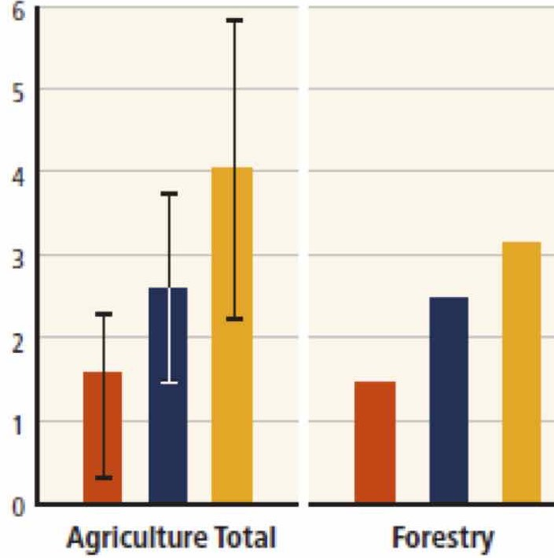
Take Carbon Out of the Air.
1 Rebuild rangelands with perennial grasses.
Add soil carbon 10 x faster
Deep roots, dung beetles move carbon into soil.
Cut CO2 80 ppm.
2 Farming, done right, can add 1.5 - 4.3 GT C / yr to soil.
Organic farms can add 2.5 T C / ha / yr:
Rebuild soil organic matter (carbon): from 1-3% now, to 6-10% before farming.
Increase humus
good for 2-3 decades
from Paustian et al. 2016. Nature 532:49.
3 Bury biochar shallow in soils:
more soil carbon - stays eons, holds water.
(Just 5-25% of rain soaks in now.)
with short rotation cattle grazing, like buffalo.
Absorb 2.5 T carbon / ha / yr.
Fungi network holds water, so 75-90% of rain soaks in.
no-till, compost cover, no chemicals.
with fungi network & glomalin, holding water many months.
6
5
4
3
2
1
0
$20/T
$50/T
$100/T
GT CO2eq / year

Slide 32
Take More Carbon Out of the Air.
4 Rocks have weathered for eons, taking 1 GT CO2 / year from the air.
Speed up the process.
Move CO2 into crushed basalt, olivine, peridotite.
Blow air thru millions of silos full of gravel, or artificial trees.
Scatter GT / year of olivine dust across the tropics,
for $5-63 per ton of CO2.
5 Add iron filings to select ocean areas.
Dead algae may not sink. Tiny critters eat them. Soon carbon returns to air.
Additional fertilizers (K, P, N, etc.) may be needed.
6 Plant more trees.
  trees need water. Evaporation leaves less in soils.
  Droughts hurt. Forest fires skyrocket.
Algae bloom, suck CO2 from the air.
Other problems will arise.
It’s a good idea, but

Slide 33
Policy
Tax carbon across fossil fuels, worldwide, in proportion to carbon content. Impose the tax upstream.
It should start low, but then rise substantially and briskly, on a pre-set trajectory.
End subsidies for production and use of fossil fuels.
Give carbon tax credits for carbon removal from ambient air, at the same rate carbon emissions are taxed.
US$40 / tonne of carbon ($10 / ton CO2), rising 10% / year.
Return net proceeds as equal tax credits to individuals.

Slide 34
We humans must go carbon negative by 2050.

