Slide 1
About OMICS Group
OMICS Group International is an amalgamation of Open Access publications and worldwide international science conferences and events. Established in the year 2007 with the sole aim of making the information on Sciences and technology ‘Open Access’, OMICS Group publishes 400 online open access scholarly journals in all aspects of Science, Engineering, Management and Technology journals. OMICS Group has been instrumental in taking the knowledge on Science & technology to the doorsteps of ordinary men and women. Research Scholars, Students, Libraries, Educational Institutions, Research centers and the industry are main stakeholders that benefitted greatly from this knowledge dissemination. OMICS Group also organizes 300 International conferences annually across the globe, where knowledge transfer takes place through debates, round table discussions, poster presentations, workshops, symposia and exhibitions.

Slide 2
About OMICS Group Conferences
OMICS Group International is a pioneer and leading science event organizer, which publishes around 400 open access journals and conducts over 300 Medical, Clinical, Engineering, Life Sciences, Phrama scientific conferences all over the globe annually with the support of more than 1000 scientific associations and 30,000 editorial board members and 3.5 million followers to its credit.
OMICS Group has organized 500 conferences, workshops and national symposiums across the major cities including San Francisco, Las Vegas, San Antonio, Omaha, Orlando, Raleigh, Santa Clara, Chicago, Philadelphia, Baltimore, United Kingdom, Valencia, Dubai, Beijing, Hyderabad, Bengaluru and Mumbai.

Slide 3


Gemma C. Arizobal- Gruyal,RPharm
Surigao del Sur State University
Cantilan, Surigao del Sur
Northern Mindanao, Philippines

Slide 4
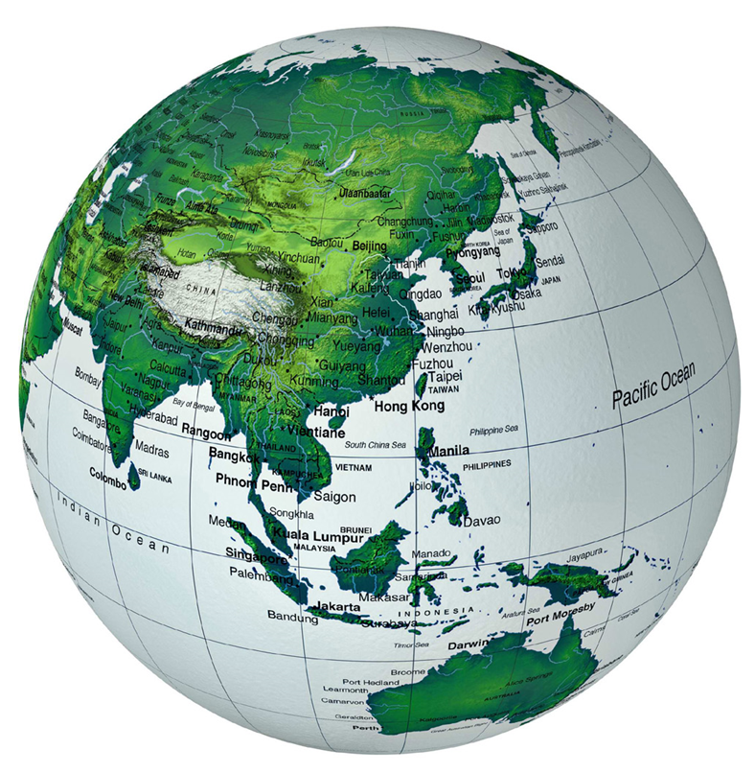
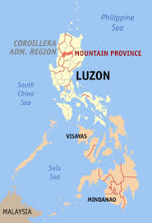
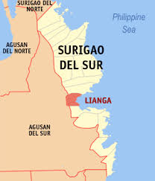
https://www.google.com.ph/search?hl=en&site=imghp&tbm=isch&source=hp&biw=1024&bih=499&q=map+

Slide 5
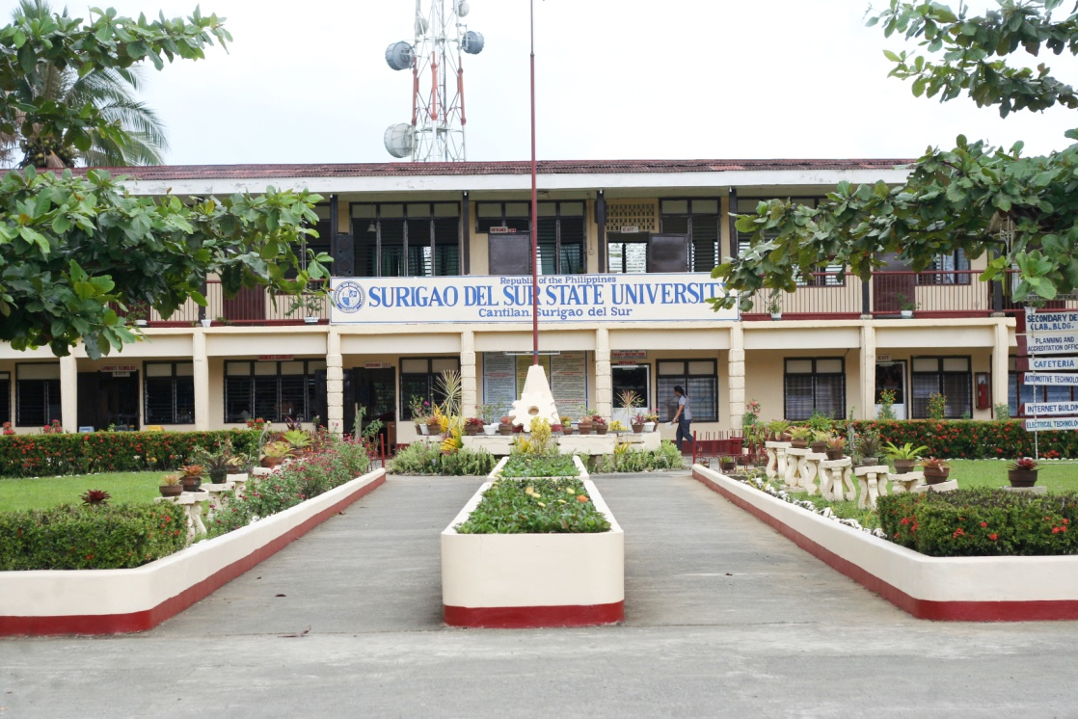
Surigao del Sur State University-Cantilan Campus

Slide 6
Ethno-medicinal Plants Used by Residents in Northern, Surigao del Sur, Philippines
by:
Gemma A. Gruyal
Romeo del Rosario,Ph.D.
Nenita D. Palmes,Ph.D.

Slide 7

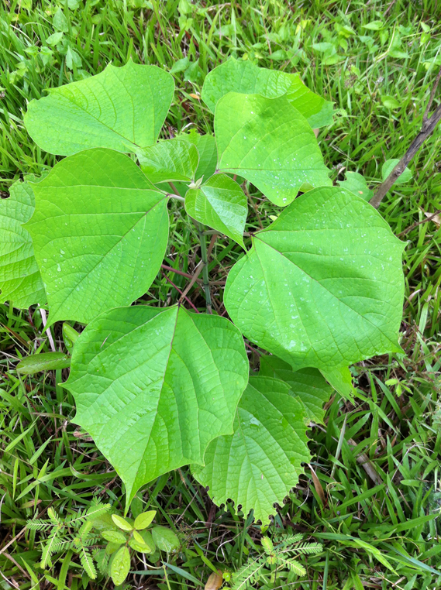
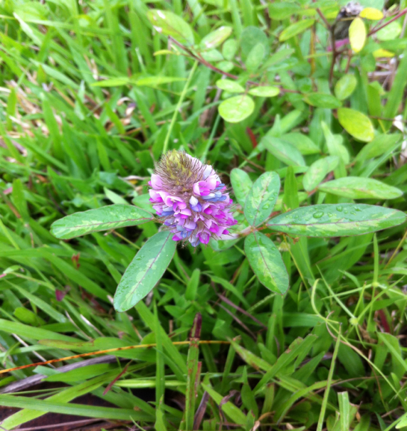
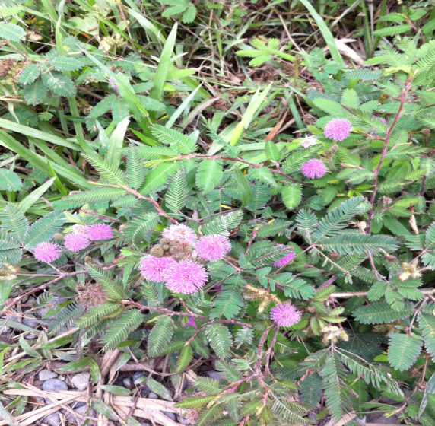
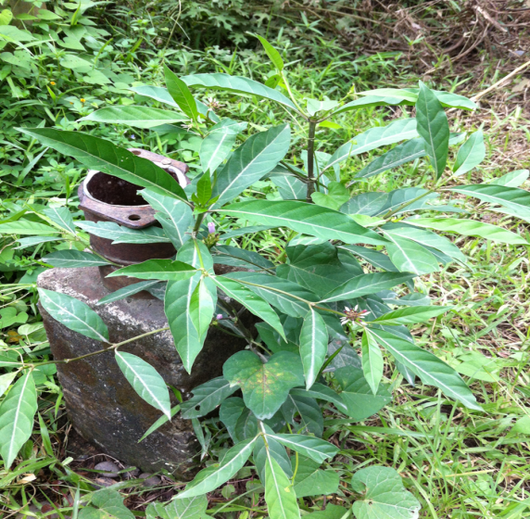
INTRODUCTION
Treatment of ailments and diseases with the use of medicinal plants have been observed way back before recorded history

Slide 8
According to World Health Organization (2003) it is estimated that up to 80% of world population depend exclusively on plants for their health and healing.
Traditional therapeutic knowledge of plants have been handed down from generation to generation through verbal communication.

Slide 9
Cause and effect of modernization resulted to natural vegetation being destroyed for the building of infrastructures, over-harvesting of the plant medicine and also introduction of new western medicinal practices.
With the growing threat of losing traditional knowledge in the modern generation many efforts have been made to record and publish this knowledge.

Slide 10
Work on ethno-medicinal knowledge has increased especially in some parts of Europe, Asia and Africa (Olowa,et.al,2012)
Despite many ethno-medicinal studies that were performed all over the world, relatively few documentation were done.
In the Philippines, in most cases they focused only on indigenous groups while the knowledge of traditional agriculturists and forest dwells were neglected (Langenberger,et al.2005).

Slide 11
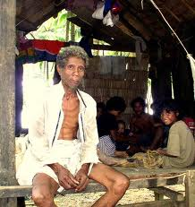
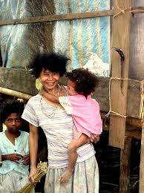
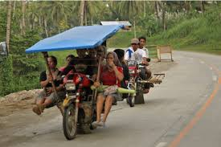
Northern Surigao del Sur, Philippines is home to citizens who were descended from native and tribal groups influenced by the rapid modernization of the country

Slide 12
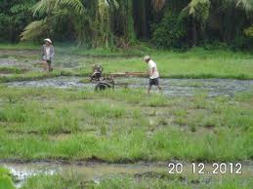
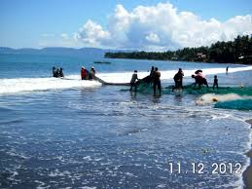
Most of the residents are farmers and fishermen
These modernized dwellers have been practicing traditional folk medicine since time immemorial.

Slide 13
But with the advent of modern medicine and technology, some of these folk medicines were relegated to sidelines or no longer practiced particularly the younger and educated populace no longer valued the usefulness of the traditional herbal medicines.

Slide 14
OBJECTIVES
To document the knowledge of indigenous plant utilization.
To record the healthcare practices in the Northern part of Surigao del Sur.
To provide a data base for future research and potential resource for the development of new drugs.

Slide 15
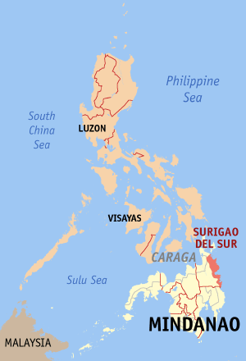

Methodology
Study site
Carrascal,Cantilan,Madrid, Carmen and Lanuza.
- A barangay from each municipality was chosen purposively as study area

Slide 16

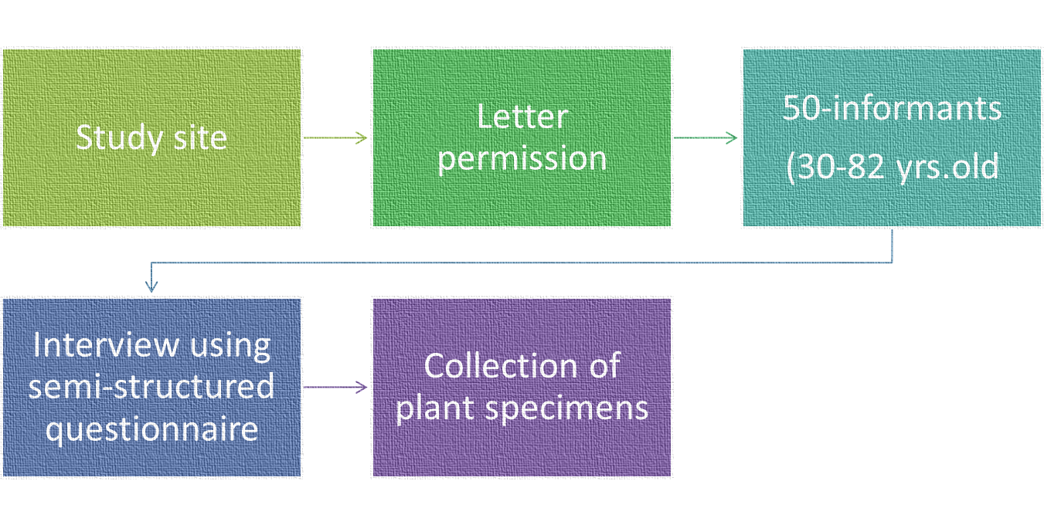
Process
Identification of plants and deposited to herbarium

Slide 17
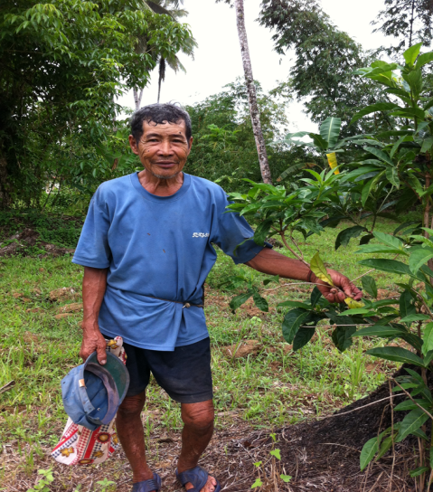
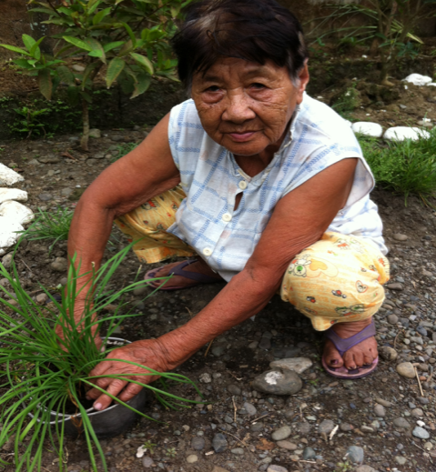
Results and Discussion

Slide 18
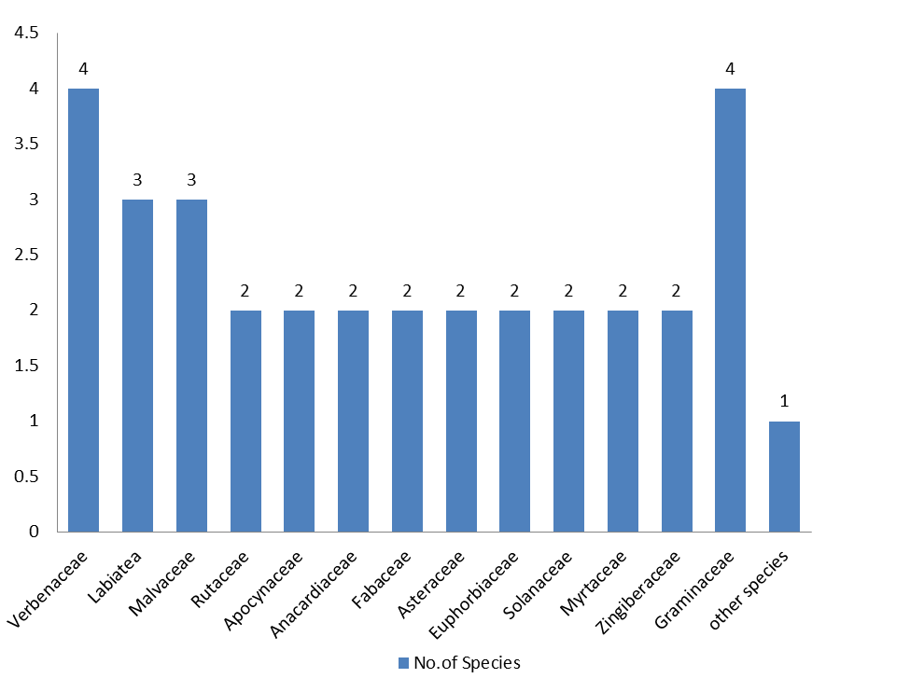
Plant Family
A total of 65 plants species were utilized as medicinal plants
The species were classified into 44 families treating different kinds of health ailments

Slide 19
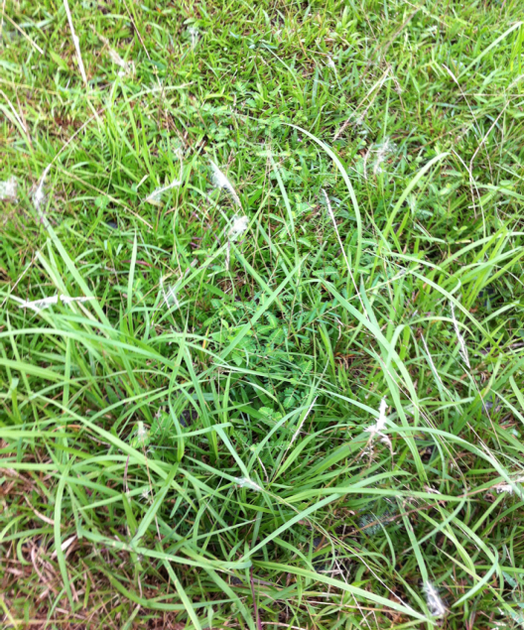
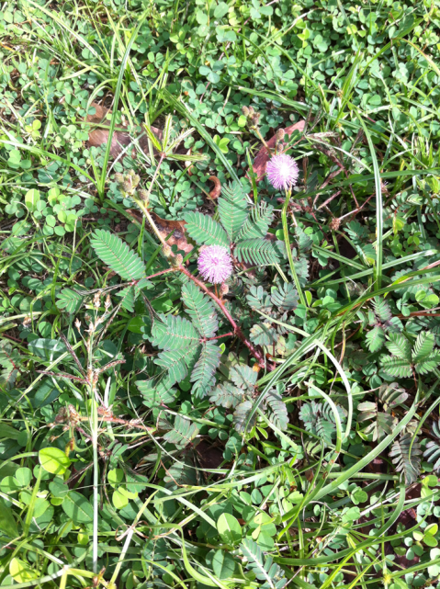
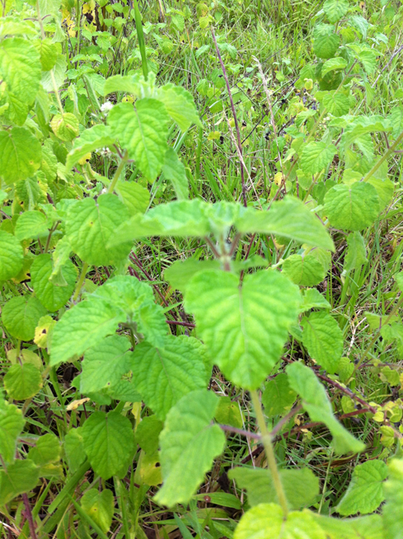
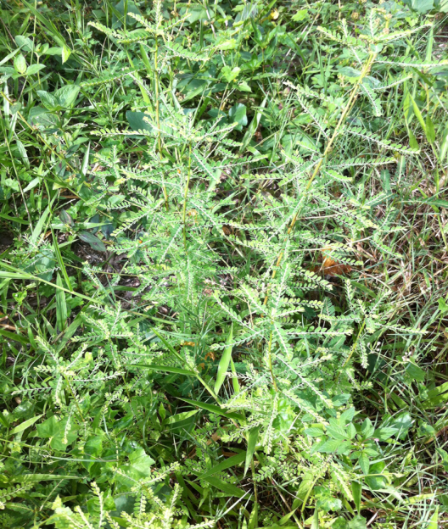
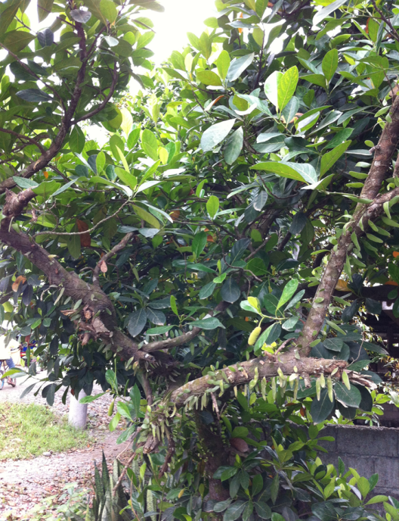
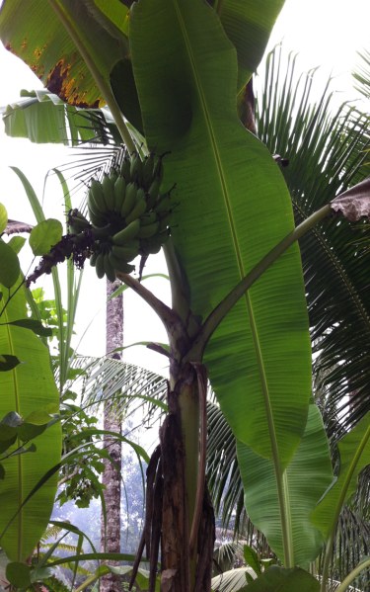
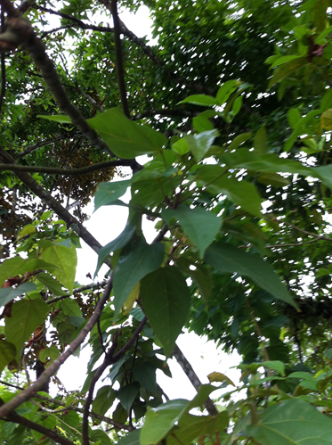
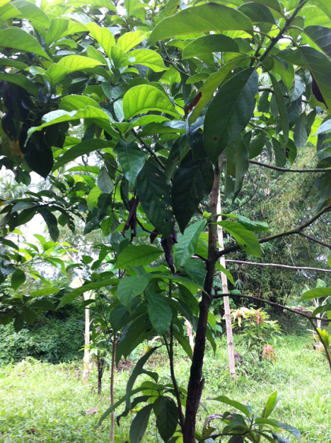

Slide 20

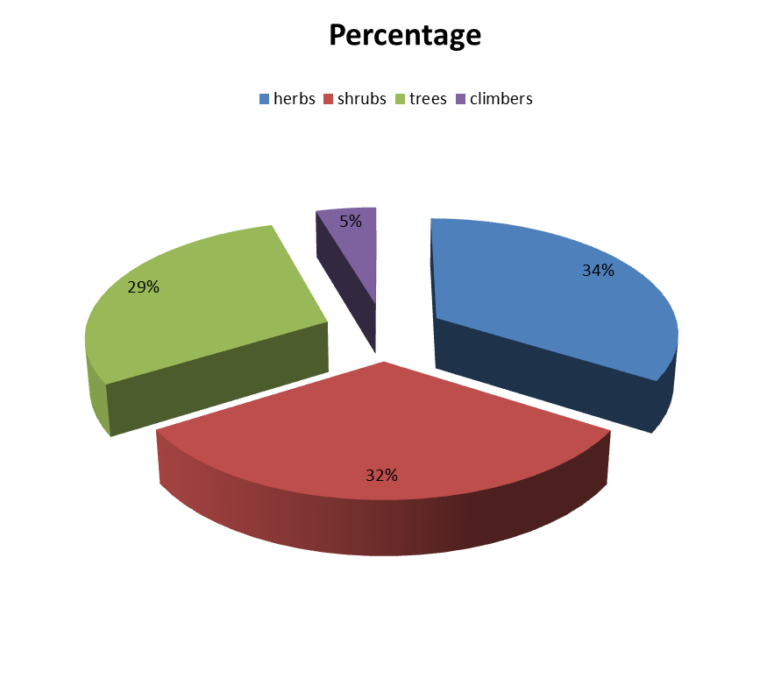
Species Habitat
Data indicates that the area has a diversity of plant species of medicinal value.

Slide 21

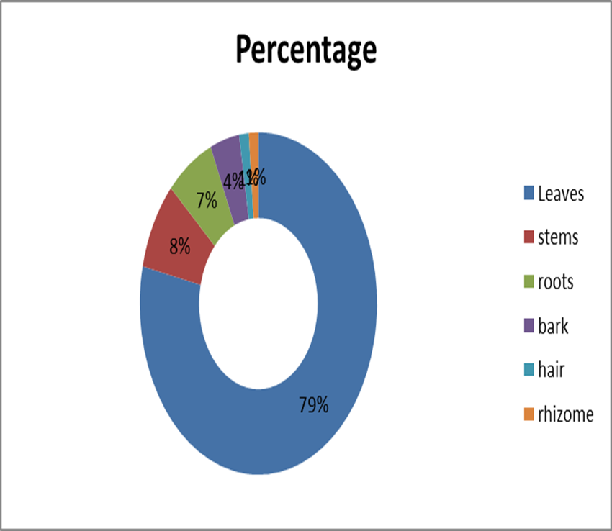
Plant Part used as Medicine
Leaves (79%) are the most frequently used plant part.
Preference on the use of leaves over other plant parts helps in the preservation, survival and sustainability of the medicinal plants.

Slide 22

Mode of Preparation
Decoction is the very common method of preparation.

Slide 23
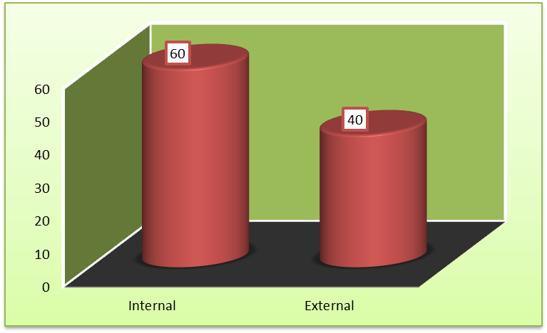
Mode of Treatment

Slide 24
Common Ailments

Slide 25
Findings
Efficacy of treatment is verified by the continuing existence of the knowledge and usage of the said plants
However, measures should be taken to identify harmful substances also found in these plants
Plants, by nature contain toxins, alkaloids that can harm rather than cure patients

Slide 26
Local folk of the region are proven to be invaluable source of knowledge with regards to the identification and usage of these plants
Handing down of information among the locals is commonly done verbally
Relatively, fast modernization of the region attributes to the steady decline of knowledgeable ethno-medicinal persons

Slide 27
Despite efforts to safeguard the population of medicinal plants, mining activities continue to threaten them to extinction
Efforts are thus made to record such information before they are gone

Slide 28

Conclusion
There is prevailing knowledge on the traditional use of medicinal plants in treating ailments and health problems among the residents in Northern part of Surigao del Sur.
Common ailments treated are cough, diarrhea and stomachache and kidney infection.
The use of leaves indicates that many of the residents in Surigao are careful to sustain the survival of medicinal plants.

Slide 29
This study records not only the ingenuity of the Surigaonons on their use of various medicinal plants and traditional health care practices but documents the invaluable knowledge of the forefathers of the inhabitants so that it may survive amidst the rapid modernization of the country.

Slide 30
References
Alpuerto, A, F.T. Bangaysiso, A. Galang, V. Maquiling, L. Taylor andG.J. Ugat, 2010. Level of Awareness and Extent of Utilization of the Ten Medicinal Plants Approved by the Department of Health. Nursing Research Journal, Vol. 2
Balangcod, T.D. and A.K.D. Balangcod,2011. Ethnomedical Knowledge ofplants and healthcare practices amongthe Kalanguya tribe in Tinoc, Ifugao,Luzon, Philippines. Indian Journal ofTraditional Knowledge, 10(2): 221-238.

Slide 31
Caniago, I. and F. Siebert, 1997.Medicinal plant ecology, knowledge and conservation in Kalimantan, Indonesia Economic Botany, 52 (3); 229-250.
Del Fierro, R. and F. Nolasco, 2013. AnExploration of the Ethno-MedicinalPractices among Traditional Healers inSouthwest Cebu, Philippines. ARPNJournal of Science and Technology, 3(12): 1182-1187.

Slide 32
Hossan, S., A. Hanif, B. Agarwala, S.Sarwar, M. Karim, T. Ur-Rahman, R.Jahan, and M. Rahmatullah, 2010.Traditional Use of medicinal Plants in Bangladesh to Treat Urinary Tract Infections and Sexually Transmitted Diseases. Ethnobotany Research &applications 8:061-074.
Khatun, A., H. Or-Rashid, and M.Rahmatullah, 2011. Scientific Validation of Eight Medicinal Plants Used in Traditional Medicinal Systems of Malaysia: A Review. American-Eurasian Journal of Sustainable Agriculture, 59(1): 67-75

Slide 33
THANK YOU

Slide 34
Lets Meet again at Pharmacognosy-2015
3rd International Conference and Exhibition on Pharmacognosy, Phytochemistry and Natural Products
October 26-28, 2015 Hyderabad, India
Theme: Advanced trends for the future of Herbal Drugs and Products
Website: http://pharmacognosy-phytochemistry-natural-products.pharmaceuticalconferences.com/

