Slide 1
EEG based biomarkers in pediatric neuropsychiatry:
ADHD – autism (ASD)
Neuropsychologist PhD Geir Ogrim – NORWAY
geir.ogrim@so-hf.no
Affiliations
Neuroteam, Child psychiatry service, Østfold Hospital Trust
The Norwegian University of Science and Technology (NTNU), Trondheim Norway
Gillberg Neuropsychiatry Centre (GNC) Gothenburg, Sweden
Head of professional board, ADHDNorge (patient organization)
NevSom – National resource centre for neurodevelopmental disorders and hypersomnias

Slide 2
Disclosure
This presenter has no financial involvement with pharmaceutical industry or manufacturers of equipment.
The research is financially supported by Østfold Hospital Trust, Norway
Professional collaboration with
  The Norwegian University of Science and Technology (NTNU), Norway
  Gillberg Neuropsychiatry Centre (GNC) Gothenburg, Sweden

Slide 3
Contents
The need for supplementary biomarkers
  ADHD and ASD
Criteria for clinically useful biomarkers
Methods based on EEG, Event Related Potentials (ERPs) and neuropsychological tests
The biomarker profile approach
Ongoing research project for EEG based biomarkres in ADHD and ASD
Clinical cases

Slide 4
ADHD – basic; DSM 5
  Symptoms observed before 12 years.
  Statistically deviant and impairing symptoms of inattention, hyperactivity/impulsivity
  At least 6 of 9 symptoms of inattention, and 6 of 9 symptoms of hyperactivity/impulsivity
  (Inattentive subtype;“ADD”)
  Seen for at least 6 months and in different settings (school, home)
  Leading to impairment in home, school, social
  Symptoms not better explained by another diagnosis
  +++

Slide 5


Slide 6


Slide 7
ASD: Autism Spectrum Disorders
DSM -5 diagnostic guidelines; two criteria domains:
  Social interaction domain (including language and social communication deficits)
  Repetitive or restrictive behaviors
  A spectrum disorder requiring specifiers
    Intelligence level
    Language
    ++++

Slide 8
I claim that:
Neuropsychiatry:
  In the future the present behavior based diagnostic criteria have to be supplemented by more objective measurements, closer to brain function
ADHD and ASD:
  The credibility of these diagnoses will increase if objective criteria are included.
  Subgroups of ADHD and ASD based on QEEG, ERPs and neuropsychological tests are potentially useful as guidelines for treatment.

Slide 9
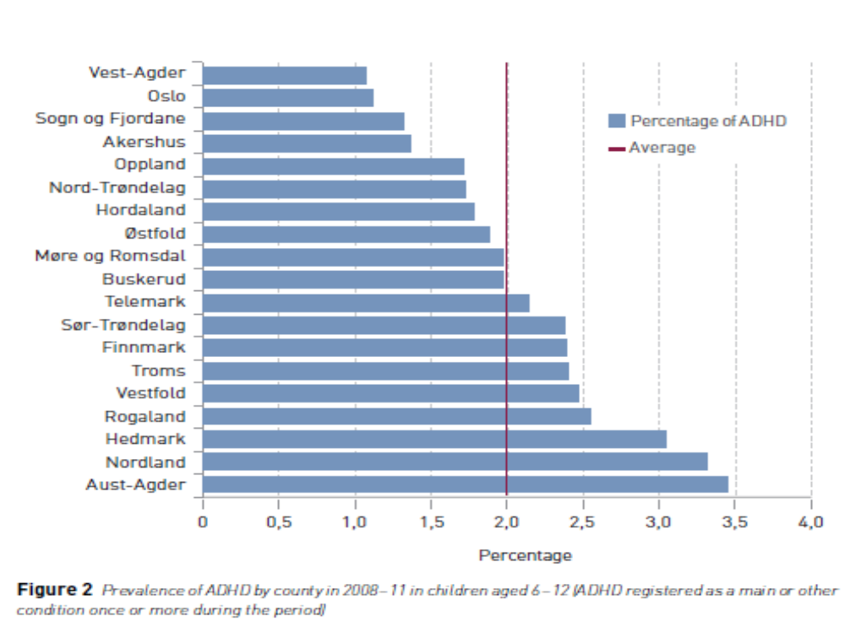
Prevalence of pediatric ADHD in Norwegian counties
From 1.6% to 3.4% in two neighbor counties:
Lack of objective criteria?

Slide 10
ADHD and ASF: Some challenges
Genetic/neurobiological causes are claimed, but criteria are based only on observed behavior
  Too much subjectivity
Different underlying mechanisms leading to similar symptoms (ex: inattention, hyperactivity)
Data from interviews, rating scales, developmental history often primarily relying on one source (usually the mother)
Improved criteria for implementing medication treatment in children are asked for
Can ADHD/ASD be differentiated from child abuse and PTSD by the use of objective, brain based methods?

Slide 11
Biomarker – neuromarker - endophenotype
A biomarker is: ”a characteristic that is objectively measured and evaluated as an indicator of normal biological or pathogenic processes, or pharmacologic response to a therapeutic intervention. Biomarkers can provide an objective basis for diagnosis, treatment selection, and outcome measures” (Wright, Hall, Matthews, & Brayne, 2009, p. 344).
In psychiatry, the concept of biological marker has been specified as an endophenotype, often called an intermediate phenotype. The concept of endophenotype is more closely associated with genetics than the concept of biomarker is.

Slide 12
Endophenotypes: Criteria
The endophenotype is associated with illness in the population.
The endophenotype is heritable.
The endophenotype is primarily state-independent (manifests in an individual whether or not illness is active).
Within families, endophenotype and illness co-segregate.
The endophenotype found among affected family members is found in unaffected family members at a higher rate than in the general population.

Slide 13
Biomarkers for clinical use
Test-retest reliability.
Exploring how well the biological marker discriminates between a diagnostic category and healthy controls,
-and between diagnoses with overlapping symptoms. A deviation from normality that is equally common in disorders that need to be differentiated (e.g. ADHD and learning disabilities) may not be clinically useful.
It would be naïve to believe that a single biological parameter can be specific for a single diagnostic category. It is more likely that the tested parameter identifies a certain subgroup covered by several diagnostic categories (e.g. inattention).

Slide 14
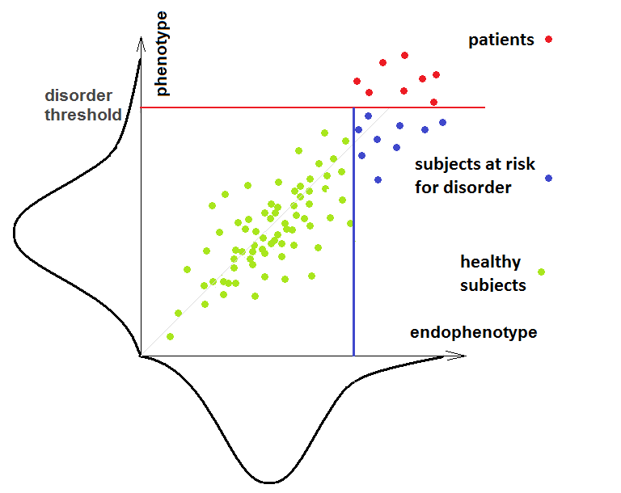
x: “look-a-likes”?
x x x
x x x x
Diagnoses
and
biomarkers
Y-axis: A ”disorder scale”. Red line: Diagnostic threshold.
X-axis: A ”biomarker scale”. Left side of blue line; deviant score.
Four groups:
Green: Healthy Red: Disordered Blue: At risk X: “Look-a-likes”?

Slide 15
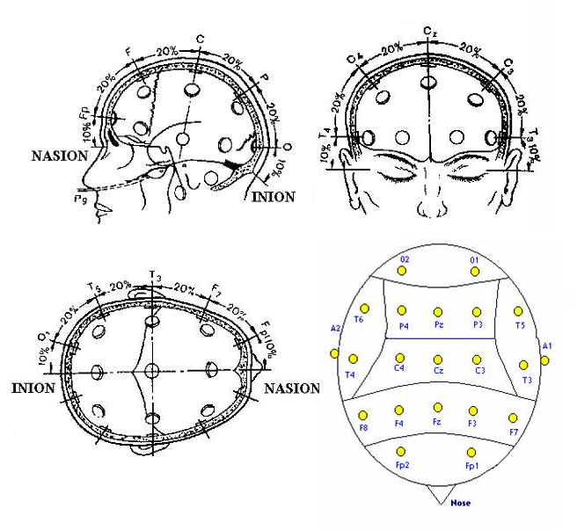
10 – 20 system: How electrodes are placed
EEG:
Registration of electrical activity from large groups of brain cells firing simultaneously

Slide 16
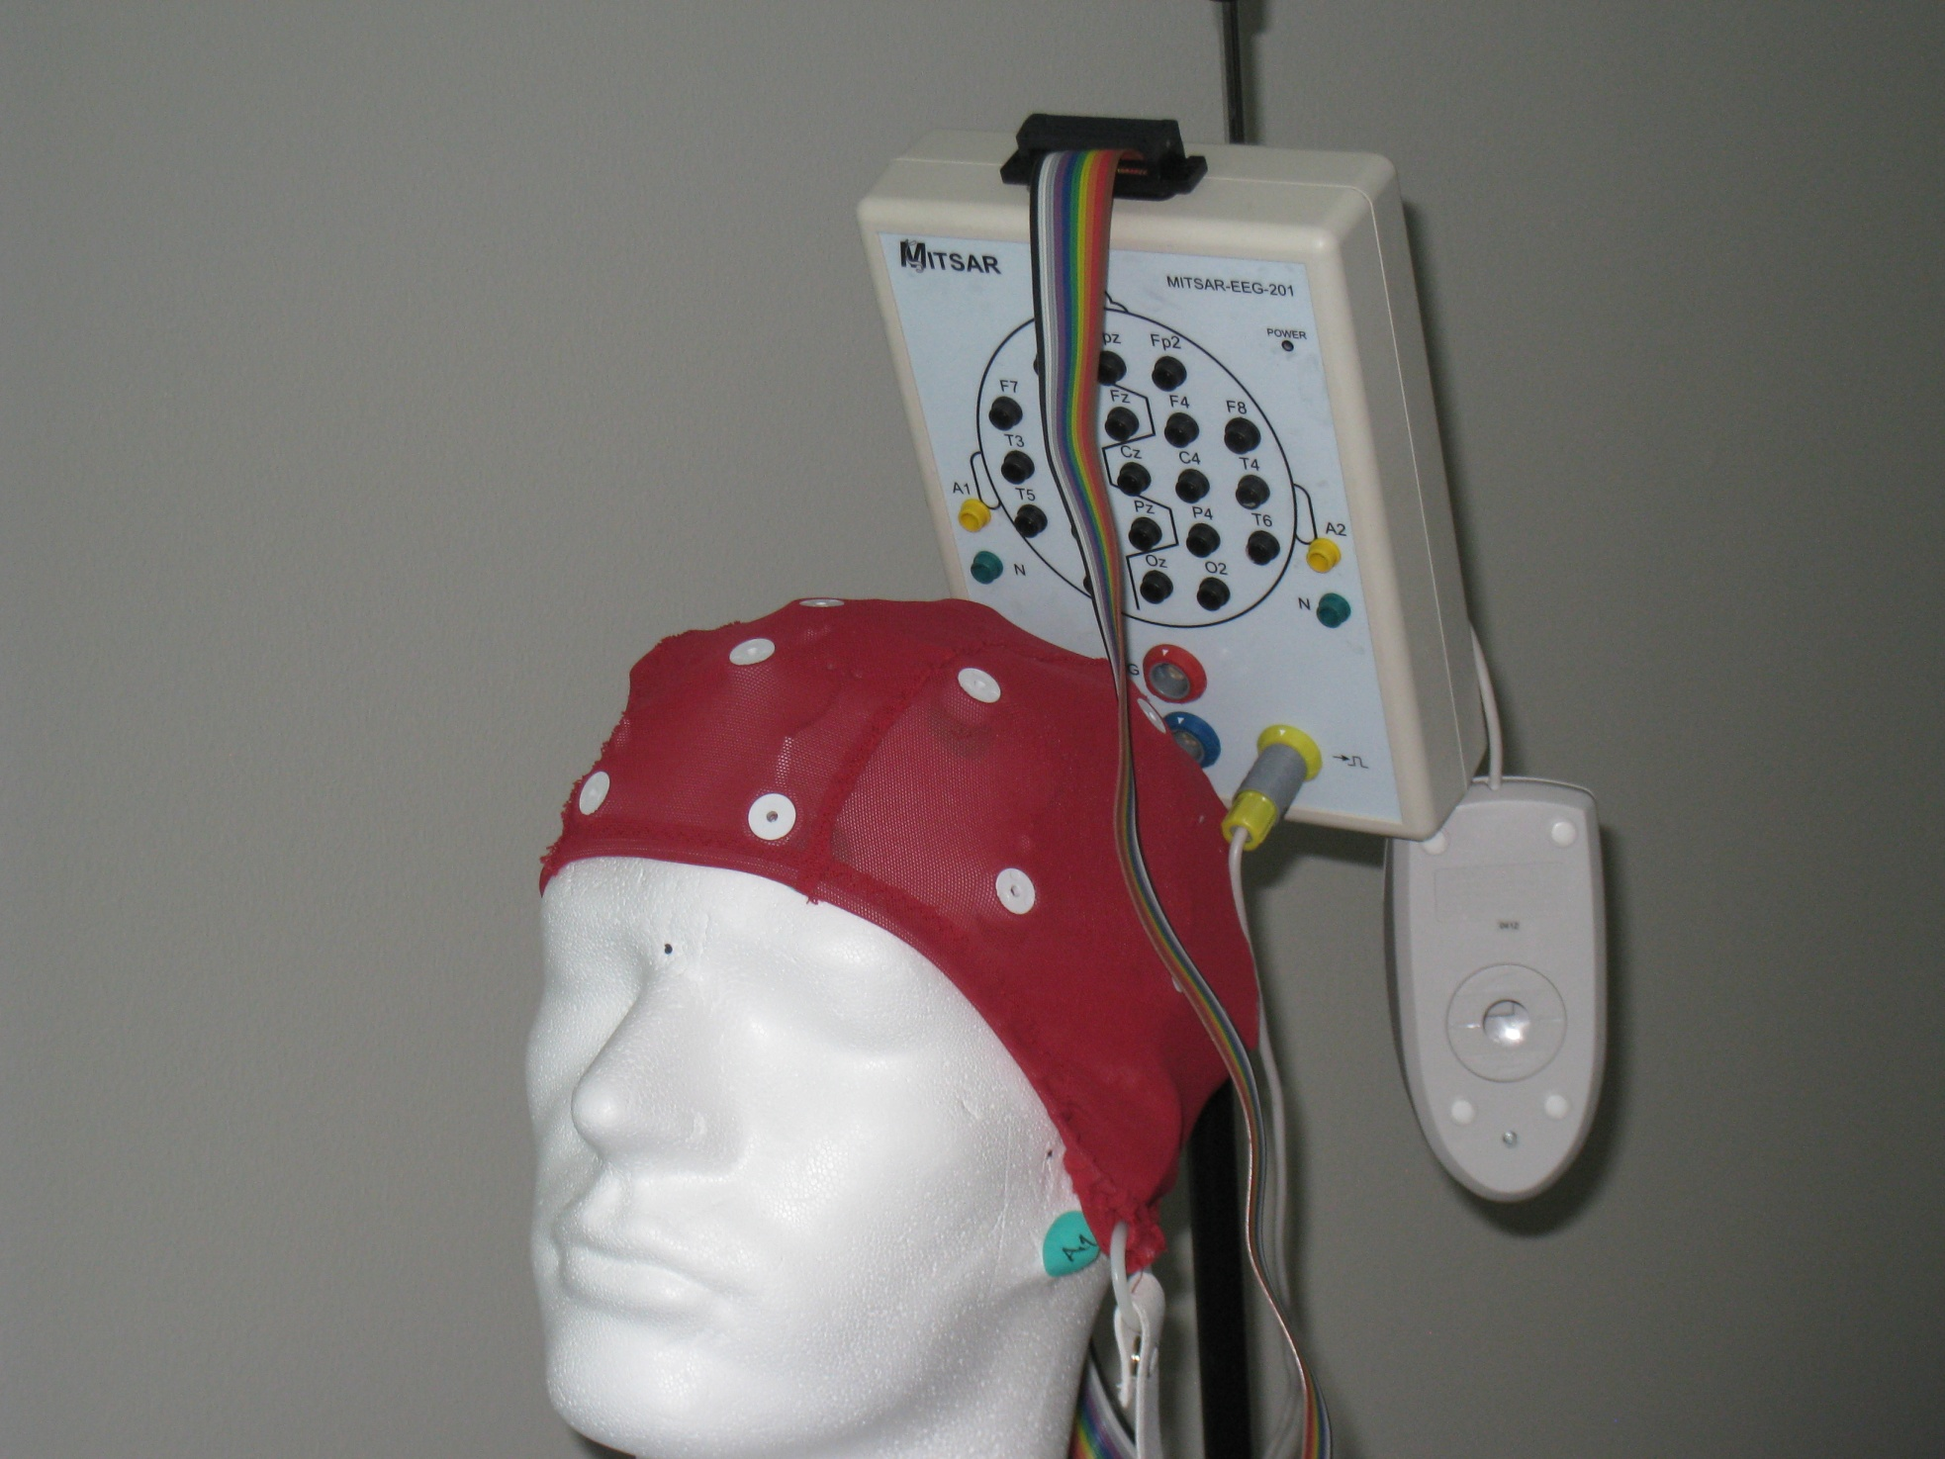
EEG
registration

Slide 17
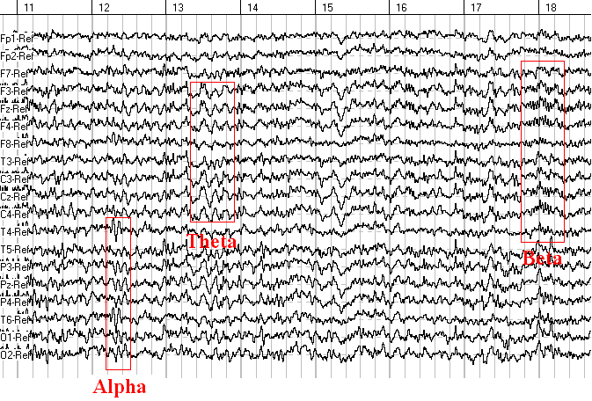
Seven sec. EEG from 19 sites. Examples of theta, alpha and beta highlighted

Slide 18
Quantitative EEG (QEEG), Fourier analysis and EEG spectra
QEEG:
  Electronical processing of raw-EEG
Fourier analysis:
  Calculating mean power, (microvolt), in different frequency bands in a specified time interval
  = EEG spectra
  Often compared with norms

Slide 19
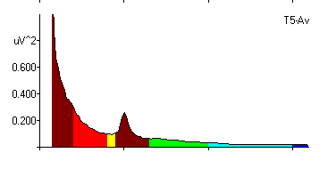
EEG spectra
X-axis: frequency (Hz)
Y-axis: power(microvolt)
Alfa:
8-12Hz
Lav beta: 13-20Hz
Høy beta: 21-30Hz
Gamma:>30Hz
Delta:
0.5-3.5 Hz
Theta: 4-8Hz

Slide 20
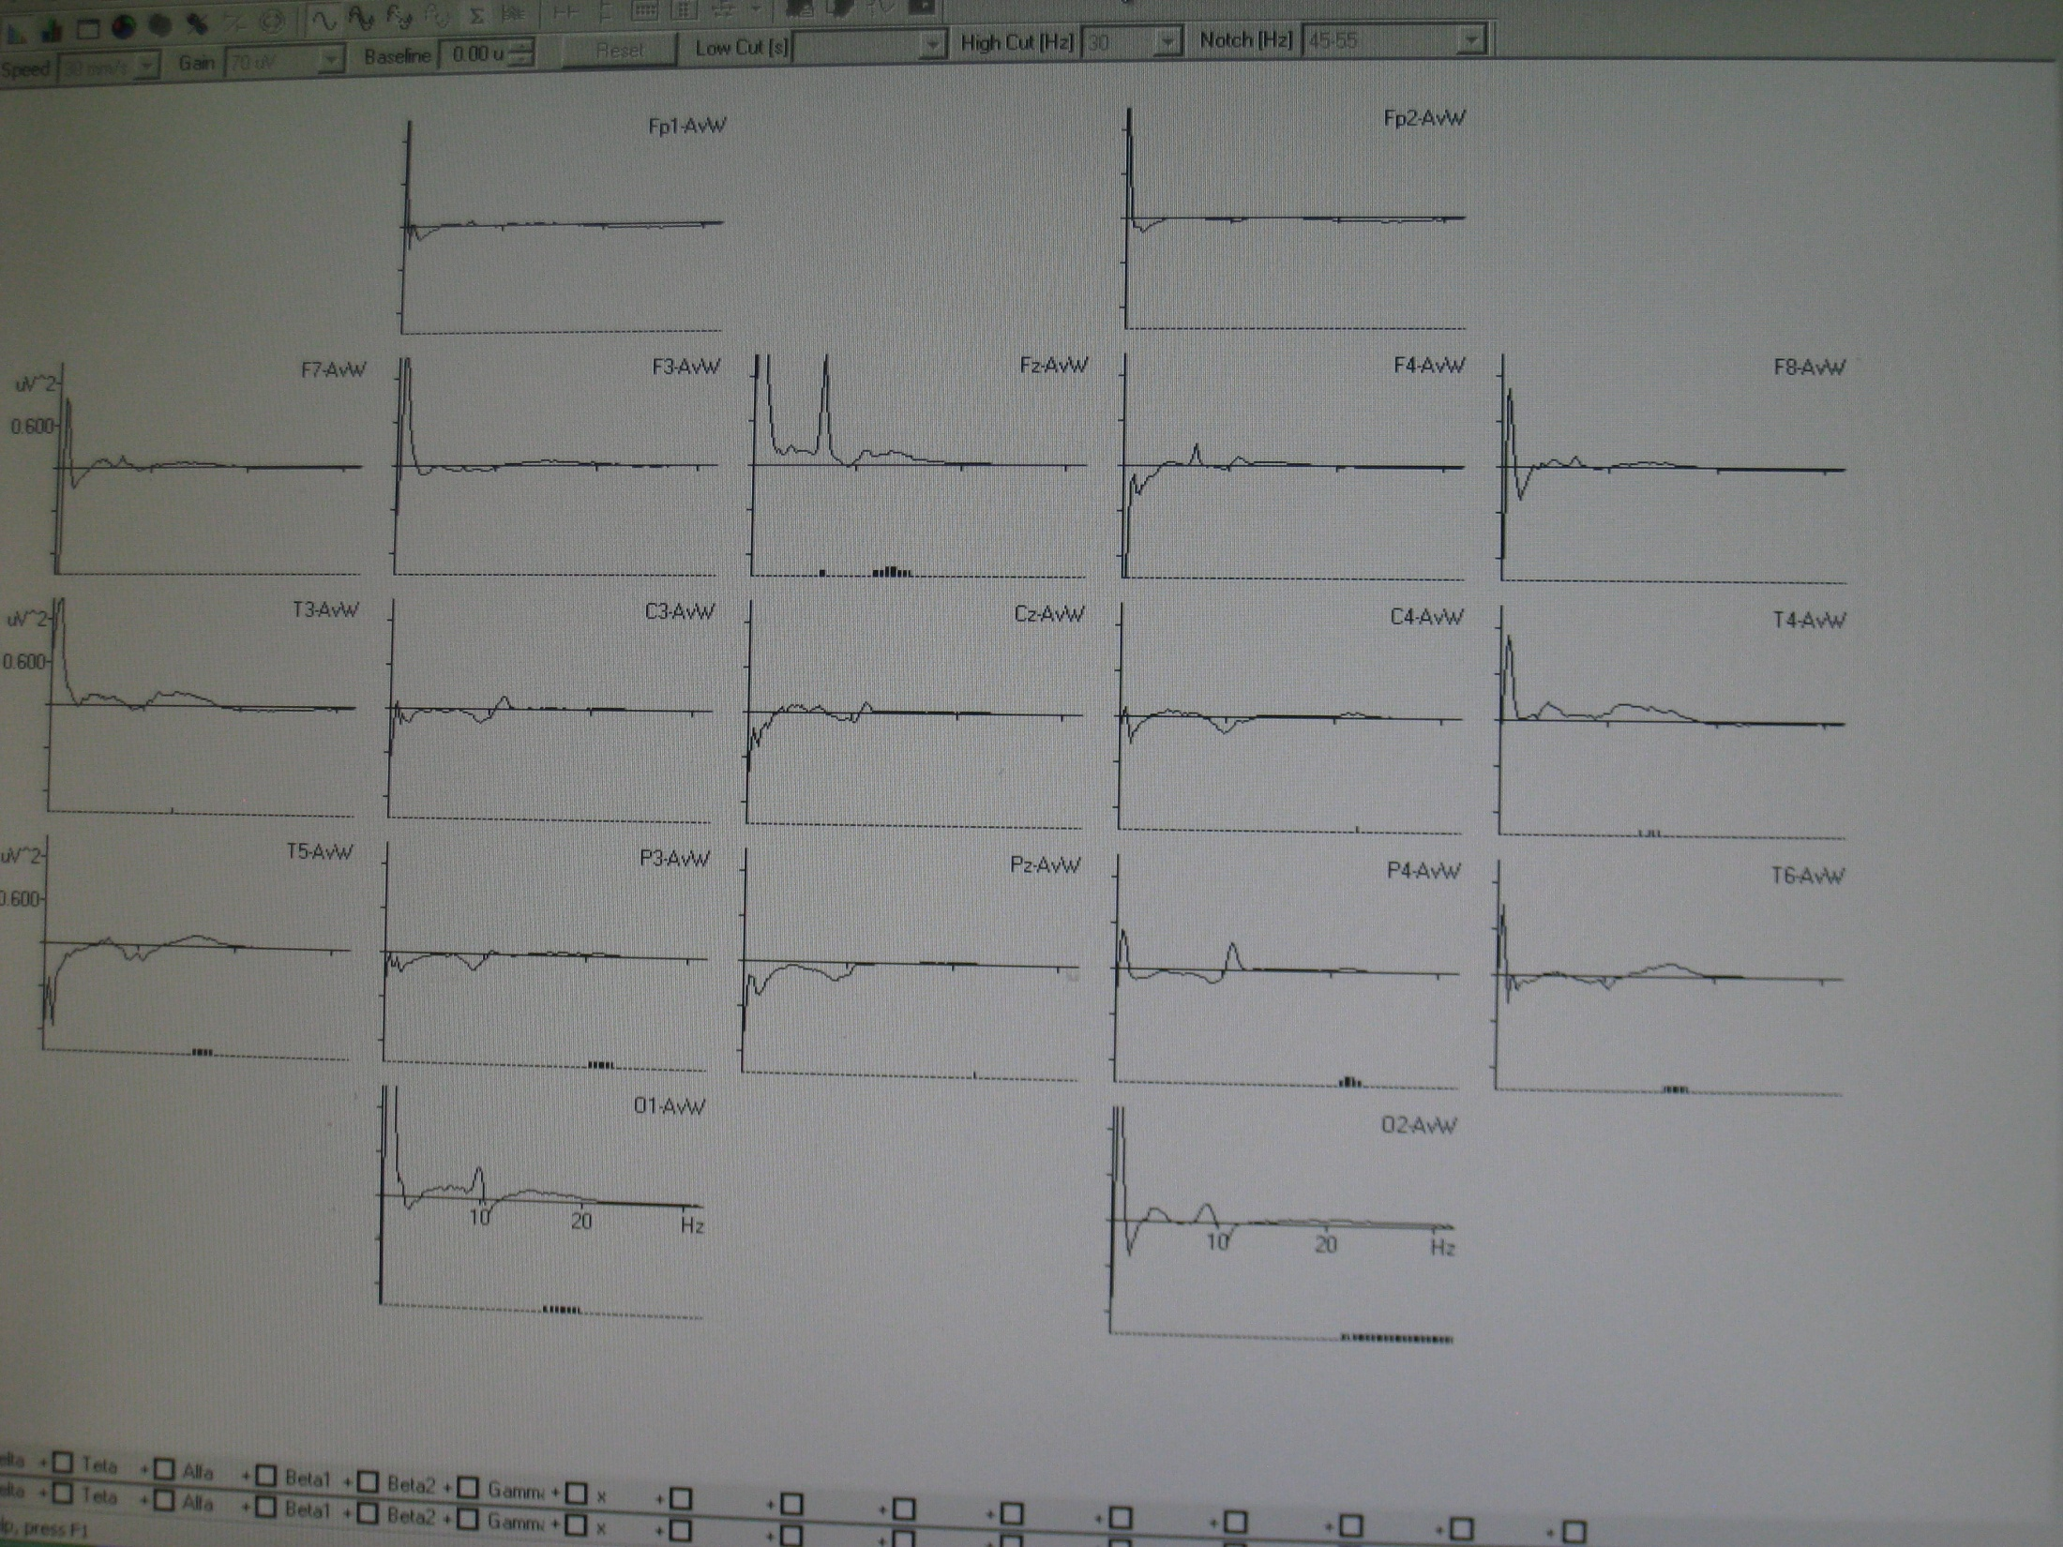
Significant deviations

Slide 21
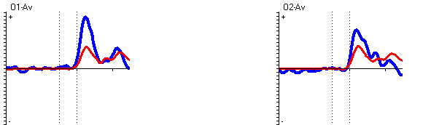
Event Related Potentials: ERPs
Sensory and cognitive activity (“events”) create small deflections in EEG.
By repeating the events a large number of times with a fixed time interval(ex: 3 sec), background EEG can be cancelled out, and the event related deflection stands out as an ERP component
ERP component P1 in patient M (blue line) compared with norm (red line).
(Significance level: p=0.0001).
(Functional meaning: sensitivity? Anxiety? (BA 31)

Slide 22
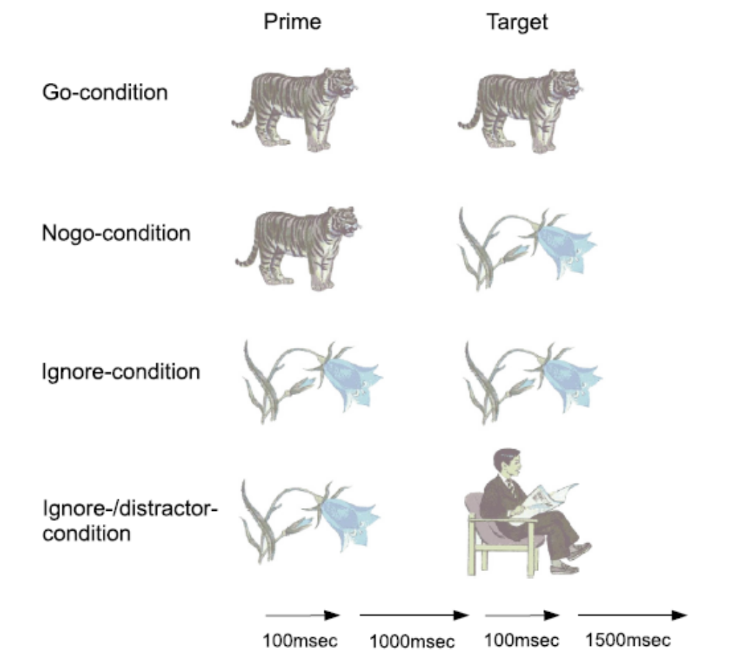
Visual Continuous Performance Test: VCPT
Conditions of the VCPT:
Animal followed by animal: press button.
Animal followed by plant: do not press button.
Plant followed by plant, and plant followed by human (+ sound): ignore.

Slide 23
VCPT: Visual Continuous Performance Test
20 min. cued go/no-go task while EEG og ERPs are registered
  Behavioral measures:
    Number of omissions: measure of attention
    Number of commission : impulsivity
    Reaction time (RT): processing speed
    RT-variability: measure of attention

Slide 24
What are we looking for?
What happens, compared with norms:
  When visual stimuli hit occipital areas?
  When visual stimuli are identified as targets (“animals” in our paradigm)?
  When picture 1 was an animal and you prepare for a go-response (press button)?
  When picture 2 is an animal (Go-condition)?
  When picture 2 is not the expected animal (“No-go”)?
  When unexpected sounds appear (“Novelty”)?

Slide 25
EEG based biomarkers for ADHD
Hypotheses based on published research and clinical experience:
  Excess theta in EEG spectra, high theta/beta ratio
    Under activation of CNS.
  Reduced amplitude of ERP component P3No-go
    Allocation of attentional recourses / inhibition
  Reduced amplitude of ERP component CNV
    Preparation of response
  Reduced amplitude of ERP component “Cue P3”
    Identification of “target”
  Increased omissions and RT variability

Slide 26
EEG based biomarkers for ASD/Asperger’s
Few studies, less experience:
  Research literature and studies under review (ALH)
    ASD not different from controls:
      VCPT: Omissions, commissions, RT, RT variability
      ERPs probably indexing cognitive control: CNV, P3 no-go
    ASD seem to be different from controls:
      Some sensory and perceptual ERP components
      Hypothesis: Novelty ERP component: Often too strong or too weak in ASD

Slide 27
Supplementary biomarkers in pediatric neuropsychiatry:
Measures from electroencephalography (EEG), Event Related Potentials (ERPs) and neuropsychological tests
Multisite study with a focus on ADHD and ASD
Four groups:
  ADHD – ASD – ADHD+ASD - controls

Slide 28
Highlights:
Diagnosing neuropsychiatric disorders like ADHD and Asperger’s syndrome/high functioning autism (HFA) is often difficult and controversial partly because criteria based on objective measures are missing.
Internationally there is an increasing focus on the need for clinically useful biomarkers.
EEG based biomarkers are excellent candidates as they are non-invasive, can be applied to children, and are affordable.
This is a multi-site study, building on our ten years of experience, and published research aiming at finding profiles of biomarkers for ADHD and HFA.

Slide 29
Aim of the study
Reduce diagnostic disagreement by applying objective measures with evidence based prediction estimates
Less time consuming diagnostic processes
Treatment options:
  The examination provides hypotheses about cognitive and emotional strengths and difficulties

Slide 30
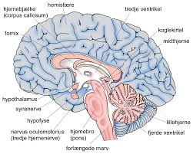
Challenges
The brain did not read DSM before deciding how to organize.
DSM does not reflect brain function
ADHD and ASD have overlapping symptoms
A single ERP biomarker may reflect (important aspects of) inhibition, working memory etc., not a specific diagnosis
A profile of biomarkers, or a scale combining biomarkers of interest may capture diagnoses like ADHD and ASD

Slide 31

Our vision
Based on a test lasting one hour plus one hour of scoring/editing, in three years we can tell the probability of an ADHD or ASD diagnosis being correct
Daniel – 17 years

