Slide 1
Diagnosis of occult hepatitis B virus infection in patients requiring chronic blood transfusion
A.Professor
Gehan Lotfy abdel Hakeem
Minia University
Egypt

Slide 2
Authors:
Prof. Salah Mahmoud Saleh
Professor of Pediatrics, Faculty of Medicine, Minia University
Prof. Sayed Fekry Abdelwahab
Professor of Microbiology and Immunology, Faculty of Medicine, Minia University
Dr. Gehan Lotfy Abdel-Hakeem
Assistant Professor of Pediatrics, Faculty of Medicine, Minia University

Slide 3
Agenda
Hepatitis B In the World
Structure of Hepatitis B virus
HBV Antigens
HBV serology interpretation
Clinical outcomes of Hepatitis B infections.
Occult hepatitis B virus
Definition
Molecular Basis & Mechanism
Diagnosis of OBI
Prevalence : Egyptian situation
Clinical Impacts of OBI
Prevention
Research presentation

Slide 4
Hepatitis B In the World
Two billion people have been infected (1 out of 3 people).
400 million people are chronically infected.
10-30 million will become infected each year.
An estimated 1 million people die each year from hepatitis B and its complications.
Approximately 2 people die each minute from hepatitis B.

Slide 5
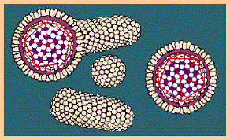
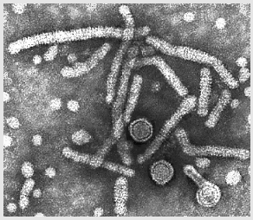
Hepatitis B
Hepadnaviridae family
  DNA virus
  Double-shelled particles
    Outer lipoprotein envelope (surface Ag)
    Inner viral nucleocapsid (core)
  Seven genotypes.
  Four major subtypes.
  All HBV subtypes share one common antigenic determinant - "a.“
  Thus, antibodies to the "a" determinant confer protection to all HBV subtypes.
Diagrammatic representation of the hepatitis B virion and the surface antigen components
EM of Hepatitis B viron

Slide 6
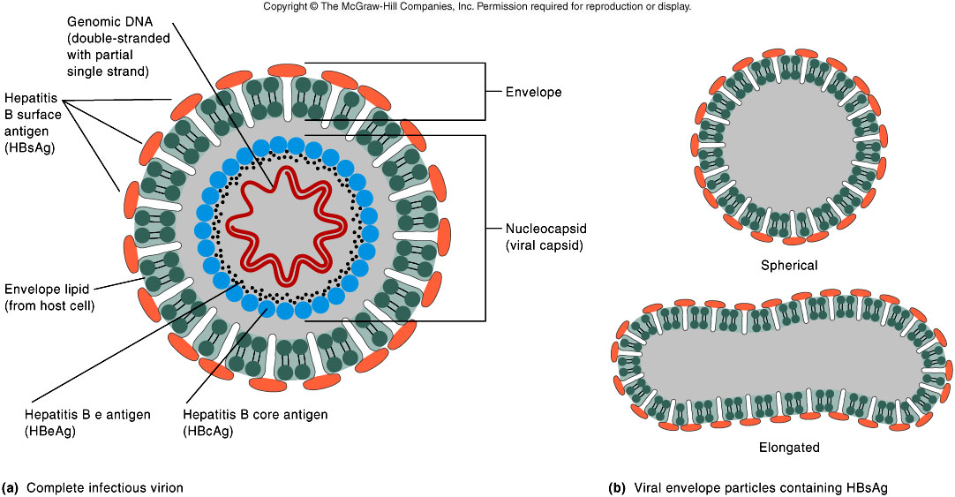
Structure of hepatitis B virus

Slide 7
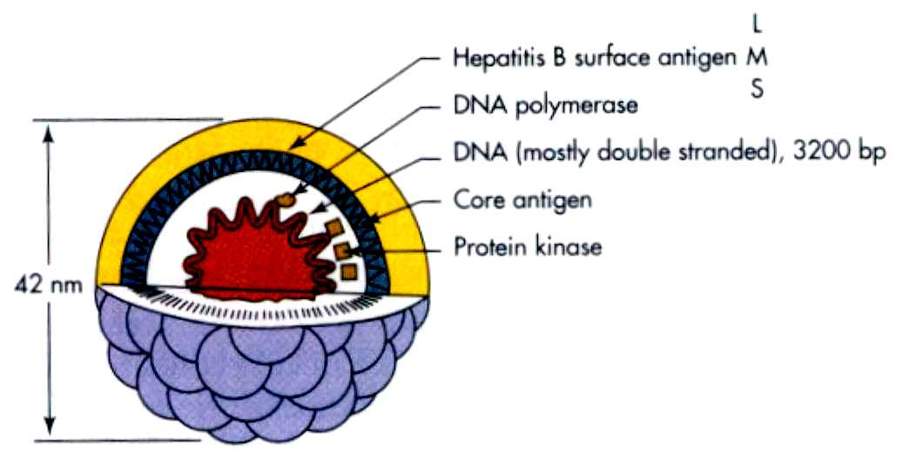
HBV Structure & Antigens
Dane particle
HBsAg = surface (coat) protein ( 4 phenotypes : adw, adr, ayw and ayr)
HBcAg = inner core protein (a single serotype)
HBeAg = secreted protein; function unknown

Slide 8
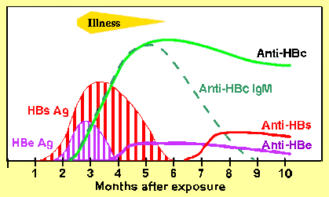
HBV serology interpretation
Acute infection
  HBsAg positive and anti-HBcAg IgM
  Rarely, IgM anti-HBc only marker
    Usually seen in acute fulminate Hep B
Chronic infection
  HBsAg positive and anti-HBcAg
Previous Infection
  HBsAg negative
  anti-HBs positive
  IgG anti-HBc positive

Slide 9
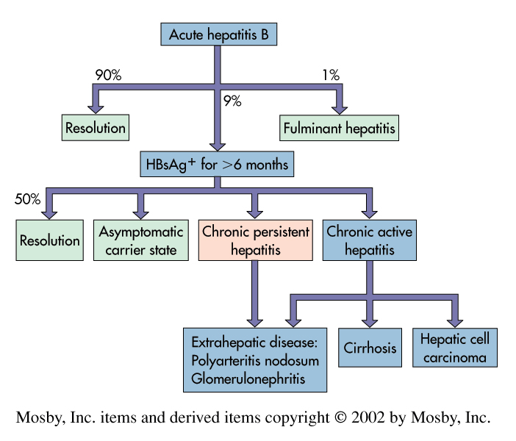
Clinical outcomes of Hepatitis B infections
. Clinical outcomes of acute hepatitis B infection. (Redrawn from White DO, Fenner F: Medical virology, ed 3, New York, 1986, Academic Press

Slide 10
Definition of occult hepatitis B infection (OBI)
The presence of HBV DNA without HBsAg, with or without the presence of HBV antibodies outside the acute phase window.
The presence of HBV-DNA in the liver tissue of individuals who test negative for HBsAg regardless of the detection of HBV-DNA in the serum is defined as occult HBV infection.

Slide 11
Mode of transmission
HBV infection can be transmitted through:
Contact with contaminated blood.
Mother-to-child transmission.
Unprotected sexual intercourse. Post transfusion

Slide 12
Mode of infection
Hepatitis is common even after practicing the stringent donor selection criteria and screening the blood for HBsAg. This is because a considerable number of HBV infected donors remained undiagnosed if only HBsAg is used for screening.

Slide 13
Serological pattern of OBI
HBsAG - & HBV DNA +
80% 20%
Seropositive OBI Seronegative OBI
( anti-HBc+ (+/-) anti-HBs+) ( anti-HBc - , anti- Hbs -)
higher DNA level lower DNA level

Slide 14
Schematic conditions leading to different seropatterns of OBI
HBsAg lost after self-limiting acute hepatitis
Anti-HBV never present
(Iry occult infection)
Seropositive
Anti-HBc positive
OBI
Seronegative
Anti-HBc negative
HBsAg lost after years of chronic carriage
Anti HBV antibodies progressively disappear over time

Slide 15
Diagnosis of OBI
Gold Standard : Analysis of liver tissue and blood for HBV DNA
HBV DNA in blood by nested-PCR, real-time PCR, and transcription based mediated amplification (TMA)
Anti-Hbc is a less than ideal surrogate marker when HBV DNA measurement is not feasible.

Slide 16
Schematic representation of possible clinical impacts of occult HB infection
Transmission Of HBV infection
HCC OBI HBV
development reactivation
Liver disease progression

Slide 17
AIM OF THE WORK

Slide 18
Aim of the work
The aim of this work was to detect the presence of occult hepatitis B virus infection among frequently blood transfused Egyptian pediatric patients

Slide 19
PATIENTS AND METHODS

Slide 20
Patients and methods
This study was carried out in the period from May 2013 to March 2014.
Forty-five patients with different etiologies were randomly selected from regional blood bank while 12 positive known HBV+ve patients were enrolled as controls.
Twenty-four out of the 45 cases (53.4%) were males while 21 (46.6%) were females.
In the 12 control cases 7 (58.3%) were males and 5 (41.7%) were females.
The age of the subjects and controls ranged from 6 months to 18 years.

Slide 21
Patients and methods
Inclusion criteria:
Subjects negative for HBsAg
Frequently transfused children (previous 6 transfusions or more)

Slide 22
Patients and methods
All patients and controls were subjected to:
A full medical history included different variables:
Age.
Gender.
Residence.
Frequency of blood transfusion in last year.
Presence of any liver disease.
Positive family history of HBV infection.
Positive family history of repeated blood transfusion.
Vaccination history for HBV including the obligatory vaccination and any booster doses.

Slide 23
Patients and methods
All subjects were completely examined clinically with stress on:
Signs of liver affection such as jaundice, hepatomegaly and splenomegaly.
The study was explained to all participants using the consent form.

Slide 24
Patients and methods
All cases and controls were tested for:
HBV-DNA (PCR).
Anti HBsAg.
Anti HBcAb.
Anti HCV Ab.
Serum ferritin.
Serum ALT and AST.
Blood Urea and serum Creatinine.
CBC.

Slide 25
Patients and methods
Blood sample collection and storage
Three to five ml of venous blood were collected in sterile tubes, and centrifuged at 3000 rpm for 10 min. The sera were collected in two screw capped sterile cryovials.
The samples were stored at -20ºC until PCR analysis and other testing. The samples were taken at least 15 days after last blood transfusion.
Serological and molecular detection of HBV
Serological diagnosis of HBV
Detection of HBV surface antigen
Detection of HBV core antibody

Slide 26
Patients and methods
Blood sample collection and storage
Three to five ml of venous blood were collected in sterile tubes, and centrifuged at 3000 rpm for 10 min. The sera were collected in two screw capped sterile cryovials.
The samples were stored at -20ºC until PCR analysis and other testing. The samples were taken at least 15 days after last blood transfusion.
Serological and molecular detection of HBV
Serological diagnosis of HBV
Detection of HBV surface antigen
Detection of HBV core antibody

Slide 27
Patients and methods
Molecular assay
HBV-DNA Detection
For each patient who was negative for HBsAg, plasma was explored for the presence of HBV-DNA by DNA Extraction and PCR amplification.
DNA Extraction
Viral DNA was extracted from 150μl of plasma, DNA samples were stored at -20ºC. Nested-PCR was used to detect HBV-DNA in the plasma using a thermal cycler.

Slide 28
Patients and methods
PCR amplification
The sequences of the primers used in the Nested PCR were as follows:
Outer-YMDD-F: 5´-GGTTATCGCTGGATGTGTCTGC-3´ (22):365- 386
Outer-YMDD-R: 5´-CCACAATACGTTGACAGACTTTCC-3´ (24): 980-1004
Inner-YMDD-F: 5´-CTCTTCATCCTGCTGCTATGCCTC-3´ (24): 404-425
Inner-YMDD-R: 5´-TGGTAACAGCGCTAAAAAGGGACTC-3´ (25): 781-805.

Slide 29
Patients and methods
Detection of PCR products
The amplified products were visualized in 1% agarose gel stained with Ethidium bromide. We used HBV-DNA posi­tive controls from HBV-DNA positive patients and negative controls containing no template and/or water at each PCR testing.
The cut­off of HBV DNA detection was 5 IU/ml.
All samples were tested for HBV-DNA detection using nested-PCR assay. We regarded the cases that showed positive re­sults in duplicate.

Slide 30
RESULTS

Slide 31
Table (1): Demographic and clinical characteristics of the studied patients and controls.
Results parameter |  |  | Cases, n=45 (%) | Controls, n=12 (%) | p
Age | Range |  | 3-17 10±4 | 6-18 11±3.6 | 0.44
 | Mean±SD
Gender | Male |  | 24 (53%) 21 (47%) | 7 (58%) 5 (42%) | 0.76
 | female
Positive family history of frequent transfusion |  |  | 19 (42%) | 0 (0%) | 0.006**
Positive family history of HBV infection |  |  | 2 (4%) | 0 (0%) | 0.46
Positive routine HB vaccine |  |  | 45 (100%) | 12 (100%) | 1
Presence of hepatomegaly |  | Positive | 15 (33%) 30 (67%) | 9 (75%) 3 (25%) | 0.01*
 |  | negative
Presence of splenomegaly |  | Positive | 19 (42%) 26 (58%) | 4 (33%) 8 (67%) | 0.56
 |  | negative

Slide 32
Table (2): Lab data for studied patients and controls
parameter |  | Cases, n=45 (%) | Controls, n=12 (%) | P value
PCR | Negative | 18 (40%) 27 (60%) | 0 (0%) 12 (100%) | 0.001**
 | Positive
HBsAg | Positive | 0 (0%) 45 (100%) | 12 (100%) 0 (0%) | 0.001**
 | negative
HBcAb | Positive | 13 (29%) 14 (31%) 18 (40%) | 12 (100%) 0 (0%) 0 (0%) | 0.001**
 | negative
 | Not done
HCVAb | Positive | 13 (29%) 32 (71%) | 6 (50%) 6 (50%) | 0.17
 | negative
Serum ferritin (ng/ml) | Range | 6:7485 2170±1547.8 | 14:42 28±9.9 | 0.001**
 | mean±SD
AST (IU/L) | Range | 14:218 59±47.2 | 15:33 22±5.7 | 0.005**
 | mean±SD
ALT (IU/L) | Range | 8:245 63±56.4 | 12:39 23±7.8 | 0.001**
 | mean±SD
Blood urea (mg/dl) | Range | 13:50 27±8.5 | 46:65 56±6.3 | 0.24
 | mean±SD
Serum creatinine (mg/dl) | Range | 0.2:0.9 0.5±0.16 | 0.8:1.7 1±0.3 | 0.001**
 | mean±SD
HB level (g/dl) | Range | 6:10 8±1.1 | 10:13 12±0.9 | 0.09
 | mean±SD

Slide 33
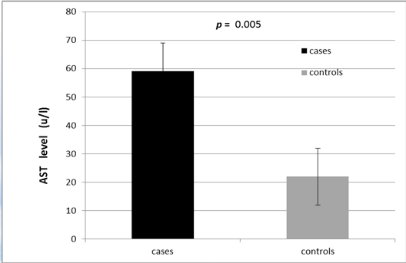
AST LEVEL IN PATIENTS AND CONTROL

Slide 34
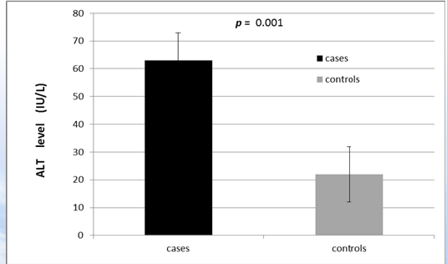
ALT level in patients and control

Slide 35
Table (3) comparison between HBcAb positive and negative occult HBV cases regarding clinical data
Parameter |  | HBcAb positive n=13 (%) | HBcAb negative n=14 (%) | p
Age (years) |  | 11±4.1 | 9±3.9 | 0.31
Gender | Male | 7 (54%) 6 (46%) | 7 (50%) 7 (50%) | 0.84
 | Female
Frequency of Bl. Transfusion (No/Year) |  | 16±4.1 | 13±5.3 | 0.13
Presence of Hepatomegaly |  | 5 (38%) | 5 (36%) | 0.88
Presence Of Splenomegaly |  | 5 (38%) | 6 (43%) | 0.82

Slide 36
Table (4): Comparison between HBcAb positive and negative occult
HBV cases regarding Laboratory data
parameters |  | HBcAb positive n=(13) | HBcAb negative n=(14) | p
PCR | Negative | 0 (0%) 13 (100%) | 14 (100%) 0 (0%) | 0.82
 | Positive
HCVAb | Positive | 6 (46%) 7 (54%) | 1 (7%) 13 (93%) | 0.02*
 | negative
Serum ferritin |  | 2605±1923.3 | 1720±1029.7 | 0.15
AST |  | 60±38.1 | 68±66.2 | 0.7
ALT |  | 77±61.2 | 72±67.6 | 0.86
Blood urea |  | 26±7.3 | 25±7.6 | 0.89
Serum creatinine |  | 0.5±0.16 | 0.5±0.17 | 0.56
HB level |  | 8±1.3 | 8±1.1 | 0.68

Slide 37
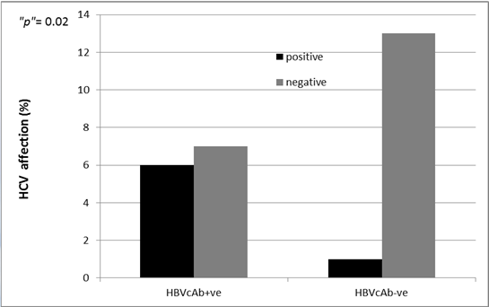
Hepatitis C virus infection prevalence in occult hepatitis B virus infection group

Slide 38
Conclusion
The risk of acquiring occult hepatitis B virus infection is high in studied children who received multiple blood transfusions.
Despite obligatory HBV vaccination schedules, chronically transfused patients were still at high risk of acquiring infection.
Screening such at-risk patients with HBsAg is not enough and PCR screening is recommended. Also, blood donors screening for HBsAg reduces, but does not abolish, the risk of transfusion-transmitted HBV infection.

Slide 39
Conclusion
A high OBI prevalence rate (60%) was found among frequently blood
transfused Egyptian children.
The frequency of hepatitis C virus infection increase in those with occult hepatitis B infection.

Slide 40
Recommendations:
Based on our findings, we recommend the following:
Frequently transfused children must be regularly screened for OBI by a sensitive PCR for HBV-DNA.
Hepatitis B surface antigen negative blood donors should be screened to exclude HBV-DNA positive ones.
Prospective studies with larger number of such patients are important to gain more insight into this important subject

Slide 41


Slide 42


Slide 43


Slide 44


Slide 45


Slide 46


Slide 47


Slide 48


Slide 49


Slide 50
THANK YOU

