Slide 1

Knowledge of risk factors of common NCDs amongst college students
Dr Geetanjali Sharma
MBBS, DNB (Community Medicine),
WiseApple Health Consultancy
INDIA

Slide 2
Face-to-Face with Chronic Non-Communicable Diseases(NCDs)
Prosperity is bringing to our nation many benefits, but all are not positive. As our diets and habits are changing, so are our waistlines.
In India projected number of deaths attributable to chronic diseases are estimated to rise from 3.78million in 1990 (~40% of all deaths) to 7.63million in 2020 (~66.7% of all deaths).
It is a wake up call for all of us to work towards a comprehensive action plan for health promotion to promote healthy diet, physical activity as well as health services to be reoriented to accommodate the needs of chronic disease prevention and control.
The financial cost of poor health and well being is enormous. It is estimated that Indians spent nearly INR 846 billion out of pocket on health care expenses in year 2004, out of which the share of NCDs incurred by households was 47.3% (~397 billion) (Source: The Economic Implication of Non-Communicable Disease for India. Ajay Mahal,Anup Karan, Michael Engelgau. January 2010)

Slide 3

Objective
Objective:
  To assess the knowledge of the risk factors of the common NCDs amongst the college students
  Assess the common eating, smoking and physical activity practices in this group.
Tool: A self-administered questionnaire.

Slide 4
Methodology
The study was part of a health promotion programme conducted amongst 106 (56 female and 50 male students)under-graduate university students in the age group 17-22 years in an urban setting in Delhi
A self administered questionnaire was filled by the students before the Health Promotion programme.
Weight and height status was assessed using self-reported height and weight information, from which body mass index (BMI, kg/m2) was calculated.
Analysis:
  Descriptive statistics were calculated to determine the percentage of young adults
  Linear regression models were used to examine associations between frequency of eating out, physical activity and gender and the BMI.
6 teaching staff members were also included in the study.

Slide 5
Study Sample Profile
The students interviewed (106) were the once who attended the Health promotion programme organized by the University college on the prevention and control of Non Communicable diseases (NCDs) and the once who agreed to take the survey.
The students belonged to the age group 17 to 22 years of age (Av.=18.8 yrs.)
All the students were undergraduate university students .
Majority belonged to the lower middle income group from the catchment area of the college selected for the study.
Availability of popular fast food chains in the area was limited.

Slide 6
Parameters assessed
Information on the following variables was collected:
1. Correct knowledge of risk factors of high Blood Pressure
2. Knowledge of the correct value of Blood Pressure
3. Smoking habit (including smokeless tobacco)
4. Eating out habit
5. Schedule of Physical activity of any form
6. Knowledge on relation between low physical activity and chronic non-communicable diseases.
7. Height, weight (self reported) and BMI calculation.
BMI-Reference values:
Below normal-<18.5
Normal Range=18.5-24.9
Overweight=25-29.9
Obese>30

Slide 7
Study Results….1
A total of 106 students (M=50;F-56))with a average age of 18.8 years were included in the sample for the current study.
STUDENTS GROUP
BLOOD –PRESSURE (BP)
  Overall only 46% students correctly knew the risk factors for high BP (21% female, 25% male students)
  63.2% students could correctly tell the value of normal BP(32% female, 31% males students)
EATING OUT
  Frequent eating out (once a week or more) was reported by 52% students (23% female & 28% male students)
SMOKING
  none reported smoking(???)
  2% informed using smokeless tobacco –Gutka

Slide 8
Study Results….2
PHYSICAL ACTIVITY
  While 52% (25.4% female, 27%male students) correctly reported that low physical activity is risk factor for high BP, Diabetes, some forms of cancers
  More than 28% reported not performing any form of exercise or doing it on less than a fortnight basis.
  28% did some form of physical activity regularly (thrice a week or more): 14% male and 14% female students performed regular exercise
BMI:
  While 68% students were in normal BMI range(18.5-24.9)
  About ~6% students were overweight (BMI-25-29.9) : 4% male and 2% female students were overweight
  Mean BMI=20.3kg/mt²

Slide 9
Study Results….3
Linear regression models were used to examine associations between frequency of eating out, physical activity , gender and the BMI
The results of the simple linear regression analysis revealed the following information about the survey:
BMI shows a positive relationship with the physical activity status of the students.
  The students who indulged in any form of physical activity atleast once a week had their BMI lowered by ~2.2 units (t value=-4.27; p value=0.001 Significance at p<0.05).
Eating out once a week or more had a positive effect on the increase in BMI by~1.5 units (t value=3.476; p value=0.001 Significance at p<0.05)
It was observed that the male students had a higher BMI(0.94 units high) as compared to females and this was found to be significant.( t value=2.077; p value=0.001 Significance at p<0.05)

Slide 10
Results…4

Slide 11
BMI OF THE STUDENTS

Slide 12
Conclusion
The students had a fair knowledge of the correct value of Blood Pressure however, the knowledge of risk factors of blood pressure was low.
As the knowledge of relation between physical activity and risk of diabetes, stroke, BP and cancers amongst the students was not adequate, very few reported performing any form of physical activity regularly in this group.
Low physical activity had a positive relation to increased BMI.
None reported smoking, with the exception of the few who reported using smokeless tobacco.
The results suggest that young adults were frequently eating and were more likely to have higher BMIs.
While majority students had a BMI in normal range (18.5-24.9), very few were found to be overweight/obese in the current study.
Compared to the students, teachers had a fairly good knowledge of risk factors of common NCDs and the relation between physical activity and the NCDs, however, the frequency of physical activity was very low and eating out by the teachers was very high compared to the students which also reflected in majority of teachers being overweight/obese.

Slide 13
Conclusion…..contd
The cost of inaction is much too high
Lives of far too many people are being devastated and cut short by chronic diseases such as heart disease, stroke, cancers, chronic respiratory illnesses and diabetes.
This is no longer happening just high income countries.
  Four out of five chronic disease deaths today are in low and middle income countries.
  People in India tend to develop disease at a younger age, suffer with preventable complications and die sooner than those in high income countries.
This is a very serious situation both for the public health and the societies and economies affected,

Slide 14
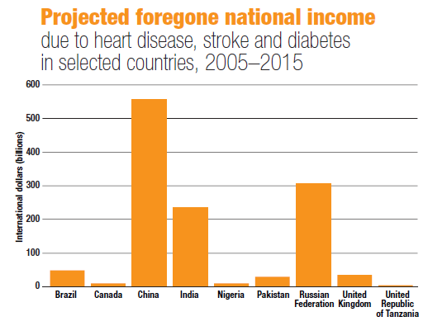
ACTION IS URGENTLY NEEDED NOW.
NCDs ARE COSTLY, AS THE EPIDEMIC KEEPS RISING, IT WILL BECOME A MAJOR ECONOMIC ISSUE FOR COUNTRIES AND FAMILIES
Source: Preventing Chronic Disease-A vital Investment: WHO

Slide 15
Healthy lifestyles and interventions can reduce NCDs as CVDs, DM, some forms of cancers, stroke, hypertension.
Interventions towards reduction of risk factors—including physical inactivity, tobacco use, unhealthy diet, harmful use of alcohol can reduce the prevalence of NCDs by as much as 70%.

Slide 16
Recommendations
Essential to communicate the latest and most accurate knowledge and information to front line health professionals and public at large.
Health Promotion programmes on prevention and control of the NCDs for the target population-at school, colleges, at workplaces.
Improve diets and physical activity, through policies that prevent obesity, promote healthy living and encourage consumption of more fruits and vegetables and less processed foods high in fat, salt and sugar.
  Besides lack of awareness, one important barrier to regular PA is lack of designated areas available for physical activity...more of a barrier for the young girls
High level political commitment and a guiding national policy.

Slide 17
Limitations of the study
The sample population of the study being very small, future studies in young adult populations are needed to confirm the results and develop a better understanding of the knowledge, attitude and practices that influence food choices, physical activity and other modifiable risk factors of NCDs.
Height and weight status was assessed using self-reported height and weight, from which body mass index (BMI, kg/m2) was calculated.
  Self-report of height and weight was not validated by actual measurements.

Slide 18
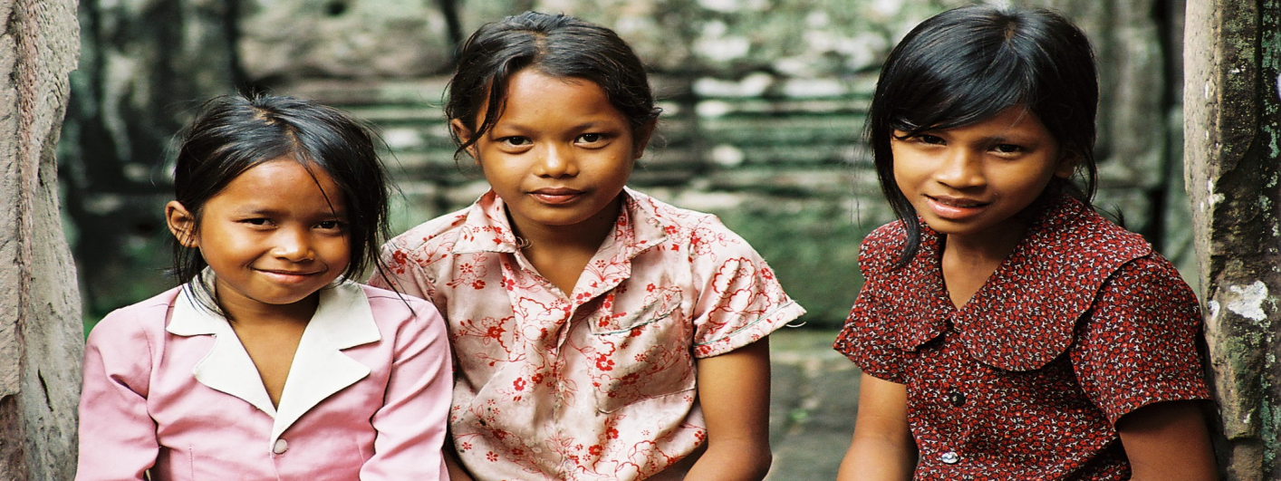
It is not enough to say-” We have told them not to smoke; we have told them to eat fruits, vegetables; we have told them to do regular exercise”
We need to create communities, schools, workplaces that make these healthy choices possible.

Slide 19

LIVE A HEALTHY LIFE
THANKS
Website: www.wiseapple.in
Email at promotehealth@wiseapple.in
Phone-011-43612655,+91-9910272655

Slide 20
Study Results
TEACHERS GROUP
BLOOD –PRESSURE (BP)-
  100% teachers correctly knew the risk factors for high BP, whereas only 67% knew the correct value of normal BP
EATING OUT
  100% teachers (N=6)reported eating out regularly (once a week or more)
SMOKING
  none reported smoking
PHYSICAL ACTIVITY
  50% teachers exercised less than a fortnight or not at all
  83% correctly knew that low physical activity is the risk factor for common NCDs.
BMI
  100% teachers had BMI higher than the normal range (18.5-24.9), while 16% (N=1)were obese

Slide 21
Study Results…Contd….
 | Students (N=106) | Teachers (N=6)
Knowledge of risk factors for BP | 46% | 100%
Knowledge of correct value of normal BP | 63.2% | 67%
Eating Out (once a week or more) | 52% | 100%
Physical activity (not at all/<fortnight) | 28% | 50%

Slide 22
BMI (normal range-18.5-24.9) |  | BMI (Overwt./Obese)
Students (N=106) | Teachers (N=6) | Students (N=106) | Teachers (N=6)
68% | 33% | 6% | 100%

Slide 23
Implement Priority NCD strategies
IMPROVE DIETS AND PHYSICAL ACTIVITY, through policies that prevent obesity, promote healthy living and encourage consumption of more fruits and vegetables and less processed foods high in fat, salt and sugar.
TOBACCO REDUCTION, by accelerating implementation of the WHO Framework Convention on Tobacco Control, which includes taxation, restrictions on marketing and sales of tobacco products, as well as banning smoking in public places.
SALT REDUCTION, through food product reformulation and public awareness, to improve prevention and control of hypertension.
REDUCE HARMFUL USE OF ALCOHOL, including through taxation and regulations on alcohol promotion and marketing.

Slide 24
raise awareness of the importance and benefits of physical activity among the population,
educate the specific population groups;
conduct local physical activity programmes and initiatives;
build capacity among individuals implementing local physical activity programmes through
training of potential programme coordinators;
create supportive environments that facilitate participation in physical activity; and
give recognition/awards to individuals who live a healthy lifestyle, engage in regular physical
activity, and encourage others to do so.

Slide 25
Essential prerequisites are:
high level political commitment/guiding national policy
funding
support from stakeholders, and
a coordinating team.
Other important factors are:
clear programme objectives
integration of physical activity within other related interventions
multiple intervention strategies
target the whole population as well as specific population groups
clear identity for the programme
implementation at different levels
implementation within the “local reality”
leadership
dissemination of the intervention
evaluation and monitoring, and
national physical activity guidelines.

Slide 26
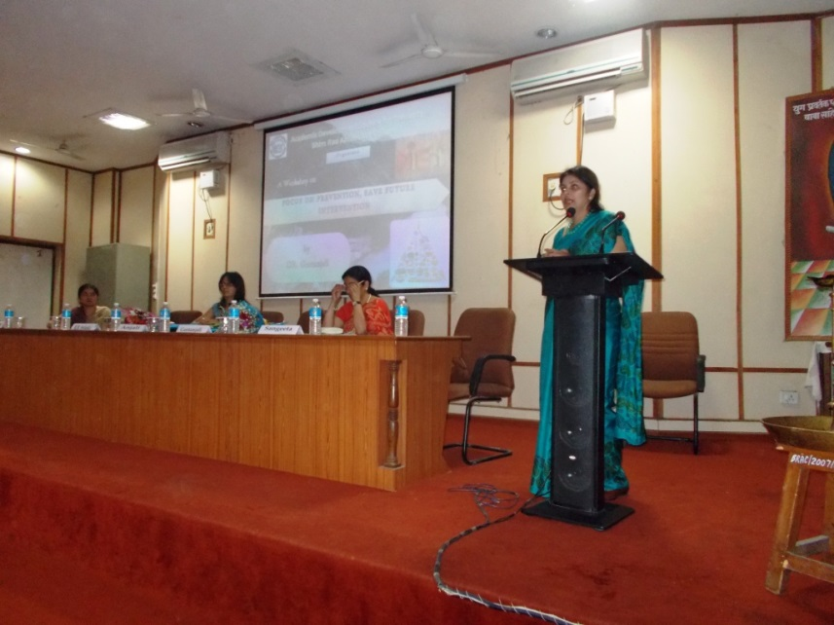
public health authorities need to raise awareness of the importance of a healthy and sustainable lifestyle as a foundation of the health of the Indian population.
need for interventions to promote healthier food choices among young adults who report frequent burger-and-fries restaurant use

