Slide 1
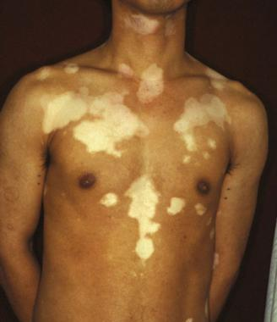
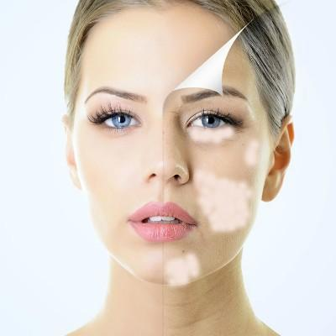
Dr. GARIMA KHURANA
INDIA
Clinico-Epidemiological Study
Of
Vitiligo

Slide 2
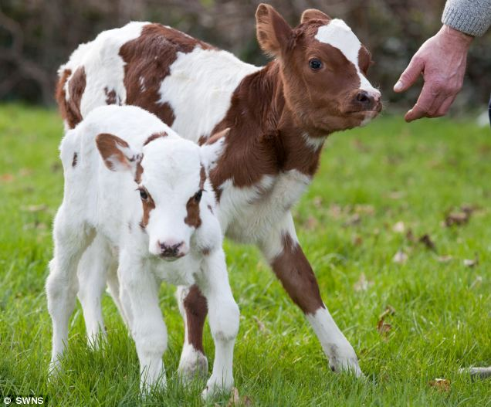
Introduction
lesions resemble white patches of a spotted calf.
Autoimmune condition presents as acquired white patches on the skin and overlying hair.

Slide 3
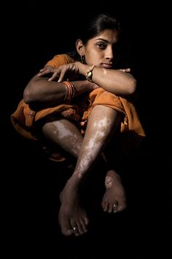

social embarrassment
Lack Of Scientific Appraisal
Confusion Of Vitiligo With Leprosy
Widespread Prejudices
Ignorance

Slide 4
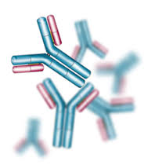
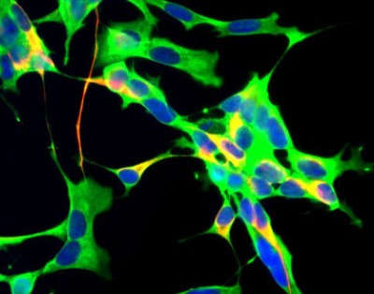
Mechanics
Immune Response Hypothesis
Association with other autoimmune disorder
Presence of autoantibodies against the melanocytes.

Slide 5
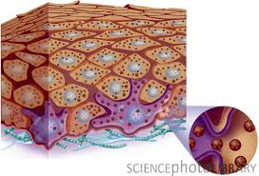
Autotoxic Self Destructive Theory
Phenolic compounds, DOPA, tryptophan have potential to cause vitiliginous lesions.
Removal of toxic melanin precursors does not occur
Melanocyte death

Slide 6
Neural Hypothesis
Norepinephrine and acetylcholine toxic to melanocytes
Destrution of melanocytes

Slide 7
OTHER THEORIES
Antioxidant Deficiency Theory: Increased Oxidative Stress Leading To Melanocytes Death.
Composite Hypothesis
Apoptosis of the Melanocytes
Melanocyte Growth Factor Reduction Which is Required for The Normal Proliferation of Melanocytes.

Slide 8
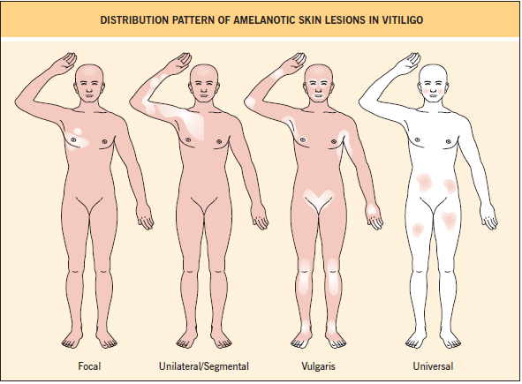
Classification of vitiligo

Slide 9
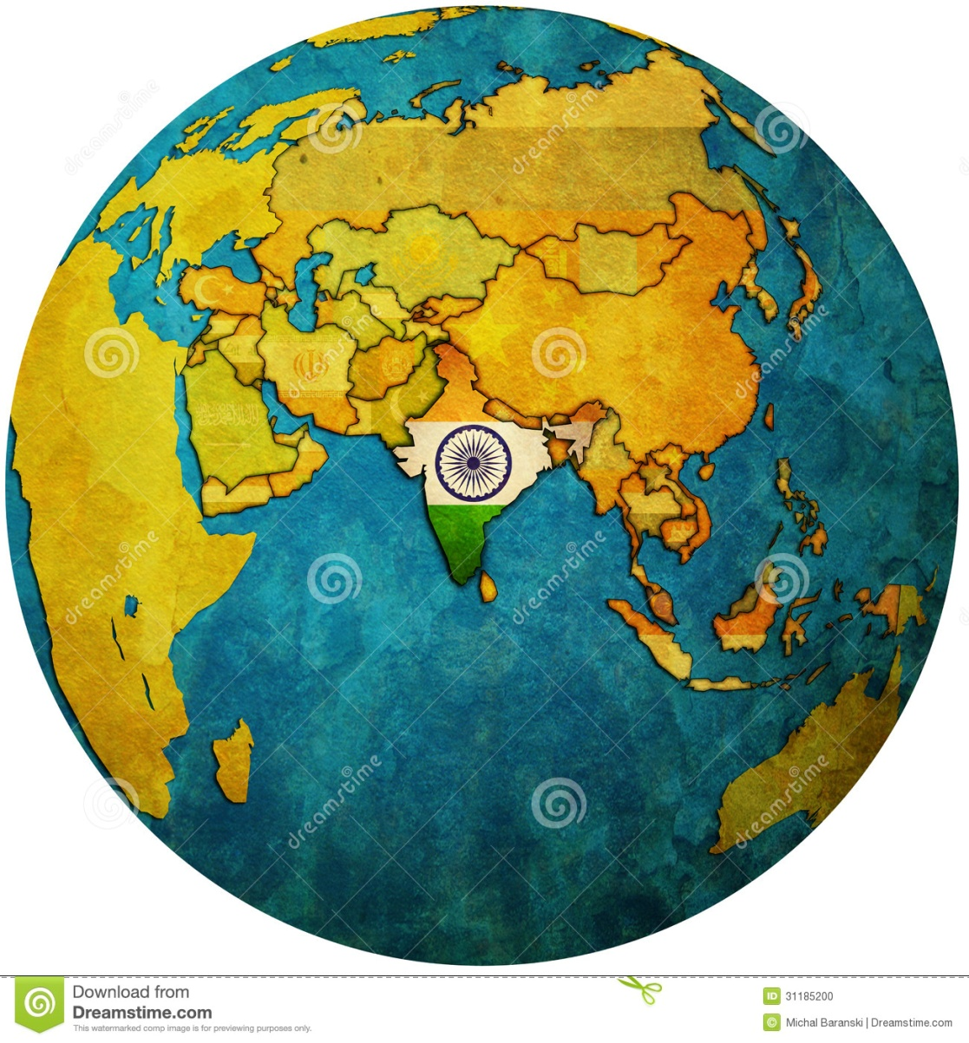
Epidemiology
Globally: 0.1-1.3%
Highest Incidence: INDIA & MEXICO.
India: Incidence 3-4 %
Rajasthan and Gujarat shows 8.8% incidence of vitiligo.

Slide 10

Aim & objectives
The Purpose Of The Study Was To Learn More About Epidemiology Of Vitiligo In India And Evaluate The Factors Like:
Age Of Onset
Sex Ratio
Role Of Hereditary Factors
Association With Other Diseases

Slide 11
Materials &Methods
Cross Sectional Study Performed With The Approval Of The Institutional Ethical Committee
Inclusion Criteria
100 Self Reporting Patients Of Vitiligo Of Any Age And Either Sex Attending Our OPD Were Included In The Study.

Slide 12
MATERIALS &METHODS
Exclusion Criteria
Patients Who Developed Depigmentation Secondary To Burns, Trauma And Other Diseases Were Excluded From The Study.
All The Patients Were Interrogated For A Detailed History And Examination.

Slide 13
SPECIAL EMPHASIS
Age Of Onset
Family History
Presence Of Any Other Diseases
Socio-demographic Profile Of The Patients.
The Data Was Statistically Described In Frequencies & Percentages.

Slide 14
Results
Majority Of Patients Were In The Age Group Of 26-35 Years. However, Other Study^{[1]} Showed The Age Of Onset To Be Between 40 And 60 Years.

Slide 15
Results
Females Outnumbered Males In Our Study Presumably Because Social Stigma And Marital Concerns Prompt Women To Seek Early Consultation.
The Female To Male Ratio Was 1.3:1

Slide 16
Results
Most Of The Patients Had History Of Multiple Lesions.
The Frequency Of Distribution Of Clinical Types Of Vitiligo Varies In Different Studies.

Slide 17
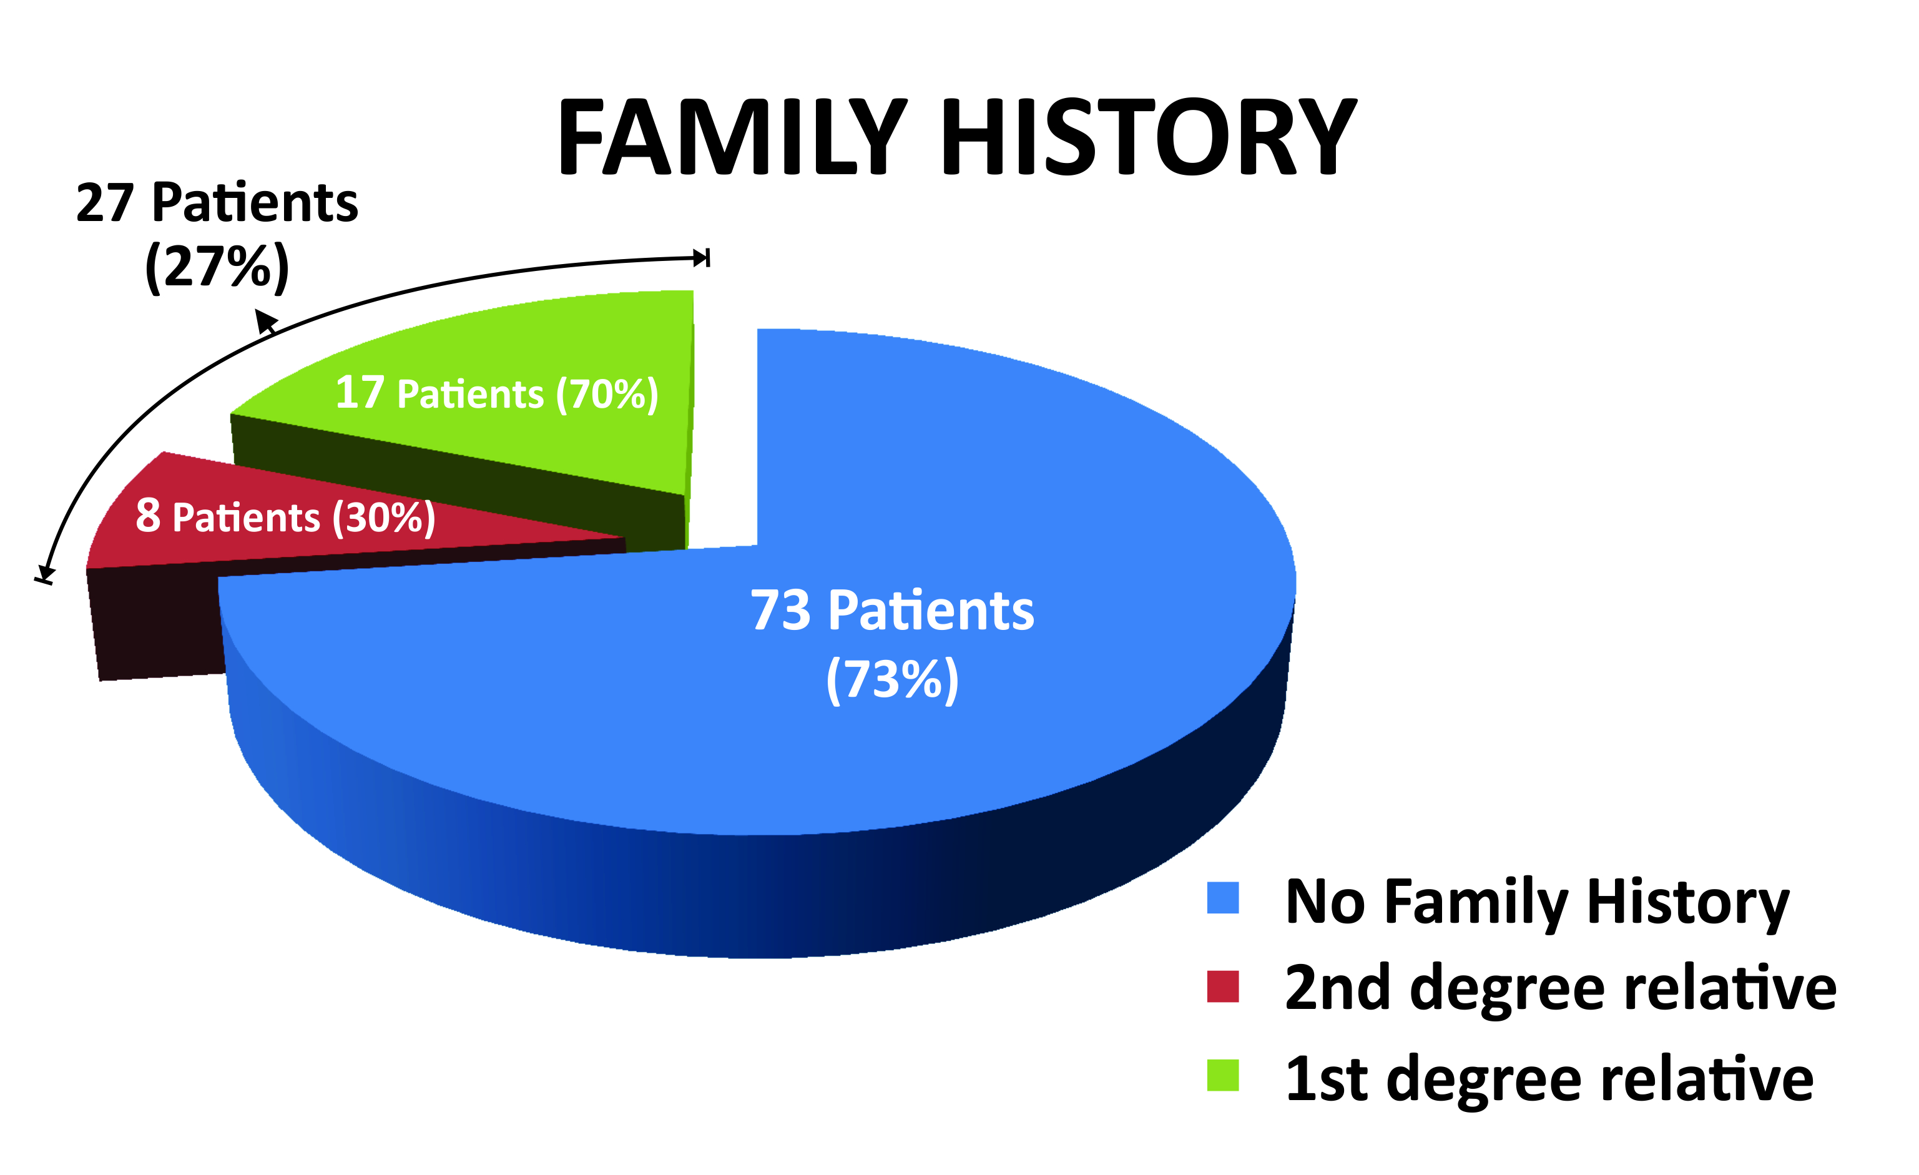
Results
27% Cases Give A Definite Family History Out Of Which 70% Were 1st Degree Relatives.
Familial Occurrence Has Been Reported To Be In The Range Of 6.25% To 20%^{[13]}

Slide 18
Results
No Significant Systemic Illnesses Were Observed In Our Study.

Slide 19
Conclusion
Various Etiologies Play A Role In The Mechanism Of Vitiligo.
Occurs Commonly In Second Decade Of Life.
Females Of The Marriageable Age Forms The Major Group.
No Significant Systemic Illnesses Were Observed In Our Patients.

Slide 20
References
Howits J, Brodthagen H, Schwarts M, Thomsen K. Prevalence of vitiligo: Epidemiological survey the Isle of Bornholm, Denmark. Arch Dermatol 1977;113:47-52
Handa S, Kaur I. Vitiligo: Clinical findings in 1436 patients. J Dermatol 1999;26:653-7.
Koranne RV, Sehgal VN, Sachdeva KG. Clinical profile of vitiligo in North India. Indian J Dermatol Venereol Leprol 1986;52:81-2.
Sarin RC, Kumar AS. A clinical study of vitiligo. Indian J Dermatol Venereol Leprol 1977;43:300-14.
Koranne RV, Sehgal VN, Sachdeva KG. Clinical profile of vitiligo in North India. Indian J Dermatol Venereol Leprol 1986;52:81-2.

Slide 21
Thank you
Dr. Garima Khurana

