Slide 1
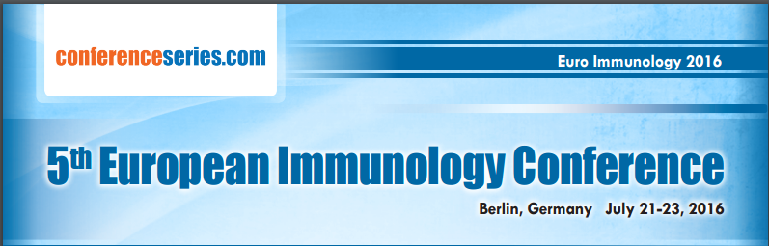

Unmasking the masquerading cancer cells: have we made progress with the revival of immunotherapy?
Dr Ganapathi Bhat M.
Consultant Medical Oncologist & Stem Cell Transplant Physician,
Jaslok Hospital & Research Centre, Mumbai. India
dr_bhat2@yahoo.com
www.drganapathibhat.in
Ganapathi Bhat

Slide 2
Presentation outline
Immune System’s Role in Cancer
Immunotherapy Landscape
State of Immunotherapy
Clinical Considerations of Immunotherapy
Where are we and How far will we go?
Ganapathi Bhat

Slide 3
Immune Evasion Recognized as a Hallmark
Evading growth suppressors
Avoiding
immune
destruction
Activating invasion and metastasis
Hallmarks
of Cancer Pathogenesis (2011)
Deregulating
cellular
energetics
Enabling replicative immortality
Sustaining proliferative signaling
Inducing
angiogenesis
Resisting
cell death
Hanahan D, Weinberg RA. Cell. 2011;144(5):646-674.
Ganapathi Bhat

Slide 4
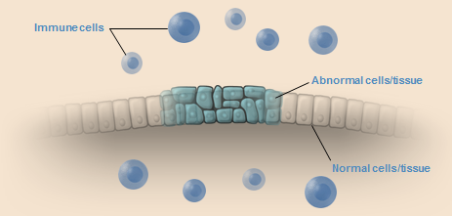
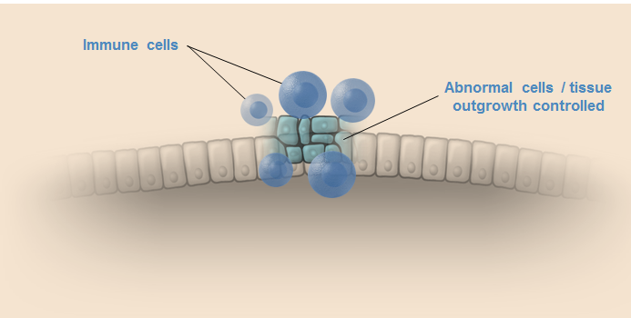
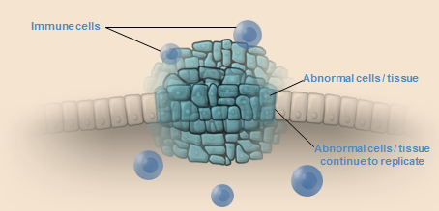
Dynamics Between Cancer and the Immune System
The 3 E’s
Elimination -Immune System Eradicates Cancer Cells
Equilibrium - Immune System Controls Cancer Cells
Escape - Cancer Cells Evade Immune System
Dunn GP, Schreiber RD, et al. Nat Rev Immunol. 2006;6(11):836-848.
Ganapathi Bhat

Slide 5
Increased Incidence of Cancer in Immunocompromised Individuals
Dynamics Between Cancer and the Immune System
Malignant tumors develop in individuals with compromised immune systems
Tumor / cancer risk in transplant patients compared to general population
Non-melanoma skin cancer
Non-Hodgkin’s lymphoma
20-fold and beyond
Kaposi’s sarcoma
Kidney cancer
15-fold
Melanoma
8-fold
Vulvovaginal cancer
Cervical cancer
5-fold
Hepatobiliary cancer
Leukemia
Bladder cancer
3-fold
Testicular cancer
Breast cancer
Ovarian cancer
Pancreatic cancer
Esophageal cancer
2-fold
Stomach cancer
Prostate cancer
Lung cancer
Colon cancer
0
5
10
15
20
Fold-increase in tumor/cancer risk
Kasiske BL, Wang C, et al. Am J Transplant. 2004;4(6):905-913.
Le Mire L, Wojnarowska F, et al. Br J Dermatol. 2006;154(3):472-477.
Herrero JI. Liver Transpl. 2009;15(suppl 2):S90-S94.
Abbas AK, Lichtman AH. Basic Immunology. 3rd ed. 2011.
Ganapathi Bhat

Slide 6
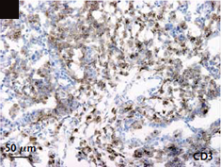
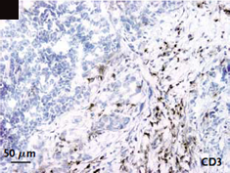
Immune Cells Within Tumors Predicts Overall Survival
Dynamics Between Cancer and the Immune System
T-cell infiltration within tumors is associated with overall survival (OS) in patients with different cancers
Kaplan-Meier Curve for OS in
Advanced Ovarian Cancer¹
P<0.001
a
a) T cells infiltrating tumor cells
100
75
Intratumoral T cells (n=102)
Median OS = 50.3 months
50
OS (%)
25
n=102
b
b) No intratumoral T cells detected: T cells restricted to tissue surrounding tumor
No intratumoral T cells (n=72)
Median OS = 18 months
0
0
12
24
36
48
60
72
84
96
108
120
132
Month
Zhang L, Coukos G, et al. N Engl J Med. 2003;348(3):203-213.
Galon J, Pagès F, et al. Science. 2006;313(5795):1960-1964.
Ganapathi Bhat

Slide 7


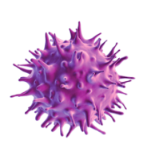
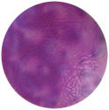
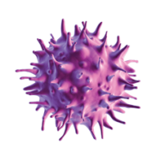


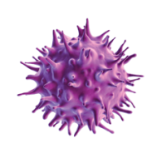
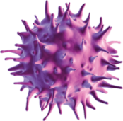
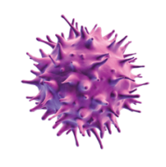
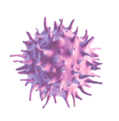
Initiation of Immune Response: Key Components
Antigen
fragments
Antigen
Naive
T-cell
Antigen receptors
Effector cells:
Activate other
immune cells
Kill “target cells”
Antigen
presenting
cell (APC)
Activated
T-cell
Memory cells:
Circulate for months → years
Ready to rapidly respond to same antigen again
Antigen
recognition
Activated
APC
T-cell
interaction
T-cell
activation
Replication of antigen-specific
T-cells
T-cells become specialized
Activation
  Lymphoid Organs
  Peripheral Tissues
Abbas AK, Lichtman AH. Basic Immunology. 3rd ed. 2011.
Ganapathi Bhat

Slide 8
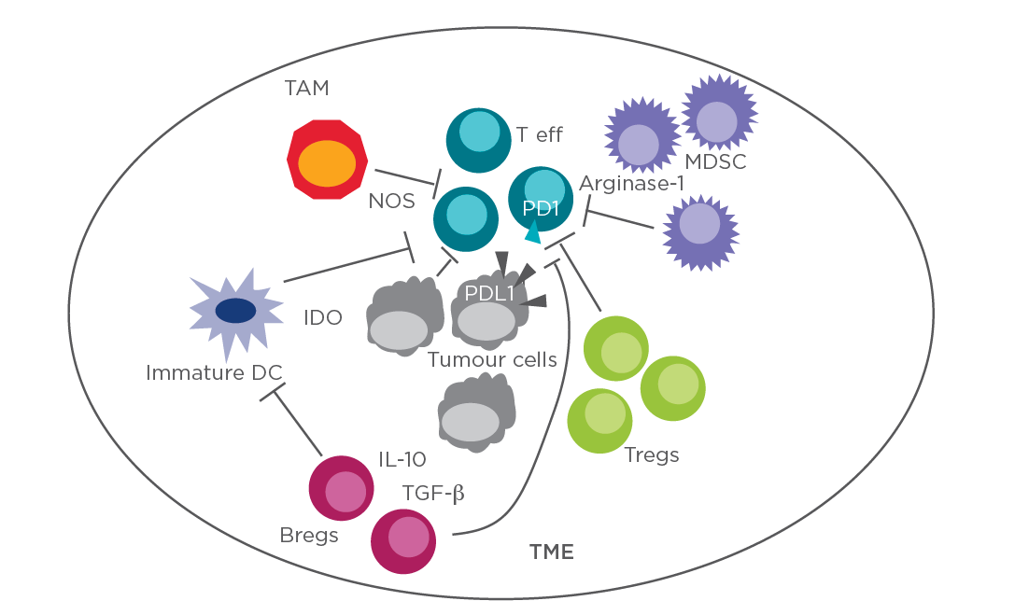
Cancer immune escape mechanisms
Within the tumour micro-environment (TME) several mechanisms that help tumours to escape immune attack:
1. regulatory B cells (Bregs) produce immunosuppressant cytokines including interleukin (IL)-10 and transforming growth factor-beta (TGF-β);
2. regulatory T cells (Tregs) directly inhibit the function of effector T cells (Teff);
3. myeloid derived suppressor cells (MDSCs) suppress effector T cells through arginase-1;
4. tumour-associated macrophages (TAM) inhibit effector T cells through nitric oxide produced by NO synthase (NOS);
5. immature dendritic cells (immature DC), but also tumour cells highly express indoleamine 2,3-dioxygenase (IDO) leading to tryptophane deprivation, which inhibits effector T cell function.
PD1: programmed death receptor
Ganapathi Bhat

Slide 9
Features of an Effective Immune Response
Specificity- Ability of immune cells to identify and target a specific antigen
Trafficking- Ability of activated immune system cells to migrate to particular antigens throughout the body
Adaptability- Allows for a broader immune response (eg, immune response to additional antigens)
Target elimination- Ability of immune cells to destroy their target (eg, cancer cells) Usually via induction of apoptosis
Durability (immune memory)- Ability of immune system to recognize an antigen to which it has previously been exposed and provide long-lasting protection against it
Abbas AK, Lichtman AH. Basic Immunology. 3rd ed. 2011.
Drake CG. Nat Rev Immunol. 2010;10(8);580-593.
Ganapathi Bhat

Slide 10
Immunotherapy in Cancer
Therapies that engage the immune system have been shown to improve patient survival in randomized, phase 3 cancer trials
Immunotherapies (cytokines, checkpoint inhibitors, therapeutic vaccines, monoclonal antibodies) have been approved by the FDA to treat certain cancers
Robert C, Wolchok JD, et al. N Engl J Med. 2011;364(26):2517-2526.
Hodi FS, Urba WJ, et al. N Engl J Med. 2010;363(8):711-723.
Kantoff PW, Schellhammer PF, et al. N Engl J Med. 2010;363(5):411-422.
Mellman I, Dranoff G, et al. Nature. 2011;480 (7378): 480-489.
Ganapathi Bhat

Slide 11



The timeline Immunotherapy
Enthusiasm Phase
Skepticism Phase
Renaissance Phase
1978-1985
1985-1997
1997-
1992
IL-2 (cytokine) approved
for CA
2010
1st cellular immunotherapy approved for CA
1986
IFN-α (cytokine) approved for CA
1985
1st study with adoptive T-cell transfer in CA
1976
1st study with BCG in bladder CA
1890s
1st CA vaccine developed (Coley)
1990s Discovery of role of checkpoint inhibitors
in CA
1978
Discovery of tumor specific mABs
2011
1st checkpoint inhibitor approved
for CA
1973 Discovery
of the
dendritic cell (Steinman)
1997
1st mAB approved
for CA
BCG, Bacille Calmette-Guerin; mABs, monoclonal antibodies; CA, cancer; IFN-α, interferon alpha; IL-2, interleukin-2
Kirkwood JM, Ferrone S, et al. CA Cancer J Clin. 2012;62(5):309-335.
Lesterhuis WJ, Punt CJ, et al. Nat Rev Drug Discov. 2011;10(8):591-600.
Krummel MF, Allison JP. J Exp Med. 1995;182(2):459-465.
Lotze M. In: Cancer: Principles & Practice of Oncology. 9th ed. 2011.
Leget GA, Czuczman MS. Curr Opin Oncol. 1998;10(6):548-551.
Ganapathi Bhat

Slide 12
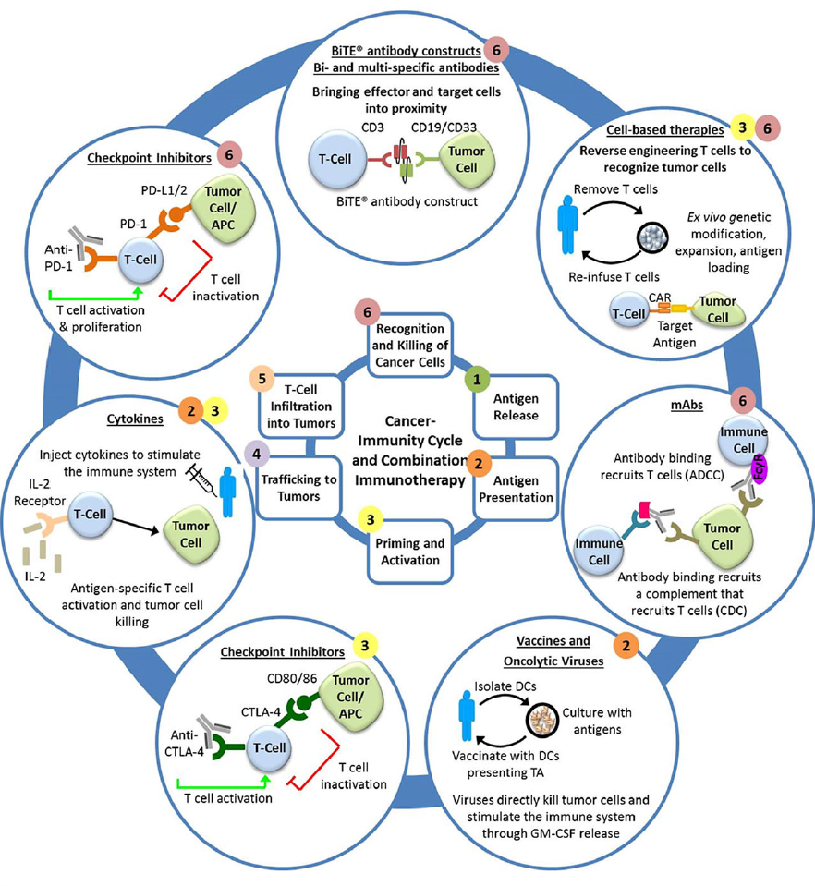
Intervention in the cancer-immunity cycle by immunotherapy agents
Overcoming resistance and restoring a functional immunesurveillance system requires leveraging multiple, complementary mechanisms of action and agents that acts in multiple phases of the
cancer-immunity cycle (numbers denote the phases at which each type of immunotherapy acts)
Clin Transl Sci (2016) 9, 89–104; doi:10.1111/cts.12391
Ganapathi Bhat

Slide 13
Immunotherapy: Gaining approval
More than a dozen different immunotherapy agents have been approved, with the majority over the last decade
Immunotherapy agents currently approved target >10 different cancer types
FDA-Approved Immunotherapiesª
Class | Approvals
Checkpoint inhibitor | 2011
Therapeutic vaccine | 2010
Monoclonal antibodies | 1997, 1998, 2000, 2001, 2002, 2003, 2004, 2006, 2009
Cytokines | 1986, 1992, 1995, 1998
ªNot inclusive of all immunotherapy classes.
Mellman I, Dranoff G, et al. Nature. 2011;480(7378):480-489.
Kirkwood JM, Ferrone S, et al. CA Cancer J Clin. 2012;62(5):309-335.
Lotze M. In: Cancer: Principles & Practice of Oncology. 9th ed. 2011.
Sondak VK, Hauschild A, et al. In: Cancer: Principles & Practice of Oncology. 9th ed. 2011.
Robinson MK, Weiner LM, et al. In: Cancer: Principles & Practice of Oncology. 9th ed. 2011.
Ganapathi Bhat
13

Slide 14

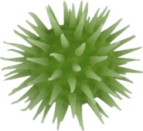
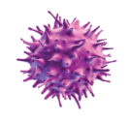
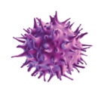
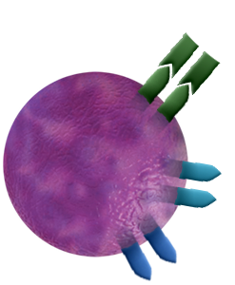
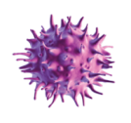

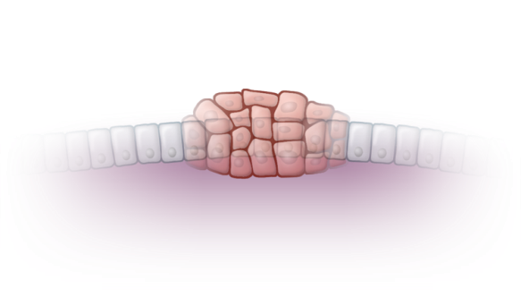

Checkpoint Inhibitors
Therapeutic Cancer Vaccines
Mechanism of action
  Block immune checkpoints that regulate T cell activation/function
Examples
  CTLA-4 and PD1
Efficacy
  Extends overall survival in certain metastatic diseases
  A significant effect on PFS not consistently observed
Mechanism of action
  Activation of T cells to seek out and destroy target cancer cells
Efficacy
  Extended overall survival in certain metastatic diseases without an effect on PFS
Naive
T cell
Activated
APC
Activated APC
Activated
T cell
Naive
T cell
CTLA4 receptor
Normal
cells/tissue
CTLA4 antibodies
PD1
receptor
PD1 antibodies
Abnormal
cells/tissue
CTLA-4, cytotoxic T lymphocyte-associated antigen 4; PD1, programmed cell death protein 1
Pardoll D. Nat Rev Cancer. 2012;12(4):252-264.
Sharma P, Allison JP, et al. Nat Rev Cancer. 2011;11(11):805-812.
Hodi FS, Urba WJ, et al. N Engl J Med. 2010;363(8):711-723.
Robert C, Wolchok JD, et al. N Engl J Med. 2011;364(26):2517-2526.
Brahmer JR, Wigginton JM, et al. N Engl J Med. 2012;366(26): 2455-2465.
Topalian SL, Sznol M, et al. N Engl J Med. 2012;366(26):
2443-2454.
Drake CG. Nat Rev Immunol. 2010;10(8):580-593.
Kantoff PW, Schellhammer PF, et al. N Engl J Med. 2010;363(5):411-422.
Kantoff PW, Godfrey WR, et al. J Clin Oncol. 2010;28(7):1099-1105.
Ganapathi Bhat

Slide 15
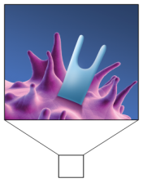
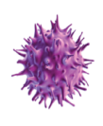



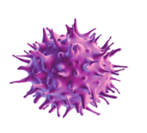

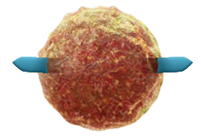
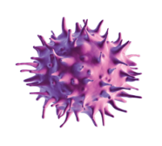
Monoclonal Antibodies (mABs)
Cytokines
Mechanism of action
  Differs between agents
  Bind to their specific target antigen ultimately causing
  cell death
Efficacy
  Improved overall and progression-free survival (PFS) in randomized, phase 3 clinical trials in breast cancer, colorectal cancer, leukemia, and head and neck cancer
Mechanism of action
  Interleukin-2 (IL-2) stimulates
  T-cell proliferation
Examples
  Interleukins, interferons
Efficacy
  High dose IL-2 administration resulted in long term disease-free survival in patients with melanoma and renal cell carcinoma
Cytokine-mAb
T cell
IL2 Receptor
Toxin-mAb
Tumor
cell
Drug-mAb
Receptor
Cell Proliferation
Tumor cell death
Cheson BD, Leonard JP. N Engl J Med. 2008;359(6):613-626.
Weiner LM, Wang S. Nat Rev Immunol. 2010;10(5):317-327.
Slamon DJ, Norton L, et al. N Engl J Med. 2001;344(11):783-792.
Curran D, Bonner JA, et al. J Clin Oncol. 2007;25(16):2191-2197.
Vermorken JB, Hitt R, et al. N Engl J Med. 2008;359(11):1116-1127.
Jonker DJ, Moore MJ, et al. N Engl J Med. 2007;357(20):2040-2048.
Robak T, Moiseev SI, et al. J Clin Oncol. 2010;28(10):1756-1765.
Bachmann MF, Oxenius A. EMBO Rep. 2007;8(12):1142-1148.
Lotze M. In: Cancer: Principles & Practice of Oncology. 9th ed. 2011.
Ganapathi Bhat

Slide 16
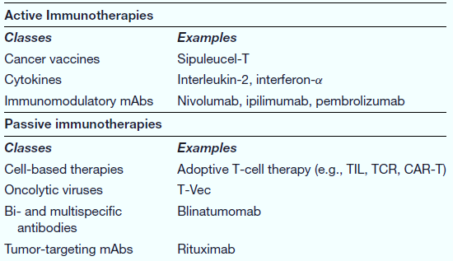
Classes of immunotherapy agents in oncology
Clin Transl Sci (2016) 9, 89–104; doi:10.1111/cts.12391
Ganapathi Bhat

Slide 17
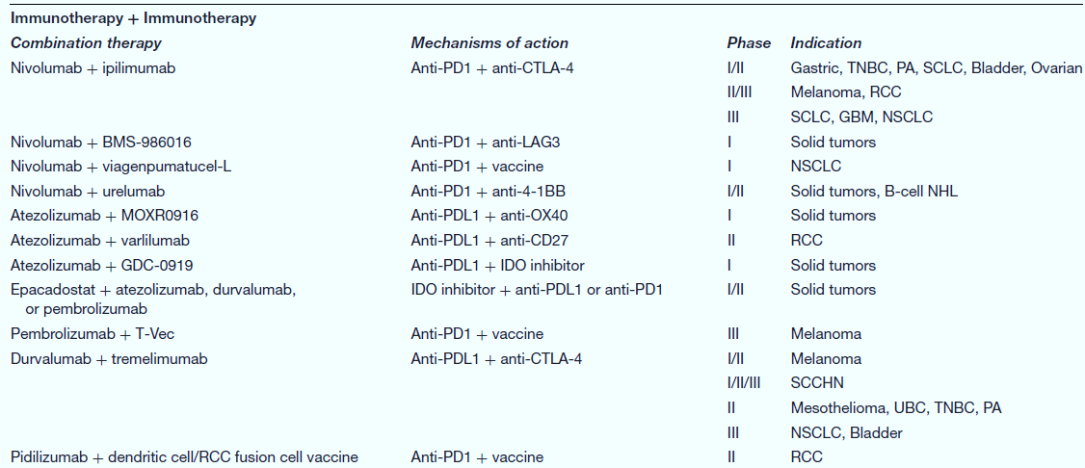
Selected list of combination immunotherapies in clinical development
Clin Transl Sci (2016) 9, 89–104; doi:10.1111/cts.12391
Ganapathi Bhat

Slide 18
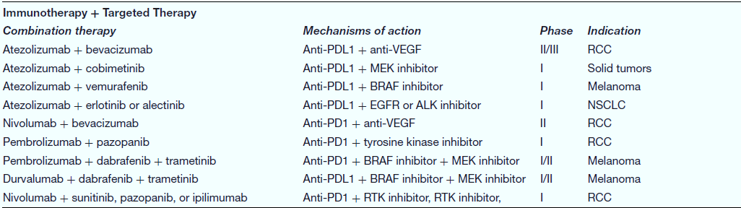
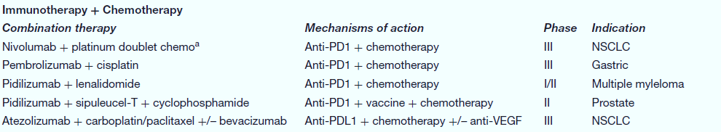
Selected list of combination immunotherapies in clinical development
Clin Transl Sci (2016) 9, 89–104; doi:10.1111/cts.12391
Ganapathi Bhat

Slide 19
Immunotherapy: Treatment Considerations
Standard practice in oncology is the use of combination agents with different mechanisms
of action
  Chemotherapy and mABs
  Radiation and chemotherapy
  Multiple chemotherapy regimens
Immunotherapy offers potential for synergy with other therapies
Relative efficacy of immunotherapy may be greater with lower tumor burden
Patient given immunotherapy earlier in disease course might have a better outcome
Tumor Growth Rate
†
†
†
Expected clinical outcome if no treatment is provided
B
†
Death
A
A
Patient given a vaccine earlier
Tumor Burden
B
Patient given a vaccine later
Time
Vermorken JB, Hitt R, et al. N Engl J Med. 2008;359(11):1116-1127.
Slamon DJ, Norton L, et al. N Engl J Med. 2001;344(11):783-792.
Gulley JL, Drake CG. Clin Cancer Res. 2011;17(12):3884-3891.
Drake CG, Adler AJ, et al. Cancer Cell. 2005;7(3):239-249.
Mercader M, Kwon ED, et al. Proc Natl Acad Sci USA. 2001;98(25):14565-14570.
Aragon-Ching JB, Gulley JL, et al. Front Biosci. 2007;12:4957-4971.
Kirkwood JM, Ferrone S, et al. CA Cancer J Clin. 2012;62(5):309-335.
Drake CG. Nat Rev Immunol. 2010;10(8):580-593.
Gulley JL, Drake CG. Clin Cancer Res. 2011;17(12):3884-3891.
Ganapathi Bhat

Slide 20

Immunotherapy: Increasing research interest
Rapid increase in immunotherapy
clinical research
  Doubling of abstracts at major conferences from 2009 to 2012
  Approximately 800 clinical trials in various phases ongoing
    eg, breast, colon, head and neck, kidney
Trials utilize agents alone and in combination with conventional therapies
SeekingAlpha.com. http://seekingalpha.com/article/667581-immunotherapy-comes-of-age-at-asco-2012. Accessed January 4, 2013.
ClinicalTrials.gov. http://clinicaltrials.gov/. Accessed January 4, 2013.
Ganapathi Bhat

Slide 21
Immune modulation does not exist in a vaccuum
primers
cytokines
vaccines
cytotoxics
checkpoints
CTLA4
PD-1
TIM3 etc
Chemotherapy
Radiation Therapy
Targeted Therapy
other (e.g SCT)
expanders
TNFRs
CAR-T
BiTEs
Such complexity offers significant challenge, but also opportunity, for new drugs to have a positive impact
Ganapathi Bhat

Slide 22
Checkpoints Dominate....
Inhibition appears to be dominant over activation
  Preclinical models support this view
  Early clinical data support this view, e.g. monotherapeutic activity of TNFR agonists is low
  Even CAR T cells can be shut down by immune checkpoint expression
The impact of removing constraints on NK cell activity and on immuno-suppression imposed by stromal cells is not known
primers
cytokines
vaccines
cytotoxics
checkpoints
CTLA4
PD-1
expanders
TNFRs
CAR T
BiTEs
Ganapathi Bhat

Slide 23
Considering a patient
Indication
Genetics
Line
Age
Surgery
Debulking
Patient
Chemotherapy
Irradiation
Targeted Tx
Transplant
Ganapathi Bhat

Slide 24
Efficacy/Tolerability: where we are headed depends on the indication
Hematologists have been excited about the "post-chemo" era.
Why? Ibrutinib, rituxumab, idelalisib, revlimid etc ...
Solid tumor oncologists already know from targeted therapies that some of their patients can be cured (e.g. targeted therapies & antibodies in breast cancer) – anticipating better cure rates with IO
  Oncologists in general are seeing success where for decades there has been only abject failure (NSCLC, H&N, bladder, etc)
  All oncologists recognize the importance of being able to treat their elderly patients
In this landscape, the efficacy/tolerability profile can be differentiating
Ganapathi Bhat

Slide 25
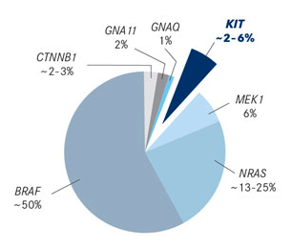
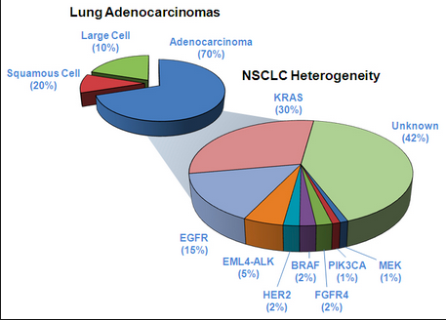
Complex indications, complex patients
Driver mutations in metastatic melanoma and in lung cancers
Ganapathi Bhat

Slide 26
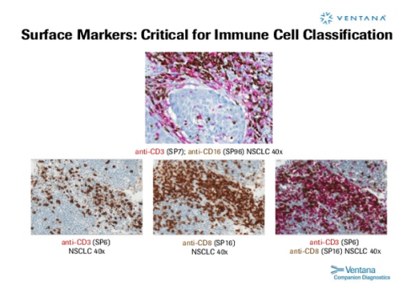
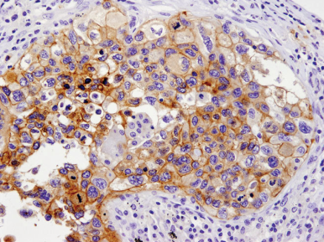
Complex indications, complex patients
Expression of lymphocyte markers and PD-L1 in NSCLC
but this picture is highly variable
  degree of infiltration (starting at none)
  geography of infiltration (marginal, interstitial, stromal, excluded)
  functionality of infiltrates (PD-1, TIM-3, LAG3)
T cells NK cells
CD3+/CD8+ T cells
Ganapathi Bhat

Slide 27
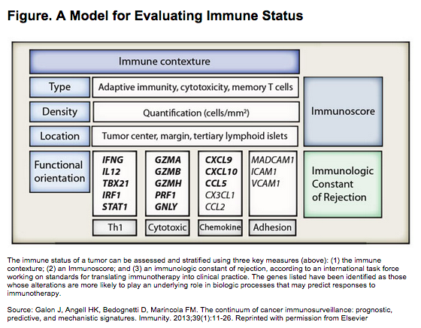
Complex indications, complex patients
CD3+
CD8+
Galon et al 2013. Immunity 39: 11-26
Ganapathi Bhat

Slide 28
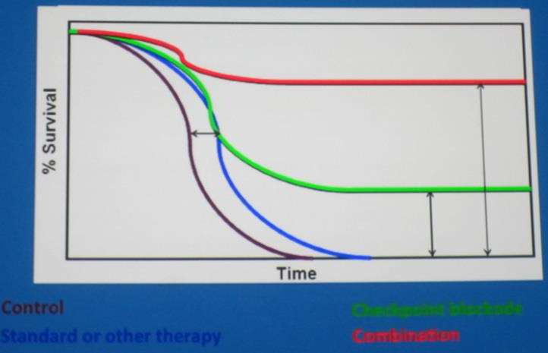
Assessing the benefit with immunotherapy
Combinations of traditional and immunotherapies could combat the initial drop in survival while also providing the long-term response (red)
Immunotherapies may show similar survival kinetics to traditional therapies as an immune response develops, but could provide a much longer survival benefit for a subset of patients (long green tail).
Idealized characteristics of traditional (blue) and immunotherapies (green).
Adapted from Perlmutter, AACR 2014
Ganapathi Bhat

Slide 29
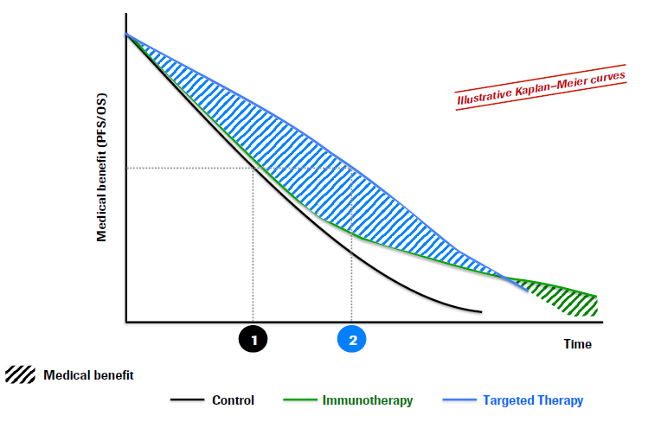
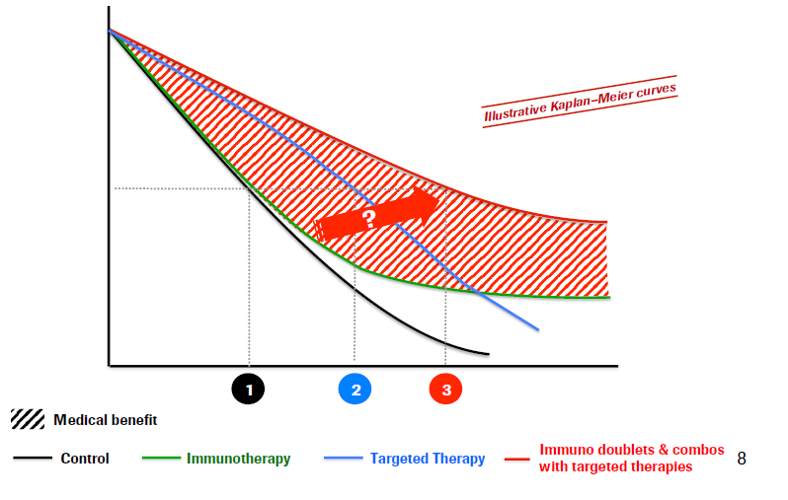
Clinical considerations
Monotherapy
one cancer type, few patients
Combinations, broader use
Better patient selection?
Ganapathi Bhat

Slide 30
Challenges: Developing them to the point of clinical utility
Where are we and How far will we go?
Immunotherapy drugs are highly effective, but not in everyone
What clinical data are needed in order to move agents and combinations to clinical practice?
What dosing schedules will determine efficacious response? And alternatively have favourable toxicity?
What is a standard criteria to measure response and prognosticate disease?
What will be the cost impact of these very expensive agents?
Ganapathi Bhat

Slide 31
Challenges: Developing them to the point of clinical utility
Development of resistant disease and disease progression on or after therapy
PK and PD paradigms remain inadequate to guide the selection of doses and schedules, both starting and recommended Phase 2 for immunotherapies
When combining an immunotherapy with another treatment modality, it is important to determine the optimal dose, schedule, sequence and tumor mutational heterogeneity.
trAEs appear to increase in rate and severity with cancer immunotherapy combinations; depending on the combination partner, alterations in the toxicity profile are also possible.
Adoption of immunodynamic endpoints that are clinically meaningful to allow the selection of the most effective front-line agents or combinations, or second-line immune agents if and when immunotherapy fails.
Journal for ImmunoTherapy of Cancer20164:15.DOI: 10.1186/s40425-016-0118-0
Ganapathi Bhat

Slide 32
Immunoprognostic and Immunotherapeutic Areas
Prognostic
 | Immunoscore
Therapeutic
 | Conventional Therapies
 | Chemotherapy
 | Radiation therapy
ITAs - Passive
 | Cellular Therapy
 | Adoptive T and NK cells
 | CAR T cells
ITAs - Active & Specific
 | Monoclonal Antibodies
 | Tumor-targeting
 | Immune-targeting, including checkpoint inhibitors
 | Vaccines
 | In situ Vaccines
 | Cell-based Vaccines
 | Dendritic cell–based Vaccines
 | Non–cell-based Vaccines
ITAs - Active & Nonspecific
 | Cytokines
 | IDO Inhibitors
Journal for ImmunoTherapy of Cancer20164:15.DOI: 10.1186/s40425-016-0118-0
Ganapathi Bhat

Slide 33
Challenges: Developing them to the point of clinical utility
The safety profile is based on the mechanism of action, and although adverse events can occur in any organ, the most commonly affected organs are gastrointestinal (diarrhea), dermatologic (rash, itchiness), hepatic (usually clinically asymptomatic elevation in transaminases), and endocrinopathies.
Most adverse events are low grade in severity and manageable, but if not properly managed, symptoms can worsen, possibly to the point of irreversibility and/or the necessity to discontinue treatment.
There is no standard approach to identifying immune related adverse events, but any inflammatory event should be taken seriously and the use of steroids should be considered.
Most adverse events, such as fatigue, headache, abdominal pain, colitis, and itchiness, can’t be identified on physical exam and the treating physician has to rely on the patient to make him/her aware of any new symptom or worsening of existing symptoms
Journal for ImmunoTherapy of Cancer20164:15.DOI: 10.1186/s40425-016-0118-0
Ganapathi Bhat

Slide 34
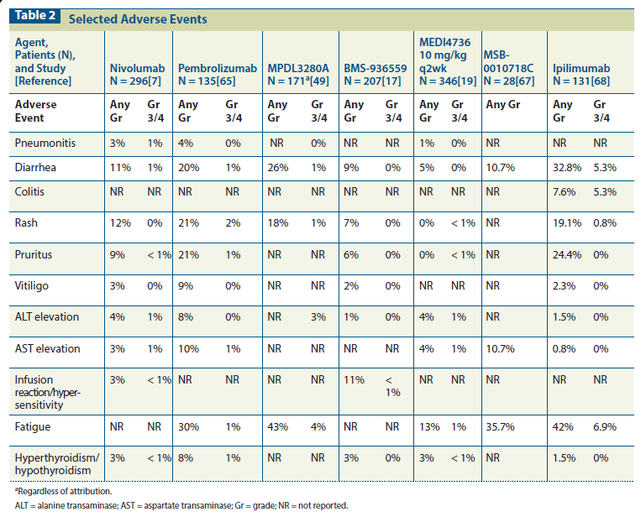
Comparative tox profiles - monotherapy
Kim and Eder 2014 Oncology
Ganapathi Bhat

Slide 35
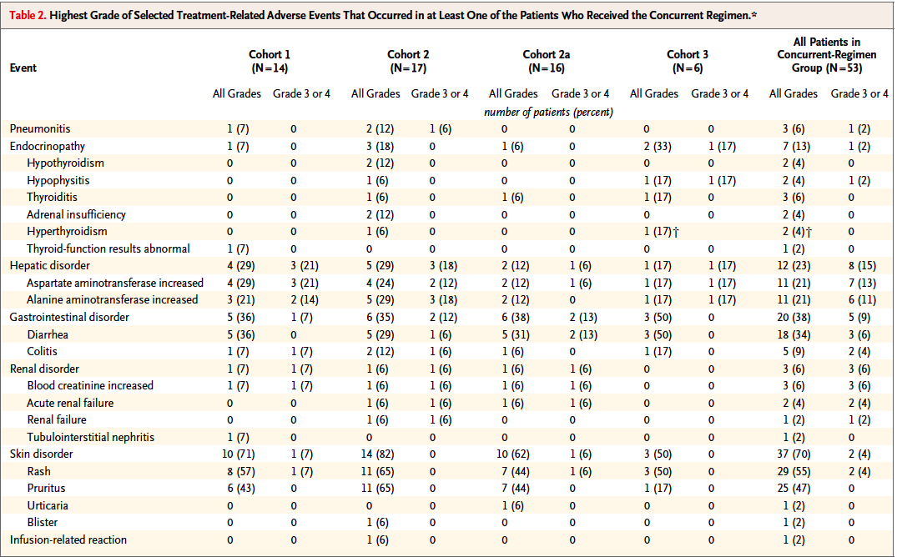
Tox profiles – combotherapy ipi/nivo
21% of patients terminated treatment due to toxicity
toxicity is associated with positive clinical response
oncologists: the GI tox is very difficult and limits use
Kim and Eder 2014 Oncology
Ganapathi Bhat

Slide 36
Challenges: Developing them to the point of clinical utility
While checkpoint blockade drugs currently focus on blocking two checkpoint mechanisms, others have been identified by research, as well as molecules that stimulate immune response.
Tumor mutational load has been shown to correlate with clinical response to checkpoint blockade in human cancers. Somatic neoepitopes were associated with a prolonged benefit in responders to aCTLA4 treatment in melanoma.
Often, a clinical response is apparent only after a period of “pseudoprogression,” when immune cell infiltration can manifest as new lesions or growth of existing ones.
Immunotherapy can work for cancer patients; in a few cases it already does, but response patterns are different from traditional therapy. For example, the time to an antitumor response can be longer.
Journal for ImmunoTherapy of Cancer20164:15.DOI: 10.1186/s40425-016-0118-0
Ganapathi Bhat

Slide 37
Challenges: Developing them to the point of clinical utility
The cost of these agents is staggering—higher than any previous class of cancer treatment
Therefore, payers are seeking better evidence that patients will clearly benefit, which brings the issue back to identifying biomarkers and their potential for predicting success.
Journal for ImmunoTherapy of Cancer20164:15.DOI: 10.1186/s40425-016-0118-0
Ganapathi Bhat

Slide 38
Immuno-Oncology- What’s Next
what we want in specific indications:
  better response rates
  more durable responses
  better tolerability
because we are addressing new benchmarks clinical practice is evolving quickly
for preclinical and early clinical programs a critical exercise is to look ahead in an effort to anticipate unmet need in a rapidly changing environment
Ganapathi Bhat

Slide 39
Summary
The immune system plays a critical role in controlling cancer
Key features of an effective immune response include
  Specificity
  Adaptability
  Durability (immune memory)
Future clinical considerations
  May elicit better immune system response if used earlier
  in disease
  Potential for durable clinical effects and synergy with
  subsequent therapies
Dunn GP, Schreiber RD , et al. Nat Rev Immunol. 2006;6(11):836-848.
Abbas AK, Lichtman AH. Basic Immunology. 3rd ed. 2011.
  Kirkwood JM, Ferrone S, et al. CA Cancer J Clin. 2012;62(5):309-335.
  Drake CG. Nat Rev Immunol. 2010;10(8):580-593.
  Vermorken JB, Hitt R, et al. N Engl J Med. 2008;359(11):1116-1127.
  Slamon DJ, Norton L, et al. N Engl J Med. 2001;344(11):783-792.
  Robert C, Wolchok JD, et al. N Engl J Med. 2011;364(26):2517-2526.
  Mercader M, Kwon ED, et al. Proc Natl Acad Sci USA. 2001;96(25):
  14565-14570.
Ganapathi Bhat

Slide 40

Tumor cells
Lymphocyte subsets
LAG3
HHLA2
TIM-3
TNFRSF proteins
KIRs
C-type lectins
Microenvironment
TGFβ
IDO-1
Chemokine receptors
NK cells: the next wave of immune-modulators
To watch out
KIRs
LIRs (ILTs)
Siglecs
The PVR/nectin family (TIGIT)
C-Type lectins
Ganapathi Bhat

Slide 41

Moving ahead
  The optimal efficacy/tolerability paradigm will impact more and more indications as therapeutics are successful
  Niche indications with high unmet need allow access to this remarkably competitive landscape
  Novel interrogation points to drive differentiation:
      T cells: effectors and Tregs
      NK cells
      The tumor microenvironment
      The tumor itself
Ganapathi Bhat

Slide 42

Ganapathi Bhat

