Slide 1
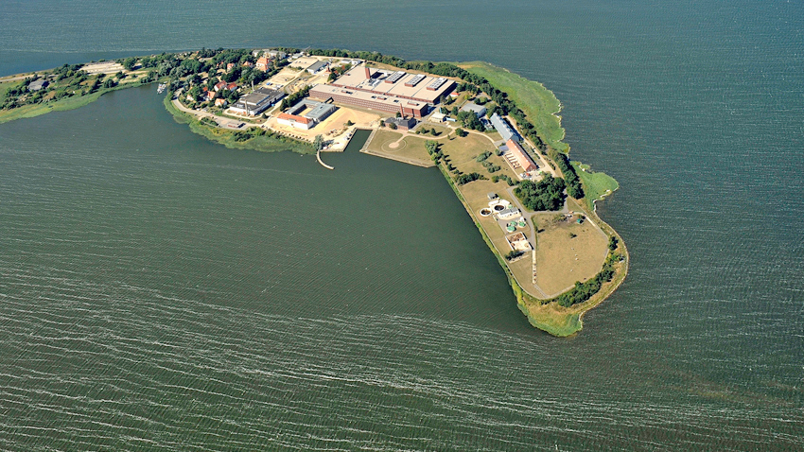
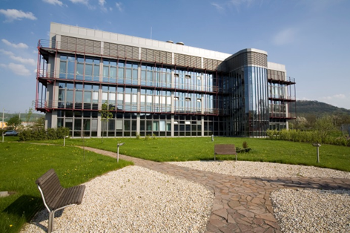
Investigation and molecular typing of Brucella isolated from dairy cattle herd immunized with Brucella abortus RB51 vaccine in Egypt.
Dr. Gamal wareth
Friedrich-Loeffler-Institut,
Federal Research Institute for Animal Health
NRL for Brucellosis, The Institute for Bacterial Infections and Zoonoses (IBIZ).

Slide 2
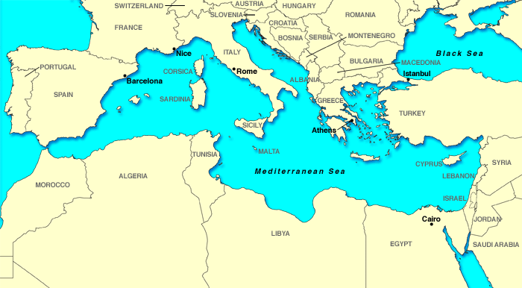
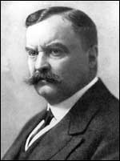
History of brucellosis
Sir David Bruce
1855-1934
(microbiologist)
In 1886 a cocco-bacillus isolated from from the spleen of a man who had died of Malta Fever.
He named it “Micrococcus melitensis”
Human disease was associated with people who consumed goat milk and had other close contact with goats.

Slide 3
History of brucellosis
In 1886 first isolation from human
In 1897 a similar microbe was isolated from the udder of cows
In 1914 isolated from swine.
In about 1920 the genus was renamed Brucella and its species became respectively B. melitensis, B. abortus, and B. suis.
Brucellosis is a highly contagious major bacterial zoonosis spread worldwide and has different names: Infectious abortion, contagious abortion, enzootic abortion in animals; and Crimean fever, Mediterranean fever, rock fever, undulant fever or Malta fever in humans.

Slide 4
Brucellosis
According to WHO brucellosis is classified among the top seven world neglected zoonotic diseases.
The true incidence of human brucellosis is not easy to estimate globally but an estimated number of more than 500,000 persons get infected newly every year.
Genus Brucella includes 11 nomo-species:
The six “classical” spp. B. melitensis, B. abortus, B. suis, B. canis, B. ovis, and B. neotomae.
Two of marine origin: B. pinnipedialis and B. ceti.
B. microti isolated from the common vole Microtus arvalis.
B. inopinata isolated from a breast implant wound of a female patient
Finally, B. papionis was described from baboons (Papio spp.)

Slide 5
Brucellosis in Egypt
1886 In Malta
After 53 years
1939 In Egypt

Slide 6
Animal population and seroprevalence in Egypt
The total number of animals was steadily increasing during the last years in Egypt. 1999-2011 (FAO, 2012).
Number of seropositive animals according to GOVS, Egypt, 2012

Slide 7
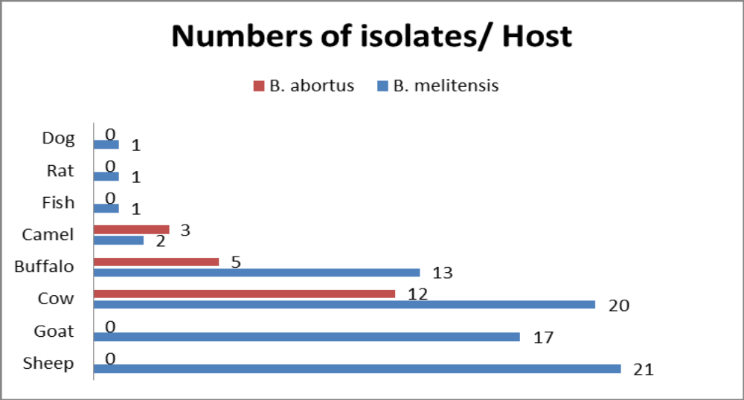
Brucellosis in Egypt
It is likely that brucellosis has been an endemic disease in Egypt for thousands of years
In 1939, brucellosis was reported in a scientific report from Egypt for the first time
Brucellosis is prevalent nationwide in all farm animal species, in the environment, and in carrier hosts.
Wareth et al., 2014: Animal brucellosis in Egypt_review_ J Infect Dev Ctries 2014; 8(11):1365-1373. doi:10.3855/jidc.4872

Slide 8
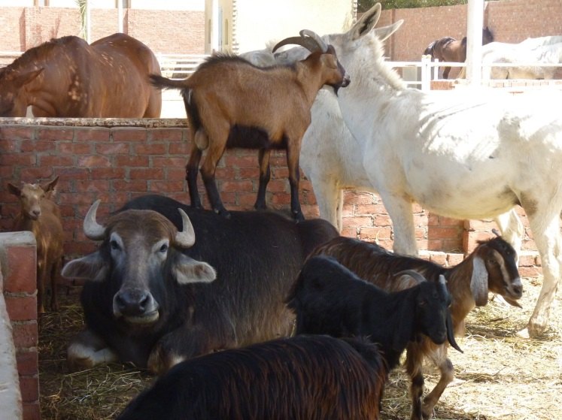
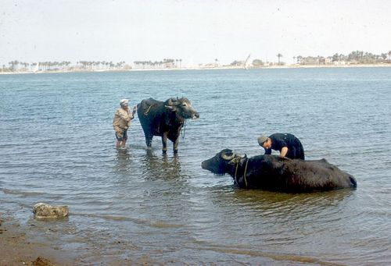
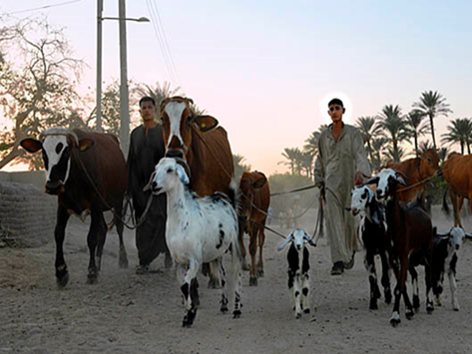
Brucellosis in Egypt
Cross species transmission of brucellosis was reported
http://webhosting.web.com/imagelib/sitebuilder/misc/show_image.html?linkedwidth=actual&linkpath=http://www.alsorat.com/sitebuildercontent/sitebuilderpictures/GoogleOverQamar.jpg&target=tlx_pichqfc&title=.
Men bathing their water buffalo in the Nile Delta Region
http://muirgilsdream.tumblr.com/post/27296121225/men-bathing-their-water-buffalo-in-the-nile-delta
What is the Solution?

Slide 9
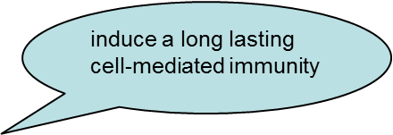

Control and Surveillance program
Surveillance and control programs in endemic developed or developing countries based on Test and slaughter strategy with assistance of vaccination.
Vaccination
Live attenuated vaccine
B. abortus S19
hampered the serodiagnosis
immunisation of pregnant cows may lead to abortion
B. abortus RB51
Thanks Google
Notes:
http://www.theatlantic.com/health/archive/2012/12/study-kids-should-drink-exactly-two-cups-of-milk-per-day/266437/

Slide 10
The study
Status | Animals | Stable ª | Serology ante vaccination | No. | Abortion | Time of abortion | Serology post vaccination ^{b} | Other
vaccinated animals | pregnant cows and heifers ≤ 3 months of pregnancy | A | negative in the past 3years | 197 | 20 cows, 1 heifer | 5-6 months post fertilization | 20 cows, 1 heifer positive
 | non-pregnant cows and heifers ≥ 8 months | B | negative in the past 3years | 93 | - | - | negative
vaccinated total |  |  |  | 290
non-vaccinated animals | Bulls | C | negative in the past 3years | 50 |  |  | negative | kept for meat production
 | young calves | D | negative in the past 3years | 185 |  |  | negative | ≤ 8 months
 | pregnant cows and heifers | E | negative in the past 3years | 75 | - | - | negative | ≥ 3 months of gestation
non-vaccinated total |  |  |  | 310
cattle total |  |  |  | 600

Slide 11
Results
Bacteriology
Two B. abortus rough strains
Two B. abortus smooth strains
Genotyping
Two different genotypes among the four isolated B. abortus strains with low genetic diversity
Histopathology
Extensive necroses accompanied by mild to moderate suppurative inflammation
Brucella antigen was detectable.
No RB51 vaccine strain was detected

Slide 12
Genotyping using MLVA-16

Slide 13
Histopathology
Fetal placenta. Severe necrosis (asterisks) of placental tissue, accompanied by mild to moderate infiltration of leukocytes (mainly neutrophils, arrowheads) and dystrophic calcification (tilde). HE.
Liver of aborted foetus. Immunohistochemical detection of scattered Brucellae (arrows) within the cytoplasm of hepatocytes

Slide 14
Summary of the study
Aborted cows were tested seronegative for brucellosis in the past 3 years.
10 % of vaccinated cows aborted after 3 months.
All aborting cows had previously delivered at least twice healthy calves without difficulties .
All aborted cows are seropositive for standard agglutination test.
All isolated B. abortus are filed strains with low (or no) genetic diversity.
No RB51 strain was isolated.
The vaccine offers no complete protection from infection by field strains but it is known to reduce spread of infection

Slide 15

What is the possible explanation for that result?
The source of infection in the present study
could not be clarified
but several scenarios are plausible

Slide 16
Scenario 1: Artificial insemination
Use of contaminated sperm for artificial insemination
Brucella spp. has been detected in semen of serologically negative bulls

Slide 17
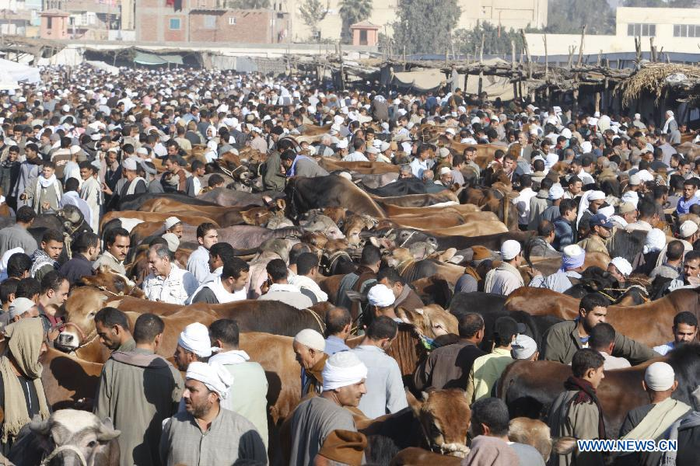
Scenario 2:
Introduction of seropositive animals without previous testing of its serological status
A cattle market hold before the Eid al-Adha festival, 10th Oktober 2011,Nile delta province of Menufiya, Egypt
http://news.xinhuanet.com/english2010/photo/2011-10/30/c_131220532_4.htm

Slide 18
Scenario 3: Latent infection a latent carrier suckler cow without antibody production against Brucella but could shed of the agent and infecting other animals

Slide 19

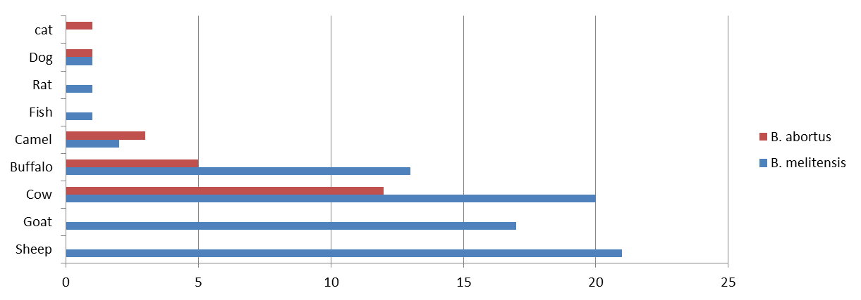
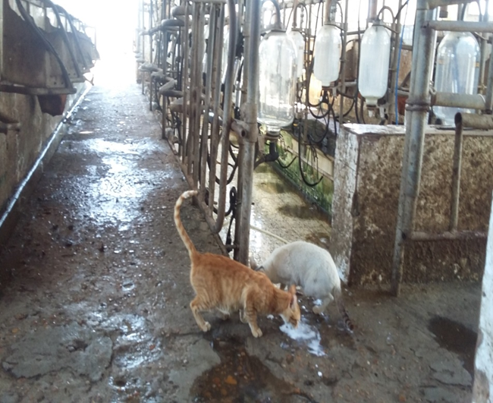
Scenario 4: Vector introduction of the agent via vectors such as rats and stray cats and dogs

Slide 20
Conclusion
B. abortus bv1 was the source of this outbreak but not the RB51 vaccine applied.
RB51 vaccine might reduce the number of abortions caused by field strains but offers no complete protection from infection.
The most likely source of infection appears to be the uncontrolled introduction of the agent via vectors or latent carrier.
Eradication of brucellosis is a multidirectional process required combination between ordinary control program and high biosecurity level in the farms.

Slide 21
Acknowledgments
We would like to acknowledge Dr. Mohamed Mosbah (Animal health research institute; Mansoura branch) for his help in sample collection.

Slide 22
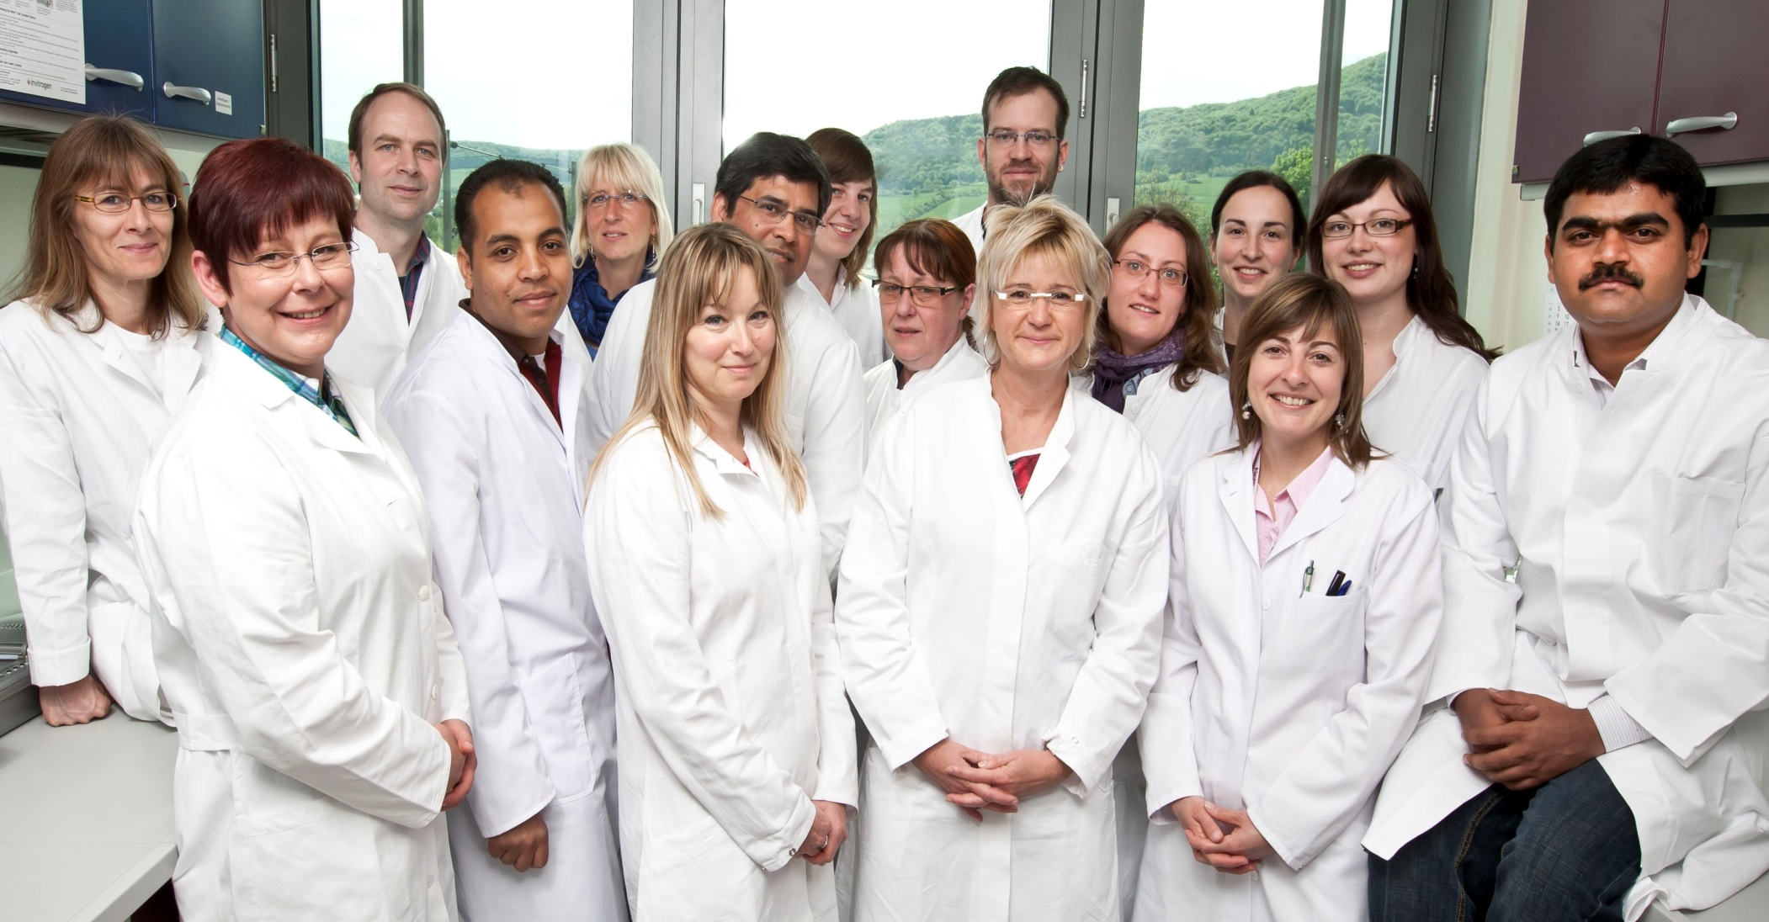
Special thanks for AGr 130 members

Slide 23
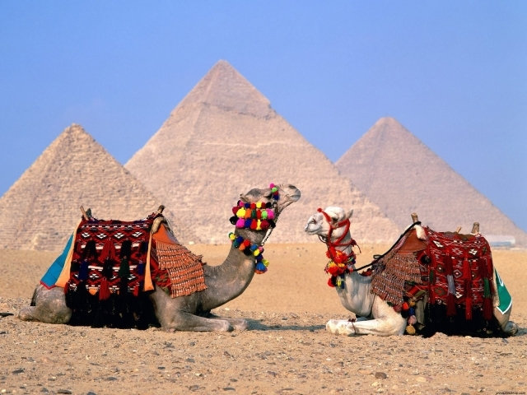
أشكركم على الاهتمام
Thank you for attention,
Gracias por su atención,
Vielen Dank für die Aufmerksamkeit,
Merci de votre attention,

