Slide 1





March 14-15, 2016 London, UK
Development of analytical fingerprints
for the quality control of snake venoms
André Sawa Kpaïbe, Gaëlle Coussot, Yoann Ladner, Michèle C. Aké, Catherine Perrin
Max Mousseron Institute, University of Montpellier, France
Université FHB in Abidjan, Ivory Coast
Notes:
Good morning.
I am going to present the results on the development of analytical fingerprints for quality control of snake venom.
This study is a collaboration between the University of Montpellier (France) and the Felix Houphouet Boigny University of Ivory Coast.

Slide 2
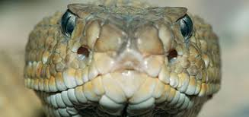
WHY SNAKE VENOMS?
Notes:
Why a study on snake venom?

Slide 3
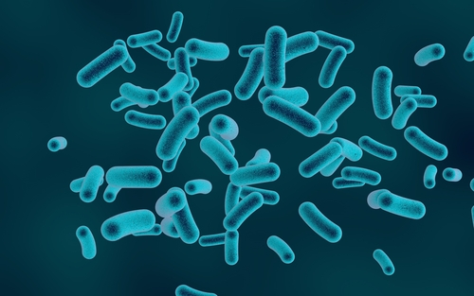
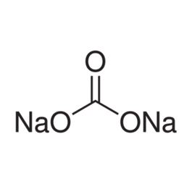
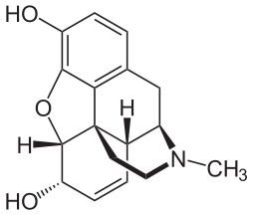
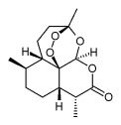
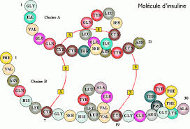
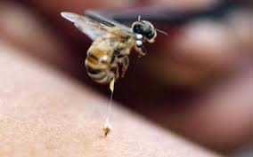
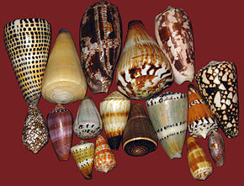
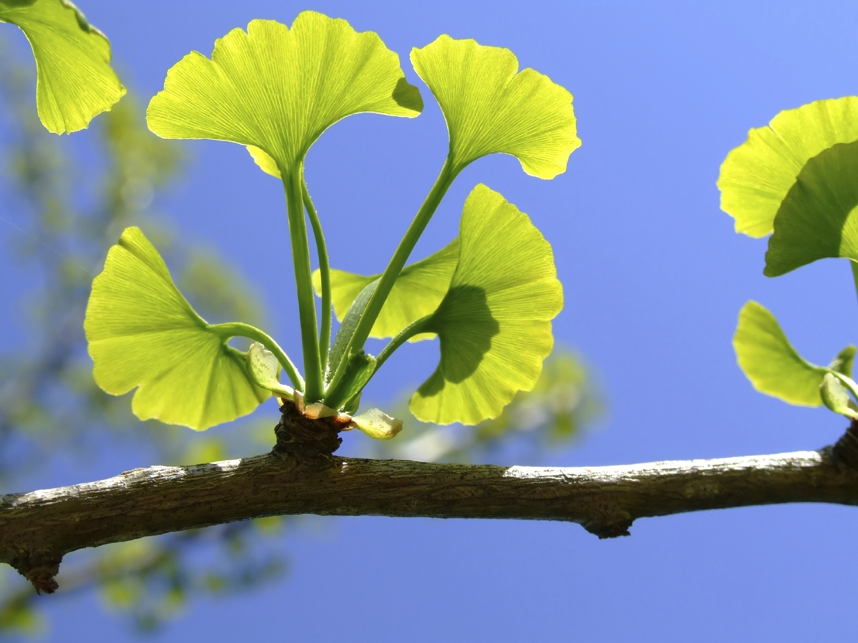
Natural active substances : 30-40 % new drugs (LEEM)
Raw materials : mineral / microbiological /plant / animal
Animal | plant
Insulin Bee venom Conus Snake venom | Morphine Quinine Artemisine Ginkgo biloba
microbiological | mineral
Bacteria Yeast | Sodium bicarbonate zinc chloride
Sodium bicarbonate
Insulin
Morphine
Artemisine
Snake venoms : new drugs to treat diseases
Notes:
Nowadays, natural active substances are increasingly used in pharmacy. They are used in production of new drugs (30% to 40% according to LEEM).
The raw materials from which these active ingredients come are of plant, microbiological, mineral or animal origin. FOR examples…..
Many active secretions produced by animals have been employed in the development of new drugs to treat diseases such as hypertension and cancer.
Snake venom toxins contributed significantly to the treatment of many medical conditions. There are many published studies describing and elucidating
the anti-cancer potential of snake venom

Slide 4
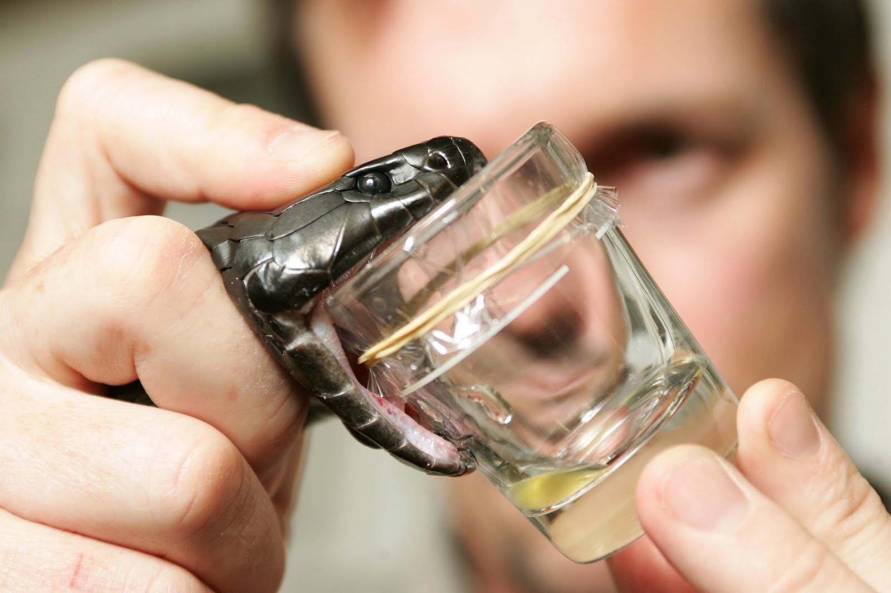
SNAKE VENOMS

Slide 5




VENOMS
raw substance, extracted and/or modified compound
Full strain
mimetic
Complex media
Single molecule
Cardiovascular effects
captopril isolated from Bothrops jacaraca
Gynecological disorders
Behavioural disorders
Homoeopathy pills of Lachesis muta
Notes:
Regarding snake venoms, the entire strain may be used in homeopathy to treat various diseases. For example, Lachesis muta granules are used to treat osteoarthritis, behavioural and gynaecological disorders and other diseases.
Also, from the venom, molecules may be isolated and modified for a therapeutic indication. This is the case of captopril, isolated from Bothrops jacaraca ( a snake from brasil), then modified and used in treatment of cardiovascular diseases.

Slide 6
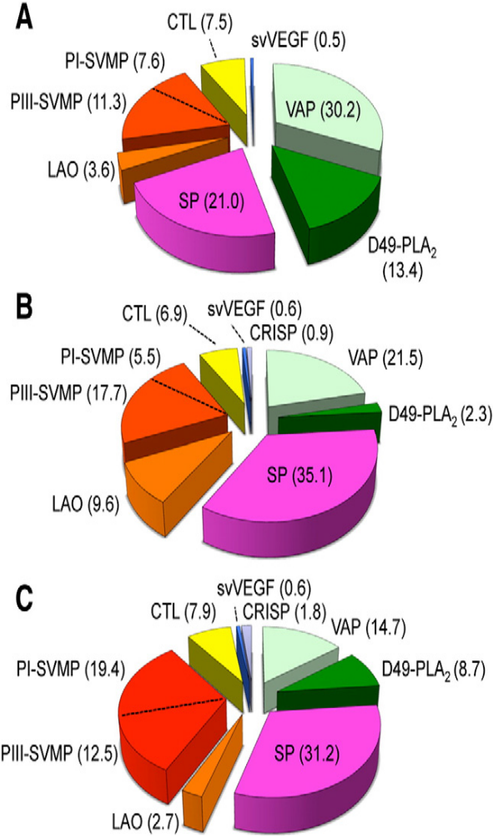
COMPOSITION
Complex molecules: peptides and proteins (90% weight)
+ mineral / carbohydrates / lipids…
- Toxins => Poisoning
- Enzymes (≤ 25 identified)
ENZYMES (20-150 KDa)
VAP: vasoactive peptide
SVMP: serine venom metalloproteinase
CTL: C-type lectin-like protein
svVEGF: snake venom vascular endothelial growth factor
SP: serine proteinase
LAO: L amino acid oxydase
PLA2: phospholypase A2
CRISP: cysteine-rich secretory protein
Lachesis melanocephala
Lachesis acrochorda
Intragender variability protein composition
of 3 species of Lachesis gender
Lachesis muta
Notes:
Snake venoms are composed of complex molecules. These are essentially enzymes and toxins that make 90% of the dry weight of the venom. Toxins are molecular proteins that weigh less than 30 kDa.
They are responsible for the poisoning, As for enzymes, nearly 25 have been idenified in snake venoms, but a single venom does not contain all these enzymes. They are molecules which weigh between 20-150 kDa.
The enzymes are responsible of the proteolytic properties of the venom.
This illusration shows the variability of enzyme composition in various venoms of snakes of the Lachesis 3 specy.
for example, we see here a higher rate of serine proteinase in the venoms of snakes B and C than in snake A.

Slide 7


VARIABILITY
Genetic composition +++
Environment
Snake diet
Geographic localisation
Very important variability
Quality Control
of raw material ???
DRUG EFFICACITY
Notes:
This composition variability of snake venoms was awarded in several studies on the genetic composition of venoms. other authors reported environmental reasons such as the way the animals are feed.
Considering the problem of variability, the development of snake venom based drugs becomes difficult and the quality of the raw material is very important to consider.
we have noticed that the quality control of the snake venom strain remains partial and insufficient.

Slide 8
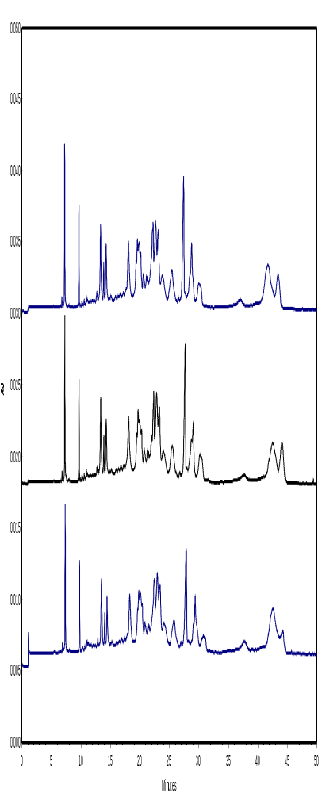
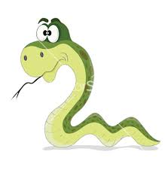
QUALITY CONTROL ???
?
Fingerprint
Biological Variability
Analytical methods
Notes:
As we see, this snake looks in a mirror and sees the reflection of a “weird” mark, which is actually the analytical fingerprint of his venom.
This fingerprint of his venom should identify strains of the venom he could product. It may be noted that quality control is different from the characterization that is simply the identification of the venom components.
The previous control method, by SDS PAGE, does not allow to take into account the biological variability of venoms as indicated above.
In case the whole strain is used, it is essential to develop analytical methods to obtain specific fingerprints for identification of snake venom strains; And these methods need to be sensitive to biological variability between venoms of snakes from the same species. This kind of quality control is well developed for vegetal raw materials.
However, this quality control of venoms raw substance is necessary to obtain reproducible biological activities and new commercial approvals. This control imposed in the Good manufacturing practice use the concept of analytical fingerprint which has become more and more popular and is now starting to be accepted by regulatory authorities such as the FDA
This so-called “pattern-approach” aims at gaining effective and stable information about common features of a given strain evaluating similarity and difference with chemometric methods.
Analytical fingerprint developed will serve as a reference for the quality control of snake venom batch in production. This new approach was adapted to quality control of snake venom raw substance.

Slide 9
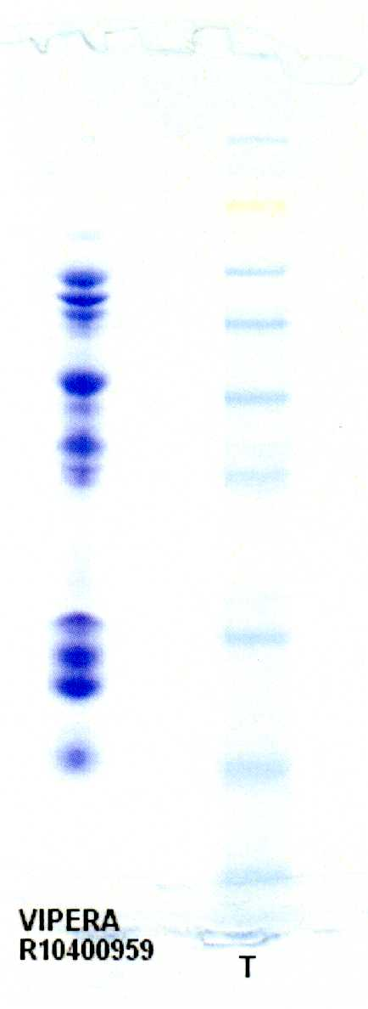
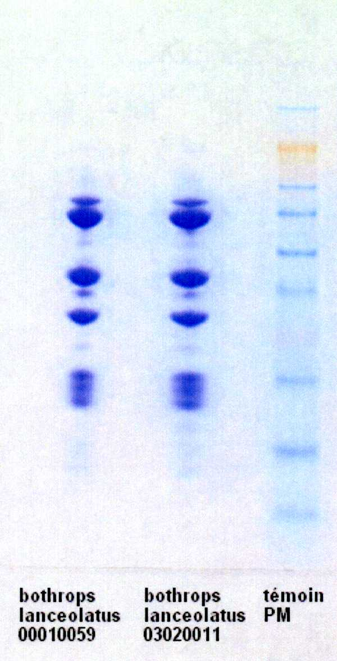
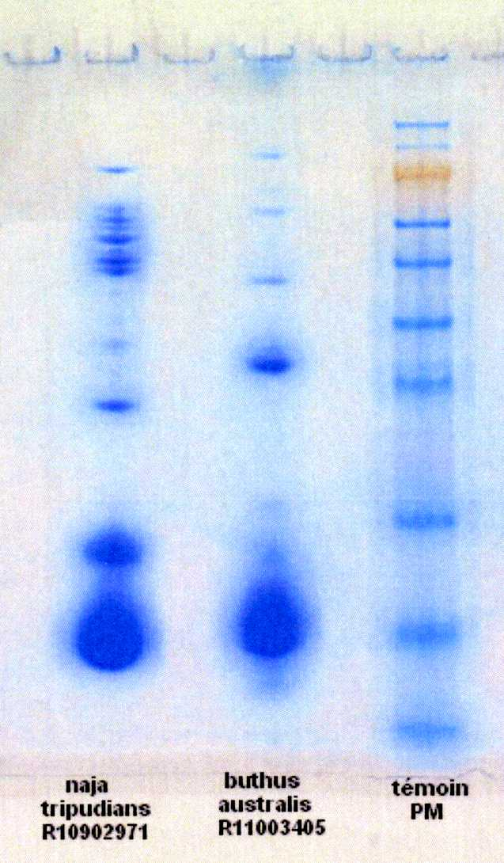
QUALITY CONTROL
SDS-PAGE : poor resolution with lack of reproducibility
(sample preparation artifacts, migration time and staining variability), do not take into account biological variability

Slide 10
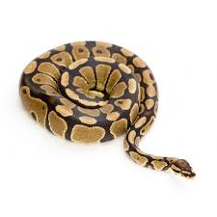
ANALYTICAL FINGERPRINTING
Notes:
What is analytical fingerprint concept

Slide 11
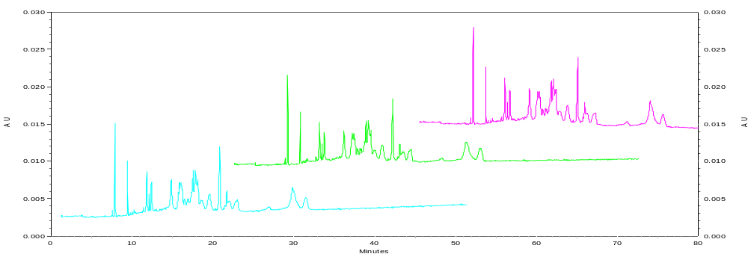
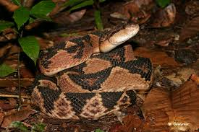
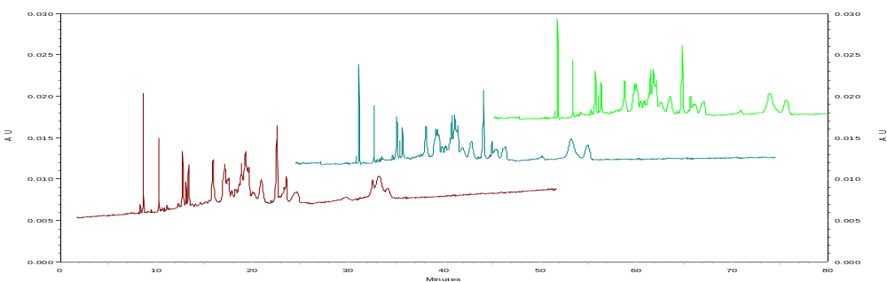
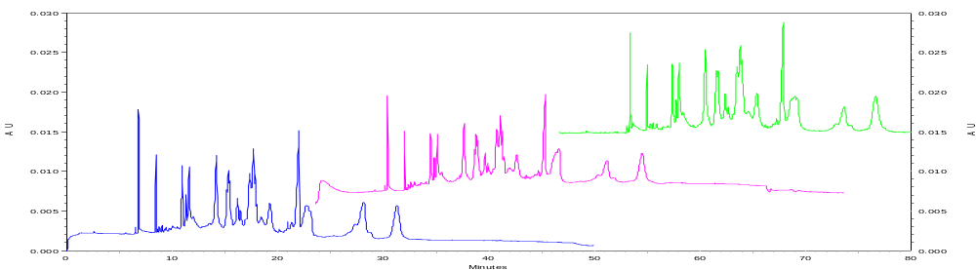
ANALYTICAL FINGERPRINT VENOMS STRAINS
BATCH 1
BATCH 2
BATCH 3
Within batches-Inter batches comparison
Notes:
So, to get the analytical mark which constitutes the fingerprint of a strain of venom, we are going to analyse several batches of this venom to get analytical profiles of each batch

Slide 12
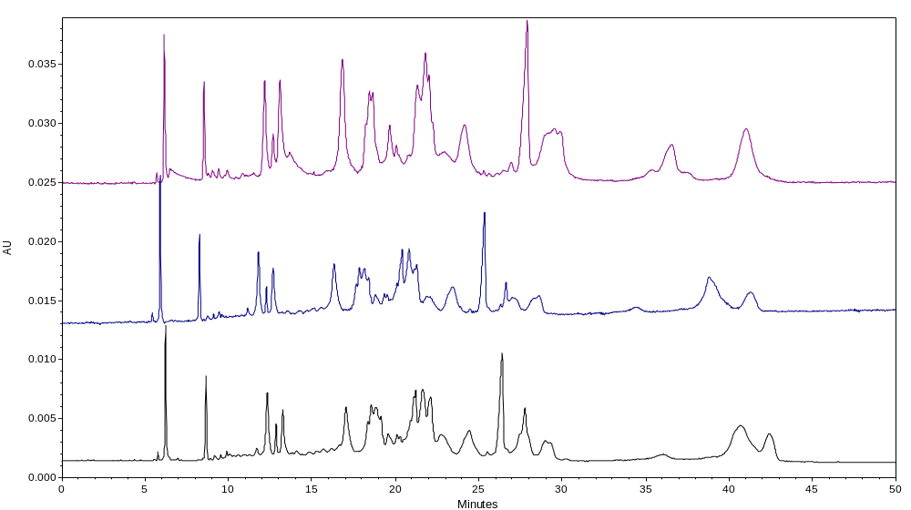
ANALYTICAL FINGERPRINT VENOMS STRAINS
BATCH 1
BATCH 2
BATCH 3
Inter batches comparison of the same species
chemometric treatment
To obtain the specific fingerprint
Notes:
Then we will search for similar marks and determine variables parts. From there the specific analytical fingerprint will be extracted by chimiometric treatment

Slide 13
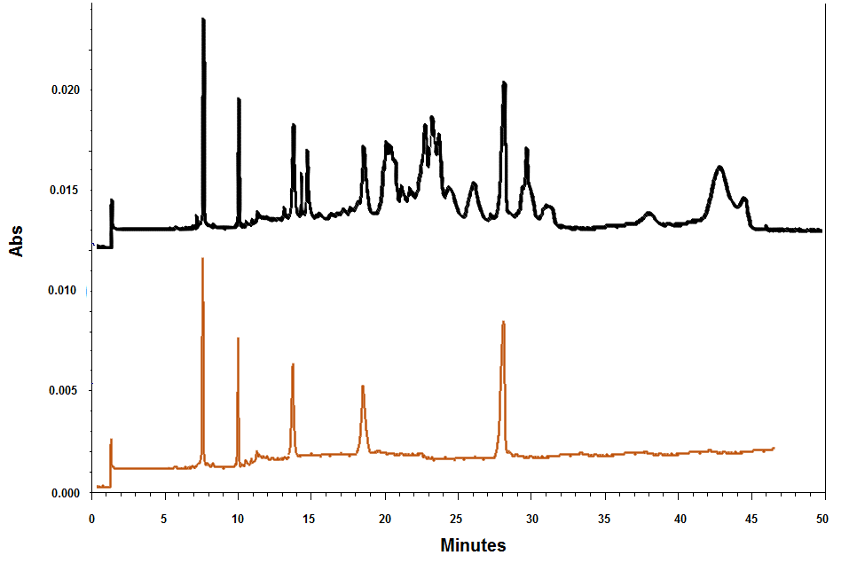

ANALYTICAL FINGERPRINT VENOMS STRAINS
Specific analytical fingerprint of the same species
Routine => reference for the CQ of that snake venom
Notes:
This specific analytical fingerprint developed will serve as reference for the quality control of snake venom batch in production and used for routine control of batches of that venom.

Slide 14
Specific fingerprints using Capillary Electrophoresis for the control quality of snake venoms
Notes:
Our goal is to develop specific analytical fingerprintings for identification and quality control of snake venoms strains by capillary electrophoresis
capillary electrophoresis fingerprint (CEFP)

Slide 15
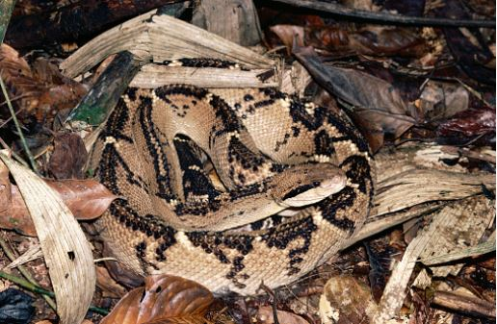
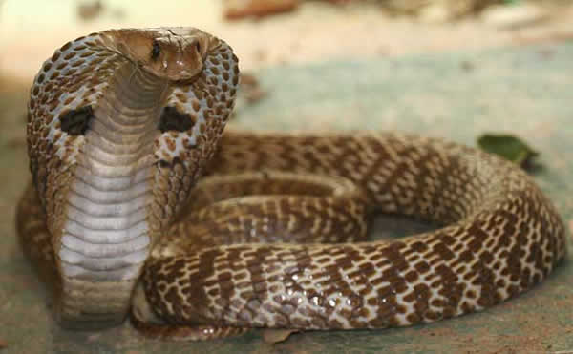
STUDIED STRAINS
Class
Reptiles
Order
Squamates
Suborder
Serpentes
Infra-order
Lachesis muta (VIPERIDEAE)
Scolecophidia
Henophidia
Caenophidia
Familly
Aniliidiae
Boidae
Elapidae
Typhlopidae
Acrochordidaedae
Uropeitidae
Colubridae
Viperidae
Anomalepidididae
Xenopeltidae
Atractaspididae
Leptotyphlopidae
Naja naja (ELAPIDEAE)
Notes:
The samples come from four snake species among the most used in therapeutics. These are Lachesis muta and Naja naja. These venoms were purchased from supplier as a lyophilized powder .
As a reminder, snakes snakes belong to the class of reptiles, order of squamates, suborder of serpentes, with three infra-order including caenophidia wherein found the familly of Elapidae and viperidae.
Lachesis muta belongs to family of viperidae and Naja naja belongs to family of Elapidae

Slide 16
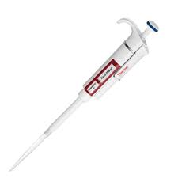
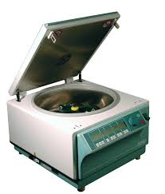
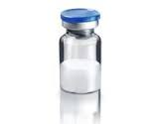
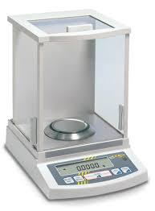
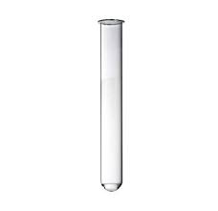
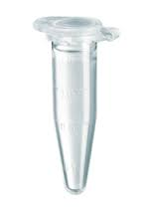
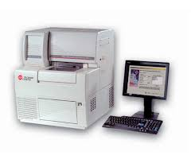

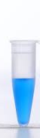
SAMPLE PREPARATION
Freeze-dried product from raw material
4°C, 11 500 g, 10 min
10 g/L
400µL
4 mg
CE analysis
5g/L , 100µL
10g/L, 50µL
- 20°C
European Pharmacopeia/ U.S Pharmacopeia
Notes:
Simple preparations were made with these lyophilizats which consist in dissolving them in water to have concentrations of 10 g / l per preparation. Then centrifugation eliminates impurities. And aliquots of 50 ul are formed which are either kept at -20 ° C, or prepared for analysis by CE. (100ul at 5g / l).

Slide 17
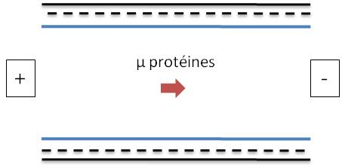
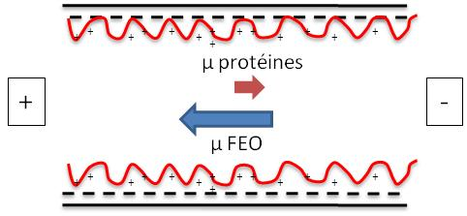
CE ANALYSIS : coating the capillary surface
Coatings: chimical modification of capillary surface to prevent protein adsorption
Neutral
Cationic
PEO
PDADMAC
Neutral: Poly(ethylene oxyde) [PEO], Hydroxypropyl Cellulose [HPC]
EOF is supposed to be zero, proteins migration in the capillary is only related to their effective mobility
Cationic : Poly(diallyldimethylammonium chloride) [PDADMAC]
EOF is directed to the anode, its mobility is opposite to protein mobility;
its large amplitude forces the proteins to migrate to the anode
Nehmé R., Perrin C., Cottet H. et al, Electrophoresis 2008, 29, 3013- 3023.
Notes:
We proceeded conventionally to determine the conditions of analysis. Different parameters were studied, such as:
The Influence of the nature of the polymer covering the surfaces in silica of separation capillaries
We have used high molecular weight polymers binding to the silica walls stably by simple capillaries rinse.
Two types of polymers were studied: two neutral polymers, polyethylene oxide (PEO) and hydroxypropylcellulose (HPC); and a cationic polymer, polydiallyldimethylammonium chloride (PDADMAC).
Due to its neutral character, PEO does not generate any movement of the electrolyte solution (electroosmotic flow) within the capillary. The various components of venoms thus migrate according to their own mobility, or to the cathode acid.The pH PDADMAC gives a strongly cationic character to the capillary wall, which generates a movement of the electrolyte solution in the direction of the anode. At acidic pH, the OTF is opposed to the direction of migration of the constituents of the venom. The mobility of the OTF is higher than that of the components of venoms, they migrate to the anode with a lower apparent mobility than their intrinsic mobility.

Slide 18
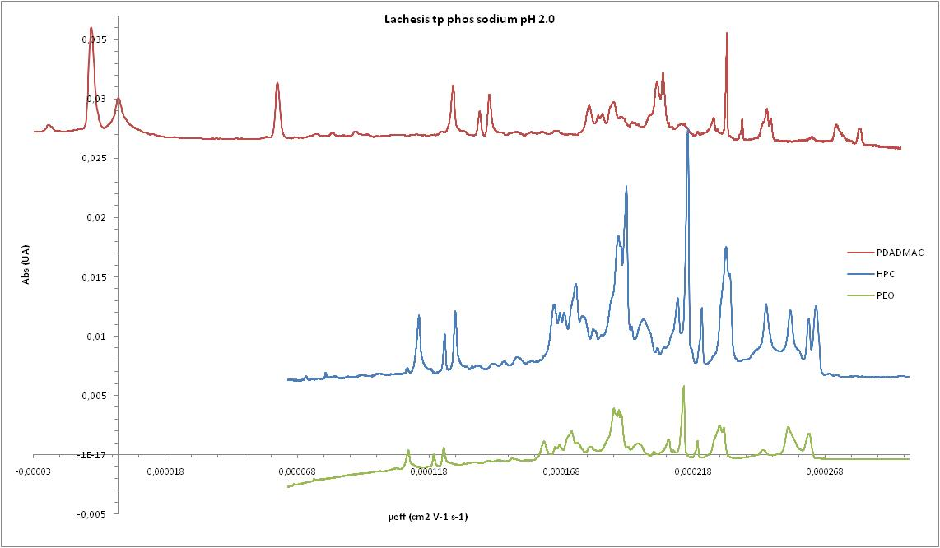
CE ANALYSIS : coating the capillary surface
Comparison of Lachesis muta venom (same batch) electropherograms obtained with coated
capillary (PEO, HPC and PDADMAC )
PDADMAC
Abs(UA)
HPC
CE conditions: BGE sodium phosphate (pH2; I: 50 mM) E : 212 V/cm ; hydrodynamic injection: 6,1 nL (5 g/L); λ = 214 nm
PEO
µeff(cm²V⁻¹ S⁻¹)
PDADMAC coating is well adapted to venom analysis
Notes:
Whatever the coating used, repeatable and differentiable profiles were obtained with the four venoms.
We have on these profiles of Lachesis muta, marked in green, the profile with PEO, in blue, the ones with the HPC , and in red profile with PDADMAC.
We have expressed each profile according to the effective mobility of the components in order to eliminate the flux mobility that influences migration time.
However,a better resolution of the peaks was observed with the PDADMAC coating, which can be explained by the fact that the EOF goes in the opposite direction to that of proteins.
The PDADMAC was so chosen as the coating solution for the capillaries silica wall for this study.

Slide 19
CE ANALYSIS : Background Electrolyte (BGE)
pH selection of electrolyte separation (efficacity, mobility)
2.0 / 3.0 / 4.0 / 7.0 / 9.2
co-ion selection of electrolyte separation (efficacity)
- sodium
- triethanolamine (trolamine)
- ε-amino caproic acid
- bis-tris
counter-ion selection of electrolyte separation (efficacity, mobility)
-Phosphate
-Citrate
Notes:
We also studied
the influence of pH of the electrolyte separation of the different constituents of each snake venom between pH 2.0 and pH 7.0.
the influence of the nature of the co-ion (cation) of the electrolyte with different solutions: sodium, triethanolamine (TEA), e-amino caproic acid and bis-tris.
And the Influence of the nature of the counter-ion (anion) of the electrolyte with phosphoric acid and citric acid

Slide 20
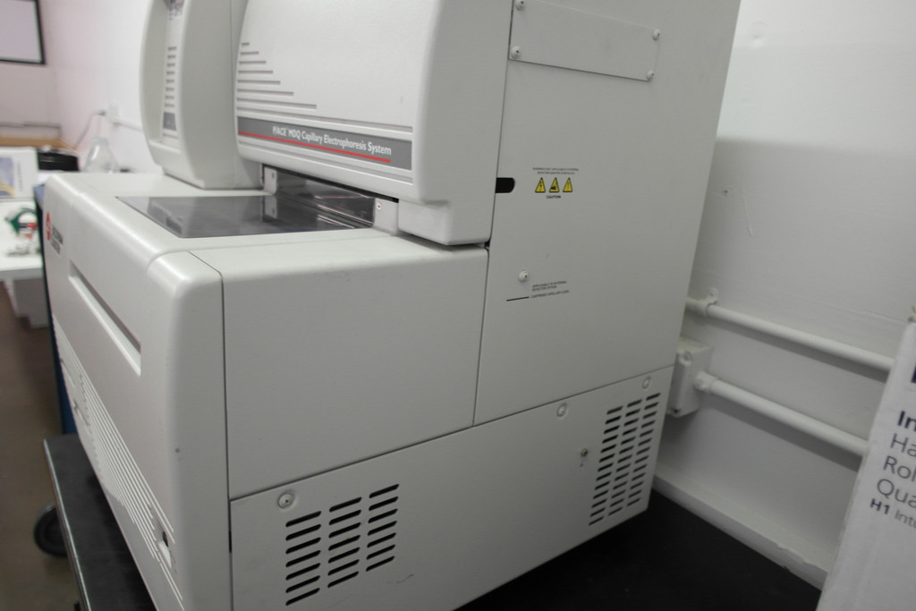
CE ANALYSIS : optimal conditions
Electrophoretic parameters selection (capillary length, temperature, ionic strength… .)
3 Batches of Lachesis muta
30 analyzes per batch
Capillary effective Length : 40cm
Temperature : 35°C
ionic strength : 30 mM
Electric field : 212V/cm
Detection: 214 nm
Inject sample: 7.81nl
BGE: sodium phosphate, pH 2.0
Coating: PDADMAC, pH 8.0
Notes:
We have also studied
- The influence of the ionic strength of the electrolyte
- The Influence of the length of the capillary of Separation
And the influence of temperature of Separation
For this study, the following conditions were selected:
- Capillary diameter was 50 microns
- Capillary effective length was 40cm
Ionic strength of the electrolyte was 30mM
- BGE was sodium phosphate and pH 2
- Electric field was 212 volt/centimeter
Detection was 214nm
Simple injected was 7.8nl
We applied this method to analyze 3 batches of Lachesis muta venom/ With 30 analyzes per batch

Slide 21
CHEMOMETRIC TREATMENT
Collaboration with:
Dr Christelle Reynes and Pr Robert Sabatier
Notes:
From these results, a chemometric study , was performed to extract the analytic fingerprint, in collaboration with Institute of Functional genomics of Monptellier,

Slide 22
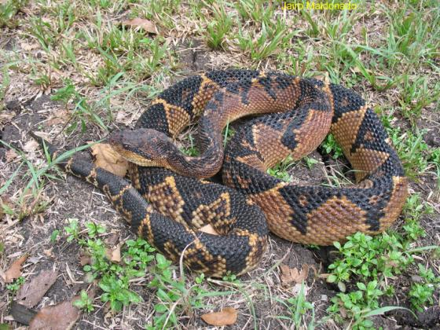
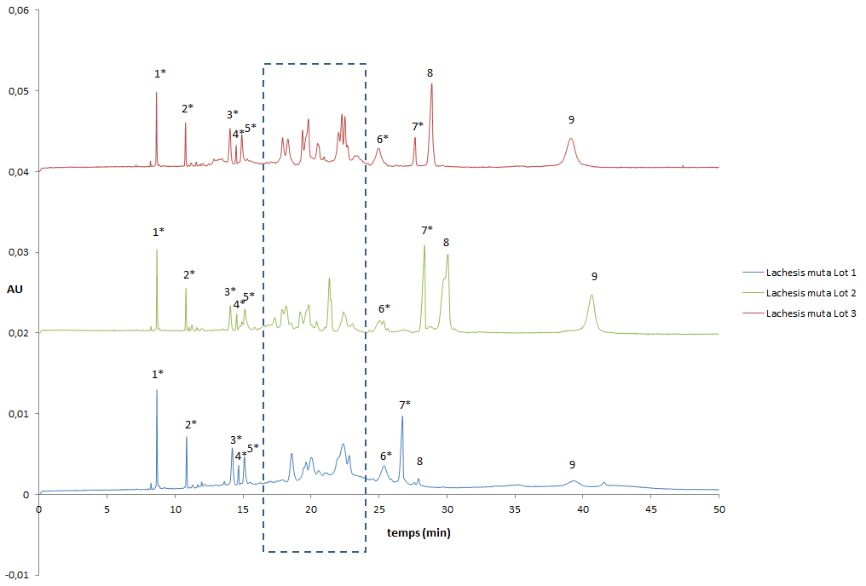
ELECTROPHORETIC PROFILES IN CZE – Lachesis muta
Lachesis muta Batch 1
Lachesis muta Batch 2
Lachesis muta Batch 3
FEO
CHARACTERISTIC PEAKS AND RSD (%)
PEAKS | P 1 | P 2 | P 3 | P 4 | P 5 | P 6 | P 7 | P 8 | P 9
RSD(%) | 0.30 | 0.24 | 0.27 | 0.31 | 0.31 | 0.36 | 0.49 | 0.43 | 0.04
Analytical conditions: BGE phosphate de sodium pH 2.0 I: 30 mM / Coating PDADMAC / Leff 50 cm / T 35°C / E 212V/cm / λ 214nm/ injection 7, 81 nl
Notes:
Here are outlined the profiles observed in different batches of venom from Lachesis Muta. We performed 100 analyzes per batch. Here we can recognize identical peaks and also identify differences related to biological variabilities

Slide 23
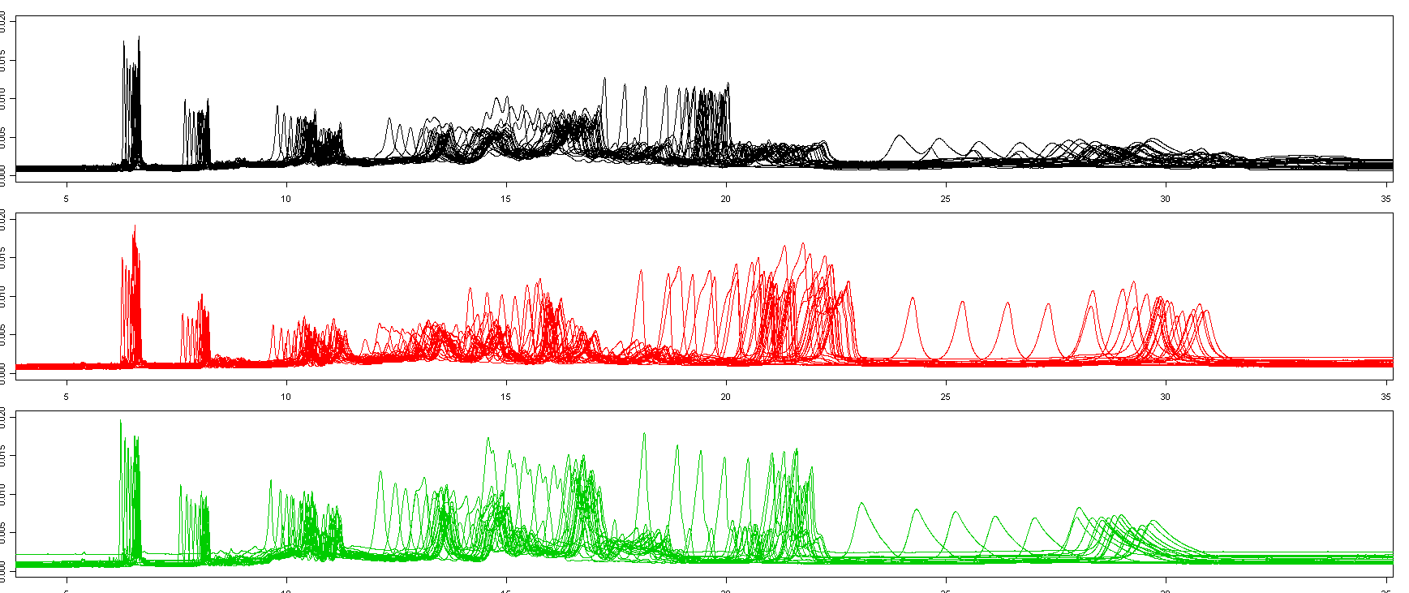
DATA PRE-PROCESSING
Raw data (per batch) – correcting baselines
Batch 1
Batch 2
Batch 3
Notes:
We compiled raw datas obtained by electropherograms per batch. we observed several shifts of signals that were due to the influence of FEO. We therefore expressed the migration time in effective mobility in order to eliminate the influence of flux and then we re-expressed it in the time.

Slide 24
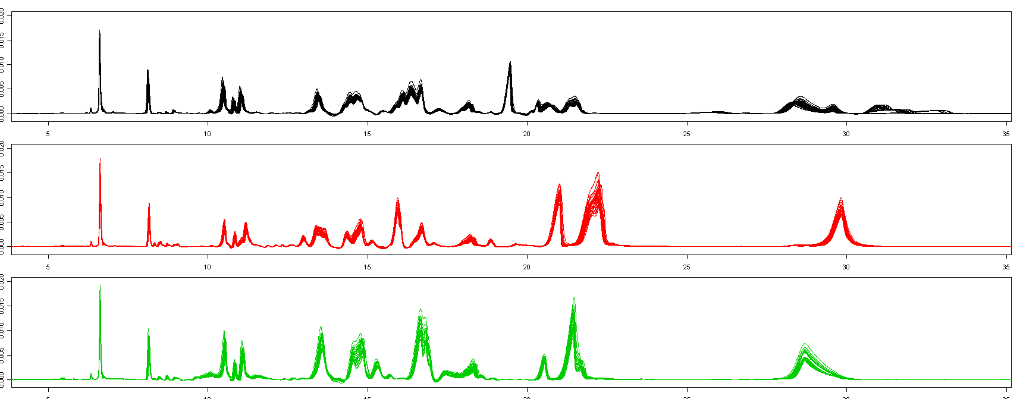
DATA PRE-PROCESSING
Alignment of batch signals:
Batch 1
Batch 2
Batch 3
Notes:
Then we aligned the electropherograms per batch, correcting baselines

Slide 25
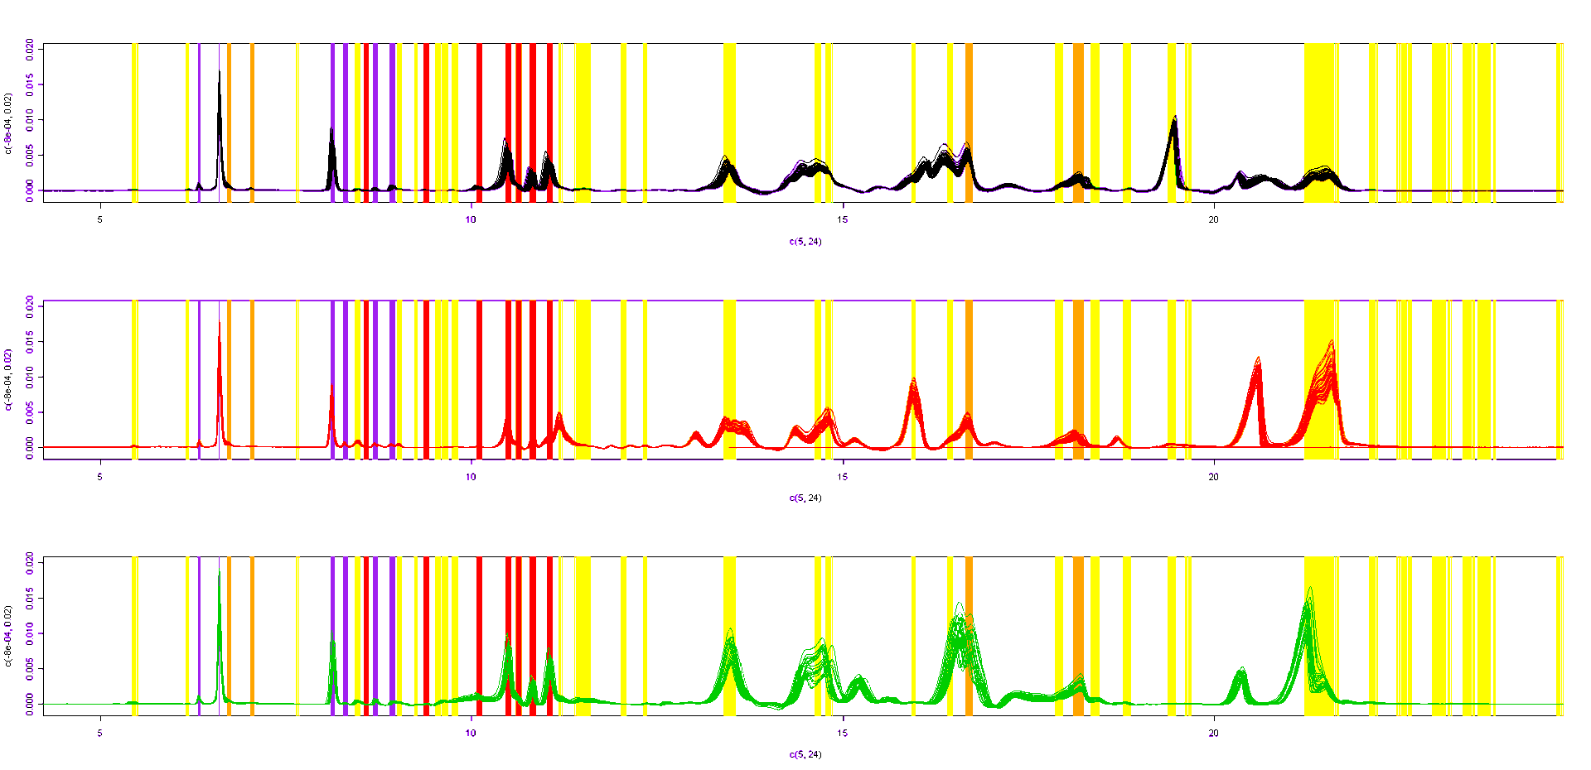
EXTRACTION AND PEAKS ALIGNMENT
Signals alignment – Recognition of common peaks
Batch 1
Batch 2
Batch 3
Specific part ?
variable part ?
Notes:
And we searched the peaks common to all signals for each batch then we extract the fingerprints

Slide 26
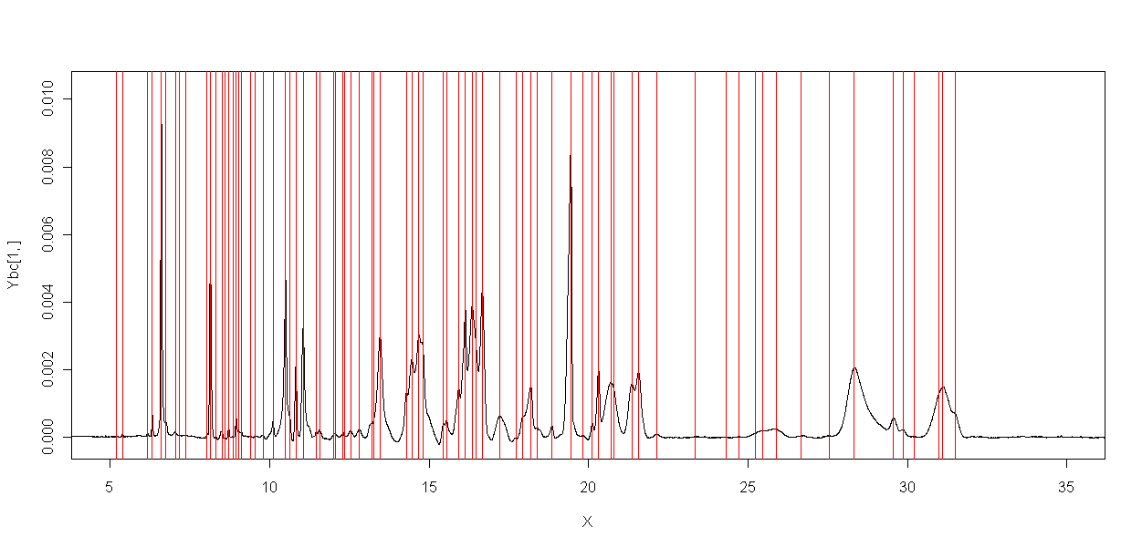
EXTRACTION AND PEAKS ALIGNMENT
Individual extraction of signals peaks
Notes:
The common peaks are extracted

Slide 27
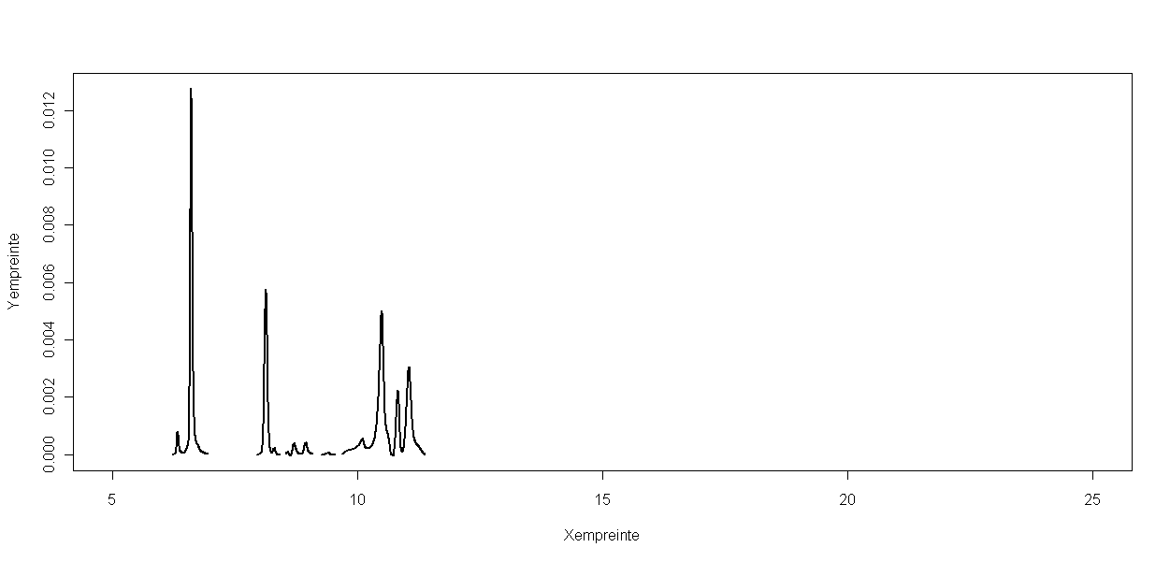
SPECIFIC PART OF FINGERPRINT
Empreinte « Lachesis »
Notes:
And We have got here The specfic analytical fingerprint of Lachesis muta snake venom

Slide 28
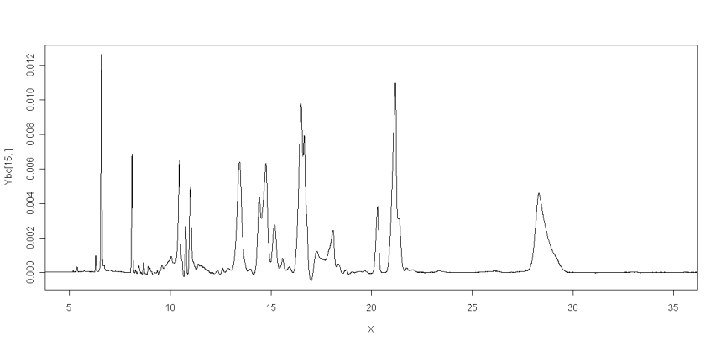
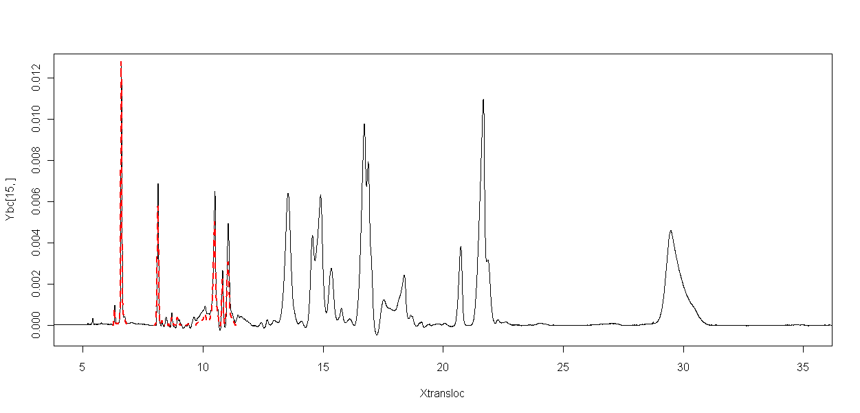
USING THE SPECIFIC PART OF THE FINGERPRINT
Fingerprint « Lachesis muta »
To apply to the quality control of Lachesis muta venom Analyses of other venoms
Notes:
This specific analytical fingerprint will serve for the quality control of lachesis muta batch in production.
We applied this analysis to Naja naja venom strains as mentioned above

Slide 29
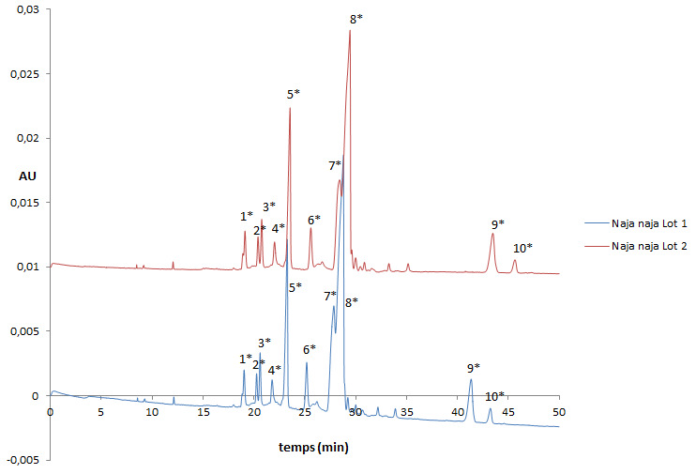
ELECTROPHORETIC PROFILES IN CZE – Naja naja
Batch 1
Batch 2
Analytical conditions: BGE phosphate de sodium pH 2.0 I: 30 mM / Coating PDADMAC / Leff 50 cm / T 35°C / E 212V/cm / λ 214nm/ injection 7, 81nl
Notes:
Here is shown the electrophoretic profiles of two batches of Naja naja venom. These profiles were obtained with the same method of analysis. For each batch 30 analyzes were performed. The profiles obtained are perfectly repeatable

Slide 30
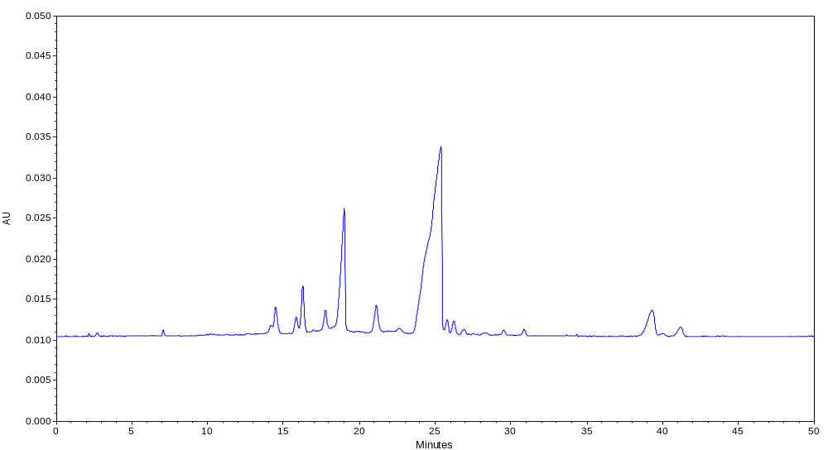
ELECTROPHORETIC PROFILES IN CZE – Naja naja
FEO
No enough peak resolution
Improved analytical conditions
Sample Preparation
Analytical conditions: BGE phosphate de sodium pH 2.0 I: 30 mM / Coating PDADMAC / Leff 50 cm / T 35°C / E 212V/cm / λ 214nm/ injection 7, 81nl
Notes:
The electrophoretic profile of naja naja obtained is less resolved, it means that protein separation may be improved.
we decided to conduct the enzymatic digestion of the venom of Naja Naja, to break the peptide bond

Slide 31
SAMPLE PREPARATION – Naja naja
Proteolysis step
Fragments
(Digest)
5g/L
CE analysis
Incubation time
Proteolysis buffer
Temperature
Denaturation step…
Notes:
The electrophoretic profile of naja naja obtained is less resolved, it means that protein separation may be improved.
we decided to conduct the enzymatic digestion of the venom of Naja Naja, to break the peptide bond

Slide 32
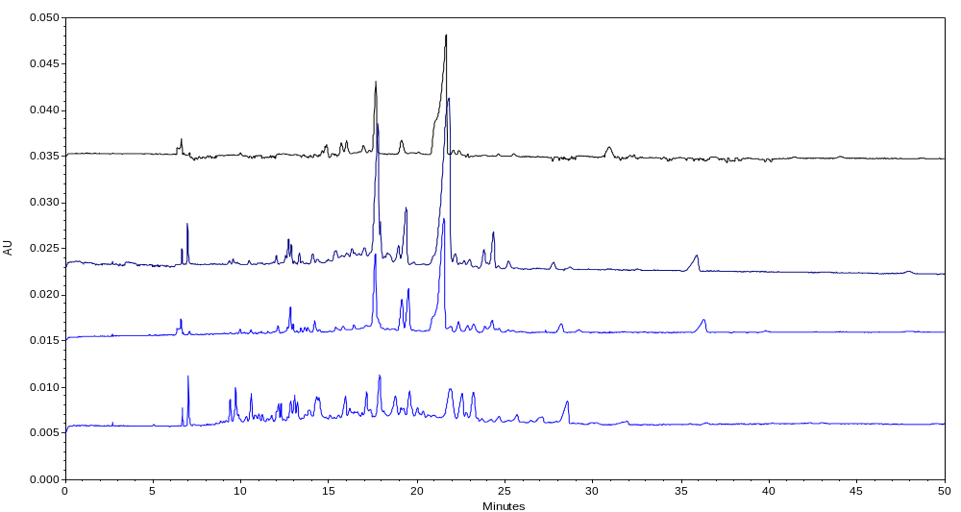
ELECTROPHORETIC PROFILES IN CZE – Digest of Naja naja
Before incubation
Incubation 30min
Incubation 3h
Incubation 12h
FEO
FEO
Conditions d’analyse: BGE phosphate de sodium pH 2.0 I: 30 mM / Recouvrement PDADMAC / Leff 50 cm / T 35°C / E 212V/cm / λ 214nm/ injection 7, 81nl
Notes:
Here are the superposition of profiles obtained after different digestion times
First, Digestion in 30 min
Secondly, Digestion in 3h
And then, Digestion in 12h
The electrophoretic profile obtained after digestion 12H shows the best separation

Slide 33
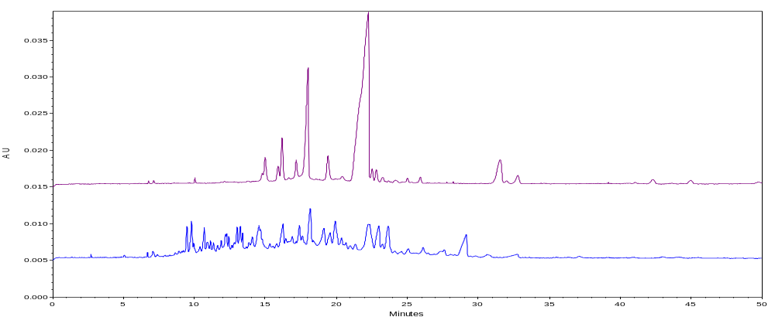
ELECTROPHORETIC PROFILES IN CZE – Digest of Naja naja
Before incubation
After incubation
FEO
Chemometric treatment => many batches
=> Integrated in-line reactor for proteolysis step => D-PES methodology
Notes:
The best result obtaines is shown on this figure
At this level, we will proceed with the analysis of several batches including enzymatic digestion step on line (told to you this morning Mister ……) , and perform chemometric treatment to extract specific analytical fingerprint.

Slide 34

ACKNOWLEDGMENTS
André Sawa Kpaibe
Dr Yoann Ladner
Dr Silvia Mas
Dr Marie-Dominique Blanchin
Pr Catherine Perrin
Pr Michèle C. Aké
Notes:
Acknowledgment to Pr Catherine Perrin, my PhD director …………. And analytical chemistry laboratory team of Pharmacy school of Montpellier
Thank you!!!

