Slide 1

Response Time of GaN-based Deep Submicron Plasmonic Terahertz Detectors
G. Rupper¹, S. Rudin¹, and M. Shur²
¹U.S. Army Research Laboratory, Adelphi, Maryland, USA
‎²Rensselaer Polytechnic Institute, Troy, New York, USA

Slide 2

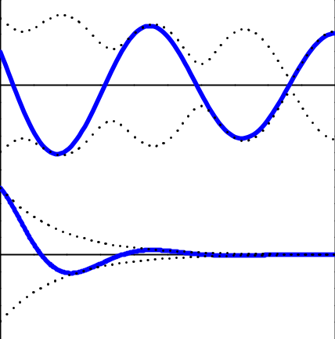
Plasmonic FET Devices
Plasma waves propagate with a higher velocity than the electron drift velocity. This allows devices based on the plasma wave propagation to operate at higher frequencies the devices based on electron drift.
U_{ac}
x = 0
x = L
U_{ac}
Gate
Gate
~
~
~~
U_{gs}
~
S
D
U_{gs}
High Mobility
Tunable Detector
Source
_{j}
Drain
ΔU
Low Mobility
Broadband Detector
Detector Configuration:
  U_{ac} from RF radiation, j < en/2τW
Source Configuration:
U_{ac} = 0, j > en/2τW

Slide 3
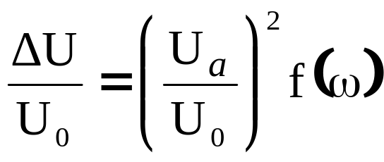
Plasmonic FET Detectors
Advantages of Plasmonic FET THz Detectors:
  High Responsivity¹ (kV/W)
  Low Noise Effective Power² (pW/Hz^{½})
  Tunable by gate voltage
  (for high mobility, short channel devices)
  Fast Response?
¹⁾ Fatimy et. al. J. App. Phys. (2010),
Watanabe et. al. IEEE Sensors (2013)
Kurita et. al. Appl. Phys. Lett. (2012)
2) Sun et. al. Appl. Phys. Lett (2012)

Slide 4
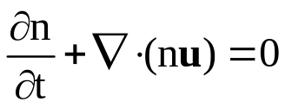
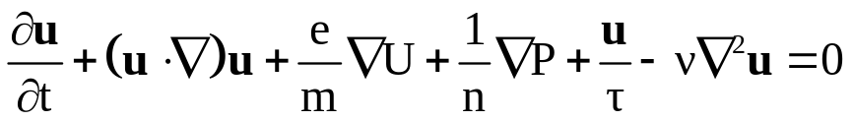
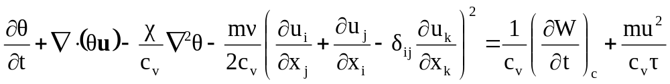
Plasma Modeling
The 2-D electron gas plasma is modeled with a hydrodynamic model
Density balance equation
Navier-Stokes equation
Heat equation
Solved numerically for arbitrary signals

Slide 5
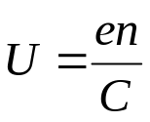
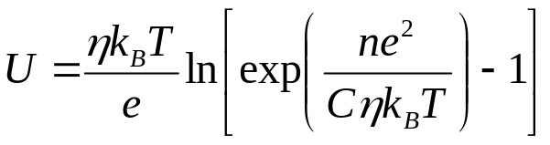
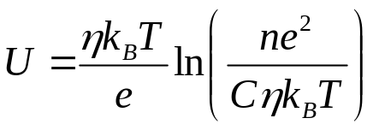
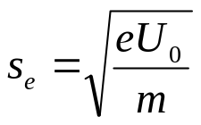
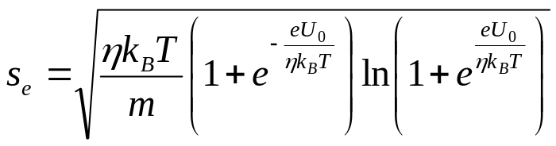
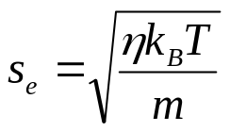
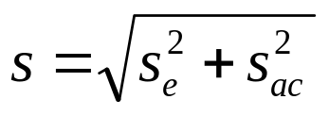
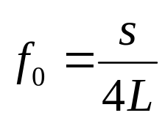
Electric Potential Model
Above threshold
=
Below threshold
Above threshold
=
Below threshold

Slide 6
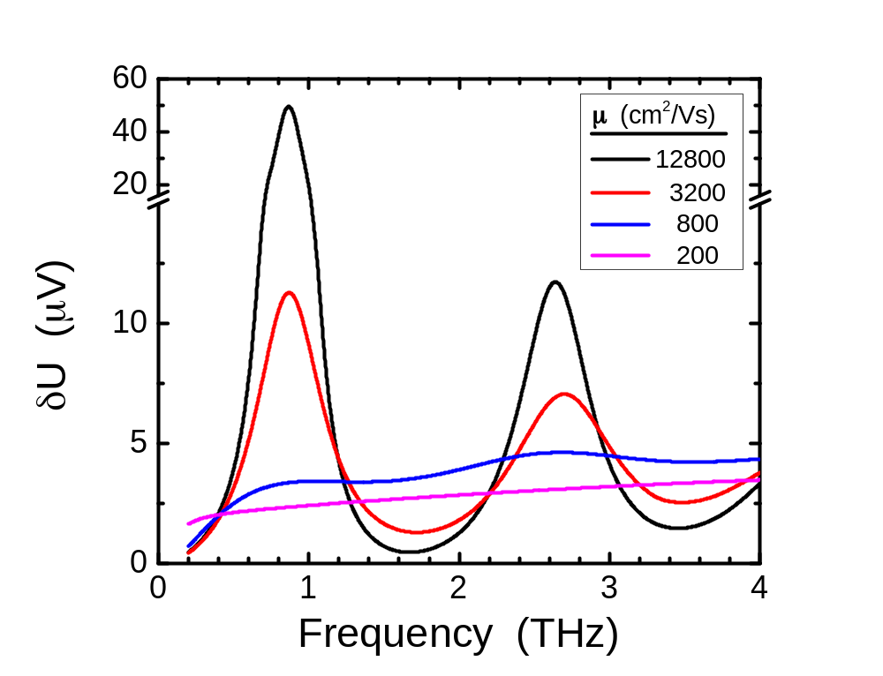
Frequency Response
Device Parameters:
GaN
L=100nm
d=15nm
µ=800 cm²/Vs
U₀=U_{gs}-U_{th}=0.1V

Slide 7
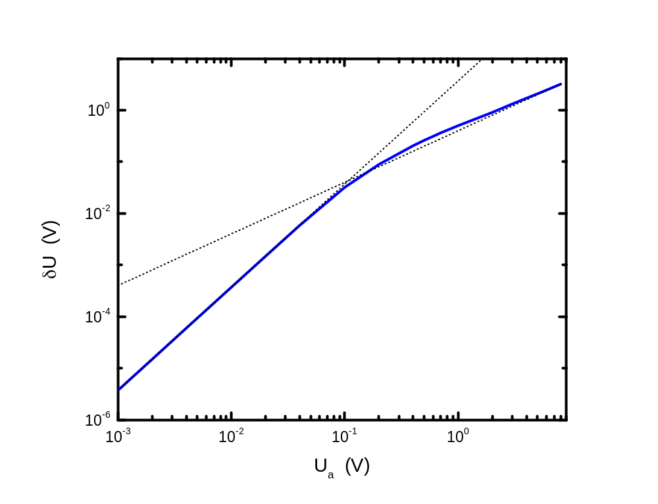
Large Signal Response
Small signal output proportional to U_{a}² (Intensity)
Large signal output proportional to U_{a} (Electric Field)

Slide 8
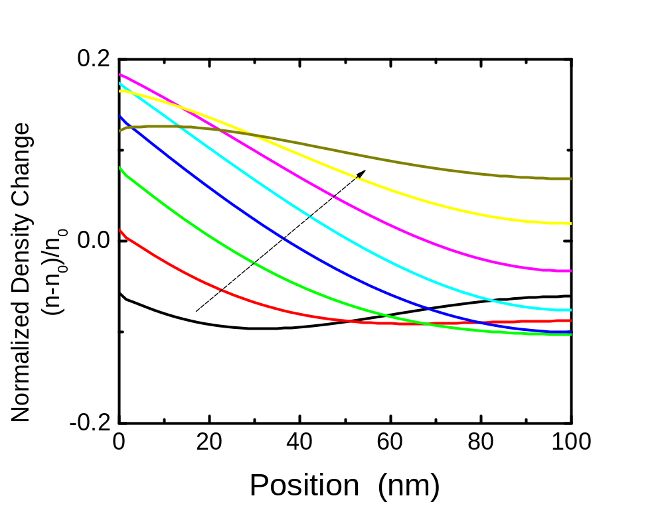
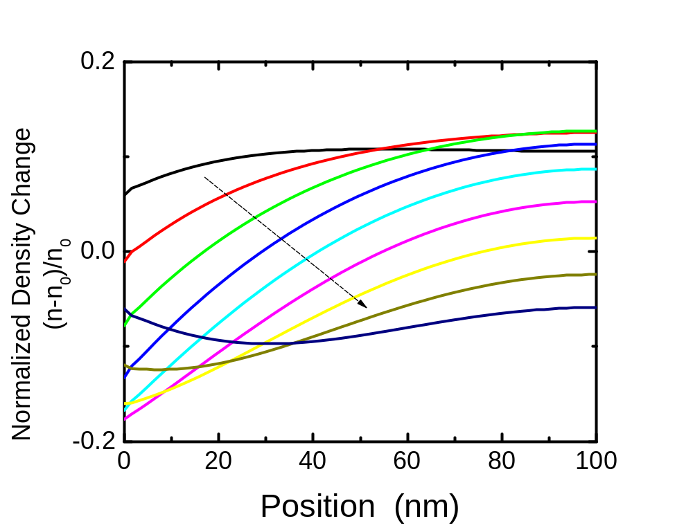
Small Signal Propagation
U_{a}=0.02V
Small signals have a smooth density transition across the device

Slide 9
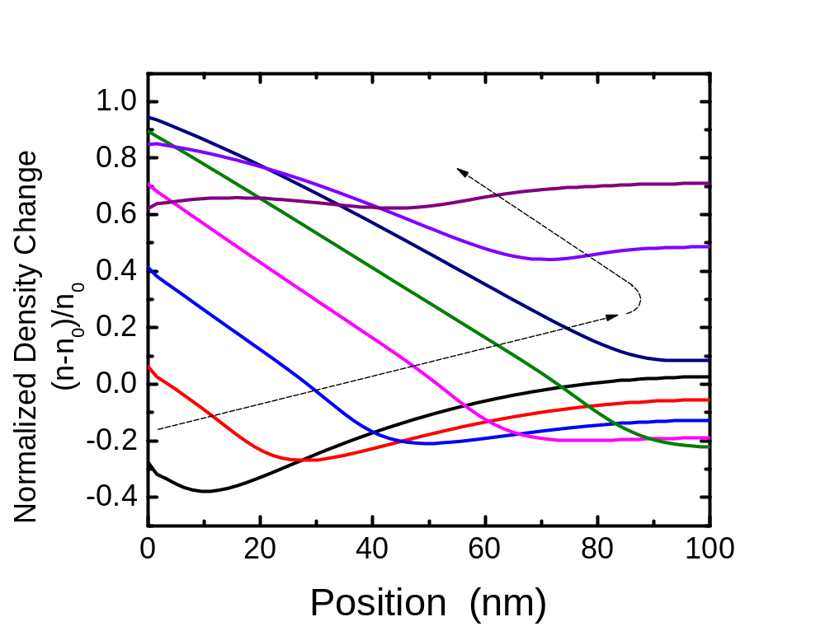
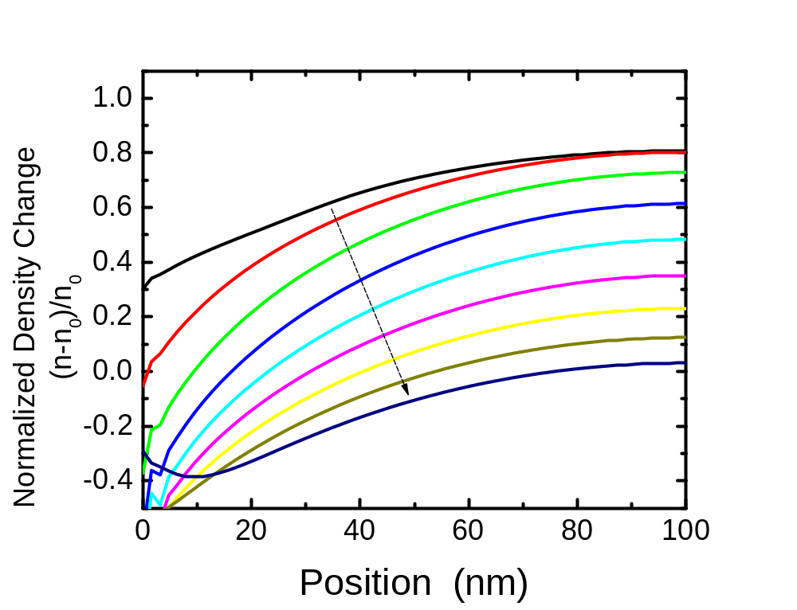
Transition Point Signal Propagation
U_{a}=0.1V
At the transition intensity, we start to see a wave front propagating across the device and reflecting off of the drain

Slide 10
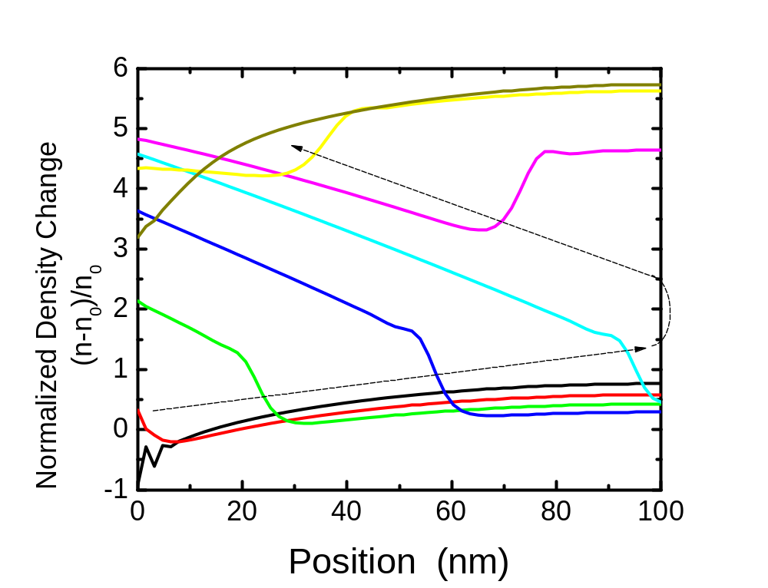
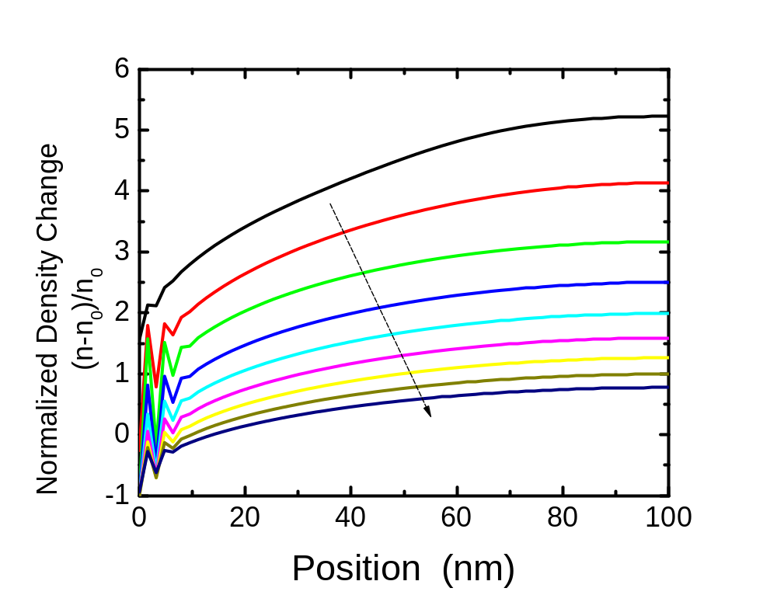
Large Signal Propagation
U_{a}=0.5V
Large signals have a clear shock wave propagation across the device

Slide 11
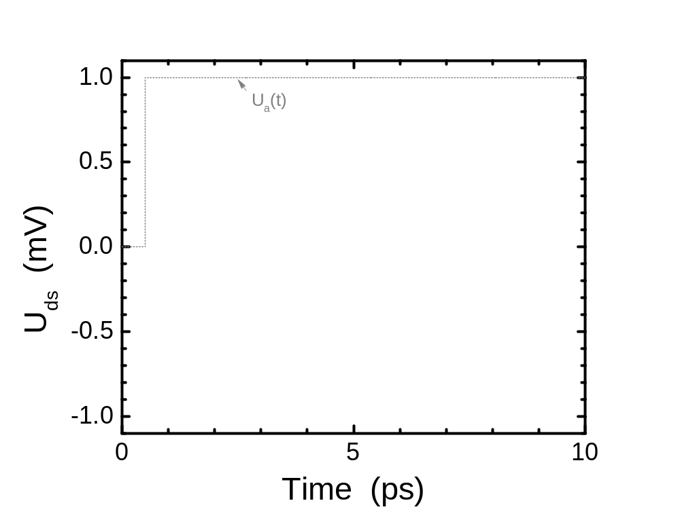
Step Response

Slide 12
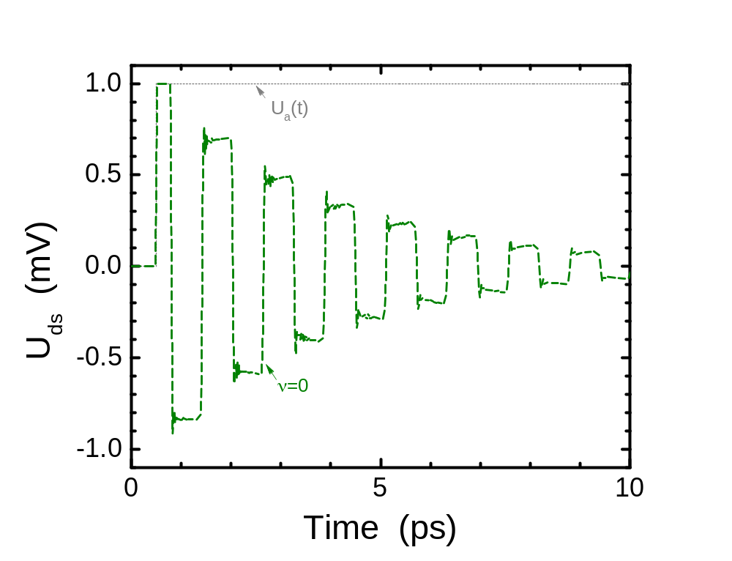
Step Response
High Mobility,
No Viscosity
Response is an exponentially decaying square wave

Slide 13
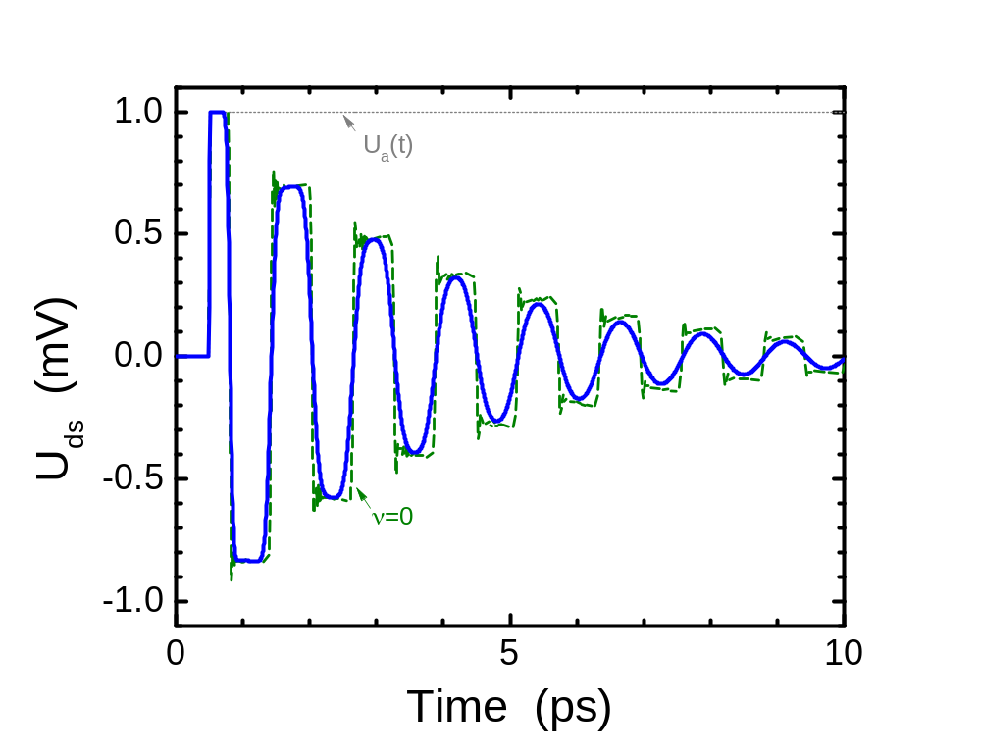
Step Response
Viscosity quickly attenuates high order modes leaving single harmonic frequency

Slide 14
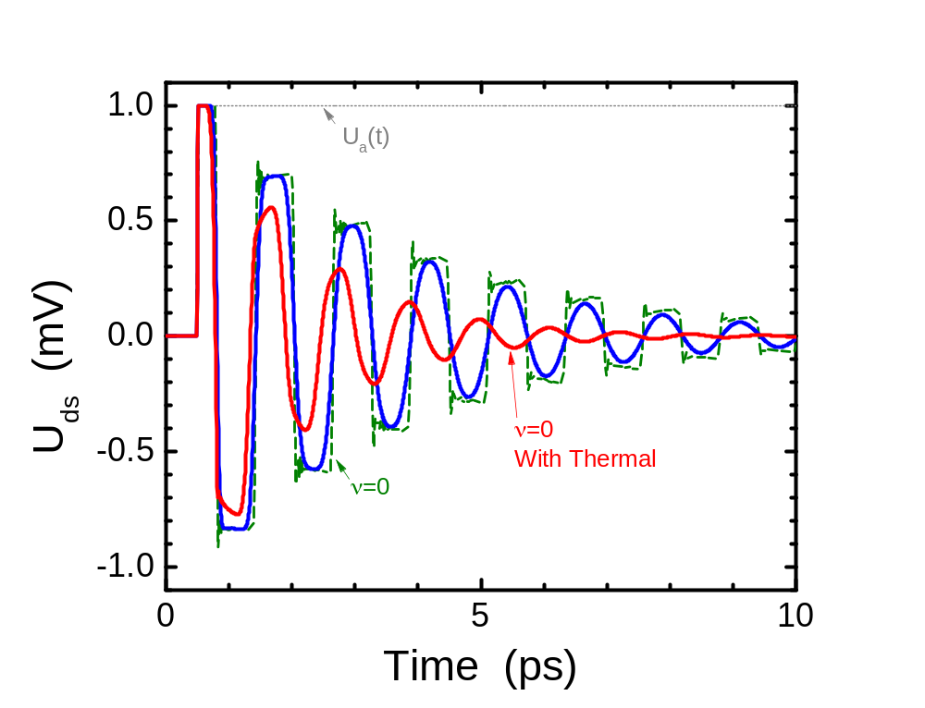
Step Response
Thermal effects also attenuates high order modes leaving single harmonic frequency

Slide 15
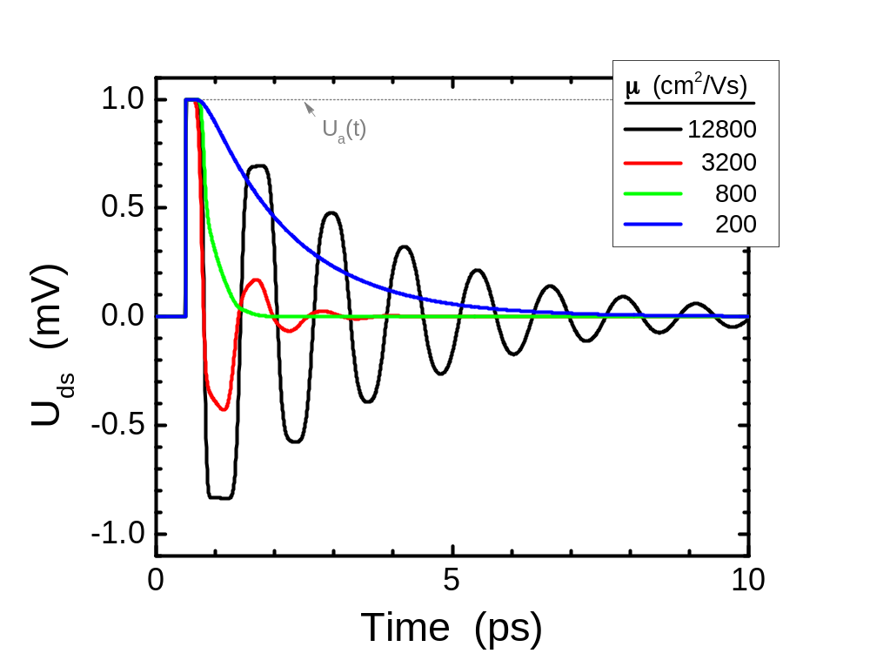
Step Response
Low mobility eliminates periodic ringing
All mobilies have short delay before exponential decay begins

Slide 16
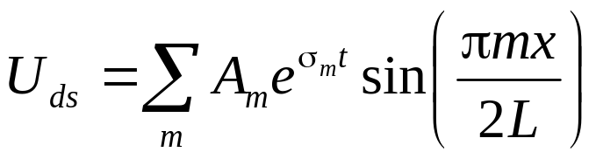
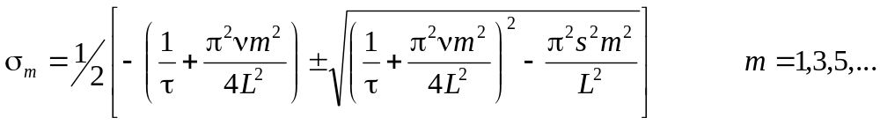
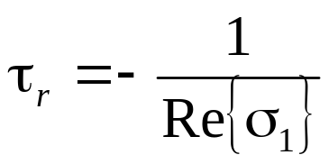
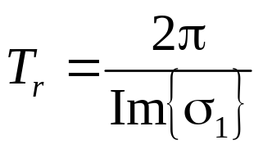
Analytical Step Response
Based on perturbation small signal analysis
Decay time:
Oscillation period:

Slide 17
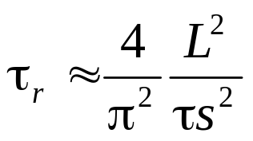
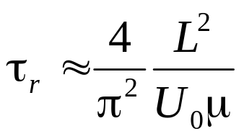
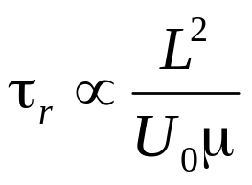
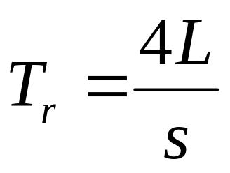
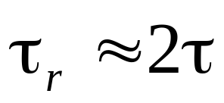
Step Response Approximations
Low Mobility
With Gradual Channel Approx.
From Drift Model
High Mobility

Slide 18
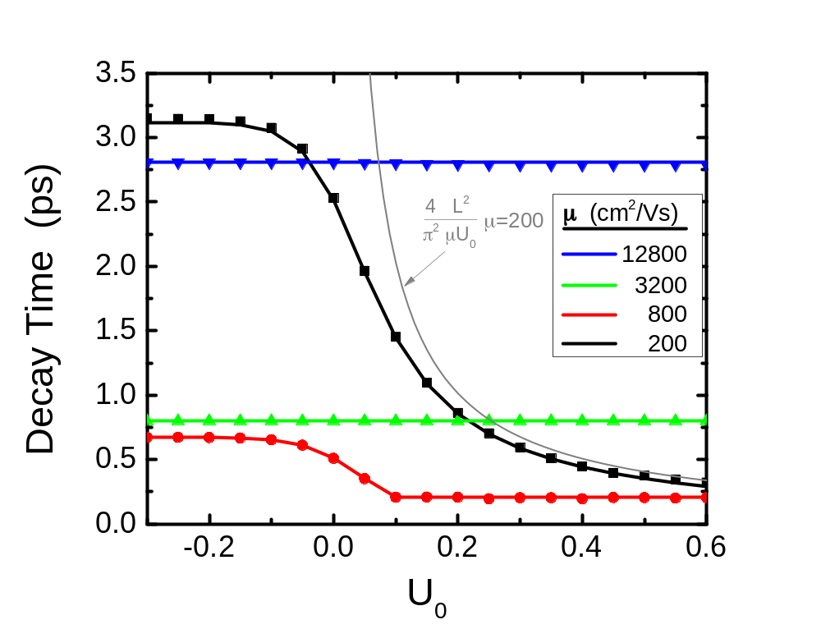
Numerical and Analytical Solution
Good agreement between numerical solution (lines) and analytical solution (dots)
GCA/Drift model reasonable above threashold
Does not include pressure effects

Slide 19
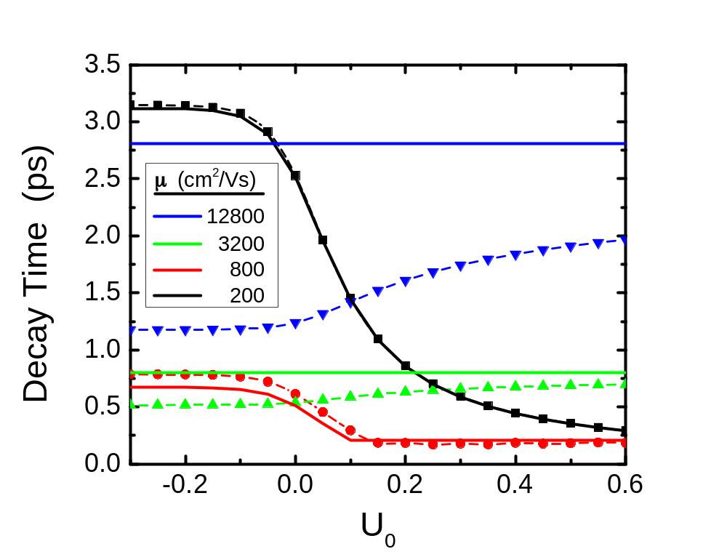
Thermal Effects
Thermal effects reduces the decay time for high mobilities
Small changes for low mobilities

Slide 20
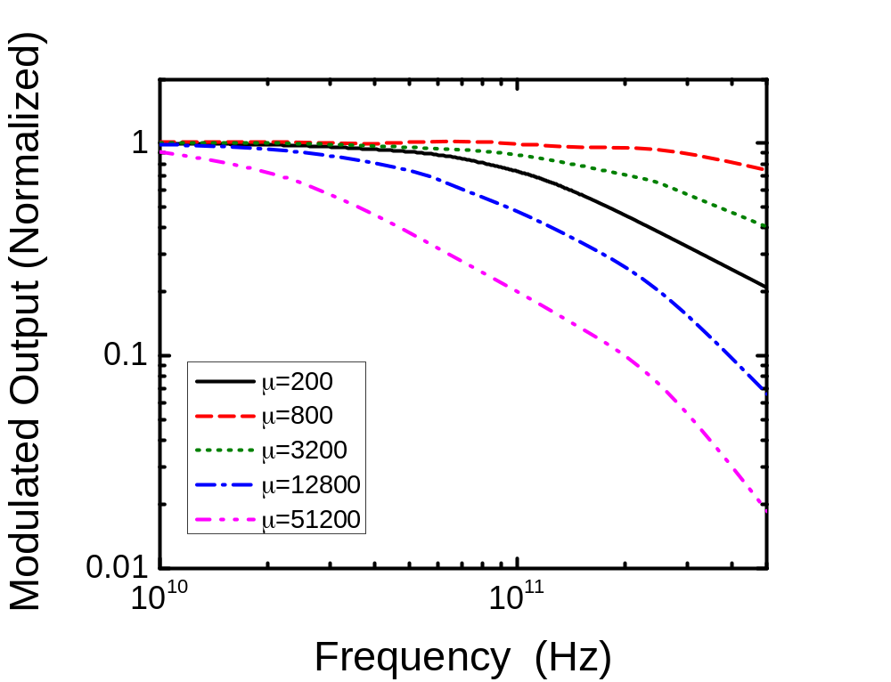
Above threshold response to AM signal
For low mobilities, increasing mobility increases the modulation frequency response.
For high mobilities, increasing mobility decreases the detector bandwidth, and decreases modulation frequency response.
There is an optimal mobility for the largest possible modulation frequency response.

Slide 21
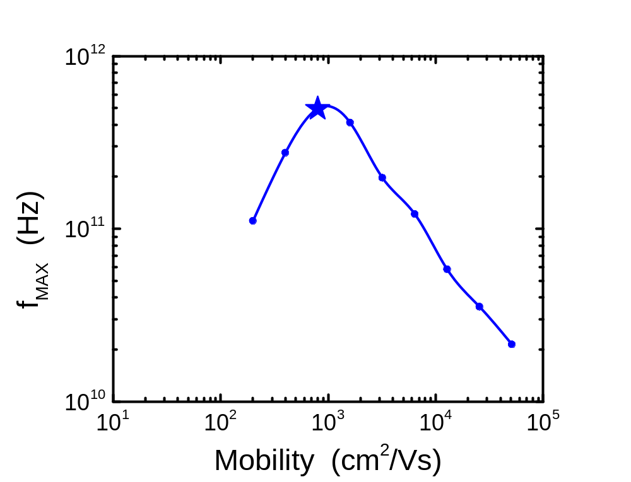
Modulation Cutoff Frequency
Optimal mobility for maximum cutoff frequency
Large range of mobilities for high bandwidth (>50GHz)
Experimental mobility (~800 cm²/Vs) close to maximum
U₀=0.1V f₀=0.81THz

Slide 22
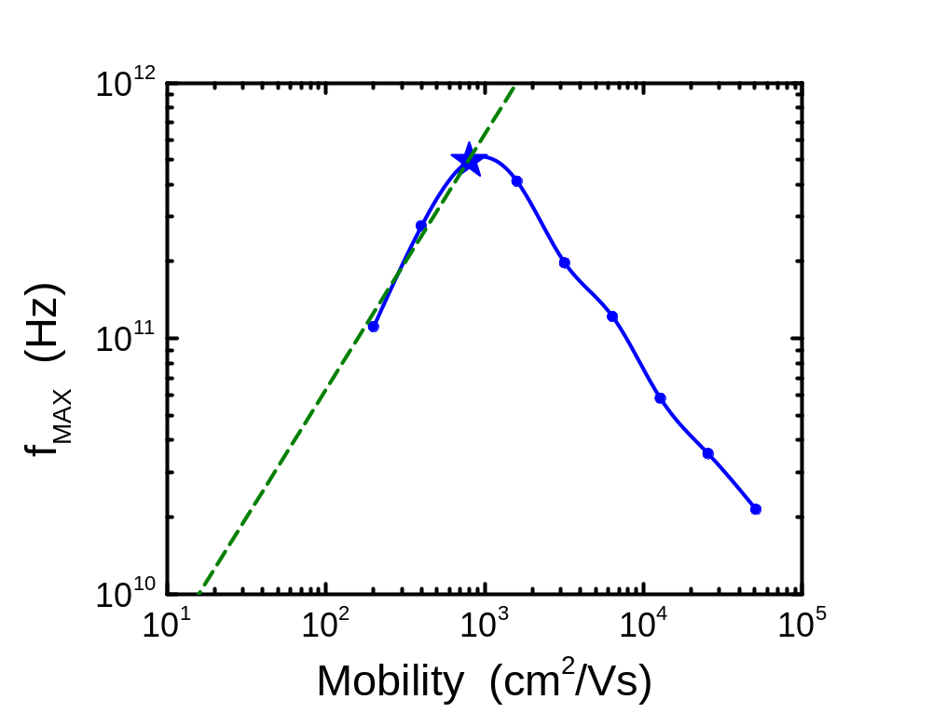
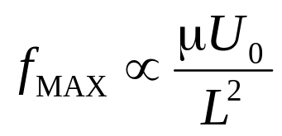
Modulation Cutoff Frequency
Drift model
Good for low mobility, above threashold
Scaling constant fit to data
Kachorovskii and Shur, Solid State Elec. (2007)

Slide 23
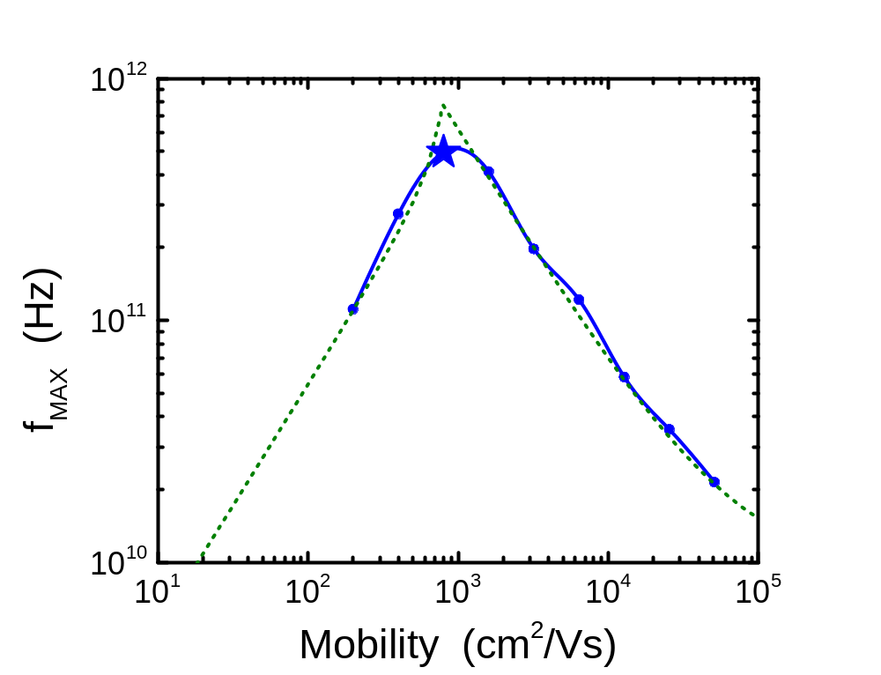
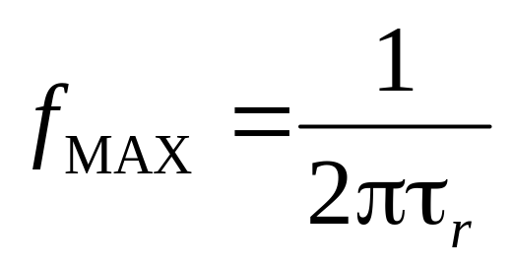
Modulation Cutoff Frequency
Good model for all mobilities
Overestimates peak

Slide 24
Modulation Cutoff Frequency
High mobility limited by bandwidth of detector
Allows gate voltage tunable detector

Slide 25
Summary
We have simulated the response of a plasmonic FET detector to step and modulated input signals
Plasmonic FET THz detectors have a fast response time (~ps). Can be used for very high bandwidth (>100GHz) signals
There is a mobility that provides the maximum detector bandwidth for modulated signals
High mobility detectors provide tunable passband detectors

Slide 26
Aknowledgement
The work at RPI (M. Shur) was supported in part by the U.S. Army Research Laboratory through the Collaborative Research Alliance (CRA) for Multi-Scale Modeling of Electronic materials (MSME).

