Slide 1

PRODUCTION OF CLOUDIFIER PRODUCTS FROM LEMON, ORANGE, MELON, PERSIMMON FRUIT AND ITS AUTOMATION
Galina.N.Ignatyeva
Roberto Vilaplana Perez

Slide 2
AUTHORS GREATLY ACKNOWLEDGES ALL CO-WORKERS, “CITROMIL”, MURCIA, SPAIN
AND GRATEFUL TO
HELENA SOLER
CARLOS NICOLAS
MARIO DIAZ BALLESTER
JOSE A. GIL
JUAN A. CUELLO
PASCUAL MOROTE
FOR THEIR STUDIES.

Slide 3

AUTHORS IS ALSO GRATEFUL TO THE UNIVERSITY UMH
OF ELCHE, SPAIN.

Slide 4
AIM
THE AIM OF THIS PAPER IS TO PRESENT RESULTS OF THE INFLUENCE OF SOLUBLE SOLIDS, PULP CONTENT, AND TURBIDITY ON THE CONDUCTIVITY AND COLLOIDAL STABILITY BY APPLYING CONDUCTIVITY FOR AUTOMATION IN THE CLOUDIFIER JUICE PRODUCTION FROM THE CITRUS, MELON AND PERSIMMON FRUIT.
2. THE OTHER AIM IS TO DEVELOP THE APPLICATION OF THE CONTINUOUS PROCESS OF FLASH
VACUUM EXPANSION IN THE INDUSTRY OF CLOUDIFIER JUICE.

Slide 5
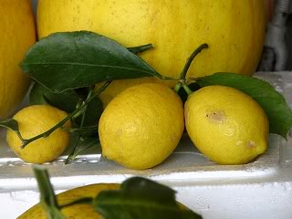
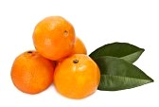
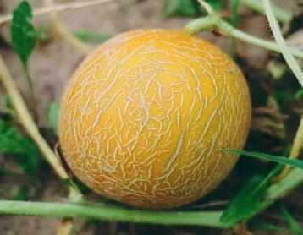
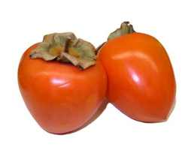
IT IS KNOWN THAT THERE IS A RELATIONSHIP BETWEEN OUR HEALTH AND FOOD.
INTRODUCTION
THE CLOUDIFIER JUICE AND CLOUDIFIER CONCENTRATE FROM:
CONTAIN THE LARGEST AMOUNT OF PECTIN, MODIFIED PECTIN, SOLUBLE FIBRE, FLAVONOIDS, VITAMIN C, LARGE AMOUNTS OF VITAMIN A , LYCOPENE AND ANTIOXIDANTS.

Slide 6
THESE CLOUDIFIER JUICE AND CLOUDIFIER CONCENTRATE ARE THE NATURAL PRODUCT WITH BENEFICIAL HEALTH PROPERTIES.
FOR EXAMPLE:
THE CONSIDERABLE INPUT OF LYCOPENE HAS A GREAT ANTIOXIDANT POWER THAT CAN ACT TO PROTECT CELLS FROM OXIDATIVE STRESS PRODUCED BY THE ACTION OF FREE RADICALS. THIS CELL PHENOMENON IS RESPONSIBLE FOR MAJOR CARDIOVASCULAR DISEASES AND CERTAIN TYPES OF CANCER AND AGING.
(ERCISLI, ET AL., 2007; CHEN ET AL. 2008; HUANG ET AL., 2008).

Slide 7
THE MODIFIED PECTIN WILL BE EFFECTIVE AGAINST CANCERS OF THE BREAST, COLON AND PANCREATIC CANCER, AND MELANOMA.
THE INHIBITION OF CANCER CELL PROLIFERATION (HT29 COLON LINE) WAS OBTAINED FROM THE SAMPLE OF MODIFIED PECTIN BY USING 1 G TO 1L CONCENTRATION.
THE INHIBITION OF CANCER CELL PROLIFERATION (SW480 COLON LINE ) WAS OBTAINED WITH THE MODIFIED PECTIN SAMPLE BY USING 2 G TO 1L CONCENTRATION TOO.
THE SLIGHT DECREASE IN CELL VIABILITY (JIMT1 CELL LINE) RELATIVE TO THE CONTROL AT THE TWO CONCENTRATIONS EMPLOYED WAS OBTAINED FOR THE MODIFIED PECTIN SAMPLE.
THE INHIBITION OF CANCER CELL PROLIFERATION (B16/F10 CELL LINE) WAS OBTAINED WITH THE MODIFIED PECTIN SAMPLE BY USING 2 G TO 1L CONCENTRATION.

Slide 8
RESULTS AND DISCUSSION
THE ASSAY AND PRODUCTION WERE DONE DURING 10 MONTHS. DURING THIS PERIOD 60 LOTS OF INDUSTRIAL CLOUDIFIER LEMON AND ORANGE CONCENTRATES WERE ANALYZED.

Slide 9
CLOUDIFIER LEMON CONCENTRATES WITH LOW ACIDITY.
TABLE 1.
ºBRIX (20ºC)
35,03
40,31
31,38
42,35
43,79
37,81
45,19
35,65
42,87
ACID, % w/w
14,26
16,24
10,81
16,72
16,57
14,37
20,58
13,52
20,14
pH
2,92
2,94
2,84
2,9
2,95
2,85
2,88
2,99
2,76
PULP, % v/v,*
0,2
0,4
0,4
0,4
0,5
0,7
1
1
0,8
OIL, % w/w,*
0,0033
0,0032
0,0016
0,003
0,0022
0,0032
0,004
0,0044
0,0033
FLAVONOIDS, % w/w, *
0,51
-
0,43
0,48
0,42
0,45
-
-
-
Imhoff test (% v/v,
24-48 h),*
1,4
0,1
0,8
1,2
1,1
4,6
3,3
2,8
3,5
ASCORBIC ACID,
mg/L,*
563
510
-
580
546
510
575
743
694
TURBIDITY, FNU, *
5687
6073
-
5900
6339
6234
5753
7428
6942
*IN 8°BRIX RECONSTITUTED JUICE.

Slide 10
PREMIUM CLOUDIFIER LEMON CONCENTRATES.
TABLE 2.
ºBRIX (20ºC)
47,77
41,28
41,69
ACID (% , w/w)
35,68
31,06
31,76
PULP (%,v/v )*
0,04
0,1
0,1
pH
2,45
2,45
2,53
OIL (%, w/w),*
0,0002
0,00016
0,00041
IMHOFF TEST (v/v, 24-48 h)*
0,2
0,2
0,6
*IN 8°BRIX RECONSTITUTED JUICE.

Slide 11
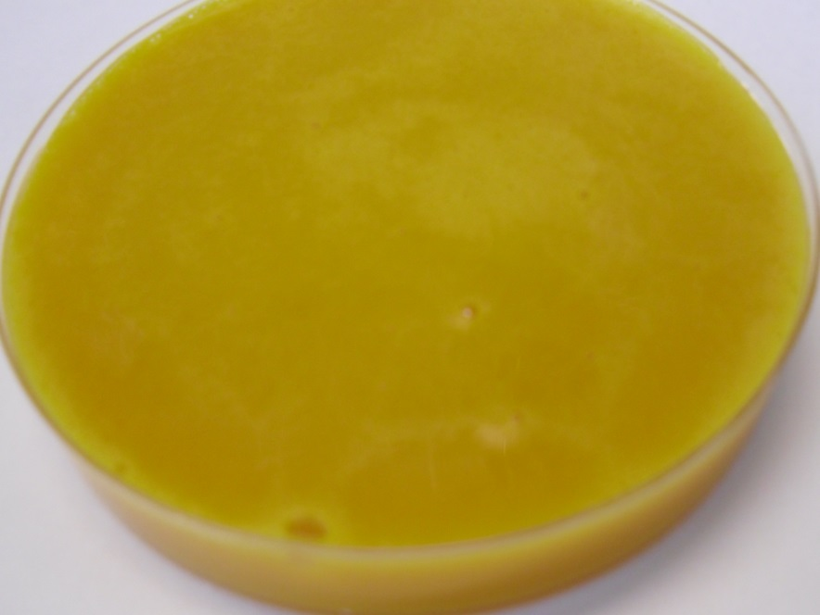
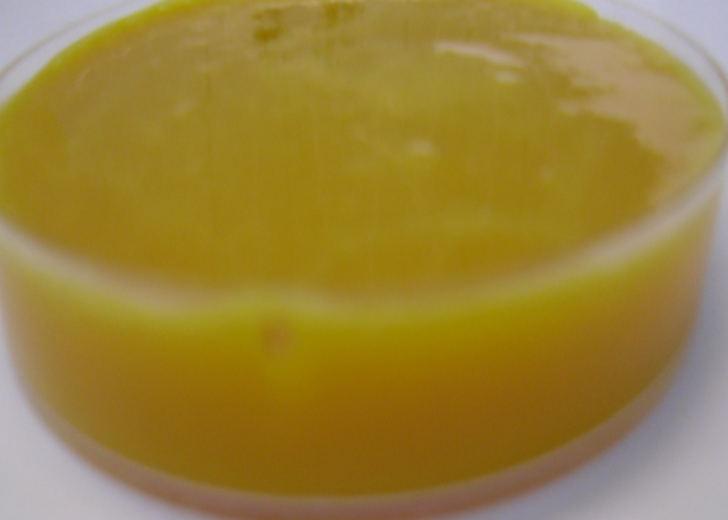
CLOUDIFIER ORANGE CONCENTRATES :
TABLE 3.
ºBRIX (20ºC)
44,35
41,93
41,61
40,78
ACID (%, w/w)
2,75
1,73
0,71
2,48
PULP (%, v/v)**
0,9
0,6
0,4
0,4
pH
3,86
4,14
4,54
3,65
OIL (%, w/w ),**
0,0081
0,0024
0,0016
0,0098
TURBIDITY, FNU,**
7550
5182
3283
7250
**IN 11,2°BRIX RECONSTITUTED JUICE.

Slide 12
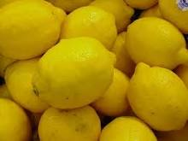
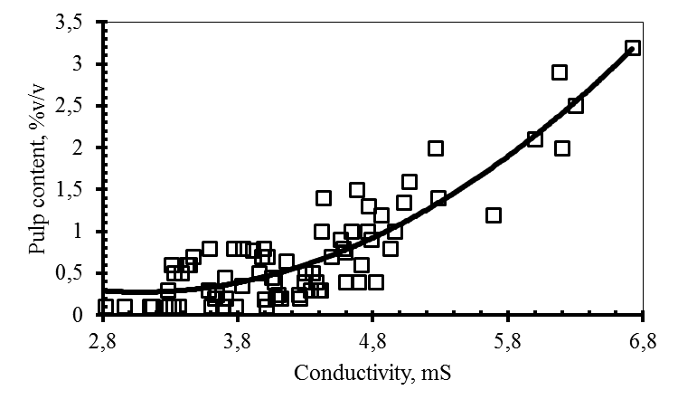
STUDIES OF BRIX, ELECTRICAL CONDUCTIVITY, TURBIDITY, RHEOLOGY, AND SEDIMENTATION OF JUICES WERE USED IN ORDER TO DETERMINE THE CLOUD STABILITY OF INDUSTRIAL CLOUDIFIER JUICE AND CONCENTRATE.
FIGURE 1. VARIATION OF PULP CONTENT IN THE CLOUDIFIER INDUSTRIAL JUICE.

Slide 13
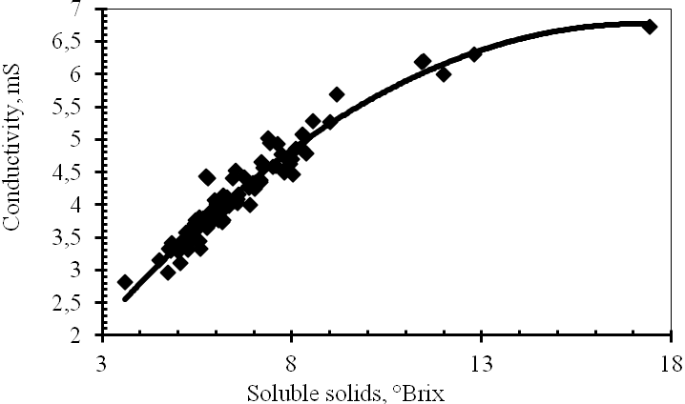
THE RELATIONSHIP BETWEEN BRIX AND CONDUCTIVITY IN CLOUDIFIER JUICES FROM CITRUS, MELON, PERSIMMON FRUIT WAS USED FOR AUTOMATION IN PROCESSING.
FIGURE 2. EFFECT OF SOLUBLE SOLIDS (°BRIX) ON THE ELECTRICAL CONDUCTIVITY OF THE CLOUDIFIER INDUSTRIAL JUICE.

Slide 14
THIS AUTOMATION PROTOCOL FOR CLOUDIFIER JUICE PRODUCTION FROM LEMON IS USED AS FOLLOWS:
c
TRIGGER - SERVER THE ELECTRICAL CONDUCTIVITY, BRIX, PULP CONTENT, TURBIDITY;
RUNBOOK – ACTIVATES A SERIES OF SCRIPTS, IN A SPECIFIC ORDER, TO PERFORM BY THE POLYNOMIAL EQUATIONS AND LINEAL EQUATIONS IN THE INTERVAL OF THE ELECTRICAL CONDUCTIVITY (4,2-4,8MS); BRIX (6,4-8,0), PULP CONTENT (0,6-0,9%);
SCRIPTS- MANIPULATE OF THE ACTIVITY OF ENZYMES, SUCH AS PECTINLYASE, ENDO-1,4-BETA-GLUCANASE, CELLULASE;
REPORT THE RESULT OF THE RUNBOOKS IS THE ELECTRICAL CONDUCTIVITY AND A MEANS OF THE MICELLE SIZE.
c
c
c

Slide 15
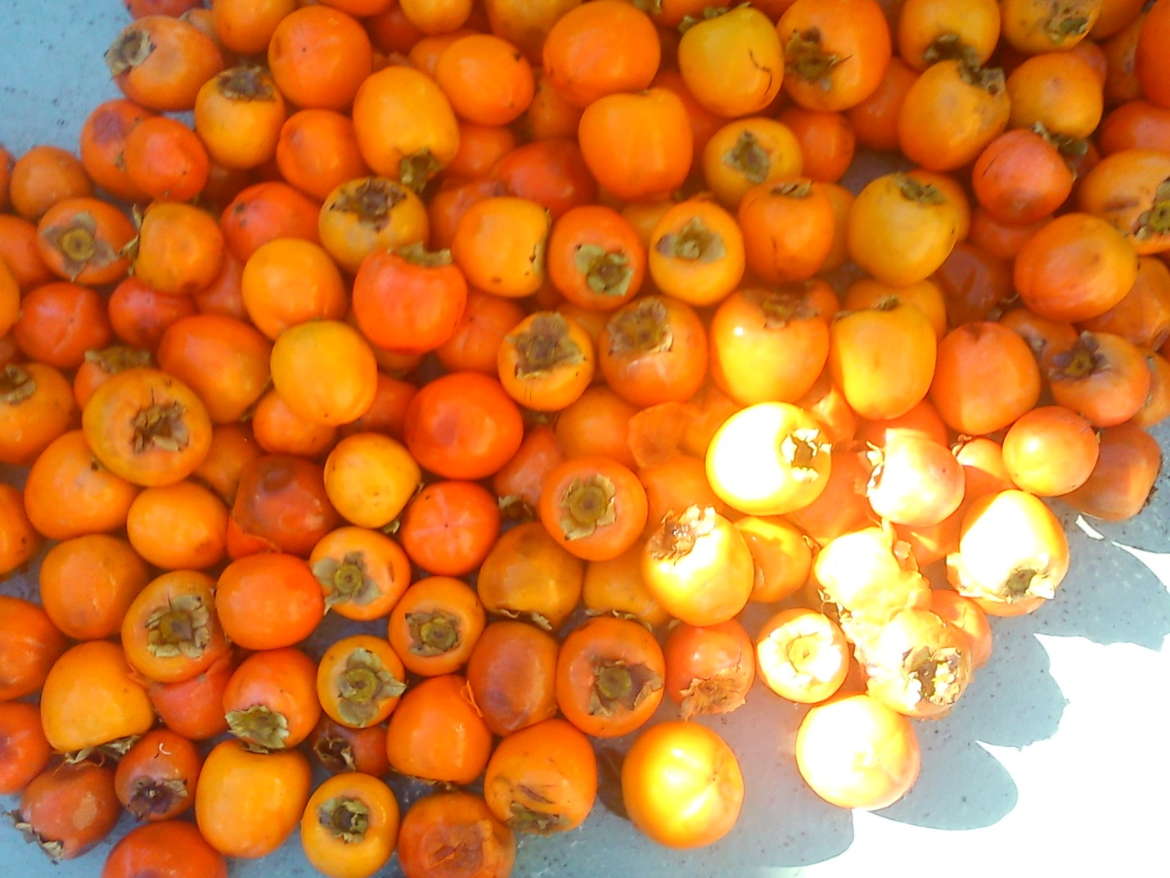
IN INDUSTRY THE TECHNOLOGY OF PRODUCTION OF CLOUDIFIER JUICES FROM PERSIMMONS WAS APPLIED COMPRISING THE FOLLOWING STEPS (FIGURE 3):
FRUITS
CRUSH
CAVITATION TREATMENT
SEPARATION
ENZYMATIC TREATMENT
ENZYMATIC TREATMENT
SUDDEN EXPANSION
PASTEURIZATION
PASTEURIZATION
CLOUDIFIER JUICES
PREMIUM CLOUDIFIER JUICES

Slide 16
THE ENZYME TREATMENT WAS APPLIED BOTH FOR ASTRINGENT AND NON-ASTRINGENT PERSIMMON FRUITS.
ENZYME APPLICATION CONDITIONS SUCH AS THE TIME AND THE TEMPERATURE LARGELY DEPEND ON THE ENZYME USED, AND THE CONTENT OF TANNINS.
THE TIME (20-40MIN) REDUCED THE CONTENT OF PHENOLIC COMPOUNDS IN THE JUICE, OR PULP
FROM BETWEEN 0,18-0,2% TO 0,08%.
2. THE SUDDEN EXPANSION (VACUUM FLASH) OCCURS IMMEDIATELY AFTER AN ENZYME TREATMENT.
THE SUDDEN EXPANSION TREATMENT OF PERSIMMON JUICE (AFTER THE ENZYME TREATMENT)
DURING 30 MIN REDUCES THE AMOUNT OF PHENOLIC COMPOUNDS IN THE JUICE, OR PULP FROM
0,08% TO 0,04%.
IF WE INCREASED THE TIME OF THE SUDDEN EXPANSION TREATMENT FROM 30 MIN TO 135 MIN THE
AMOUNT OF PHENOLIC COMPOUNDS IN THE JUICE, OR PULP HAS INCREASED FROM 0,05% TO 0,12%.
3. THE MINIMUM CONCENTRATION OF POLYPHENOLS IS ACHIEVED BY USING 0,03BAR OF VACUUM.

Slide 17
THE SUDDEN EXPANSION OPENS THE POSSIBILITY OF PRODUCING THE CLOUD STABILITY JUICES.
THE SUDDEN EXPANSION TREATMENT OF PREMIUM JUICE CHANGES:
THE VISCOSITY,
THE pH,
BRIX,
THE CONCENTRATION OF TOTAL POLYPHENOLS,
THE CONTENT OF SETTLED PULP,
THE PECTIN METHYLESTERASE ACTIVITY,
THE PARTICLE CHARGE,
THE PRECIPITATION FORMATION.

Slide 18
THE SUDDEN EXPANSION RESULTED IN :
A SIGNIFICANT ALTERATION OF JUICE PARTICLE SIZE DISTRIBUTION PATTERN;
THE FORMATION OF THE PARTICLE SIZE LESS THAN OR EQUAL TO 0.1 MM;
THE INCREASE OF THE CONDUCTIVITY (FOR LEMON JUICE - 5,38-5,62MS);
A SIGNIFICANT INCREASE OF THE TURBIDITY; (FOR LEMON CONCENTRATE - THE TURBIDITY RANGED FROM 445-1420FNU FOR A SOLUTION OF 0,8 BRIX);
THE INCREASE CLOUD STABILITY.

Slide 19
THE SUDDEN EXPANSION TREATMENT OF CLOUDIFIER JUICES FROM PERSIMMON FRUIT MODIFIED THE PECTIN SUBSTANCES.
FIGURE 4. VARIATION OF DEGREE OF ETHERIFICATION IN THE PREMIUM CLOUDIFIER PERSIMMON FRUIT JUICES

Slide 20
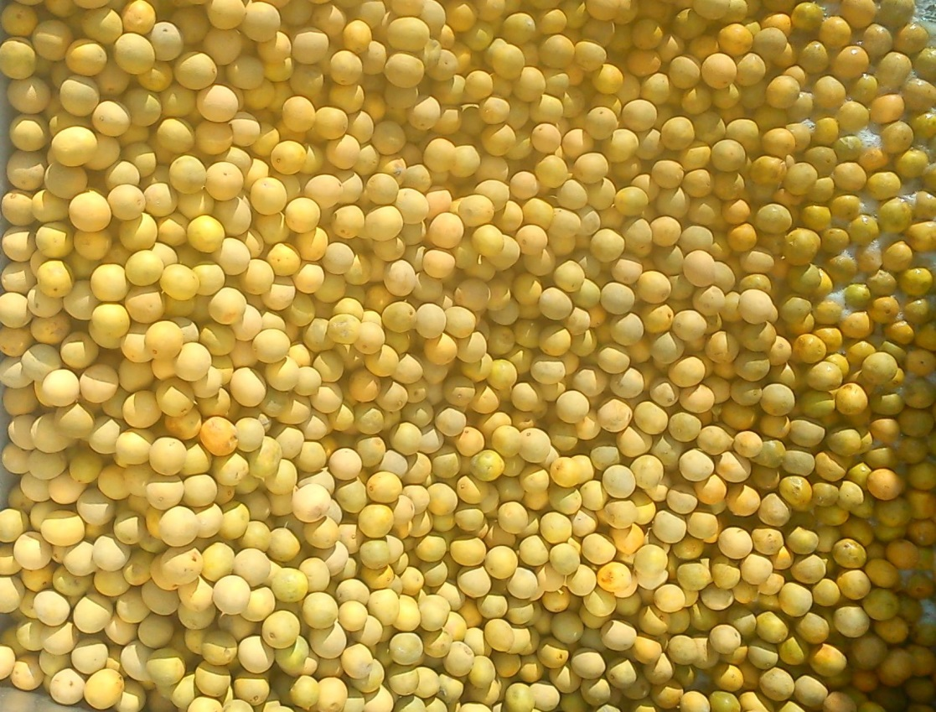
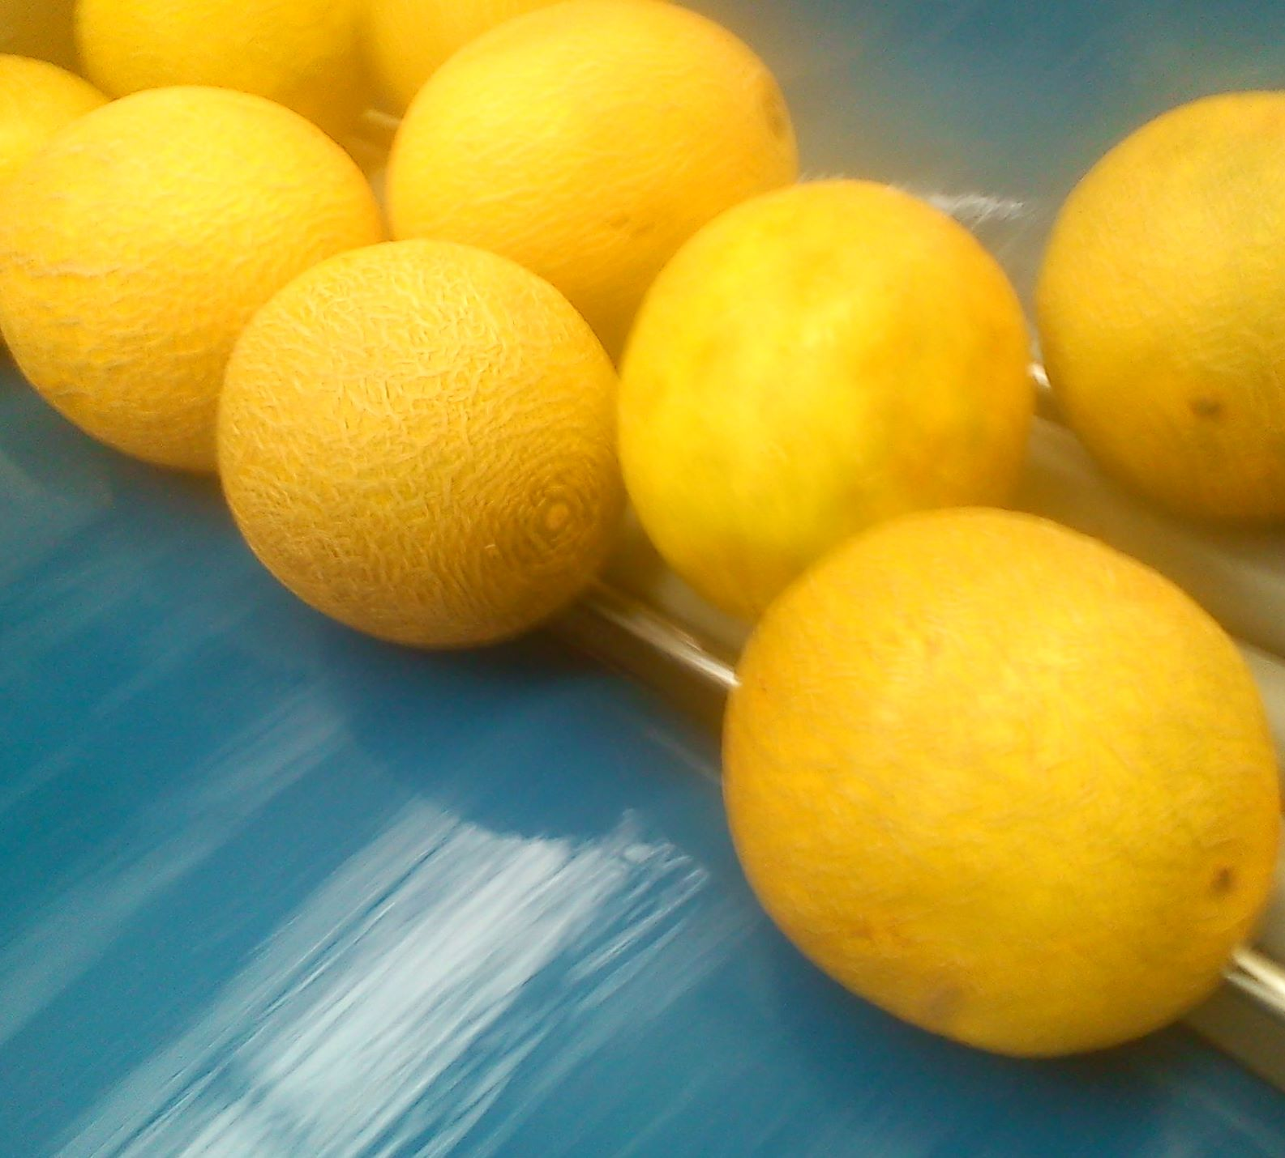
THE INCREASE OF TIME FACTOR DURING CONCENTRATION OF THE CLOUDIFIER JUICE FROM MELON LED TO THE ALTERATION OF THE COLOUR PARAMETERS.
TABLE 4.
SOLUBLE SOLIDS, °BRIX
COLOUR PARAMETERS
Hue
Brightness
11
149
4,21
31
190
4,06
36
183
3,53
40
163
4,42
45
150
4,8
55
145
5,69

Slide 21
THE INCREASE OF TIME FACTOR DURING CONCENTRATION OF THE CLOUDIFIER JUICE FROM MELON LED TO THE INCREASE OF CLOUD LOSS.
FIGURE 5. VARIATION OF PULP CONTENT IN THE CLOUDIFIER INDUSTRIAL MELON CONCENTRATE FROM 0,2÷0,4 TO 3÷4%.

Slide 22
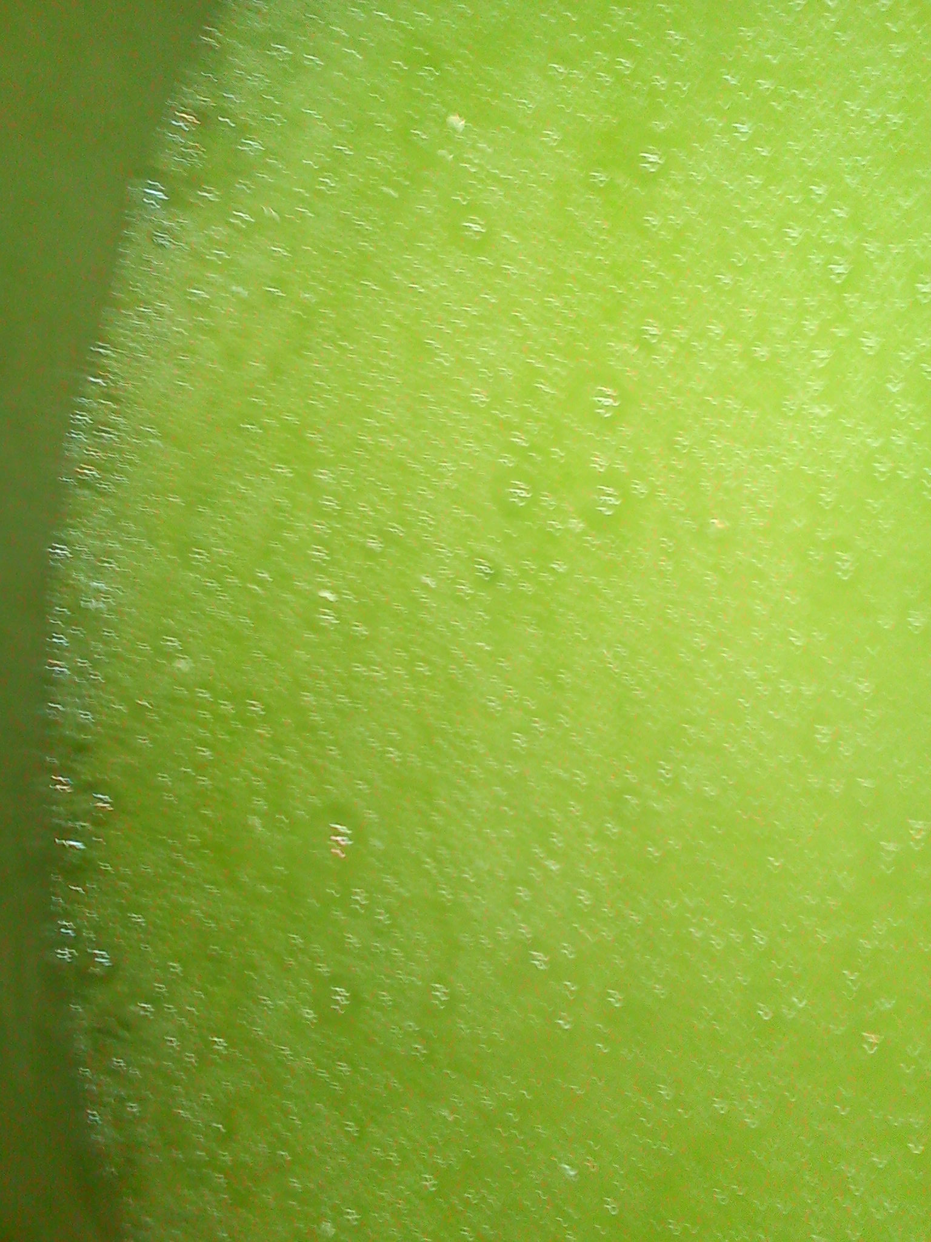
ANALYSIS THE STABILITY OF COLOUR PARAMETERS FOR A SOLUTION OF 10°BRIX HAD TO BE DETERMINED DURING 14 DAYS AT ROOM TEMPRETURE.
FIGURE 6. THE HUE OF CLOUDIFIER CONCENTRATE (30-55°BRIX) FROM MELON DURING 14DAYS (IN 10°BRIX RECONSTITUTED JUICE).

Slide 23
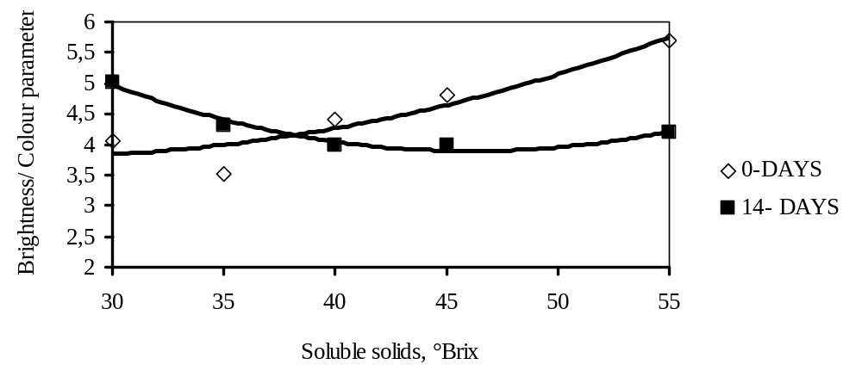
THE INDUSTRY PREMIUM CLOUDIFIER CONCENTRATE OF 55°BRIX SHOWED A HIGHER CHANGE OF COLOUR PARAMETERS AT ROOM TEMPRETURE
FIGURE 7. THE BRIGHTNESS OF CLOUDIFIER CONCENTRATE (30-55° BRIX) FROM MELON DURING 14 DAYS (IN 10°BRIX RECONSTITUTED JUICE).

Slide 24
THE CLOUD LOSS IN INDUSTRY CLOUDIFIER CONCENTRATES WAS NO MORE THAN 21-38,4% DURING STORAGE AT ROOM TEMPRETURE.
TABLE 5. VISUAL JUDGMENT OF RELATIVE TURBIDITY AFTER 4, 14 DAYS. THE MORE TURBID THE SAMPLE IS THE MORE + SIGNS IT GETS.
SAMPLE
4 DAYS
14 DAYS
Cloudifier lemon juice
++++++++
+++++++
Premium cloudifier lemon juice
+++++
+++++
Cloudifier lemon concentrate
++++++++
+++++++
Cloudifier orange concentrate
+++++++
++++++
Cloudifier persimmon fruit juice
++++++
++++++
Premium cloudifier persimmon fruit juice
+++++
+++++
Cloudifier melon juice
++++++++
++++++
Premium cloudifier melon juice
++++++++
+++++
Premium cloudifier melon concentrate
++++++++
++++++

Slide 25
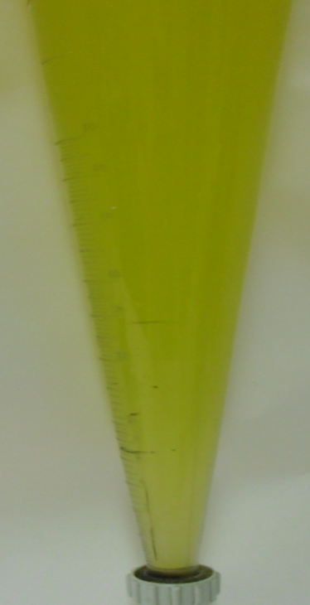
THE FREEZING EFFECT AND THE STORAGE TIME ON STABILITY OF THE CLOUDIFIER CONCENTRATE FROM CITRUS, MELON, PERSIMMONS WAS STUDIED.
SAMPLES WERE STORED AT -20°C DURING 2- 36 MONTHS.
2. THE TURBIDITY, CLOUD STABILITY, PULP CONTENT, SEDIMENTATION IN IMHOFF CONE DIDN'T SHOW
DIFFERENCES BETWEEN THE CONTROL SAMPLE AND FROZEN SAMPLES.
3. THE SIGNIFICANT CHANGE IN COLOUR PARAMETERS WAS OBSERVED IN INDUSTRY PREMIUM
CLOUDIFIER MELON CONCENTRATE OF 55 BRIX (TABLE 6).
TABLE 6.
PARAMETER***
STORAGE TIME AT -20°C , MONTH
0
36
BRIGHTNESS
5,69
8,39
HUE
145
163
SENSORY CHARACTERISTICS
MELON
MELON
COLOUR
GREEN -YELLOW
GREEN - YELLOW
***IN 10°BRIX RECONSTITUTED JUICE

Slide 26
CONCLUSION
THE INCREASE OF CLOUD LEVEL OF CLOUDIFIER JUICES, CONCENTRATES OF CITRUS, MELON AND PERSIMMON FRUIT CONSIDERABLY INCREASED THEIR BENEFICIAL HEALTH PROPERTIES.
ENZYMES IN THE RANGE TO MAINTAIN CLOUD STABILITY WERE USED FOR MICELLE FORMATION AND INACTIVATION OF PECTIN ESTERASE.
THE APPLICATION OF PROPOSED PROCEDURE CONSIDERABLY INCREASED THE TURBIDITY TO
350÷1420FNU IN 0,4÷0,8°BRIX RECONSTITUTED JUICE

Slide 27
4. THE PRESSURE TREATMENT OF CLOUDIFIER JUICES FROM PERSIMMON FRUIT MODIFIED THE PECTIN SUBSTANCES AND FORMED THE MOLECULES WITH 60% DEGREE OF ESTERIFICATION.
5. THE INCREASE OF OLIGOMER PECTIN CONTENT WITH 60% DEGREE OF ESTERIFICATION LED TO THE CLOUD STABILITY OF SAMPLES.
6. THE SAMPLES WERE STABLE DUE TO FORMATION OF MICELLE (1,0÷1,3ΜM) NETWORK AND MODIFICATION OF CONTINUOUS PHASE VISCOSITY BY MEANS OF PECTIN OLIGOMERS.
7. THE THERMAL TREATMENT OF CLOUDIFIER SAMPLES AT 85÷95°C NOT ACCELERATED THE SEDIMENTATION PROCESS.
8. AS EXPECTED CLOUDIFIER INDUSTRY CONCENTRATES AFTER COOLED WERE STABLE FOR LONGER TOO.

Slide 28

THANK YOUR FOR ATENTION

