Slide 1
Assessment of sea water intrusion into the coastal aquifers
By
Dr. Kasi Viswanadh Gorthi
Professor of Civil Engineering
OSD to Vice-Chancellor, JNTUH , India
Email: gkviswanadh@jntuh.ac.in

Slide 2
Contents – Presentation outline
Introduction
Methodology
General quality of ground water
Chemical constituents
Criteria for reorganisation of sea water intrusion
Results and Discussions
Conclusions

Slide 3
Introduction:
The coast is where land, water and air interact.
The coastal areas comprise of low lands with
small gradients bordering sea and /or lower
reaches of rivers of coastal marshes
The economic significance of coastal regions
requires no elaboration.
Largest cities of the world are near to see and about 1/3rd of the human habitant is within a 100 km strip along the coast line and coastal deltas are major areas of grain productions.

Slide 4
The issues relevant to coastal zones are
  Storm, flood control,
  Protection from coastal erosion and reclusive of land,
  coastal inundation, depletion of forest resources,
  increased salinity intrusion in coastal land and aquifers,
  marines and industrial pollution,
  effects due to change in agricultural practices,
  land use pattern,
  impact of aquaculture and fisheries.

Slide 5
Groundwater
An important component of water resource systems.
Extracted from aquifers through pumping wells and supplied for domestic use, industry and agriculture.
With increased withdrawal of groundwater, the quality of groundwater has been continuously deteriorating.
Growing concern about the water resources especially Water Crisis
To meet the increasing demand of water – need to tap ground water resources

Slide 6
Hydrological Issues of Coastal Regions:
Hydrology of coastal areas is distinct
In a delta the water levels and flows are influenced
by the water levels of sea
The impact assessment of development activities on
coastal area is normally complicated due to the
involvement of so many factors
As a result, it is not feasible to draw guidelines to
address the various interactive processes
It would be realistic to confine to impacts that
expressed in terms of changes in the quantity and
quality of water for subsequent use as inputs

Slide 7
The coastal aquifers constituent an important source
of water in the world.
The fresh water aquifers are in contact with the sea
due to that the planning and management of such
aquifers requires special attention associated with
the danger of seawater intrusion.
As seawater intrusion progresses, the part of the
aquifer close to the sea become saline and pumping
wells that operate close to the coast have to be
dissolute.
Also, the area above the intruding seawater wedge,
which remains fresh by natural replenishment, is lost
as source of freshwater

Slide 8
Problems with groundwater
Groundwater overdraft / mining / subsidence
Water logging
Seawater intrusion
Groundwater pollution

Slide 9
Coastal aquifers prove to be an important source of ground water resource.
Seawater is the most common pollutant of fresh water in coastal aquifers
Seawater intrusion in fresh water aquifers- Results from the activities of Man.
Excessive ground water pumping
  Deterioration of water quality
  Dictating expensive remedies

Slide 10
Objectives:
The main objective of present work is to assess the
seawater intrusion in coastal areas of Nellore
district, Andhra Pradesh . Nellore district is situated in the south-eastern part of the Andhra Pradesh.

Slide 11
To study shallow groundwater hydrochemistry and its variations from sea coast.
  a) Hydro chemical variations [Ca/Mg ratio, TA/TH ratio, Cl/(Co3 + HCo3) ratio, base exchange Index, Mg/Ca Vs Cl ratio, I/Cl ratio]
  b) SAR & % NA variations
To assess ground water quality parameters with WHO & ISI drinking water standards and its suitability for drinking and agricultural purposes.
To suggest possible mitigation measures for saltwater intruded areas in the study area.

Slide 12
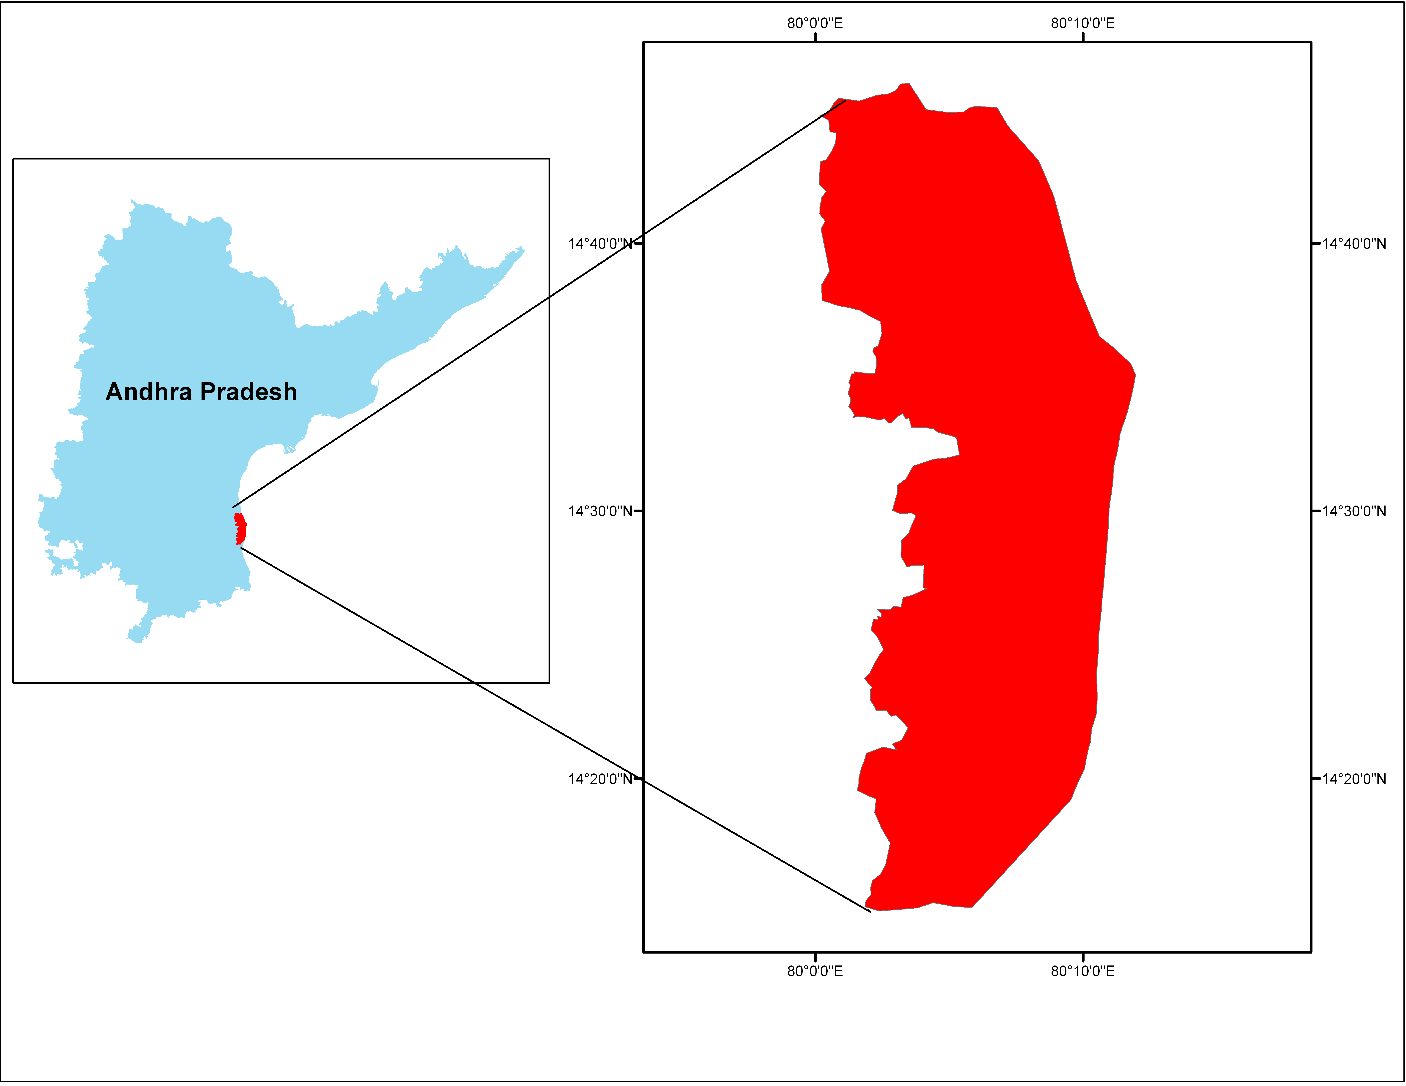
Location:
The study area comprises, nine coastal mandals, viz
Kavali, Allur, Vidvalur, Indukurpet, T.P Gudur,
Muthukur, Kota, Vakadu, Chittamur situated along
eastern part of the Nellore district
Nellore district is approximately between 13°30’- 15°05’
of North Latitude, 79°05’- 80°15’of East Longitude.
Fig. Location Map of the Study area

Slide 13
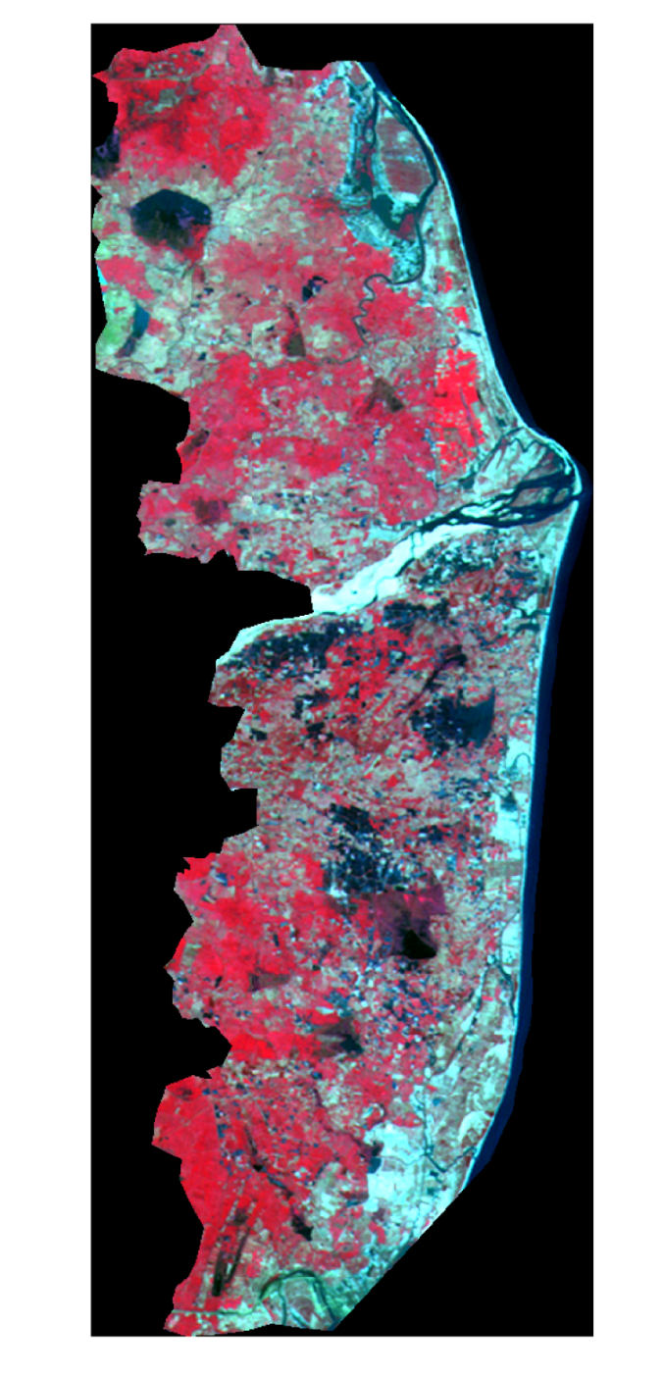
Study Area
SATELLITE IMAGE OF THE STUDY AREA DURING 2010

Slide 14
Rainfall:
Due to SW and NE monsoons in Nellore district the
rainfall ranges from 700-1000 mm
In the year 2009-10 the normal rainfall of the district is
1080mm
During the reference year 2009-10, the actual quantum of
rainfall received was 996.1mm
From September to December the major portion of the
rainfall is received during the northeast monsoon period
to an extent of 610.8 mm
The total rainfall received during 2011 is 1309.71 mm
But most of the rainfall received during two months only,
i.e., in October and November with a rainfall of 813.51mm

Slide 15
Soils:
The soils of the district are classified as red, black and sandy.
The red soils are predominant with 40% of the area whereas
black cotton soil and sandy loams occupy 23% and 34% of
the area respectively.
A major portion of the area is covered by red soils
Land utilization and Crop Particulars:
The principle crops being grown are paddy, bajra, sugarcane,
groundnut, fruits & vegetables, chilies, cotton and tobacco

Slide 16
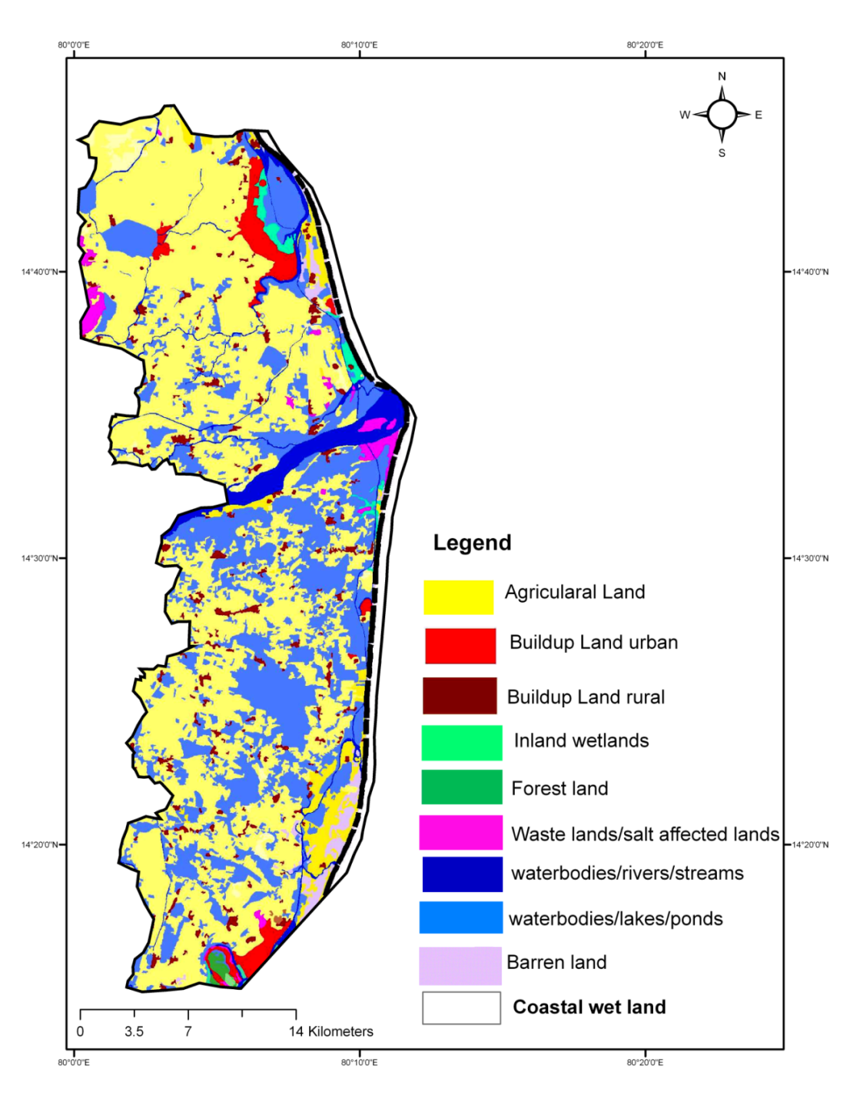
Land Use

Slide 17
Methodology
The following methodology has been adopted in the present study
Collection of monthly rainfall data from District Statistical Department
Collection of periodic groundwater levels from State Groundwater Department
Correlation of groundwater levels with rainfall data
Preparation of contour maps and drainage maps of the study area
Model conceptualization and data preparation
Model Simulations and calibration

Slide 18
Methodology
Analysis of water samples
Comparison of hydro chemical data with various parameters to identify seawater intrusion
Suitability of groundwater for drinking and agricultural purposes
Identification of saline water intrusion with the help of MODFLOW

Slide 19
Collection of Rainfall Data:
Monthly rainfall data collected from District Statistical
Department, Nellore for the period 2011 for the Coastal
mandals viz Kavali, Allur, Vidvalur, Indukurpet, T.P
Gudur, Muthukur, Kota, Vakadu, and Chittamur
Table 1 Amount of rainfall in the year 2011
MONTH | RAINFALL(2011) (mm) | G.W.LEVEL(2011) (mm)
January | 18.81 | 3.42
February | 38.88 | -
March | 0 | 4.11
April | 74.74 | -
May | 1.16 | 5.89
June | 57.62 | -
July | 63.06 | 6.57
August | 142.95 | -
September | 51.56 | 5.89
October | 371.52 | -
November | 441.88 | 3.15
December | 47.53 | -

Slide 20
Chemical Analysis:
Groundwater analysis data of 33 samples (May, 2011)
from 9 coastal mandals was collected from the State
Groundwater Department, Nellore for the following
parameters/ ions, viz., Hydrogen ion concentration
(pH), Electrical Conductivity (EC), Total Dissolved
Solids (TDS), Calcium (Ca), Magnesium (Mg),
Chlorides (Cl), Sulphates (SO₄ ), Sodium (Na),
Potassium (K), and Total hardness (as CaCO₃)

Slide 21
Chemical Parameters
Various chemical ratios, viz. Ca /Mg, Cl / CO3 +HCO3), Na /Cl were calculated based on equivalent parts per million (epm) of respective cations and ions present in the groundwater to recognise the salt water intrusion in coastal aquifers of Nellore district.

Slide 22
Results and Discussions
The groundwater analysis data of 33samples (May, 2011)
from 9 coastal mandals was collected from the State
Groundwater Department, Nellore. These parameters
/ions are expressed in mg/l.
The details of groundwater quality particulars are shown in Table

Slide 23
General Quality of Ground Water:
Hydrogen ion Activity (pH):
The pH of groundwater in the study area ranges from
7.59 to 8.94.
The pH generally ranges from 7.0 to 8.5 with the higher
range 7.5 to 8.0 confined to the eastern, central and
north western parts.
Higher pH is observed in area where the soil profile
contains higher concentrations as at Alluru,
Kudithipalem, and Mypadu.

Slide 24
Total Dissolved Solids:
In the study area the TDS values are ranging from 428
to 4463 mg/lit.
The TDS with less than 500 mg/l is observed in
Kesavaram belonging to Kota Mandal.
Maximum ranges TDS with more than 1500 mg/l
occurs in the Ramudupalem belonging to Indukurpet
Mandal with the range of 4463 mg/l.
According to the classification given by Robinove et
al. groundwater in the study area are, in general
nonsaline (less than 1000 mg/l) and in a few parts of
study area are slightly saline (1000 to 3000 mg/l).

Slide 25
Toatal Hardness:
Hardness of ground waters in the study area ranges
from 36 to 1238 mg/l. But the general range is 300 to
600 mg/l.
Water is classified with respect to TH as shown below.
Description | TH (mg/l)
Soft | < 75
Moderately hard | 75-150
Hard | 150-300
Very hard | >300

Slide 26
In the study area, TH with less than 75 mg/l is not
observed, shows that no sample falls under soft category.
Moderately hard water (75-150 mg/l) occurs in Pallipadu
and Mothali.
Hard water with 150-300 mg/l range covers most of the
area.
Maximum range of more than 300 mg/l, i.e., very hard
waters are observed in most of the places in Kudithipalem
belonging to Indukurpet Mandal.

Slide 27
Chemical constituents:
Calcium (Ca):
Calcium concentration in the study area varies from 16-
320mg/l.
Low concentration of 16 mg/l is observed mostly in the
Kesavaram belonging to Kota Mandal.
Higher concentrations with 50-100 mg/l are found the
Indukurpet and Vidavlur Mandals.
Maximum range of more than 100 mg/l occurs in the
Alluru Mandal.
Groundwater body modifies its chemical composition by
the process of cation exchange in the study area, and
inverse relation is observed between Ca & Na ions.
The Ca rich show low Na concentration and vice-versa.

Slide 28
Magnesium (Mg):
In the groundwater study area Mg content is less than Ca.
It varies from 19 to 340 mg/lit. Most of the area shows 30
to 50 mg/lit.
Higher range of 50-150 mg/lit is observed in the Mandals
Vakadu & Kavali.
Maximum content above 150mg/lit observed in Mandal
Alluru
Generally Mg content is also controlled by the presence
of CO₂ like Ca. About 190mg/lit of Mg will remain in the
solution under the influence of atmospheric CO₂.
Therefore it is possible that all the Mg in the groundwater of the study area remains in solution.

Slide 29
Sodium (Na):
It is found that Na is the dominant cation in the study
area and its concentration in the groundwater’s of the
study area varies between 106 and 680mg/lit.
Most of the study area falls in the range of 100-250mg/lit.
The minimum range of Na is about 106mg/lit situated in
Indukurpeta Mandal and the maximum range of 680mg/lit
situated in Mypadu present in Indukurpeta Mandal.

Slide 30
Chloride (Cl):
Among anions, Chloride is the dominant anion in the
groundwater of the study area. Its concentration ranges from 30- 1300 mg/lit.
Low concentration of 30 mg/lit is observed in
Kesavaram situated in Kota Mandal.
The lowest concentration of Cl is almost coincides with
the lowest of TDS.
The maximum concentration of Cl is 1300mg/lit
observed in the Kudithipalem situated in Indukurpeta
Mandal.
High Chloride contains in certain zones in the study
area may be due to its accumulation in the permeable
zones as in the finites sediments and in topography
lows as there is no source of pollution in the area.

Slide 31
Sulphates (SO4):
Sulphate is generally less abundant than chloride in most of the natural water; the same is observed in the ground waters of the study area also.
In the study area the sulphates are ranges from 3-372
mg/lit.
The lower concentrations are observed in Mypadu
situated in Indukurpeta Mandal.
The higher concentrations are observed in Kudithipalem
situated in Indukurpeta Mandal.

Slide 32
Table: Maximum, Minimum Values and General Range in the Study Area.
S.No. | Parameter | Min.Value (mg/l) | Max.Value (mg/l) | General range (mg/l)
1. | Ph | 7.59 | 8.94 | 8-8.6
2. | TDS | 428 | 4463 | 400-1000
3. | Total hardness | 36 | 1238 | 100-300
4. | Calcium | 16 | 320 | 25 – 50
5. | Magnesium | 19 | 340 | < 50
6. | Sulphates | 3 | 372 | 50-250

Slide 33
Criteria for reorganisation of saltwater intrusion
Hydrogeochemical parameters:
In order to identify saline waters hydro geochemical
parameters are normally used.
A few hydro chemical parameters that are suggested as
criteria for Ca/Mg, Cl/(CO₃+HCO3), Mg/Ca, and
Na/Cl ratios.
In the study area the ratios are ranging by following
values.

Slide 34
Ca/Mg Ratio:
A low Ca/Mg ratio may be indicative of salt water
contamination because magnesium is present in sea
water in much greater concentration than calcium.
Therefore, Ca/Mg ratio is considered as a parameter
for determining sea water contamination.
According to Ca/Mg ratio, in the above 33 samples
only one sample that is Muthukur is contaminated with seawater and 32 samples free from seawater intrusion.

Slide 35
Cl / (CO₃+HCO₃) Ratio:
Revelle (1941) recommended the Cl / (CO₃+HCO₃)
ratio as a criterion to evaluate the salt water intrusion.
Chloride is the domination ion of ocean water and
normally occurs in only small amount in groundwater
while HCO₃ is usually the most abundant negative ion
in ground waters, but it occurs in only minor amounts
in sea water. The degree of concentration is assessed
by Simpson (1946) as follows:

Slide 36
Range of Cl / (CO₃+HCO₃) Ratio: | Description
<0.05 | Normally fresh ground water
0.05-1.30 | Slightly contaminated ground water
1.30-2.80 | Moderately contaminated ground water
2.80-6.60 | Injuriously contaminated ground water
6.60-15.50 | Highly contaminated ground water (near sea water)
>200 | Sea water

Slide 37
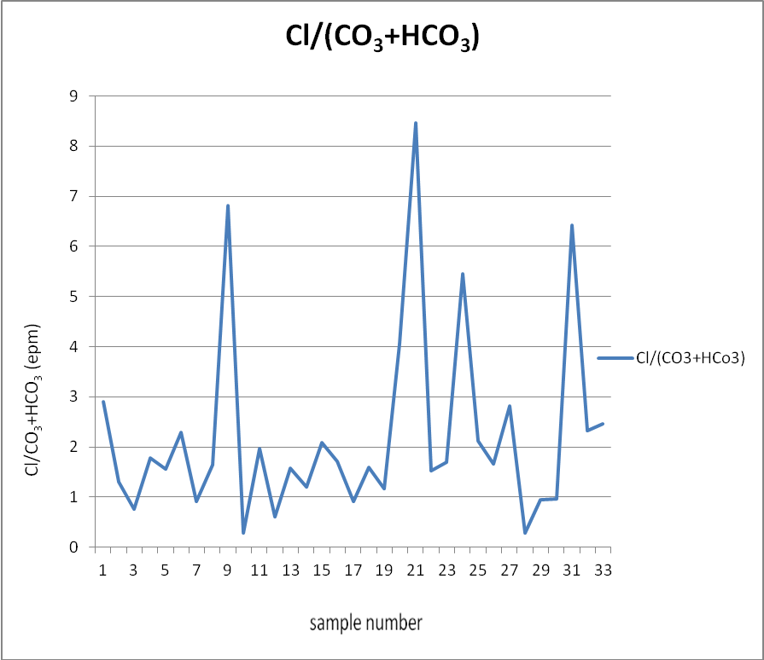
From the above limit values out of 33 samples only one
sample which is Kesavaram situated in Kota mandal is
free from contamination, 8 samples are slightly
contaminated ground water, 15 samples are moderately
contaminated groundwater, 9 samples are injuriously
contaminated groundwater and only 3 samples are highly contaminated but no one is fully seawater intrusion.
Fig: Cl/CO₃+HCO₃ Ratio

Slide 38
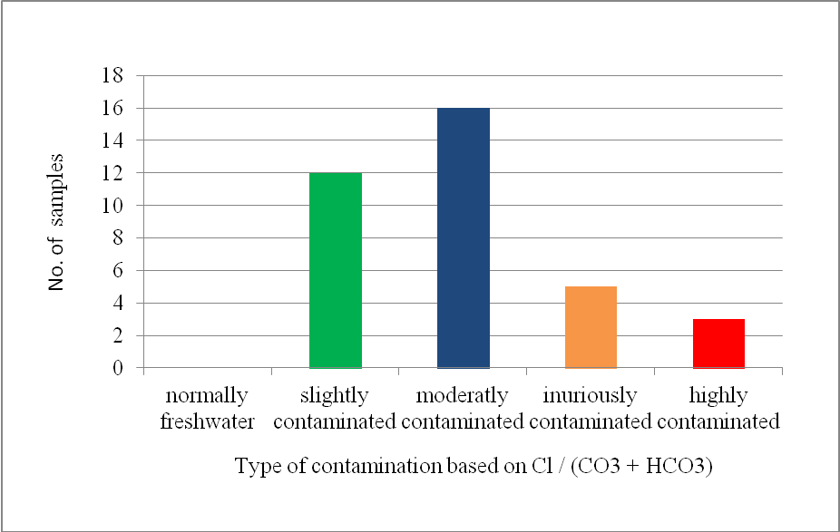
Type of contamination based on Cl / (CO₃ + HCO₃) in the study area:

Slide 39
Na/Cl Ratio:
Na / Cl ratios of saltwater intrusion are usually lower
than the marine values.
On the other hand, high Na/Cl ratios, typically
characterize anthropogenic sources like domestic waters.
Thus low Na/Cl ratios combined with other geological
parameters, can foretell the arrival of saltwater intrusion.
According to Na/Cl ratio, with less than 0.86 value in 23
samples indicates marine source of contamination.
Remaining 10 samples may be due to anthropogenic
sources like salt water pans and aquaculture farms.

Slide 40
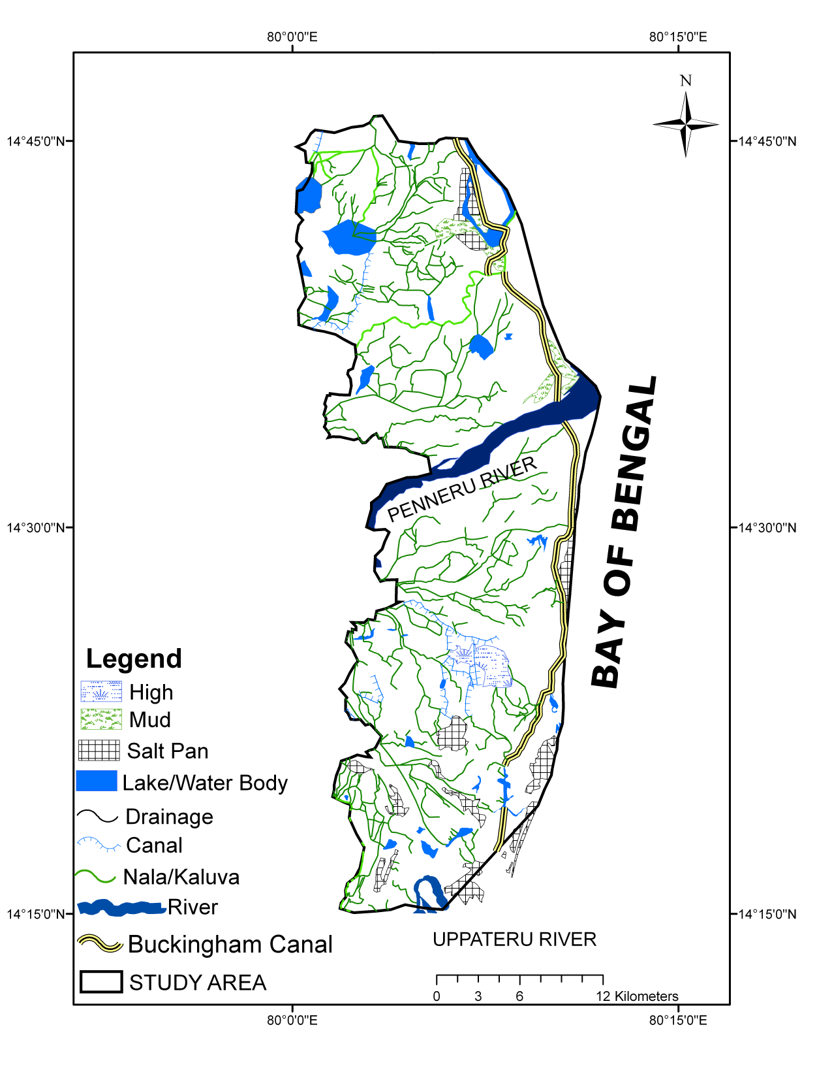
Drainage Map

Slide 41
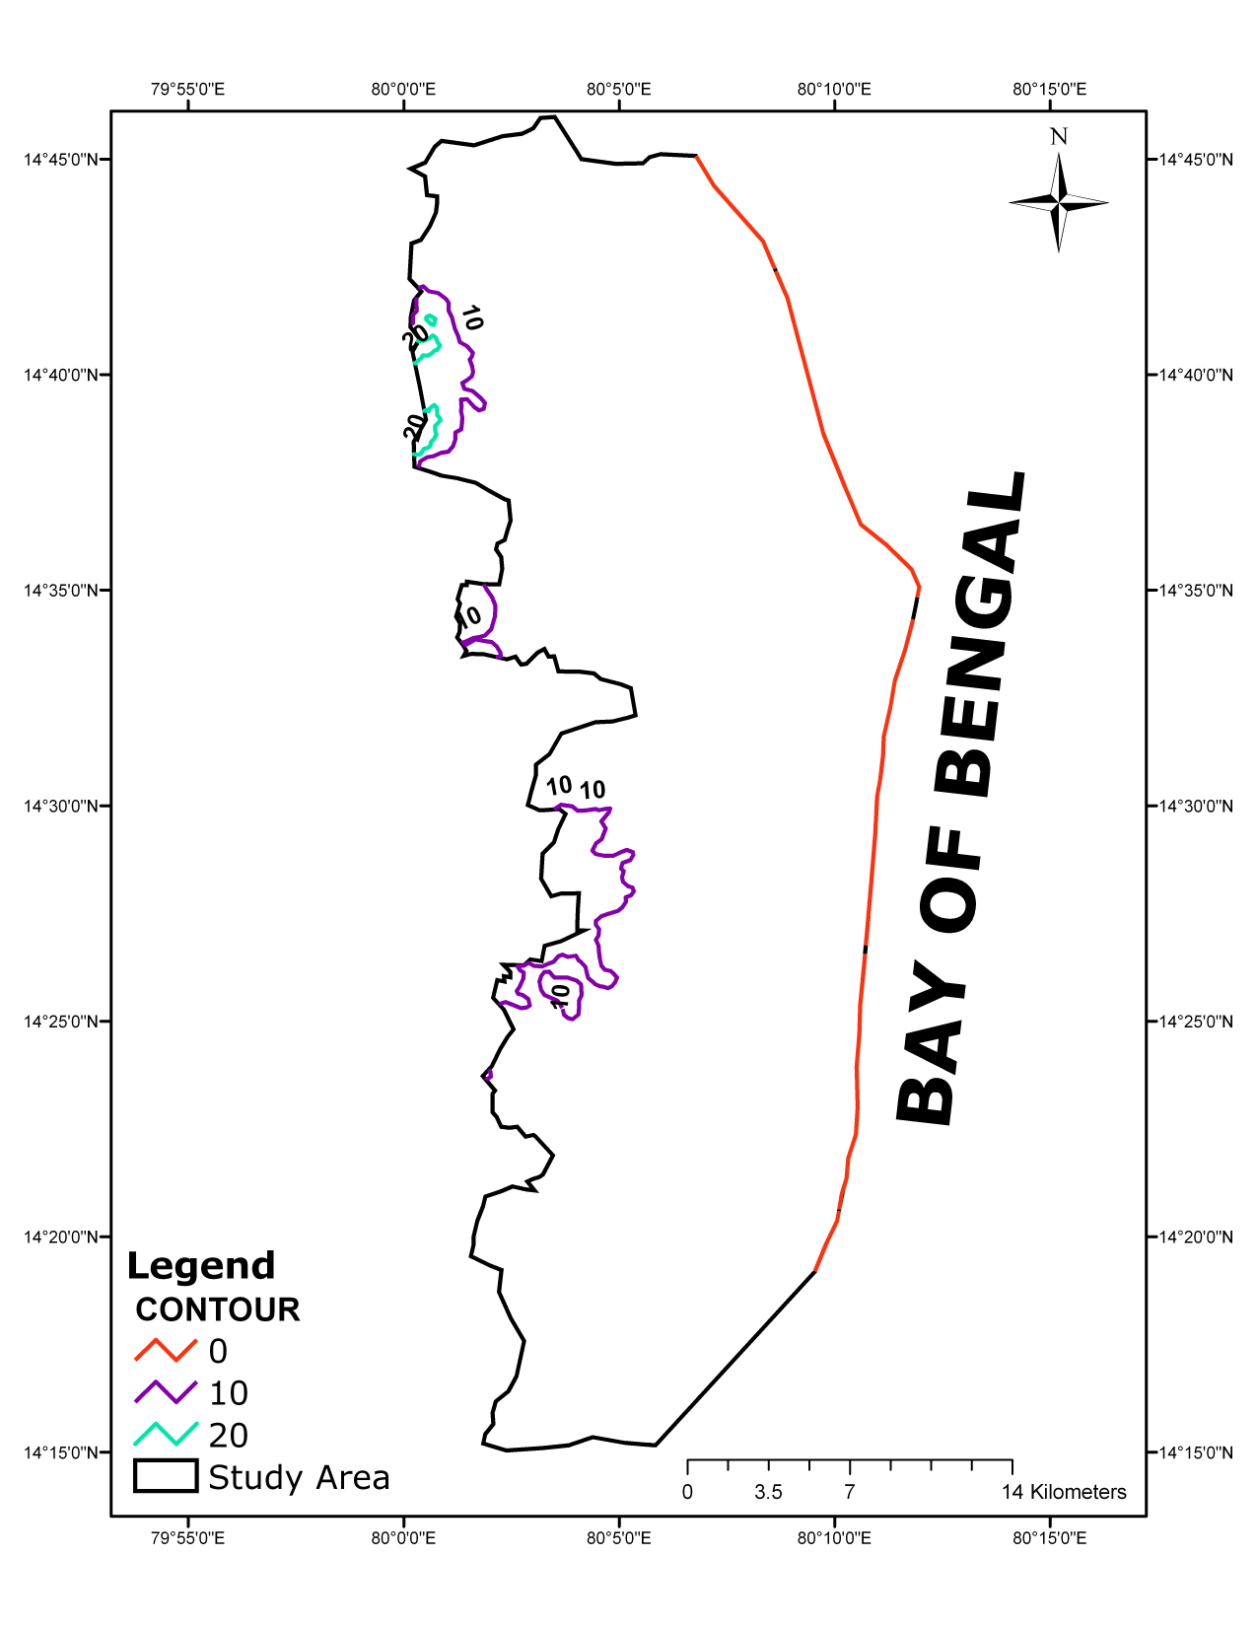
Slope Map

Slide 42
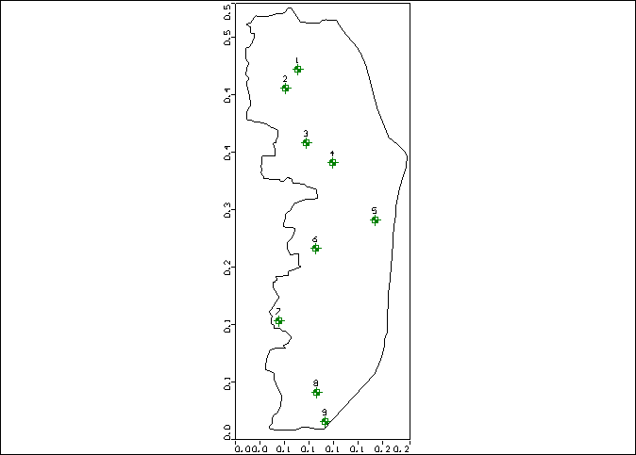
Observation Wells

Slide 43
Pumping Wells

Slide 44
Model Calibration and Sensitivity
In this study, groundwater flow model calibration has been achieved through a trail and error method by adjusting the two key parameters i.e., hydraulic conductivity and recharge rates until head values as calculated by SEAWAT match the observed hydraulic head values to a satisfactory degree.
No attempt was made just several transport parameters including effective porosity set at 0.3. Their values remain the same as initially assigned. The aquifer hydraulic conductivity was decreased with depth due to increased overburden of the aquifer material.

Slide 45
Model Calibration and Sensitivity
The conductivity of the clay was reduced to 8.2m/day, 7.1m/day and 6.5m/day from top to bottom from the initial value of 10.1m/day, where as conductivity of sand was increased to 10.1m/day to 9.9m/day and 9.7m/day from 10m/day top to bottom.
Calibration result show an overall correlation coefficient of 0.91, root mean square of 1.389 and standard error of 0.258 were obtained when model calibration was finished and indicates a reasonable matching between observation and calculated heads.

Slide 46
Transient Modeling
The transient modeling was performed to simulate density dependent solute transport modeling using SEAWAT with period May 2012 and January 2013 hydrological parameters including TDS Values in which have been obtained from the analytical results and identified that there is a mismatch at the initial stage.
Therefore greater effort was made to obtain a better match by modifying the magnitude and distribution of the background salt concentration closer to the analysed values.
By changing the transport parameters, dispersivity, effective porosity values.

Slide 47
Transient Modeling
The dispersivity changed to 95m (from 100m) and effective porosity changed to 0.3 (from 0.25) then it was found that there is a good match between observed and computed TDS concentrations with correlation coefficient 0.971 and normalized RMS error of 12.95. All the concentration values are based on the concentrations at the bottom of the top sand layer.

Slide 48
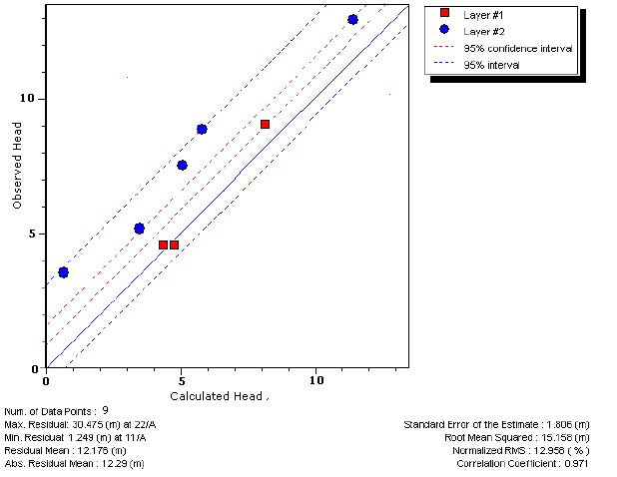
Transient State Calibration

Slide 49
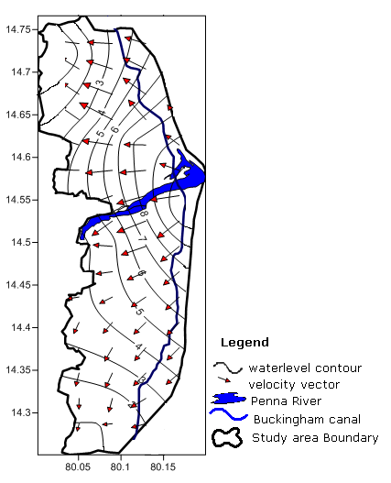
Groundwater Contours In m (amsl) in January 2013

Slide 50
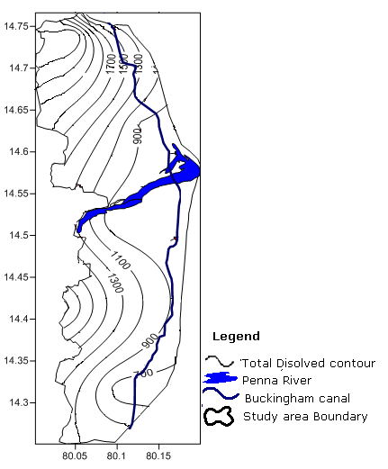
Observed TDS Contours In The Study Area
During May 2012

Slide 51
Conclusions
The study area covering 9 coastal of Nellore district
Groundwater development is mainly for drinking
purpose and certain areas are for agricultural purposes.
A total number of 33 villages of the study area were
observed and groundwater quality data taken from the
State Groundwater Department, Nellore.
Groundwater quality was assessed by estimating major
cations and anions.
The dominant cation is magnesium and dominant anion
is chloride in the study area.
According to drinking water standards, the ground
water in the study area is potable

Slide 52
Regarding salt water intrusion, the low Ca / Mg ratio may be
indicative of salt water contamination.
According to Cl / (CO₃+HCO₃) ratio, the study area is found to
be contaminated with slightly to moderately contaminated
groundwater and there are no fresh ground water is encountered.
According to Na / Cl ratio, the contamination may be due to
marine source of origin.
Based on the hydrogeochemcial parameters the seawater
intrusion is noticed in Indukurpet mandal followed by
Muttukur.

Slide 53
Thank You!!!

