Slide 1

In vitro propagation and DNA profiling of Acorus calamus Linn.
G. J. Sharma
Department of Life Sciences, Manipur University, Imphal 795003, India
Plenary Lecture
3rd International Conference on Plant Science & Physiology, 21-22 May 2018, Osaka, Japan

Slide 2
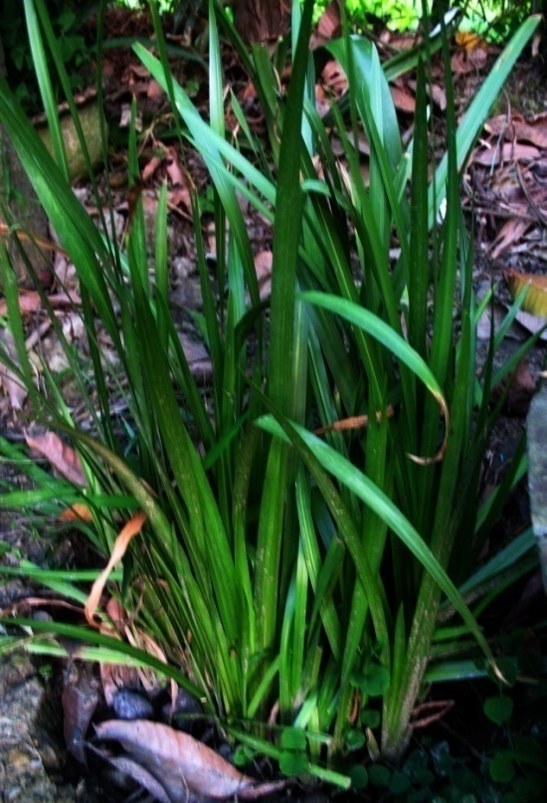
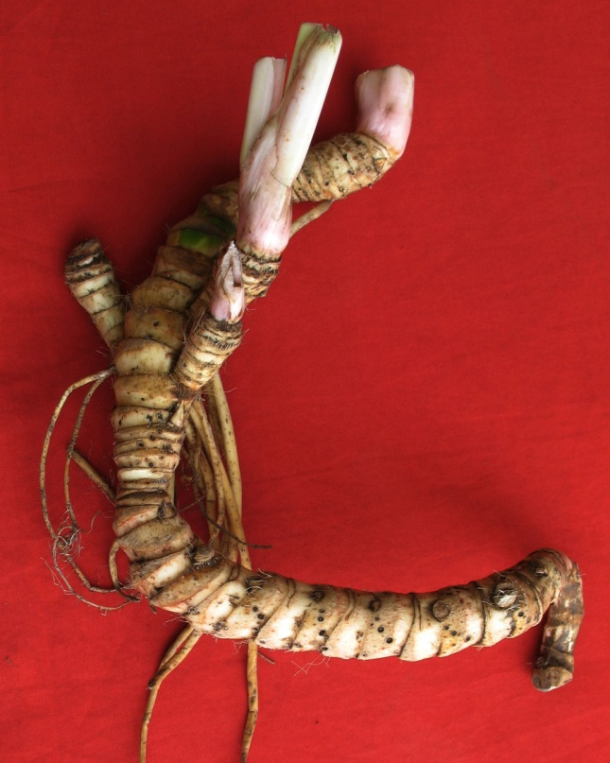

Slide 3
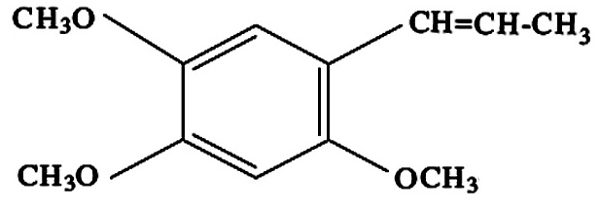
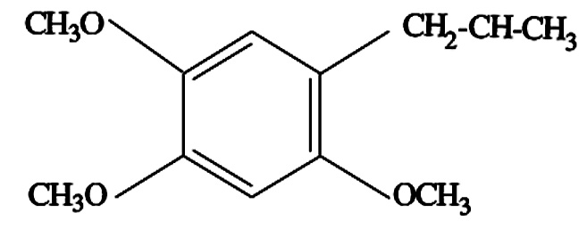
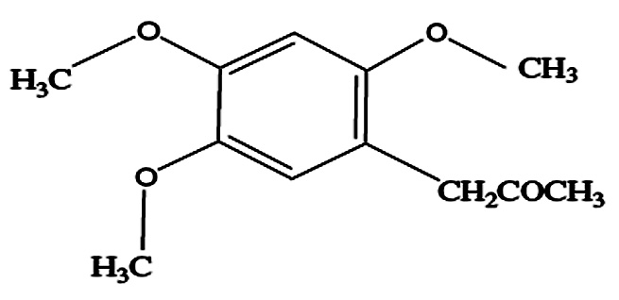
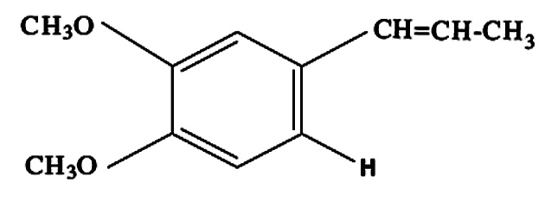
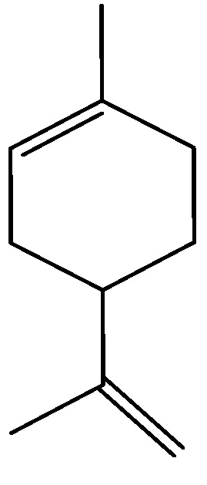
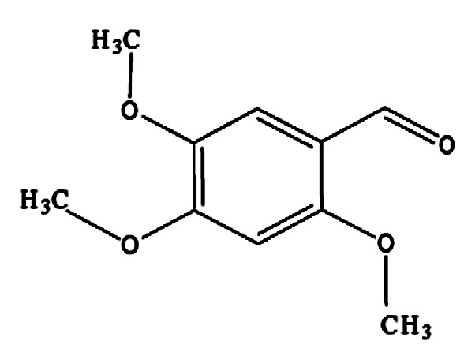
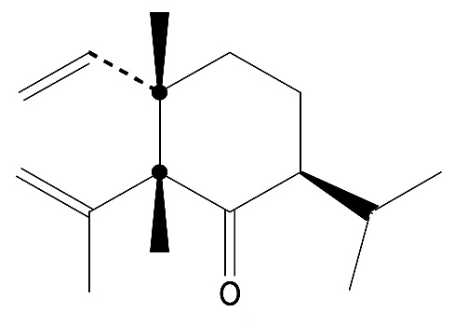
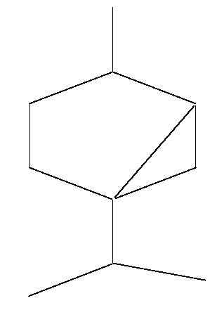
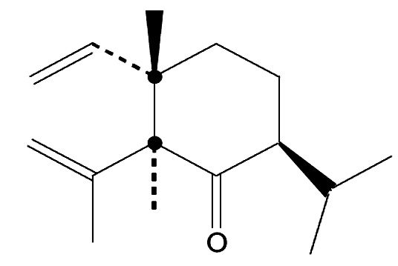
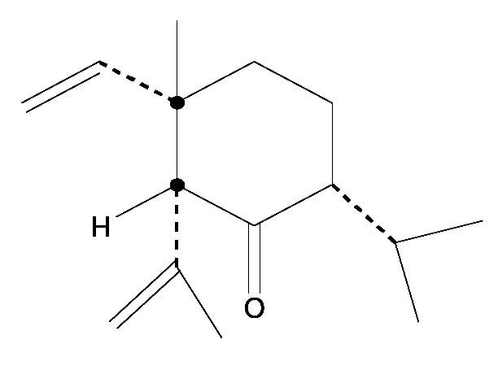
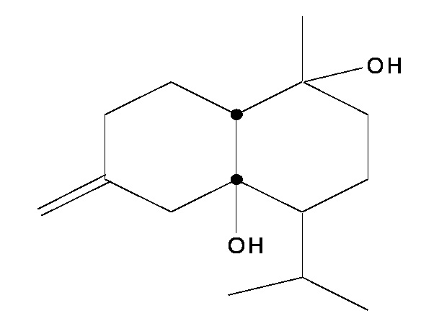
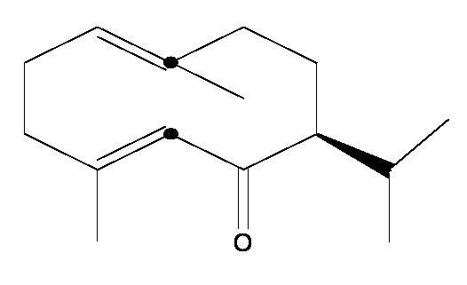
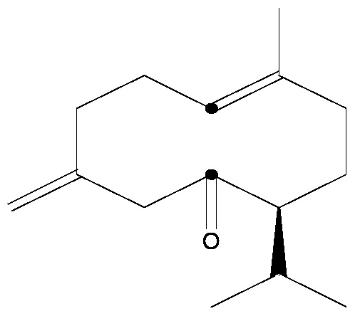
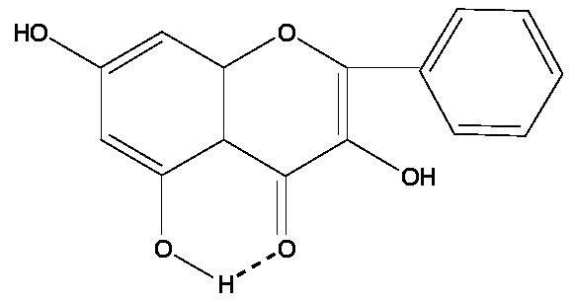
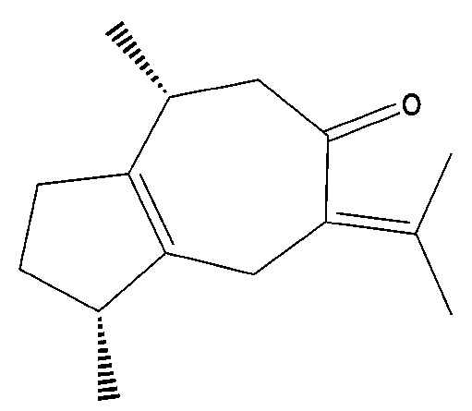
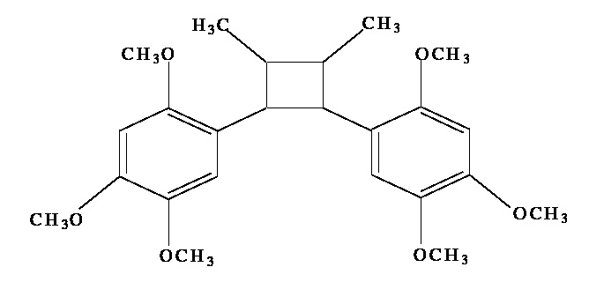
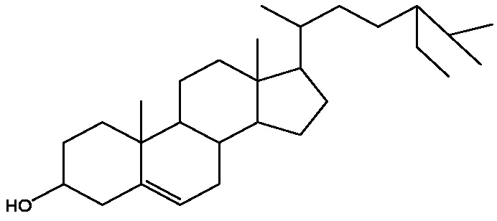
β-asarone
γ-asarone
Calamol
Acoramone
Limonene
Asarylaldehyde
Methyl isoeugenol
Epishyobunone
Thujane
Shyobunone
2,6-diepishyobunone
Isocalamendiol
Acoragermacrone
Presocalamendiol
Galangin
Calamusenone
Acoradin
β-sitosterol
Fig: Known bio-active molecules from Acorus calamus Linn.

Slide 4
Acorus calamus Linn. (sweet flag) is a perennial littoral plant widely used in traditional medicine
Fragrant oils from rhizome are used for flavoring alcoholic beverages and as essences in perfumes and sacred oils. Used as tonic, stimulant, aphrodisiac and for treatment of rheumatism, toothache and respiratory ailments.
Ethanolic extract prevents acrylamide-induced limb paralysis, increase dopamine receptors in corpus striatum.
Rhizome extract possesses anti-spasmodic, anti-diarrheic, carminative, anti-oxidant, anti-helminthic, anti-depressant and CNS anxiolytic properties.
Treatment of ethanol extract shows hypolipidemic activity. Effectively prevents noise stress-induced changes in rat brain.
Crude extracts possess protective and preventive properties. Traditional healers use rhizomes to cure cold and cough.
Chinese medicine prescribes it for curing memory disorder, learning performance and anti-aging effects.

Slide 5
Bioactive compounds are acorone, acorenone, β-asarone, safrol, asaryldehyde, caryophylene, isoasarone and methyl isoeugenol
Used in shampoo, bath soap, skincare, perfume and air refresher.
β-asarone causes chromosome/ DNA damages and duodenal tumor. Has anti-proliferative and immuno-suppressive properties.
Banned in US as food additive and medicine. In Europe, highest acceptable level of β-asarone in food and beverage is 0.1 mgkg⁻¹.
Has ecological importance in water purification including removal of nitrogen and phosphorus.
Dried roots are used for flavoring bitter liquors and appetizers.
Triploids contain 7-7.8% β-asarone as against 73-88% in tetraploids. Diploids are characterized by its absence.

Slide 6
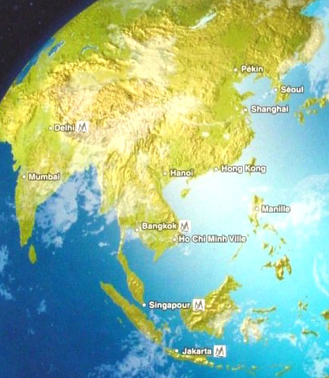
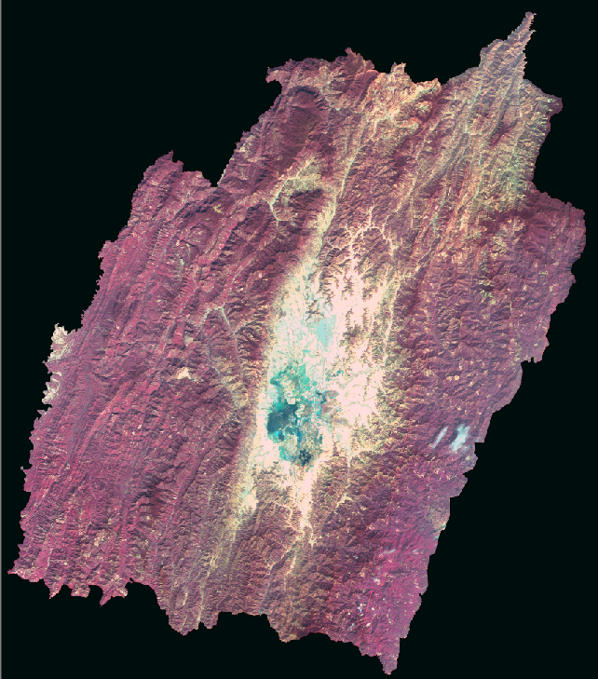
Figure 1. Satellite image of Indian sub-continent showing Manipur

Slide 7
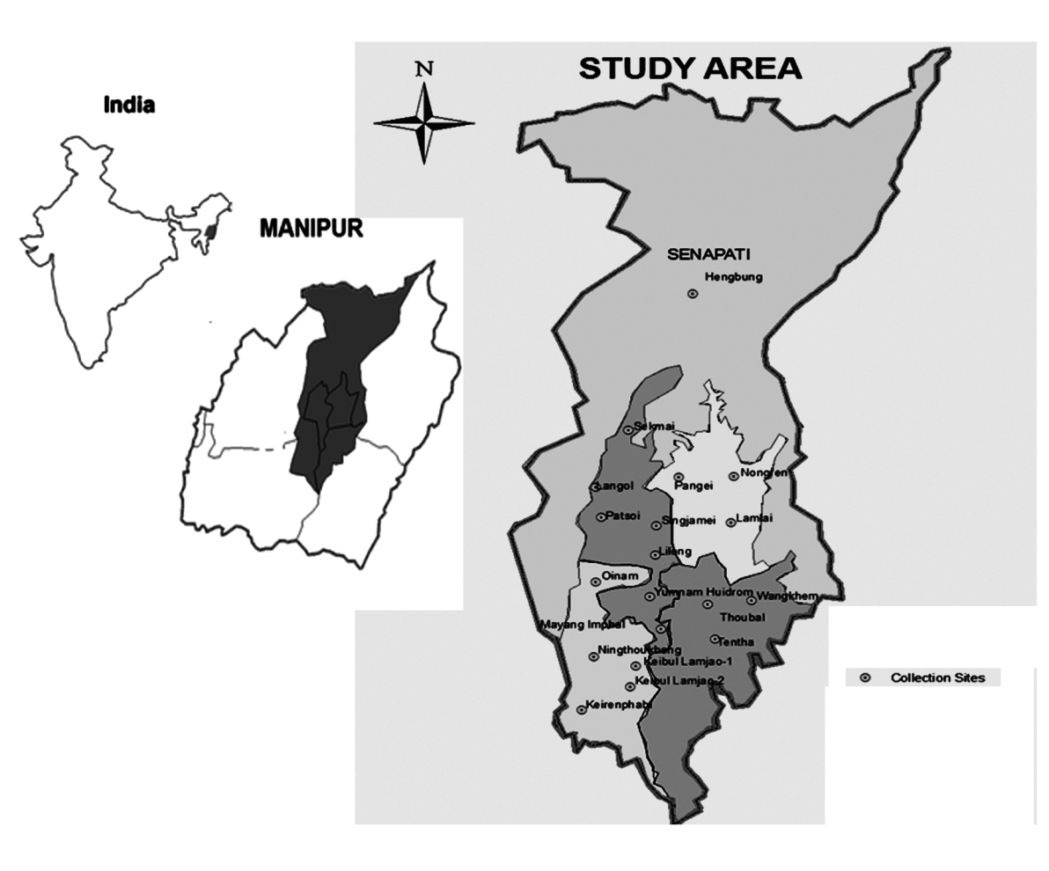
Materials and Methods
Acorus calamus Linn. collected from nineteen locations of Manipur (23º50’-25º42’NL ; 92º58’-94º45’ EL) maintained in the Experimental Garden of the Department of Life Sciences, Manipur University
Fig 2: Map showing
collection site of the
different accessions

Slide 8
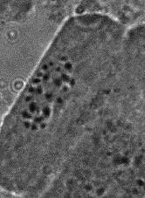
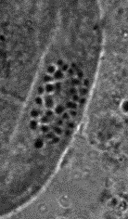
Ploidy level analysis
A
B
Fig 3. Photomicrograph of A. calamus root-tip chromosomes,
A) 2n=24, diploid; B) 2n=36, triploid

Slide 9
Table 1. Acorus calamus accessions collected from different locations of Manipur with their ploidy level
Sl. No. | Accession code | Collection site | Latitude (N) | Longitude (E) | Altitude (M) | Chromosome no./Ploidy level
1 2 3 4 5 6 7 8 9 10 11 12 13 14 15 16 17 18 19 | MU/AC-01 MU/AC-02 MU/AC-03 MU/AC-04 MU/AC-05 MU/AC-06 MU/AC-07 MU/AC-08 MU/AC-09 MU/AC-10 MU/AC-11 MU/AC-12 MU/AC-13 MU/AC-14 MU/AC-15 MU/AC-16 MU/AC-17 MU/AC-18 MU/AC-19 | Pangei Keibul Lamjao-1 Thoubal Keirenphabi Ningthoukhong Keibul Lamjao-2 Oinam Mayang Imphal Nongren Tentha Yumnam Patsoi Lilong Lamlai Wangkhem Sekmai Langol Singjamei Hengbung | 24º51’37” 24º32’49.67” 24º38’20.26” 24º27’33.97” 24º34’36.39” 24º31’55.44” 24º41’44.77” 24º35’53.29” 24º52’11.05” 24º34’30.03” 24º39’42.16” 24º47’26.65” 24º43’11.36” 24º52’1.18” 24º38’42.70” 24º57’56.05” 24º49’40.98” 24º46’47.97” 25º13’34.45” | 93º58’33.43” 93º50’5.90” 94º0’0.84” 93º47’17.34” 93º45’47.05” 93º31’55.44” 93º48’22.64” 93º52’17.21” 94º3’51.37” 93º57’59.11” 93º54’14.18” 93º53’13.09” 93º56’3.84” 94º3’3.79” 94º0’23.30” 93º53’12.17” 93º54’8.93” 93º56’18.41” 94º0’0.16” | 785 780 795 777 772 787 778 772 789 774 779 786 780 792 783 885 789 784 1169 | 3x=36/Triploid 3x=36/Triploid 3x=36/Triploid 2x=24/Diploid 3x=36/Triploid 3x=36/Triploid 3x=36/Triploid 3x=36/Triploid 3x=36/Triploid 3x=36/Triploid 3x=36/Triploid 3x=36/Triploid 3x=36/Triploid 3x=36/Triploid 2x=24/Diploid 3x=36/Triploid 3x=36/Triploid 3x=36/Triploid 3x=36/Triploid

Slide 10
Acorus calamus Linn. is grown wild in wetland ecosystems ascending to an altitude of 2200 metres. It is becoming highly vulnerable and increasingly threatened due to habitat degradation and indiscriminate use in traditional medicine. Unless massively propagated using either conventional method or through in vitro culture techniques, the species would soon face risk of being genetically impoverished and become extinct.
With this objective, rapid multiplication protocols have been developed by inducing multiple shoots using rhizome eye/ bud as explants. Microrhizome induction has also been successfully achieved. These protocols would help in eco-restoration in the wild habitats as well as sustainable utilization of the plant.

Slide 11
Table 2: Effect of agar-gelled and dual-phase MS media on the growth of axillary buds of Acorus calamus Linn. after 60 days
__________________________________________Characteristics Agar-gelled Dual-phase
(mean ± SE) (mean ± SE)
__________________________________________________________________________
Shoot height (cm) 2.50 ± 0.16 5.60 ± 0.30
No. of leaf/shoot 2.12 ± 0.18 5.33 ± 0.29
Remarks slow growth rate, better growth rate, yellow leaves dark green leaves
__________________________________________
Values are expressed as means ± SE (n = 10). Mean separation was done by Tukey’s test

Slide 12
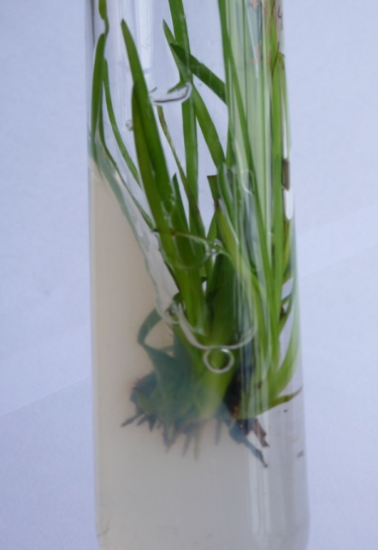
Multiple shoot induction
Best response was produced in the medium supplemented with BAP (2.0 mg/L) in combination with NAA (0.5 mg/L) which produced 10.4 microshoots per explants, 31.3 leaves per treatment and 6.3 cm long leaves.
Besides obtaining a high multiplication rate, the overall growth rate of the regenerants were also very high in the dual-phase culture of A. calamus as indicated by high number of regenerated leaves (up to 31.3 per explants) and leaf length (up to 6.3 cm).
Overall growth of microshoots was better in the dual-phase culture system than in agar-solidified medium.
Devi, Kishor & Sharma: J Crop Sci Biotechnol 14: 2011, 213-217
Fig 4. Multiple shoot induction of Acorus calamus in dual-phase MS medium supplemented with NAA and BAP

Slide 13
Table 3. Effect of various concentrations of BAP and its combination with NAA on multiple shoot induction in plantlets of Acorus calamus under dual-phase culture using MS medium
NAA | BAP | No. of microshoots per plant | No. of leaves per plant | Leaf length (cm)
0 0 0 0 0 0.1 0.1 0.1 0.1 0.5 0.5 0.5 0.5 1.0 1.0 1.0 1.0 | 0 0.1 0.5 1.0 2.0 0.1 0.5 1.0 2.0 0.1 0.5 1.0 2.0 0.1 0.5 1.0 2.0 | 1.6° ± 0.19a 2.0° ± 0.19ab 2.1° ± 0.16abc 3.0° ± 0.19bc 4.3° ± 0.27d 1.6° ± 0.13a 3.1° ± 0.18c 4.7° ± 0.18de 5.6° ± 0.23ef 4.9° ± 0.35de 5.5° ± 0.23ef 8.7° ± 0.25g 10.4° ± 0.27h 2.3° ± 0.17ab 3.0° ± 0.19bc 1.7° ± 0.18a 5.9° ± 0.38f | 3.5° ± 0.40a 4.0° ± 0.33ab 4.1° ± 0.32ab 8.1° ± 0.70de 9.7° ± 0.40ef 3.7° ± 0.28a 6.5° ± 0.41bcd 11.3° ± 0.50fg 15.3° ± 0.75j 11.9° ± 0.38fghi 13.0° ± 0.45ghij 21.4° ± 0.80k 31.3° ± 1.11h 5.3° ± 0.46abc 7.7° ± 0.47cde 4.4° ± 0.55ab 14.1° ± 0.96ij | 5.3° ± 0.14e 4.6° ± 0.09bc 4.1° ± 0.09a 4.6° ± 0.09bc 5.0° ± 0.06de 5.0° ± 0.10de 5.0° ± 0.07de 4.7° ± 0.06cd 5.0° ± 0.04de 4.5° ± 0.06bc 5.0° ± 0.12de 5.7° ± 0.09f 6.3° ± 0.07g 4.5° ± 0.05bc 4.6° ± 0.06bc 4.3° ± 0.06ab 4.8° ± 0.03cd
Values are mean ± standard error. Means followed by different letters indicate the
significant differences among treatments by Tukey’s b test (P = 0.05). Data recorded after 45 days of inoculation.

Slide 14
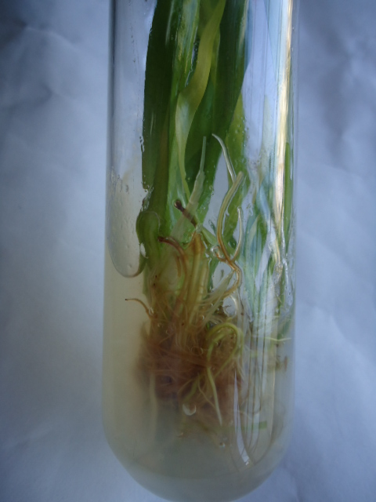
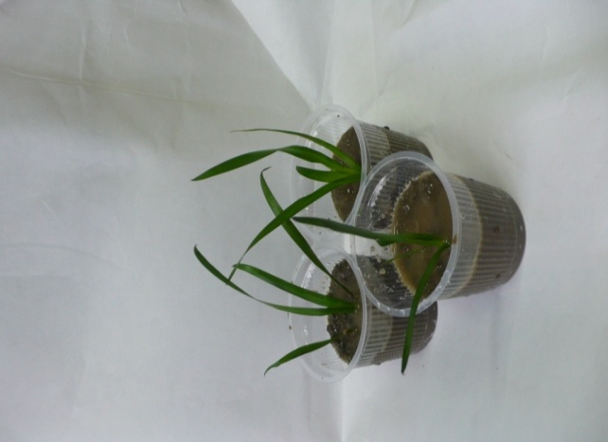
Root induction and hardening
Figure 5: A) In vitro rooting of Acorus calamus in dual-phase MS medium supplemented with indole butyric acid (2.0 mg /L), B) hardened plantlets.
A
B
IBA at 2.0 mg/L exerted the best rooting response by producing 14.3 roots per microshoot with an average root length of 2.5 cm.
Other treatments, viz., IBA (0.5, 1.0 mg/L), IAA (0.5 mg/L) and control also induced profuse rooting without any significant differences among treatments.
Maximum root length (3.5 cm) was obtained in medium without any auxin and high concentrations of NAA were inhibitory in root induction.
Devi, Kishor & Sharma: J Crop Sci Biotechnol 14: 2011, 213-217

Slide 15
Table 4. Effects of various concentration of IBA, IAA and NAA on root induction in Acorus calamus using MS medium
IBA | IAA | NAA | No. of roots per plant | Root length (cm)
0 0.1 0.5 1.0 2.0 0 0 0 0 0 0 0 0 | 0 0 0 0 0 0.1 0.5 1.0 2.0 0 0 0 0 | 0 0 0 0 0 0 0 0 0 0.1 0.5 1.0 2.0 | 12.1±0.30^{f} 8.6 ±0.33e 10.5±0.75^{f} 11.5±1.35^{f} 14.3±0.59^{g} 6.9±0.34^{cd} 10.6±0.57^{f} 6.8±0.44^{cd} 6.3±0.18^{bcd} 7.7±0.19de 5.7±0.27^{bc} 4.8±0.29^{b} 0 | 3.5±0.08^{j} 2.3±0.09^{h} 1.4±0.04de 1.7±0.07^{ef} 2.5±0.04^{i} 1.2±0.10^{d} 1.5±0.03^{ef} 1.2±0.03^{d} 1.9±0.08^{g} 0.8±0.02^{c} 0.5±0.03^{b} 0.3±0.01^{b} 0
Values are mean ± standard error. Means followed by different letters indicate the significant differences among treatments by Tukey’s b test (p=0.05). Data recorded after 45 days of inoculation. Conc (mg/L).

Slide 16
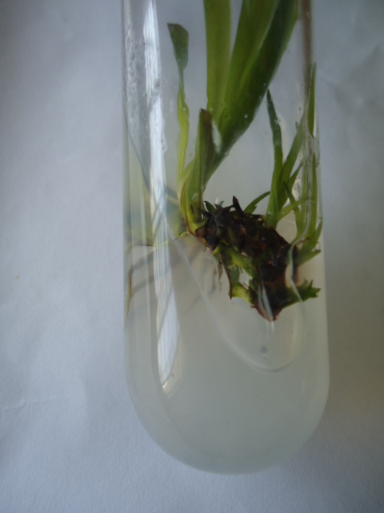
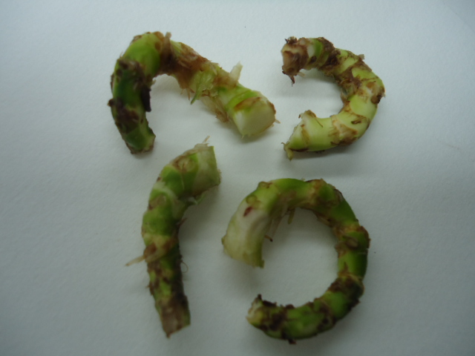
Microrhizome induction
Figure 6. Microrhizome induction in Acorus calamus, A) a plantlet with induced microrhizome in dual-phase MS medium supplemented with 6% sucrose and IBA (2.0 mg/L); B) harvested microrhizomes
A
B
Medium having 6% sucrose induced the largest size (length 3.9 cm, diameter 0.47 cm) and maximum fresh weight (0.72 g). Size and fresh weight gradually decreased with the further increase in sucrose concentration.
On further supplementation of IBA and NAA in the medium having 6% sucrose, the former auxin showed better effect on microrhizome induction.
Medium supplemented with 2 mg/L IBA and 6% sucrose produced largest microrhizomes with an average length of 4.8 cm and a diameter of 0.55 cm with the highest average fresh weight of 0.82 g.
Devi, Kishor & Sharma: Hort Environ Biotechnol 3: 2012, 410-414

Slide 17
Somatic embryogenesis through callus induction in diploid species
An efficient and reproducible callus mediated plant regeneration protocol developed for large scale production.
Plant growth regulators (PGRs) such as 2,4-D and NAA were used in full-strength MS medium using different explants.
Callus was induced with optimum frequency by shoot axillary bud in MS medium supplemented with 2 mgL⁻¹ 2,4-D.
MS medium supplemented with 0.5 mgL-1 NAA and 2 mgL-1 BAP resulted in higher regeneration (90%) with maximum number of shoots capable of growing into independent plantlets.

Slide 18
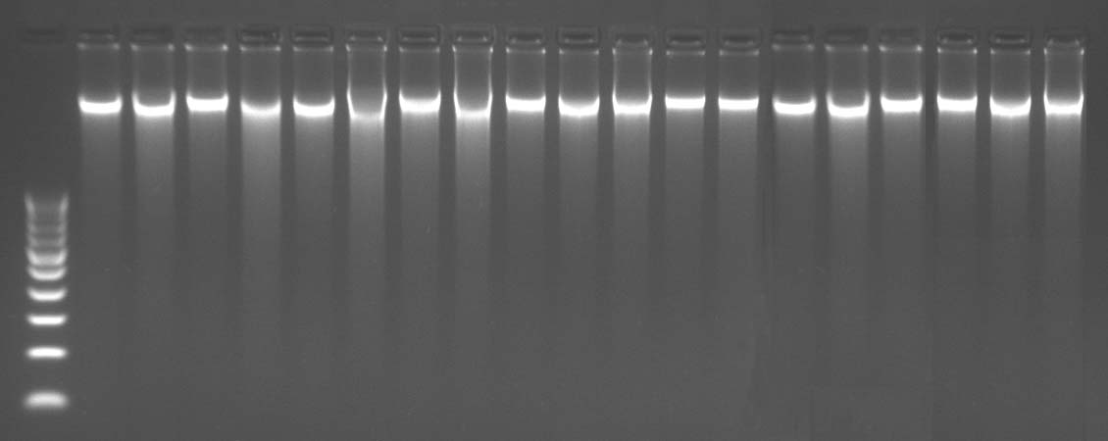
Molecular profiling
PCR-based DNA marker techniques RAPD and ISSR were employed for molecular profiling. Genomic DNA was extracted using the protocol of Doyle and Doyle (1987) with minor modifications
Fig 7. Genomic DNA of nineteen populations of Acorus calamus Linn.

Slide 19
Fresh plant tissue (300 mg) ground in pre-heated mortar with 400 μL pre-warm extraction buffer
300 μL extraction buffer added, mixed thoroughly & incubated for 60 mins at 65ºC in a water bath
700 μL of phenol:chloroform:IAA in the ratio of 25:24:1 was added
Samples centrifuged for 10 minutes at 12,000 rpm
Upper aqueous phase transferred to a fresh eppendorf tube with a wide bore tip of 1.0 mL pipette
Re-extracted again in chloroform: IAA (24:1)
DNA precipitated by 1/10 volume of 7.5 M ammonium acetate and twice the volume ice cold absolute alcohol
Scoop out the ppt. and transferred to a clean centrifuge tube containing 100μL 70% alcohol
1.0 mL of wash buffer was added and left at room temperature for 1 hr
Wash buffer was pour off and tube were kept inverted on paper towel for 1hr
DNA was washed with 100 μL 70% alcohol, centrifuge at 10,000 rpm for 5 minutes
Alcohol was discarded and DNA pellet was air dried again for 5 minutes
DNA re-suspended in 50 μL 1M TE buffer and the tube was centrifuged for few seconds and kept in -20ºC

Slide 20
PCR amplification
RAPD
Chemicals except primers were obtained from Genei, Bangalore, India
Primer sequences used were obtained from OPERON Technologies Inc., USA and University of British Columbia, Canada synthesized at Xcelris Genomics, India
The thirty primers were screened for obtaining maximum polymorphic bands with clarity and reproducibility
Accordingly, eighteen RAPD primers showing clear and consistent bands were finally selected
ISSR
A total of ten primers from University of British Columbia, Canada
synthesized at Sigma, India were tried
Out of the total ten primers tested, seven primers were selected for
analyzing the specimens

Slide 21
Electrophoresis of RAPD and ISSR products
Agarose gel was prepared by dissolving 2g agarose in 200ml of 0.5 × TBE buffer
20×20 cm running tray prepared by sealing both the ends with tape firmly to contain agarose
Running tray along with the required size of the comb was leveled using the spirit level
Solution was cooled to 65ºC and poured into the running tray and allow to set for 1hr
Running tray was transferred to the running platform of electrophoresis unit and 1800 mL of 0.5 × TBE buffer was added to the tank
DNA sample was loaded in each well. One of the wells was loaded with 100 bp DNA as the standard molecular weight marker
Electrophoresis carried out at 70 V for 3 hours and stained with ethidium bromide
Gel was viewed under UV transilluminator and photographed using Gel Doc System
Sizes of the amplified fragments were estimated from a marker DNA profile

Slide 22
Data scoring and statistical analysis
Primer banding characteristics such as number of total bands, number of polymorphic bands and percentage of polymorphic bands were obtained.
To analyze the suitability of both the markers for evaluating genetic profiles, the performance of the markers was measured using three parameters: polymorphic information content, marker index and resolving power.
The data obtained by scoring RAPD and ISSR profiles with different primers individually as well as collectively were subjected to the construction of similarity matrix based on simple matrix coefficients.
Cluster analysis was performed on the basis of genetic similarity matrix, and the resulting similarity coefficients were used for constructing dendrograms using UPGMA with SHAN module.

Slide 23
Genetic diversity analysis
DNA profiles of 19 different accessions of Acorus calamus were generated and the clustering patterns of the population were estimated
Genetic polymorphisms and cluster analysis based on RAPD markers
PCR amplification performed using 25 random RAPD primers: 18 primers showed reliable banding patterns with high reproducibility and clear band resolution.
Of the 188 bands generated, 124 bands were monomorphic and 64 were polymorphic (34.04%).
The number of polymorphic bands varied from one (OPU-05, OPU-16) to five (OPA-09, OPD-03, UBC-2, UBC-04 and UBC-05).
Percentage polymorphism ranged from 14.28% (OPU-05) to a maximum of 71.42% (UBC-05).
The polymorphic information content (PIC) was maximum in UBC-02 (0.245) and marker index (MI) varied from 0.026 (OPU-5) to 0.154 (UBC 05).
Most informative primers were UBC-02 and UBC-05.
The highest RP value was observed with the primer UBC-02 (0.295) and the lowest with the primers OPD-03, OPD-05 , OPD-11 and UBC 03 with 0.010.

Slide 24
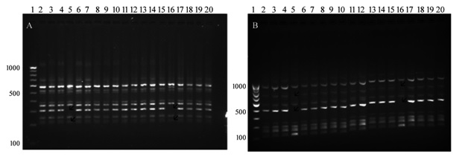
Fig 8. PCR products of genomic DNA from A. calamus accessions with RAPD primers, A) OPA-9 and B) OPA-11.

Slide 25
Table 5. Marker parameters calculated for each RAPD primer used with Acorus calamus
TB: total band, PB: polymorphic band, PPB (%): percentage polymorphic band (%), PIC: polymorphism informatio content, RP: resolving power, EMR: effective multiplex ratio, MI: marker index.
Sl no. | Primer | Sequence(5’ to 3’) | TB | PB | PPB (%) | Product size (bp) | PIC | RP | EMR | MI
1 2 3 4 5 6 7 8 9 10 11 12 13 14 15 16 17 18 | OPA-4 OPA-9 OPA-11 OPA-15 OPC-5 OPC-7 OPC-11 OPD-3 OPD-5 OPD-11 OPQ-5 OPU-5 OPU-16 UBC-1 UBC-2 UBC-4 UBC-5 UBC-6 | AATCGGGCTG GGGTAACGCC CAATCGCCGT TTCCGAACCC GATGACCGCC GTCCCGACGA AAAGCTGCGG GTCGCCGTCA TGAGCGGACA AGCGCCATTG CCGCGTCTTG TTGGCGGCCT CTGCGCTGGA CCTGGGCTTC CCTGGGCTTG CCTGGGCTGG CCGGCCTTAA CCGGCTGGAA | 8 10 10 5 4 10 12 11 12 14 11 7 2 13 14 13 7 8 | 3 5 3 2 2 4 4 5 4 4 4 1 1 3 5 5 5 4 | 30.00 50.00 30.00 40.00 50.00 40.00 33.34 45.45 33.34 28.57 36.36 14.28 50.00 23.08 36.42 38.46 71.42 50.00 | 630-270 560-230 1000-210 520-390 500-130 1500-180 870-150 1000-280 850-210 910-200 800-240 720-270 380-280 1000-190 790-190 710-210 810-220 1500-210 | 0.223 0.187 0.235 0.187 0.187 0.187 0.187 0.187 0.187 0.187 0.187 0.187 0.187 0.187 0.245 0.187 0.216 0.187 | 0.264 0.211 0.281 0.211 0.211 0.211 0.211 0.210 0.210 0.210 0.211 0.212 0.212 0.212 0.295 0.211 0.211 0.211 | 0.500 0.500 0.300 0.400 0.500 0.400 0.333 0.454 0.333 0.285 0.363 0.142 0.500 0.230 0.357 0.384 0.714 0.500 | 0.111 0.093 0.070 0.074 0.093 0.074 0.062 0.084 0.062 0.053 0.067 0.026 0.093 0.043 0.087 0.071 0.154 0.093
Total |  |  | 188 | 64 | 34.04 |  | 0.196 | 0.22 |  | 0.078

Slide 26
Table 6. Similarity index for RAPD
 | S1 | S2 | S3 | S4 | S5 | S6 | S7 | S8 | S9 | S10 | S11 | S12 | S13 | S14 | S15 | S16 | S17 | S18 | S19
S1 | 1.00
S2 | 1.00 | 1.00
S3 | 1.00 | 1.00 | 1.00
S4 | 0.07 | 0.07 | 0.07 | 1.00
S5 | 1.00 | 1.00 | 1.00 | 0.07 | 1.00
S6 | 1.00 | 1.00 | 1.00 | 0.07 | 1.00 | 1.00
S7 | 1.00 | 1.00 | 1.00 | 0.07 | 1.00 | 1.00 | 1.00
S8 | 1.00 | 1.00 | 1.00 | 0.07 | 1.00 | 1.00 | 1.00 | 1.00
S9 | 1.00 | 1.00 | 1.00 | 0.07 | 1.00 | 1.00 | 1.00 | 1.00 | 1.00
S10 | 0.79 | 0.79 | 0.79 | 0.13 | 0.79 | 0.79 | 0.79 | 0.79 | 0.79 | 1.00
S11 | 0.80 | 0.80 | 0.80 | 0.13 | 0.80 | 0.80 | 0.80 | 0.80 | 0.80 | 0.99 | 1.00
S12 | 1.00 | 1.00 | 1.00 | 0.07 | 1.00 | 1.00 | 1.00 | 1.00 | 1.00 | 0.79 | 0.80 | 1.00
S13 | 1.00 | 1.00 | 1.00 | 0.07 | 1.00 | 1.00 | 1.00 | 1.00 | 1.00 | 0.79 | 0.80 | 1.00 | 1.00
S14 | 1.00 | 1.00 | 1.00 | 0.07 | 1.00 | 1.00 | 1.00 | 1.00 | 1.00 | 0.79 | 0.80 | 1.00 | 1.00 | 1.00
S15 | 0.07 | 0.07 | 0.07 | 1.00 | 0.07 | 0.07 | 0.07 | 0.07 | 0.07 | 0.13 | 0.13 | 0.07 | 0.07 | 0.07 | 1.00
S16 | 1.00 | 1.00 | 1.00 | 0.07 | 1.00 | 1.00 | 1.00 | 1.00 | 1.00 | 0.79 | 0.80 | 1.00 | 1.00 | 1.00 | 0.07 | 1.00
S17 | 1.00 | 1.00 | 1.00 | 0.07 | 1.00 | 1.00 | 1.00 | 1.00 | 1.00 | 0.79 | 0.80 | 1.00 | 1.00 | 1.00 | 0.07 | 1.00 | 1.00
S18 | 1.00 | 1.00 | 1.00 | 0.07 | 1.00 | 1.00 | 1.00 | 1.00 | 1.00 | 0.79 | 0.80 | 1.00 | 1.00 | 1.00 | 0.07 | 1.00 | 1.00 | 1.00
S19 | 1.00 | 1.00 | 1.00 | 0.07 | 1.00 | 1.00 | 1.00 | 1.00 | 1.00 | 0.79 | 0.80 | 1.00 | 1.00 | 1.00 | 0.07 | 1.00 | 1.00 | 1.00 | 1.00
  Genetic similarity coefficients ranging from 0.07 to 0.99 were obtained using the NTSYS-pc software with an average of 0.53. Such wide range of dissimilarity values represent genetically diverse population, Sample No.10 and No.11 exhibit highest similarity, with similarity coefficient of 0.99 each.

Slide 27
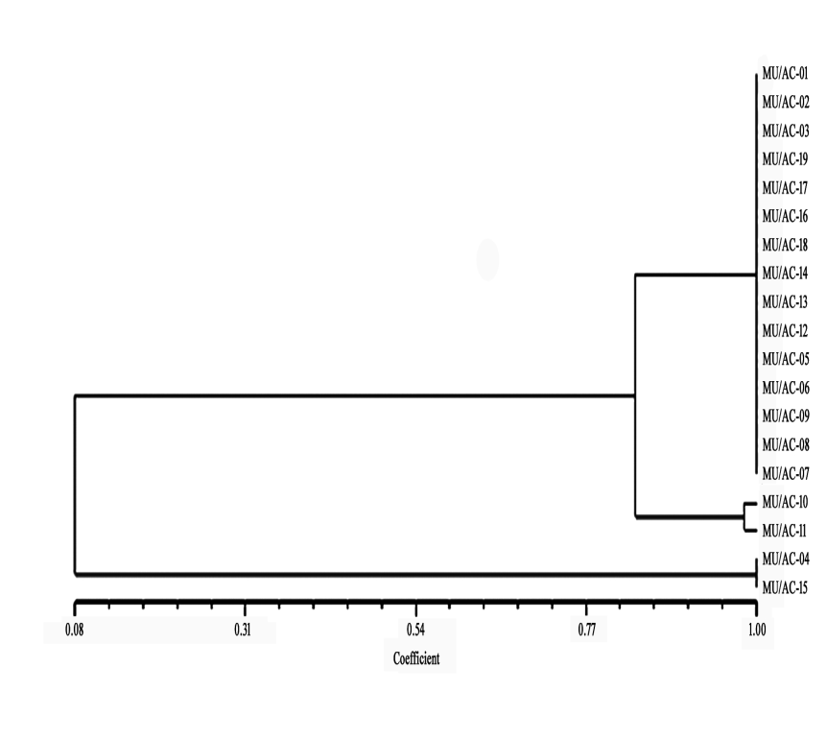
Figure 9. Dendrogram demonstrating relationship among nineteen different accessions of Acorus calamus Linn. collected from different parts of Manipur based on RAPD
Dendrogram was constructed using SAHN clustering through UPGMA from the RAPD data. The dendrogram separated the 19 populations into two major clusters, one smaller with two populations which are diploid and larger with two sub-clusters. The smaller sub-cluster has two triploid populations which show the highest similarity whereas the larger sub-clusters have the remaining triploid populations.

Slide 28
Genetic polymorphism and cluster analysis based on ISSR markers
Total of 10 ISSR primers based on dinucleotide and trinucleotide repeats were used to amplify each genotype of the population. Primers were screened and seven primers showing clear band resolution were selected for further study.
DNA samples of 19 populations produced distinct reproducible amplification with seven selected ISSR markers.
Total of 50 bands were amplified with seven primers, of which, 30 were monomorphic and 20 polymorphic ones (40%).
Polymorphism (%) ranged from 25% (UBC 802) to 66. 66% (UBC 815). Size of amplified products ranged from 200-1900 bp.
PIC varied from 0.187 (UBC 802, UBC 808 and UBC 827) to 0.332 (UBC 824) with an average of 0.26 and MI from 0.046 (UBC 802) to 0.249 (UBC 824).
Highest RP value was observed with the primer UBC 824 (0.42) and the lowest with the primer UBC 812, 808, 815 and 827 (0.21) with an average RP of 0.31 per primer.

Slide 29
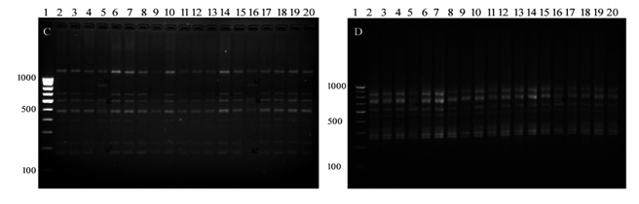
Figure 10: PCR products of genomic DNA from Acorus calamus accessions with ISSR primers, C) UBC 808 and D) UBC 802.
NS Devi, R Kishor & GJ Sharma: Eur J Biomed Pharm Sci 5, 2018, 651-658

Slide 30
Table 7. Marker parameters calculated for each ISSR primer used with Acorus calamus
TB: total band, PB: polymorphic band, PPB (%): percentage polymorphic band (%), PIC: polymorphism information content, RP: resolving power, EMR: effective multiplex ratio, MI: marker index
Sl no. | Primer no. | Sequence (5’ to 3) | TB | PB | PPB (%) | Product size (bp) | PIC | RP | EMR | MI
1 2 3 4 5 6 7 | UBC-802 UBC-808 UBC-815 UBC-818 UBC-820 UBC-824 UBC-827 | ATATATATATATATATG AGAGAGAGAGAGAGAGC CTCTCTCTCTCTCTCTG CACACACACACACACAG GTGTGTGTGTGTGTGT TCTCTCTCTCTCTCTCTG ACACACACACACACACG | 8 11 3 10 8 4 6 | 2 3 2 4 4 3 2 | 25 27.27 66.66 40 50 75 33.33 | 210-810 250-660 290-800 390-940 400-900 200-790 450-1900 | 0.187 0.187 0.187 0.259 0.223 0.332 0.187 | 0.21 0.21 0.21 0.31 0.26 0.42 0.21 | 0.25 0.27 0.66 0.40 0.50 0.75 0.33 | 0.046 0.050 0.123 0.103 0.110 0.249 0.061
Total |  |  | 50 | 20 | 40 |  | 0.223 | 0.26 |  | 0.106

Slide 31
Table 8. Similarity index for ISSR
 | s1 | s2 | s3 | s4 | s5 | s6 | s7 | s8 | s9 | s10 | s11 | s12 | s13 | s14 | s15 | s16 | s17 | s18 | s19
s1 | 1
s2 | 1 | 1
s3 | 1 | 1 | 1
s4 | 0.05 | 0.05 | 0.05 | 1
s5 | 1 | 1 | 1 | 0.05 | 1
s6 | 1 | 1 | 1 | 0.05 | 1 | 1
s7 | 1 | 1 | 1 | 0.05 | 1 | 1 | 1
s8 | 1 | 1 | 1 | 0.05 | 1 | 1 | 1 | 1
s9 | 1 | 1 | 1 | 0.05 | 1 | 1 | 1 | 1 | 1
s10 | 0.65 | 0.65 | 0.65 | 0.3 | 0.65 | 0.65 | 0.65 | 0.65 | 0.65 | 1
s11 | 0.65 | 0.65 | 0.65 | 0.3 | 0.65 | 0.65 | 0.65 | 0.65 | 0.65 | 1 | 1
s12 | 1 | 1 | 1 | 0.05 | 1 | 1 | 1 | 1 | 1 | 0.65 | 0.65 | 1
s13 | 1 | 1 | 1 | 0.05 | 1 | 1 | 1 | 1 | 1 | 0.65 | 0.65 | 1 | 1
s14 | 1 | 1 | 1 | 0.05 | 1 | 1 | 1 | 1 | 1 | 0.65 | 0.65 | 1 | 1 | 1
s15 | 0.05 | 0.05 | 0.05 | 1 | 0.05 | 0.05 | 0.05 | 0.05 | 0.05 | 0.3 | 0.3 | 0.05 | 0.05 | 0.05 | 1
s16 | 1 | 1 | 1 | 0.05 | 1 | 1 | 1 | 1 | 1 | 0.65 | 0.65 | 1 | 1 | 1 | 0.05 | 1
s17 | 1 | 1 | 1 | 0.05 | 1 | 1 | 1 | 1 | 1 | 0.65 | 0.65 | 1 | 1 | 1 | 0.05 | 1 | 1
s18 | 1 | 1 | 1 | 0.05 | 1 | 1 | 1 | 1 | 1 | 0.65 | 0.65 | 1 | 1 | 1 | 0.05 | 1 | 1 | 1
s19 | 1 | 1 | 1 | 0.05 | 1 | 1 | 1 | 1 | 1 | 0.65 | 0.65 | 1 | 1 | 1 | 0.05 | 1 | 1 | 1 | 1
Genetic diversity of 19 populations was estimated using ISSR data. Genetic similarity coefficients ranging from 0.05 to 0.65 with an average of 0.35 were obtained using the NTSYS-pc software. The ISSR data revealed that most of the populations are having genetic similarity to some level.

Slide 32
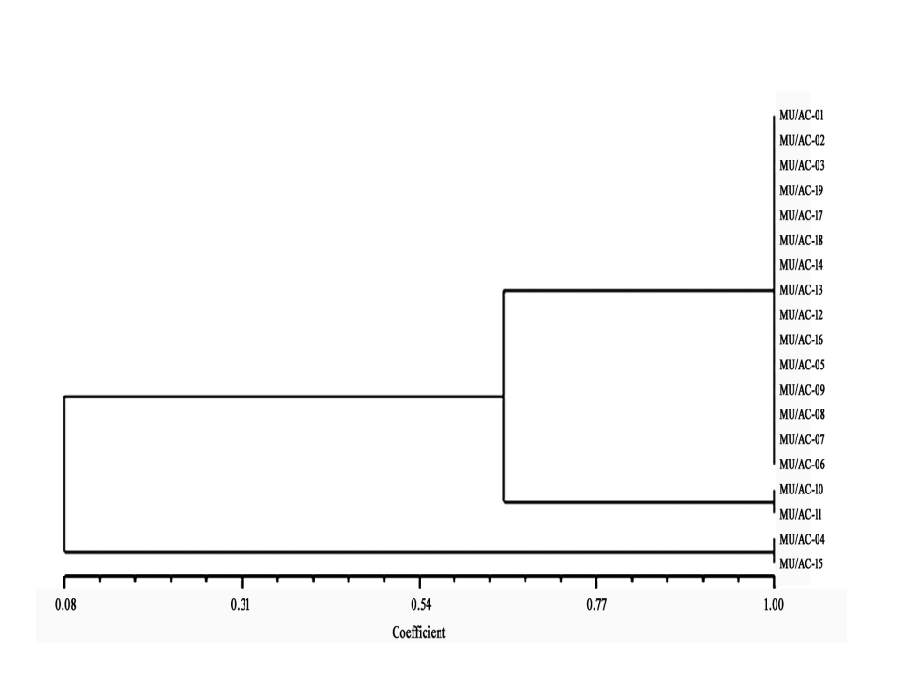
Figure 11. Dendrogram demonstrating the relationship among nineteen different accessions of Acorus calamus Linn. collected from different parts of Manipur based on ISSR
The dendrogram constructed using the SAHN clustering separated the 19 populations into two major clusters one smaller with two populations which are diploid and larger with two sub-clusters . The smaller sub-cluster have two triploid populations (Sample No. 10 & 11) whereas the larger sub-cluster have the remaining triploid populations

Slide 33
Experimental findings
Ploidy levels of A. calamus was made and it was found that accessions collected from Keirenphabi and Wangkhem were diploid (2n=2x=24) with 24 chromosome numbers whereas samples from remaining collection sites, viz., Hengbung, Keibul Lamjao-1, Keibul Lamjao-2, Lamlai, Langol, Lilong, Mayang Imphal, Ningthoukhong, Nongren, Oinam, Pangei, Patsoi, Sekmai, Singjamei, Tentha, Thoubal and Yumnam Huidrom were all found to be triploid (2n=3x=36) with 36 chromosome numbers. No tetraploid and hexaploid cytotypes were observed.
RAPD and ISSR profiling show separate clusters of the diploid and the triploid accessions. ISSR markers were more efficient compared to RAPD markers. Cluster analysis revealed a strong distinctness of the profiles from different geographical locations. Within a cluster, all the accessions of particular geographical region were not clustered in distinct groups reflecting a high genetic differentiation among genotypes from same locations.

Slide 34
Conclusion
Different propagation methods using tissue culture techniques have been developed which would ensure multiplication in large numbers and help in ecorestorative measures. Micropopagation of the elite cytotypes will ensure conservation and sustainable development at the same time. Only diploid (2n=3x=24) and triploid (2n=2x=36) cytotypes of Acorus calamus are found in Manipur.
Molecular profiles using RAPD and ISSR analyses show clusters separately in the various accessions collected from different geographical locations. These findings will provide proper genetic identification of plant material for IPR related pharmaceutical drug discovery and formulation, and ensure the reproducibility and the efficacy of commercial herbal products.

Slide 35
ACKNOWLEDGEMENT
The author thanks the University Grants Commission, Government of India for supporting this research through Grant No. F.18-1 (103)/2017 (BSR) dated 16 March 2016
Rajkumar Kishor PhD
N Sandhyarani Devi MSc
were research collaborators

Slide 36
THANK YOU

