Slide 1
REFRACTIVE CATARACT SURGERY
FOUNDATION AND OPTIONS
Fuxiang Zhang, MD
Henry Ford Health System
USA
August 11, 2017
Beijing

Slide 2
HENRY FORD HEALTH SYSTEM

Slide 3
FINANCIAL DISCLOSURE
No financial or proprietary interest in any material or method mentioned in this presentation.

Slide 4
WHAT IS REFRACTIVE CATARACT SURGERY?
Traditional cataract surgery
Refractive cataract surgery:
decreased dependence on glasses or contact lenses.

Slide 5
PERCENTAGE
My own clinical survey
  50% partial
  25% total.
If cost factor is eliminated, the percentage will be much higher.

Slide 6
EDOF
LIGHT ADJUSTED
FLACS
ACCOMMODATIVE
TORIC
REFRACTIVE CATARACT SURGERY
REAL ACCOMODATIVE
MULTIFOCAL
LRI
CONSULT
AVOID
C/I
BIOMETRY
IOL MONOVISION

Slide 7
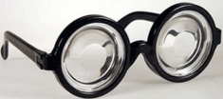
WHEN WE DID NOT HAVE IOL

Slide 8
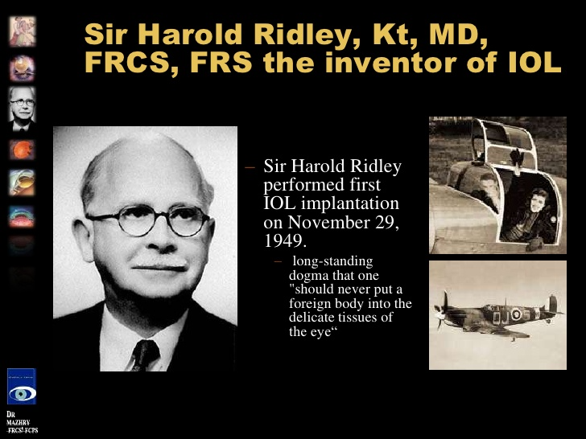

Slide 9
HISTORY
Harold Ridley invented and performed first IOL 11/29/1949 in England.
He noticed no inflammation from the injured eye Royal Air Force pilot of World War II, Gordon Cleaver, a splinter of acrylic plastic in the eye.
First IOL surgery in USA in 1952 at Wills Eye.
FDA approval in 1981.

Slide 10
HISTORY OF REFRACTIVE CATARACT SURGERY
The first known pseudophakic monovision paper was published by Boerner and Thrasher¹ in 1984.
The first toric IOL study was from Japan published in JCRS in 1994.² It was a PMMA IOL. Big incision.
The first foldable toric IOL was Staar Toric. Approval by FDA in November 1998.
First multifocal IOL Array IOL of AMO.
FDA approval in 1997.
Notes:
I did about a few hundreds of Staar Toric.

Slide 11
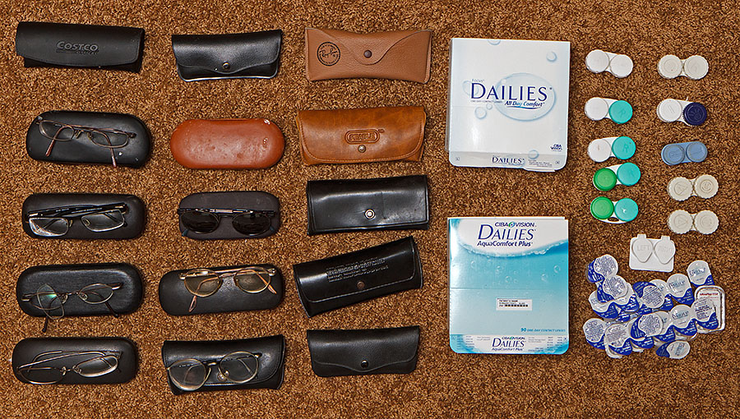
ONLY <10% GLASSES FREE IF AIMING AT EMMETROPIA OU

Slide 12
WHY START FROM IOL MONOVISION?
If one does not know how to do a good IOL monovision, one can not be a great refractive cataract surgeon.
What is monovision?

Slide 13
WHY DO WE STILL USE IOL MONOVISION?

Slide 14
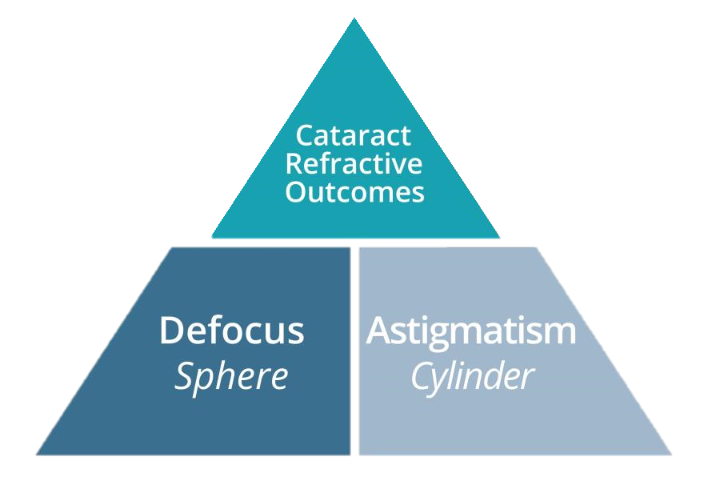
Courtesy of Alcon Laboratories, Inc. Fort Worth, TX USA

Slide 15
THE FOUNDATION OF REFRACTIVE CATARACT SURGERY

Slide 16
WHY DO WE STILL USE IOL MONOVISION?
Still the most common surgical option for presbyopia. Almost twice as common when compared to premium IOLs per 2013 ASCRS survey³.
The trend is more now, about 25% of all IOLs implanted in 2014 in USA.

Slide 17
WHY DO WE STILL USE IOL MONOVISION?
Good vision quality.
High satisfaction rate.
IOL exchange is rare.
Unique beauty is back up glasses can fully reverse bilateral visual function if needed.

Slide 18
TEN-YEAR IOL MONOVISION REVIEW
All of my 5660 cataract patient charts from 2004 to 2014 were reviewed. 359 qualified, 194 enrolled. Average follow up 35 months.
De-identified survey sent out for each patient to improve accountability and reliability.
I did not have direct access for the original data.

Slide 19
PATIENT SATISFACTION

Slide 20
GLASSES INDEPENDENCE

Slide 21
DEPTH PERCEPTION

Slide 22
NIGHTTIME DRIVING

Slide 23
IT IS OPHTHALMOLOGIST CHOICE⁴
Monovision 45% (37% regular IOL+8% Crystalens)
Emmetropia OU monofocal IOL with reading glasses 37%
Multifocal 16%
Emmetropia OU with Crystalens 2%
Notes:
It was a survey of 97 participating ophthalmologists in eyeCONNECTIONS online, North American anonymous to encourage candor and cost is not a factor in the survey description.
So monofocal and multifocal as two groups is 84% and 16%.

Slide 24
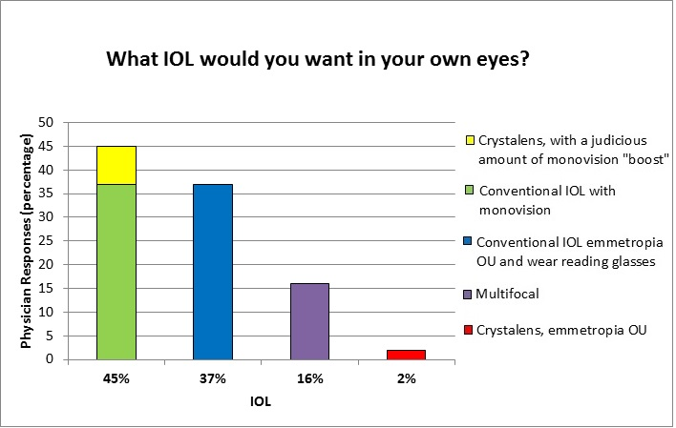
Notes:
Among all the slides today, this is my favorite one. It is unbiased decision.

Slide 25
WHY DO WE SAY FOUNDATION?
Easier to make patients happy because:
  Cost less than other modalities.
  Downsides are negligible.
  Good vision quality.
  More predictable and reliable.

Slide 26
WHY DO WE SAY FOUNDATION?
You are ready for premium IOL if you are good at:
  Preoperative consultation.
  Near perfect biometry and surgical skills.
  Skills for astigmatism correction.

Slide 27
NEW TECHNOLOGIES
IOL monovision is not perfect and is not the summit.
Surgeons should keep an open mind and keep trying new things.
I started Toric IOL, Multifocal IOL and EDOF IOL at the same year when they were first approved by FDA.
I have used all FDA approved premium IOLs in USA.

Slide 28
ASTIGMATISM CORRECTION
Limbal relaxing incision
Toric IOL

Slide 29
Notes:
FDA 1998

Slide 30
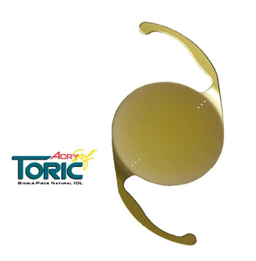
ACRYLIC TORIC
Notes:
2005

Slide 31
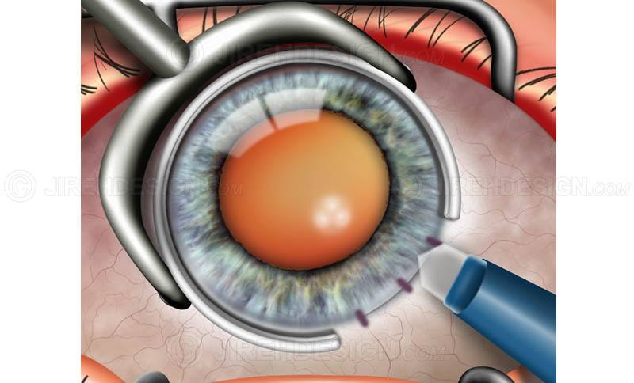
MANUAL LRI

Slide 32
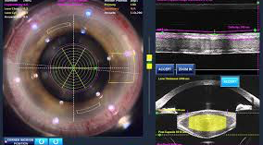
LASER CREATED LRI

Slide 33
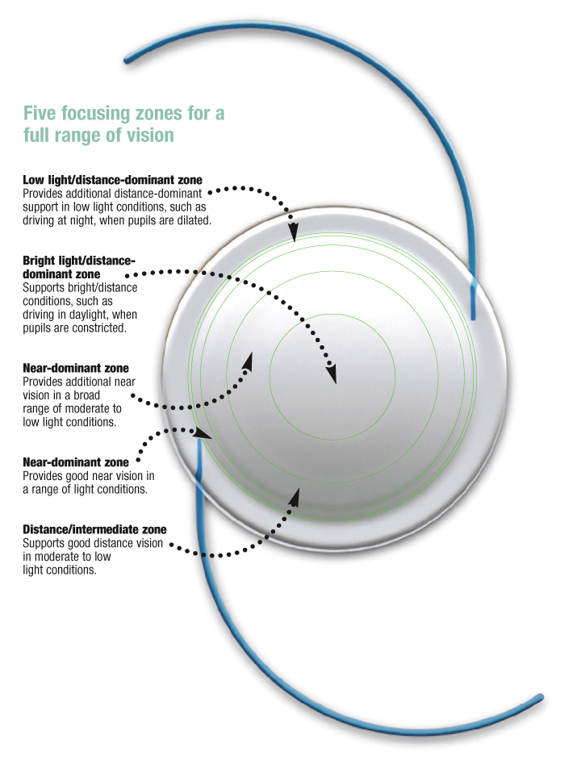
FIRST MF IOL ARRAY 1997

Slide 34
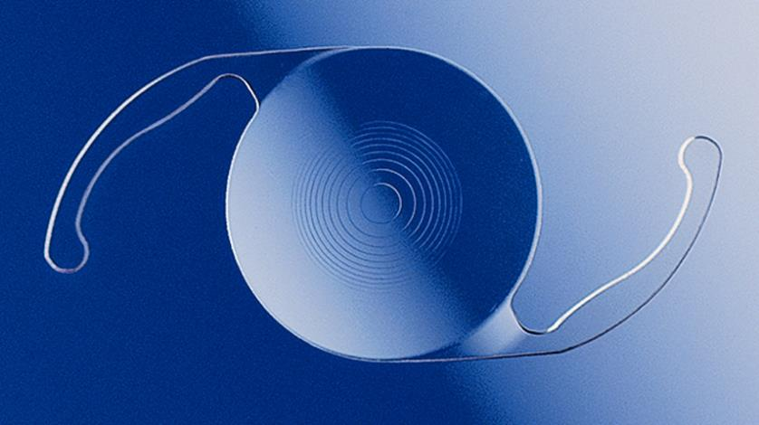
MULTIFOCAL IOL, ReStor

Slide 35
MULTIFOCAL IOL
Array lens from Advanced Medical Optics (AMO) was approved by FDA in 1997.
  Five zones. 1 3 5 for far and 2 4 for near
  I myself Implanted a few in 1998
  Good thing: No extra cost to patients at that time.
ReZoom also from AMO was approved by FDA in 2005. It was the second generation of Array lens, also refractive MF IOL.
ReStor from Alcon was approved by FDA in 2005.

Slide 36
ReStor IOL
It is a diffractive IOL.
Splits incoming light into far and near
Incoming light was designed to split to create separate distance and near focal points to see both far and near with high spectacle independence.

Slide 37
ADVANTAGES
High percentage of glasses freedom.
Generally speaking, patient satisfaction is high.
Newer generations better quality than old ones.

Slide 38
DISADVANTAGES
Decreased contrast sensitivity.
Halo and glare.^{5Zhang6Wilkin7Packer}
Much higher rate of IOL exchange.^{8Chang}

Slide 39
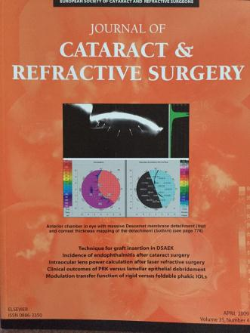
March 2011

Slide 40
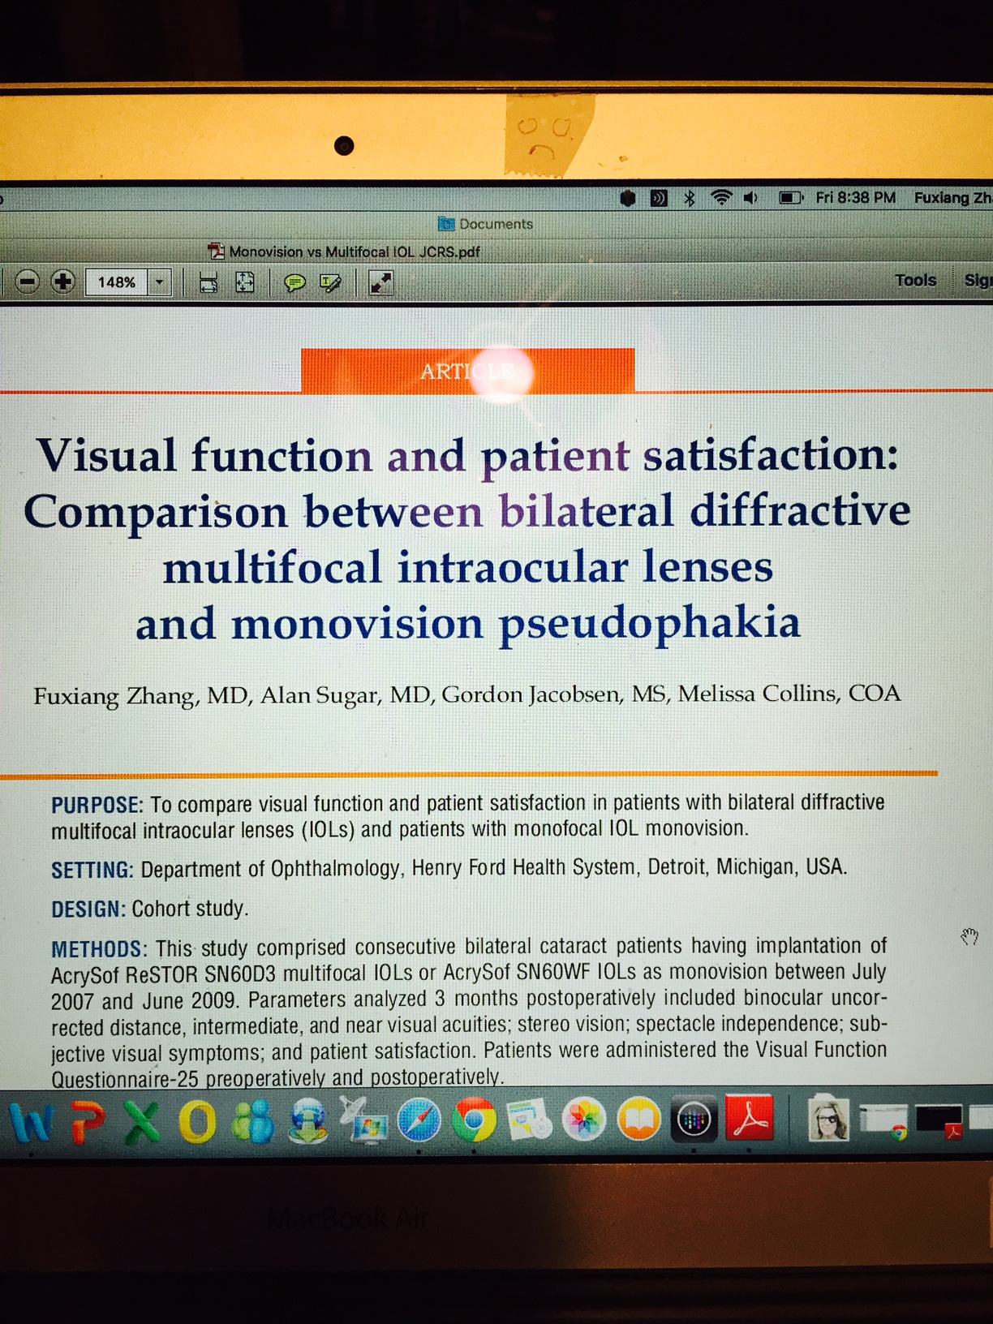
JOURNAL OF CATARACT & REFRACTIVE SURGERY
Notes:
March 2011. It triggered a national debate, which one is better, monovision or Restor?

Slide 41
IF YOU STILL USE MF
Try to avoid those patients who drive at night.
Consider patient height and arm length and reading posture habit when you choose add power.
Do the nondominant eye first and then give the patient at least a few weeks to test the tolerance. This is to decrease IOL exchange rate.
Better CCC with laser.

Slide 42
ACCOMMODATIVE IOL
The ideal IOL.
New products are in the pipeline now.

Slide 43
ACCOMMODATIVE IOL
Crystalens from Bausch & Lomb is the only accommodative IOL approved by FDA in USA since 2003.
Trulign Lens from the same company is the combination of Crystalens and toric addition to correct astigmatism.
1CU accommodative IOL of HumanOptics, Erlangen, Germany is available in Europe and the rest of the world, but not FDA approved in the USA.

Slide 44
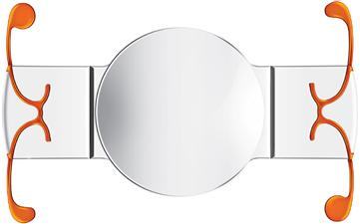
ACCOMMODATIVE IOL, CRYSTALENS
Notes:
Hinges and grooves

Slide 45
ADVANTAGES
Monofocal, no increased halo or glare.
Successful patients can be very happy with good glasses independence.

Slide 46
DISADVANTAGES
Glasses independence is not as good as MF IOL.
The forward movement can become an issue when the joints are covered by fibrotic scar tissue.
Not as predictable and durable.

Slide 47
DISADVANTAGES
Pseudo accommodative.^{9Pepose}
significant percentage of paradoxical posterior optic movement during accommodative effort.^{9Pepose}
Higher YAG capsulotomy rate^{10ong}
Z-syndrome often needs IOL exchange.

Slide 48
PEARLS
Use mini-monovision to enhance near vision.
Crossed IOL monovision works.^{11Zhang}
Good centration of CCC with FLACS provides extra value
Complete cortex removal and bag polishing prior to the insertion.
Rotate the IOL 180 or 360 is advisable.
Good wound structure without leaking is a must.

Slide 49
EXTENDED DEPTH OF FOCUS
(EDOF)
Currently it seems to be the most favored premium IOL.

Slide 50
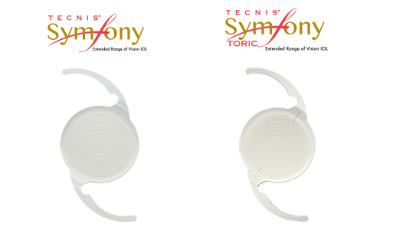
ZXROO and ZXT

Slide 51
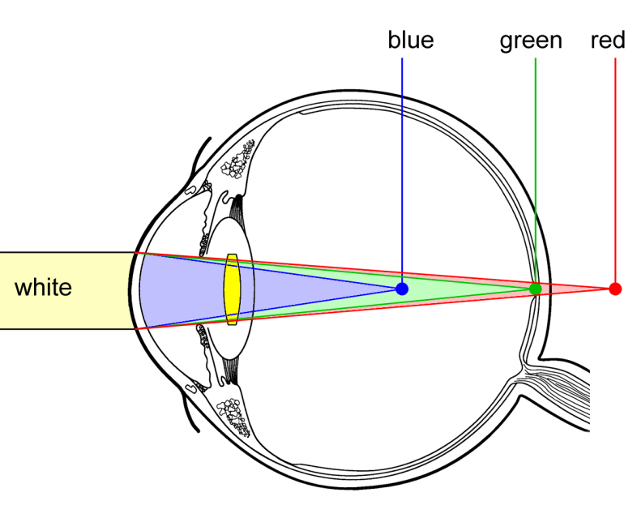
WHAT IS CHROMATIC ABERRATION?
The power of the eye is wavelength dependent. Colors that are out-of-focus cause blur and reduce contrast.
The phakic eye has approximately 1.38 D of chromatic aberration between 450 and 700 nm. Pseudophakic eyes have between 1.45 and 2 D of chromatic aberration, depending on the dispersion of the IOL material
2. DOF2015OTH0004. 2. Data on file. Longitudinal Chromatic aberration of a monofocal TECNIS Achromat IOL. 3.Weeber et al. Differences in Chromatic Aberration of IOLs, ESCRS 2016.
PP2016CT1448

Slide 52

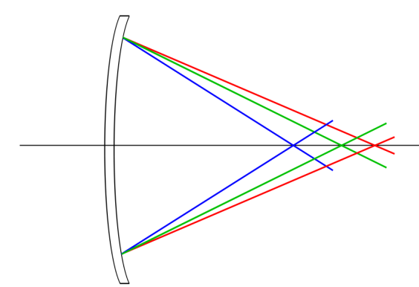
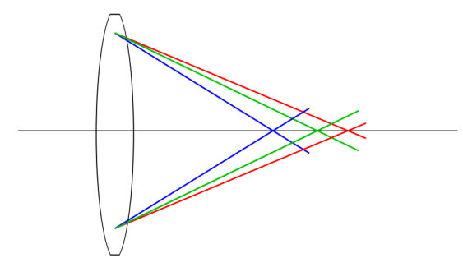
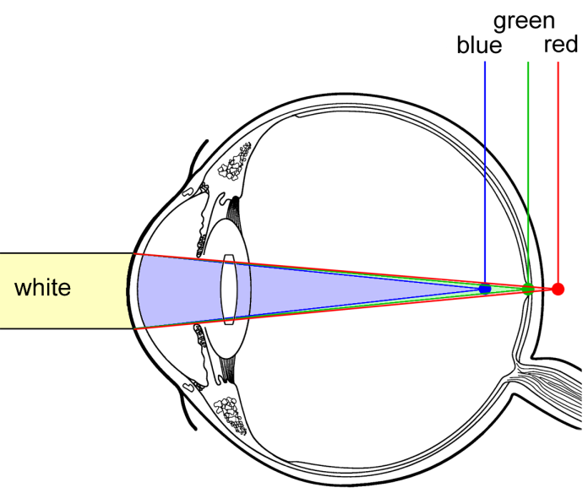
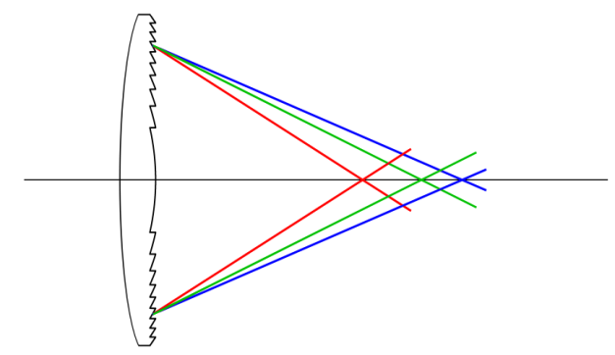
ACHROMATIC TECHNOLOGY
A DIFFRACTIVE IOL WITH ACHROMATIC TECHNOLOGY CAN CORRECT CHROMATIC ABERRATION OF THE EYE
Cornea
Typical IOL
+
=
+
=
Cornea
TECNIS Symfony® Diffractive Technology
PP2016CT1448

Slide 53
SYMFONY IOL
It induces -0.27 microns of spherical aberration to compensate positive spherical aberration from cornea.^{12Yuan}
Together with diffractive technology, Symfony implant elongates the focus and increases the contrast.^{13Cochener}

Slide 54


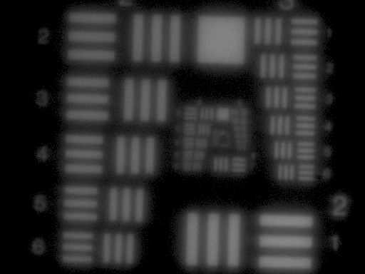
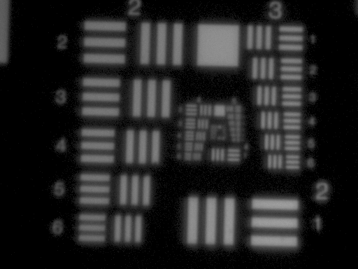
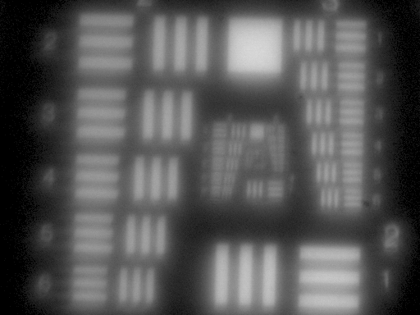
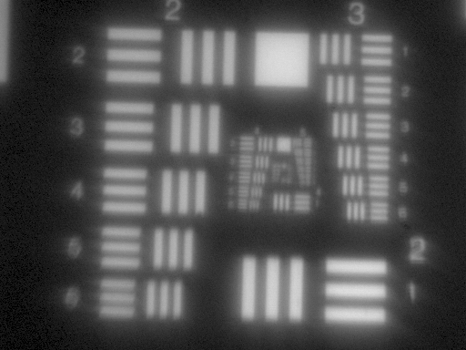
Achromatic Technology
DRIVES CONTRAST ENHANCEMENT
Correction of longitudinal chromatic aberration (LCA) enhances contrast.
Correction of corneal chromatic aberration results in a sharper focus of light.
Combined with spherical aberration correction, retinal image quality increases, without negatively affecting depth of focus.
The benefits of chromatic aberration correction occur for all pupil-sizes.
LCA = 1.20 Diopters³
LCA = 0.14 Diopters
4
4
Photopic Pupil
Mesopic Pupil
1. Weeber, H.A., & Piers, P.A. (2012). Theoretical Performance of Intraocular Lenses correcting both Spherical and Chromatic Aberration. J Refr Surg, 28 (1), 48-52.; 2. Artal, P., Manzanera, S., Piers, P., & Weeber, H. (2010). Visual effect of the combined correction of spherical and longitudinal chromatic aberrations. Opt Express, 18 (2), 1637-1648.; 3. Chromatic aberration between 500nm and 640nm, Nagata et al, 1999; ; 4. Piers et al, “IOLs for the Combined Correction of Chromatic and Spherical Aberration” ASCRS 2008
PP2016CT1448
Notes:
Tecnis Symfony induces -.27 microns of SA.

Slide 55

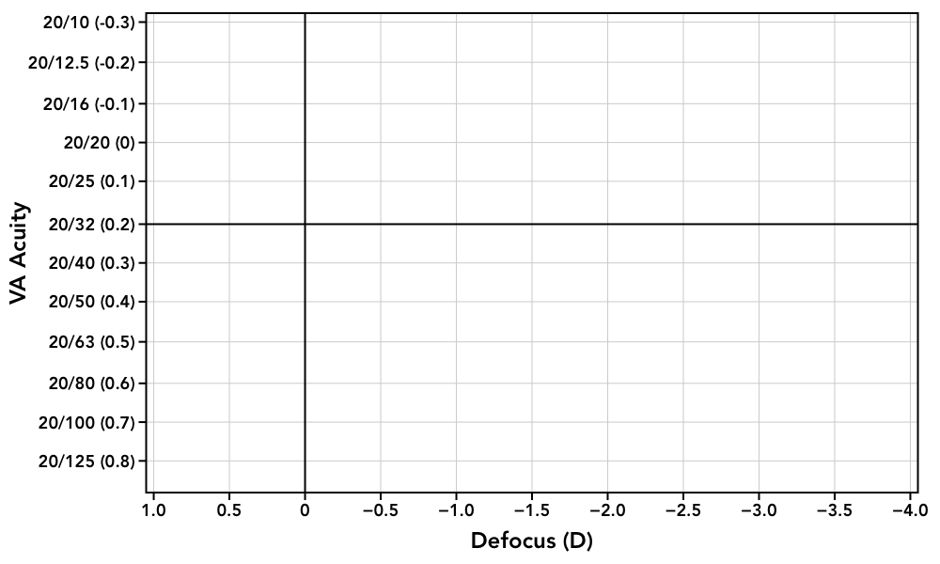


Visual Symptoms
TECNIS Symfony® IOL MINIMIZES NIGHT VISION SYMPTOMS
ZLB00
3.25 add
ZXR00
ZCB00
Simulated photopsia images for conceptualization only.
Defocus curves originate from different studies and methods vary between studies.
PP2016CT1448

Slide 56
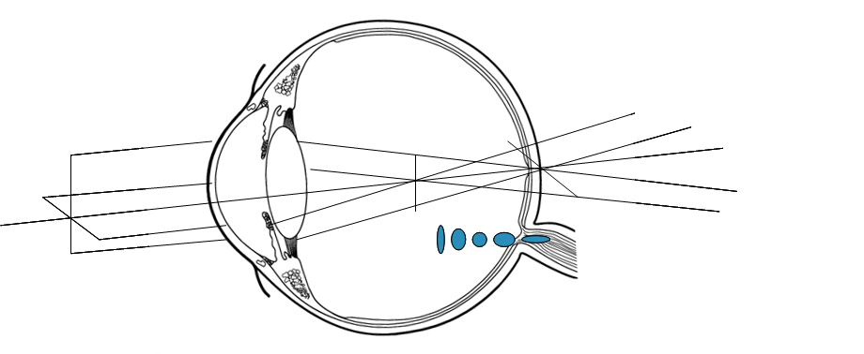
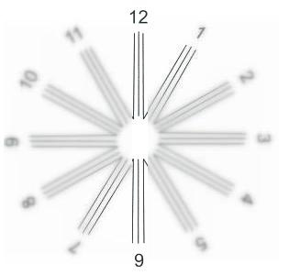
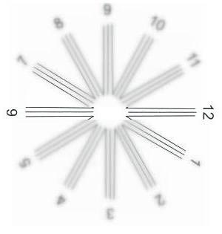
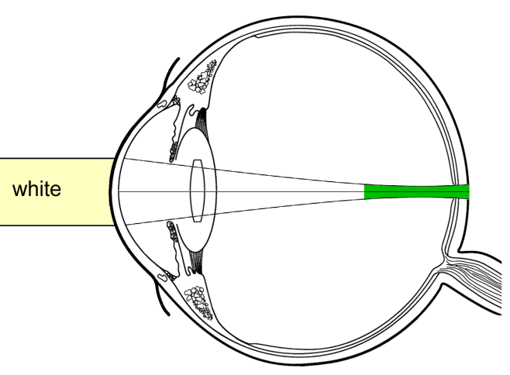
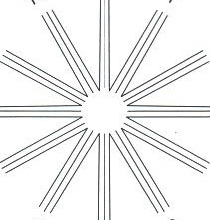
ENHANCED FUNCTIONALITY
Forgiveness
TECNIS Symfony ® IOL's DESIGN DELIVERS TOLERANCE TO ASTIGMATISM
An eye with astigmatism has greater power in one axis and lower in the other.
              This generates multiple focal “points/ lines” in the eye.
The TECNIS Symfony® IOL design elongates depth of focus, resulting in an extended range of vision.
This tubular zone of good focus creates both depth of focus and tolerance to astigmatism.
Elongated focus
PP2016CT1448

Slide 57
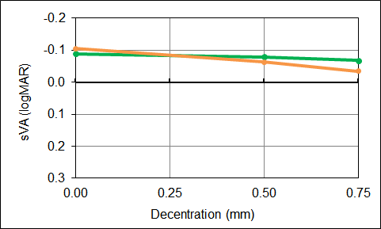

ENHANCED FUNCTIONALITY
Forgiveness
TECNIS Symfony® IOL’s DESIGN DELIVERS TOLERANCE TO DECENTRATION
Tolerance to decentration was assessed in physiological raytracing models and shows similar tolerance to decentration as the TECNIS® monofocal IOL.
The TECNIS Symfony® IOL is tolerant to decentration throughout 0.75mm of decentration¹.
1. DOF2016CT0023 TECNIS Symfony® IOL Tolerance to decentration
PP2016CT1448

Slide 58
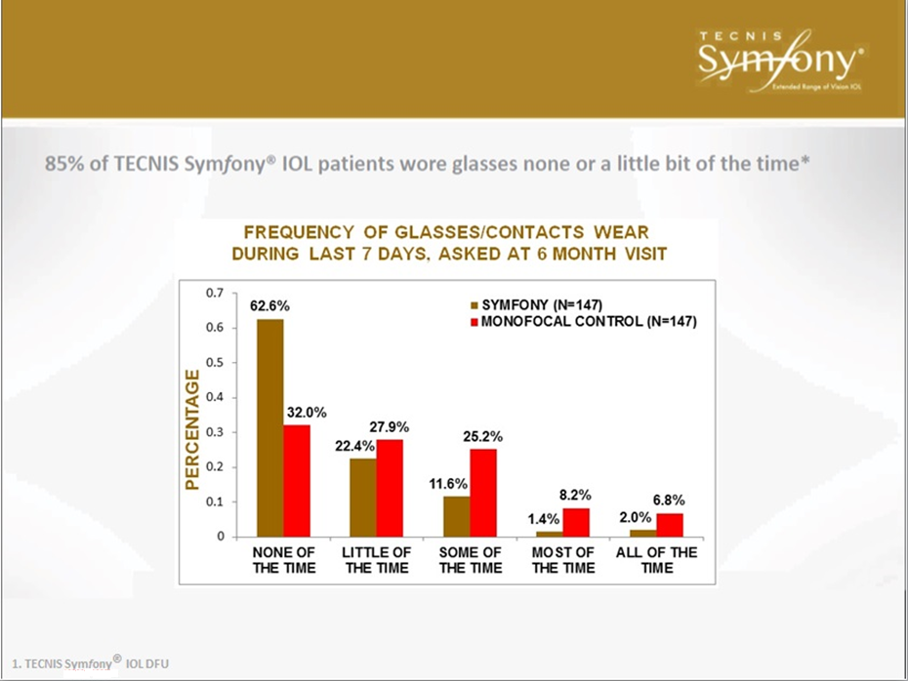
Notes:
85% is a very good high number. It is not a multifocal IOL and glare/halo reported much lower than MF.

Slide 59
SYMFONY LENS
85% is a very good number.
Doing well in Europe in the last few years according to published papers.
My limited experience has been good so far, but still need minimonovision to enhance near vision and most patients still have some mild glare and halo at nighttime driving.

Slide 60
PEARLS AND PITFALLS
Near vision is limited, so minimonovision is still recommended at -0.50 D level to enhance near vision.
Preoperative consultation still important for halo and glare.

Slide 61
FEMTOSECOND LASER ASSISTED CATARACT SURGERY (FLACS)
Invented in the 90s by Ron Kurtz, MD
LenSx from Alcon (California USA) was approved for cataract surgery by FDA in September 2009.
LRI and CCC size and centration are the main advantages.
More accurate and precise.

Slide 62
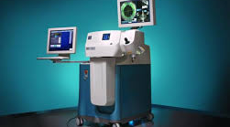
LenSx Laser

Slide 63
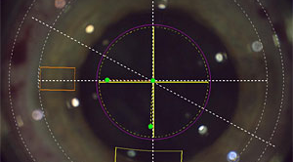
CCC SIZE AND CENTRATION

Slide 64
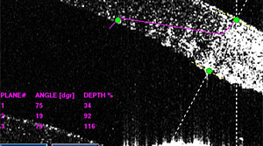
CORNEAL THICKNESS

Slide 65
LRI AND FRAGMENTATION

Slide 66
COMPARISON

Slide 67
COMPARISON
Germany, JCRS 2015^{14Conrad-Hengerer}
100 patients, intraindividually randomized, 100 eyes each method. Follow up up to 6 months.
92% in FLACS 71% in MCS within ± 0.50 D of target. P<0.05. No LRI in either group.
FLACS had faster visual recovery and earlier stabilization of refraction.

Slide 68
COMPARISON

Slide 69
COMPARISON
Austria, JCRS 2017^{15Mursch-Edlmayr}
50 patients, intraindividually randomized, 50 eyes each method. Follow up up to 6 months.
No statistically significant differences in all major outcomes including:
  endothelial cell density,
  central corneal thickness,
  central retinal thickness,
  Effective phaco time,
  IOL centration.

Slide 70
COMPARISON

Slide 71
COMPARISON
Ophthalmology 2016^{16Popovic}
15 randomized trials in 10 years from 2007 to 2016.
14,567 eyes
Primary outcomes of UCDVA and CDVA, refractive endpoint, there were no statistically significant difference.
Effective phaco time, postop corneal thickness favor FLACS with statistically significant difference.
PC rent more in FLACS with statistically significant difference.

Slide 72
PERSONAL EXPERIENCE
It is a fantastic technology.
Does have indications for certain patients, mainly for more precise LRI and CCC size and centration.
Not impressed with main incision and cut ability in very dense cataract. Main incision variation.
The cost is the major disadvantage.

Slide 73
SUMMARY
Refractive cataract surgery is the future trend.
IOL monovision is a premium practice; it requires accurate biometry, seamless surgical skills and detailed preoperative consultation.
Surgeons should keep mind open and try new technologies.
Follow evidence based principle.
Be ethical and professional.

Slide 74
EDOF
LIGHT ADJUSTED
FLACS
ACCOMMODATIVE
TORIC
REFRACTIVE CATARACT SURGERY
REAL ACCOMODATIVE
MULTIFOCAL
LRI
CONSULT
AVOID
C/I
BIOMETRY
IOL MONOVISION

Slide 75
REFERENCES
Boerner CF, Thrasher BH. Results of monovision correction in bilateral pseudophakes. J Am Intraocul Implant Soc. 1984 Winter;10(1):49-50.
Shimizu K et al. Toric intraocular lenses: correcting astigmatism while controlling axis shift. JCRS 1994;20 (5) : 523-526
ASCRS Clinical Survey 2013. EyeWorld Vol.18, Number 11. November 20 2013
Gossman M. What intraocular lens would you want in your eyes. EyeWorld July 2016 page 34
Zhang F, Sugar A, Jacobsen G, Collins M. Visual function and patient satisfaction: Comparison between bilateral diffractive multifocal intraocular lenses and monovision pseudophakia. J Cataract Refract Surg. 2011 Mar;37(3):446-53.
Wilkins, MR. MD, FRCOphth, et al, Randomized Trial of Multifocal Intraocular Lenses versus Monovision after Bilateral Cataract Surgery, Ophthalmology, 2013-12-01Z, Volume 120, Issue 12, Pages 2449-2455.
Packer M, Chu YR, Waltz KL, Donnenfeld ED, Wallace RB, Featherstone K, Smith P, Bentow SS, Tarantino N. Evaluation of the Aspheric Tecnis Multifocal Intraocular Lens: One-Year Results from the First Cohort of the Food and Drug Administration Clinical Trial. Am J Ophthalmol 2010;149: 577-584.
Chang DH Interview. Low-Add multifocal and extended-depth-of-focus IOLs. Cataract 360. Volume 1 Number 4. November 2016.

Slide 76
REFERENCES
Pepose JS, Burke J, Qazi MA. Benefits and barriers of accommodating intraocular lenses. Curr Opin Ophthalmol. 2016 Sep 20.
Ong HS, Evans JR, Allan BD. Accommodative intraocular lens versus standard monofocal intraocular lens implantation in cataract surgery. Cochrane Database Syst Rev. 2014 May 1;(5):CD009667. doi: 10.1002/14651858.CD009667.pub2.
Zhang F, Sugar A, Arbisser L, Jacobsen G, Artico J Crossed versus conventional pseudophakic monovision, J Cataract Refractive Surg. 2015;41:1845-1854.
Yuan L, Bao Y. Analysis of the cornea spherical aberration in people with senile cataract. Zhonhua Yan Ke Za Zhi. 2014 Feb; 50(2): 100-4
Cochener B. Clinical outcomes of a new extended range of vision intraocular lens: international multicenter concerto study. J Cataract Refract Surg 2016; 42: 1268-1275
Conrad-Hengerer A, Sheikh MA, Hengerer FH, et al. Comparison of visual recovery and refractive stability between femtosecond laser-assisted cataract surgery and standard phacoemulsification: six-month follow-up. J Cataract Refract Surg 2015; 41:1356-1364
Mursch-Edlmayr A, Bolz M, Luft N et al. Comparison between femtosecond laser-assisted and conventional cataract surgery. J Cataract Refract Surg. 2017;43:215-222
Popovic M, Campos-Moller X, Schlenker MB, Ahmed IK. Efficacy and safety of femtosecond laser-assisted cataract surgery compared with manual cataract surgery. Ophthalmology 2016;123:2113-2126

Slide 77
THANK YOU

