Slide 1
On the Issue of Carbon Dioxide Concentrations and Global Climate Change
by
Frederick House, Professor Emeritus
Dept. of Physics, Drexel University, Philadelphia, PA 19104 USA
There are two issues to consider in this paper:
Issue 1: Climate scientists look at global warming as a time series of increasing
CO2 concentrations and a separate time series of global temperature anomalies.
This process seems to be a fault in their analysis procedures.
Issue 2: Cross Correlation analysis of these time series determines
how does CO2 impact the climate and by how much?.
Theme: Evidence of climate warming is not evidence of what causes the warming!

Slide 2
Global Increase in Carbon Dioxide from NASA GISS Dzta Set (US)
(ppm)

Slide 3
Plot of Temperature Anomalies from the HadCRUT4 Data Set - (UK)

Slide 4
Comparison of Carbon Dioxide Increase and Temperature Anomalies
(ppm)
Year of Observation
Year of Observation

Slide 5
Comparison of Carbon Dioxide Increase and Temperature Anomalies
Year of Observation

Slide 6
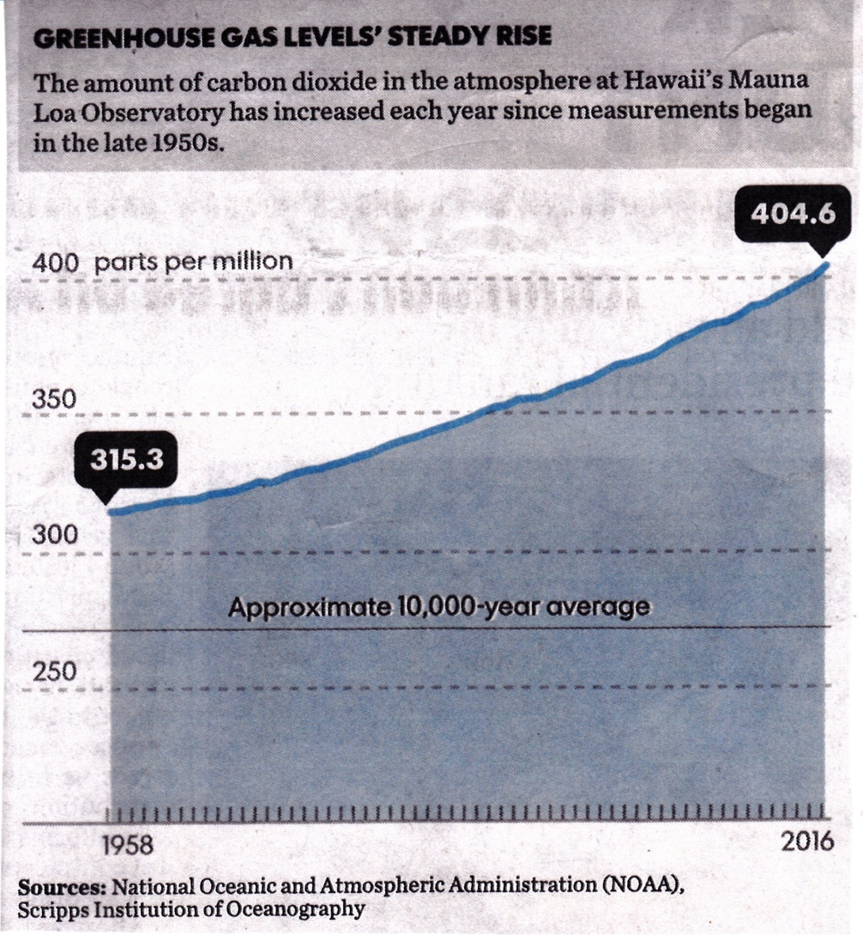
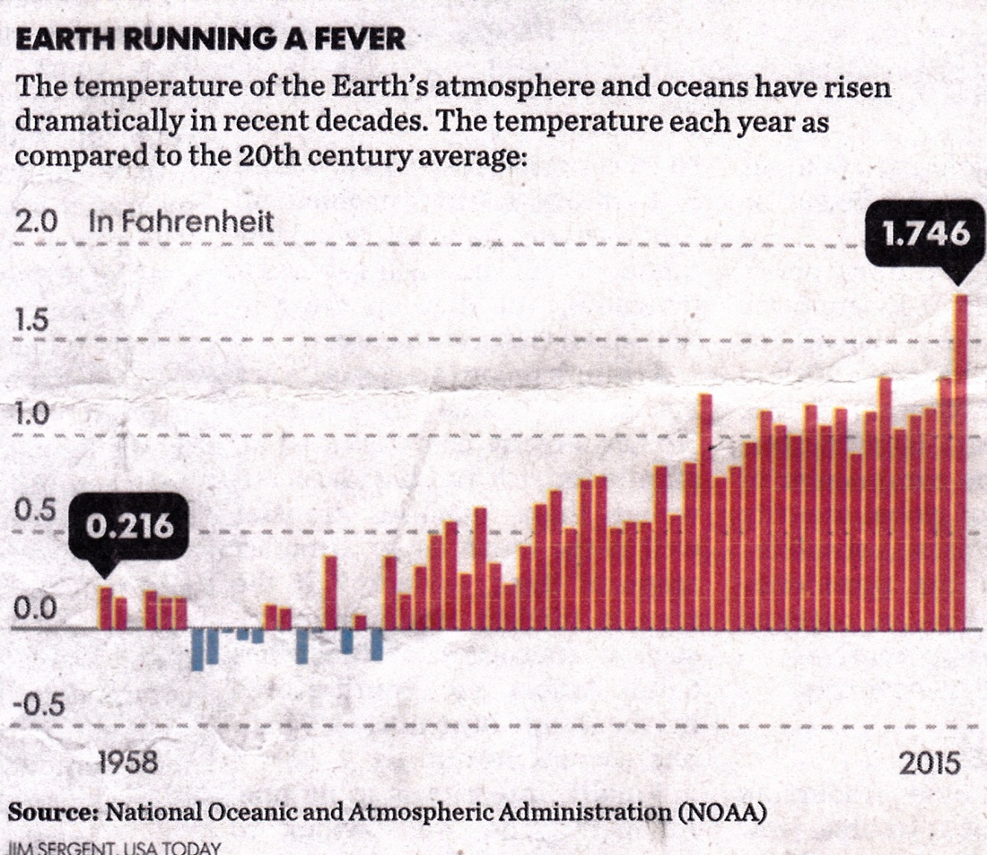
Carbon Dioxide Concentrations and Global Temperature Anomalies

Slide 7
Cross Correlation Formulation
Cross correlation is a standard method of estimating the degree to which two series are correlated. Consider two series X(i) and Y(i) where i = 0,1,2…N-1.
The cross correlation coefficient ρ is defined as
ρ(x,y) = Σi [(x(i) – mX) * (Y(i) – mY)] divided by (σx * σy)
mX and mY are the means of their corresponding series and σx and σy are their respective standard deviations. The denominator serves to normalize the correlation coefficient such that (-1 <= ρ <= +1), the bounds indicating maximum correlation and 0 indicating no correlation.
The term R² is defined as the square of the correlation coefficient (ρ² ) and is a measure of how much the variance of Y(i) is explained by the variance of X(i).

Slide 8
Cross-Correlation of Increases in CO₂ with Temperature Anomalies
Driving Question::
How much do increases in CO₂ concentration
explain the record of global temperature warming?
Global Data: . . . . . . . . . . . . . ⎝ ρ = 0.69 and R² = 48%;
Northern Hemisphere:. . . . . ➔ ρ = 0.68 and R² = 47%;
Southern Hemisphere:. . . . . . ➔ ρ = 0.66 and R² = 44%.
Results indicate less than 50% of the variance of global temperatures
are explained by the variance of CO₂ concentrations.

Slide 9
Partitioning of Variances for Temperature Anomalies - HadCRUT4 Data Set.

Slide 10
Concluding Remarks
Driving Question::
The correlation between CO2 emissions and global temperature rise
is poor at 60%. If global warming is caused primarily
by manmade increases in CO2,
Why is there not a 0.90 or higher correlation?
Theme:
Evidence of global warming is not evidence of what causes the warming!

