Slide 1
Abortion Pathology
Dr. Fred Williams III, DVM, DACVP
Assistant Professor
Veterinary Medical Diagnostic Laboratory
University of Missouri
E-mail: williamsfre@missouri.edu

Slide 2
Defining Terms
Abortion: Expulsion of the fetus before full development; may be alive or dead
Stillbirth: Expulsion of a dead fetus at full gestational development
  Determination of term in bovines?
Embryonic death vs. Fetal death: Occurs earlier in the gestational period
  May appear as infertility

Slide 3
Frequency of good Dx on abortion cases?
Confounding factors
  Loss of agent
  In utero autolysis
  Loss of placenta
  Genetic causes
  Toxic causes
  Other non-infectious causes
In 814 abortions, a specific cause was identified in 29.5%
  Anderson, Blanchard, Barr. A survey of causes of bovine abortion occurring in the San Joaquin Valley, CA. Journal of Veterinary Diagnostic Investigation. 1990 Oct; 2(4):283-7
In 1,784 abortions, etiologic Dx was made in 44%
  Kirkbride CA. Diagnoses in 1,784 ovine abortions and stillbirths. Journal of Veterinary Diagnostic Investigation. 1993 Jul; 5(3):398-402

Slide 4
Species variation
Sheep/goats no diagnosis in approximately 55%
Pigs 1/3 of cases have a diagnosis
Equine occur 10-15%, with 16% idiopathic
  Typically in 1st 40 days or late in term
  Shoulder joints of late term fetus for hemarthrosis/fractures

Slide 5
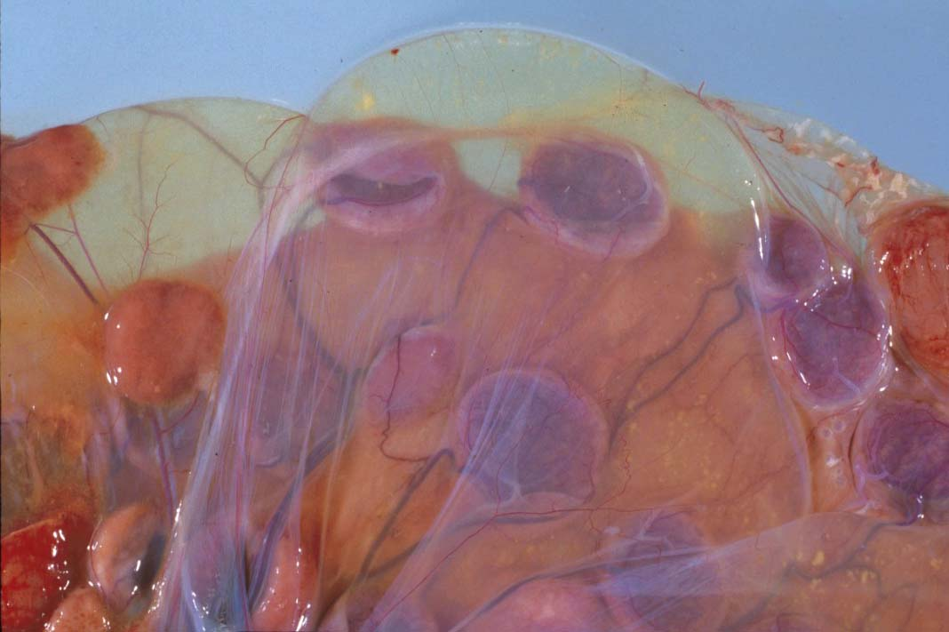
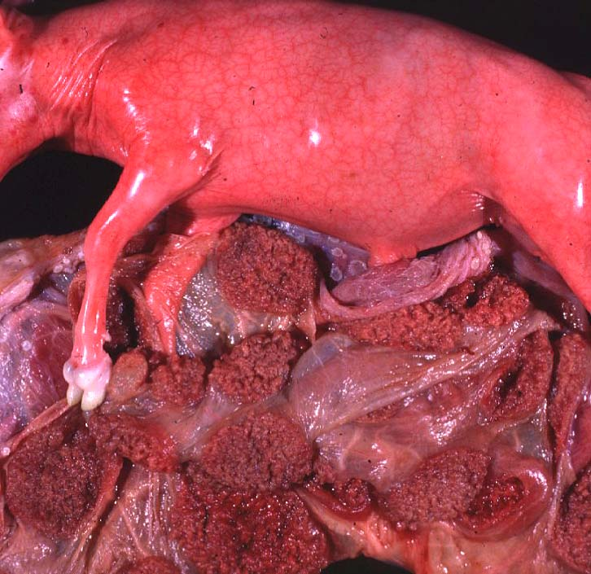
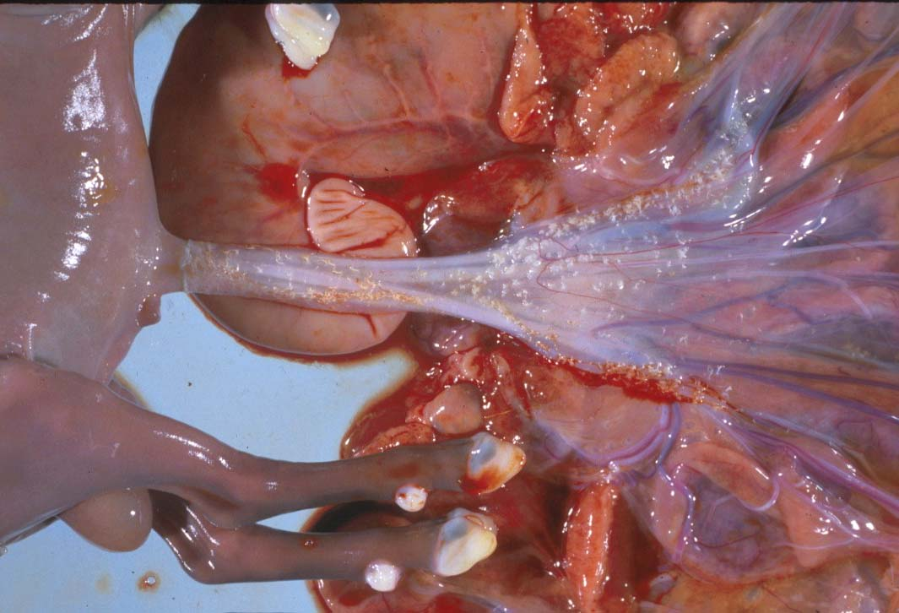

Slide 6
Maceration vs. Mummification
Maceration: putrefactive destruction of the fetus; assoc’d with endometritis
  Fetid odor
  Bacterial etiologies
  Emphysema
Mummification: retained fetus, progressively dehydrated; virtually sterile => no lytic organisms
  Viral or non-infectious etiologies
  May be held indefinitely
  Parvovirus (porcines) => vary among piglets

Slide 7
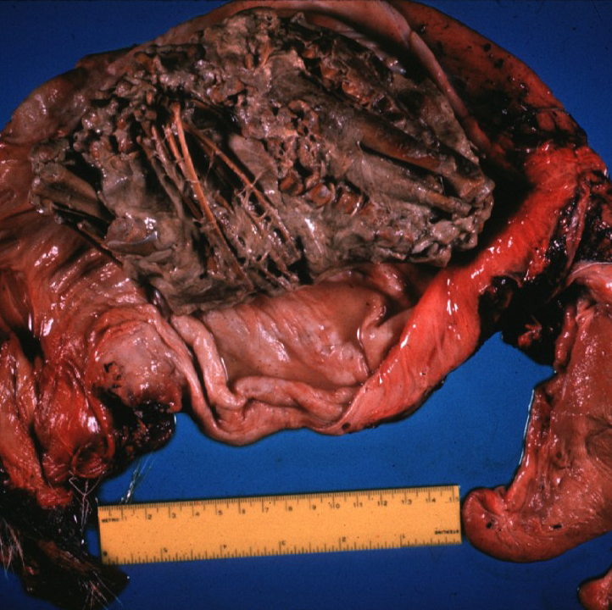
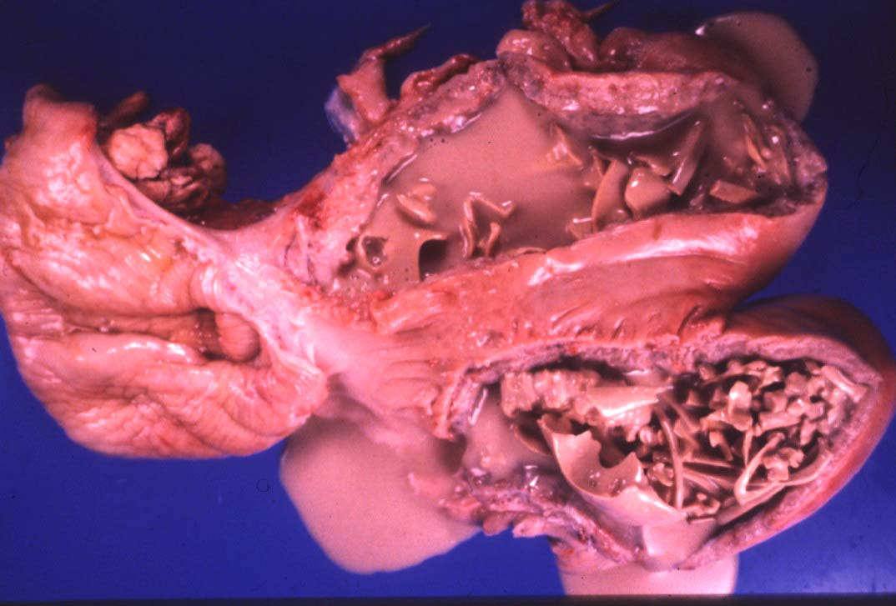
Maceration => “Chewed up”

Slide 8
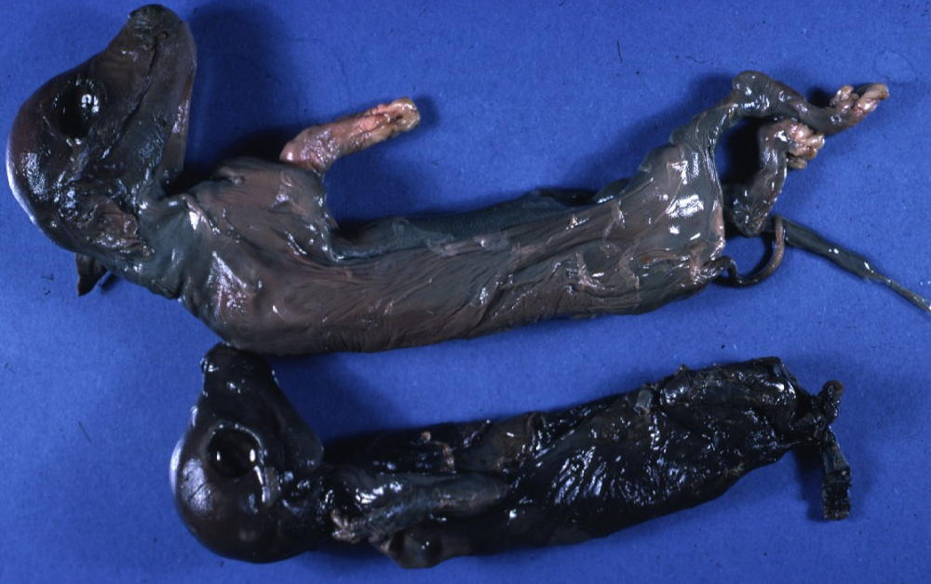
Mummification => “Dried up”

Slide 9
Twinning
  MC a problem in the mare
  Assoc’d with Freemartinism

Slide 10
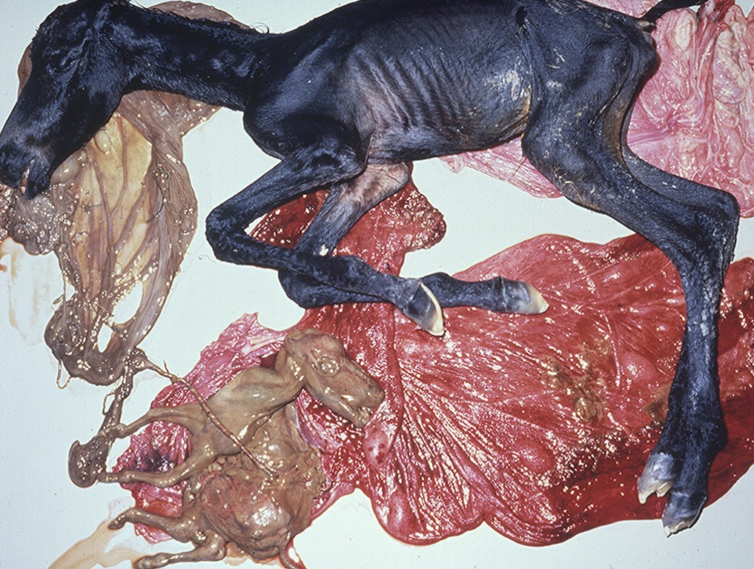

Slide 11
Bacterial Causes
Can be nearly anything that infects the uterus and/or placenta
  Salmonella, Pasteurella, Haemophilus, Streptococcus, E. coli, T. pyogenes, etc.
Lesions are non-specific
  Suppurative placentitis
  Suppurative bronchopneumonia, fetal
  Septicemia, fetal
Fetal abomasal fluid is critical

Slide 12
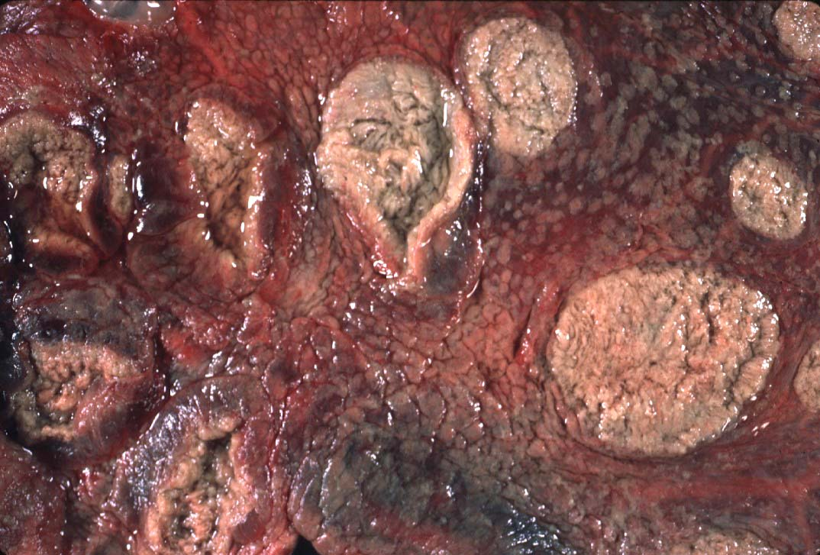

Slide 13
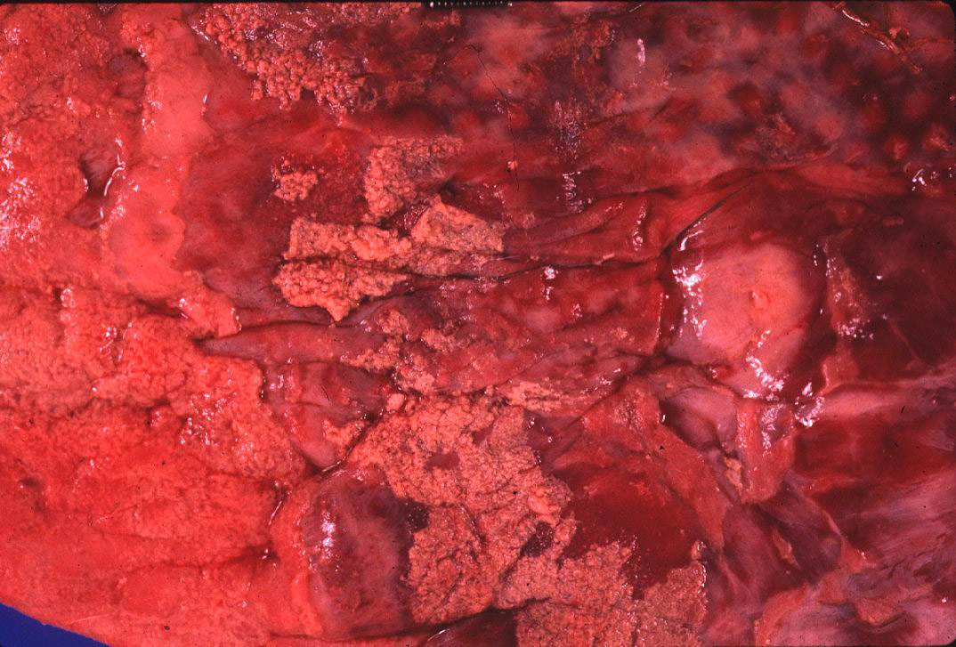
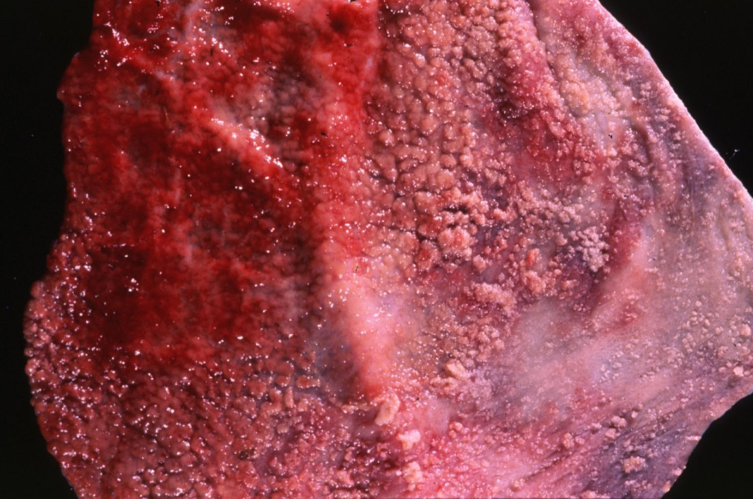
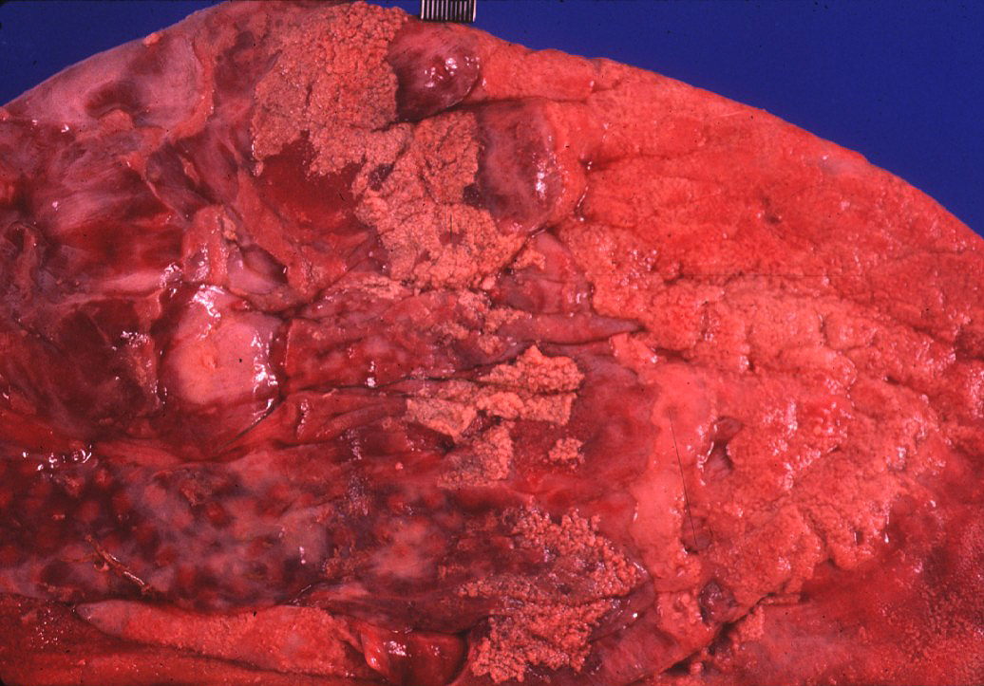
Fibrinous Placentitis

Slide 14
Side by side comparison
Normal
Inflamed

Slide 15
Campylobacter
Campylobacter fetus var. venerealis
  Bovine
  Venereally transmitted from prepuce/penis
  ED or early fetal death => irregular estrus
  Increased resistance
Campylobacter fetus subsp. fetus and jejuni
  Ovine => develop metritis => death
  Late term abortions => abortion storms
  Hepatic necrosis, fetus

Slide 16
Brucella => ZOONOTIC!!!
Brucella abortus
  Bovine => ingestion => systemic
  May infect trophoblast cells
Brucella canis
  Ingestion or venereal => head/neck lymphadenitis
  Fetus: endocarditis, pneumonia, hepatitis
Brucella ovis / melitensis (goats)
  Venereal
  Shed in milk
Brucella suis
  Lesions in bone/joints
  Does not require pregnancy => endometritis

Slide 17
Coxiella burnetti => ZOONOTIC!!!
  Q-fever in humans
  Ovines and Caprines, goats MC
  Ingestion or inhalation
  Shed in vaginal discharge or milk, Giemsa stain
  Intercotyledonary chorioallantois
    Thick yellow, covered with exudate
Chlamydophila abortus (ovine)
  Late term abortion, fetal autolysis
  Oral transmission
  Immune to re-infection
  Intercotyledonary chorioallantois

Slide 18
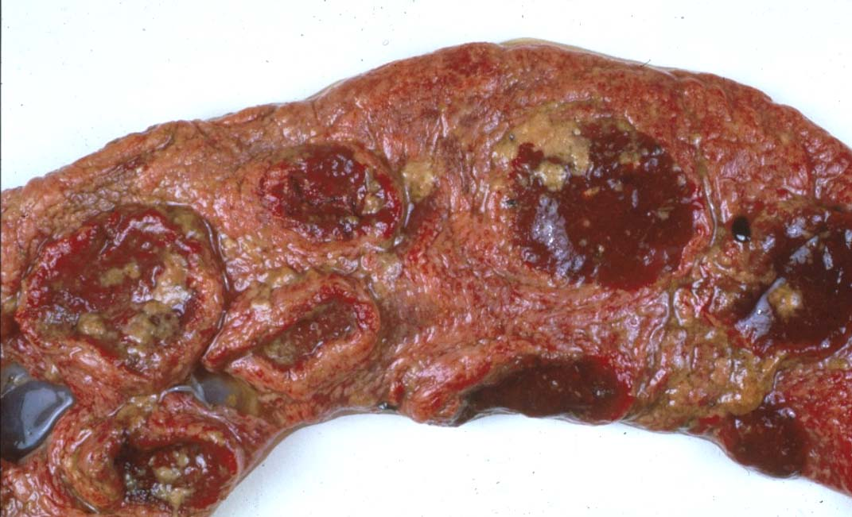
Intercotyledonary Chorioallantois

Slide 19
Leptospira => ZOONOTIC!!!
  Largely bovine and porcine
    L. interrogans serovar hardjo and serovar pomona
  Often no c/s => localize in the kidneys
  Abortion weeks after septicemic phase, in last trimester
  Placental edema with fetal ascites and peritonitis
  Advanced fetal autolysis
Flexispira rappini
  Similar to Campylobacter, liver necrosis, Giemsa +
Foothill abortion
  In CA and adjacent states
  Cows new to the territory
  Lesion
    Petechiation of conjunctiva and tongue

Slide 20
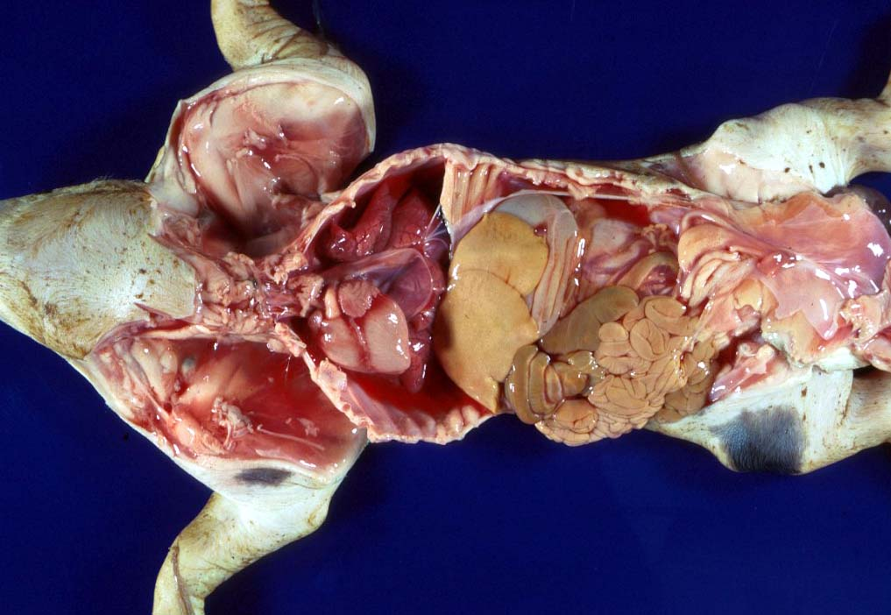
Leptospirosis

Slide 21
Listeria monocytogenes => ZOONOTIC
Bovine, ovine, and caprine
Last trimester
Lesions
  Suppurative hepatitis
  Fibrin in body cavities
  Suppurative placentitis
Lesion in the fetus/calf?

Slide 22
Viral Causes
Multiple etiologies
  “Herpesvirus hates babies!”
Fetal mummification
Developmental anomalies
Akabane and Cache Valley (Bunyaviridae)
  Ovines and other ruminants
  Nervous malformation
  Arthrogryposis
Bluetongue (orbiviridae) => Summer/Early Fall
  MC in ovine
  Nervous malformation: encephalitis and retinitis
  Arthrogryposis
  Exposed prior to day 100, may clear the virus => neg PCR

Slide 23
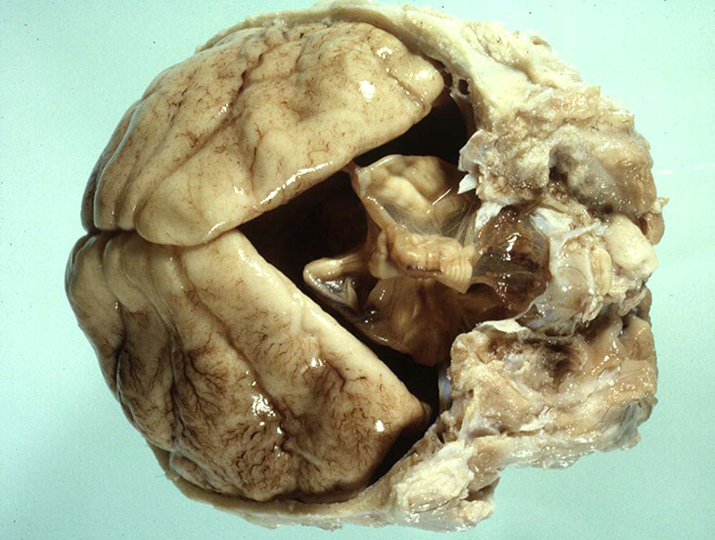

Slide 24
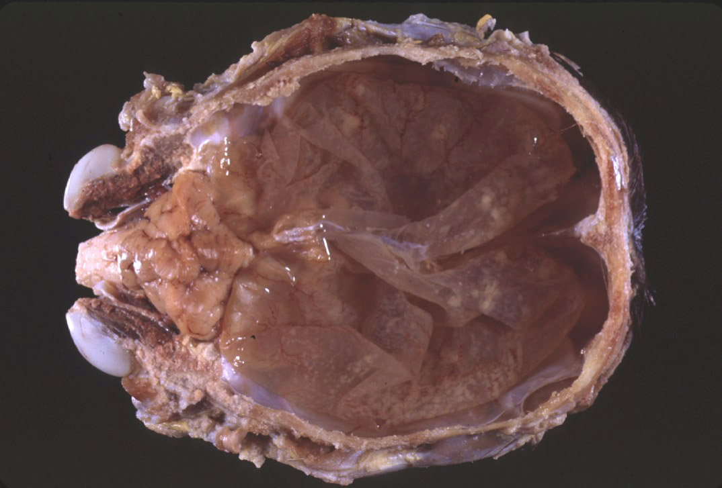
Equine

Slide 25
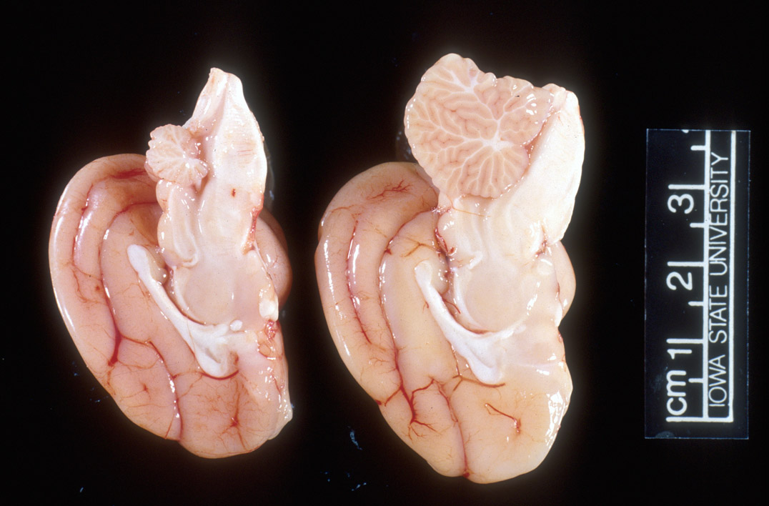
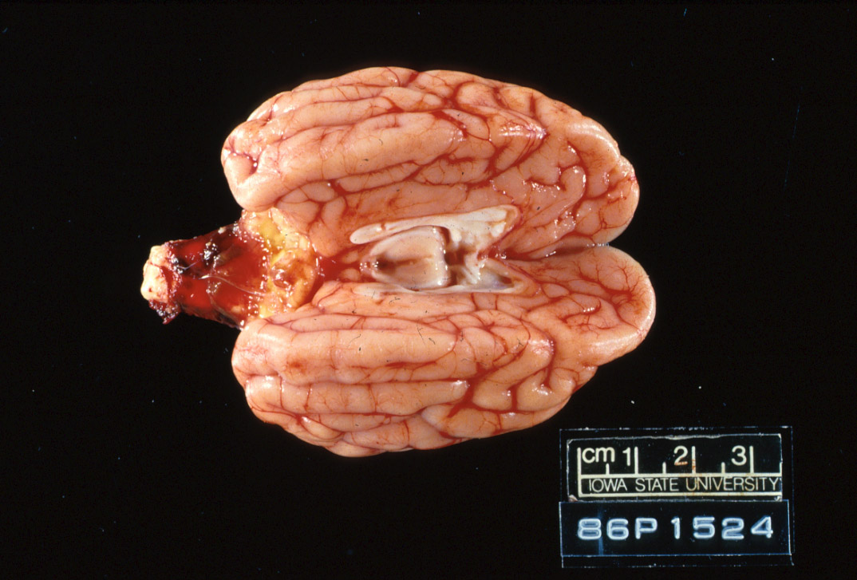
Feline

Slide 26
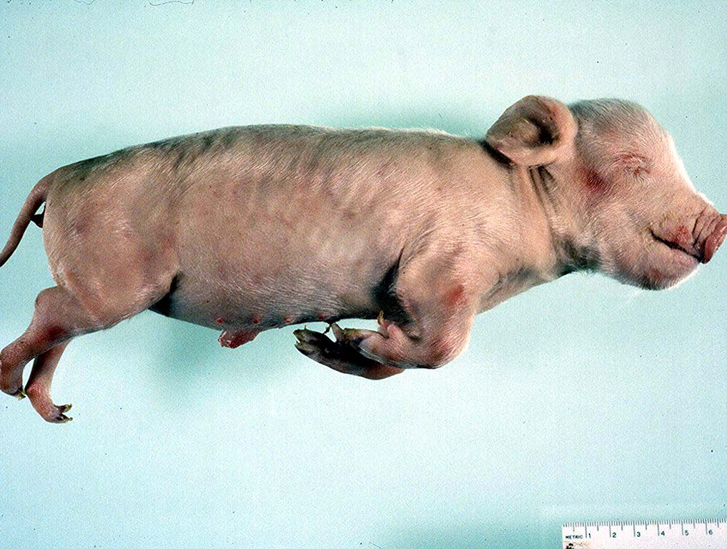
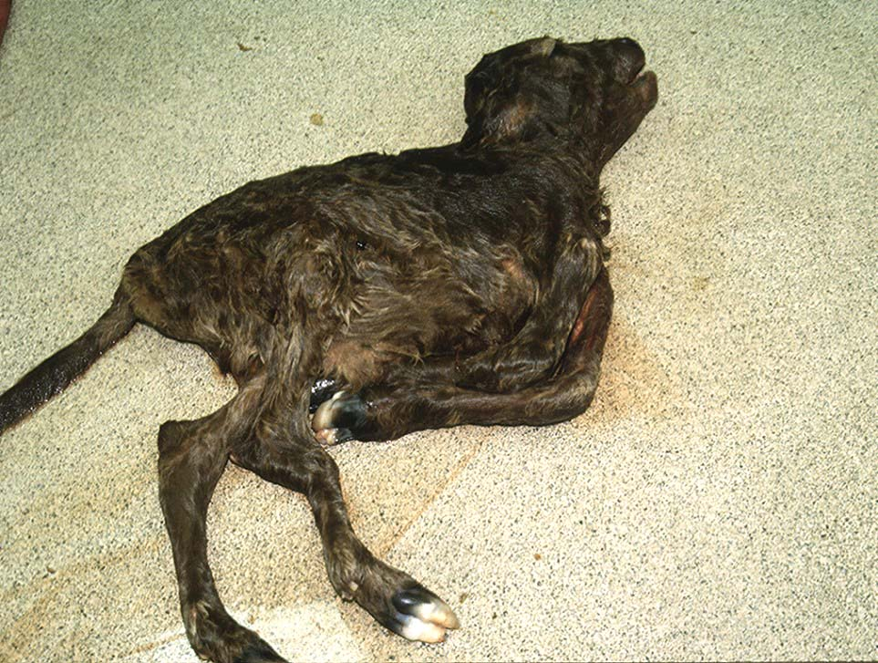
Arthrogryposis

Slide 27
Herpesvirus
  Lymphoid necrosis spleen/thymus
  Hepatic necrosis, multifocal
  Pulmonary necrosis, multifocal (equine)
    Fibrin plaques in lung & trachea => characteristic
Pestivirus
  BVD (bov); Border Dz (ovi); Hog Cholera (por)
  Fetal death or malformation
  Persistently infected BVD calves, day 120
  Persistently infected kids, b/f day 60-80
  “Hairy Shakers” => sheep, thick haircoat, pigmented
  Targets oligodendrocytes => hypomyelinogenesis

Slide 28
SMEDI (78% in pigs)
Porcine parvovirus (environmental)
  Embryonic and early fetal loss
  Mummification
PRRS (Arteriveridae), 60% of porcine abortions
  Hemorrhage in umbilical cords
  Affects 50% of fetuses in litter
    Interstitial pneumonia in live littermates
Porcine Circovirus => myocardium and lymphoid
CSF/Pseudorabies => Feral pig reservoir
Sow Infertility Syndrome (Virus X)

Slide 29
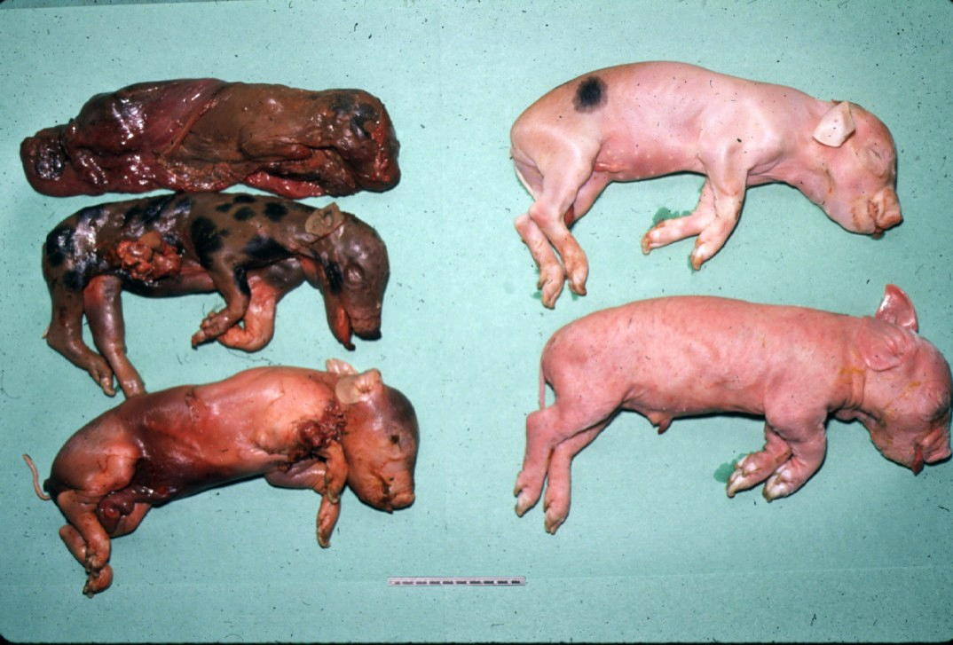
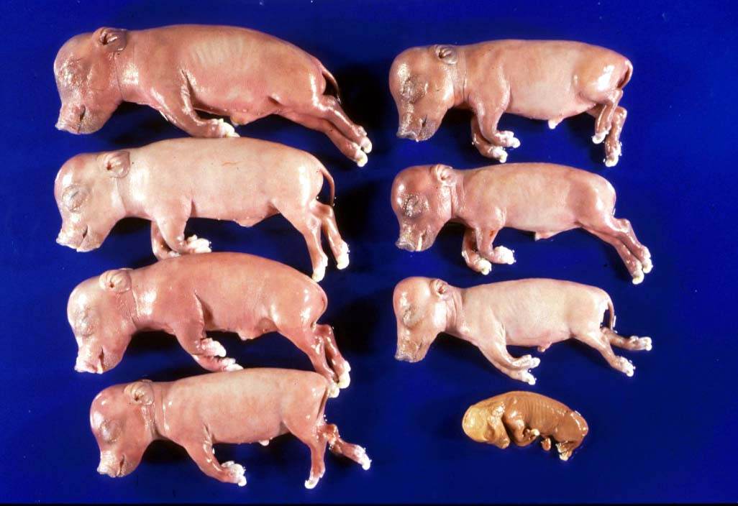

Slide 30
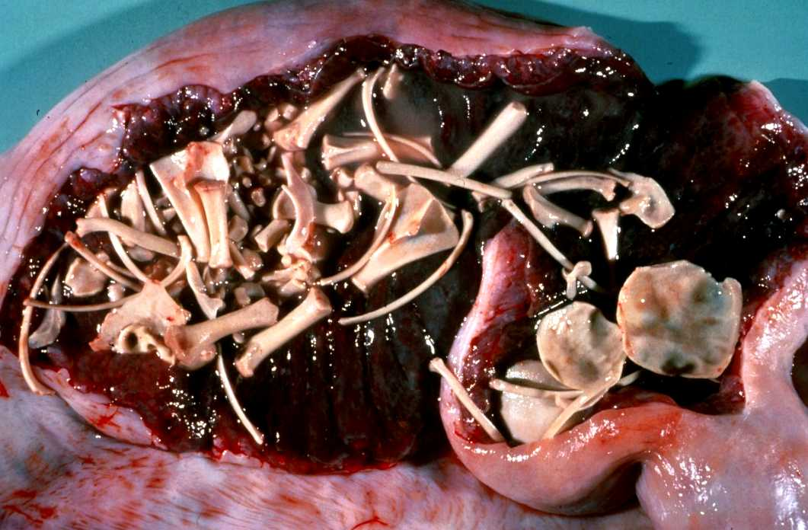
Porcine Maceration

Slide 31
Protozoal Etiologies
Toxoplasma gondii (ovine)
  Ingestion
  Necrotic, “rice grain” on cotyledons
  Leukoencephalomalacia, fetus
  Placentitis
Neospora caninum (bovine)
  Abort in 2nd trimester, few lesions
  Necrosis in the brain and heart with cysts
  Vertical transmission
  Variable pathogenicity
Tritrichomonas foetus (bovine)
  Mild placentitis, may have severe endometritis => pyometra
  No fetal lesions
  Protozoa within abomasal fluids, smegma, or vaginal swab
  Giemsa highlights organism in placenta, lung, and abomasum

Slide 32
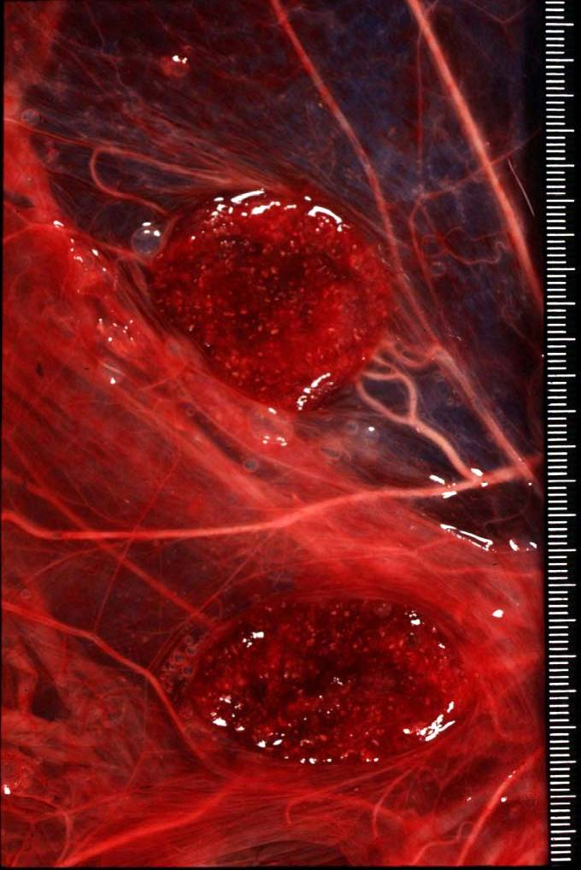
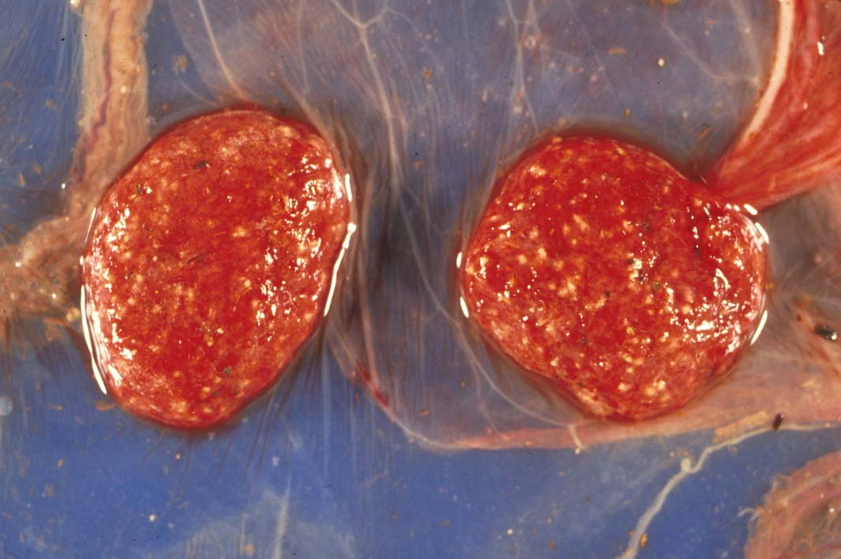
Toxoplasmosis gondii

Slide 33
Chlamydophila vs. Toxoplasma
Intercotyledonary
Cotyledonary

Slide 34
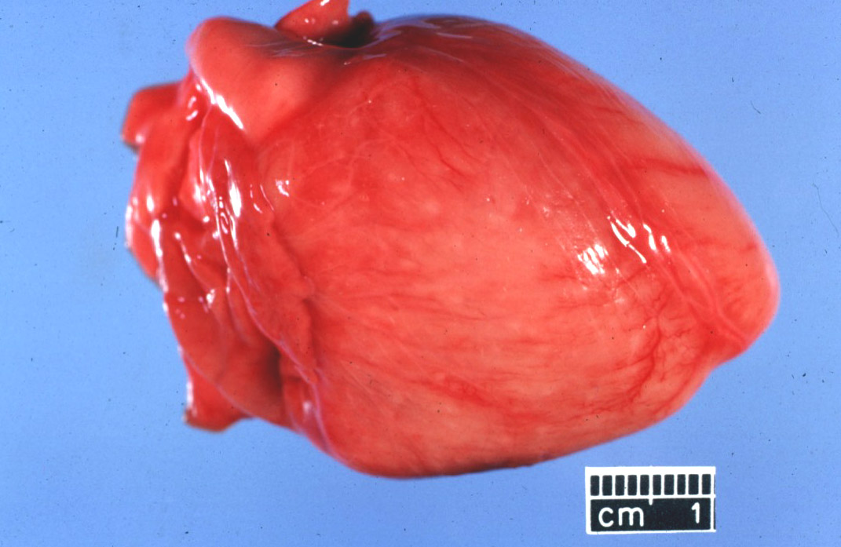
Neospora

Slide 35
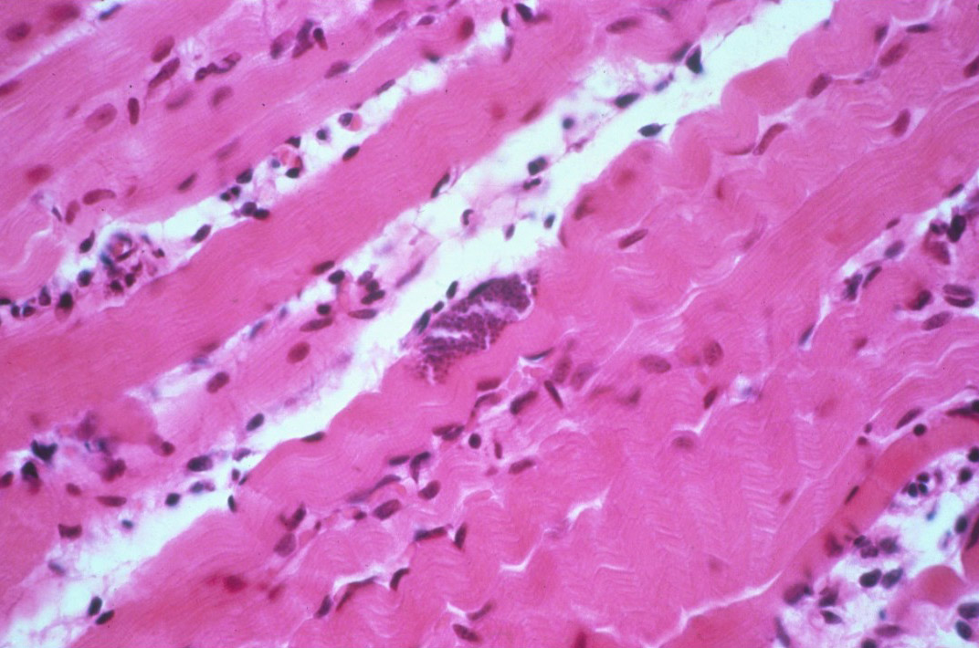
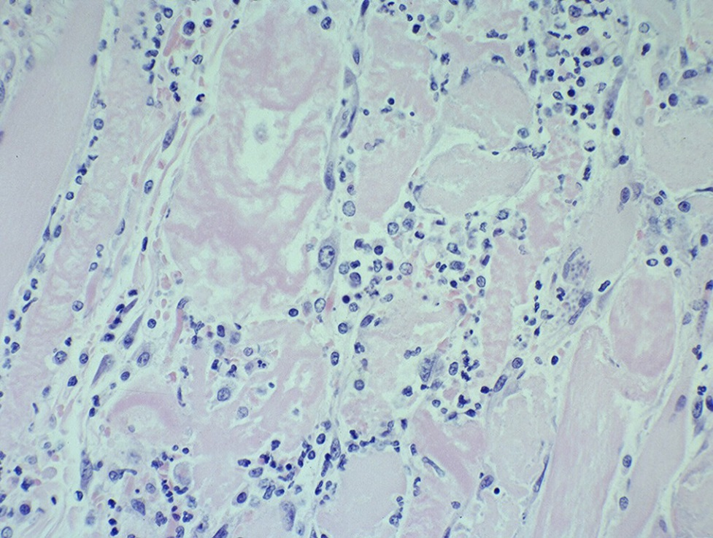
Neospora

Slide 36
Fungal abortions
MC assoc’d with plaques on the skin
MC cause of abortion Aspergillus sp.
  Others: Mucor, Rhizopus, Absidia, Candida
MC in bovine & equine
  Bovine => hematogenous
  Equine => cervix
RARE in porcine, approximately 0.3% fungal
Fibrinous placentitis => identical to bacterial

Slide 37
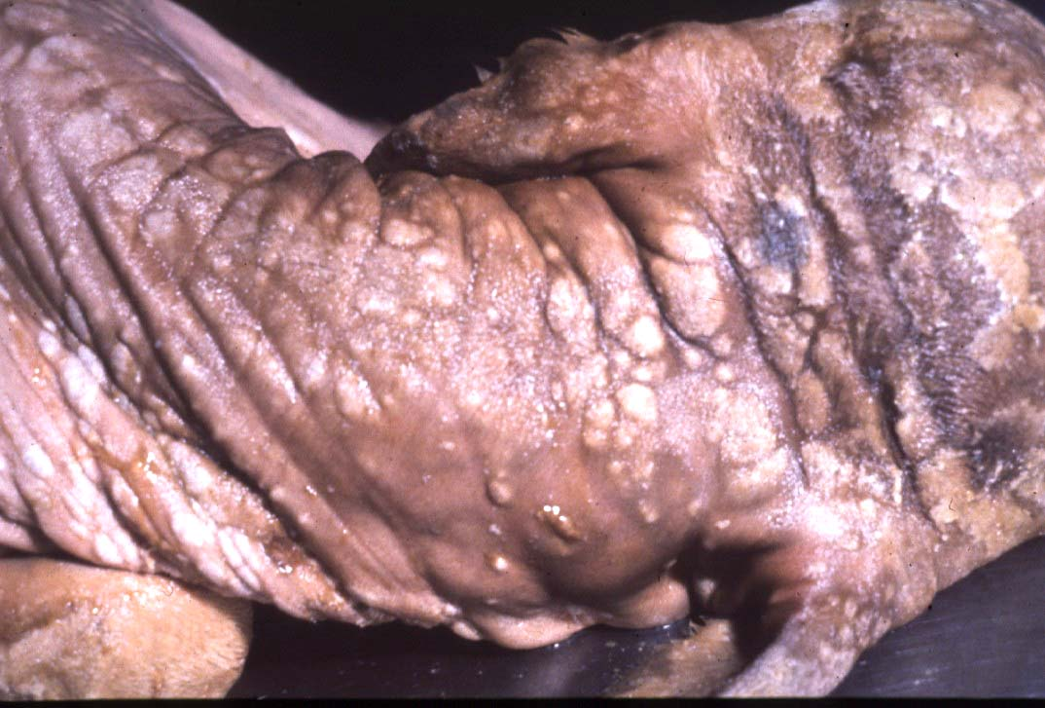

Slide 38
Canine & Feline
Virus
  Herpesvirus
  Canine Parvovirus type 1 / Panleukopenia
    Necrotizing enteritis w/ eos i/b, no crypt necrosis
  Adenovirus type 1
Bacteria
  Brucella, E. coli, Staphylococcus aureus, Beta hemolytic Streptococcus spp.
Other
  Feline: Antifungal drugs =>teratogenic effects
  NSAIDS, glucocorticoids, tetracyclines, chloramphenicol

Slide 39
Other causes
Nitrate Toxicosis
  Consumption of plants high in nitrates or contaminated water (nitrogen fertilizers)
  Chocolate brown blood, no lesions
  Test levels of nitrate in aqueous humor
CO in porcine (b/t 120 and 260 pppm)
  Dx with 5-10 mL of thoracic fluid
  Carboxyhemoglobin levels >2% are diagnostic
Variable Toxicity Teratogens
  Pine needles, broomweed, swainsonine, Sweet pea,
  Arthrogryposis
    Lupine, Tobacco, Poison Hemlock, Locoweed
  Clover => Estrogen => Infertility

Slide 40
Fetal anomalies
Synophthalmia (cyclopia) in ovines
  Veratrum californicum, day 13-15
Schistosomas reflexus
Amorphous globosus
Spider Lamb Dz = > Suffolk
Torsion of the umbilical cord
  Equines
  XS twisting compromises umbilical vessels

Slide 41
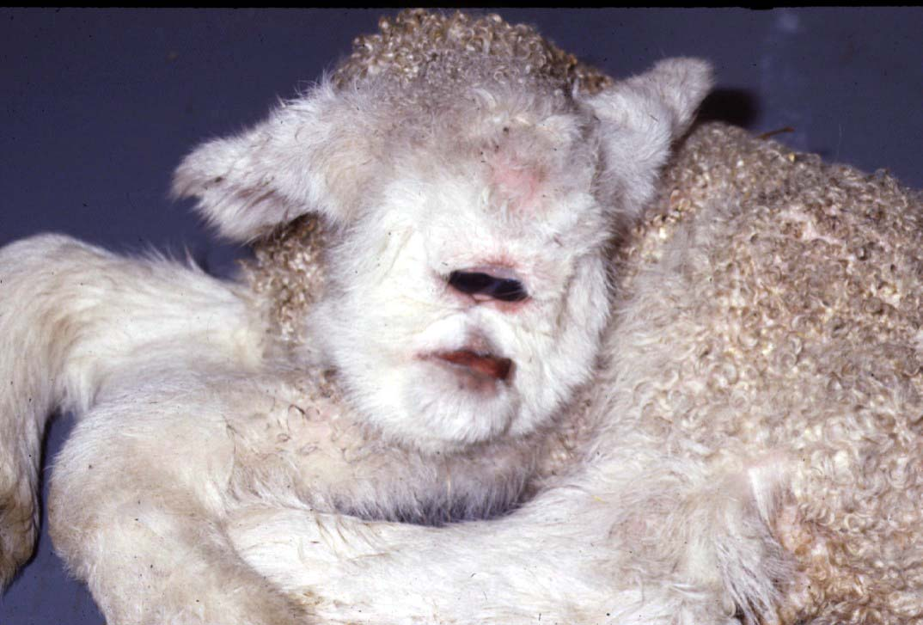
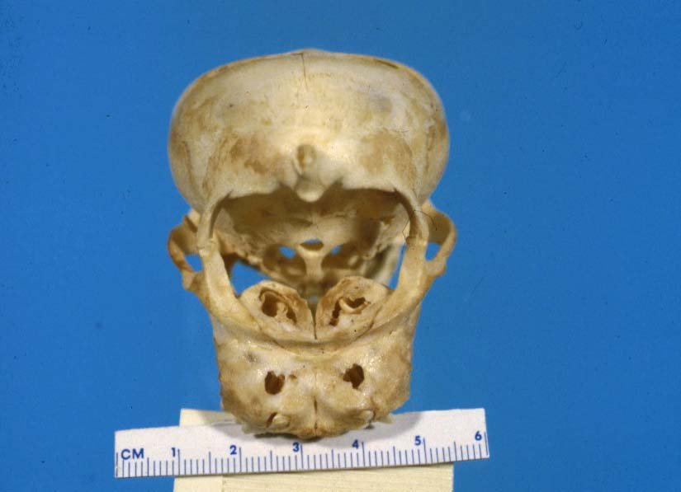

Slide 42
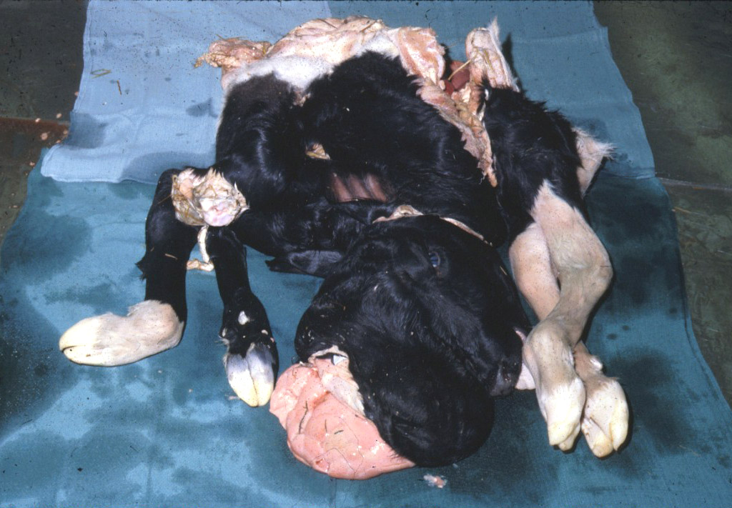

Slide 43
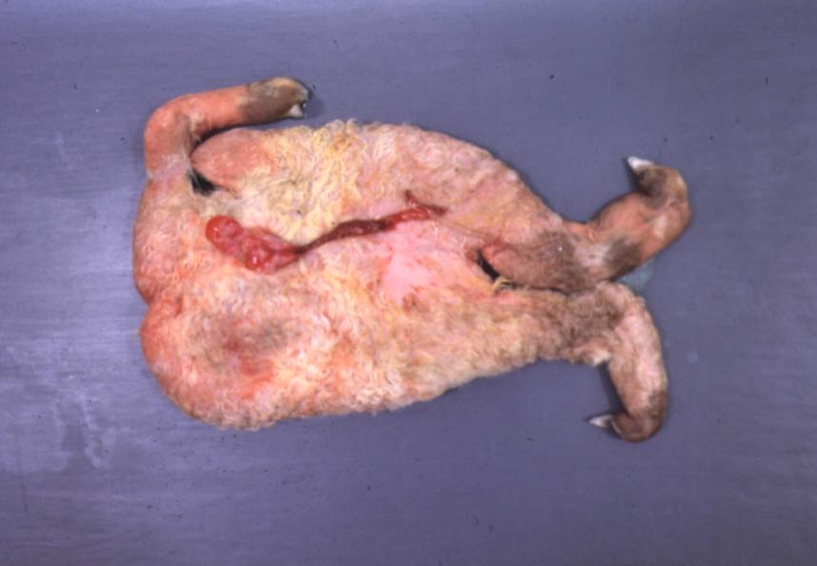
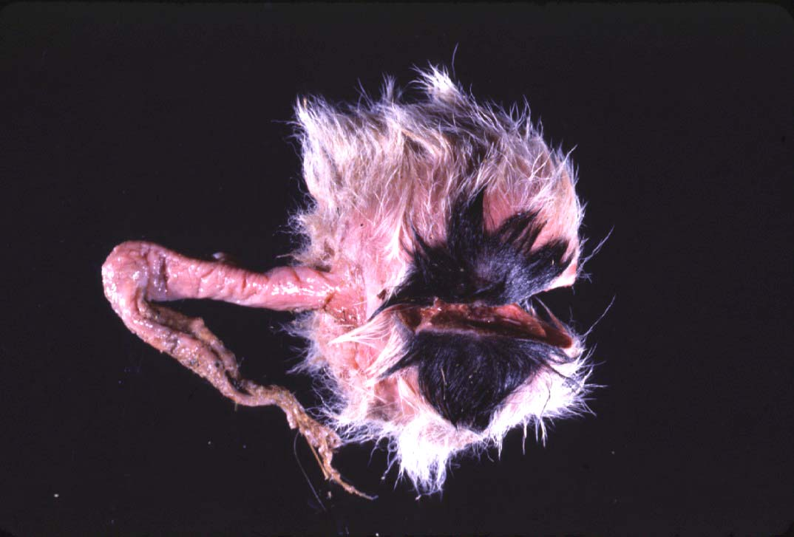

Slide 44
Fetal Necropsy Protocol
Determination of Fetal Age
  CR length AND body weight
  Developmental features
Timing of Fetal Death
  Lungs, eponychium, colostrum in the stomach/abomasum, umbilical hematoma
Tissue collection
  Bacterial
    Lungs, Abomasal/stomach fluid, brain, placenta, liver
  Viral
    Lymphoid tissues, placenta

Slide 45
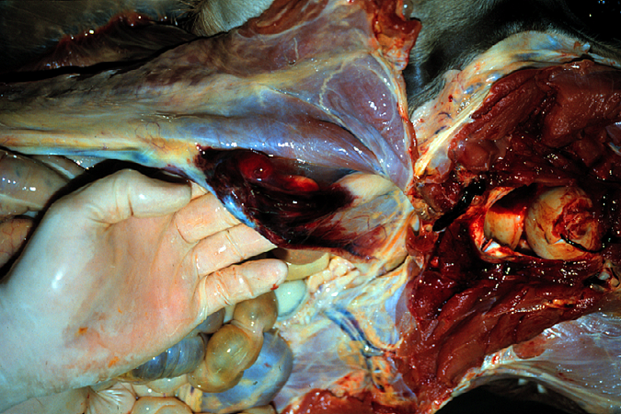
Umbilical Hematoma

Slide 46
Fetal Nx (cont’d)
  Serology
    Fetal fluids
    Interpretation: What is normal?
  Toxicology
    Ocular fluid/eyes in bovines => Nitrates
  Cytology
    Impression smears
  Histopathology
    GI tract can be largely ignored

Slide 47
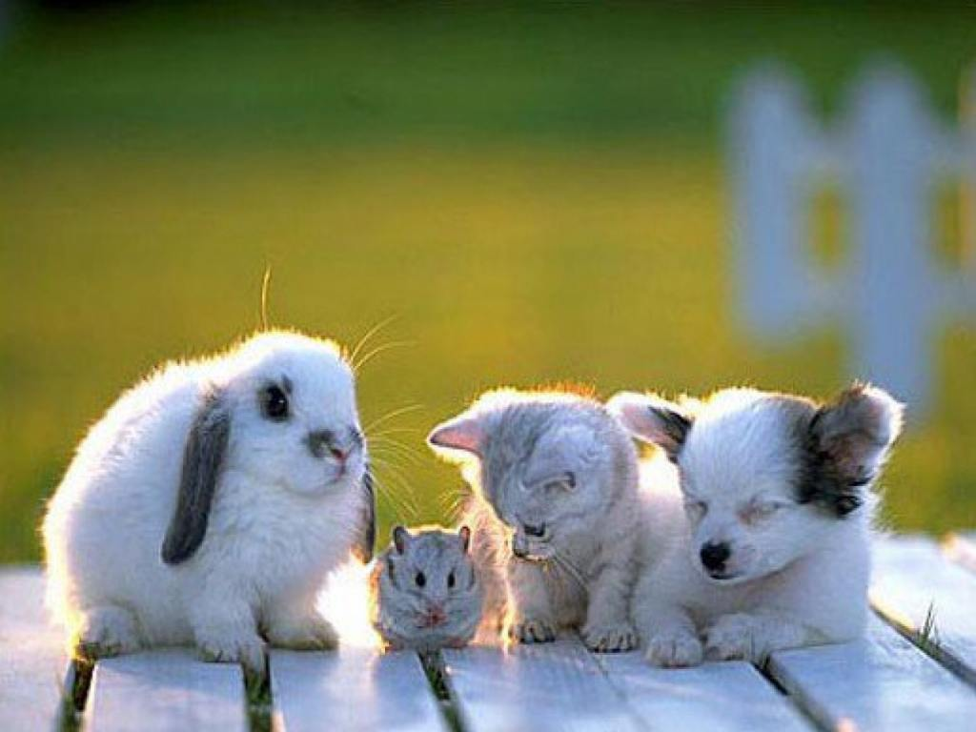
Questions?
Notes:
http://forums.au.reachout.com/t5/image/serverpage/image-id/941i6385EB477719EC2A?v=mpbl-1

