Slide 1
Next-Generation Sequencing in Personalized Medicine
Erick Lin, MD, PhD
Senior Manager, Medical Affairs
In vitro Diagnostics (IVD), Illumina, Inc.

Slide 2
Disclosures
I am an employee of Illumina, Inc. and declare stock ownership in the company.
Some of the genomic testing applications mentioned herein are not available as commercial products and/or do not have marketing authorization in all countries.

Slide 3
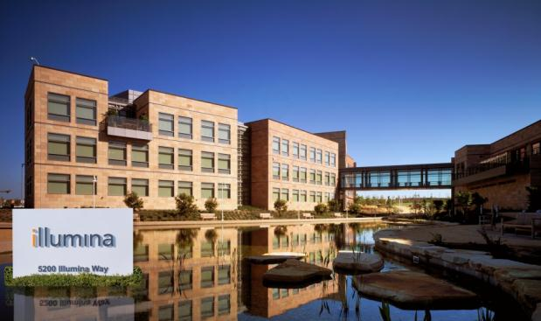
Our Background
Leading Innovation Regionally and Around the Globe
Founded Fall 1998
  IPO July 27, 2000
Headquartered in San Diego, CA
  1.2M square ft. in 7 countries
  >3,200 employees
  13 offices around the world
  65% of employee base in California
AWARDS
  MIT Technology Review
    50 Disruptive Companies
    2010, 2013
    Smartest Company
    2014

Slide 4

Dawn of the Genomic Medicine Era
First FDA Clearance of a Next-Gen Sequencing Platform (Nov, 2013)
The FDA's review of the MiSeqDx… provides clinical laboratories with information about the expected performance of the device and the quality
of the results. This information was not previously available for next generation sequencers. With this platform, labs can develop tests for clinical use with greater confidence.
Alberto Gutierrez, FDA (OIVD)
The marketing authorization for the first next-gen genome sequencer represents a significant step forward in the ability to generate genomic information that will ultimately improve patient care... this marketing authorization of a non-disease-specific platform will allow any lab to test any sequence for any purpose.
Francis Collins, NIH Director & Margaret Hamburg, FDA Commissioner
Gutierrez, A. FDA clears next-generation sequencer for routine medical care. NHGRI. Nov 20, 2013.
Hamburg, M. & Collins, F. S. First FDA Authorization for Next-Generation Sequencer. N. Engl. J. Med. 1–3 (2013).

Slide 5
Genomic Era of Medicine
NGS continues to drive down the cost of sequencing
Moore’s Law
$1M genome
2012 - 2013
HiSeq 2500
Ion Torrent Proton
NextSeq
Cost per Raw Megabase
of DNA Sequence (US$)
2008
First tumor:normal
genome sequenced
$10K genome
2014
HiSeq X Ten
2001
IHGSC reports the
sequence of the first
human genome
2007
Entry of NGS
into the market
2005
Start of NGS
$1,000 genome
Capillary electrophoresis Sanger sequencing
Massively parallel sequencing
Newer NGS systems
2005
454 pyrosequencing
GS-20
2006
Solexa/Illumina
sequencer
2007
ABI/SOLiD
sequencer
2008
Helicos
BioSciences
2009
Illumina GAIIX,
SOLiD 3.0
2010
Illumina HiSeq 2000
Oxford Nanopore
2011
Ion Torrent PGM
PacBio RS
Illumina MiSeq
Adapted from: MacConaill LE. Existing and emerging technologies for tumor genomic profiling. Journal of Clinical Oncology, 31(15), 1815-1824 (2013).

Slide 6
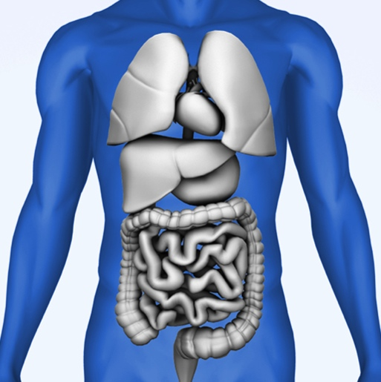
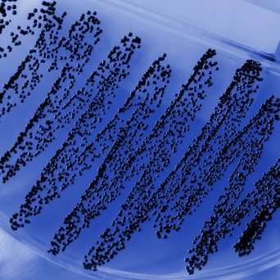

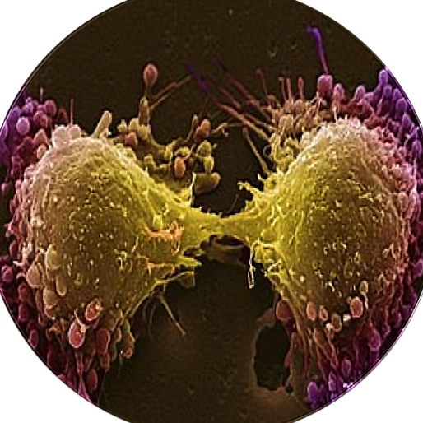

Applications of Genomic Testing in Medicine
Transplant Medicine
Microbiology
Inherited Disease
Cancer
Reproductive Health

Slide 7
Applications of Genomic Testing in Medicine
Cancer

Slide 8
A New Taxonomy of Cancer
From organs to molecules
  Genomics and the Future of Cancer Treatment
According to the President of the Dana Farber Cancer
Institute, we may soon look at the concept of “organ-based”
cancer types as ancient history.
For more than a century, cancers have been classified by the organ or tissue
– with therapies geared to those specific areas
As more is learned about the basic biological processes in cancers, a new perspective has emerged
The shift from an organ-focused to a gene-focused approach to cancer is already having a profound effect on the way cancer is treated
Interview with Edward J. Benz, Jr., MD
www.standup2cancer.org/innovations_in_science/view/genomics_and_the_future_of_cancer_treatment

Slide 9
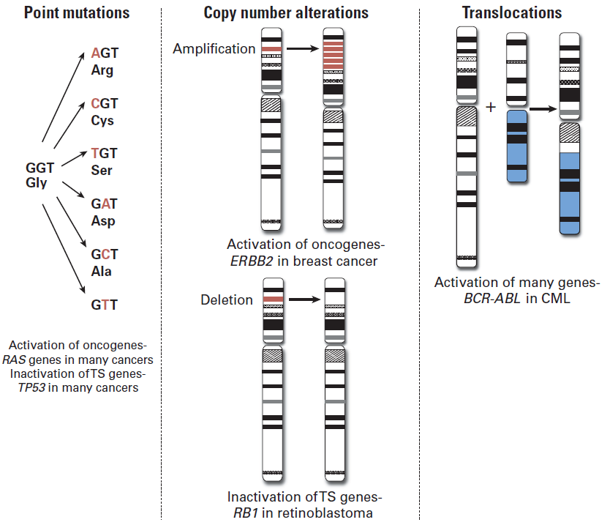
Genomic Alterations in Cancer
Major classes
TS, tumor suppressor
CML, chronic myelogenous leukemia
Macconaill LE, Garraway LA. Clinical implications of the cancer genome. Journal of Clinical Oncology, 28(35), 5219-5228 (2010).
Notes:
Translocations create “fusion genes”

Slide 10
Genomic Alterations in Cancer
Major classes
TS, tumor suppressor
CML, chronic myelogenous leukemia
Macconaill LE, Garraway LA. Clinical implications of the cancer genome. Journal of Clinical Oncology, 28(35), 5219-5228 (2010).
Notes:
Translocations create “fusion genes”

Slide 11
Genomic Alterations in Cancer
Major classes
TS, tumor suppressor
CML, chronic myelogenous leukemia
Macconaill LE, Garraway LA. Clinical implications of the cancer genome. Journal of Clinical Oncology, 28(35), 5219-5228 (2010).
Notes:
Translocations create “fusion genes”

Slide 12
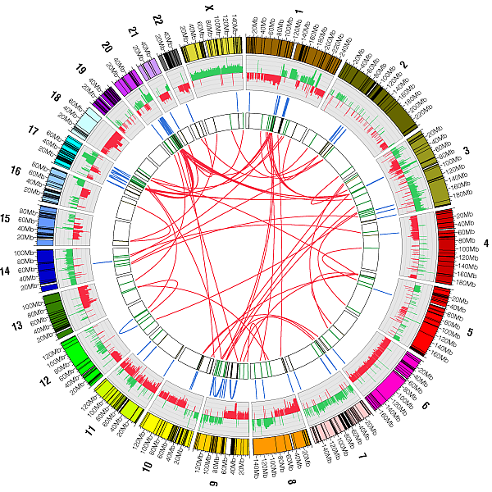
Breast Cancer
Genomic analysis
Hampton OA, Den Hollander P, Miller CA et al. A sequence-level map of chromosomal breakpoints in the MCF-7 breast cancer cell line yields insights into the evolution of a cancer genome. Genome Research, 19(2), 167-177 (2009).
Notes:
MCF-7 Breast Cancer Genome Analysis
Circular visualization of the MCF-7 genome obtained using Circos software courtesy of Dr. Martin Krzywinski. Chromosomes are individually colored with centromeres in white and Low Copy Repeat (LCR) regions in black. MCF-7 BAC array Comparative Genome Hybridization data (Jonsson et al. 2007) is plotted with gains is green and losses in red using log(2)ratio. The inner chromosome annotations depict 157 somatic MCF-7 breast tumor chromosomal rearrangements associated with LCRs (black) and breakpoints not associated with LCRs (green). Chromosomal rearrangements are depicted on each side of the MCF-7 breakpoints; intra-chromosomal rearrangements (blue) are located outside and inter-chromosomal rearrangements (red) are located in the center of the circle.

Slide 13
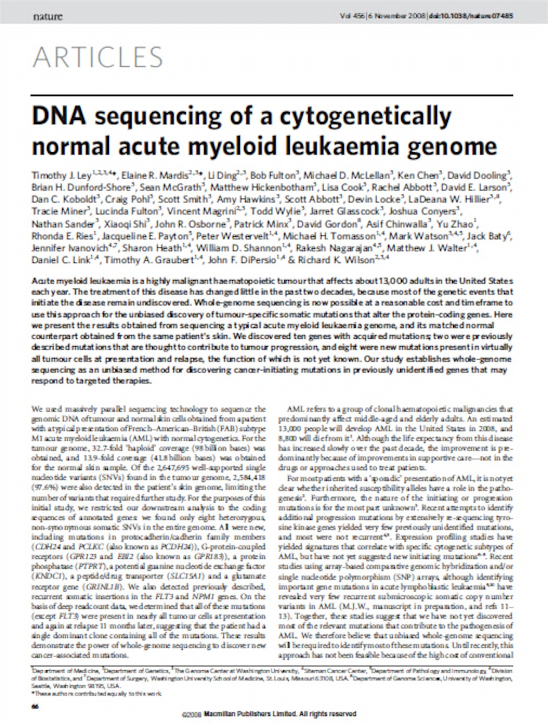
WGS
A new era in cancer genomics
Sequenced leukemia genome vs. matched normal (skin) genome
8 new mutations discovered in AML
  Most in coding genes
  Out of millions of total SNPs!
“Most of these genes would not have been candidates for directed sequencing on the basis of current understanding of cancer.”
All Normal
Variants
All Tumor
Variants
Unique
Somatic
Variants
Ley TJ, Mardis ER, Ding L et al. DNA sequencing of a cytogenetically normal acute myeloid leukaemia genome. Nature, 456(7218), 66-72 (2008)
Notes:
A Lot Can Happen in 6 Years…
In cancer analysis, we need to find mutations in tumor not present in normal (germline) sample
This is a challenge because:
There are many more normal variants compared to somatic variants
Tumors often have normal sample “impurity” mixed-in
Tumors have copy number changes in many genes
Tumors can have multiple sub-clones of cancer cells

Slide 14
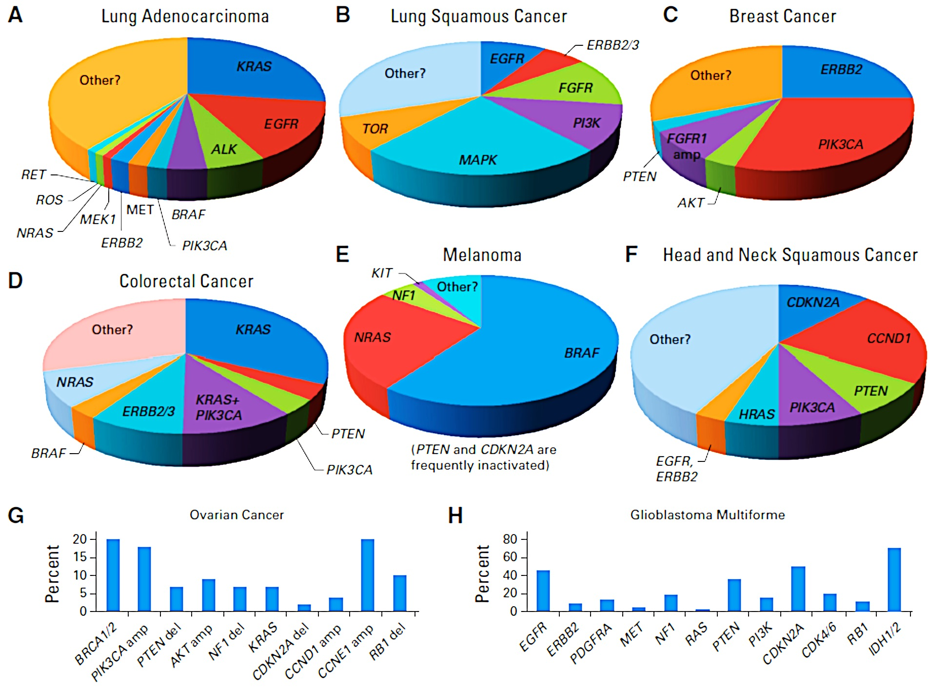
A New Taxonomy of Cancer
From organs to molecules
Garraway LA. Genomics-driven oncology: framework for an emerging paradigm. Journal of Clinical Oncology, 31(15), 1806-1814 (2013).

Slide 15
Cancer Genomes Are Dynamic
Cancer genomes are not static.
In cancer, one snapshot is not enough.
WGS is a snapshot
Certain mutations reflect paternal and/or maternal germline variation
Additional somatic mutations accumulate through life
“Driver” mutations cause cancer, “passenger” mutations are carried along
Additional drivers evolve and diversify the cancer
Some alter aggressiveness…
…which may be treatable
Others may alter treatment response, leading to relapse
Relapse
Germline
Somatic
Cancer
(Primary)
Cancer
(Metastasis)
Treatment
Notes:
Review the main themes that underlie the huge potential of cancer genome sequencing:
Cancer is a disease of the genome. Every cancer is different, containing a unique combination of germline and somatic mutations that together give rise to the specific properties of the individual cancer. Our particular focus is therefore on whole genome sequencing, which has opened the possibility for the first time to determine comprehensive, ultimately near-complete catalogues of genomic variation, whether germline or somatic; and to use sequencing both for discovery and routine screening. In the last few years, attention of substitutions has expanded to include comprehensive studies on all other types of variant as well as they are all important as candidates for biological effects and disease mutation. Near-complete ascertainment of all changes in a cancer creates a new and unrivalled opportunity for understanding the mechanism of cancer onset, progression, sensitivity to chemotherapy as well as providing new biomarkers for diagnosis and prognosis. In the near future we anticipate a revolution in healthcare and personalised cancer treatment with accurate, high throughput, low cost sequencing at the heart of clinical practice.

Slide 16

Evolution of Cancer Genomes
Primary vs. metastatic tumors
  24% of patients with HER2-positive primary breast tumors had HER2-negative metastatic tumors
Niikura N, Liu J, Hayashi N et al. Loss of human epidermal growth factor receptor 2 (HER2) expression in metastatic sites of HER2-overexpressing primary breast tumors. Journal of clinical oncology : official journal of the American Society of Clinical Oncology, 30(6), 593-599 (2012).

Slide 17
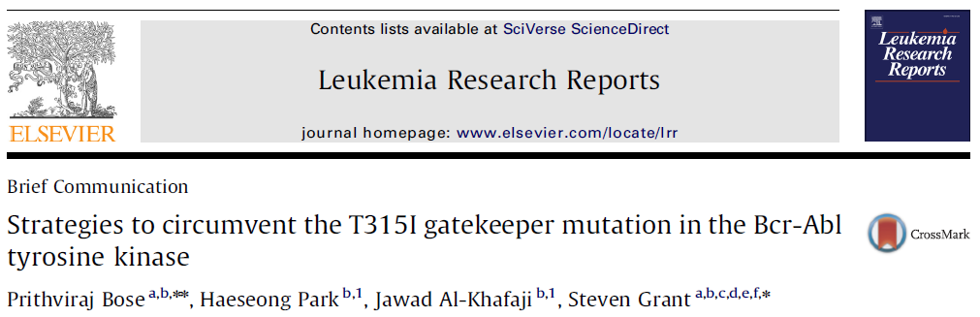

Evolution of Cancer Genomes
Tumors change in response to treatment
Example #1
Chronic Myelogenous Leukemia (CML)
T315I “gatekeeper mutation” leads to acquired BCR-ABL tyrosine kinase inhibitor resistance
Example #2
Non-Small Cell Lung Cancer (NSCLC)
T790M mutation leads to acquired EGFR tyrosine kinase inhibitor resistance
1. Bose P, Park H, Al-Khafaji J, Grant S. Strategies to circumvent the T315I gatekeeper mutation in the Bcr-Abl tyrosine kinase. Leukemia research reports, 2(1), 18-20 (2013).
2. Nurwidya F, Takahashi F, Murakami A et al. Acquired resistance of non-small cell lung cancer to epidermal growth factor receptor tyrosine kinase inhibitors. Respiratory investigation, 52(2), 82-91 (2014).

Slide 18
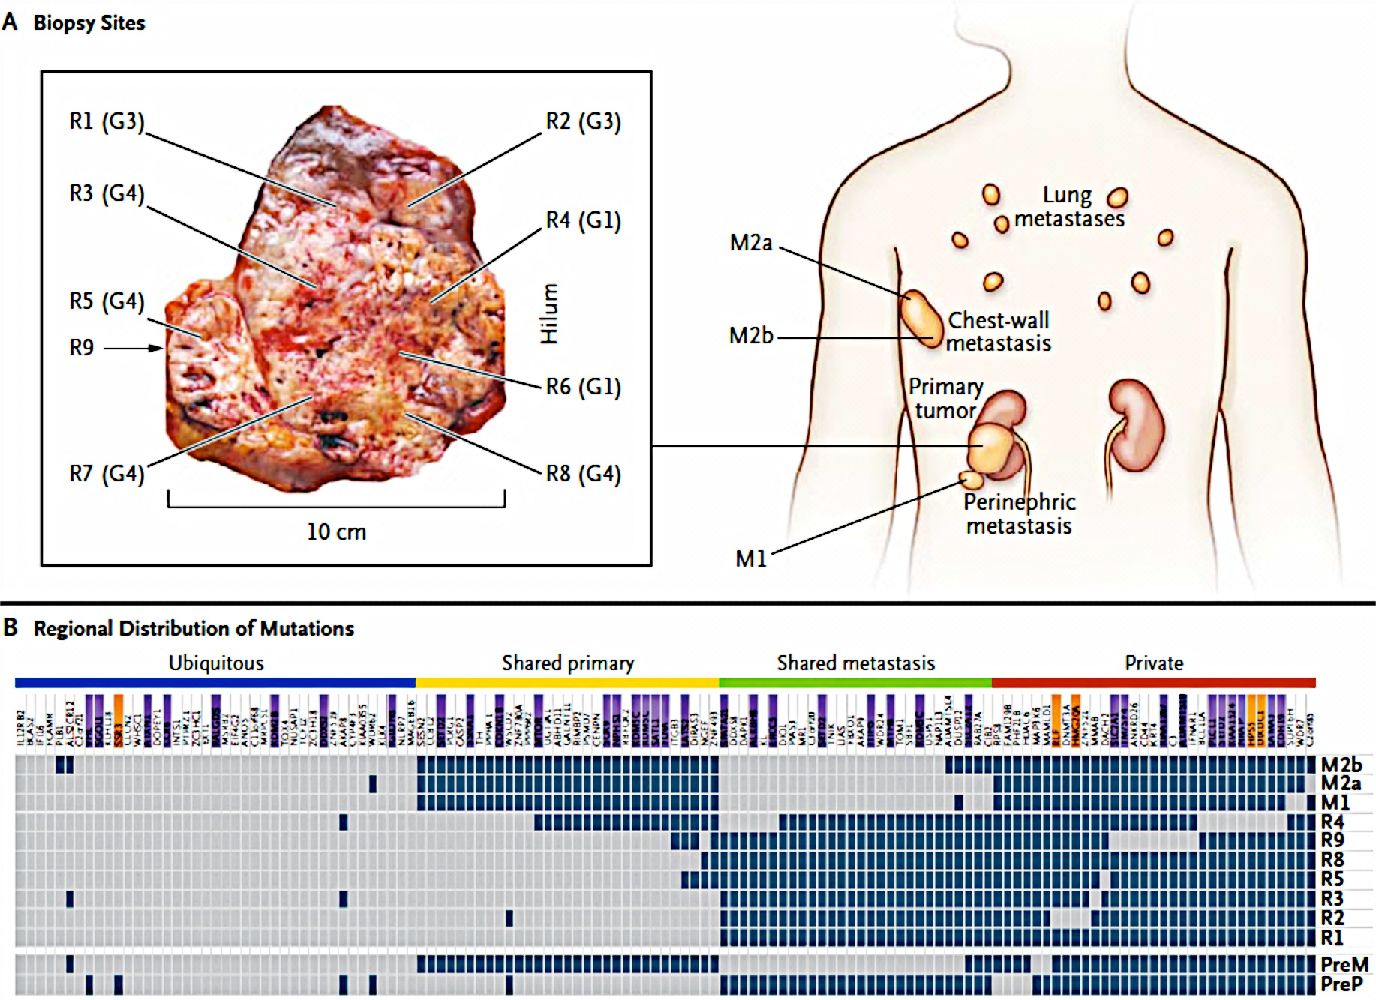
Intratumoral & Intermetastatic Clonal Heterogeneity
Heterogeneity within single patient
Gerlinger M, Rowan AJ, Horswell S et al. Intratumor heterogeneity and branched evolution revealed by multiregion sequencing. The New England Journal of Medicine, 366(10), 883-892 (2012).
Notes:
Intratumor Heterogeneity Revealed by multiregion Sequencing
n engl j med 366;10
march 8, 2012
Background
Intratumor heterogeneity may foster tumor evolution and adaptation and hinder
personalized-medicine strategies that depend on results from single tumor-biopsy
samples.
Methods
To examine intratumor heterogeneity, we performed exome sequencing, chromosome
aberration analysis, and ploidy profiling on multiple spatially separated samples obtained
from primary renal carcinomas and associated metastatic sites. We characterized
the consequences of intratumor heterogeneity using immunohistochemical analysis,
mutation functional analysis, and profiling of messenger RNA expression.
Results
Phylogenetic reconstruction revealed branched evolutionary tumor growth, with 63 to
69% of all somatic mutations not detectable across every tumor region.
Allelic composition and
ploidy profiling analysis revealed extensive intratumor heterogeneity, with 26 of 30 tumor
samples from four tumors harboring divergent allelic-imbalance profiles and with
ploidy heterogeneity in two of four tumors.
Conclusions
Intratumor heterogeneity can lead to underestimation of the tumor genomics landscape
portrayed from single tumor-biopsy samples and may present major challenges to
personalized-medicine and biomarker development. Intratumor heterogeneity, associated
with heterogeneous protein function, may foster tumor adaptation and therapeutic
failure through Darwinian selection.
Biopsy samples were obtained before
the initiation of 6 weeks of treatment with everolimus.
After a 1-week washout period in which
patients did not receive everolimus, a nephrectomy
was performed. Everolimus treatment was continued
after recovery from surgery until tumor progression.
**************
Take home messages
•Tumours are composed of multiple, genetically diverse clones
–Additional mutations are accumulated over time
–At diagnosis, tumours are already mosaics!
•Which sample should be used for biomarker testing?
–Primary vs metastasis vs CTCs

Slide 19
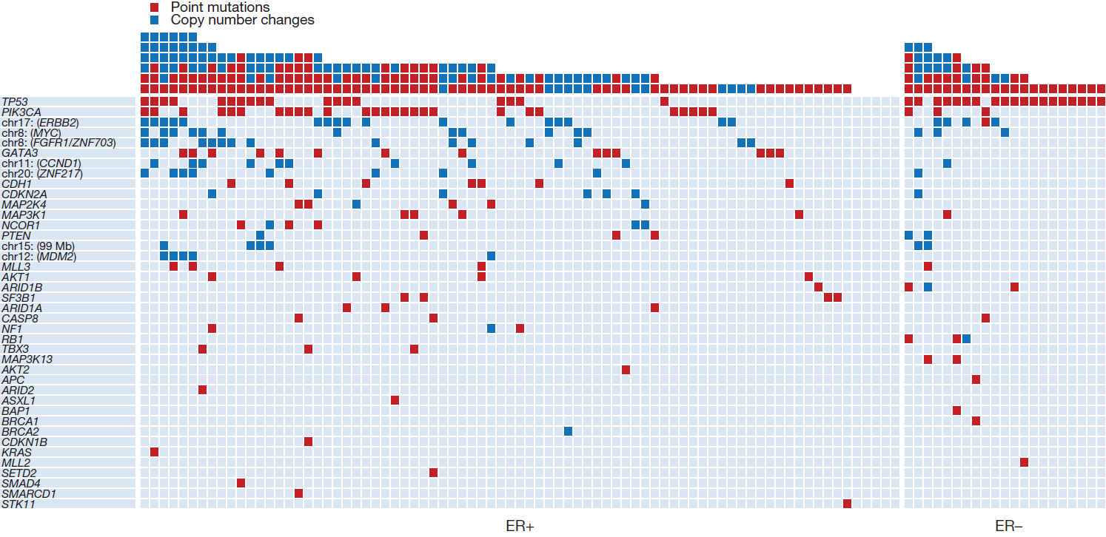
Interpatient Genetic Heterogeneity
Breast Cancer – 40 Cancer Genes Across 100 Tumors
Stephens et al, Nature 2012; Shah et al. Nature 2012; Ellis et al. Nature 2012; Banerji et al. Nature 2012
Notes:
Landscape of cancer genes and mutational processes in breast cancer
Nature 2012;486;7403;400-4
16 May 2012
IMAGE:
The landscape of driver mutations in breast cancer. Each of the 40 cancer genes in which a driver mutation or copy number change has been identified is listed down the left-hand side. The number of mutations in each gene in the 100 tumours is shown, as is the number of driver mutations in each breast cancer.
TEXT FROM SANGER INSTITUTE SUMMARY
In a study published today in Nature, researchers describe nine new genes that drive the development of breast cancer. This takes the tally of all genes associated with breast cancer development to 40.
The team examined all the genes in the genomes of 100 cases of breast cancer. The mutated cancer-causing genes were different in different cancer samples, indicating that breast cancer is genetically very diverse. Understanding the consequences of this diversity will be important in progressing towards more rational treatment.
Changes to DNA lie behind all cases of cancer. Cancer develops as a result of mutations - called somatic mutations - that are acquired during a person's lifetime. Driver mutations, which occur in cancer genes, are a small subset of somatic mutations that drive the development of cancer.
"Breast cancer is the most common cancer in women," explains Dr Patrick Tarpey, first author from the Wellcome Trust Sanger Institute. "To identify new cancer genes that lead to the development of breast cancer, we searched for driver mutations in over 21,000 genes, and found evidence for nine new cancer genes involved in the development of this cancer."
These genome analyses provide a direct survey of the landscape of driver mutations in breast cancer. The team found driver mutations were present in at least 40 different cancer genes. Most individual cancers had different combinations of mutated cancer genes, demonstrating the substantial genetic diversity in breast cancer.
"In 28 cases we found only a single driver, but the maximum number of driver mutations in an individual cancer was six," says Professor Mike Stratton, lead author and Director of the Wellcome Trust Sanger Institute. "We found that breast cancer can be caused by more than 70 different combinations of mutations.
"If we consider three breast cancers, each with four driver mutations: they might share none of those driver mutations - so each is a different genetic 'animal'. They are different cancers driven by different genes. We need to classify them as carefully as we can. This study is a step towards that goal."
"One of the most striking things about breast cancer is how it progresses differently in each patient and how each patient responds differently to therapy," explains Dr Andy Futreal, until recently, Head of Cancer Genomics at the Wellcome Trust Sanger Institute and currently an Honorary Faculty Member at the Institute. "Our results can help us to understand these differences."
Our genomes are scarred by decades of continual assault that leave mutations scattered though our DNA. This is the most comprehensive study thus far of mutations in breast cancers, discovering nine new mutated genes that cause breast cancer, and revealing the full diversity of the driving events that convert normal breast cells into breast cancers.
"The picture is certainly more complicated than we would have wanted, but as with many other things knowledge is our strongest weapon. These comprehensive insights reveal the faulty wiring of the cellular circuit board that causes cells to behave as cancers. Understanding our enemy at this level of detail will allow us to take more rational approaches to therapy, to understand why some cancers respond to drugs and others do not, and direct us to new vulnerabilities to be exploited in new treatments," adds Professor Stratton.

Slide 20
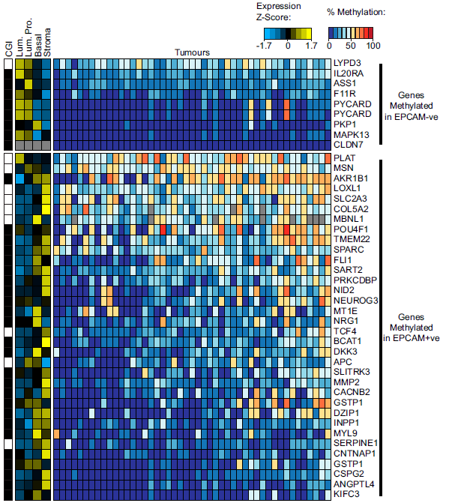
Interpatient Epigenetic Heterogeneity
Breast Cancer
PNAS March 15, 2011 vol. 108 no. 11 4364-4369
Notes:
PNAS March 15, 2011 vol. 108 no. 11 4364-4369
Transcriptionally repressed genes become aberrantly methylated and distinguish tumors of different lineages in breast cancer
Fig. S5. (A) Primary tumors show differential methylation of SRAM genes preferentially methylated in EPCAM+ve and −ve cell lines. The heat map shows the
methylation frequency of differentially methylated SRAM genes in 47 primary breast tumors. Only genes that are unmethylated in the normal breast are
shown. Genes and samples are ordered by their frequency of methylation. Multiple probes are shown for some genes. This is a larger version of Fig. 5A and
includes additional data. The sidebars indicate which probes are in CpG islands (as defined in Illingworth et al.; ref. 1) and the expression of each gene in
different cell types in the normal breast (2). Expression is shown as median z scores. Missing data are indicated in gray. Lum, luminal epithelial cells; Lum. Pro., luminal epithelial progenitors; Basal, basal myoepithelial cells; Stroma, stromal fraction.
ChIP-Seq, also known as ChIP-Sequencing, is widely used to analyze protein interactions with DNA. It combines chromatin immunoprecipitation (ChIP) with massively parallel DNA sequencing to identify binding sites of DNA-associated proteins, and can be used to precisely map global binding sites for any protein of interest. ChIP sequencing offers higher resolution and more precise and abundant information in comparison with array-based ChIP-chip.

Slide 21
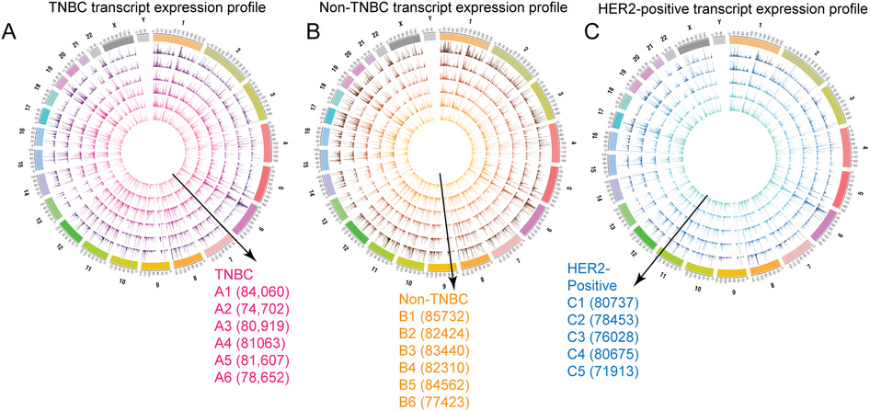
Interpatient Transcriptomic Heterogeneity
Breast Cancer
Transcriptomic landscape of breast cancers through mRNA sequencing. Scientific Reports 2, Article number: 264. 14 February 2012

Slide 22
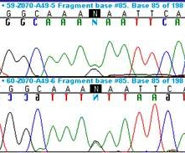
NGS vs. Sanger
A. Capillary sequencing
B. NGS / Massively parallel sequencing (MPS)
GENE
amplicon
amplicon
AAAACCAGAGTCTAGCACCTTCTCATCAGGAGCA
G
NGS
>100x–1000x
AAACCAGAGTCTAGCACCTTCTCATCAGGAGCA
A
Bi-directional 2x
C
A
AACCAGAGTCTAGCACCTTCTCATCAGGAGCA
CG
ACCAGAGTCTAGCACCTTCTCATCAGCAGCA
A
CGT
ACCAGAGTCTAGCACCTTCTCATCAGGAGCA
G
CGT
A
CCAGAGTCTAGCACCTTCTCATCAGGAGCA
CGTC
A
GAGTCTAGCACCTTCTCATCAGGAGCA
CGTCTGC
G
CTAGCACCTTCTCATCAGGAGCA
CGTCTGCCTTC
A
TAGCACCTTCTCATCAGAAGCA
CGTCTGCCTTCG
AGCACCTTCTCATCAGGAGCA
A
SEQUENCE
CGTCTGCCTTCGC
G
CCCTTCTCATCAGGAGCA
CGTCTGCCTTCGCTAG
A
ACCTTCTCATCAGTAGCA
CGTCTGCCTTCGCTAG
CTTCTCATCAGGAGCA
A
CGTCTGCCTTCGCTAGGC
G
ATCAGGAGCA
CGTCTGCCTTCGCTAGGCTGACAT
A
ATCAGGAGCA
CGTCTGCCTTCGCTAGGCTGACAT
TCAGGAGCA
G
CGTCTGCCTTCGCTAGGCTGACATC
A
GAGCA
CGTCTGCCTTCGCTAGGCTGACATCGCGG
A
GAGCA
CGTCTGCCTTCGCTAGGCTGACATCGCGG
A
A
CGTCTGCCTTCGCTAGGCTGACATCGCGGGACC
A
A
CGTCTGCCTTCGCTAGGCTGACATCGCGGGACC
AAAACCAGAGTCTAGCACCTTCTCATCAGGAGCA
G
CGTCTGCCTTCGCTAGGCTGACATCGCGGGACC
A
G
A
G
VARIANT

Slide 23
Clinical Laboratory Analysis
Sanger vs NGS cost of sequencing per run
Sanger
Lab specific
Goal is to utilize NGS platform as a
cost-effective and financially-
sustainable technology in clinical labs
Cost of Sequencing per Run
NGS
NGS is more cost-effective
compared to Sanger per run
Number of Base Pairs Sequenced

Slide 24
NGS vs. Sanger
Summary table
Technology | Data Generated | Analysis | Output per Run | Limited of Detection (LOD)
Sanger | Electropherograms (“Sanger traces”) | Manual Automated | 550 bp – 86,400 bp | 20%
NGS | Raw Data FASTQ Files * BAM Files ** VCF Files | Bioinformatics (Automated) | 15 Gb – 600 Gb | 3 – 5%
* BAM or SAM = Binary Alignment/Map or Sequence Alignment/Map
** VCF = Variant Call Format

Slide 25
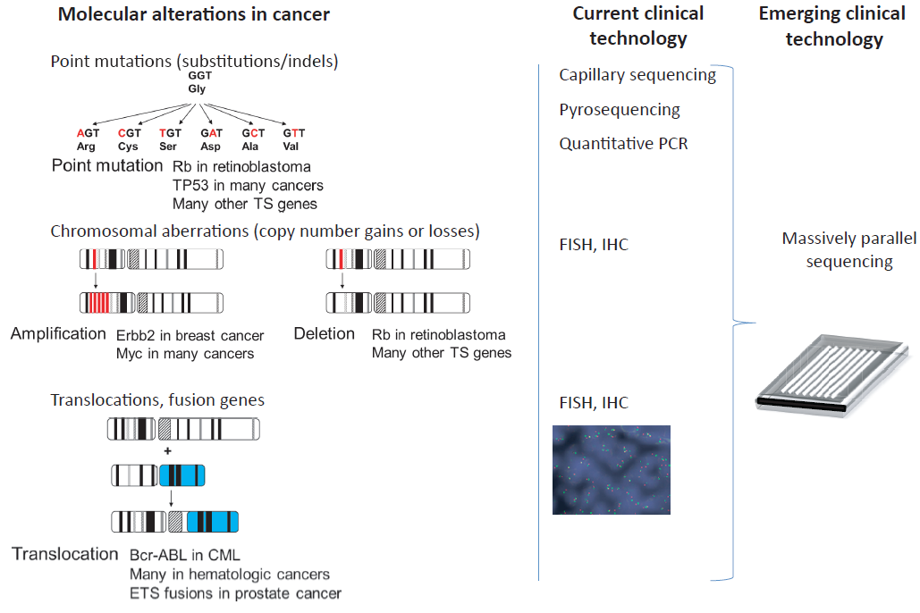
Characterization of Cancer Genomes
Technologies
ddPCR
, ddPCR
Adapted from: Clinical Implementation of Comprehensive Strategies to Characterize Cancer Genomes: Opportunities and Challenges
MacConaill, et al. Cancer Discovery 2011;1:297-311.

Slide 26
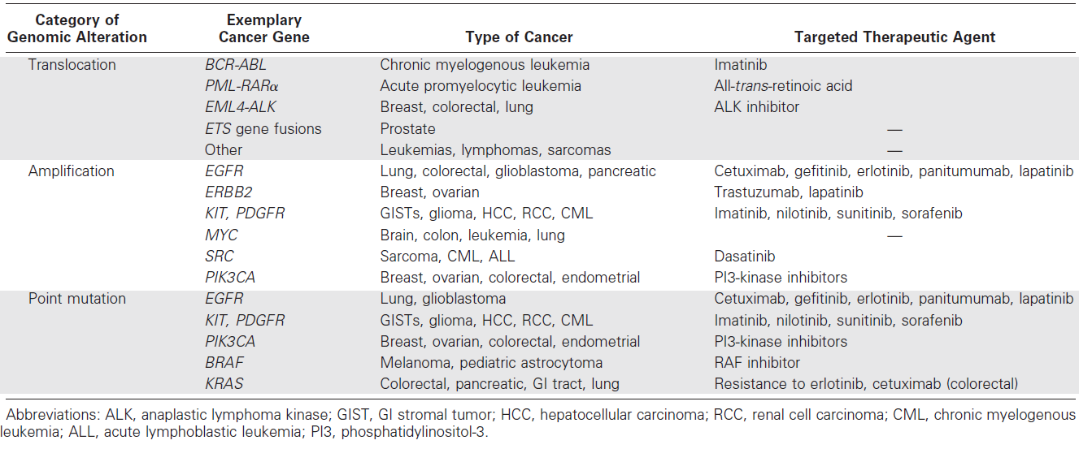
Genomic Alterations in Cancer
Categories of Genomic Alteration and Exemplary Cancer Genes
Clinical Implications of the Cancer Genome. J Clin Oncol 28:5219-5228.

Slide 27
Nucleic Acid Companion Diagnostics
FDA-approved CDx tests
 | Drug Trade Name | Device Trade Name | Device Manufacturer
1 | Erbitux; Vectibix | therascreen KRAS RGQ PCR Kit | Qiagen Manchester, Ltd.
2 | Gilotrif | therascreen EGFR RGQ PCR Kit | Qiagen Manchester, Ltd.
3 | Herceptin | INFORM HER-2/NEU | Ventana Medical Systems, Inc.
4 | Herceptin | PATHVYSION HER-2 DNA Probe Kit | Abbott Molecular Inc.
5 | Herceptin | SPOT-LIGHT HER2 CISH Kit | Life Technologies, Inc.
6 | Herceptin | HER2 CISH PharmDx Kit | Dako Denmark A/S
7 | Herceptin | INFORM HER2 DUAL ISH DNA Probe Cocktail | Ventana Medical Systems, Inc.
8 | Herceptin; Perjeta | HER2 FISH PharmDx Kit | Dako Denmark A/S
9 | Mekinist; Tafinlar | THxID™ BRAF Kit | bioMérieux Inc.
10 | Tarceva | cobas EGFR Mutation Test | Roche Molecular Systems, Inc.
11 | Xalkori | VYSIS ALK Break Apart FISH Probe Kit | Abbott Molecular Inc.
12 | Zelboraf | COBAS 4800 BRAF V600 Mutation Test | Roche Molecular Systems, Inc.
TOTAL (12): FISH/CISH → HER2 (6); ALK (1) qPCR → KRAS (1) ; EGFR (2); BRAF (2)
US Food and Drug Administration [Last Updated: 07/31/2014]

Slide 28
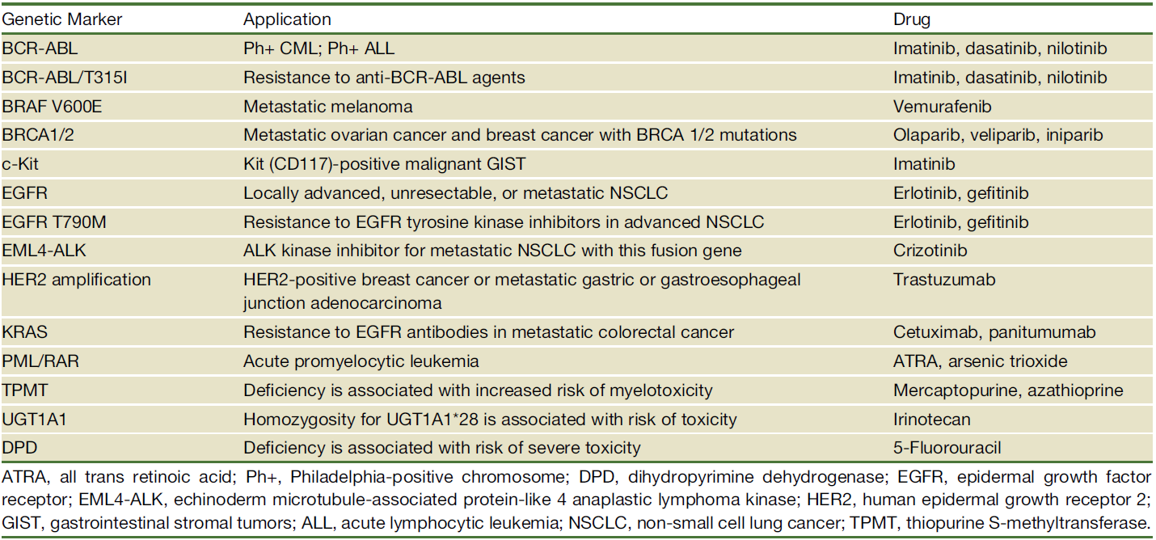
Companion Diagnostics Scene 2012: Single Genes
Selected Genetic Markers and Their Application in Cancer Treatment
Small molecule inhibitors
mAbs
Chemo
The Genetic Basis for Cancer Treatment Decisions. Hudson et at. Cell 148, February 3, 2012

Slide 29

Molecularly Informed Clinical Trials
Basket study design
Single therapeutic agent
Specific genetic or molecular abnormality
Lung
Cancer
Colorectal
Cancer
Breast
Cancer
Prostate
Cancer
Renal
Cancer
Notes:
Single Therapeutic Agent +
Multiple Cancer Types or Subtypes
Single agent targeting a specific genetic or molecular abnormality (i.e. BRAF V600E)
Single agent tested on different cancer types or subtypes

Slide 30
Molecularly Informed Clinical Trials
Basket study example
National Cancer Institute
at the National Institutes of Health
NCI’s MATCH (Molecular Analysis for Therapy CHoice)
Identify mutations/amplifications/translocations in patient tumor sample
– eligibility determination
Assign patient to relevant agent/regimen
Stable disease, complete or partial response (CR+PR)
MATCH Study Design
Continue on study agent until progression
Genetic sequencing
Actionable mutation detected
Study
agent
Progressive disease
(PD)
Check for ADDITIONAL actionable mutations
No additional actionable mutations, or withdraw consent
NO
YES
Off study
Adapted from http://deainfo.nci.nih.gov/advisory/ncab/164_1213/Conley.pdf

Slide 31

Molecularly Informed Clinical Trials
Umbrella study design
Single Cancer Type
Therapeutic Agent #1
Therapeutic Agent #2
Therapeutic Agent #3
Therapeutic Agent #4
Therapeutic Agent #5
Molecular
Target #1
Molecular
Target #2
Molecular
Target #3
Molecular
Target #4
Molecular
Target #5
Notes:
Single Therapeutic Agent +
Multiple Cancer Types or Subtypes
Single agent targeting a specific genetic or molecular abnormality (i.e. BRAF V600E)
Single agent tested on different cancer types or subtypes

Slide 32

Molecularly Informed Clinical Trials
Umbrella study example
I-SPY 2 TRIAL (Investigation of Serial Studies to Predict Your Therapeutic Response with Imaging And moLecular Analysis 2)
  Clinical trial for women with newly diagnosed locally advanced breast cancer
  Test whether adding investigational drugs to standard chemotherapy is better than standard chemotherapy alone before having surgery
  Treatment phase of this trial will be testing multiple investigational drugs that are thought to target the biology of each participant’s tumor
  Help the study researchers learn more quickly which investigational drugs will be most beneficial for women with certain tumor characteristic
http://www.ispy2.org/

Slide 33
Exceptional Responders
N-of-1 experiences
Case #1
A 70-year-old woman with advanced melanoma
29-patient study of a drug under development by Pfizer Inc.
Only 1 of 29 patients, the 70-year-old woman came away with her cancer in remission
Researchers are now studying how her unique genomic alterations may have interacted with the drug to spur her recovery
Case #2
A woman with advanced bladder cancer
45-patient study of a drug by Novartis
"Every other patient died, but she's without evidence of disease for more than three years now," said Dr. Solit (MSKCC oncologist)
Researchers discovered a combination of two gene mutations made her particularly receptive to the treatment
Case #1 - http://www.bloomberg.com/news/2014-04-11/cancer-miracle-patients-studied-anew-for-disease-clues.html
Case #2 - http://www.reuters.com/article/2013/09/15/us-cancer-superresponders-idUSBRE98E07420130915

Slide 34



Drug-Centered Oncology Rx: Traditional Approach
The (One) Drug
The “Companion” Test
(single-target)
The Patients
One drug
… that is efficacious in a small fraction of patients…
Requires a (single-target) CDx for each patient…
to identify likely responders

Slide 35
Cancer Is A Heterogeneous Disease
Need For Combination Therapies
A tumor consists of…
  genetically distinct subpopulations
  of cancer cells, each with its own characteristic sensitivity profile
  to a given therapy
Each cancer therapy can be
viewed as…
  a filter that removes a subpopulation
  of cancer cells that are sensitive to
  this treatment
Combination therapy…
  for management of cancer as a
  chronic disease
Therapy 1
Therapy 2
Therapy 3
Adapated from Luo J, Solimini NL, Elledge SJ. Principles of cancer therapy: oncogene and non-oncogene addiction. Cell, 136(5), 823-837 (2009).

Slide 36





Patient-Centered Oncology Rx: Emerging Paradigm
The (One) Test
(multi-target)
The Patient
The Drug
CRx
Target 1
Target 2
Target 3
One patient…
evaluated by one (multi-target) test…
… to identify the best drug for each patient
Rise of the “companion therapeutic”?

Slide 37




Partnering for New Paradigm of Precision Oncology
Leading cancer centers
Pharma
Actionable Genome Consortium
Illumina Universal Test for clinical trial and regulatory approval
Biotech
Leading research centers
CROs
Notes:
The AGP and Oncopanel strategy then feed into a collaborative ecosystem between leading cancer and research centers, pharma, biotech and CROs.

Slide 38



Partnering for New Paradigm of Precision Oncology
Leading cancer centers
Pharma
Actionable Genome Consortium
Illumina Universal Test for clinical trial and regulatory approval
Biotech
Leading research centers
CROs
Notes:
The AGP and Oncopanel strategy then feed into a collaborative ecosystem between leading cancer and research centers, pharma, biotech and CROs.

Slide 39
Partnering for Precision Oncology Enables
A Collaborative Ecosystem:
With the Ability To:
Illumina
Develop/make/test/
submit/provide
Standardize
  Enables standardization of multiplexed platform for relevant genes
Streamline
  Optimizes introduction of new biomarkers through standard system
Decentralize
  Deliver universal platform for routine testing enabling rapid commercial access
Investigate
  Brings trial enrollment to local clinics, increasing candidate pool for studies
Collaborate
  Facilitates combination trials within and across pharma companies
CRO’s
Use through Pharma contracts
Biotech
Specify/Use
Cancer Centers
Use in clinical trials
Universal
Test
Pharma
Specify/Use
AGC
Inherit for inclusion in AGP
FDA
Evaluate/approve

Slide 40
The Actionable Genome Consortium
Driving guidelines and answering questions
Clinical Guidelines
  Create and disseminate the content, standards, performance characteristics and workflow of an NGS cancer Actionable Genome Panel (AGP*) to guide clinical decision making
Collaborative Research
  Create a research consortium to enable collaborative projects aimed at Cancer Genomics
*AGP: The set of molecular assays that can be recommended to all practicing oncologists as necessary to guide clinical decision making.

Slide 41
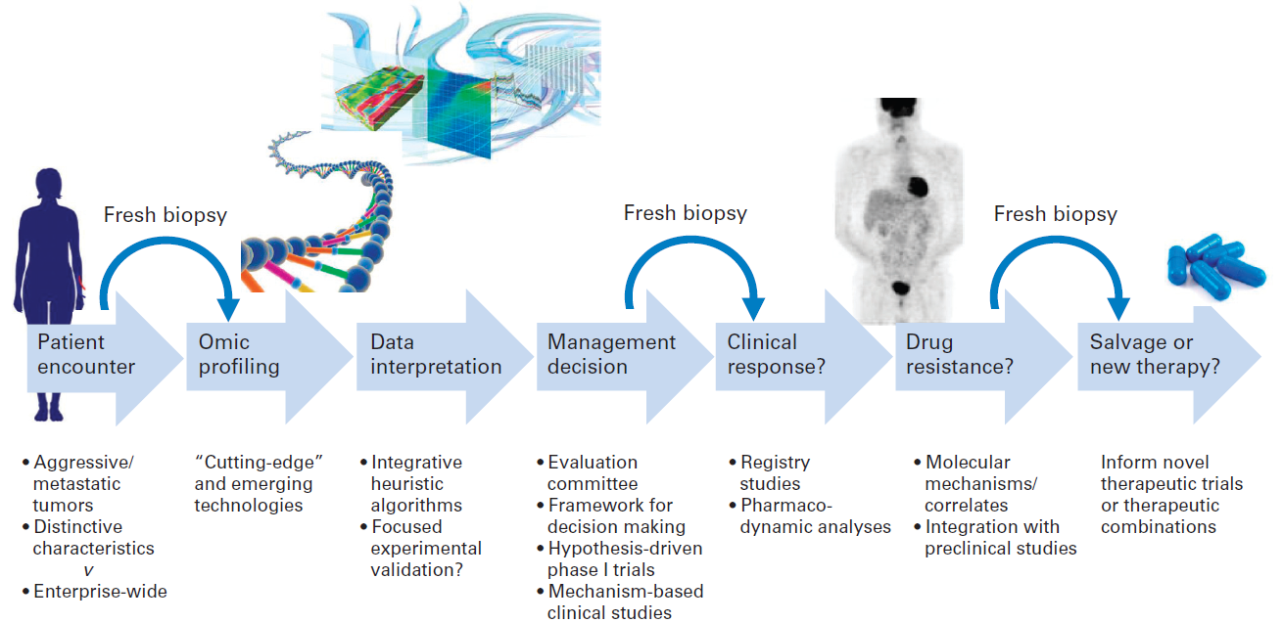
Transforming Oncology with Genomics
Conclusions
Comprehensive genomic interrogation of tumors will be commonplace
At multiple-time points, from primary screening to advanced disease
Resulting in earlier detection, precise diagnosis, and targeted treatment
With great potential for non-invasive testing methods (CTCs and ctDNA)
Leading to improved outcomes (chronic management and ultimately cure)
Garraway LA. Genomics-driven oncology: framework for an emerging paradigm. Journal of clinical oncology : official journal of the American Society of Clinical Oncology, 31(15), 1806-1814 (2013).

Slide 42
Thank You!

