Slide 1
From Food versus Fuel Debate to Food and Fuel
25 August 2015, Valencia
Frank Rosillo-Calle, PhD
Honorary Senior Research Fellow
Imperial College London

Slide 2
THE THREE KEY THEMES OF THIS SESSION
Moving beyond the fuel-food debate to food and fuel
(Frank Rosillo-Calle)
  Moving from a unscientific to a science-based debate
Water-energy-food nexus and sustainability issues affecting biofuel development (Rocio Diaz-Chavez)
  Examine the major implications
The role of 2G and 3G biofuel technologies and impact on food security (Sebastian Sanchez et al)
  How G2 and G3 biofuels will enrich energy and food production while avoiding competition

Slide 3
Summary of debate FvF, FRC
  THE FOOD VERSUS BIOFUEL DEBATE
    Key issues of the debate
    Ethical dilemmas
The hidden hunger
The terrible huge food waste
  Population trends
Biofuels and agriculture
  International bioenergy trade
By-way of summary

Slide 4
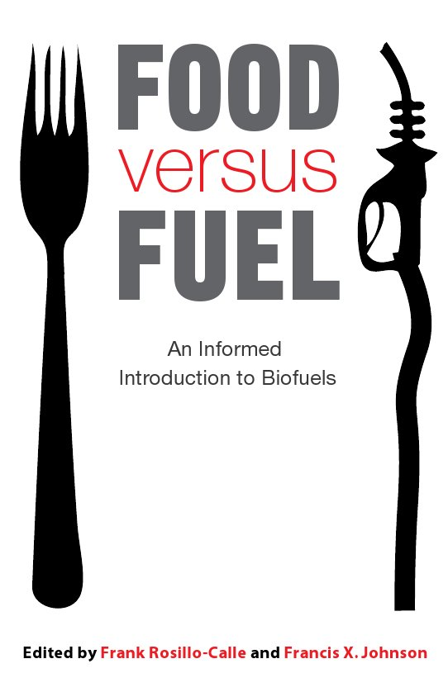

Slide 5
Why such debate…
Rooted in the diversity of the feedstocks and potential impacts (positive and negative) in different parts of the world;
Diversity of views, and assumptions taken by the different actors on issues related to biofuels, scale, know-how and availability of technology; impacts
Attitudes to climate change, environmental objectives, economic development priorities, rural vs. urban poverty and many other factors.
Poor understanding the issues involved (poor science)
This new situation requires far more credible answers

Slide 6
The questioning of biofuels
Some studies questioned some environmental and social benefits of biofuels, intensifying the debate [e.g. see FAO (2007); Royal Society (2008)].
A common feature of many studies has been lack rigorous long term scientific data to back up most of the claims.
Worse, most of the criticisms have been blown up out of proportion by the general press and detractors of biofuels.
Production of biofuels is complex given the key role of agriculture, the potential impacts of climate change, increasing demand for food and energy, food waste, and environmental scrutiny.

Slide 7
Key points of the debate
The biofuels debate in particular has centred around FIVE main areas:
i) food versus biofuel production;
ii) their positive and negative effects (i.e. GHG, and the broader environment);
iii) a socio-economic component
iv) rapid expansion of solid biomass for electricity and heat generation
v) and potential adverse impacts of climate change, driven primarily by recent droughts e.g. USA, flooding...

Slide 8
The ethical critiques…
Three ethical critiques can be levelled at the food vs. fuel debate.
First, although market drivers of biofuels indeed skew consumption of agricultural grains, this is not a problem that is unique to biofuels.
Second, the critique does not reflect an adequate understanding of the way that rising food prices and changes in agricultural technology affect the food security of the poorest people.
Third, rising food prices could be beneficial to poor farm producers among the world’s poor. But this needs concerted programs to deliberately select biofuel development

Slide 9
Key ethical dilemmas (…)
Should we produce food or fuel?
  A lot of people think it is unethical to use land to produce fuel instead of food (no scientific proof needed)
  But you need energy to produce food! Cheap oil was the key to the WEST, but this is the past
  People do not go hungry for lack of food- simply they cannot effort to buy it!
  There is not land shortages- there is an enormous injustice when it comes to land distribution
  Give the farmers the right tools- they will deliver far more food than you think!

Slide 10
The rise of pragmatism… Changing FAO stand
A more pragmatic view is gradually emerging toward food and fuel.
Recognition of the importance of biofuels in agricultural modernization and the positive impacts on the farming community.
Flexibility is key to using biofuels to boost agricultural productivity, accelerate rural development and increase food security, in addition to energy
Biofuels will help to modernise agriculture
Complementarity of biofuels and food production, if done properly
Dealing with food waste, a must!

Slide 11
How much land is available? Far too many discrepancies
There are more than 2Gha of underexploited land, plus 700 Mha of other type of land that could be used for non-food purposes.
Direct land competition is a myth rather than a reality considering that merely 1-2% of the global land area is currently dedicated to biofuels.
Estimates of agricultural land needed to provide 10% biofuels range from 120Mha to over 500Mha. Biofuels expansion must be assessed in the context of growing demand for food security due to:
  Population growth
  Changing living standards
  Changing diets
  Agricultural modernization, efficiency…. (and huge waste)

Slide 12
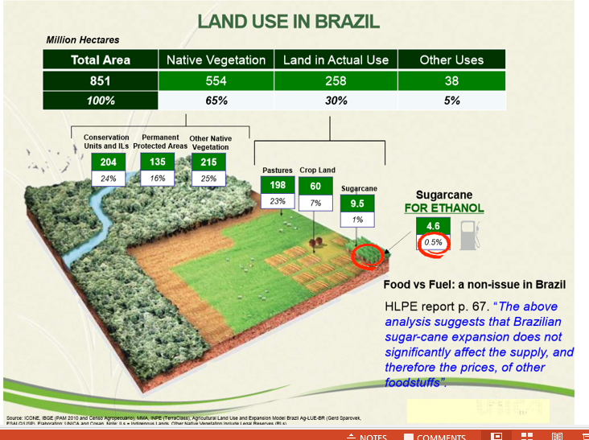

Slide 13
Where do we stand with biofuels today?
FAO/OECD data show: biofuels accounted for 3% of global transport fuels in 3013 and c. double this figure by mid 2020s
The main producers and consumers are USA (corn) and Brazil (sugarcane), followed by the EU (grains)
LET HAVE A BRIEF HISTORIAL LOOK AT GLOBAL BIOFUEL PRODUCTION

Slide 14
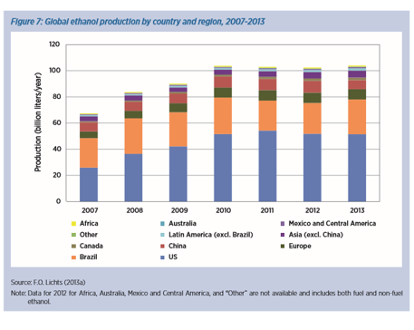

Slide 15
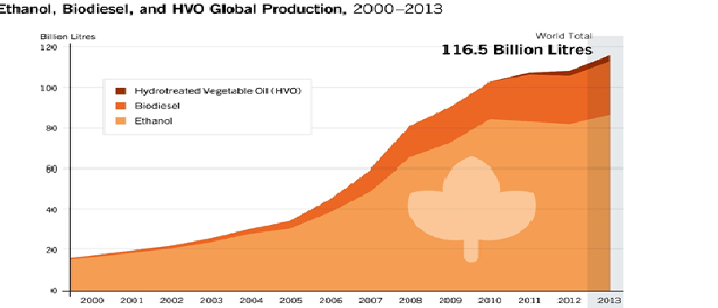

Slide 16
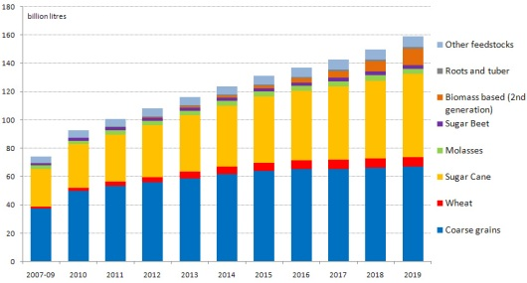
Global bioethanol production by feedstock, 2007/9 to 2019,OECD/FAO,

Slide 17
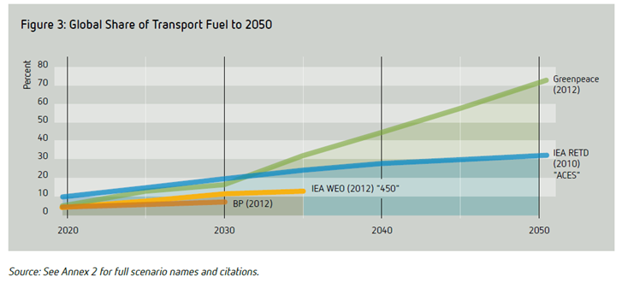

Slide 18
The intertwine nature of biofuels e.g. USA corn industry, worth $125 billion
44% of last year's harvest went to animal feed
Another 44% became ethanol fuel
and the remaining 12% went to "other" uses that included food and sweeteners, according to data compiled by the U.S. Department of Agriculture.
WE NEED TO MOVE TO MULTI-PRODUCT STRATEGY (BIOREFONERIES) AND FEEDSTOCKS WITH MULTIPLE END-USES

Slide 19
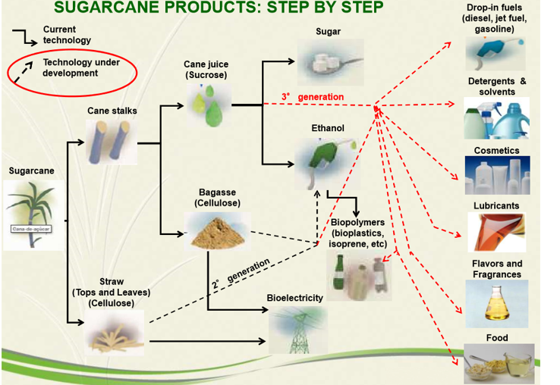

Slide 20
The “hidden hunger”
Food vs. nutrition, Amatya Sen wrote in 1960:
“what really matters with food is not the overall supply, but individual assess”
Of the seven billion people:
  1B go without enough calories
  1B are undernourished (lack-micro nutrients)
  1B are undernourished (eat too much)
  3B eat too little, are too unhealthy, or too much
  (The Economist, 18/2/12 pp 59-60)

Slide 21
… and huge food waste!!
it is estimated that 30 to 50% of the global food production rots away uneaten;
In some countries as much as 75% of the harvest is lost, particularly fresh vegetables.
A recent report by the Natural Research Defence Council says Americans throw away nearly half their food every year, waste worth roughly $165 billion annually!
US discard 40%; the average American family of four ends up throwing away an equivalent of up to $2,275 annually in food.

Slide 22
A terrible food waste!! (Inst. Mechanical Engineering (2013) report says:
It is estimated that 30–50% (or 1.2–2 billion
tonnes) of all food produced on the planet is lost
In South East Asian countries, losses of rice can range from 37–80% of the entire production.
In India 21Mt of wheat is wasted each year due to inadequate storage and distribution systems.
In the UK , 7Mt of food valued at about £10B is thrown away from home s every year.
Feed given to livestock could feed over 2 billion people

Slide 23
And the population “Armageddon”
Population bomb, seen by many at the biggest challenge e.g. Ehrlich’s 1968 book “The Population Bomb” said that late 20thC and early 21stC will be marked by mass starvation… with some estimates putting population at 10-20 billion by early 21stC.
Growing numbers of demographers are challenging this perception as population is declining in many countries, and instead of starvation we are facing an epidemic of “obesity”, even in many developing countries.

Slide 24
Current population trends
Some demographers think population may peak c.9bn and then decline to 2-4bn by 2300s.
Birth rates:
  1950-1955 = 4.95
  1970-1975 = 4.45
  1990-1995 = 3.04
  Today down to 2.47
Lowest: Singapore, 0.78; Japan, 1.39; China, 1.55; EU,1,58
Highest: Africa, Niger = 7.52

Slide 25
A problem of lack of investment, skills, capital, market…
Agriculture has suffered from chronic under investment in most parts of the world e.g. in the 1980s about 17% of international development aid was for agriculture, but just 3% in 2005
Agric. product. increased 150-200% between 1960 and 2010 compared to 12% increase in land use
Give the farmers the right conditions and they will be able to produce far more food, energy and industrial products.

Slide 26
Science-based agriculture (…)
Farming cannot be seen as a backward activity, but as a science driven industry.
Investment on modern scientific research for agriculture led to dramatic yield breakthroughs in the last century
Example, in England wheat yields took nearly 1000 years to increase from 0.5 to 2 t/ha/yr, but just 40 years increased to 6 t/ha/yr (Hazel & Woods, 2007).
  Today 8 t/ha/year

Slide 27
International trade in biofuels, is a positive development (www.bioenergytrade.org)
Task 40 under the IEA Bioenergy Agreement entitled: ‘Sustainable International Bioenergy trade; securing supply and demand’,
Set up in 2004 to assess the potential implications of international bioenergy trade
A recent trend that can have a major impact on BIOFUELS demand
Need to ensure “sustainability”

Slide 28
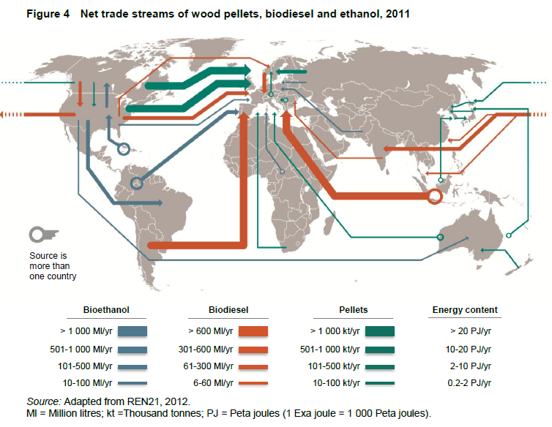
Notes:
CFS-HLPE

Slide 29
By-way of summary
Biofuels and food competition is a false dichotomy; in most cases can be complementary
Biofuels and agricultural production can be an integral part
Market/policy will ensure food rather fuel will come first
Biofuels can only substitute a small fraction of road/aviation transport fuel
Biofuels is part of the problem and part of the solution (NOT the solution neither the problem)
Need to move from unscientific debate driven my the media, ethical/moral considerations, to science-based debate
Need to mature a balance all the PROS and CONS
Let have a balance and fair playing field for food and energy

Slide 30
Refs…
Rosillo-Calle F, & Johnson F (editors) (2010): The Food versus Fuel Debate: An Informed Introduction to Biofuels, Zed Books, London; ISBN: 9781848133822, 217pp.
Rosillo-Calle F (2012) Food versus Fuel: Toward a New Paradigm- The need for a Holistic Approach (Commissioned paper “Spotlight Article for ISRN Renewable Energy, Volume 2012, Article ID 954180; www.hindawi.com/isrn/re/contents
M Junginger, C S Goh and A Faaij (eds), 2014: International bioenergy trade- History, status and outlook on securing sustainable bioenergy supply, demand and markets, Springer, ISBN 978-94-007-6982-3
Searchinger T & Heimlich R (2015) Avoiding bioenergy completion for food and land , World Resources Institute, Working paper.

Slide 31
(Overview of ethanol fuel market by Frank Rosillo-Calle and A. Walter, Visit www.ieiglobal.org/vol10_issue1.html for ESD Special Issue on bioenergy trade and development
www.datagro.com
GRFA (2011) Global Renewable Fuels Alliance (www.globalrfa.org) , 11 Feb/2011
www.epure.org/statistics, USA Energy Information Administration
www.ren21.net
www.unica.com.br
www.ethanolrfa.org
www.bp.com/content/

