Slide 1


Single amino acid substitution in the HIV-2 gp36 ectodomain part interacting with BST-2 impairs viral release
Madrid, March 10th 2016
Dufrasne François
Assistant, PhD student
AIDS Reference Laboratory
Pôle de microbiologie médicale (MBLG-Université catholique de Louvain, Belgium)

Slide 2
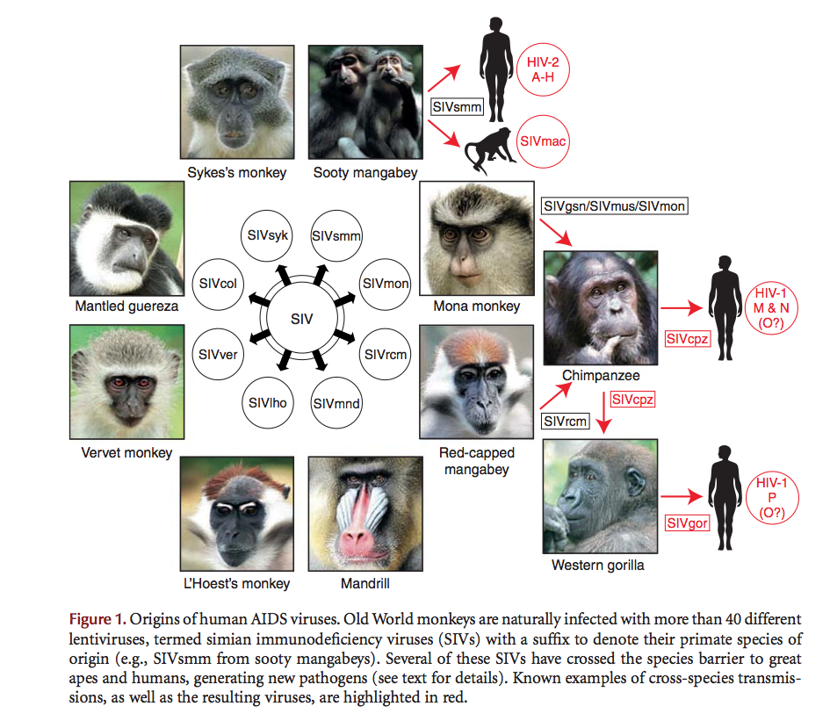
Human immunodeficiency viruses type 1 and 2
Interspecies transmissions:
- SIVsmm ➔ HIV-2
- SIVcpz ➔ HIV-1
Although HIV-1 is found worldwide, HIV-2 is mainly localized in West Africa
Origins of AIDS viruses, from Sharp and Hahn, Cold Spring Harb Perspect Med 2011
Notes:
HIV-2 belongs to Retroviridae family and arises from an interspecie transmission of sooty mangabey monkey SIV.
Whereas HIV-1 arises from Chimpanzee SIV.
Although HIV-1 is found worlwide and is pandemic, HIV-2 is mainly localized in West Africa (with sporadic cases in France, Portugal, Brazil or India)
In Belgium, we count around an hundred HIV-2 infection cases

Slide 3
Clinical features of HIV-2 infection
The asymptomatic phase is longer than HIV-1 disease progression
HIV-2 can cause AIDS, but there are a lot of long term non- progressors
The viral load is always lower compared to HIV-1. The HIV-2- positive individuals seem to « control » the infection, without ART.
Notes:
Long term non progressors represent 80% of the HIV-2 cases
The viral load, which is the number of viral copies per mL of blood, is always lower compared to HIV-1, even indetectable

Slide 4
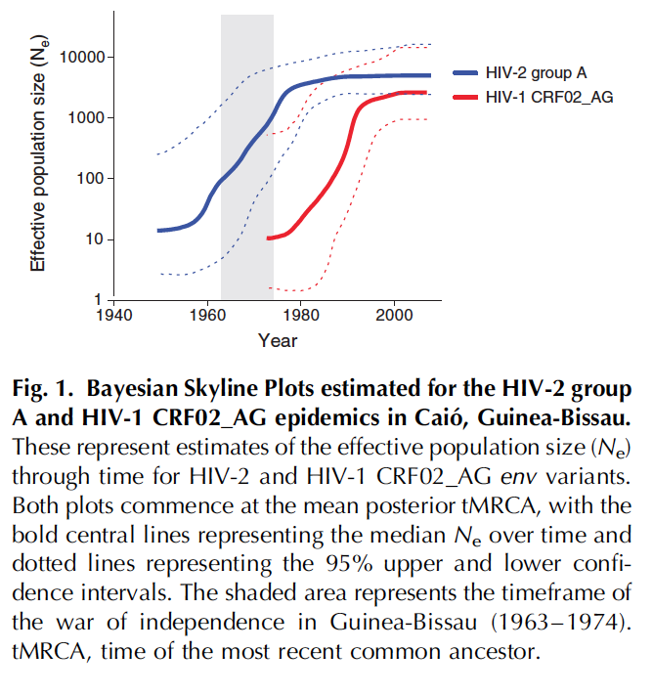
Phylodynamics of HIV-1 and HIV-2 in the same community:
Competition, HIV-1 may play a role in the decline of HIV-2
Ongoing HIV-2 transmissions by new cases
de Silva et al., AIDS 2013
Notes:
This graph shows phylodynamics of HIV-1 and HIV-2 in the same community. As we can see, HIV-1 will overhang HIV-2 in Guinea. HIV-1 plays a role in the decline of HIV-2.
Nevertheless, we observe ongoing HIV-2 transmissions.

Slide 5
Why do we continue to study a disappearing or stable virus, under control?
At the patient level: develop more reliable diagnostic tools, define the place of new antiretroviral agents for those in need of therapy.
At the population level: have reliable statistics, model how the virus is dropping
Natural human model of attenuated retroviral infection: learn how we can control HIV-1 or other possible new human retroviruses
Notes:
So it’s interesting to study this virus in order to further understand the reasons of this atypical disease evolution

Slide 6
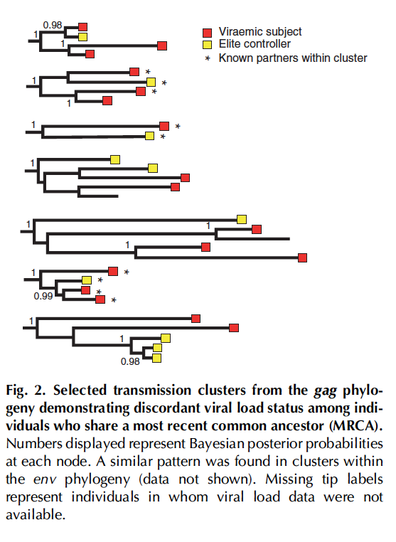
What explains those disparities?
Vireamic subject OR elite controller can be infected by a related strain
➔ Importance of the host factors
de Silva et al., AIDS 2013
Notes:
A study showed that different individuals infected by a related strain of HIV-2 could be vireamic subject or elite controller, as we can see in this image.
The four-sided shape represents two known partners infected by a close related strain and however their status are opposed. One is a vireamic subject and will certainly progress to AIDS stage whilst the other individual is an elite controller
This study highlights the importance of the host factors in infection evolution

Slide 7
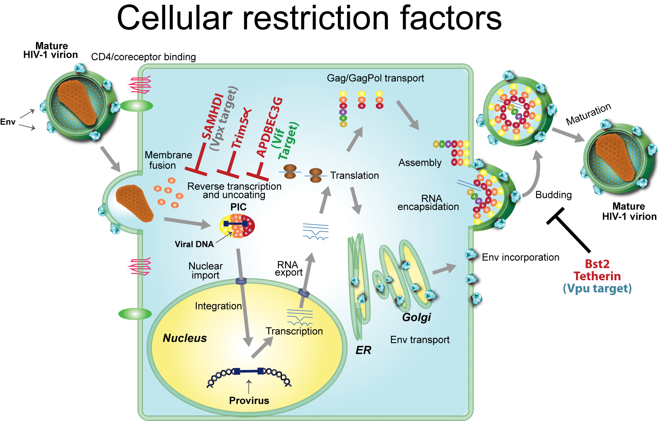
Host restriction factors
SAMHD1
TRIM-5-alpha
APOBEC3G (3F)
Tetherin (BST-2)
Research topic: Is the host factor BST-2 involved in non-progression?
Notes:
Considering the host factor, we focused in the host restriction factors
Host restriction factors are human proteins expressed in a large amount of cells.
Each step of the viral cycle can be impacted or hindered by these factors.
For example, SAMHD1, TRIM 5 alpha and APOBEC proteins hinder the reverse transcription
We are interested in studying a particular restriction factor, which is tetherin (or BST-2). This protein impairs the viral budding and so the viral spread.
Therefore, our research topic is: is the host factor BST-2 involved in non-progression?

Slide 8
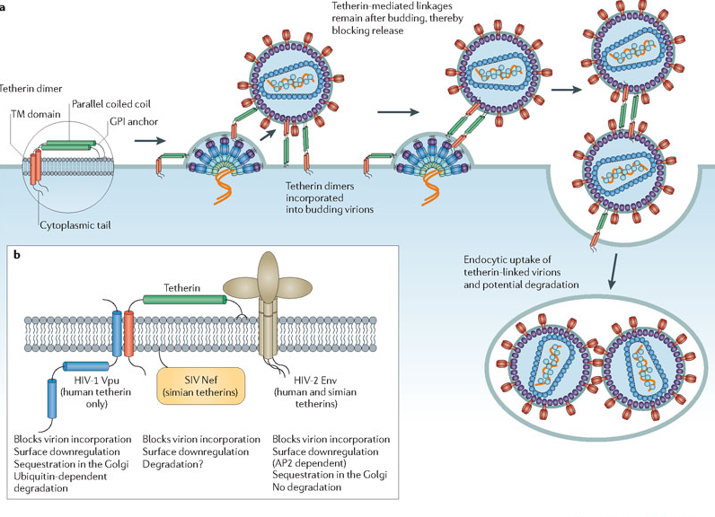
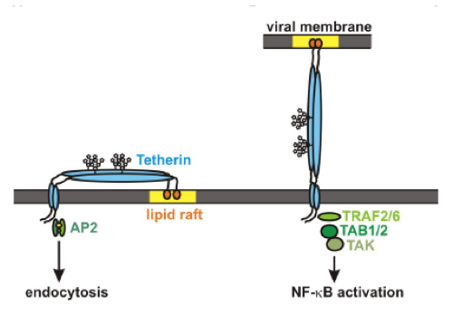
Tetherin: mechanism of action
Juan Martin-Serrano & Stuart J. D. Neil, Nature Review Microbiology (2011)
Notes:
BST-2 is a short transmembrane protein, displayes 160 amino acids, and is composed of a cytoplasmic domain, an MSD, and an extracellular domain. BST-2 presents an unusual GPI anchor in its C terminal end.
Tetherin is part of IFN-dependent antiviral response pathway.
This restriction factor can retained the budding virions by embedding its GPI anchor in the viral membrane.
Once the virions attached at the cell surface, BST-2 promotes their endocytosis and subsequent degradation

Slide 9
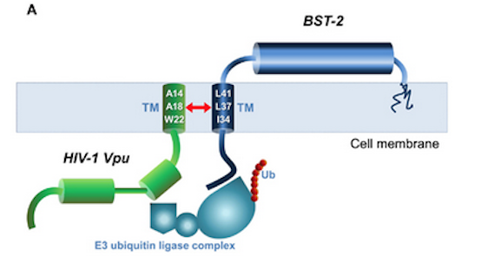
BST-2 and its viral antagonists
In HIV-1:
Vpu
Interaction through their TM
Vpu recruits E3 ubiquitin ligase
Endocytosis and degradation of BST-2
Downregulation of BST-2
Arias et al., Front. Microbiol (2011)
Notes:
BST-2 is a potent antiviral factor and is highly conserved. So it’s not surprising that HIVs developed several means to counteract and antagonise such a factor
In HIV-1, the viral antagonist is Vpu. This accessory protein interacts with tetherin throught its membrane spanning domain
Vpu recruits E3 ubiquitin ligase complex and BST-2 undergoes endocytosis and degradation. That leads to a dowregulation of BST-2 and therefore facilitates the later viral budding and spread

Slide 10
Vpu antagonises BST-2/Tetherin
Tetherin - HIV-1 wt
Tetherin - HIV-1 Vpu -
Tetherin + HIV-1 wt
Tetherin + HIV-1 Vpu -
Neil et al., Nature 2008
Notes:
On this slide are shown electron micrographs of plasma membrane of HT1080 cells, cells that does not express tetherin naturally. Viral particles are released.
If those cells expressed tetherin, you see an huge amount of particles tethered to the membrane if Vpu is absent.

Slide 11
Model of Vpu-mediated down-regulation of tetherin
Dubé et al., Plos Pathogens 2010
Notes:
We considered two different cell models. One Vpu is not expressed, in the other, Vpu is expressed.
When Vpu is absent, BST-2 is well recycled and the steady state of BST-2 is normal.
When Vpu is expressed, BST-2 is ubiquitinated, the recycling is inhibited and Tetherin undergoes lysosomal or proteosomal degradation.
That leads to a downregulation of BST-2 and therefore facilitates the later viral budding and spread

Slide 12
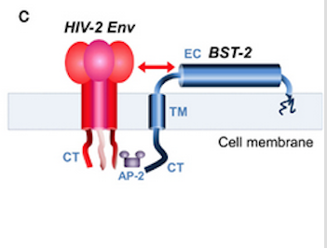
BST-2 and its viral antagonists
In HIV-2:
Envelope protein (Env or gp140)
Functional region(s) involved in the interaction is (are) unknown
Env recruits AP-2 to promote endocytosis and sequestration of BST-2
Downregulation of BST-2
Arias et al., Front. Microbiol (2011)
Notes:
In HIV-2, the Envelope protein seems to fulfill the antagonistic role. But the functional region involved in the interaction is unknown.
We intend to identify it before connecting BST-2 with the HIV-2 infection evolution

Slide 13
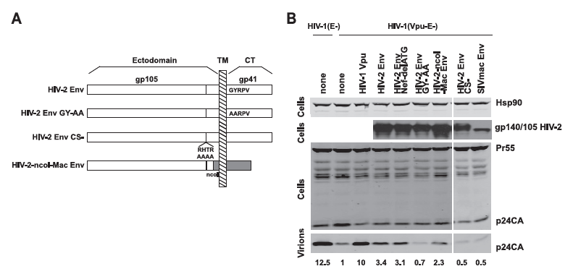
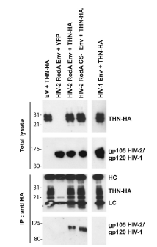
BST-2 and HIV-2 envelope glycoprotein
C
Where in the ectodomain?
HIV-2 Env proteins interact with and antagonise BST-2
• The endocytosis motif (GYRPV) is necessary to antagonise BST-2.
The viral release decreases when this motif is mutated
• Amino acids involved in this antagonistic role are apparently in the HIV-2 gp36 ectodomain
Le Tortorec et al., Journal of Virology (2009)
Notes:
HIV-2 Env protein is composed of two units: gp 105, entirely extracellular, and gp36 divided in three domains: an ectodomain, a MSD and a cytoplasmic tail.
A study published in 2009 brought three important knowledges about BST-2 and HIV-2 Env protein
First, antagonism necessitates an intermolecular link between Env and BST-2, as the Co-IP reveals (we see this in the panel C, BST-2 is co-immunoprecipitates with Env)
Second, a mutation in the endocytosis motif in the CT impairs the antagonism and the viral release (we see that with this western blot, compared to HIV-2 Env WT)
Third, they constructed a chimeric protein in which the MSD and the CT of HIV-2 Env were substituted with a SIVmac Env corresponding part (that does not antagonise BST-2)
This mutant maintains a certain ability to antagonise BST-2 and to promote viral release.
Therefore, amino acids involved in this antagonistic role are apparently in the HIV-2 gp 36 ectodomain. We intend to identify them

Slide 14
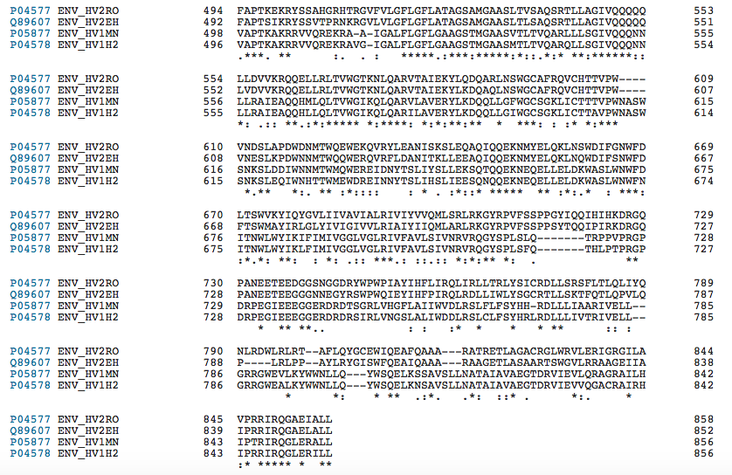
Selection of amino acids potentially involved in antagonism
In silico comparison of HIV-1 and HIV-2 gp36 protein sequences
Residue conserved in HIV-2 AND different in HIV-1
➔
42 possibilities of substitution
gp36 ectodomaine
TM
Notes:
How to proceed to distinguish the residue potentially involved in antagonism?
Since HIV-1 Env protein does not antagonise BST-2, we realize an in silico comparison of HIV-1 and HIV-2 gp36 protein sequences.
The two first lines are HIV-2 ROD and EHO reference strains, respectively, and the two last lines are HIV-1 reference strains.
The blue bracket shows the gp ectodomain and the transmembrane domain is indicated.
We hypothetised that the residues potentially involved in antagonism to tetherin are conserved in HIV-2 Env proteins AND different in HIV-1. The aim is to substitute a HIV-2 residue with the corresponding HIV-1 residue.
Green arrows show some examples. With this method, we selected 42 potential mutants.

Slide 15
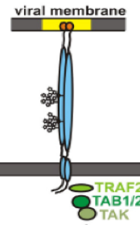
Study design and protocol (1)
Site-directed mutagenesis to introduce substitution mutations (in pKP59 HIV-2 infectious clone) ➔ 42 different mutants tested
Transfection of 293T cells to generate viral particles
Infection of H9 cells with this mutant (MOI=2), compared to HIV-2 WT virus
RT-qPCR to quantify the quantity of viral RNA released in the cell culture media at 2, 3 and 6 days post-infection
At day 3 PI, infected cells were treated with subtilisin protease. RT-qPCR to quantify the quantity of viral copies « tethered » and then « released » by this protease
Subtilisin
Notes:
MOI = multiplicity of infection is the ratio of the number of virus particles to the number of target cells
Subtilisin is a bacterial exotoxic protease. This serine protease cleaves external peptides. So BST-2 peptides will be cleaved and the attached viruses will be released in the culture media. It’s a robust evidence to relate the env mutation with the antagonism to BST-2
I will present the results in two distinct parts: first part, the discovery of the functional region involved in antagonism to BST-2 and second part, the assessment of the lack of antagonism to tetherin using a FRET-based assay.

Slide 16
Results
We caracterized a mutant (Env N659D) that shows a significant lack of release from infected cells.
gp36 ectodomaine
TM
Notes:
I don’t show the results for all mutants but we caracterized a mutant, which is Env N659D that shows a lack of release from infected cells
An aspartic acid replaces an asparagine

Slide 17
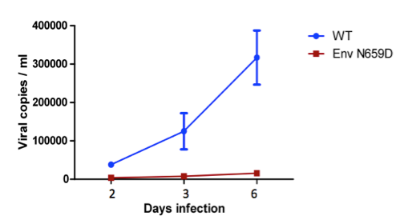
Results
Figure 1: Quantification by RT-qPCR of viral copies produced by infected H9 cells after 2, 3 and 6 days (n=3, mean ± s.d.).
Env N659D mutant shows a significant lack of release compared to wild type virus (8-fold decrease of viral release)
➔ Is this lack of release related to a lack of antagonism to BST-2 ?
Notes:
This graph shows the quantification of viral copies released by infected H9 cells at 2, 3 and 6 days post-infection.
The blue line represents the data for the HIV-2 WT virus and the red one the data for the HIV-2 Env N659D mutant. All experiments were performed in triplicate
Env N659D mutant shows a significant lack of release compared to wild type virus (8-fold decrease of viral release)
Is this lack of release related to a lack of antagonism to BST-2? Or to another viral process (like a lack of production or a disruption of Env adressing)?

Slide 18
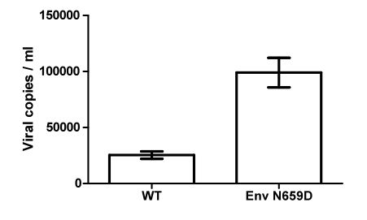
Results
Figure 2: Quantification by RT-qPCR of viral copies released after the treatment with subtilisin (3 days post-infection; n=3, mean ± s.d.).
➔ Subtilisin treatment reveals that the mutant virus is more « tethered » at the cell surface than HIV-2 wild type virus
Notes:
To prove that (partially prove), we perform the subtilisin treatment of the infected cells.
This graph shows the quantification of viral copies released (« detached ») by subtilisin treatment.
This result is in agreement with a lack of antagonism to BST-2. To further prove this lack of antagonism to BST-2, we perform a FRET-based assay.

Slide 19
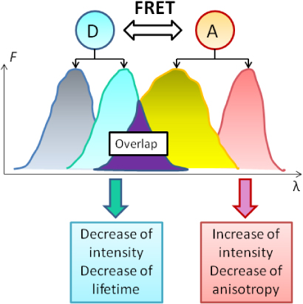
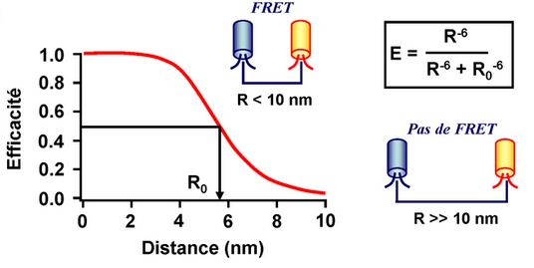
Study design and protocol (2)
FRET-based assay: set up of a FACS AriaTM to assess the intermolecular link between BST-2 and HIV-2 Env WT, then compared to Env N659D mutant previously described.
- FRET principle:
Efficacity
No FRET
Notes:
We will set up of a FACS Aria to assess the intermolecular link between BST-2 and HIV-2 Env wild type. Since antagonism to BST-2 necessitates a link, we furthermore study the binding capacity of HIV-2 Env mutant.
FRET (for Forster Resonance Energy Transfer) is an energy transfer from a donor fluorochrome to an acceptor fluorochrome. It’s one of the means to assess a protein:protein link.
This transfer appears only if the two fluorochromes are at a distance of less than 10 nm.
In FRET, the emission of the acceptor fluorochrome is enhanced, as we can see in this image.

Slide 20
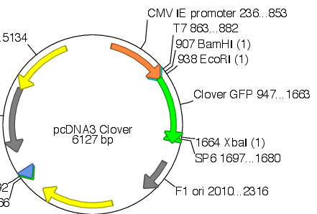
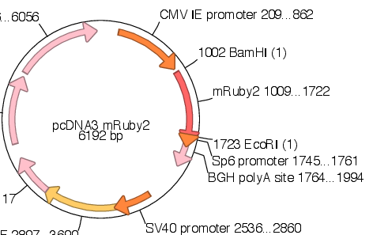
Study design and protocol (3)
- Construction and expression of fluorescent fusion proteins
GFP
(clover)
BST-2 protein
C terminal
Env protein
RFP
(mRuby)
C terminal
Notes:
The aim is to create fluorescent fusion proteins, namely Env and BST-2, each fused with either a donor fluorochrome or an acceptor fluorochrome.
We used two distinct fluorochromes-coding plasmids to clone the BST-2 or HIV-2 Env WT or mutant coding sequences. Through restiction sites, we are able to clone the protein coding sequence upstream or dowstream to fluorochrome DNA sequence into plasmid.
In our study, the donor fluorochrome is called Clover (a GFP variant) and the acceptor fluorochrome is called mRuby2 (a RFP variant). We constructed two fusion proteins as we can note in this slide.
293T cells (or HeLa cells) were co-transfected with these two plasmids encoding fusion proteins.

Slide 21
Study design and protocol (4)
- Fusion proteins topology and FRET
BST-2
Env
Membrane
Cytoplasm
RFP emission
GFP emission
GFP
(clover)
E
RFP
(mRuby)
Increased emission of RFP = FRET
488 nm laser
excitation
567 nm laser excitation
Notes:
48h after cotransfection, BST-2 fused to Clover and HIV-2 Env fused to Ruby are expressed into the cells.
The proteins are transmembrane proteins and fluorochromes are intracellular.
If proteins form a complex and therefore are close, fluorochromes will be close too. This closeness permits an energy transfer.
Ruby will produce an increased emission and we can analyse this FRET signal with a FACS Aria using an appropriate filter
We used two lasers simultaneously, to ensure that Ruby is expressed.

Slide 22
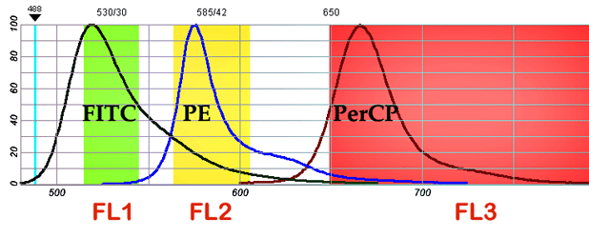
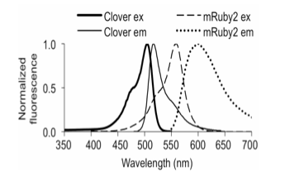
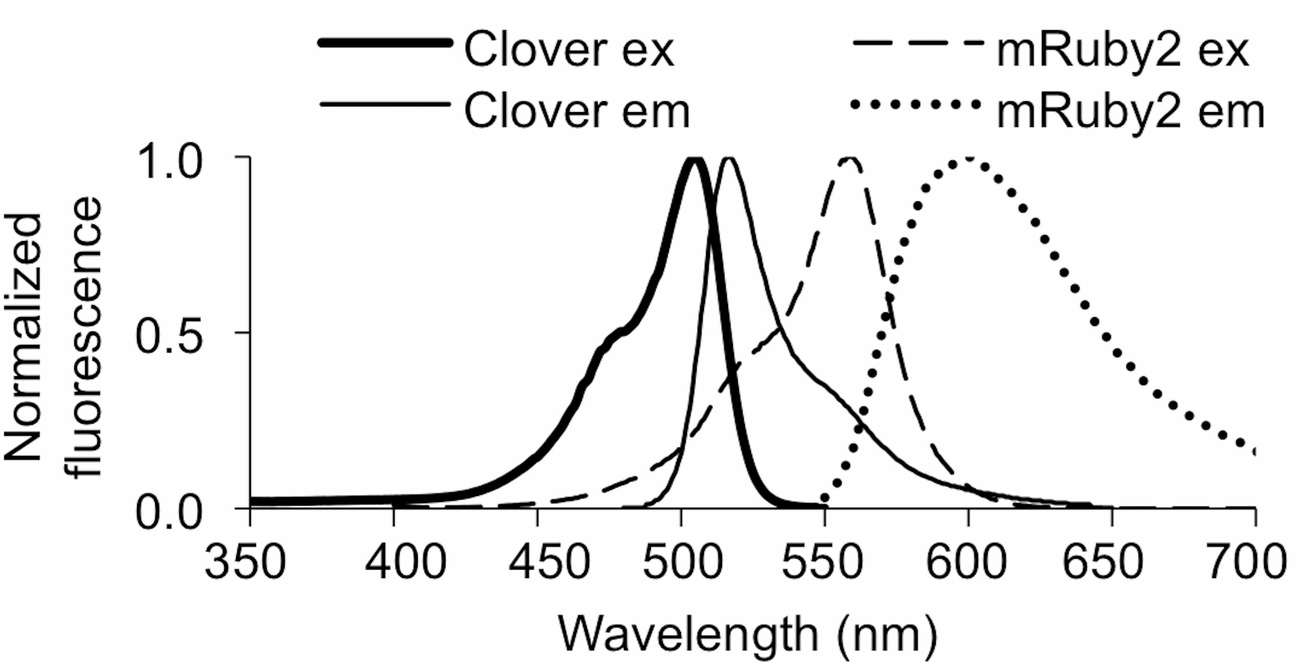
Study design and protocol (5)
- Fluorochromes emission spectra (Clover-GFP and Ruby-RFP) and FACS filters
For Clover
For Ruby
For FRET
Notes:
Initialy, FACS Aria hasn’t been created to assess FRET signal, but this engine is equipped of a panel of different filters. So this engine offers this possibility when we choose the appropriate filters.
We observed in this slide the emission spectrum of each fluorochrome.
Clover produces a fluorescence emission between 510-530 nm. We used the FITC filter to analyse this femission
Ruby produces a fluorescence emission about 600 nm. We used the PE filter (PE-mCherry)
And for the FRET signal, the increased emission of Ruby is between 630 and 700 nm. Therefore we used a third filter to analyse the real FRET signal. This filter is called PerCP

Slide 23
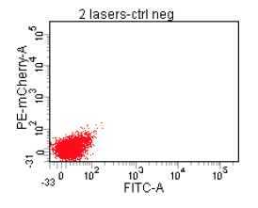
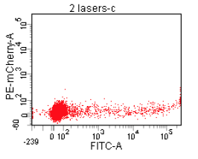
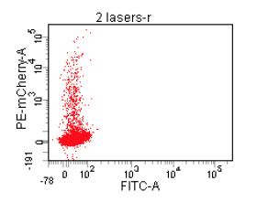
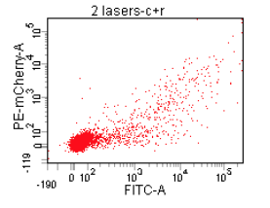
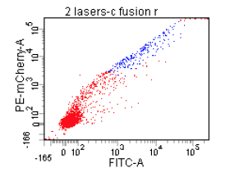
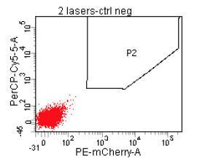
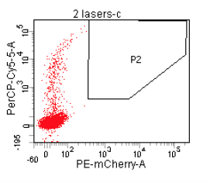
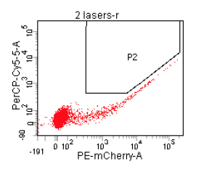
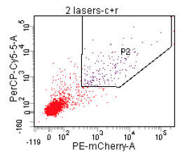
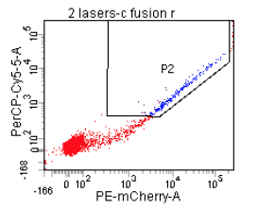
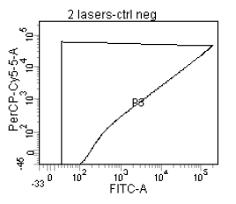
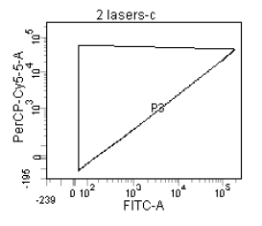
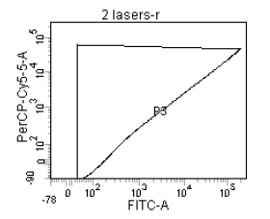
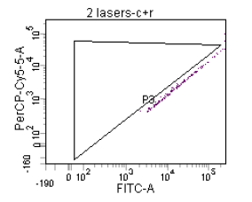
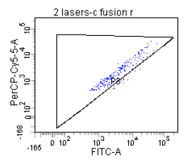


FACS configuration
Mock
Clover
Ruby
Clover + Ruby
Clover fus. Ruby
Notes:
We had to set up the FACS Aria.
The cells were transfected or cotransfected with several appropriate controls to enable the FRET analysis.
First, a negative control. Cells were transfected with an empty backbone. As we can see, there is no signal.
Second, cells were transfected with the clover-expressing plasmid. We noted a normal signal in FITC filter. Nevertheless, there is a signal in the PerCp filter. It was unexpected. Clover seems to go over in this filter. This is a background noise, we had to exclude it. So we began to build a gate (the black stroke)
Third, cells were transfected with the ruby-expressing plasmid. We noted a normal signal in the PE-mCherry filter
Again, there is a signal in the PerCP filter but FRET is impossible. We finished to build the gate P2 in order to exclude this signal.
Fourth, cells were cotransfected with clover and ruby-expressing plasmids. We obtained a aleatory FRET signal, which is the purple dots in P2. This « false-positive » signal is also observed in the third window. This window shows the two appropriate filters to assess FRET signal (FITC and PerCP). We had to also exclude this signal. Therefore, we built a second gate P3. The gate serves as to analyse the real FRET signal. In this case, this gate contains 0% of positive FRET cells.
Finally, cells were transfected with a plasmid expressing the fused fluorochromes (clover fused to mRuby). It’s a robust positive control to assess the FRET signal
The gate P3 contains 95% of cells included in P2 or 2,7% of grand parental positive cells. We normalized this result as the 100% of positive FRET signal

Slide 24
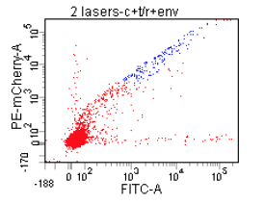
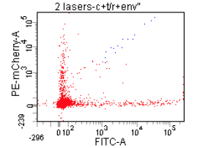
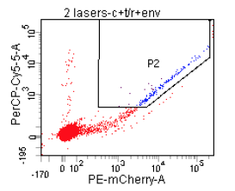
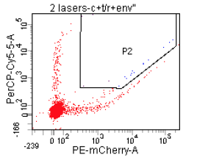
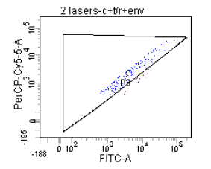
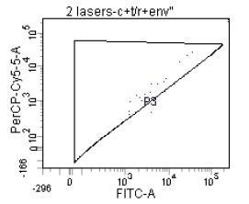


Results (FACS-FRET)
Notes:
Once the FACS is configured, on one hand we tested the capacity of HIV-2 Env wild type to bind Tetherin, and on the other hand we tested the binding capacity of our HIV-2 Env mutant virus that showed a dramatically lack of released from infected cells.
The left panels show the results for the cotransfection of BST-2 fused to Clover and HIV-2 Env WT fused to Ruby.
We note that 1,9% of grand parentals cells are FRET positive. I remind that the positve control of FRET has been normalized at 2,7
The right panels show the results for the cotransfection of BST-2 fused to Clover and HIV-2 Env N659D mutant fused to Ruby.
We note that 0,2% of grand parentals cells are FRET positive.
This mutant is not capable to bind to BST-2 any more. Hence the decreased viral release that we had observed.

Slide 25
Conclusions
N659D mutation is located in the HIV-2 gp36 ectodomain part interacting with BST-2
The results demonstrate that this HIV-2 mutant shows a significant lack of viral release and is more tethered at the cell surface
FACS-based FRET assay confirms that BST-2 and HIV-2 Env proteins form a protein complex. The antagonism necessitates an intermolecular link.
The N659D mutation hinders the viral release and it is certainly due to a lack of antagonism to BST-2: this Env mutant is not capable of binding to tetherin any more
We demonstrate and confirm that this residue is involved in the antagonism to BST-2 and a single amino acid substitution inhibits this antagonism

Slide 26
Perspectives
Performing a CRISPR-Cas9 KO of bst-2 gene expression in H9 cells.
Experiment of viral release from infected PBMCs.
Sequencing of Env sequences from HIV-2 positive individuals. Do we observe sequence variability in the interacting part with BST-2?
Some allelic variants in the gene promoter influencing the transcription level were described: association with faster disease progression in HIV-1 (Laplana et al., 2013)
We intend to study this hypothesis by sequencing bst-2 gene from HIV-2 positive patients
➔ Association with HIV-2 disease progression for bst-2 variants?
Notes:
To confirm, we are performing a CRIPS Cas9-based KO of the bst2 gene expression.
Cells without BST-2 will be infected with this mutant virus and we expect to note that this mutant will be released at least at the same level than the WT virus

Slide 27
Acknowledgements
- The team involved in research projects at the ARL-UCL:
  Dr Jean Ruelle
  Léonie Goeminne
  Anne-Thérèse Vandenbroucke
  Armelle Duquenne
  Philippe de Sany
  Dr Patrick Goubau
At the Luxembourg Institute of Health:
  Karthik Arumugam
  Danielle Perez-Bercoff
  Carole Devaux
- Belgian ARLs, AIDS reference centres, ISP/WIV
- AcHIeV2e collaborators
- HIV-2 EU resistance tool: Ricardo Camacho, Diane Descamps, Charlotte Charpentier, Martin Obermeier, Rolf Kaiser, Lutz Gürtler, Martin Stuermer, Alejandro Pironti, Josef Eberle.

Slide 28
