Slide 1
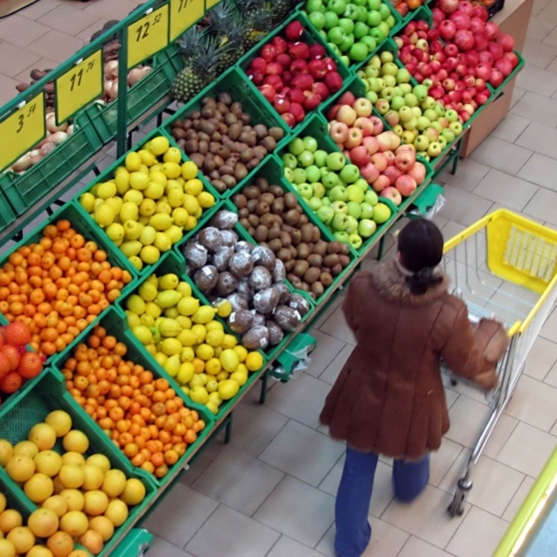
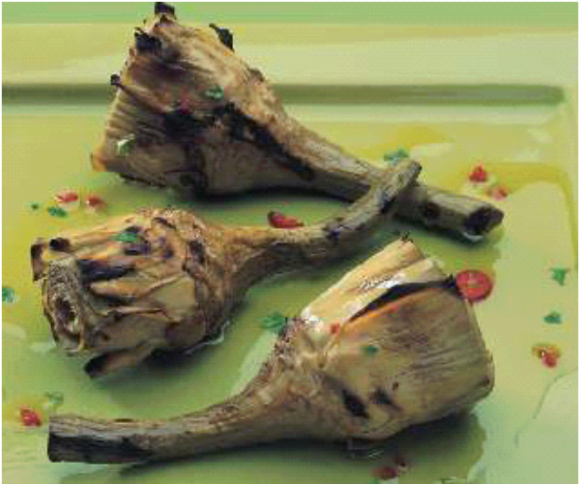
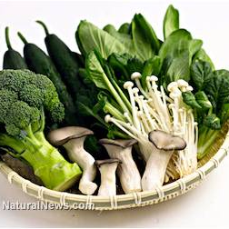
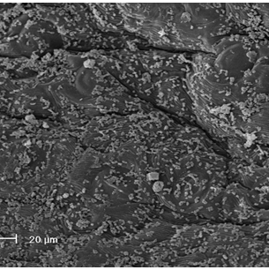

Track 11/SubTrack 11-5: Probiotic foods and beverages
Probiotic vegetable foods containing health promoting molecules.
F. Valerio, S. L. Lonigro, M. Di Biase, Sisto, A. De Bellis P., M. Dekker, P. Lavermicocca

Slide 2
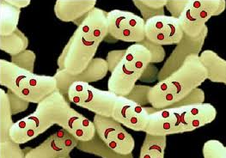
Vegetables as carriers of probiotic cells and bioactive compounds
The functional benefits of probiotic vegetable foods are linked to the presence of health promoting molecules - polyphenols, glucosinolates, vitamins, monounsaturated fatty acids, prebiotic sugars, etc. - as well as to the high count of live probiotic cells able to colonize the human gut (Lavermicocca et al., 2005; Valerio et al., 2011).
The use of a probiotic strain as a starter can allow the consumption of probiotics in fermented vegetables as an alternative to the milk-based products.

Slide 3
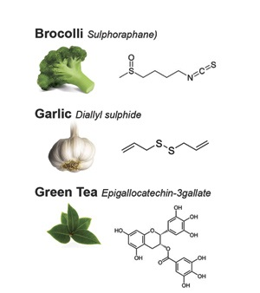
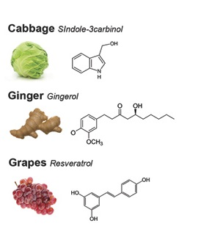

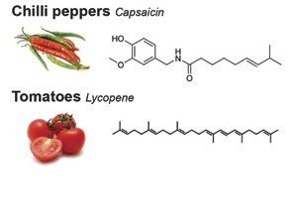
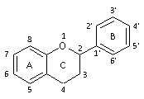
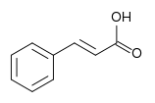
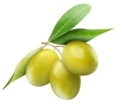
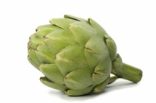
Secondary Plant Metabolites
Some examples from > 10,000 compounds:
Broccoli Sulphoraphane
Olives polyphenols
Artichokes hydroxycinnamic acids
Support the survival of the probiotic L. paracasei LMG P22043

Slide 4
Ability to adhere to Caco-2 cells, survival to low pH and bile salts, survival during simulated gastric and intestinal digestion
Human isolate
Immunomodulatory activity in transgenic mice
Realization of probiotic vegetable gastronomy
Inhibition of bacterial pathogens
L. paracasei IMPC 2.1 LMGP22043
Application of the strain in the manufacturing process of debittered green olives cultivar “Bella di Cerignola”
Good survival on vegetable surface
Colonization of the human gut

Slide 5

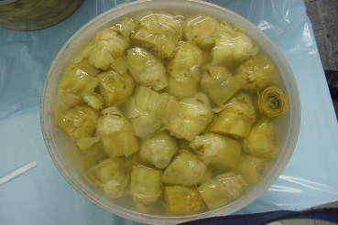
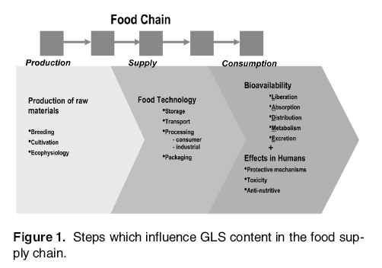
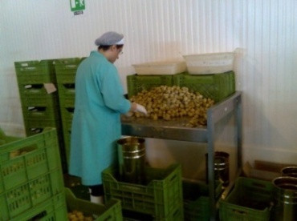
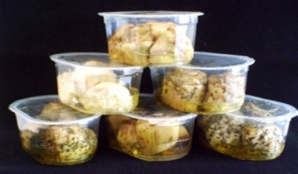
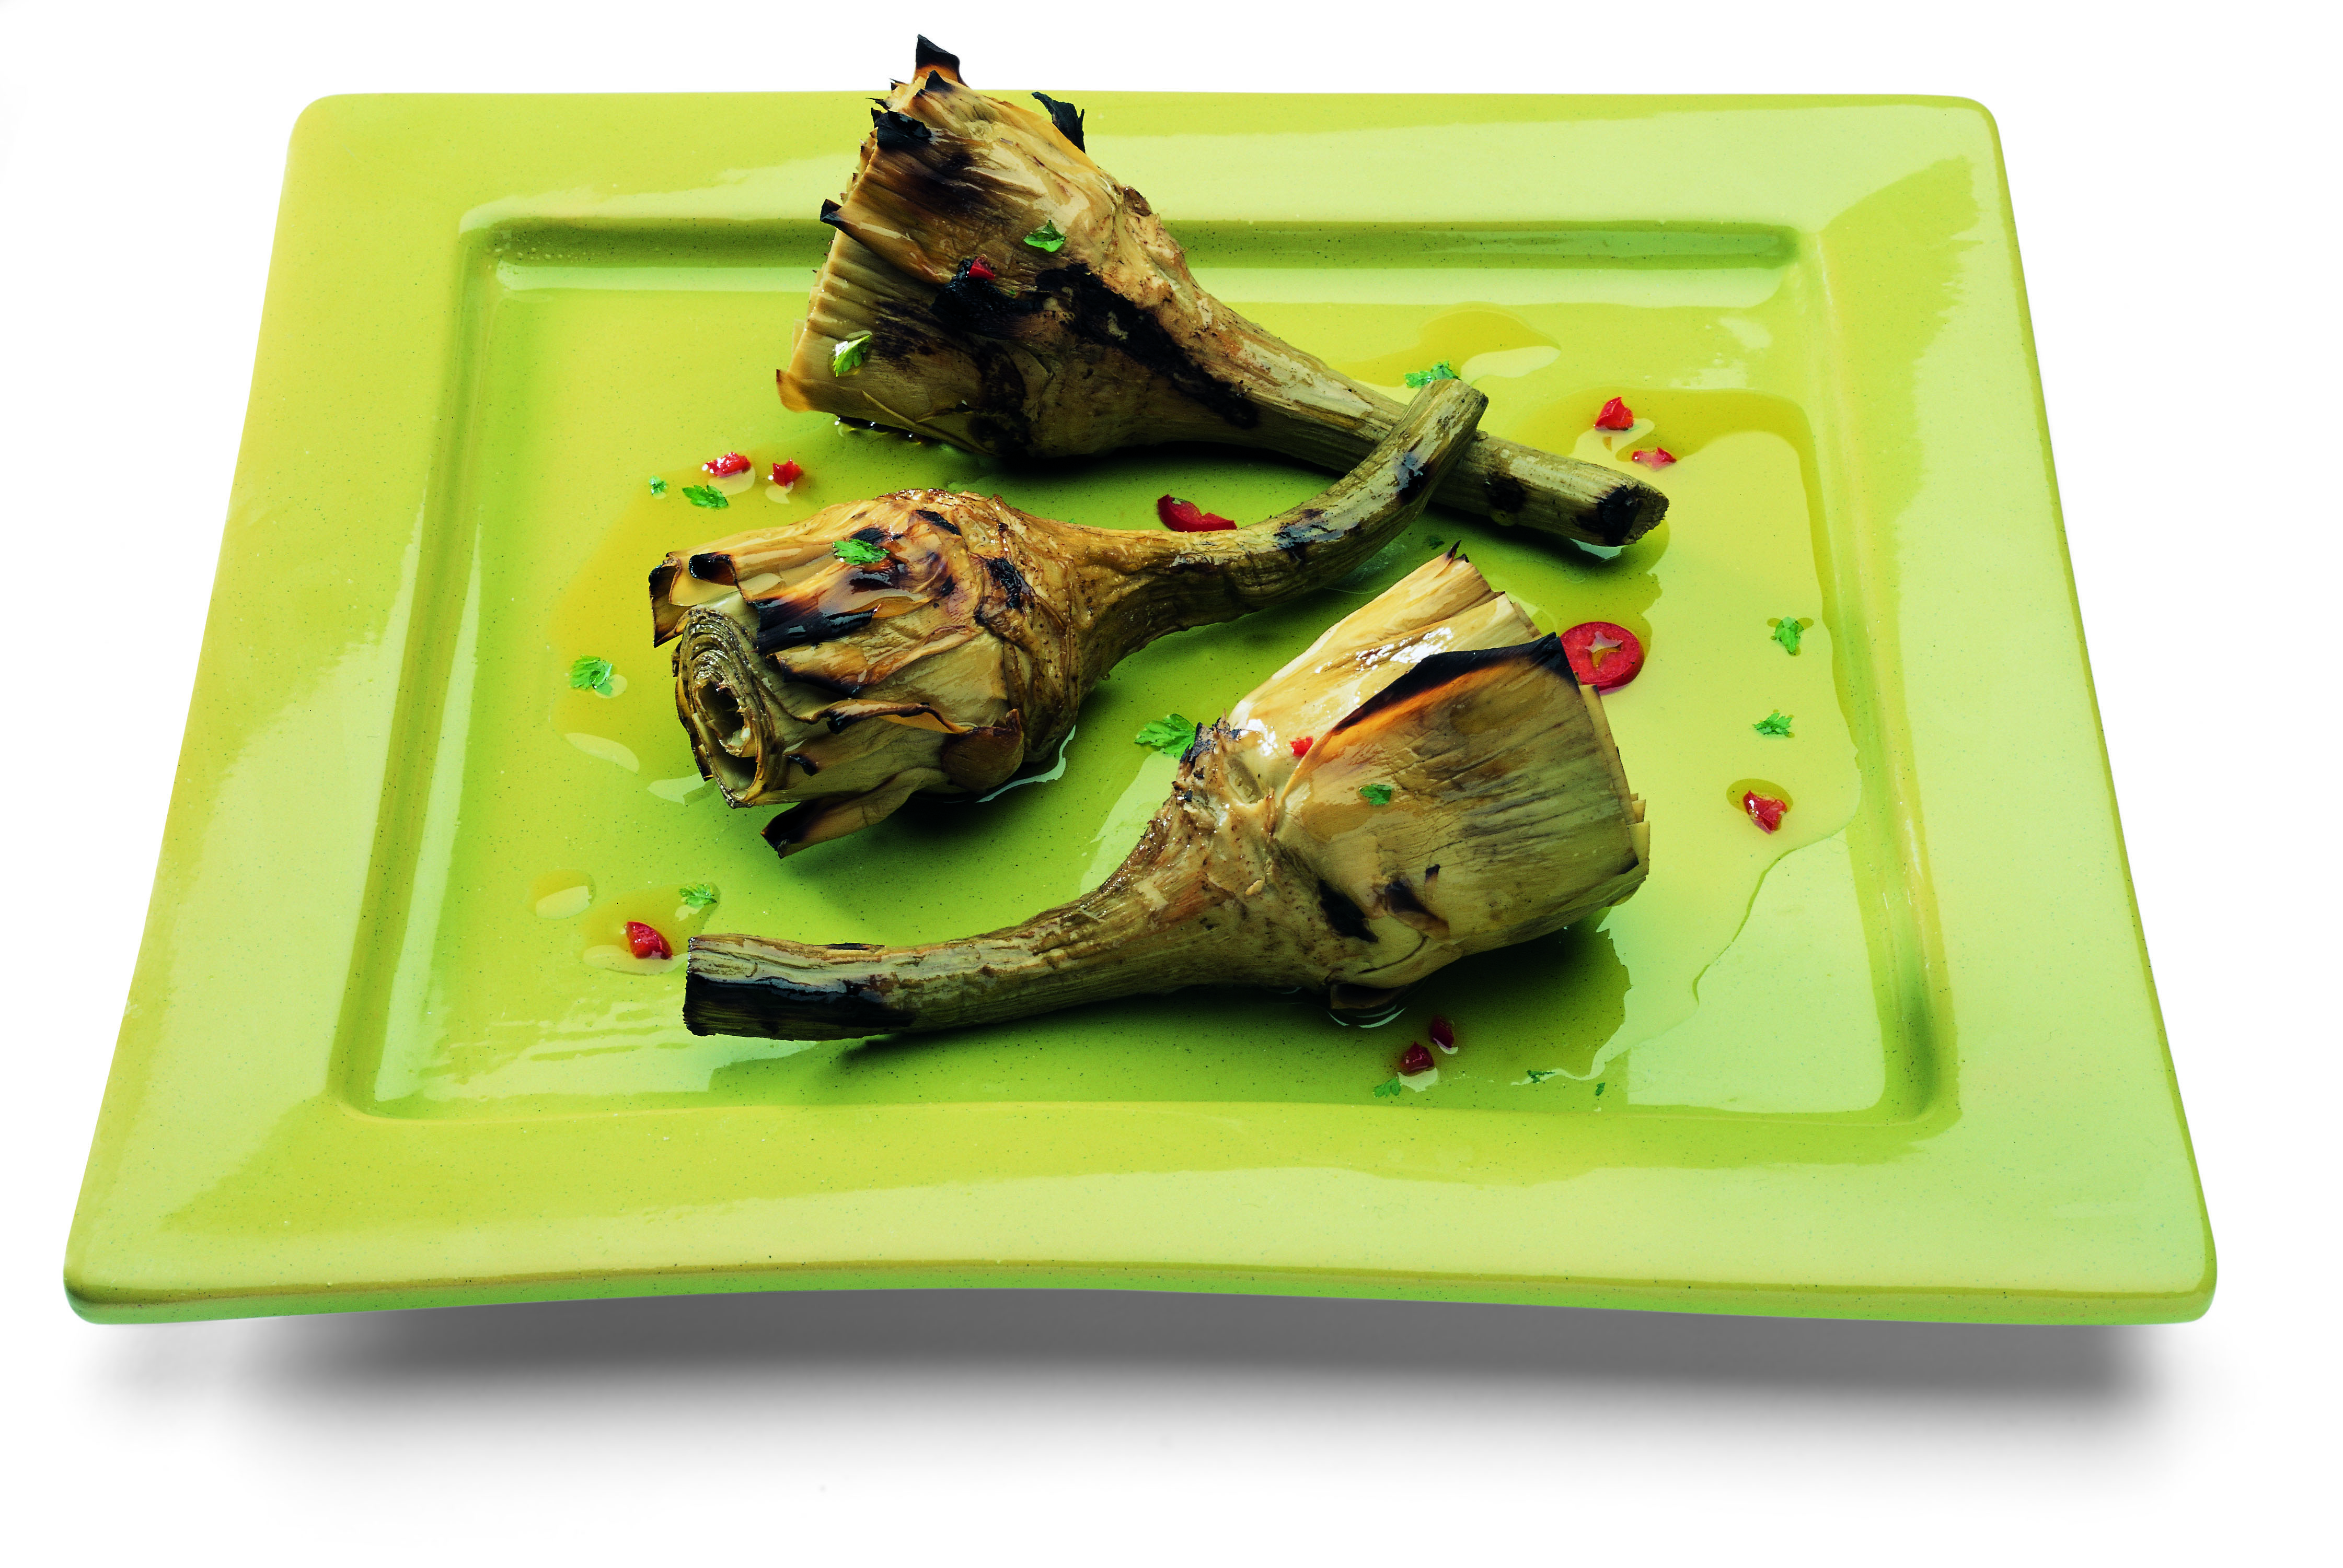
Vegetables as probiotic carriers
The efficacy of a probiotic food mainly depends on the ability of the probiotic strain to survive during processing and/or to compete with metabolically active microorganisms occurring in the food matrix.

Slide 6
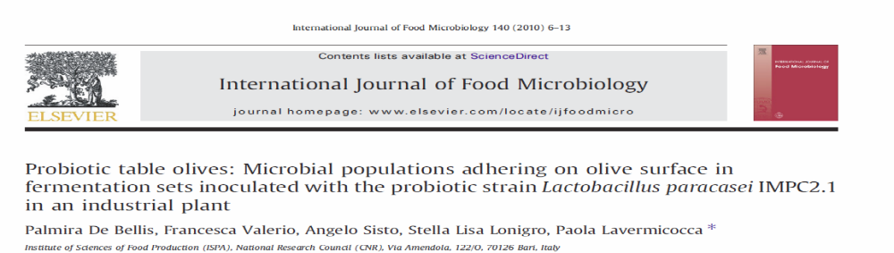
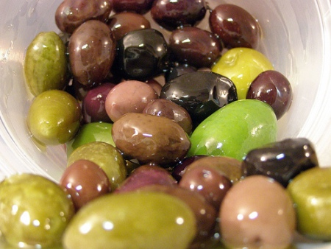

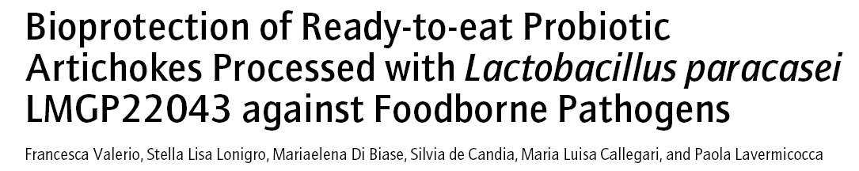

L. paracasei LMG P22043 during vegetable processing

Slide 7
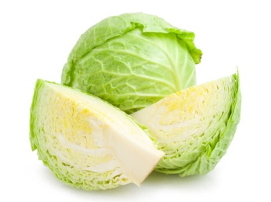
Brassica vegetable as a carrier for delivering probiotic cells into the gut
Cabbage (Brassica oleracea var. capitata) is a cruciferous vegetable.
Glusosinolates (GSs): secondary plant metabolites with anticancer effect (Kim & Park, 2009; Steinbrecher et al, 2009):
The GS content and pattern will differ between varieties, but depend also on breeding location and conditions.
Sauerkraut: spontaneous or started lactic acid fermentation of shredded and salted white cabbage, which allows a rapid decline in pH of the product and prevents spoilage .
Traditional fermentation of cabbage (sauerkraut): no detectable GSs left in final product

Slide 8
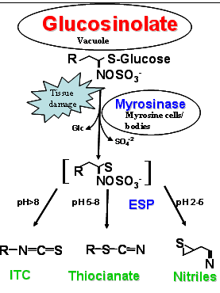
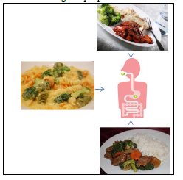
Glucosinolate’s hydrolysis
up to 40% of ingested GSs can be hydrolyzed by the human gut flora as well (Fahey et al, 2012) and the bioactive breakdown products can enter the human body.
Isothiocyanates (ITC) recognized as bioactive compounds

Slide 9


Glucosinolate loss during processing
Plant tissue
Processes affecting GSs
Initially:
Cell lysis
Diffusion of enzymes
Diffusion of GSs
Enzymatic GSs hydrolysis
At higher T:
Enzyme denaturation
GSs degradation

Slide 10
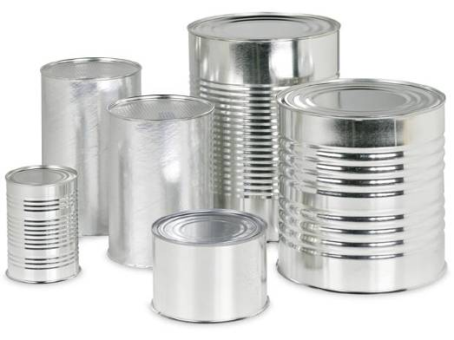
Process Simulation
5%

Slide 11
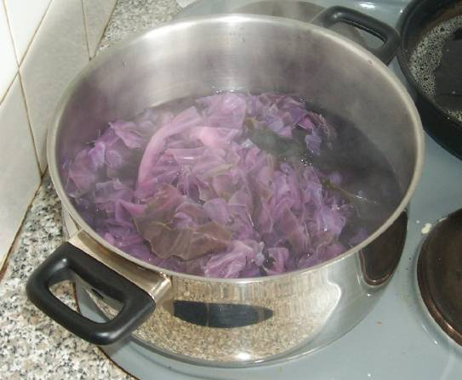
Process Simulation
25%

Slide 12
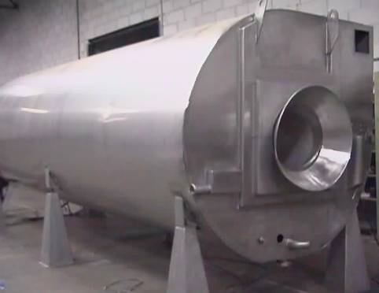
Process Simulation
65%

Slide 13
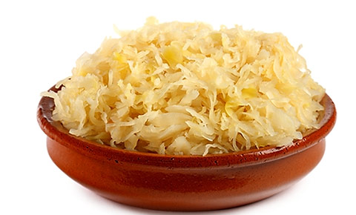
Probiotic Fermented Cabbage with GSs
Develop a ‘functional’ sauerkraut!
  Containing probiotic bacteria
  Containing GSs
Assumption:
  Endogenous myrosinase is cause of GS loss
  Blanching can inactivate myrosinase
  Blanching can reduce the presence of contaminants
  Probiotic strain can be added after blanching and before fermentation

Slide 14
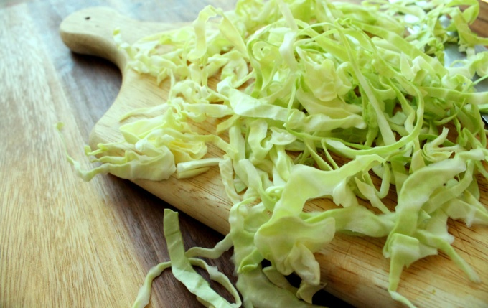

Behaviour of L. paracasei LMGP22043 during storage of blanched white cabbage and fate of GSs content
cooking at 100°C for 5 min BLANCHING
Inactivation of myrosinase
Inoculum with L. paracasei (1x10⁵ CFU/g) (4% brine)
Growth kinetic at 25°C
Glucosinolate content
L . paracasei monitoring
Cabbage drained from brine after fermentation (71 h) vacuum packed and stored at 4°C

Slide 15
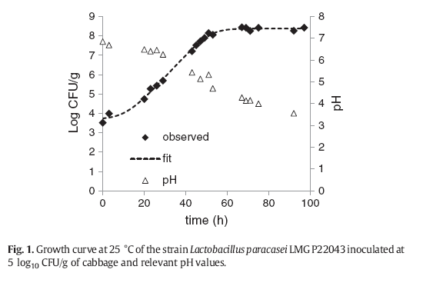
L. paracasei LMG P22043 growth during blanched cabbage

Slide 16
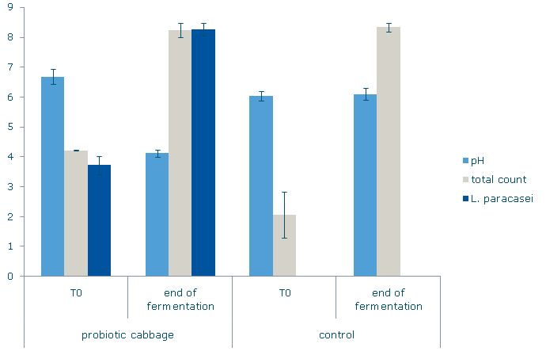
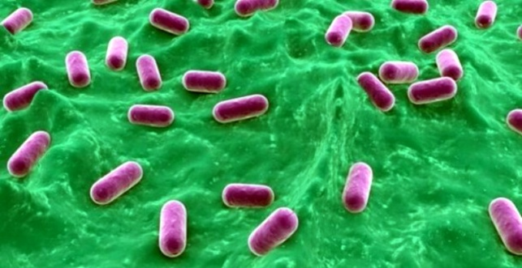

FERMENTATION OF BLANCHED CABBAGE
L. paracasei inoculum (3.72 log₁₀ CFU/g)
LOW pH VALUES
INHIBITION OF UNDESIDERABLE MICRORGANISMS
GOOD FINAL QUALITY
Inoculum load 1000 times lower than that usually used in industrial practices for vegetable fermentation

Slide 17
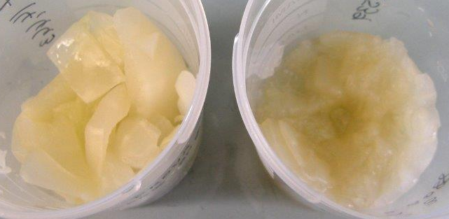
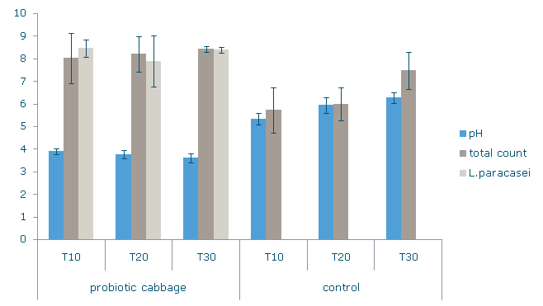
Probiotic survival in vacuum packed cabbage during refrigerated storage
The probiotic population remained steady over 8.00 log₁₀ CFU/g
Vacuum packaging storage at 4°C
9 log CFU of live probiotic cells should be daily consumed to have functional effects
10 g of probiotic cabbage could be enough to deliver 9 log CFU of probiotic cells
No L. paracasei in control cabbage
Probiotic cabbage
Days of storage
Control

Slide 18
Glucosinolate content
About the 50% of GS was preserved
About the 35% of GS of the blanched material was preserved after fermentation

Slide 19
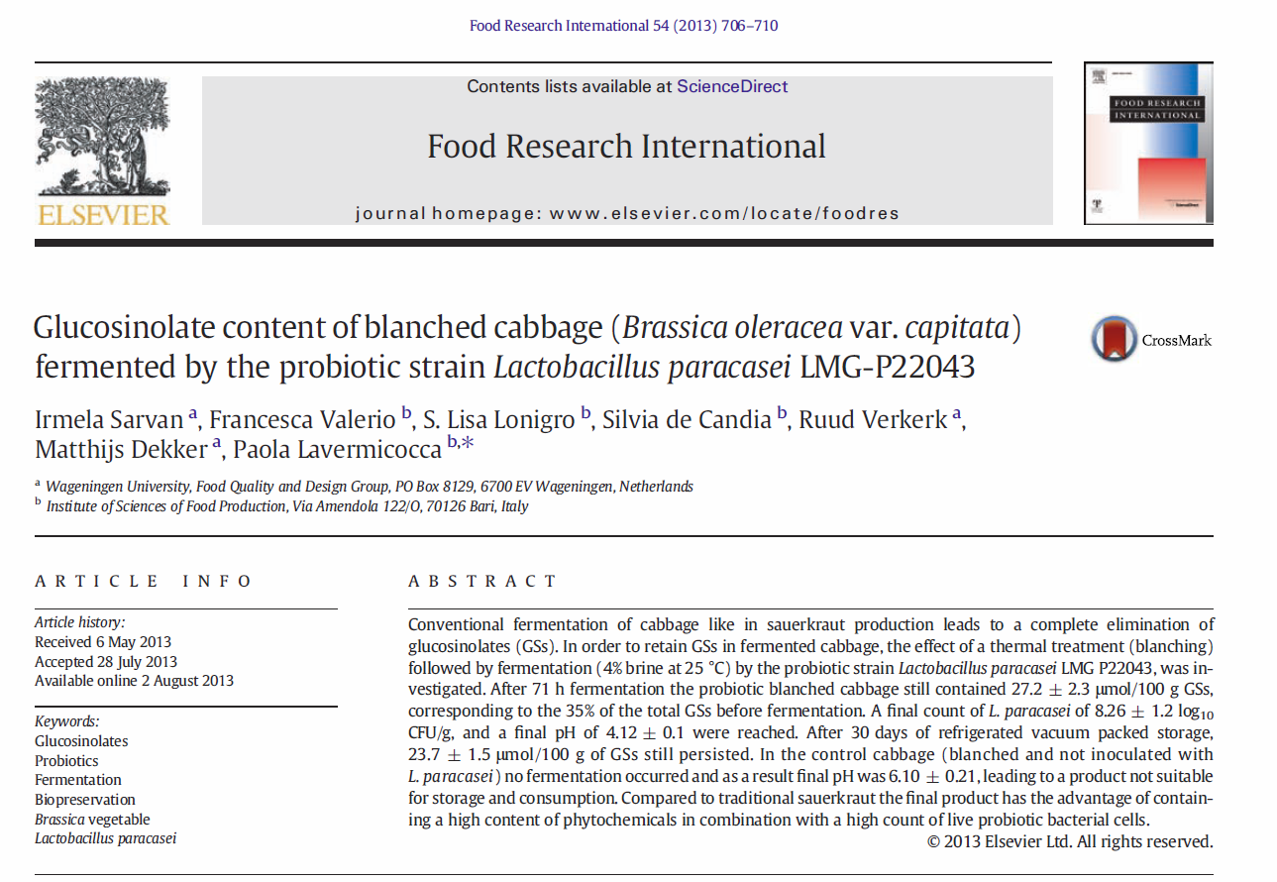
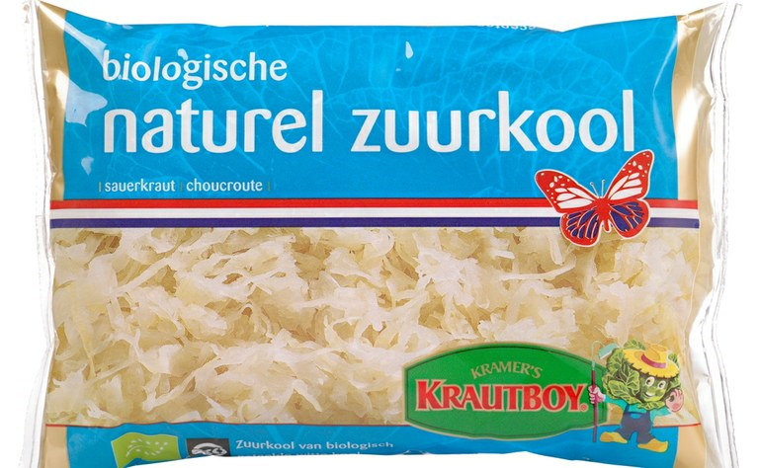
FUNCTIONALKRAUT
CNR-ISPA & WUR
Probiotic
& Glucosinolates

Slide 20
Conclusions
Glucosinolates (GSs) are important for human health and cabbage is a rich source
Processing affects the GSs content
Traditional sauerkraut does not retain GSs
Inactivating cabbage myrosinase retains GSs during fermentation
A probiotic bacteria can be used to ferment blanched cabbage
The final probiotic sauerkraut contains an adequate amount of live probiotic cells which can ensure a daily consumption of 9 log cfu of cells
A ‘functional’ sauerkraut is produced
containing both GSs and probiotics!

Slide 21

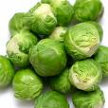
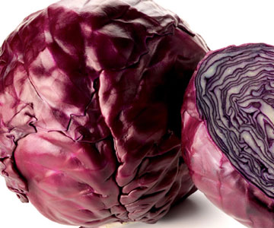
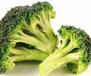
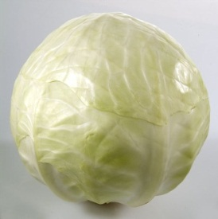
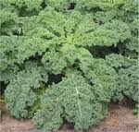
Questions?

