Slide 1




Effects of Highly Diluted Acetylcholine on Nonneuronal Cholinergic System in Keratinocytes
Uberti F,
Physiology Lab. & noiVita Spin Off, Dept of Translational Medicine, UPO
Novara, Italy
Notes:
1

Slide 2
Problem of wound
Slow healing wounds featuring classic pressure injuries are a major burden to patient suffering but also cost to the healthcare system.
Various treatments have been proposed, but full and rapid wound repair remains an open challenge.
The main problem of skin re-epithelialization or mucosal wounds is the lateral migration of epidermal keratinocytes (KC).

Slide 3
Acetylcholine and non neuronal cholinergic system
KC functions (viability, proliferation, and migration) depend on a fine balance in control pathways in which the nonneuronal cholinergic system plays a major role
This system involves acetylcholine (Ach) and its nicotinic and muscarinic receptors via autocrine and paracrine mechanisms.
Ach is not only a neurotransmitter but is an ancient molecule that can be released by and act on non-neuronal cells present in a wide range of living organisms
To date, studies on the biological role of Ach have mainly focused nonneuronal cell functions

Slide 4
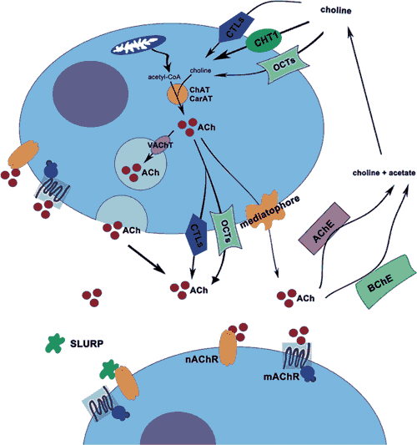
Non colinergic system and skin
KC are able to synthesize ACh in large amounts: a single KC synthesizes and releases a mean of 2 × 10⁻¹⁷ mol ACh and 7 × 10⁻¹⁹ mol ACh per minute, respectively.
Skin exhibits molecular components of the NNCS and it is assumed to regulate proliferation, differentiation, apoptosis, adhesion and migration of KC

Slide 5
Acetylcholine and Keratinocytes
Ach or a cholinergic drug exert different effects on KC during their maturation [Grando et al., 2006].
Several important functions, including control of cell viability, proliferation, adhesion, migration, and differentiation, have been also attributed to muscarinic receptors in KC [Beck et al., 2006].
Simultaneous stimulation of nicotinic and muscarinic receptors by Ach may be necessary to synchronize the metabolic and ionic events within cells.

Slide 6
Acetylcholine a new strategy
In recent years, the study of skin trophism, lead to identifying new therapeutic strategies for skin diseases: some evidence is available about the therapeutic capability of cholinomimetics or blockers in two important skin diseases, i.e., pemphigus or psoriatic lesions [Grando et al., 1993, 2006].
The role of nonnervous Ach in KC could have important clinical implications for patients with various skin disorders such as nonhealing wounds

Slide 7
Therapeutic Application
Main problem: the therapeutic use. Ach is a highly reactive molecule and consequently, its use can lead to systemic side effects [Beck et al., 2006]
ii) Main problem: ACh has a very short half-life being metabolized by acetylcholinesterase
Main solution: cholinergic information transmitted by ultra-diluted and activated acetylcholine can provide natural tonic stimulation that can promote the proliferation of keratinocytes in the wound repair process.

Slide 8
Low Dose Application
A promising way to obtain a fine regulation of physiological mechanisms could be the use of highly diluted substances (Low Dose)
IL-12 in modulation of Th1 versus Th2 was demonstrated in an asthma preclinical model suggesting a novel therapeutic approach to diseases which involve a Th1/Th2 imbalance [Gariboldi et al., 2009]
Low dose SKA cytokines have been demonstrated to have a significant beneficial effect in skin diseases both in patients and in cultured cells
[Barygina et al., 2015; Radice et al., 2015]

Slide 9
Low Dose SKA
Highly diluted forms have been obtained via a sequential kinetic activation (SKA) technique
The activated solutions, were kinetically energized by a mechanically applied force via a standardized shaking process called SKA; the applied shaking procedure is characterized by vertical shaking, a 10-cm motion range, and a shaking speed corresponding to 100 oscillations in 10 s.

Slide 10
Aim of the project
Thus, the aim of this study is to evaluate the effects of highly diluted Ach solutions obtained by SKA on cultured normal human KC on an in vitro incisional wound model in order to confirm the hypothesis that a highly diluted form (Low Dose) of Ach could be a greater physiological stimulus for KC viability and proliferation.

Slide 11
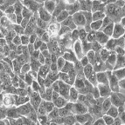
Methods
NHEKs cell line: a primary normal human keratinocyte used in scientific research, utilized for their high capacity to proliferate in vitro. They were purchased from Lonza (Basel, Switzerland) and cultured in KBM medium (Lonza, Basel, Switzerland) containing KGM 2 growth supplements (Lonza,Basel, Switzerland) in a incubator at 37°C, 5% CO2 and 95% humidity. Experiments were conducted at passage 3-6.

Slide 12
Methods
Cell viability MTT test
Cell proliferation Crystal violet
(cell counting)
Cell migration Woundhealing
Intracellular mechanism Western blot
Analysis of mitocondria ROS, potential membrane, oxygen consumption

Slide 13
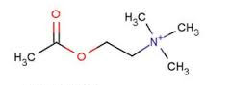

Methods
in physiological solution to prepare
Ach 1 μg/ml
10 fg/ml (Ach 5.26x10⁻¹⁴moli/l corrispondenti a 10fg/ml)
1 pg/ml (Ach 5.26x10⁻¹² moli/l corrispondenti a 1pg/ml).
NO SKA
SKA

Slide 14
Methods
Control
Ach 1 μg/ml
Ach SKA 1pg/ml
Ach SKA 10fg/ml
Ach NO SKA 1pg/ml
Ach NO SKA 10fg/ml
In presence or absence of:
Atropine (muscarinic antagonist)
H89 (inhibitor of PKA)
Cheleritrine (inhibitor of PKC)

Slide 15
Methods
Protocol A
Treatment only at the beginnig of experiment and stopped at 6 days (144h).
In this condition was also tested the mechanism using the specific inhibitor (30min before the stimulations)
Control
Ach 1 µM
Ach SKA 1pg/ml
Ach SKA 10fg/ml
Ach NO SKA 1pg/ml
Ach NO SKA 10fg/ml
Protocol B
Treatment each 24h till 6 days and stopped at 6 days (144h).

Slide 16
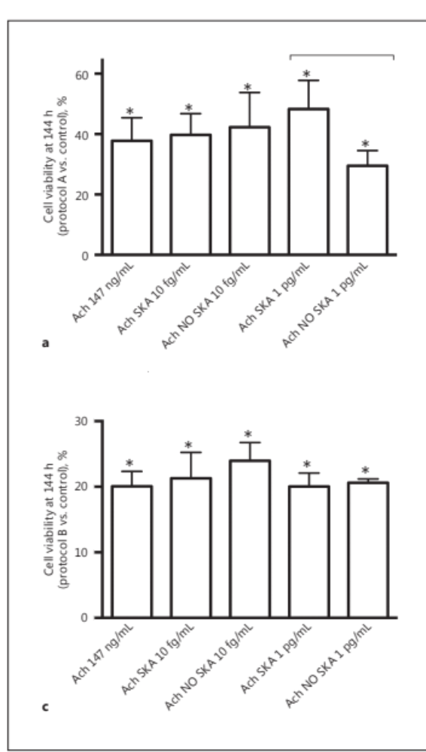
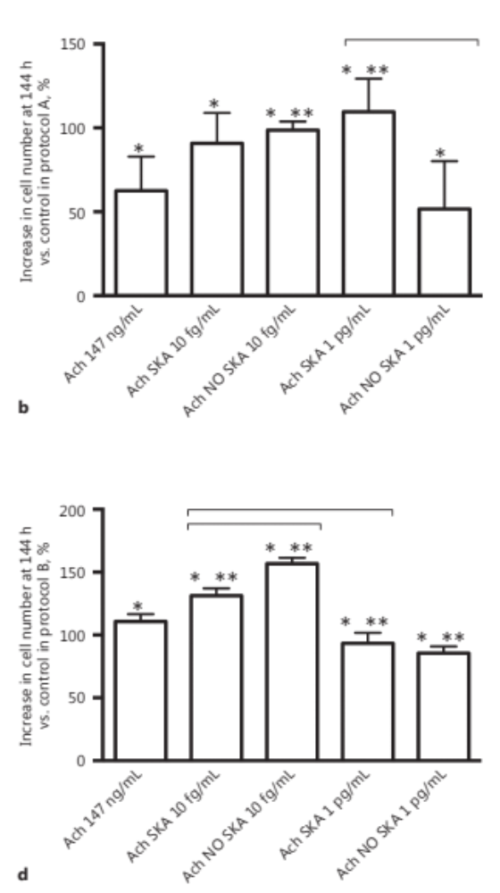
Results: cell viability and proliferation
Protocol A
1pg/ml SKA induced greater cell viability than others formulations
1pg/ml SKA induced greater proliferation than others formulations
* p<0.05 vs control; ** p<0.05 vs Ach 147ng/ml

Slide 17
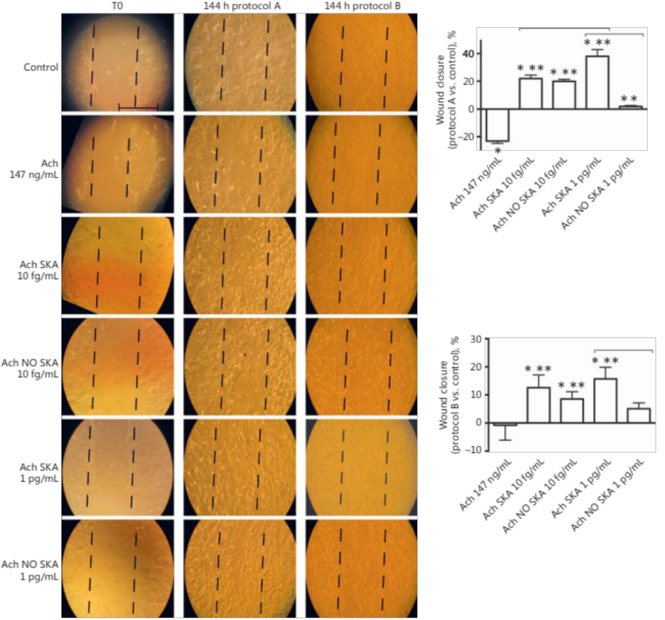
Results: wound healing
Only one stimulation with 1pg/ml SKA induced a major closure of wound after 6 days
Ach 147ng/m confirmed its negative effects
50µm
* p<0.05 vs control; ** p<0.05 vs Ach 147ng/ml

Slide 18
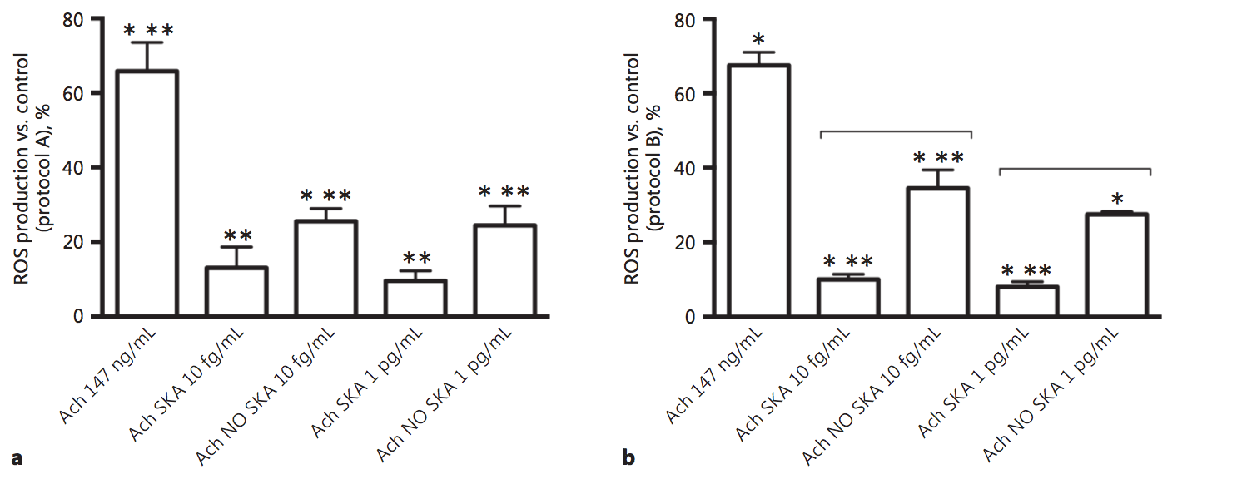
Results: ROS production
Ach 147ng/ml induced ROS production on both protocols supporting it negative effects on wound closure in a dose dependent manner
Ach 1pg/ml SKA showed a physiological effect on both protocol
* p<0.05 vs control; ** p<0.05 vs Ach 147ng/ml

Slide 19
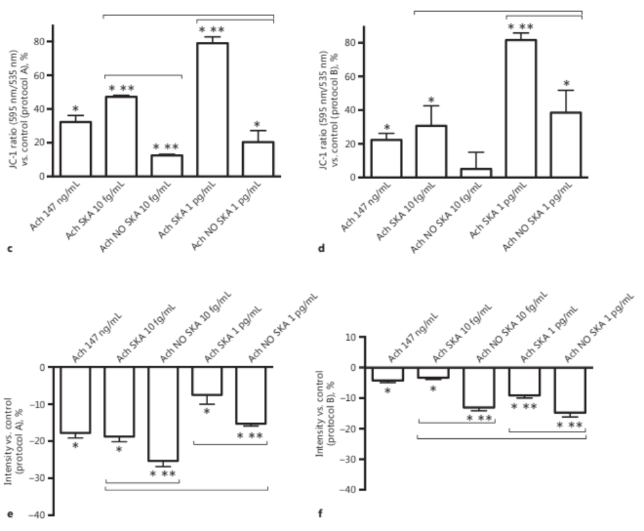
Results: Mitochondrial potential and Oxygen Consumption
Ach 1pg/ml SKA showed high mitochondrial potential with major evidence with protocol A
in a physiological manner explained by the reduction of oxygen consumption
* p<0.05 vs control; ** p<0.05 vs Ach 147ng/ml

Slide 20
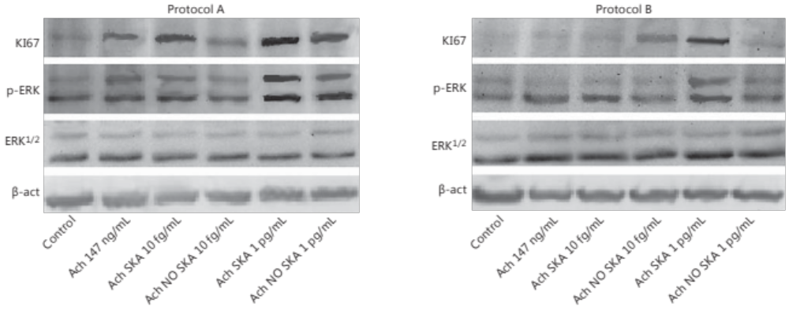
Results: Western blot analysis
Ki67 and ERK/MAPK in combination to exclude an uncontrolled proliferation of KC

Slide 21
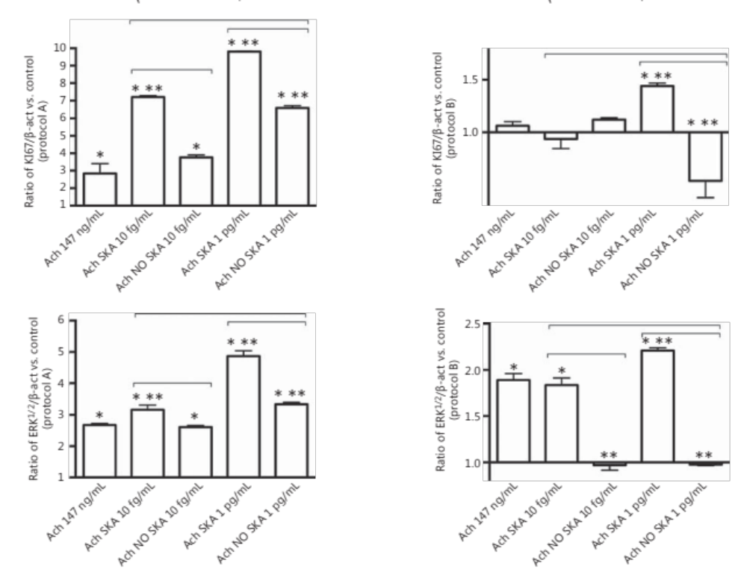
Results: densitometric analysis
Ach 1pg/ml SKA induced Ki67 confirming proliferation
Ach 1pg/ml SKA induced ERK expression indicating cellular health
* p<0.05 vs control; ** p<0.05 vs Ach 147ng/ml

Slide 22
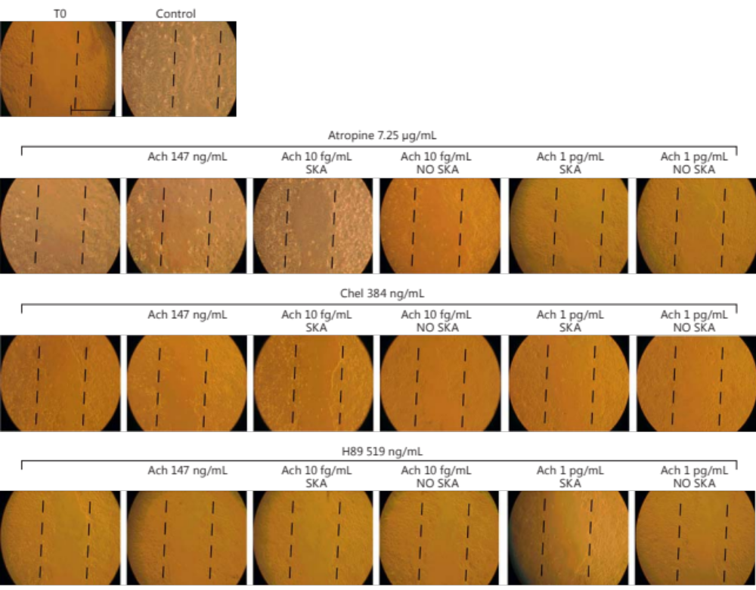
Results: wound with antagonist
Since the better effects were observed with protocol A than B, the specific mechanisms were analyzed only in Protocol A

Slide 23
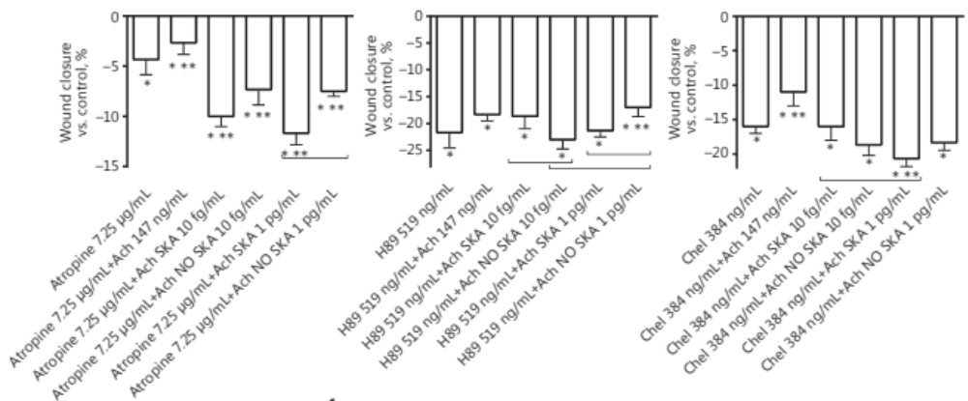
Results: wound with antagonist
The inhibition of M1, PKA and PKC prevented all wound closure, indicating the importance of M1 receptor, PKA/cAMP and PKC on wound closure
* p<0.05 vs control; ** p<0.05 vs Ach 147ng/ml

Slide 24
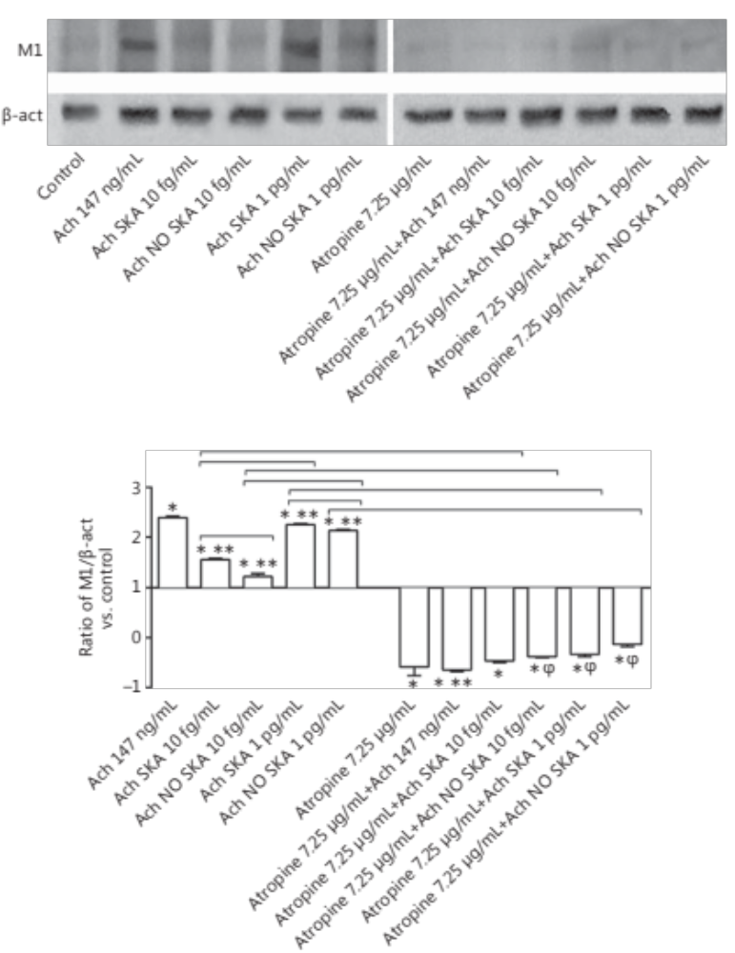
Results: Western blot and densitometric analysis of M1
The pre-treatment prevented the activation of M1, and successive stimulation with different formulations of Ach was not able to restore this condition.
* p<0.05 vs control; ** p<0.05 vs Ach 147ng/ml
These data confirm the involvement of muscarinic receptor on Ach effects

Slide 25
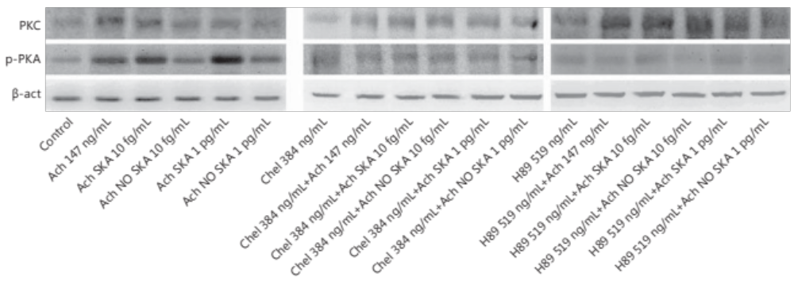
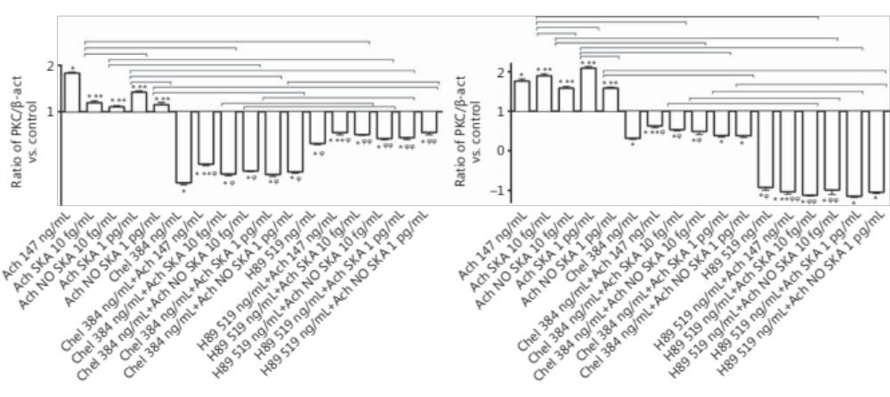
Results: Western blot and densitometric analysis
The downstream signaling from the muscarinic receptors involves the second messenger pathways that control the expression and activity of effector molecules via the common signaling cascade Ca2+-CamKII-PKC-ERK
* p<0.05 vs control; ** p<0.05 vs Ach 147ng/ml

Slide 26
Discussion
In KC Ach SKA low doses in an incisional wound model confirmed the hypothesis that low-dose Ach could be a more physiological stimulus for KC on viability, proliferation and migration
Protocol A, characterized by a single stimulation, appears to be more effective than the protocol B with repeated stimulations every 24 h and the amount of Ach administered to cultured cells was physiological
Proliferation and migration were involved in physiological skin regeneration – during the creation of a wound the cells migrate and after its closure the cells return to a normal turnover

Slide 27
Discussion
A single stimulation triggers a sequence of intracellular reactions without any negative effect
Ach SKA demonstrated its effectiveness for the first time within the nonneuronal cholinergic system
Data indicate for the first time the effectiveness of activated low doses of Ach and demonstrate a minor toxicity compared to Ach 147 ng/mL.

Slide 28
Discussion
SKA forms showed a statistically significant decrease in ROS production accompanied by an increase in mitochondrial membrane potential and decreased oxygen consumption indicating the better biochemical energy of the cells
The involvement of ERK/MAPK (marker of cell migration) and KI67 (proliferating cells) in the mechanism activated by Ach confirmed the better influence of the single treatment

Slide 29
Discussion
Ach SKA 1 pg/mL confirmed its greatest effectiveness in M1 receptor, PKC, and PKA activations.
These findings confirm that low dose Ach acts through the same mechanisms as concentrated Ach and support the hypothesis of beneficial effects exerted by low doses without any negative effect (e.g., oxidative injury).

Slide 30
Conclusion
Low doses of Ach SKA triggers a cascade of dynamic events that results in better regulation of KC functions, cell viability, proliferation, and migration (important for hypothetical application in the clinical).
Data suggest that administration of Ach at doses in a physiological range may not only be effective but is also likely to be safe.
Low-dose Ach could be important for the development of new therapies for nonhealing wounds.
Uberti F., et al., Stimulation of the Nonneuronal Cholinergic System by Highly Diluted Acetylcholine in Keratinocytes. Cells Tissues Organs. 2017;203(4):215-230. doi: 10.1159/000451023.

Slide 31
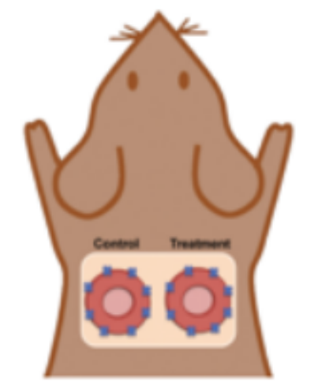
Ongoing work
Animal wound model to verify the effectiveness on protocol A of 1pg/ml SKA Ach
Wound analysis (planimetric area)
Hystochemistry (ematoxin/Eosin staining)
Muscarinic/nicotinic receptor analysis
Matrix and microvascular formation
Plasmatic ROS and Choline quantification
Dunn et al. 2013

Slide 32
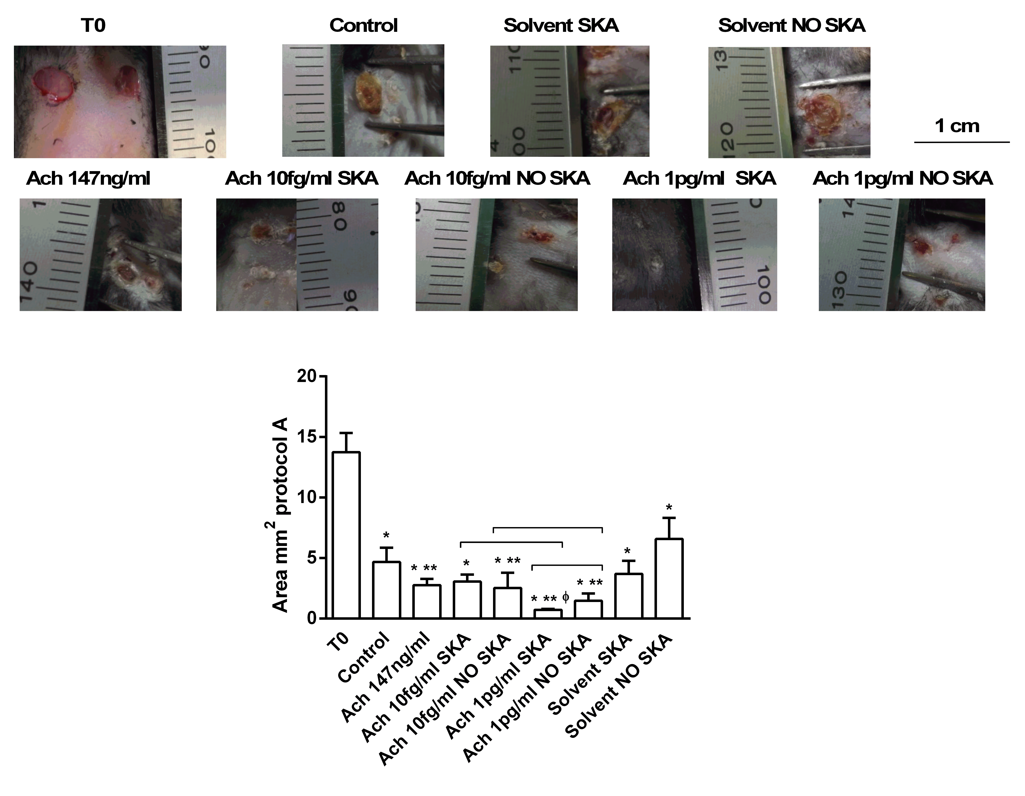
Ongoing work: preliminary data
Ach SKA 1pg/ml exert a better effect on closure compared to other formulation
Ach SKA 1pg/ml in a single administration exert an active role during closure

Slide 33
THANK YOU FOR YOUR ATTENTION
Physiology Lab
Prof C. Molinari
&
GUNA Spa, Milan Italy
Dr V. Miranda

