Slide 1



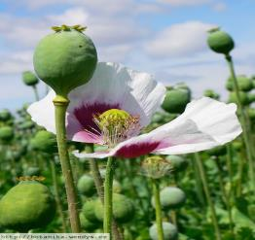
The case study and the law regulations of opiate concentrations in the seeds and urine after ingestion of poppy seeds from free market v.s. rare genotypes grown under temperate climate
F. Bavec¹, M. Gorenjak², S. Grobelnik Mlakar¹, M. Jakop¹, A. Bavec³, M. Bavec¹
¹Faculty of Agriculture and Life Sciences, University of Maribor, Pivola 10, Hoče/Maribor, Slovenia;
franci.bavec@uni-mb.si
²Clinical Institute of Chemistry, Clinical Centre Maribor, Maribor, Slovenia
³Hospital Celje and Thermana Laško, Celje, Slovenia
4th International Conference on Agriculture & Horticulture
July 13-15, 2015 Beijing, China

Slide 2

Content
Introduction - underutilized crops
… incl. poppy
Methods and materials
Results
  Opiates in the urine
  Regulation(s)
Conclusions
References

Slide 3
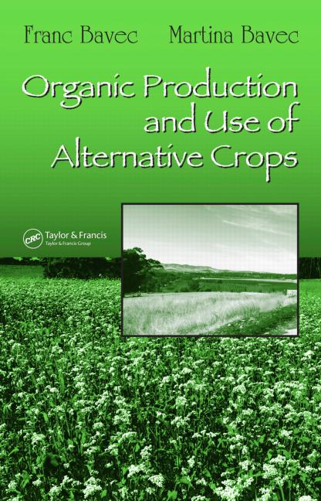
Introduction
Considering more than 30 disregarded and neglected crops suitable for growth in temperate climates, chapters covers the botany, climate conditions, cultivars, production and yield, growth and ecology, organic cultivation, harvesting, handling and storage, and utilization where the information is available and applicable to the crop under discussion.
Other topics include organic production systems, the nutritional and health benefits of products, food processing, and suggestions for some homemade foods.
In research we are specially focused into oil seed pumpkins, grain amaranths, buckwheat, cereals like spelt … and the garden poppy.
Target is to create:
traditional and
high valued foods with
special niche markets

Slide 4
It is considered one of the oldest cultivated plants and was known as far back as the Stone and Bronze Ages.
Some forms of poppy was widely grown in the teritories of France, Germany, Hungary, Spain in 4000-5000 BC.
Especially popular with old Greeks, it later spread to the Arabic world, China, India and Bulgaria.
The milky-colored substance consist of 44 identified alkaloids (morphine, codeine, anrcotine, papaverine, tebaine and more) used in pharmaceutical industry as irrplaceable substances for medicines (like painkiller, prevention of iodine deficiency, contrast agent and cancer therpies). The genotypes that contain highly concentrated opiate alkaloids are used for this kind of producrion, and they grown in hot areas, mostly tropical climates (10 – 13.5% of morphine in raw opium).
Poppy seeds often appear in food products like bread, cakes (in Slovenia is protected recipie for cake Prekmurska gibanica‘ content up to 1/3 poppy seeds), than is known traditional cake poppy ‚potica‘, etc.
It believes that mature seeds did not contain opiate alkaloids. However the new findings confirm different concetrations of opiates in the seeds.

Slide 5
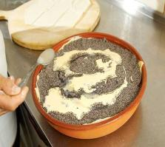
28 cultivars produced in Tapioszele (Hungary) contains 100 to 8600 g opiate alkaloids per kg seeds (Dobos et al., 1997).
Normal poppy seed consumption is generally regarded as safe. There are no unambiguous markers available to differentiate poppy food ingestion from heroin or pharmaceutical morphine use (Lachenmeier et al., 2010).
But ….
What about the sportists
and childs …(low body weight..?)
Aim:
However, in this contribution we feel that we can make clearer separation of cultivars without or with low opiate alkaloids content, focusing on these kind of substances.

Slide 6
Because of opiates content in the grains,
four Slovenian rare populations
and 5 varieties from supermarkets were analysed (content of morphine in µg per g of poppy seed)
and intakes for consumption 10 g (and 20 g, twocases, data not shown) of seeds per person by the 33 students
(3 repetitions plus control without poppy seed consumption).
LC-ESI-MS/MS was used to determine morphine and mtabolites in urine (364).
Morphine (µg per l of urine) was calculated like as a ratio between content of morphine and U-creatinin (mmol/l).

Slide 7
The results of opiates in grain seeds show great variation from 4.9 to 28.3 µg of morphine per g seeds in varieties produced in Slovenian and Czech temperate climate, to 44.4 and 46.0 µg of morphine per g seed in Turkish varieties, and from 133.7 µg in an unknown sample to 466.6 µg of morphine per g seed produced in Hungary. This values highly correlate with the content of morphine and codeine in the urine.
 | Table: Source of poppy, content of opiates in the seeds, opiates in the urine and content of morfin + codein in the urine after intake 10 g seeds
Source of poppy | Opiates (µg/g seeds) | Opiates conc. ng/mL * clinically positive test | Morfine +codeine/U creatinin (mµ/l)
1. Czech Rep. | 28.3 | 344.3* | 37.8
2. Turkey | 46.4 | 683.3* | 60.7
3. Turkey | 44.4 | 55.0 | 26.5
4. Unknown | 133.7 | 67.0 | 5.8
5. Hungary | 466.6 | 1397.7*** | 107.1
6. Rare (Slo) 7. Rare (Slo) | 4.9 19.9 | 76.3 165.3 | 10.3 12.0
8. Rare (Slo) 9. Rare (Slo) | 5.0 8.7 | 39.7 46.0 | 4.9 4.5
SD± Corr. seed: | 1.1 - 56 | 18.7 – 86.2 0.88 | 09.9-18.9 0.76

Slide 8

On this basis, we can discuss the limitations of poppy seed consumption regarding sportists, drivers and different ages (or body mass) of persons and which kind of restrictions for opiates in the poppy seeds are actual according to the international laws.
In Germany volunteErs ate poppy products (50 mg morphine /kg poppy seeds) , all on-site urine tests were positive, but not blood samples – accordig to German law they could drive a car (Moeller et al. 2004).
In ingesting a curry meal or two containing various amounts of washed seeds (morphine intake: 200.4 to 1002 micrograms; codeine intake: 95.9 to 479.5 micrograms), the urinary morphine levels were found to be in the range 0.12 to 1.27 micrograms/ml urine and urinary codeine levels in the range 0.04 to 0.73 micrograms/ml urine. In any large scale screening for abuse of opiate drugs, the possibility of urinary alkaloids arising from consuming food containing poppy seeds must be considered and, if possible, eliminated (Lo and Chua, 1992)
But ….
What about the sportists
and childs …(low body weight..?)

Slide 9
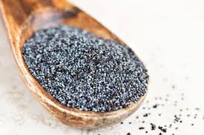
Standard oral dose?
A standard oral dose consists of about 10 to 30 mg of morphine. Is it possible to get a full dose of morphine from eating poppy seeds?
One report in the Journal of Forensic Sciences found that the morphine content of poppy seeds varies widely with poppy seed source. Spanish poppy seeds seem to have the most morphine - about 251 micrograms of morphine per gram of seeds. This translates to about 0.025% morphine by weight. Thus, to get a medically relevant dose of morphine (10 mg) from Spanish poppy seeds you would have to consume ... About 40 grams of poppy seeds!
In our case of Hungarian poppy is enough 20 grams of poppy seeds per person!
(http://boingboing.net/2011/05/03/can-poppy-seeds-get.html)

Slide 10
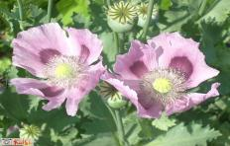
Drug testing
School athletes may want to pay attention to this. Across the country, about one in seven school districts perform some sort of drug testing on their students. Students in middle school, high school, or college may be asked to take a drug test in order to participate in athletic activities or other programs.
False positives (when the test wrongly reports someone used drugs) can and do happen. For example, Federal prisoners, who undergo drug tests with some frequency, are forbidden to eat foods that contain poppy seeds.
Over the past 20 years, legal cases by law enforcement officials, workers, athletes, or students “caught” or penalized for positive urine tests for opiates have made famous the “poppy seed bagel defense.” A series of lawsuits and evolving research have proven that an individual’s urine can indeed produce a positive test result for opiates after the person eats poppy seed-containing cakes, muffins, or bagels. In one large study, up to 87% of tests considered positive for opiate use were due in part to poppy seeds in foods as well as prescription medications.
When positive test results are proven to have been due to eating poppy seeds, they are overturned. More accurate measurement of opiate levels can be done by analyzing a blood or hair sample. These tests cost more and may be used to double-check a positive urine result.
(http://teens.drugabuse.gov/blog/post/drug-testing-poppy-seeds)

Slide 11
Regulations
The European Commission asked the European Food Safety Authority (EFSA) to provide a scientific opinion on the risks for public health related to the presence of opium alkaloids in poppy seeds intended for human consumption. Following a call for data, EFSA received the results from analyses of opium alkaloids, primarily morphine, codeine, thebaine, papaverine and noscapine, in samples of poppy seeds, bakery products and baking ingredients. Based on the relative prevalence of the alkaloids present in poppy seed and food samples analysed, and on their pharmacological potency, the EFSA Panel on Contaminants in the Food Chain (CONTAM Panel) concluded that the risk assessment could be based on dietary exposure to morphine alone. (b.w.) an acute reference dose (ARfD) of 10 μg morphine/kg b.w. Estimates of dietary exThe CONTAM Panel applied an uncertainty factor of 3 to establish from the lowest known single oral therapeutic dose of 30 µg morphine/kg body weight posure to morphine from foods containing poppy seed demonstrate that the ARfD can be exceeded during a single serving by some consumers, particularly children, across the EU. This risk assessment relates to poppy seed samples with an alkaloid profile comparable to that of the submitted data and should not be extrapolated to poppy seed samples with a qualitatively different alkaloid profile.

Slide 12
http://www.livestrong.com/article/491206-can-you-eat-poppy-seeds-when-pregnant/
Poppy Seeds During Pregnancy
Play close attention to what you put in your mouth while pregnant because what you consume can affect the development of your unborn baby. Drugs.com notes that it is most likely that the poppy seeds consumed in food are safe for pregnancy, but complete information is lacking regarding the safety of use while expecting. The USA Federal Institute for Risk Assessment reports that women should avoid poppy seeds while pregnant because of their connection to illegal substances, but also because some types of poppy seeds are highly contaminated during the growing and harvesting process. Contaminated poppy seeds may pose a danger to you and to your unborn baby because of their high morphine or pesticide content.

Slide 13
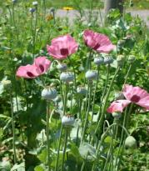
Athlete Guide to the 2015 Prohibited List
Poppy seeds can contain trace amounts of opium. ... may be decriminalized or legalized in some states, it is still illegal under federal law.
Dubai Customs Regulations and Laws - Dubai Online
drugs and medicines are very strict. ...
Narcotic drugs (cocaine, heroin, marijuana,
hallucination pills, poppy seeds etc.) ... January 28, 2015 ....
You are also only allowed to bring in a reasonable amount suitable for the …

Slide 14
TEST TYPES Urine Testing
Poppy seeds contain both Morphine and Codeine and can cause false positives for Opiates in urine tests. Most Opiate urine tests have a cut off level of 300 ng/ml. Ingestion of a single poppy seed bagel can produce an opiate level somewhere around 250 ng/ml three hours later. 3 teaspoons of store bought poppy seeds can result in 1200 ng/ml 6 hours later (1). We have read an estimate that 70% of DOT opiate positives are from poppy seeds. The U.S. Military uses cut off levels of 3000 ng/ml in order to minimize false positives.
The profile and levels of Opiates that show up in a urine test can generally be distinguished from Opiate use if care is taken...however it is not a simple thing and results are often mis-read by companies giving drug tests. If eaten recently and in great enough quantity, poppy seeds will result in positive morphine and codeine results, with morphine predominant. This can be distinguished from recent Codeine use because of the comparative levels of Morphine and Codeine present. However Codeine use in the past (not recent) can result in a similar profile as Morphine is a metabolite of Codeine. Codeine is eliminated from the system more quickly than Morphine, so an extended period after Codeine use, levels of Morphine may be higher than those of Codeine.
The Discovery Channel's MythBusters show did a piece testing whether poppy seeds could cause a false positive on an over-the-counter drug test. Two people were tested for opiates before the experiment began. Both tested negative on this initial test. One person then ate three poppy seed bagels and the other ate poppy seed cake. Both tested positive for opiates within 30 minutes of ingesting the seeds and continued to test positive until 16 hours after ingestion. The same brand of drug test was used in all cases. They called a number of manufacturers of over-the-counter drug tests and were told by all but one that poppy seeds could not cause a false positive.
https://www.erowid.org/plants/poppy/poppy_testing.shtml

Slide 15
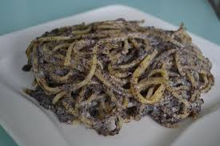
http://www.state.gov/documents/organization/239560.pdf
Bureau for International Narcotics and Law Enforcement Affairs
International Narcotics Control Strategy Report
Table: Production of narcotics poppy (in Afganistan, Burma, Colombia, Quatemala, Laos, Mexico, Pakistan)
________________________________________________________________________________
2006 2007 2008 2009 2010 2011 2012 2013
__________________________________ ha____________________________________________
203,680 232,700 197,100 172,245 180,300 168,120 191,565 264,950
From which production are the poppy seeds for consumption –
who really control this at inernational market?

Slide 16

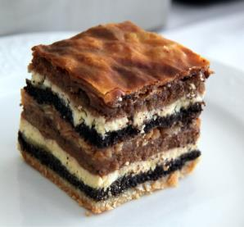
Only safe way for consumption od poppy seeds, even for children, sportists and pregnants is low content of opium alkaloids in poppy seeds.
It is possible to rich in temperate climate with selection of genotypes (base are rare populations like in Slovenia) with low content of opiataes in the seeds.
Than welcome to taste
Slovenian traditional food!
Thank you for your attention!

