Slide 1
Treating Patients with hepatitis C Genotype 1 using Viekira Pak in the Real World – An Australian Nursing Perspective
Saroja Nazareth, Vincenzo Fragomeli on behalf of Australian Liver Nurses

Slide 2
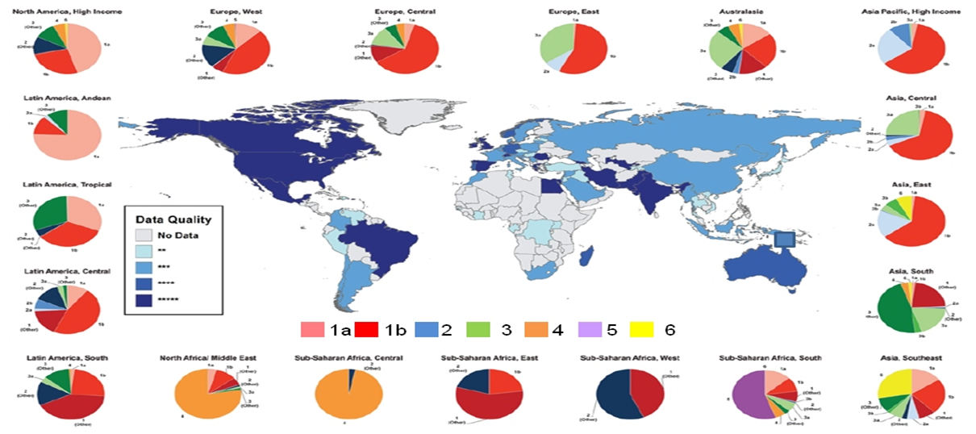
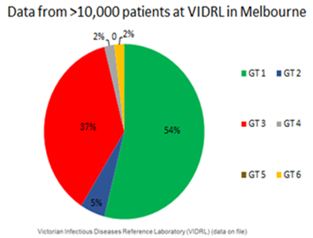
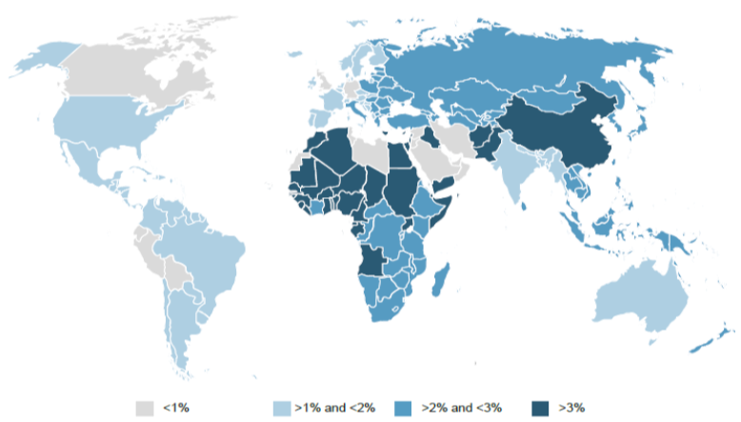
Hepatitis C is a Global Problem
Global prevalence of 2-3%:
>185 million people worldwide have been infected with HCV
130–170 million are chronically infected
350,000 deaths occur each year as a result of HCV-related cirrhosis and liver cancer
7
Messina JP et al, Hepatology, 2015; 61: 77-87.

Slide 3
Study Background
Viekira Pak (paritaprevir/ritonavir/ombitasvir, dasabuvir +/- ribavirin) was first the interferon-free (DAA) compassionate program introduced in Australia for the treatment of chronic hepatitis C.
This was a Special Access Scheme (SAS) for genotype 1 patients.
Patients treated in “Liver Clinics” throughout Australia

Slide 4
VIEKIRA PAK – Mode of Action
Ribavirin (RBV) is a synthetic nucleoside analogue that shows in vitro activity against some RNA and DNA viruses.
3. MID-/LATE LIFECYCLE INHIBITION
NS5A inhibitor
HCV Receptor binding
and endocytosis
Transport and release
Ombitasvir
(OBV)
Replication, virion assembly
and egress
Fusion and
uncoating
GOLGI
1. EARLY INHIBITION
NS3/4A
protease inhibitor
ER
(+) RNA
ER
Translation
and polyprotein processing
Paritaprevir
(PTV)
RNA
replication
2. MID-LIFECYCLE INHIBITION
non-nucleoside
NS5B polymerase inhibitor
Ritonavir is not active against HCV and is a pharmacokinetic enhancer that increases peak and trough plasma drug concentrations of paritaprevir and overall drug exposure (i.e. area under the curve)
Dasabuvir
(DSV)

Slide 5
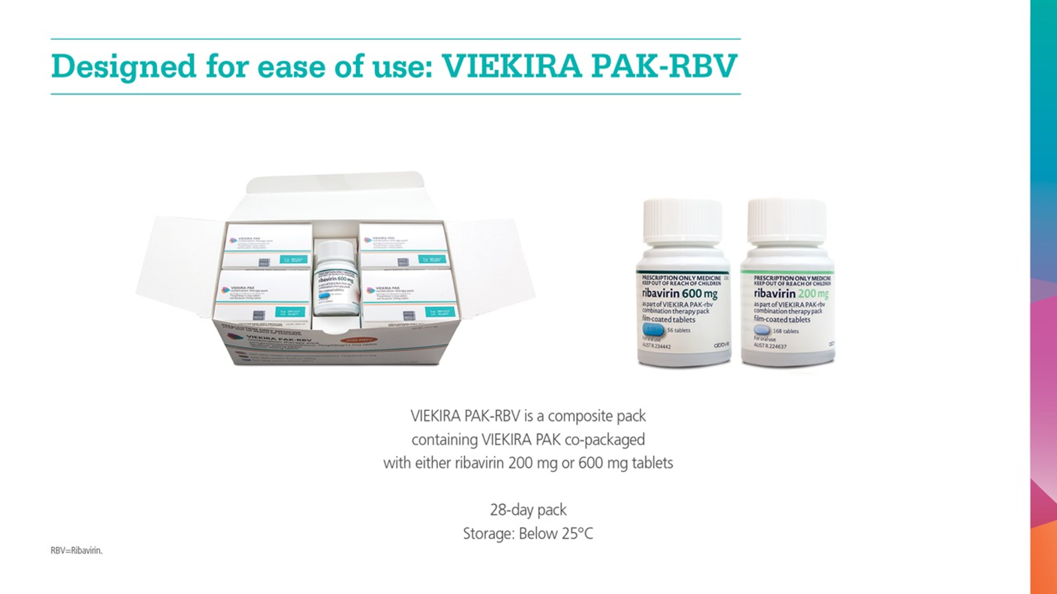
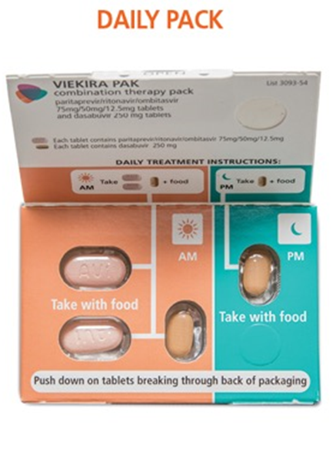
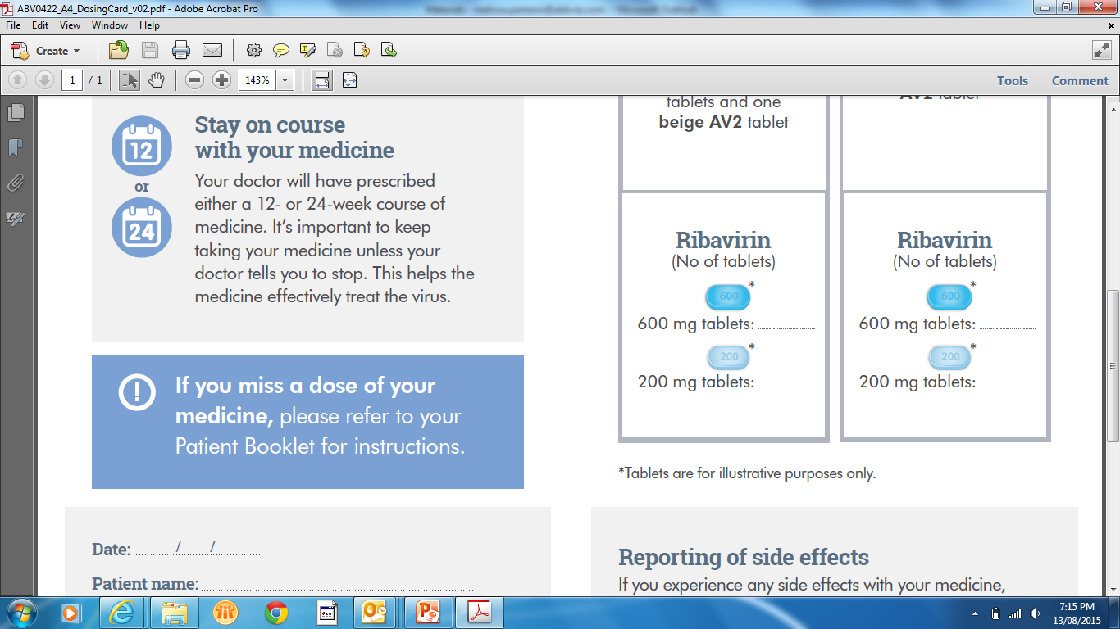
VIEKIRA PAK+/- RBV
+ RBV (BD)
RBV
200mg OR
600mg
Example 1200mg RBV dose (600mg BD) for patient ≥ 75kg

Slide 6
Indication and Treatment Regimen in Australia
In Australia, VIEKIRA PAK is indicated for the treatment of genotype 1 chronic hepatitis C infection, including patients with compensated cirrhosis. NOT Child Pugh B or C or HCV G 4
Duration of therapy and addition of ribavirin are dependent on patient population.
VIEKIRA PAK-RBV is recommended in patients with an unknown Gt1 subtype or with mixed Gt1 infection.
Patient Population | Treatment | Duration | Ribavirin Dosage
Genotype 1b, without cirrhosis | VIEKIRA PAK | 12 weeks | N/A
Genotype 1a, without cirrhosis | VIEKIRA PAK-RBV* | 12 weeks | <75 kg = 1000 mg ≥ 75kg = 1200 mg Ribavirin taken in two doses, morning & evening
Genotype 1, with cirrhosis | VIEKIRA PAK-RBV | 12 weeks†
*VIEKIRA PAK without ribavirin for treatment-naïve patients with genotype 1a infection without cirrhosis
† 24 weeks for patients with genotype 1a-infection with cirrhosis who have had a previous null response to pegIFN/RBV
Reference: VIEKIRA PAK-RBV Australian Approved Product information. AbbVie Pty Ltd

Slide 7
Efficacy in Non-Cirrhotic Patients – Clinical Trial Results
Trial name | Sapphire-I¹ | Sapphire-II² | Pearl-III⁴ | Pearl-II³ | Pearl-IV⁴
Treatment | Naïve | Experienced | Naïve | Experienced | Naïve
Genotype | Gt1 | Gt1 | Gt1b | Gt1b | Gt1a
96%
95%
98%
96%
96%
97%
100%
99%
97%
100%
97%
90%
SVR12 (%)
473
322
151
297
173
123
210
209
88
91
100
205
Overall GT1a GT1b
Overall GT1a GT1b
VP-RBV VP
VP-RBV VP
VP-RBV VP
VIEKIRA PAK-RBV
VIEKIRA PAK-RBV
Reference : 1 Feld JJ, et al. N Engl J Med 2014; 370:1594–1603. 2 Zeuzem S, et al. N Engl J Med 2014; 370(17):1604–14.
3 Andreone P, et al. Gastroenterol 2014;147:359–65. 4 Ferenci P, et al. N Engl J Med 2014;370(21):1983–92.
7

Slide 8
Efficacy in Patients with Compensated
Cirrhosis (n=380)
12 weeks
24 weeks
Gt1a
Gt1b
SVR12 (%)
nN
59
64
52
56
14
15
13
13
11
11
10
10
40
50
39
42
22
22
18
18
14
14
10
10
6
7
3
3
25
25
20
20
12 weeks recommended for most patients with cirrhosis
24 weeks recommended for cirrhotic patients with GT1a and prior null response to pegIFN/RBV
Reference: Poordad F et al. N Engl J Med 2014:370;1973−82.

Slide 9
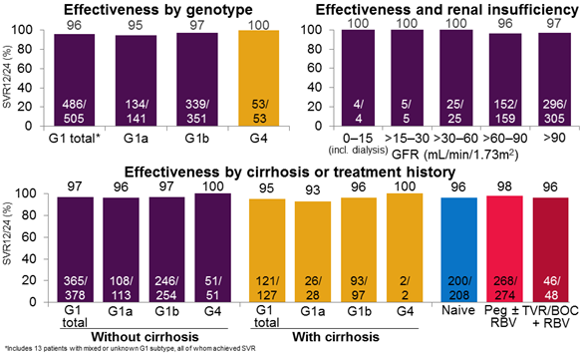
German Hepatitis C Registry: PrOD or PrO ± RBV for GT 1 and 4, respectively
Hinrichsen, H et al. EASL 2016 Abstract GS07
Notes:
Hinrichsen and colleagues reported their experience with ombitasvir/paritaprevir/r + dasabuvir + RBV in the German Hepatitis C Registry. In this non-interventional, prospective cohort study (254 study sites), genotype 1 patients received ombitasvir/paritaprevir/r + dasabuvir + RBV and genotype 4 patient received ombitasvir/paritaprevir/r + RBV. The choice of treatment and regimen duration was at the physician’s discretion.
The percentage of patients who received label-recommended regimens included:
Genotype 1: 86% (no cirrhosis/cirrhosis: 88%/78%).
Genotype 4: 94% (no cirrhosis/cirrhosis: 94%/92%).
Results
The overall SVR12 rate was 99%, with no difference among genotype. In general, patients who treated according to the treatment guideline recommendations achieved higher SVR12 rates.
SVR12 rates did not differ across various subgroups.
The overall relapse rate was 1.1% (6/558).
The regimens were well tolerated with 2.3% of patients discontinuing therapy due to adverse events.

Slide 10
Study Rationale/Objectives
Determine safety of Viekira Pak in real world population
Determine efficacy of Viekira Pak in real world population
Assess Drug-Drug Interactions (DDI’s)
Assess patient compliance and adherence
Discuss implications for nursing practice

Slide 11
Study Method
140 patients
8 Liver Clinics throughout Australia
12 months study period October 2014 to September 2015
Data collected via two page data collection sheet

Slide 12
Baseline Characteristics n=140 n(%)
Age, mean (years) | 56
Male | 91 (65.0)
Weight, mean (kgs) | 84.8
Caucasian | 133 (95.0)
Genotype 1a | 90 (64.3)
Treatment Naïve | 71 (50.7)
Prior Null Response (Interferon) | 26 (18.6)
Cirrhosis (F4) | 109 (77.9)
History of Decompensation | 10 (7.1)

Slide 13
Results
95% n= 133 achieved SVR12 = PCR not detected 12 weeks post treatment
Seven patients (5.0%) did not achieve an SVR12.
One patient (0.7%) experienced virological failure on treatment
One patient (0.7%) relapsed after completing treatment
One patient (0.7%) was lost to follow-up
Four patients (2.9%) discontinued prematurely

Slide 14
Treatment Outcome by Prior Treatment Experience

Slide 15
Treatment Outcome by Genotype

Slide 16
Treatment Outcome by Fibrosis

Slide 17
Adverse Events
126 (90%) patients reported adverse events
Mainly mild to moderate in nature
Fatigue
Nausea
Headaches
Bilirubin elevation 47.9%
Grade 4 hyperbilirubinaemia - 3 patients (2.1%)

Slide 18
Serious Adverse Events n(%)
 | All patients n=140 | No cirrhosis n=32 | Compensated Cirrhosis n=99 | History of decompensation n=10
Hyperbilirubinaemia | 4(2.9) | 0(0) | 3(3.0) | 1(10.0)
Decompensation | 3(2.1) | 0(0) | 2(2.0) | 1(10.0)
Anaemia and transfusion | 2(1.4) | 1(3.1) | 1(1.0) | 0(0)
Dehydration | 1(0.7) | 0(0) | 1(1.0) | 0(0)
Lithium Toxicity (possible drug-drug interaction) | 1(0.7) | 0(0) | 1(1.0) | 0(0)
Suicidal Ideation | 1(0.7) | 0(0) | 1(1.0) | 0(0)
Other | 7(5.0) | 2(6.3) | 4(4.0) | 1(10.0)
Total | 19(13.6) | 3(9.4) | 13(13.1) | 3(30.0)

Slide 19
Premature Discontinuation (n=6)
Two patients (1.4%) discontinued at week 3 and week 6 due to an infection and decompensation respectively, however they both achieved an SVR12.
Two (1.4%) ceased due to hyperbilirubinaemia at week 1 and week 6 respectively
Wk 6 = PCR detected - SVR 12 achieved
Two (1.4%) ceased due to unrelated pre-existing medical conditions at week 1 and 3 respectively (lung disease and abdominal pain)

Slide 20
On Treatment Virological Failure
Baseline Characteristics | Caucasian male, 56 years of age, BMI 26.2
Viral Characteristics | Genotype 1a, baseline viral load 4,190,000IU/mL
Fibrosis Stage | Cirrhosis, FibroScan 15.4kPa, no history of decompensation
Medical History | Diabetes mellitus, anxiety, depression
Prior Treatment | Partial response
Baseline Pathology Results | AFP 15kIU/L, ALT 71U/L, AST 31U/L, Albumin 38g/L, Bilirubin 41umol/L, Platelets 84x10^9/L, INR 1.2
Treatment Duration | Allocated 24 weeks, ceased at week 10 due to virological failure at week 8 Viral load 240,000iu/ml week 4 then 5,000,000iu/ml at week 8
Compliance and Adherence | 100% self-reported dosing 100% appointment attendance

Slide 21
Post Treatment Relapse
Baseline Characteristics | Aboriginal male, 44 years of age, BMI 33.0
Viral Characteristics | Genotype 1a, baseline viral load 820,000IU/mL
Fibrosis Stage | Cirrhosis, FibroScan 34.3kPa, no history of decompensation
Medical History | Diabetes mellitus, haemophilia, hypertension
Prior Treatment | Null response
Baseline Pathology Results | AFP 10kIU/L, ALT 197U/L, AST 123U/L, Albumin 39g/L, Bilirubin 37umol/L, Platelets 79x10^9/L, INR 1.2
Treatment Duration | Allocated 24 weeks
Compliance and Adherence | 100% self-reported dosing 100% appointment attendance

Slide 22
Other Findings
Majority of clinic visits were conducted by Liver nurses
Average of 5 clinic visits from week 1 to week 12 post treatment
85% appointment attendance
85% reported 100% compliance to Viekira Pak
No patient deaths
Retrospectively, Liver Nurses reported a reduction in consultation time in comparison to interferon based therapies (15 minutes)

Slide 23
Conclusions
SVR rate 95% = Real world data!
Viekera Pak was safe and well tolerated in this sample of complex patients who were ineligible/intolerant to interferon based therapies
SAE’s were reported in 13.6% of patients
Good compliance and adherence rates were reported despite BD dosing
Drug Drug Interactions (DDI’s) require ongoing vigilance
Liver Clinic nurses reported decreased # of clinic visits and consultation time
Reduced frequency of monitoring requirements for majority of patients
Study supports the treatment of HCV patients through a Nursing Model of Care
Implications for enhancing clinic capacity in a resource poor HCV environment

Slide 24
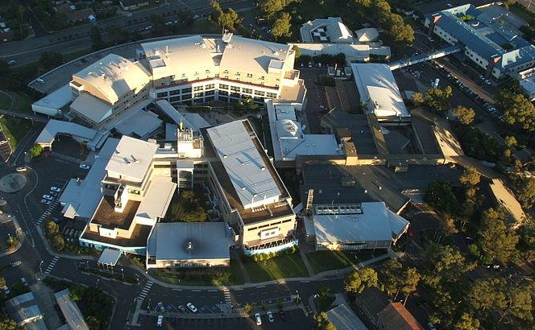
Acknowledgements:
140 patients who participated in this study
Australian Liver nurses for their collaboration- Royal Perth, John Hunter, Royal Prince Alfred, St Vincent’s (NSW), Royal Adelaide, Monash Health, Flinders Medical Centre
Notes:
Journal of Hepatology

Slide 25
Thank you!

