Slide 1
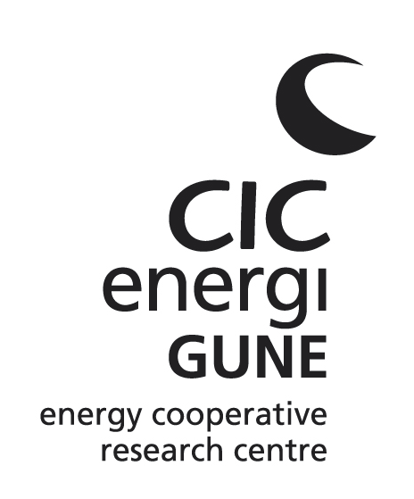

Exploring the limitations of garnet ceramic electrolytes for all-solid-state batteries
Frederic Aguesse
W. Manalastas, L. Buannic, J-M. Lopez del Amo, G. Singh, A. Llordés, J. Kilner
© CIC energiGUNE. 2015 All rights reserved
2016
2nd International Conference and Expo on
Ceramics & Composite Materials
Berlin, July 26th, 2016
Notes:
PORTADA

Slide 2
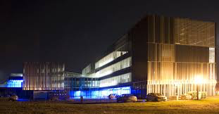
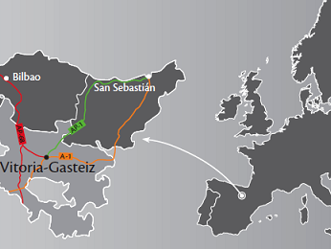
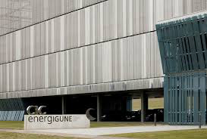
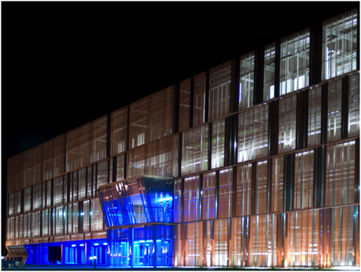
Where are we
Vitoria Gasteiz, capital of Alava province in the Basque country
Initial research circa Sept 2011, Dec 2015 71 researchers

Slide 3


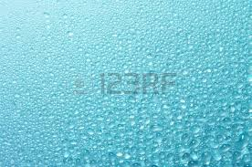
Current Li-ion Battery
e⁻
e⁻
e⁻
e⁻
Negative electrode
Liquid electrolyte
Positive electrode
Li⁺
Li⁺
e⁻
Li⁺
Li⁺
Li⁺
Li⁺
e⁻
Cu
Li⁺
Al
Li⁺
Li⁺
Li⁺
Li⁺
Li⁺
Current collector
Current collector
Discharge
Charge
Negative electrode:
- High capacity
- Low voltage
- Stability
Electrolyte:
- High ionic conductivity
- Low electronic conductivity
- Large electrochemical window
Positive electrode:
- High energy density
- Long cycling life
- Cost effective

Slide 4
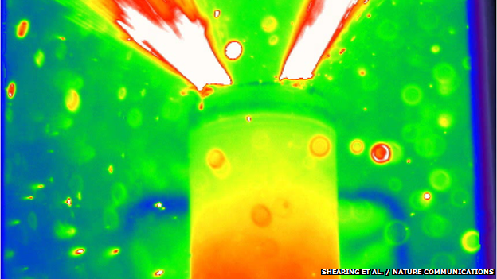
Motivation
Why use ceramic electrolyte in batteries
Organic liquid electrolytes cause serious safety issues and instability of Li-ion batteries
Finegan, D.P., M. Scheel, J.B. Robinson, B. Tjaden, I. Hunt, T.J. Mason, J. Millichamp, M. Di Michiel, G.J. Offer, G. Hinds, D.J.L. Brett, and P.R. Shearing, In-operando high-speed tomography of lithium-ion batteries during thermal runaway. Nat Commun, 2015. 6.
e⁻
e⁻
Negative electrode
Ceramic electrolyte
Positive electrode
All-solid-state batteries using non-flammable inorganic solid electrolytes
Li⁺
Li⁺
Li⁺
Li⁺
Li⁺
Li⁺
Li⁺
Li⁺
Li⁺
Main goals:
High safety
High reliability
High energy density
Li⁺
Li⁺
Li⁺
Current collector
Current collector
Discharge
Charge
Notes:
High energy density
(with higher voltage cathodes)

Slide 5
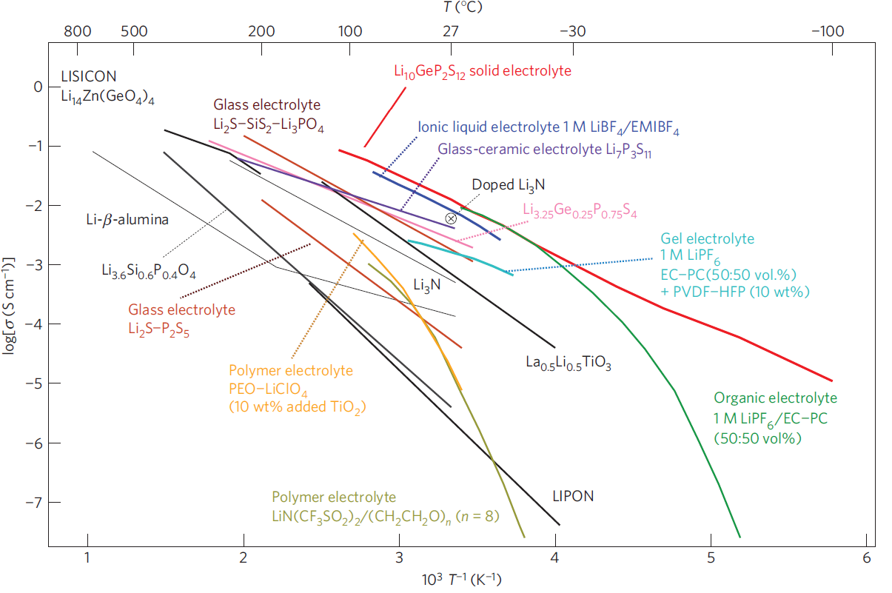
Li-ion electrolyte : State of the art
doped Li₇La₃Zr₂O₁₂
(Li,La)TiO₃
Kamaya N et al. (2011) Nature Materials 10, 682–686

Slide 6
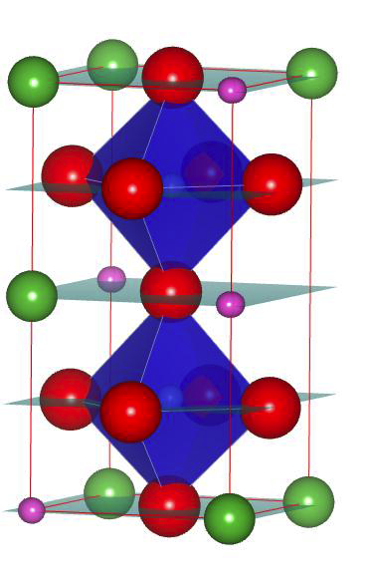
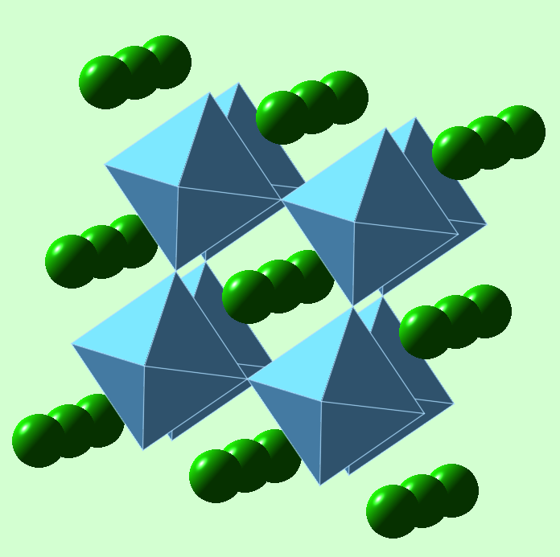
Ceramic Electrolytes: Li_{0.34}La_{0.55}TiO₃
Formed from the cubic perovskite but heavily modified
Ba²⁺Ti⁴⁺O₃
La³⁺_{2/3}TiO₃
Li_{3x}La_{2/3-x}TiO₃
ABO₃
La rich layer
A
La poor layer
(1/3 of A-site vacant)
La rich layer
BO₃
La O Li Ti
Tetragonal distortion of the cubic perovskite which forms into a layered structure

Slide 7
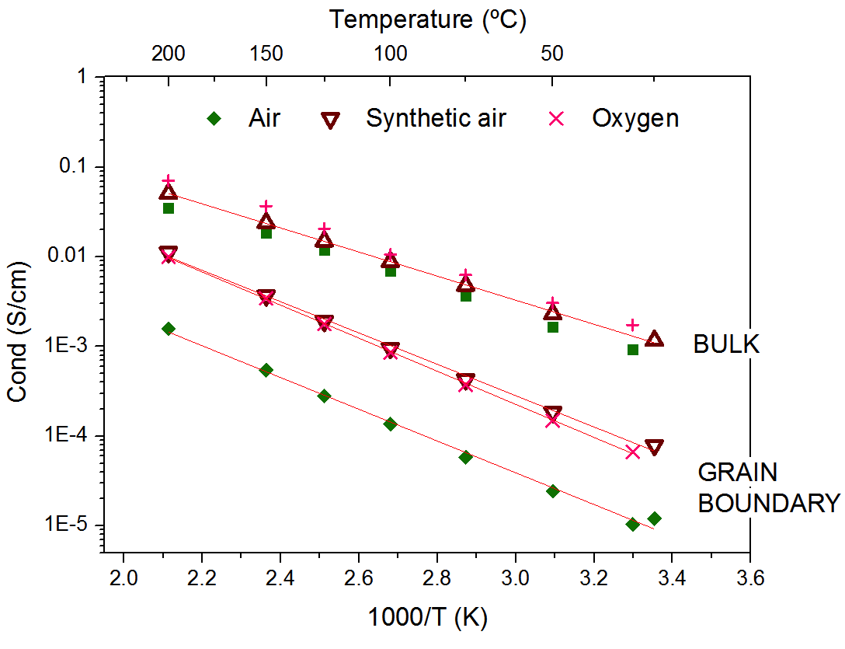
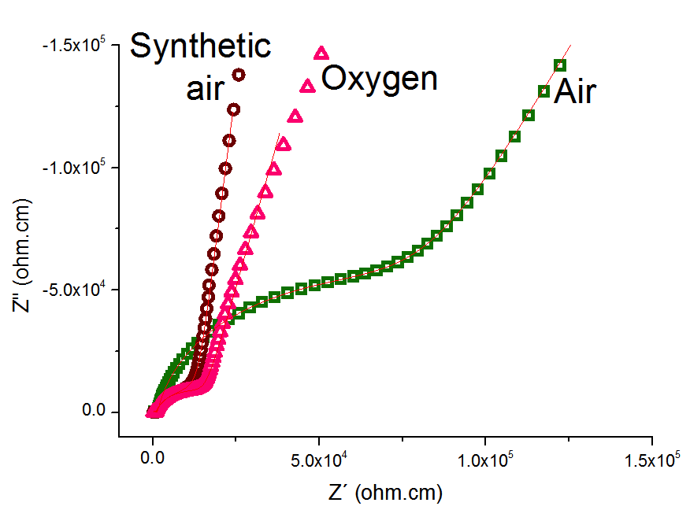


  Influence of sintering atmospheres
  Li_{0.34}La_{0.55}TiO₃
Sintering of the sample in different atmospheres:
    Air
    Synthetic air (mixture of N₂, CO₂, O₂, etc. but no H₂O)
    Pure O₂ (protected with a humidity trap)
Increase of the GB conductivity by almost a decade
Similar bulk conductivity values
F. Aguesse, J-M. Lopez del Amo, V. Roddatis, A. Aguadero, J. Kilner

Slide 8
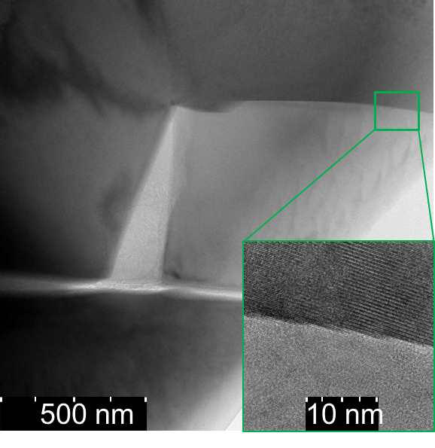
Influence of the moisture level
on the Li-ion mobility : Solid State NMR
H⁺/Li⁺ exchange when exposed to air
  In perovskite : formation of Li₂CO₃
Air processing
Reduction of Li⁺ transport numbers
Blocking Li⁺ migration path
  Li₂CO₃ at GB
Li_{0.34}La_{0.55}TiO₃
Dry oxygen processing
10
0
-10
δ (⁷Li) (ppm)
Li_{0.34}La_{0.55}TiO₃

Slide 9
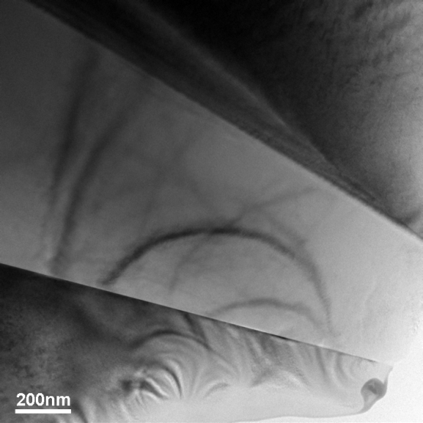
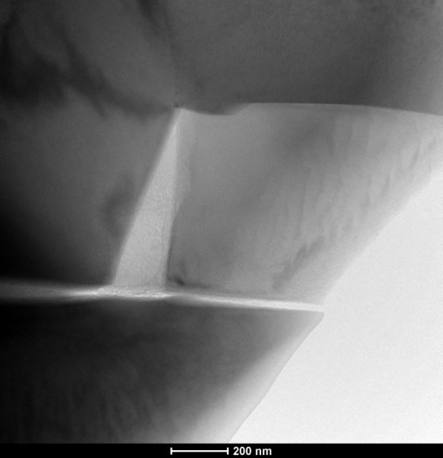
  Effect on the microstructure
Oxygen sintering
Air sintering
GBs
GBs
Li₂CO₃
Direct grain to grain contact
Secondary phase

Slide 10
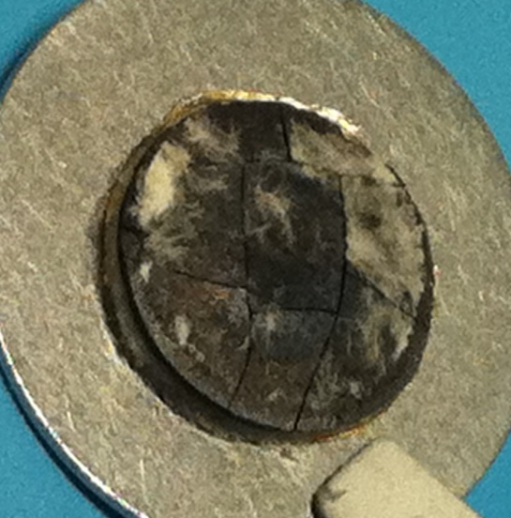
Limitations of perovskite LLTO electrolyte
Low total ionic conductivity (10⁻⁴ S/cm)
Reduction of Ti^{+3/+4} at low voltage
  Mixed conductivity
Needs of a better candidate !!

Slide 11
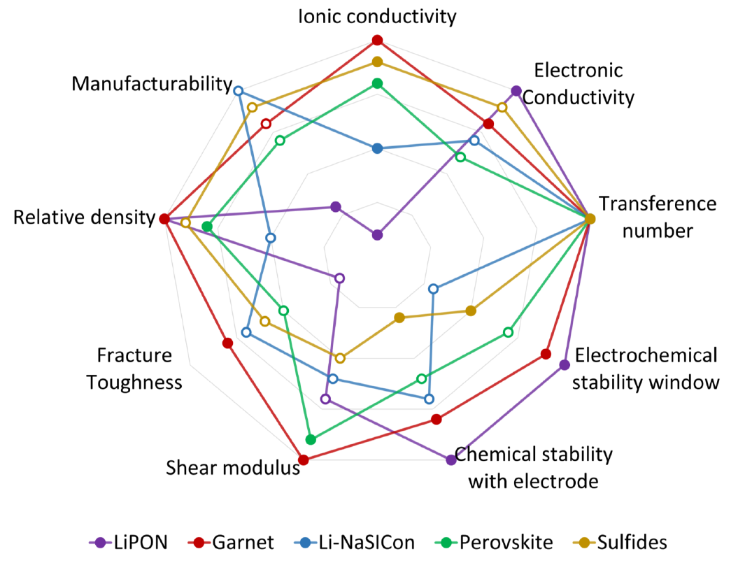
Garnets : attractive properties
Courtesy of Travis Thompson-PlugVolt Webinar-April 20th 2016

Slide 12
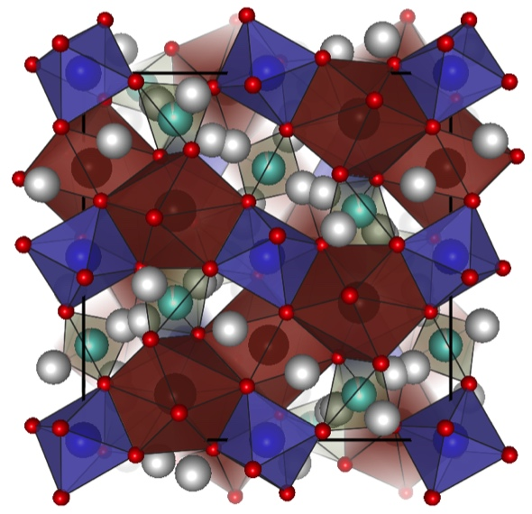
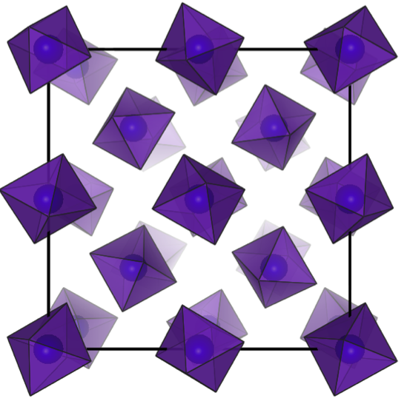
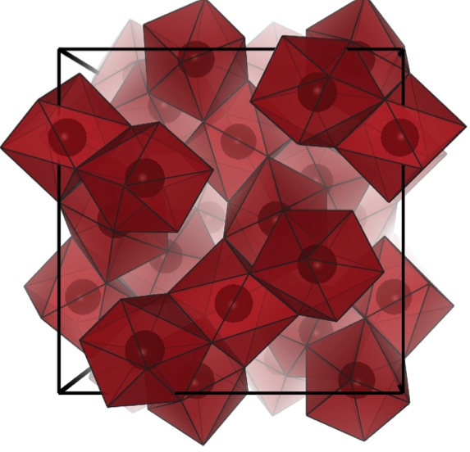
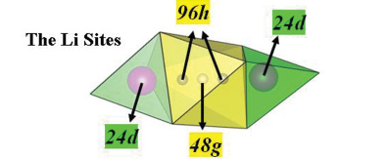
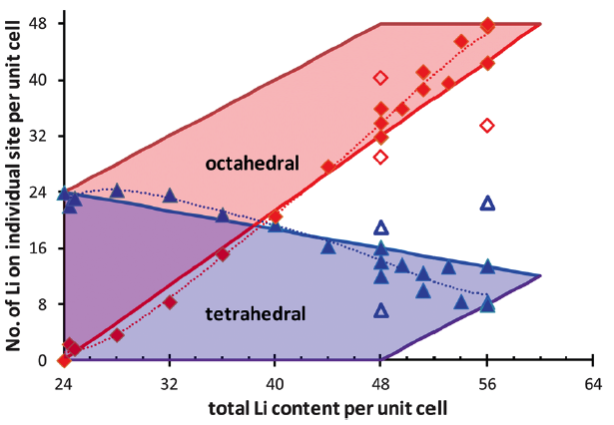
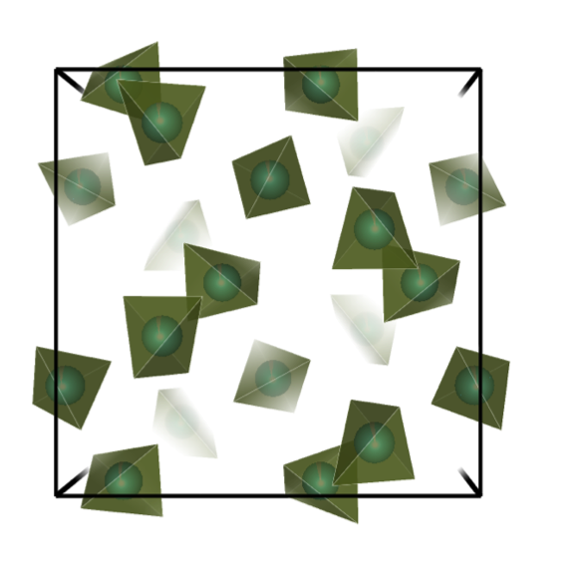
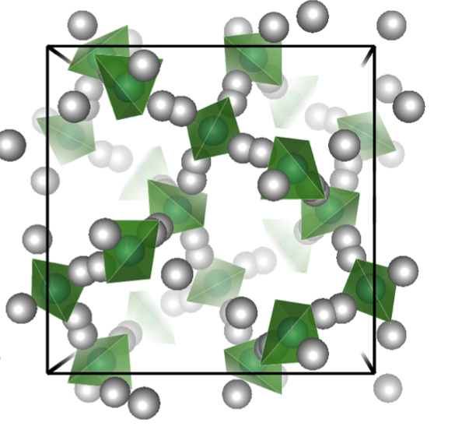
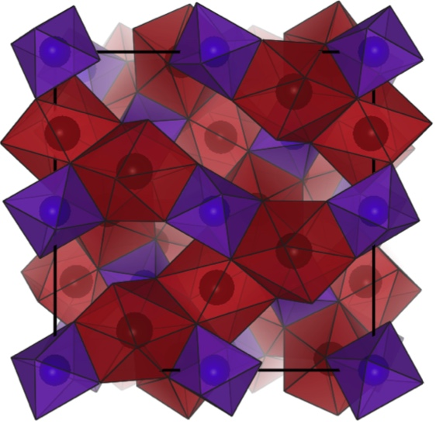
Structural organisation of garnet
for high Li-ion mobility
ZrO₆ incontiguous scaffold
Garnets
Complex crystal structure
C₃A₃B₂O₁₂
where
CO₄ - tetrahedral cages
AO₈ - dodecahedral cages
BO₆ - octahedral cages
LaO₈ contiguous scaffold
Lithium network formed
from face-shared polyhedra
Isolated lithium cages
Adams S and Rao P (2012) J. Mater. Chem. 22, 1426
Awaka J et al. (2011) Chemistry Letters. 40 (1), 60-62
Notes:
Stuffed Garnets (Ia-3d space group)
Complex crystal structure
C3A3B2O12
where
CO4 - tetrahedral cages
AO8 - dodecahedral cages
BO6 - octahedral cages
Relieve structural strain to prevent Tg distortion
Modulate Li occupancy/vacancy distribution
Act as sintering aid
No aliovalent cationic state (voltage stability)

Slide 13
Processing : Influence of the moisture level
H⁺
LiOH*
54%
Presence of H⁺ when processed in air for both garnet and perovskite
Close to 1:1 in ratio + two spin reservoirs are separated in space
Low protonation of the sample when prepared in dry atmosphere (e.g.: dry O₂)
46%
Air processing
10
0
-10
δ (¹H) (ppm)
LOW HUMIDITY LEVEL
Dry oxygen processing
10
0
-10
Much attention should be paid to moisture level during synthesis and storage
δ (¹H) (ppm)
Li_{6.55}Ga_{0.15}La₃Zr₂O₁₂
* Y. Hu et al., Nature Materials 12, 1130-1136 (2013)

Slide 14
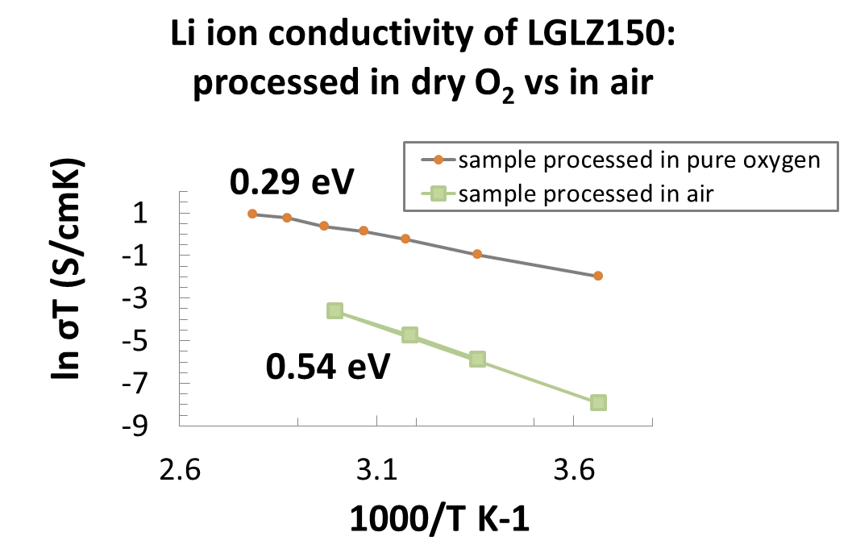
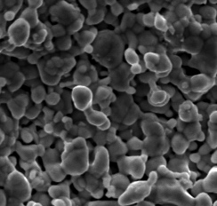
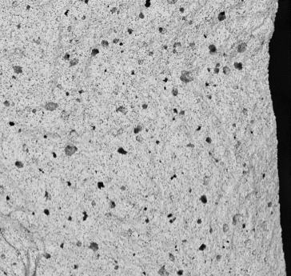
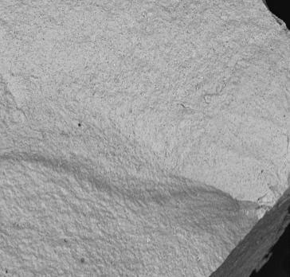
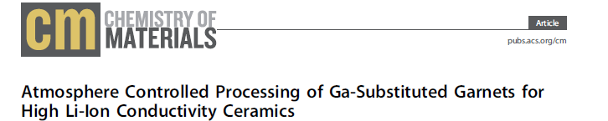
σ_{Li+} : 2 orders of magnitude higher when processed in O₂
Conductivity
@ RT σ_{GARNET} = 1.5 mS.cm⁻¹
σ_{PEROVSKITE} = 0.07 mS.cm⁻¹
σ_{e-}= 10⁻⁶ mS.cm⁻¹
Garnet processed in dry O₂
Garnet processed in air
Li_{6.55}Ga_{0.15}La₃Zr₂O₁₂
Li_{0.34}La_{0.55}TiO₃
Densification
Air
Improvement of the densification when sintering in dry O₂ to densities higher than 92 %
20 µm
500 µm
Dry
O₂

Slide 15
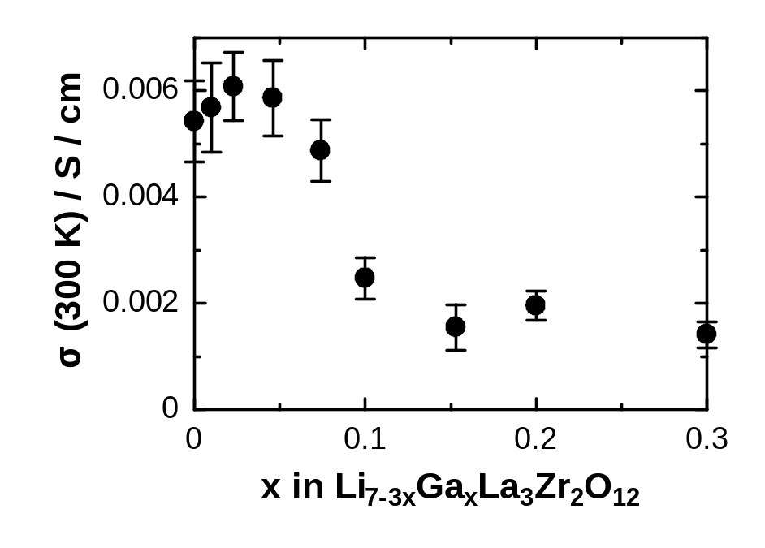

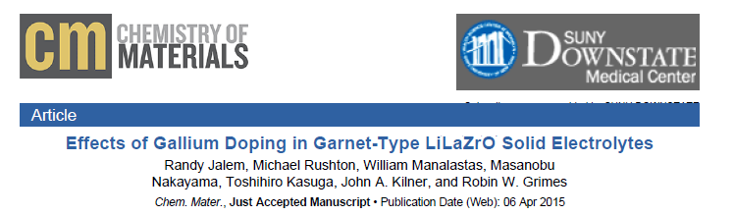
Ionic conductivity : on the track with the literature
Percolation study of
lithium pathway availability
Conductivity vs substituent x in
Li_{7-3x}□_{2x}Ga_{x}La₃Zr₂O₁₂
predicted from MD runs
Best experimental value
“Effects of Gallium Doping in Garnet-Type Li₇La₃Zr₂O₁₂ Solid Electrolytes”
R. Jalem, M. Rushton, W. Manalastas, Jr., M. Nakayama, T. Kasuga, J.A. Kilner and R. W. Grimes, Chem. Mat. A, 2015

Slide 16
Implementation of ceramic electrolyte in a full cell battery
LiFePO₄
Cathode: Commercial LiFePO₄ for flat plateau at 3.45 V
Interfacial catholyte: LP30 for good Li⁺ transfer at the interface
Ceramic electrolyte: garnet Ga:LLZO
Anode: Metallic lithium for high gravimetric capacity
on Al
charge
Interfacial
catholyte
Li⁺
Ga:LLZO
dishcarge
Li metal

Slide 17
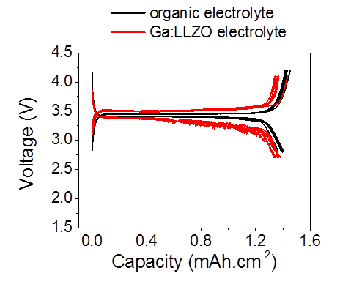
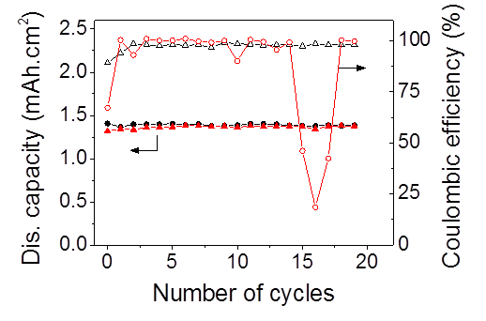
Good capacity retention with increase polarization at discharge
Increased interfacial resistance at discharge
Li metal
Li⁺
Notes:
Very good capacity retention for more than 10 cycles
Inconsistent Coulombic efficiency
→ Side reactions, degradation of electrolyte (?)

Slide 18
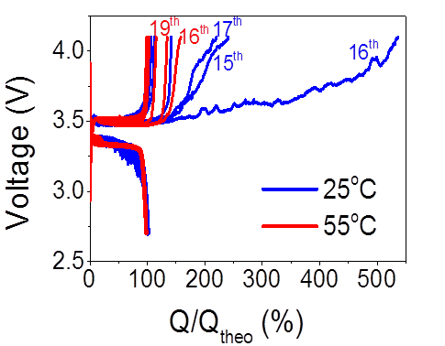
Limit of the system: instability at charge
Intermitent degradation at charge
Improvement when cycling at higher temperature

Slide 19
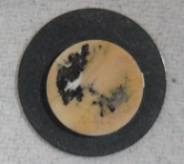
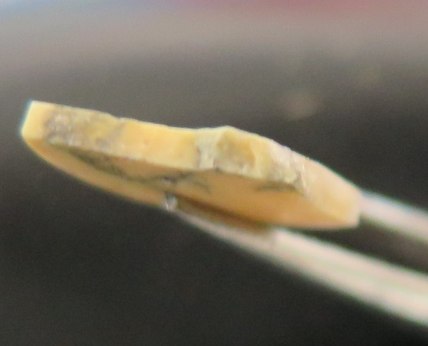
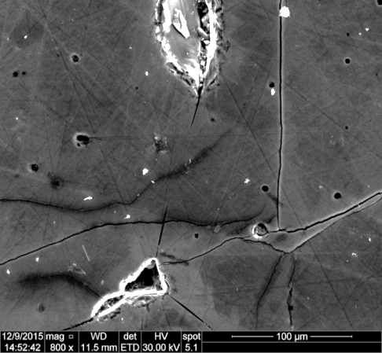
Post-test analysis
Li-rich regions
6 mm
200 μm
Mobile Li-ion
Dendritic Li
Bulk Li
500 µm
40 µm
350
150
0
-150
-350
340
260
180
δ (⁷Li) (ppm)
δ (⁷Li) (ppm)

Slide 20
Conclusion
  Dry condition processing is a preriquisite to achieve high density, purity and conductivity of garnet and perovskite Li-ion conductors
  Solid State NMR is a unique tool to ensure the absence of undesired H⁺ and to analyse the Li-ion mobility
  LiFePO₄ cathode active material can retain good cycleability with a garnet electrolyte BUT suffers from dendrite formation leading to cracks

Slide 21

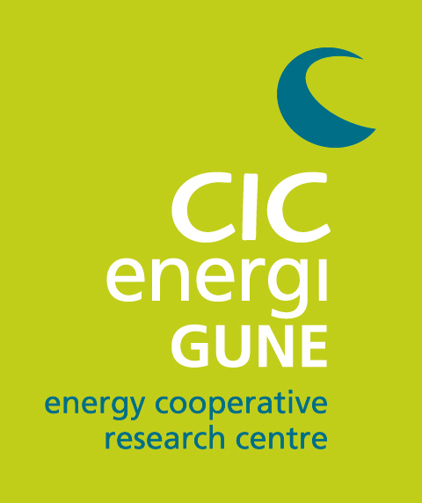
Thank you for your attention !

