Slide 1
PRODUCTION OF INFRA-STRUCTURE READY BIOFULES FROM OLIVE MILL WASTEWATER SLUDGE
Foster Agblevor, H. Abdellaoui, S. Beis, D. Djebbi, K. Halouani*
USTAR Bioenergy Center, Biological Engineering, Utah State University, Logan UT USA
*Sfax University, Sfax, Tunisia

Slide 2
Contents
Introduction
Objectives
Experimental
Results
Discussion
Conclusions

Slide 3
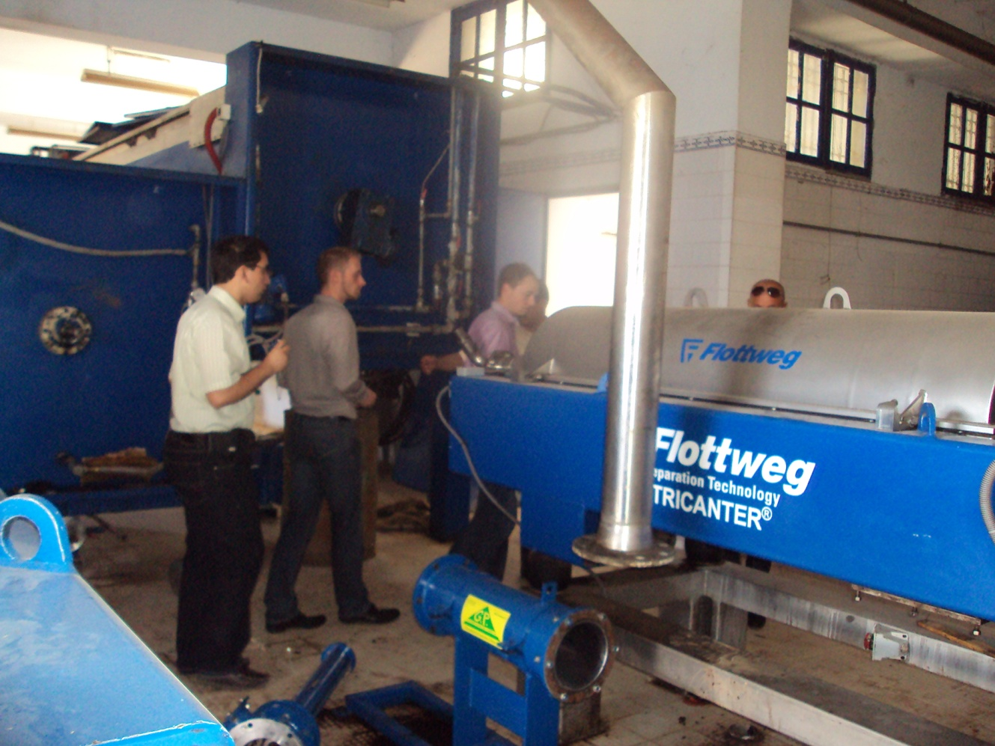
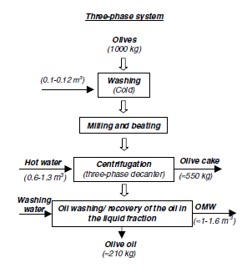
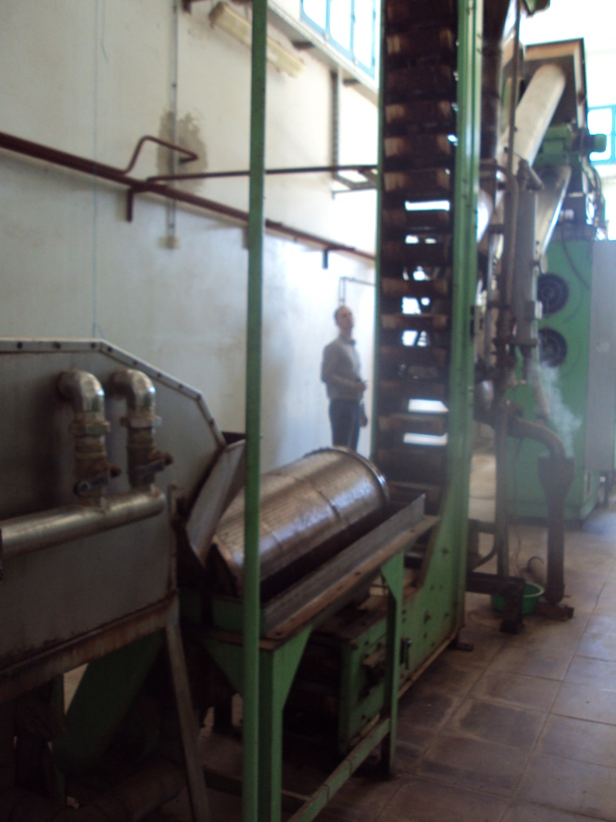
Three-Phases decanter

Slide 4
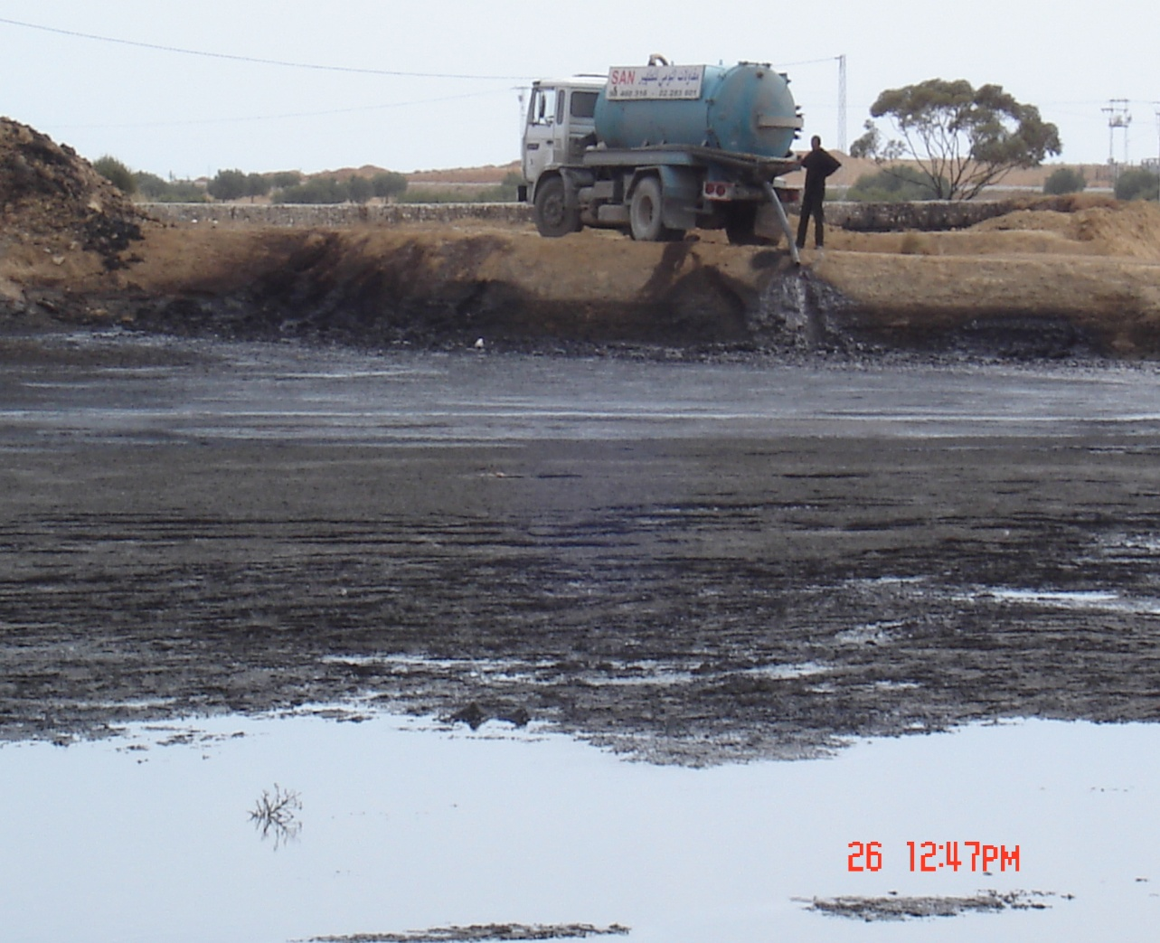
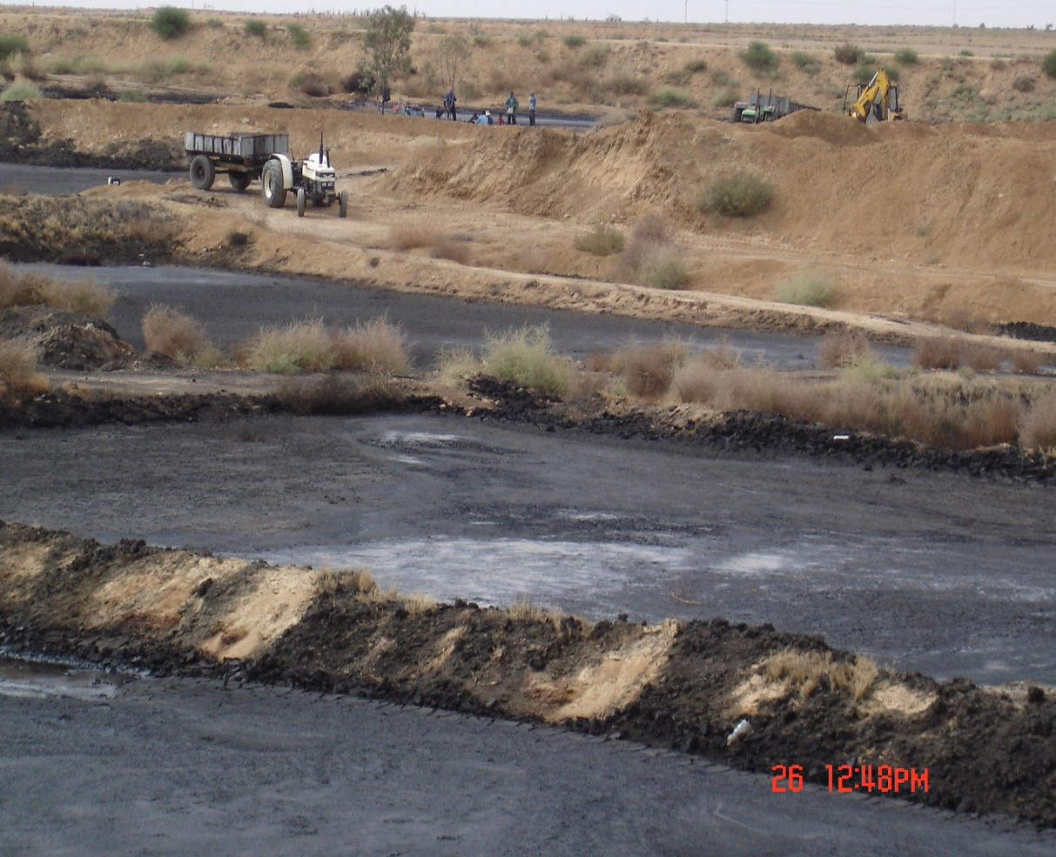
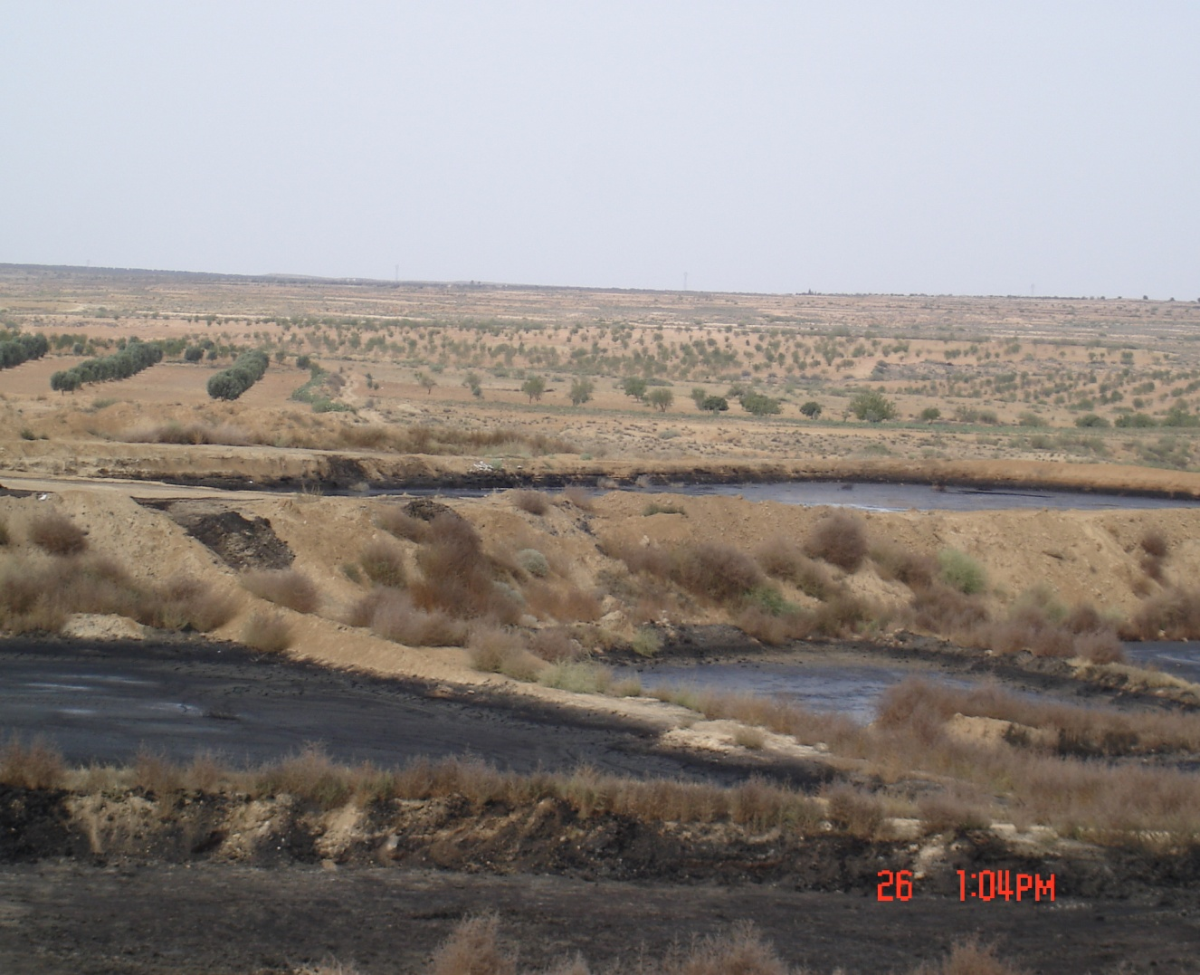
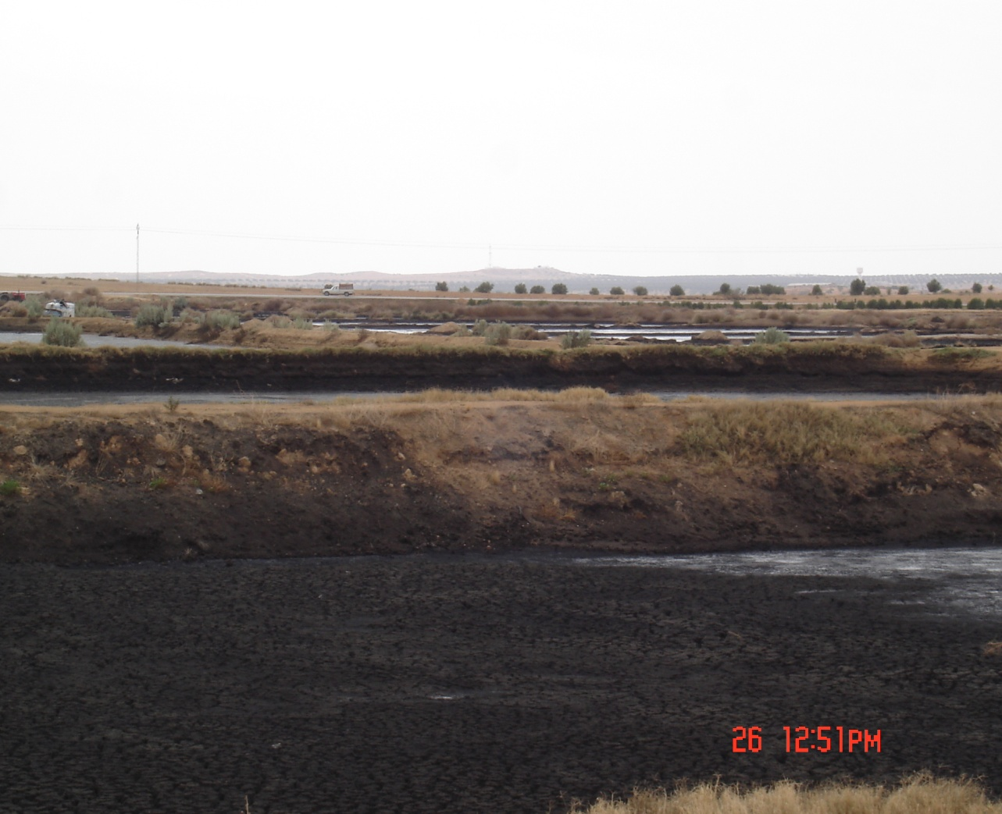
Serious Environmental Impact of olive mill waste water
Evaporation ponds

Slide 5
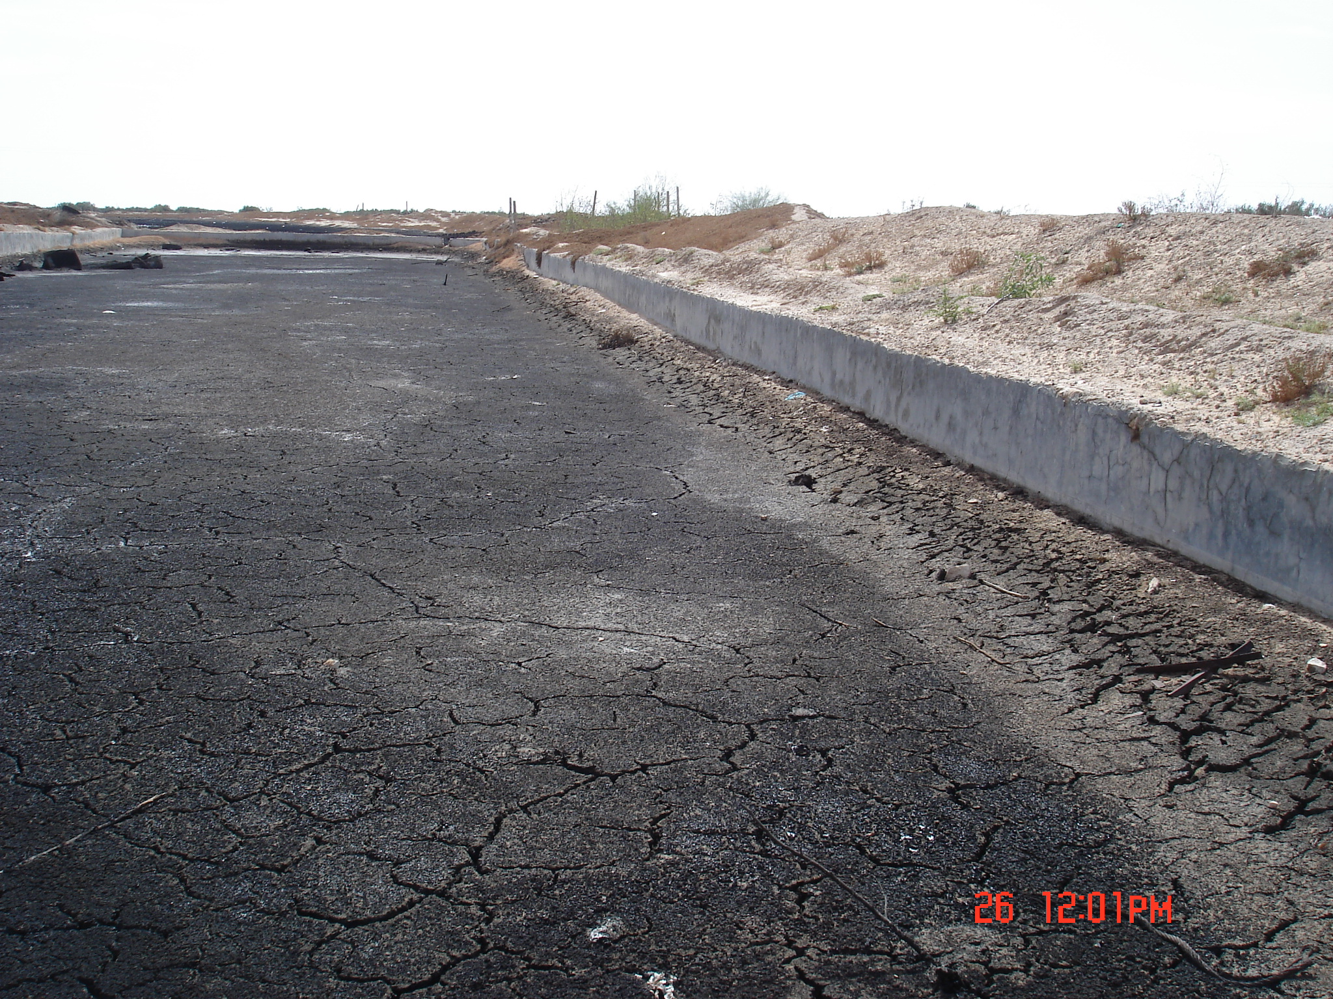
Évaluation des aspects techniques et financiers actuels en matière de gestion des margines en Tunisie
^{PHOTO}
Storage pond

Slide 6
Characteristics of OMWS

Slide 7
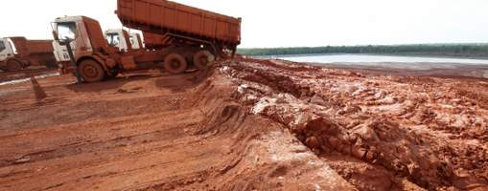
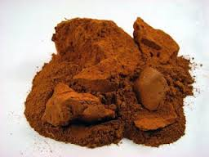
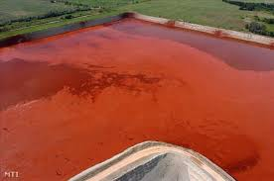
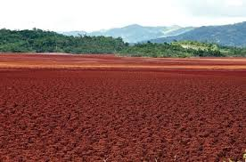
Red mud from polutant to Catalyst

Slide 8
Table 1. Summary of X-Ray Diffraction Results
Sample iD | Mineral Constituents
Fresh Red mud | Gibbsite Hematite Calcite Magnetite Perovskite Quartz Goethite Anatase 3NaAISi04.Na2C03
Regenerated Red mud | Hematite Calcite Magnetite Perovskite Quartz Anatase 3NaAISi04.Na2C03

Slide 9
Pyrolysis conditions
Feedstock---OMWS
Pyrolysis medium --- Sand or red mud
Pyrolysis temperature 400-500 C
Residence time---- 2-3 s
Feed rate 1 kg/h

Slide 10

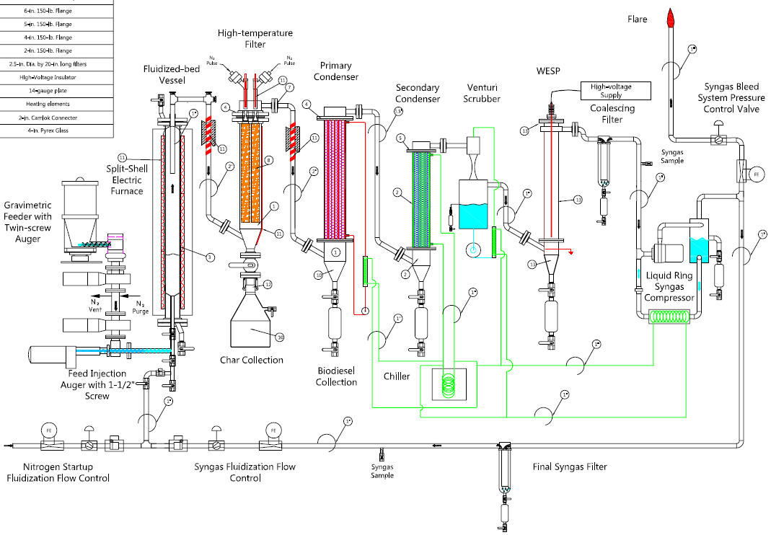

Slide 11
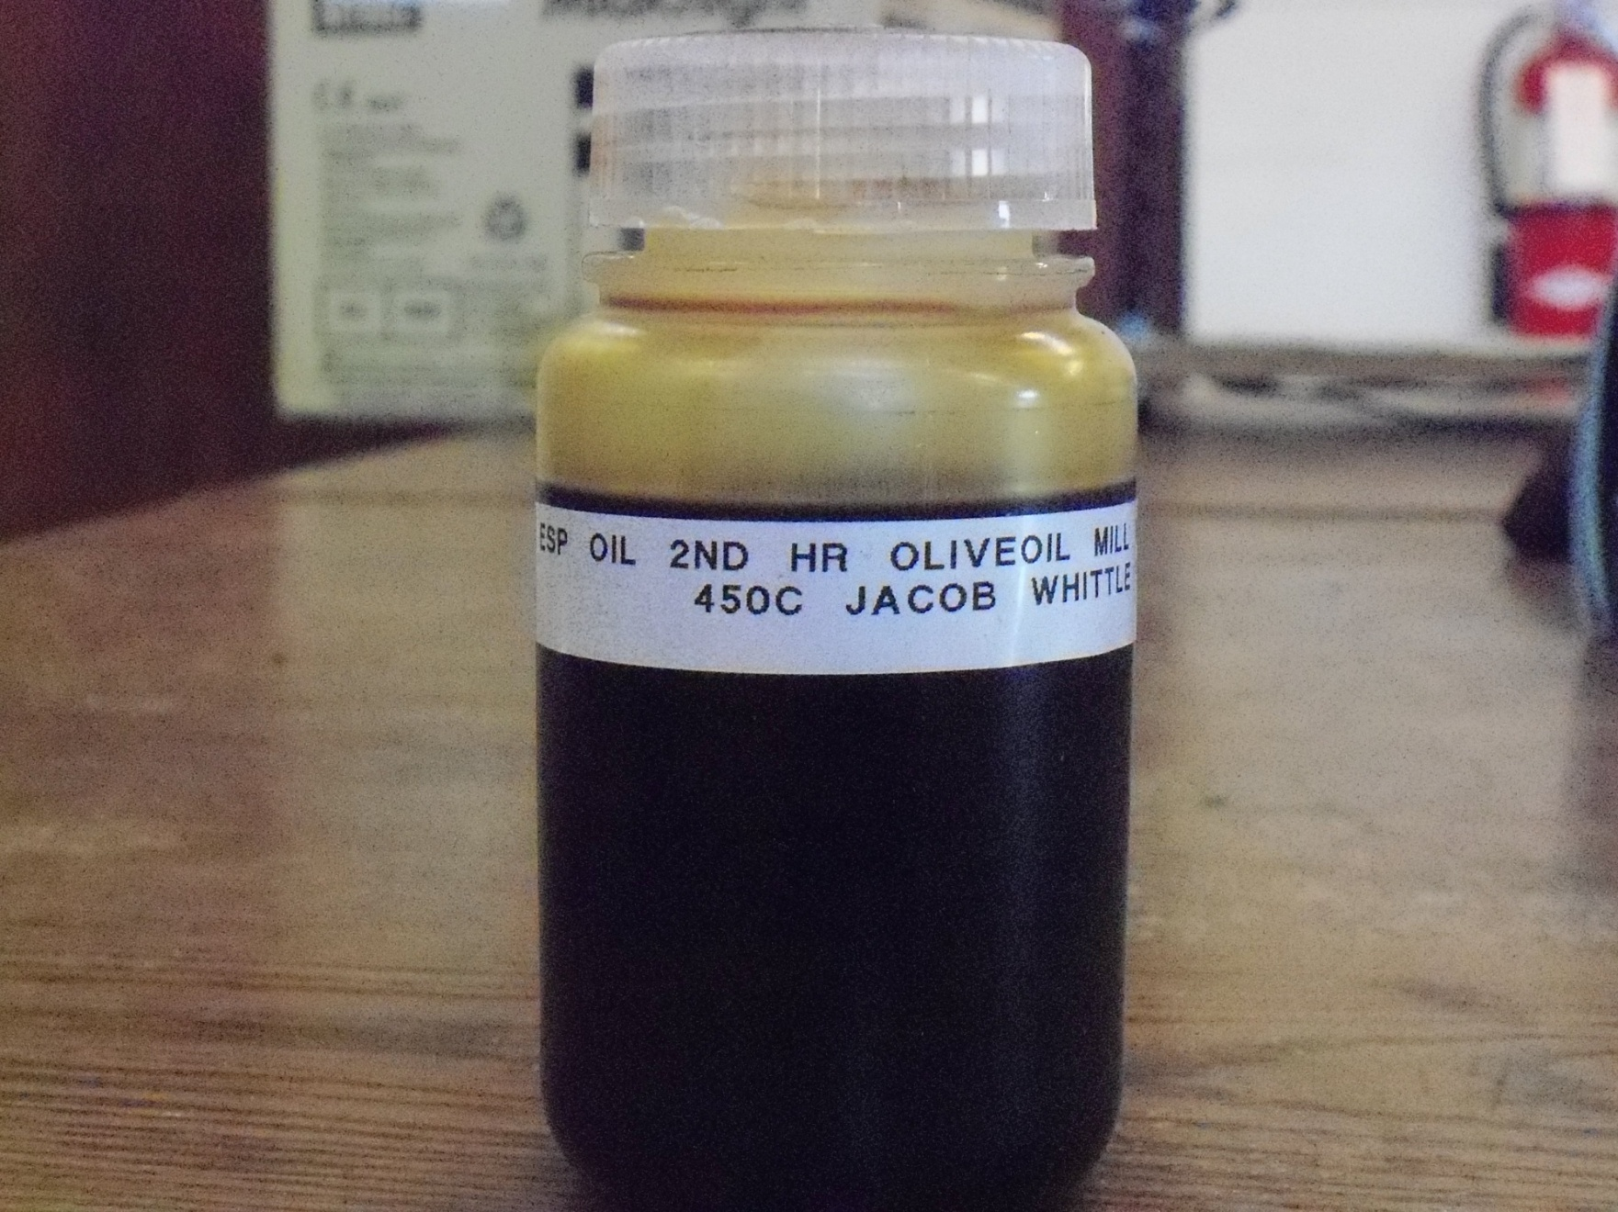
Green diesel fuel; HHV = 43 MJ/kg

Slide 12
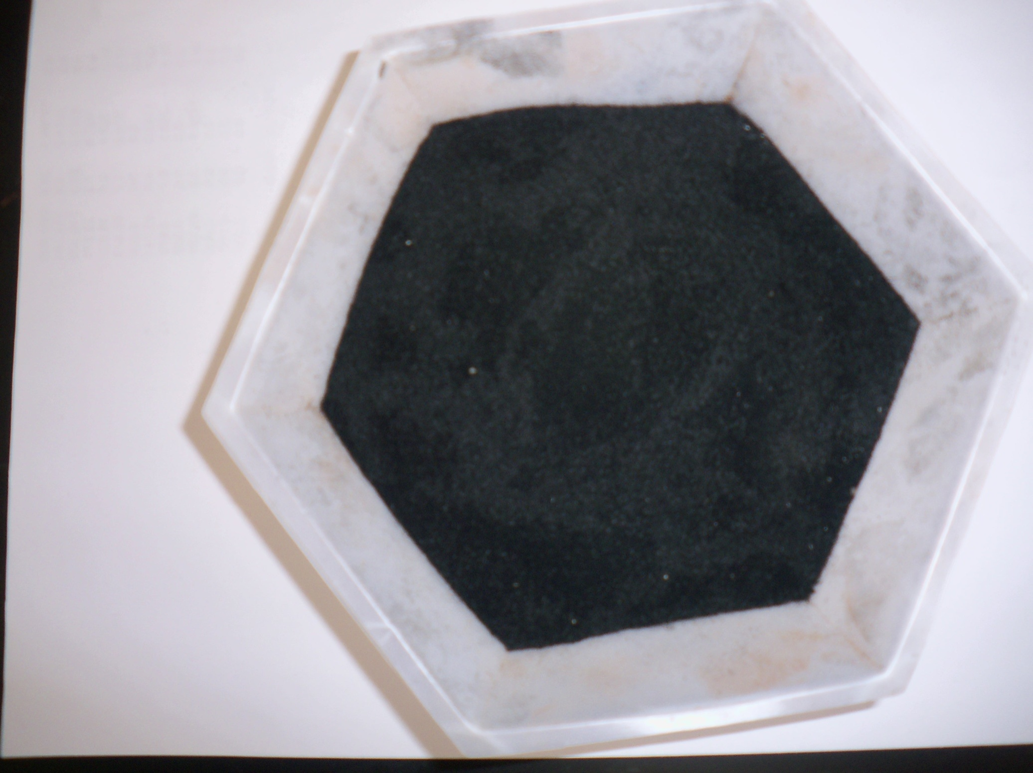
Biochar

Slide 13
Pyrolysis products yields for red mud and silica sand media
Pyrolysis medium | Sand |  |  | Red mud
Pyrolysis temp (ºC) | 400 | 450 | 500 | 400 | 450 | 500
Organic liquid (%) | 33.1±0.5 | 37.47±1.4 | 30.4±1.9 | 34.6±2.6 | 29.8±1.4 | 29.5±0.4
Pyrolytic water (%) | 8.8±1.9 | 7.93±1.8 | 8.8±0.1 | 11.3±1.8 | 17.6±1.5 | 11.8±0.9
Total liquid (%) | 42.3±2 | 45.4±0.4 | 39.4±1.8 | 45.9±4.4 | 47.4±0.1 | 42.3±1.3
Char/coke (%) | 31.7±2.3 | 25.7±0.3 | 24.4±0.2 | 29.1±1.8 | 22.7±0.2 | 20.4±0.4
Gas (%) | 26.0±3.7 | 29.3±1.0 | 36.2±1.6 | 24.3±2.6 | 30.0±0.04 | 37.3±1.7

Slide 14
Pyrolysis liquid characteristics
Pyrolysis medium | Silica sand |  |  | Red mud
Pyrolysis temp (ºC) | 400 | 450 | 500 | 400 | 450 | 500
pH | 6.5 | 6.25 | 6.4 | 7.1 | 7.3 | 7.4
Dynamic viscosity (cP) | 42.9 | 42.9 | 28.0 | 9.2 | 5.4 | 4.6
Density (g/cm³) |  | 0.92 | 0.92 | 0.91 | 0.91 | 0.90
HHV (MJ/kg) |  | 37.5 | 38.8 | 39.5 | 40.4 | 41.3

Slide 15
Major peaks of bio-oil (>1%) without catalyst identified by GC-MS
No. | Retention time (min) | Percentage (%) | Chemical name
1 2 3 4 5 6 7 8 9 10 11 12 13 14 | 14.149 16.379 16.450 18.916 19.624 19.849 20.746 20.793 20.934 21.477 21.583 21.808 22.351 22.469 | 1.29 1.60 1.27 1.98 7.28 2.75 1.88 3.33 4.62 28.54 9.72 5.85 2.22 2.39 | Pentadecane 8-Heptadecene 1-Heptadecene Heptadecane Hexadecanoic acid Hexadecanoic acid, ethyl ester Unknown Unknown 9-Octadecenoic acid (Z), methyl ester Oleic acid Ethyl oleate Unknown Unknown Unknown

Slide 16
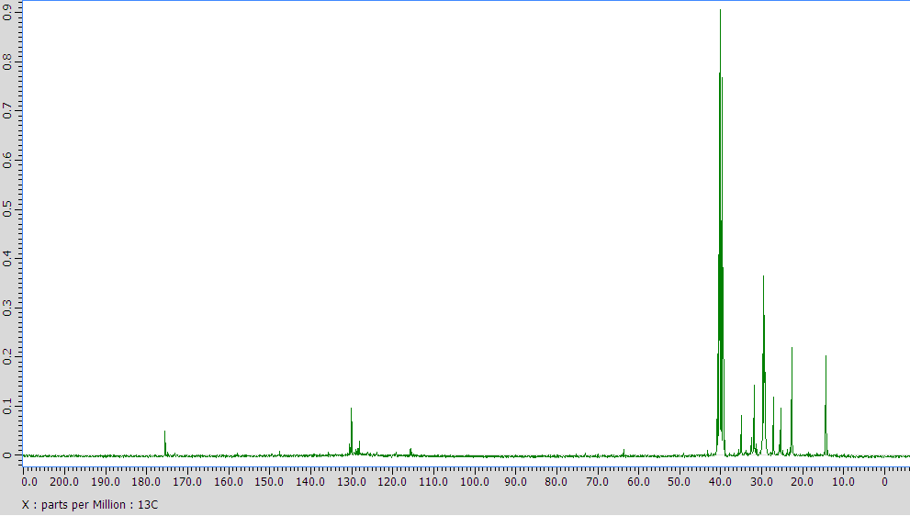
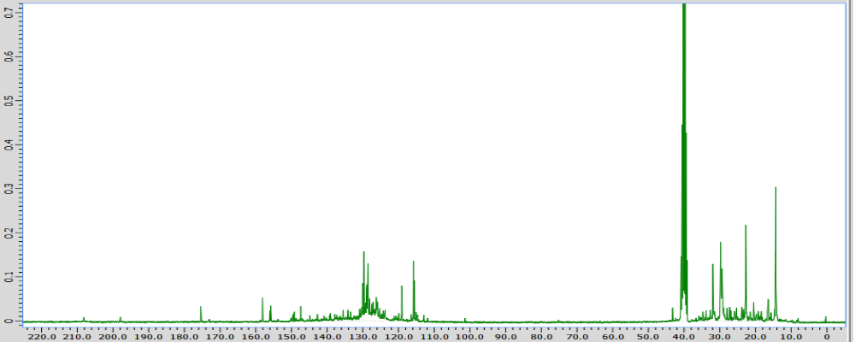
Sand 450 C
Red mud 450 C

Slide 17
Table 5. Composition of pyrolysis gases generated from sand and red mud OMWS pyrolysis at various temperatures (mass%).
Pyrolysis media | Silica sand |  |  | Red mud
Pyrolysis temp (ºC) | 400 | 450 | 500 | 400 | 450 | 500
H₂ | 0.45±0.03 | 0.8±0.1 | 1.1±0.1 | 2.15±0.03 | 3.8±0.3 | 3.88±0.1
CO | 4.7±0.1 | 6.3±0.4 | 6.0±0.6 | 5.9±0.2 | 7.3±0.01 | 10.9±0.9
CO₂ | 81.1±2.6 | 76.6±1.4 | 74.6±0.7 | 78.5±0.1 | 72.5±0.9 | 65.2±1.5
CH₄ | 1.5±0.4 | 2.1±0.2 | 2.6±0.2 | 1.6±0.2 | 2.6±0.1 | 3.8±0.04
C₂-C₅ | 10.5±1.9 | 11.5±1.5 | 13.3±0.8 | 10.0±1.1 | 10.8±0.9 | 13.6±0.9
Other hydrocarbons | 1.9±0.5 | 2.8±0.2 | 2.5±0.5 | 1.9±0.3 | 2.9±0.6 | 2.6±0.5
CO/CO₂ (mass/mass) | 0.06 | 0.08±0.01 | 0.09 | 0.08±0.00 | 0.10±0.00 | 0.17±0.02

Slide 18
Hydrotreating of red mud pyrolysis oil
High pressure batch reactor
400 C
37 bar initial hydrogen pressure
15 wt% catalyst
Reaction time 30 min.

Slide 19
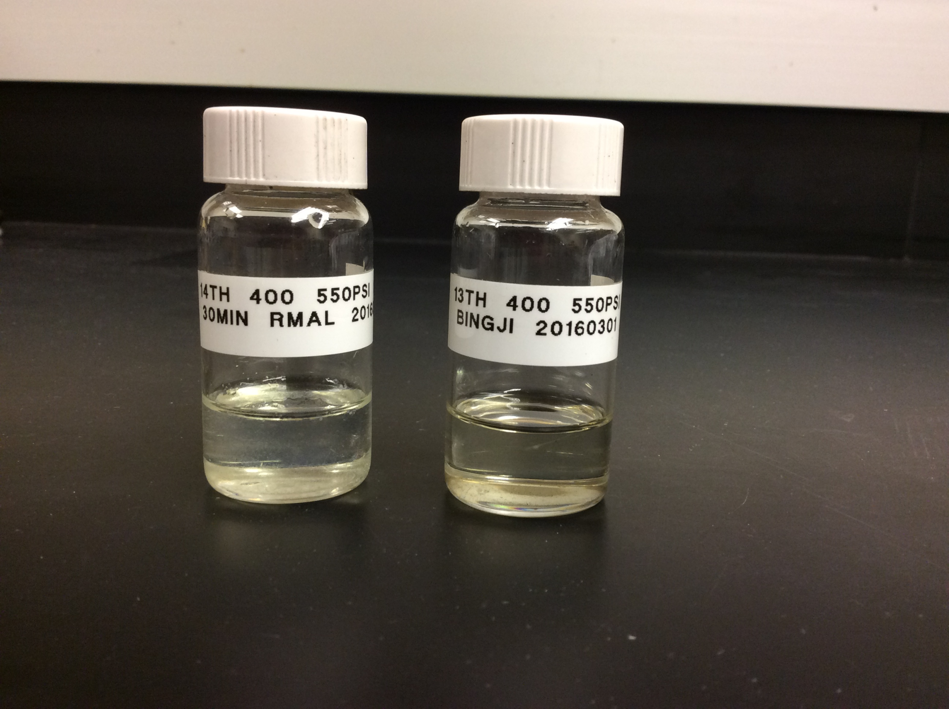
Hydrogenated OMWS pyrolysis oil

Slide 20
Oil properties
 | Red mud pyrolysis oil | Hydrotreated oil
C (wt%) | 77.70 | 85.55
H (wt%) | 10.07 | 13.15
N (wt%) | 2.33 | 0.55
O (wt%) | 9.88 | 0.79
HHV (MJ/kg) | 40.58 | 45.07
Density (g/cm3) | 0.92 | 0.79

Slide 21
Olive oil Industry
Bauxite Industry
OMWS
Red mud
Catalytic Pyrolysis
in Fluidized Bed Reactor
Gas
H₂, CO, CH₄, CO₂
Green
Diesel
Fuel
Char
Fertiliser

Slide 22
Conclusions
Straight pyrolysis of OMWS produces mostly long chain fatty acidic products and hydrocarbons
Red mud catalytic pyrolysis of OMWS produces mostly hydrocarbons, ketones, and alcohols
Hydrotreatment of the red mud catalytic pyrolysis oils produces C11 to C24 hydrocarbons with HHV 46 MJ/kg

Slide 23
Thank you
Questions?

