Slide 1
Geometric Data Analysis: Analytics of Processes and Behaviours
The Geometry and Topology of Data and Information for Analytics of Processes and Behaviours:
Building on Bourdieu and Addressing New Societal Challenges
Data Mining 2016, 26-27 September 2016
Fionn Murtagh

Slide 2
This presentation: focus of analysis, contextualizing the analysis and interpretation, visualization in biplots, ranking important data components.
Part 1: New challenges and opportunities in the context of Big Data analytics. To begin, a few words of background. The geometry and topology of data and information – between narratives of lives and lives of narratives.
Part 2: Short review of analytics methodology. Integrated narrative analysis. (Example of Casablanca movie.) Understanding deep semantics. (Example: tracking emotion – Casablanca, Madame Bovary.)
Part 3: Social media analytics. (Example of use of Jürgen Habermas’s convergent processes.)
Part 4: Mental health analytics: early stage.
Part 5: Semantic mapping of Twitter data, relating to festivals – music, film, art, parades.

Slide 3
Part 1
The following slides will discuss the importance for Big Data analytics, and associated paradigm shifts.
Then: Open Data and lots of other sources.
Essential analytics methodology uses the geometry and topology of data and information.
“This is my motto: Analysis is nothing, data are everything. Today, on the web, we can have baskets full of data ... baskets or bins?"
Jean-Paul Benzécri, 2011.

Slide 4
N. Keiding and T.A. Louis, Perils and potentials of self-selected entry to epidemiological studies and surveys, J.R. Statist. Soc. A, 179, Part 2, pp. 1-28, 2016
This comprehensive survey (118 citations) sets out new contemporary issues of sampling and population distribution estimation. An interesting conclusion is the following.
"There is the potential for big data to evaluate or calibrate survey findings ... to help to validate cohort studies". Examples are discussed of "how data ... tracks well with the official", far larger, repository or holdings.

Slide 5
Keiding and Louis (contd.)
It is well pointed out how one case study discussed "shows the value of using ‘big data’ to conduct research on surveys (as distinct from survey research)".
Limitations though are clear: "Although randomization in some form is very beneficial, it is by no means a panacea. Trial participants are commonly very different from the external … pool, in part because of self-selection, ...".

Slide 6
Keiding and Louis (contd.)
This is due to, "One type of selection bias is self-selection (which is our focus)".
Important points towards addressing these contemporary issues include the following.
"When informing policy, inference to identified reference populations is key”
This is part of the bridge which is needed, between data analytics technology and deployment of outcomes.

Slide 7
The following slides will further discuss the importance for Big Data analytics.

Slide 8
The following 50 page report makes interesting reading.
“The classic statistical paradigm was one in which researchers formulated a hypothesis, identified a population frame, designed a survey and a sampling technique and then analyzed the results … . The new paradigm means it is now possible to digitally capture, semantically reconcile, aggregate, and correlate data.”
In what follows: semantic contextualization, aggregation, metric (i.e. geometrical) and ultrametric (i.e. topological) mapping that incorporates correlation.

Slide 9


Slide 10
From AAPOR Report: What is Big Data?
… large data sources have been mined to enable insights about economic and social systems, which previously relied on methods such as surveys, experiments, and ethnographies to drive conclusions and predictions …
Example 1: Online prices. … prices collected daily from hundreds of online retailers around the world to conduct economic research. One statistical product is the estimation of inflation in the US. Changes in inflation trends can be observed sooner in PriceStats than in the monthly Consumer Price Index (CPI).
Example 2: Traffic and infrastructure. Big Data can be used to monitor traffic or to identify infrastructural problems. … real-time information … to fix problems and plan long term investments
Example 3: Social media messages. … Twitter … generating early predictions of Initial Claims for Unemployment Insurance. The predictions are based on a factor analysis of social media messages mentioning job loss and related outcomes

Slide 11
The bridge between the data that is analyzed, and the calibrating Big Data, is well addressed by the geometry and topology of data. Those form the link between sampled data and the greater cosmos.
Bourdieu's concept of field is a prime exemplar.
Consider, as noted by Lebaron (2009), how Bourdieu's work, involves "putting his thinking in mathematical terms", and that it "led him to a conscious and systematic move toward a geometric frame-model".
This is a multidimensional, "structural vision".

Slide 12
F. Lebaron, "How Bourdieu "quantified" Bourdieu: the geometric modelling of data”, chapter 2 in K. Robson and C. Sanders, Eds., Quantifying Theory: Pierre Bourdieu, Springer 2009.
Bourdieu's analytics "amounted to the global [hence Big Data] effects of a complex structure of interrelationships, which is not reducible to the combination of the multiple [... effects] of independent variables".
The concept of field, here, uses Geometric Data Analysis that is core to the integrated data and methodology approach used in the Correspondence Analysis platform.

Slide 13
Through analysis of social fields and homology, and beyond.
General and broad relevance and applicability.
Learning and drawing inspiration from the work of P. Bourdieu.
Underpinning analytics, we may consider that we have: data → information → knowledge → wisdom.
Geometric data analysis, and based on GDA, topology, is the essential basis for all such work.

Slide 14
Part 2
Short review of analytics methodology: Integrated narrative analysis. (Example of Casablanca movie.) Understanding deep semantics. (Example: tracking emotion – Casablanca, Madame Bovary.)

Slide 15
Analysis of Narrative
Technical Issues Addressed
We must consider complex web of relationships.
Semantics include web of relationships - thematic structures and patterns. Structures and interrelationships evolve in time.
Semantics include time evolution of structures and patterns, including both: threads and commonality; and change, the exceptional, the anomalous.
Narrative suggests a causal or emotional relationship between events.
A story is an expression of causality or connection
Narrative connects facts or views or other units of information.

Slide 16
A further theme: tracking emotion
Emotion determining and tracking in an unsupervised way. (Not machine learning like in sentiment analysis, which is supervised.)
Emotion is understood as a manifestation of the unconscious. Social activity causes emotion to be expressed or manifested. (This leads to later discussion of psychoanalyst, Matte Blanco.)

Slide 17
Some references on this work
F. Murtagh, A. Ganz"Pattern Recognition in Narrative: Tracking Emotional Expression in Context", Journal of Data Mining and Digital Humanities, vol. 2015 (published May 26, 2015).
J. Reddington, F. Murtagh and D. Cowie, "Computational properties of fiction writing and collaborative work", in Advances in Intelligent Data Analysis XII, Lecture Notes in Computer Science Volume 8207, 2013, pp 369-379.
F. Murtagh, A. Ganz and J. Reddington, "New methods of analysis of narrative and semantics in support of interactivity", Entertainment Computing, 2, 115-121, 2011.
F. Murtagh and A. Ganz, "La sémantique d'un récit : état de l'art et perspectives", La Revue MODULAD, 42, 36-44, 2010.
F. Murtagh, A. Ganz, S. McKie, J. Mothe and K. Englmeier, "Tag Clouds for Displaying Semantics: The Case of Filmscripts", Information Visualization Journal, 9, 253-262, 2010.
. Murtagh, A. Ganz and S. McKie, "The structure of narrative: the case of film scripts", Pattern Recognition, 42, 302--312, 2009. (See discussion in Z. Merali, "Here's looking at you, kid. Software promises to identify blockbuster scripts.", Nature, 453, p. 708, 4 June 2008.)
F. Murtagh, "Ultrametric model of mind, I: Review", p-Adic Numbers, Ultrametric Analysis and Applications, 4, 193-206, 2012.
F. Murtagh, "Ultrametric model of mind, II: Application to text content analysis", p-Adic Numbers, Ultrametric Analysis and Applications, 4, 207-221, 2012.
F. Murtagh, "Pattern recognition of subconscious underpinnings of cognition using ultrametric topological mapping of thinking and memory", International Journal of Cognitive Informatics and Natural Intelligence (IJCINI), 8(4), 1-16, Oct.-Dec. 2014. (Also Guest editor of this Special Issue on Computational Psychoanalysis.)
F. Murtagh, "Mathematical representations of Matte Blanco's bi-logic, based on metric space and ultrametric or hierarchical topology: towards practical application", Language and Psychoanalysis, 3(2), 40-63, 2014.

Slide 18
Part 3
Social media analytics. (Example of use of Jürgen Habermas’s convergent processes.)

Slide 19
Social Media case study – Twitter
Take some work of noted social / political science theorist, Jürgen Habermas
Motivated by: Theory of Communicative Action (Theorie des kommunikativen Handelns)

Slide 20
1) Testing social media with the aim of designing interventions
2) Application here to environmental communication initiatives
3) Measuring impact of public engagement theory (in the Jürgen Habermas sense – public engagement centred on communicative theory; by implication therefore, discourse as a possible route to social learning and environmental citizenship)
1) Qualitative data analysis of twitter.
2) Nearly 1000 tweets between 1.10.2012 and 24.11.2012.
3) Evaluation of tweet interventions.
4) Eight separate twitter campaigns carried out.

Slide 21
Background and aims
Analyse the semantics of the discourse in a data-driven way. (Pianosi, Bull and Rieser: “top-down communication campaigns both predominate and are advised by those involved in “social marketing” …. However, this rarely manifests itself through measurable behaviour change …”) Thus our approach is, in its point of departure and vantage point, bottom-up.
Mediated by the latent semantic mapping of the discourse, we develop semantic distance measures between deliberative actions and the aggregate social effect. We let the data speak in regard to influence, impact and reach.
Impact: semantic distance between the initiating action, and the net aggregate outcome. This can be statistically tested. It can be visualized. It can be further visualized and evaluated.

Slide 22
The 8 Twitter campaigns in late 2012
1.10-7.10: Climate change: The big picture and the global consequences
8.10-14.10: Climate change: The local consequences
15.10-22.10: Light and electricity
23.10-28.10: Heating systems
29.10-4.11: Sustainable Food choices
5.11-11.11: Sustainable Travel choices
12.11-18.11: Sustainable Water use
19.11-25.11: Sustainable Waste

Slide 23
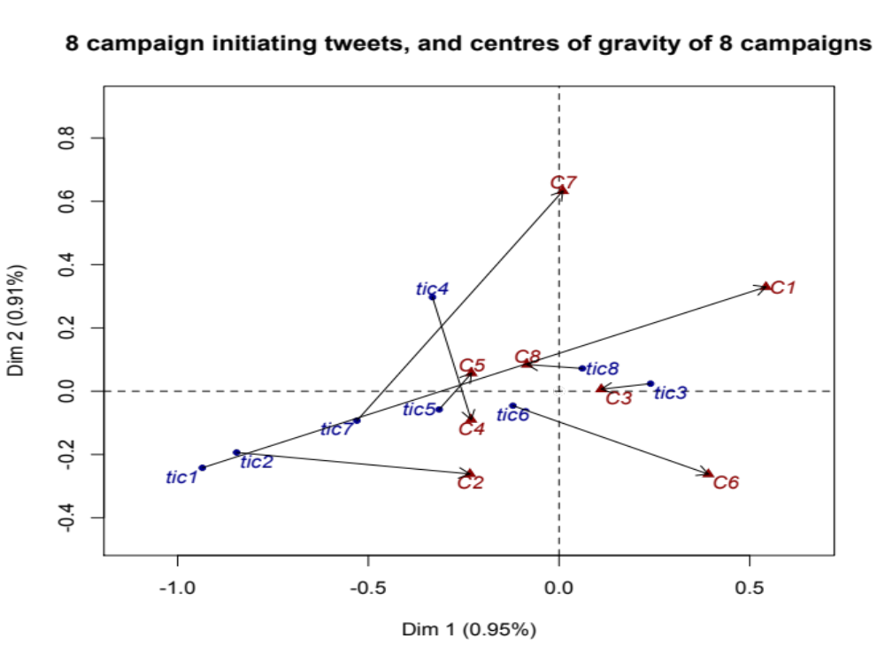

Slide 24
Statistical significance of impact
The campaign 7 case, with the distance between the tweet initiating campaign 7, and the mean campaign 7 outcome, in the full, 338-dimensional factor (semantic) space equal to 3.670904.
Compare that to all pairwise distances of non-initiating tweets. (They are quite normally distributed, with a small number of large distances.)
F. Murtagh, M. Pianosi, R. Bull, "Semantic Mapping of Discourse and Activity, Using Habermas's Theory of Communicative Action to Analyze Process", Quality and Quantity, 50(4), 1675-1694, 2016.

Slide 25
Part 4
In the following preliminary study of mental health, the following is described:
Choice and selection of main and supplementary variables.
Therefore: our main focus of analysis, and an explanatory context.

Slide 26
“Rehabilitation of individuals. The context model is always formulated at the individual level, being opposed therefore to modelling at an aggregate level for which the individuals are only an ‘error term’ of the model.”
B. Le Roux and F. Lebaron. “Idées-clefs de l'analyse géometrique des données” (Key ideas in the geometric analysis of data). In F. Lebaron and B. Le Roux, editors, La Méthodologie de Pierre Bourdieu en Action: Espace Culturel, Espace Social et Analyse des Données, pages 3-20. Dunod, Paris, 2015.

Slide 27
Mental Health: Adult Psychiatric Morbidity Survey,
England, 2007
HSCIC, Health and Social Care Information Centre (National Health Service, UK) (2009). National Statistics Adult Psychiatric Morbidity in England – 2007, Results of a household survey, Appendices and Glossary. 174 pp.
Available at: http://www.hscic.gov.uk/pubs/psychiatricmorbidity07
1704 variables, including questioning of the subjects about symptoms and disorders, psychoses and depression characteristics, anti-social behaviours, eating characteristics and alcohol consumption, drug use, and socio-demographics, including gender, age, educational level, marital status, employment status, and region lived in.

Slide 28
First analysis: relating to
“Neurotic symptoms and common mental disorders"
14 questions, hence 14 categorical variables, 14 categorical variables, relating to this.
Almost all of these variables had as question responses, whether or not there were symptoms or disorders in the past week, one question related to one's lifetime, and one question related to the age of 16 onwards.
Another question set was selected, relating to 9 socio-demographic variables.

Slide 29
It was checked whether neurotic symptoms and common mental disorders data should be jointly analysed with the socio-demographic data. The following figure shows this outcome.
On the positive first factor, what is particularly important, from the contribution to the inertia, is PTSDcom, “TSQ (Trauma Screening Questionnaire) total score".
The negative second factor, is highly influenced by these two variables: “gor06", “newsha", respectively: “Government office region" and “Strategic Health Authorities". These were both sets of geographic regions in England, respectively 9 and 10. (The 7th such region in each of these variables was London.)
A summary interpretation derived from the following figure is how factor 1 accounts for recorded trauma, and factor 2 accounts for region of the respondent.

Slide 30
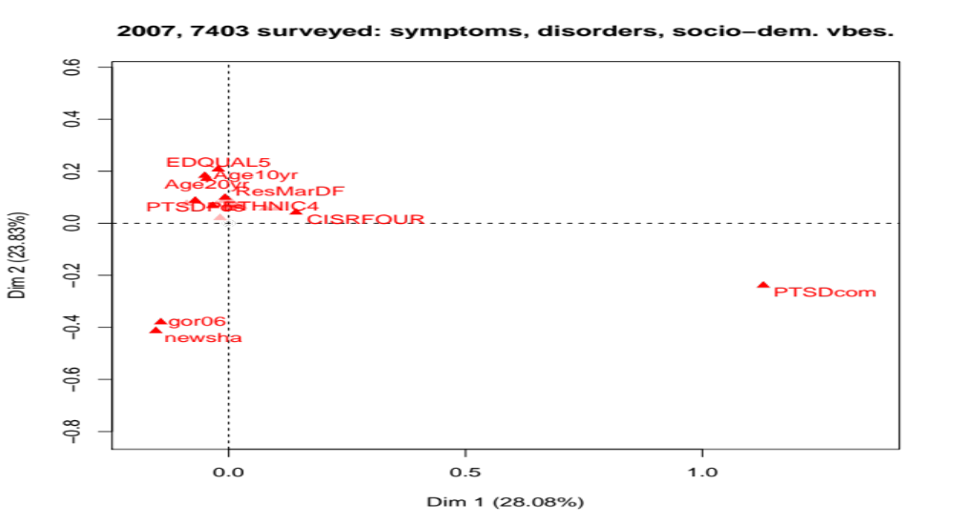
Adult psychiatric morbidity survey 2007, England, household survey.
The analysis has the neurotic symptoms and common mental disorders, and the socio-demographic variables. Displayed are the 10 highest contributing variables to the principal plane.

Slide 31
Future work relating to Bourdieu’s field and homology analytics: Mental capital
Kleinman A., Lockwood Estrin G., Usmani S., Chisholm D., Marquez P.V., Evans T.G., and Saxena S. (2016), “Time for mental health to come out of the shadows”. The Lancet vol: 387, 2274-2275.
Cooper C., Wilsdon J., and Shooter M. (2016), “Making the Case for the Social Sciences, No. 9 Mental Wellbeing”. 28 pp. BACP, British Association for Counselling and Psychotherapy.
It is noted in Kleinman et al. (2016) how relevant and important mental health is, given the integral association with physical health. There is the following: “... parity between mental and physical health conditions remains a distant ideal". “The global economy loses about $1 trillion every year in productivity due to depression and anxiety". “Next steps include ... integration of mental health into other health and development sectors".
In Cooper et al. (2016), under the heading of “Five Ways to Wellbeing”, reference is made to “mental capital and wellbeing". A section (page 14) is entitled “The `mental capital’ values of the outdoors". At issue here: going for a walk, therefore taking exercise, in the countryside or parkland.

Slide 32
Part 5: Semantic Mapping
Semantic mapping of Twitter data, relating to festivals – music, film, art, parades.

Slide 33
Data Selection to Focus Our Analysis
Analytic focusing, i.e. selecting and recoding relevant or important data.
E.g. in summarization of tweets starting with frequent phrases, common word usage.
Based on B.E. Harcourt, legal studies: not “content analysis”, of the Twitter sources, but rather “map analysis”. “to visually represent the relationship between structures of social meaning and the contexts and practices within which they are embedded”.
Therefore, not directly predictive mapping (of course, in a secondary sense, we are interested in all that is relevant for prediction and forecasting). Rather, our primary interest is in having informative and revealing mapping out of narratives of behaviour and practices, as a foundation for all that follows.
Not using (not yet, anyway) URLs contained, or of linked Wikipedia or other data sources.

Slide 34
Data preparation (first: work a few months ago)
11,952,123 tweets, from 2015-05-11 to 2015-12-31.
For each day’s tweets, the hashtags were obtained.
Retweets not here to remove redundant semantic content.
16837 such not-retweeted tweets. Up to 14 hashtags in a tweet.
For a given day, repeated use of the same hashtag was not retained.
So: 233 days (from 11 May to 31 December 2015; 70503 hashtags.
#, tweeter name preceded by @, and punctuation removed, upper case set to lower case, non-Roman characters removed, accented characters. So:
#Reynié. becomes reynie and #Sarkozy, #sarkozy become sarkovy ; #Cannes, #CANNES, #cannes become cannes

Slide 35
Example of top and bottom ranked hashtags
cannes 635, avignon 516, france 488, frenchriviera 458, festival 426, nice 423, cotedazur 419, film 415, paris 414, travel 401, monaco 392, marketing 381, fashion 379, love 373, news 371, art 365, immobilier 364, la 362, live 361, hotel 356, photo 356, job 343, culture 339, luxury 338, provence 338, deal 335, video 332, promos 331, music 327, paca 321, marseille 317, europe 317, sttropez 312, london 312, emploi 310, cinema 309
...
sorellaterra 2, estilismos 2, provinssirock 2, katzenjammer 2, electriccastlefestival 2, rapradar 2

Slide 36
From the 76098 hashtag word list, the most frequently occurring 5595 were selected. This selection was from the frequency of occurrence being greater than 30.
Such is standard practice in textual data mining, because the analyses are based of commonality of usage, i.e. shared usage, of terms.
Analysis now carried out on 233 days crossed by 5595 hashtags.
Both days and hashtags (rows, columns) endowed with the chi squared metric. Cloud of day points in 5595-dimensional space, and cloud of hashtag points in 233-dimensional space, mapped into factor space, endowed with the Euclidean distance. Dimensionaly of the factor space, i.e. principal axis space, found to be 161. More than 50% of inertia in these dual space is explained by point (day, hashtag) coordinates on the 11 principal factors/axes.

Slide 37
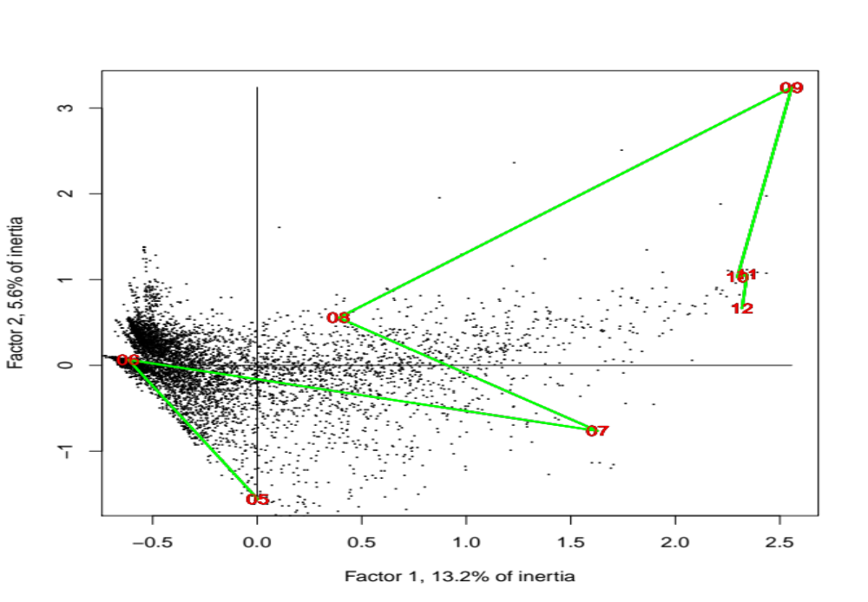
Months May (05) to December (12), 2015, as supplementary or contextual variables. The cloud of dots are the locations of the hashtag projections.

Slide 38
Factors 1 and 2 projections of the hashtags with the highest contributions to factor 1.
Factor 1 Factor 2
cannes 1.185046 0.1157641
avignon 1.341975 0.3057062
france 1.259990 0.1704328
paris 1.199826 0.1786310
travel 1.161375 0.1893705
monaco 1.181179 0.1488680
immobilier 1.283816 0.2323571
promos 1.321608 0.4335699
appartement 1.563006 0.4364088
carhaix 1.941503 1.0825339
We also look at the highest (positive), and lowest (negative) projections on the axes/factors.

Slide 39
Previously studied, days x hashtags
Now: days x all words from the tweets
(deleted though: tweeter, URLs, and hashtags)
Next analysis: select a set of festivals, not including Yulin Dog Festival; use them as the principal variables, and use the rest of the retained word set as supplementary variables

Slide 40
Next (here – final) analysis: towards behavioural or activity patterns or trends
Consider the tweeter, variable: from_user
As an important characteristic of the tweeter, consider the associated language, variable: iso_language_code
This language indicated is indicative only. We assume it to be an indicative, and relevant, characteristic of the tweeter.
From 2015-05-11 to end 2015 data: 75 languages in use, including Japanese, Arabic and so on, with the majority in Roman script.

Slide 41
For a language label, the activity over time
As indicative association to language, we take the following: English, Spanish, French, Japanese, Portuguese.
We consider the days 2015-05-11 to 2016-08-02, with two days removed, 2015-08-29, 2015-08-30, due to lack of tweets.
The numbers of tweets for these languages were as follows (carried out on 11 Aug. 2016): en, 37681771; es, 9984507; fr, 4503113; ja, 2977159; pt, 3270839
Following removal of the null dates, and the two days with 0 tweets for some case, there were these totals of tweets:
en, 37681567; es, 9984485; fr, 4503077; ja, 2977156; pt, 3270837

Slide 42
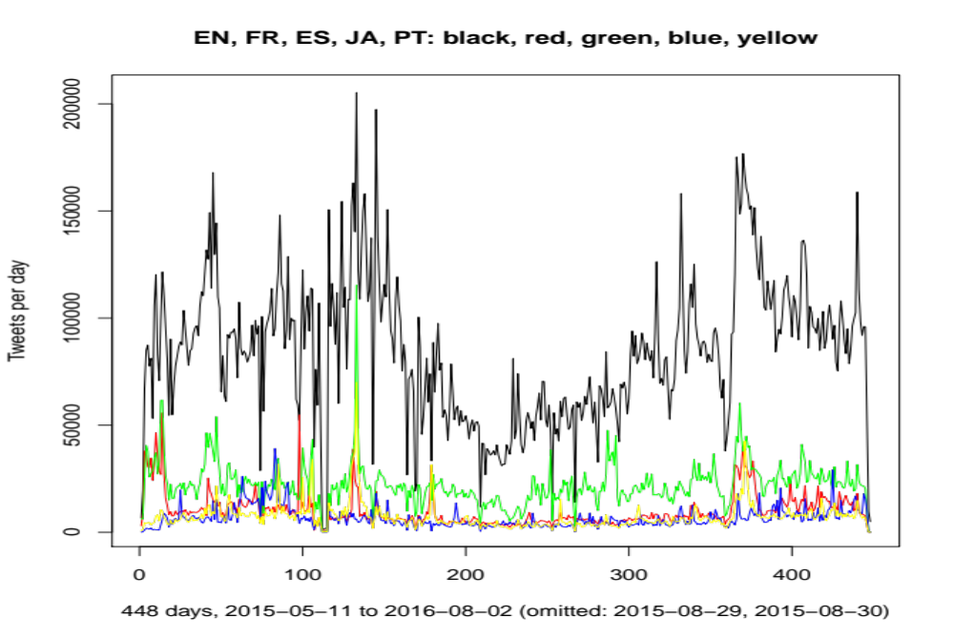
The dominant labels of tweets for these languages: English, French, Spanish, Japanese, Portuguese. There are numbers of tweets per day from 2015-05-11 to 2016-08-02, with two days removed.

Slide 43
For a given language label – which serves as a preliminary selection that is potentially relevant for one or more specific festivals – carry out the following.
Determine the set of tweeters (variable from_user), crossed by the day (variable created_at). In this matrix there is the number of tweets by each tweeter on each day.
Just consider days that have non-zero tweet activity.

Slide 44
Compactification – piling – is quite clearly the case here.
This can be due to very high dimensionality. Or sparsity.
The following slide just expresses this Euclidean distance endowed, factor space (latent variable space) mapping.
That motivates the behavioural analysis carried out here: to look for tweeters and days that are exceptional for factors. I.e. tweeters and days that are the most important and predominant in defining the factors.

Slide 45
Portuguese, ISO Label PT
For iso_lang_code as PT, Portuguese, there were:
449 days, 744584 tweeters, maximum of 21 tweets by a tweeter per day, and total number of tweets: 3166418
(Carried out on 29 August 2016.)
Very sparse matrix, tweeters x days: 0.63% non-zero values.
The first eigenvalues explained the following % inertia: 0.49, 0.46, 0.42, 0.39, 0.38, 0.37, 0.36, 0.34, 0.33 …
(Top contributions to factors are in following slide.)

Slide 46
The first few factors, the highest contributions (inertia, that defines the factor) by tweeter, and by day
Factor tweeter (contr.) tweeter (contr.) tweeter (contr.)
1 GiannaAdamson (0.002) gumartinslive (0.001) CamilaMacielSer (0.001)
2 newslarts (0.0005) herdersonfile (0.0004) biebersmaniabr (0.0004)
3 Onlifebiebsr (0.0005) justindrewluz (0.0005) sandybieber1 (0.0005)
4 AlissonNobrien (0.0007) Music_Industry3 (0.0006) PAULINAUSURPA (0.0005)
5 cacolizei (0.002) knowhoneymoon (0.001) Tayanediass (0.001)
Factor day (contr.) day (contr.) day (contr.)
1 2015-09-22 (0.018) 2016-05-17 (0.013) 2015-09-21 (0.012)
2 2015-11-07 (0.111) 2015-08-24 (0.086) 2015-08-23 (0.060)
3 2015-11-07 (0.161) 2015-09-22 (0.143) 2015-08-24 (0.084)
4 2015-09-22 (0.108) 2015-11-07 (0.059) 2015-09-23 (0.042)
5 2015-12-17 (0.656) 2016-01-25 (0.017) 2015-08-24 (0.013)

Slide 47
The Tweeters and the Festivals
Tweets characterized as French, accessed on 11 Sept. 2016 (dating from 11 May 2015).
4913781 tweets. (For user, date and tweet content, the file size was: 667242607 bytes.)
The following were sought in the tweets: Cannes, cannes, CANNES, Avignon, avignon, AVIGNON.
Upper and lower case retained in order to verify semantic proximity of these variants.
By the way, these related to the Cannes Film Festival, and the Avignon Theatre Festival.
The following total numbers of occurrences of these words were found, and the maximum number of occurrences by a user: Cannes, 1230559 and 3388; cannes, 145939 and 4024; CANNES, 57763 and 829; Avignon, 272812 and 4238; avignon, 39323 and 2909; AVIGNON, 14647 and 900.
Total number of tweeters, also called users here: 880664; total number of days retained, from 11 May 2015 to 11 Sept. 2016, 481
Cross-tabulated are: 880664 users by 481 days. There are 1230559 retained and recorded tweets. The non-sparsity of this matrix is just: 0.79%

Slide 48
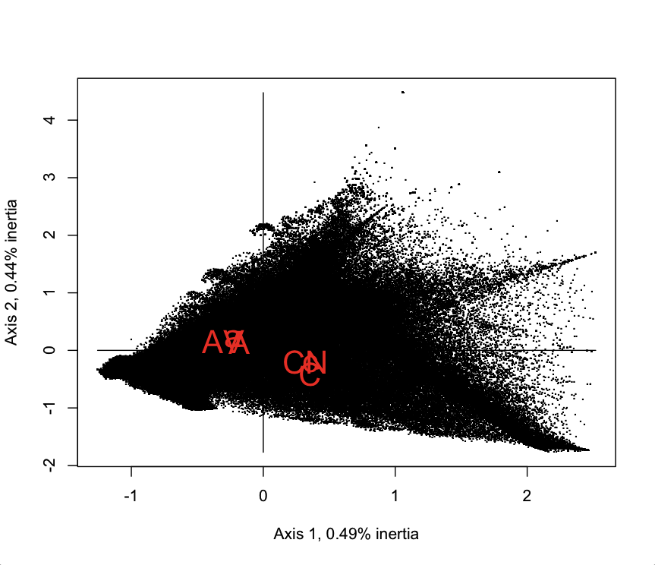
C, c, CA (Cannes, cannes, CANNES) and A, a, AV (Avignon, avignon, AVIGNON)
They are supplementary variables in the Correspondence Analysis principal factor plane.
Semantically they are clustered. They are against the background of the Big Data, here the 880664 tweeters, represented by dots.

Slide 49
Projections of supplementary variables on the principal factors (to 2 digits of precision)
word Factor 1 Factor 2
Cannes 0.357 -0: 426
cannes 0.355 -0: 244
CANNES 0.320 -0: 2131
Avignon - 0.182 0.136
avignon - 0: 226 0.193
AVIGNON - 0: 303 0.141
So Cannes is positive F1, negative F2; Avignon is negative F1, positive F2. We see their opposition or polarity, against the background of the large set of tweets.

Slide 50
Current Considerations
Determine some other, related or otherwise, behavioural patterns that are accessible in the latent semantic, factor space.
Retain selected terms from the tweets, and, as supplementary elements, see how they provide more information on patterns and trends.
Year by year trend analysis.

Slide 51
Some references
(1) F. Murtagh “Semantic mapping: towards contextual and trend analysis of behaviours and practices”, online proceedings of the CLEF 2016 Cultural Microblog Contextualization Workshop,event.
(2) F. Murtagh, “The geometry and topology of data and information for analytics of processes and behaviours: building on Bourdieu and addressing new societal challenges”, 2016, submitted.
(3) F. Murtagh, “Sparse p-Adic Data Coding for Computationally Efficient and Effective Big Data Analytics”, p-Adic Numbers, Ultrametric Analysis and Applications, 8(3), 236-247, 2016.
(4) F Murtagh, “Big Data Scaling through Metric Mapping: Exploiting the Remarkable Simplicity of Very High Dimensional Spaces using Correspondence Analysis”, Proc. IFCS 2015 – International Federation of Classification Societies, forthcoming, 2016.
(5) F Murtagh and P Contreras, “Clustering through High Dimensional Data Scaling: Applications and Implementations”, ECDA 2015 – European Conference on Data Analysis, Archives of Data Science (KIT Scientific Publishing), in press, 2016.

Slide 52
Short Review of Analytics Methodology

Slide 53

Correspondence Analysis is
A Tale of Three Metrics
Χηι σθυαρεδ μετριχ, αππροπριατε φορ προφιλεσ οφ φρεθυενχιεσ οφ οχχυρρενχε
Ευχλιδεαν μετριχ, φορ ϖισυαλιζατιον, ανδ φορ στατιχ χοντεξτ
Υλτραμετριχ, φορ ηιεραρχηιχ ρελατιονσ ανδ φορ δψναμιχ χοντεξτ

Slide 54
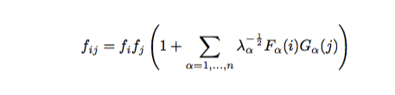
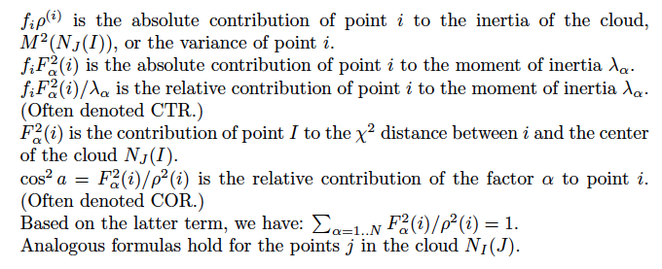
For data array frequencies, of dual clouds I and J, Correspondence Analysis, transform relative to product of marginal frequency distributions.
Absolute and relative contribution to inertia.

Slide 55



Pierre Bourdieu, 1930-2002, renowned French social scientist.
La Distinction, published in French in 1979,
and in English in 1984.
In it, Bourdieu developed his methodology
using social and aesthetic preferences,
cultural and educational capital.
The figure on the next slide shows
a figure from this book,
using Multiple Correspondence Analysis of
individuals and of properties
(professions, age, education
with their interests in music, art, and so on).
In The Craft of Sociology, Bourdieu wrote: “I use Correspondence Analysis very much, because I think that it is essentially a relational procedure whose philosophy fully expresses what in my view constitutes social reality. It is a procedure that 'thinks' in relations, as I try to do it with the concept of field.”

Slide 56
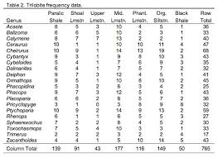
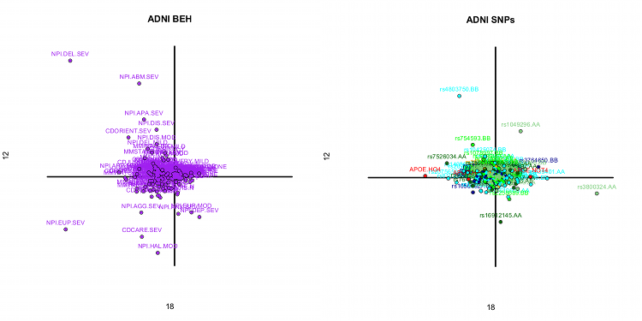
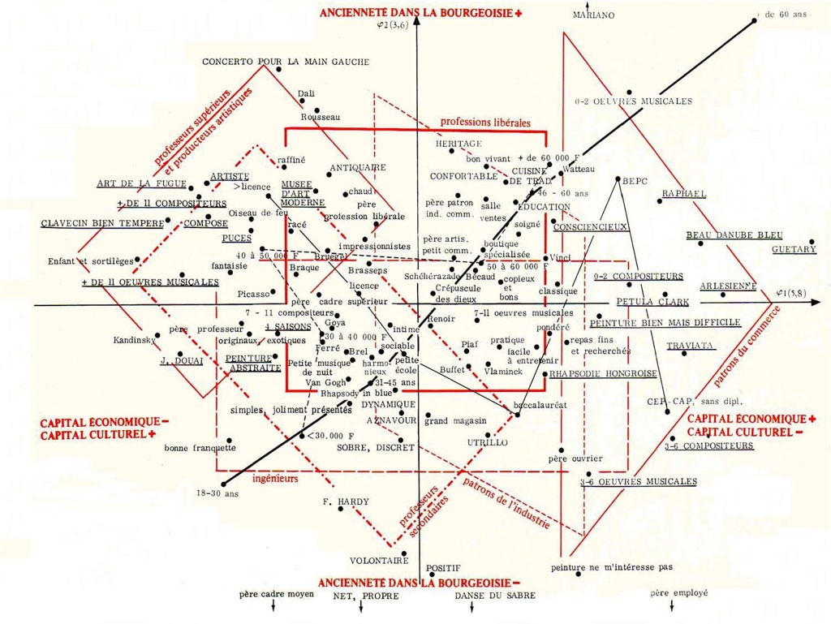
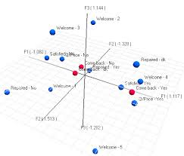
Dual spaces, transition formulae. Importance includes (1) interpretation in simultaneous display; (2) computational - we will not dwell on this here; (3) supplementary elements.
Variables
Individuals
(1) Use the attributes to understand the individuals, and vice versa. As well as study the subclouds of each. (Right: Bourdieu figure - see earlier slide.)
(3) Carry out correspondence analysis. Then use essentially what are the transition formulae to take new elements (rows or columns) and project them into the analysis - i.e. into the factor space.
Examples: in the “cultural tastes” data we will use, there is a set of subject respondents who came later and/or were different from the main set of subject individuals. For the variables used, i.e. responses to the cultural tastes, we use as supplementary variables gender, and salary, because these are different in nature from the variables analysed.

Slide 57
Hierarchy, as well as geometry (Euclidean factor space as in Correspondence Analysis) for both understanding and working in complex systems.
Following slide is of: Herbert A Simon (1916-2001), Nobel Prize in economics 1978. He coined the terms: “bounded rationality”, “satisficing”, - and hierarchy as the architecture of complex systems. See: The Sciences of the Artificial, MIT Press.

Slide 58
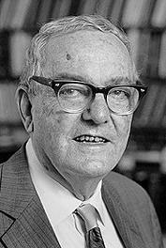

Chapter titles include:
- The psychology of thinking
- Remembering and learning
- The science of design
- Social planning
- The architecture of complexity: hierarchic systems
MIT Press, 3rd edn., 1996

