Slide 1
Using nasopharyngeal carriage surveillance in children hospitalized with pneumonia to demonstrate direct and indirect effects of pneumococcal conjugate vaccine
Associate Professor Fiona Russell
Centre for International Child Health,
WHO Collaborating Centre for Research & Training in Child & Neonatal Health,
Dept of Paediatrics, The University of Melbourne
Pneumococcal Group
Murdoch Childrens Research Institute, Melbourne

Slide 2
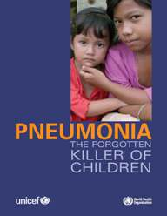
Pneumococcal disease
High pneumococcal burden
(pneumonia, sepsis, meningitis) in
children globally, particularly low-income
countries
Pneumonia:
  ~400 million cases per year
  > 1.6 million deaths per year: ~20% of U5s deaths
  Kills more children than any other disease - AIDS, malaria & measles combined
  Lack of attention to the disease means too few children have access to currently available interventions

Slide 3
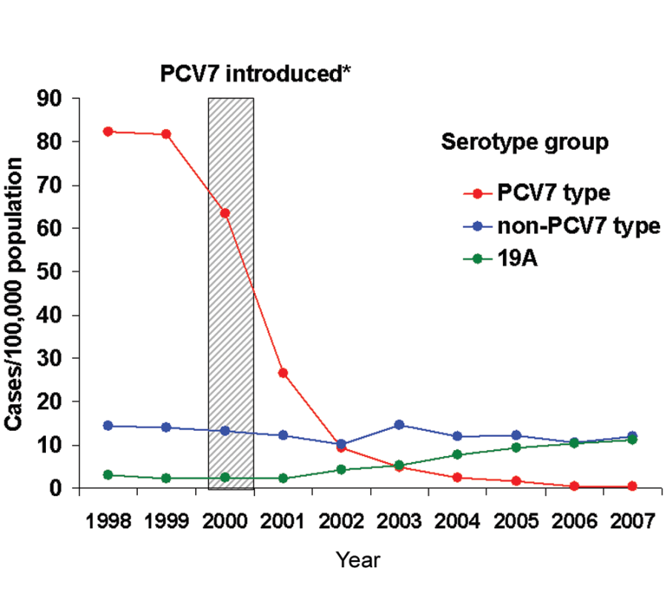
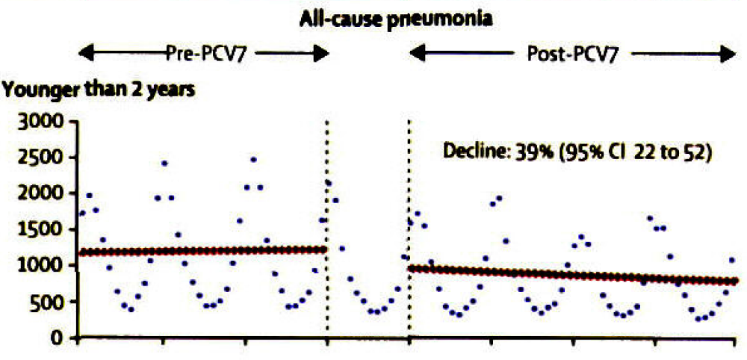
IPD in U5s, USA
Pilishvili, JID 2010
All-cause pneumonia
in children U2
Grijalva et al., Lancet 2007

Slide 4
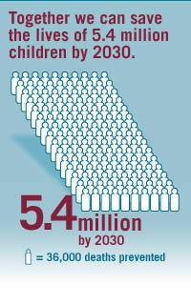
WHO position paper 2012
“inclusion of PCVs be given priority in childhood immunization programmes world-wide, especially in countries with under-5-mortality of >50/1000 live births.”

Slide 5
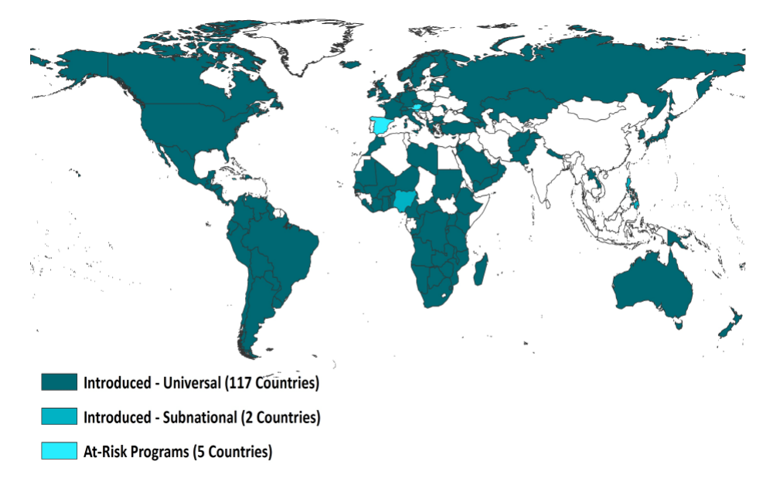
Pneumococcal conjugate vaccines
PCVs used successfully for ~ 15 years

Slide 6
Gambia - Radiologic Pneumonia
Evaluation: using carriage as an outcome
Why?
Courtesy G McKenzie, MRC Gambia
Notes:
As I get into the results, I will only present results for the under 5 age group and give greater emphasis to the 2-23 month age group. These are preliminary results to the end of 2012.
The radiologic pneumonia results represent standardised reading using the WHO definition for end-point consolidation. Our readers achieved very high agreement with the WHO standard before reading radiographs. Discordant readings were resolved by a paediatric radiologist who helped develop the WHO standard.
From 2008 – 2012 we found 850 radiologic end-point consolidations in children <5, at the end of 2014 we project detection of around 2400 end-point consolidations.

Slide 7
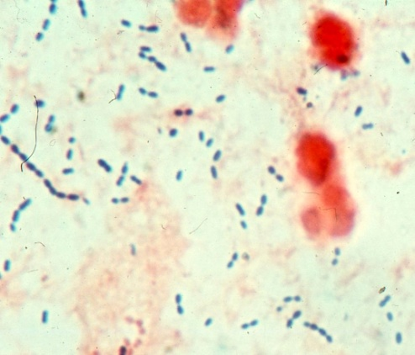
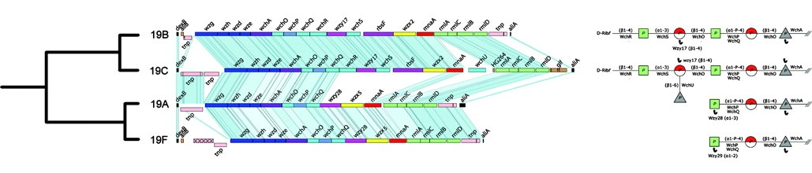
Streptococcus pneumoniae
Gram positive bacteria with a polysaccharide capsule
  Virulence factor
  Basis for immunity
  Highly variable
> 90 immunologically distinct serotypes
  Encoded by the cps locus
microbeworld.com
Mavroidi A et al. J. Bacteriol. 2007;189:7841-7855

Slide 8
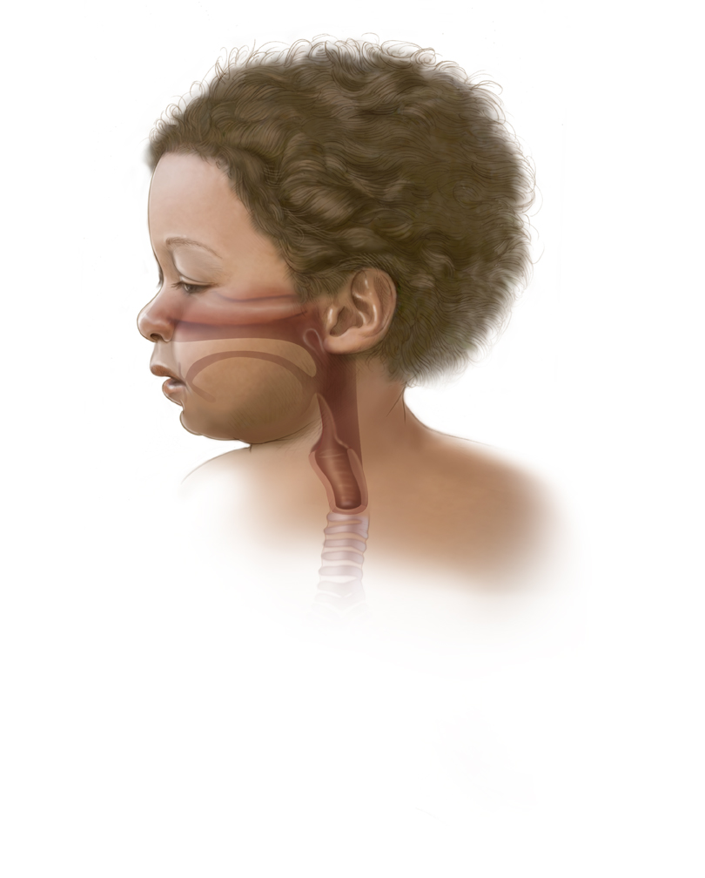
Nasopharyngeal colonisation
>50% of children U3 are
nasopharyngeal (NP) carriers, an
important reservoir for spread
  Children in LICs carry pneumococci
  at an earlier age
  higher numbers
  greater range
  multiple serotypes
Risk factors: ethnicity, crowding, family size, smoking exposure, & recent antibiotic use
Notes:
NP colonization with the pneumococcus is age-dependent. Colonization peaks within the first few years of life and then decreases.
In a study comparing Kenyan children with HIV infection to those without HIV infection, NP colonization was not more frequent in HIV+ children in the absence of respiratory symptoms. (Ref: Rusen I. Ped Inf Dis J 1997; 16(7): 656-662.)

Slide 9
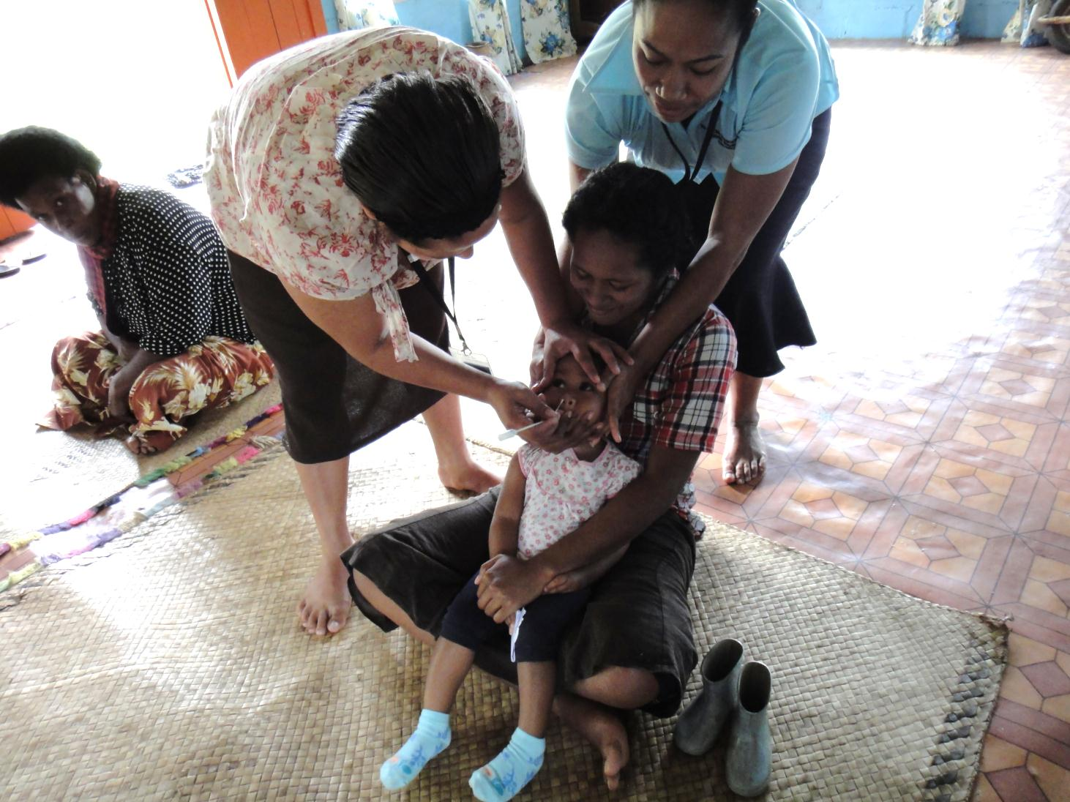
Pneumococcal carriage
Most NP colonisation
asymptomatic
Prerequisite for disease
Spreads via respiratory tract to cause
primary infections (OM, sinusitis & pneumonia)
Spreads via the blood to cause a secondary, more distal infection (meningitis, septic arthritis)

Slide 10
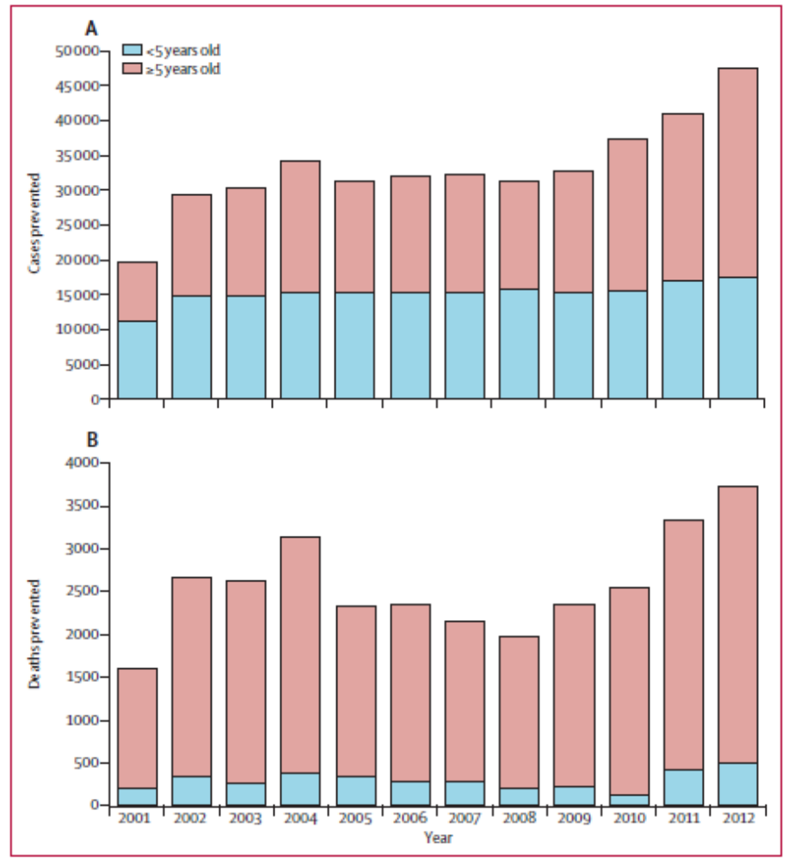
  ~>30 000 IPD
  cases & 3000
  deaths prevented
  in 3 years
  post PCV13
  ↓ nasal carriage in
  vaccinated children
  prevents spread to
  unvaccinated →
  ↓of IPD in older ages
Moore, Lancet Infect Dis 2015

Slide 11
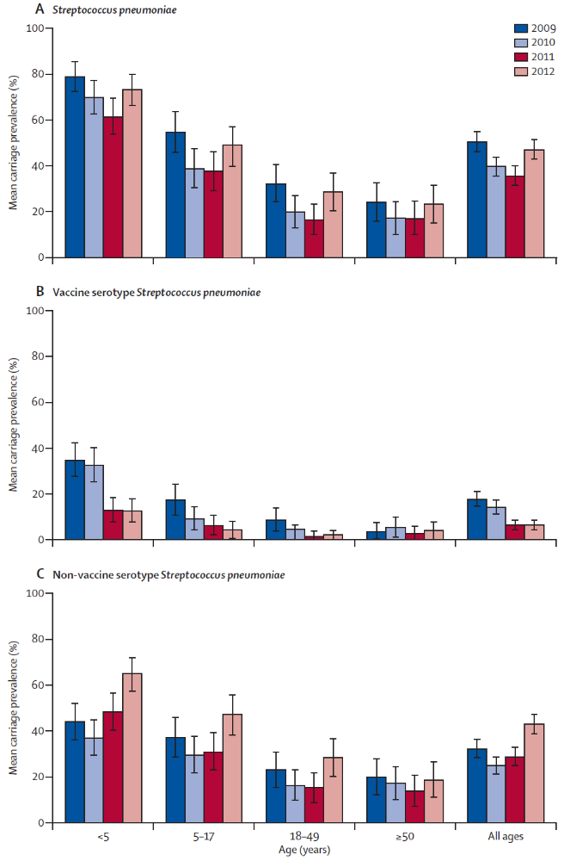
Kenya: PCV10 types declined by 2/3 in U5s & older people
Hammitt, L et al. Lancet 2014

Slide 12

PneuCarriage Project
Field Sample testing
  260 NP swab aliquots from children in low-income countries
  Also characterised by traditional serotyping of >100 colonies
Method | Sensitivity | PPV
Microarray | 96 | 92
Latex sweep | 81 | 91
RFLP and multiplex PCR | 79 | 97
Real-time PCR (culture) | 83 | 84
Real-time PCR (direct) | 79 | 92
Traditional serotyping (100+) | 96 | 98
Satzke, C et al. submitted

Slide 13






PCV13 Impact Evaluation, Lao PDR 2013-2017

Slide 14
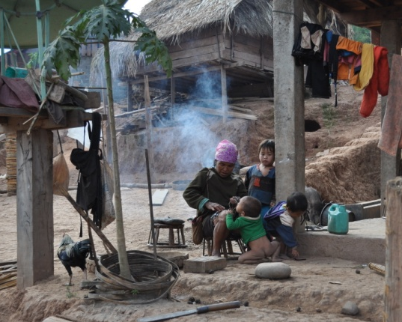
PCV13 in Lao PDR
PCV13 started Nov 2013
In April 2013 MoH requested WHO support for evaluation to ensure sustainability; no regional
data
WHO PCV evaluation guidelines inadequate for many countries
No baseline data, imminent vaccine introduction

Slide 15
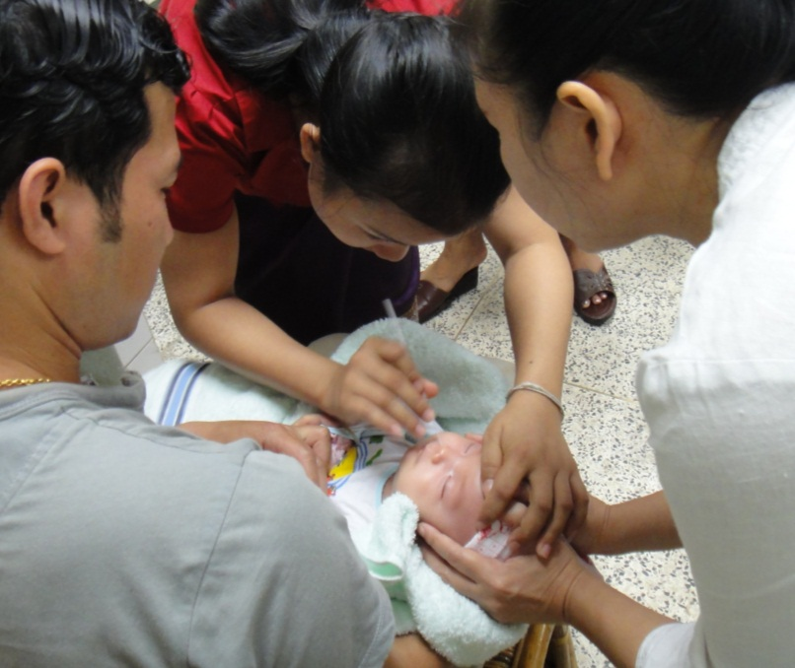
Lao PDR PCV13 evaluation: carriage endpoints
Impact on transmission in healthy children
  Community carriage survey: before & after PCV13
    Vaccinated: 12-23mo
    Unvaccinated: 5-8wo
Describe trends in carriage in hospitalised ARI in U5s
  PCV13 coverage needed for carriage decline

Slide 16
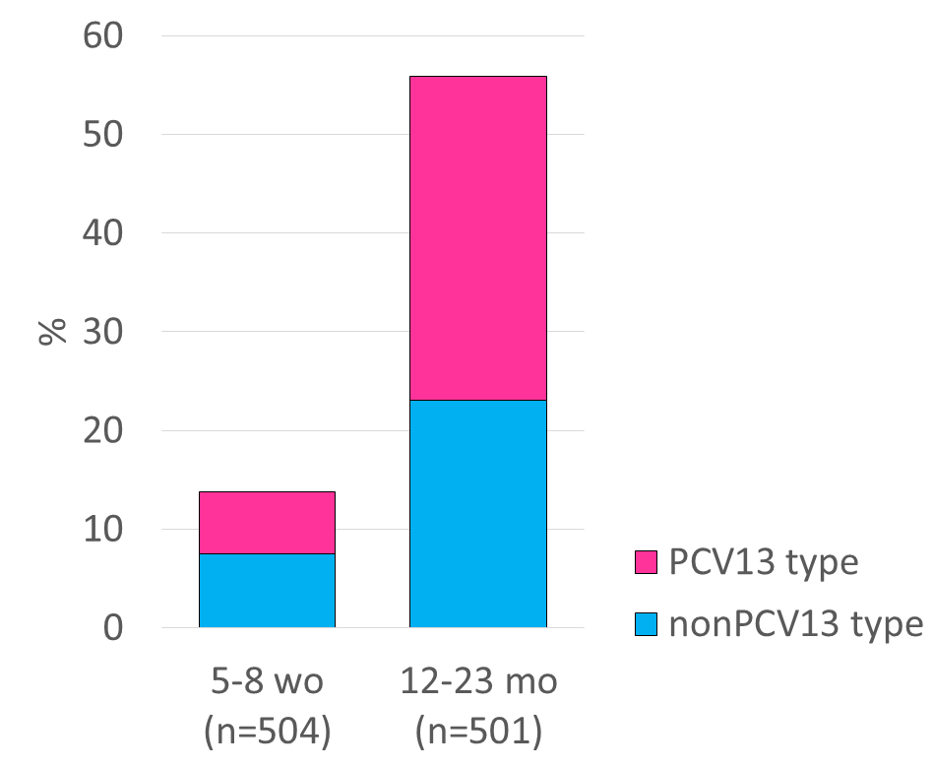
Community carriage surveys
PrePCV13 survey in 2013/2014
55.9%
32.9%
13.9%
6.3%

Slide 17
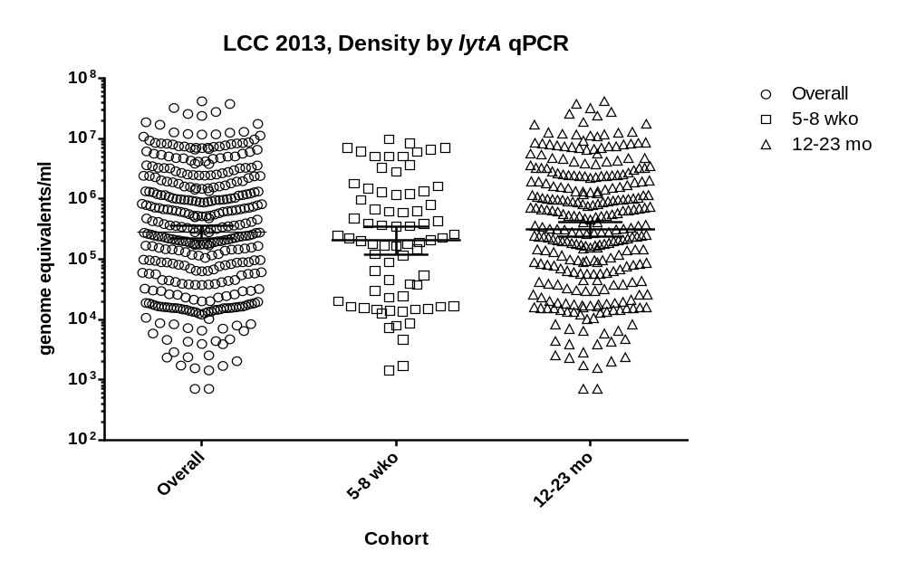
Despite the age groups having different carriage rates, they carry the same pneumococcal load

Slide 18
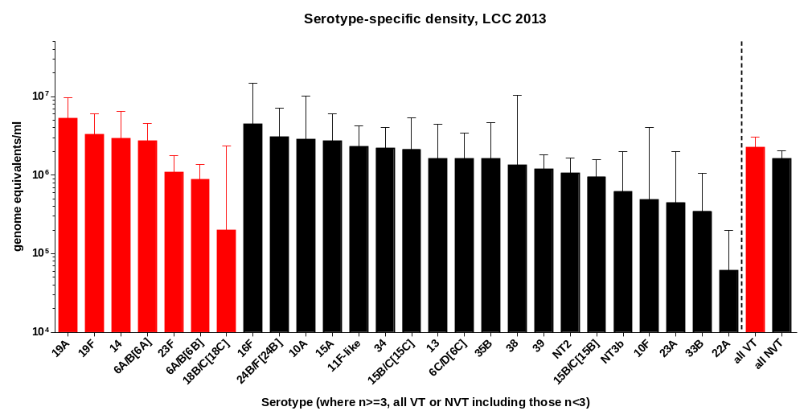

Slide 20
  Pneumonia & carriage
    PCV coverage needed & how long it takes to show carriage decline in vaccinated & unvaccinated pneumonia cases
    Feasible methods for LMICs
    3 sites: Laos, PNG, Mongolia

Slide 21
Anticipated results in 2-3 years time
Transmission:
  ↓ VT in vaccinated children
  ↓ VT in unvaccinated neonates where NMR high
  as carriage is a pre-requisite of pneumococcal disease, disease is likely to have ↓ in both age groups
Pneumonia:
  ↓ VT carriage in pneumonia cases & this most likely indicates that pneumonia is no longer due to VTs
  PCV13 coverage required to show direct & indirect effects

Slide 22
Summary
  Value in PCV evaluation
    Show biological effects on VT
      direct
      indirect effects
    Relatively “easy” to do
    Monitor NVT serotypes
    Estimate PCV coverage required to show maximum benefits
    Mathematical models: carriage & IPD

Slide 23
Collaborators
Ministry of Health
Dr Anonh Xeuatvongsa
Dr Kongxay Phounphenghcak
Dr Chansay Pathammvong
Lao Oxford Mahosot Welcome Research Unit
Prof Paul Newton
Dr David Dance
Dr Chanthaphone Syladeth
University of Health Sciences
Dr Vanphanom Sychareun
Dr Molina Choummanivong
MCRI
Fiona Russell
Kim Mulholland
Catherine Satzke
Eileen Dunne
Kathryn Bright
Eleanor Neal
WHO
Kim Fox
Siddhartha Datta
University of London
Jason Hinds

