Slide 1
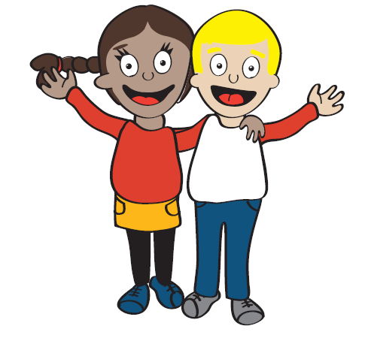

Brave Beginnings
Dr Fiona Martin,
Sydney Child Psychology Centre

Slide 2



Collaborative Research
Emeritus Professor Susan Hayes, Faculty of Medicine University of Sydney
Dr Fiona Martin, Sydney Child Psychology Centre

Slide 3
“Each year, approximately 10,000 parents are told they have cancer. By these estimates, every day, 27 Australian children (13 and under) will be deeply affected by the diagnosis of a parent who has cancer”.
(Camp Quality, 2014)

Slide 4
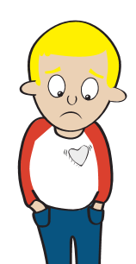
Reasons For Research
1) There is a lot of miscommunication and uncertainty in families facing a cancer diagnosis…

Slide 5
Misunderstanding and Uncertainty
Children and adolescents face substantial changes to their lives when a parent is diagnosed with cancer.
It is often emotionally difficult for young children to contemplate their parent’s mortality, as they experience the seriousness of cancer.
As young people frequently hide their feelings to protect their families, parents are often left unaware of the emotional difficulties that their children may be experiencing.

Slide 6
Misunderstanding and Uncertainty
Also, there are a number of reasons why parents may find it hard to discuss their illness with their children. For example:
  Parents may find it too emotionally challenging and overwhelming to talk to their children about a cancer diagnosis.
  Parents may feel that by hiding the diagnosis, they are protecting their children from the realities of cancer.
  Parents from some cultures may believe that it is not appropriate to talk about cancer. Some cultures believe that cancer is caused by bad luck or that it is contagious or always fatal. Others may believe that the cancer has been sent to test them.
(Cancer Council, 2012)

Slide 7
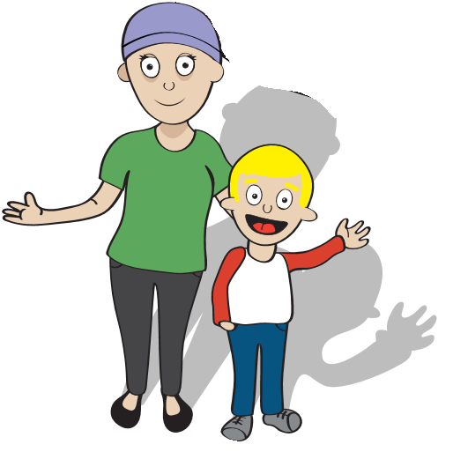
Misunderstanding and Uncertainty
Parents may first react by keeping the news from their children or to delay telling them.
However, research shows that being open and honest with children is the best way to help them cope with the cancer diagnosis of someone close to them (Ellis, Wakefield, Antill, Burns & Patterson, 2017; Cancer Council, 2012) .

Slide 8
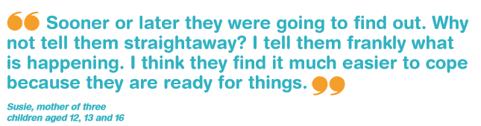
(Cancer Council, 2012)

Slide 9
Reasons For Research
2) Children and adolescents with a parent who has cancer are at increased risk of poor psychosocial outcomes…

Slide 10
Psychosocial Outcomes
Children have poor psychosocial outcomes due to uncertainty and perceived uncontrollable nature of cancer.
As a consequence, they have fewer opportunities to exert an appropriate level of personal/internal locus of control.
This leads to internalising problems like stress, anxiety and depression

Slide 11
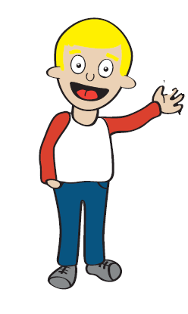
What is Internal Locus of Control?
Locus of control is our perception of where the seat of power over our lives is located.
Internal locus of control is the belief that one’s own ability, effort, or actions determine what happens.
Whereas, those with a low internal locus of control believe that fate, luck, or outside forces are responsible for what happens. This has been significantly related to life stress, depression and anxiety (Sullivan, Thompson, Kounali, Lewis, Zammit, 2017).
Increasing internal locus of control may help children who have a parent with cancer take more personal control over their lives.
Why does everything bad happen to me?
I can determine my future

Slide 12
Psychosocial Outcomes
Children receive less emotional and practical support when their parents are suffering from the stresses associated with a cancer diagnosis.
Parents become more busy with hospital visits, doctors appointments and dealing with the emotional, physical and financial burdens that come with treating cancer.
This may, however, have negative repercussions on children, as less support may cause difficulties relating to school, leisure, family functioning and relationships.

Slide 13
What Is Parental Stress?
Though parental stress is a normal part of the parenting experience. It arises when parenting demands exceed the expected and actual resources available to the parents that permit them to succeed in the parent role.
A child’s ability to cope is often closely linked to how their parents are managing. If parental stress is high, children are likely to adopt that behaviour too.
In addition, parental stress impacts both individuals and family relationships. It makes parents less responsive and supportive towards their children, which can lead to lowered coping skills and lowered resilience.
(Deater-Deckard, Chen & El Mallah, 2015; Cancer Council, 2012)

Slide 14
What Do Children Who Have A Parent With Cancer Need?
The Camp Quality charity commissioned Dr Claire Wakefield from Sydney Children's Hospital and University of NSW to undertake a comprehensive worldwide Literature Review on the support and interventions currently available to children with a parent with cancer, the largest of its kind, capturing 330 abstracts.

Slide 15
What Do Children Who Have A Parent With Cancer Need?
The Literature Review found that despite the need for it, there is currently limited research and no evidence-based programs available for young children who have a parent with cancer.
These evidence-based programs should include:
  Age-appropriate information
  A safe space to share their experiences and feelings with other children
  Support in communicating with their parents and family members
  Peer support to reduce feelings of isolation and to feel ‘normal’
  Support to enhance resilience and coping skills in dealing with distress and the possibility of loss

Slide 16
Purpose of the Brave Beginnings Intervention
Therefore, the purpose of the Brave Beginnings program is to provide a evidence-based, manualised group treatment program for children between the ages 8-13 who have a parent diagnosed with cancer.

Slide 17
Aims of the Brave Beginnings Intervention
The program aims to provide a psychological intervention in a supportive environment. For children to:
  Learn age-appropriate information about cancer.
  Share their experiences and feelings in a peer support group.
  Enhance their resilience and coping skills.
  Develop problem-solving and communication skills.
The program also aims to assist parents to develop a comprehensive understanding of how to provide better support for kids.

Slide 18
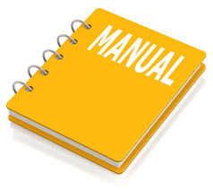
Child, Therapist & Parent Manual
Cognitive-Behavioural
Therapy
Cognitive-Behavioural model
Cognitive reframing
Psychoeducation
Practical problem solving
skills
2) Social Skills
Understanding emotions
Communication skills
Building resilience
3) Relaxation Skills and Mindfulness
4) Dealing with Grief and Loss
5) Assess to Further Resources and Help

Slide 19
1) Cognitive-Behavioural Therapy (CBT)
What is CBT?
CBT is a psychotherapy that was developed by a psychologist named Aaron Beck. Beck (1979) contributed to the idea that our thoughts are greatly influential on our feelings and our behaviours. This relationship between our thoughts, feelings and behaviours is illustrated by the cognitive model, which can be seen in the following diagram:
Event
What is happening
Thoughts
Feelings
Behaviours
How you are feeling
What you do

Slide 20
1) Cognitive-Behavioural Therapy (CBT)
What is Cognitive Reframing?
Event
What is happening: My sick mum is working at the school canteen
Event
Thoughts
ANT: people will stare at her and think she is weird
Feelings
Feelings
Behaviours
How you are feeling: Embarrassed
What you do: Avoid other kids

Slide 21

1) Cognitive-Behavioural Therapy (CBT)
Event
My sick mum is working at the school canteen
PET: people won’t notice Mum has no hair specially if she is wearing a wig or a beanie. Some of the other mums will be wearing beanies too and most kids are too busy chatting to their friends to notice
Thoughts
Feelings
Feelings
Behaviours
Happy
Join in with the other kids

Slide 22
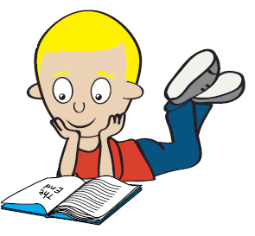
1) Cognitive-Behavioural Therapy (CBT)
What is Psychoeducation?
  Psychoeducation is about giving people the knowledge of the cognitive model and cognitive restructuring. This will allow people to understand their problems more effectively.
  Upon understanding their problems, they will be able to manage them and gain autonomy over them in life.
  This is also aided by teaching people skills that can be use in difficult situations, such as problem solving skills.

Slide 23
1) Cognitive-Behavioural Therapy (CBT)
Problem-Solving Skills: Children are informed on the processes involved in solving problems that may occur in their lives. Knowing how to solve problems can help them feel more confident in their ability to find solutions, and cope better when faced with challenges. There are seven steps to solving a problem, as seen below.
Step 1
work out what the problem is
Step 2
decide whether you are going to try to solve the problem
Step 3
make a list of all the possible ways you could solve the problem
think about each possible solution and list the positives and negatives for each solution
Step 4
Step 5
choose which solution you think would be best
Step 6
carry out that solution and determine whether it was successful. If it didn’t work, why not?
Step 7
if the first solution worked, then great! You don’t need to do anything further
If it didn’t work, go back and try the next best solution from your list/try to think of some new solutions. Repeat the steps until you find a solution that works.

Slide 24
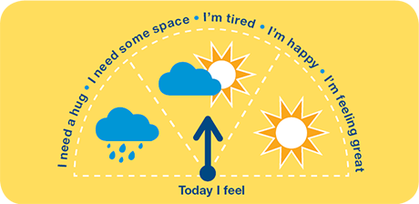
2) Social Skills
Understanding Emotions
  Children are introduced to feelings and thoughts. We will be encouraging them to share their thoughts and feelings in the safe space with other children in the group. This session teaches children the importance of talking about how we feel to manage our feelings.
  Some feelings are good and some can be difficult. It is important to know that it is normal to have lots of different feelings, even the difficult ones. Just like the weather changes, the difficult feelings can pass.

Slide 25
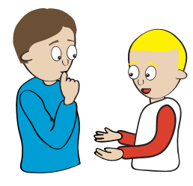
2) Social Skills
Communication Skills
  The program explains that good communication is very important and children will be taught basic skills that are necessary for good communication.
  This also includes an understanding of the different communication styles; aggressive, passive and assertive.
  Tips for talking to their parents and how they can help parents at home.

Slide 26
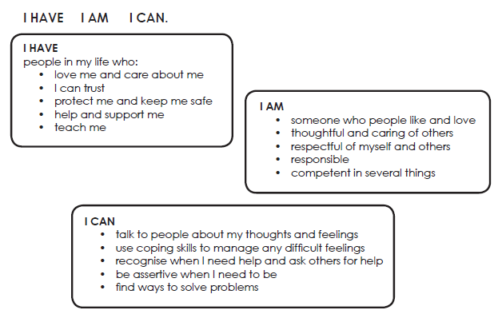
2) Social Skills
  Building Resilience: Resilience is the ability to be able to cope with difficult situations in life. Sometimes things happen that we don’t plan for and they can be difficult for us to cope with. Having people around us who love, help and support us, knowing and liking who we are, and feeling confident in our abilities all help build resilience. These can be summarised as follows:

Slide 27
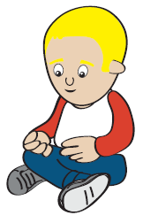
3) Relaxation Skills and Mindfulness
Relaxation Skills
  Being able to relax is an important skill in being able to cope with daily life and any challenges we may face. There are many things we can do to relax.
  Some examples might be going for a walk, read a book, watch a movie, listen to music, or play with your dog if you have one. Children will be introduced to relaxation exercises that they can practice at home.
  Example: Calm breathing exercise
    Take a deep breath
    Hold it and count to 5
    Slowly let your breath out
    As you let your breath out, say the word “relax” to yourself
    Repeat this over and over until you begin to feel relaxed

Slide 28
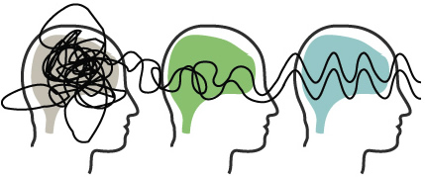
3) Relaxation Skills and Mindfulness
What is Mindfulness?
  Mindfulness is a whole body state of mind that involves paying close attention to what you are doing in the present moment. Though it is normal for your attention to wander, mindfulness is about noticing when your attention wanders and bringing your attention back to the present moment (Kids Matter, 2017).
  Activity: Most of us breathe automatically without paying any attention to our breath. For the next few minutes just pay attention to your breath…

Slide 29
4) Dealing with Grief and Loss
Children will be introduced to palliative care and what happens when someone you love dies.
They will gain an understanding that mourning is the process that people go through to deal with the death of someone they loved
They will also learn about the stages of grief and that it helps to understand the stages because it helps us accept our feelings of sadness. Children will understand that the stages are like feelings. The stages don’t happen in certain order and some people may not experience them at all. Sometimes it takes a long time before they allow themselves to feel anything.

Slide 30
5) Access to Further Resources and Help
Children will be encouraged to ask for help when they need it. They will be told that everyone needs help from time to time and that asking for help is okay. It is important to find a good support person that you can talk to when things get hard.
They are also given a list of people they can ask for help (parents/grandparents/teachers/gps/support groups etc.)
As well as resources such as online information, organisations and books

Slide 31
Hypothesis
It is proposed that the Brave Beginnings program:
  H1: Will increase children’s levels of personal locus of control
  H2: Will decrease parent’s levels of parental stress

Slide 32
Participants
Participation is voluntary and participants can withdraw at any time.
Estimated N= 48, with 6 groups of 8 participants.
Children aged 8-13 years of age who have a parent currently receiving treatment for cancer.
Children who will not be included are those with parents in the final stages of cancer treatment or children who have been diagnosed with a major psychological disorder.
Each group will compromise children in a similar age band (e.g. 8-10 years, 11-13 years).

Slide 33
Methodology
A repeated measures/within subjects design will be used to examine the pre and post effects of the intervention on a child’s sense of internal locus of control and parental stress.
We will be testing the same participants twice. Once before the intervention (pre-test), and again after the intervention (post-test).
Though a repeated measures design requires less participants, we are anticipating recruitment difficulties as we are sampling from a quite a specific population.
Participant
Pre-test:
Intervention:
Brave Beginnings Resilient Kids Program
Post-test:
Internal locus of control
Parental stress
Internal locus of control
Parental stress

Slide 34
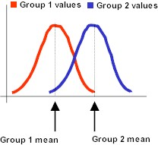
Methodology
The data will be statistically analysed through a parametric paired sample t-test.
These statistical analyses look at the mean difference between the scores for each participant from their scores on locus of control and parental stress from Time 1 to Time 2.
We are hoping that the mean difference is substantial enough to be considered a significant difference.
Time 1
Time 2
Time 1 mean score
Time 2 mean score

Slide 35
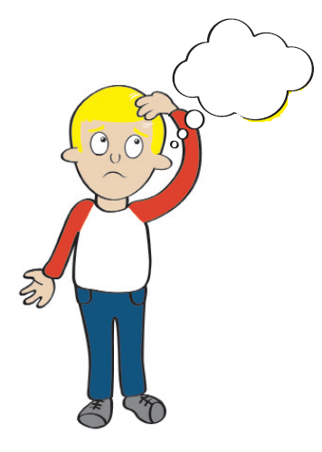
Methodology
Advantages of a repeated measures design is that individual differences are controlled for. There is also less variability which makes differences in mean scores easier to detect. This means that the study is more powerful.
Disadvantages are that scores on the pre-test to post-test can either decrease due to fatigue/boredom or increase due to learning/practice effects. Randomising the questions in the pre-test and post-test may lessen these effects.

Slide 36
How Will The Intervention Be Administered?
The intervention is a pilot study and will take place in the North Shore of Sydney, Australia over 3 Saturdays in September.
The intervention is expected to be practiced in two major hospitals in Sydney, Australia; The Royal Prince Alfred Hospital in Sydney’s Inner West and Westmead Hospital in Western Sydney.
Parents will attend 2 sessions and children will attend 12 sessions.
Morning tea and lunch breaks will be scheduled into the 3 x 4 hour long child workshops.

Slide 37
How Will The Intervention Be Administered?
Day 1
Session 1: Families together (Children & Parents present)
Session 2: Welcome and introduction (Children only)
Parent session I (Parents only)
Session 3: Understanding cancer (Children)
Session 4: Understanding feelings and thoughts (Children)
Day 2
Session 5: Building resilience (Children)
Session 6: Communication (Children)
Session 7: Relaxation and Mindfulness (Children)
Session 8: Problem Solving (Children)

Slide 38
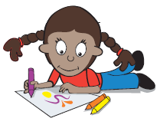
How Will The Intervention Be Administered?
Day 3
Session 9: Feeling better (Children)
Session 10: What if I have to say goodbye (Children)
Session 11: Where can I get help and putting it all together (Children) Parent session II (Parents)
Session 12: Families together (Children & Parents)

Slide 39

How Will The Intervention Be Administered?
Parents and child will be asked to complete questionnaires before and after the intervention.
The questionnaires will assess the child’s current level of emotional and behavioural functioning. Parents will be asked to completed questionnaires about themselves and aspects about the family.
Some tests we will include in the questionnaire are:
  A general questionnaire on demographic statistics
  Child Behaviour Checklist for Ages 6-18 (CBCL 6-18; Achenbach, 2001)

Slide 40
How Will The Intervention Be Administered?
  Resiliency Scales for Children & Adolescents (RSCA; Prince-Embury, 2007)
  Parental Stress Index- Fourth Edition (PSI-IV; Abindin, 2012)
  Social Skills Improvement System (SSIS; Gresham & Elliot, 2008)
  Spence’s Children Anxiety Scale (SCAS; Spence,1994)
  Depression Self-Rating Scale for Children (DSRS; Birleson, 1978)
  Parenting Style Questionnaire (PSQ; Robinson, Mandleco, Olsen & Hart, 1995)
  Depression Anxiety Stress Scale-21(DASS-21; Lovibond & Lovibond, 1995)
  Nowicki-Strickland’s Locus of Control Scale for Children (Nowicki & Strickland,1971)

Slide 41
Possible Risks And Costs
There is no cost involved in participating in the study and any travel costs incurred will be reimbursed.
There is a possibility that discussing a parent’s illness may cause discomfort:
  Group facilitators will be present and they are trained in providing psychological support.
  Children will be assisted individually at any time during the program if any discomfort is experienced, and parents will be notified.

Slide 42

Confidentiality And Information Storage
Information about participants will be stored securely for 20 years or until the child reaches the age of 25
The participants will have their identity and information kept strictly confidential, except as required by law.
Only the researcher will have access to the child’s personal information.
The results of the study will be disseminated in a research paper and may be published in a research journal and or presented at a conference, but participants will not be individually identifiable in these publications.

Slide 43
Benefits Of The Research
The children will benefit by participating in the study and will not only have the opportunity to share their experiences and feelings but learn valuable communication, resilience and coping skills.
Additionally, the knowledge we gain from participation will ultimately benefit many other children in the future who have a parent diagnosed with cancer.

Slide 44
Thank you for your time
For further information please feel free to contact:
Dr Fiona Martin, Educational and Developmental Psychologist/
Clinical Director of Sydney Child Psychology Centre
fiona@sydneychildpsychologist.com.au

Slide 45
References
  Achenbach, T.M., & Rescorla, L.A. (2001). Manual for the ASEBA School-Age Forms & Profiles. Burlington, VT: University of Vermont, Research Center for Children, Youth, & Families.
  Abindin’s (2012) Parental Stress Index- Fourth Edition (PSI-4). FL: Psychological Assessment Resources.
Beck, A. (1979). Cognitive Therapy and the Emotional Disorders. New York: Penguin Books.
Birleson, P. (1981), the validityof depressive disorder in childhood and the development of a self-rating scale: a research report. J. Child Psychol. Psychiat., 22:73-88.
Cancer Council. (2012). Talking to kids about cancer: A guide for people with cancer, their families and friends. AU: Cancer Council.
Camp Quality. (2014). Camp quality will be first Australian charity to support children under 13 who have a parent with cancer. Retrieved from https://www.campquality.org.au/about-us/media-and-news/national/26-national/119-camp-quality-will-be-first-australian-charity-to-support-children-under-13-who-have-a-parent-with-cancer
Deater-Deckard, K, Chen, N., & El Mallah, S. (2015). Parenting Stress. Oxford Bibliographies. doi: 10.1093/obo/9780199828340-0142

Slide 46
References
Ellis, S.J., Wakefield, C.E., Antill, G., Burns, M., & Patterson, P. (2017). Supporting children facing a parent’s cancer diagnosis: A systematic review of children’s psychosocial needs and existing interventions. European Journal of Cancer Care, 26, e12432, doi: 10.1111/ecc.12432
Gresham, F., & Elliott, S. N. (2008). Social skills improvement system (SSIS) rating scales. Bloomington, MN: Pearson Assessments.
Lovibond, S.H. & Lovibond, P.F. (1995). Manual for the Depression Anxiety Stress Scales. (2nd. Ed.) Sydney: Psychology Foundation.
  Prince-Embury’s (2007) Resiliency Scales for Children & Adolescents. TX: Harcourt Assessment, Inc.
  Spence, S.H. (1994) The structure and assessment of anxiety in children. Paper presented at the Association for the Advancement of Behaviour Therapy, San Diego:CA.
Strickland, B. R., & Nowicki Jr, S. (1971). Behavioral Correlates of the Nowicki-Strickland Locus of Control Scale for Children.
Sullivan, SA; Thompson, A; Kounali, D; Lewis, G; Zammit, S. (2017). The longitudinal association between external locus of control, social cognition and adolescent psychopathology. Social Psychiatry and Psychiatric Epidemiology. doi: 10.1007/s00127-017-1359-z
Robinson, C. C., Mandleco, B., Olsen, S. F., & Hart, C. H. (1995). Authoritative, authoritarian, and permissive parenting practices: Development of a new measure. Psychological reports, 77(3), 819-830.

