Slide 1
Conference Series LLC Conferences
Conference Series LLC is a pioneer and leading science event organizer, which publishes around 500 open access journals and conducts over 500 Medical, Clinical, Engineering, Life Sciences, Pharma scientific conferences all over the globe annually with the support of more than 1000 scientific associations and 30,000 editorial board members and 3.5 million followers to its credit.
Conference Series LLC has organized 500 conferences, workshops and national symposiums across the major cities including San Francisco, Las Vegas, San Antonio, Omaha, Orlando, Raleigh, Santa Clara, Chicago, Philadelphia, Baltimore, United Kingdom, Valencia, Dubai, Beijing, Hyderabad, Bengaluru and Mumbai.

Slide 2
ESTABLISHING “FINGERPRINT-LIKE” BIOSIMILARITY - CRITICAL FIRST STEPS FOR BIOSIMILAR ASSESSMENT
MEETING REGULATORY CHARACTERIZATION EXPECTATIONS
Dr Fiona M Greer
Global Director, BioPharma Services Development
SGS Life Sciences
EuroBiosimilars 2016, 27-29 June 2016 Valencia, Spain

Slide 3

AGENDA: MEETING REGULATORY ANALYTICAL CHARACTERIZATION EXPECTATIONS
What are the challenges and regulatory expectations associated with biosimilarity testing?
What analytical strategies can be used -which techniques, old & new, are suitable
  Establishing the Quality Target Product Profile (QTPP)
  Package of analytical tools/ battery of methods
  Strategies for primary and higher order structure
  Structure-function relationship

Slide 4



GLOBAL REGULATORY BACKGROUND
EUROPE
2005, EMEA guidelines on
“Similar biological medicinal
products”. Many updated
since then.
Approved 1st Biosimilar in
2006, now has >20
including mAbs.
Experienced regulators
REST OF WORLD
Brazil, Australia, Turkey,
Taiwan, Malaysia,
Argentina, Mexico, Japan,
Canada, S.A. and others
have some form of pathway.
Oct 2009, WHO “Guideline
on Evaluation of Similar
Biotherapeutic Products”.
Mar 2016, draft “Evaluation
of mAbs as SBPs” guideline.
UNITED STATES
Biologics Price Competition
and Innovation Act (BPCIA)
Mar 23rd 2010. New
pathway-351(k) in PHS Act.
Feb 2012-2015, FDA issued
draft Guidances. Apr 2015 -
finalized.
Mar 2015 - 1st approval
(Zarxio)
Apr 2016 - approval of
Inflectra biosimilar of
Remicade.
Notes:
Missing title
Animate – globes come in with squares
Europe First
Then ROW in middle
US on the far right
4

Slide 5
US REGULATORY PATHWAY (1/2)
351(k) pathway requires comparison with a single reference product approved under the normal 351(a). The application must include information demonstrating biosimilarity based on data derived from:
  Analytical studies demonstrating that the biological product is “highly similar” to the reference product notwithstanding minor differences in clinically inactive components
  Animal studies and
  A clinical study or studies
Two basic types of Biosimilar, from two steps:
  Biosimilar - requires analytics (“highly similar”), preclinical & clinical (including immunogenicity) studies, any of which can be waived
  Interchangeable Biosimilar – possible clinical “switching” studies

Slide 6
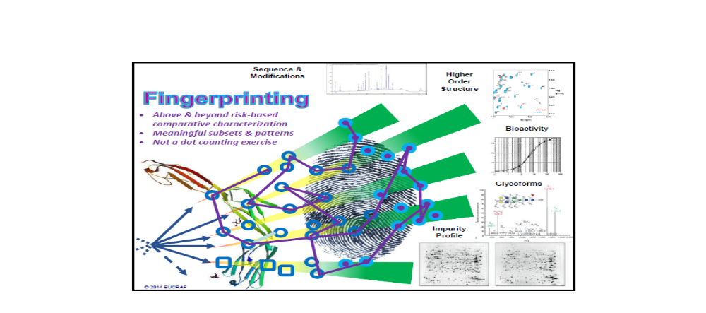
US REGULATORY PATHWAY (2/2)
FDA will consider the “totality of the data and information submitted”
Suggests the use of a “meaningful fingerprint-like analysis algorithm”
Statistical Analysis of Analytical Similarity Data: ranking QAs –Tiered approach.
  1. Critical- statistical equivalence test. Focus on a few high risk
  2. Less critical- quality ranges eg based on RP SDs. (Mean +/- XSD)
  3. Least – raw/graphical comparisons
Steven Kozlowski, M.D.
Director, Office of Biotechnology Products
OPS/CDER/US FDA
Notes:
Fix Fingerprinting slide – it’s inserted and there’s too much white around it.
6

Slide 7
US REGULATORY PATHWAY (2/2)
FDA will consider the “totality of the data and information submitted”
Suggests the use of a “meaningful fingerprint-like analysis algorithm”
Statistical Analysis of Analytical Similarity Data: ranking QAs –Tiered approach.
  1. Critical- statistical equivalence test. Focus on a few high risk
  2. Less critical- quality ranges eg based on RP SDs. (Mean +/- XSD)
  3. Least – raw/graphical comparisons
Steven Kozlowski, M.D.
Director, Office of Biotechnology Products
OPS/CDER/US FDA
Notes:
Fix Fingerprinting slide – it’s inserted and there’s too much white around it.
7

Slide 8
BIOSIMILARS DEVELOPMENT PARADIGM
ADDITIONAL
CLINICAL STUDIES ***
351(a)
BLA
351(k)
BLA
CLINICAL
S&E.*
CLIN.
PHARM.
PK/PD
INITIAL
CLINICAL STUDIES **
CLIN. PHARM.
NON-CLINICAL
NON-CLINICAL
ANALYTICAL
ANALYTICAL
* Pivotal
**Pivotal in biosimilar development
***Confirmatory, as needed
Adapted from Emily Shacter, “Current Regulatory and Scientific Issues with Biosimilars in the US;
CHI Biotherapeutics Analytical Summit, 13 March 2015, Baltimore, MD

Slide 9
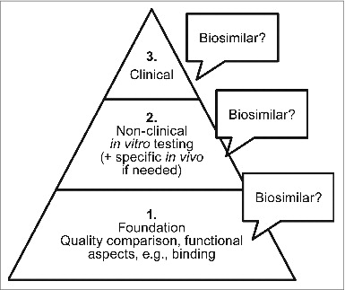
A STEPWISE APPROACH
Analytical comparison to reference product
  Structure
  Function
Non-clinical testing
Clinical evaluation in intended population
Each step supported by previous one.
Published in: Mark A Socinski; Giuseppe Curigliano; Ira Jacobs; Barry Gumbiner; Judith MacDonald; Dolca Thomas; mAbs 2015, 7, 286-293.
Notes:
9

Slide 10
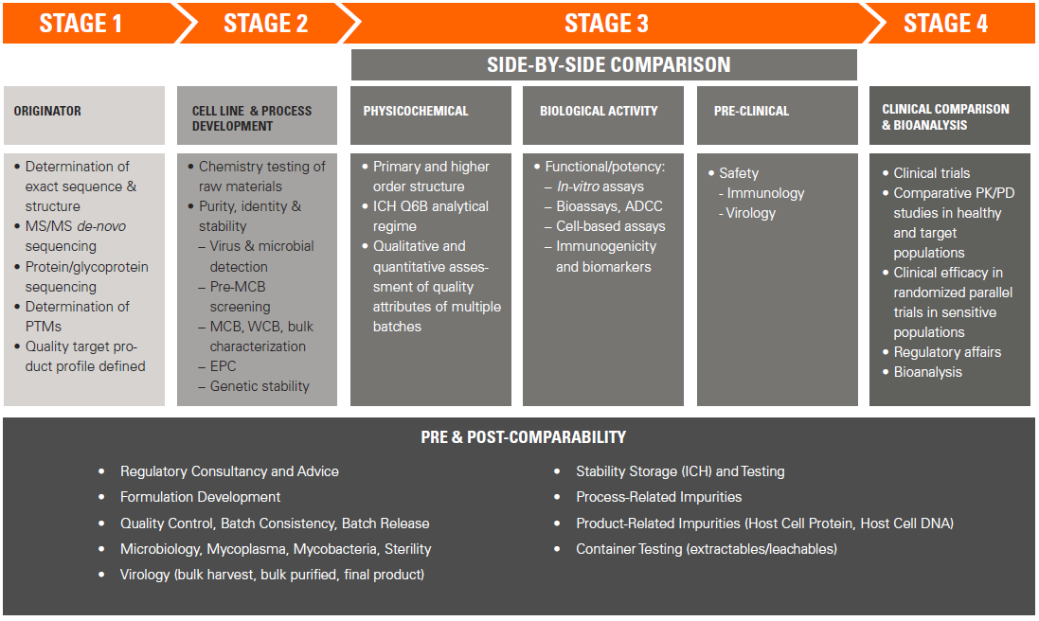
WHEN IS ANALYTICAL CHARACTERIZATION REQUIRED?

Slide 11
MEETING REGULATORY CRITERIA FOR BIOSIMILARITY DEMONSTRATION
The development of a biosimilar product requires comprehensive physicochemical structural characterization of the (glyco)protein at MANY stages.
Initially, batches of the originator molecule are studied to determine the exact protein sequence, post-translational modifications and variability of quality attributes. These data form the Quality Target Product Profile (QTPP) for the biosimilar.
At early stage, characterization surveys may help to guide choice of an appropriate cell line. Build similarity concept.

Slide 12
COMPARISON OF THE BIOSIMILAR SIDE-BY-SIDE WITH THE ORIGINATOR
“Comparability”
  Comparable to Reference Product
  Determine if proteins have the same biochemical, biophysical and physiological attributes
  Product related variants and impurities
Choice of reference material
Batches of Biosimilar vs batches of Originator
Changes in Originator product
Strategies for Primary and Higher Order Structure-battery of physicochemical analytical techniques with appropriate sensitivity
Which techniques to utilise? “Fingerprinting”
STAGE 3

Slide 13
REVISED EMA QUALITY GUIDELINE: COMPARABILITY EXERCISE
EMA/CHMP/BWP/247713/2012
Revision 1, Effective 1 Dec 2014
Use state-of-art analytical, orthogonal methods
Comparative characterization studies should include assessment of composition, physical properties, primary & higher order structures, purity, product-related substances (e.g. isoforms) and impurities, and biological activity with “sufficiently sensitive analytical tools”
Quantitative ranges for quality attributes established
Use material from final process for clinical trials (i.e. avoid additional comparability exercises)
Suitability of the formulation should be demonstrated (need not be identical)

Slide 14
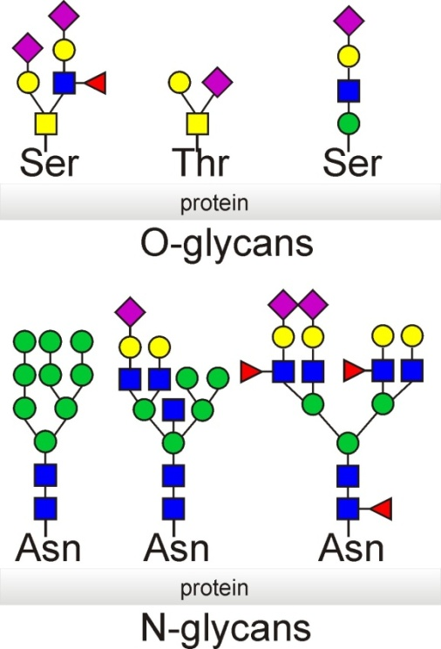
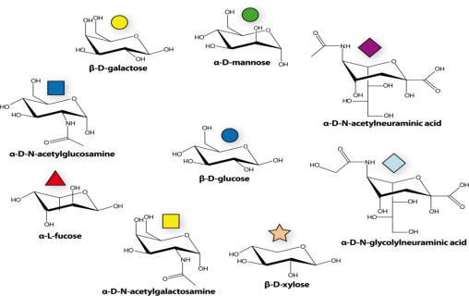
WHY ARE BIOPRODUCTS A CHALLENGE ?
Acetylation
Acylation
Amidation (deamidation)
Carbamylation
Carboxylation
Formylation
Glycation
Glycosylation
Methylation
Methionine Oxidation
Norleucine
Phosphorylation
Sulphation
During/ after translation of the oligonucleotide code into an AA sequence, processing events occur to confer biological activity. These Co- and Post-Translational events change the primary structure but are NOT predictable from the gene sequence. So it is essential to study the expressed protein products not the genes.
Carbohydrate is a source of product heterogeneity. Glycoproteins are mixtures of glycoforms i.e. the same polypeptide but different sugars.
Notes:
14
14

Slide 15
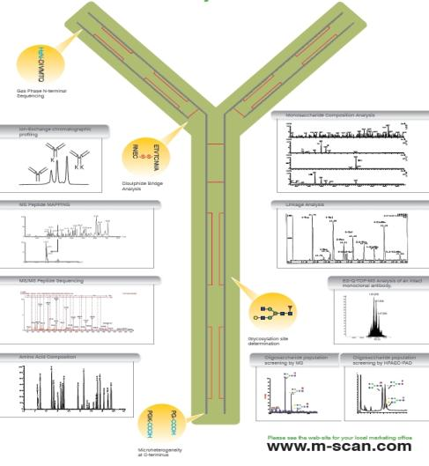
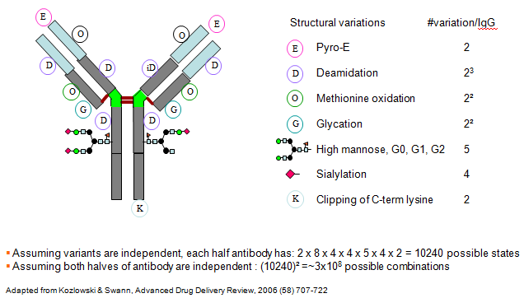
EXAMPLE OF COMPLEXITY: ANTIBODY CASE
  Mass spectrometry of intact protein and released L &H chains
  Amino Acid Composition Analysis
  N- and C-terminal sequencing
  Peptide “MAPPING” Analysis
  (Sequence coverage: 100% LC and 100% HC)
  Monosaccharide and sialic acid analysis
  Oligosaccharide population analysis
  SDS-PAGE analysis
  Circular Dichroism
  Analytical Ultracentrifugation
Notes:
15
Slide 14 image comes on top in the middle with appear.

Slide 16

WHAT REGULATIONS COVER PHYSICOCHEMICAL CHARACTERIZATION?
ICH Topic Q6B “Specifications: Test Procedures
and Acceptance Criteria for Biotechnological/Biological Products”
Structural characterization and confirmation
  Amino acid sequence
  Amino acid composition
  Terminal amino acid sequence
  Peptide map
  Sulfhydryl group(s) and disulfide bridges
  Carbohydrate structure
Physicochemical properties
  Molecular weight or size
  Isoform pattern
  Extinction coefficient
  Electrophoretic pattern
  Liquid Chromatographic pattern
  Spectroscopic profiles

Slide 17
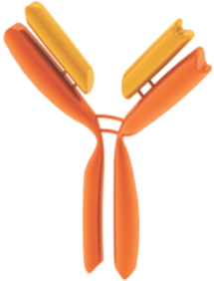
POTENTIAL ANALYTICAL TOOLS
Amino acid sequence and modifications: Mass Spectrometry (MS), peptide mapping, chromatography
Glycosylation: Anion exchange, enzymatic digestion, peptide mapping, Capilary Electrophoresis, MS
Folding: MS S-S bridge determination, calorimetry, Hydrogen-Deuterium exchange (HDX) and ion mobility MS (IM-MS), Nuclear Magnetic Resonance (NMR), circular dichroism, Fourier transform spectroscopy, fluorescence
PEGylation & isomers: chromatography, peptide mapping
Aggregation: Analytical ultracentrifugation, size-exclusion chromatography SEC-MALS, field flow fractionation (A4F), light scattering DLS, microscopy, Transmission Electron Microscopy (TEM)
Proteolysis: electrophoresis, chromatography, MS
Impurities: proteomics, immunoassays, metal & solvents analysis
Subunit interactions: chromatography, ion mobility MS
Heterogeneity of size, charge, hydrophobicity: Chromatography; gel & capillary electrophoresis, light scattering, IM-MS, CESI-MS

Slide 18

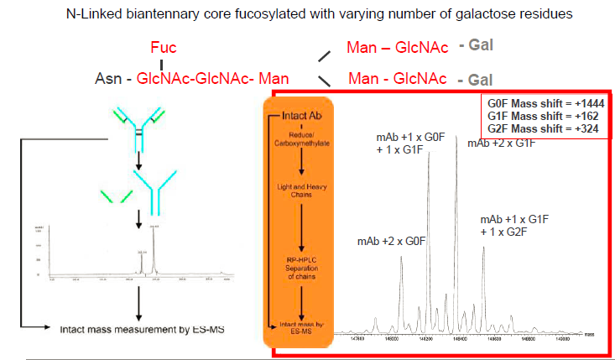
INTACT MASS MEASUREMENT- MONITORING GLYCOSYLATION

Slide 19
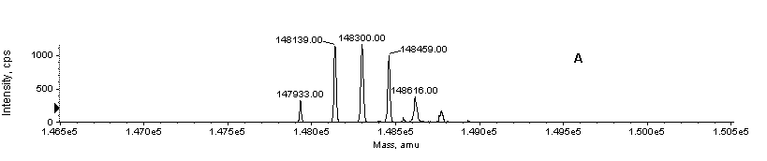

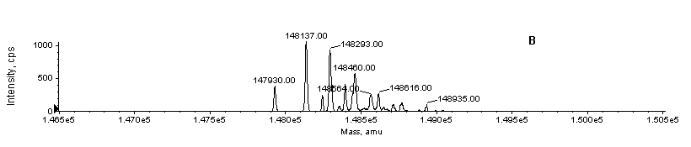
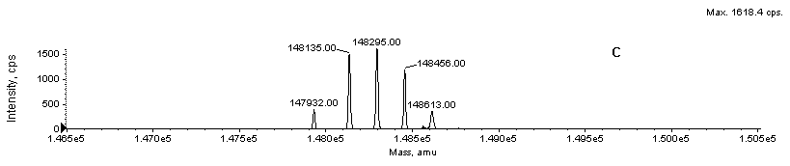
INTACT MASS COMPARISON OF THREE BIOSIMILAR mABs

Slide 20
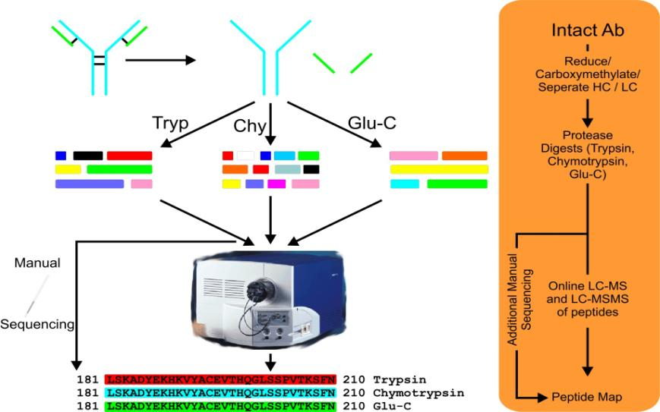
PEPTIDE MAPPING WORKFLOW

Slide 21
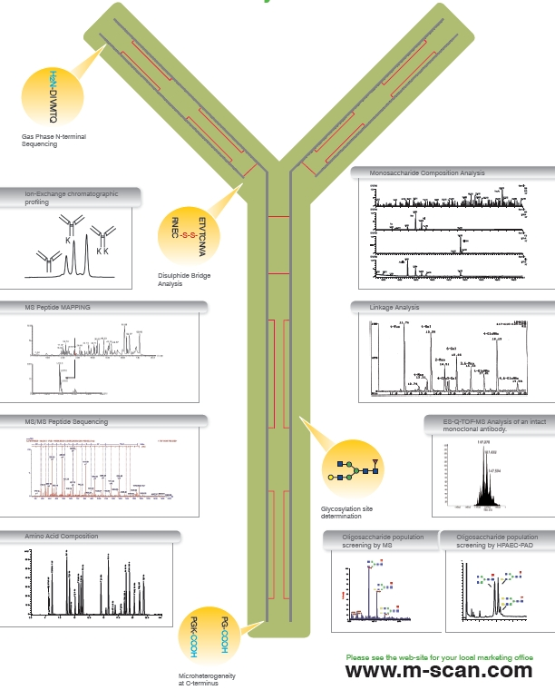
HOW CAN MS PROVIDE ANALYTICAL DATA FOR ANTIBODY CHARACTERIZATION?
  Mass spectrometry of intact protein and released L &H chains
  Amino Acid Composition Analysis
  N- and C-terminal sequencing
  Peptide “MAPPING” Analysis
  (Sequence coverage: 100% LC and 100% HC)
  Monosaccharide and sialic acid analysis
  Oligosaccharide population analysis
  SDS-PAGE analysis
  Circular Dichroism
  Analytical Ultracentrifugation
Notes:
21

Slide 22
INTACT MASS MEASUREMENT-MONITORING GLYCOSYLATION

Slide 23
INTACT MASS COMPARISON OF THREE BIOSIMILAR mABs

Slide 24
PEPTIDE MAPPING WORKFLOW

Slide 25
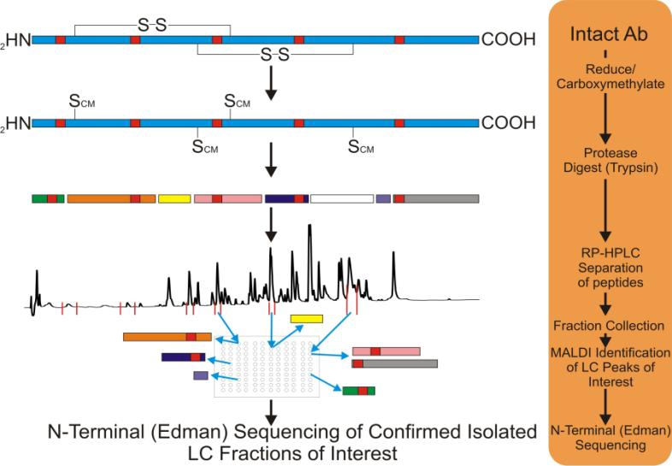
ANTIBODY ANALYSIS – GENERAL WORKFLOW
Notes:
25

Slide 26
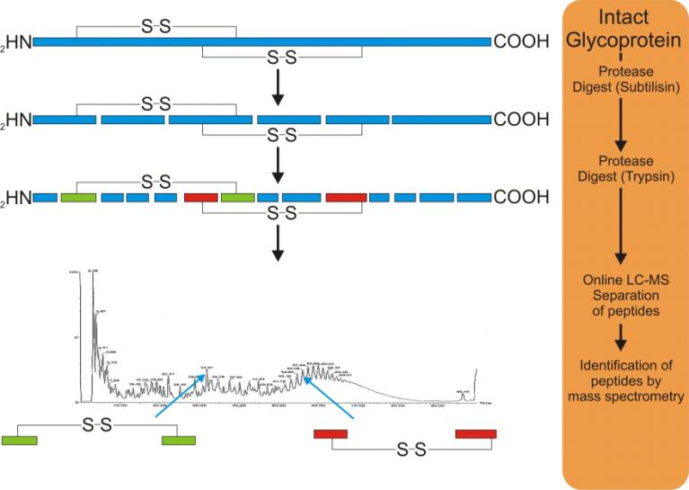
SULFHYDRYL GROUP(S) AND DISULFIDE BRIDGES
Notes:
26

Slide 27
GLYCOSYLATION CHARACTERIZATION
Structural characterisation and confirmation of carbohydrate.
For glycoproteins, the following should be determined:
Carbohydrate content (neutral sugars, amino sugars and sialic acids)
Structure of the carbohydrate chains, the oligosaccharide pattern, the antennary profile, linkage
Glycosylation site(s) on the protein chain
Notes:
27

Slide 28
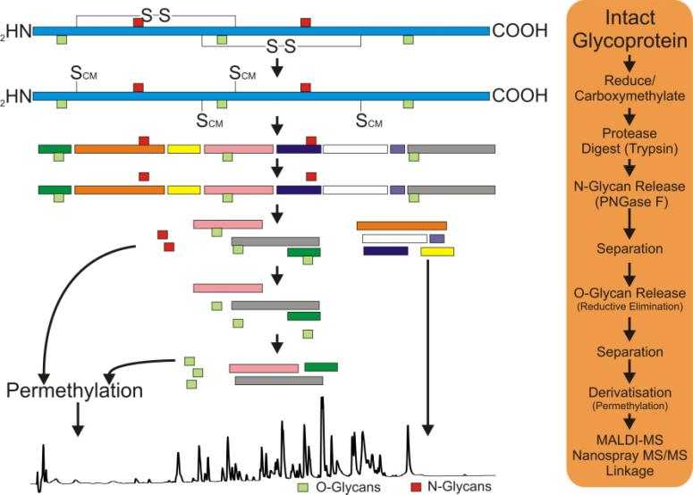
ANALYSIS OF GLYCOPROTEINS

Slide 29
ANALYSIS OF GLYCOPROTEINS
Anomeric specific Intermonosaccharide Linkages
Glycan Composition
Glycan Profile
MALDI-MS
HPAEC-PAD
MALDI-MS
Heterogeneity & Extent of Glycosylation
Glycan Sequence
Native Glycans
Intact mass vs.
Deglycosylated
ES-MS / MALDI-MS
MALDI-MS/MS
Derivatised Glycans
Antennary Profile
Glycoprotein
Sample
Quantitative Monosaccharide Composition
ESI-MS
Glycopeptides
Inter-monosaccharide Linkages
GC-MS
Quantitative Sialic Acid Content
PMAA GC-MS
Qualitative Site-specific Glycosylation
HPAEC-PAD
Quantitative Glycan profile
Peptide mapping
LC-ES-MS
2AB-LC-MS

Slide 30
BIOPHYSICAL TECHNIQUES FOR HIGHER ORDER STRUCTURE & CONFORMATION
TECHNIQUE | REPORTS ON | ADVANTAGES | DISADVANTAGES
Circular Dichroism | Secondary/ Tertiary Structure | Quantitative Sensitive to helix content | Formulation buffers can interfere
FTIR | Secondary Structure | Quantitative Sensitive to sheet content Less prone to buffer interference
Intrinsic Fluorescence | Local Tertiary Structure | Sensitive Potential for moderate HTP | Qualitative
Extrinsic Fluorescence | Surface Hydrophobicity | Sensitive Ensemble tertiary structure-no local Potential for moderate HTP | Qualitative
UV-VIS (2ndderivative) | Local Tertiary Structure | Simultaneous to concentration determination Potential for moderate HTP | Qualitative
Differential Scanning Calorimetry | Thermal Stability | Screening method for formulation (HTP) | Qualitative
HDX-MS | Dynamics, conformation, interactions | Automation has improved throughput. | Cost, data processing
2D Protein NMR | 3D Structure Elucidation | More resolving than 1D
Notes:
30

Slide 31
BIOPHYSICAL TECHNIQUES FOR AGGREGATION
TECHNIQUE | REPORTS ON | ADVANTAGES | DISADVANTAGES
SDS PAGE | Aggregates | Inexpensive | Low throughput
SV-AUC | Oligomers/ aggregates | Matrix free, quantitative, resolution | Slow, low throughput, estimated m.wts
DLS | HMW aggregates | Matrix free, sensitivity, moderate for HTP | Poor resolution, qualitative
SEC-MALS | Oligomers/ aggregates | Direct MW determination, rapid analysis, quantitative | Matrix present High shear forces
FFF | Macromolecule size distribution | Non-column separation with high resolution
Notes:
31

Slide 32

BIOLOGICAL/FUNCTIONAL ASSAYS - WHY?
“Any differences in higher order structure between a proposed product and a reference product should be evaluated in terms of a potential effect on protein function and stability. Thus, functional assays are also critical tools for evaluating the integrity of the higher order structures.”
“As a scientific matter, the type of bridging data needed will always include data from analytical studies (e.g., structural and functional data) that directly compares all three products (i.e., the proposed product, the U.S.-licensed reference product, and the non-U.S.-licensed comparator product)“
“The stepwise approach should start with extensive structural and functional”
Scientific Considerations in Demonstrating Biosimilarity to a Reference Product (FDA – 2015)
Quality Considerations in Demonstrating Biosimilarity of a Therapeutic Protein Product to a Reference Product (FDA – 2015)
“Extensive, robust comparative physicochemical and functional studies (these may include biological assays, binding assays, and enzyme kinetics) should be performed to evaluate whether the proposed product and the reference product are highly similar.”
“Multiple functional assays should, in general, be performed as part of the analytical similarity assessments”.

Slide 33
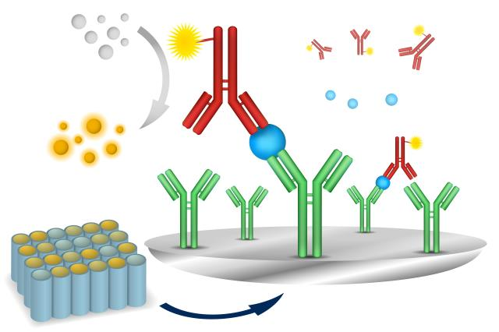
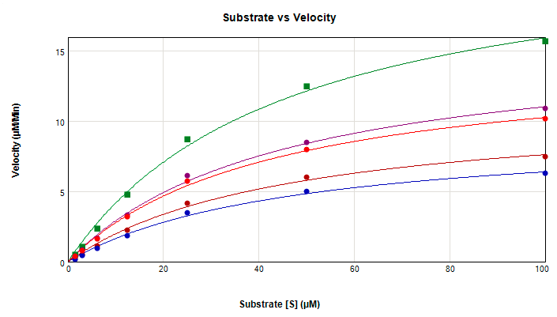
FUNCTIONAL ASSAYS
Q6B
Potency :
“the measure of the biological activity using a suitably quantitative biological assay, based on the attribute of the product which is linked to the relevant biological properties. ”
and Biological Activity as “the specific ability or
capacity of the product to achieve a defined
biological effect”
Cell Uptake
Proliferation
Cytotoxicity
Secondary Messenger
PCR Based Functional Assays
Cell culture-based Biological Assay
Enzymatic Assays
Ligand Binding
Immunoassays
RIA
Biochemical Assays

Slide 34
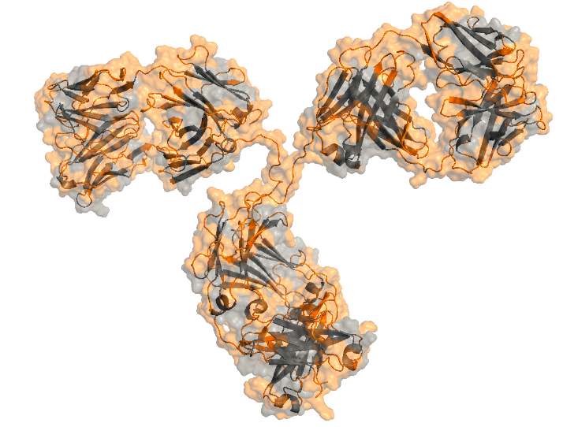
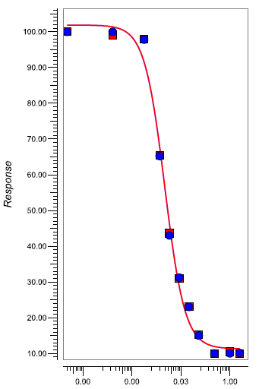
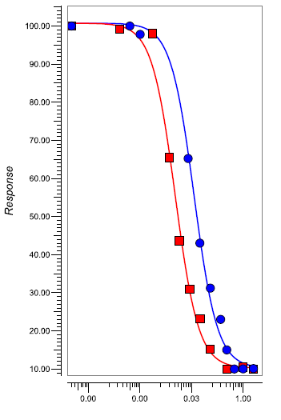
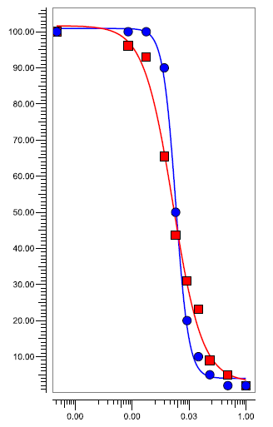
BIOASSAYS CRITICAL FOR DEMONSTRATING BIOSIMILARITY
Fc Domain Functional Assays
  ADCC
  CDC
  Whole Blood
Fab Domain
  Neutralization
  Receptor activation
  Receptor blockade
Target binding
Binding
  FcγR
  FcRn
  complement

Slide 35
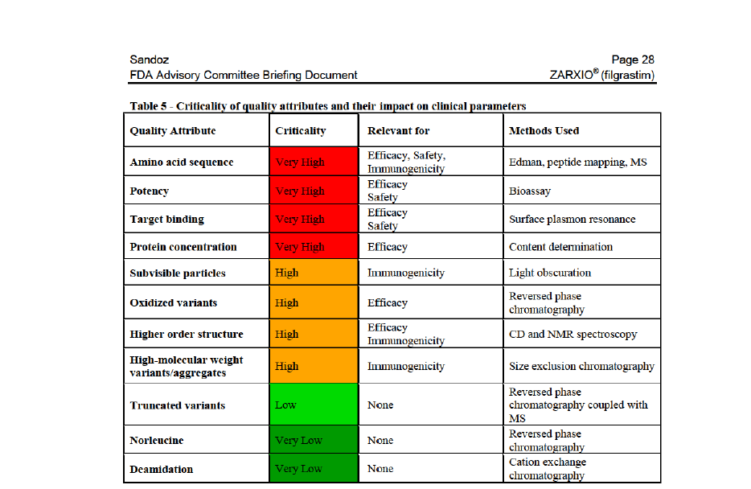
REAL EXAMPLE: SANDOZ ZARXIO (EP2006)
ANALYTICAL METHODS cf. US & EU NEUPOGEN

Slide 36
EXAMPLE 2: CELLTRION REMSIMA (INFLIXIMAB) ANALYTICAL METHODS
PRIMARY STRUCTURE | HOS | GLYCOSYLATION | PURITY/ IMPURITY | CHARGED ISOFORMS
PEPTIDE MAPPING (HPLC) | FTIR | OLIGOSACC. PROFILE | SEC-HPLC | IEF
PEPTIDE MAPPING (LC-MS) | DSC | N-LINKED GLYCAN | SEC-MALS | IEC-HPLC
INTACT MASS (LC-MS) | CD | SIALIC ACID ANALYSIS | AUC
AAA/MOLAR ABSORPTIVITY | FREETHIOL &S-S | MONOSACC. ANALYSIS | CE-SDS (RED/NON)
N-TERM SEQUENCE | ANTIBODY ARRAY
C-TERM SEQUENCE | X-RAY CRYSTALLOGRAPHY
Notes:
36

Slide 37
RE-CAP: ANALYTICAL CHARACTERIZATION DATA FOR BIOSIMILARS
Development of a Biosimilar requires comprehensive physicochemical structural characterization at MANY stages.
Initially, batches of originator are studied to determine the exact protein sequence, PTMs and variability of quality attributes. These data form the Quality Target Product Profile (QTPP).
Various regulatory guidelines then require side-by-side comparative data to demonstrate “Biosimilarity”.
MS techniques are applicable at all stages, but essential for determination of originator sequence. Advances in instrumentation and Proteomic/Glycomic strategies enable rapid identification of QTPP.
Multiple orthogonal analytical methods are used to define “fingerprint” comparison.
Increasing importance on HOS techniques to link with biological activity.

Slide 38


THANK YOU FOR YOUR ATTENTION
Life Sciences Fiona Greer
Global Director, BioPharma Services Development
SGS M-Scan Ltd Phone: +44 (0) 118 989 6940
2-3 Millars Business Centre, Fax: +44 (0) 118 989 6941
    Fishponds Close,
    Wokingham E-mail : fiona.greer@sgs.com
    Berkshire, RG41 2TZ, UK Web : www.sgs.com/biosimilars
+ 41 22 739 9548
+ 1 866 SGS 5003
+ 65 637 90 111
+ 33 1 53 78 18 79
+ 33 1 41 24 87 87
+ 1 877 677 2667
Notes:
Conclusion:
As you are, SGS is « LIFE INSPIRED »
Pharma labs : saving lives and finding resources (raw material-plants, trees) and Inspiration (R&D) within the nature
SGS LSS : supporting our clients to save life and finding Inspiration for our trials & bio assays – SGS is supporting the sustainability
- ADVERTISEMENT TEXT –
Just as LIFE derives its source from nature’s flora and fauna, the Life Science industry finds its inspiration drawing from it for past and future discoveries. While working with our clients in their efforts to save lives, SGS shares an environmentally sustainable approach with our clients. With a strong focus on biologics, SGS’s mission is to safeguard the quality of medicines by providing professional and independent services in clinical research, investigational studies and quality control testing of pharmaceuticals, biopharmaceuticals and medical devices – thereby creating value for our clients, employees, shareholders and patients worldwide.
- RATIONALE -
SGS is one of the two main sponsor of the TOPtoTOP non profit organisation under the patronage of the United Nations Environment Program that takes action focussed on the impacts of climate. http://www.toptotop.org/
LIFE = Industry commitment
INSPIRED = Expertise in R&D

Slide 39
Let us meet again..
We welcome you to our future conferences of Conference Series LLC
through
6th International Conference and Exhibition on Biologics and Biosimilars
October 19-21, 2016 Houston, TX, USA
http://biosimilars-biologics.pharmaceuticalconferences.com/europe

