Slide 1
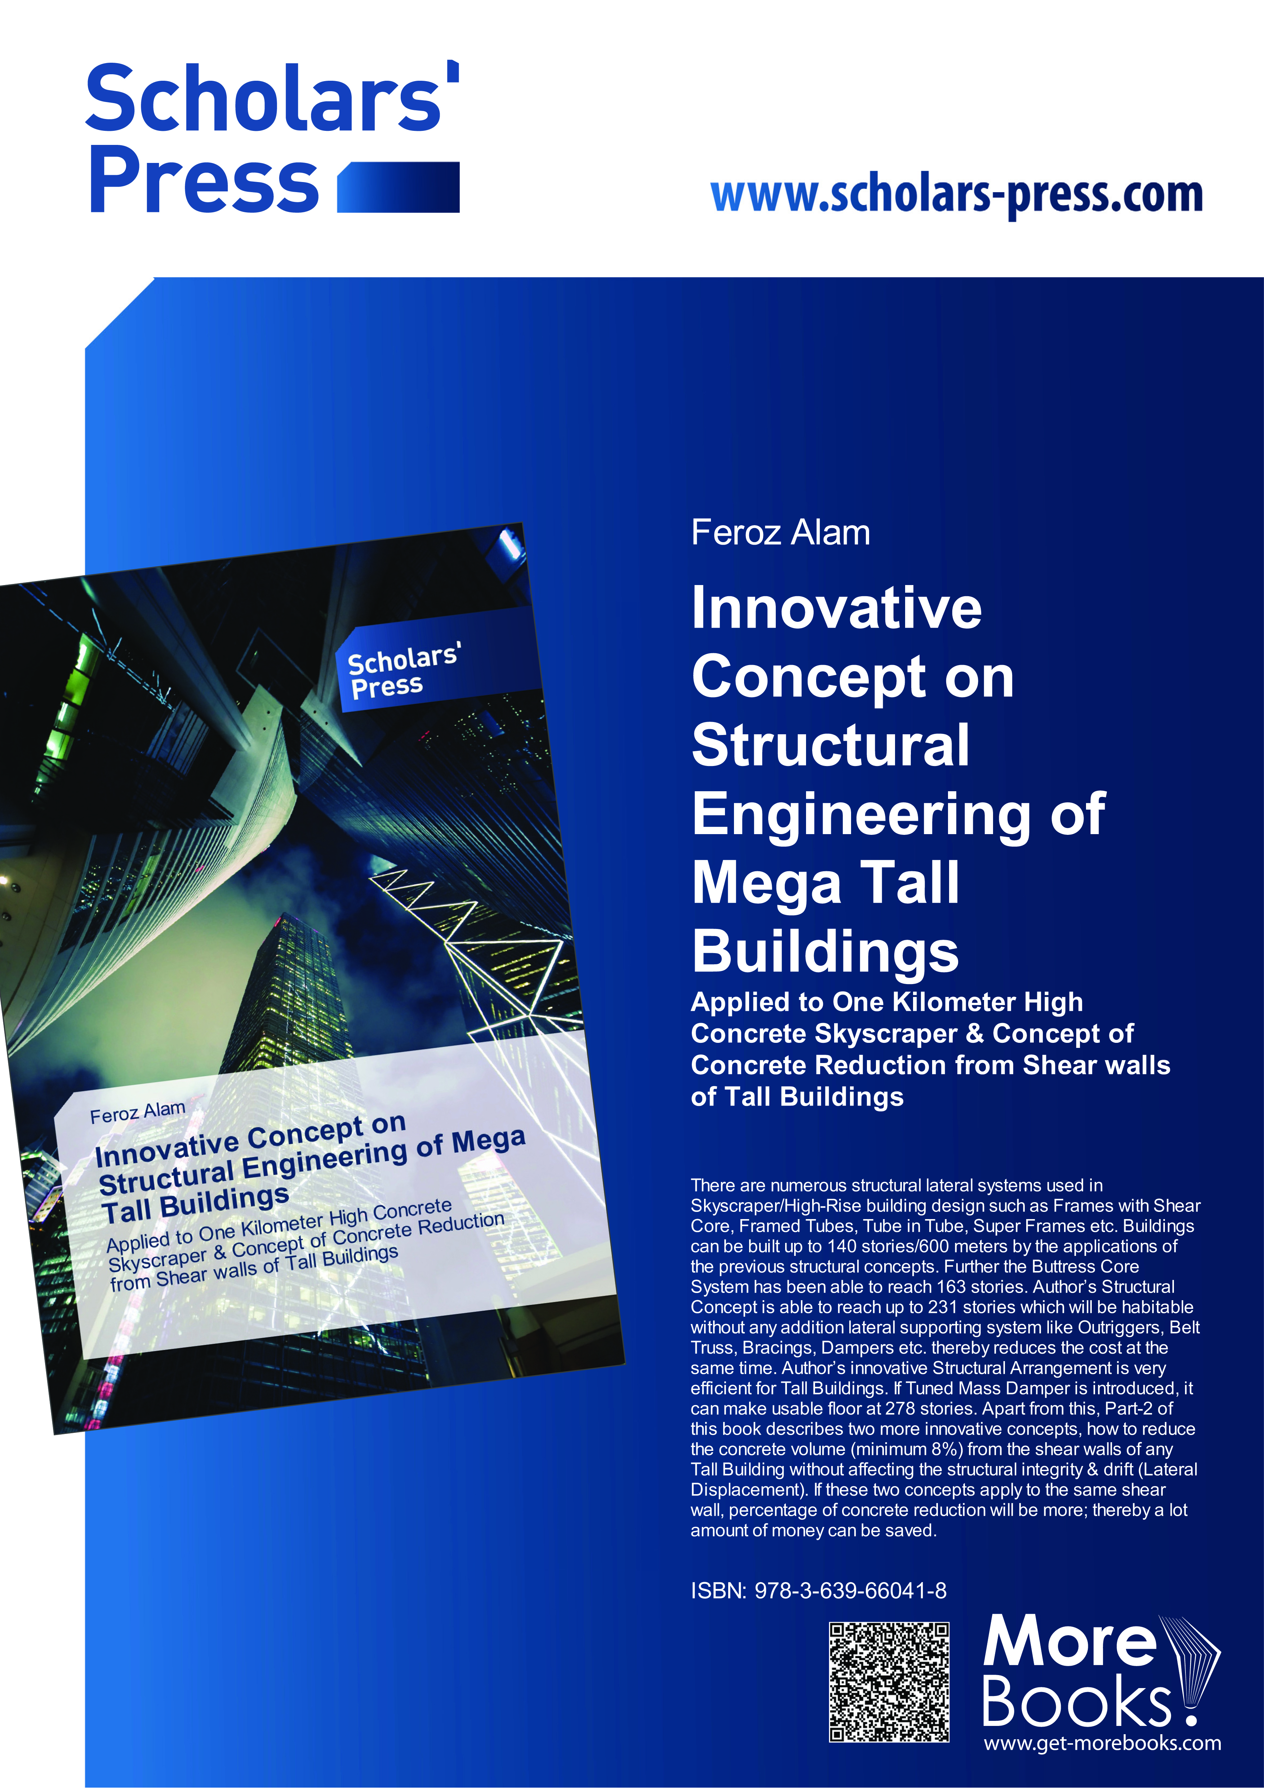
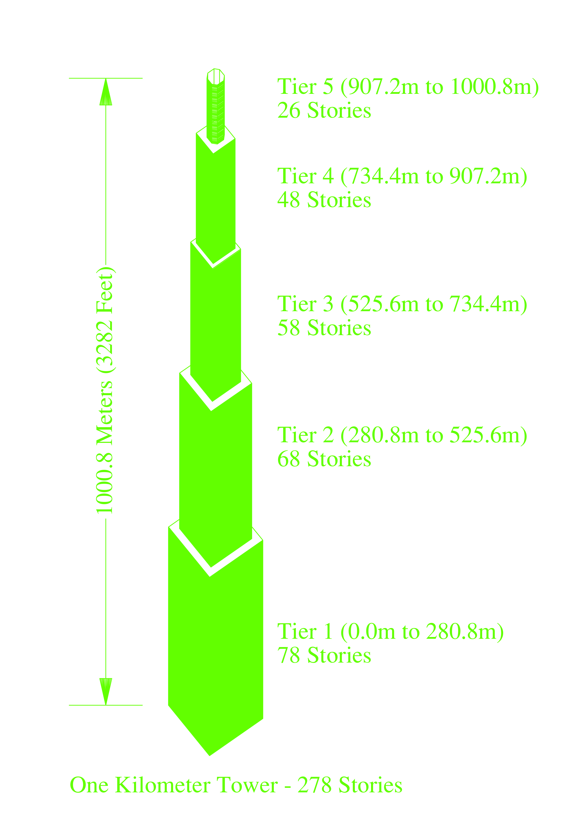
One Kilometer Tower (278 Stories)

Slide 2
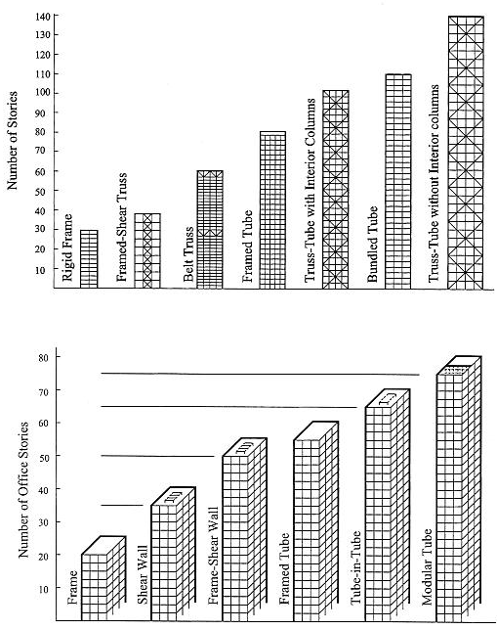
Classification of tall building structural systems by Fazlur Khan
Above: Fig. 1 Steel; Below: Fig. 2 Concrete

Slide 3
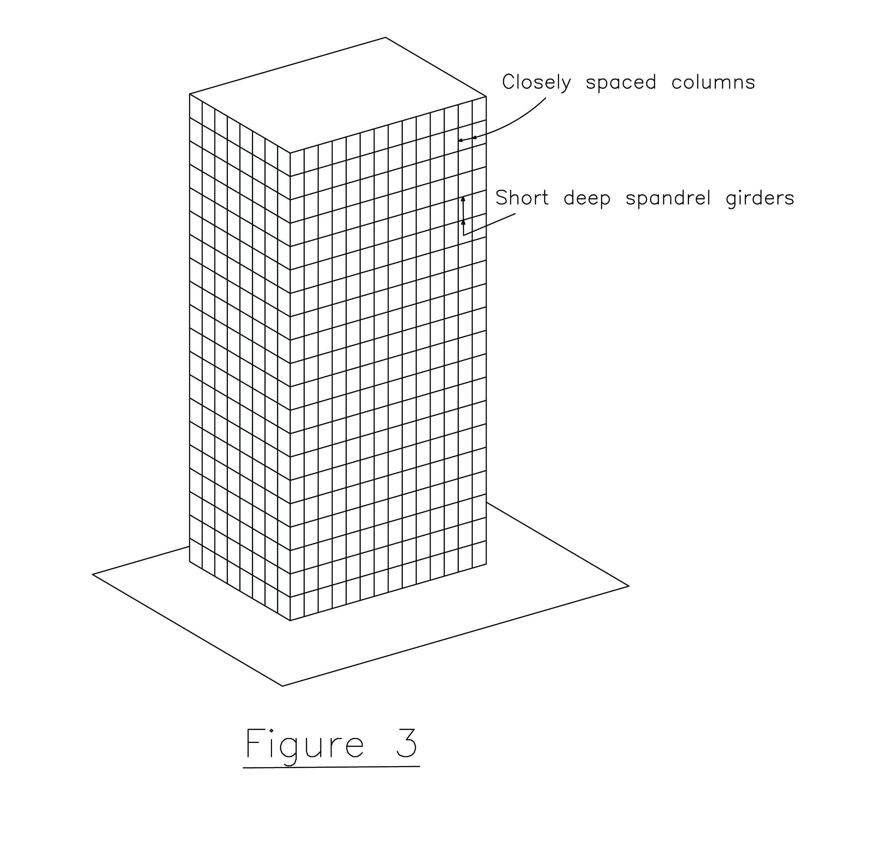
Fig. 3 Tube Structure

Slide 4
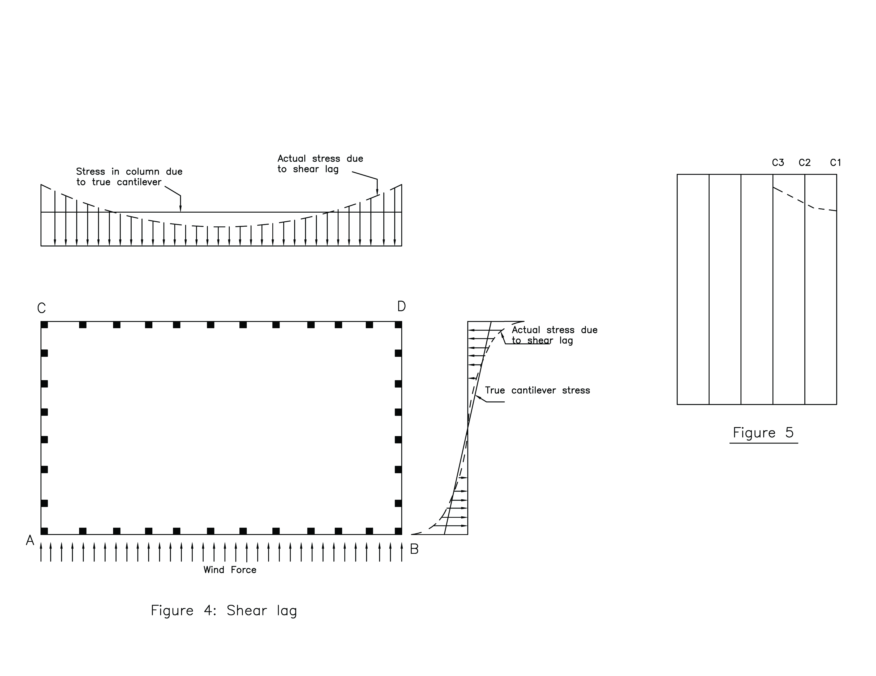
Fig. 5
Fig. 4 Shear lag effect

Slide 5
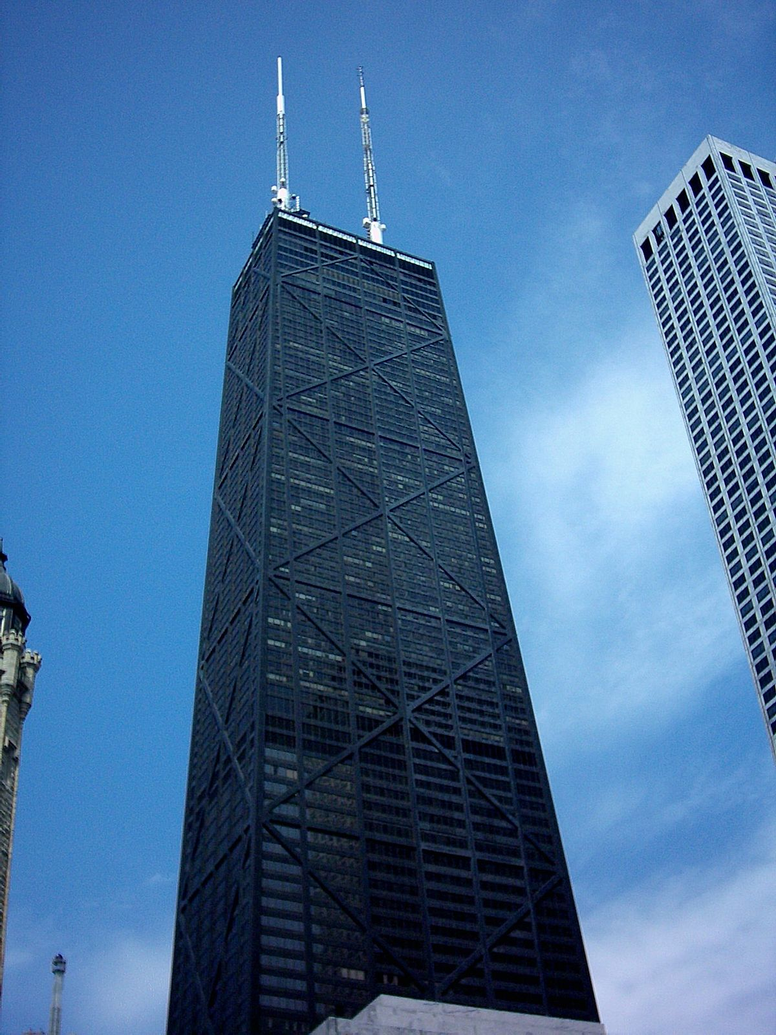
Fig. 6 100-story John Hancock Center (Braced-Tube)

Slide 6
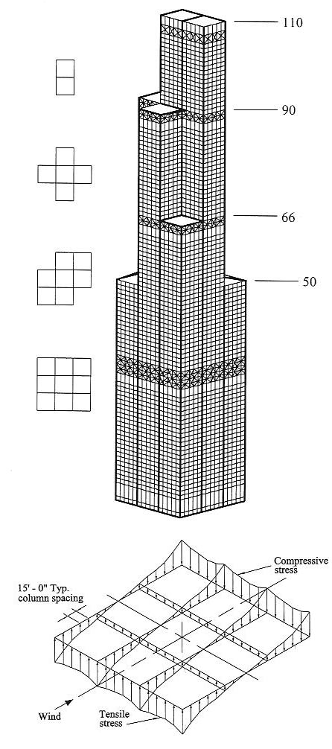
Fig. 7 110-Story Sears Tower (Bundled-Tube).

Slide 7
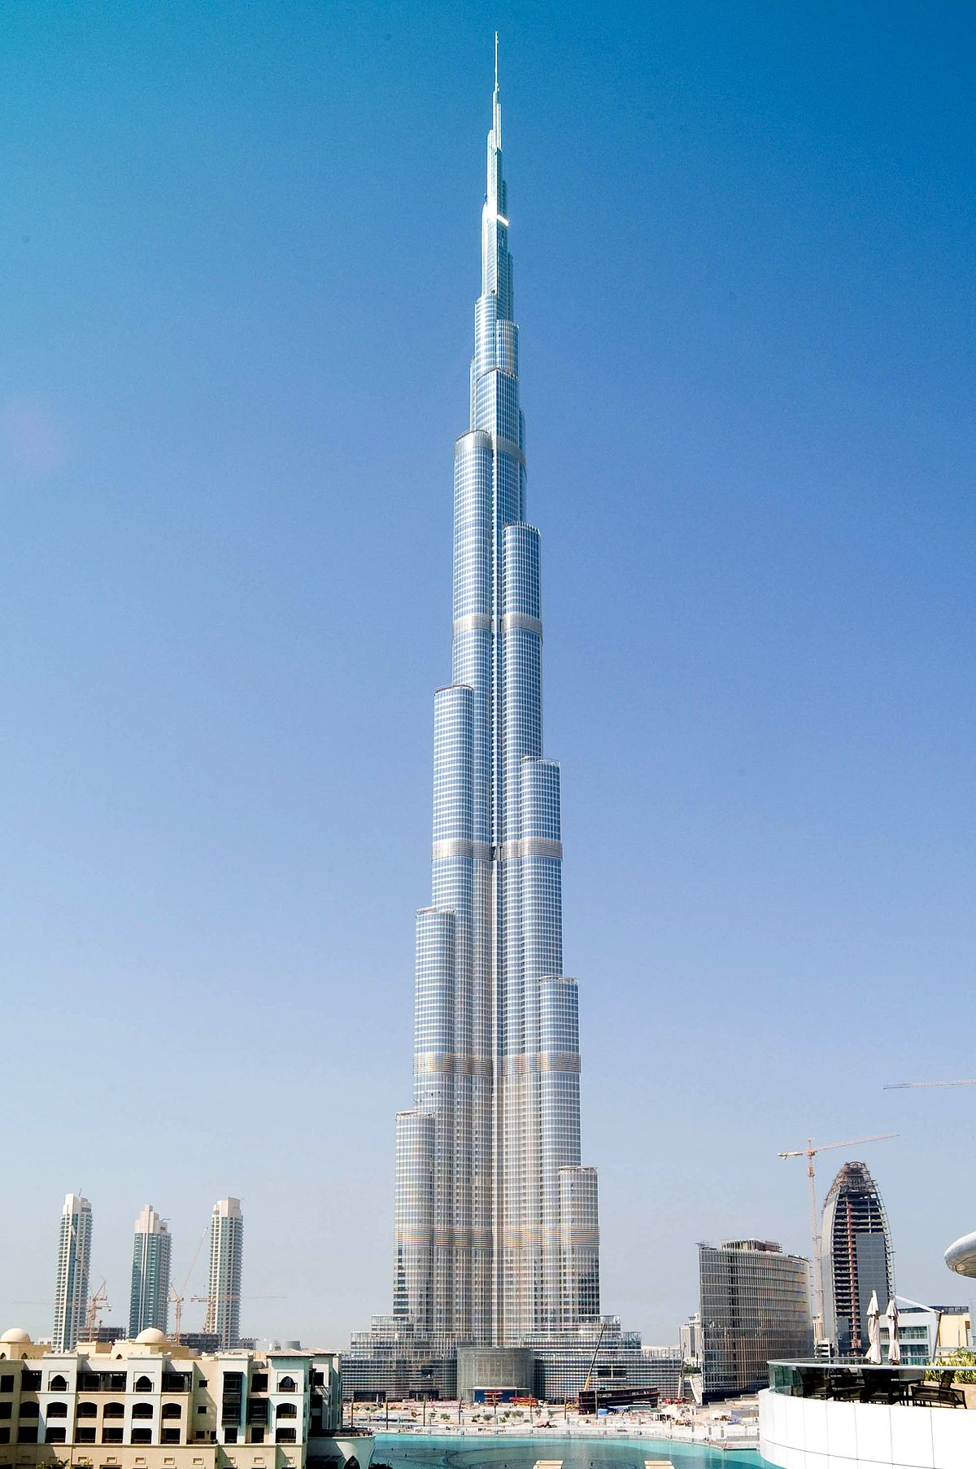
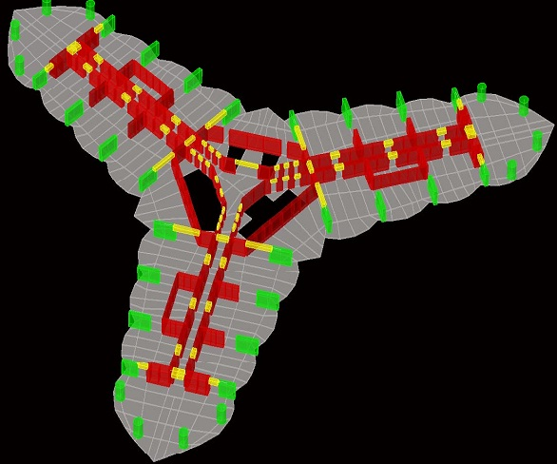
Fig. 9 Structural Arrangement at base – Burj Khalifa
Fig. 8 World Tallest Building - Burj Khalifa.

Slide 8
Table1.Building’s Data
Height-Ground Floor to Roof | 3282 feet (1000.8 m)
Number of Stories | 278
Building uses (Assumed) | Hotel, Office and Residential.
Frame Materials | Concrete Structure
Typical Floor Live Load | 3kn/m2 (60 psf).
Basic wind velocity (100 years returned period for Qatar, wind load considered for Qatar) | 41.67 m/sec, (150km/hour).
Allowable Sway (Drift) [9]- (Commentary Appendix C-Sec: CC.1.2 ASCE 7-10) | H/500 (H = Height of the Structure)
Allowable Sway at top | 1000.8m/500 = 2001.6 mm (6’-6”)
Sway of the Structure at top for dynamic analysis | 1930 mm (6’ - 4”)
Type of structure | Arrangements of Concrete Shear Walls and Beams for Tier-1, Tier-2, Tier-3 and Tier-4. Tier-5 is the frame structure.
Foundation Type | Future Assignment
Typical Floor height | 3.6 m
Floor type | R.C.C. Slab
Shear Wall spacing | 12m, 9m & 6m c/c
Core area | Column-beam framing
Shear Wall thickness at ground floor | 1.6m, 1.5m, 1.4m & 1.3m, gradually decreasing the thicknesses toward top.
Typical Beam sizes | Depth 0.8 m, Width 1.1m & 1.2 m
Column spacing | 6m (20 feet) c/c
Column sizes at base | 1.5m x 1.5m
Covered area at base by ShearWalls & Columns | 14.53%
Concrete Strength | Shear Walls & Columns 80MPa, Beams & Slab 40MPa
Aspect Ratio (Building Height/Least length at Base) | 9.8

Slide 9
Fig. 10 One Kilometer Tower (278 Stories).

Slide 10
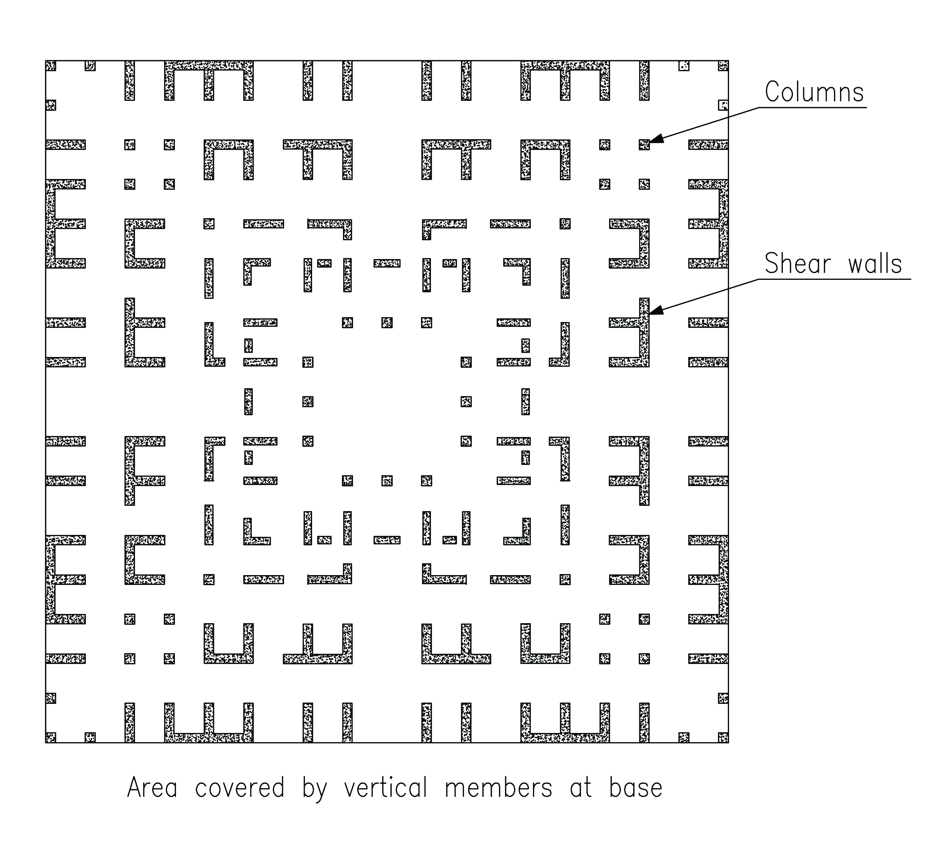
Columns
Shear walls
Fig. 11 Vertical Members (Covered Area) at base.

Slide 11
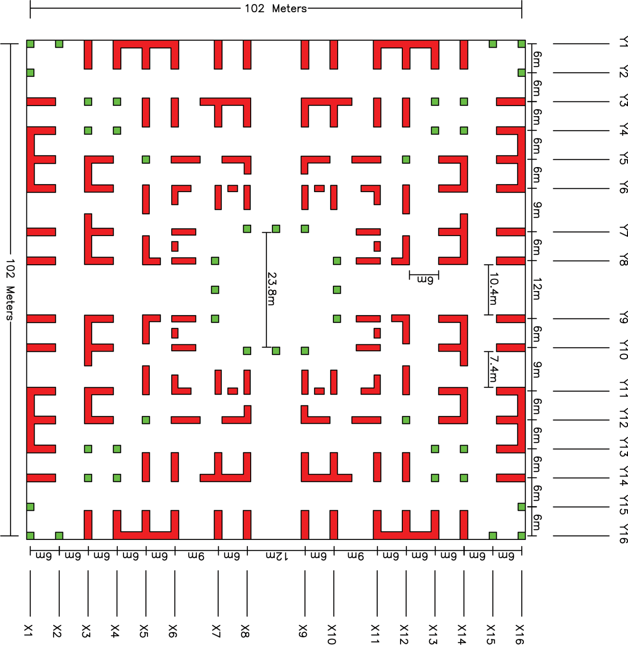
Fig. 12a Plan at base

Slide 12
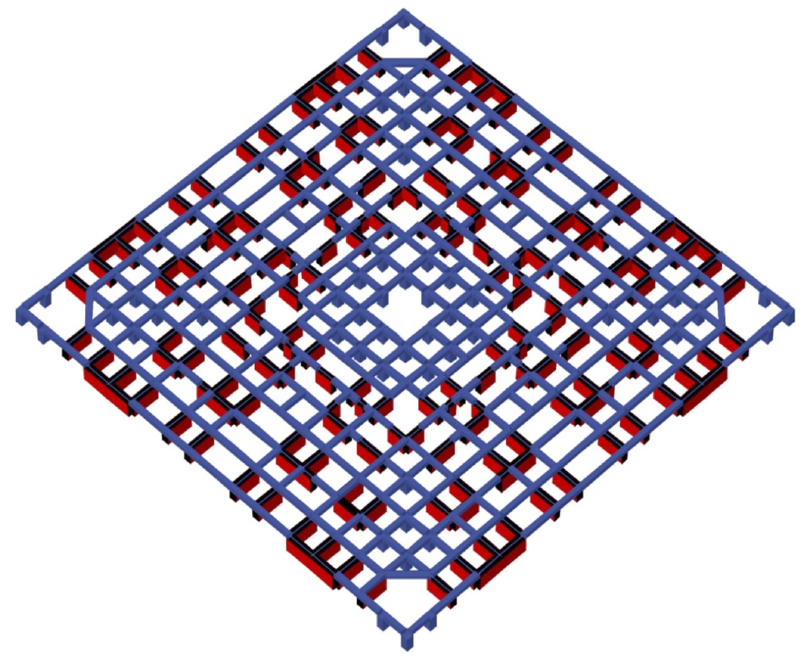
Fig. 12b Beam Connections with shear walls & Columns

Slide 13

Fig. 12-1a Shear wall & Column arrangement of Tier-1

Slide 14

Fig. 12-1b Shear wall & Column arrangement of Tier-2

Slide 15
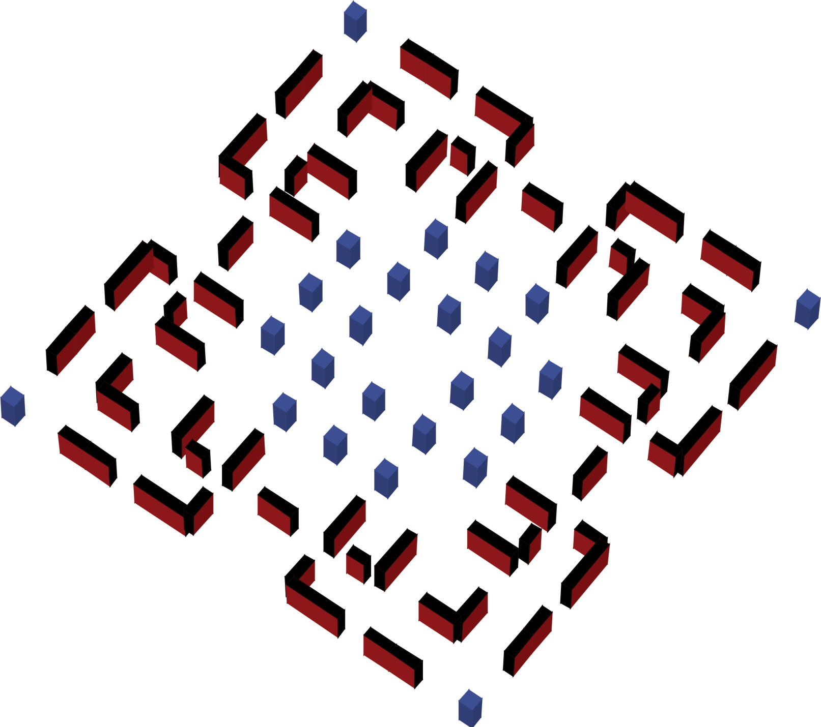
Fig. 12-1c Shear wall & Column arrangement of Tier-3

Slide 16

Fig. 12-1d Shear wall & Column arrangement of Tier-4

Slide 17
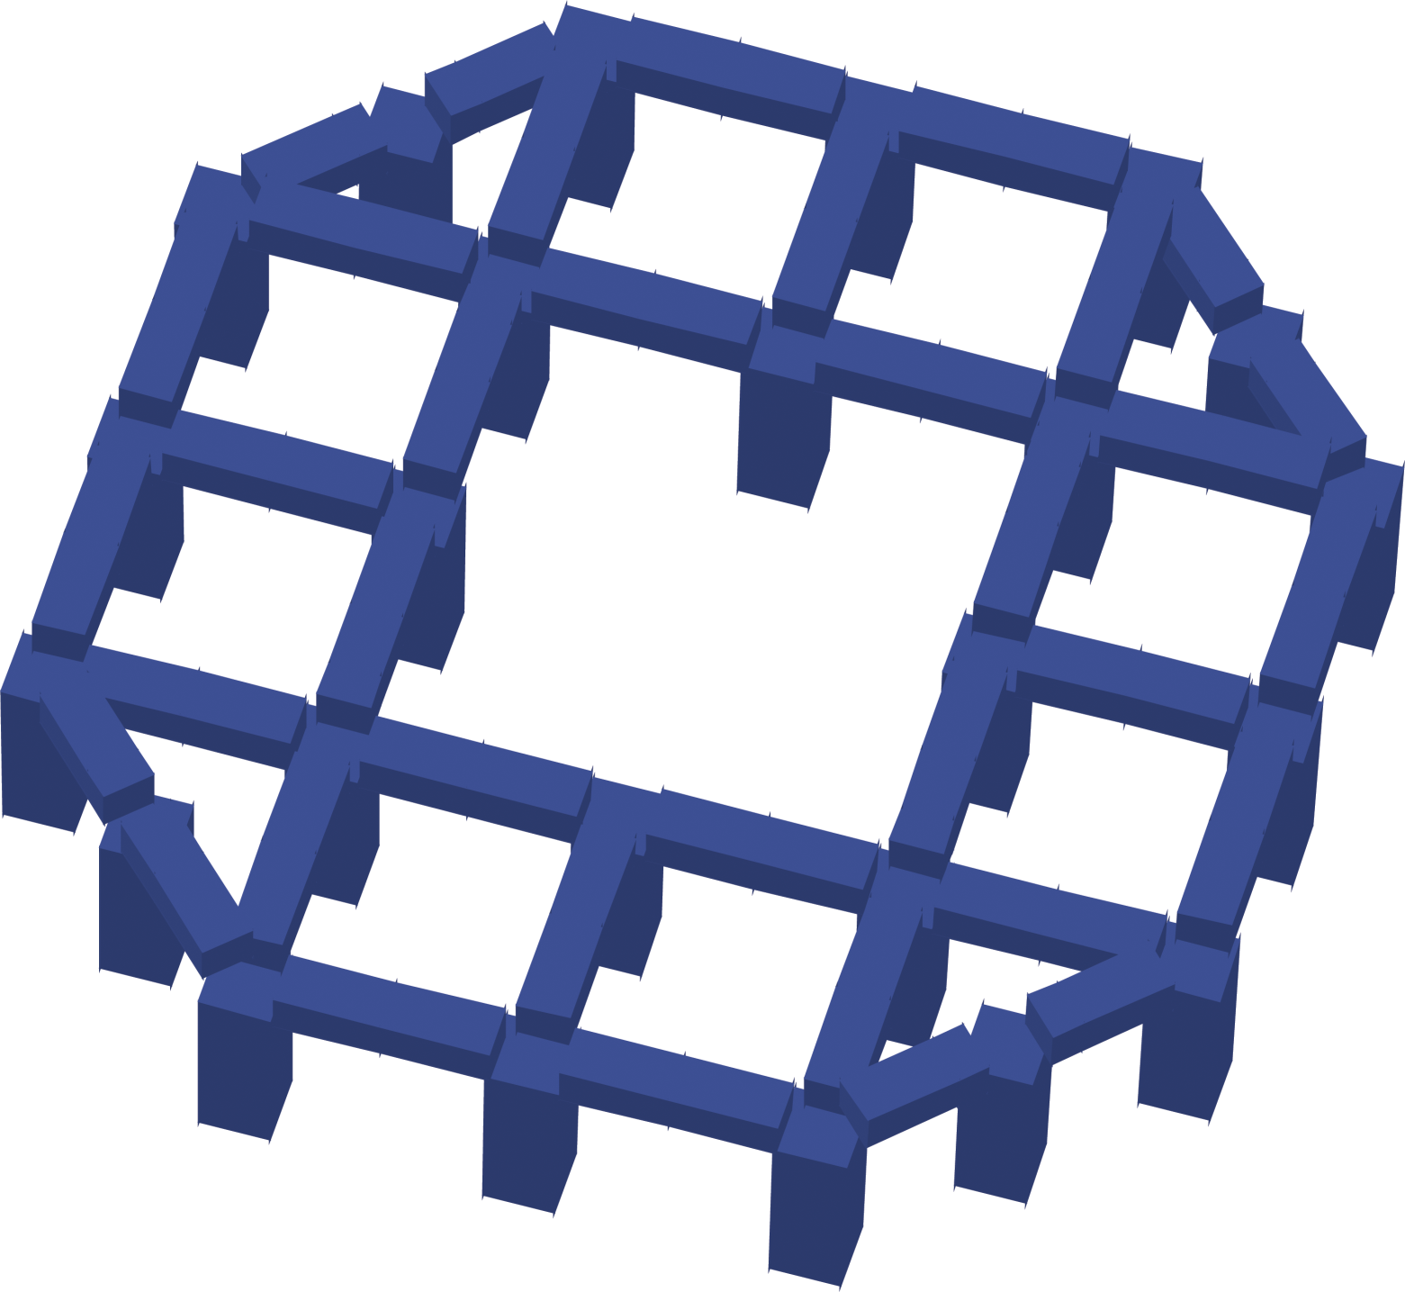
Fig. 12-1e Columns & Beams arrangement of Tier-5

Slide 18
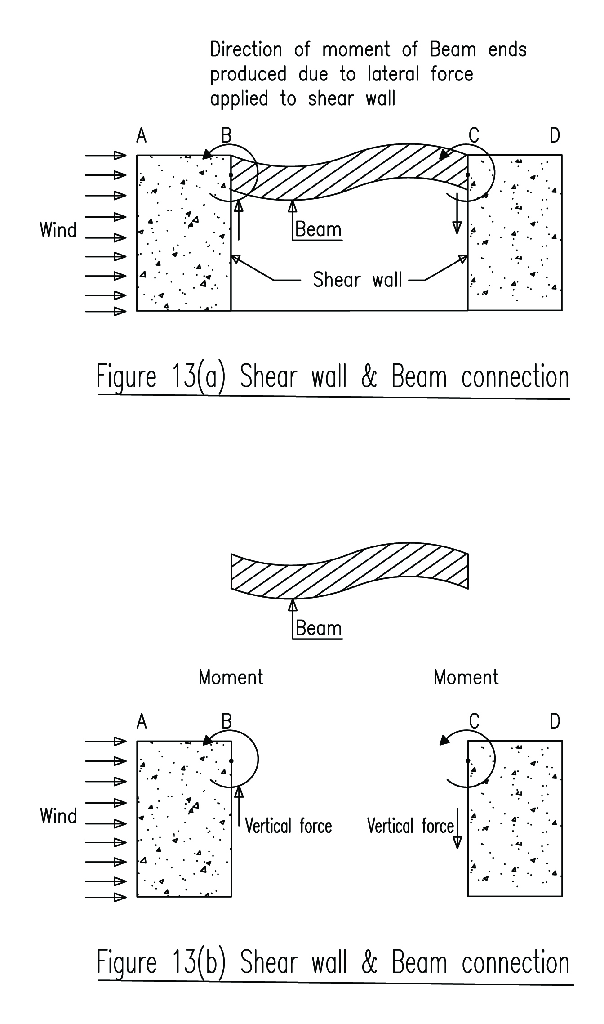
Fig. 13(a) Shear walls & Beam connection
Fig. 13(b) Free body diagram

Slide 19
Fig. 14a Gird-5x interaction between Shear walls & Beams

Slide 20
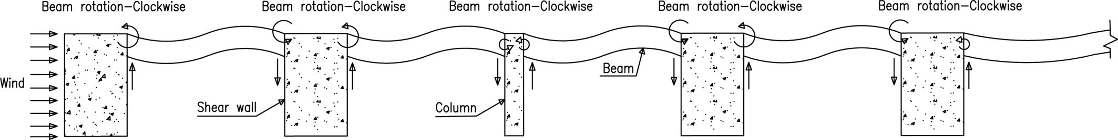
Fig. 14b Gird-5x interaction between Shear walls & Beams

Slide 21
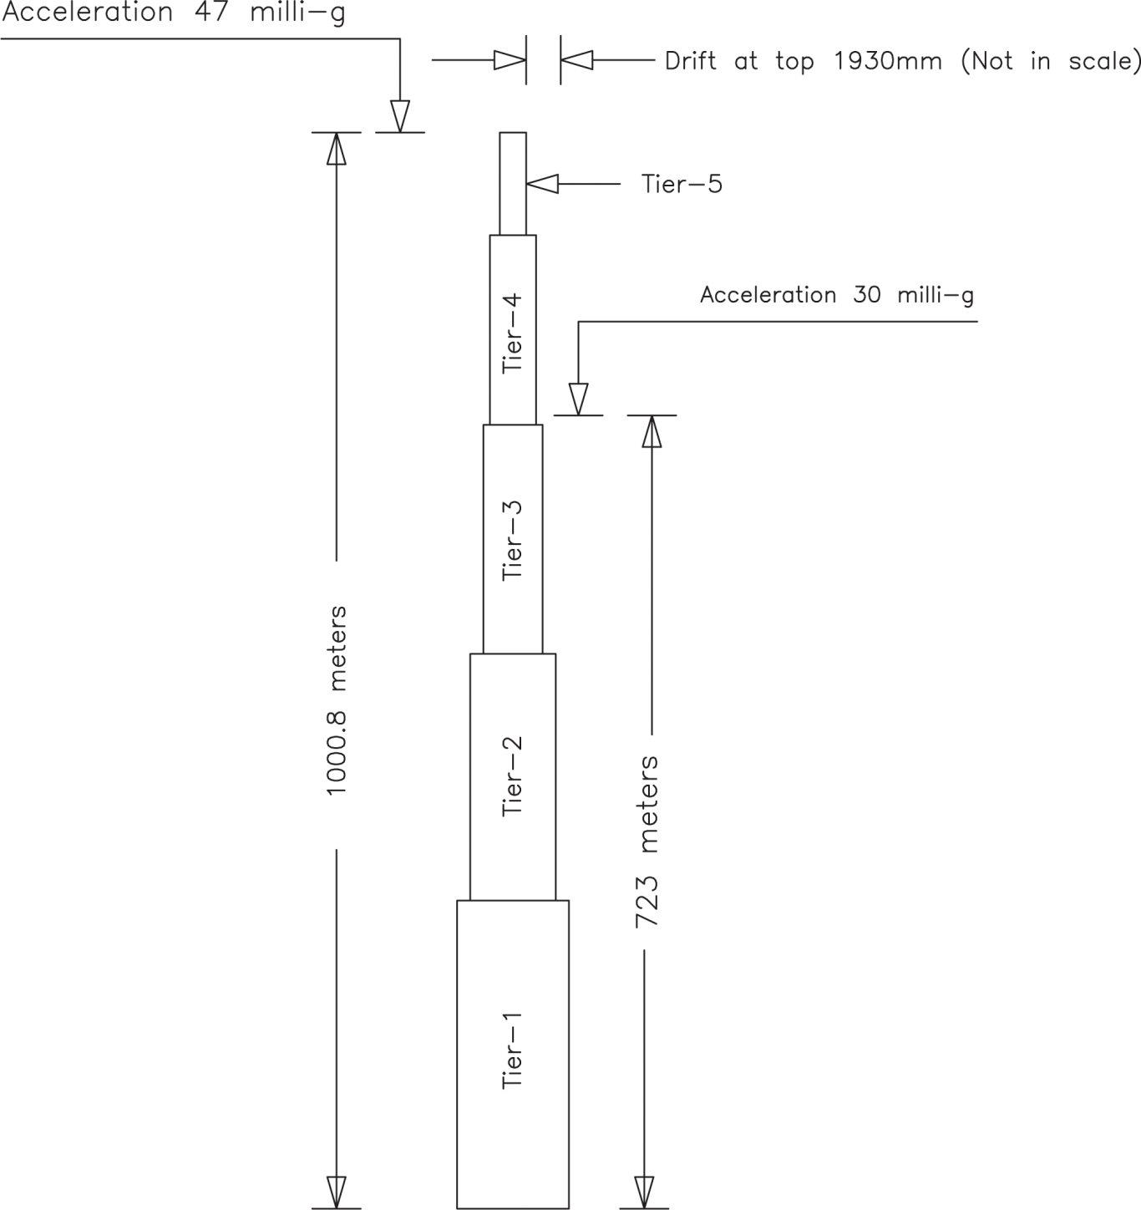
Fig. 15 Result Analysis

Slide 22
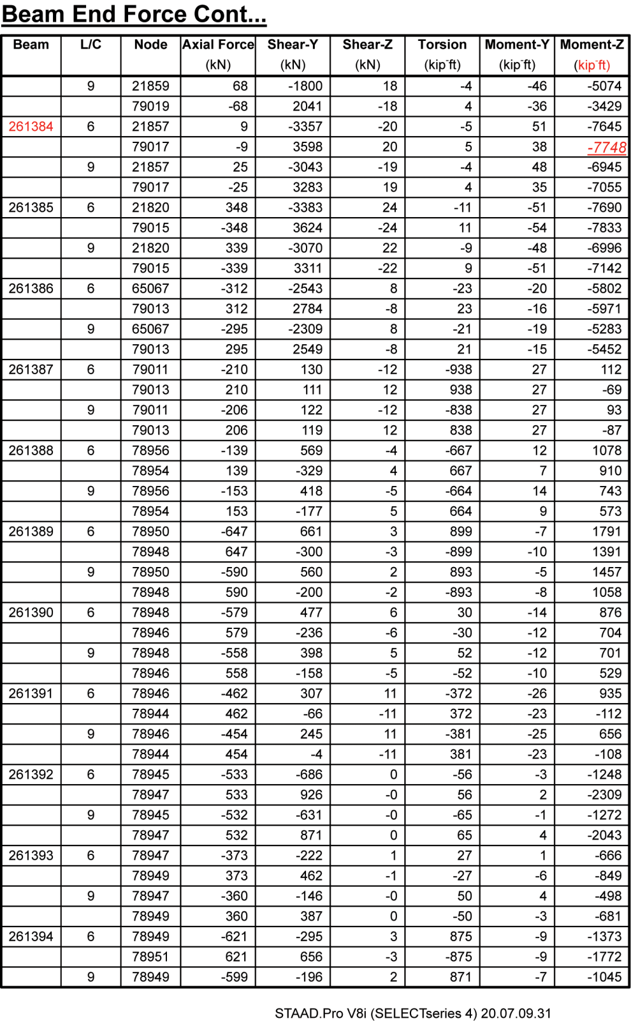

Fig. 15-1c Bending moment of beams at 70th Floor

Slide 23
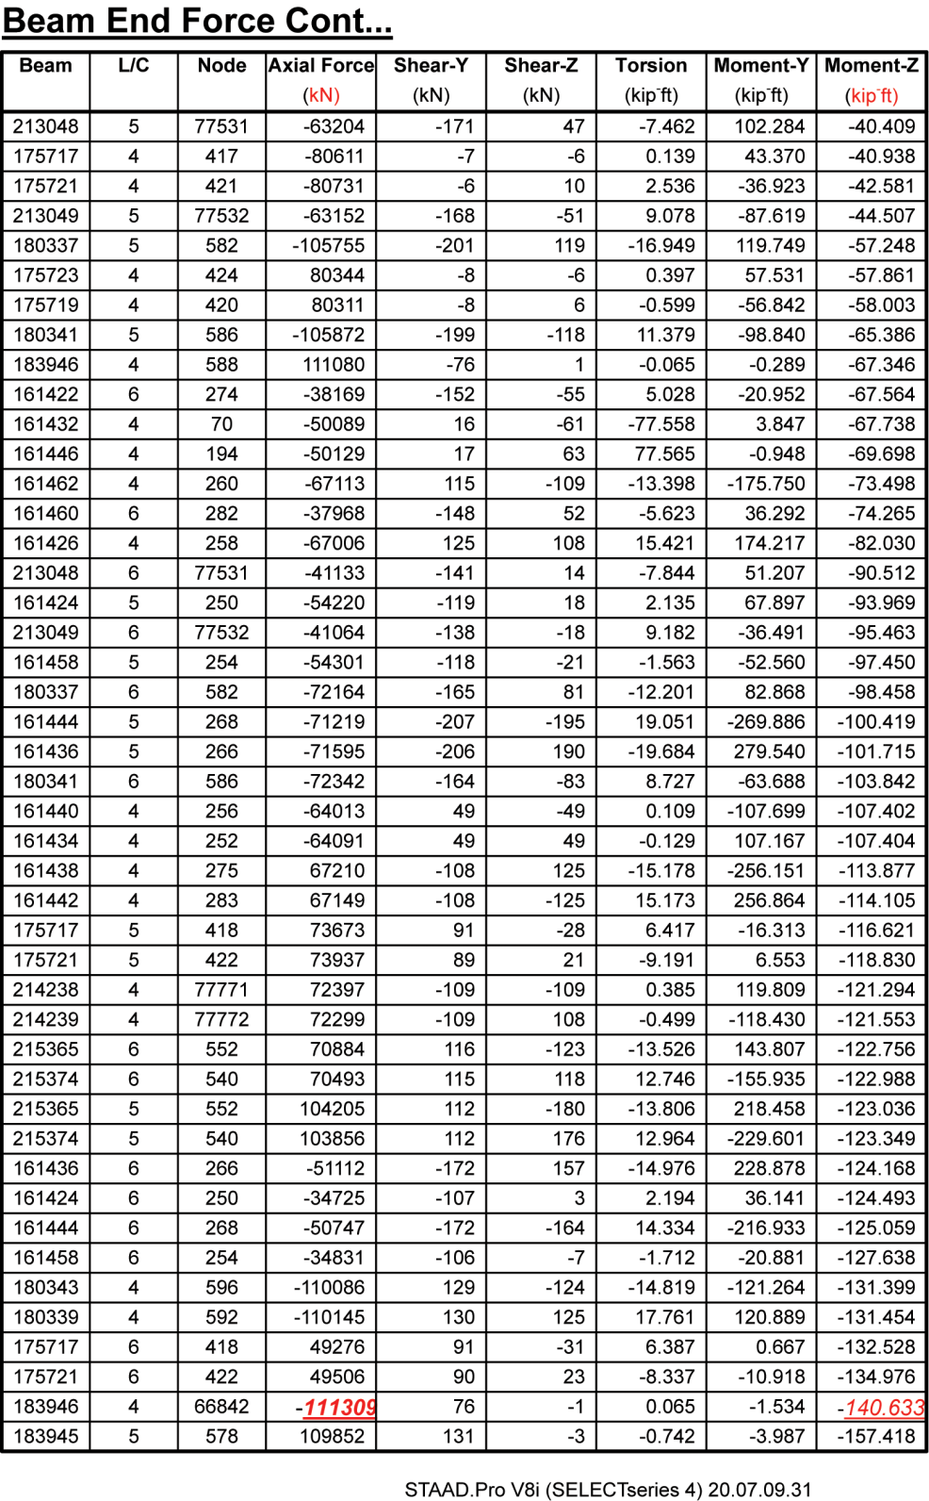
Fig. 15-2a Column reactions at base

Slide 24
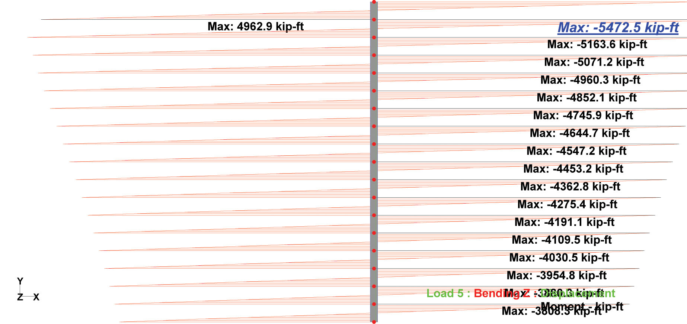
Fig. 15-2h Bending moment diagrams of columns from 60th to 78th floor

Slide 25

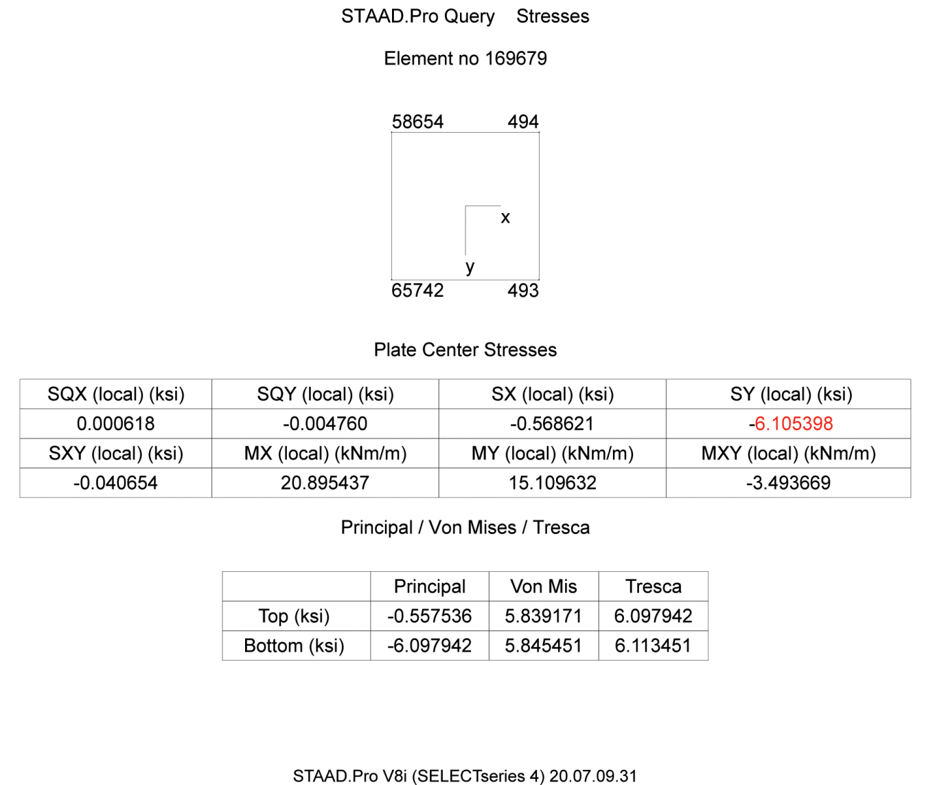
Fig. 15-3a Maximum Compressive stresses of shear walls at base

Slide 26
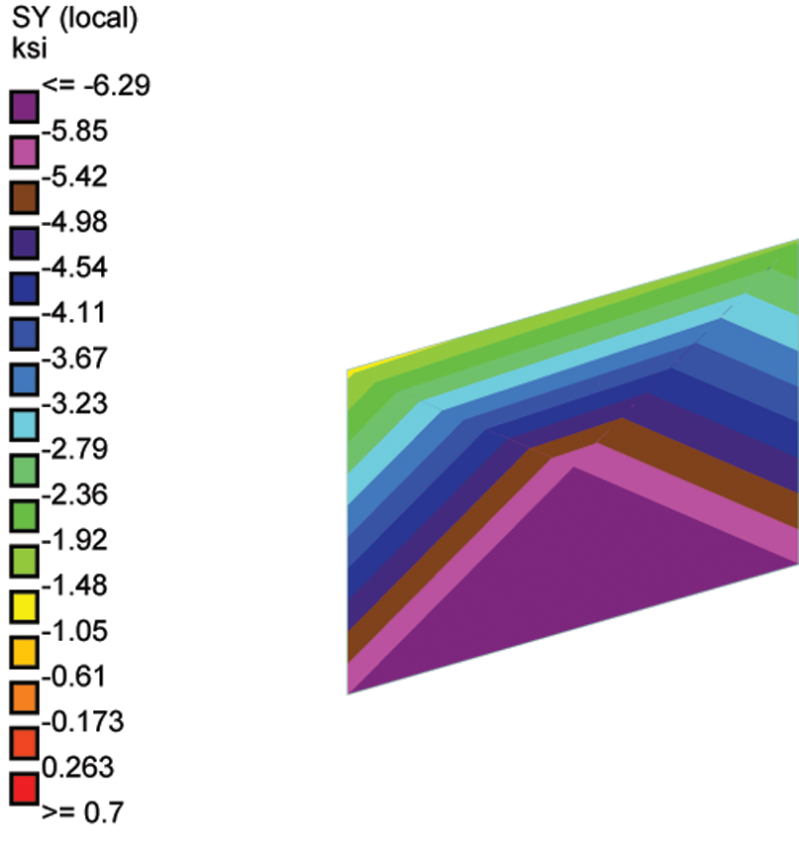
Fig. 15-3b Maximum Compressive stress diagram of shear walls at base

Slide 27
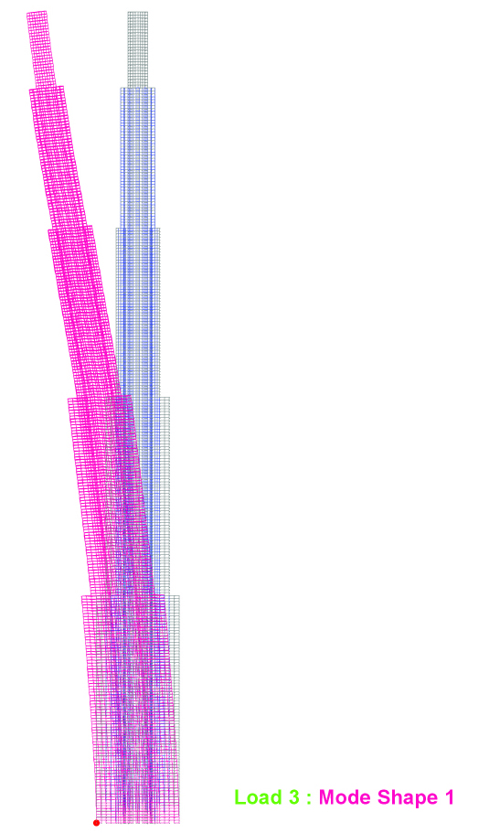
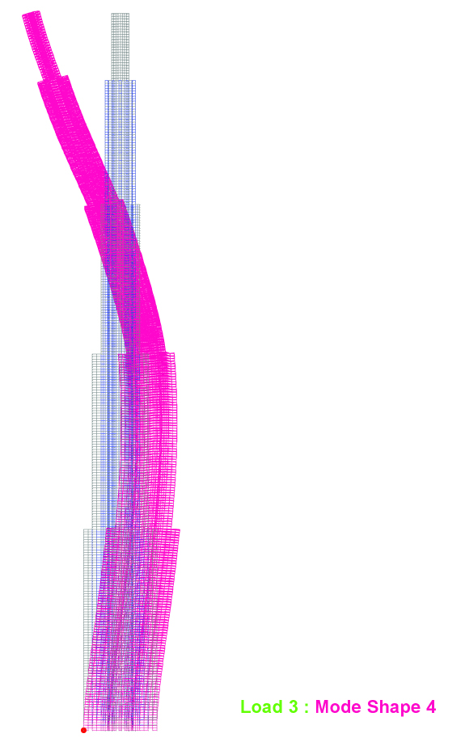
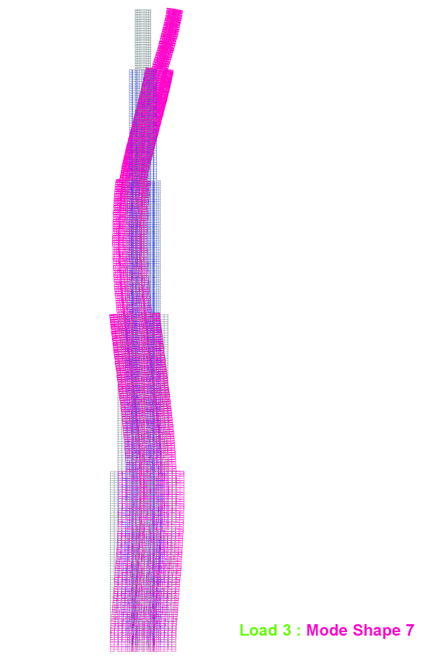
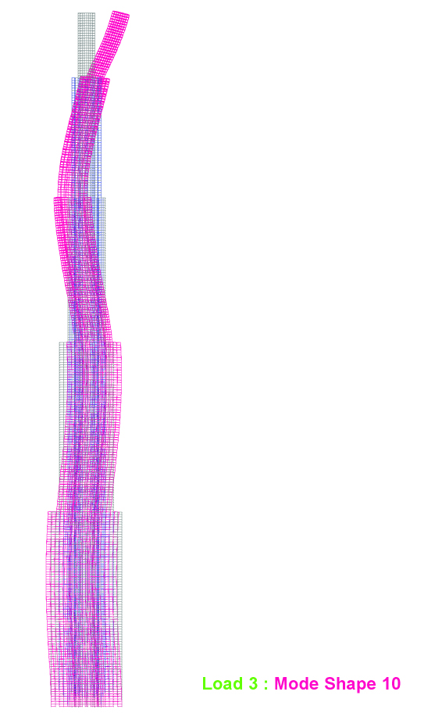
Fig. 15-4a Mode shapes in x-directions

Slide 28
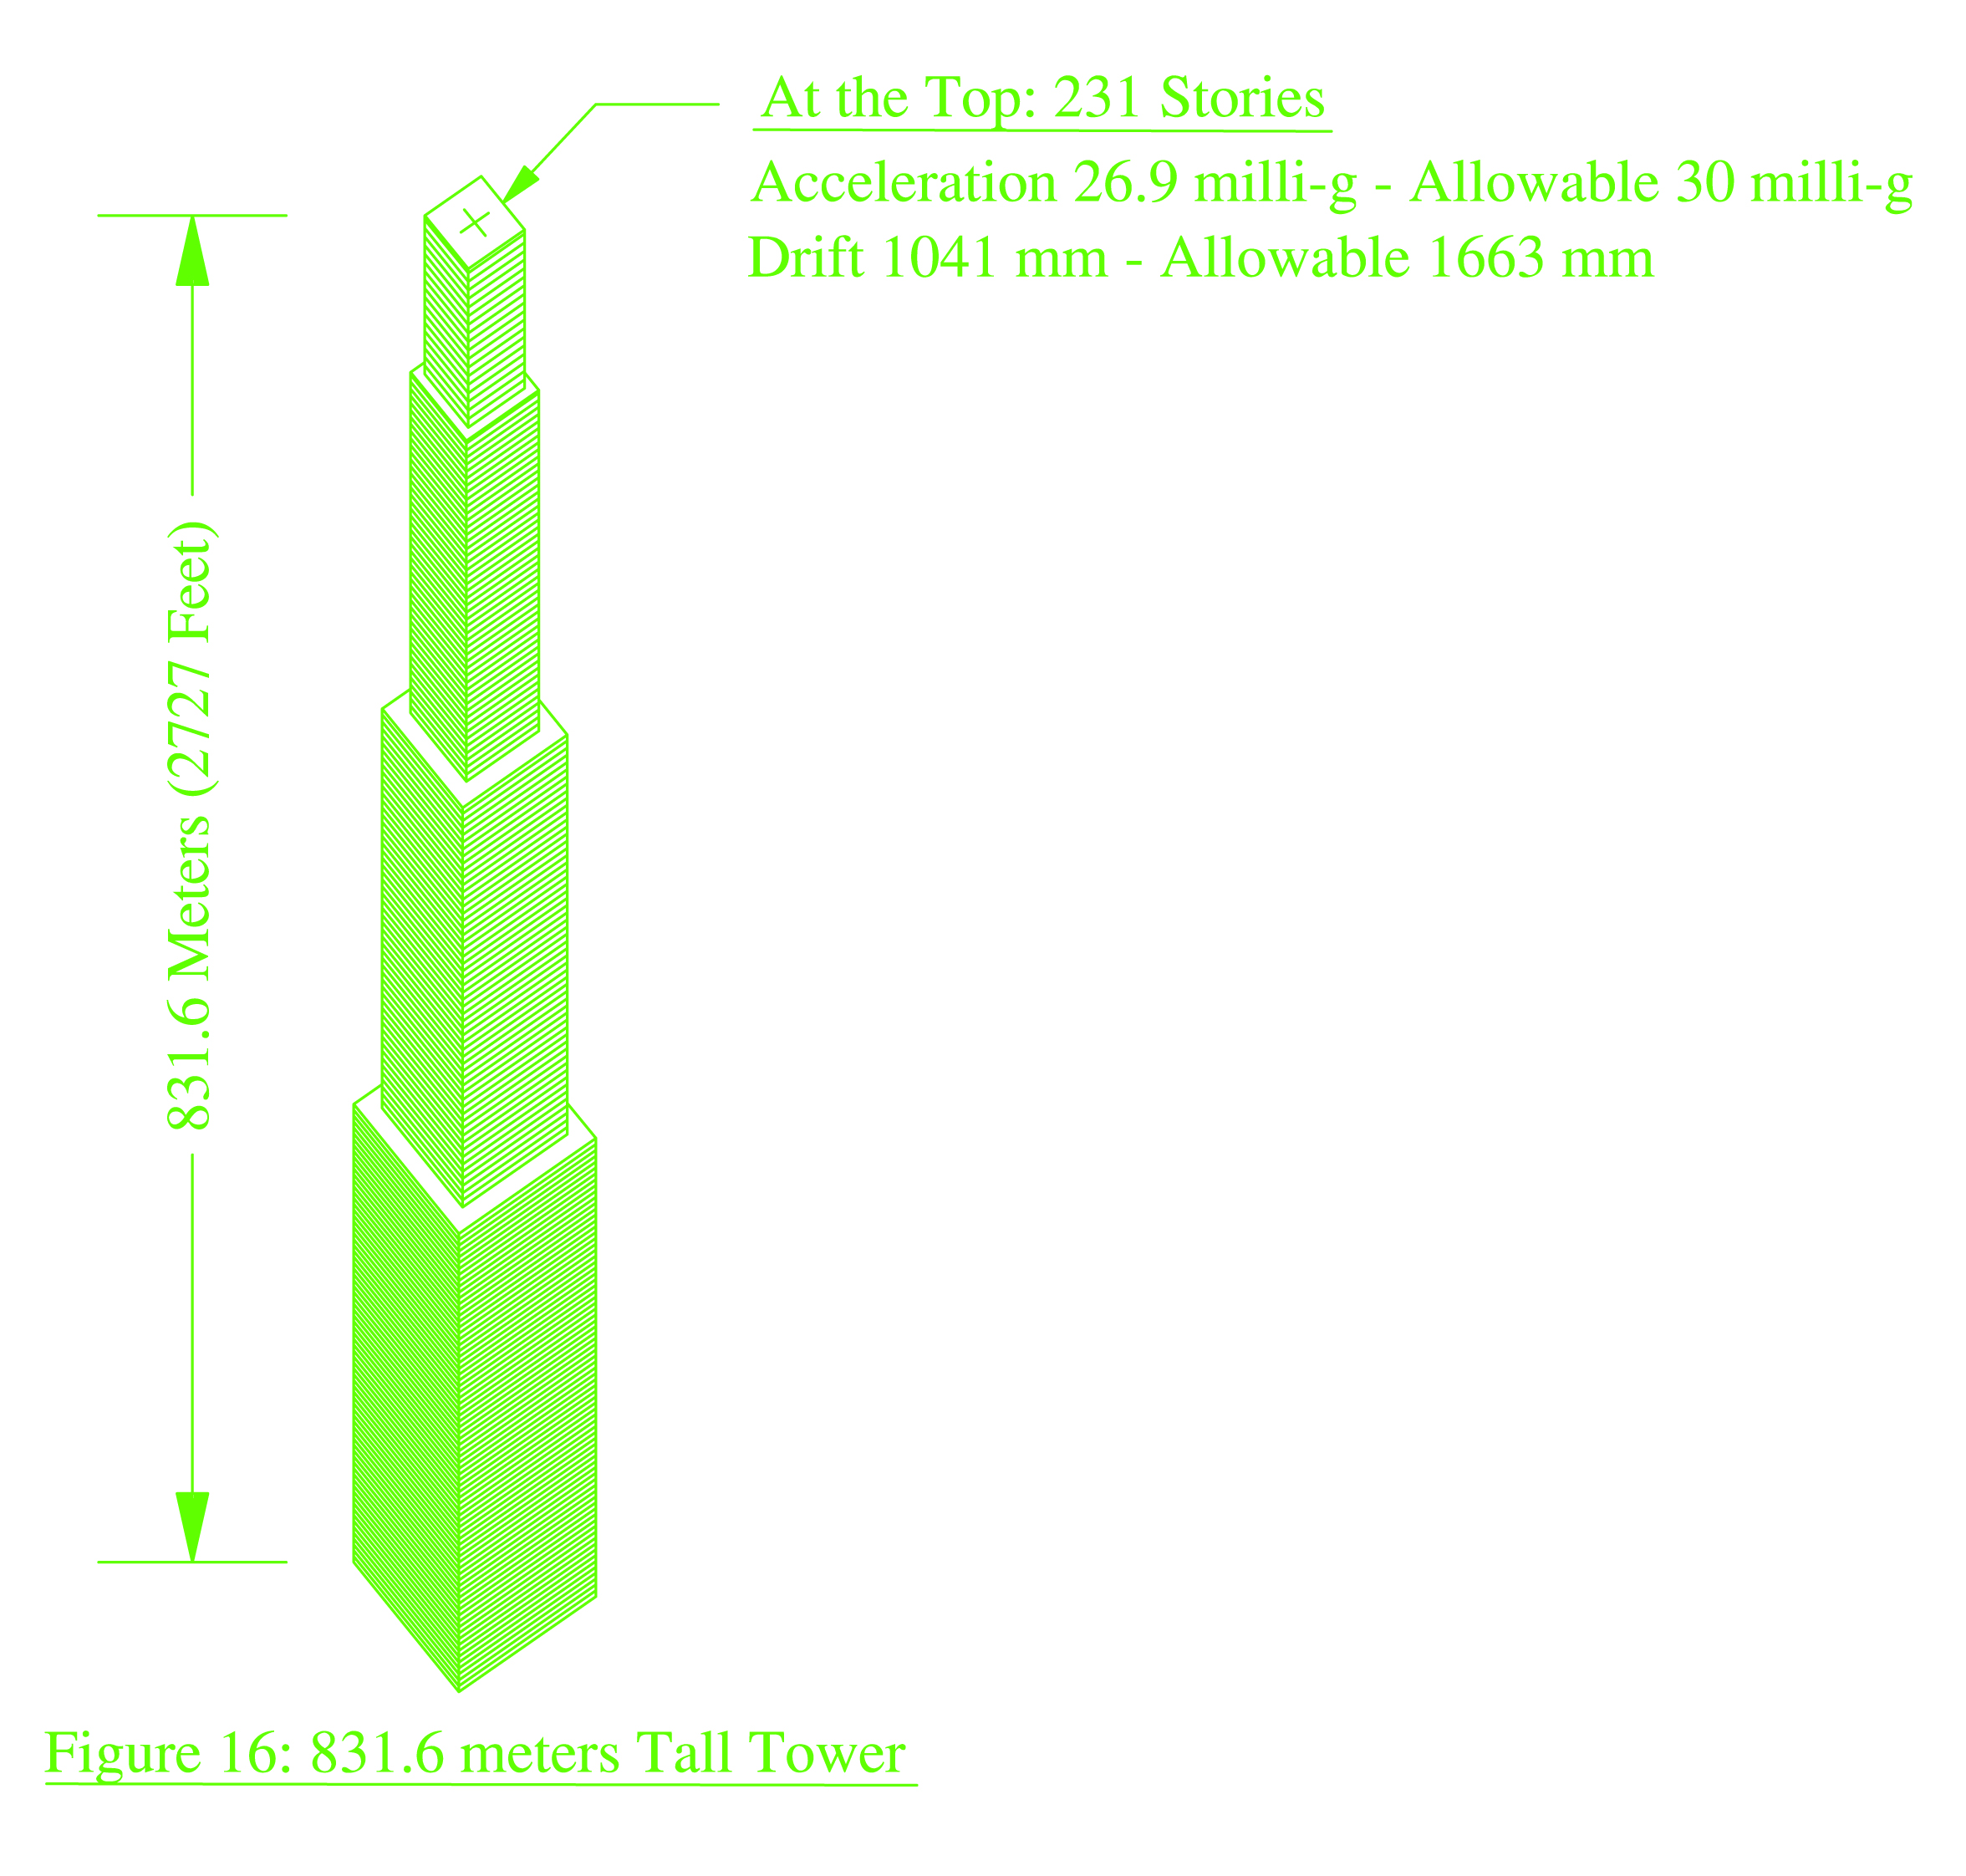
At the Top: 231 Stories Acceleration
26.9 milli-g – Allowable 30 milli-g
Drift 1041 mm – Allowable 1663mm
831.6 Meters (2727 feet)
Fig. 16: 831.6 meters Tall Tower

Slide 29
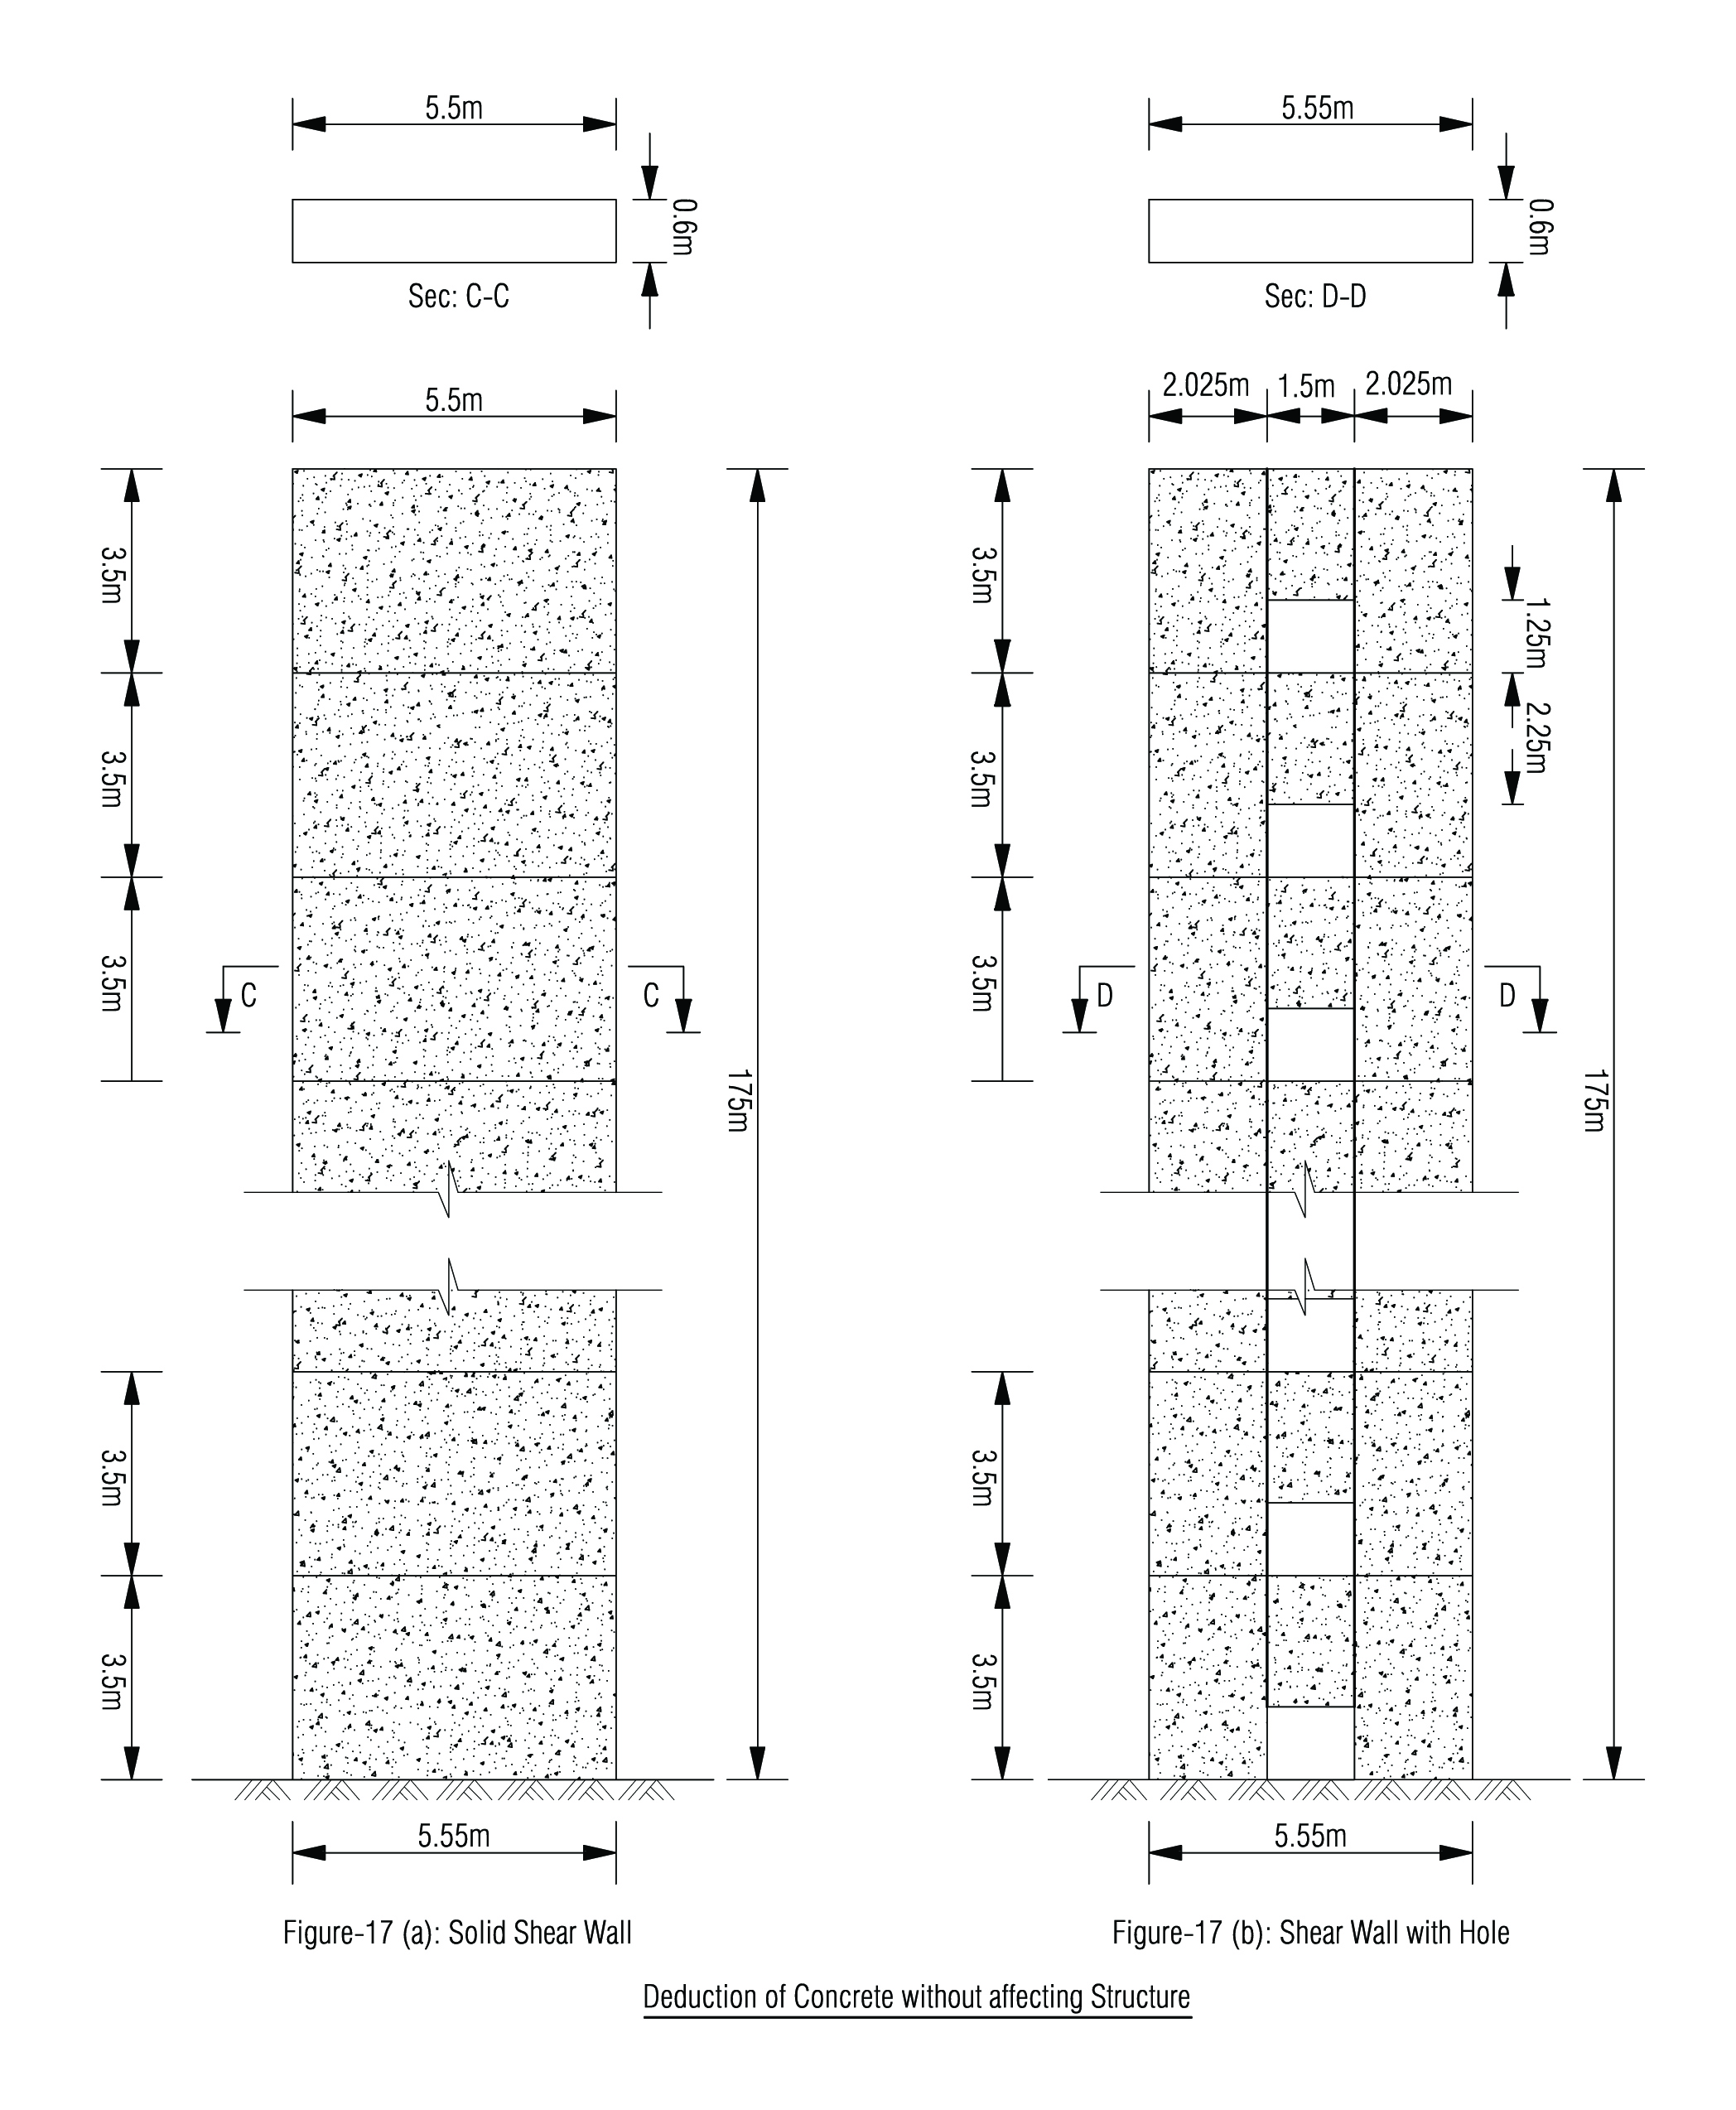

Slide 30
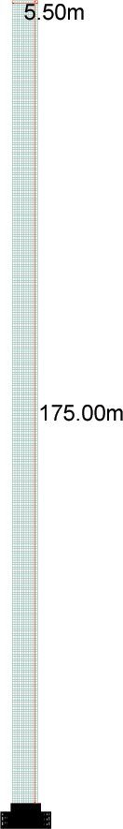
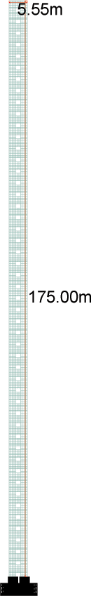
Fig. 17c Solid Shear wall 175m x 5.5m x 0.6m
Fig. 17d Shear wall with opening 175m x 5.55m x 0.6m
(Opening 1.5m x 1.25m)

Slide 31
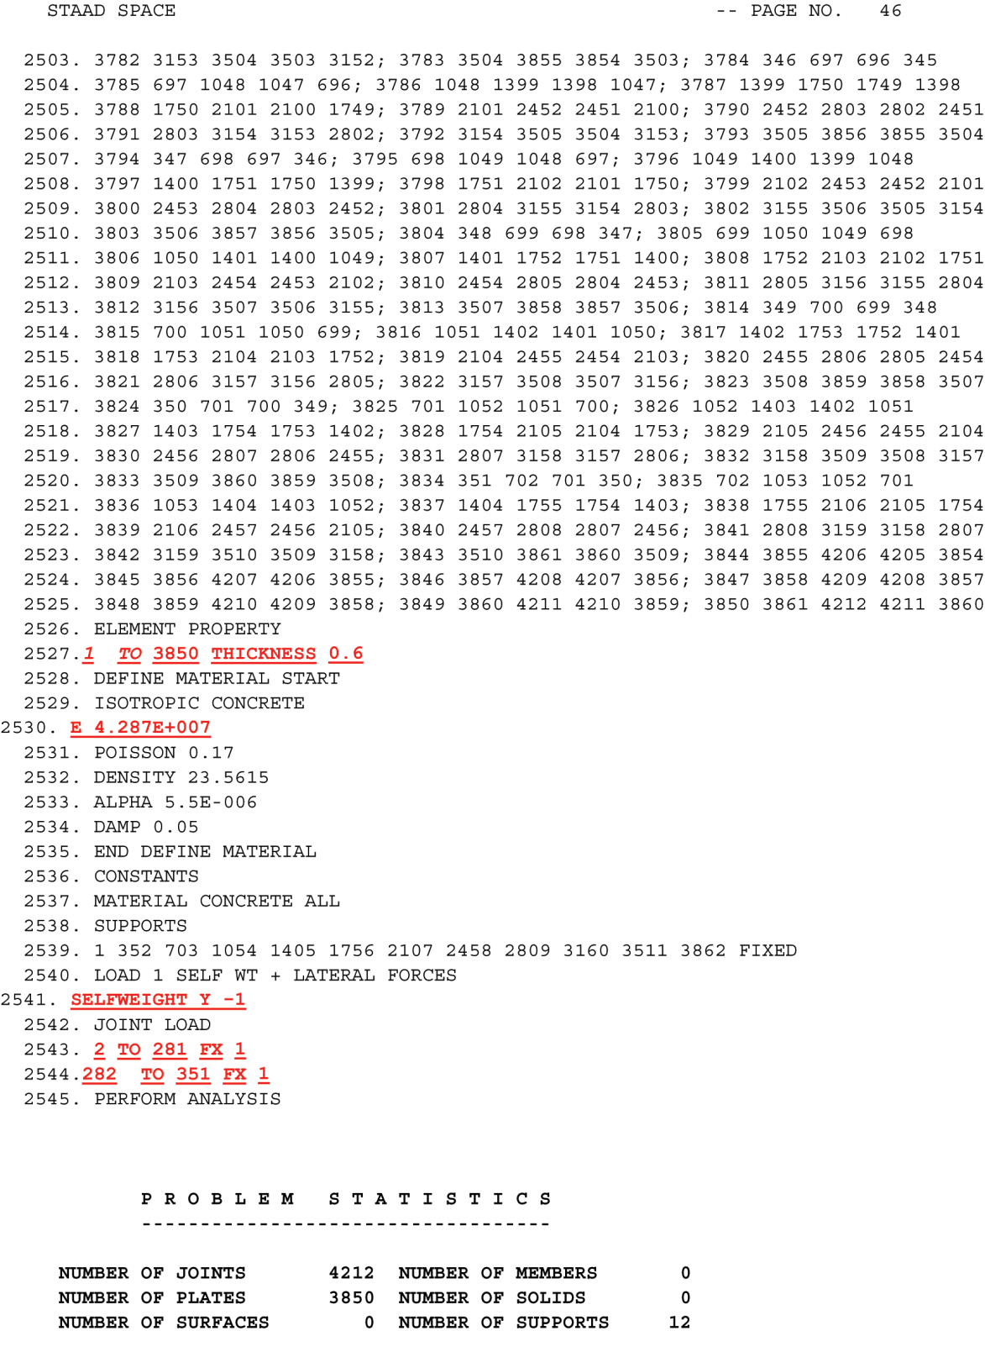
Shear Wall
(No Opening)

Slide 32
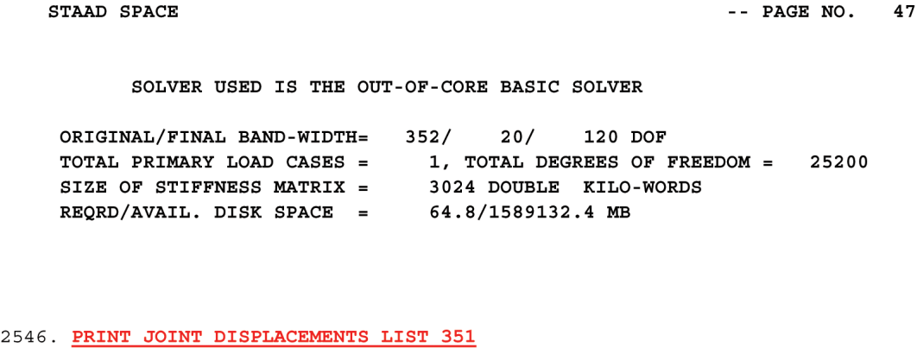
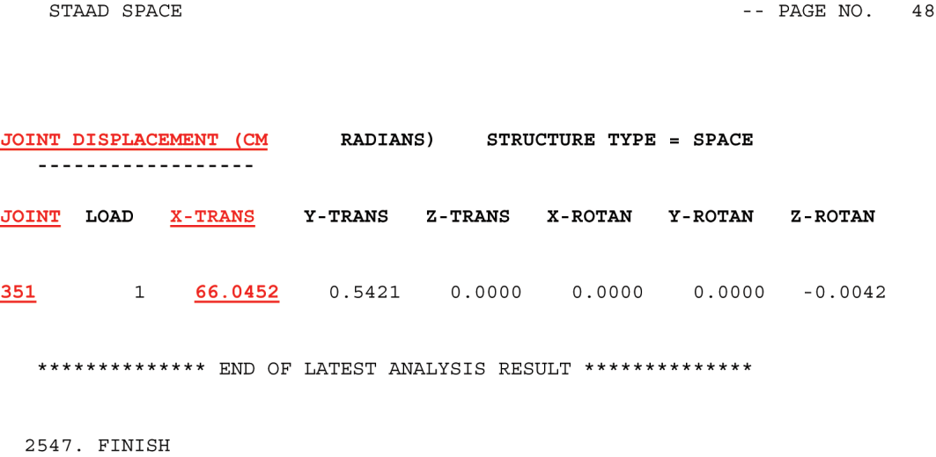

Slide 33
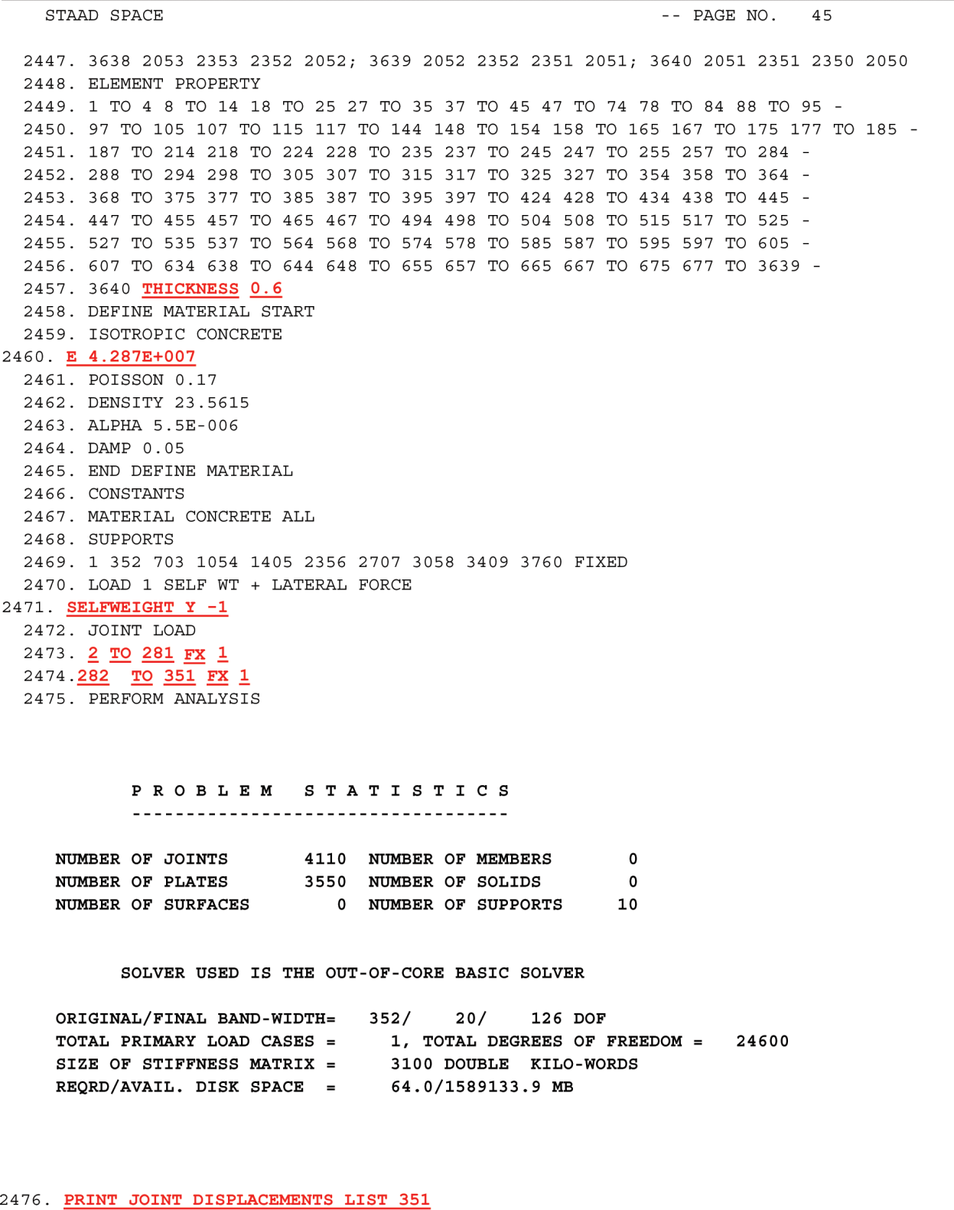
Shear Wall
(With Openings)

Slide 34


Slide 35
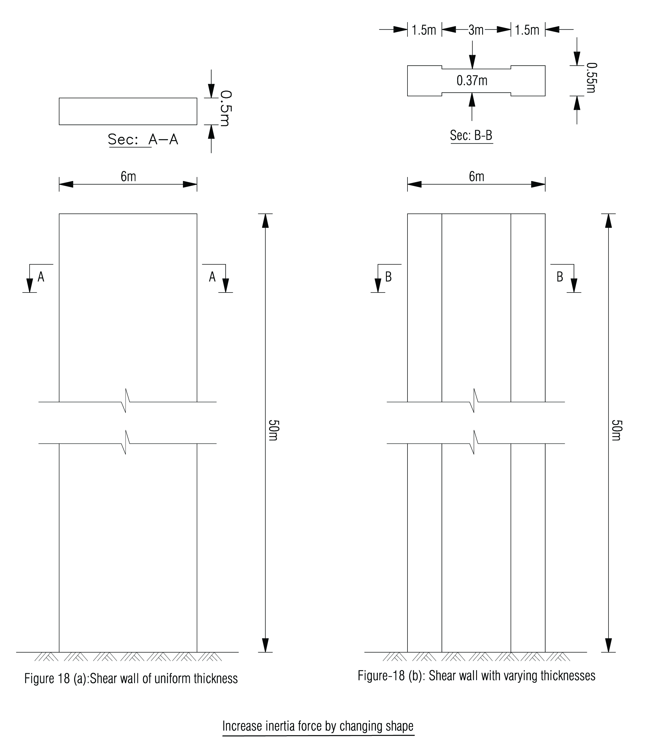

Slide 36
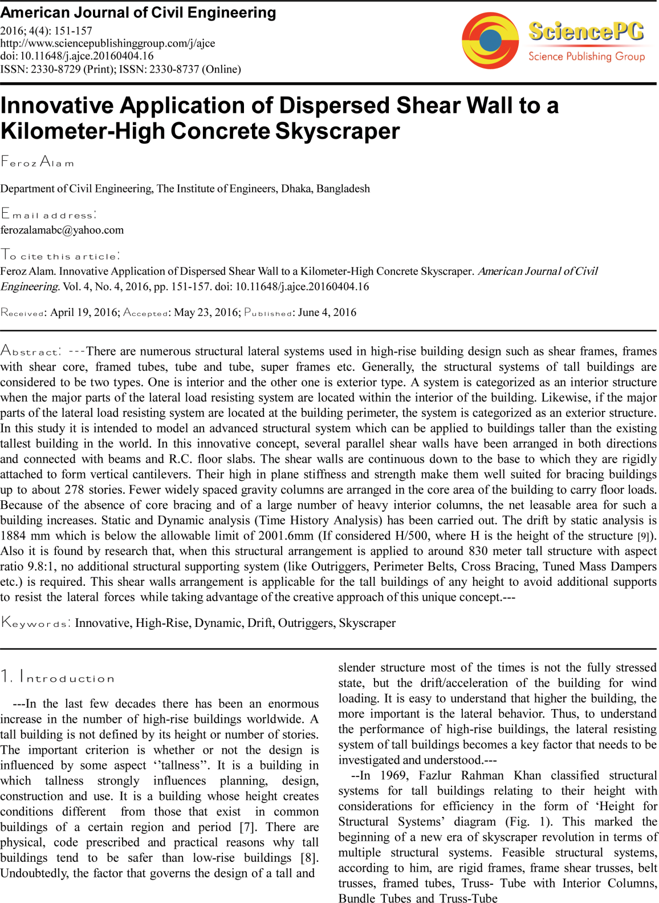

Slide 37
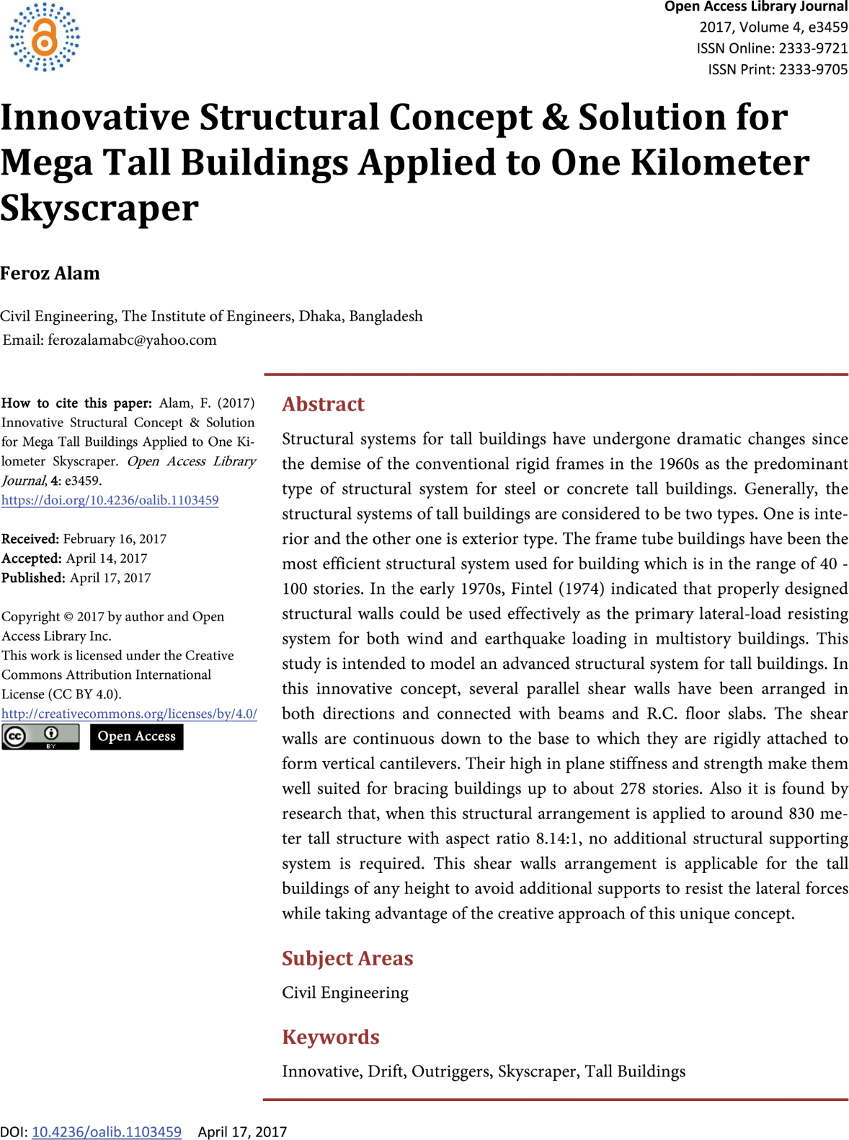

Slide 38
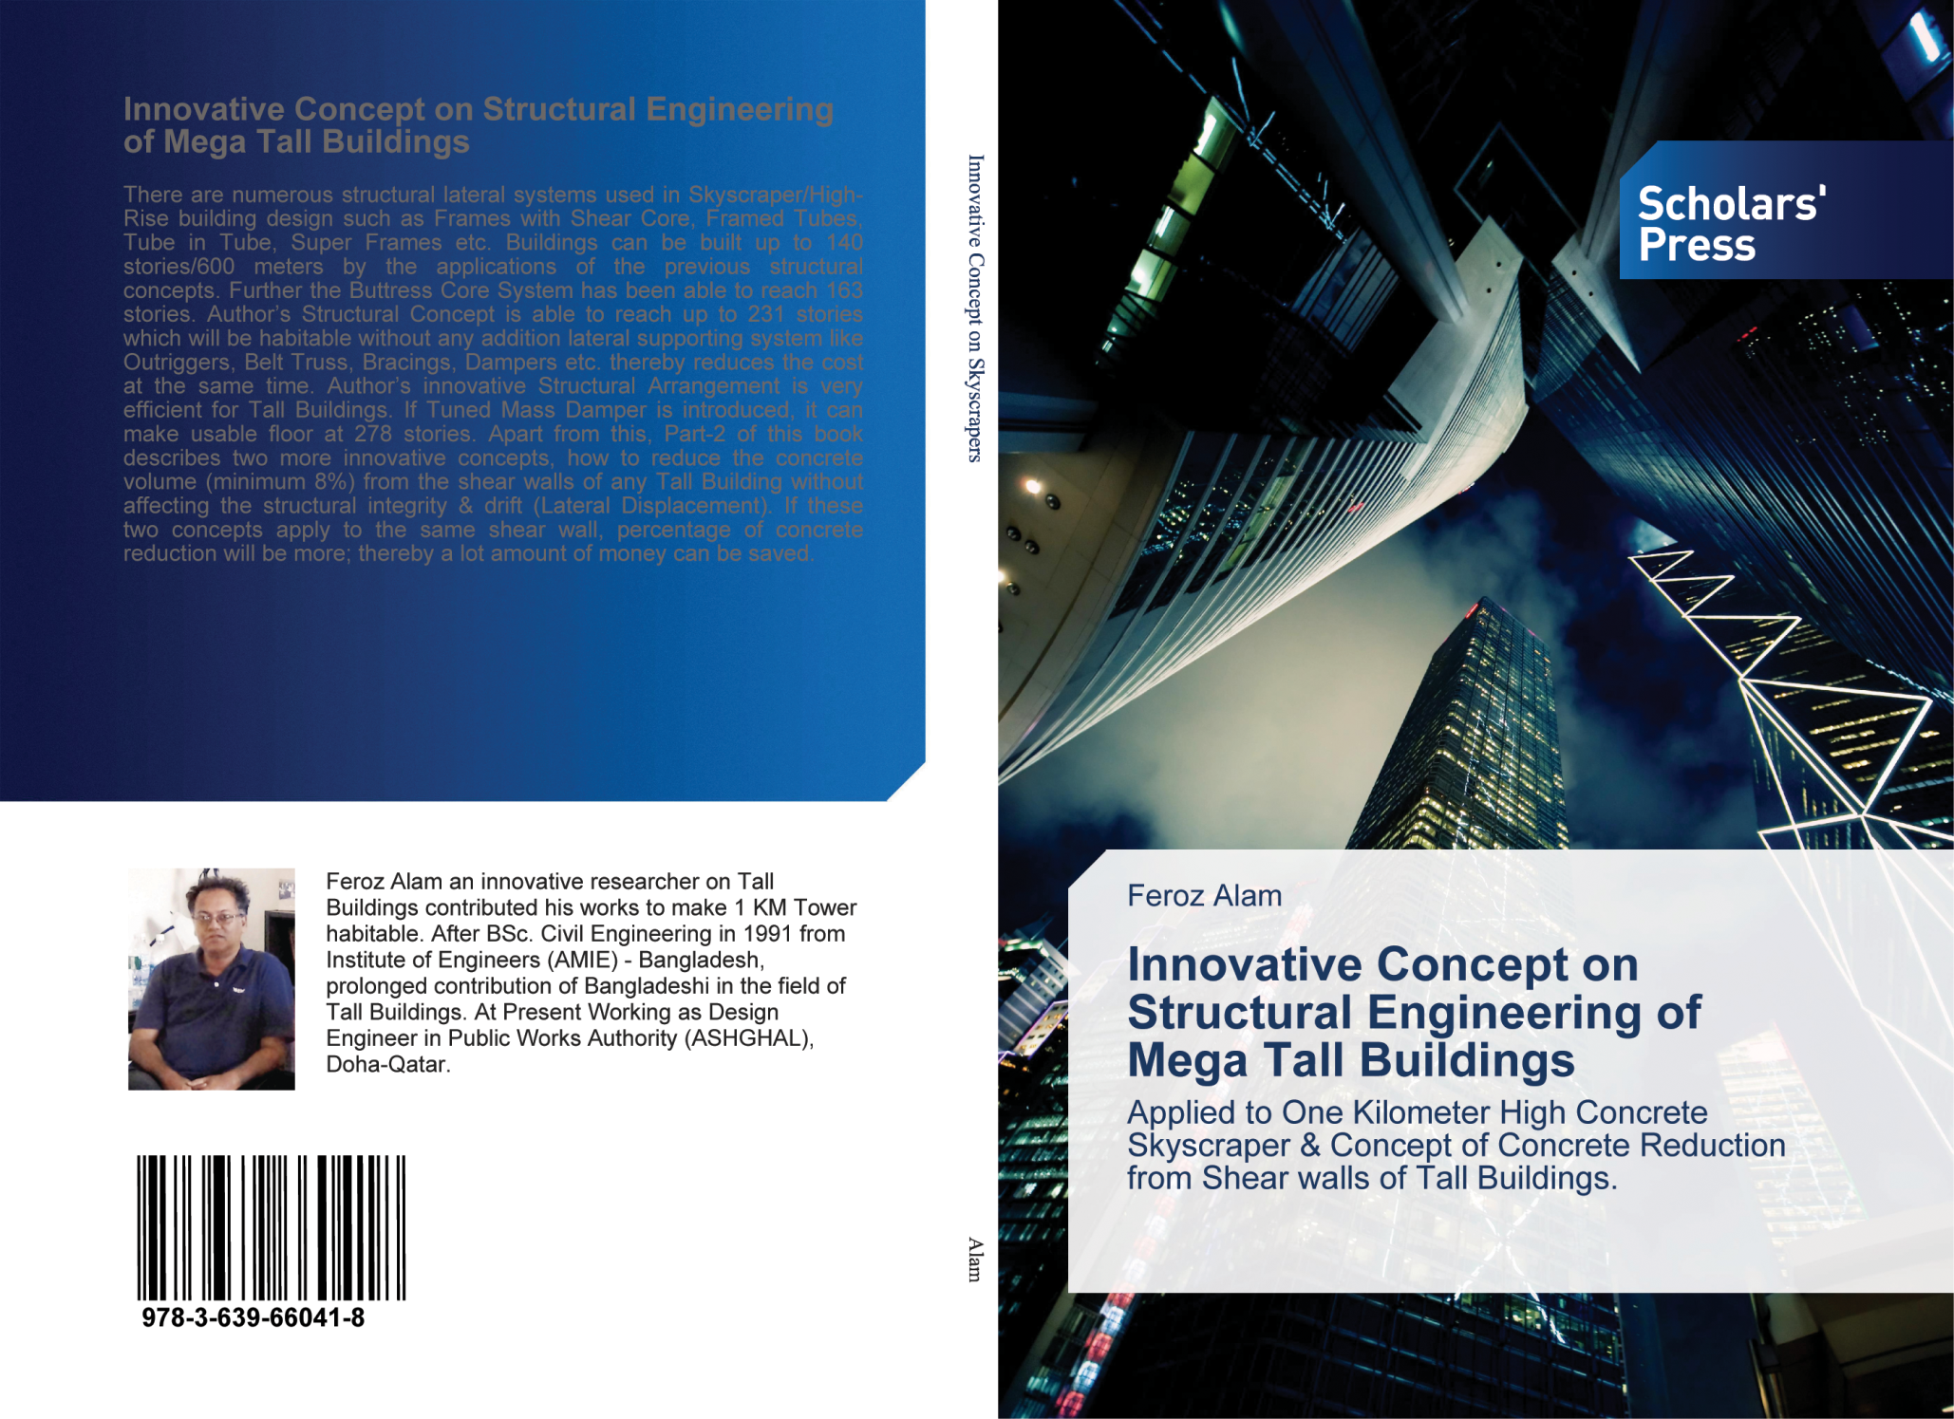

Slide 39


