Slide 1

The Impact of Air Pollution on Human Health
Fernando Holguin MD MPH
Associate Professor of medicine and Pediatrics
Director, Clinical and Translational Research Center , MUH
University of Pittsburgh Medical Center

Slide 2
Air pollution, a complex mixture of particles and gases
Criteria air pollutants
Ground-level ozone
Forms from the reaction of pollutants emitted by industrial facilities and motor vehicles
Particulate matter (PM)
Diverse chemical and physical substances that exist in discrete particles over a wide range of particles. Derived from anthropogenic sources (<2.5 microns); whereas PM10 mostly derive from dust dispersion
Lead
Used to be a major air pollution component until banned in gasoline; more of an industrial pollutant

Slide 3
Air pollution, a complex mixture of particles and gases
Criteria air pollutants
Sulfur – dioxide
Gas emitted primarily by fuel combustion from electrical utilities and industry
Carbon dioxide
Gasoline-fueled vehicles and on-road mobile sources
Nitrogen dioxide
Gas emitted by trucks, cars, buses, power plants, non-road engines and equipment
Source : Environmental Protection Agency

Slide 4
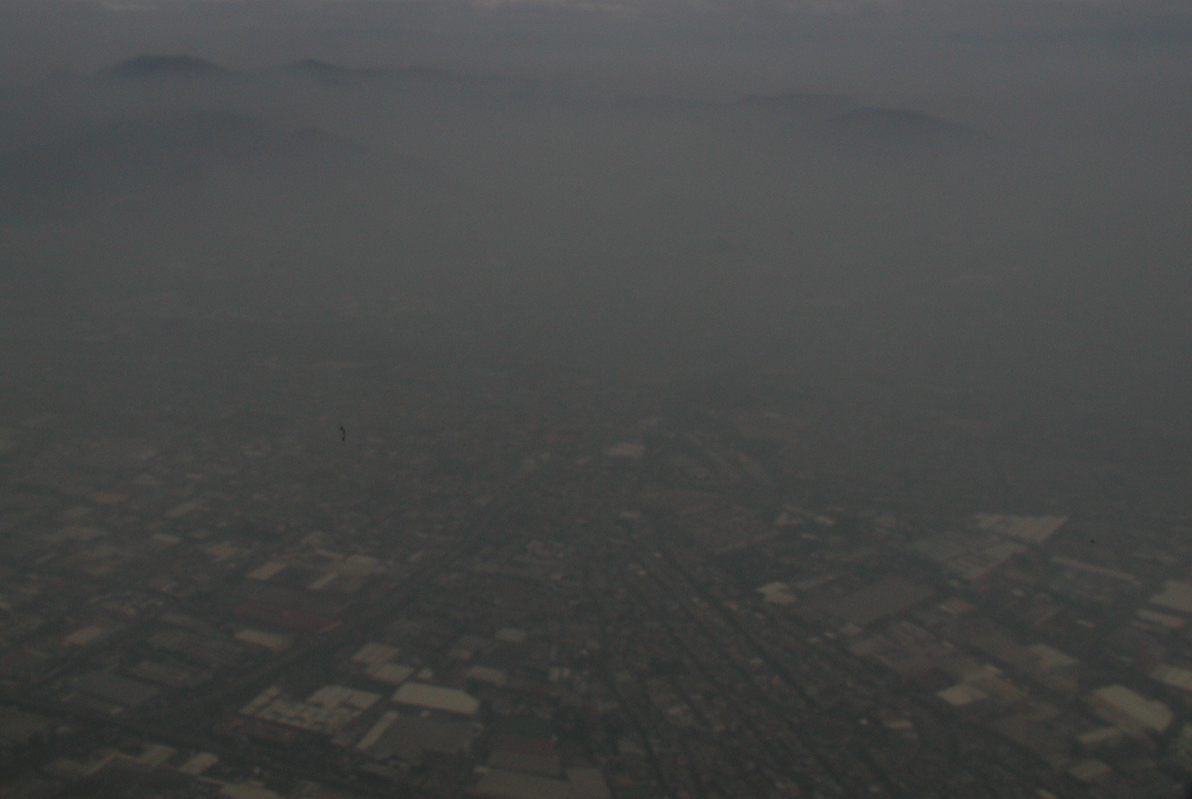
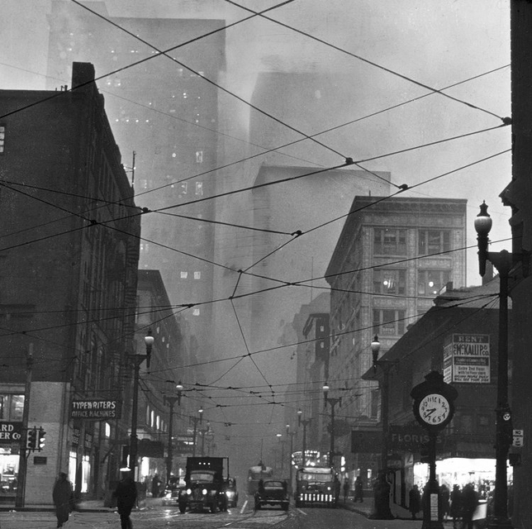
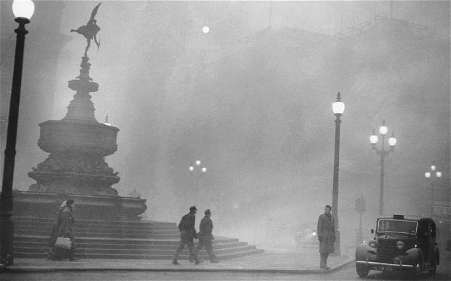

Slide 5
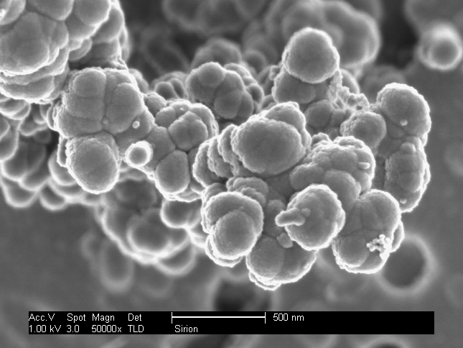
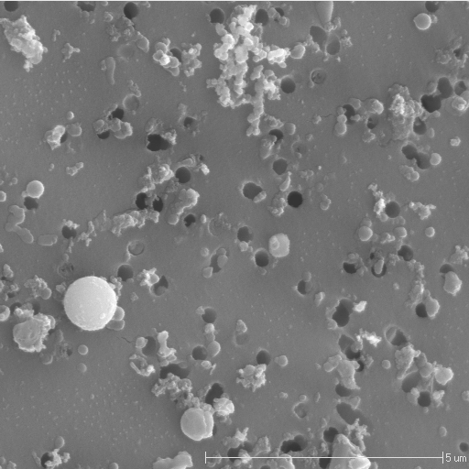
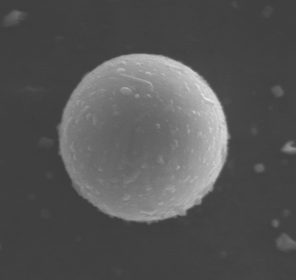
PM < 2.5 Ambient Sample – Field Image
Fossil Fuel Combustion
Mexico City sample from
The Desert Research Institute, Reno Nevada
Coal Combustion

Slide 6
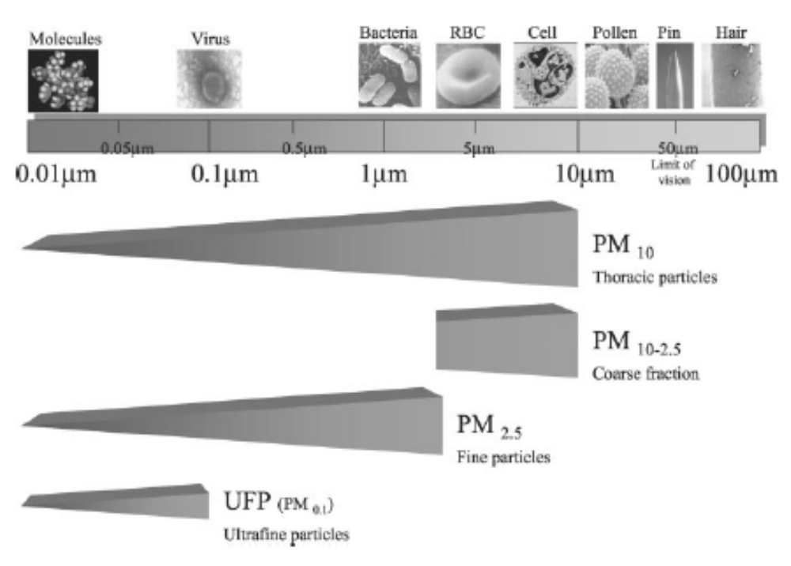

Slide 7
Air pollution levels and health risks
No discernible threshold; linear association
Combination of multiple exposures, multiple susceptibilities
RISK
National ambient standards, do not aim for a zero risk , rather an acceptable one
Air pollution concentration

Slide 8
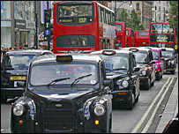
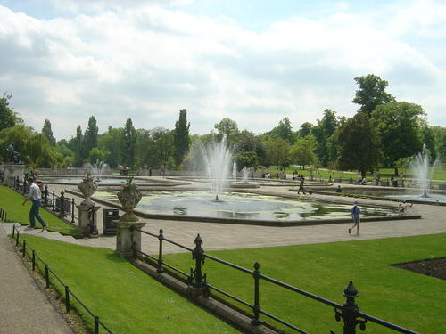
Relatively short-term exposures translate into adverse
Airway functional and inflammatory responses
Oxford Street Hyde Park
McCreanor et al NEJM 2007

Slide 9
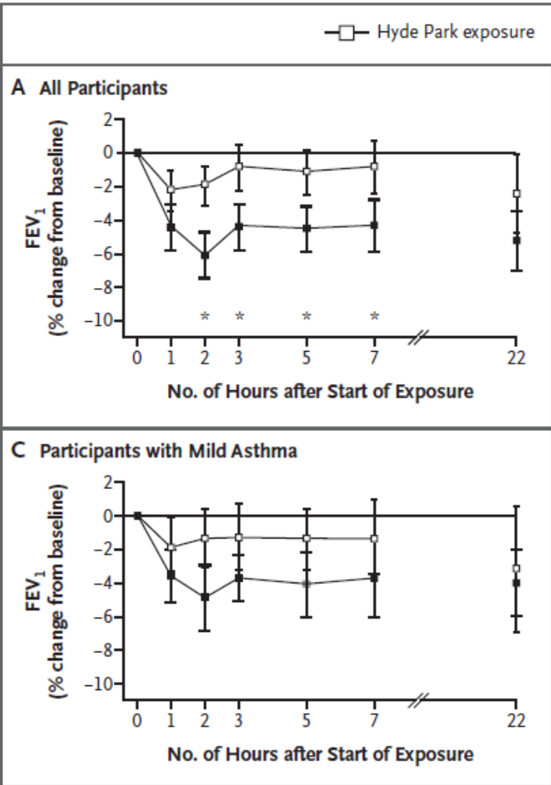
Short – term exposures to traffic-related emissions are associated with transient reductions in lung function

Slide 10
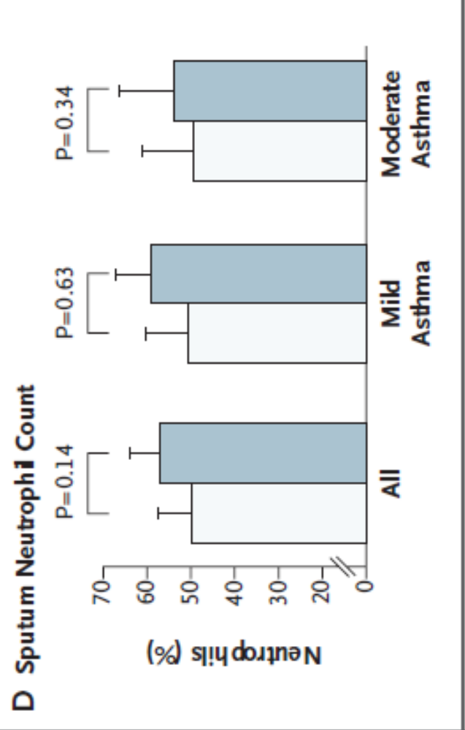
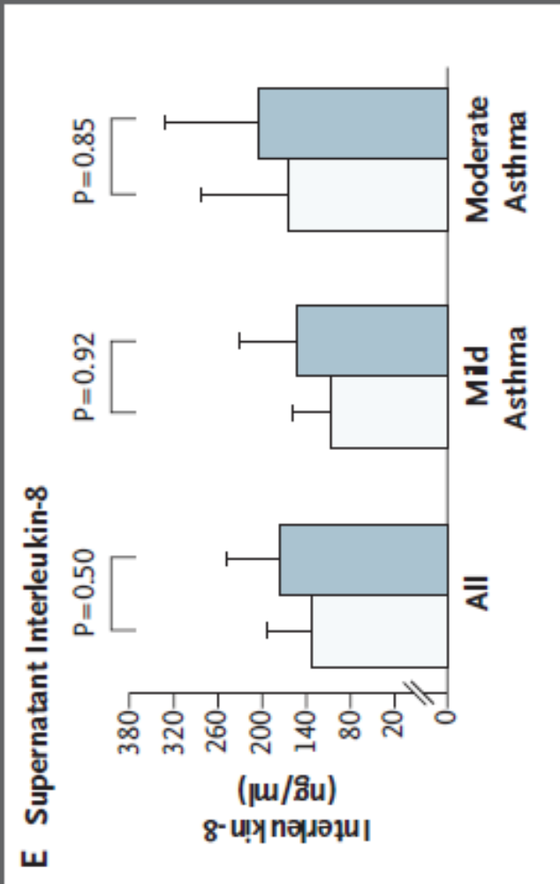
Short – term exposures to traffic-related emissions are associated with airway inflammation

Slide 11
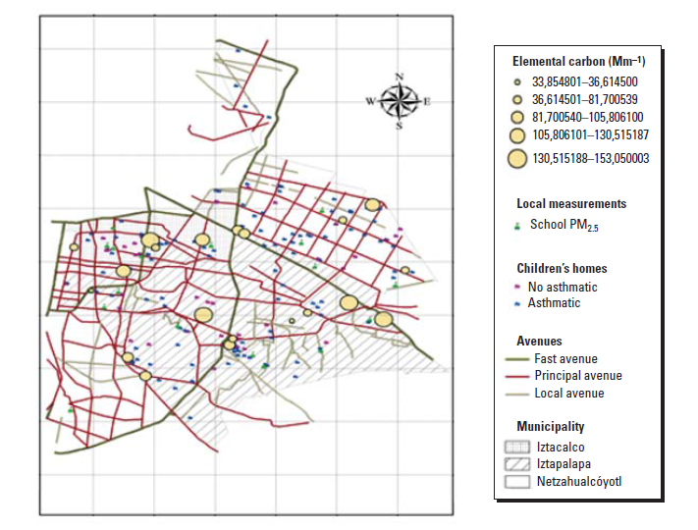
Barraza A, et al 2008; EHP

Slide 12
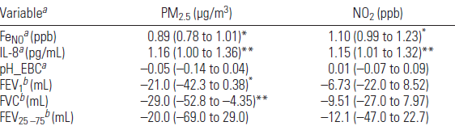
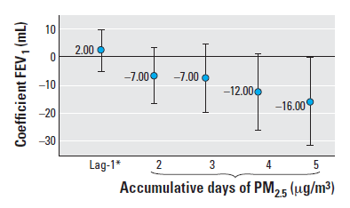
Lung function models were adjusted for sex, body mass index, previous day minimum temperature and chronological time. *p > 0.05, < 0.08. **p < 0.05 .

Slide 13
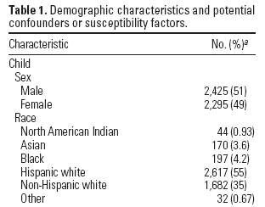
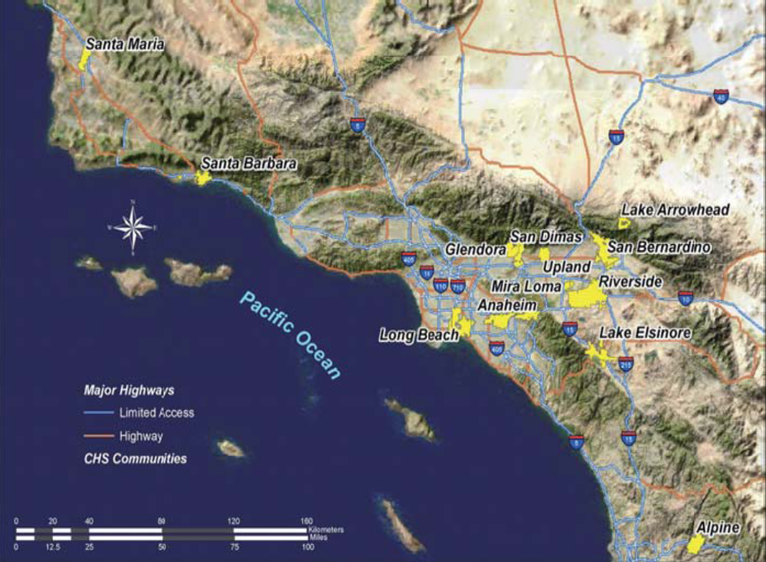
Traffic, Susceptibility, and Childhood Asthma
Environ Health Perspect 114:766–772 (2006).

Slide 14
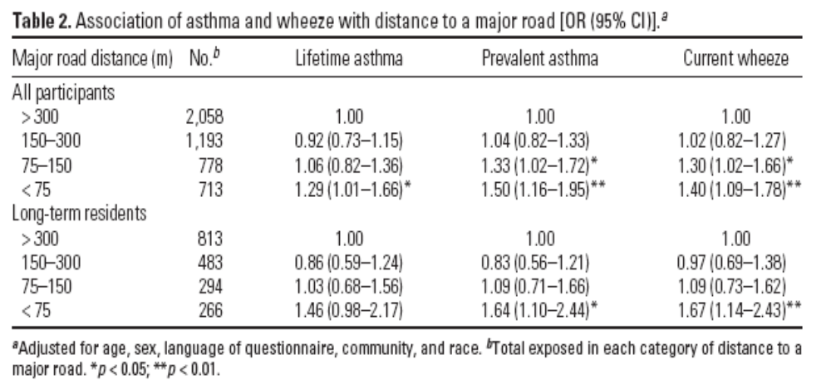
Asthma and wheezing in relation to road proximity

Slide 15
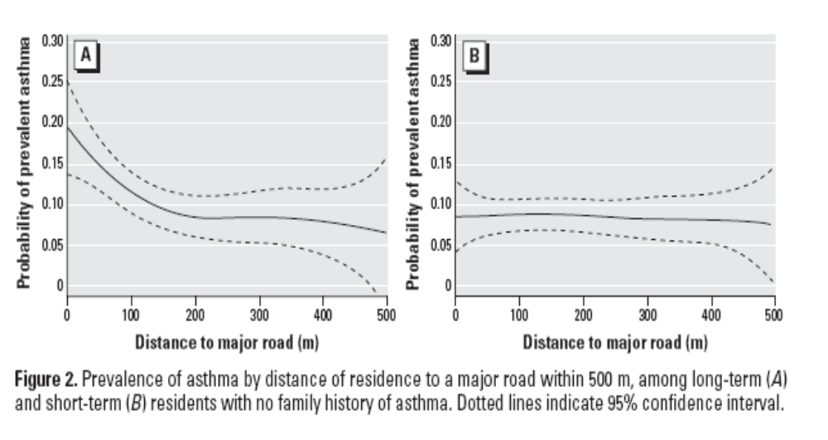
Probability of asthma prevalence and distance to roads

Slide 16
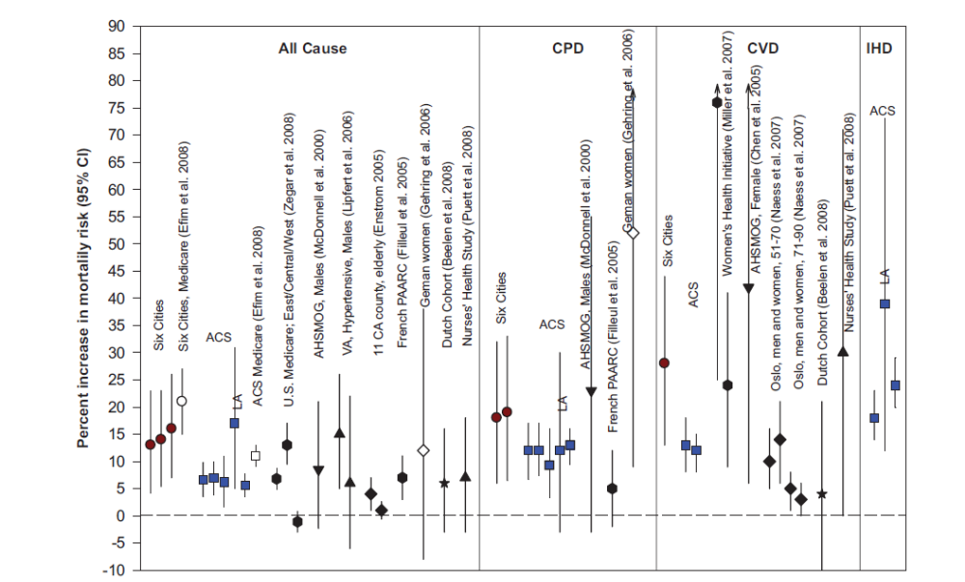
Particulate matter pollution, a risk for multiple chronic diseases
Brooks et al, Circulation AHA statement 2010

Slide 17
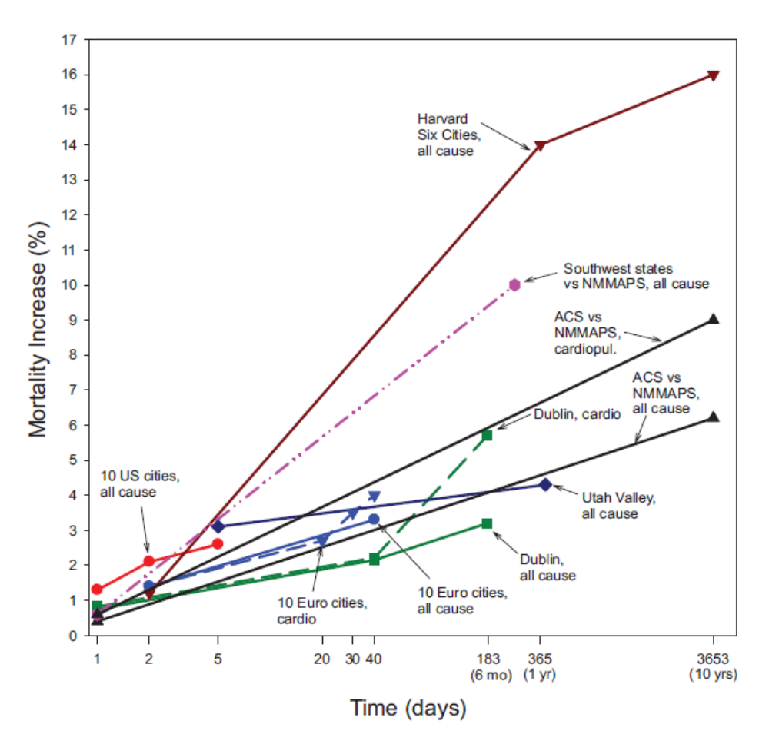
Mortality increase associated with a 10 µg/m³ in PM2.5 or 20 µg/m³ in PM10,
For different time scales
Brooks et al , Circulation 2010 AHA statement

Slide 18
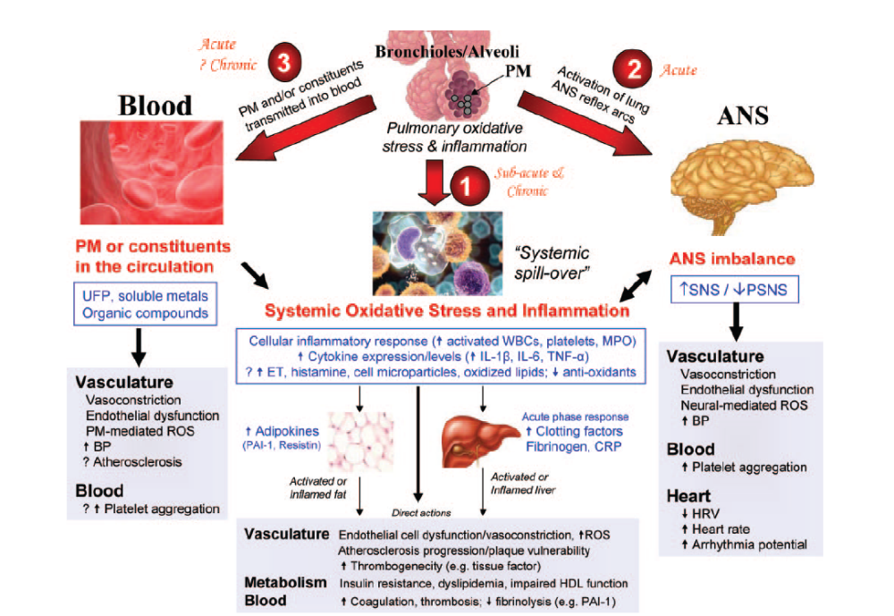

Slide 19
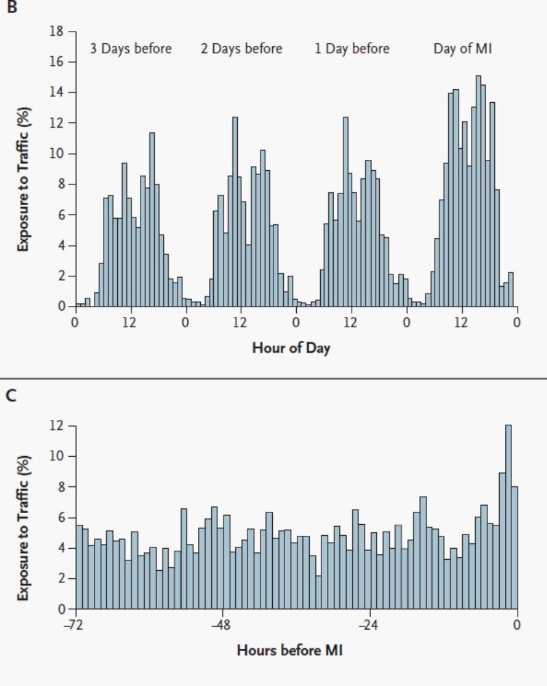
Recent traffic exposure to vehicular traffic is associated with increased ORs for acute myocardial infarction
691 AMI survivors from whom the onset of chest pain and traffic exposure could be quantified
Peters et al NEJM

Slide 20
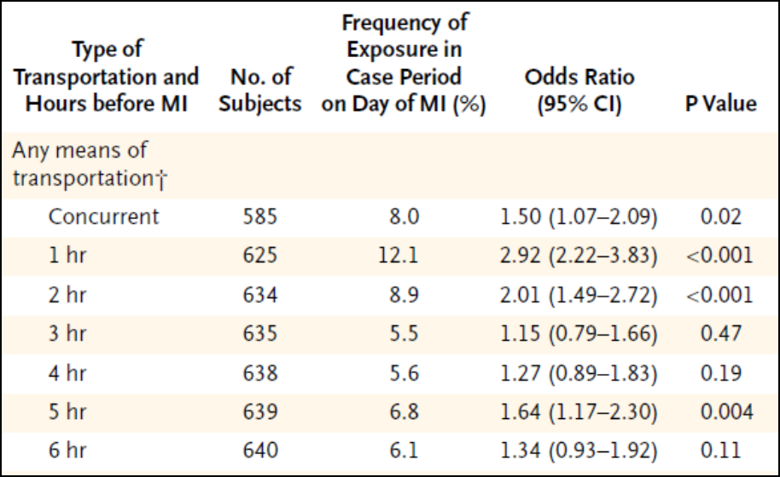
ORs for AMI (vulnerable period vs control periods), by time spent in traffic
Peters et al, NEJM

Slide 21
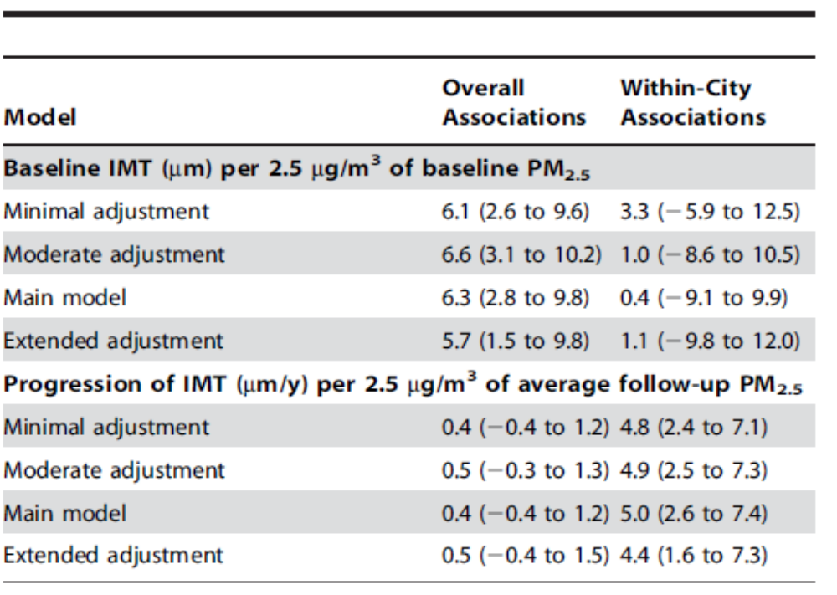
Air pollution (PM2.5) and chronic peripheral vascular disease
Adar S, PLoS One 2014

Slide 22
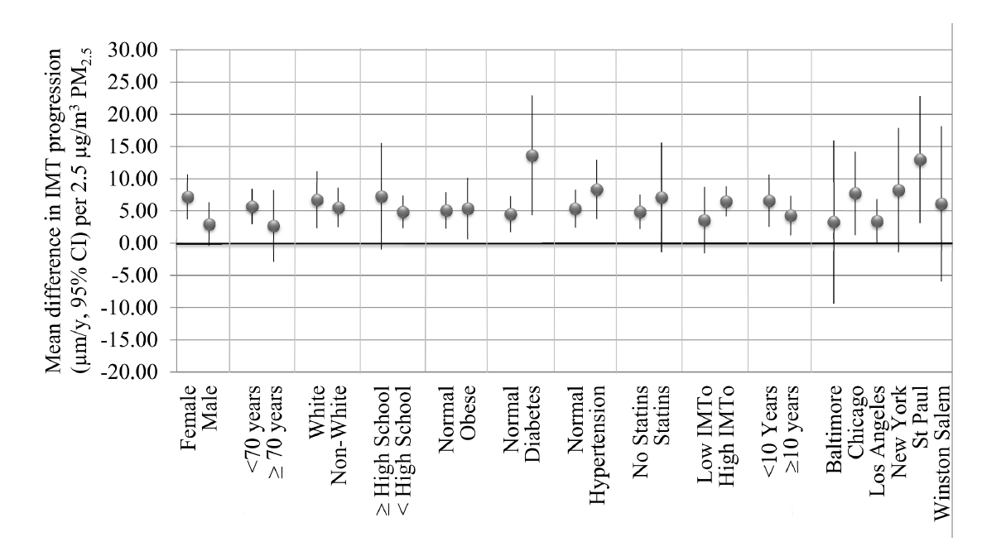
Fine particulate matter and chronic cardiovascular disease
Mean difference in IMT progression (mm/y, 95% CI) per 2.5 µg/m³ PM2.5 concentration averaged over follow-up in select stratified analyses controlled for metropolitan area.
Adar S, PLoS One 2014

Slide 23
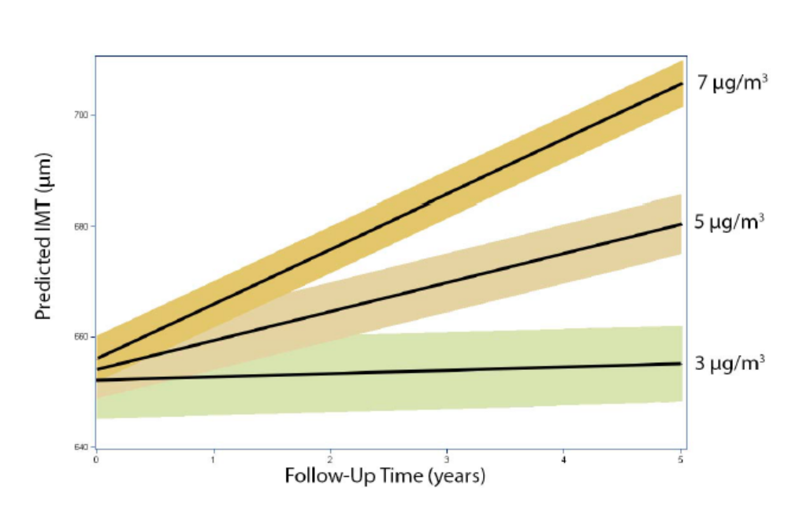
Estimated IMT (95% CIs) over time at varying levels of average residential PM2.5
concentrations exceeding the city average during the follow-up period
Results are reported for concentration increments above the city mean with confidence intervals around the mean

Slide 24


Slide 25
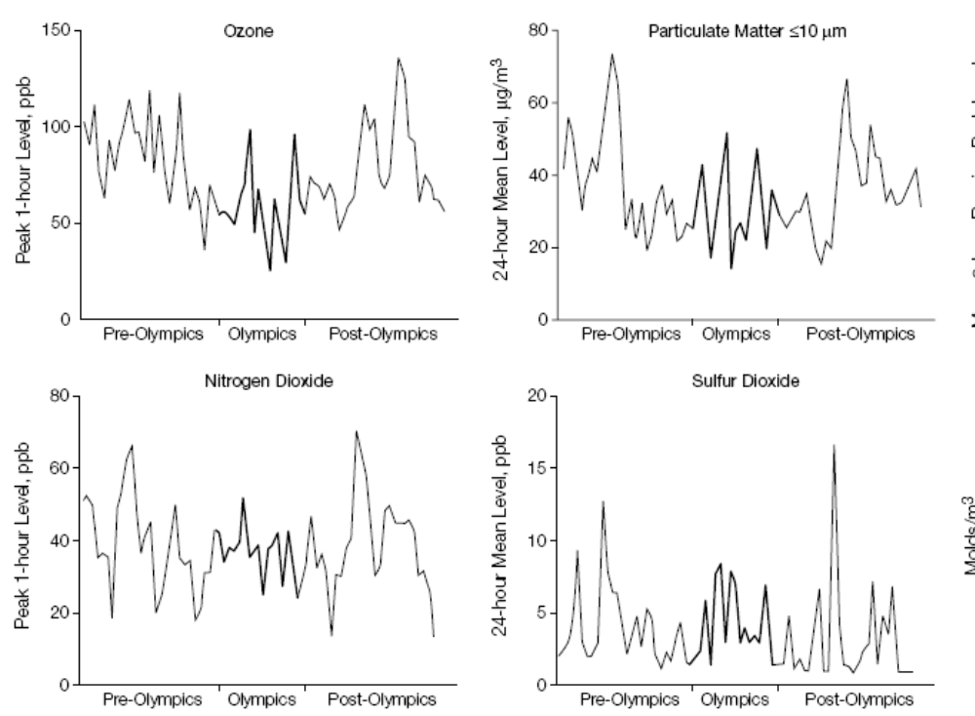
Freeman, M JAMA 2001

Slide 26
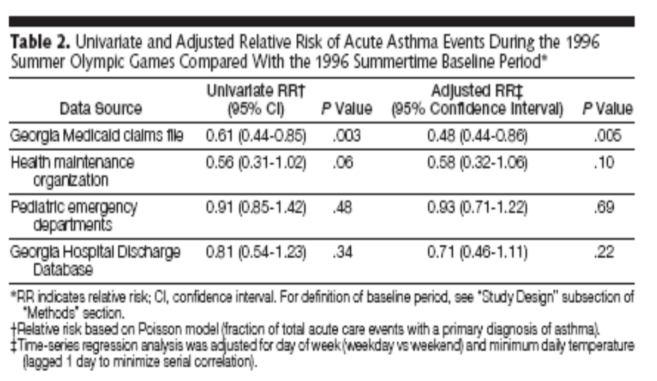
Less pollution, less asthma morbidity
Freeman, M. JAMA 2001

Slide 27
When it comes to air pollution and its impact on
human health
Not all air pollution exposures are the same
It matters who you are
Chronic and acute exposures lead to different outcomes; may involve different mechanistic pathways (Synergistic?)
No absolute safe level exists
Reducing emissions improves outcomes
Important questions remain; how and whom can we protect.

