Slide 1


Federal Government of Nigeria
Have policy responses resulted in improvements in infant and young child feeding practices in Nigeria?
Felix Ogbo MBBS, MHM, MPH (Hons)

Slide 2


Prologue
An emerging trend – adults now drink breastmilk ‘to’:
- boost energy/immune syst
- build muscles
- increase fitness
- prevent infection
Reports from China, USA, UK
A pint of breastmilk for USD 80
Source: Google image

Slide 3
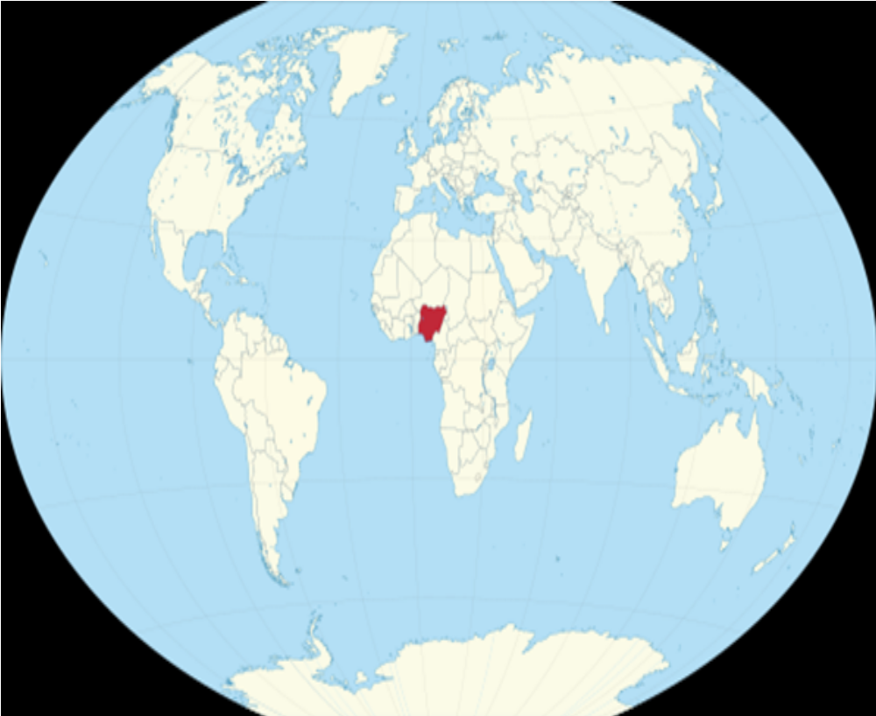
Introduction
Nigeria – Africa’s leading economy and population, including 40 million children
Also the largest recipient of developmental assistance for Health in Africa – IHME, 2015
Source: Google image

Slide 4
An estimated 2,300 children under-five years are lost daily in Nigeria – Unicef, Nigeria
Suboptimal feeding practices contribute largely to these deaths (through diarrhoea, URTI & malnutrition) –
Felix Ogbo et al., (2016). Paediatric & Perinatal Epidemiology, accepted **

Slide 5
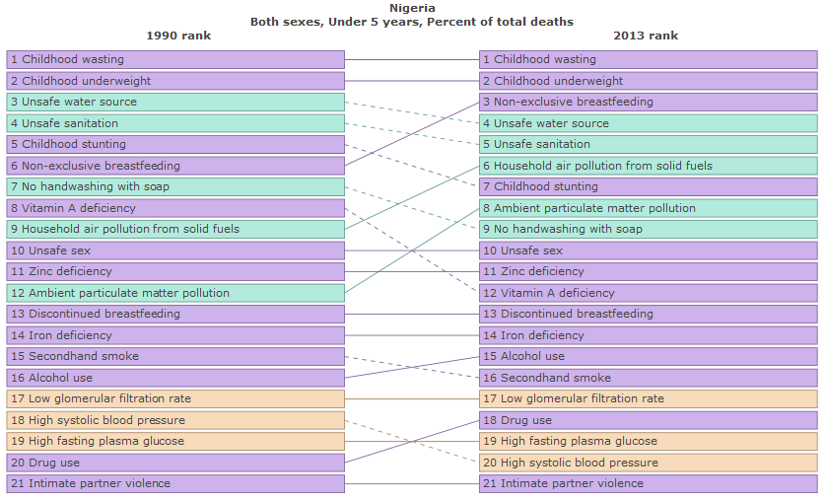
Source: IHME, 2015

Slide 6
Optimal breastfeeding & appropriate complementary feeding (IYCF) practices are important for the child, the mother & the household – WHO, 1991; 2008; Ladomenou et al., 2010

Slide 7
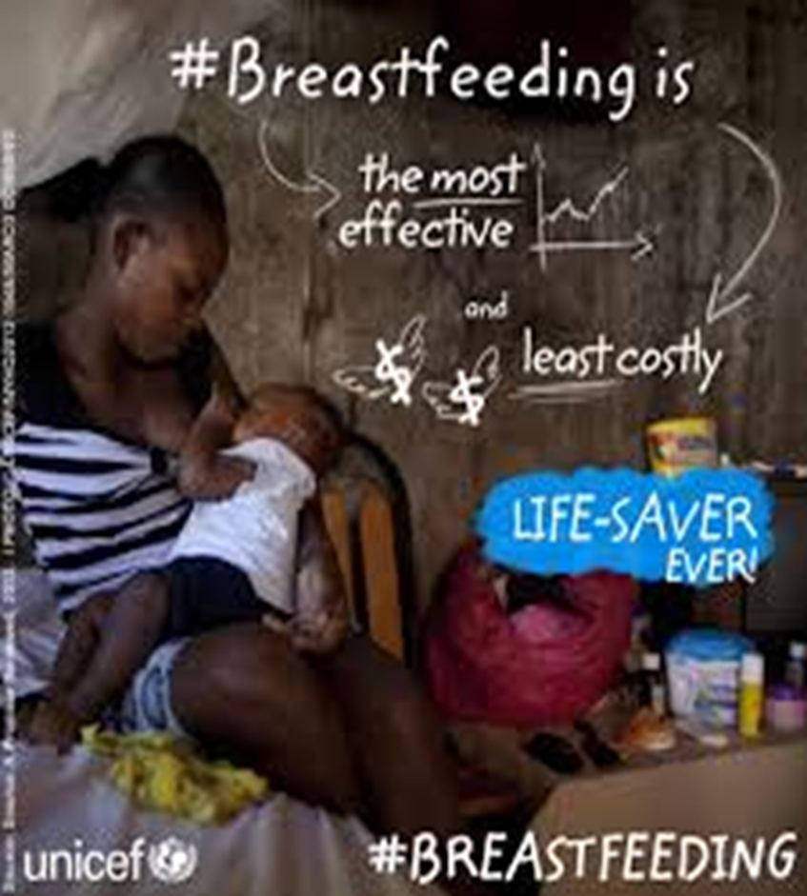
UNICEF states that
Source: Google image

Slide 8
Based on the benefits of optimal IYCF practices, WHO/UNICEF recommends (in 1991):
- Early initiation of breastfeeding (EIBF)
- Exclusive breastfeeding (EBF)
- Appropriate introduction of complementary foods
- Continued breastfeeding ≥2 years
WHO, 1991; 2008

Slide 9
Introduction cont’
Following these recommendations, Nigeria initiated:
- BFHI in 1992
- National Breastfeeding Policy in 1998
- National Policy on Food and Nutrition in 2001
- National Policy on IYCF in 2005
- Including various subnational MCH initiatives
Aim: protect, promote & support optimal IYCF
Ogunlesi, et al., 2004; FMOH, 2005

Slide 10
Compared to other developing countries (such as India and Indonesia), Nigeria has an established national legislative and health system framework to promote and support recommended IYCF practices. However, this is not reflected on current evidence from Nigeria
Felix Ogbo et al., (2015a). Public Health Nutrition, 18, 1-13

Slide 11
Country-specific evidence are needed to advocate for and guide more effective and sustainable health initiatives & policy responses; and also to monitor & evaluate the impact of current/previous initiatives in this domain

Slide 12
Aim
To present time-trends series of IYCF practices in Nigeria (using nationally representative data) for the period 1999-2013, spanning the development and implementation of a range of key national policy responses and initiatives

Slide 13
Method
Nigeria Demographic and Health Survey (NDHS) data from 1999-2013, which are nationally representative
Participants: Maternal responses of 88,152 children under-24 months
WHO definitions of IYCF indicators were used
NDHS, 2000; 2014; WHO, 2008

Slide 14
Outcomes
Early initiation of breastfeeding (EIBF)
Exclusive breastfeeding (EBF)
Predominant breastfeeding (PBF)
Bottle feeding
Introduction of solid, semi-solid & soft foods
Minimum dietary diversity
Minimum meal frequency
Minimum acceptable diet

Slide 15
Statistical analysis
Prevalence estimates, and corresponding CIs were calculated
Stata version 13·0 with prevalences calculated using the ‘svy’ function to allow for cluster sampling employed in the NDHS

Slide 16
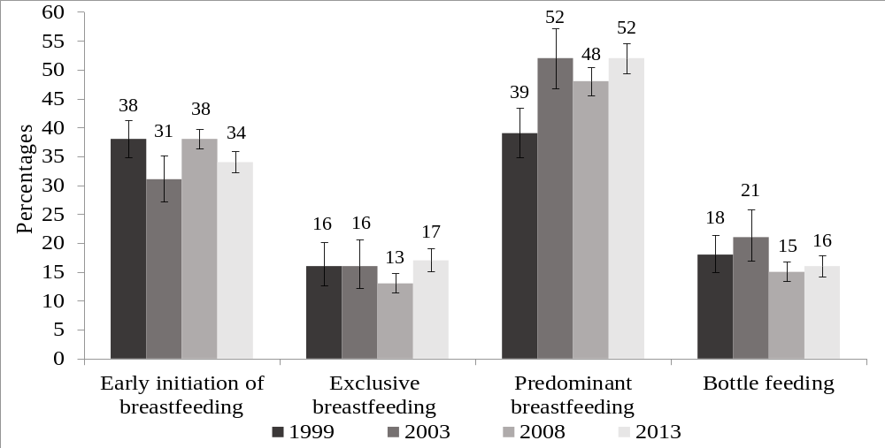
Results – Breastfeeding practices
Felix Ogbo et al., (2015a) Public Health Nutrition, 18, 1-13

Slide 17
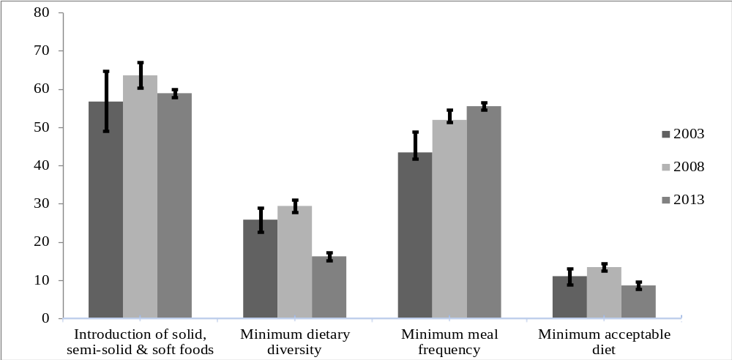
Complementary feeding practices
Felix Ogbo et al., (2015b) BMJ Open, 5, (10), e008467

Slide 18
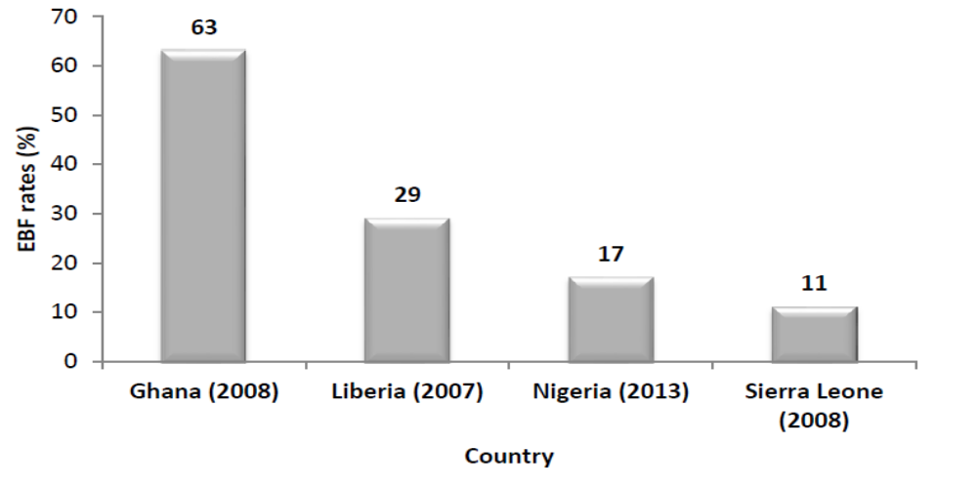
Issaka AI., (2015). PhD thesis submitted to the Western Sydney University

Slide 19
Policy implications
In Nigeria, both key breastfeeding and complementary feeding practices were very low and remain one of the lowest compared to other sub-Saharan African countries
Ogbo et al., 2015a; 2015b

Slide 20
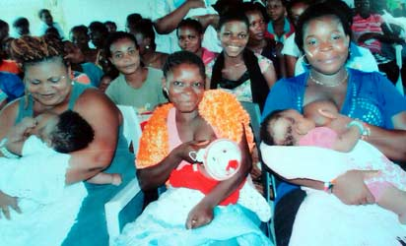
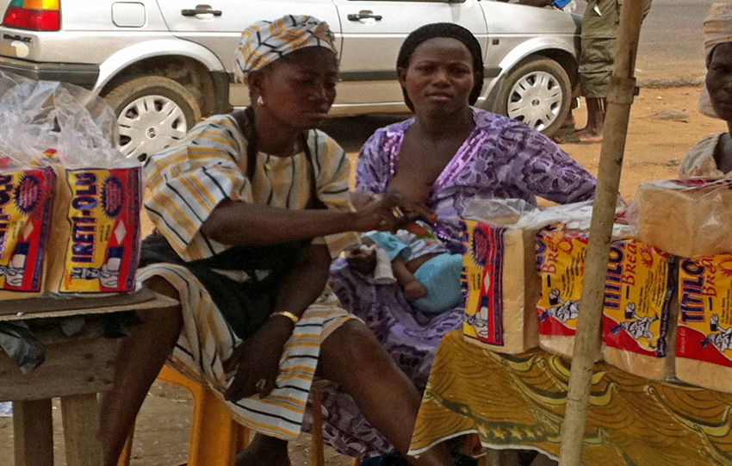
What else do we know about IYCF in Nigeria?
Nigerian mothers have a great attitude towards IYCF practices, similar to Ghana
Most mothers are willing to breastfeed their babies anywhere (comfortable), regardless of who is present
Source: Google image

Slide 21
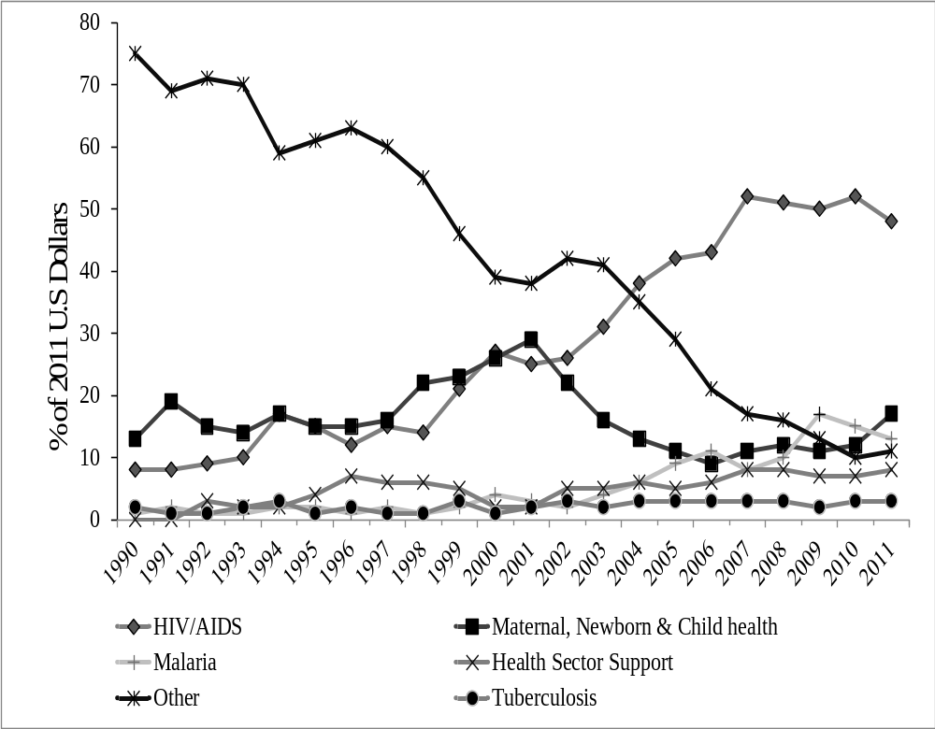
Change in the proportion of health focus areas of development assistance for health in Sub-Saharan Africa, 1990-2011
A shift from maternal, newborn and child health interventions to HIV initiatives
IHME DAH Database, 2013

Slide 22
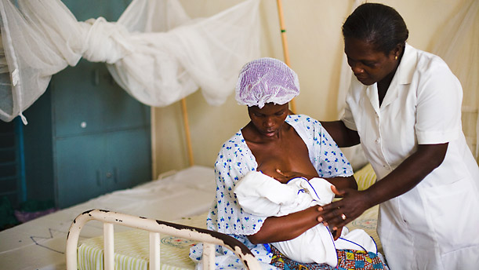
Going forward
Facility-based initiatives (e.g. strengthening BFHI)
Source: Google image

Slide 23
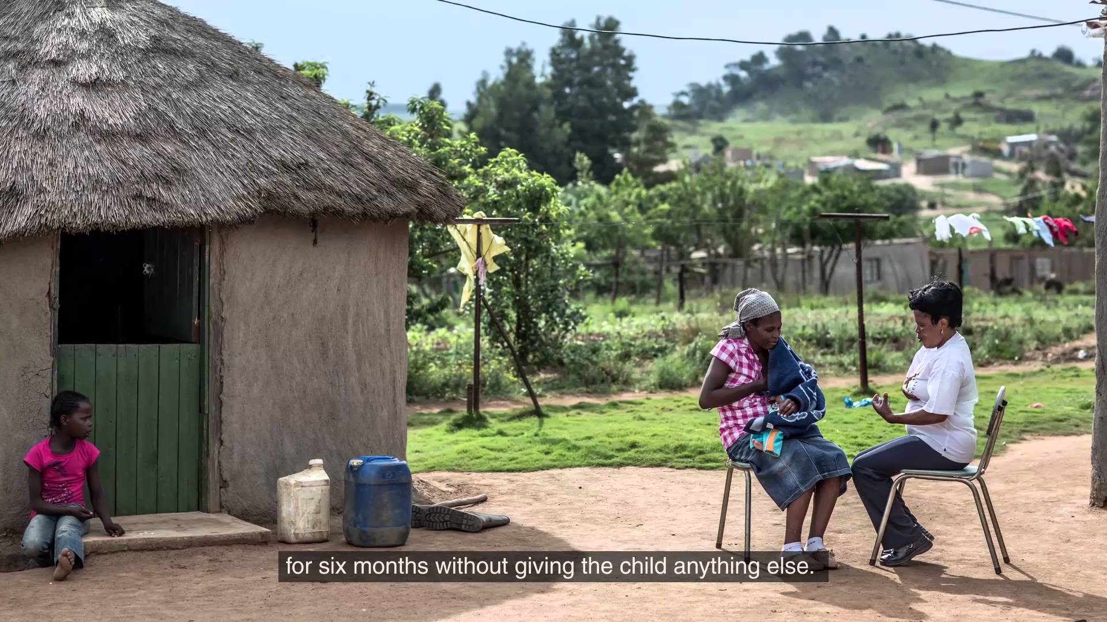
BFCI : Large scale community-based initiatives that target mothers, husbands and grandparents (if available)
Source: Google image

Slide 24

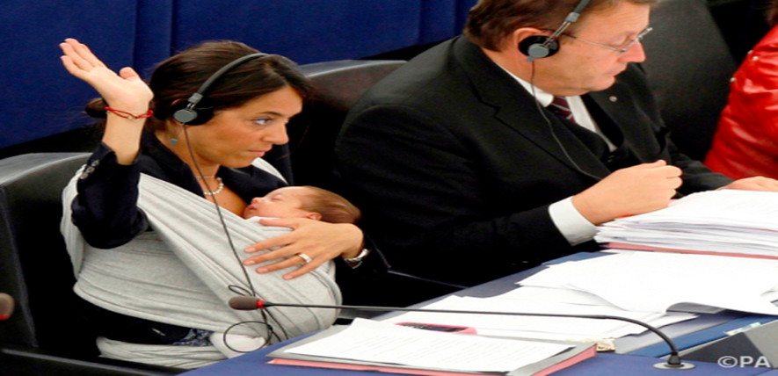
Political resolve on workplace BF policy
Nigerian legislators rejected a bill on breastfeeding rights at work – Nigerian Watch, 2013
Maternity leave extension
Source: Google image

Slide 25
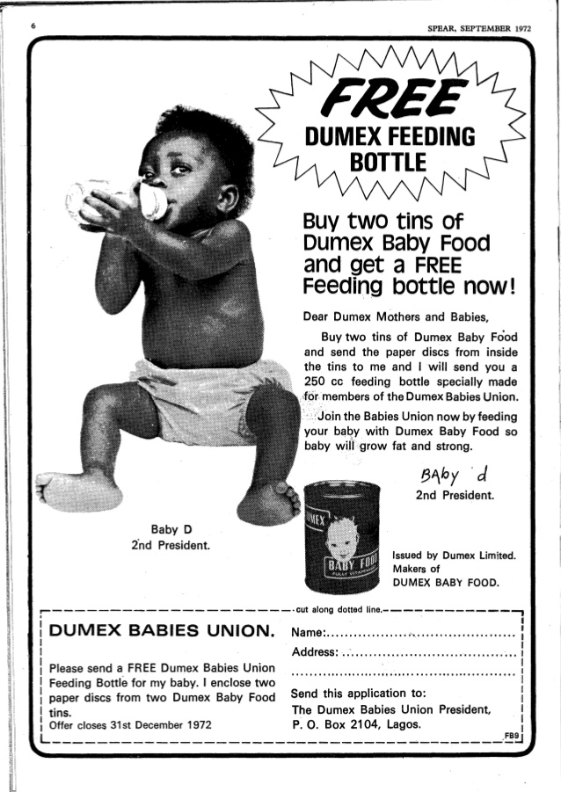
Strengthening the 1981 International Code of Marketing of Breastmilk Substitutes
Source: Google image

Slide 26
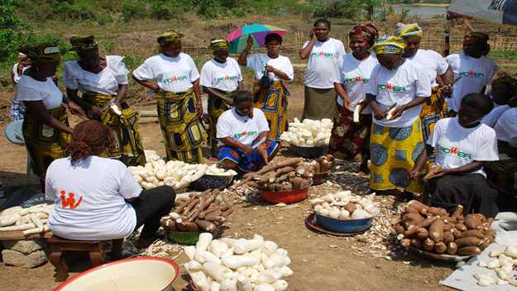

SDGs
Goal 2: End hunger & improved nutrition
Goal 5: Empower all women and girls
Source: Google image

Slide 27


An emerging trend… ‘Public breastfeeding’ – UK
Source: Daily mail; Google image;

Slide 28

Mass breastfeeding protest in Australia sparked after mother is asked to leave food court – ABC News, Feb 2016

Slide 29

Internet backlash as a graduate breastfeed in the USA
Source: Google image

Slide 30

“He who comes into equity must come with clean hands”
Source: Google image

Slide 31

Source: Google images

Slide 32


In the future perhaps – from China…
Source: Google image

Slide 33
Limitation & strengths
Limitations
- Recall bias
- National level – regional specifics needed
Strengths
- Selection bias unlikely
- National representativeness
- Used data – important source for IYCF

Slide 34
Conclusion
Despite various policy responses and implementation of initiatives in Nigeria, infant and young child feeding practices remain below expected levels
A multi-prong approach is needed to improve IYCF practices in Nigeria

Slide 35
Acknowledgement
Co-authors:
- Prof Andrew Page (WSU)
- Dr Kingsley E. Agho (WSU)
- Prof John Idoko (FGN)
- Dr Fernanda Claudio (UQ)
Measured DHS / ICF International, USA

Slide 36

THANK YOU !

Slide 37
References
1. Ladomenou, F., Moschandreas, J., Kafatos, A., Tselentis, Y. Galanakis, E.,. (2010). Protective effect of exclusive breastfeeding against infections during infancy: a prospective study. Arch Dis Child, 95(12), 1004-1008.
2. National Population Commission Federal Republic of Nigeria and ICF International. (2014). Nigeria Demographic and Health Survey 2013. Rockville, Maryland: National Population Commission Federal Republic of Nigeria and ICF International.
3. National Population Commission (NPC) [Nigeria], & ICF Macro. (2000). Nigeria Demographic and Health Survey 1999. Calverton, Maryland, USA: National Population Commission and ICF Macro.
4. Ogbo, F. A., Page, Andrew, Agho, Kingsley E., Claudio, Fernanda. (2015). Determinants of trends in breast-feeding indicators in Nigeria, 1999–2013. Public health nutrition, 18, 1-13.
5. Ogbo, F. A., Page Andrew, Idoko John, Claudio Fernanda, & Agho, K. E. (2015). Trends in complementary feeding indicators in Nigeria, 2003–2013. BMJ open, 5(10), e008467.
6. World Health Organization. (2008). Indicators for assessing infant and young child feeding practices. Geneva: World Health Organization.
7. World Health Organization. (1991). Indicators for Accessing Breastfeeding Practices. Retrieved from Geneva:

