Slide 1

Experimental Study and Scale Up of Adsorption Column for Reclaiming Lean Methyldiethanolamine Solvent from Natural Gas Sweetening Unit
Fawzi Banat, Priyabrata Pal, Anjali A. Edathil Department of Chemical Engineering
Khalifa University of Science and Technology
Petroleum Institute, Abu Dhabi, U.A.E.

Slide 2

Outline of Discussion
Background
Objectives
Laboratory Experimental Studies
Scale Up of Adsorption Column
Conclusion
Acknowledgement

Slide 3
MDEA Amine Chemistry (Simplified)
H₂S + Amine AmH ⁺ + HS ⁻
CO₂ + H₂O + Amine AmH ⁺ + HCO₃⁻

Slide 4
MDEA Amine Chemistry (Simplified)
Formate
Acetate
Glycolate
Thermal
Degradation
Organic
Degraded
Products
Amine
+
A⁻

Slide 5
MDEA Amine Chemistry (Simplified)
HSS
AmH⁺ + A⁻ AmH⁺A⁻
Excessive Foaming
Corrosion & Fouling
Reduction in absorption capacity
Loss of amine solution
Accumulation of
HSS

Slide 6
MDEA Amine Chemistry (Simplified)
Amine + Acid Salt
Salt + Heat Amine + Acid Gas
Note: Heat is generated by the reaction of the acid gas with the amine. Conversely, heat is required to free the acid gas from solution.

Slide 7
Absorption / Stripping
Technical Diagram
Clean gas
CO2 + H2S
Natural
gas
ABS
40°C
High P
STRP
120°C
HX
Low P
ENERGY
Recirculating (amine) solvent

Slide 8
Reclamation of Lean Amine
Distillation
Electro-dialysis
Ion-Exchange
Neutralization
Nano-filtration
Adsorption
P
R
O
C
E
S
S
E
S
High Treatment Efficiency
Easiness in design & operation
  Low installation cost
  Easy recovery and reusability
  Environmentally friendly

Slide 9
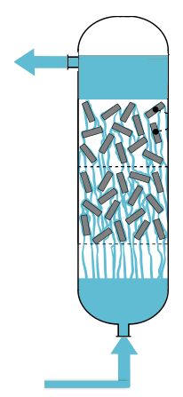
Bio-Polymer based Adsorptive Reclamation
Activated Carbon is replaced by
Porosity
Surface area
Low sorption capacity
Low selectivity
Contaminant free Lean Amine
Activated Carbon is replaced by
Bio-polymer based hydrogels
High adsorption capacity
Biodegradability
Contaminated
Lean Amine
Environmentally friendly
Low Carbon footprint

Slide 10

Alginate-Clay Composite Hydrogel as Adsorbent
Naturally abundant bio-polymer:
Source: Brown seaweed
It is cheap, readily available, and environment friendly.
Alginate
Ability to form hydrogels by crosslinking with metal ions such as Ca²⁺ ions.
It has high surface area and strong adsorption capability.
As filler decreases swelling of native hydrogels & increase mechanical strength. Clay used: Bentonite, Sepiolite etc.
Clay as reinforcing agent:
Alginate/Clay composites
High adsorbent density
Exceptional mechanical properties
Enhanced adsorption capacity
Biocompatibility

Slide 11
Objectives
1
Prepare Calcium Alginate clay Hybrid composites (CAH)
2
Analysis of Total Organic Acid anions and Metal Ions as contaminants
3
Laboratory scale adsorption experiments using CAH in continuous fixed bed column using different diameter and height
4
Investigate the regeneration efficiency of CAH in column including foaming test
5
Scale up Studies
6
Results of Designed Column

Slide 12
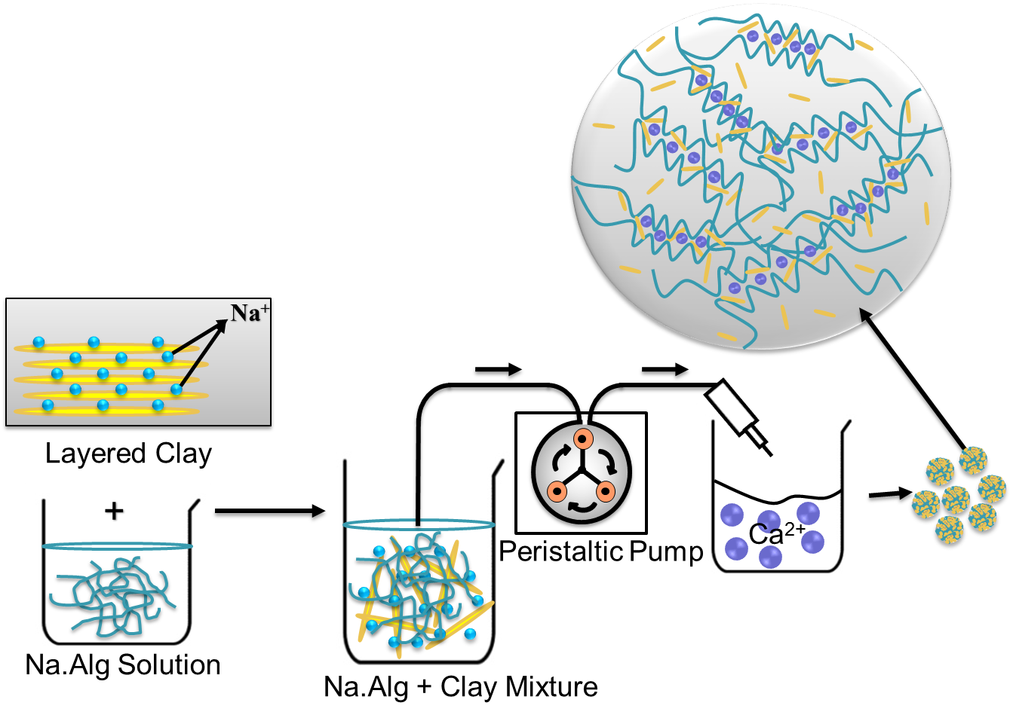
1. Preparation of alginate-clay composites
Calcium Alginate/
clay Hybrid (CAH) composites

Slide 13
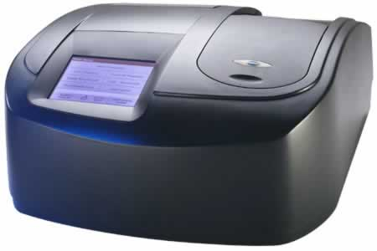
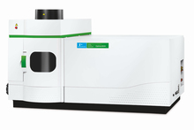
2. Analysis of contaminants in Industrial Lean Amine
UV-VIS Spectrophotometer
ICP-OES
ICP-OES (Optima
8000; Perkin Elmer)
UV-VIS Spectrophotometer
(DR 5000; Hach Lange)
Total organic acid anions:
  5685 ppm
Major Metal ions:
  Iron: 1.114 ppm
  Chromium: 0.615 ppm
  Cadmium: 0.121 ppm etc.

Slide 14
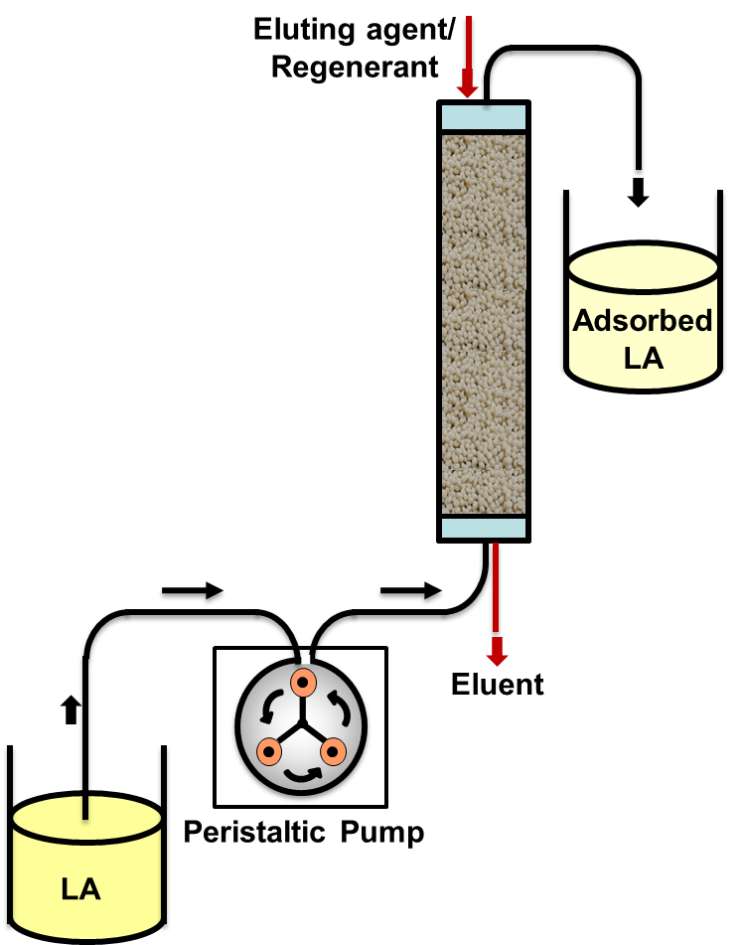
3. Fixed Bed Adsorption
Column studies:
Known amount of hybrid composites packed in a pyrex column.
Lean Amine (LA) solutions fed to the bottom of the column with the help of a peristaltic pump.
From the top of the column, samples were withdrawn periodically.
Analyzed for Total Organic Acid (TOA) anions and metal ion present on it with time.

Slide 15
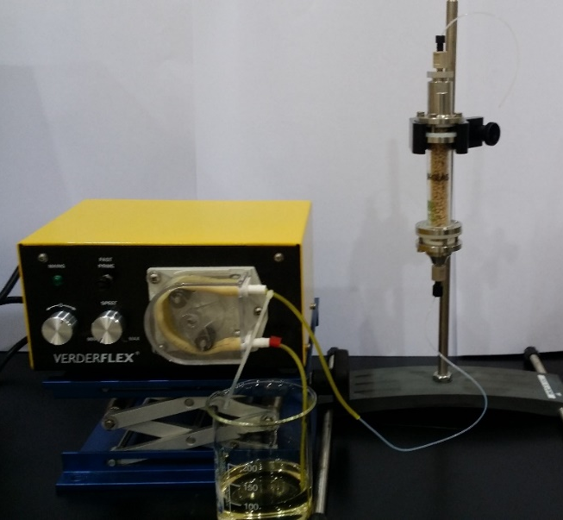
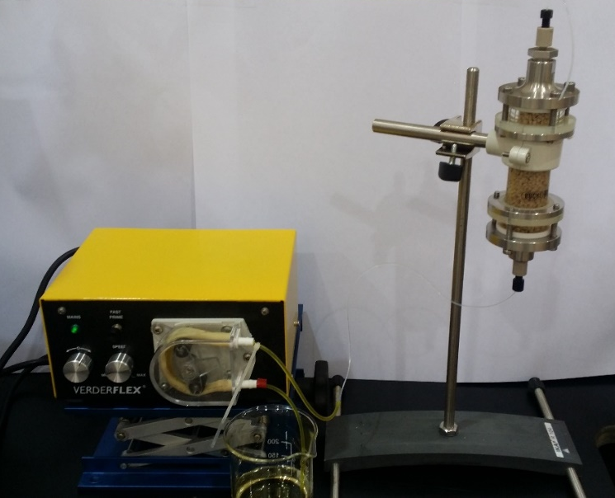
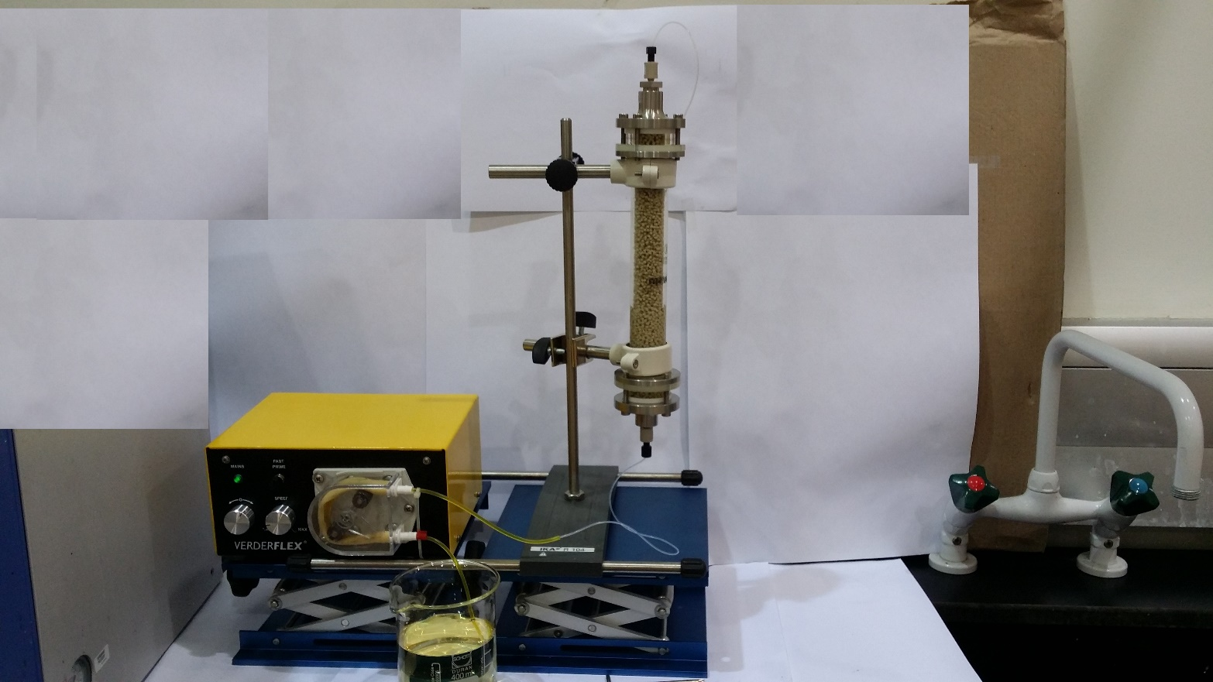
Various Parameters Studied
Effect of bed diameter on Breakthrough
Effect of bed height on Breakthrough
Regeneration using continuous adsorption/desorption cycles
(A)
Bed Diameter = 1.5 cm
Bed Height = 10 cm
(B)
Bed Diameter = 2.6 cm
Bed Height = 10 cm
(C)
Bed Diameter = 2.6 cm
Bed Height = 23 cm
Flow rate used: 0.75mL/min

Slide 16
Breakthrough Studies
Effect of bed diameter
Effect of bed height
As bed diameter increased (bed height 10 cm), breakthrough time was increased using Bentonite (CAB) as filler. With increasing diameter, residence time of lean amine increased from 23.5 min to 70.9 min to have higher breakthrough.
As bed height increased (bed diameter 2.6 cm), a larger capacity of the bed (using CAB) having residence time of 238.77 min, reached the breakthrough at 180 min.

Slide 17
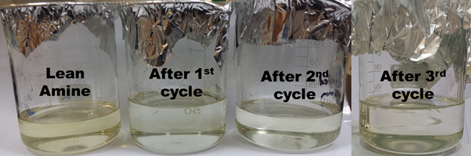
4. Regeneration studies
Effect of continuous adsorption-desorption cycles
CAB as adsorbent
Bed Diameter= 2.6 cm
Bed Height= 23 cm
Removal efficiency of total organic acid anions was reduced less than 4% after third adsorption-desorption cycles using 4% CaCl₂ as regenerant.

Slide 18
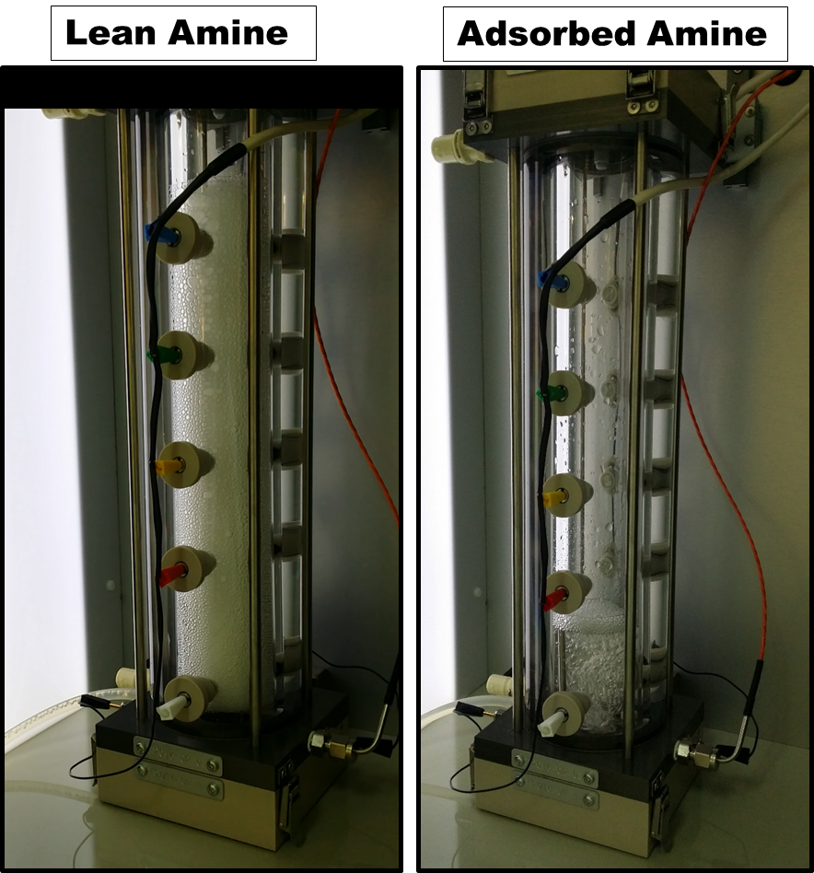
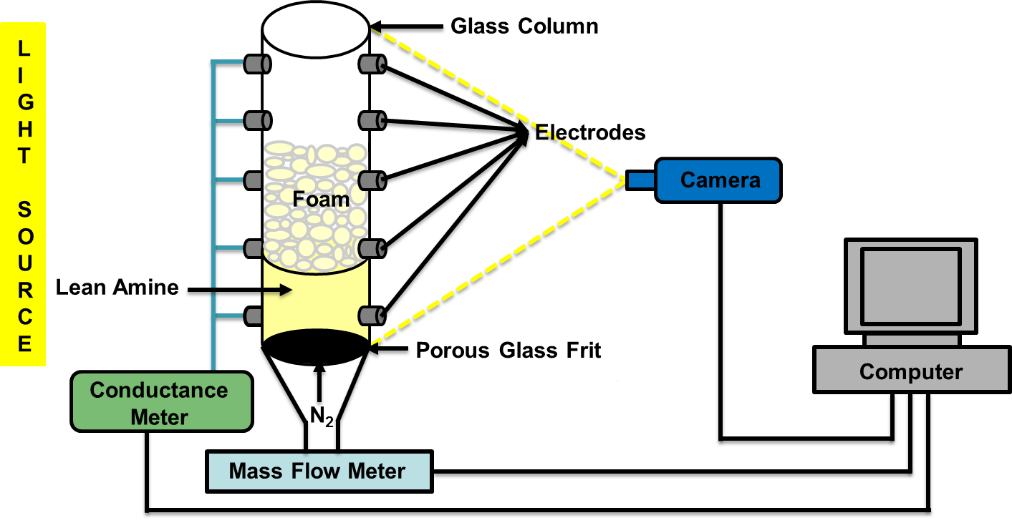
Foaming Studies
Foam Scan Instrument
No. of Cycle | Foam Volume, mL | Foam Stability, sec
Lean Amine | 245 | 142
1st Cycle | 0 | -
2nd Cycle | 0 | -
3rd Cycle | 10 | 2
After 1st & 2nd cycle: No foam
After 3rd cycle: Foam volume < 5%

Slide 19
5. Packed Column Design
Scale-Up Methodology
Use a Laboratory Test Column (Bed height; 45 cm) filled with the Bentonite (CAB) to be used in Full Scale Application.
Apply a Filtration Rate which will be the same for Full-Scale Application (to obtain similar Mass Transfer Characteristics).
Two Different Approaches to justify the Column Design:
i. Scale Up Approach
ii. Kinetic Approach
Compare the design parameters obtained from two different Approaches.

Slide 20
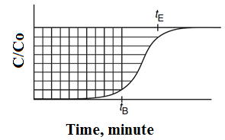
I. Scale Up Approach
The Column was divided into Two Zones:
1. Larger ‘Saturated Zone’ until Breakthrough
2. Smaller ‘Unused’ Zone’ after Breakthrough
Assumptions:
  Size of ‘Saturated zone’: Increase
  Size of ‘Unused Zone’: Constant
Concentration profiles at Bed outlet
Horizontally shaded region proportional to bed’s capacity
Vertically shaded region the amount adsorbed at breakthrough

Slide 21
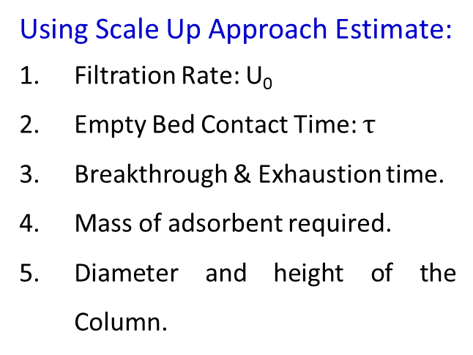
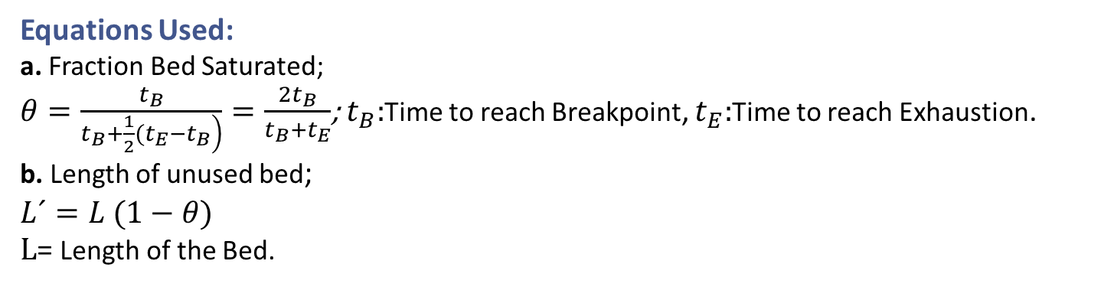
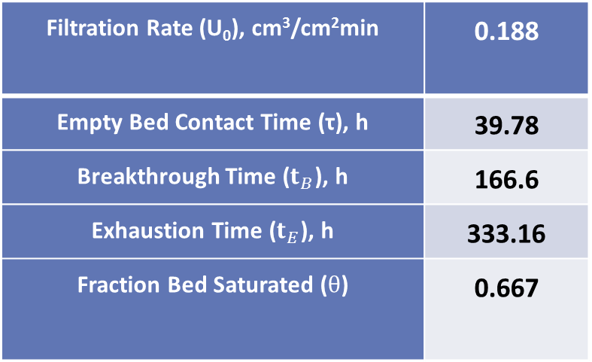
Parameters from Scale Up
Parameters
Using Scale Up Approach Estimate:
Filtration Rate: U₀
Empty Bed Contact Time: $τ$
Breakthrough & Exhaustion time.
Mass of adsorbent required.
Diameter and height of the Column.
Filtration Rate (U₀), cm³/cm²min | 0.188
Empty Bed Contact Time (τ), h | 39.78
Breakthrough Time ($t_{B}$), h | 166.6
Exhaustion Time ($t_{E}$), h | 333.16
Fraction Bed Saturated ($θ$) | 0.667
Equations Used:
a. Fraction Bed Saturated;
$θ=\frac{t_{B}}{\left.t_{B}+\frac{1}{2}(t_{E}−t_{B}\right)}=\frac{2t_{B}}{t_{B}+t_{E}}$; $t_{B}:$Time to reach Breakpoint, $t_{E}:$Time to reach Exhaustion.
b. Length of unused bed;
$L´=L (1−θ$)
$L$= Length of the Bed.

Slide 22
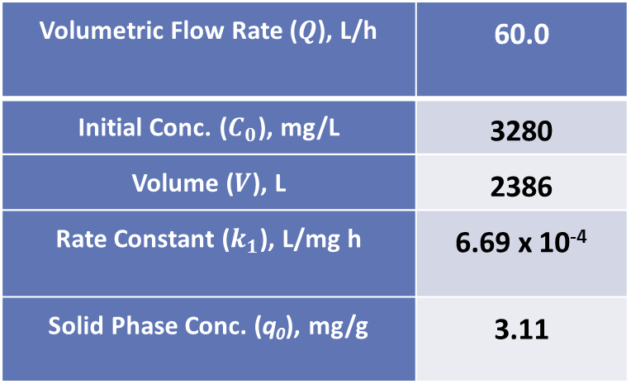
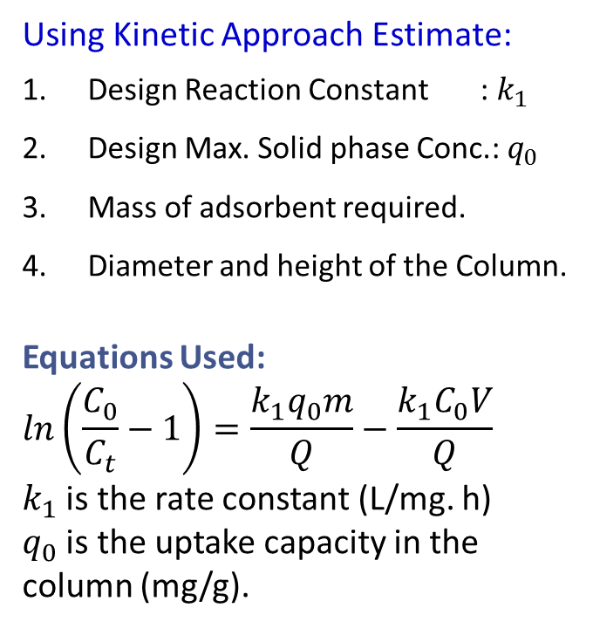
II. Kinetic Approach
Parameters
Using Kinetic Approach Estimate:
Design Reaction Constant : $k_{1}$
Design Max. Solid phase Conc.: $q_{0}$
Mass of adsorbent required.
Diameter and height of the Column.
Equations Used:
$$\ln\left(\frac{C_{0}}{C_{t}}−1\right)=\frac{k_{1}q_{0}m}{Q}−\frac{k_{1}C_{0}V}{Q}$$
$k_{1}$ is the rate constant (L/mg. h)
$q_{0}$ is the uptake capacity in the column (mg/g).
Volumetric Flow Rate ($Q$), L/h | 60.0
Initial Conc. ($C_{0}$), mg/L | 3280
Volume ($V$), L | 2386
Rate Constant ($k_{1}$), L/mg h | 6.69 x 10⁻⁴
Solid Phase Conc. (q₀), mg/g | 3.11

Slide 23
6. Results of Designed Column
Scale Up Approach
Kinetic Approach
Length : 4. 5 m
Bed Diameter : 0.822 m
Volume of the Bed : 2.386 m³
Flow Rate : 60.0 L/h
Breakthrough time : 166.6 h
Mass of Adsorbents : 2546.0 Kg
Length : 4.44 m
Bed Diameter : 0.823 m
Volume of the Bed : 2. 515 m³
Flow Rate : 60.0 L/h
Breakthrough time : 166.6 h
Mass of Adsorbents : 2684.3 Kg

Slide 24
Conclusions
Calcium Alginate/clay hybrid (CAH) composites
Successfully prepared by in-situ polymerization using ubiquitous sodium alginate and clay.
Fixed bed column adsorption using CAH composites
Breakthrough increases with increasing bed height and bed diameter.
Relatively lower reduction in total organic acid anions breakthrough after three successive regeneration cycle.
Lower foam volume after 3 successive regeneration cycle in fixed bed column proved the ability of the CAH as reusable adsorbents.
Foaming Experiments
With respect to Laboratory Scale results Scale Up has been provided.
Scale Up Studies

Slide 25
Acknowledgement
The Petroleum Institute Material Science and Gas Research Center to funding the project (GRC#006).
GASCO Company, Abu Dhabi.
Department of Chemical Engineering, Khalifa University of Science and Technology, Petroleum Institute.

Slide 26
Thank You

