Slide 1

SYNTHESIS AND EVALUATION OF SELECTED BENZIMIDAZOLE DERIVATIVES AS POTENTIAL ANTIMICROBIAL AGENTS
FATMAH ALI ALASMARY
Presentation for 8th International Conference and Exhibition on March 07-09, 2016 Madrid, Spain
Pharmaceutics & Novel Drug Delivery Systems
9th March 2016

Slide 2
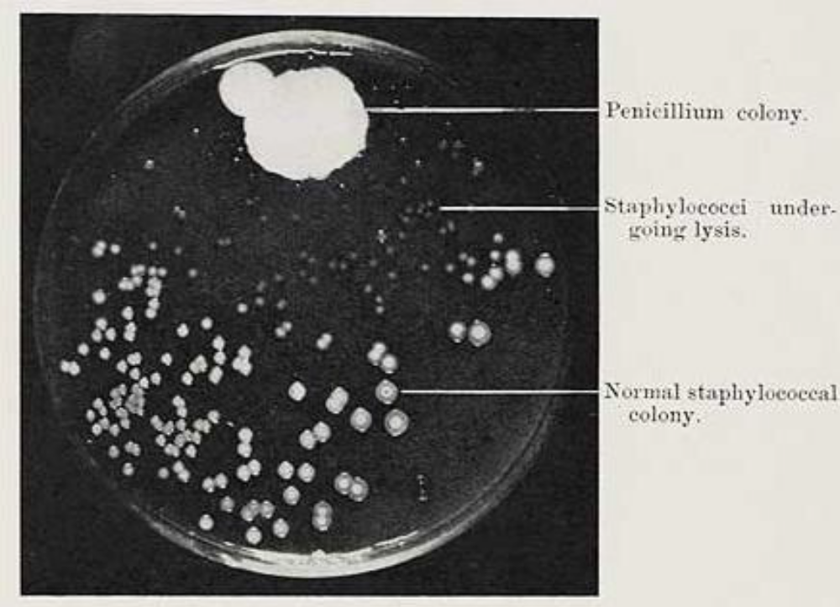
Alexander Fleming and penicillin discovery
Alexander Fleming’s original photograph of the contaminated dish.
http://www.nationalww2museum.org/learn/education/for-teachers/lesson-plans/pdfs/penicillin-fact-sheet.pdf

Slide 3
Agenda
Antibiotic resistance
BAD BUGS, NEED DRUGS
Aims of this project
Why Benzimidazole?
Sites of benzimidazole derivatives available for further reaction
Improving Phillips method
Pathogenic Strains used in this project
Antimicrobial methods used In Vitro
Results
SAR Study
Conclusions

Slide 4
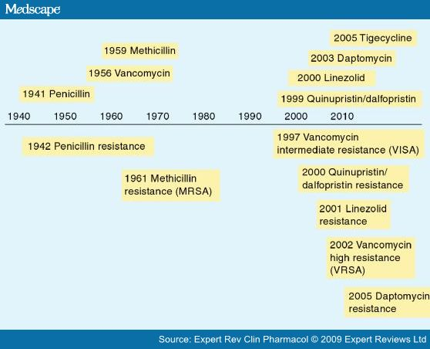
Antibiotic resistance & the need to develop new drugs
New Antibiotic
Resistance

Slide 5
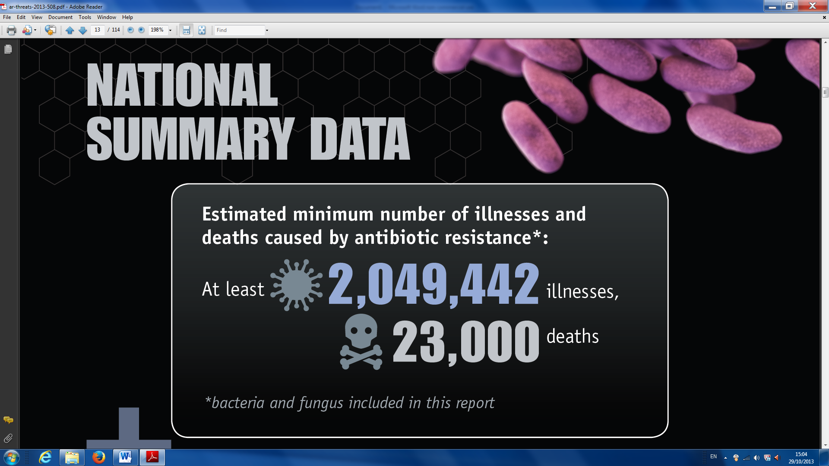
Antibiotic resistance
USA Data
Centres for Disease Control and Prevention. (2013) Antibiotic resistance threats in the United States, 2013. [Online] [Accessed 10 Feb 2016 http://www.cdc.gov/drugresistance/threat-report-2013/

Slide 6

U.S. President Barack Obama signed an agreement with the representative of the European Union (the Swedish Prime Minister Fredrik Reinfeldt) to solve the problem of the antimicrobial drugs pipeline (IDSA, 2010)

Slide 7
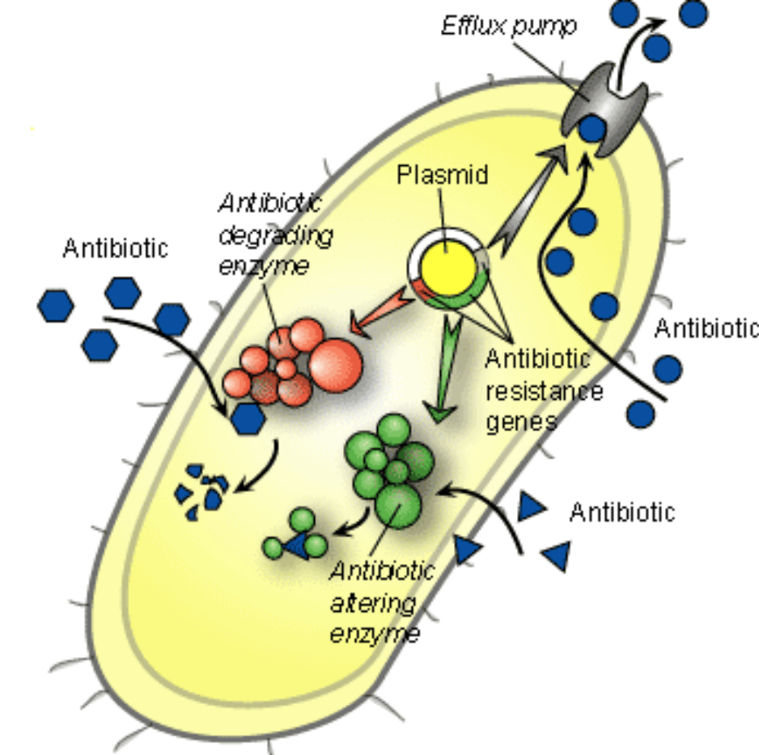
General mechanisms of antibiotic resistance in bacteria. Source: (Todar, 2008).
Todar, K. 2008. Todar's Online Textbook of Bacteriology. Madison.

Slide 8
Table ‎1 Key Mechanisms of bacterial resistance against some drugs. Source: (Silver, 2011).
Origin | Mechanism | Examples of affected drug classes affected
Exogenous | Class-specific efflux | Tetracycline, macrolides
 | Class-specific degradation/modification | β-Lactams, aminoglycosides, chloramphenicol, streptogramin A, metronidazole (for anaerobes), fosfomycin
 | Target protection/modification | Tetracycline, macrolides, lincosamides, oxazolidinones, streptogramin B
 | Replacement with reduced-affinity target | β-Lactams, vancomycin, trimethoprim, mupirocin, sulfonamides
 | Sequestration of target | Fluoroquinolones, fusidic acid
Endogenous | Single mutations reducing target affinity | Rifamycin, streptomycin, trimethoprim (for Gram+ve organisms), fusidic acid
 | Multistep mutations reducing affinity or remodeling of target | Fluoroquinolones, oxazolidinones, daptomycin, vancomycin, polymyxin, β-lactams (for transformable species)
 | General efflux mechanism | Most classes for Pseudomonas; many classes for other species
 | Reduced uptake (porin or permease loss) | Carbapenems, fosfomycin
 | Loss of activation | Metronidazole (for H. pylori)
 | Upregulation of target | Fosfomycin

Slide 9
Aims of this project
Synthesise novel derivatives of benzimidazole that have a degree of antimicrobial activity
Investigate the activity against a range of pathogens to see if any compounds have an enhanced spectrum of activity, relative to that of related structures
Undertake a detailed study of the structure-activity relationship of these derivatives to inform the design of more potent compounds

Slide 10
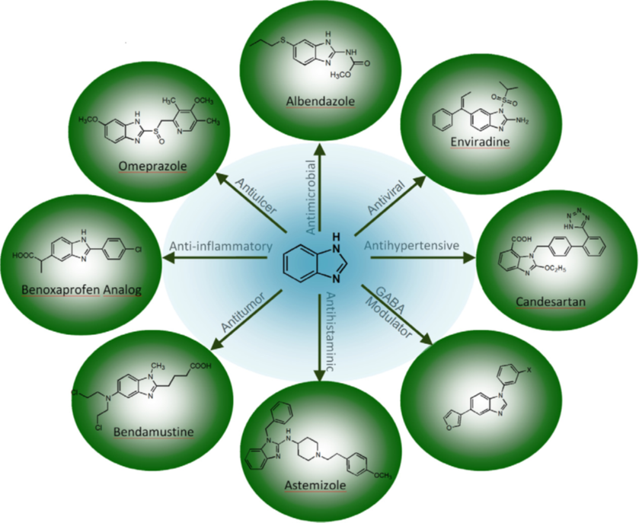
Why Benzimidazole?
Bansal, Y. & Silakari, O. (2012). ‘The therapeutic journey of benzimidazoles: A review.’ Bioorganic & Medicinal Chemistry, 20 (21), pp.6208-6236.

Slide 11
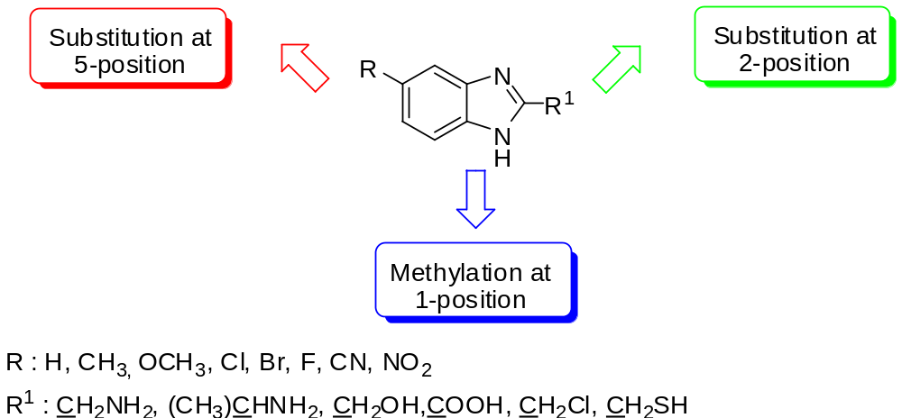
To Achieve main project Aim:
Sites of benzimidazole derivatives available for further reaction
Podunavac-Kuzmanovic, S. O., Leovac, V. M., Perisic-Janjic, N. U., Rogan, J. & Balaz, J. (1999). ‘Complexes cobalt(II), zinc(II) and copper(II) with some newly synthesized benzimidazole derivatives and their antibacterial activity.’ Journal of the Serbian Chemical Society, 64 (5-6), pp.381-388.

Slide 12
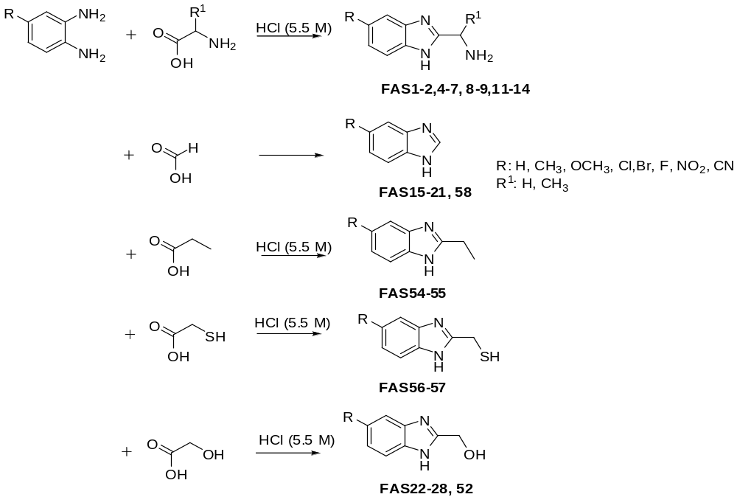
Synthesis (1)
Group 1: target benzimidazole derivatives

Slide 13
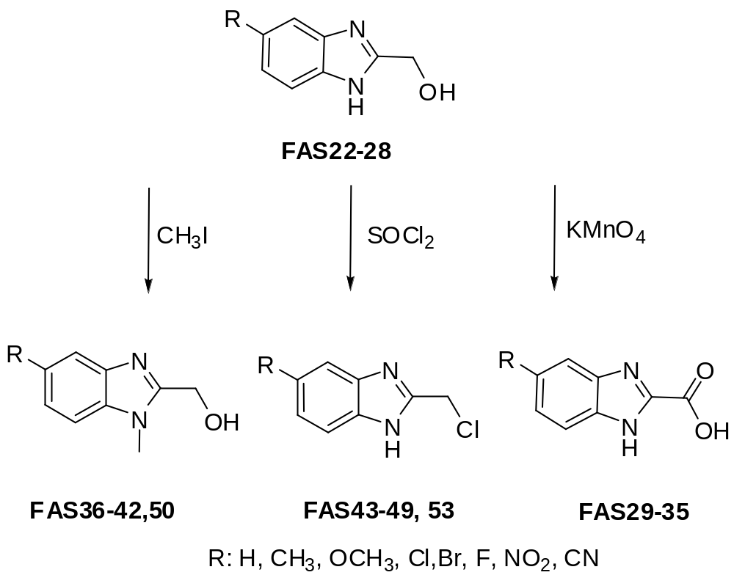
Synthesis (2)
Group 2: target benzimidazole derivatives

Slide 14
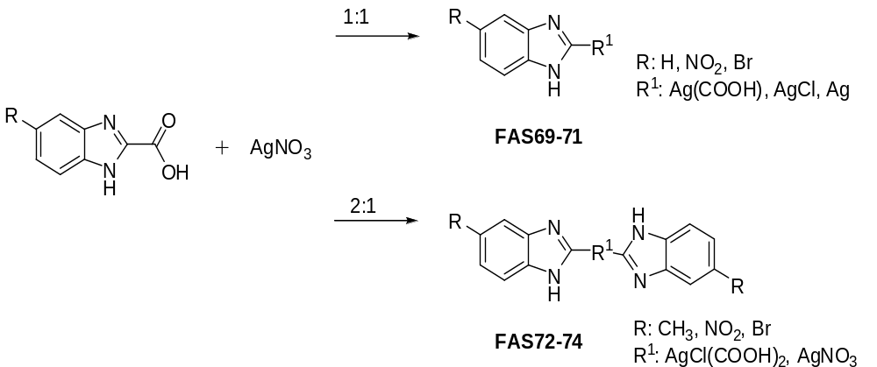
Synthesis (3)
Group 3: target silver benzimidazole complexes

Slide 15
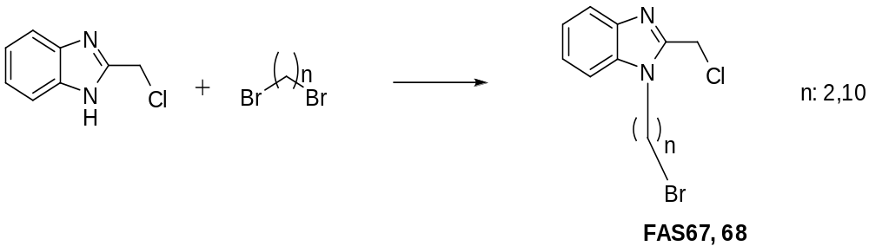
Synthesis (4)
Group 4: target N-bromoalkylbenzimidazole derivatives

Slide 16
Improving Phillips method
Entry | Amino acid | Ionic liquid | a IL + MW yield (%) | b IL + Heat yield (%) | c Traditional Phillips
1 | glycine | Bu4P+Cl- | 0 | 0 | (89%, 13 days)
2 | glycine | n-Oct4P+Br- | 0 | 0
3 | glycine | i-Bu3P+Me OTs- | 0 | 0
4 | glycine | Bu3P+Et Br | 0 | 0
5 | glycine | Bu3P+Oct Br | 27 | 29
6 | alanine | Bu4P+Cl- | 0 | 0 | (67%, 11 days)
7 | alanine | Oct4P+ Br- | 0 | 0
8 | alanine | i-Bu3P+Me OTs- | 0 | 37
9 | alanine | Bu3P+ Et Br | 0 | 51
10 | alanine | Bu3P+Oct Br | 0 | 0
11 | β-alanine | Bu4P+ Cl- | 0 | 75 | (66%, 8 days)
12 | β-alanine | Oct4P+ Br- | 25 | 39
13 | β-alanine | i-Bu3P+Me OTs- | 0 | 13
14 | β-alanine | Bu3P+Et Br | 0 | 0
15 | β-alanine | Bu3P+Oct Br | 0 | 0
Reactions conducted in ionic liquids and in a microwave
a: 5 minutes reaction at 80˚C
b: 24 h at 80˚C
c: in 5.5 M HCl
Phillips, M. A. (1928). ‘CCCXVII.-The formation of 2-substituted benziminazoles.’ Journal of the Chemical Society (Resumed), pp.2393-2399.

Slide 17
Pathogenic Strains used in this project
Evaluation of antibacterial activity of compounds against a reference collection of bacteria that included:
    15 strains of Staphylococcus spp. (inc 2 x S. aureus, 8 x MRSA, 2 x EMRSA, 2 x S. epidermidis and 1 x S. haemolyticus).
    5 strains of E. coli,
    4 strains of Ps. aeruginosa,
    1 strain of Serratia marcescens,
    and 1 strain of Burkholderia cepacia.
Evaluation of antifungal activity of compounds against a reference collection of fungi that included:
    4 unicellular fungi (4 x Candida),
    6 filamentous fungi, (1x Absidia), (2 x Aspergillus), (1 x Mucor), (1 x Penicillium ), (1 x Syncephalastrum).

Slide 18
Antimicrobial methods used In Vitro
Diffusion tests: disc / well
Determination of Minimum Inhibitory Concentration (MIC)

Slide 19
Results
No. of compounds synthesized (13 series) | 70
No. available for antimicrobial testing | 67
No. not previously screened for antimicrobial activity | 62
Significant antibacterial activity (MIC results) (includes some with activity against MRSA) | 5
Significant antifungal activity (MIC results) (includes some that are more potent than leading antifungal drug) | 26

Slide 20
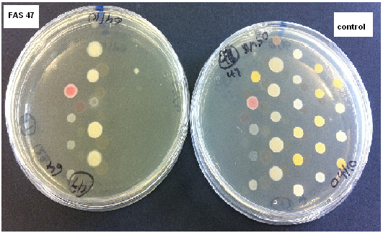
MIC screening by agar dilution of FAS47 at 64µg/ml VS the growth control against bacteria strains

Slide 21
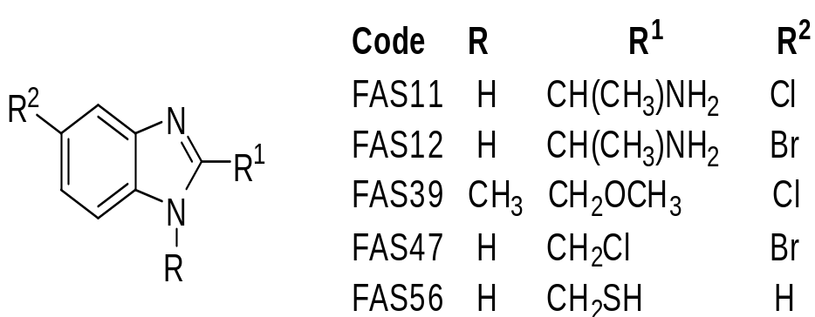
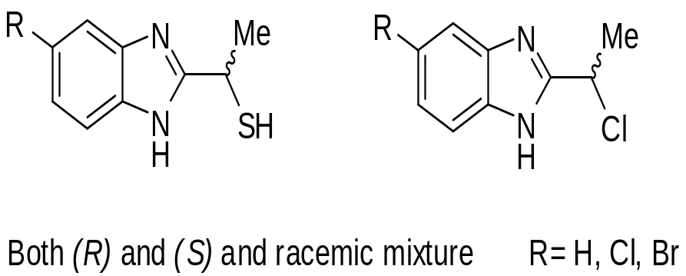
SAR Study (antibacterial)
Structures of the compounds most active against bacterial species
Proposed next generation antibacterial agents

Slide 22
MIC results of the 5-substituted-benzimidazole derivatives against Fungal strains
Fungal | MIC µg/ml
 | FAS18 | FAS19 | FAS20 | Amphotericin B
Aspergillus fumigatus RCMB 02564 | 0.06 | 0.015 | 0.06 | 0.06
Aspergillus clavatus RCMB 02593 | 0.12 | 0.06 | 0.12 | 0.12
Mucor circinelloides RCMB 07328 | 0.24 | 0.12 | 0.12 | 3.9
Absidia corymbifera RCMB 09635 | 0.12 | 0.03 | 0.06 | 0.98
Penicillium marneffei RCMB 01267 | 0.12 | 0.03 | 0.03 | 0.49
Syncephalastrum racemosum RCMB 05922 | 0.98 | 0.98 | 0.98 | 0.98
Candida albicans RCMB 05035 | 0.03 | 0.007 | 0.03 | 0.12
Candida tropicalis RCMB 05049 | 0.015 | 0.007 | 0.06 | 0.015
Candida krusei RCMB 05051 | 1.95 | 0.98 | 0.98 | 0.98
Candida parapsilosis RCMB 05065 | 0.03 | 0.003 | 0.06 | 1.95
MICs < MICs of Amphotericin B are highlighted

Slide 23
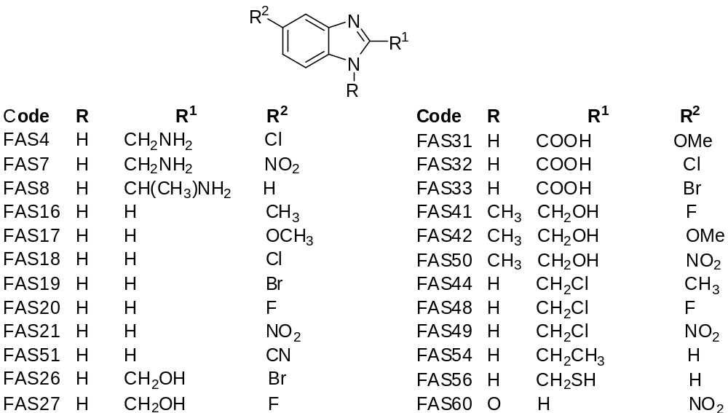
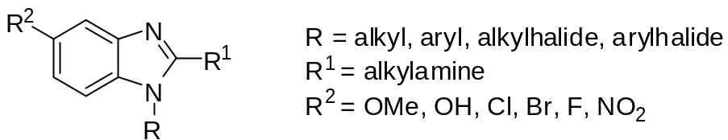
SAR Study (antifungal)
Structures of the compounds most active against fungal species
Proposed next generation of antifungal agents

Slide 24
Conclusions
Method development: promising results from pilot studies to improve the Phillips method .
Significant results found in activity against Gram +ve and –ve bacteria . Some compounds active against multidrug resistant strains .
Several compounds were active against pathogenic fungi .
SAR analysis: some derivatives of benzimidazole offer enormous possibilities for the development of new broad spectrum antimicrobials. Through appropriate modification and fine-tuning of substituents at positions 1, 2, and 5, new microbial inhibitors may be possible .

Slide 25
Publication
Synthesis and evaluation of selected benzimidazole derivatives as potential antimicrobial agents, F.A. S. Alasmary, A. M. Snelling, M. E. Zain, A. M. Alafeefy, A. S. Awaad, N. Karodia, Molecules, 20, 15206-15223, 2015.

Slide 26
Your Time to ask
* All Questions and Queries are welcome *

