Slide 1
The Value of Measurement of Circulating Tumor Cells in Hepatocellular Carcinoma
Nashwa Sheble, Gehan Hamdy, Moones A Obada, Gamal Y Abouria, Fatma Khalaf , Enas A Khattab
Presented by: Fatma Khalaf
Lecturer of Clinical Biochemistry, National Liver Institute, Menoufiya University, Egypt

Slide 2
Background
- Hepatocellular carcinoma (HCC) is one of the most common malignancies worldwide. Major risk factors for the development of HCC include chronic infections with hepatitis B and hepatitis C viruses, alcohol consumption, and exposure to dietary aflatoxin B, hereditary liver disease or liver cirrhosis of any etiology.
- HCC is one of the most aggressive cancers and the treatment outcomes have remained generally poor.

Slide 3
- Alpha-Fetoprotein (AFP) which expressed in the cytoplasm of HCC cells is a useful tumor marker for HCC, but although total AFP has been considered for a long time the ideal serological markers, for detecting HCC, the false-negative or -positive rate with AFP level alone may be as high as 40%, especially for its early diagnosis or the finding of small size HCC (<3 cm)
- Even in patients with advanced HCC, the AFP levels may remain normal in 15%- 30% of the patients.

Slide 4
- The term circulating tumor cells (CTC) defines specifically the tumor cells detected in blood or lymphatic vessels.
-The CTCs detection and identification can be used to estimate prognosis and may serve as an early marker to assess antitumor activity of treatment.
- AFP mRNA in the peripheral blood detected by reverse transcriptase-PCR (RT-PCR) has been most extensively studied.

Slide 5
- AFP mRNA may be a valuable indicator of poor prognosis for HCC patients and its expression is correlated with portal thrombosis, nodules of tumor, tumor diameter and TNM stage.
- Hepatocellular carcinoma has shown to secret a lot of cytokines related to the development of tumor, like transforming growth factor-beta 1(TGF-β).

Slide 6
- Though a growth inhibitor, the over expression of hepatic TGF-β1 mRNA was found in HCC tissues and correlated with carcinogenesis, progression and prognosis of HCC.
- The sensitivity and specificity of circulating TGF β1 level were 90% and 94% for HCC diagnosis, and the combined detection of TGF-β1 and serum AFP could raise the detection rate of HCC up to 97%

Slide 7
Aim of the study
- The aim is to estimate the expression of CTCs (AFP mRNA & TGF- β1 mRNA) in the peripheral blood of patients with HCC as an early non invasive marker of HCC and to detect their relevance to the prognostic parameters of HCC

Slide 8
Patient and methods

Slide 9
- Hundred patients were selected from outpatient
clinic and inpatient hepatology department of the
National Liver Institute, Menoufiya University and
Internal Medicine department, faculty of medicine,
Cairo University.
The included patients were classified into 2 groups:
Group I included 58 patients (38 males & 20 females) with confirmed HCC. Their age ranged from 46 to 63 years.

Slide 10
Group II: included 42 patients (29 male & 13 females) with liver cirrhosis (LC). Their ages ranged from 41 to 57 years.
Twenty healthy volunteers (14 males and 6 females) were included in the study as a control group, age ranged from 35 to 59 years

Slide 11
Clinical examination and investigations:
- All patients were subjected to: full history and thorough clinical examination.
- The Milan criteria was defined as the presence
of a tumor 5 cm or less in diameter in patients with
single HCC or no more than 3 tumor nodules, each
3 cm or less in diameter, in patients with multiple
tumors, and no extra hepatic metastasis, and no
major hepatic vessel invasion

Slide 12
Exclusion criteria:
- Patients with clinically evident distant metastasis (detected by brain and chest CT scan or total body bone scintigraphy) or simultaneous other malignant disorders were excluded from the study.

Slide 13
The following laboratory investigations were done
- Complete blood count (CBC), Liver function tests (LFTs), Prothrombin time(PT) and AFP.
-Serum levels of TGF-β1.
-Hepatitis viral marker including anti-HCV and HBV.
- HCV RNA was measured by RT-PCR .
-Detection of TGF-β1mRNA by nested-PCR.

Slide 14
Results

Slide 15
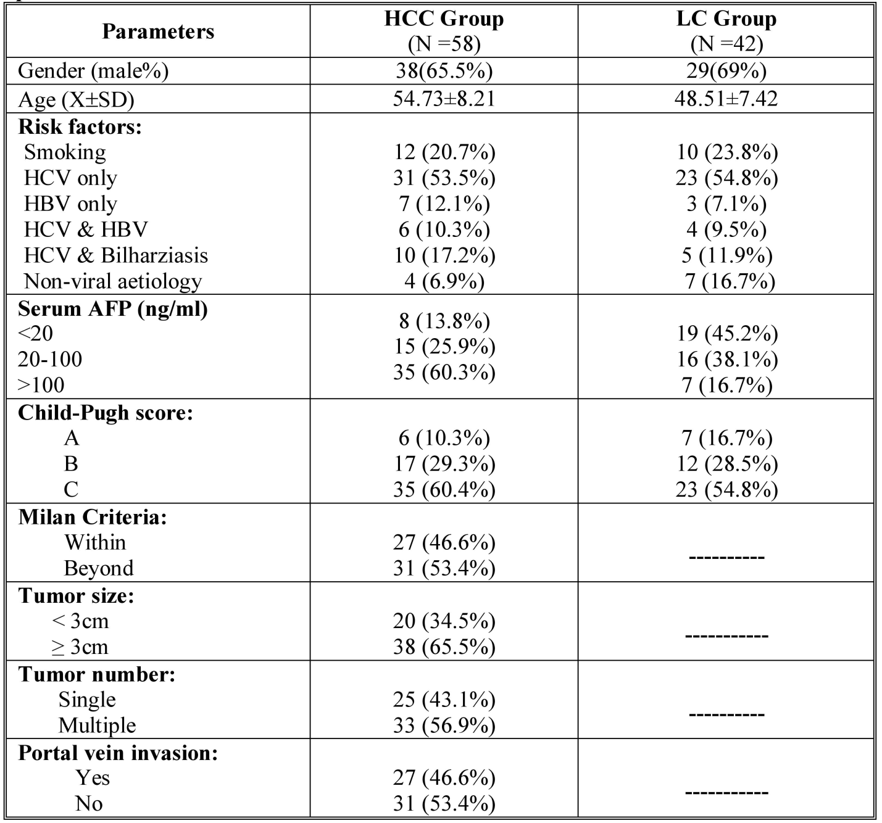
Table (1): Demographic data, associated risk-factors and patient characteristics in studied patients.

Slide 16
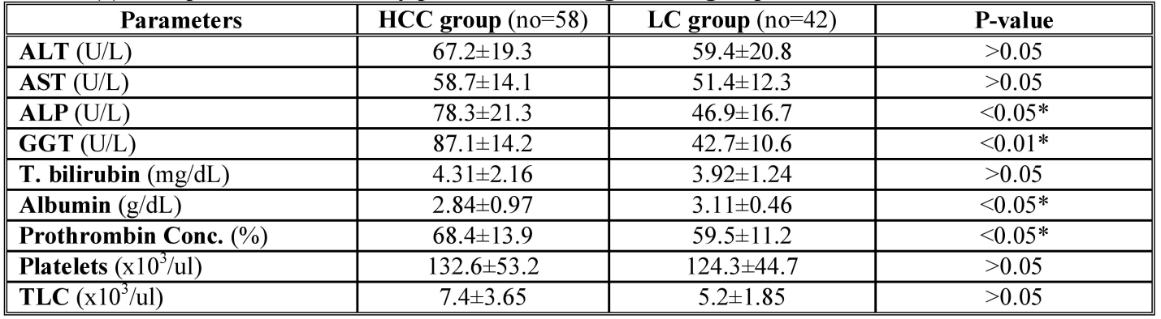
Table (2): Comparison of laboratory parameters among studied groups.

Slide 17
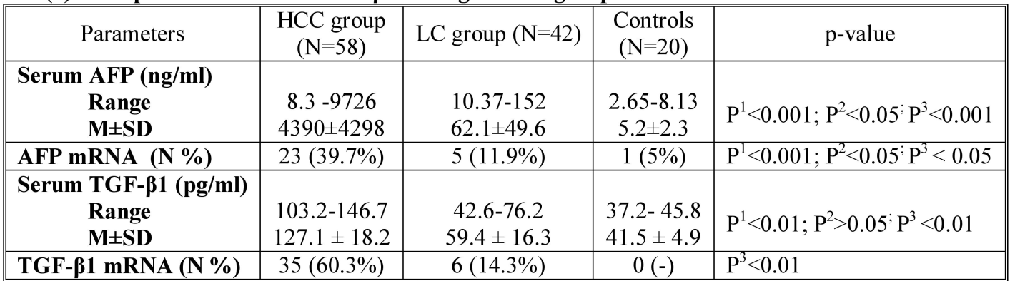
P1: HCC vs. control, P2: LC vs. control, P3: HCC vs. LC (p<0.05 is statistically significant)
Table (3): Comparison of AFP & TGF-β1 among studied groups.

Slide 18
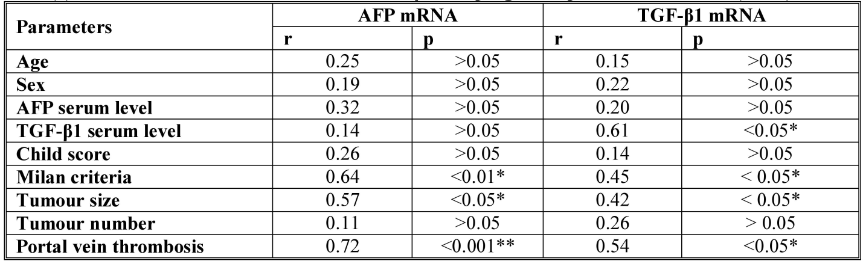
Table (4): Correlation between AFP mRNA, TGF-β1 and prognostic parameters of HCC (N=58)

Slide 19
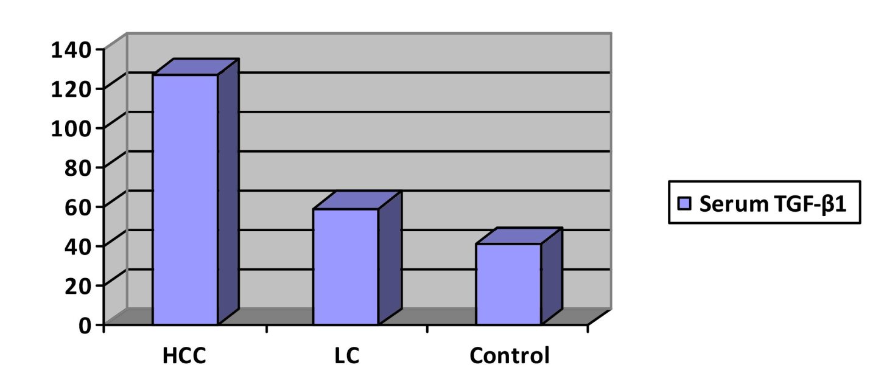
Figure (2) Shows the serum levels of TGF-β1 in studied groups

Slide 20
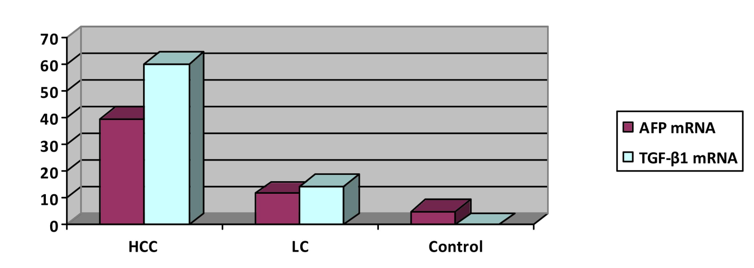
Figure (3) Shows the percentage positive cases of AFP mRNA & TGF-β1 mRNA in studied groups

Slide 21
Conclusion

Slide 22
-Since HCC is among the cancers with worst
prognosis, early diagnosis and treatment are essential
for effective treatment.
CTCs are an interesting source of biological .information for tumor activity
-‘‘liquid biopsy’’ for CTCs detection can be carried out routinely in patients due to accessibility and ease of blood collection.
-AFP mRNA and TGF-β1 mRNA could be detected in the blood of HCC patients without clinical evidence of extra hepatic metastasis.

Slide 23
Recommendations
-TGF-β1 mRNA is a more reliable marker for diagnosis of HCC and if combined with AFP mRNA yielded better prediction of HCC prognosis and it might be interesting to assess the disease consequences of including more than one CTC markers in the scoring system to select HCC patients for liver transplantation and their follow up.

Slide 24
Thank you

