Slide 1
The Effect of PTEN and TRAIL genes loaded on Nanoparticles on Hepatocellular carcinoma
Fathia El Sharqawi ,Shaimaa Ewais, Rania Fahmy and Laila Rashid

Slide 2
Introduction

Slide 3
Hepatocellular carcinoma (HCC)
World wide
  5th most common cancer and the 2nd leading cause of cancer mortality.
(lafaro et al., 2015)
In Egypt
  2nd most common cancer in men and the 6th most common cancers in women
(Ferlay et al., 2010).
  3rd leading cause of death in males and the 4th in females with more than 600 000 deaths per year
(Abdel-Atti., 2015)

Slide 4
Only curative therapy for HCC
Surgical
interventions
Percutaneous
intervention
Tans-arterial intervention
HCC treatment
No proven efficacy till now
Chemotherapy
Radiation therapy
(liu et al.,2015)

Slide 5
Gene therapy
The insertion of gene into an individual's cells and tissues to treat a disease, such as a hereditary disease
It is used to correct a deficient phenotype so that sufficient amounts of a normal gene product are synthesized → to improve a genetic disorder
(Chira et al., 2015)

Slide 6
Application of gene therapy
(Misra 2013)

Slide 7
Apoptosis
Intrinsic pathway
Extrinsic pathway
PTEN
Phosphatase and tensin homologue
TRAIL
Tumor necrosis factor (TNF)–related apoptosis-inducing ligand (TRAIL)

Slide 8
PTEN gene
Was discovered by two different groups and recognized as tumor suppressor gene frequently lost on human chromosome 10q23
(Li et al., 1997; Steck et al., 1997).
PTEN is one of the most commonly silenced genes in different cancers including HCC
(Ruan et al., 2012)

Slide 9
TRAIL
TRAIL is a cytokine that is produced and secreted by most normal tissue cells and its binding to its receptors induces apoptosis selectively in carcinoma cells not in normal cells.
(Wang & El-Deiry 2003)
TRAIL is unique antitumor agent:
  Nontoxic to normal cells
  killing a broad range of tumor cells.
  (Wang et al., 2015)

Slide 10
PTEN and TRAIL in cancer treatment
Several studies showed the potential role of both PTEN and TRAIL genes in treatment wide range of cancers including: Lung, colon, pancreatic cancer and HCC using different vectors
(Ding et al.,2012; Li et al.,2013; Lathrop et al., 2014; Cao et al., 2014; Yu et al., 2015)

Slide 11
Gene therapy vectors
                In gene therapy, using just naked DNA is ineffective.
                A carrier is needed to pass different barriers to reach nucleus and be transcripted to protein.
                The success of gene therapy is largely dependent on the development of a vector or vehicle that can selectively and efﬁciently deliver a gene to target cells with minimal toxicity
                One of this vector that efficiently used is nanoparticles
                (PATIL P.M;2012)

Slide 12
Nanoparticles (NPs)
Polymeric NPs
Metallic NPs
Solid Lipid NPs
Protein NPs (eg: zein)

Slide 13
Zein
Zein is the major protein of corn.
(Cabra et al. 2005 )
Hydrophobic
Aggregate → NP
Amphiphilic
Hydrophilic
Interact with DNA

Slide 14
Advantage ZNPs as drug carrier
Biocompatibility
Safety to cells
Capability for sustained release
Interaction with cell membranes
Its versatility to interact, encapsulate and protect the loaded particles.

Slide 15
ZNPs application
ZNPs used as carrier for different drugs such as:
  Ivermectin, Gitoxin, Catalase and Superoxide dismutase, Metformin → improve their effect and and protect from GIT allow oral application and as carrier
  5- fluorouracil for targeting liver in HCC treatment.
  (Lee et al., 2013; Lai & Guo., 2011)
  Regier et al. (2012) revealed the possibility of using ZNPs as non viral vector.

Slide 16
Aim of the work

Slide 17
The aim of the present study
Formulation of ZNP (safe targeting non viral vector) to carry PTEN &TRAIL genes
Invitro assay on HepG2 cell lines to study anti-proliferatory activity of PTEN &TRAIL genes loaded on ZNPs.
Invivo assay on wistar female HCC rats.
Study effect of both genes on different hallmarks of cancer such as apoptosis, angiogenesis and metastasis.

Slide 18
Study design
Invitro assay
Invivo assay
ZNPs preparation and gene loading
ZNPs optimization and characterization
In-vitro cytotoxicity on HepG2
Determination of IC50 of both genes (using the MasterPlex reader 2010 hitachia .)
HCC induction chemically using DEN & CCL4
Single IV injection of the selected formula
Determination of following:
  Serum AFP
  Expression levels P53,VEGF and MMP-2
Histopathological examination of liver tissues

Slide 19
Methodology

Slide 20
I- Invitro Assay

Slide 21
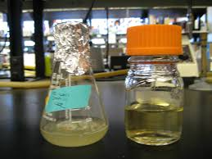
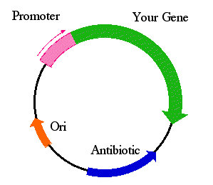
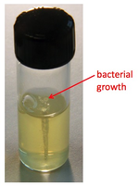

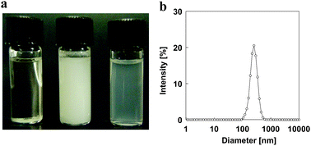
1) PTEN-GFP plasmid & pEGFP-TRAIL plasmid
purchased from Addgene (Cambridge,MA) transformed &Shipped as Ecoli in an agar stab
2) Bacterial growth:
LB broth with the resistant AB
3) Plasmid extraction
alkaline lysis method
(Feliciello & Chinali 1993).
4) ZNPs formulation and gene loading Using coaservation
(Hu & McClements 2014; Regier et al. 2012)..

Slide 22
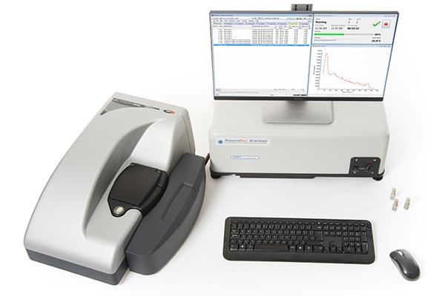
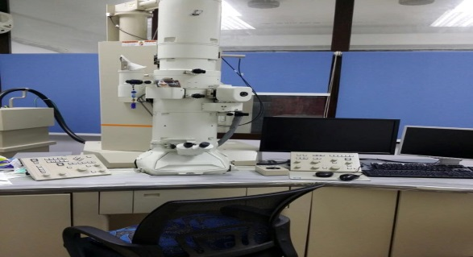
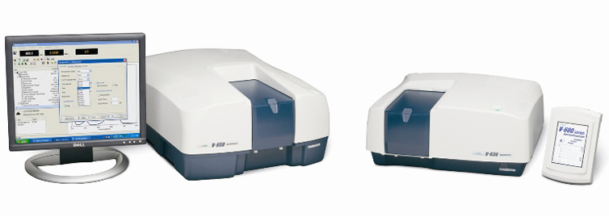
5) Optimization of the formulae
Minimize PS
Maximize ZP
Maximize NP yield
Maximize Encapsulation Efficiency
Colorimetry
(lawry et-al.,1953)
EE → % of DNA trapped on NPs
Spectrophotometricaly
at 260 nm
6 formulations of NP → using full factorial design (by design expert® 9).
ZP → represent charge on NP surface
allows prediction about the stability of the nanodispersion.
↑↑ ZP → ↑↑ stability of disperstion
By DLS
Zetasizer Nano ZS90, Malvern Instruments Ltd, UK.
NPs morphology
Zein conc
Two variables
DNA:Zein
JASCO® V-630 UV-Vis Spectrophotometer
Transmission electron microscope

Slide 23
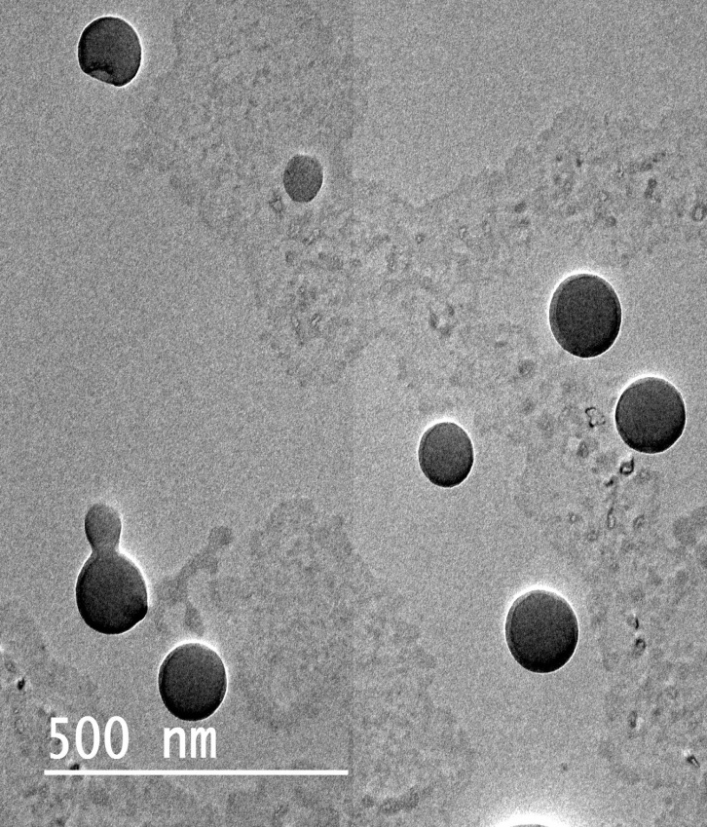
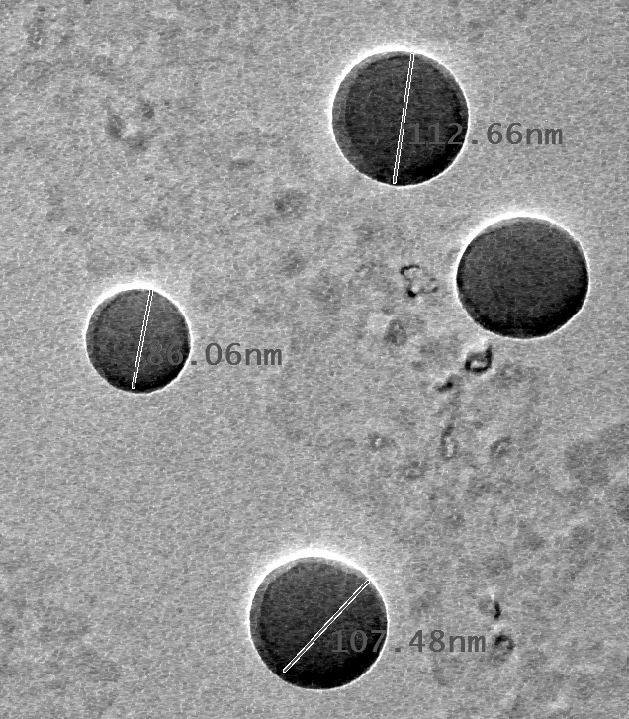
TEM
Figure 22: TEM image of nanoparticles.

Slide 24
After statistical analysis of effect of two variables (using design expert 9 software
Optimum formula to be used in subsequent studies is that of
zein concentration → 0.2% W/V
DNA to zein ratio →1:80

Slide 25
6) Determination of cytotoxicity of both genes loaded on ZNPs
Antiproliferatory activity of both genes on HepG2 were tested using neutral red assay.
(Repetto etal., 2008)
IC50 of both genes loaded on ZNPs were calculated using MasterPlex reader 2010 hitachia

Slide 26
II- Invivo Assay

Slide 27
Invivo Assay
40 wistar Rats
10 Healthy
30 HCC
10 untreated Control
10 PTEN treated
10 TRAL treated

Slide 28
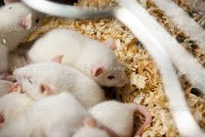
Single IP injection of DEN
+
SC injection of CCl4 once per week for 3 months
Healthy rats
HCC rats
Animals were sacrified
After 2 weeks
Single IV injection of selected formula contain 200 µg DNA
AFP (ELISA); Diagnostic Systems Laboratories, Inc., USA.
Serum
Liver Tissue
Expression levels of P53, VEGF & MMP-2
Histopathological examination

Slide 29
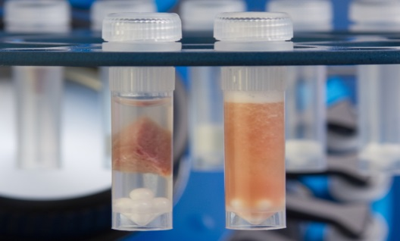

Determination of Expression levels of P53, VEGF and MMP2
5) Fold expression
3) cDNA synthesis
(SensiFAST™ cDNA Synthesis Kit; Bioline, Madrid, Spain.)
1) Liver homogenization
2) mRNA extraction
(RNeasy® Mini Kit (50) Isolation System; Qiagen, Valencia, CA, USA)
4) qPCR (sybr green master-mix)
(KAPA SYBR® FAST qPCR Kits; Kappa Bioscience, MA, USA.

Slide 30
Results

Slide 31
Invitro cytotoxicity assay
PTEN IC₅₀ = 0.09 µg/ml
TRAIL IC₅₀=0.25 µg/ml.
Plain ZNPs and both free genes show no cytotoxicity.

Slide 32
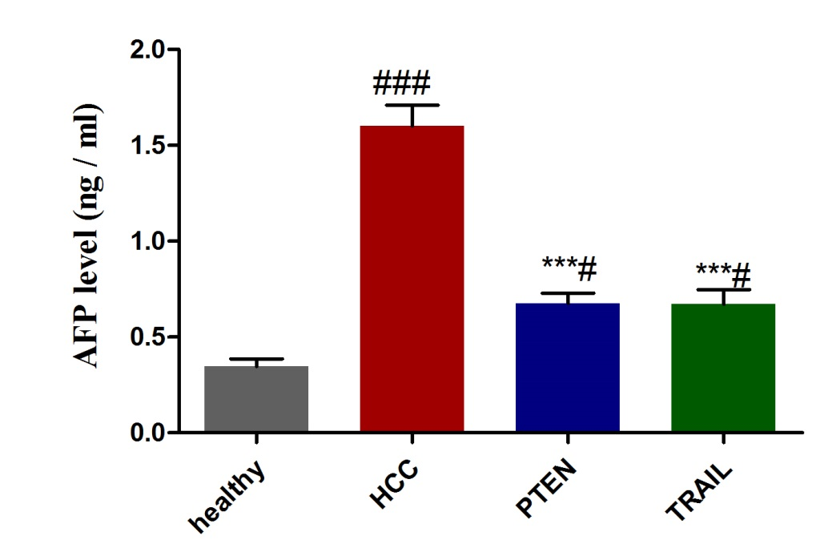
Serum AFP level
#(p<0.05),###(p<0.001): significantly from healthy control group.
***(p<0.001): significant from HCC group.

Slide 33
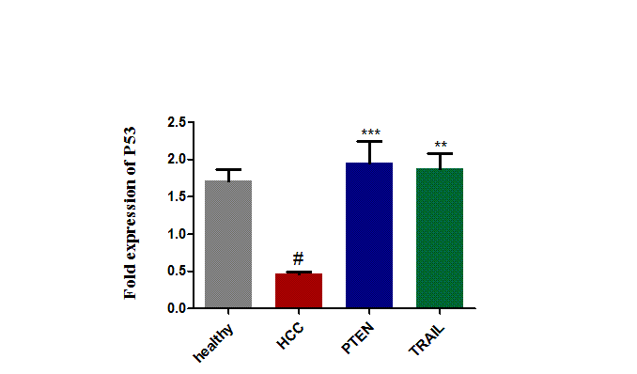
P53 fold expression
#(p<0.05): significantly from healthy control group.
**(p<0.01), ***(p<0.001): significant from HCC group.

Slide 34
VEGF fold expression
##(p<0.01): significantly from healthy control group.
*(p<0.05), **(p<0.01): significant from HCC group.

Slide 35
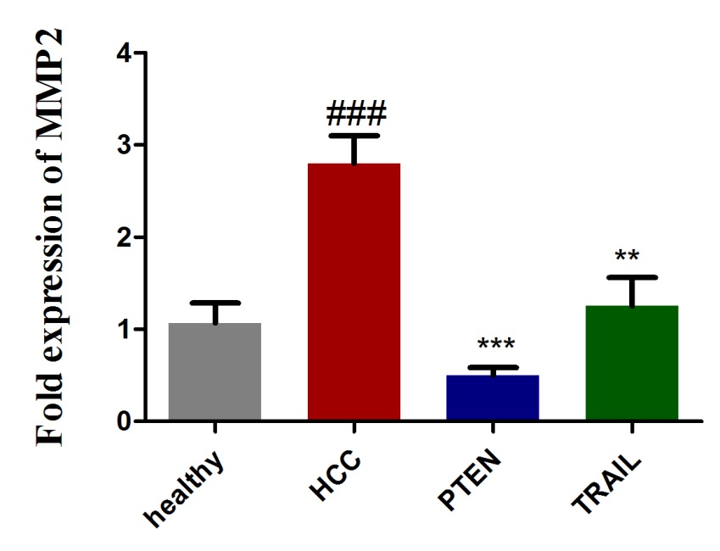
MMP-2 fold expression
###(p<0.001): significantly from healthy control group.
**(p<0.01), ***(p<0.001): significant from HCC group.

Slide 36
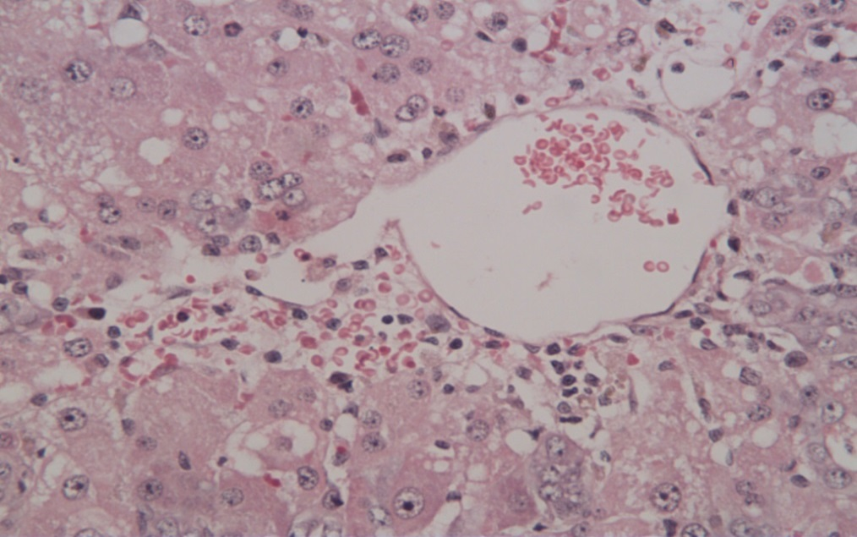
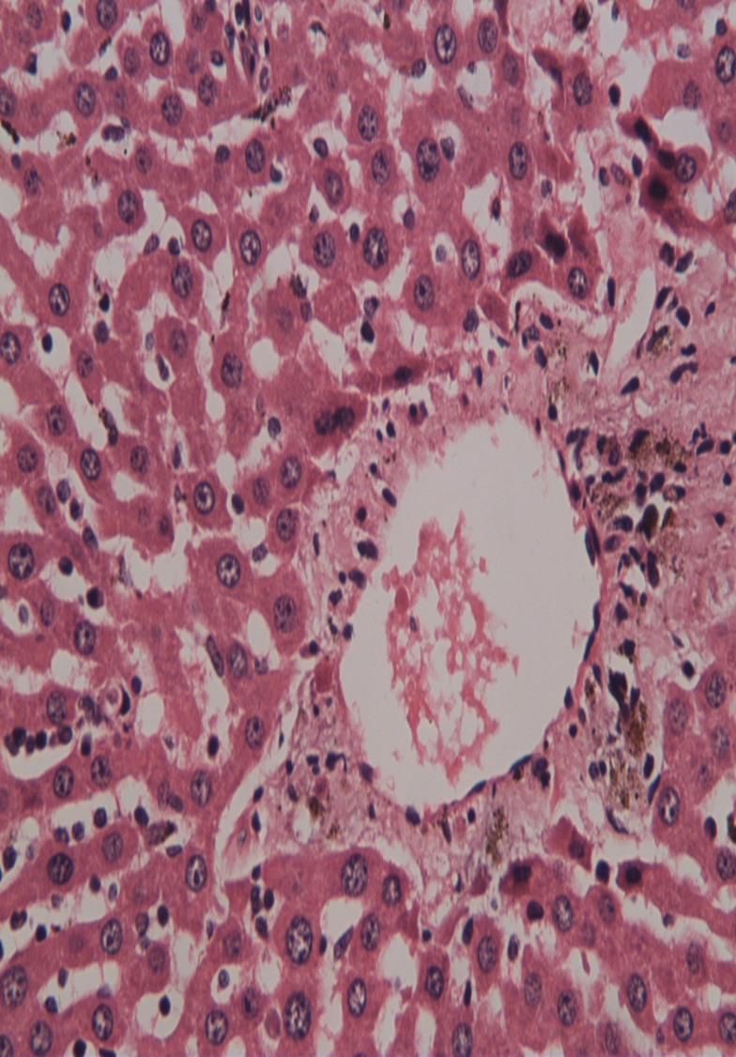
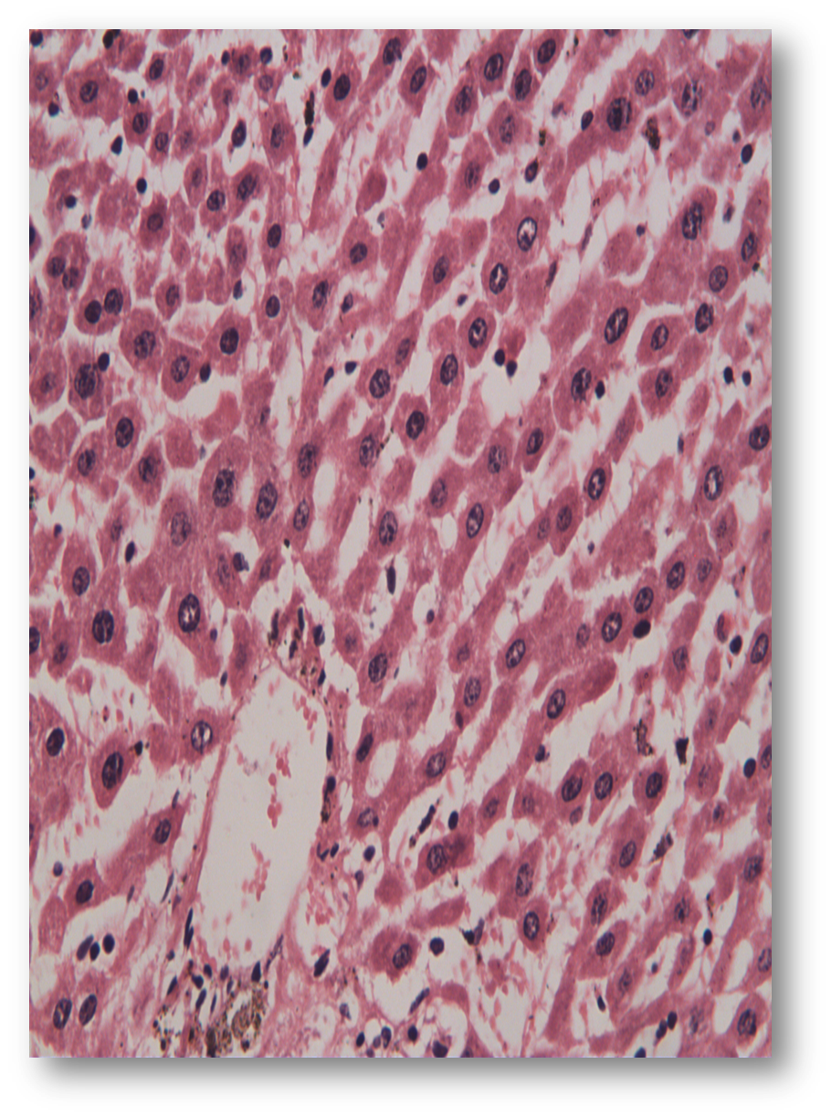
Healthy control
Histopathological examination
HCC untreated
Healthy
TRAIL treated group
PTEN treated group

Slide 37
conclusion

Slide 38
ZNPs can be used as safe and efficient nonviral vector
Both PTEN and TRAIL loaded on ZNPs showed cytotoxic activity on HepG2 cell line.
(IC₅₀ of PTEN < TRAIL)
PTEN and TRAIL showed significant effects on P53, VEGF & MMP-2 expression.
PTEN and TRAIL loaded on ZNPs may be used as gene therapy for HCC

Slide 39

Thanks and ready for question

