Slide 1
Evaluation of Multi-Slice Computed Tomography in Assessment of Cochlear Implant Electrode Position:
A pictorial essay
By:Fatemeh Nasri
Tehran University Of Medical Science

Slide 2
Cochlear Implant
The standard therapy to rehabilitate patients with severe to profound bilateral sensorineural hearing loss especially in children

Slide 3
Postoperative Imaging for Positioning Cochlear Implant
Multi-Slice CT
Cone-Beam CT
High Resolution CT (HRCT)
Digital Volume Tomography (DVT)
Magnetic Resonance Imaging (MRI)

Slide 4
What are the Main Purposes of Postoperative Imaging
Documentation of electrode placement and its position
Quality control of cochlear implant surgery
The evaluation of the temporal bone in case of complications or additional central morbidities
decreasing the patient radiation dose

Slide 5
Predicting Factors of Hearing Outcomes in Patients with Cochlear Implants
Level of pre-implant speech recognition
Duration of deafness
Pre-lingual/post-lingual status
One of the most important factor: the position of the electrode in the scala tympani and the depth of its insertion.

Slide 6
Surgical Technique
Non traumatic insertion of electrode array to avoid any damage to delicate inner ear structures such as organ of corti and scala media is mandatory

Slide 7
The number of auditory nerve fibers activated by the electrode array and proximity of electrodes to the nerve fibers (perimodiular location)
Increased the loudness of the sound perceived by the patient
Notes:
Tittle is missing

Slide 8
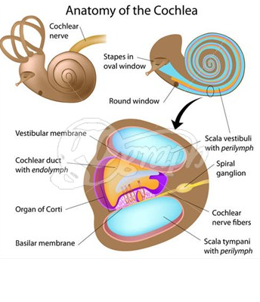
Rapid Review Over Cochlear Anatomy

Slide 9
Keep In Mind
Exact positioning of electrode array in cochlea during cochlear implant surgery
Better post operative audiometric outcomes
Notes:
Title is missing

Slide 10
Details About the MSCT Technique
All acquisitions were made with 16-slice multi-detector computed tomography scanner (General Electronic, Bright Speed) in axial plane, parallel to infra-orbito meatal basic line or parallel to orbitomeatal basic line with 0 to 15 degrees angle to caudal with purpose of not including of orbital lens
Notes:
Make bold the important words

Slide 11
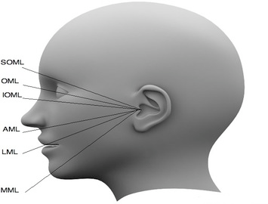

Slide 12
MSCT Parameters
Voltage 140 kv
Amperage 250mA
Pitch 0.56
Matrix 512*512
Slice thickness 0.6mm
Collimation 0.6 mm
Rotation time 1s
Without inter slice gap
Fov 100 mm

Slide 13
suitable window width and window level were 4500 and 1050 CT number respectively.
Image reconstruction was done in bony algorithm.

Slide 14
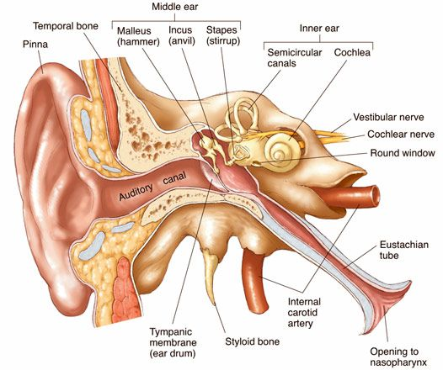
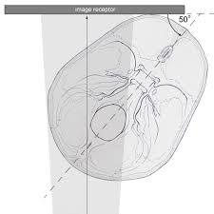
Reconstruction of Images
Images were reconstructed with software AW4/4 in the oblique coronal plane, parallel to cochlea (modified stenverse view) and oblique sagittal plane (perpendicular to modiolus) with the help of volume rendering technique

Slide 15
Results
Oblique coronal and oblique sagittal reformations were helpful in detecting the location of intra-cochlear electrode position, relative to scala media and lateral wall of scala tympani.
True axial graphs were helpful in detecting the depth of insertion.

Slide 16
Results (Cont.)
Three dimensional reconstructed images were not helpful in detecting the depth of insertion and they underestimated the number of cochlear implant turns.

Slide 17
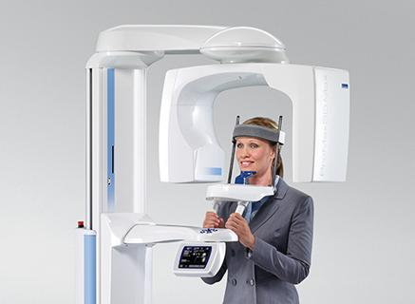
Results (Cont.)
Cone beam CT is a useful technique for post-operative imaging for identifying the cochlear implant position. However, it has dramatic limitation in usage for children who are the main group of patients requiring cochlear implant. this limitation is because of the special positioning of the patients required during the performance of this type of CT

Slide 18
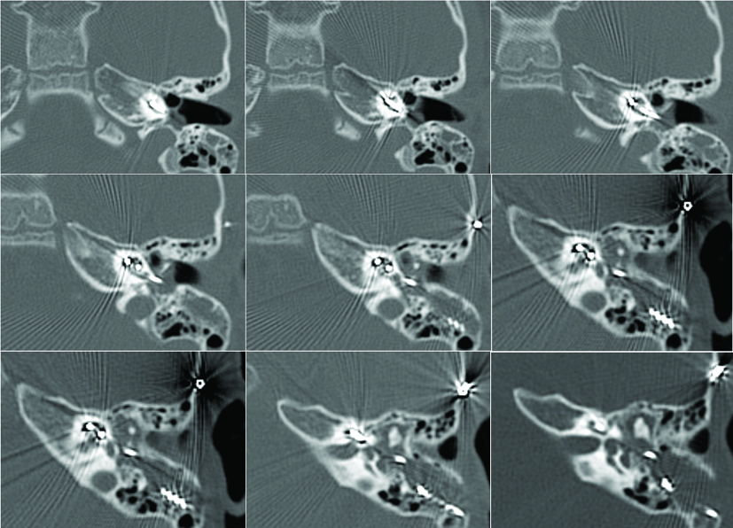
Case 1
Figure 1- Consecutive axial images of a 2.5 Year old boy In whom the electrode was inserted deeply in the cochlea. The audiometric outcome after one year follow up was good

Slide 19
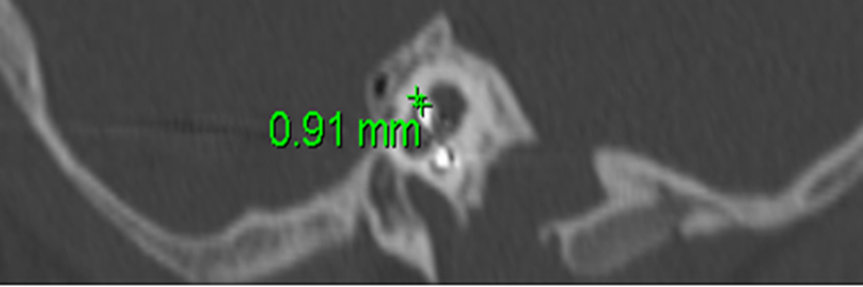
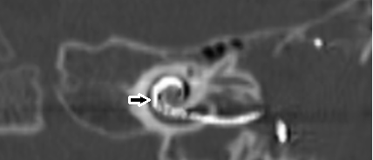
Case 2
Figure 2-oblique coronal and sagittal images from a 2-years old patient, one year after cochlar implant surgery which shows electrode is located in perimodiular position(medial compartment) in coronal image(arrow), the distance between electrod and lateral cochlear wall is about .9 mm in sagittal image. this patient had better audiometric outcome than other patients in follow up tests

Slide 20
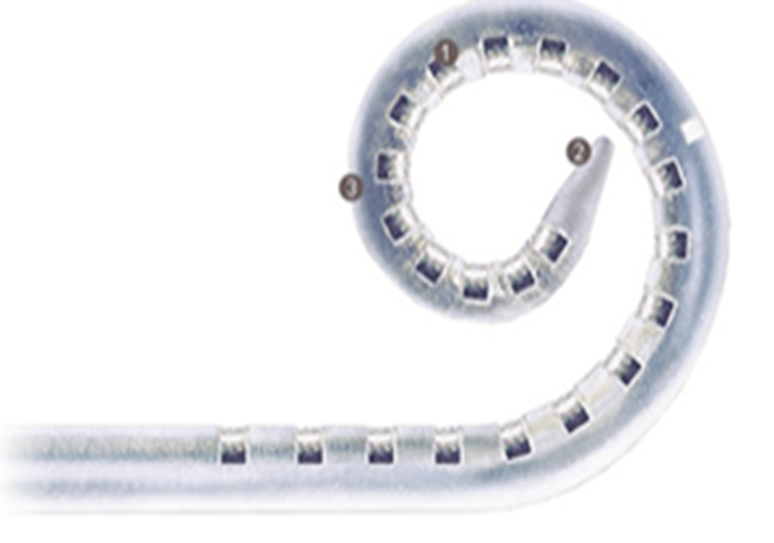
Schematic Image Of Electrode Array
A schematic picture of an electrode. the electrode is provided by a soft tip to protect the delicate walls of the cochlea during the surgery. This soft tip shows low density in the imaging and might not biased the determination of the exact depth of the electrode insertion.
The next case is an example indicating
that this point should be considered

Slide 21
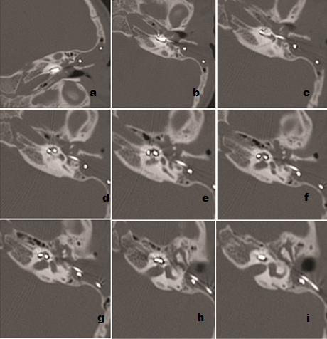
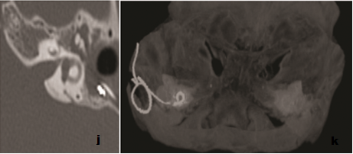
Case 3
Consecutive axial and 3D images of a two-year old boy. In this case, it appears from the images that the depth of insertion of the implant is not adequate. This finding is related to a considerable fact that, the soft tip of electrode array has lower density( figure j) and may not appear in the imaging, also after one year follow up this patient had good audiometric outcome.

Slide 22
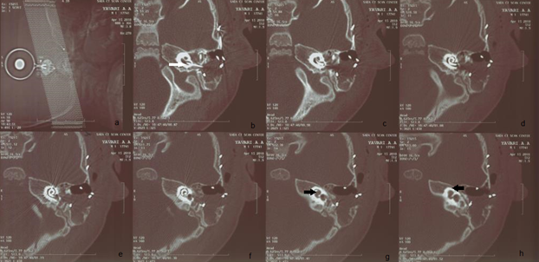
Case 4
Consecutive axial images of a three-year old boy with labyrinthine dysplasia and Mondini disease which shows that widening of base of the cochlea at the entrance of the cochlear implant electrode( white arrow in b), absence of modiolous and dysplastic vestibule (black arrow in g & h). As it is shown in the images, the electrode array has not reached to the end of cochlea and the audiometric findings after one year was not fine.

Slide 23
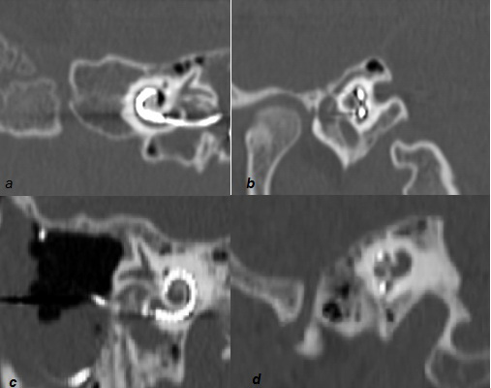
Case 5 & 6
Cochlear implant position in the medial compartment (a in oblique coronal and b in oblique sagittal plane) which showing the distance from the lateral cochlear wall with white arrow and lateral compartment (c in oblique coronal and d in oblique sagittal plane) of scala tympani which showing no distance from lateral wall of cochlea with black arrow

Slide 24
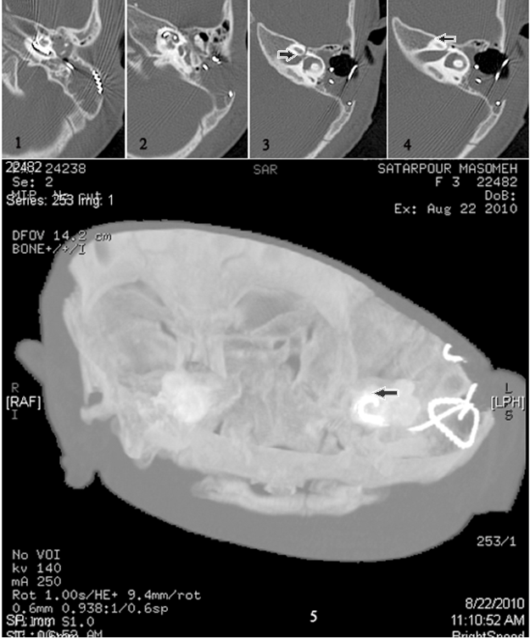
Case 7
consecutive axial and 3D images from a 2 year-old girl , one year after CI surgery ,which is depicted the electrode was not reached the end of cochlea(black arrow in 3,4 & 5) and unfortunately after one year follow up audiometric results were not fine.

Slide 25
Conclusion
Patients with increased electrode insertion and perimodiular location had better audiometric outcomes
Oblique coronal and sagittal images are best in determination of electrode array position
Soft tip of electrode array has lower density and should be considered in determination of electrode insertion

Slide 26
Thank You!
Questions?
fatemeh.nasri.62@gmail.com

