Slide 1
Synthetic-Natural Polyblend Nano-micro structured Scaffolds for Tissue Engineering Applications
Fatemeh Ajalloueian
Technical University of Denmark, Copenahegn, Denmark

Slide 2
Bladder Tissue engineering

Slide 3
Requirements with Artificial Bladder to replicate Native ?
Macroscopic view:
musculomembranous hollow organ
Three major parts anatomically: the apex, the body, and the base
average wall thickness of around 3 mm (human)
Microscopic View:
Three layered wall
Urothelium includs basal cells, intermediate cells and umbrella cells
The submucosal layer composed of fibrillar or bundle-shaped collagens (type I and type III) as well as elastin fibrous network
Outer: The muscular component of the bladder wall
Middle: Submucosal layer
Inner: The urothelium (multilayered specialized epithelium)

Slide 4
Anatomy of bladder
The two posteriolateral openings are entrances of the ureters to the bladder
The anterior opening (called the neck of the bladder) connects the bladder to urethra
Urachus
Ureter
Mucosa
Submucosal layer
Detrusor muscle
Trigon
Intramular striated muscle
Pelvic floor

Slide 5
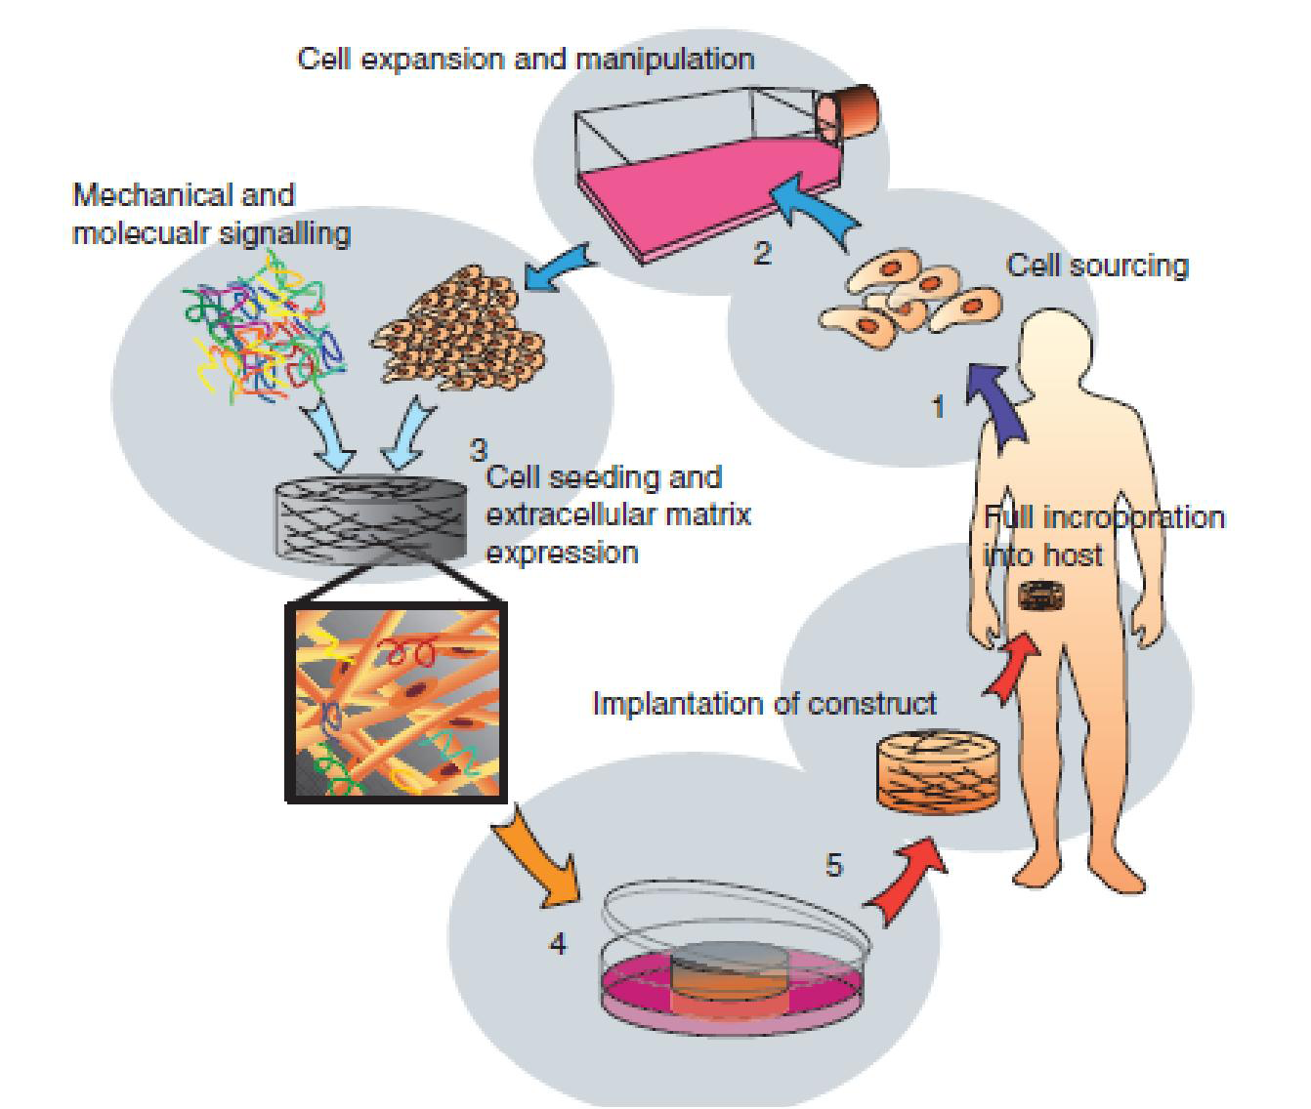
Cells
Common method: urothelial/smooth muscle cells
Our method:
bladder minced tissue

Slide 6
Why minced tissue?
No need to individual cell culturing which is:
Time consuming
Needs high quality cell culturing facilities
Limits surgical usage
Can be put on/in the support on the surgical table and be back to the patient body in minutes

Slide 7
Minced tissue preparation
Laparotomy and excision of a portion of bladder under general anesthesia
Mechanical removal of the detrusor muscle to have the bladder mucosa
Mincing the mucosa to have particles around
0.3 x 0.3 x 0.3 mm

Slide 8
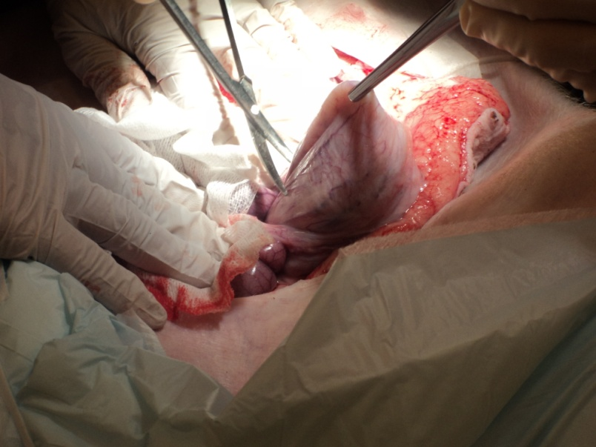
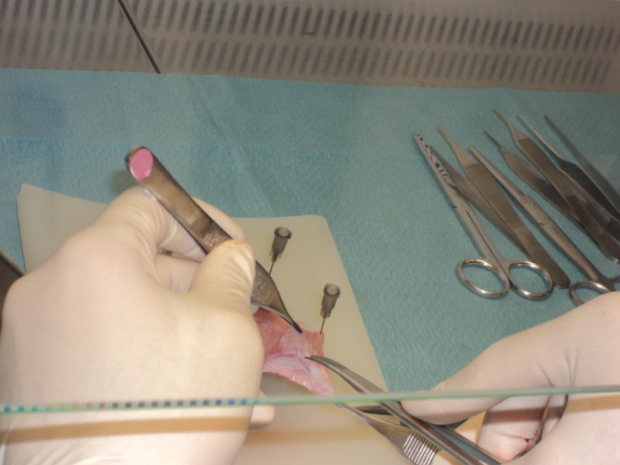
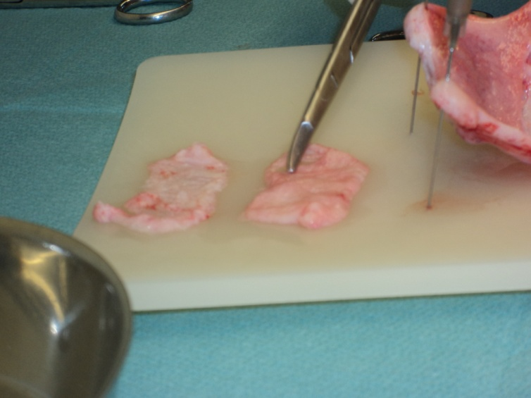
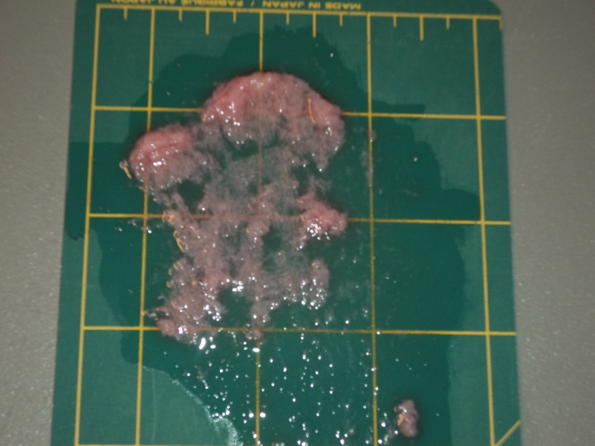
Minced tissue preparation

Slide 9
Scaffold: Support for minced tissue
Which biomaterial(s)?
Which fabrication technique(s)?
Collagen
Plastic Compression
The urinary bladder wall (UBW): consists largely of collagen (about 30-60% of dry weight)
Conventional collagen-based scaffolds (gels or sponges) suffer from weak properties

Slide 10
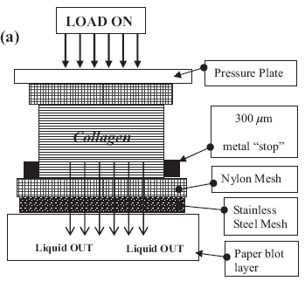
Plastic Compression
+ Robert A. Brown, 2005, adv. Funct. Mater.

Slide 11
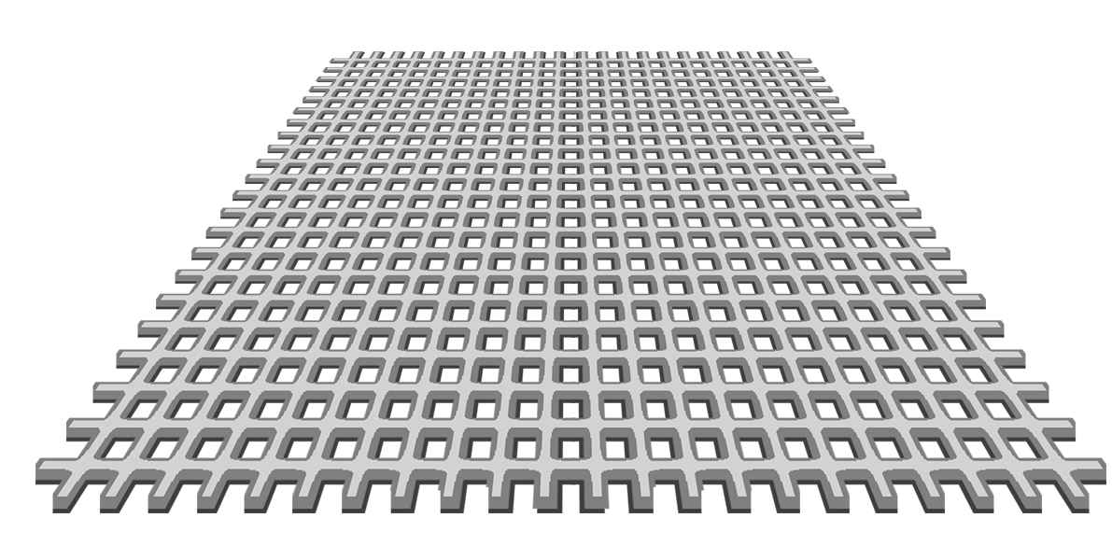
Plastic Compression_Common Method
120 grams
30’
5”
Notes:
the first is for a normal compression and the second is for the hybrid that Michael developed using your polymer meshes sandwiched between two layers of PC collagen (we published this in Tissue Engineering). In the animation the bottom mesh is the nylon lace fabric that we use and the three layers below that is Whatman number 10 blotting paper. The top is a glass slide which we use (it is broader than the standard slide) but any glass panel will do and we use 120gm weight on top for up to 5 minutes. By removing the water we increase the collagen density and mechanical properties.

Slide 12
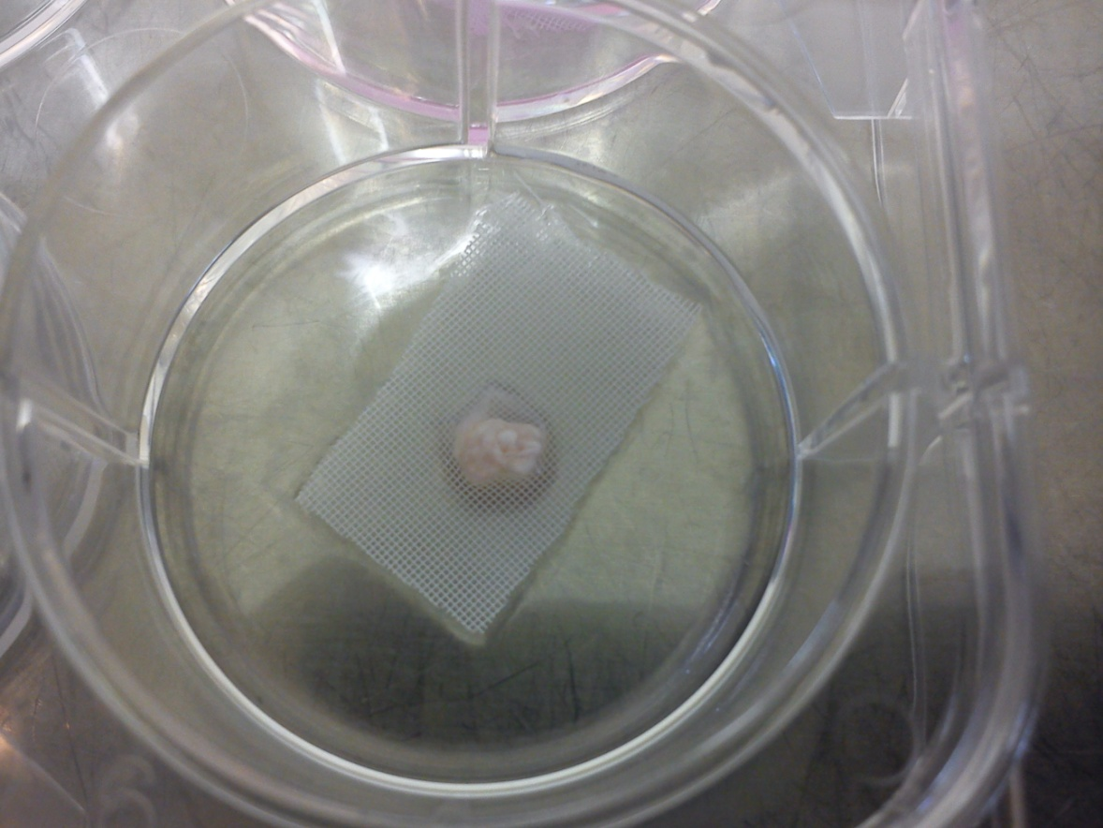
PC collagen-Minced tissue
Sandwich method: minced tissue between two layers of collagen gel and then plastic compression

Slide 13
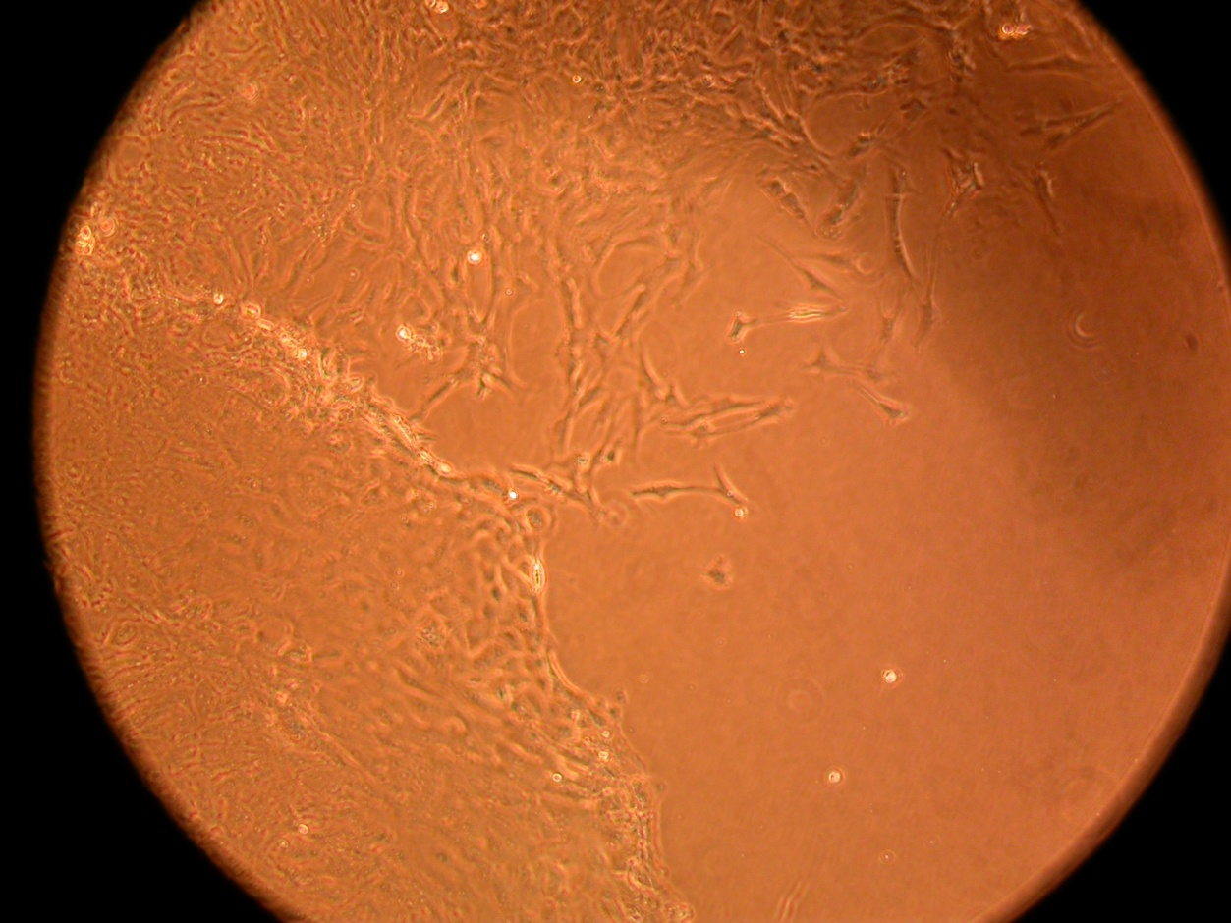
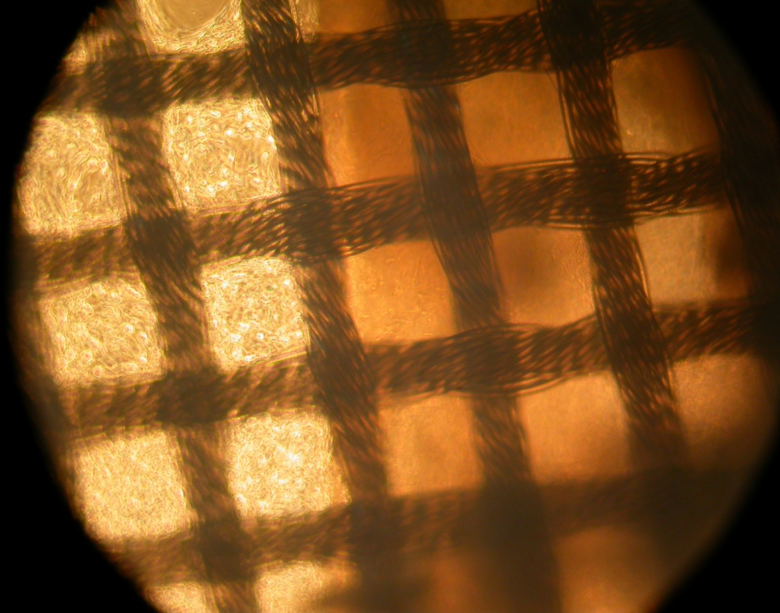
Epithelial cells and connective tissue in sandwich method
Connective tissue cells in collagen and on nylon mesh in smoothie method

Slide 14
Reinforcing PC collagen
Natural-synthetic hybrid constructs
Synthetic polymers applied:
PCL (Knitted fabric)
PLGA (Electrospun mat)
Silk fibroin (Electrospun mat)

Slide 15
Hybrid construct fabrication

Slide 16
PC collagen - PCL knitted fabric
PCL (Polycaprolactone): a biocompatible and biodegradable polymer
FDA approved
Good mechanical properties
But there is a problem:
Different hydrophilic properties of collagen and PCL leads to partial separation of PCL knitted fabric from collagen after plastic compression.

Slide 17
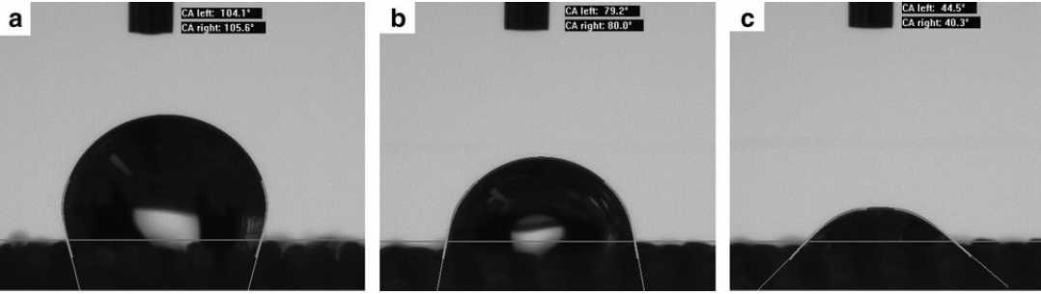
Improving PCL hydrophilicity
1. An alkaline hydrolysis on PCL knitted fabric
(2.5 M NaOH for 40 minutes under 40 °C )
2. A treatment with PVA solution (1% w/v)
Contact angle measurement of the surface of PCL-knitted mesh: (a) without any treatment; (b) after slight alkaline hydrolysis; and (c) after poly(vinyl alcohol) treatment following alkaline hydrolysis

Slide 18
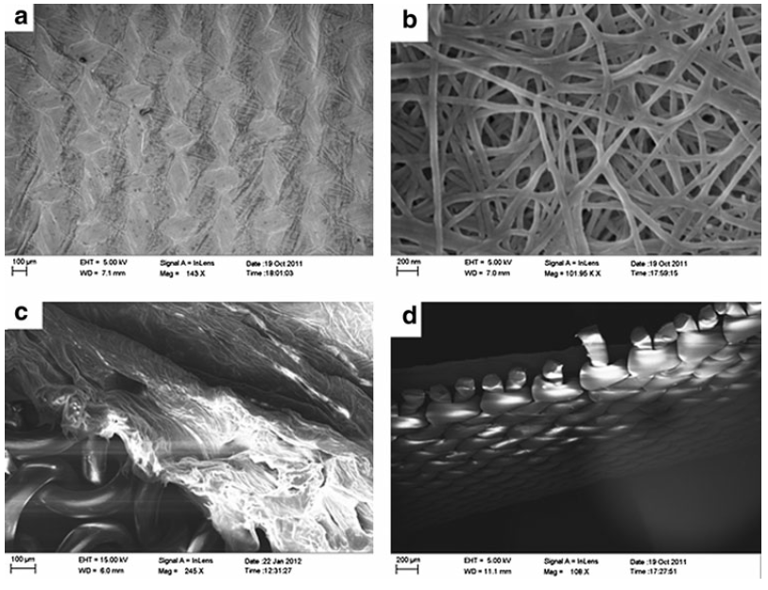
PC Collagen/PCL hybrid structure
Surface of plastically compressed collagen-PCL- knitted mesh in (a) macroscopic and (b) microscopic view, and the cross-sectional view of the construct (c, d).

Slide 19
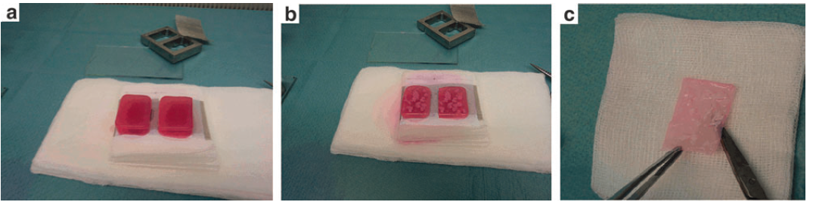
Minced tissue seeding
Procedure for seeding minced tissue onto the hybrid construct: (a) the poly(e-caprolactone) (PCL)-knitted mesh between slabs of collagen hydrogel; (b) minced tissue distributed on the surface of (a); (c) hybrid construct of PCL-collagen.

Slide 20
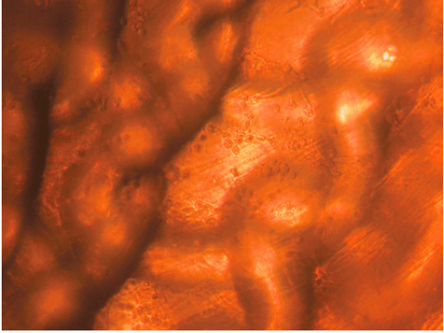
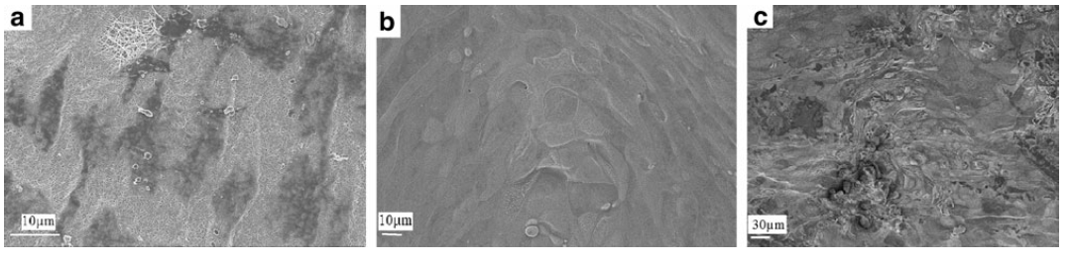
Microscopy images of tissue-seeded scaffolds
a
b
c
d
Phase-contrast microscopy (a) and SEM images (b-d) of minced bladder mucosal particles seeded onto a PCL-collagen after (b) 2 weeks, (a,c) 4 weeks, or (d) 6 weeks in cell culture

Slide 21
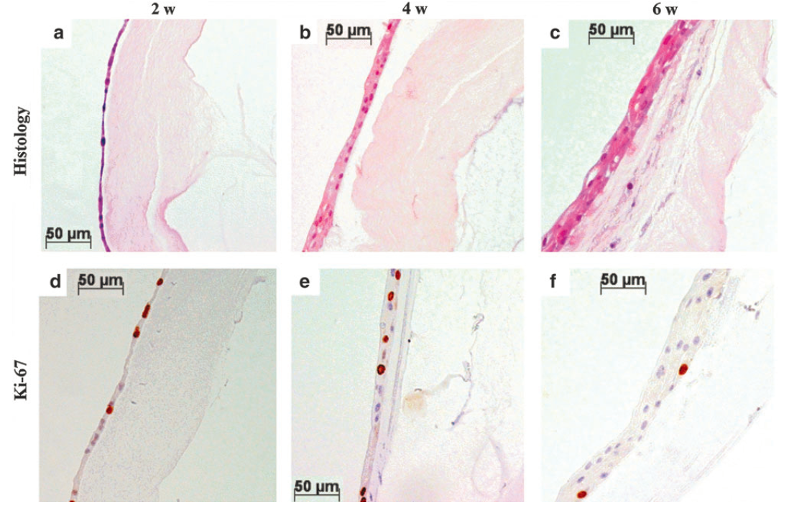
Histology
Histologic appearance hematoxylin (HTX)-Eosin): from single layer tomultilayer epithelium (a–c);in (c) there are also cells inside the collagen. Cells positive for Ki-67 stained brown (in a proliferative state) (d–f).HTX staining of nuclei of other cells (d–f).

Slide 22
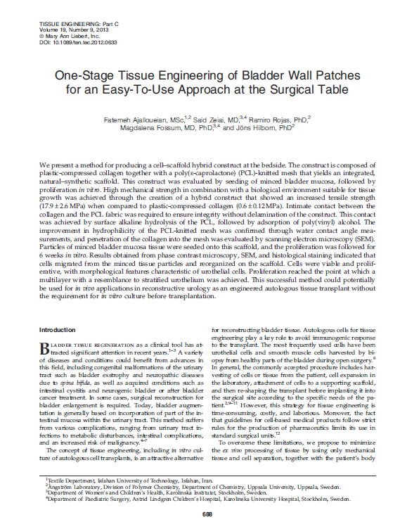
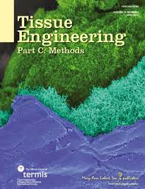

Slide 23
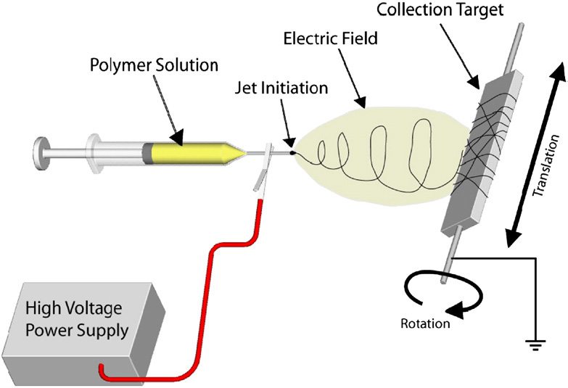
PC Collagen-PLGA hybrid construct
Electrospinning involves the ejection of a charged polymer fluid onto an oppositely charged surface.
Simple and not expensive
control over fiber diameter and scaffold architecture
Final mat:
Mimicking the ECM fibrillar structure
High surface to volume ratio
High porosity
A schematic of the electrospinning process to illustrate the basic phenomena and process components¹

Slide 24
PCL Knitted fabric VS PLGA electrospun mat
Mass per similar area
PCL knitted: Area 30 mm x 20 mm: 65.5 mg (thickness:400 µm)
PLGA mat: Area 30 mm x 20 mm7.6 mg (Thickness: 200µm )
Biodegradation
(PCL: more than 2 years, PLGA: 5-6 months)
Further treatment
(No need to hydrophilic improvement for PLGA mat)

Slide 25
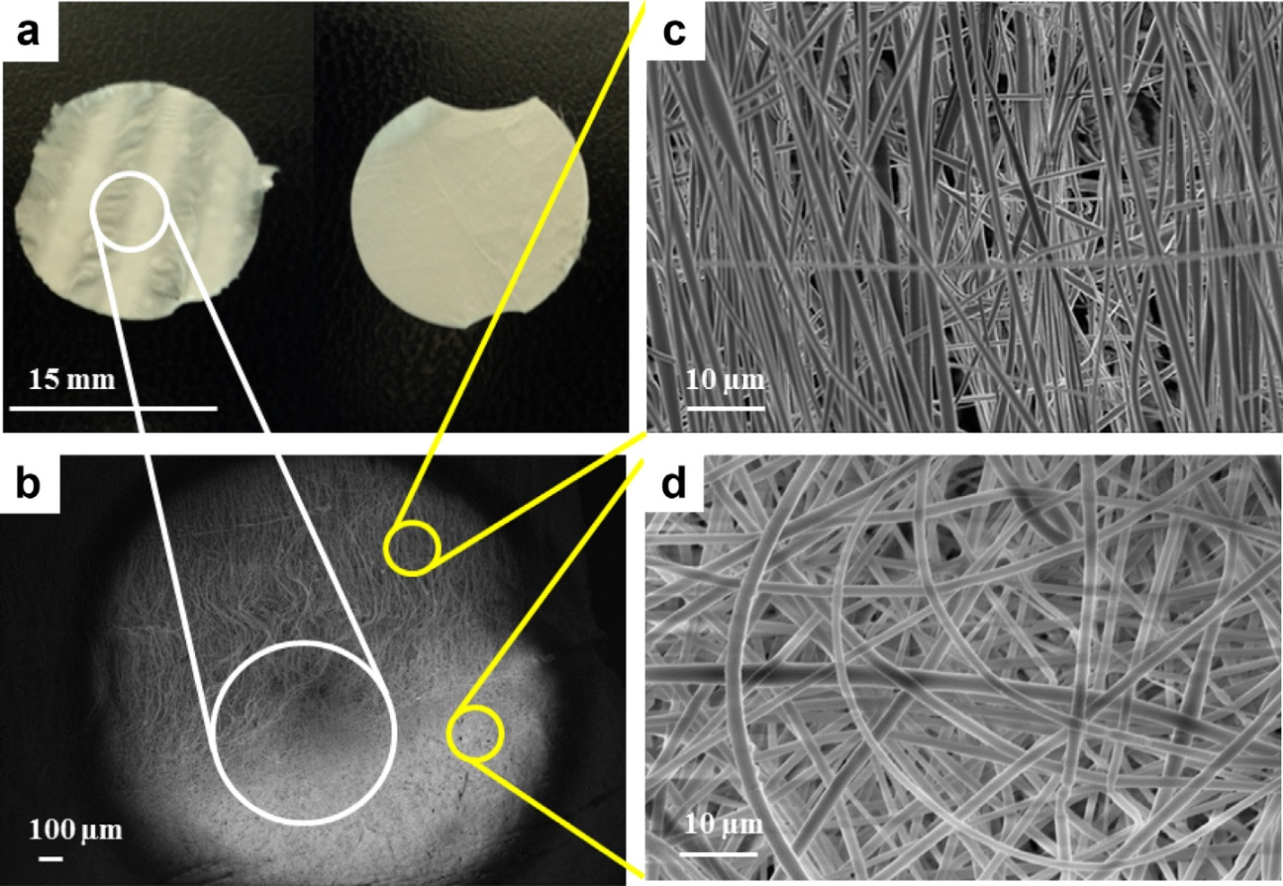
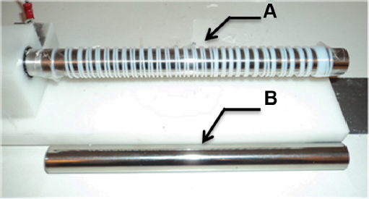
optimised PLGA electrospun mat

Slide 26
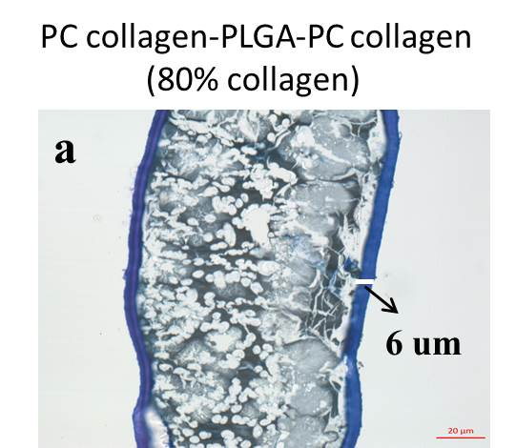
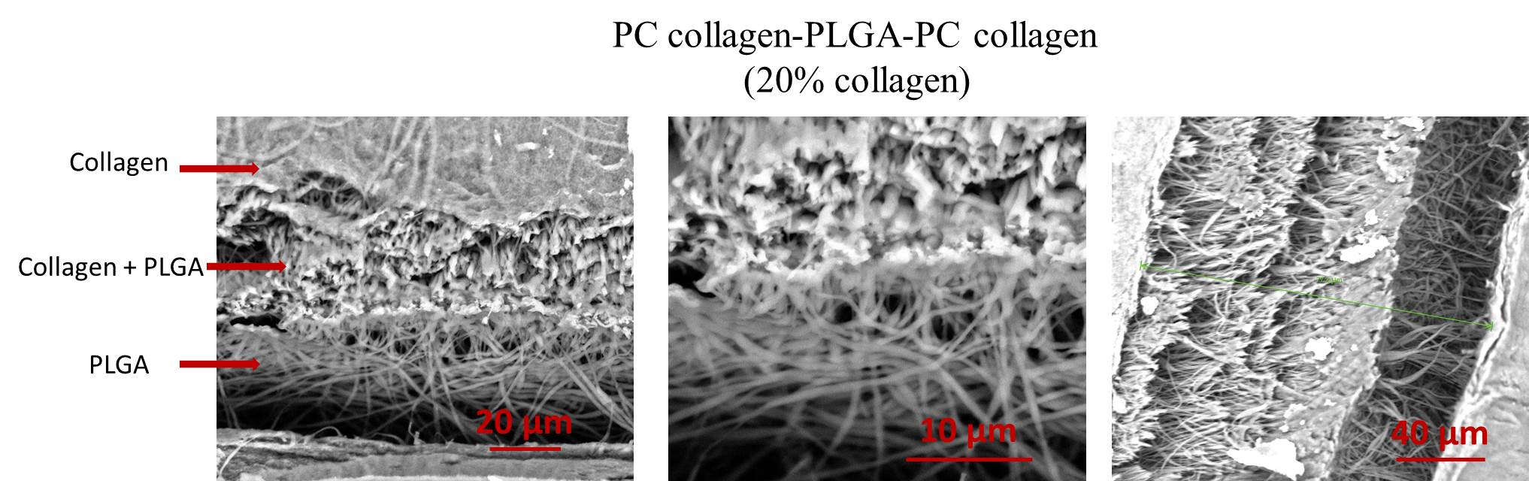
PC collagen - PLGA electrospun mat

Slide 27
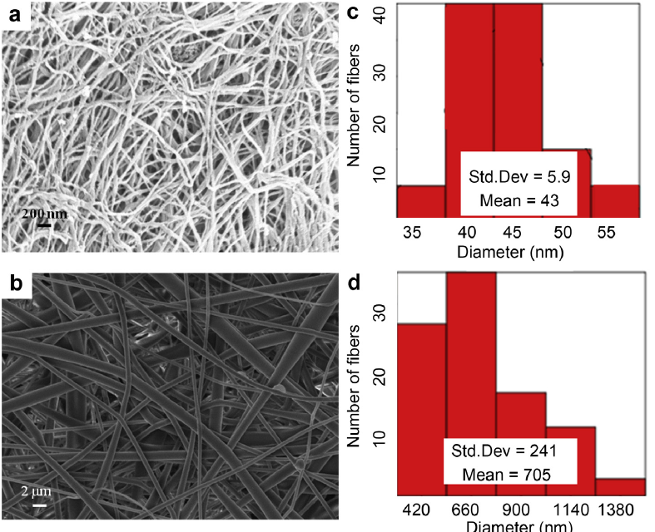
Microscopy images of tissue-seeded scaffolds
Representing fibrous morphology of the PC collagen and PLGA electrospun mat: SEM images and diameter distribution of the collagen nanofibers (a and b) and PLGA mat (c and d) are shown

Slide 28
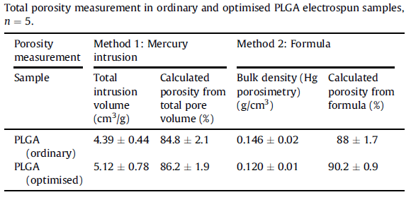
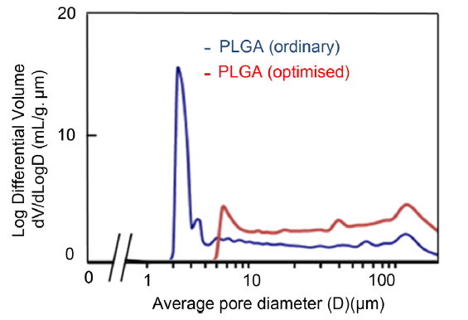
Optimized PLGA with lagrer pore size

Slide 29
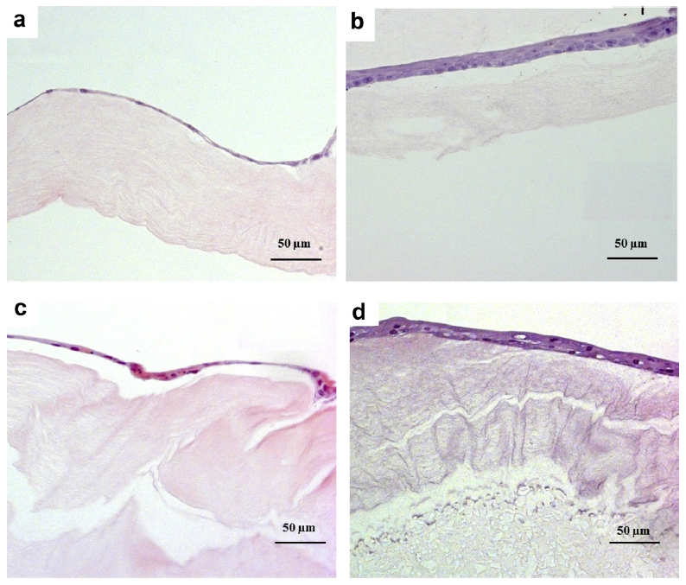
Histology
Histologic appearance (Haematoxylin (HTX)eEosin) from single layer to multilayer epithelium: (a and b) by the top method after 2 and 4 weeks in culture and (c and d) by the mixed method after 2 and 4 weeks in culture. PC-collagen is stained pale pink, and PLGA mesh is shown in white (unstained) between two collagen layers. Cell morphology appears typical for urothelial cells in all samples.

Slide 30
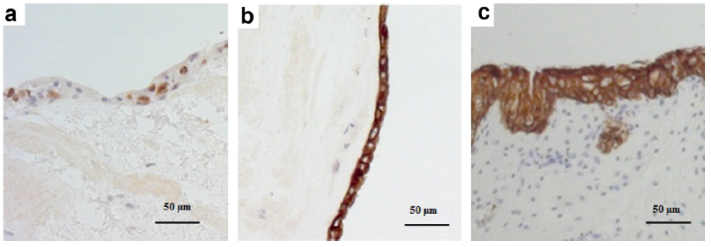
The minced tissue-seeded scaffold vs. native pig bladder
Comparing the minced tissue-seeded scaffold and native pig bladder: (a, b) Cells after 4 weeks in culture (mixed method) and (c) normal pig bladder: (a) cells positive for Ki- 67 stained brown (in a proliferative state) and HTX staining for detection of other cells (purple nuclei), (b, c) brown cell cytoplasm in cytokeratin containing epithelial cells (MNF116) and HTX counterstaining. In the pig, the bladder urothelium is only about 2-4 layers thick

Slide 31
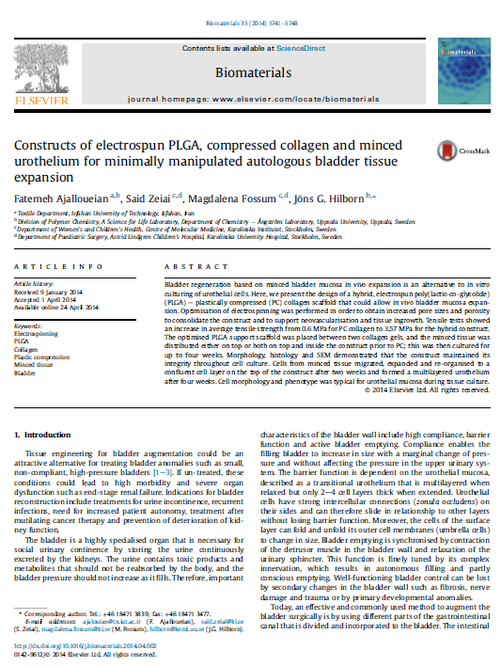
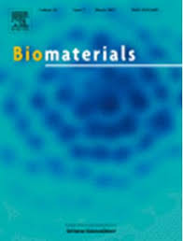

Slide 32
Next Steps
Improving mechanical properties of the scaffold
Comprehensive mechanical and degradation studies
In vivo studies

Slide 33



Acknowledgment
Danish Research Council Foundation
Swedish Society for Medical Research
The Solstickan Foundation, and
The Swedish Society of Medicine

