Slide 1

Replication Competent Viral Vectors
Farshad Guirakhoo, PhD.
Senior VP RD, GeoVax
5th World Congress on Virology
December 7, Atlanta, GA

Slide 2
Contents
Current approaches for development of viral human vaccine
Rationale for development of replication competent viral vectors
Common barriers and challenges
Examples of replication competent vectors in clinical development
Selected replication competent vectors vaccines, marketed or in late stages of development
  VSV-based replication competent vectors
  YFV-based replication competent vectors
Summary

Slide 3
Current approaches for development of viral human vaccines
Vaccine Type | Approach | Example on the market
Inactivated | Whole killed virus | Influenza, Polio, Hepatitis A, rabies
Subunit | Expressed and purified proteins | Hepatitis B, HPV
Live attenuated | Empirical attenuation | YFV, Varicella, MMR, influenza, smallpox
Vector Based | Viral gene(s) in vector are replaced by protective genes from vaccine targets | JEV (based on YF vector)
Nucleic acid based | DNA or RNA is injected directly into the host using a delivery system or an adjuvant | None
Notes:
There are multiple approaches for the development of viral vaccines for humans:
Vaccines can be whole inactivated virus, such as flu, polio, HA and rabies
Part of the protective antigens from the virus is used as a subunit vaccine, generally delivered with an adjuvant to boost the immune response.
There are also live attenuated vaccines such as YF, VZV, MMR, flu, smallpox vaccine. Other vaccines are vector based, the main focus of this talk – and nucleic acid based (delivered as RNA or DNA vaccines, none has been approved for human use sofar)

Slide 4
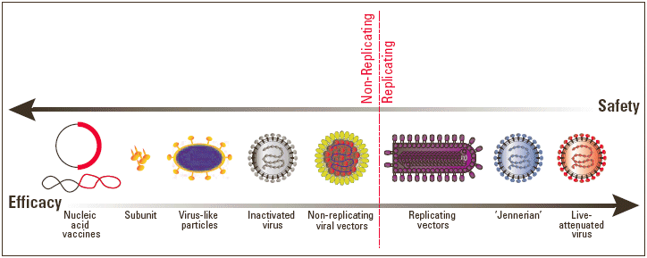
There must be a balance between safety and immunogenicity of viral vaccine vectors
Safety
Immuno-geni-
city
Safety and efficacy of replicating and non-replicating vaccine approaches.
http://www.iavireport.org/Back-Issues/Pages/IAVI-Report-12%283%29-GoForthandMultiply.aspx
Notes:
The most important factor in the construction of viral vectors or any vaccine in general is finding the right balance between safety and immunogenicity. If it replicates too much you will get the disease, if not, it is safe but you may not be protected from the real disease. As mentioned before, there are a number of distinct technologies used to develop viral vaccines. Some of the most efficacious vaccines in use today, such as YF, measles, mumps, and rubella vaccines, are based on live-attenuated viruses. Although live viral vaccines are highly efficacious, there is also potentially a greater risk involved with these vaccines because they are replication-competent. Vaccines that are based on replication-incompetent viruses are perceived to be safer but they have not yet delivered any vaccine to the market for human use. There are also some safe and efficacious vaccines made as inactivated virus vaccines such as poliovirus vaccine, subunit proteins such as Hepatitis B vaccine and virus-like particle (HPV vaccines for cervical cancers).

Slide 5
Rationale for development of replication competent viral vector vaccines
Cost effective manufacturing
Low dose requirement for seroconversion
  (sometime 1000-fold less than a non-replicating vector)
Immunogenicity profile similar to natural infection
  Induction of both humoral and cellular immune responses
  High level of antigen dissemination in the host
  Th1 type biased of response in the host
Anti vector immunity not a significant problem for chimeric viruses
No need for adjuvant, self adjuvanted
No evidence of genetic instability during manufacturing or in humans
Potential as a single dose vaccine
Booster maybe required (1-10 years depending on the type of vector)
Regulatory pathway similar to live viral vaccines with the exception of requirement for a GMO dossier
Notes:
The rationale for using replication competent viral vectors are:
their cost effectiveness,
low dose requirements, in some cases 1000 fold less than replication deficient vectors
Mimicking natural infections
High antigenic mass in humans, Where Both antibody and cellular arms are stimulated,
Th1 response, no anti vector immunity seen for chimeric viruses, no adjuvant requirement, and so far no evidence of genetic instability
They have Potential as single dose vaccines with booster between 1-10 y depending on the vector
And have Similar regulatory pathway to attenuated vaccines with the exception of requirement for a GMO dossier

Slide 6
Common Barriers and Challenges
Size of insert
Genetic stability of insert
Anti vector immunity
  Already present in humans (Vaccinia, VSV, Ad5, measles)
  Induced after the first injection
Balance between safety (attenuation) and immunogenicity (replication)
Safety
  Persistence in hosts (latency and reactivation in vivo)
  Pathogenicity
  Neurovirulence/viscerotropism
Regulatory requirements (GMO issues)
Environmental safety (GMO)
  Reversion to virulence
  Shedding from the vaccinated person
  Natural vector (e.g. mosquito) transmission
  Recombination with WT virus
    In vitro, during manufacturing
    In vivo, in host
  Differentiation of vaccine from natural virus
Notes:
Similarly here genetic stability could be an issue if the transgene is too large, which is not the case for chimeric viruses (e.g. YF-JE, DEN or WN), vector immunity could prevent multiple immunizations
Generally there is balance between safety and immunogenicity except for the HIV vector, which was not safe as shown with an accident of infection; Sydney Blood Bank Cohort comprised eight individuals who were infected with an attenuated, nef/LTR-deleted strain of HIV-1 from a single donor. They were followed up for 30 years and some showed low levels of viremia. These observations made it clear that live-attenuated HIV vaccines are not safe enough to be tested in humans.
Similar to incompetent vectors, genetic stability during manufacturing needs to be monitored

Slide 7
Examples of replication competent viral vectors in clinical development
Vaccine | Indication | Comments | Ref
Ad4-Env | HIV | Replacing Ad E3 gene with HIV env genes. Induced both antibody and cellular responses against HIV Env in rabbits. Currently in ph1 (no data available) | Alexander J et al. (2013), PLoS ONE 8(12): e82380. doi:10.1371/journal.pone.0082380)
Varicella-zoster virus (VZV) | HIV, others? | Proven safety and efficacy (chickenpox and shingles vaccines). Large genome (125KB) allows stable transgene. Replications limited to humans avoid spread into environment. Mimic natural infection, Th1 immune response. No genes associated for oncogenesis. Vector immunity and lack of animal models could have negative impact on vaccine development (Simian VZV used as surrogate) | Wayne L. Gray (2013), Advances in Virology, Volume 2013. http://dx.doi.org/10.1155/2013/219439
Tiiantan vaccinia | HIV | Derived from smallpox, TV-HIV delivered by scarification induced HIV specific T cell response (Ph2 by china CDC). Used as boost for DNA primed by electroporation. Significant protection (SIV) as prime boost with adeno | Shao, Y., et al. AIDS Vaccine 2009. Vol. 6. Retrovirology; Paris, France: 2009. p. P404P404
VSV | HIV, Ebola, Marburg (Chimera)* | VSV G replaced with functional Env. VSV –HIVgag in ph1, induced T cell specific response w/o causing serious AEs. VSV-Ebola in Ph3 completed, 100% efficacy in ring vaccination (n=7651) | Fuchs, JD., et al. AIDS Vaccine 2012. Retrovirology; Boston, MA, USA: 2012.; p. P134. NCT02287480. Lancet July 31, 2015
Sendai virus | HIV | Prime-boost with DNA, strong suppression of SIVmac239 replication after IV challenge. Ph1 with SeV-HIV gag by IAVI and DNAVEC, ongoing with Ad35 prime/boost | Hara H, et al. Hum Vaccin. 2011; 7:639–645. ClinicalTrials.gov NCT01705990
Measles and CDV | HIV, Chik, dengue | MV-HIV and MV-Chik , immunogenic in macaques, in Ph1 by Inst Pasteur. Used by mucosal route with high dose or exchanged envelope with GP with CDV to overcome preexisting immunity. (CDV neut is low in humans, no human disease) | ClinicalTrials.gov NCT01320176 http://www.themisbio.com
YFV | WNV, JE, Dengue (Chimera)* | Not NV for mice or monkeys by IC route, do not replicate in mosquitoes, lack of recombination, YF-WNV approved as a horse vaccine, YF-JE approved as human vaccine, YF-DEN successfully tested in in 2 Ph3 trials (40,000 subjects) | Capeding MR et al (2014). The Lancet (Published online July 11, 2014). Vilar L, et al. NEJM. 2014 (published online November 3)
*: In chimeric viruses, the envelope of vaccine target is functionally incorporated into virions, whereas in other replication competent vectors, the envelope of vaccine target is only expressed in infected cells and not incorporated into virions
More readings: Excler et al, Biologicals 38 (2010) 511-521
Parks et al, Curr Opin HIV AIDS. 2013 September ; 8(5): 402–411. doi:10.1097/COH.0b013e328363d389.
Notes:
Here are some examples of replication competent vectors in clinical development: Multiple vectors like adeno, Varicella an others are constructed as vaccine viruses for delivery of protective antigens for HIV. However Due to time constrains, We will focus in the following slides on 2 vectors highlighted in pink here;
One is VSV vector used for the ebola vaccine, which has just successfully completed the phase 1 trial,
The second vector is YF vector, which is used to construct chimeric vaccine viruses and is already approved as WN vaccine for horses, a vaccine against JE licensed for humans in Asia, and for dengue vaccine which has successfully completed 2 large efficacy trials and is currently in registration for endemic countries
I like to mention here a difference between chimeric vectored viruses and other replication competent viruses is that in chimeric viruses the immunizing target antigen, or the transgene is incorporated in the mature virions, whereas in other vectored viruses the transgene is only expressed in virus infected cells and is not incorporated into virions

Slide 8
Selected replication competent vectors vaccines (chimera), marketed or in late stages of developments
VSV vector for Ebola vaccine, Ph3
YF-based vectors
  YF-WN (veterinary vaccine), marketed as PreveNile™
  YF-WN (human vaccine), completed Ph2 in elderly
  YF-JE (human vaccine), marketed as Imojev™
  YF-DEN TV( Human vaccine), in registration
*:IMOJEV™ is trademark of Sanofi Pasteur
Notes:
In the following slides I will talk about VSV vector for ebola, and YF vector for WN, JE and dengue vaccines

Slide 9
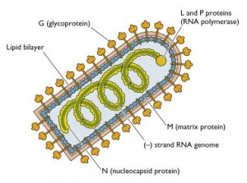
Vesicular Stomatitis Virus (VSV) as a replication competent vector for vaccine against Ebola
Prototype genus Vesiculovirus of the family Rhabdoviridae
An arbovirus transmitted by sand fly insects to animals, causes a mild flu like illness in humans
Genome contains a single molecule of negative-sense RNA, 11,161 nucleotide long, encodes five major proteins
Poorly replicates in normal human cells (possibly due to intact interferon system)
Used as an oncolytic virus for some cancer therapy*
Used as a vector for Ebola vaccine
*: Bell, J. C., et al. (2000) Nature Medicine 6(7), 782–89
the bullet-shaped morphology of vesicular stomatitis virus (a virus related to rabies virus)
http://www.virology.ws/2010/02/23/architecture-of-a-bullet-shaped-virus/
Jeffrey E Lee
Ebolavirus glycoprotein structure and mechanism of entry
Future Virol. 2009 ; 4(6): 621–635. doi:10.2217/fvl.09.56.
Notes:
VSV is the prototype of vesiculovirus from Rhabdoviridae family, is an arbovirus transmitted by sand fly insects to mostly animals. Rare Human infections are mild flu like illness
Genome consists of A single negative sense RNA about 11KB coding for 5 proteins.
In human cells, it replicates poorly, possible due to an intact IFN system, but can be used as oncolytic virus which allows its replication due to reduced IFN response in cancer cells,
Since it does not naturally infect healthy humans, there is low ab prevalence therefore less issue for vector immunity using as a vaccine for example for ebola

Slide 10
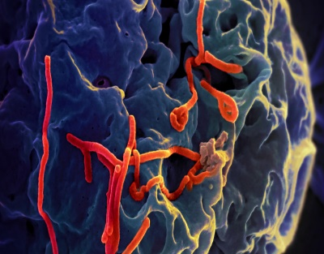
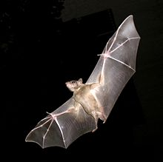
Ebola virus (EBOV)
Member Filoviridea (2 genera; Marburg virus and Ebola virus)
SS, neg-sense RNA, ~19,000 nt, 7 structural and 1 non-structural protein
Highly virulent, causes severe, often fatal disease (50-90% fatality) in humans and other mammals
Bats believed to be natural reservoir, primarily transmitted to animals and humans through bodily fluids
First disease outbreak in 1976 in Central Africa, near the Ebola River, in Congo, most recent outbreak in 2014 in West Africa
On August 8, 2014, WHO declared the new EBOV outbreak as a public health emergency of international concern*
This has been the largest outbreak with more cases and deaths than all others combined
  There have been 28,601 human cases and more than 11,300 deaths as of December 2, 2015
Ebola viruses (red) adhere to the surface of a monkey cell (blue) in this scanning electron micrograph
Common fruit bats (Rousettus aegyptiacus) flying
*: (http://www.who.int/mediacentre/factsheets/fs103/en/).
Notes:
Some info about ebola
Member of Filoviridae including Marburg virus as well, ss negative sense RNA of 19KB codes for 7 Structural and one NS protein. Highly virulent (50-90% fatality) for humans and other mammals. fruit bats are believed to serve as a natural reservoir, primarily transmitted the virus to animals and humans through bodily fluids.
It has caused multiple epidemics, the first one in 1976 near the Ebola river in The Democratic Republic of Congo
But the largest outbreak occurred in Aug. last year with more than 27705 human cases and more than 11269 death as of Jul 19, 2015

Slide 11
Construction of VSV-Ebola vector (Chimera)
  GP of an attenuated VSV was replaced by GP of EBOV
  GP of EBOV is the only viral protein targeted by neutralizing antibodies
  GP of EBOV is critical for virus attachment and fusion process*
  rVSV-ZEBOV-GP chimera was:
    Non-pathologic in primates and mice
    Protected 100% of non-human primates given 4 w before challenge**
  Merck MSD holds exclusive license from NewLink Genetics for dev/commercialization
  Large Ph3 ring vaccination efficacy model was conducted
  However, sequencing of close to 100 EBOV from patients revealed that the virus mutates as fast as seasonal influenza which may pose challenges for the development of an effective universal vaccine***
*: Lee at al., Nature 454, 177-182 (10 July 2008)
**: Geisbert & Feldmann H. J Infect Dis 2011, 204:S1075-S1081
**: Gire et al,. Science 12 September 2014:Vol. 345 no. 6202 pp. 1369-1372. DOI: 10.1126/science 1259657
Notes:
For construction of VSV-EBOLA, the GP of an attenuated strain of VSV is replaced by that of Ebola which is the only viral proteins on the virion and therefore is target of neut abs, GP of Ebola is also required for attachment to host cells and fusion process to release its genome into the host.
The chimera was non pathogenic in mice and primates and showed 100% protection when monkeys were challenged with WT Ebola 4 w post vaccination
Merck and Newlink genetics have teamed up to develop and commercialize this vaccine, they have successfully finished the Ph1 in Switzerland, and planning to move into efficacy trials in Liberia. The trail called Prevail, plans to enroll 27000 subjects receiving one of the 2 experimental vaccines, one replication competent based on VSV as described here and another a replication deficient vector from GSK based on Adenovirus vector. They hope with this number of subjects they have enough cases of disease to show efficacy for the vaccines
Moreover, the efficacy of VSV ebola vaccine candidates needs to be evaluated against natural Ebola isolates; since a study of 100 EBOV isolated form patients indicated that the virus may be mutating as much as the seasonal influenza virus.

Slide 12
YF 17D vaccine virus as a replication competent vector
YFV is the prototype virus within the Flaviviridae family
Strain YF 17D was developed as as live, attenuated vaccine in 1937
Used in >400 MM persons
Single dose for complete immunization
Efficacy ~100%
Rapid immunity (<10 days)
Lifelong immunity
Approved for persons > 9 mo
Well tolerated, very rare serious AEs
Notes:
YFV is the prototype of flaviviridae family. YF 17D has been derived from WT YF Asibi strain, and has been used as a vaccine for more than 75 years in >400 million persons. It is a single dose vaccine with almost 100% efficacy, rapid onset of immunity within 10 days and protection is almost life long. Used in infant as young as 9 m with rare SAEs. These attributes make it an ideal vector for vaccine development

Slide 13
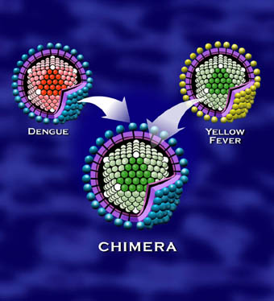
ChimeriVax® Platform*
Chimerization
Replacing the envelope genes of the YF 17D vaccine virus with those of another Flavivirus
The resulting live attenuated virus contains replication engine of YF 17D vaccine virus but the immunogen proteins of a vaccine of interest
OR
OTHER VACCINE
TARGETS
*: CHIMERIVAX® is a registered trademark of Sanofi Pasteur Biologics. It was Originally developed by Acambis, Inc. now part of Sanofi Pasteur
Notes:
YF 17 D is used as a vector to develop vaccines against other flaviviruses such as WN, JE, and dengue.
In this platform, the envelope genes of YF 17D are removed and replaced with those of vaccine targets, creating a chimeric virus where the envelope proteins are the immunogens of the new vaccine target, delivered by the replication machinery of the YF 17D virus

Slide 14
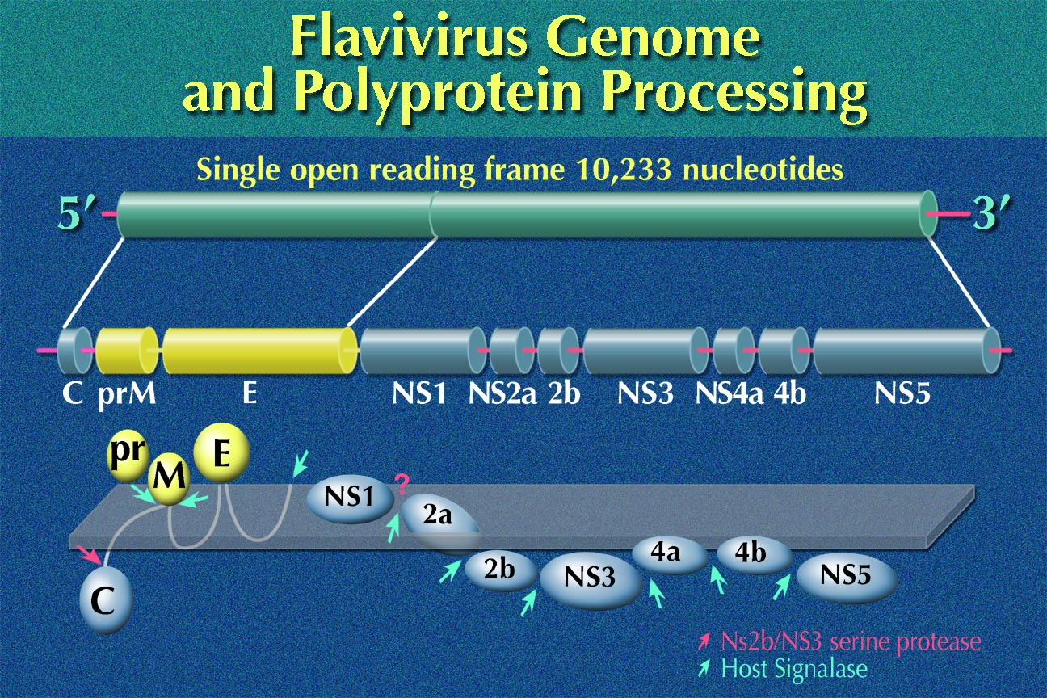
Genome organization
Notes:
The genome of Flaviviruses contains an open reading frame of about 10 kb
It codes for 2 structural proteins, PrM and E and at least 7 non structural proteins (NS1-NS5)

Slide 15

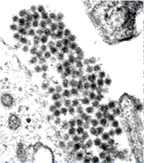
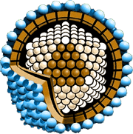
ChimeriVax® Virus Construction
Full length cDNA  RNA
17D YF virus genome cloned as cDNA
C
prM
E
Non-structural sequences
C
prM
E
Non-structural
RNA transfection
Exchange coat proteins sequences for vaccine virus (e.g. JE, WN, DEN)
prM
E
Vero cell
culture
Sequence coding for
17D non structural proteins
C
Non-structural
  A single dose of a LAV induces both humoral and cellular responses and provides a longer protection than inactivated vaccine or recombinant antigens
Recombinant cDNA
C
prM
E
Non-structural
* ChimeriVax™ technology
Vaccine envelope
proteins
Notes:
As mentioned before for the construction of chimeras, the PrM and E proteins of 17D virus are replaced by those of vaccine targets such as JE, WN, and dengue. In vitro CDNA is then transcribed to mRNA which is directly transfected into cell substrates such as Vero cells. Progeny chimeric viruses are harvested and used for large scale production of the vaccine under GMP manufacturing

Slide 16
Preclinical studies of ChimeriVax® viruses
In vitro
  Genetic stability
  Phenotypic stability
  Biochemical and structural analysis
In vivo
  Immunogenicity in animal models
  Viremia
  Neurovirulence testing
  Protection studies
GMO related studies
  Vector transmission
  Reversion to virulence
  Recombination
Notes:
Preclinical studies of all chimerivax vaccines include in vitro genetic and phenotypic stability as well as biochemical and structural analysis.
in vivo characterizations include immunogenicity, viremia, NV tests and protection studies in relevant animals models, and, of course, safety studies required for GMO dossier such as lack of transmission by mosquitoes, risk assessments of reversion to virulence, and recombination with WT viruses

Slide 17
YF-DEN
Notes:
The last part of this talk is focused on preclinical and clinical development of the YF-Den vaccine

Slide 18
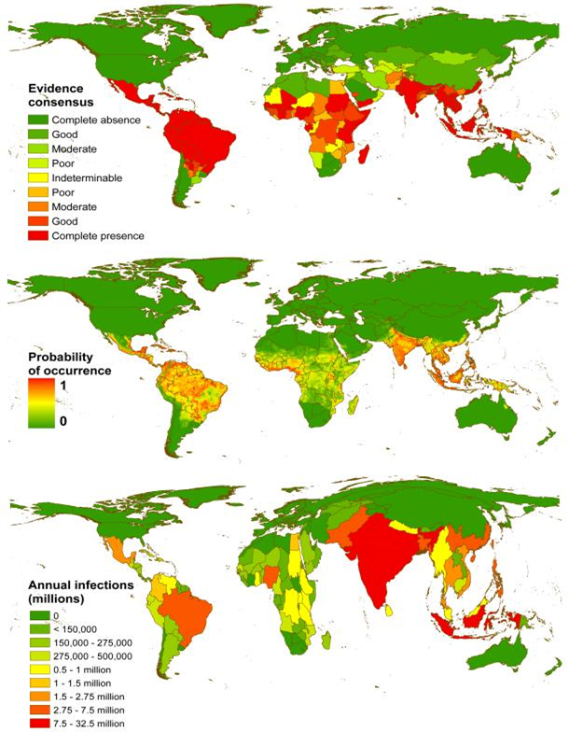
Dengue Disease: A Major Public Health Concern
Transmitted from mosquitoes to humans
World’s fastest growing vector-borne disease
Endemic in > 100 countries
  2.5 billion people currently at risk, rising to 5 or 6 billion people by 2085 (assuming climate change and population growth)
  400 million infections per year
  96 million manifestation (any level of clinical or subclinical severity)*
  2 million severe disease (90% children)
  25,000 deaths
Increasing geographic spread and burden of disease
  Large parts of Europe, West and Central Africa, and South America face the threat of outbreaks**
Notes:
Dengue is also a mosquito borne flaviviral disease like WN and JE, but is growing at a much faster rate.
It is now endemic in >100 countries putting more than 2.5 billions people at risk of infections rising to 5-6 B people by 2085. There are about 400 M infections, 96 M disease manifestations, 2 millions of which are severe diseases mostly in children, resulting in 25,000 cases of deaths per year.
The foot print of the disease is now changing and expanding beyond Asian countries. The disease has been found in parts of Europe, West and Central Africa, and parts of south America as shown on the dengue map at the right side of this slide.
Global warming, increase in travel and urbanization could result in increased exposure and pose a serious threat to areas that do not currently experience endemic dengue.
The UN estimate that the increase due to climate change alone would more than double the number of those at risk to an estimated 3.5 billion.

Slide 19
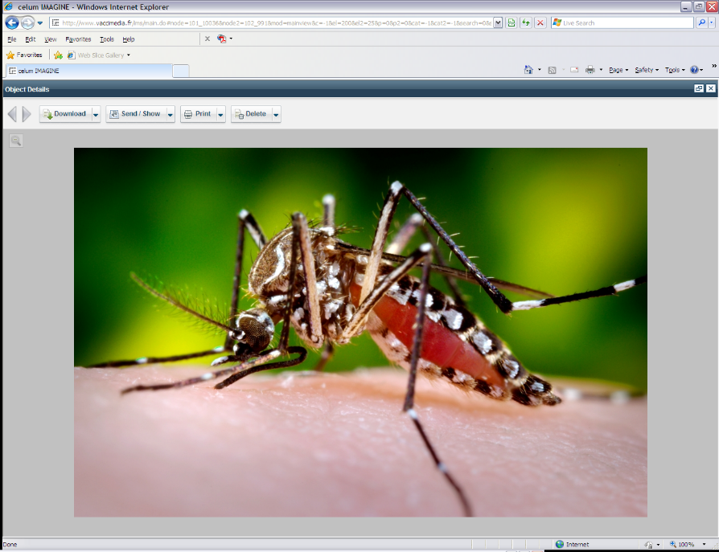
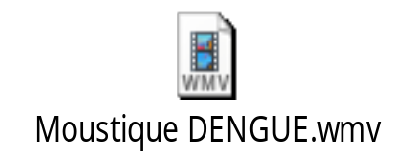
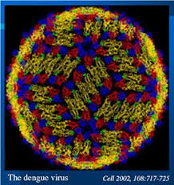
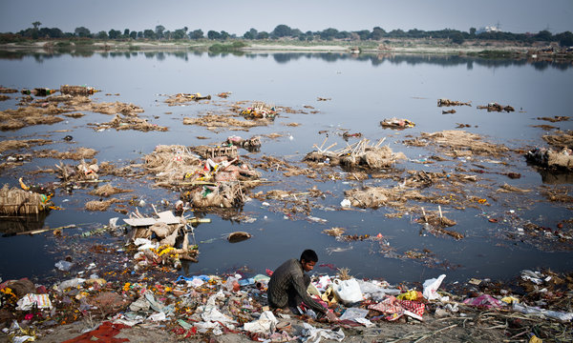
Dengue virus and its vector
Virus is transmitted to humans by Aedes mosquitoes,
especially A. aegypti
Dengue virus is a Flavivirus
4 antigenically distinct viruses DEN-1, DEN-2, DEN-3, DEN-4
Single stranded +RNA
Stagnant water is the main habitat for mosquitoes
Notes:
Dengue virus has 4 serotypes called Den1-4 and similar to JE and WN, has a single stranded RNA genome with positive polarity. In the lower left panel of this Fig, dengue envelope proteins are shown in dimer formations.
Virus is transmitted by mosquitoes after a blood meal from infected persons to healthy persons. Stagnant water is the main habitat for the mosquitoes to lay eggs and reproduce themselves

Slide 20
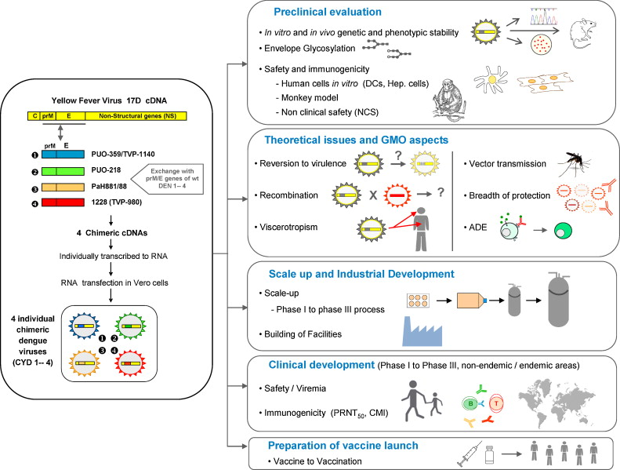
Construction of the YF-dengue vaccine and overall development strategy*
*: Guy et al, Vaccine, Volume 29, Issue 42, 2011, 7229 - 7241
Notes:
The construction and development strategy of the dengue YF chimera is similar to the WN or JE vaccines described earlier, with the difference that the envelope genes for dengue were derived from WT viruses without any manipulation. The vaccine composition is a tetravalent mixture of 4 YF-DEN viruses each representing one of the 4 serotypes shown in the left side of the figure.
At the right side of this figure, the preclinical and clinical development are described; it encompasses genetic stability, safety and immunogenicity in vitro and in animal models.
The theoretical risks assessments and GMO issues such asr eversion to virulence, recombination and viscerotropism, vector transmission and breath of protection and ADE are all well documented. The vaccine was produced at large scale manufacturing using SF Vero cells and tested in volunteers in endemic and non endemic areas around the globe

Slide 21
Phase 2 Trail of TV YF-Den vaccine was however disappointing
4002 children in Thailand were inoculated with Tetravalent vaccine
The overall efficacy was 30% and not statistically significant to that of control
The reason for lower efficacy was mainly due to YF-DEN 2 chimera
Nevertheless multiple Ph3 trials around the globe were planned to allow for precision in efficacy
Notes:
The vaccine program moved from monovalent Ph 1 to tetravalent Ph2.
More than 4,000 children in Thailand were inoculated with the YF-Den tetravalent vaccine. The overall efficacy against all 4 serotypes was 30% which was disappointing.
The reason was mainly due to a low response to the dengue 2 serotype in the TV mixture.
Nevertheless the program moved forward to large phase 3 efficacy trials

Slide 22
Comparison of two Ph3 efficacy trials of YF-DEN tetravalent vaccine
Parameters | Ph 3 in Asia* | Ph3 in Latin America**
Study sites | Indonesia, Malaysia, The Philippines, Thailand, Vietnam | Brazil, Colombia, Honduras, Mexico, Puerto Rico (US)
Number of subjects | 10,275 | 20,869
Age range (Year) | 2-14 | 9-16
No of doses | 3 | 3
Primary objective (safety & efficacy in preventing dengue disease | Safe and 57% efficacious against DF, 81% efficacy against sever disease DHF/DSS | Safe and 61% efficacious against DF 95% efficacy against sever disease DHF/DSS
Additional objectives (Efficacy against 4 serotypes) | 50% against DEN1 35% against DEN2 78% against DEN3 75% against DEN4 | 50% against DEN1 42% against DEN2 74% against DEN3 78% against DEN4
Pre-immunity factor | Efficacy higher in older population: 74% in 12-14 y old 60% in 6-11 y old 34% in 2-5 y old | Efficacy higher in seropositive subjects: 84% in sero+ 43%in sero-
*: Capeding et al. Lancet 2014. **: Vilar et al. NEJM 2014
Notes:
In this slide 2 phase 3 trails are summarized and compared
One performed in Asian countries, including Indonesia, Malaysia, The Philippines, Thailand, and Vietnam; and another conducted in Latin America, such as Brazil, Colombia, Honduras, Mexico, and Puerto Rico.
There were twice as many subjects (20,869) in Latin America than in Asia.
The primary objective of both studies were safety and efficacy in preventing dengue disease. Other objectives were efficacy against individual serotypes as well as the role of pre-immunity in protection against dengue.
In the Asian trial, the efficacy was 57% against dengue fever but 81% against severe diseases such as DHF/DSS. Similarly, in the Latin Am trial the efficacy was 61% for DF but 95% against DHF/DSS. In both trials the lowest seroconversions were again against DEN2 serotype shown in red here.
It was also revealed from these studies that efficacy is higher in pre immune subjects (those who have been previously exposed to WT dengue viruses) as shown by higher seroconversion in older population in the Asian trial or in seropositive subjects in the Lat Am trial.

Slide 23
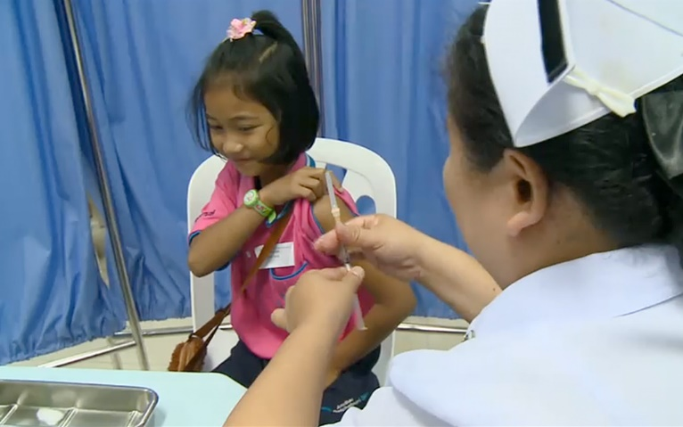
Summary of YF-Den TV vaccine
First successful construction in 1999
>40,000 subjects (ages from 9m-60y) have been inoculated
No SAE to vaccination
Low level of viremia (Serotype 4 and 3 most frequently detected)
Viremia lower in pre-immune subjects or after the 2nd or the 3rd dose
Balance immune response to all serotypes with trend for higher efficacy in older population
Pre-exposure to YF vaccination or WT dengue have booster effects
Highly efficacious against sever dengue diseases
Despite lower response to D2 serotype, no increased AEs was observed in follow up studies (longer post licensure safety monitoring maybe needed)
Licensing strategy is submission for endemic countries first and then for travelers and military personnel
Dengvaxia™* (YF-DEN TV) will be the world’s first dengue vaccine for prevention of mid-severe dengue after
More than 16 years of R&D work
Participant dengue vaccine clinical study in Ratchaburi, Thailand – Feb 2011
*: http://en.sanofi.com/rd/rd_portfolio/rd_portfolio.aspx
Notes:
In summary:
Since the first chimera constructed in 1999, more than 40,000 subjects have received the chimerivax vaccine, including >7000 in Ph2 and >30,000 in ph3 trials.
No SAE have been observed so far. The vaccine viremia has been low especially in preimmune subjects and efficacy higher in older population. Preimmunity to YF vaccination or WT dengue infection had booster effects for the vaccine. Most importantly vaccine was protective against severe dengue diseases. No increaded AEs has been seen sofar due to a lower response to the YF-DEN2 serotype, but monitoring post licensure tis needed to assure safety.
Licensing strategy is first submission for endemic countries followed by submission for travellers and military personnel.
It is anticipated that the worlds first dengue vaccine under the registered name of Dengvaxia from Sanofi based on YF 17D vector would be launched in coming years. This program has come a long way since its development in early 1999

Slide 24
Summary Replication competent Vectors
  Replication competent viral vaccines are licensed for human use and more anticipated entering into clinical trials in future
  VSV-Ebola (Merck) is the most advanced Ebola vaccine completing the Ph3 trial (J&J and GSK are in clinic with replication deficient vectors)
  YF-based vectored vaccines are the world’s only licensed replication competent human vaccines
    Single dose YF-WN chimera (Prevenile® horse vaccine), marketed
    Single dose YF-WN chimera (Human vaccine) completed Ph2 in elderly subjects
    Single dose YF-JE (Imojev™ human vaccine), marketed
    Tetravalent YF-DEN1-4 successfully completed efficacy trials and expected to be marketed in 2015/16
  No safety issues observed with YF-vectored vaccines
    No viscerotropic or neurotropic cases in human
    No enhanced diseases after vaccinations
    No shedding of vaccine viruses into environment
    No transmission by mosquito vectors
    No natural recombination events (artificially recombinant viruses were less virulent than wt viruses)
Notes:
In summary, replication competent vector vaccines have been licensed for humans and are more anticipated entering into clinics in the near future.
Replication competent VSV-Ebola from Merck has completed its phase 1 trial and moving into further efficacy trails. However it faces similar challenges as any other vaccines for ebola, for examples one based on a replicating incompetent Adeno vector candidate from GSK: that is finding enough cases of disease to meet an efficacy endpoint with the number of subjects enrolled in clinical trials which is around 27,000 subjects
YF 17D based replication competent vectors are the only ones so far licensed in humans (IMOJEV), with dengue candidate vaccines already preparing for registration for endemic countries
So far, the YF 17 based vectors have been safe, with no viscerotrpism, neurotropism, enhanced disease, shedding, transmission by mosquitoes or natural recombination with WT viruses as shown in many preclinical and clinical studies.
Nevertheless, with many replication competent vectors currently in development, especially for HIV, one should pay close attention for their safety profile as much as their immunogenicity and effectiveness for a broader population

Slide 25
THANK YOU

