Slide 1
Effective Way to Stretch the Hamstring Muscle; Randomized Clinical Trial
Faris Alshammari, PT, MPT, PhD

Slide 2
Hamstring Muscle
Hamstring muscle is a major muscle that contributes to human body posture.
Shortening and tightness of Hamstring muscle affect postural alignment and lower quarter mechanics resulting in possible mechanical pain.

Slide 3
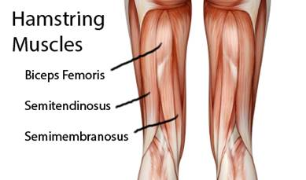

Slide 4
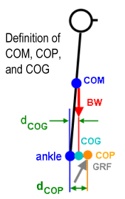
Balance Components

Slide 5
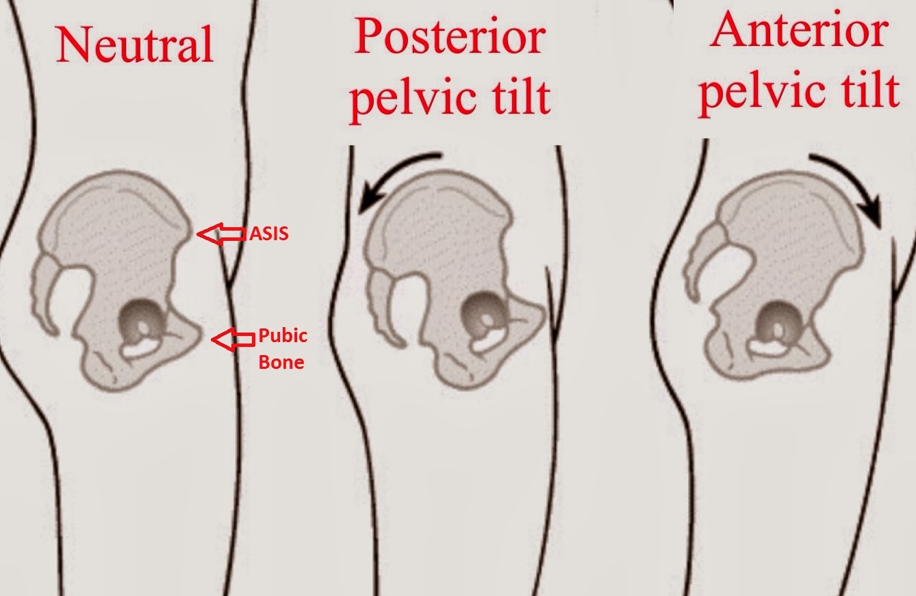

Slide 6
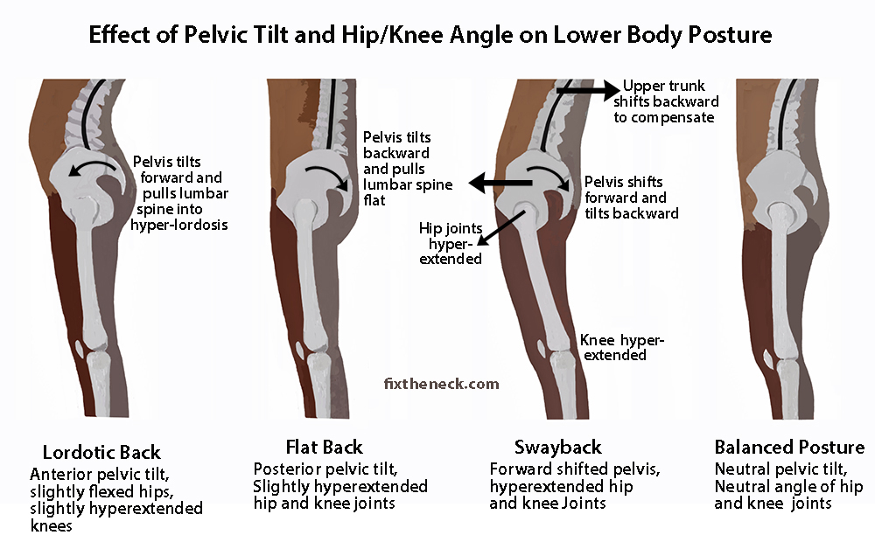

Slide 7
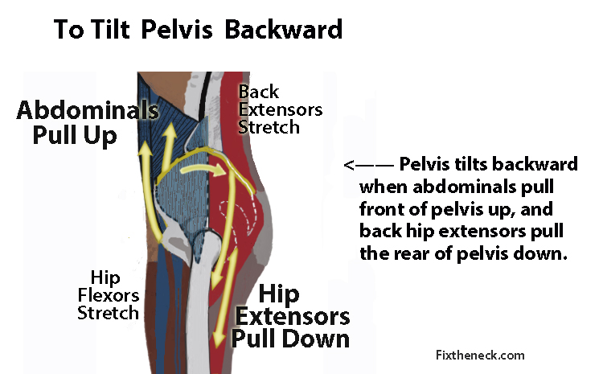

Slide 8
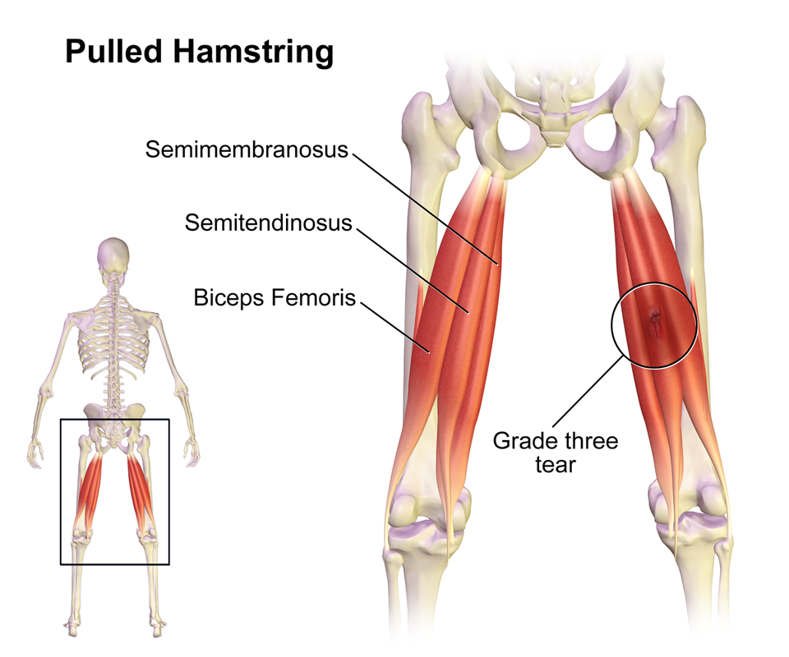

Slide 9
Literature
Cipriani and colleagues- the effect of gender and stretch frequency on hamstring muscle flexibility.
Findings:
-Stretching of hamstring muscle 3 times per week was as effective as stretching once daily
- No relationship between the improvement and gender
Cipriani et al. 2012

Slide 10
Literature
Nishikawa and colleagues- immediate effect of passive stretching compared to active hamstring stretching on muscle flexibility.
Findings:
Passive stretching was more effective than active stretching in increasing hamstring muscle flexibility
Nishikawa et al. 2015

Slide 11
Literature
Johnson and colleagues- the effect of stretching repetition on hamstring muscle flexibility.
Applied stretch of 10 seconds for 9 times or stretch of 30 seconds for 3 times. Stretching was provided over a period of 6 weeks.
Findings:
Hamstring flexibility increased with 90 seconds stretching regardless the number of repetitions
                Johnson et al. 2014

Slide 12
Thoughts
Hamstring muscles is a major muscle in our body
It is antigravity/ postural muscle
It is prone to be injured
Lifestyle change made the hamstring muscle prone to be shortened and lose flexibility
It is important to find an effective way to improve the hamstring muscle flexibility

Slide 13
Research Question
Which of the following techniques is more effective in improving the hamstring muscle flexibility: passive stretching, quad activation following passive stretching, or neurodynamic of tibial nerve?

Slide 14

Aim of the study
The aim of this study was to find a new effective way in stretching Hamstring muscle to improve muscle's flexibility and body mechanics.

Slide 15
Study Design
A single blinded randomized clinical trial

Slide 16
Subjects
60 subjects will be recruited for this study
Subjects recruitment in progress
Subjects are assigned randomly into one of three intervention groups.

Slide 17
Inclusion and Exclusion Criteria
Inclusion criteria:
Limited hamstring flexibility/ Shortening
Healthy subjects
Age 18-24 years old
Exclusion criteria:
Lumbar spine pathology
Working out regulary in the last 3 months
Lower limb pathology

Slide 18
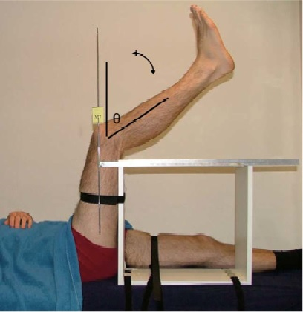
Operational Definition of Limited Hamstring Flexibility/ Shortening
Reduction in knee extension ROM by 20 degree or more while holding the hip joint at 90 degree.
Measurement tool:
- Goniometer

Slide 19
Intervention groups
Group I– Received Neurodynamic (NDG) of tibial nerve ( 3 sets of 10 reps)
Group II- Received Passive stretching (QAG) followed by Quad activation (3 reps 30 seconds each followed by 3 sets of 10 reps of acitve knee extension)
Group III- Received Passive stretching technique (PSG) (3 reps 30 seconds each)

Slide 20
Measurement
Demographic data including age, height, and weight were taken.
Knee extension ROM was measured with hip held in 90 degree pre and post intervention to record the changes on muscles flexibility.

Slide 21
Procedure
60 subjects
Blocked Design
Assigned Randomly
PSG
QAG
NDG
Pre-measures
Proper Intervention
Post-measures

Slide 22
Results
The preliminary results were calculated based on 10 subjects in each intervention group (Total N=30).
There were no significant differences in baseline muscles flexibility, subjects age, and BMI among groups.
There was no significant difference in the improvement of hamstringmuscles flexibility among groups

Slide 23
P=0.002

Slide 24
*

Slide 26
Discussion
It is expected to have significant difference among group with the increase of sample size.

Slide 27
Conclusion
Priliminary data showed better improvement in hamstring muscle flexibility using Neurodynamic or Quad muscles activation compared Passive hamstring Stretching.

