Slide 1

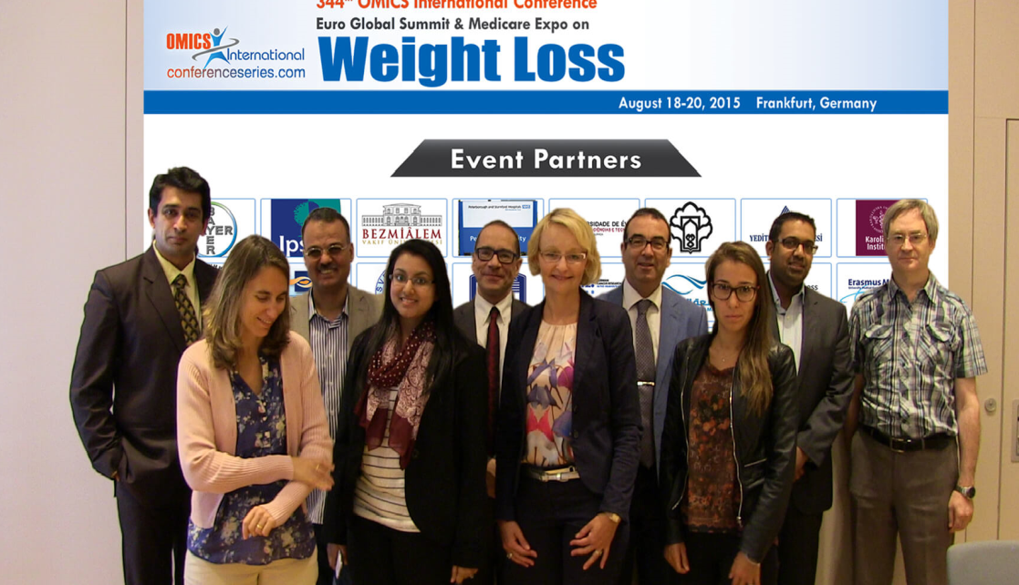

Euro Weight Loss-2015
Frankfurt, Germany
August 18 – 20, 2015
Farid Saad

Slide 2
Progressive weight loss in 104 obese hypogonadal men
with type 2 diabetes mellitus (T2DM) treated with testosterone undecanoate up to 84 months in an observational registry study
Saad F^{1,2}, Haider A³, Doros G⁴, Traish A⁵
¹Global Medical Affairs Andrology, Bayer Pharma, Berlin, Germany; ²Gulf Medical University, Ajman, UAE; ³Private Urology Practice, Bremerhaven, Germany; ⁴Department for Epidemiology and Statistics, Boston University School of Public Health, Boston, Mass, USA; ⁶Department of Biochemistry and Department of Urology, Boston University School of Medicine, Boston, Mass, USA

Slide 3
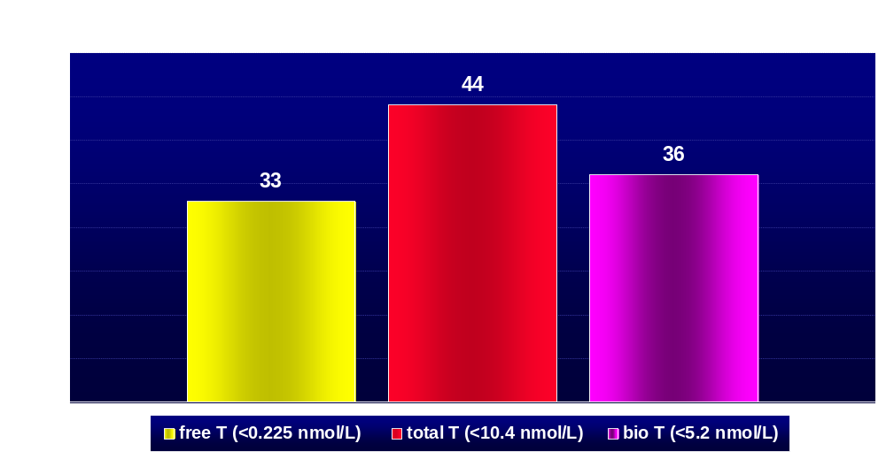
Proportion of Hypogonadism in 103 Consecutive Male Patients with Diabetes
Dhindsa S et al. J Clin Endocrinol Metab 89(11): 5462-5468 (2004)

Slide 4
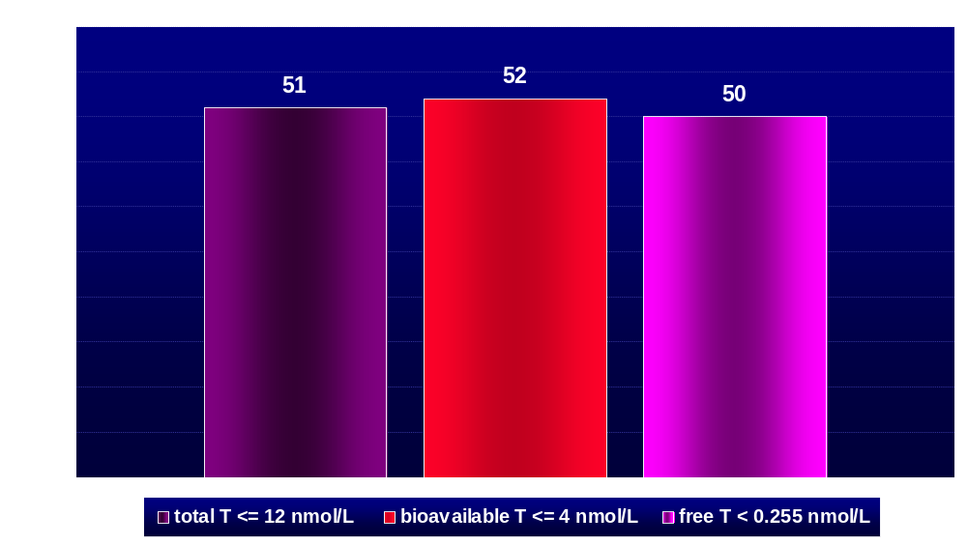
Proportion (%) of Hypogonadism in 355 Male Patients with
Type 2 Diabetes (mean age 58 years, range: 32 – 83)
Kapoor D et al. Diabetes Care 30: 911-917 (2007)

Slide 5
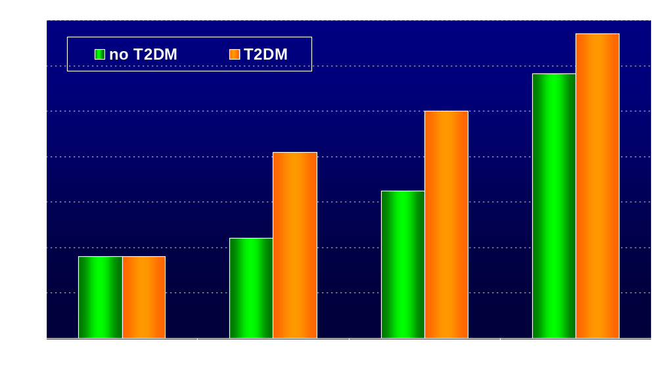
Prevalence (%) of Hypogonadism in Diabetic and Non-Diabetic Obese Men Separated into Quartiles of Age
p=0.05
p<0.01
p<0.01
Dhindsa S et al. Diab Care 33: 1186-1192 (2010)

Slide 6
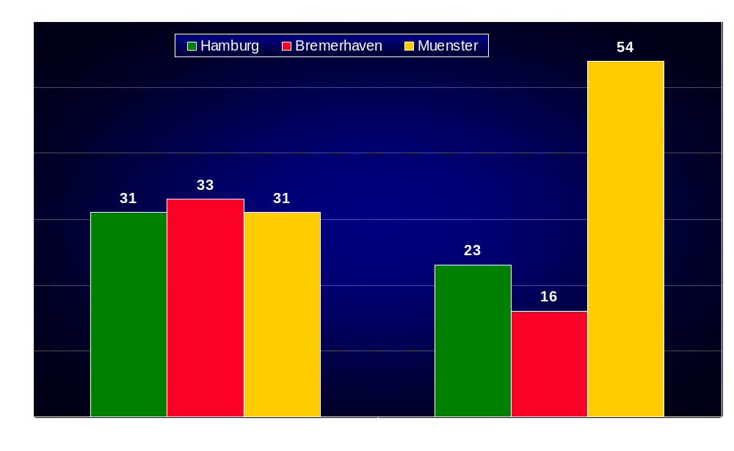
Proportion of Type 2 Diabetes and Prediabetes
in 1023 Hypogonadal Men from 3 German Centers
Haider A et al. J Urol 193: 80-86 (2015)

Slide 7
Background:
There is a robust bi-directional association between obesity and testosterone (T) deficiency (hypogonadism) in men with a prevalence of hypogonadism in obese men as high as 52%. We investigated effects of normalising T in obese hypogonadal men on anthropometric parameters.
Methods:
Cumulative, prospective, observational registry study of 340 men with T levels ≤12.1 nmol/L receiving parenteral T undecanoate 1000 mg/12 weeks following an initial 6-week interval for up to seven years. A subgroup of 104 men (30.6% of the total group) with obesity and T2DM was analysed.

Slide 8
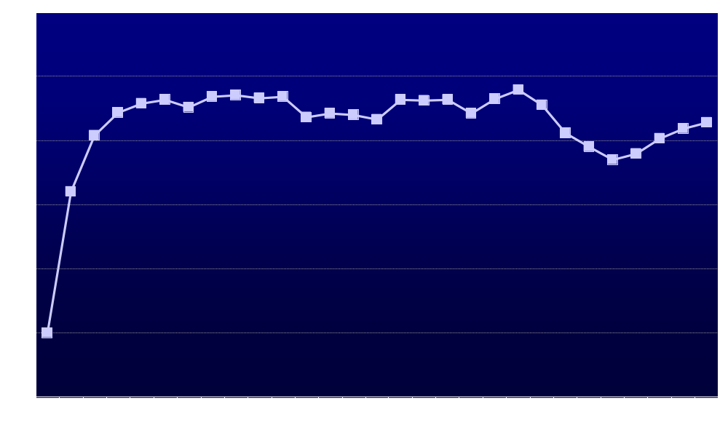
Total Testosterone (nmol/L)
+ 5.32 ± 0.4 nmol/L
p=NS
p=NS
p=NS
*
p=0.0012
*
*
*
*
p=0.0126
*
#
*
*p<0.0001 vs baseline # p<0.0001 vs previous year
N=
104
104
103
102
87
73
71
65
58
54
53
50
43
38
25

Slide 9
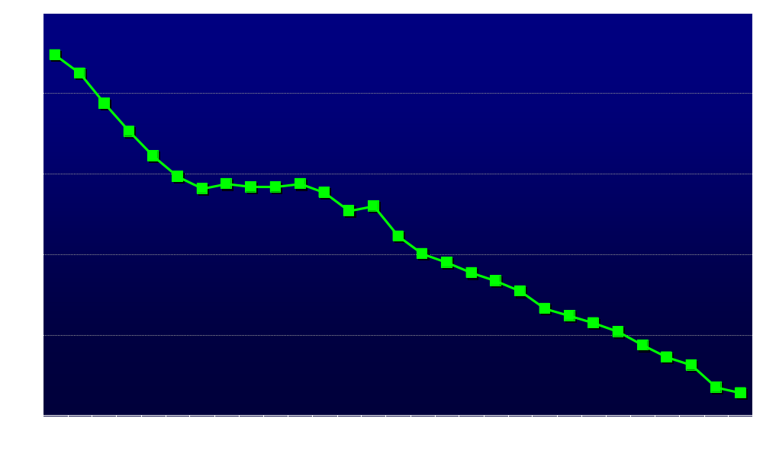
Weight (kg)
- 22.87 ± 0.77 kg
*
#
*
#
*
p=0.0001
*
#
*
p=0.0026
*
p=NS
*p<0.0001 vs baseline # p<0.0001 vs previous year
*
N=
104
104
104
102
87
73
71
65
58
54
53
50
43
38
25

Slide 10
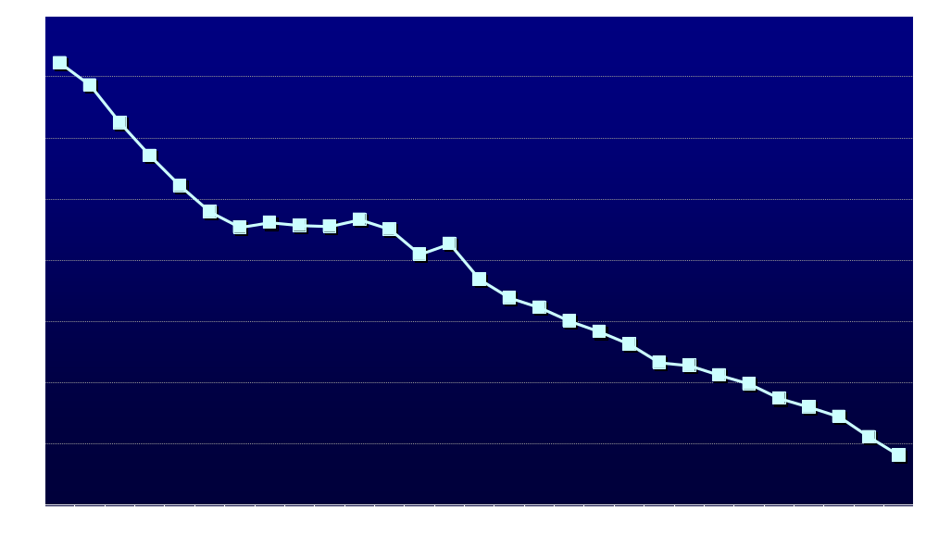
Body Mass Index (BMI, kg/m²)
- 7.4 ± 0.25 kg/m²
*
#
*
#
*
p=0.0001
*
#
*
p=0.0021
*
p=NS
*
*p<0.0001 vs baseline # p<0.0001 vs previous year
N=
104
104
104
102
87
73
71
65
58
54
53
50
43
38
25

Slide 11
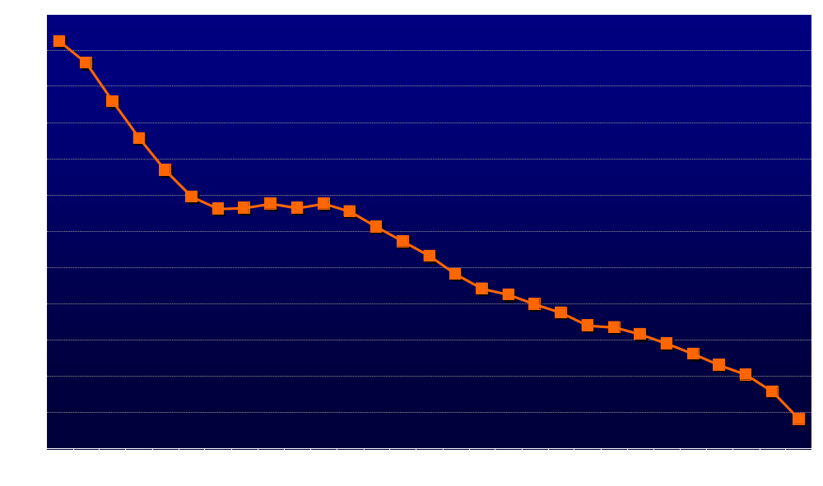
Waist Circumference (cm)
- 11.89 ± 0.3 cm
*
#
*
#
*
#
*
#
*
p=0.0025
*
p=0.0126
*
*p<0.0001 vs baseline # p<0.0001 vs previous year
N=
104
104
104
102
87
73
71
65
58
54
53
50
43
38
25

Slide 12
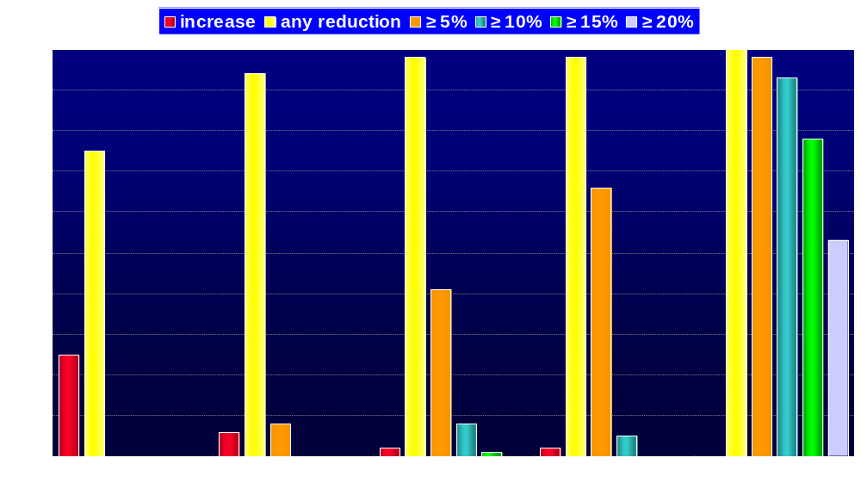
Proportion of Patients with Varying Degrees of Weight Loss
%

Slide 13
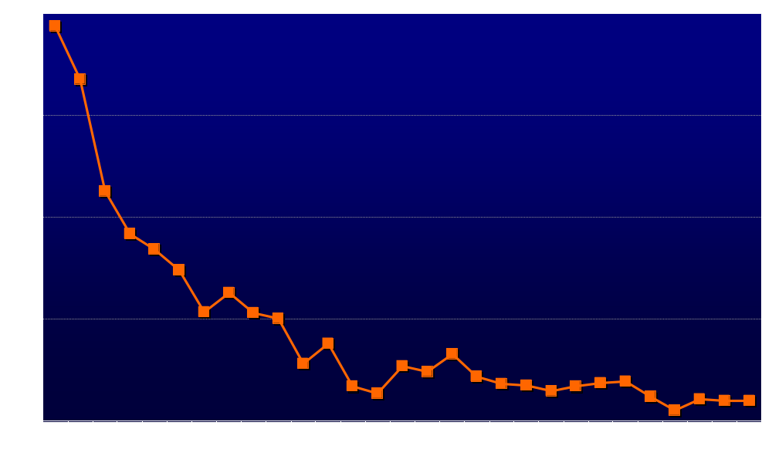
Fasting Glucose (mg/dl)
- 23.64 ± 1.92 mg/dl
*
p=0.001
*
p=0.0006
p=NS
*
*
p=NS
p=NS
*
*
p=NS
*
*p<0.0001 vs baseline # p<0.0001 vs previous year
N=
104
104
103
102
87
73
71
65
58
54
53
50
43
38
25

Slide 14
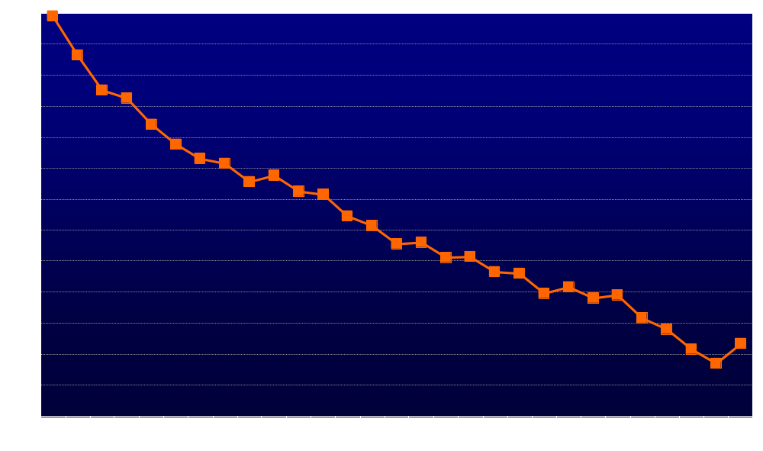
HbA_{1c} (%)
- 2.32 ± 0.07%
*
#
*
#
*
#
*
p=0.0001
*
p=0.0416
*
p=0.0002
*
*p<0.0001 vs baseline # p<0.0001 vs previous year
N=
104
67
62
58
56
43
45
40
37
35
35
31
29
25
15

Slide 15
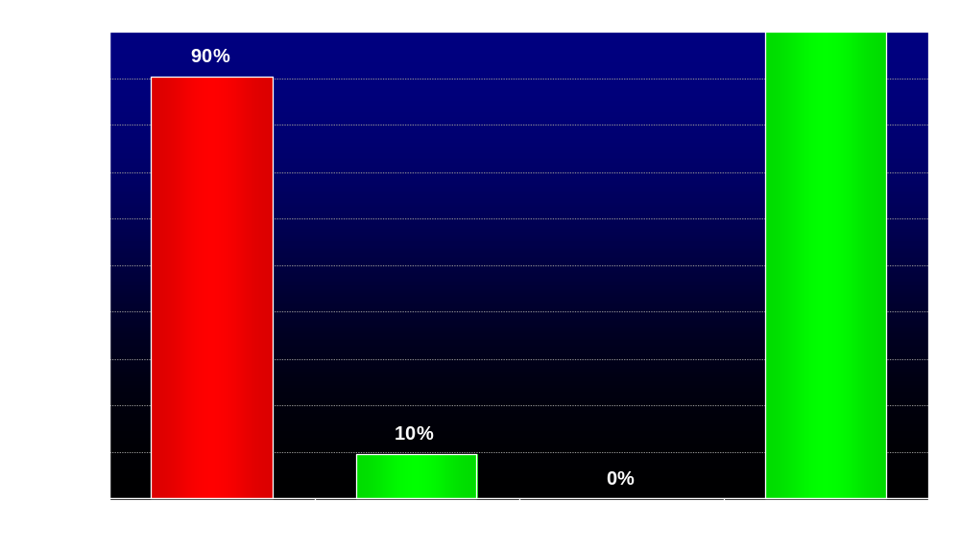
Patients Reaching HbA_{1c} Target of ≤ 7.0%
baseline
endpoint

Slide 16
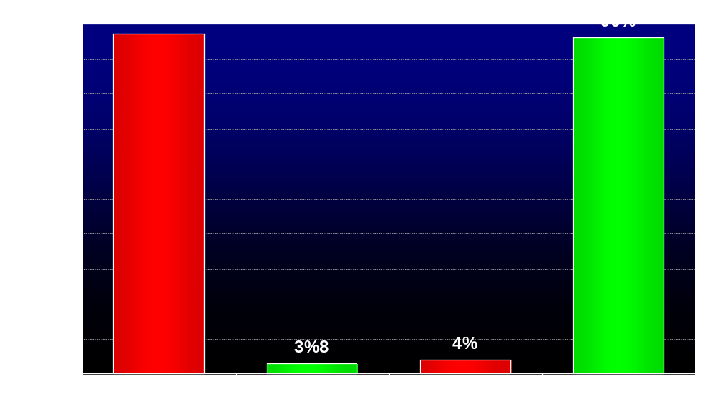
Patients Reaching HbA_{1c} Target of ≤ 6.5%
baseline
endpoint

Slide 17
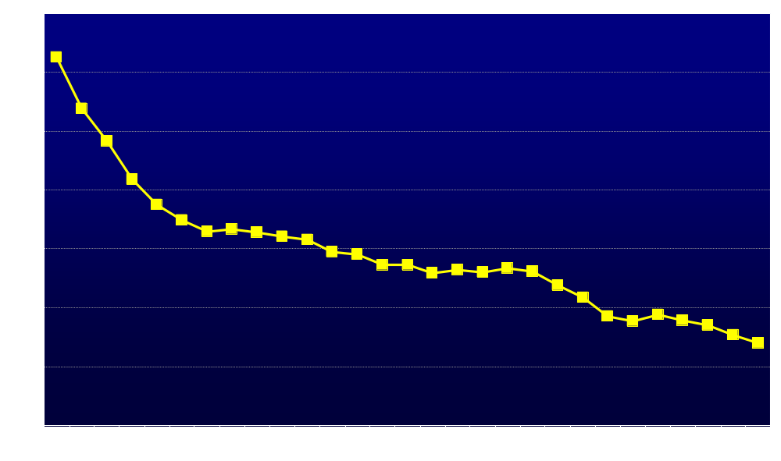
Systolic Blood Pressure (mmHg)
- 24.72 ± 1.11 mmHg
*
#
*
p=0.0007
*
p=NS
*
p=NS
*
p=NS
*
p=NS
*
*p<0.0001 vs baseline # p<0.0001 vs previous year
N=
104
104
103
102
87
73
71
65
58
54
53
50
43
38
25

Slide 18
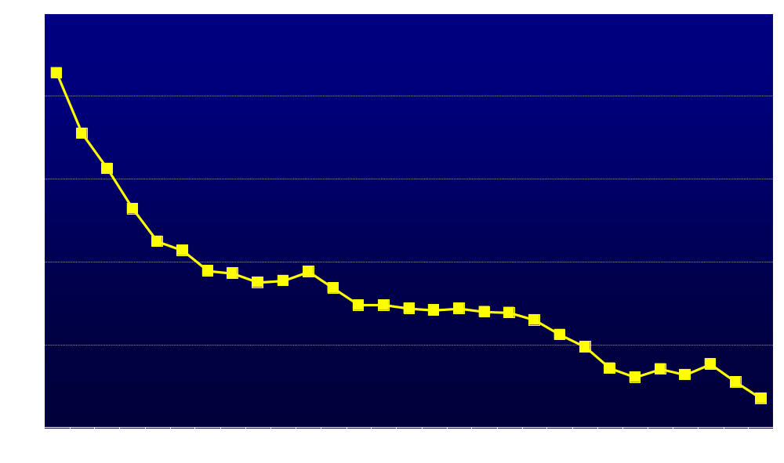
Diastolic Blood Pressure (mmHg)
- 21.94 ± 0.93 mmHg
*
#
*
p=0.0005
p=NS
*
*
p=0.0253
*
p=NS
*
p=NS
*
*p<0.0001 vs baseline # p<0.0001 vs previous year
N=
104
104
103
102
87
73
71
65
58
54
53
50
43
38
25

Slide 19

Heart Rate (bpm)
- 3.77 ± 0.66 bpm
*
p=NS
p=NS
*
*
p=NS
p=NS
*
*
p=NS
*
p=NS
*
*p<0.0001 vs baseline # p<0.0001 vs previous year
N=
104
104
103
102
87
73
71
65
58
54
53
50
43
38
25

Slide 20
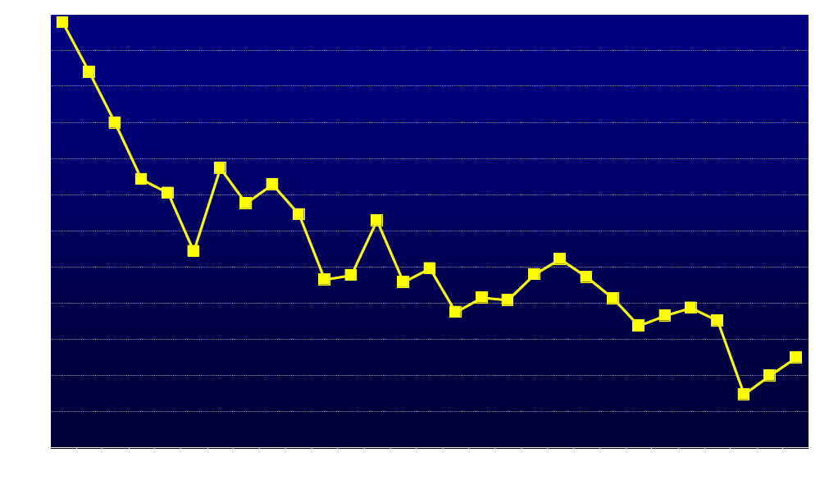
Pulse Pressure
- 2.8 ± 0.93
p=NS
*
*
p=NS
*
p=NS
p=NS
*
*
p=NS
*
p=NS
*
*p<0.0001 vs baseline # p<0.0001 vs previous year
N=
104
104
103
102
87
73
71
65
58
54
53
50
43
38
25

Slide 21
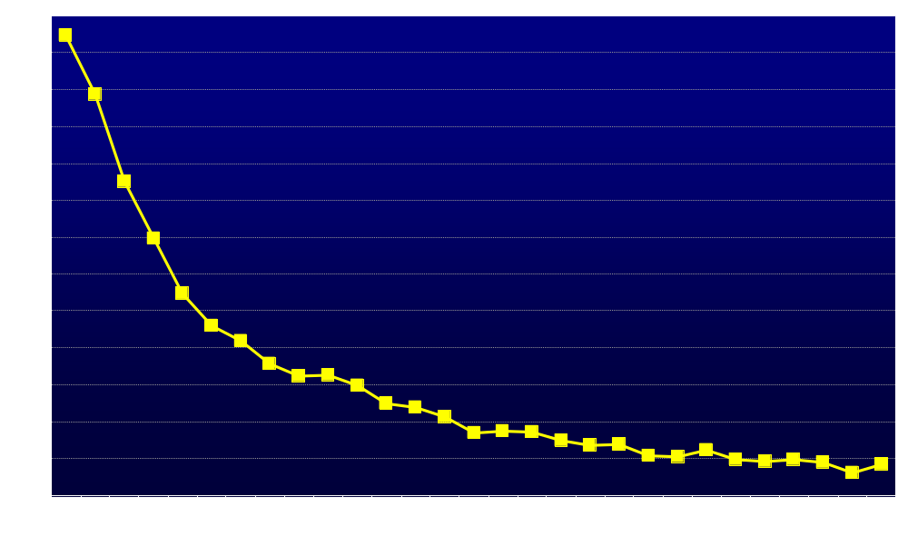
Total Cholesterol (mg/dl)
- 116.04 ± 3.59 mg/dl
*
#
*
p=0.0067
*
p=NS
*
p=0.0359
p=NS
*
*
p=NS
*
*p<0.0001 vs baseline # p<0.0001 vs previous year
N=
104
104
103
102
87
73
71
65
58
54
53
50
43
38
25

Slide 22
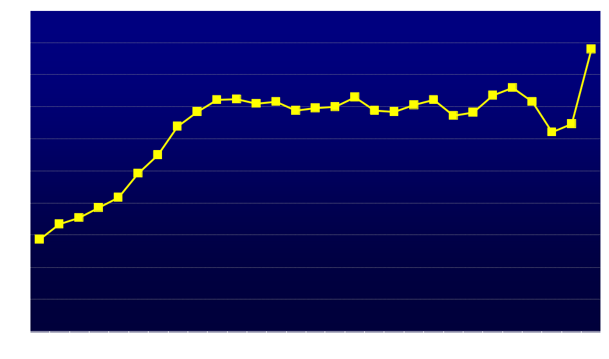
HDL Cholesterol (mg/dl)
p=0.0001
+ 12.36 ± 0.69 mg/dl
*
p=0.0011
#
p=NS
p=NS
p=NS
*
*
*
*
*
*
*p<0.0001 vs baseline # p<0.0001 vs previous year
N=
104
104
103
102
87
73
71
65
58
54
53
50
43
38
25

Slide 23
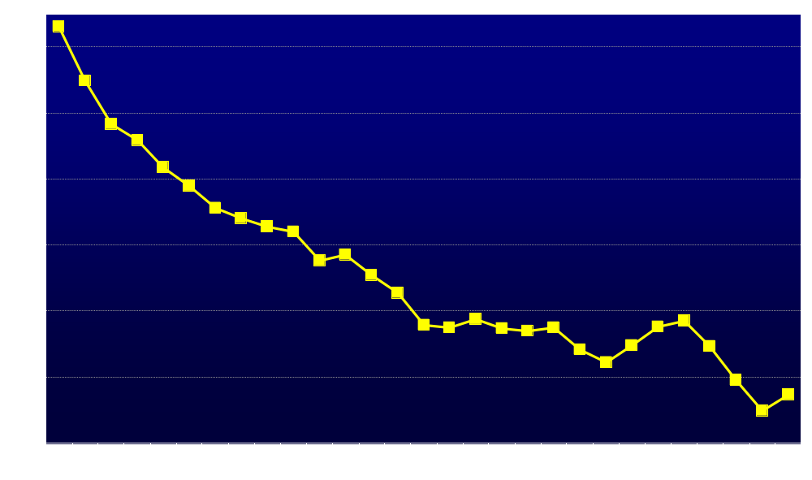
LDL Cholesterol (mg/dl)
- 41.24 ± 2.73 mg/dl
*
#
*
p=0.0363
*
p=NS
p=0.0002
*
*
p=NS
*
p=0.0002
*
*p<0.0001 vs baseline # p<0.0001 vs previous year
N=
104
104
103
102
87
73
71
65
58
54
53
50
43
38
25

Slide 24
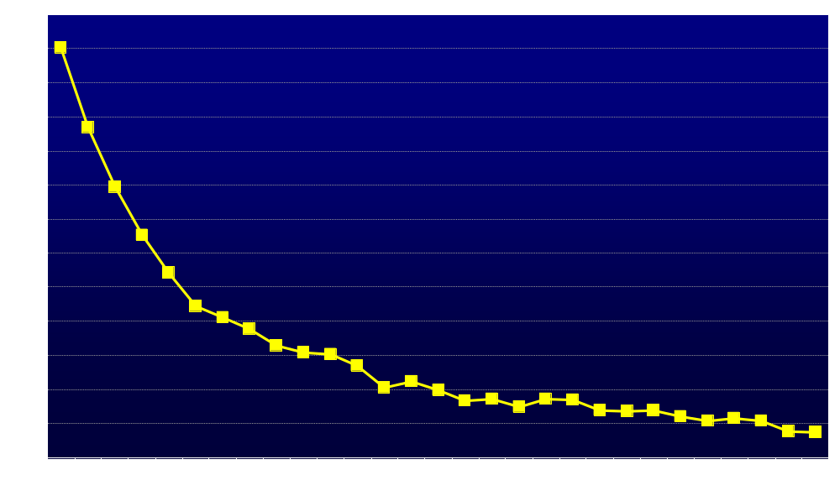
Triglycerides (mg/dl)
- 111.41 ± 4.74 mg/dl
*
#
*
p=0.0006
*
p=NS
*
p=NS
p=NS
*
p=NS
*
*
*p<0.0001 vs baseline # p<0.0001 vs previous year
N=
104
104
103
102
87
73
71
65
58
54
53
50
43
38
25

Slide 25
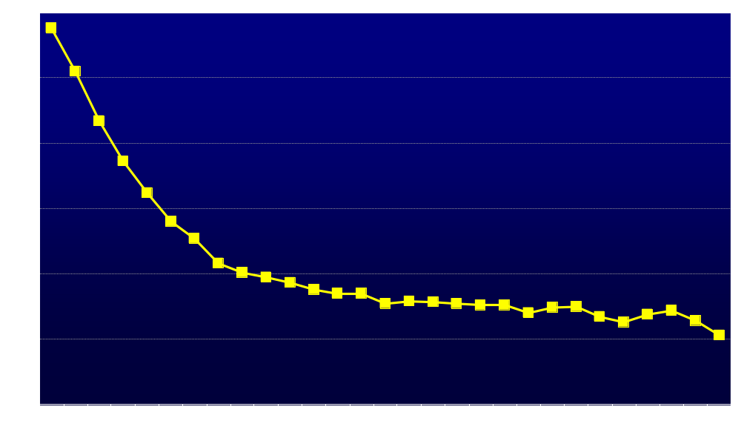
Total Cholesterol:HDL Ratio
- 2.36 ± 0.07
*
#
*
p=0.0102
*
p=NS
*
p=NS
p=0.0444
*
*
p=NS
*
*p<0.0001 vs baseline # p<0.0001 vs previous year
N=
104
104
103
102
87
73
71
65
58
54
53
50
43
38
25

Slide 26
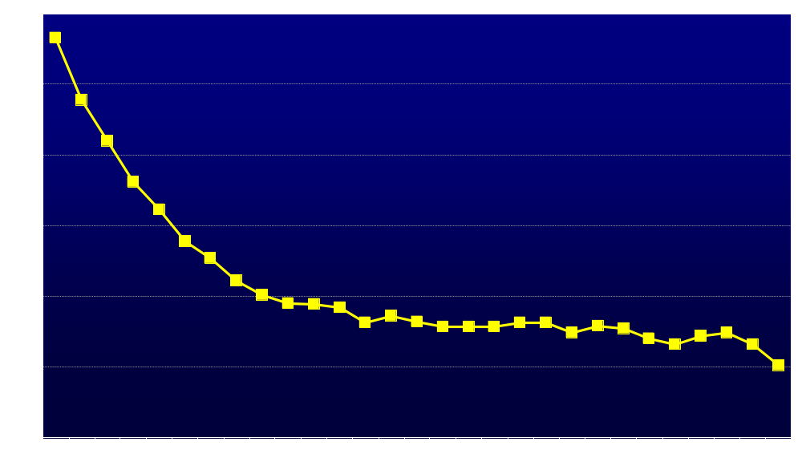
Triglycerides:HDL Ratio
- 2.31 ± 0.09
*
#
*
p=0.0027
*
p=NS
p=NS
*
*
p=0.0451
*
p=NS
*
*p<0.0001 vs baseline # p<0.0001 vs previous year
N=
104
104
103
102
87
73
71
65
58
54
53
50
43
38
25

Slide 27
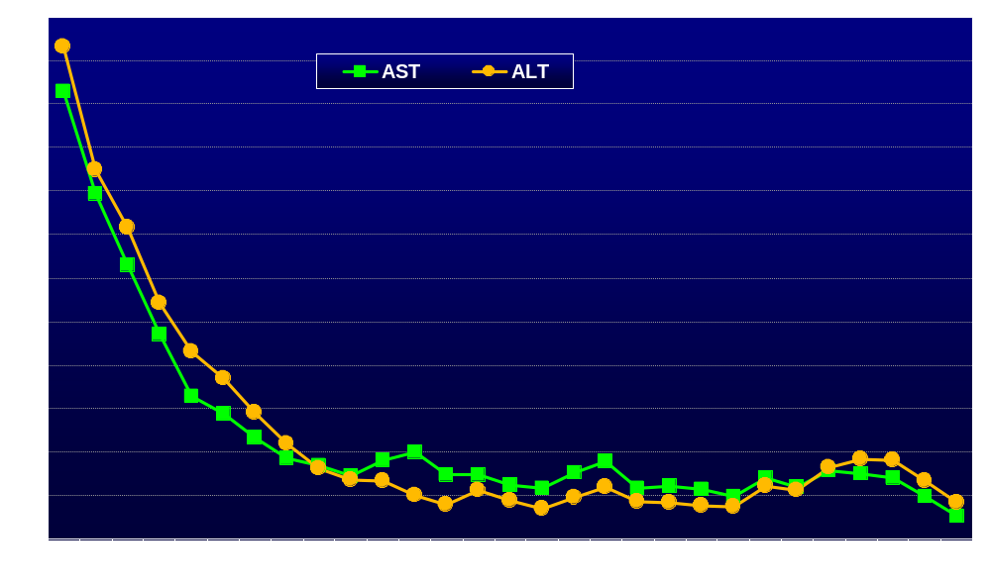
Liver Transaminases (U/L)
- 20.51 ± 1.14 U/L
- 22.48 ± 1.22 U/L
*
*
#
*
p=NS
p=NS
p=NS
#
*
*
p=NS
*
*
p=NS
*
p=NS
p=NS
p=NS
*
*
*
p=NS
*
*
p=NS
*
*p<0.0001 vs baseline # p<0.0001 vs previous year
N=
104
104
103
102
87
73
71
65
58
54
53
50
43
38
25

Slide 28
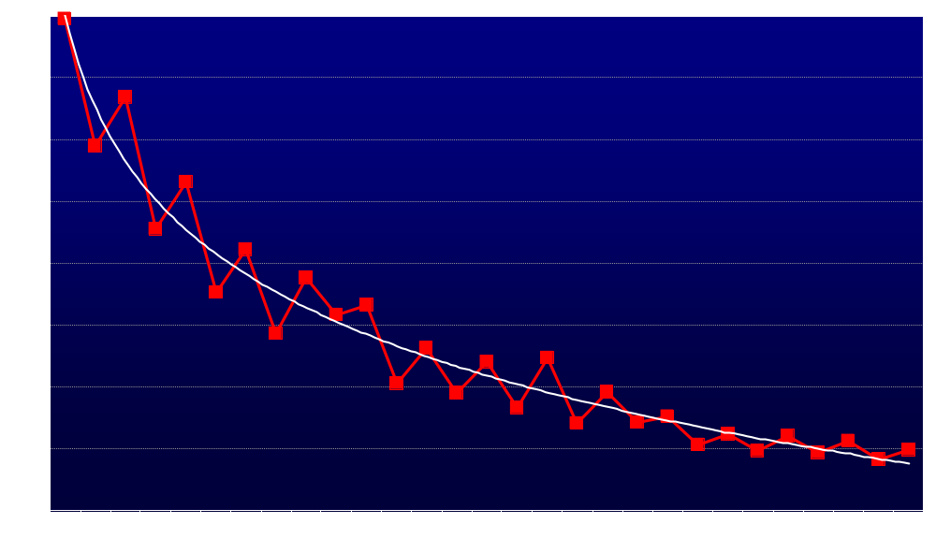
CRP (mg/dl)
- 5.05 ± 0.57 mg/dl
*
p=0.0003
*
p=0.0165
p=NS
*
*
p=NS
*
p=NS
*
p=NS
*
*p<0.0001 vs baseline # p<0.0001 vs previous year
N=
104
104
103
102
87
73
71
65
58
54
53
50
43
38
25

Slide 29
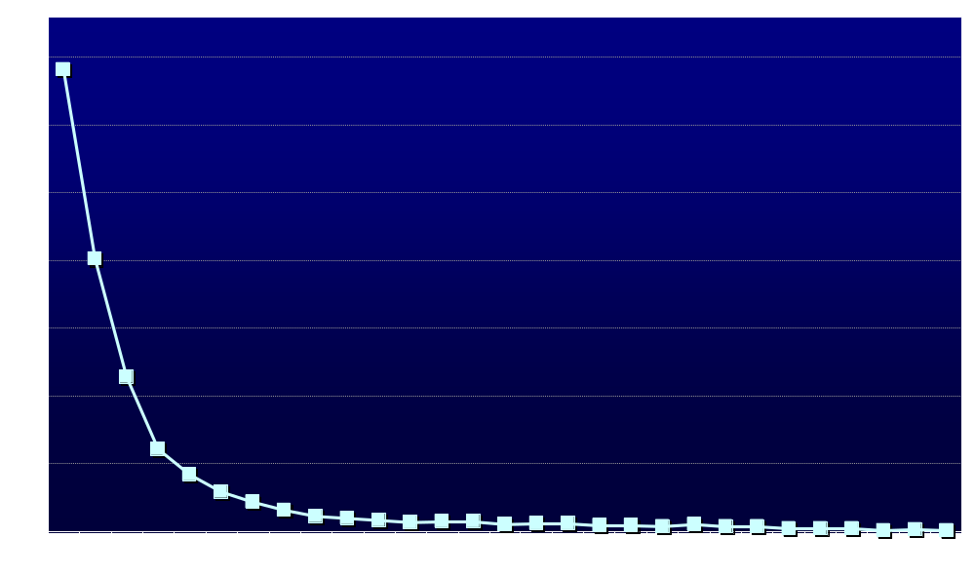
Quality of Life Measured by Aging Males‘ Symptoms Scale (AMS)
*p<0.0001 vs baseline # p<0.0001 vs previous year
- 34.49 ± 0.7
*
#
*
p=NS
p=NS
p=NS
p=NS
p=NS
*
*
*
*
*
N=
104
104
104
102
87
73
71
65
58
54
53
50
43
38
25

Slide 30
There was no major adverse cardiovascular event (MACE).
No patient dropped out.

Slide 31
Summary and Conclusions
Obesity and type 2 diabetes are common in men with testosterone deficiency and vice versa.
Testosterone therapy induces meaningful and sustained weight loss.
Long-term testosterone therapy progressively and sustainably improves metabolic parameters and glycaemic control thus improving the cardiometabolic risk profile.
These effects require long-term treatment.
Testosterone treatment was well tolerated.
Treatment adherence was excellent suggesting a high level of patient satisfaction.
farid.saad@bayer.com
Notes:
31

Slide 32

Meet the eminent gathering once again at
Euro Weight Loss-2016
Vienna, Austria
September 19-21, 2016
Euro Weight Loss – 2016
Website:http://weightloss.global-summit.com/europe/

