Slide 1

Buckling Capacity of Pretwisted Steel Columns: Experiments and Finite Element Simulation
Farid Abed & Mai Megahed
Department of Civil Engineering
American University of Sharjah
Sharjah, U.A.E.
Notes:
.

Slide 2
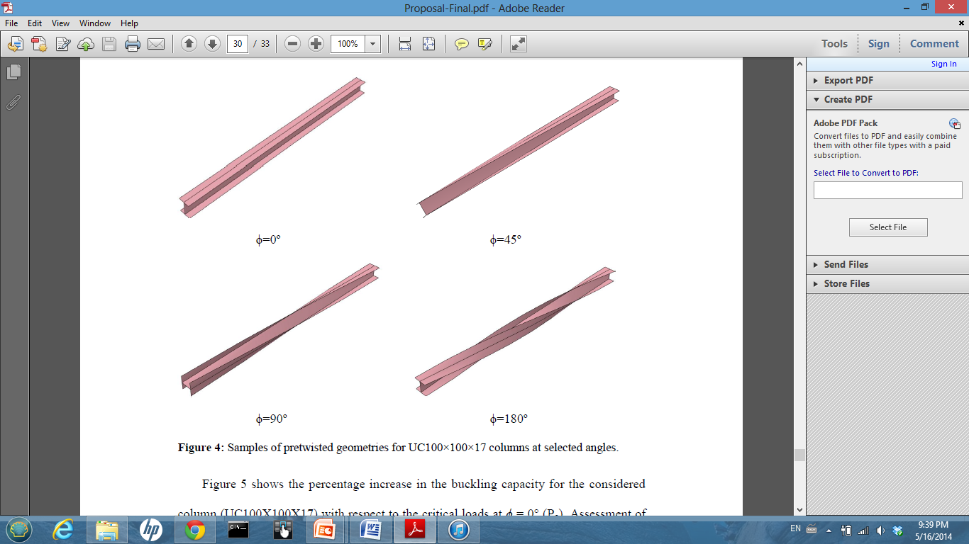
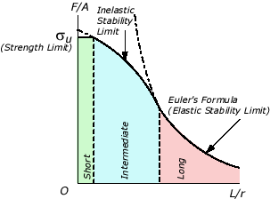
Outline
Introduction and Background
Previous Studies
Elastic Buckling Analysis using Perturbation Analysis
  Experimental Tests
  Nonlinear Finite Element Analysis
Remarks and Conclusions

Slide 3
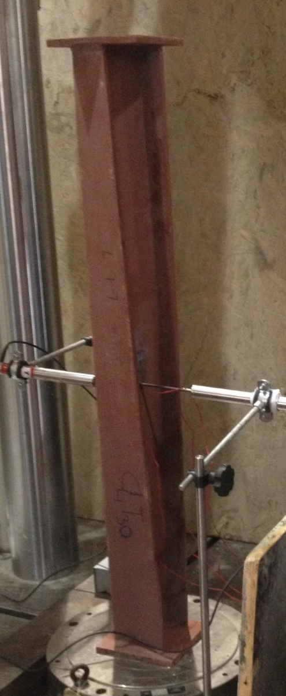
Introduction and Background
Pretwisting
  Steel structures are increasingly used in constructions as they proved to be more user- and environmental-friendly.
  Columns usually buckle along the plane of least resistance. However, the column resistance varies at each point along its centroidal axis when its section is permanently pretwisted.
  During buckling, the deformed configuration of the pre-twisted column is no longer perpendicular to the axis of least resistance. This will result into nonlinear differential equations, which describe the equilibrium of the member, whose solution is not simple.
Notes:
Pre-twisting is known to induce a coupling effect on the weak and strong flexural planes of a column

Slide 4
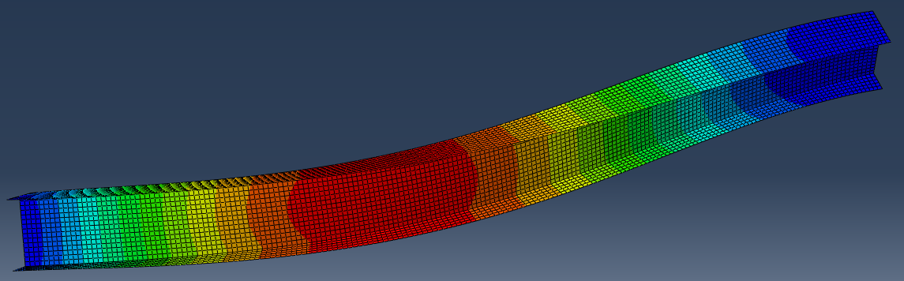
Introduction and Background
Effect of Pretwisting
  Inducing a natural pretwist along the length of a column section makes the column have a different resistance at every point along its centroidal axis.
  Transition between the two flexural planes (minor and major) varying the direction of weak resistance at every point along the column’s length.
  This research work aims at throwing the light on the potential improvement in the buckling capacity of pre-twisted UC-section steel columns.
Notes:
Pre-twisting is known to induce a coupling effect on the weak and strong flexural planes of a column

Slide 5
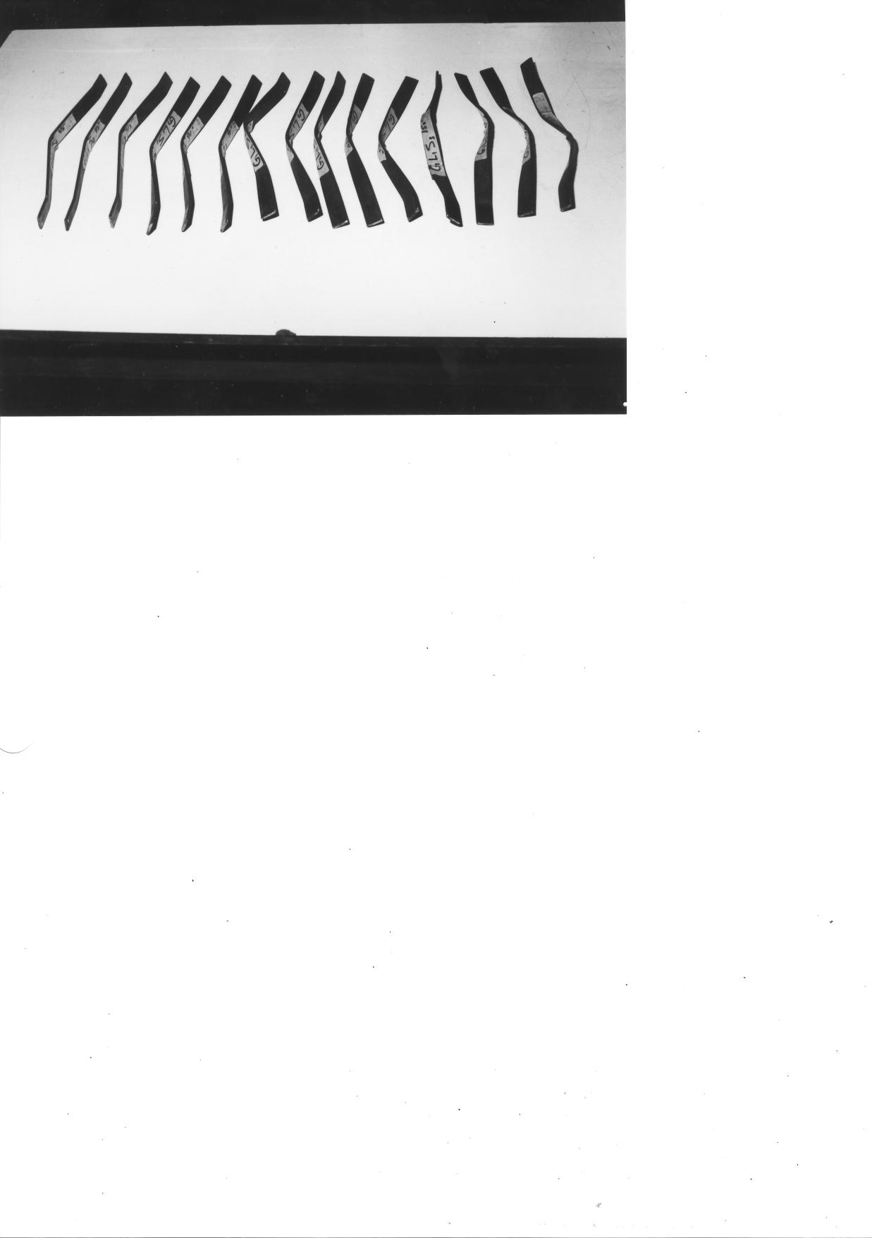
Previous Studies
Insufficient theoretical and experimental works were found in the literature on the study of buckling of pre-twisted members. Mainly, analytical studies to derive exact solution and model the stability and static performance of pretwisted rods and beams.
  Recent experimental and numerical studies by Abed and his co-workers to investigate the buckling capacity of pretwisted bars.
Abed et al. (2012)
Barakat and Abed (2010)
Notes:
More than 200 specimens were twisted at selected angles of twists and tested using UTM machine.

Slide 6
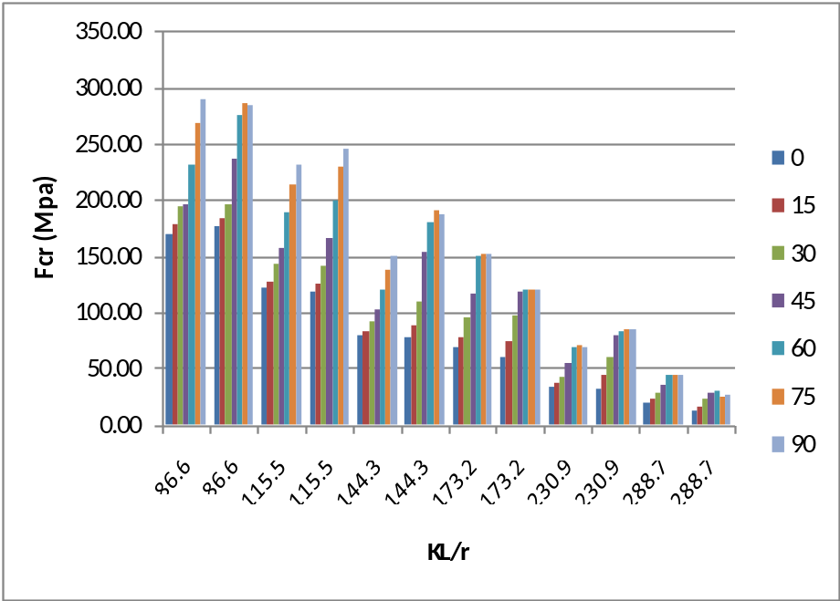


Previous Studies
Buckling strength ratio and the critical stress sharply increase as the angle of twist increase up to 90 degrees for lower slenderness ratio (KL/r ≤ 144)
A model that predicts the buckling behavior of pretwisted bars was developed within range up to 90º .
Abed et al. (2012)

Slide 7
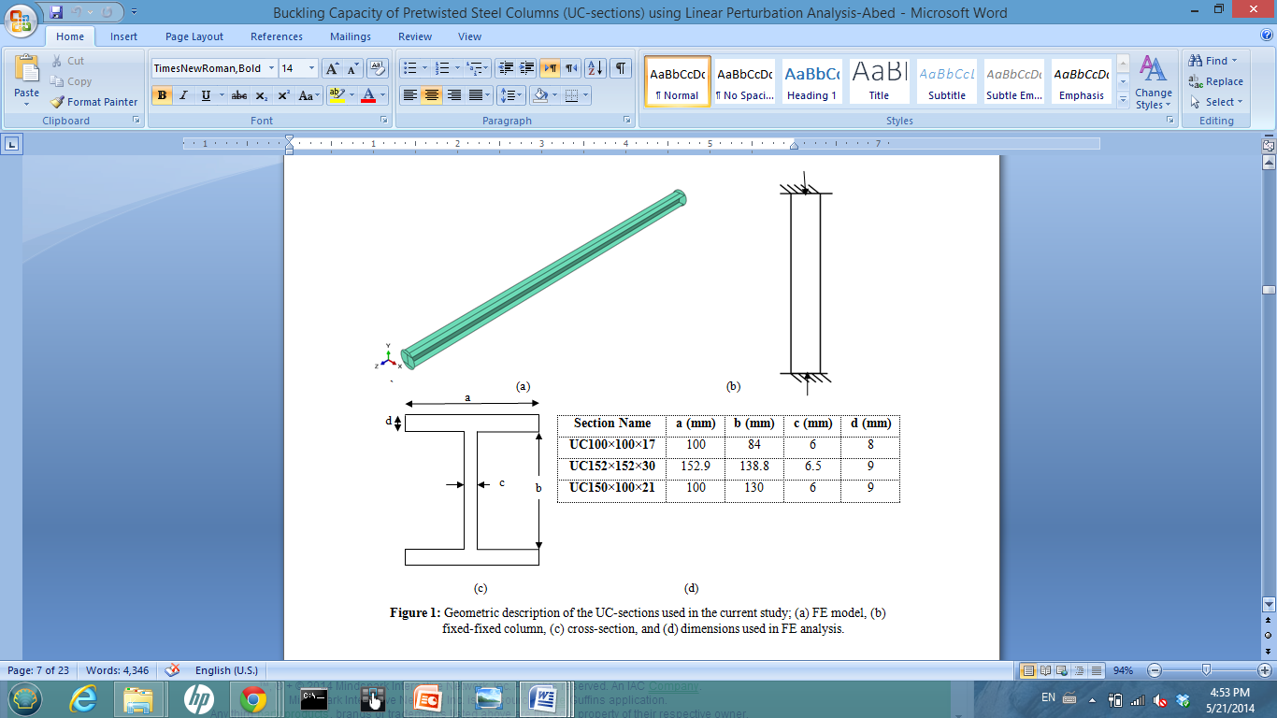
Elastic Buckling Analysis using Perturbation Analysis
Linear Finite element analysis
  A range of pretwisted angles between 0 and 180 was investigated for each section

Slide 8
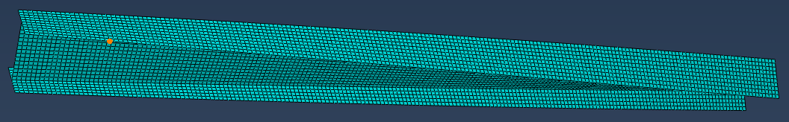

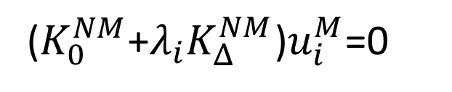
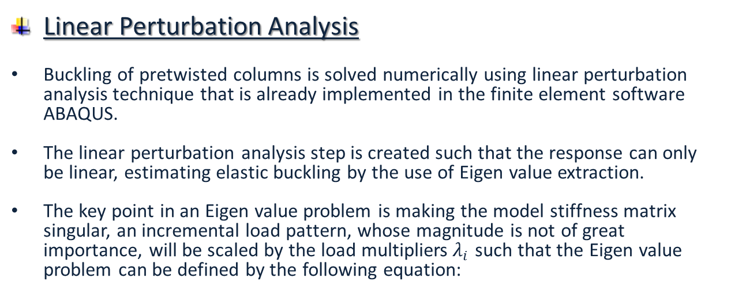
Elastic Buckling Analysis using Perturbation Analysis
Linear Perturbation Analysis
Buckling of pretwisted columns is solved numerically using linear perturbation analysis technique that is already implemented in the finite element software ABAQUS.
The linear perturbation analysis step is created such that the response can only be linear, estimating elastic buckling by the use of Eigen value extraction.
The key point in an Eigen value problem is making the model stiffness matrix singular, an incremental load pattern, whose magnitude is not of great importance, will be scaled by the load multipliers$λ_{i}$ such that the Eigen value problem can be defined by the following equation:
($K_{0}^{NM}$+$λ_{i}K_{Δ}^{NM}$)$u_{i}^{M}$=0
where ${u^{M} \text{is} \text{the} \text{displacement} \text{vector} and{ K}_{Δ}^{NM}}^{}$ is the tangent stiffness matrix that is related the differential loading pattern while $K_{0}^{NM}$corresponds to the initial loading condition.
The superscripts M and N are the degrees of freedom for the whole system while the subscript i denotes the i^{th} buckling mode.
Notes:
The Subspace iteration Eigen solver is used in this analysis step, based on the number of Eigenvalues specified. However, the critical buckling load is taken as the load that corresponds to the first buckling mode for each twisting angle.

Slide 9
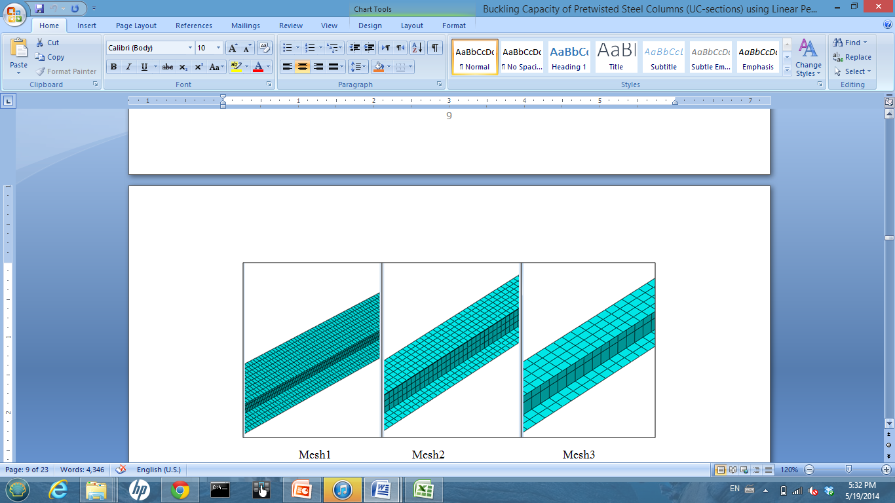
Elastic Buckling Analysis using Perturbation Analysis
Mesh Sensitivity Analysis
  4-node 3D shell elements of S4R ABAQUS type were utilized
  Different Mesh configurations were checked to select a proper element size to obtain the desired level of accuracy with the least computational time.

Slide 10
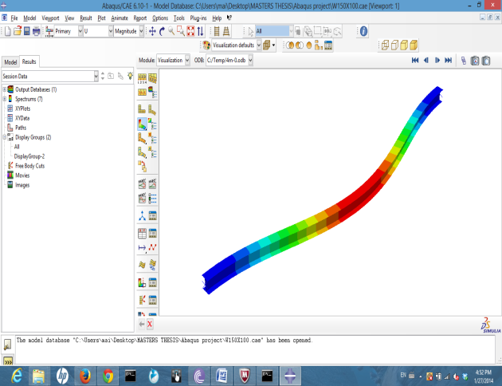
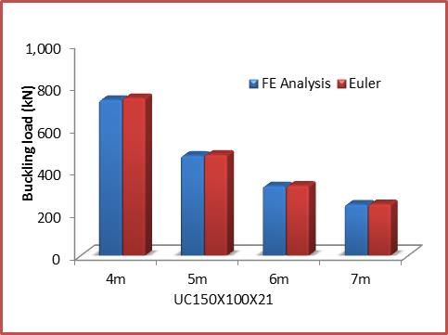
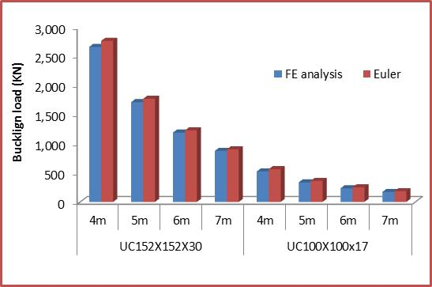
Elastic Buckling Analysis using Perturbation Analysis
Model Verification
  FE results for straight (untwisted) columns were verified against Euler Buckling Equation

Slide 11
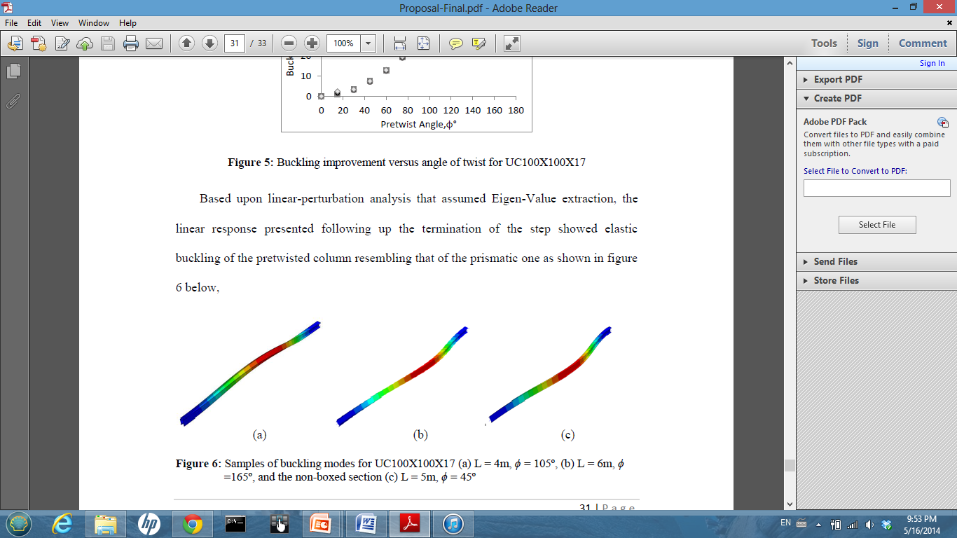
Elastic Buckling Analysis using Perturbation Analysis
Results for Fixed-ended B.C.s
  Length has no effect
  70 – 90 % buckling capacity improvement at angle of twists between 120-150.

Slide 12
Elastic Buckling Analysis using Perturbation Analysis
Results for Fixed-ended B.C.s
- Histograms of Buckling improvement versus slenderness ratio up to ϕ = 150°

Slide 13
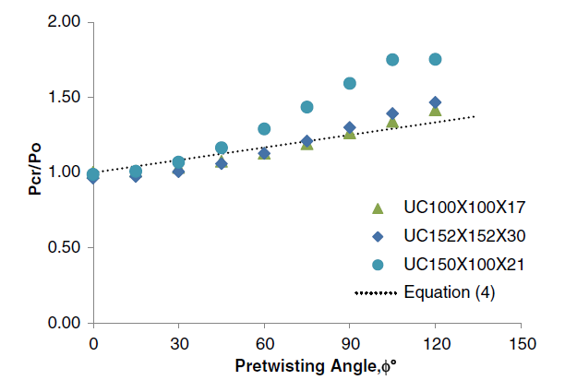

Elastic Buckling Analysis using Perturbation Analysis
Results for Fixed-ended B.C.s
- Comparisons with previous equation that was developed for pretwisted bars with rectangular cross-sections.
Abed et al. (2012)

Slide 14
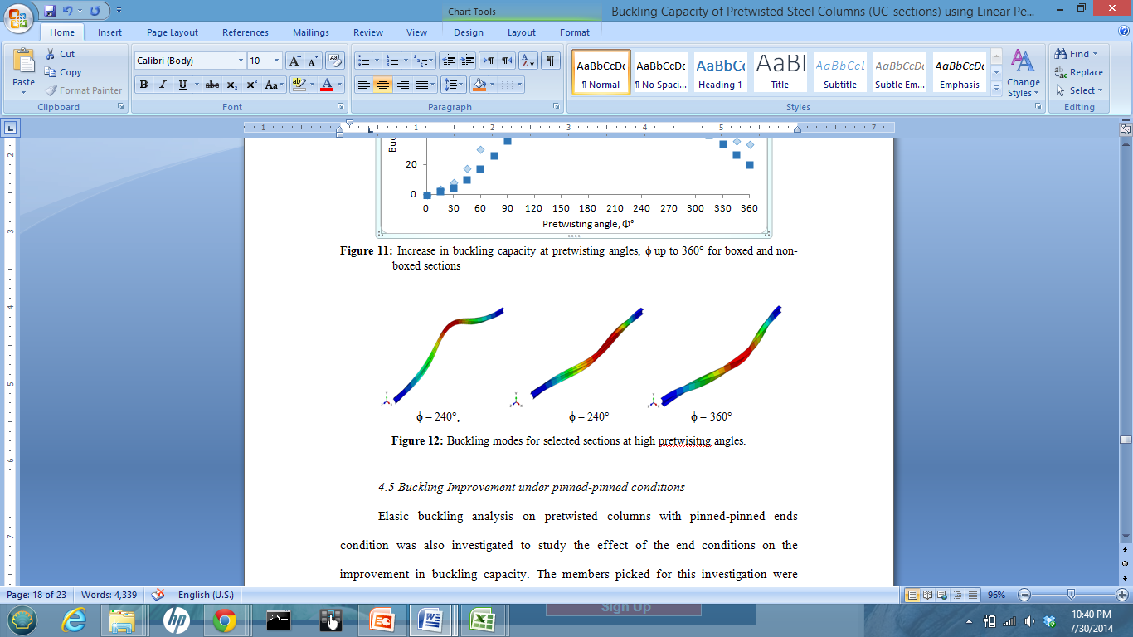
Elastic Buckling Analysis using Perturbation Analysis
Results for Fixed-ended B.C.s
Finite element analysis run for 0°-360° under fixed-ended boundary condition

Slide 15
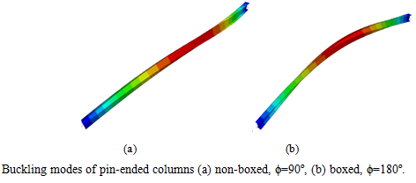
Elastic Buckling Analysis using Perturbation Analysis
Results for Pinned-ended B.C.s
  Length has no effect
  No significant buckling capacity improvement up to 180 angle of twist.

Slide 16
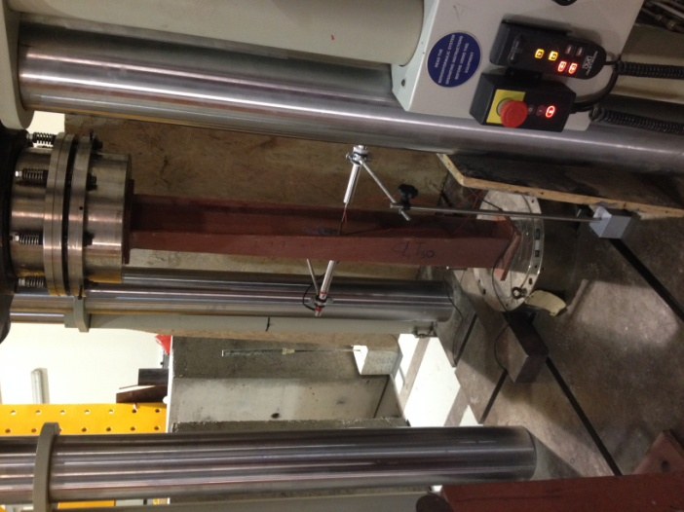
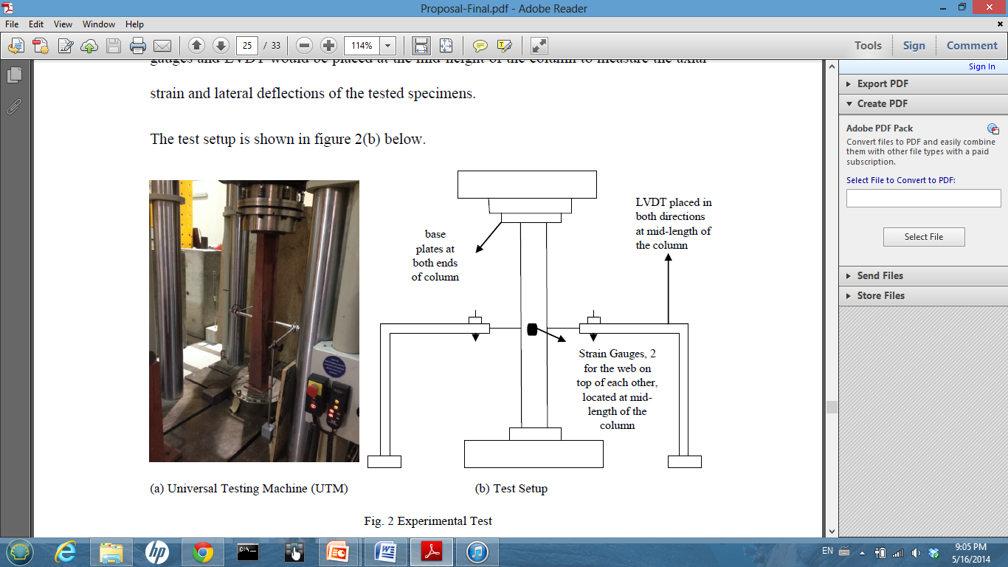
Experimental Tests
Test Setup
  Universal Testing Machine (UTM), capacity = 1200 KN
  UC 100x100x17

Slide 17
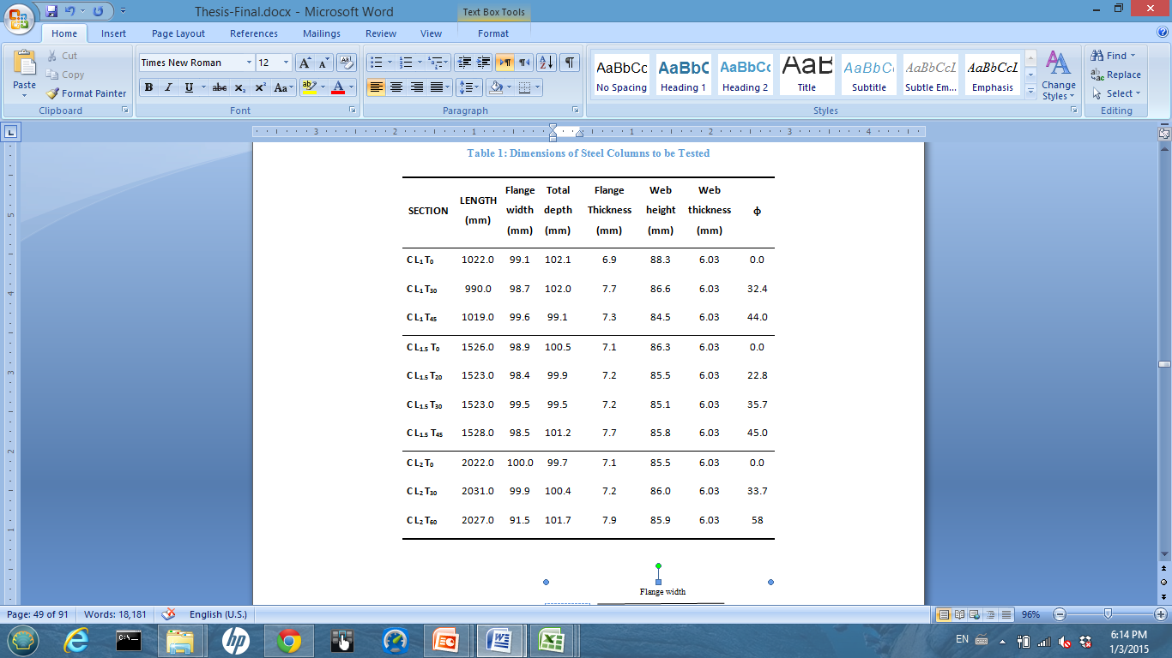
Experimental Tests
  Dimensions of UC 100x100x17 considered for testing

Slide 18
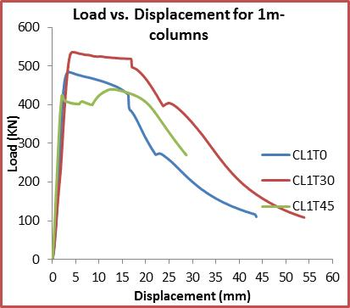
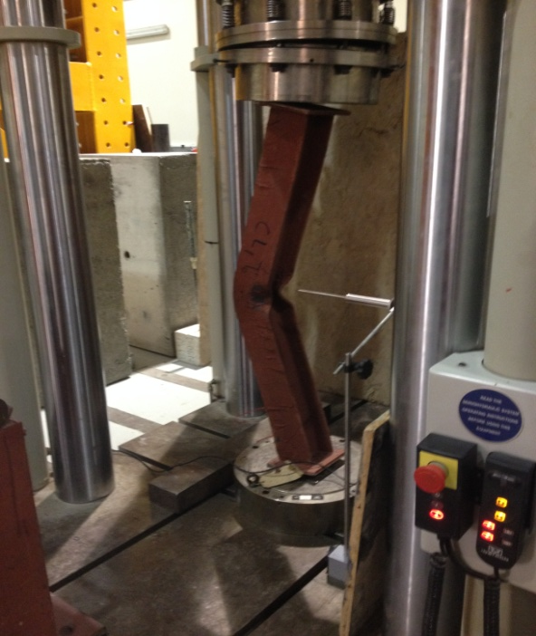
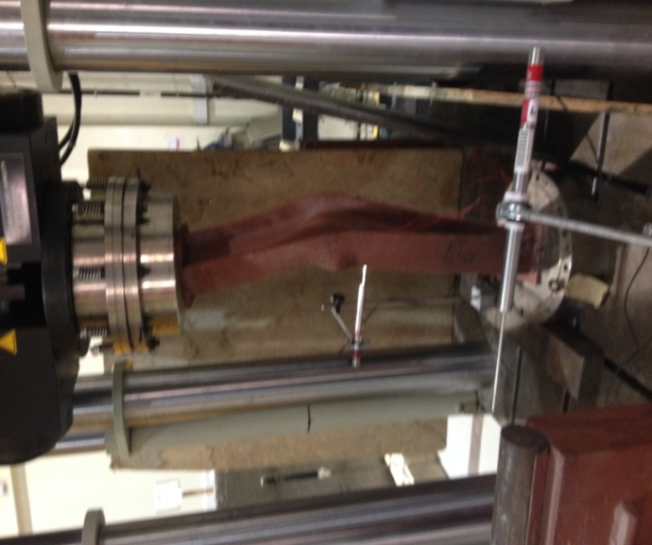
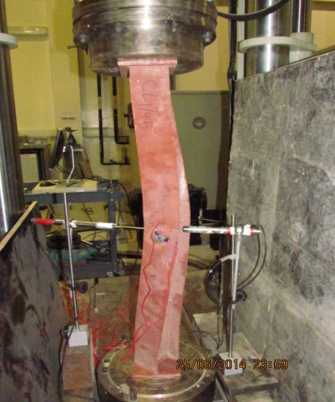
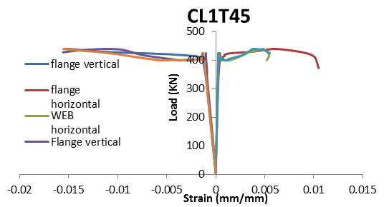
Experimental Tests
1.0 meter Lengths

Slide 19
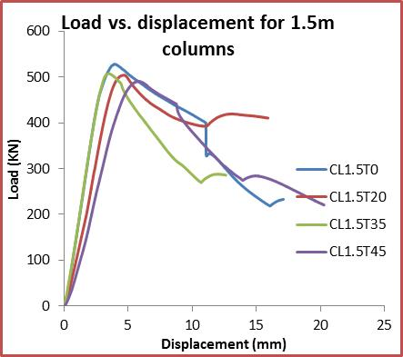
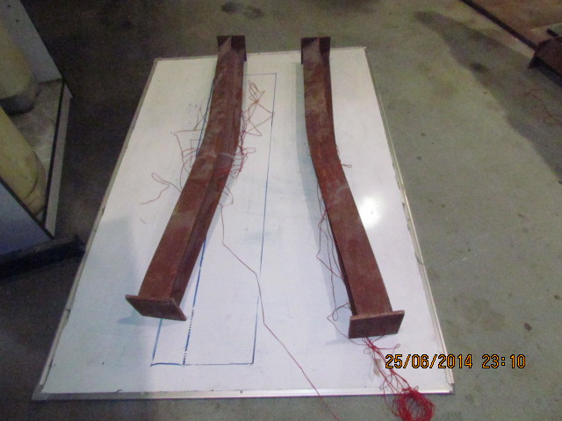
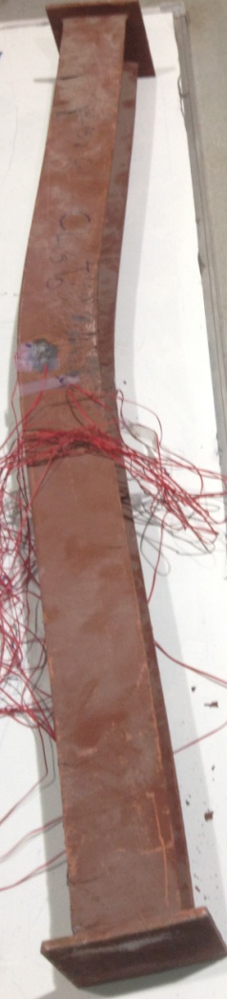
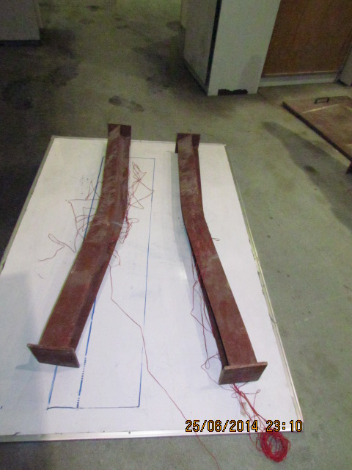
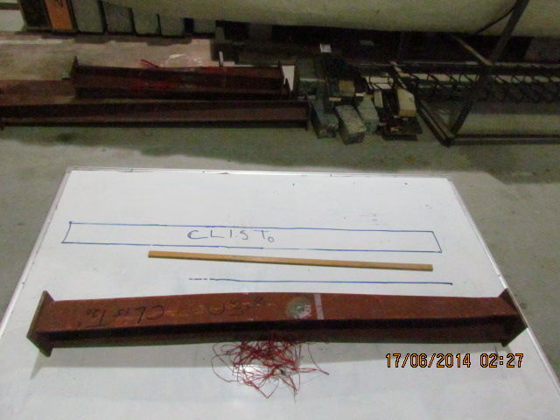
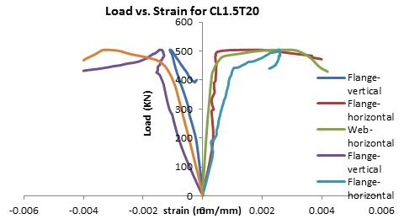
Experimental Tests
1.5 meter Lengths

Slide 20
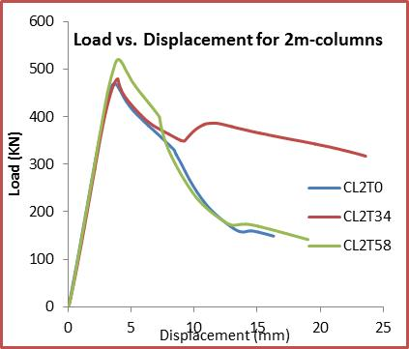
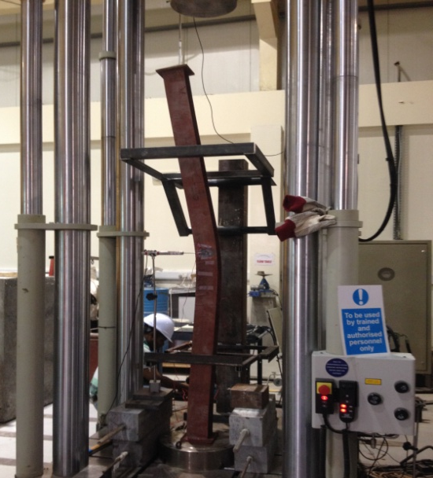
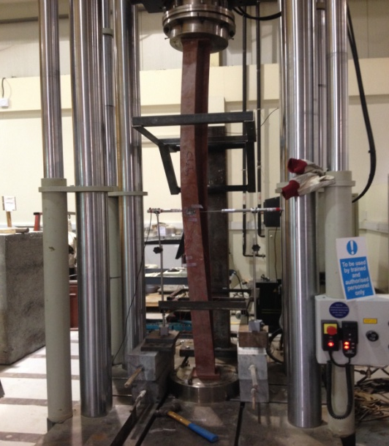
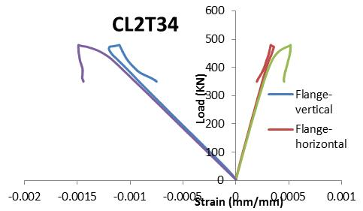
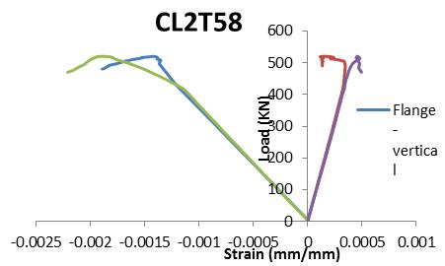
Experimental Tests
2.0 meter Lengths

Slide 21
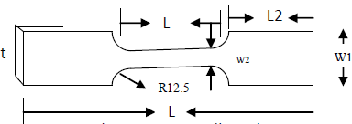

Nonlinear Finite Element Analysis
Nonlinear material
  Coupon Tests on 6 specimens from the flange and the web of H-section to define the elasto-plastic behavior of the material.
  Geometric imperfection was also considered.
  Buckling was modeled using two approaches:
    Riks Analysis
    Displacement control

Slide 22
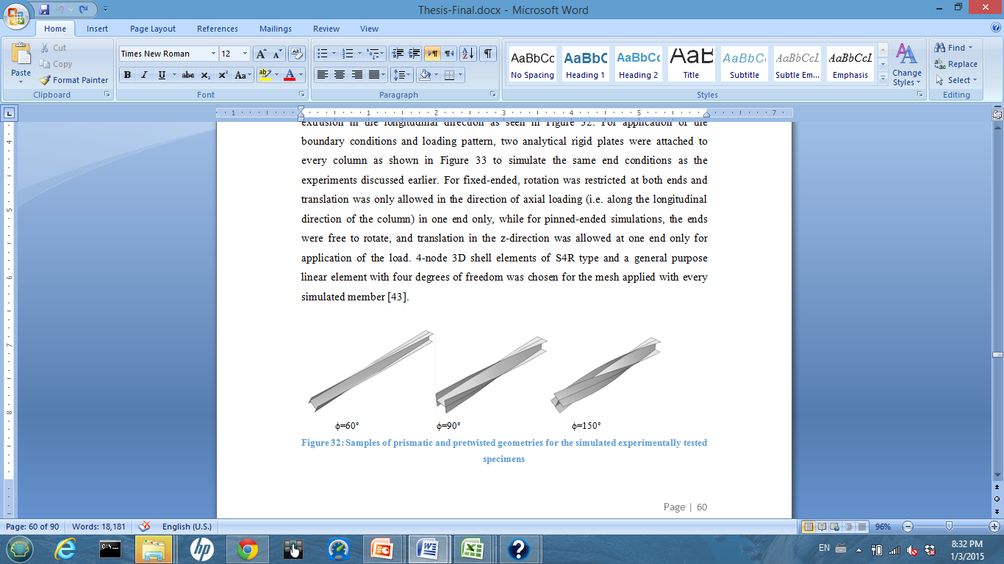
Nonlinear Finite Element Analysis
  Riks Analysis
    Built-upon the results achieved using Linear Perturbation analysis
    Solves for Load and Deflection simultaneously
    Accounts for material nonlinearity by implementing the true stress-strain curve of the material
  Displacement-based General Static Analysis
    Load is input in the form of axial displacement at the end that is allowed to translate in longitudinal direction
    A value of geometric imperfection ranging from L/1000-L/2000 induced as lateral displacement at the column mid-height

Slide 23
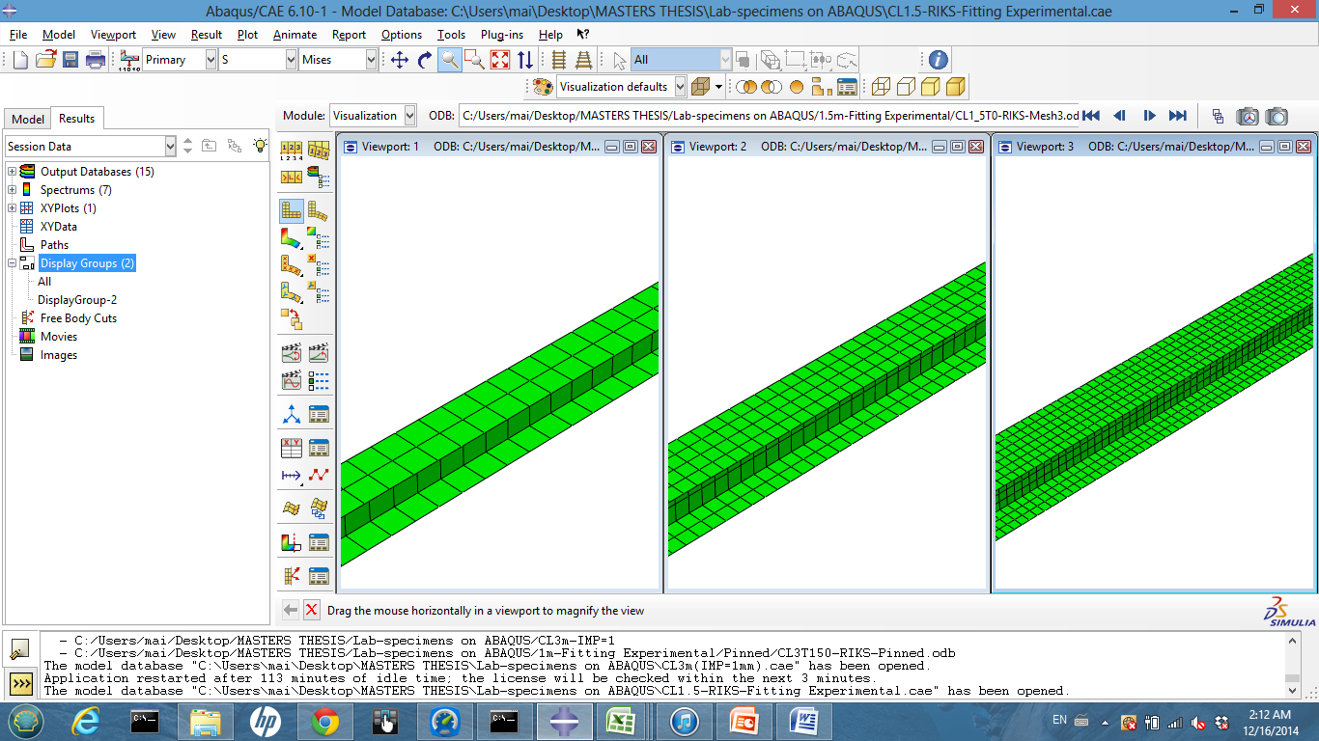
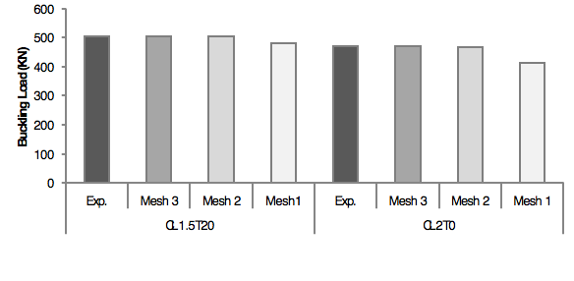
Nonlinear Finite Element Analysis
Mesh Sensitivity Analysis
Mesh 1= 50
Mesh 2 = 25
Mesh 3 = 10
Mesh 1 exceeded 4% for
CL1.5T20 and reached
around 12% with CL2T0.
Mesh 2 and Mesh 3 both
Showed < 0.5% variation.

Slide 24
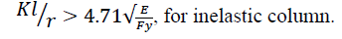
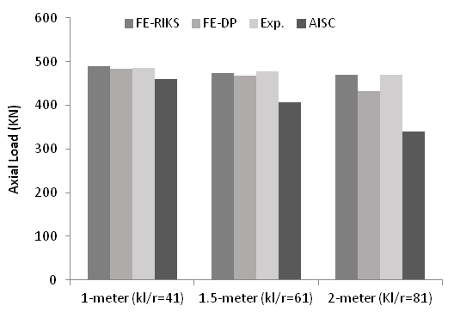
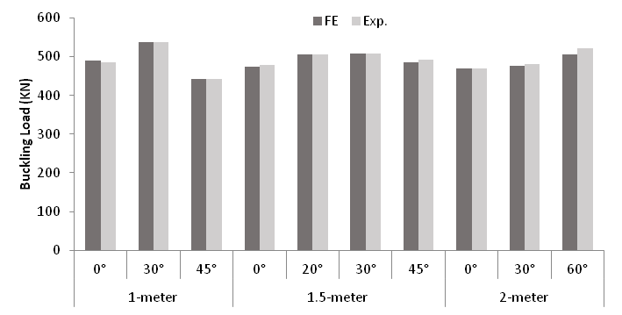
Nonlinear Finite Element Analysis
Nonlinear FE model Verification
Experimental and Nonlinear Finite element results compared against the AISC code provisions for the prismatic columns.
Pretwisted columns simulated through FE analysis

Slide 25
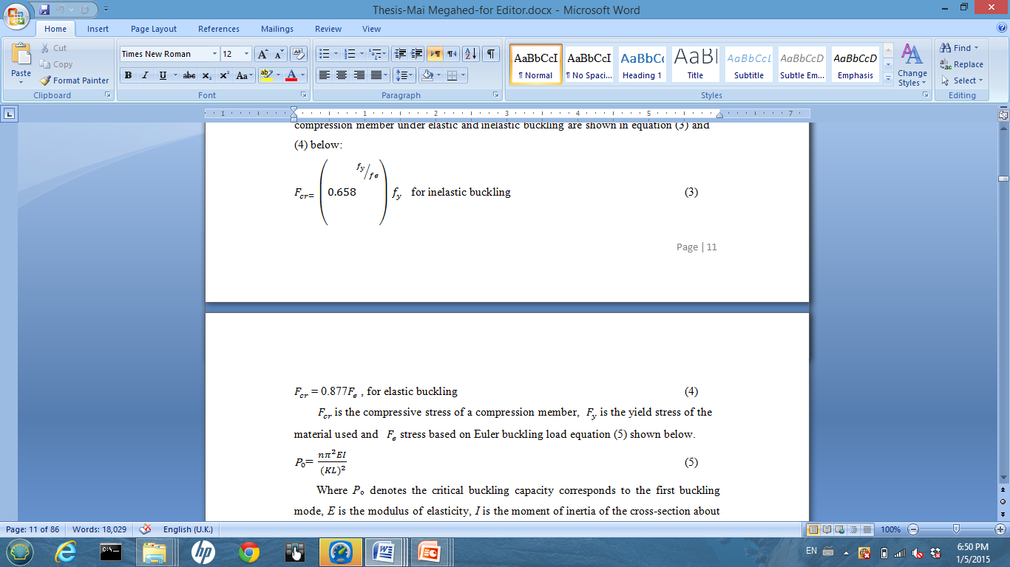

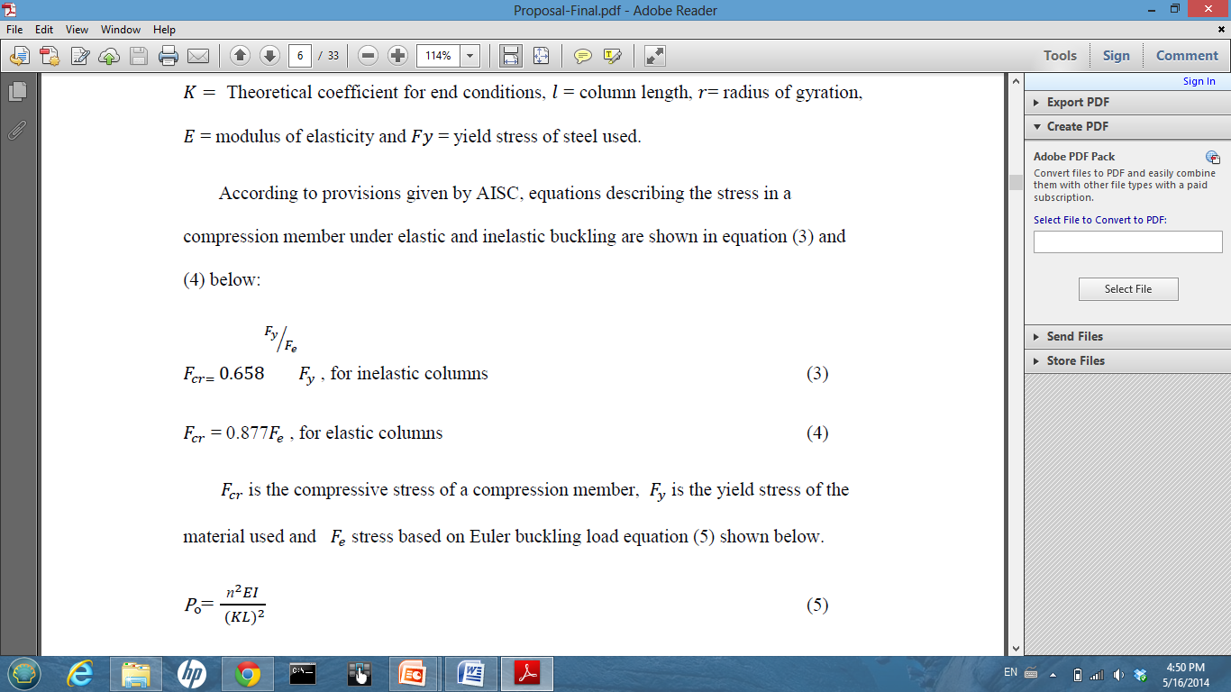
Nonlinear Finite Element Analysis
Nonlinear FE model Verification
Experimental and Nonlinear Finite element results compared against the AISC code provisions for the prismatic columns.
Pretwisted columns simulated through FE analysis

Slide 26
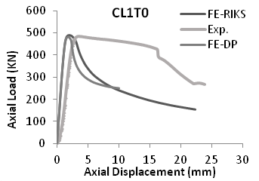
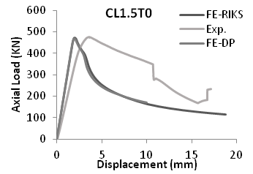
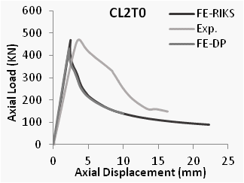
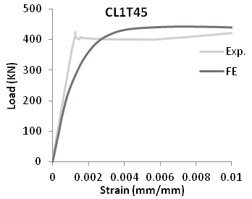


Nonlinear Finite Element Analysis
Nonlinear FE model Verification:
Axial Load versus Displacement:
Axial Load versus Strain:

Slide 27




Nonlinear Finite Element Analysis
Expanded Parametric Study
Fixed-ended models

Slide 28



Nonlinear Finite Element Analysis
Expanded Parametric Study
Pinned-ended models

Slide 29
Remarks
Pretwisting is to be perceived as an effective technique to increase the buckling capacity of any steel compression member
Results obtained via Linear Perturbation analysis showed that there is a significant improvement (up to 90%) in the critical buckling capacity for different slenderness ratios. However, the effect of various column lengths on the buckling improvement for a given UC section was insignificant.
The improvement in the axial capacity of pretwisted UC sections with pinned-pinned ends conditions was found to be very small (only 20%) as compared its fixed-ended counterparts, for the three UC sections used in this study.
More experimental tests and numerical analysis are deemed necessary to reach a more generalized equation that could accurately predict the critical buckling capacity of pretwisted steel columns.
Thanks!

Slide 30


