Slide 1


Impacts of the Renewable Energy and Recycling on the Sustainability of Economic Growth
Faraz Farhidi
Georgia State University
September 2017

Slide 2

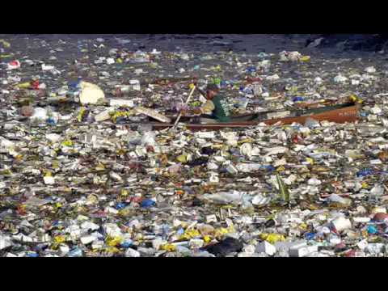

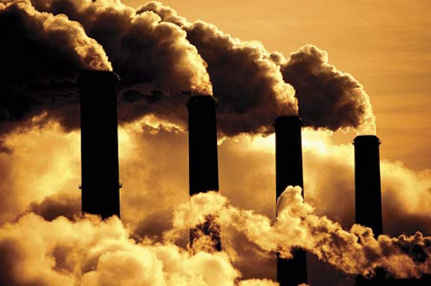
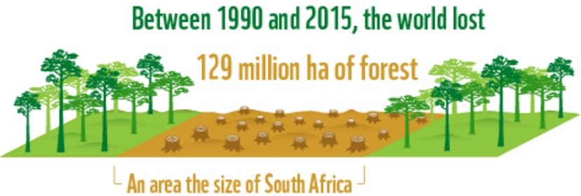
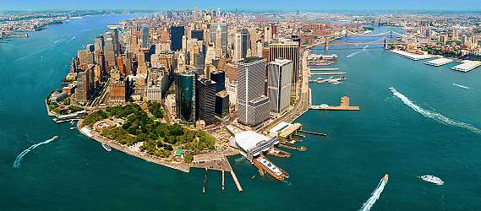
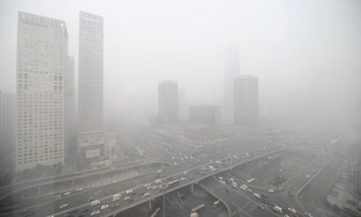
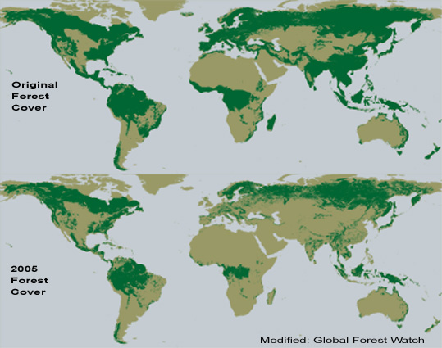
Motivation:
Notes:
Annual worldwide urban waste is estimated to more than triple, from 0.68 to 2.2 billion tones per year.
129 million hectares of forest - an area almost equivalent in size to South Africa - have been lost since 1990
Every year more than five million people die due to complications brought on by air pollution.
Anticipating environmental change and its impacts on the ecosystem is a major challenge for scientists

Slide 5
Questions:
Verifying how realistic the current models of economic growth are, considering environmental deterioration
Sustainability-Endurance of the current capital accumulation, considering the environmental concern

Slide 6
What is the plan?
I plan to develop a generalized structural economic model that explicitly allows for the interaction between an economy and an ecosystem, based on existing literature, in a separate phases
Endogenizing the technological progress and population growth, while including the environmental erosion get the more plausible prediction of the economic growth
Renewable energies and non-renewable natural resources are the exogenous factors to this model, utilizing those are control variables; while the latter factor is limited but not the prior

Slide 7
What I find so far?
The growth rate of Green GDP per capita falls below zero with the current rate of capital accumulation and existing production technologies in the steady state
Population growth leads to the economic growth through knowledge accumulation, while at the same time it adjusts itself by diminishing the resources through living standards
Switching to the clean energy-based resources, might have positive impact on both short-run and long-run growth

Slide 8
Outline
Background
Base Idea
Basic Model
Results
Take-away

Slide 9
Background:
  Daly (1991): Claims environment, natural resources, and pollution, are not noteworthy in the leading textbooks in macroeconomics
  Stern (2011): Economic sustainability and global environmental changes is represented by the models that consider energy to be a primary factor of production
  Nordhaus (2008): Increasing the amount of carbon dioxide leads to global surface temperature, sea level rise, and hurricanes
Notes:
Winkler (2011) & Dornfield (2012): the improvement in innovative production systems that reuse emissions and wastes

Slide 10
Background:
  Gowdy and Erickson (2005): Show that the production of capital is biophysical process in which waste is simultaneously produced
  Fratzscher and Stephan (2003): Entropy will rise from the emission of the energy that is wasted thorough the economic activities
  Payne et al. (2010): Confirm the bidirectional causality between renewable energy consumption and economic growth in both the short, and long-run in OECD countries
Notes:
Winkler (2011) & Dornfield (2012): the improvement in innovative production systems that reuse emissions and wastes

Slide 11
Background:
Land
Natural Resources
Waste Production and pollution
Physical Capital
Energy
Human Capital
Production/Income
Technology
Non-renewable Energy
Government
Labor/consumer
Renewable Energy

Slide 12
Base Idea (major drivers):
Economic Drivers
  Production
  Physical Capital
  Human Capital
  Technological Progress
Societal Drivers
  Population
  Living Standards
  Government policies
Environmental and Ecological Drivers
  Non-renewable energy
  Ecological attraction
  Environmental Deterioration (Waste production and pollution)
  Renewable Energy (solar energy)

Slide 13
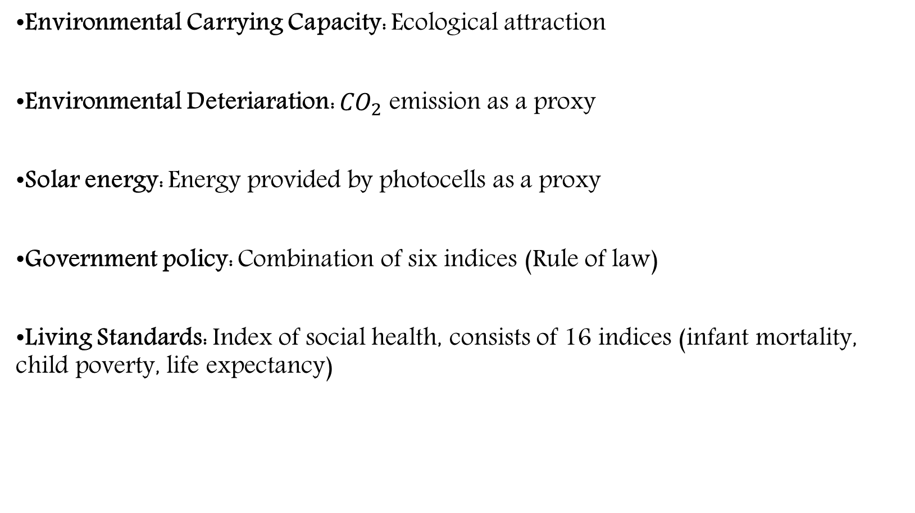
Data (1990-2012):
Environmental Carrying Capacity: Ecological attraction
Environmental Deteriaration: ${CO}_{2}$ emission as a proxy
Solar energy: Energy provided by photocells as a proxy
Government policy: Combination of six indices (Rule of law)
Living Standards: Index of social health, consists of 16 indices (infant mortality, child poverty, life expectancy)
Notes:
"Living standards" refers to the index of social health and consists of sixteen indicators: affordable housing, alcohol-related traffic fatalities, child poverty, high school completion, infant mortality, teenage births, unemployment, wages, poverty among senior citizens, child abuse, health care coverage, inequality in family income, life expectancy, teenage drug use, violent crime, and youth suicide. Index of social health was used as a proxy for living standards.
Voice and Accountability, Rule of Law, Government Effectiveness, Political stability and absence of violence, Regulatory Quality, and Control of Corruption

Slide 14
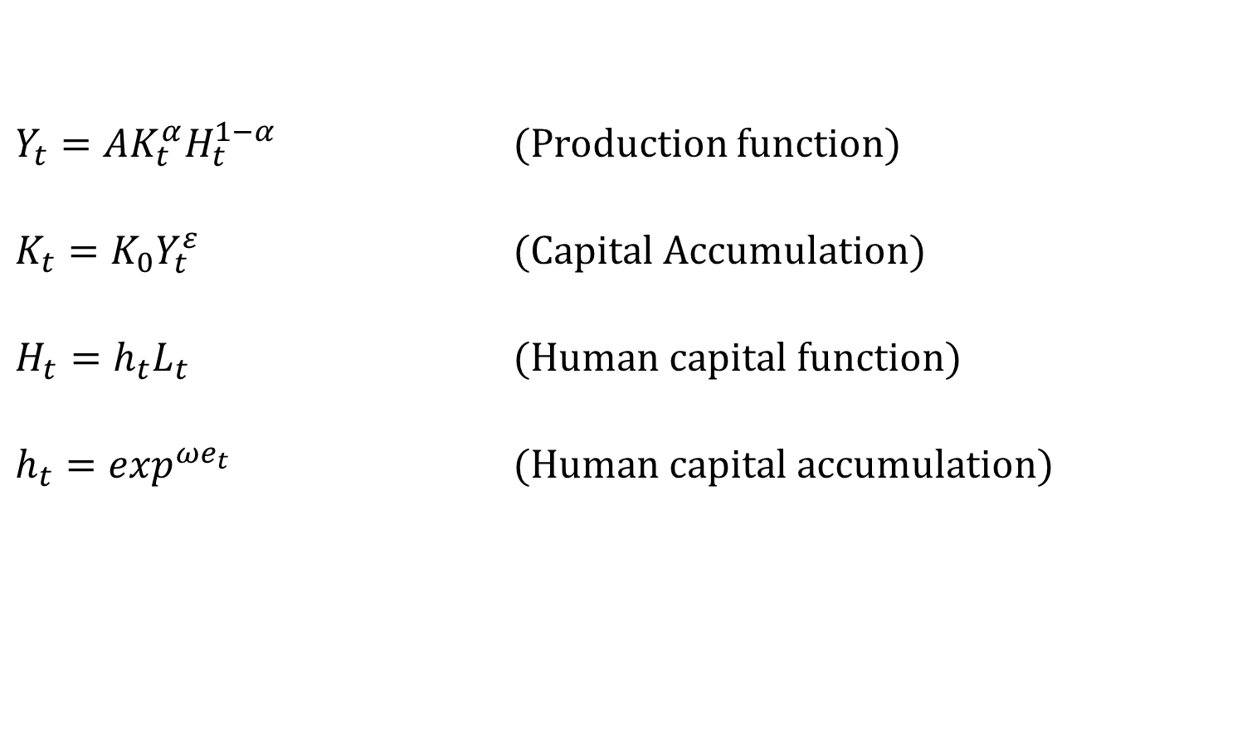
Base Idea (First Step):
Exogenous Technological Progress (TP) and Population Growth (PG), no Governmental and Environmental Impacts
$Y_{t}=AK_{t}^{α}H_{t}^{1−α}$ (Production function)
$K_{t}=K_{0}Y_{t}^{ε}$ (Capital Accumulation)
$H_{t}=h_{t}L_{t}$ (Human capital function)
$h_{t}=\exp^{ωe_{t}}$ (Human capital accumulation)

Slide 15
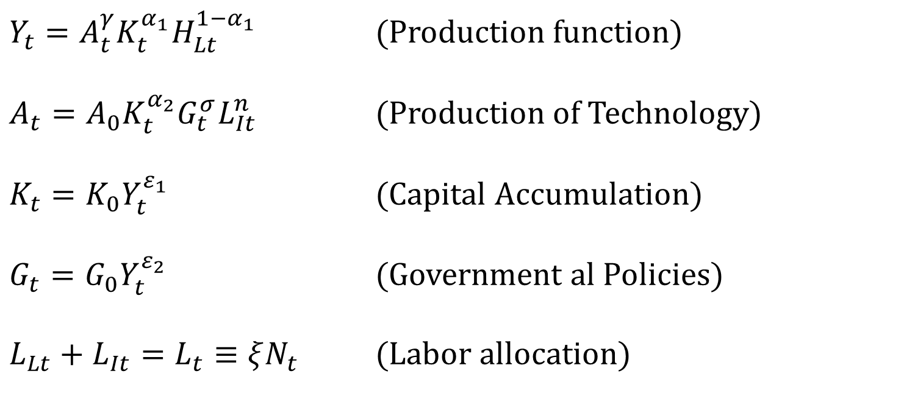
Base Idea (Second Step):
Endogenous TP and Governmental Effect, Exogenous PG and no Environmental Impact
$Y_{t}=A_{t}^{γ}K_{t}^{α_{1}}H_{Lt}^{1−α_{1}}$ (Production function)
$A_{t}=A_{0}K_{t}^{α_{2}}G_{t}^{σ}L_{It}^{n}$ (Production of Technology)
$K_{t}=K_{0}Y_{t}^{ε_{1}}$ (Capital Accumulation)
$G_{t}=G_{0}Y_{t}^{ε_{2}}$ (Government al Policies)
$L_{Lt}+L_{It}=L_{t}≡ξN_{t}$ (Labor allocation)

Slide 16
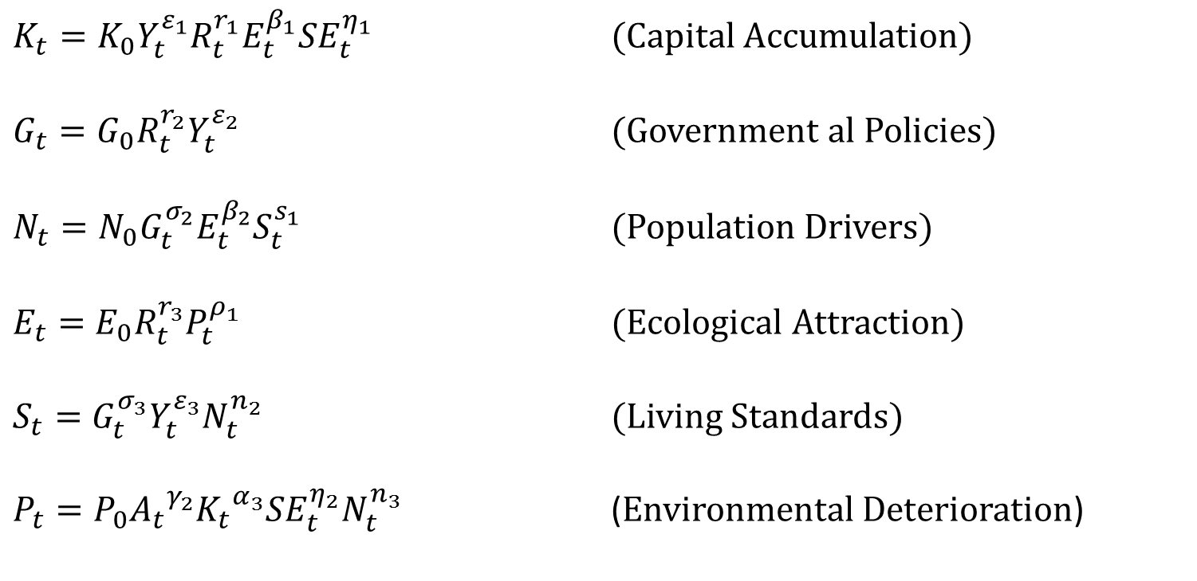
Base Idea (Last Step):
Endogenous TP and PG, Governmental and Environmental Impacts are Included
Exogenous factors: Solar Energy and Non-renewable Natural Resources
$K_{t}=K_{0}Y_{t}^{ε_{1}}R_{t}^{r_{1}}E_{t}^{β_{1}}{SE}_{t}^{η_{1}}$ (Capital Accumulation)
$G_{t}=G_{0}R_{t}^{r_{2}}Y_{t}^{ε_{2}}$ (Government al Policies)
$N_{t}=N_{0}G_{t}^{σ_{2}}E_{t}^{β_{2}}S_{t}^{s_{1}}$ (Population Drivers)
$E_{t}={E_{0}R}_{t}^{r_{3}}P_{t}^{ρ_{1}}$ (Ecological Attraction)
$S_{t}=G_{t}^{σ_{3}}Y_{t}^{ε_{3}}N_{t}^{n_{2}}$ (Living Standards)
$P_{t}={{P_{0}A}_{t}}^{γ_{2}}{K_{t}}^{α_{3}}{SE}_{t}^{η_{2}}N_{t}^{n_{3}}$ (Environmental Deterioration)

Slide 17
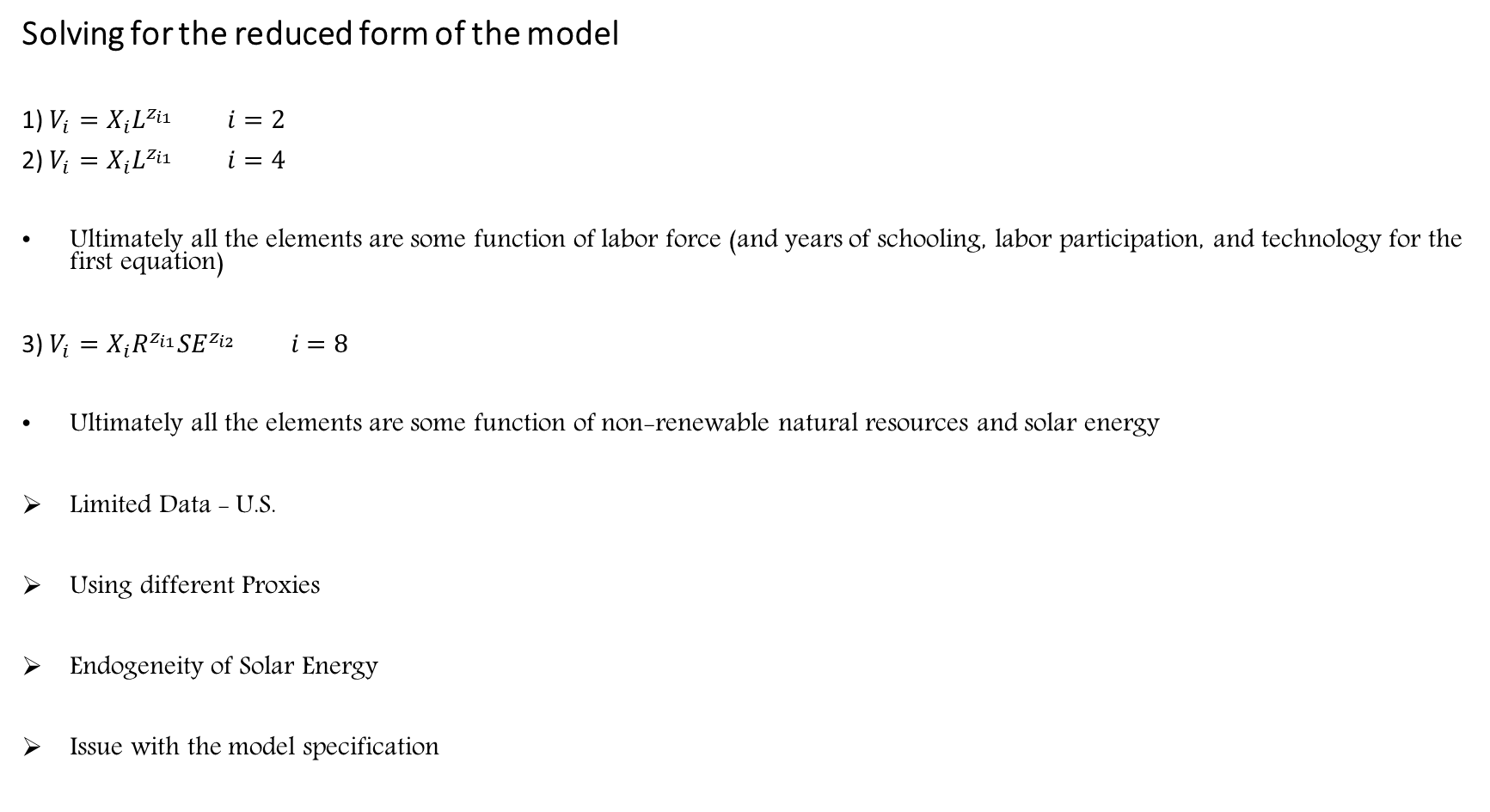
Solving for the reduced form of the model
1) $V_{i}=X_{i}L^{z_{i1}} i=2$
2) $V_{i}=X_{i}L^{z_{i1}} i=4$
Ultimately all the elements are some function of labor force (and years of schooling, labor participation, and technology for the first equation)
3) $V_{i}=X_{i}R^{z_{i1}}{SE}^{z_{i2}} i=8$
Ultimately all the elements are some function of non-renewable natural resources and solar energy
Limited Data - U.S.
Using different Proxies
Endogeneity of Solar Energy
Issue with the model specification

Slide 18
Main Elements’ Impact
Impact of Technology on Production
Impact of Physical Cap. on Production
Impact of Production on Physical Cap.
Impact of Government on Technology
Impact of Human Cap. on Technology
Impact of GDP on Government
Impact of Government on Population
Impact of Government on Living Std.
Impact of Physical Cap. on Env. Det.
Impact of Solar Energy on Env. Det.
Impact of Population On Env. Det.
Exogenous TP & Exogenous Pop
-
0.406
0.114
-
-
-
-
-
-
-
-
Endogenous TP & Exogenous Pop
0.071
0.156
0.988
-0.001
-1.624
-0.117
-
-
-
-
-
Endogenous TP & Endogenous Pop
0.151
0.025
0.1768
0.172
1.324
-1.121
0.02
-0.152
-0.2982
-0.001
1.2628

Slide 19
Capital accumulation under three different scenarios for solar energy utilization

Slide 20
Take-away:
Running out of the natural resources may not be the end of the world
At some point we have to switch to renewable energy, completely
Overestimating the growth by not including environmental externalities
Advancing recycling decreases the entropy, erode less of the environment, thus, might lead to sustainable economic growth

Slide 21

Questions & Comments

