Slide 1
Androgens, cellular stress, and prostate cancer
Fahri Saatçıoğlu
Dept. of Biosciences
University of Oslo
Institute for Medical Genetics and Informatics
Oslo University Hospital, Oslo

Slide 2
Cellular Stress
Heat Shock
Response
DNA Damage
Response
UPR
(ER and Mt)
Oxidative Stress
Response
Survival,
or Death (Apoptosis/Autophagy/Necrosis)
Notes:
In the majority of cancers, tumors experience stressful conditions in their microenvironment due to poor vascularisation and their high growth rate. These conditions include low oxygen supply, nutrient deprivation, and pH changes, all of which could result in cell death in normal tissues. These settings activate a range of pro-adoptive cellular stress response pathways that enable the cancer cells to survive under such hostile conditions. The main cellular stress response pathways include the heat shock response, unfolded protein response (UPR), response to oxidative stress (redox homeostasis), and the DNA damage response (15) (Figure 2). These responses are highly interconnected; however, significant information is still missing, both in terms of the details of the individual pathways, as well as the crosstalk between them.

Slide 3
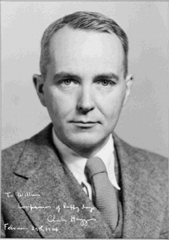

History of Androgen Deprivation Therapy: Charles B. Huggins
In 1940 Huggins reported that testosterone removal (castration) resulted in rapid shrinkage of the enlarged prostate of older dogs.
In 1941 Huggins and Hodges reported that androgen removal greatly aided patients with advanced prostate cancer.
“Prostatic cancer is influenced by androgenic activity in the body.”

Slide 4
Prostate Cancer Progression
Androgen
Ablation
Tumor Growth
Androgen-dependent
growth
Regression
Androgen-independent
growth
Time

Slide 5
Prostate Cancer Progression
Androgen
Ablation
Tumor Growth
Androgen-dependent
growth
Regression
Hormone resistant/
Castration resistant
Time

Slide 6
Androgen Receptor Activation
SHBG
TST
Albumin
TST
TST
TST
5α-
reductase
DHT
HSP
NAPDH
NAPD
AR
DHT
Kinase
DHT
DHT
AR
AR
AR
P
HSP
P
ADP
ATP
Cytoplasm
BRM
SWI-SNF
Nucleus
CBP
PolII
SRC
AR target genes
Proliferation
Differentiation
ARE
Ac
Ac
Ac

Slide 7
Importance of AR in Prostate Cancer
Progression
● Vast majority of CRPC patients have marked increase in AR
● Forced AR expression increases PCa cell growth whereas AR knockdown empedes CRPC
● A large number of somatic mutations in AR in CRPC
● AR stimulates expression of TMPRSS2-ERG fusions associated with PCa
● High AR levels turn antagonists into agonists
● Expression of ligand-independent AR splice variants is enhanced in CRPC
Notes:
Intratumoral androgen levels do not decrease as much in the ’castrate’ state
Various mechanisms of ligand-independent activation of AR have been uncovered, in addition to mutations in the LBD, AR gene amplifications, increases in coactivator levels etc.
Some mutations convert antagonists (flutamide and casodex) to potent aganists.
Although mutation rate in CRPC is low, they could be selected for by different treatments.
In addition, changes in the levels of coactivators and corepressors of AR have been identified during disease progression.
Accumulating evidence suggest that CRPC is a ligand and AR-driven disease
This is the ’AR addiction’ pathway!

Slide 8
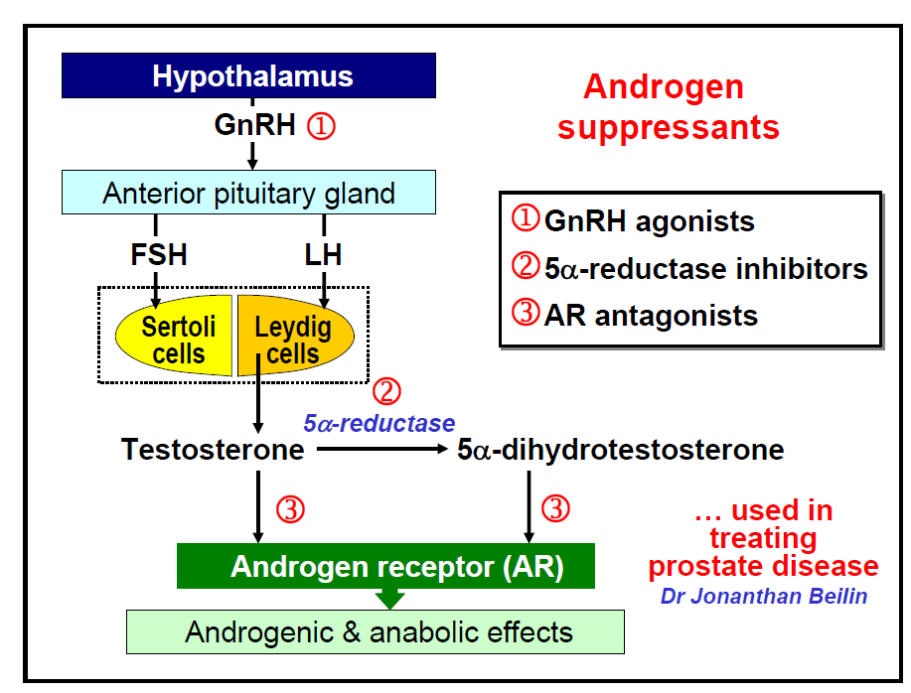
Androgen
suppressants
Notes:
Abiraterone + bicalutamide combination therapy etc.
MDV3100 , EPI001 (from the Sadar group here), as AR antagonist
Abiraterone (recently recieved FDA approval for metastatic CRPC, TAK-700 (millenium/Takeda), and TOK-001 (Tokai) as CYP17A inhibitors
Importantly, while novel agents targeting ligand synthesis and AR activation have demonstrated significant responses in CRPC, not all patients respond and many eventually demonstrate progression.
Therefore, it is vital to understand further details of androgen signaling in PCa cells.

Slide 9
Three Components of Androgen Action
● Androgens
● AR and its cofactors
● AR target genes

Slide 10
Three Components of Androgen Action
● Androgens
● AR and its cofactors
● AR target genes

Slide 11
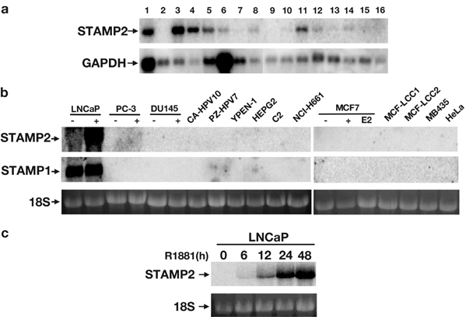
STAMP2 is an androgen regulated gene in prostate cancer cells
1. heart, 2. brain, 3. placenta, 4. lung, 5. liver, 6. skeletal muscle, 7. kidney, 8. pancreas, 9. spleen, 10. thymus, 11. prostate, 12. testis, 13. ovary, 14. small intestine, 15. colon, 16. peripheral blood leukocyte
Korkmaz et al., Oncogene 2005
Notes:
Over 10 years ago, our lab cloned STAMP2 from prostate tissue. Northern assay of multiple tissues showed that STAMP2 is abundant in heart, placenta, lung and liver, besides prostate.
And then it was idenified as an androgen regulated gene. As shown here, the mRNA level of STAMP2 is induced in a time course of androgen treatment.

Slide 12

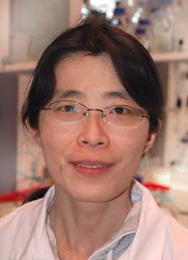
STAMP2 team
Yang Jin
Ling Wang
Jin et al., EMBO Mol Med 2015
Notes:
Over 10 years ago, our lab cloned STAMP2 from prostate tissue. Northern assay of multiple tissues showed that STAMP2 is abundant in heart, placenta, lung and liver, besides prostate.
And then it was idenified as an androgen regulated gene. As shown here, the mRNA level of STAMP2 is induced in a time course of androgen treatment.

Slide 13
STAMP2 is a member of transmembrane ferrireductase family
extracellular
Fe
cytosolic
NADPH
COOH
NH2
Regulates energy metabolism and inflammatory output
Atherosclerosis in Stamp2 knockout mice
Metalloreductase activity
Regulates uptake of iron and copper
Ohgami et al., Nature Genetics. 2005
Wellen et al., Cell. 2007
Ten Freyhaus, et.al. Cell Metabolism. 2012.
Notes:
STAMP2 has six transmembrane domains in the C-terminal part, a conserved NADPH binding domain at the N-terminal cytosolic domain. Studies on STAMP2 knockout mice showed that STAMP2 is important in regulation of energy metabolism and inflammatory output. STAMP2 deficiency promotes atherosclerosis in mice.

Slide 14
Mechanisms of STAMP2 function in PCa cells
AR
STAMP2
Fe³⁺
Fe²⁺
NADPH NADP+
ROS
ATF4
PCa cell proliferation,
growth and survival
Jin et al., EMBO Mol Med 2015
Notes:
Based on the data presented herein, we proposed a model of how STAMP2 influences PCa growth. Androgens activate the AR that increases STAMP2 expression. Through its iron reductase activity, STAMP2 reduces Fe³⁺ to Fe²⁺ and at the same time consumes available NADPH. Both increased Fe²⁺ and decreased NADPH then increase intracellular ROS levels. ROS in turn activate the pathway that increases ATF4 expression which then activates expression of downstream targets that are involved in PCa growth and progression.

Slide 15
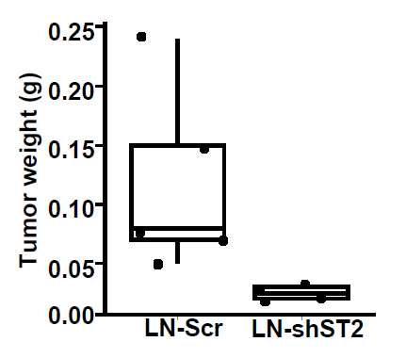
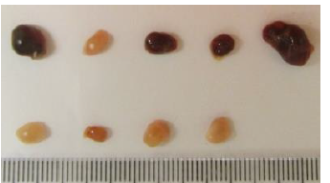
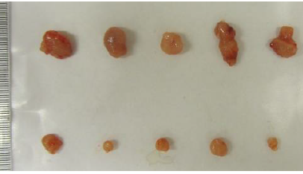
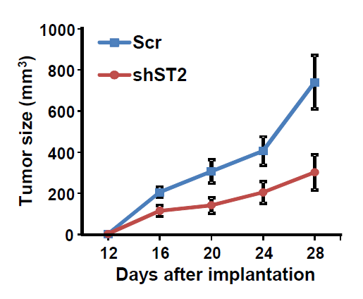
STAMP2 loss inhibits prostate cancer cells growth in vivo
Scr
LNCaP
shST2
Scr
22RV1
shST2

Slide 16
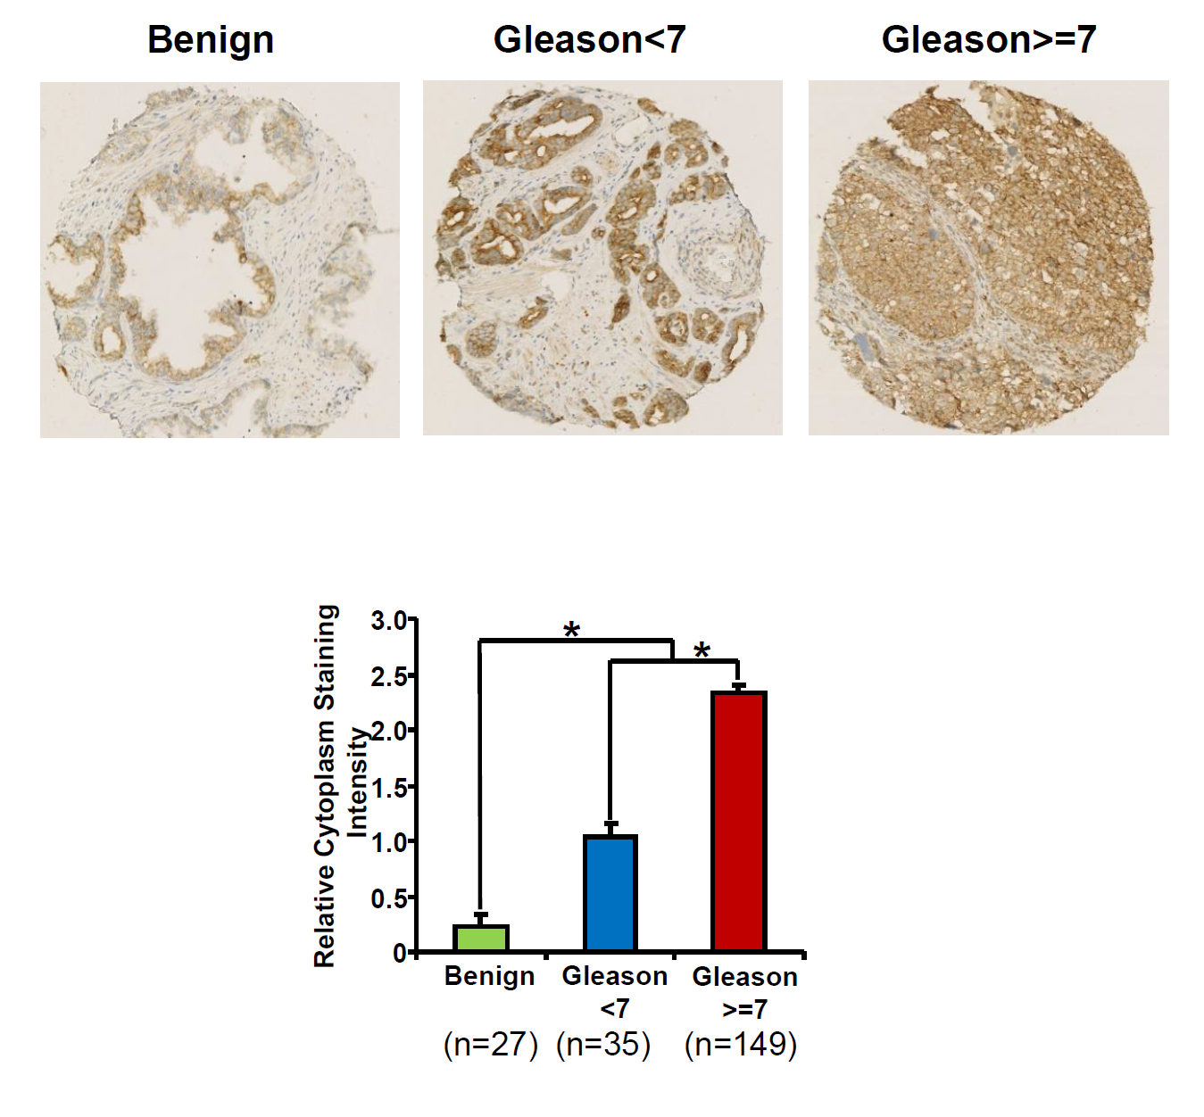
STAMP2 expression is up-regulated
in human PCa specimens
Notes:
Then we assessed STAMP2 expression by immunohistochemistry on a tissue microarray that contained benign and malignant prostate tissue. STAMP2 expression was significantly increased in PCa compared to benign prostate tissue. In addition, STAMP2 cytosolic staining correlated with the tumor grade.

Slide 17
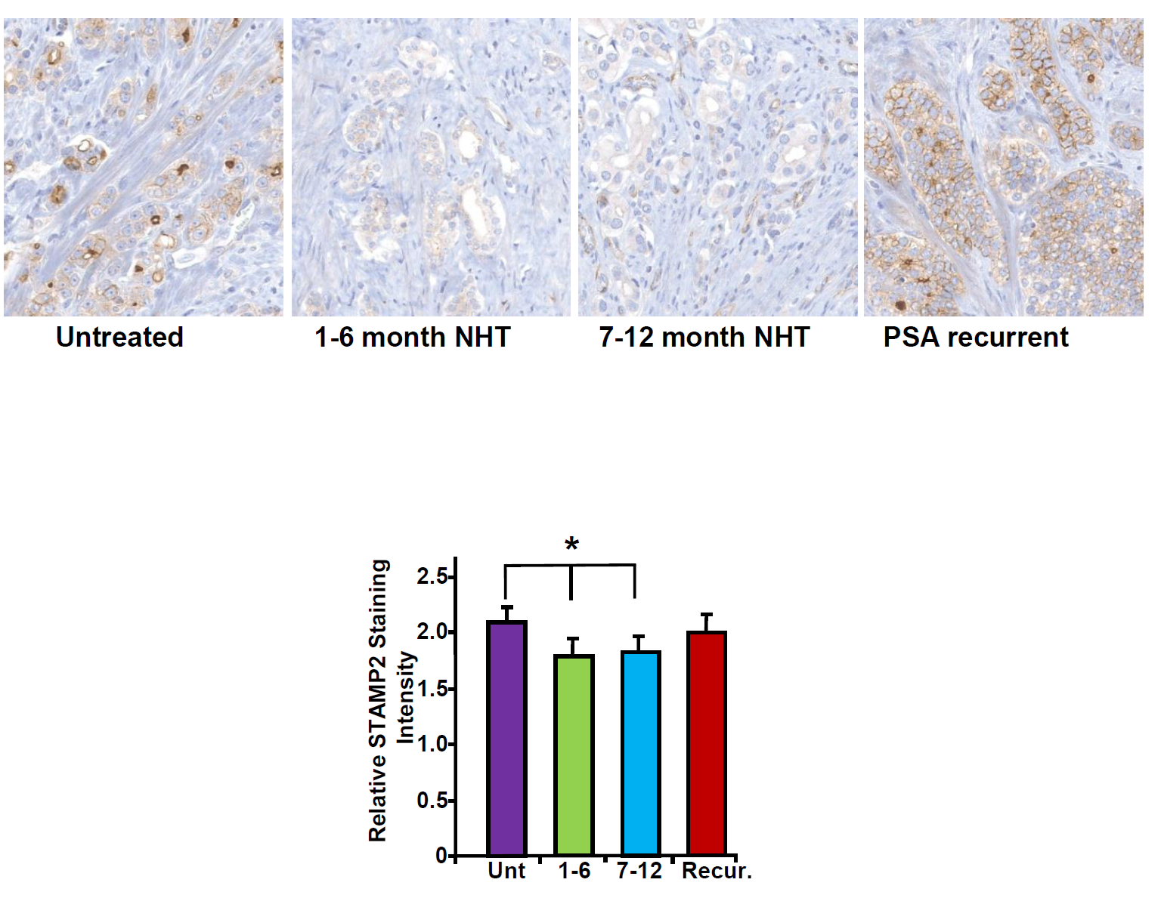
STAMP2 is associated with neoadjuvant
hormone therapy
Notes:
Furthermore, STAMP2 levels were reduced following neoadjuvant hormone therapy and remained low in patients responding to therapy. Interestingly, upon PSA recurrence STAMP2 levels were again increased. Collectively, these data show that STAMP2 expression is increased in PCa compared with normal prostate and it is associated with both tumor grade and neoadjuvant hormone therapy response.

Slide 18
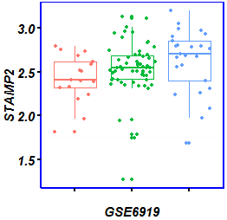
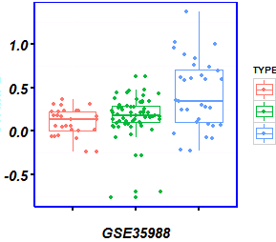
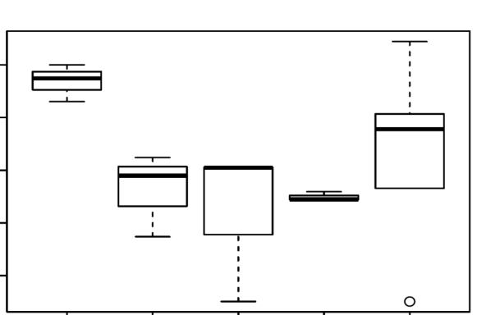
STAMP2 is associated with CRPC
A
B
0
*
*
Normal
PCa
CRPC
-2
Log expression of STAMP2
-4
-6
-8
0
1
2
4
Refractory
Weeks after castration
 | PCa | CRPC
Normal | 0.0607 | 0.0079
PCa |  | 0.0350
 | PCa | CRPC
Normal | 0.0754 | 8.3E-05
PCa |  | 9.8E-05

Slide 19
Nanoliposomal siRNA delivery to tumors
Efficiency: DOPC based nanoliposomes can deliver siRNA in vivo into tumour cells 10- and 30-fold more effectively than cationic liposomes (e.g. DOTAP) and naked siRNA, respectively (Ozpolat et al, 2009).
● Efficacy: Twice weekly intravenous or intraperitoneal injections of DOPC-nanoliposomes incorporating siRNA, at a dosing schedule of 150 μg kg⁻¹ day⁻¹, resulted in substantial reduction in the expression of target genes (e.g., FAK, neuropilin-2, IL-8 or Bcl-2) and tumour size in mice with different human cancers (e.g. Landen et al., 2005; Halder et al., 2006)
● Safety: DOPC-based nanoliposomes did not cause any detectable distress or toxicity and were found to be safe in mice and in nonhuman primates.

Slide 20
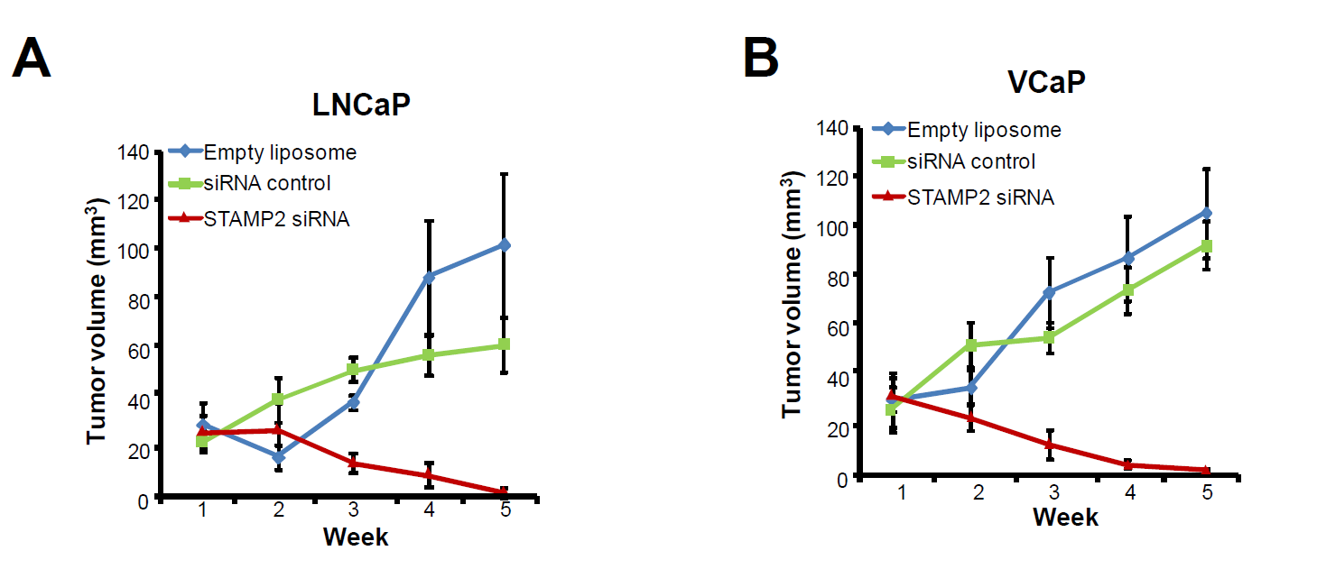
Therapeutic efficacy of STAMP2 silencing in preclinical models of prostate cancer
Notes:
As shown above, STAMP2 expression is increased in high grade tumor and it is critical for PCa cell growth. It is interesting to evaluate the therapeutic potential of STAMP2 knockdown in preclinical models. To assess this possibility, STAMP2 was silenced using systemically administered nanoliposomal siRNA in nude mice carrying xenografted tumors of LNCaP. As shown here, while tumors continued to grow rapidly in mice injected with the empty or control siRNA loaded nanoliposomes, there was a dramatic and time-dependent reversal of tumor size upon nanoliposome injection containing STAMP2 siRNA. This effect was confirmed in another model carring VCaP tumors.

Slide 21
Future Perspectives, STAMP2
● Further molecular characterization of STAMP2-ATF4 axis
● Explore whether STAMP2 knockdown can improve efficacy of hormone and chemotherapy
● Targeted nanoliposomal siRNA mediated knockdown/optimization
● Clinical studies

Slide 23
The Unfolded Protein Response
BiP
BiP
ER
BiP
BiP
BiP
BiP
IRE1α
PERK
ATF6
TRAF2
eIF2α
P
Alarm stress
pathways
XBP-1S
ATF6
JNK
ATF4
Apoptosis
UPR gene expression
Quality control
Folding
Protein secretion
Protein degradation
Lipid synthesis
RIDD
ERAD
Autophagy
Apoptosis
Notes:
CHOP repress Bcl2, increase Bim, translocation of Bax, induce PUMA, p53
RIDDRREgulated IRE1 dependent decay of mRNA
ER asscociated death

Slide 24
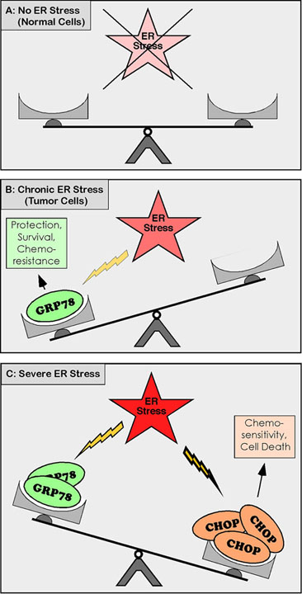
ER stress in cancer
(Schonthal et al., 2012)
Notes:
Perspectives of modulation of the UPR in therapeutics. Strong ER stress
and activation of the UPR triggers apoptosis of cancer cells. In contrast, mild
UPR activation induces a beneﬁcial ER-mediated hormetic response that decreases the load of misfolded proteins and activates cellular protective mechanisms, such as an antioxidant response and autophagy.

Slide 25
Androgens and ER stress?
The hypothesis:
induction of prostate secretory cells by androgens activates the UPR to induce ER expansion to accommodate increased protein expression.
B) activation of the UPR may be part of the differentiation program induced by androgens that occurs prior to induction of high-level protein synthesis.
Thus, the UPR may contribute to a programmed response to androgen that increases the prostate cell’s protein-secretory demand/cell survival. This may be deregulated in prostate cancer.

Slide 26



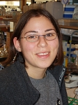

Yke Arnoldussen
Xia Sheng
Margrethe Storm
Androgens and ER stress
Martina Tesikova
Yang Jin
Zeynep Kirli

Slide 27
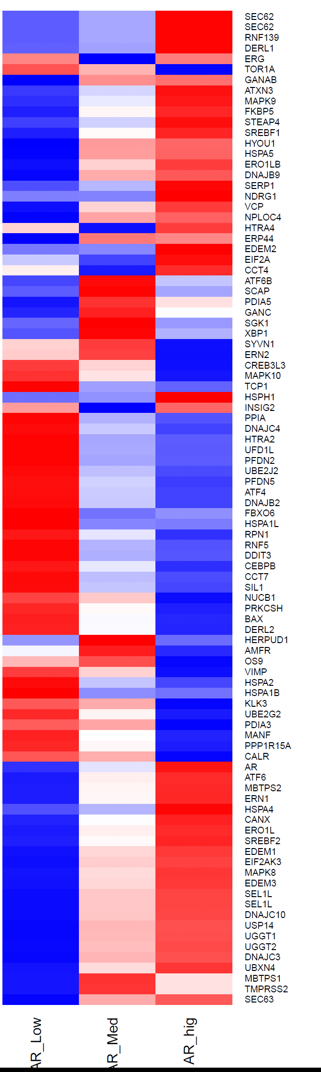
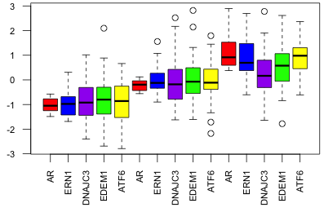
AR and UPR gene expression are correlated in
human prostate cancer
A
B
Relative Expression
AR low
AR medium
AR high
AR:
Low
Med
High
Notes:
Given the role of androgens in PCa progression and the secretory function of the prostate, we hypothesized that UPR signaling may be affected by AR signaling. To assess this, we investigated the possible concordance between AR and UPR gene expression in a gene expression data set from 190 human PCa tumors. AR expression in the PCa tumors was significantly correlated with UPR gene expression (Supplementary Figure S1, Table S1). The tumors were then stratified into three groups according to AR status, i.e. AR_Low (n=60), AR_medium (n=70), and AR_high (n=60), and assessed for UPR gene expression. As shown in Figure 1A, stratified AR levels correlated with UPR gene expression (Table S2). The expression profiles of prominent UPR genes, including ERN1 (IRE1), EDEM1, ATF6 and DNAJC3 (P58IPK), are presented separately for ease of evaluation (Figure 1B). These data were validated using an independent patient cohort (Table S3) suggesting that AR and UPR gene expression are linked in PCa.

Slide 28
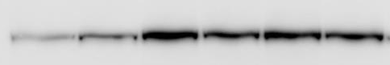
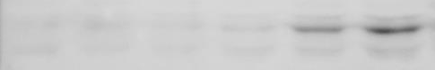
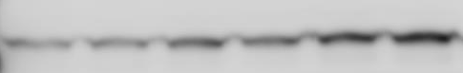

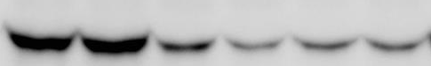
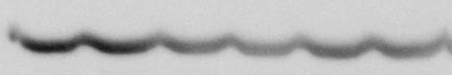
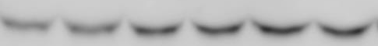
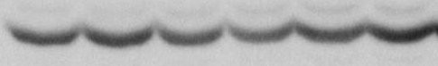
Androgens activate IRE1, but inhibit PERK
signaling in prostate cancer cells
A
B
1400
*
500
1200
*
400
*
1000
*
IRE1α/GAPDH
mRNA expression
300
*
800
*
*
XBP-1S/GAPDH
mRNA expression
*
*
*
600
*
*
*
200
*
400
*
*
200
100
0
1.5
3
6
9
12
24
36
48
60
72
84
0
1.5
3
6
9
12
24
36
48
60
72
84
CTRL
R1881 (h)
CTRL
R1881 (h)
C
6h
24h
36h
48h
72h
6h
24h
36h
48h
72h
R1881:
-
+
+
+
+
+
R1881:
-
+
+
+
+
+
IRE1α
XBP-1S
P58IPK
XBP-1U
P-eIF2α
GAPDH
T-eIF2α
GAPDH

Slide 29
Androgens activate the IRE1 pathway in
prostate cancer xenografts
A
B
C
2.5
1.4
2.5
2
1.2
2
IRE1α/GAPDH
mRNA expression
1
*
XBP-1U/GAPDH
mRNA expression
1.5
XBP-1S/GAPDH
mRNA expression
*
1.5
0.8
*
1
*
0.6
1
0.5
*
0.4
0.5
0.2
0
0
0
24
48
72
96
120
0
0
24
48
72
96
120
0
24
48
72
96
120
hours after castration
hours after castration
hours after castration

Slide 30
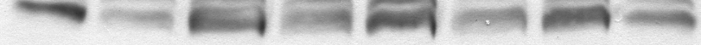
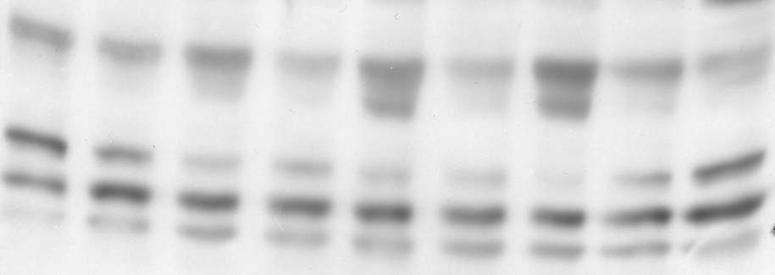
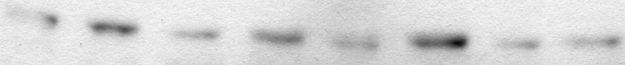

AR is required for androgen regulation of ER stress
in prostate cancer cells
A
B
500
CTRL siRNA
300
CTRL siRNA
400
AR siRNA
AR siRNA
IRE1α/GAPDH
mRNA expression
200
300
XBP-1S/GAPDH
mRNA expression
200
100
*
*
100
*
*
R1881:
-
-
+
+
+
+
+
+
R1881:
-
-
+
+
+
+
+
+
24h
36h
48h
24h
36h
48h
C
48h
24h
36h
48h
R1881:
-
-
+
+
+
+
+
+
siAR:
-
+
-
+
-
+
-
+
AR
IRE1α
XBP-1S
XBP-1U
P-eIF2α
T-eIF2α
GAPDH

Slide 31
AR binds to regulatory sites
in ER stress genes in vivo
A
LNCaP
B
VCaP
PSA-enhancer
PSA enhancer
*
30
*
9
27
8
24
7
*
21
6
18
5
Fold enrichment
15
Fold enrichment
12
4
9
3
6
2
3
1
0
0
*
12
IRE1-02
6
IRE1-02
*
10
*
5
8
4
6
Fold enrichment
Fold enrichment
4
3
2
2
0
1
0
5
RAMP4
*
4
RAMP4
*
4
3
*
3
Fold enrichment
Fold enrichment
2
2
1
1
0
0
*
4
*
2.5
EDEM1
EDEM1
2
3
*
1.5
Fold enrichment
Fold enrichment
1
2
0.5
1
0
IgG
C
24h
48h
0
IgG
C
24h
48h

Slide 32
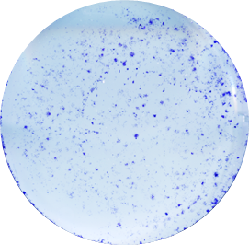
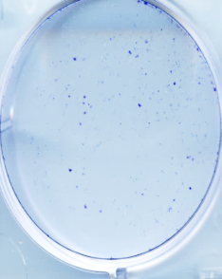

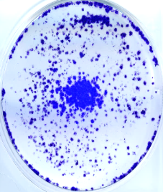
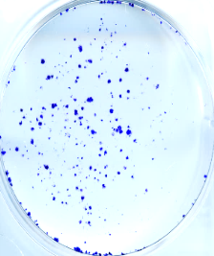
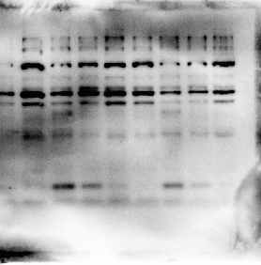
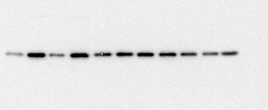
IRE1 signaling is necessary for prostate
cancer growth in vitro
A
B
Scr shIRE1
IRE1
Relative Colony Area
Actin
*
Scr
shIRE1
C
Scr shXBP-1
D
XBP1
Relative Colony Area
*
Actin
Scr
shXBP-1

Slide 33
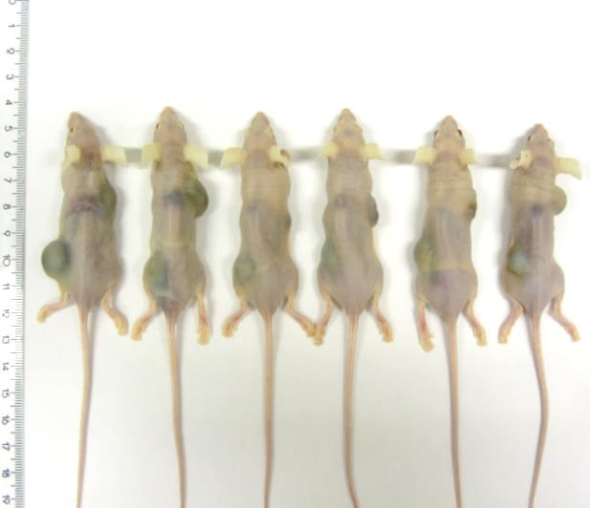
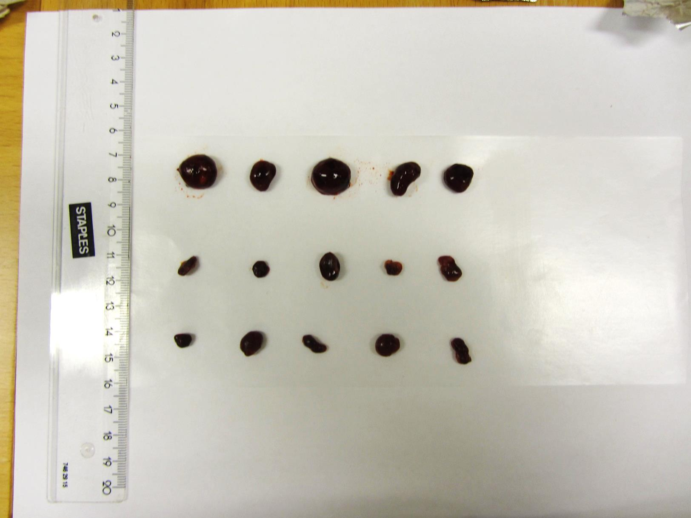
IRE1 signaling is necessary for prostate
cancer growth in vivo
A
B
Scr
shIRE1
shXBP-1
1200
**
1000
*
800
Scr
Tumor Volume (mm³)
600
shIRE1
400
shXBP-1
200
Scr
0
Week 5
Week 6
Week 7
Week 8
shIRE1
shXBP-1

Slide 34
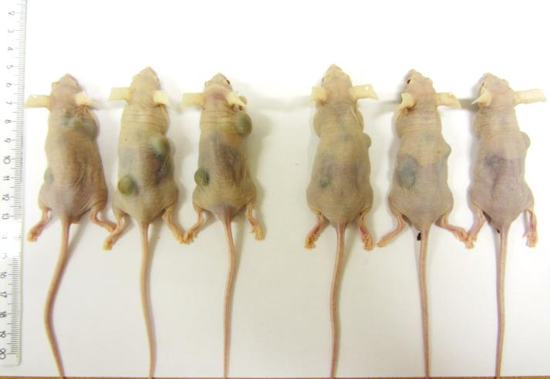
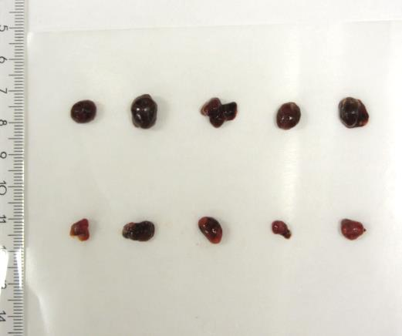
A small molecule inhibitor of IRE1 inhibits prostate
cancer growth in vivo
A
B
LNCaP
LNCaP
**
Vehicle
Toyocamycin
300
250
200
**
Tumor Volume (mm³)
*
Vehicle
150
Toyocamycin
100
50
Vehicle
0
12
19
26
33
40
Day
Toyocamycin
Toyocamycin: An adenosine analogue isolated from a Streptomyces species

Slide 35
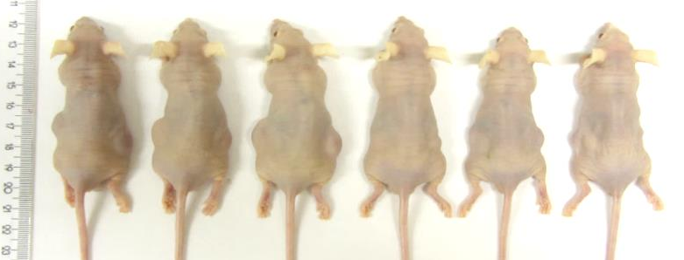
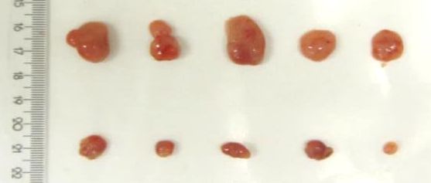
A small molecule inhibitor of IRE1 inhibits prostate
cancer growth in vivo
A
VCaP
B
VCaP
Vehicle
Toyocamycin
1200
**
1000
*
800
Tumor Volume (mm³)
Vehicle
600
Toyocamycin
400
200
0
Vehicle
7
14
21
28
Day
Toyocamycin

Slide 36
Divergent androgen regulation of ER signaling
in prostate cancer
AR
IRE1
PERK
XBP-1S
peIF2α
JNK
RAMP4, EDEM
ERdj4, P58IPK
ATF4
CHOP
Proliferation
Survival
Apoptosis

Slide 37
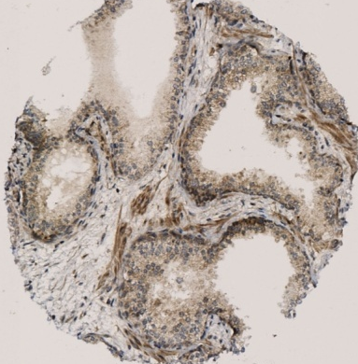
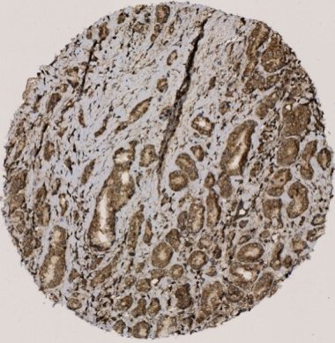
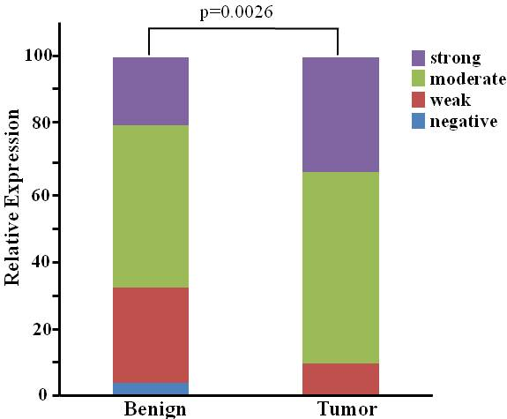
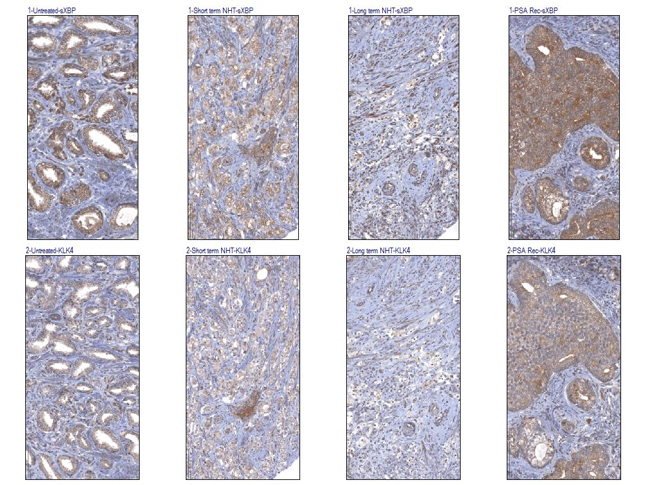
IRE1 signaling is deregulated in
human prostate cancer
A
B
Benign
Tumor
C
D
*
3.0
2.5
2.0
Relative XBP-1S Staining
Intensity
1.5
1.0
0.5
0
Unt 1-6 7-12
Untreated
1-6 M NHT
7-12 M NHT

Slide 38
Future Perspectives, androgens and ER stress
● Molecular details of how IRE1 and PERK signaling are divergently regulated by AR
● Could simultaneous IRE1 pathway inhibition and PERK activation have added effect?
● Targeted nanoliposomal siRNA mediated knockdown of IRE1 signaling
● Further development of small molecule inhibitors of IRE1 signaling and clinical testing

Slide 39
Acknowledgements
U. of Oslo
Haiying Kong
Martina Tesikova
Su Qu
Ling Wang
Jin Yang
Zeynep Kirli
Sen Zhao
DNR, Oslo
Håvard Danielsen
Alexander Kristian
Gunhild Mælendsmo
Bjørn Risberg
Håkon Wæhre
HSPH, Boston
Gokhan Hotamisligil
Katy Wellen
NCMM, Oslo
Ian G. Mills
MD Andersen Cancer Center
Neslihan Alpay
Kivanc Gorgulu
Gabriel Lopez-Berestein
Bulent Ozpolat
Anil Sood
Ibrahim Tekedereli
Erkan Yuca
Vancouver Pros. Centre
Ladan Fazli
Paul Rennie
U. of Porto/Port. Onc. Inst
Carmen Jerónimo
Manuel R. Teixeira

Slide 40
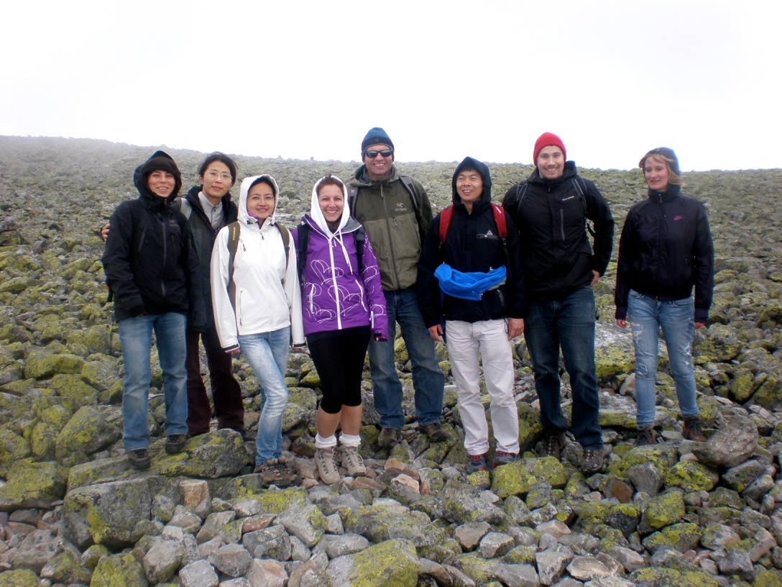

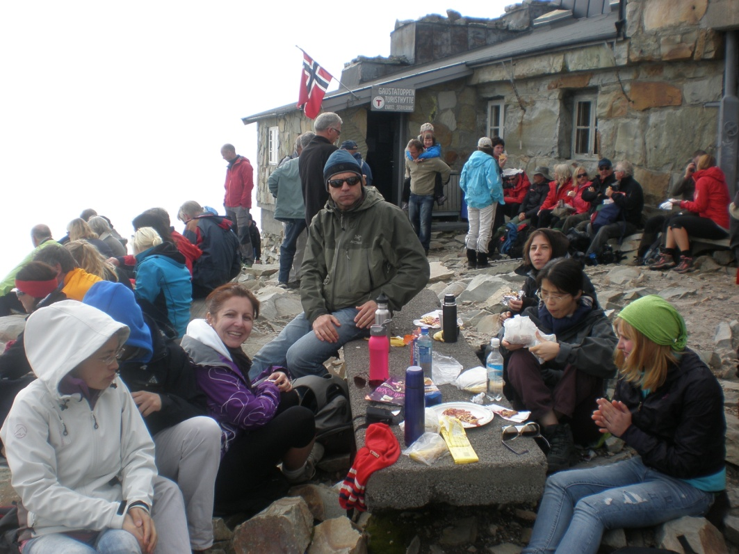

Notes:
!883 moh Gaustatoppen
303 moh Rjukan

Slide 41


Slide 42


Slide 45
ER stress and cancer
ER stress is increased in hypoxic tumors to help protein folding and to protect the tumor (Marx 2006).
PERK-/- xenografts grow poorly (Bi et al, 2005).
XBP1 mediates survival of cells under hypoxia and is essential for tumor growth (Koong et al, 2006).
UPR contributes to resistance for some cancer drugs, but some studies have also shown that UPR increases the sensitivity to chemotherapeutic drugs (Backer et al., 2009).

Slide 46
ER stress in prostate cancer
Increased expression of BiP/GRP78 is associated with greater risk of PCa recurrence and worse survival (Pootrakul et al., 2006).
BiP/GRP78 is upegulated in PCa and correlates with recurrence and survival (Daneshmand et al., 2007).
Down-regulation of BiP/GRP78 sensitizes resistant prostate cancer cells to gene-therapeutic overexpression of REIC/Dkk-3 (Tanimoto et al., 2010).

Slide 47
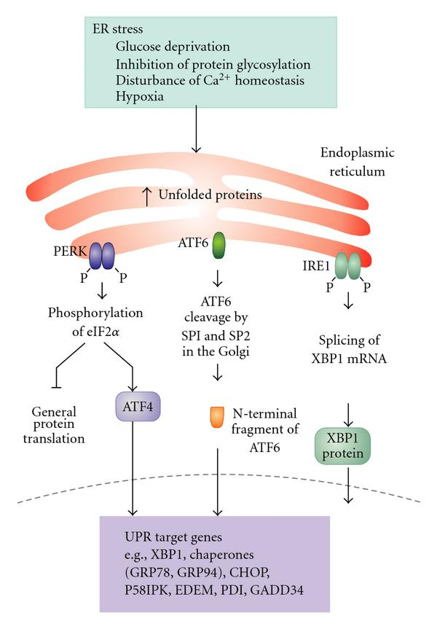
Endoplasmic reticulum (ER) stress
(Fulda et al. 2009)
Notes:
The UPR is activated in response to an accumulation of unfolded or misfolded proteins in the lumen of the endoplasmic reticulum. In this scenario, the UPR has three aims: initially to restore normal function of the cell by halting protein translation,degrade misfolded proteins and activating the signaling pathways that lead to increasing the production of molecular chaperones involved in protein folding. If these objectives are not achieved within a certain time lapse or the disruption is prolonged, the UPR aims towards apoptosis. Inositol-requiring enzyme 1 (IRE1) , Double stranded RNA activated protein kinase like ER kinase (PERK), Activating transcription factor 6 (ATF6).

Slide 48
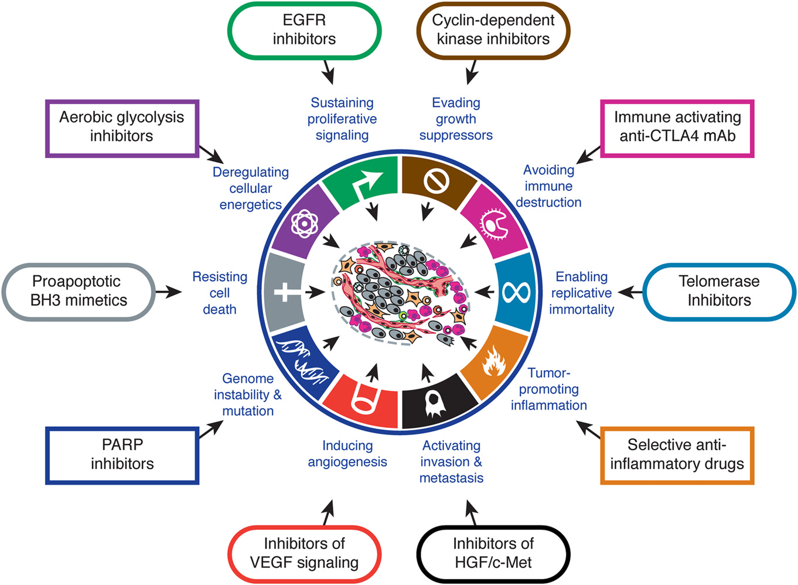
Hallmarks of cancer
Hanahan and Weinberg, 2011

Slide 49
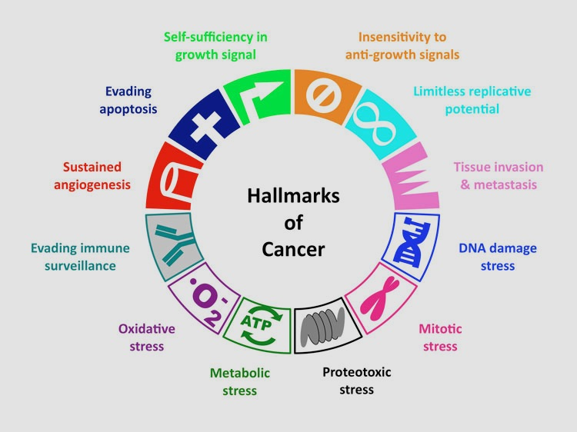
Hanahan and Weinberg, Cell. 2011.
Kroemer and Pouyssegur, Cancer Cell. 2008.
Stephen Elledge: Cancer Biology: Theoretical perspectives
Notes:
As you know, there are several well-established hallmarks of cancer, including various types of stress. Oxidative stress is a hallmark that is directly or indirectly involved in multiple processes of carcinogenesis.

Slide 50
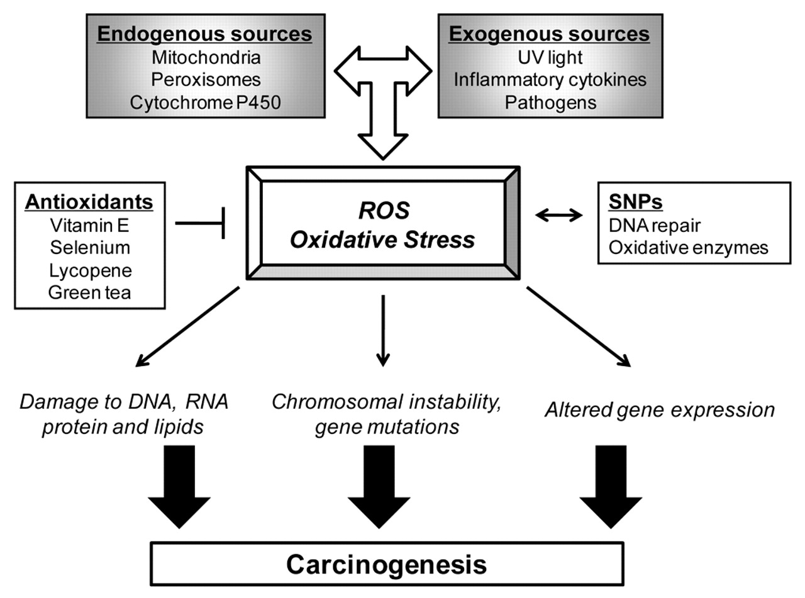
Oxidative stress and its role in cancer development
Oxidative Stress
(ROS)
Damage to DNA, RNA,
protein, and lipids
Chromosomal instability,
gene mutations
Altered gene expression
Carcinogenesis
Klaunig J E et al. Toxicol Pathol. 2009
Notes:
Oxidative stress induced by over-production or accumulation of reactive oxygen species, such as superoxide, hydroxyl radical, etc., lead to damage to macromolecules, chromosomal instability, gene mutation, altered gene expression and result in dysregulated oncogeneic signaling. All these alterations can lead to carcinogenesis.

Slide 51

STAMP2 increases intracelular ROS levels
Relative superoxide
production
Yang et al. EMBO Mol Med, 2015
Notes:
Since the mouse ortholog of STAMP2 is a oxidoreductase, and its functional involvment in energy metabolism and inflammation. All these observations are related to oxidative stress to some extent. We therefore proposed that STAMP2 might paticipate in the production of reactive oxygen species. The result of NBT staining, which is a used to determine the production of superoxide, clearly shows that STAMP2 overexpression increased the production of ROS in cells.

Slide 52
STAMP2 reduces NADPH/NADP⁺ ratio
Notes:
The requirement of iron-reductase for ROS generation was also confirmed by use of reductase-inactive mutant, which lacking the binding site for NADP binding motif. Furthermore, we found that wide type STAMP2 significantly reduced the ratio of NADPH and NADP+ , while the mutant did not. NADPH is a key component of cellular antioxidation capacity. These data show that STAMP2 is direct mediator of androgens induced oxidative stress.

Slide 53



STAMP2 loss deregulates ATF4 signaling pathway
siCtrl siST2
MSKCC
SLC7A11
ASNS
ATF4
STAMP2
GSE35988
ASNS
SLC7A11
ATF4
STAMP2
GSE6919
ASNS
ATF4
SLC7A11
STAMP2

Slide 54



STAMP2 loss reduces ATF4 expression
22Rv1 xenografts

Slide 55


STAMP2 affects cell growth through regulating ATF4
Notes:
Activating transcription factor 4 (ATF4) is a member of the activating
transcription factor family. ATF4 expression is increased in response to
a diverse array of microenvironmental stresses including amino acid depletion,
oxidative stress and endoplasmic reticulum (ER) stress that are sensed
by upstream eukaryotic translation initiation factor 2a (eIF2a) kinases. In
tumours, ATF4 expression is detected in hypoxic- and nutrient-deprived
regions where it promotes metabolic homeostasis and cancer cell survival by
transcriptionally regulating amino acid uptake and biosynthesis, autophagy,
redox balance and angiogenesis.

