Slide 1


Turkish Adaptation and Validity-Reliability Study of the Cancer İnformation Overload Scale
Assistant Professor: Fadime Hatice İNCİ

Slide 2
İntroduction
Cancer is a major public health problem
The incidence of cancer is increasing steadily
Cancer patients seek information regarding their disease
They have a lot of information
Too much information can cause problems
One of these problems is the information overload

Slide 3
Cancer Information Overload
CIO is defined as feeling overwhelmed by the amount of cancer-related material in the information environment

Slide 4
CIO
anxiety
stress
avoid information
screening and preventive behaviors

Slide 5
It is therefore important to determine the cancer information overload.
There is no scale that can be used to determine the cancer information overload in Turkey

Slide 6
Methods

Slide 7
Purpose
The aim of this study was to test the validity and reliability of the Turkish version of the Cancer Information Overload Scale

Slide 8
Research Design
This research is a methodological study

Slide 9
Sample and Setting
The sample consists of 144 women aged between 18-49 registered to a family health center between March-July 2015.
The center is affiliated to the Denizli Provincial Health Center.

Slide 10
The Inclusion Criteria
being Between the ages of 18-49
being female
not being cancer
having the ability to read and write Turkish

Slide 11
The sociodemographic characteristics questionnaire
Instruments
Cancer Information Overload Scale
Breast Cancer Health Belief Model

Slide 12
The Sociodemographic Characteristics Questionnaire
Age
Educational status
Health insurance
Income level
Marital status
Family cancer history
Source of information about cancer

Slide 13
Health Belief Model scale
This model was developed by Champion in 1984
and adapted to Turkish by Gözüm and Aydın in 2004
The scale was scored on a 5-point Likert scale (1‘strongly disagree’ and 5 ‘strongly agree’)
Higher scores indicated more positive health beliefs
Internal consistency ranged from 0.69 to 0.83

Slide 14
Cancer Information Overload Scale
The CIO is an 8-item instrument developed by Jensen et al
The scale was scored on a 4-point Likert scale (from strongly agree 4 to strongly disagree 1)
Total possible score of 8 to 32.
The scale is unidimensional.
The internal consistency was 0.87’dir.

Slide 15
Language equivalence
The scale was translated into Turkish by three people with proficiency in the language
Turkish form was then translated back into the original language
The back-translated and original forms of the CIO were compared and found to be highly similar regarding meaning and grammar.

Slide 16
 | Kesinlikle katılmıyorum | Katılmıyorum | Katılıyorum | Kesinlikle katılıyorum
Kanseri önlemeye yönelik pek çok öneri var, hangisini yapacağımı bilemiyorum
Kanseri önlemek için yapılan önerilerin hepsini uygulamak için yeterli zamanım yok
Kanser hakkında yeni bir bilgi duymak istemeyecek noktaya geldim.
Hiç kimse kanser hakkında verilen önerilerin hepsini yapamaz.
Kanser hakkındaki bilgilerin hepsi bir süre sonra kulağa aynı gelmeye başlıyor.
Kanser hakkında duyduğum bilgilerin çoğunu hemen unuttum
Kanser hakkında duyduğum ya da okuduğum şeylerin çoğu inandırıcı gelmiyor
Bilmem gereken kanser bilgisi nedeniyle kendimi aşırı yüklenmiş hissediyorum.
 | strongly disagree | disagree | agree | strongly agree
There are so many different recommendations about preventing cancer, it's hard to know which ones follow.
There is not enough time to do all of the things recommended to prevent cancer.
It has gotten to the point where I don't even care to hear new information about cancer.
No one could actually do all of the cancer recommendations that are given.
Information about cancer all starts to sound the same after a while.
I forget most cancer information right after I hear it.
Most things I hear or read about cancer seem pretty far-fetched.
I feel overloaded by the amount of cancer information I am supposed to know.
turkish version
original version

Slide 17
Content Validity
Content validity index was used to quantify the extent of agreement between the experts.
The CVI contained a 4-point rating scale (1 not relevant, 4 very relevant).
The CVI of the scale was calculated by dividing the number of items rated 3 or 4 by the total number of items.
CVI is 1.0, indicating an acceptable level of content validity.

Slide 18
Data analysis
The statistical analysis was conducted using the Statistical Package Program for Social Sciences and LISREL.
Descriptive data were evaluated with numbers, percentages, mean and standard deviation.
Pearson’s correlation test was used for concurrent validity
Construct validity was examined using exploratory factor analysis (EFA), confirmatory factor analysis (CFA).
The reliability of the CIO was evaluated by Cronbach’s Alpha and item-total correlations

Slide 19
Ethical Considerations
written permission was obtained from Jakop D. jensen et al., who developed the CIO
Ethical approval was obtained from Pamukkale University Ethics Committee.
The women participating in the study were given information about the study both verbally and in writing by the researcher.
Written informed consent was obtained from all of the participants..

Slide 20
Results

Slide 21
Table 1. Demographic Characteristics
Values |  | N (%)
Age (mean ±SD) |  | 30.93±9.43
Educational status | Primary school | 44 (30.6)
 | Middle school | 31 (21.5)
 | High school | 38 (26.4)
 | University | 31 (21.5)
Health insurance | Yes | 134 (93.1)
 | no | 10 (6.9)
income level | Low | 62 (43.1)
 | Moderate | 75 (52.1)
 | High | 7 (4.9)
Marital status | Married | 94 (65.3)
 | Single | 50 (34.7)

Slide 22
Table 1. Demographic Characteristics
Values | N (%)
Family cancer history
Yes | 45 (31.3)
No | 99 (68.8)
Information source
No | 12 (8.3)
Health provider | 51 (35.4)
Newspaper | 14 (9.7)
Television | 59 (41.0)
Internet | 42 (29.2)
Other | 13 (9.2)

Slide 23
Concurrent validity
Health-Belief Model Scale & cancer information overload scale
r = .63
p < .001

Slide 24
Construct validity
Exploratory factor analysis
Confirmatory factor analysis

Slide 25
Table 3. Results of exploratory factor analysis of CIO
İtems | Factor loading
Item 1. | 0.51
Item 2. | 0.59
Item 3. | 0.62
Item 4. | 0.67
Item 5. | 0.67
Item 6. | 0.62
Item 7. | 0.64
Item 8 | 0.62
Eigen values | 3.068
Variance | %38.351
*Kaiser-Meyer-Olkin Measure of Sampling Adequacy | 0.742
Bartlett's Test of Sphericity /p | 264.582/0.001

Slide 26
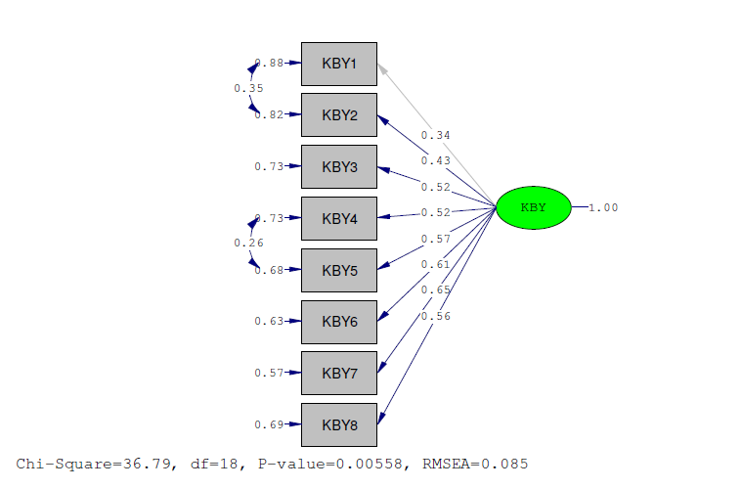
Figure 1. Confirmatory factor analysis of CIO
KBY:CIO
X² | RMSEA | GFI/AGFI | CFI | NFI/NNFI | Factor loading Min/Max
36.78-18 | 0.085 | 0.94/0.88 | 0.95 | 0.91/0.92 | 0.34-0.65

Slide 27
Table 5. Realiability of CIO
Items | Mean | SD | İtem-total correlation | İf item deleted Cronbach Alpfa
Item 1. | 2.65 | 0.82 | 0.38 | 0.76
Item 2. | 2.24 | 0.81 | 0.46 | 0.75
Item 3. | 2.06 | 0.83 | 0.46 | 0.74
Item 4. | 2.57 | 0.84 | 0.50 | 0.74
Item 5. | 2.52 | 0.78 | 0.52 | 0.74
Item 6. | 2.25 | 0.88 | 0.47 | 0.74
Item 7. | 2.16 | 0.88 | 0.49 | 0.74
Item 8 | 2.25 | 0.81 | 0.48 | 0.74
Cronbach’s alpha | 0.77
Mean of scale | 18.69 ±4.12

Slide 28
Conclusions
Turkish version of the CIO showed adequate reliability and validity for use in
Turkish women. It could easily be used to evaluate the information overload about cancer.

Slide 29


Thank you for your attention!
DĚKUJI ZA POZORNOST

