Slide 1
About OMICS Group
OMICS Group International is an amalgamation of Open Access publications and worldwide international science conferences and events. Established in the year 2007 with the sole aim of making the information on Sciences and technology ‘Open Access’, OMICS Group publishes 400 online open access scholarly journals in all aspects of Science, Engineering, Management and Technology journals. OMICS Group has been instrumental in taking the knowledge on Science & technology to the doorsteps of ordinary men and women. Research Scholars, Students, Libraries, Educational Institutions, Research centers and the industry are main stakeholders that benefitted greatly from this knowledge dissemination. OMICS Group also organizes 300 International conferences annually across the globe, where knowledge transfer takes place through debates, round table discussions, poster presentations, workshops, symposia and exhibitions.

Slide 2
About OMICS Group Conferences
OMICS Group International is a pioneer and leading science event organizer, which publishes around 400 open access journals and conducts over 300 Medical, Clinical, Engineering, Life Sciences, Phrama scientific conferences all over the globe annually with the support of more than 1000 scientific associations and 30,000 editorial board members and 3.5 million followers to its credit.
OMICS Group has organized 500 conferences, workshops and national symposiums across the major cities including San Francisco, Las Vegas, San Antonio, Omaha, Orlando, Raleigh, Santa Clara, Chicago, Philadelphia, Baltimore, United Kingdom, Valencia, Dubai, Beijing, Hyderabad, Bengaluru and Mumbai.

Slide 3

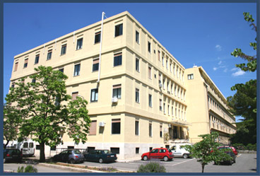


In vitro and in silico minimal cell models
Fabio Mavelli
fabio.mavelli@uniba.it

Slide 4
Outline
Introduction
  Notion of minimal cell
  Stochastic vs Deterministic models
In vitro models
  Polymer-Enzymes Complex for cascade reactions
  Membrane Pore formation
  Photosyntetic Reaction Renter membrane recostitution
In silico models
  Osmotic Synchronization
Conclusions

Slide 5


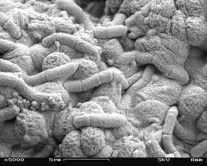


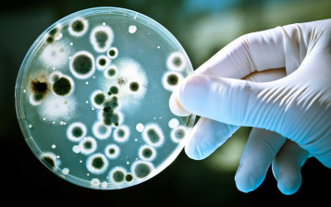


Is it possible to construct a simplified cell from separated molecules?⁽*⁾
Origin of Life On Earth
Transition from no living to living matter
lipid
membrane
Emergence of Life in Test Tube
⁽*⁾ Luisi’s group, ETH Zurich and Roma3 Univ.

Slide 6
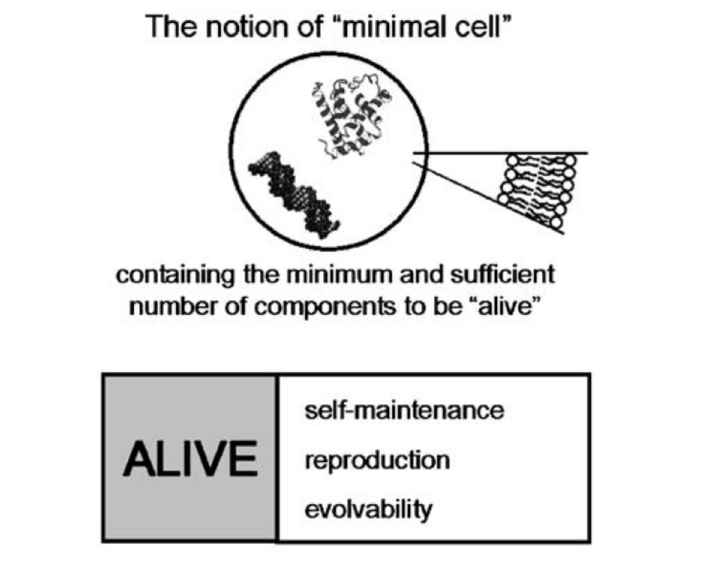
The notion of minimal cell
“…the one having the minimal and sufficient number of components to be called alive. What does “alive” mean?
Living at the cellular level means the concomitance of three properties:
self-maintenance (metabolism),
self-reproduction,
and evolvability.”
“A living system is a system capable of self-production and self-maintenance through a regenerative network of processes which takes place within a boundary of its own making and regenerates itself through cognitive or adaptive interactions with the medium.”
Damiamo and Luisi, OLEB (2010) 40 145

Slide 7
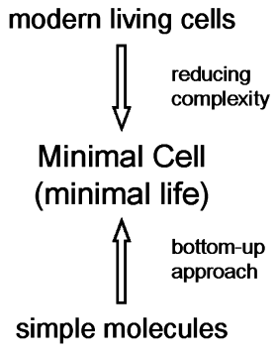
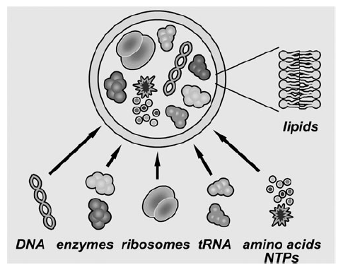
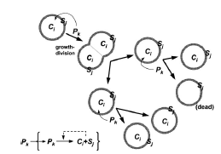
Semi-synthetic approach to MC
Luisi PL, OLEB (2006) 36 605, Stano P, ChemComm (2010) 46 3639

Slide 8
Aim of Modeling
Deterministic | Stochastic
Macroscopic | Microscopic
Positive real numbers of Molecules | Integer numbers of Molecules
Reaction Rates | Propensity Probabilities
Average Behaviour | Average + Fluctuations
Bridging the gap between in silico and in vitro experiments in the bottom-up approach to the minimal artificial cell
Protocell Model
ODE Set
Master Equation
Theoretical approaches:
Deterministic
Stochastic
Theoretical models have been developed in order to analyse the feasibility of minimal cell models (protocells) able to exhibit:
Self-maintenance
Self-reproduction
Evolution
Numerical Solutions (MATLAB)
Monte Carlo Simulations (ENVIRONMENT)
Single cell
average
behavior
Protocell
Population
behavior
Time evolution
comparison

Slide 9
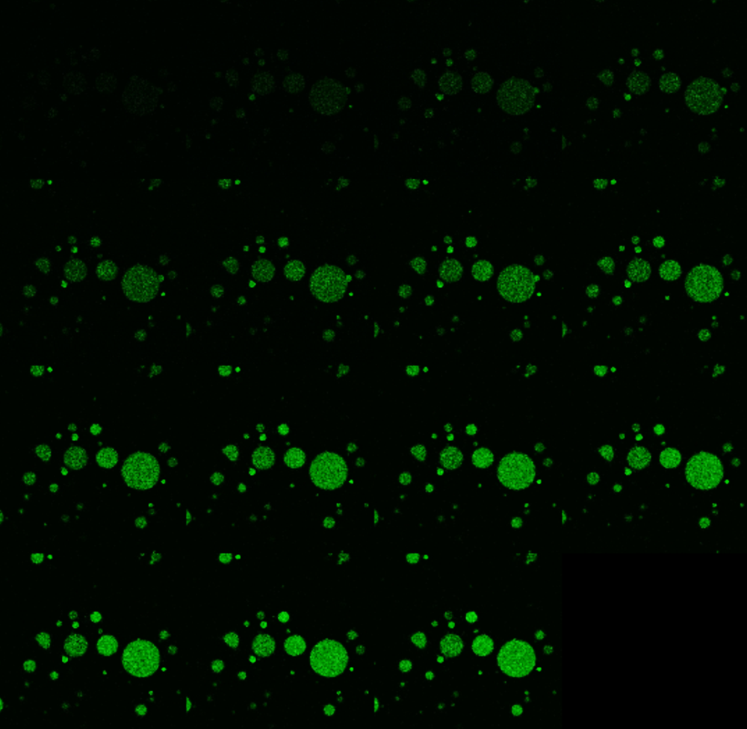
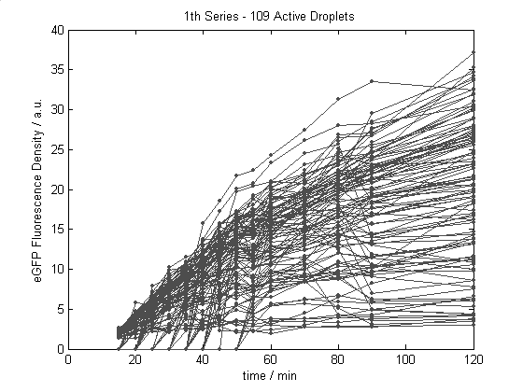
GFP Expression in a w/o emulsion
The time behavior of each compartment in the population could be highly affected by random fluctuations:
Intrinsic effects
Extrinsic effects
PURESYSTEM encapsulated in a water/oil emulsion
Data from Luisi’s Lab experiments by P.Carrara, M.Caputo and P.Stano
time / sec

Slide 10
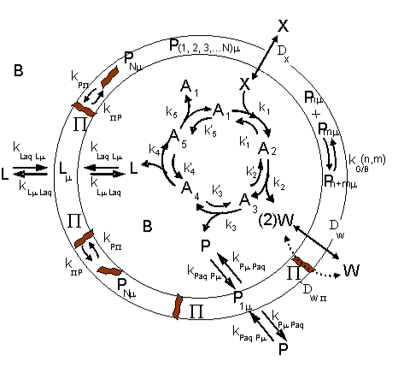
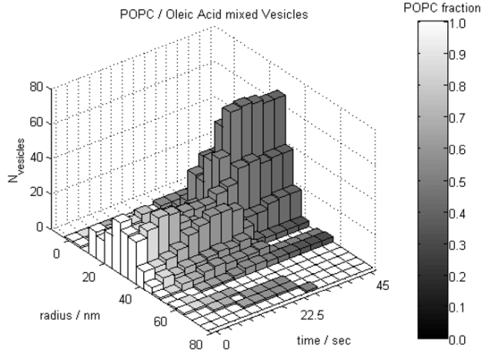
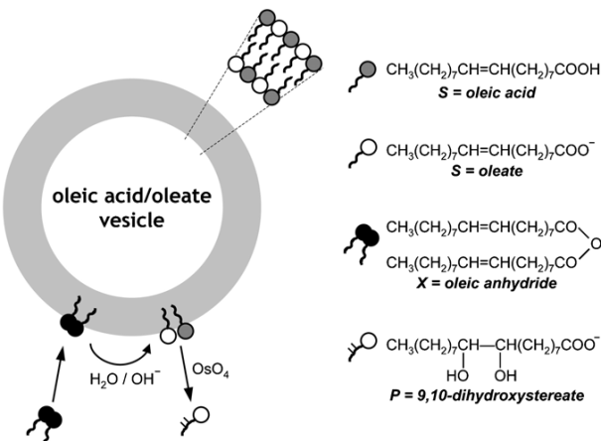
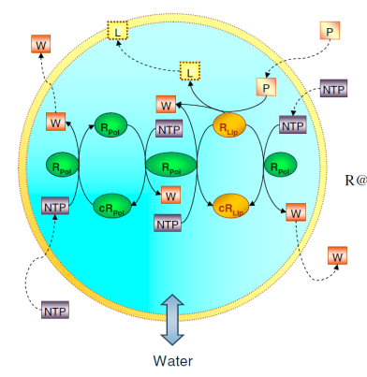
Lipid Vesicle Dynamics
Minimal Petide Cell
Mavelli F., Ruiz-Mirazo K.,
Phys Biol 7, (2010) , 36002
Ruiz-Mirazo K., Mavelli F.,
Biosystems 91, (2008), 374
ENVIRONMENT
Autopoietic Vesicles
Ribocell Model
Mavelli F., Ruiz-Mirazo K.,
Phil. Trans. R. Soc. Lon. B
362, (2007) , 1789.
P
L
R_{P}
R_{L}
R_{P}
_{c}R_{P}
_{c}R_{L}
Mavelli F., Stano P.,
Phys Biol 7, (2010) , 16010
Mavelli F. (2012) BMC Bioinformatics 13 , supp4, S10

Slide 11
In vitro modeling

Slide 12
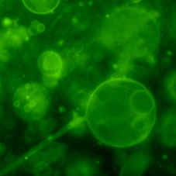
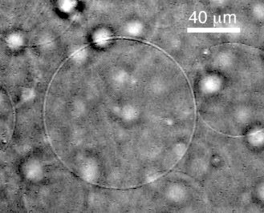
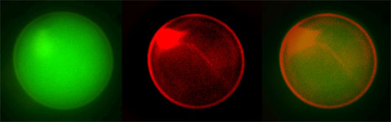
Giant lipid vesicles (GVs)
Features:
Cell-like size
Large encapsulation volume
Single vesicle analysis
Direct visualization by microscopy techniques
Use of High-throughput analysis (flow cytometry)
Conventional preparation methods:
Natural swelling
Electroformation
New Method
Phase Transfer Method
Giant vesicles (1-100μm)

Slide 13
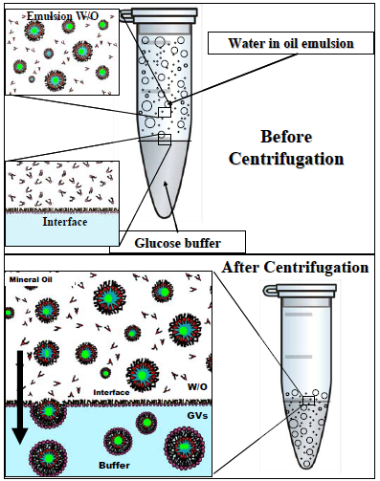
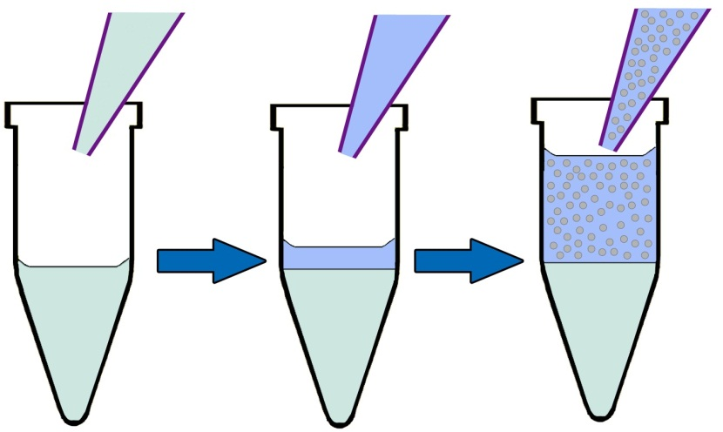
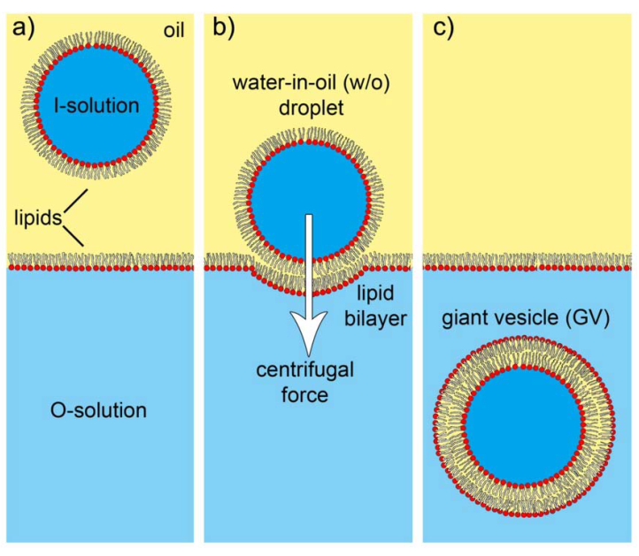
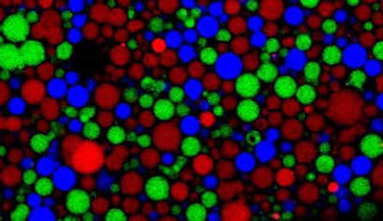
The “Droplet transfer method”
The “droplet transfer” method
Pautot et al., Langmuir 2003; PNAS 2003
POPC in
Mineral
oil
Water in oil
emulsion
External buffer
Carrara, Altamura, Stano, Luisi, submitted

Slide 14
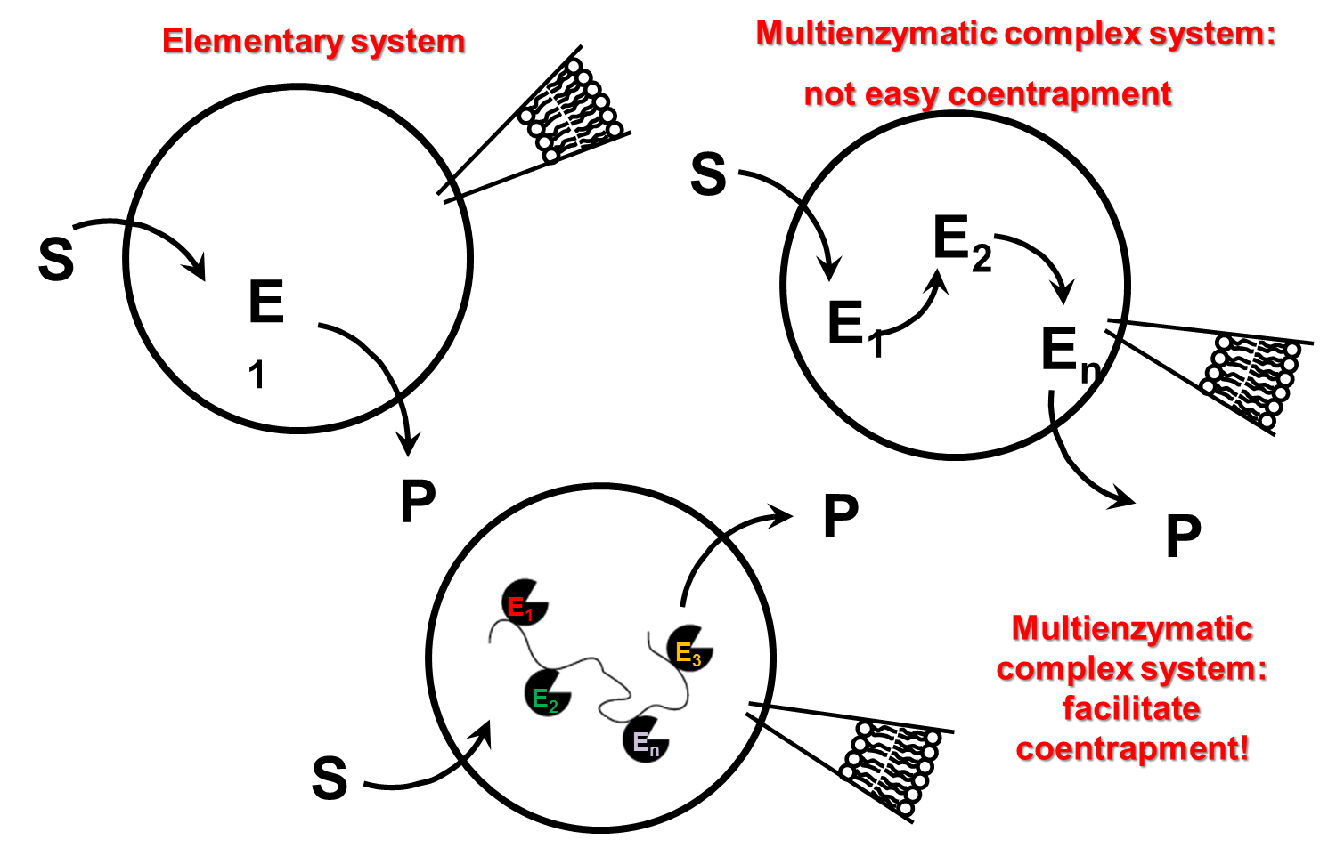
GVs as biochemical reactors
Improving enzyme encapsulation

Slide 15
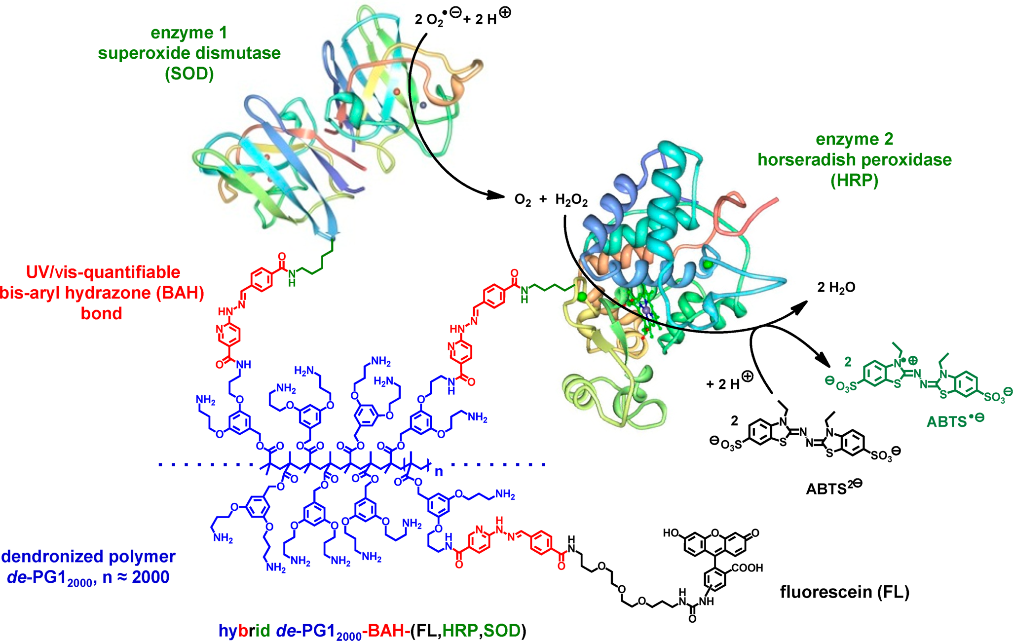
de-PG1-(BAH)-FL-HRP-SOD synthesis:
Polymethacrylate backbone
(M.W. ̴ 600 KDa)
Grotzky A. et al. JACS 2012

Slide 16
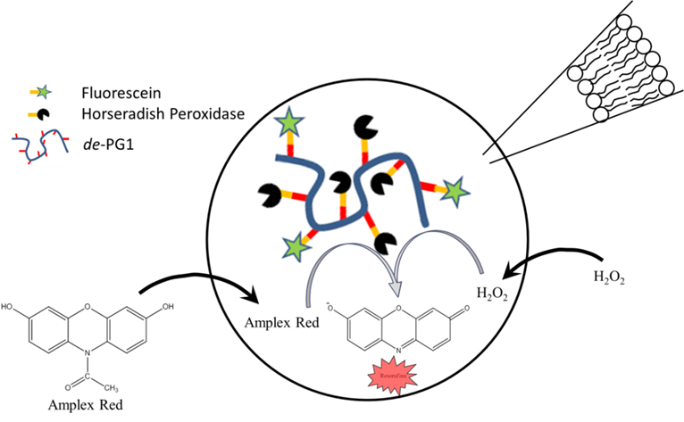
Enzymatic system
Activity assay for individual GVs

Slide 17
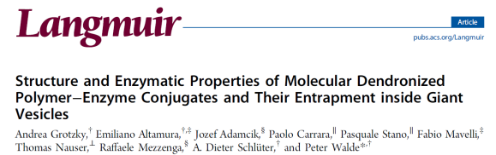
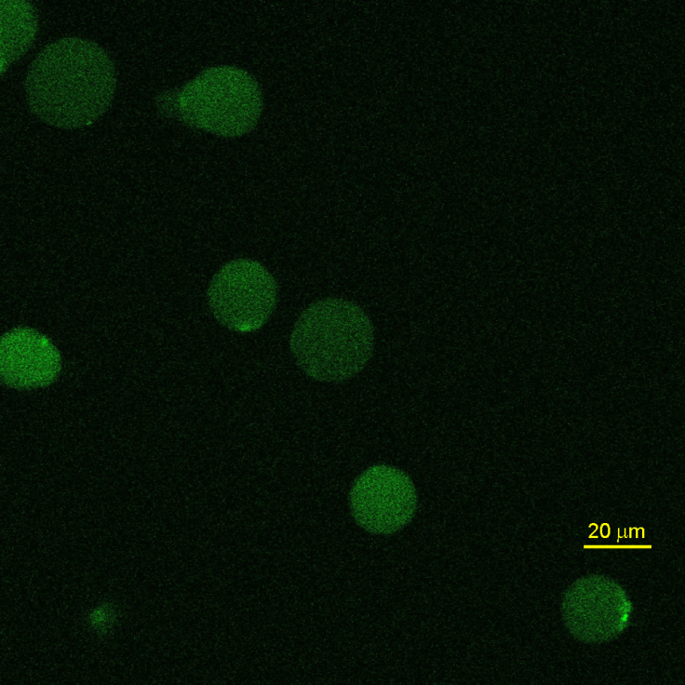
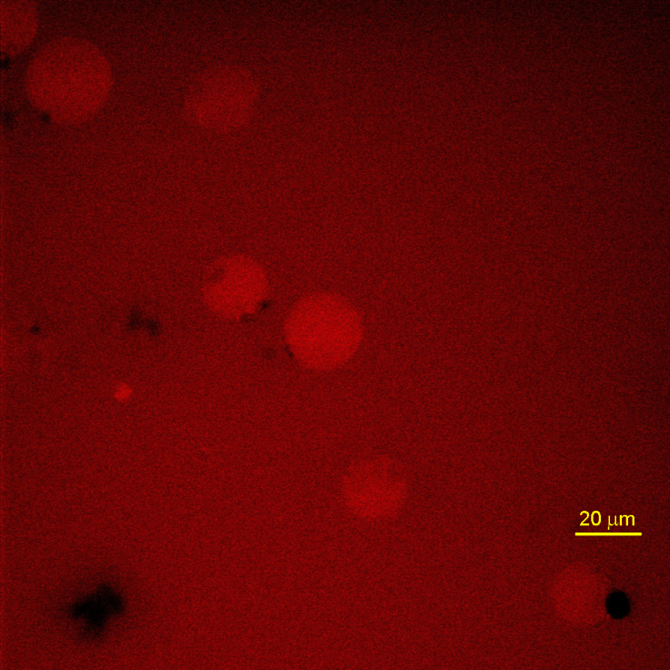
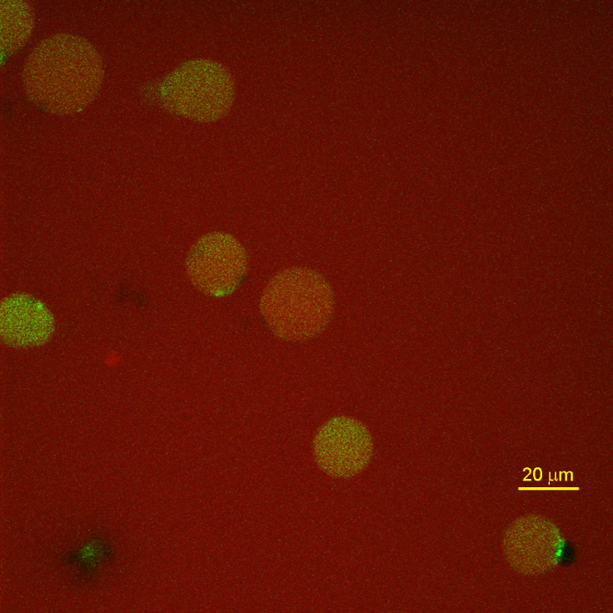
de-PG1-Fl-HRP entrapment
[HRP] = 1 µM,
[Amplex Red] = 10 µM,
[H₂O₂] = 10 µM
t = 200 s

Slide 18
Membrane engineering

Slide 19
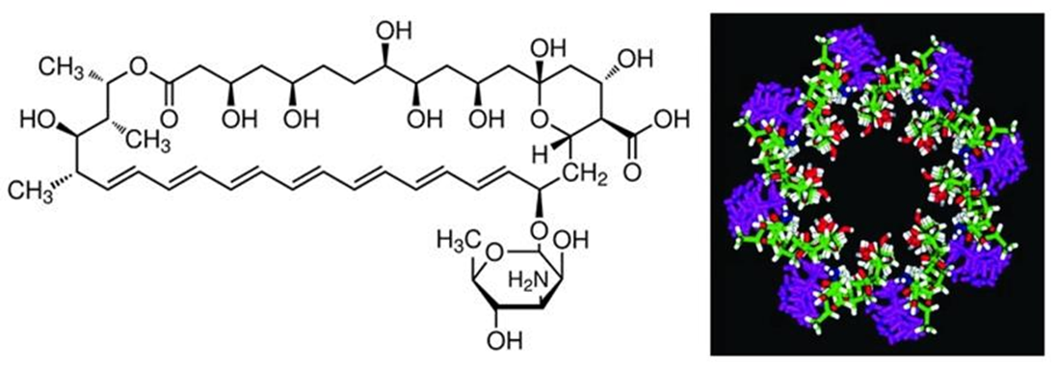
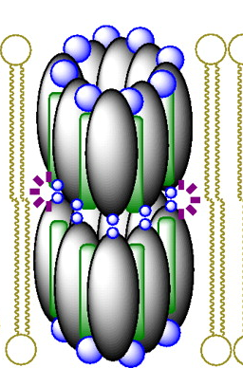
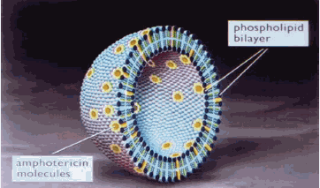
Pore formation: Amphotericin B
Among the variety of antifungal antibiotics Amphotericin B (AmB) is an amphiphilic molecule that forms pores in phospholipid membranes (Khutorsky 1996), allowing the diffusion of glucose, as experimentally demonstrated for nano-sized liposomes (Fujita et al. 2013).
Phospholipid bilayer
Amphotericin molecules

Slide 20
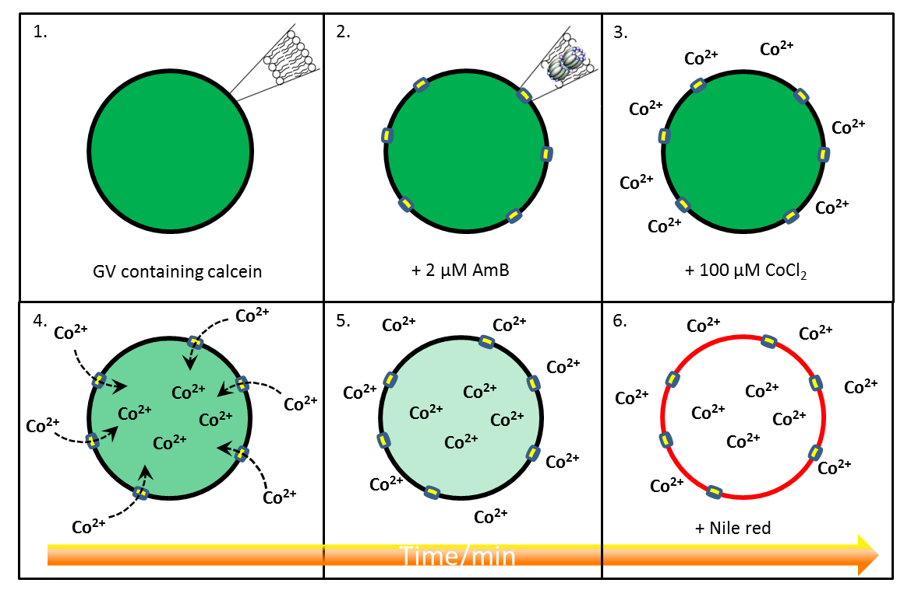
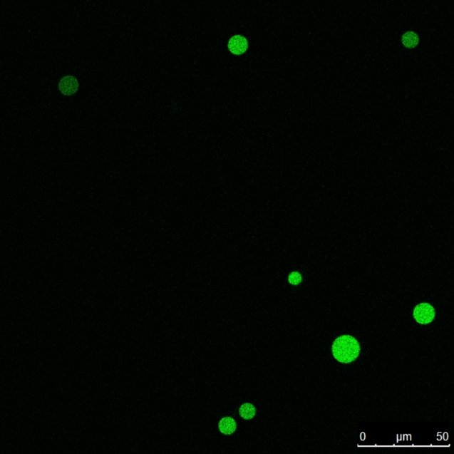
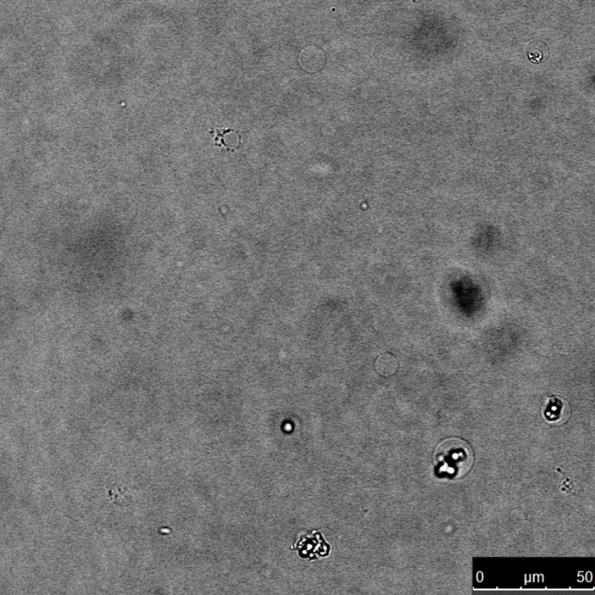
The assay for the pore formation
2
2
GV containing calcein and AmB pore formation, followed by internal calcein fluorescence extinction after addition of a Co²⁺ ions to the vesicle.
GVs encapsulating 10 µM calcein after the addition of AmB 2 μM

Slide 21
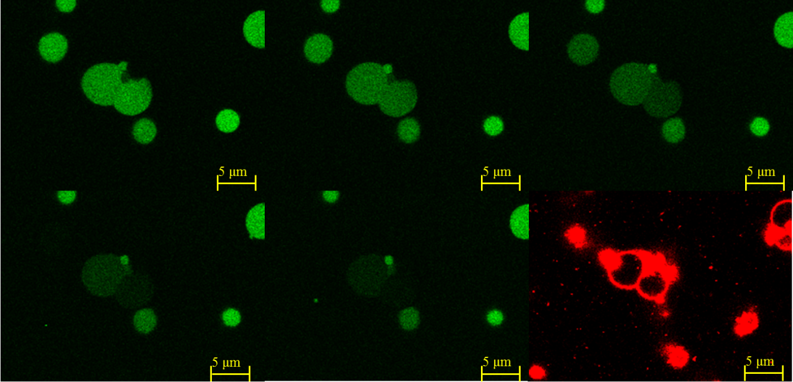
The assay for the pore formation
t=0
t=2 min
t=4 min
t=6 min
t= 8 min
GVs containing Calcein 10 μM. In the external buffer CoCl₂ 100 μM is added as quencher.
Time scan recorded after the addition of Amphotericin B 2 μM, that is able to create pores through the membrane with an high dimensional selectivity.
The graph indicates the decrease of calcein green fluorescence during time due to the quenching effect of the Co²⁺ ions.

Slide 22
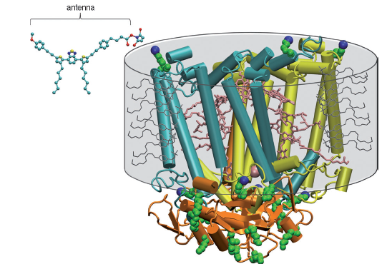
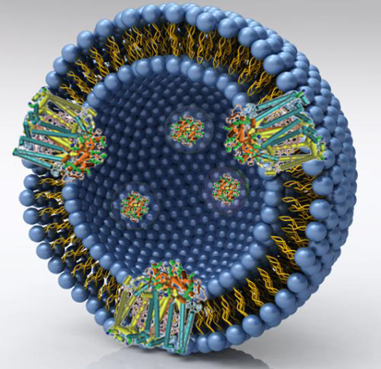
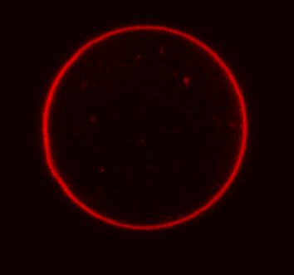
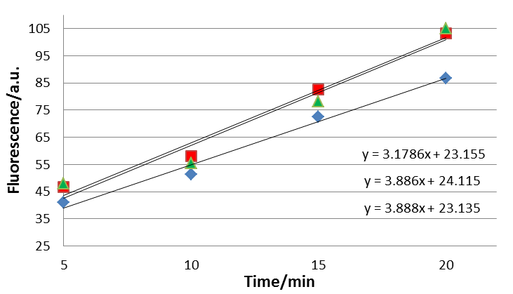
Photosynthetic Reaction Center in GVs
in preparation
Crystallographic structure of the R. sphaeroides R26 reaction center (RC).
Reconstitution of the photosynthetic RC within
the GV membrane
Confocal microscope images of GV made by POPC with RC reconstituted in membrane.
Manuscript in preparation
pH increase of the vesicle internal solution due to the activity of RCs monitored by the fluoresce of an entrapped dye (pyranine)
t=5
t=10
t=20
t=0

Slide 23
In silico modeling

Slide 24
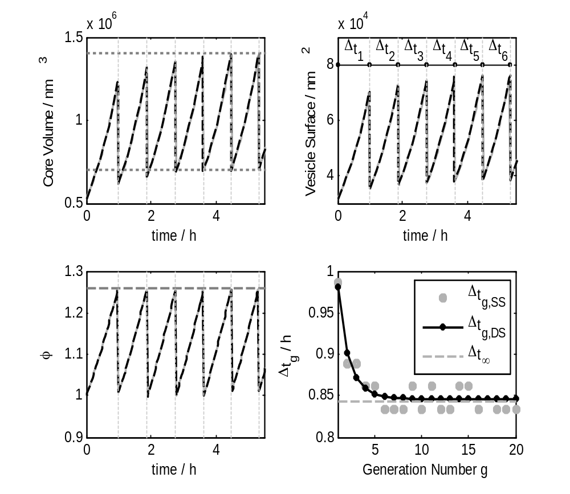
Protocells stationary reproduction
We would like to determine the conditions that drive minimal self-producing vesicles to regular growth/division cycles, making possible that subsequent generations inherit size and internal chemical composition.
L
L
L
P
P

Slide 25
In silico Vesicles
Vesicles are described as compartmentalized reacting systems (CSTR) made of two different homogeneous domains:
the membrane
the water core
Lipids and molecules can be exchanged between the membrane and water core, between the membrane and the external environment.
Transport processes can also occur, exchanging molecules directly from the external environment to the internal water pool.
Membrane
Lipid Exchange
Water Core
k_{in}
k_{in}
L
L_{E}
L
L
μ
L_{C}
k_{out}
μ
k_{out}
X_{C}
Transport Process
Water flux
X_{E}
D_{X}
External Environment
Mavelli F, Ruiz-Mirazo K, (2007) Phil. Trans. Royal Soc. London B 362, 1789.
Mavelli F, Ruiz-Mirazo K, (2010) Phys Biol 7, 036002

Slide 26
Stability of closed membrane
Reduced Surface
ratio of the actual membrane surface S_{μ} and the area of a sphere with the actual volume V_{c} of the core
Vesicle
swollen spherical deflated
S_{μ} /2
S_{μ}
V_{C}/2
V_{C}
S_{μ} /2
V_{C}/2
Osmotic
Crisis
Division

Slide 27
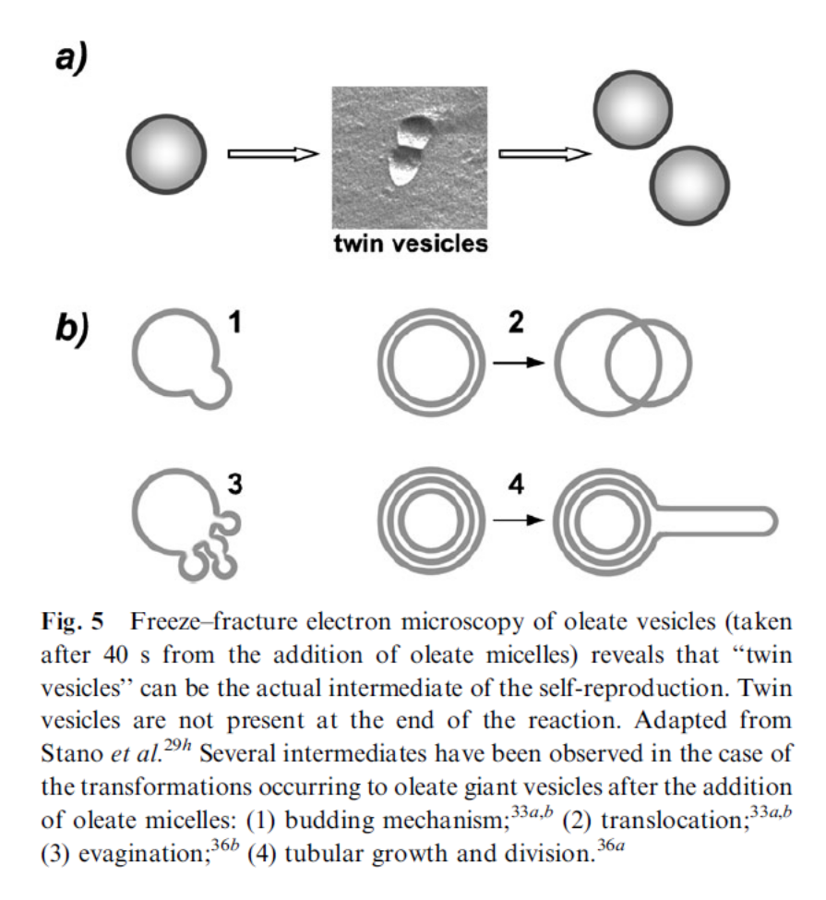
Vesicle division
Small unilammellar vesicles
Giant uni-lammellar vesicles
Giant multi-lammellar vesicles
Stano P, ChemComm (2010) 46 3639

Slide 28
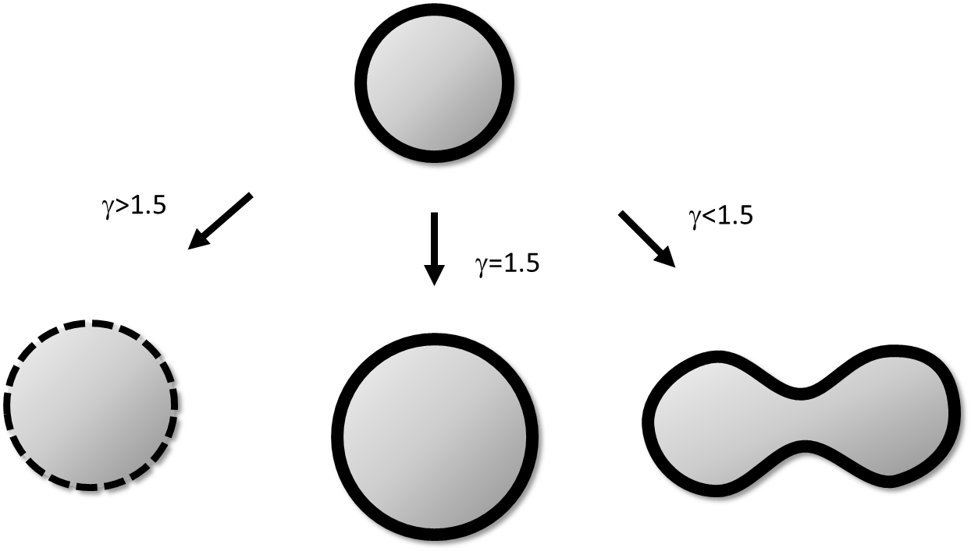
Growth control coefficient
γ is a dimensionless observable is defined as the ratio between the relative velocities of variation of core volume and membrane surface of a vesicle
Protocells stationary reproduction
γ=1
Mavelli F, Ruiz-Mirazo K , (2013) Integr. Biol., 5, 324-341

Slide 29
Osmotic synchronization
γ = 1
different metabolic steps occurring inside the protocell, each at a particular rate r_{ρ}, with a net number of molecules produced or consumed Δm_{ρ}
net fluxes of molecules that can come in or escape across the membrane through passive transport
v_{L}
metabolic lipid production rate

Slide 30
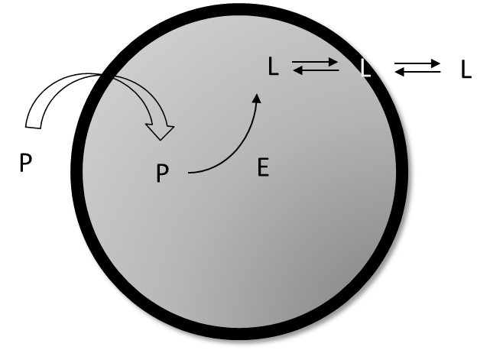
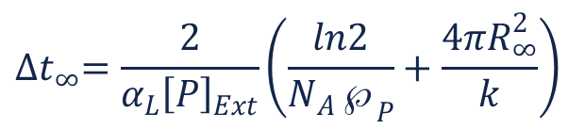
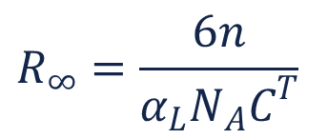
Case Study
Self-producing enzymatic vesicle: a hypothetical model where the production of lipid L takes place through the chemical transformation of a precursor molecule P, assumed to occur only in the presence of an additional compound E,
$$R_{∞}=\frac{6n}{α_{L}N_{A}C^{T}}$$
Stochastic simulation outcomes (in grey)
the deterministic curve by numerical integration (in black).
$${∆t}_{∞}=\frac{2}{α_{L}{\left[P\right]}_{Ext}}\left(\frac{ln2}{N_{A}℘_{P}}+\frac{4πR_{∞}^{2}}{k}\right)$$

Slide 31
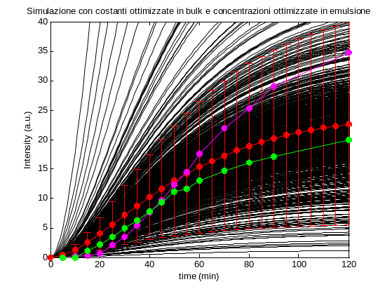
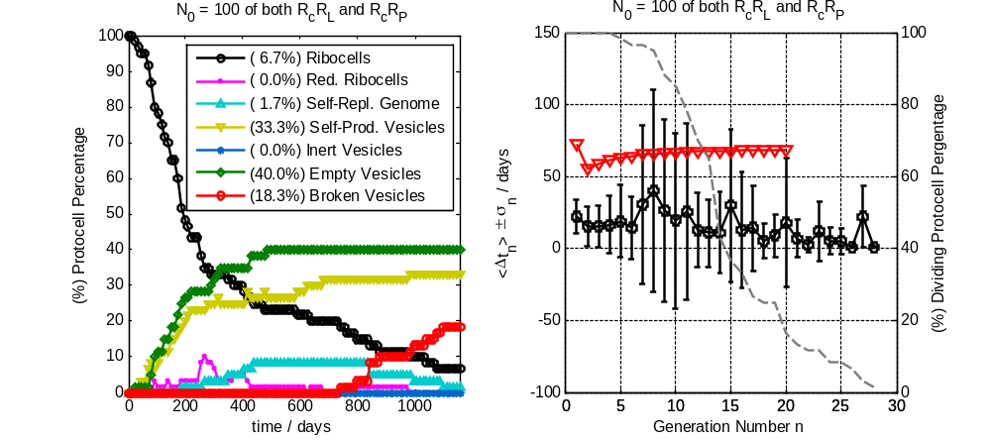

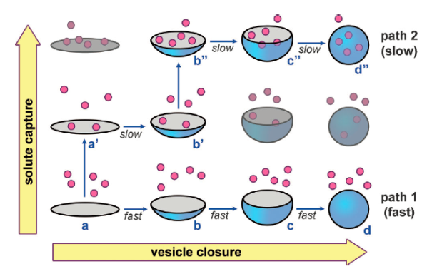
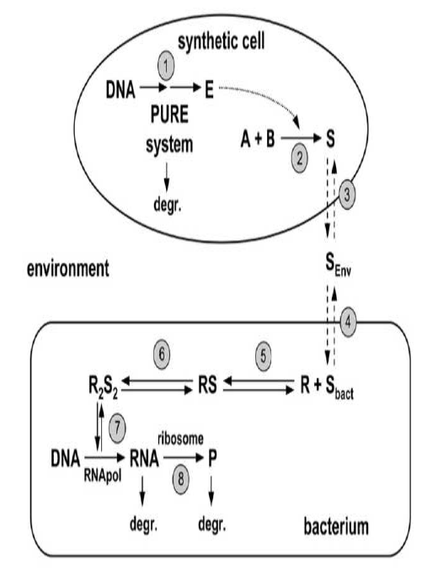
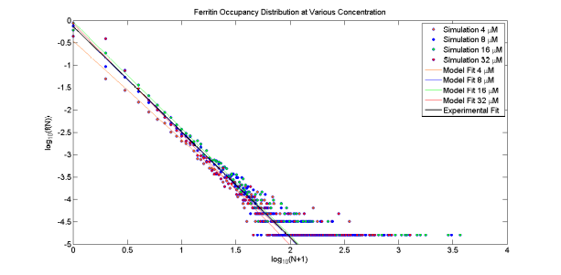
Theoretical modelling
GFP Expression in a w/o emulsion
the Ribocell model
the Crowding effect
Chemical communication
between artificial cells and bacteria

Slide 32








Acknowledgments
Pasquale Stano
Emiliano Altamura
Kepa Ruiz-Mirazo
Peter Walde
Pier Luigi Luisi
colleagues
Marco Lerario
Pierluigi della Gatta
Angelo Lanzillotto
Gaetano Regina
Carmen Bonasia
Marika De Palo
students

Slide 33
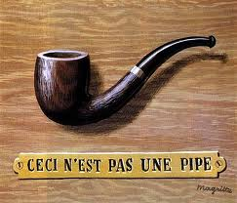
Conclusions
In vitro and in silico minimal artificial cell models (protocells) have been present.
By the integration between numerical model and protocells implemented in the test tube it will be possible to design and synthetize a real minimal artificial cell in a no too far future.
Thank you for your attention
“All models are wrong,
but some are useful”
George Box

Slide 34
Let Us Meet Again
We welcome you all to our future conferences of OMICS Group International
Please Visit:
www.omicsgroup.com
www.conferenceseries.com
www.pharmaceuticalconferences.com

